Slide 1
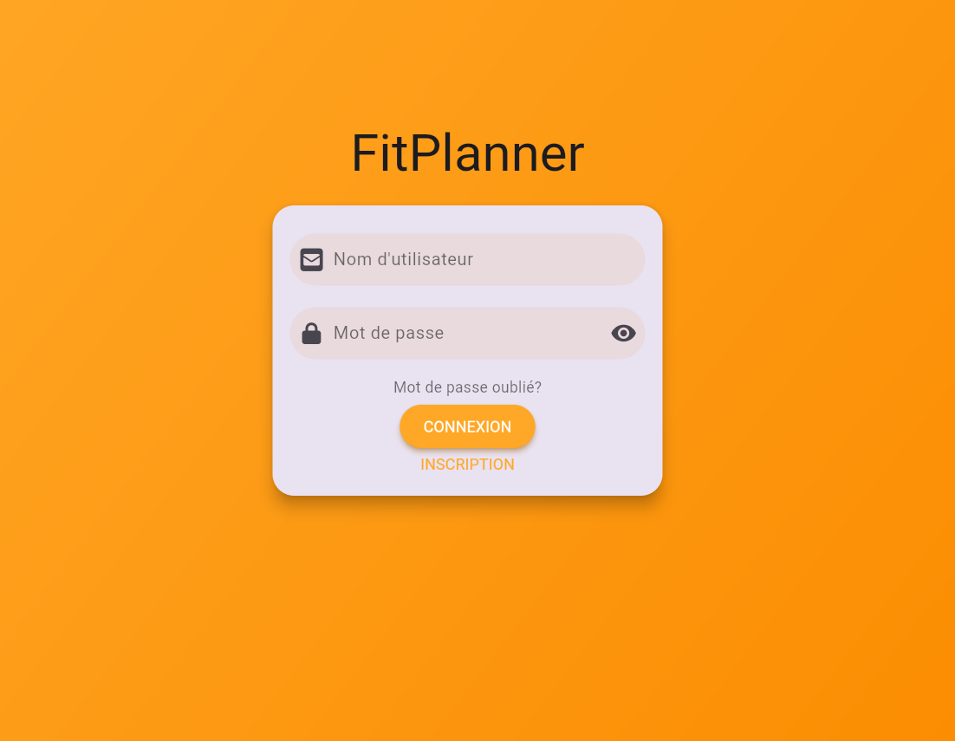
FitPlanner
Erwin DZIUBA
Gwenolé BINET

Slide 2
Programme
Introduction
Fonctionalities
Architecture
Project Management
Demonstration
Titre de la présentation

Slide 3
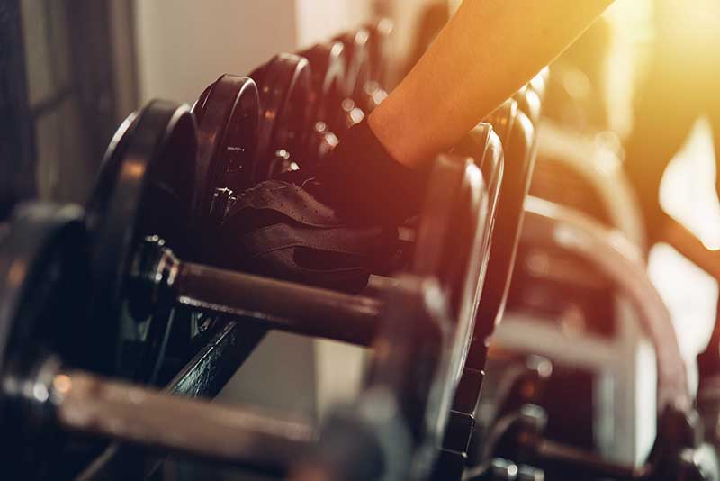
Introduction
Weightlifting is one of the most practiced sports in France. A weightlifting session is composed of several exercises, and each exercise consists of multiple sets and repetitions. Some people use a paper notebook, while others rely on memory to remember which session to do, on what day, how many exercises, which muscle, etc.
That is why we decided to create a planner for people who practice weightlifting, in a digital version that is simpler and quicker to use than a notebook, and more reliable than memory!

Slide 4
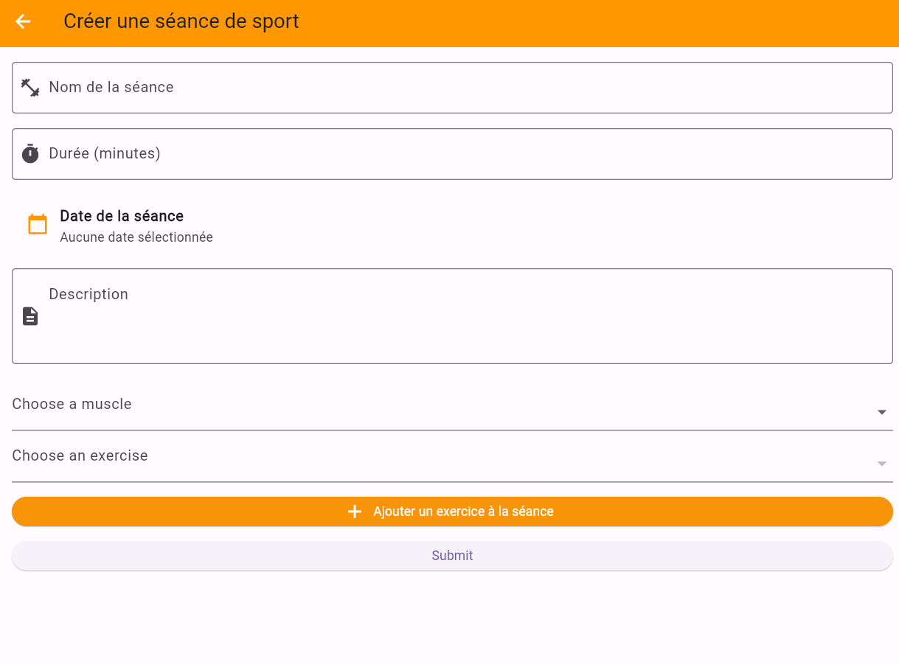
Fonctionalities
The user can log in.
The user can create an account.
The ability to create a session by entering: the title of the session, the duration (in minutes), the date (in year/month/day format), selecting the muscle to be trained, and selecting the exercise associated with that muscle.
The possibility of including multiple exercises in a session.
The ability to record multiple sessions.

Slide 5
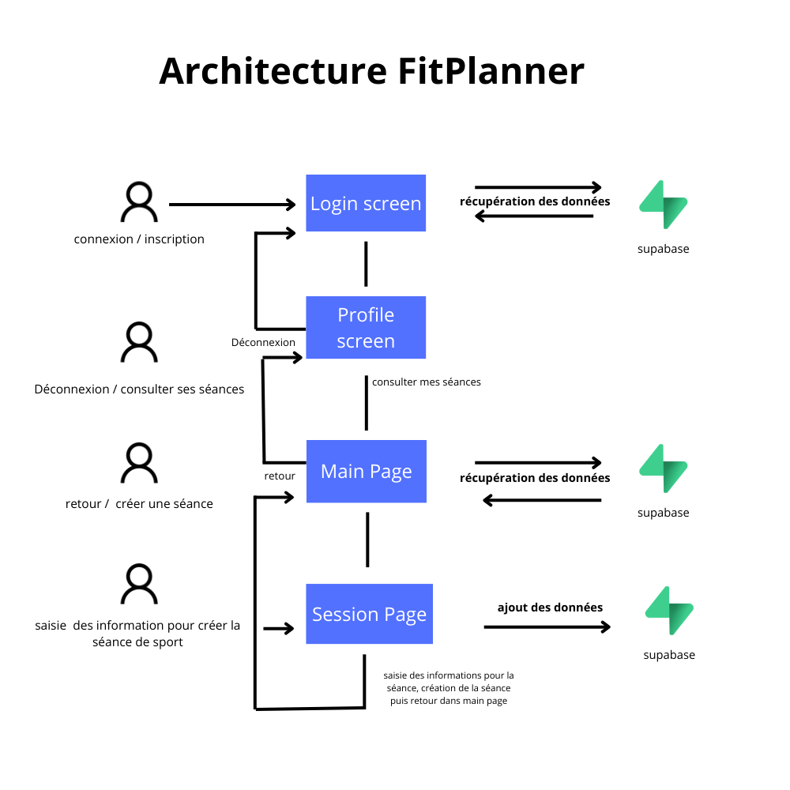
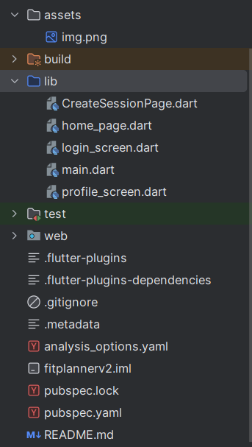
Architecture

Slide 6




Technologies used

Slide 7
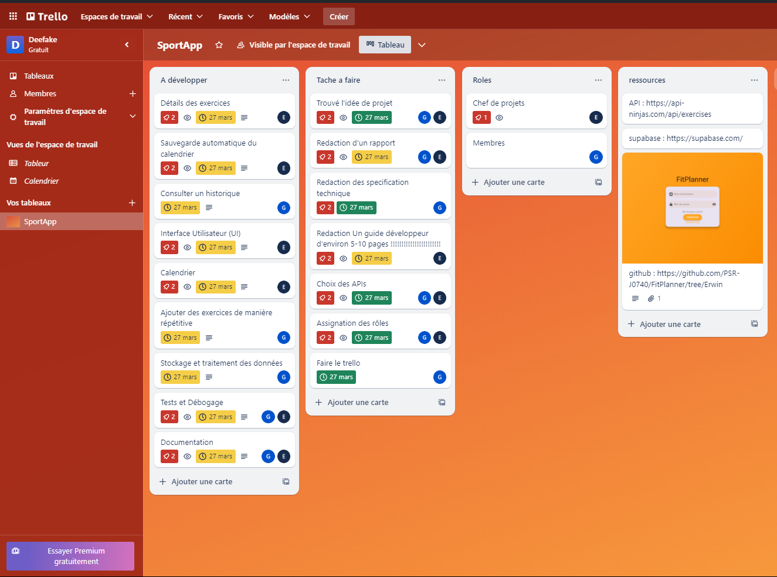
Gestion de projet

Slide 8
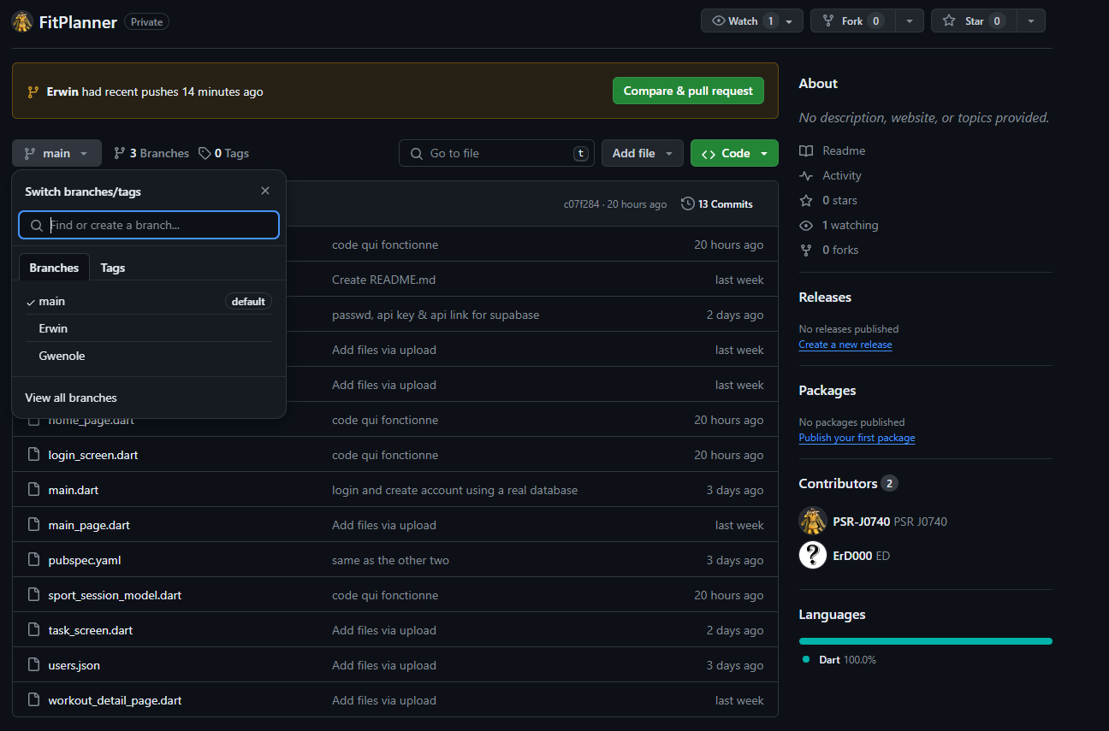
Gestion de projet

Slide 9
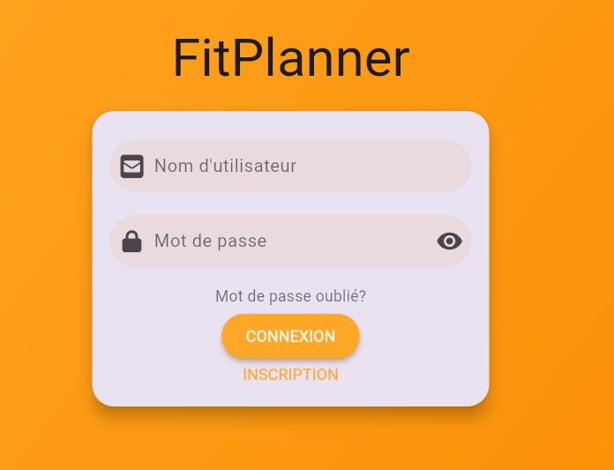
Demonstration

Slide 10


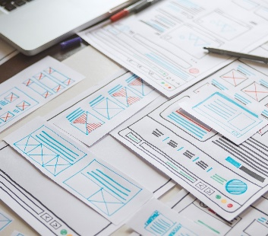

Merci

