Slide 1

Title: Intel Product Sentiment Analysis from Online Reviews
Aarupadai Veedu Institute Of Technology ,Chennai
Name: IMRAN KHAN
Reg No: 3502110522

Slide 2

PROBLEM STATEMENT
Identifying the Problem
The growing volume of online reviews makes it challenging for Intel to manually analyze customer feedback.
Current manual processes are time-consuming and prone to human error.
Lack of structured insights from customer reviews hinders eﬀective decision-making.t.

Slide 3
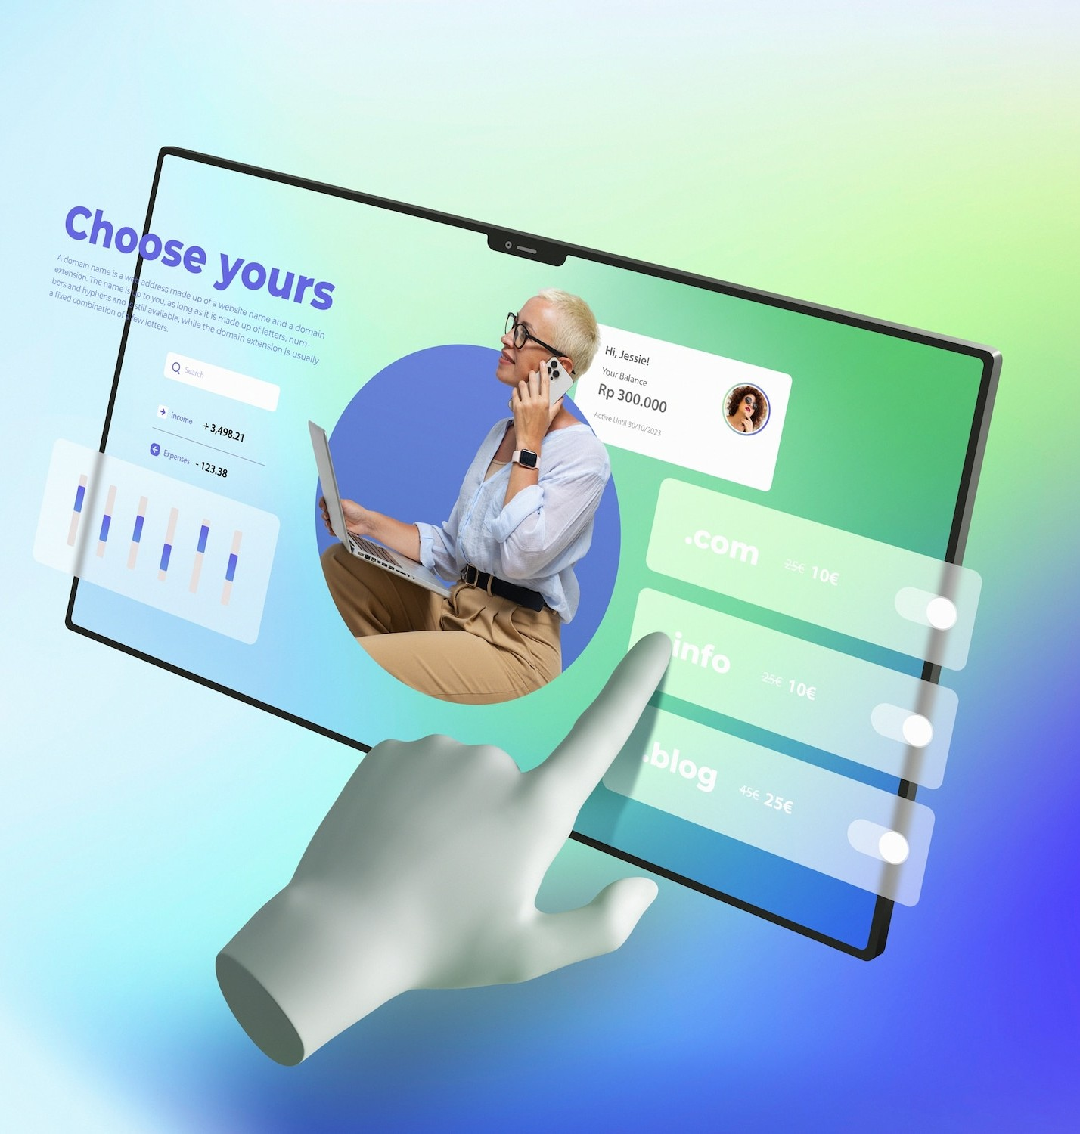
SOLUTION
Our Innovative Solution
Implementing an AI-powered sentiment analysis system.
Automatically categorizes and evaluates customer
reviews for Intel products.
Provides actionable insights by highlighting trends and key sentiment drivers.

Slide 4
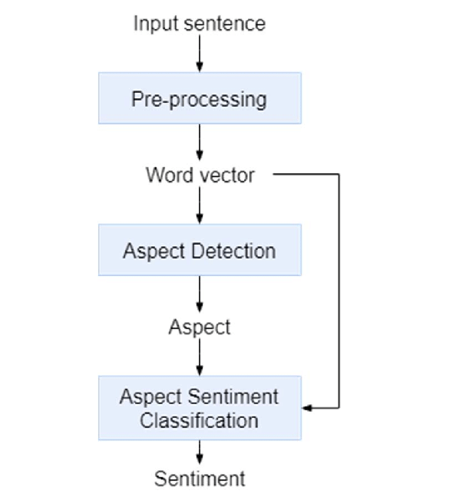
PROCESS FLOW
Process Flow Overview
Data Collection: Aggregating reviews from multiple online platforms.
Preprocessing: Cleaning and organizing the data. Sentiment Analysis: Applying NLP algorithms to determine sentiment.
Result Integration: Incorporating analysis results into
dashboards and reports.
Feedback Loop: Continuously improving the model based on new data.

Slide 5

FEATURES OFFERED
Key Features
Automated Sentiment Analysis: Uses natural language processing (NLP) to assess review sentiments (positive, negative, neutral).
Real-time Data Processing: Continuously updates with new reviews.
Detailed Reporting: Generates comprehensive reports and visualizations.
Customizable Dashboards: Tailored to diﬀerent user roles and
needs within Intel.
Alert System: Notiﬁes stakeholders about signiﬁcant sentiment changes.

Slide 6
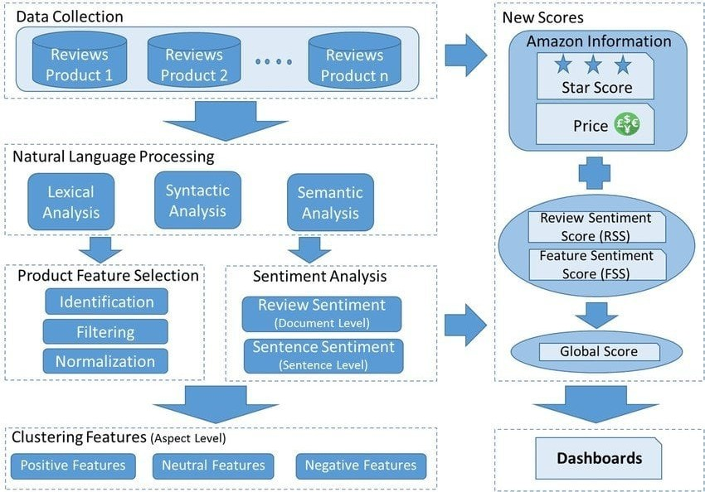
Architecture Diagram

Slide 7

TECHNOLOGIES USED
Technology Stack
Data Collection: Web Scraping tools, APIs
Preprocessing: Python, Pandas, NLTK etc
Sentiment Analysis: Machine Learning frameworks (TensorFlow, PyTorch), NLP libraries (BERT, GPT)

Slide 8

CONCLUSION :
The Intel Product Online Review Sentiment Analysis system simplifies and automates the process of understanding customer feedback from various platforms. By using advanced NLP and ML techniques, Intel gains valuable insights to enhance product quality, improve customer satisfaction, and make informed business decisions. This system ensures efficiency, scalability, and continuous improvement, positioning Intel to respond effectively to customer needs and stay competitive in the market.

Slide 9

THANK YOU

