Slide 1
Analysis and classification of electroencephalographic data
Elia Rizzo
20/11/2024
Digitalcity.brussels

Slide 2
Outline
Introduction to electroencephalography (EEG)
Data presentation and objectives
Preprocessing and analysis of the EEG data
Classification using deep dearning

Slide 3
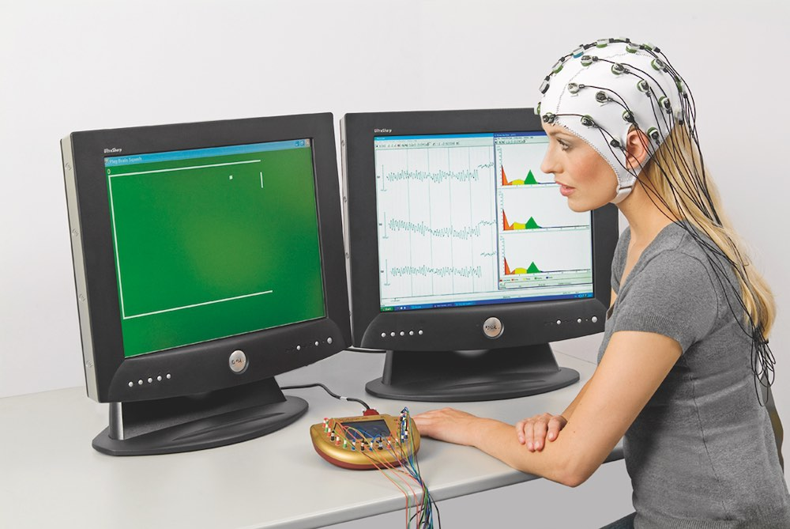
Electroencephalography

Slide 4
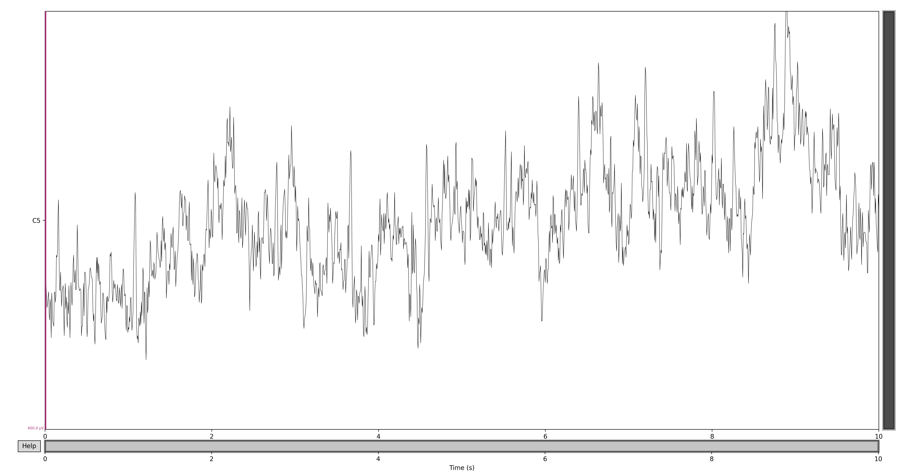
Electroencephalography
μV
S

Slide 5
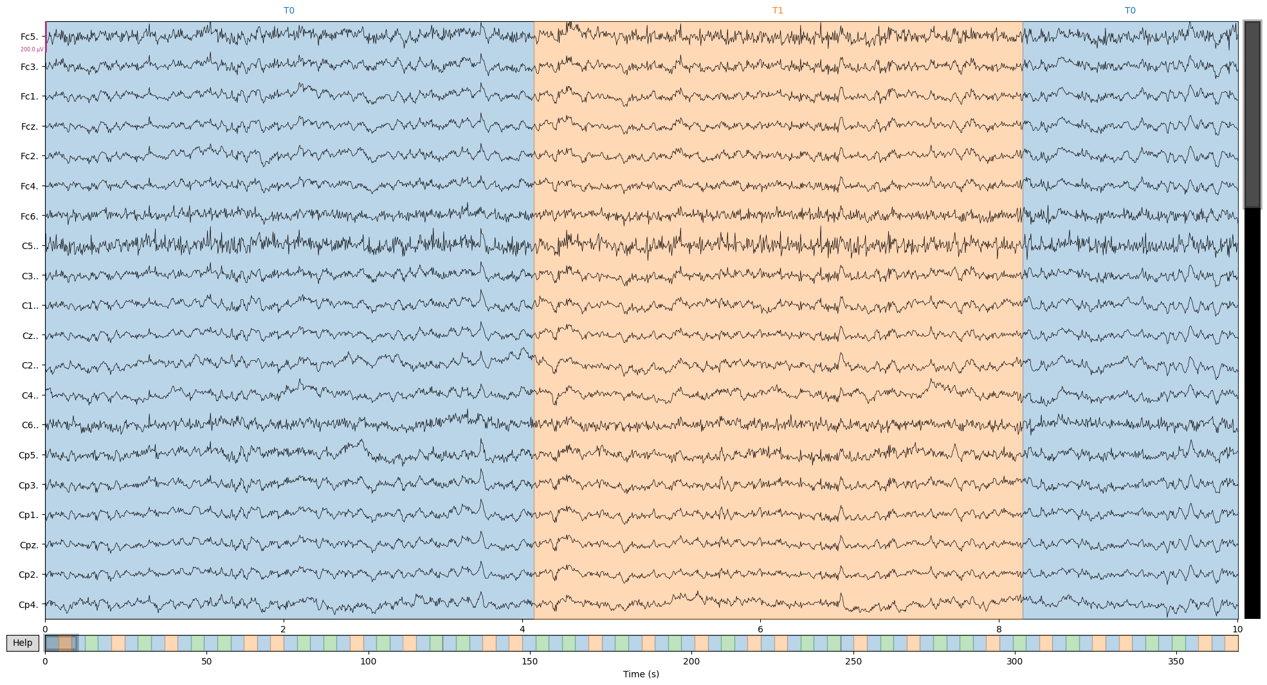
Electroencephalography

Slide 6
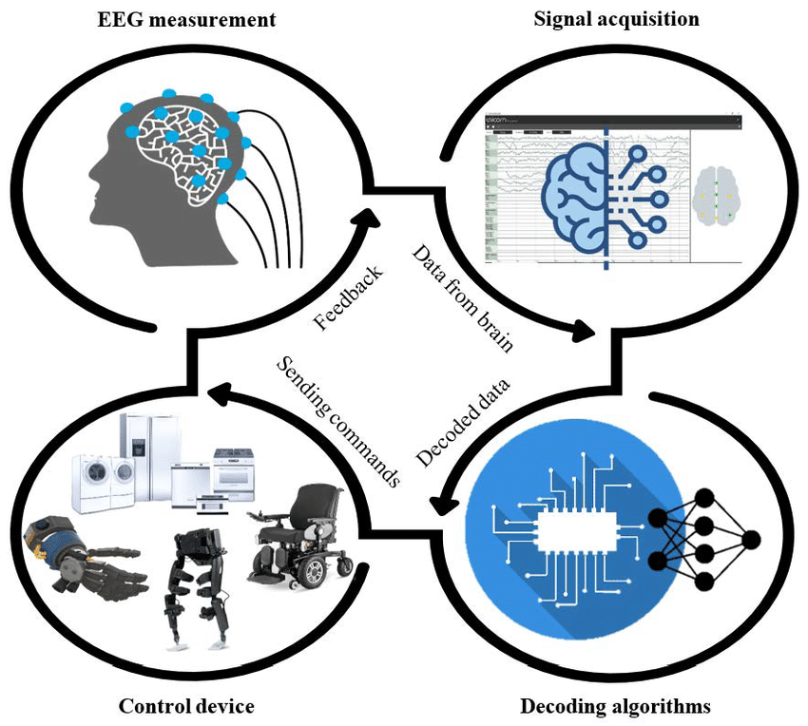
Why?
Brain-Coputer Interface!

Slide 7
EEG signals are A BIG MESS
Every electrode records:
Brain activity
Muscle activity (blinks, heart beats, movments)
Electrical noise from external sources (electronic tools, power system)

Slide 8
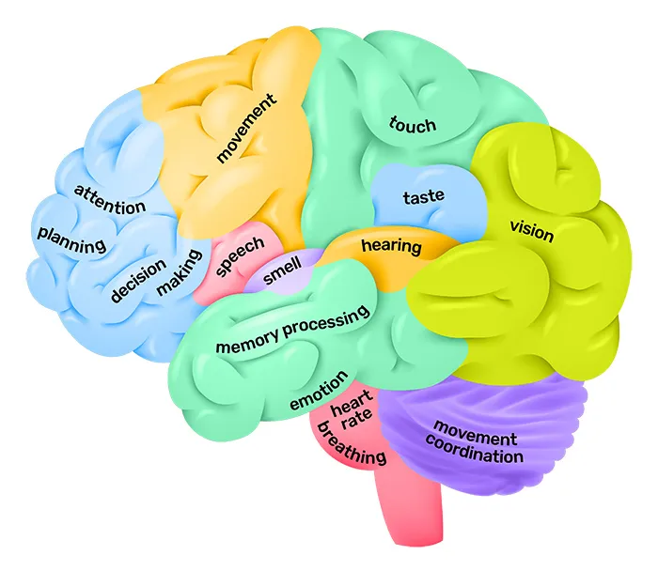

Slide 9
WE ARE ALL UNIQUE :)
Differnet people can exhibit different brain activity patterns when performing the same task

Slide 10
DataSet
109 Subjects:
3 experiment per participant
2 minutes per experience
A sequence of 4 second visual signals instructing the participants to rest or open and close either the right or the left fist

Slide 11
Objectives
Clean the data to reduce the noise and enhance the ability to detect meaningful patterns
Implement a model that recognizes the subject’s movement from these (EEG) patterns

Slide 12

Cleaning, or preprocessing
Filtering the data frequencies
Decomposing the signals and eliminating artifacts (eye blinks, and muscle movements…)
Changing the reference of the EEG signals

Slide 13
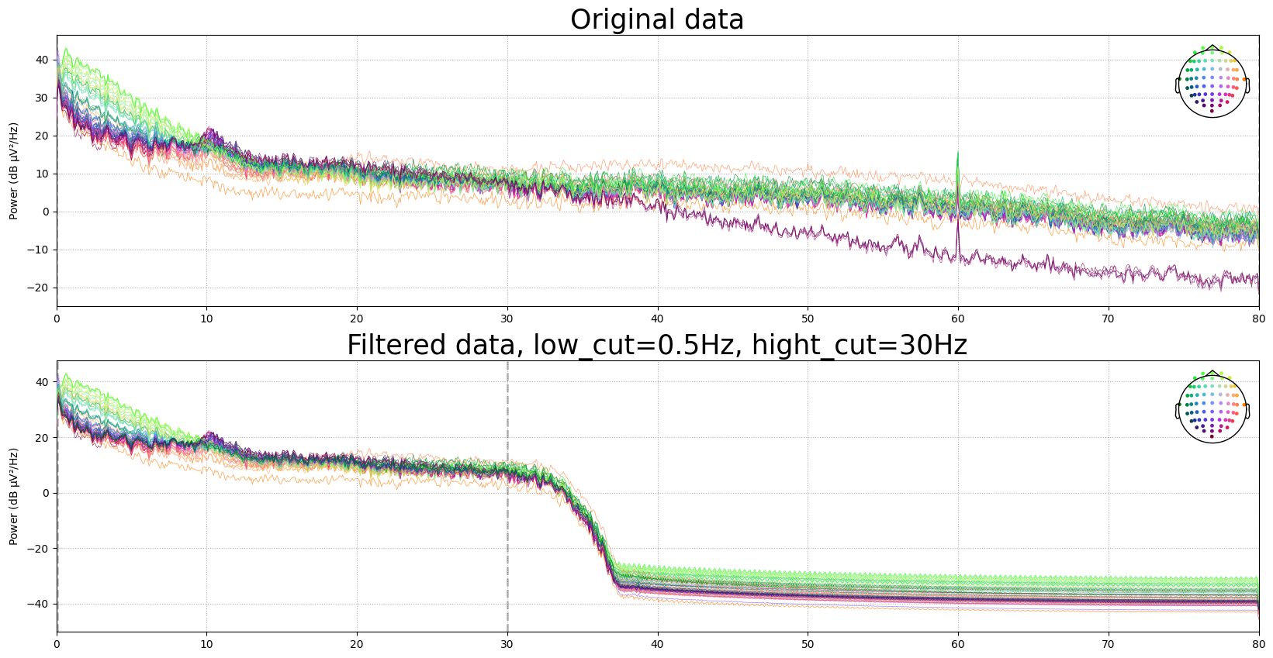
Filtering
Frequency of the power system in the U.S.

Slide 14
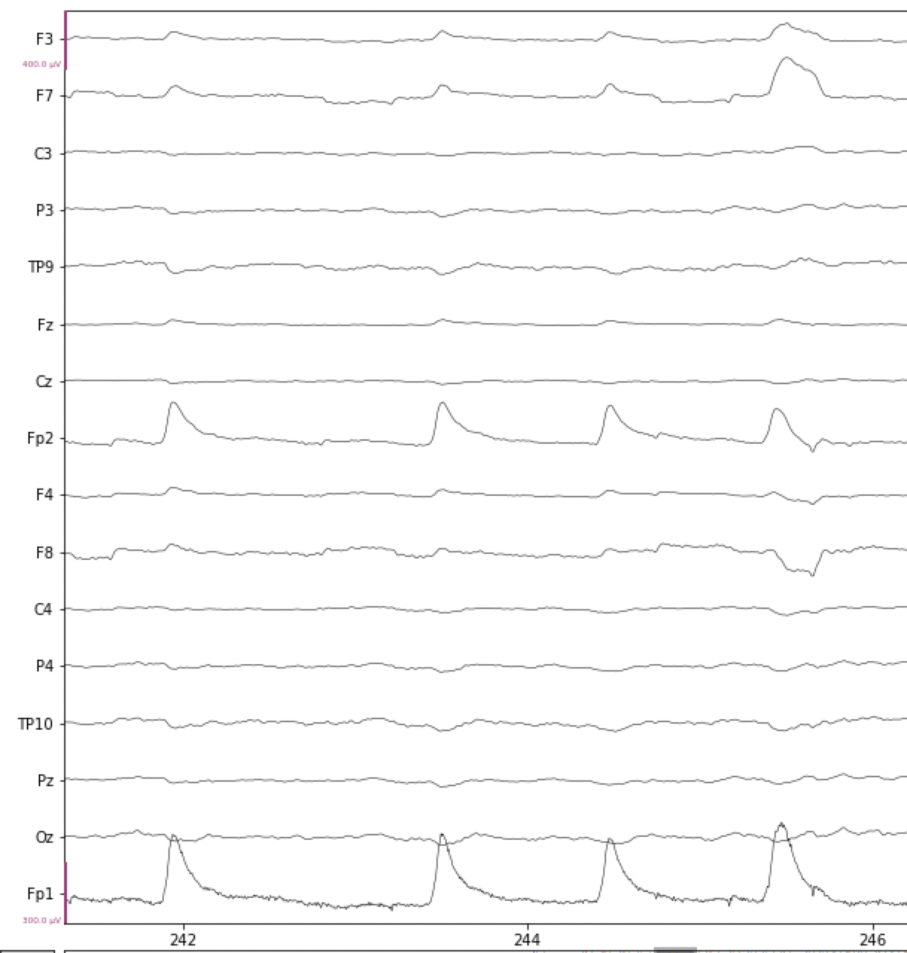
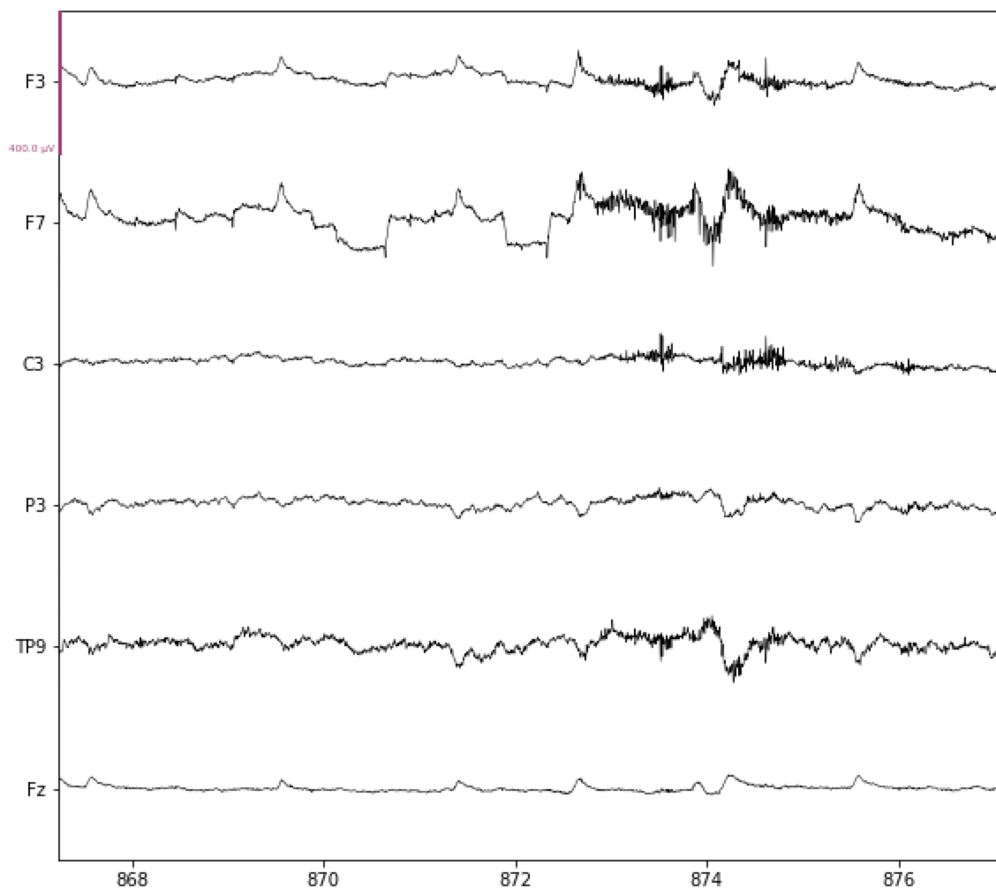
Artifacts detection
Muscles contractions
Eyes blink

Slide 15
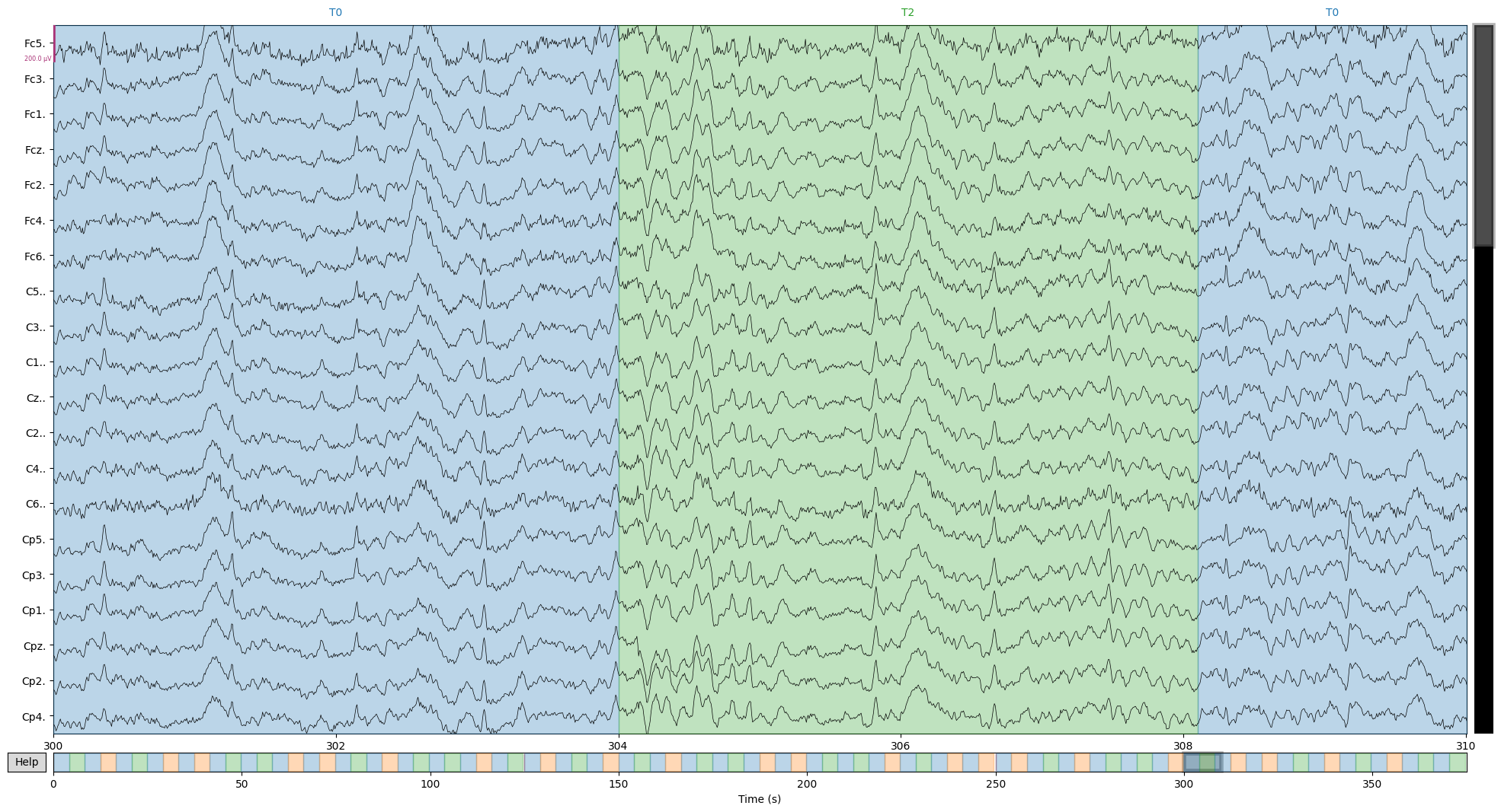

Slide 16
Automatic artifacts elimination
Dividing the signals in 1s epochs
Delete bad epochs
(Autoreject lib.)
Compute the indipendent component analysis (ICA)
Eliminate bad indipendent components
Using ICA to the original filtered data
Eliminate bad experimental epochs
(Autoreject lib.)

Slide 17
Automatic artifacts elimination
Dividing the signals in 1s epochs
Delete bad epochs
(Autoreject lib.)
Compute the indipendent component analysis (ICA)
Eliminate bad indipendent components
Using ICA to the original filtered data
Eliminate bad experimental epochs
(Autoreject lib.)

Slide 18
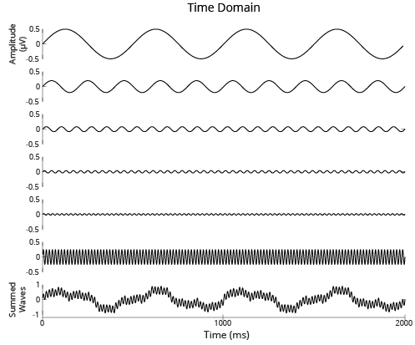
Indipendent component analysis

Slide 19
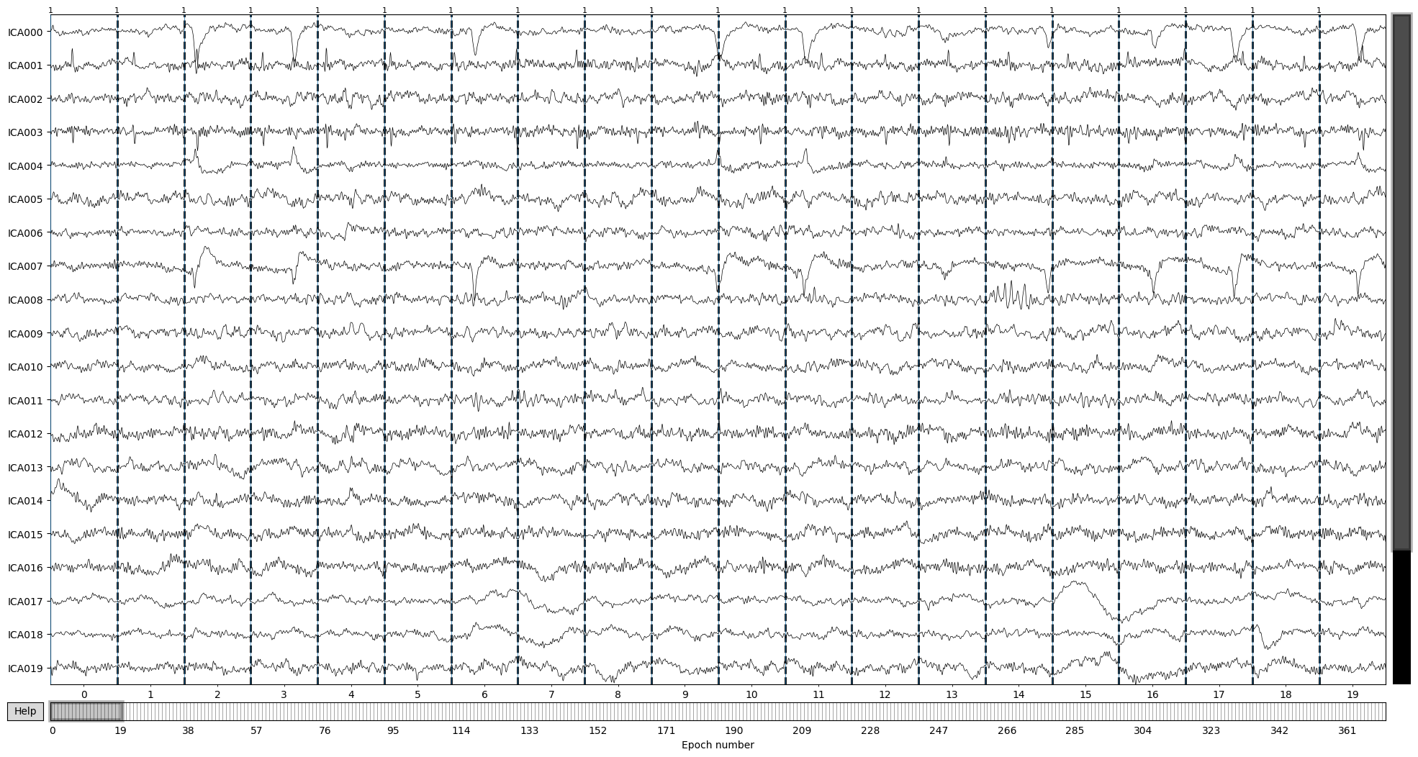

Slide 20
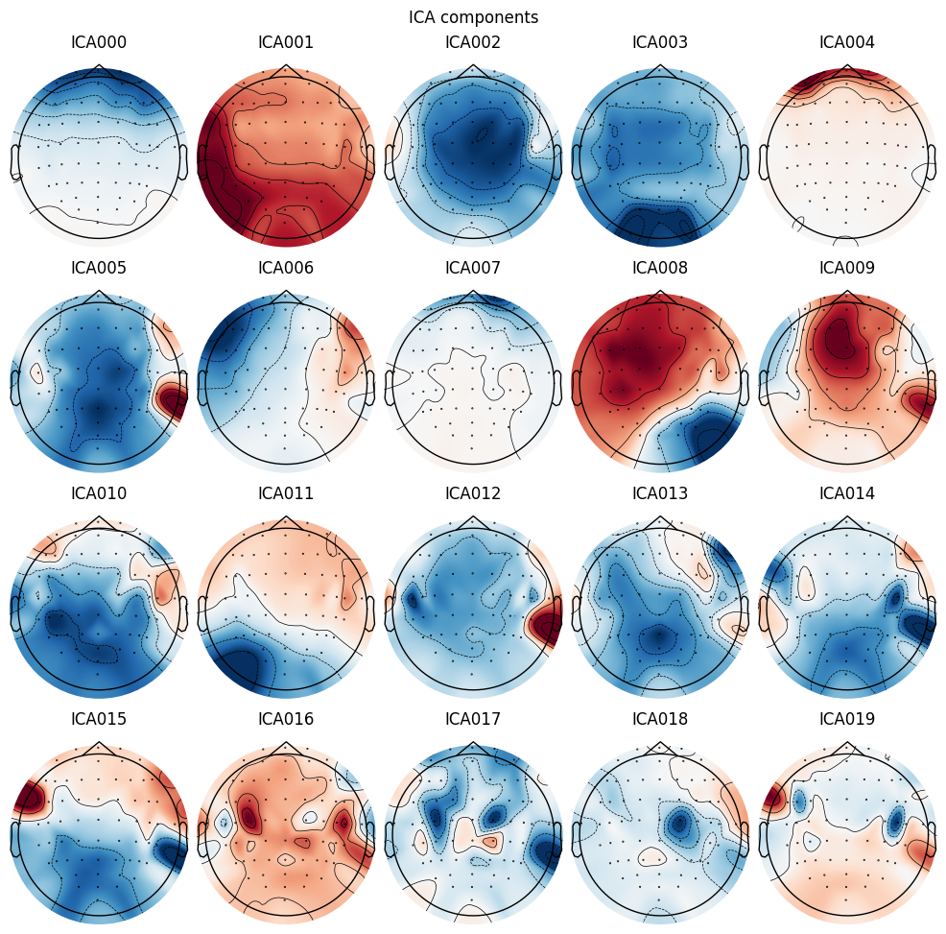

Slide 21
Automatic artifacts elimination
Dividing the signals in 1s epochs
Delete bad epochs
(Autoreject lib.)
Compute the indipendent component analysis (ICA)
Eliminate bad indipendent components
Using ICA to the original filtered data
Eliminate bad experimental epochs
(Autoreject lib.)

Slide 22
Automatic artifacts elimination
Dividing the signals in 1s epochs
Delete bad epochs
(Autoreject lib.)
Compute the indipendent component analysis (ICA)
Eliminate bad indipendent components
Using ICA to the original filtered data
Eliminate bad experimental epochs
(Autoreject lib.)

Slide 23
Decomposition using the independent components found by the ICA algorithm.
Reconstruct the signal by summing the components we decide to keep
Original signal

Slide 24
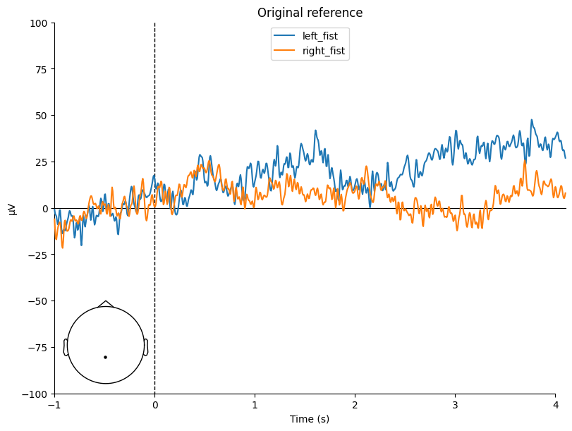
Original Referece

Slide 25
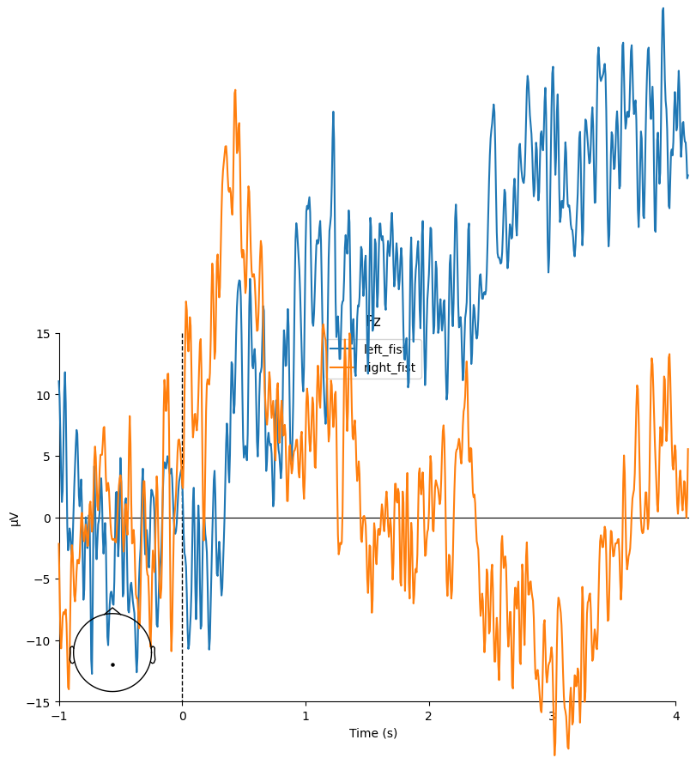
Ears refactoring

Slide 26
Models
EEGNet (Convolutional Neural Network):77% accuracy.

Slide 27
What’s next...
Different filters
Choose smaller sets of electrodes
Try methods different than ICA to decompose the signals
Play a bit more with deep learning models
Access better resources

Slide 28
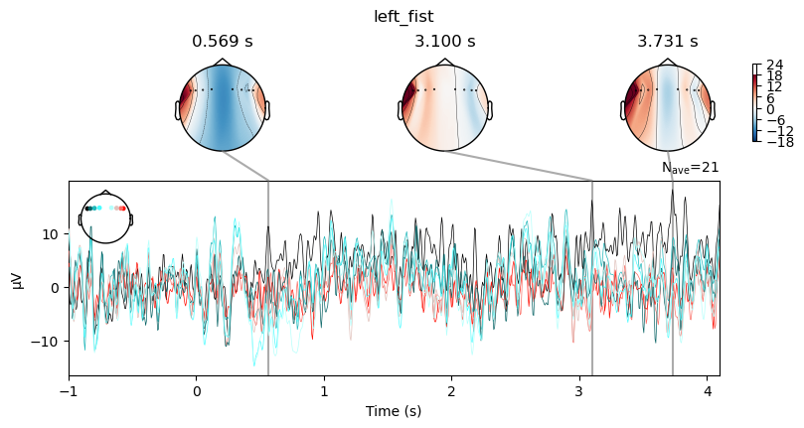
THANK YOU!

