Slide 1
Modeling the Band Gaps of Binary Compounds with Machine Learning

Slide 2
Introduction
Can we use ML to model and predict Band Gaps of compounds?
Methods used:
Linear Ridge Regression
Random Forest Ensemble

Slide 3
Background
Band Gap
Distance between the valence band of electrons and the conduction band²
Minimum energy required to excite an electron up to a state in the conduction band
Conductors v. Semiconductors v. Insulators
Various applications: particularly in Solar Cells

Slide 4
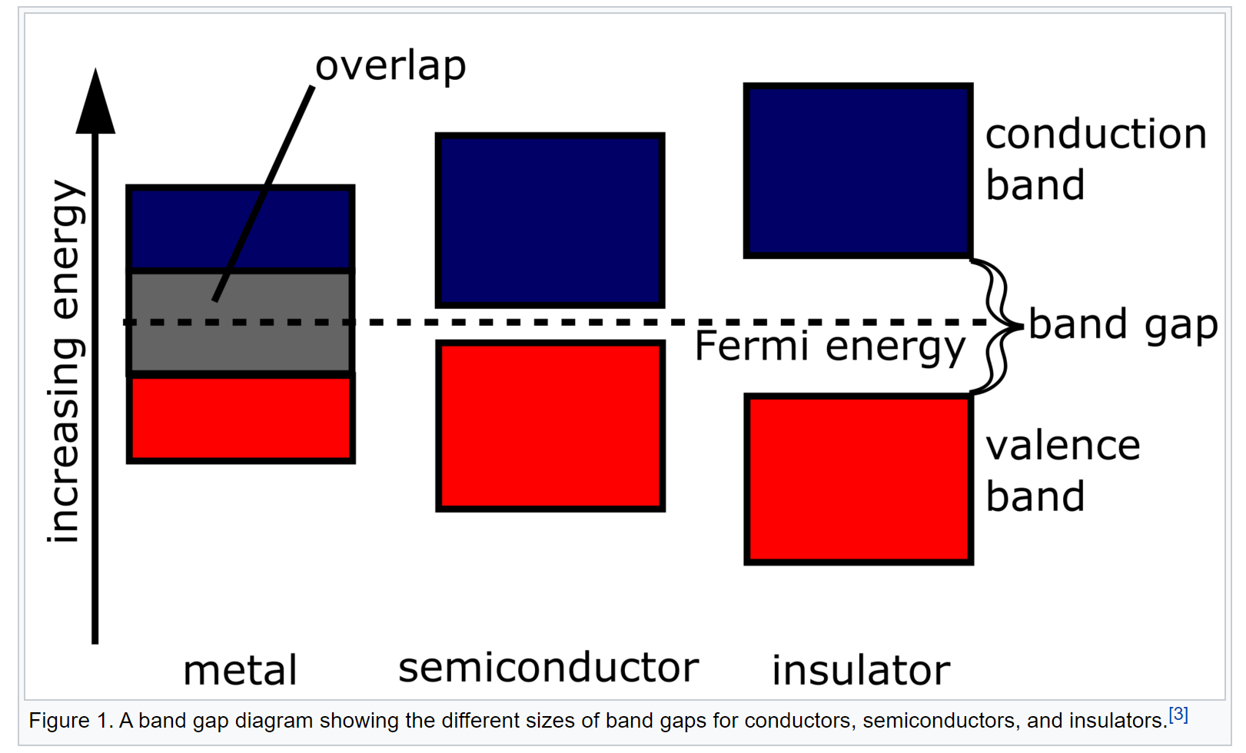
Ref: J.M.K.C. Donev et al. (2015). Energy Education - Band gap [Online]. Available: https://energyeducation.ca/encyclopedia/Band_gap.

Slide 5
Applying Maching Learning
Features: Calculated using Pymatgen
Electronegativity Difference (Band Gap increases as this increases)
Molecular Weight
Atomic Fraction
Periodic Group (Band Gap decreases as this increases)
Target: Band Gap

Slide 6
Data Generation
MPQuery
Obtained various Band Gaps for several compounds
Started with 700 compounds, including duplicates
Cut out duplicates, with one assumption
Also removed any compounds with MM>1000 and Elecronegativity Difference>10

Slide 7
Results
Low Training and Test Scores with Ridge Regression Model
test score: 0.352, train score: 0.412
High Training and Moderately High Test Score with Random Forest Ensemble
test score: 0.744, train score: 0.966

Slide 8
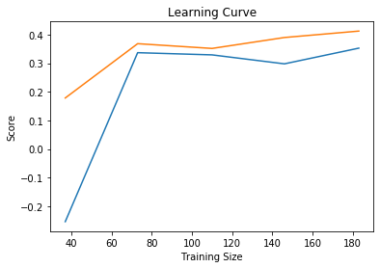
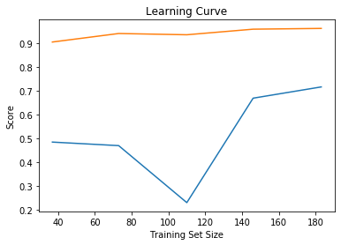
Results
Left: The Ridge Regression Learning Curve
Right: Random Forest Learning Curve

Slide 9
Results
Tried Grid Searching parameters for Random Forest to reduce variance
Particularly min_samples_leaf, min_samples_split, n_estimators, max_depth and max_features
No real improvement shown

Slide 10
Discussions
Ridge: High Bias Issue
More Features? More Complex Ones?³
Scaling? And More Data?
Kernel Ridge Regression
Random Forest: High Variance
More Data/More Compounds
Another Grid Search
Try with Experimental Data (both cases really)
Try different Metrics(for both again, MASE)

Slide 11
References
Natarajan, AS, Varadhan R, Ezhilvel ME. 2016. Band Gap Estimation Using Machine Learning Techniques. Vixra.org
J.M.K.C. Donev et al. (2015). Energy Education - Band gap [Online]. Available: https://energyeducation.ca/encyclopedia/Band_gap.
Zhang, Y., Ling C. 2018. A strategy to apply machine learning to small data sets in materials sciences. Nature
Ong, S. P.; Cholia, S.; Jain, A.; Brafman, M.; Gunter, D.; Ceder, G.; Persson, K. a. The Materials Application Programming Interface (API): A simple, flexible and efficient API for materials data based on Representational State Transfer (REST) principles, Comput. Mater. Sci., 2015, 97, 209–215. doi:10.1016/j.commatsci.2014.10.037.
Some Previous Notebooks

