Slide 1
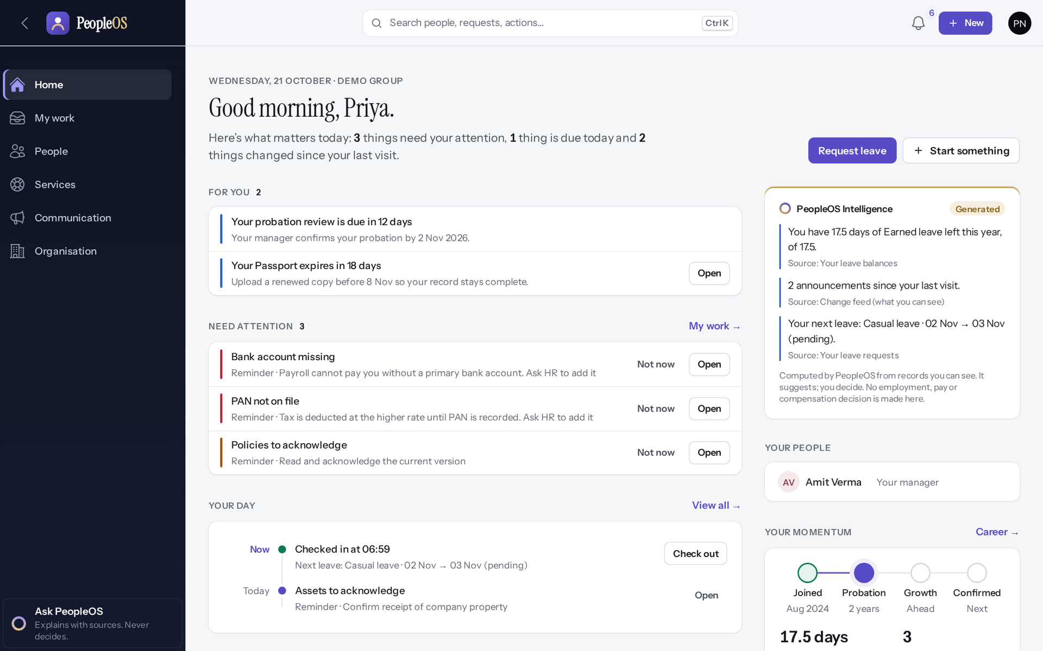
Employee User Training
MARKEDGE PEOPLEOS · TRAINING LIBRARY
Deck 01 of 12
Use PeopleOS for your own work: find your way, ask for leave, fix attendance, get help from HR, and follow your goals and learning.
For: Every employee with a PeopleOS account
Built from the running application (local, disposable database, fictional people) · 21 October 2026
Real screen, fictional data
Notes:
SAY: Welcome. In about an hour you will know how to do the everyday things in PeopleOS yourself. Everything you see is the real application with invented people.
EVIDENCE: Captured on the training database on 21 Oct 2026 as Priya Nair and Rahul Sharma, fictional employees of the fictional Demo Group (tools/capture/30-employee.mjs, 10-leave-flow.mjs, 20-attendance-flow.mjs).
AVOID in a shared training tenant: submitting real leave or real personal details.

Slide 2
How to read this deck
BEFORE YOU START
Verified in the running application
We ran it on the training database and captured each step.
1
Numbered markers on a screenshot match the numbered steps beside it.
Implemented · not verified end to end
The screen exists; the last steps need data or a second party we could not provide.
Every screenshot is a real capture of PeopleOS. The people and companies in it are fictional.
Available only after configuration
Works once an administrator or Markedge has set it up.
Disabled by safety or commercial gates
Switched off on purpose until owner decisions and approvals arrive.
Diagrams are marked "Conceptual diagram". They explain ideas; they are not screens.
Incomplete · known defect or gap
Partly working: a known defect or gap is stated on the slide.
Release gate: NO-GO (10 of 14 gates blocked, re-verified 13 Oct 2026). Not yet generally available.
Not implemented
Not in the product today.
Unable to verify
Could not be checked in this environment.
Notes:
SAY: Each picture is a real PeopleOS screen. The green label means we tried it and it worked. A red label means there is a known problem; the slide tells you what to do instead.

Slide 3
Where PeopleOS stands today
BEFORE YOU START
This training uses the real application on a practice database with invented people. PeopleOS is not yet generally available.
What works today
Payroll is not live yet
Known issues are named
The screens in this deck were run end to end on the practice database: you will see exactly what you will use.
Payslips appear only after a payroll run is finalised. Finalising is blocked until statutory rules are verified (0 of 24 today).
Where something does not work as it should, the slide says so and shows the workaround.
Notes:
SAY: We trained on the real PeopleOS screens, not mock-ups. The practice database contains invented people only.
AVOID: promising dates for general availability or payroll. The release gate is NO-GO (docs/saas/SaaS-Final-Release-Gate.md (decision NO-GO, re-verified 13 October 2026 at 7314f7d)).
ASK: "Who has used an HR self-service portal before?"
SAY: Where PeopleOS stands today. This training uses the real application on a practice database with invented people. PeopleOS is not yet generally available.
- What works today: The screens in this deck were run end to end on the practice database: you will see exactly what you will use.
- Payroll is not live yet: Payslips appear only after a payroll run is finalised. Finalising is blocked until statutory rules are verified (0 of 24 today).
- Known issues are named: Where something does not work as it should, the slide says so and shows the workaround.
ASK: "Which of these points needs more explanation for your team?"

Slide 4
What you will be able to do
LEARNING OBJECTIVES
Sign in and find your way
Home, menus, search
Get help from HR
requests, policies, announcements
1
4
Look after your own record
details, documents, letters
See pay and tax information
what is available today
2
5
Ask for leave and fix attendance
and see your manager's answer
Follow your goals and learning
check-ins, reviews, courses
3
6
Notes:
ASK: "What do you most often need from HR?" Point to the section that answers it.

Slide 5
Getting started
01
Sign in, read your Home, and find anything in a few keystrokes.
Notes:
TRANSITION: Section 1, Getting started. Sign in, read your Home, and find anything in a few keystrokes.
SAY: Tell learners what they will be able to do by the end of this section, then move on.
ASK: "What questions do you have before we start this section?"

Slide 6
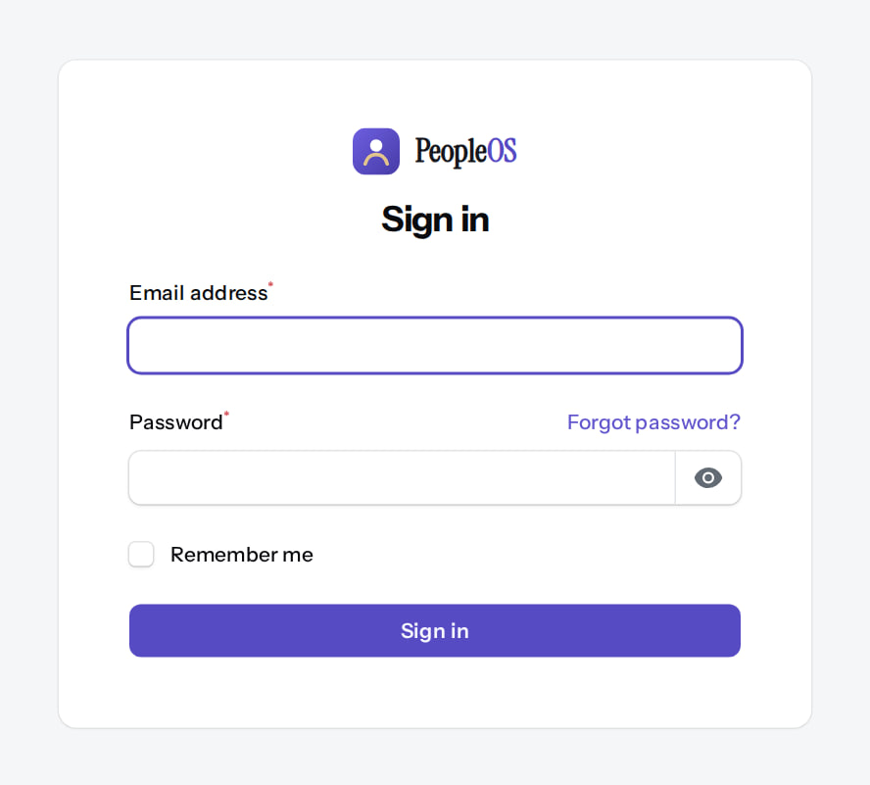
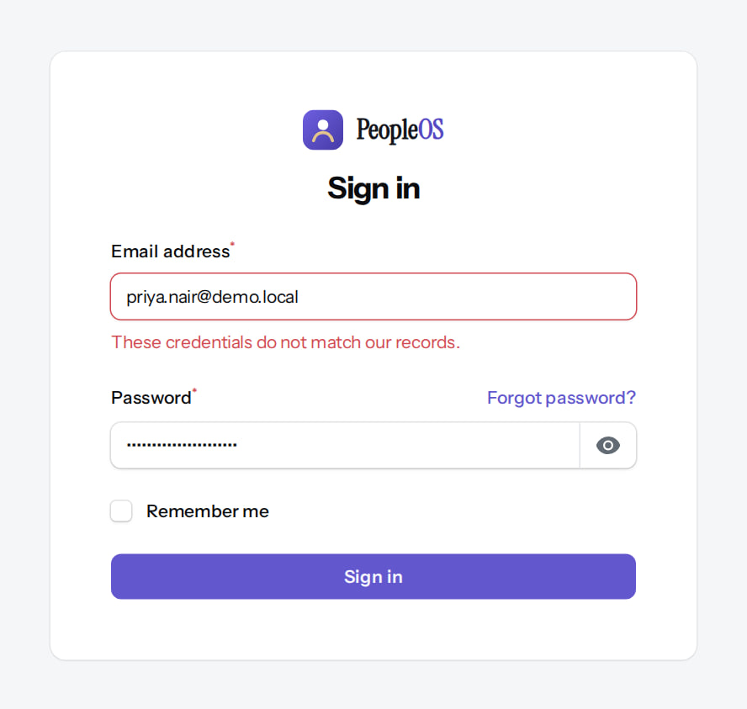
Sign in
GETTING STARTED
Sign-in page
Verified
If it does not work
Verified
Your work e-mail and password, then Sign in. Forgot password? sends a reset link.
"These credentials do not match our records." Check your password or use Forgot password?. If it still fails, ask HR.
Real screen (cropped) · Signed out (Visitor) · Sign in (/admin/login)
Real screen (cropped) · Signed out (Visitor) · Sign in (failed attempt)
Notes:
SAY: The message never says exactly what is wrong, on purpose: it protects your account.
IF YOUR ORGANISATION REQUIRES IT: you will also enter a 6-digit code from an authenticator app.
SAY: Sign in.
LEFT, Sign-in page: Your work e-mail and password, then Sign in. Forgot password? sends a reset link.
RIGHT, If it does not work: "These credentials do not match our records." Check your password or use Forgot password?. If it still fails, ask HR.
OBSERVE: point out what differs between the two screens.
EVIDENCE: left = employee/30-self-01-sign-in [Signed out (Visitor), Sign in (/admin/login)]; right = employee/30-self-02-sign-in-failed [Signed out (Visitor), Sign in (failed attempt)]. Real screens, fictional data (SCREENSHOT-INVENTORY.md).

Slide 7
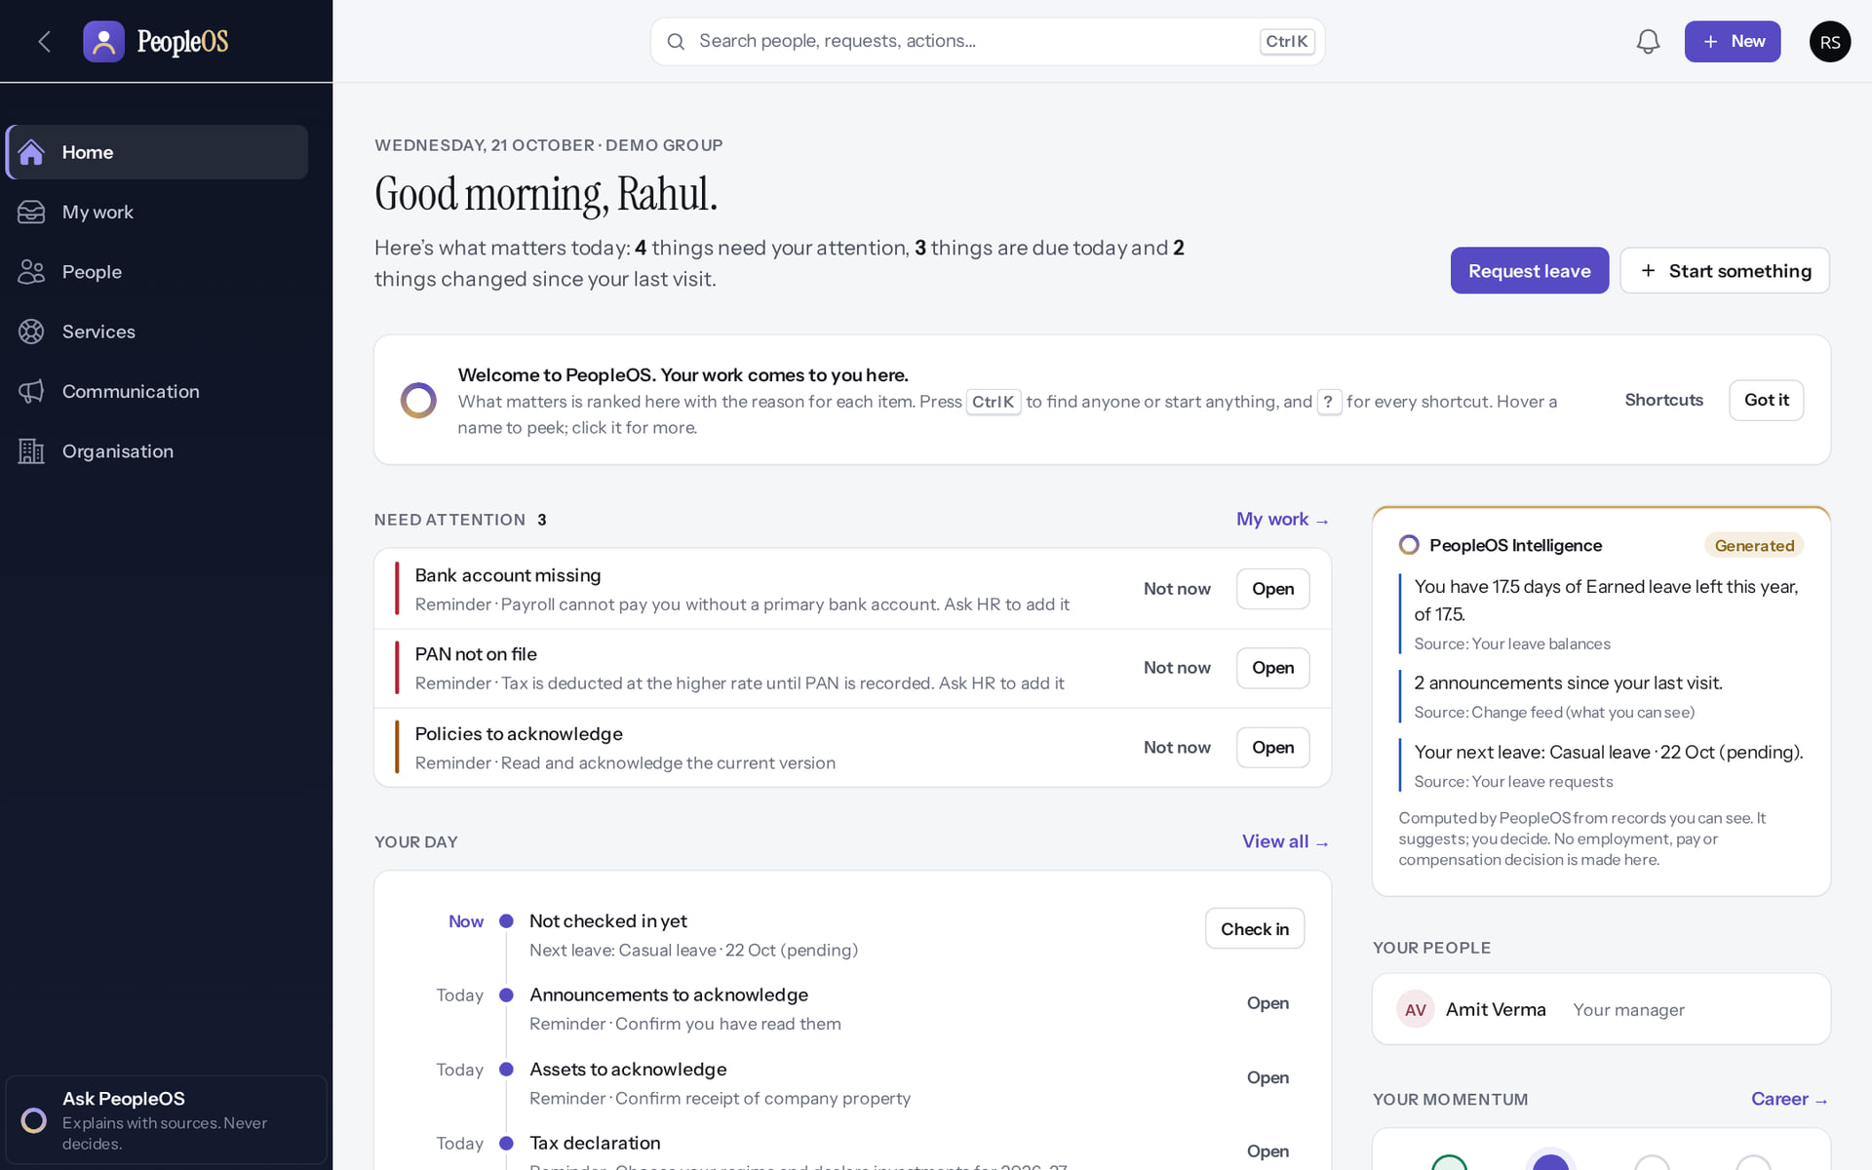
Your first visit
GETTING STARTED
3
Verified in the running application
1
A short welcome note.
4
2
Got it hides the note.
2
3
Search anything (Ctrl K).
1
Request leave.
4
RESULT PeopleOS puts your work on Home, each item with the reason it is there.
Real screen · Rahul Sharma (Employee) · Home (first visit)
Notes:
SAY: PeopleOS puts your work on Home, each item with the reason it is there.
ON SCREEN: First sign-in: Home explains how PeopleOS brings work to you.
WALK THROUGH: (1) A short welcome note. (2) Got it hides the note. (3) Search anything (Ctrl K). (4) Request leave.
LEARNERS SHOULD SEE: Welcome note with Shortcuts and Got it; Request leave and Start something
SCREEN: Home (first visit). Signed in as Rahul Sharma (Employee).
EVIDENCE: screenshot screenshots/employee/30-self-03-first-home-welcome.png, captured 2026-10-21 on the disposable training database (fictional people).

Slide 8
Read your Home
GETTING STARTED
Verified in the running application
1
For you: things about you, such as probation or an expiring passport.
4
1
2
Need attention: reminders such as missing bank details.
3
3
PeopleOS Intelligence: short facts with their source.
2
4
Start something: common requests.
RESULT Not now hides a reminder for a while; Open takes you to the place to act.
Real screen · Priya Nair (Employee) · Home
Notes:
SAY: Not now hides a reminder for a while; Open takes you to the place to act.
ON SCREEN: Read Home from top to bottom.
WALK THROUGH: (1) For you: things about you, such as probation or an expiring passport. (2) Need attention: reminders such as missing bank details. (3) PeopleOS Intelligence: short facts with their source. (4) Start something: common requests.
LEARNERS SHOULD SEE: For you, Need attention, Your day and PeopleOS Intelligence; each item says why it is there
SCREEN: Home. Signed in as Priya Nair (Employee).
EVIDENCE: screenshot screenshots/employee/30-self-04-home.png, captured 2026-10-21 on the disposable training database (fictional people).

Slide 9
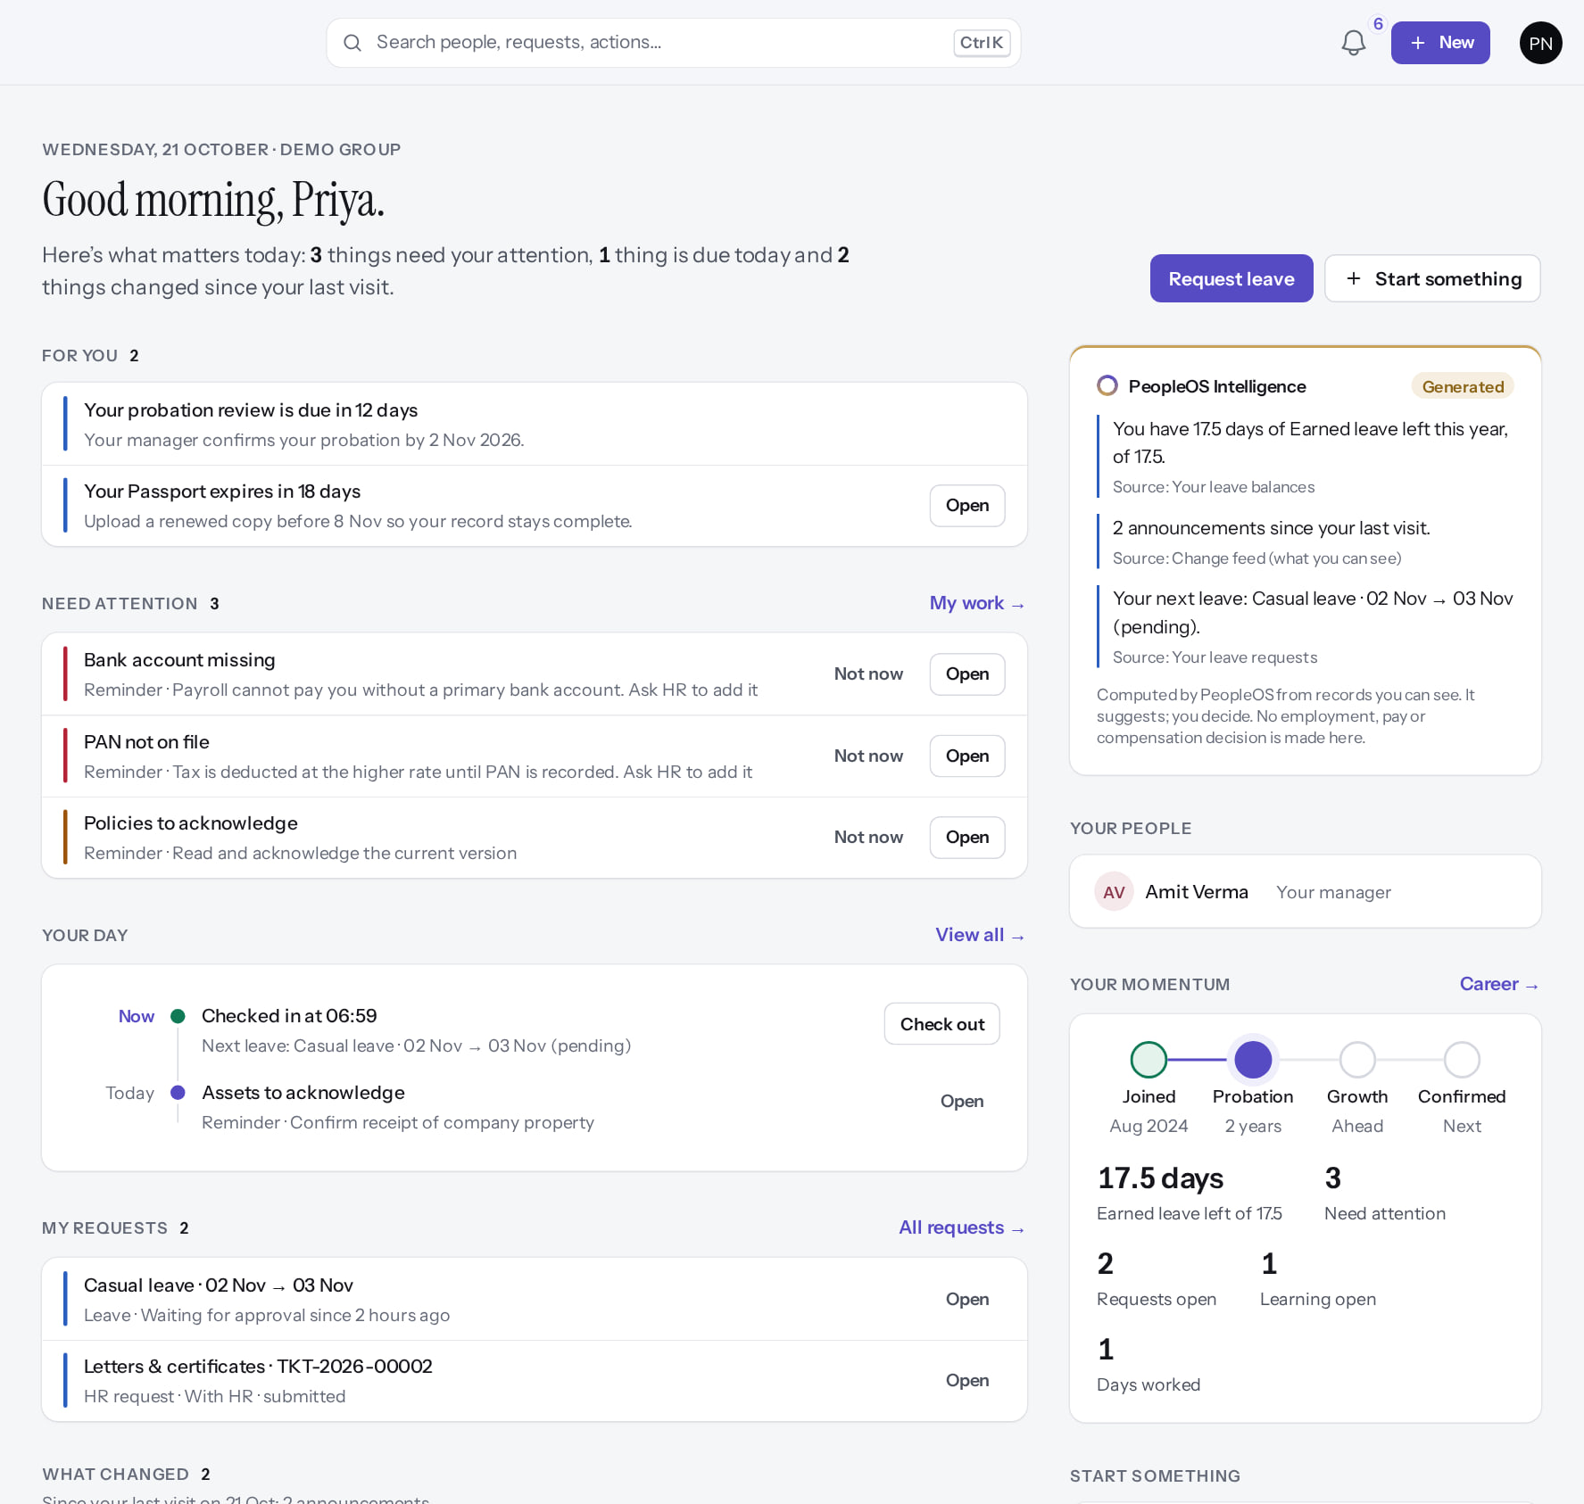
Further down Home
GETTING STARTED
Verified in the running application
4
1
Your day: check in and out.
2
My requests and their status.
3
Your momentum: from joining to confirmation.
4
Start something.
1
RESULT Scroll for your day, your requests, what changed and your people.
3
2
Real screen (cropped) · Priya Nair (Employee) · Home (whole page)
Notes:
SAY: Scroll for your day, your requests, what changed and your people.
ON SCREEN: Scroll Home.
WALK THROUGH: (1) Your day: check in and out. (2) My requests and their status. (3) Your momentum: from joining to confirmation. (4) Start something.
LEARNERS SHOULD SEE: Your day (check in/out), My requests, What changed, Your people, Your momentum, Start something
SCREEN: Home (whole page). Signed in as Priya Nair (Employee).
EVIDENCE: screenshot screenshots/employee/30-self-05-home-full.png, captured 2026-10-21 on the disposable training database (fictional people).

Slide 10
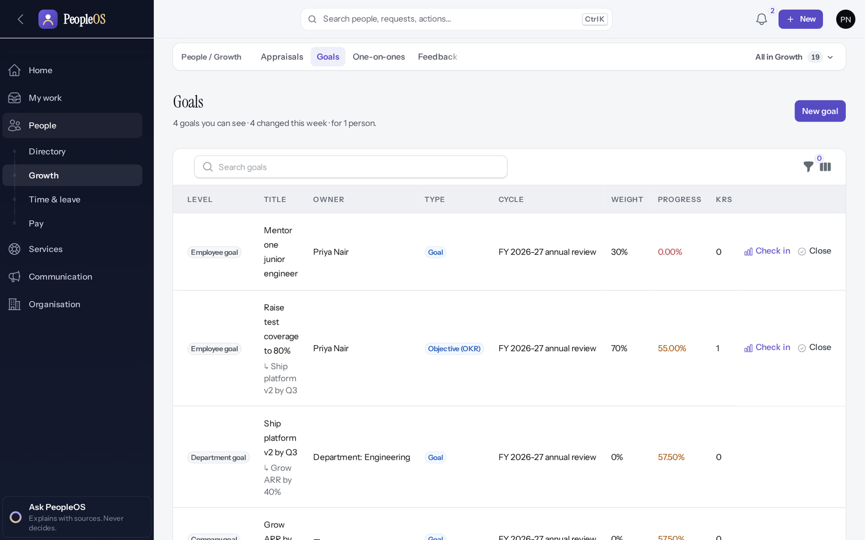
Menus
GETTING STARTED
Verified in the running application
3
4
1
Sidebar sections.
2
The area you are in.
1
3
Area bar: pages in this area.
2
4
"All in …" lists everything in the area.
RESULT You only see menus your role allows.
Real screen · Priya Nair (Employee) · People › Growth › Goals (navigation shell)
Notes:
SAY: You only see menus your role allows.
ON SCREEN: Use the sidebar section, its sub-menu and the area bar.
WALK THROUGH: (1) Sidebar sections. (2) The area you are in. (3) Area bar: pages in this area. (4) "All in …" lists everything in the area.
LEARNERS SHOULD SEE: Sidebar sections; sub-menu of the open section; area bar with the pages of the area and All in …
SCREEN: People › Growth › Goals (navigation shell). Signed in as Priya Nair (Employee).
EVIDENCE: screenshot screenshots/employee/30-self-06-navigation.png, captured 2026-10-21 on the disposable training database (fictional people).

Slide 11
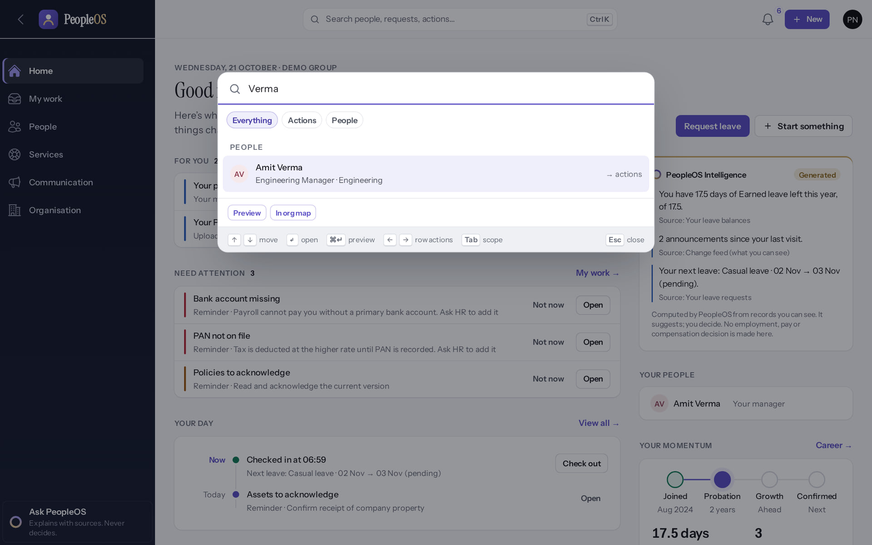
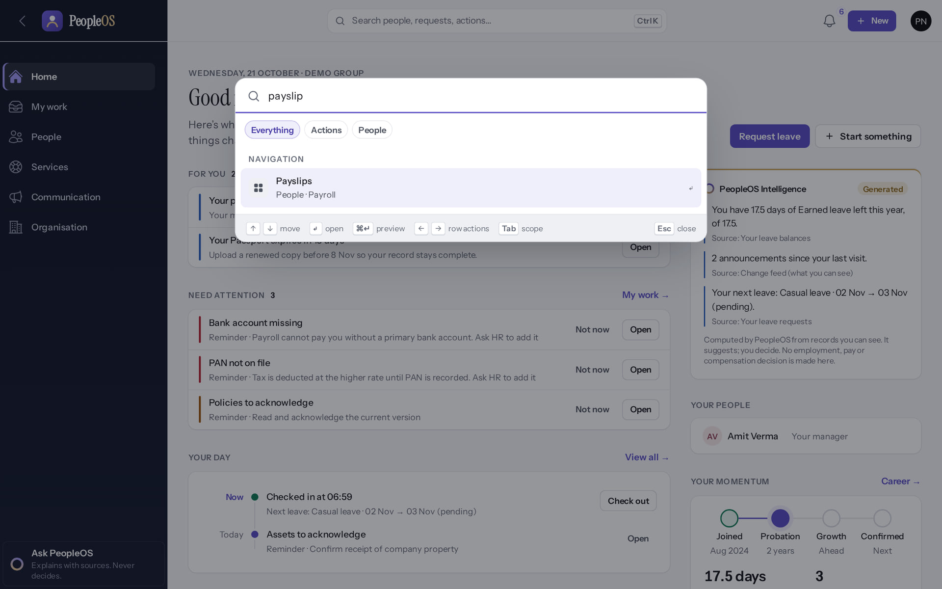
Search: Ctrl K
GETTING STARTED
Find a person
Verified
Find a page
Verified
Type a name: Preview or see them in the org map.
Type "payslip": pages and actions you are allowed to open.
Real screen · Priya Nair (Employee) · Command center (Ctrl K)
Real screen · Priya Nair (Employee) · Command center (Ctrl K)
Notes:
SAY: Search: Ctrl K.
LEFT, Find a person: Type a name: Preview or see them in the org map.
RIGHT, Find a page: Type "payslip": pages and actions you are allowed to open.
OBSERVE: point out what differs between the two screens.
EVIDENCE: left = employee/30-self-07-search-person [Priya Nair (Employee), Command center (Ctrl K)]; right = employee/30-self-08-search-payslip [Priya Nair (Employee), Command center (Ctrl K)]. Real screens, fictional data (SCREENSHOT-INVENTORY.md).

Slide 12
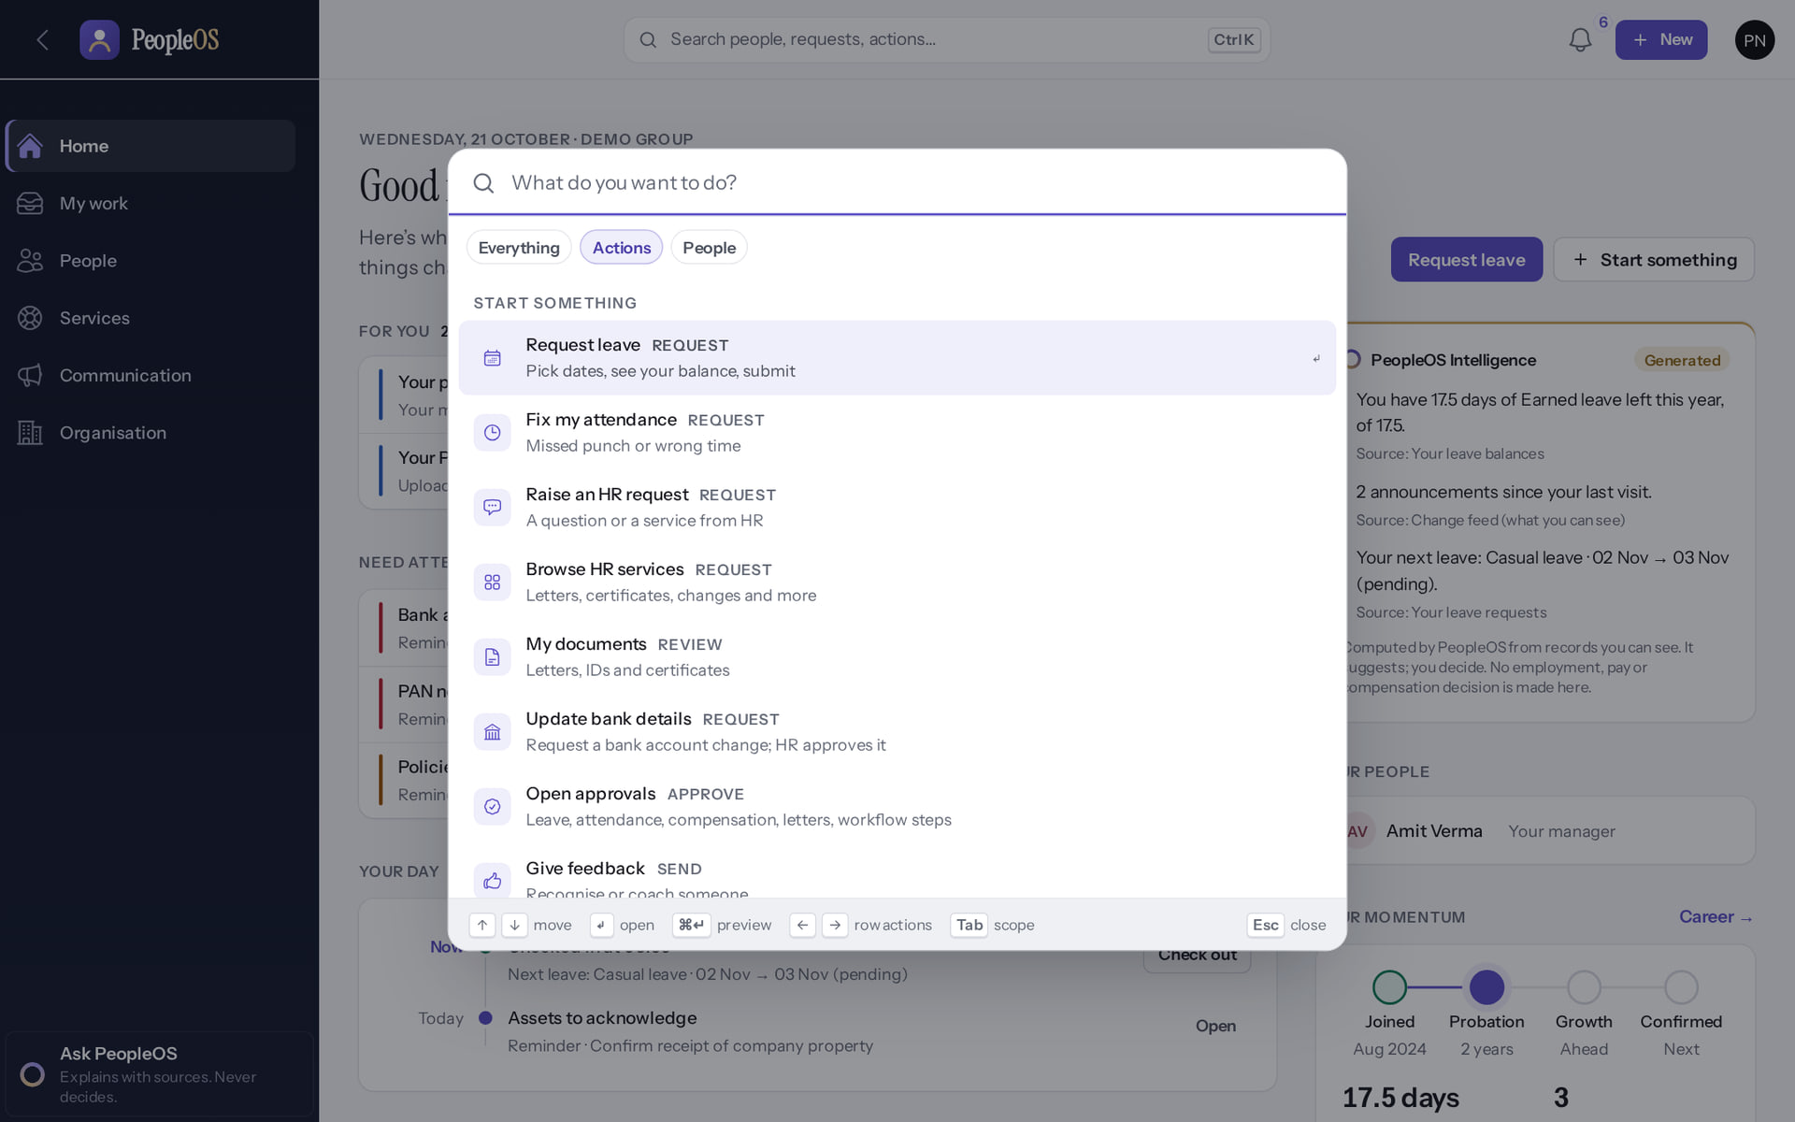
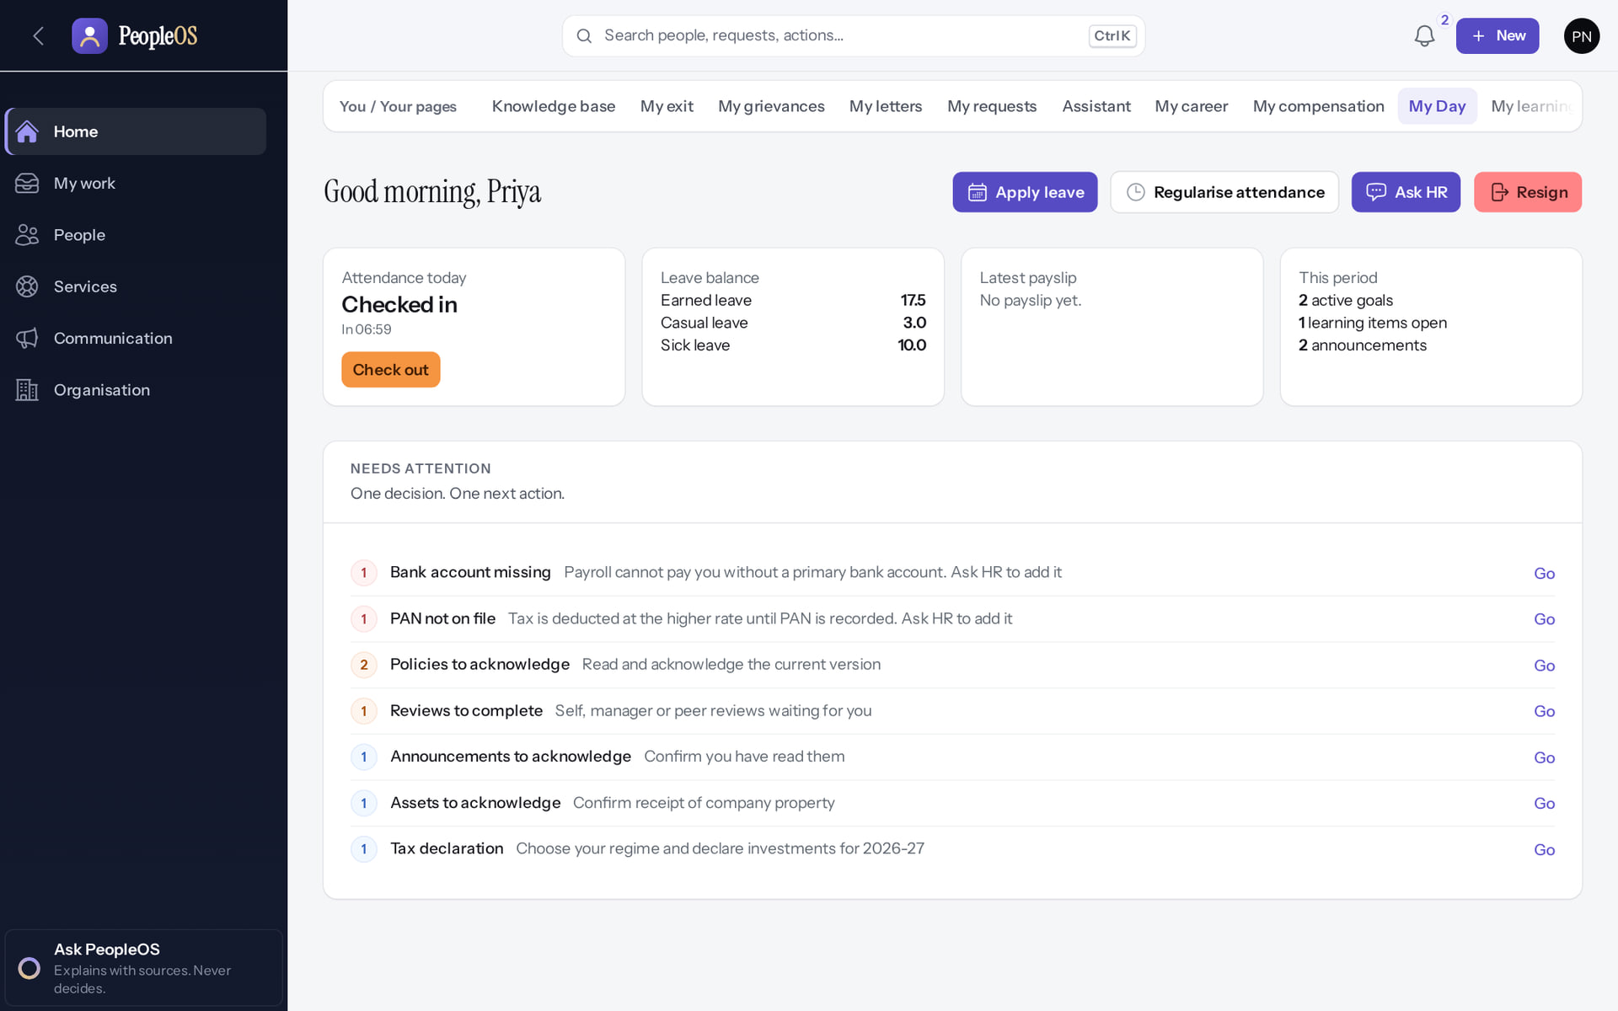
Start something and My day
GETTING STARTED
+ New
Verified
My day (avatar menu)
Verified
Everything you can start: leave, attendance correction, HR request…
Apply leave, Regularise attendance, Ask HR; today's attendance and balances.
Real screen · Priya Nair (Employee) · + New (Start something)
Real screen · Priya Nair (Employee) · My day (avatar menu › My day)
Notes:
SAY: Start something and My day.
LEFT, + New: Everything you can start: leave, attendance correction, HR request…
RIGHT, My day (avatar menu): Apply leave, Regularise attendance, Ask HR; today's attendance and balances.
OBSERVE: point out what differs between the two screens.
EVIDENCE: left = employee/30-self-09-quick-launch [Priya Nair (Employee), + New (Start something)]; right = employee/30-self-10-my-day [Priya Nair (Employee), My day (avatar menu › My day)]. Real screens, fictional data (SCREENSHOT-INVENTORY.md).

Slide 13
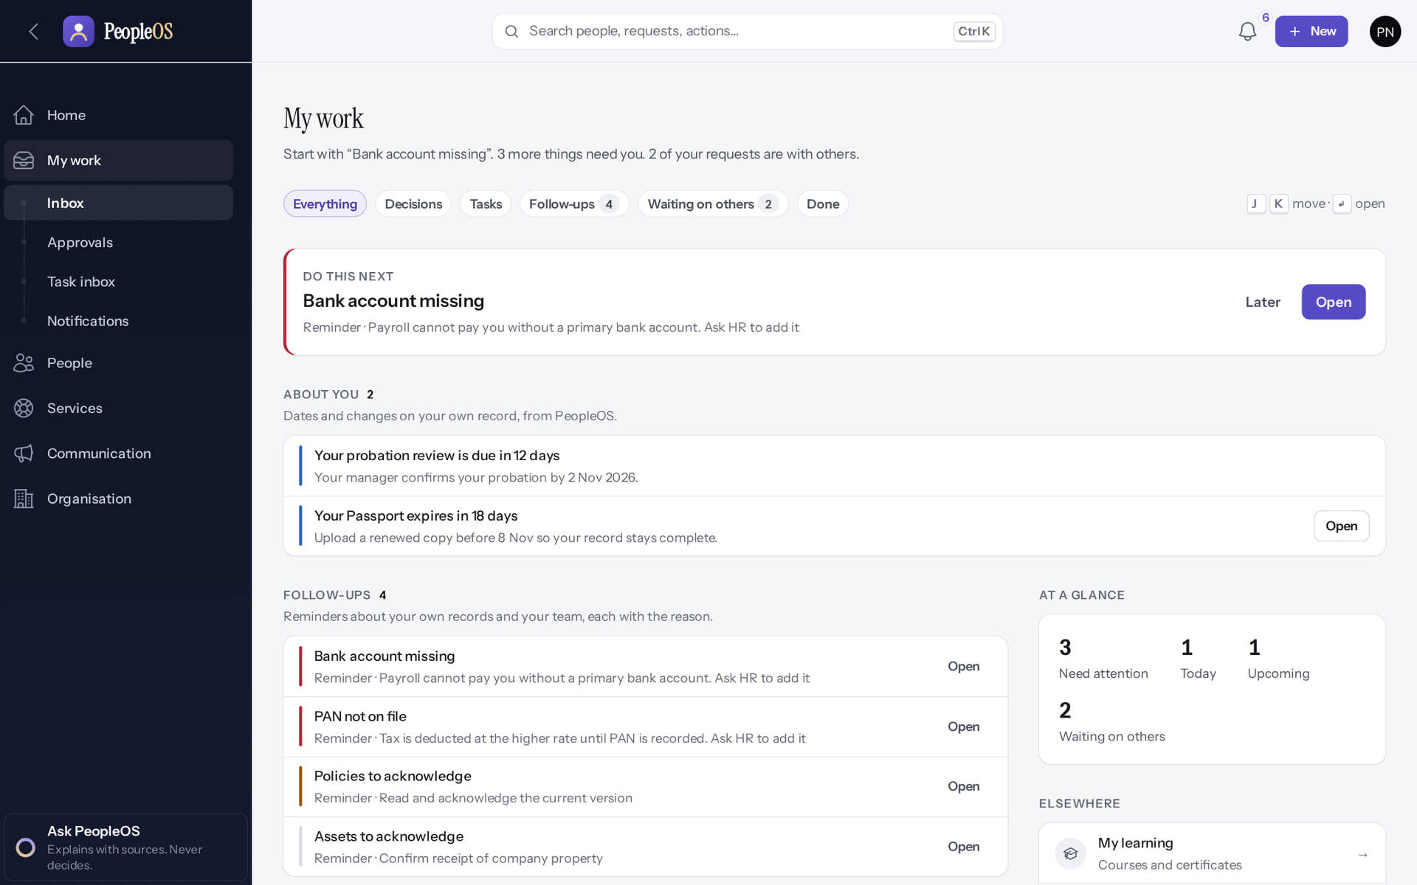
My work: everything waiting
GETTING STARTED
Verified in the running application
1
Filters: Everything, Tasks, Follow-ups, Done…
1
2
2
Waiting on others: requests with someone else.
RESULT "Do this next" suggests the most urgent item first.
Real screen · Priya Nair (Employee) · My work › Inbox
Notes:
SAY: "Do this next" suggests the most urgent item first.
ON SCREEN: Open My work.
WALK THROUGH: (1) Filters: Everything, Tasks, Follow-ups, Done… (2) Waiting on others: requests with someone else.
LEARNERS SHOULD SEE: Everything, Decisions, Tasks, Follow-ups, Waiting on others, Done; Do this next
SCREEN: My work › Inbox. Signed in as Priya Nair (Employee).
EVIDENCE: screenshot screenshots/employee/30-self-11-my-work.png, captured 2026-10-21 on the disposable training database (fictional people).

Slide 14
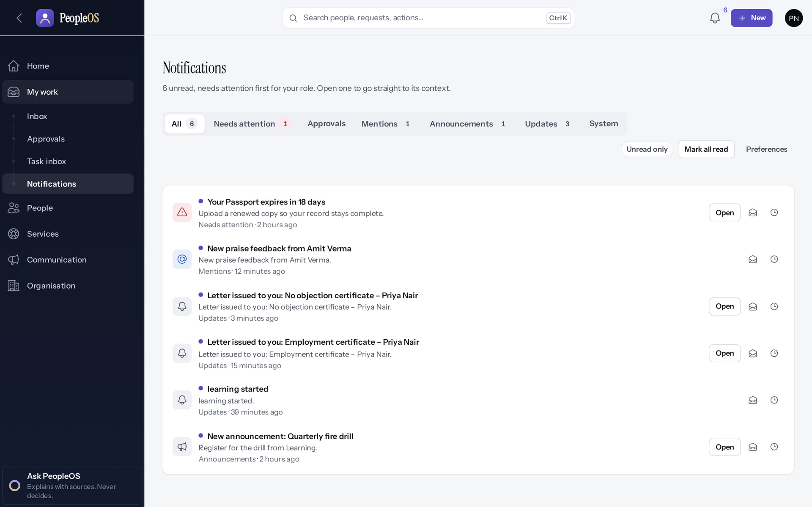
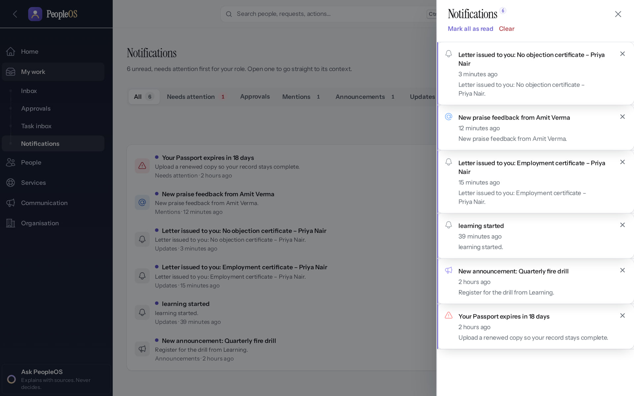
Notifications
GETTING STARTED
Notifications page
Verified
Bell
Verified
Grouped; Open, Mark read, Snooze. Preferences decide e-mail or in-app.
Unread notifications in a side panel.
Real screen · Priya Nair (Employee) · My work › Notifications
Real screen · Priya Nair (Employee) · Notification bell (top bar)
Notes:
SAY: Some notices depend on rules your HR team sets up; not every event sends an e-mail.
SAY: Notifications.
LEFT, Notifications page: Grouped; Open, Mark read, Snooze. Preferences decide e-mail or in-app.
RIGHT, Bell: Unread notifications in a side panel.
OBSERVE: point out what differs between the two screens.
EVIDENCE: left = employee/30-self-12-notifications [Priya Nair (Employee), My work › Notifications]; right = employee/30-self-13-bell-panel [Priya Nair (Employee), Notification bell (top bar)]. Real screens, fictional data (SCREENSHOT-INVENTORY.md).

Slide 15
Your record
02
See your details and documents; ask HR to change anything that is wrong.
Notes:
TRANSITION: Section 2, Your record. See your details and documents; ask HR to change anything that is wrong.
SAY: Tell learners what they will be able to do by the end of this section, then move on.
ASK: "What questions do you have before we start this section?"

Slide 16
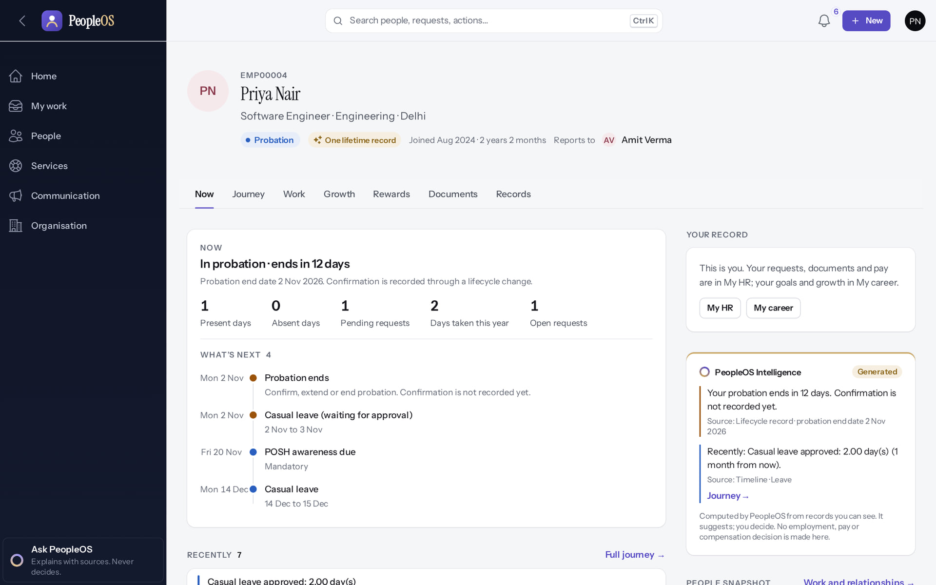
Your record
YOUR RECORD
Verified in the running application
1
Your record (open it from the avatar menu › My profile).
3
2
2
Views: Now, Journey, Work, Growth, Documents, Records.
1
3
Who you report to.
RESULT Read only. Changes go through HR so they are recorded properly.
Real screen · Priya Nair (Employee) · Your record (own Employee 360) › Now
Notes:
SAY: Read only. Changes go through HR so they are recorded properly.
ON SCREEN: Avatar menu › My profile (or My HR › Your record).
WALK THROUGH: (1) Your record (open it from the avatar menu › My profile). (2) Views: Now, Journey, Work, Growth, Documents, Records. (3) Who you report to.
LEARNERS SHOULD SEE: Read-only record: status, what is next, recent changes; no action menus
SCREEN: Your record (own Employee 360) › Now. Signed in as Priya Nair (Employee).
EVIDENCE: screenshot screenshots/employee/30-self-14-my-record-now.png, captured 2026-10-21 on the disposable training database (fictional people).

Slide 17
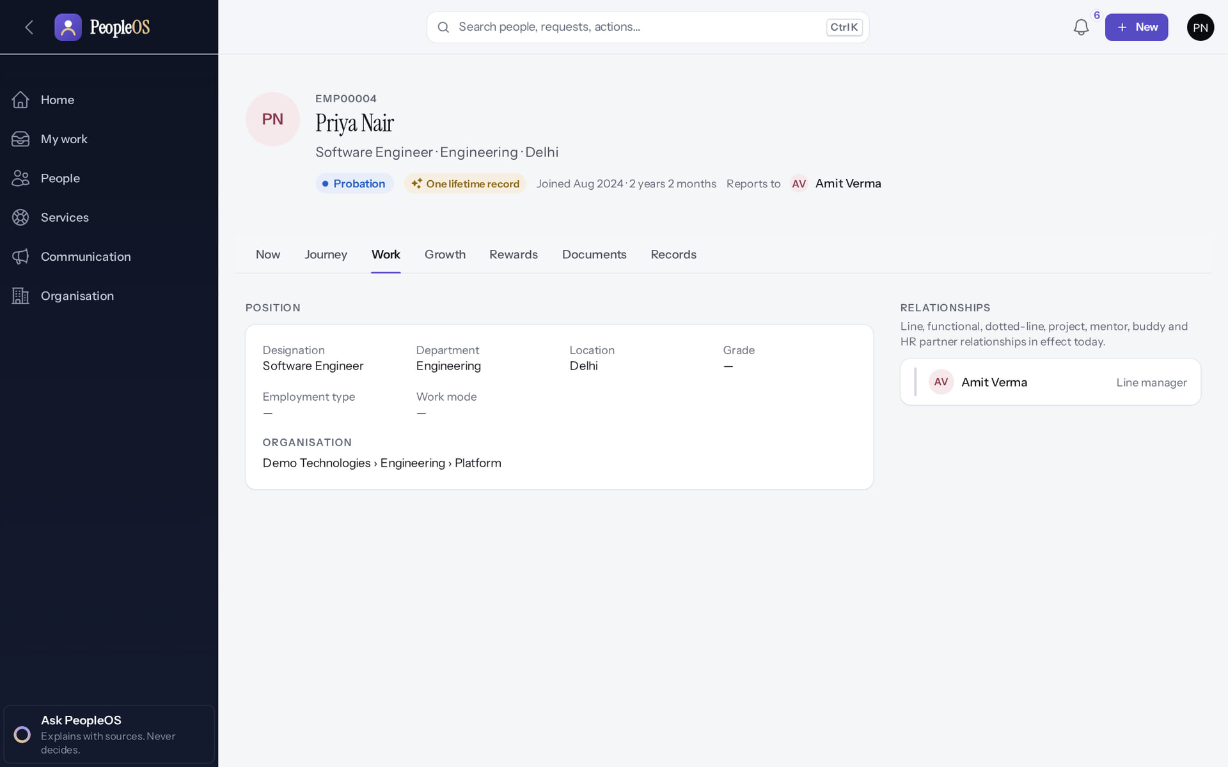
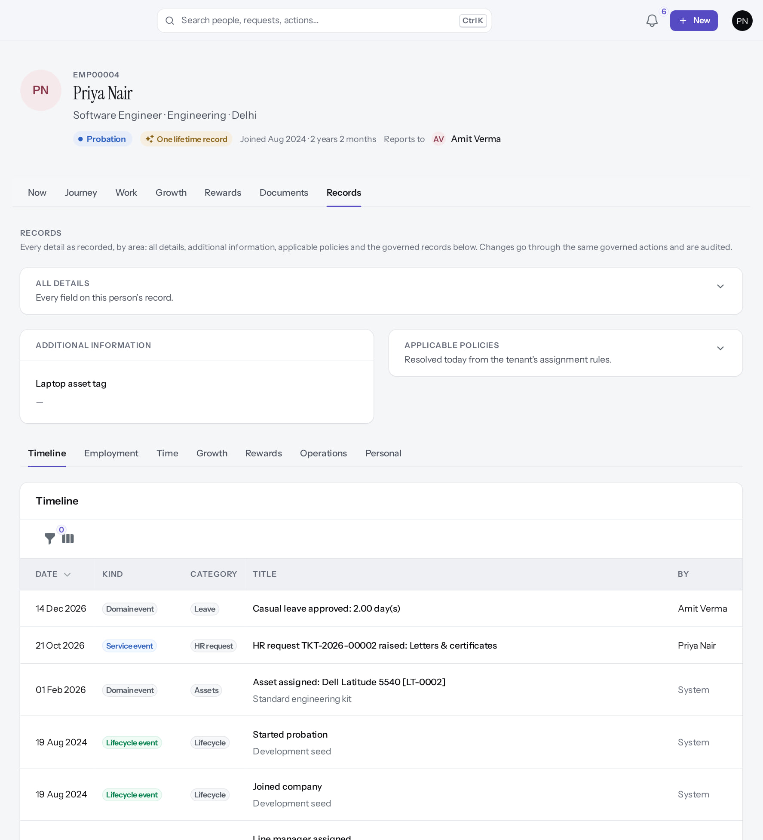
Work details and history
YOUR RECORD
Work
Verified
Records › Timeline
Verified
Position, organisation and working relationships.
Every change to your record with its date: the same history HR sees.
Real screen · Priya Nair (Employee) · Your record › Work
Real screen (cropped) · Priya Nair (Employee) · Your record › Records › Timeline
Notes:
SAY: Work details and history.
LEFT, Work: Position, organisation and working relationships.
RIGHT, Records › Timeline: Every change to your record with its date: the same history HR sees.
OBSERVE: point out what differs between the two screens.
EVIDENCE: left = employee/30-self-15-my-record-work [Priya Nair (Employee), Your record › Work]; right = employee/30-self-16-my-record-timeline [Priya Nair (Employee), Your record › Records › Timeline]. Real screens, fictional data (SCREENSHOT-INVENTORY.md).

Slide 18
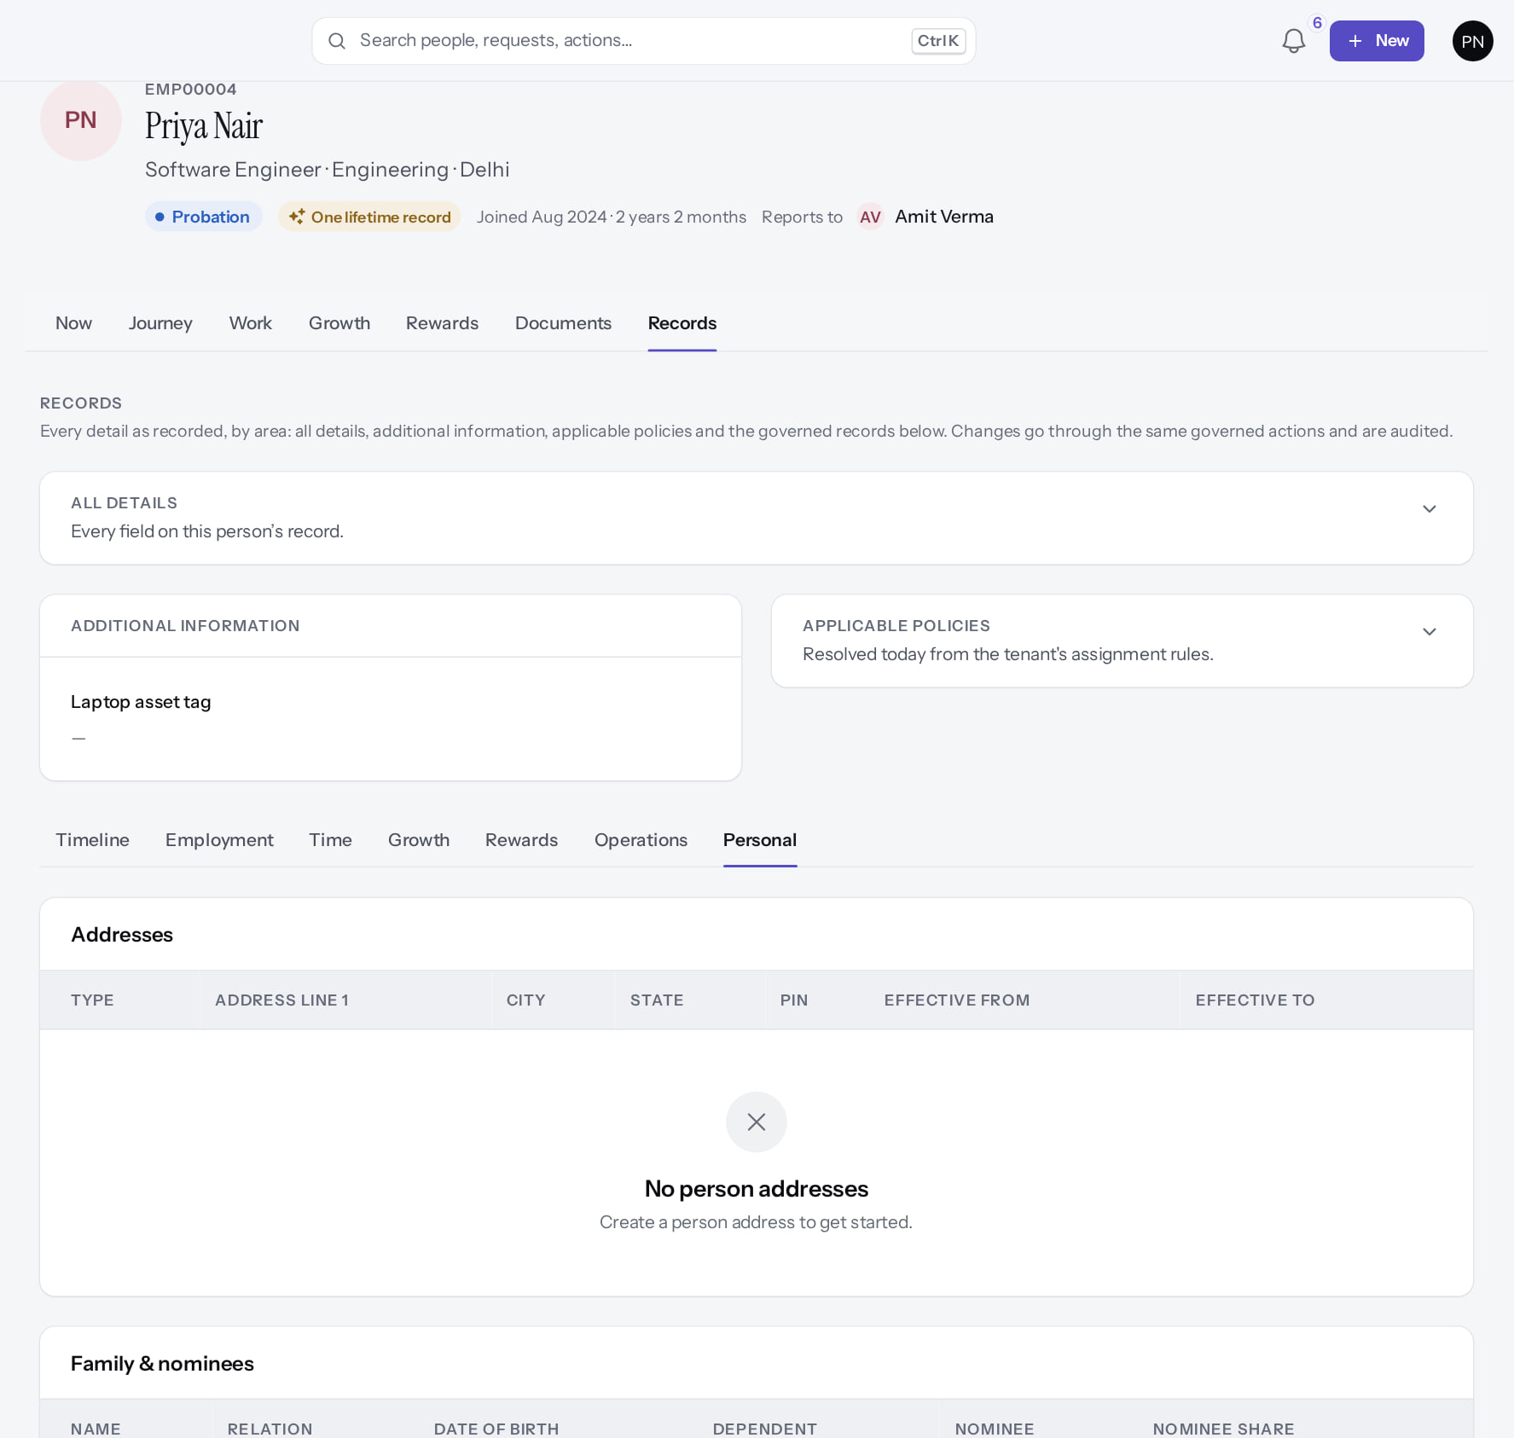
Personal details
YOUR RECORD
Verified in the running application
1
Records › Personal.
RESULT Addresses, family and other personal details (empty for this fictional employee). You cannot edit them yourself: raise an HR request (Ask HR) for a correction.
1
Real screen (cropped) · Priya Nair (Employee) · Your record › Records › Personal
Notes:
SAY: Addresses, family and other personal details (empty for this fictional employee). You cannot edit them yourself: raise an HR request (Ask HR) for a correction.
ON SCREEN: Records › Personal.
WALK THROUGH: (1) Records › Personal.
LEARNERS SHOULD SEE: Personal details; changes are requested from HR (employees do not edit their own record)
SCREEN: Your record › Records › Personal. Signed in as Priya Nair (Employee).
EVIDENCE: screenshot screenshots/employee/30-self-17-my-record-personal.png, captured 2026-10-21 on the disposable training database (fictional people).

Slide 19
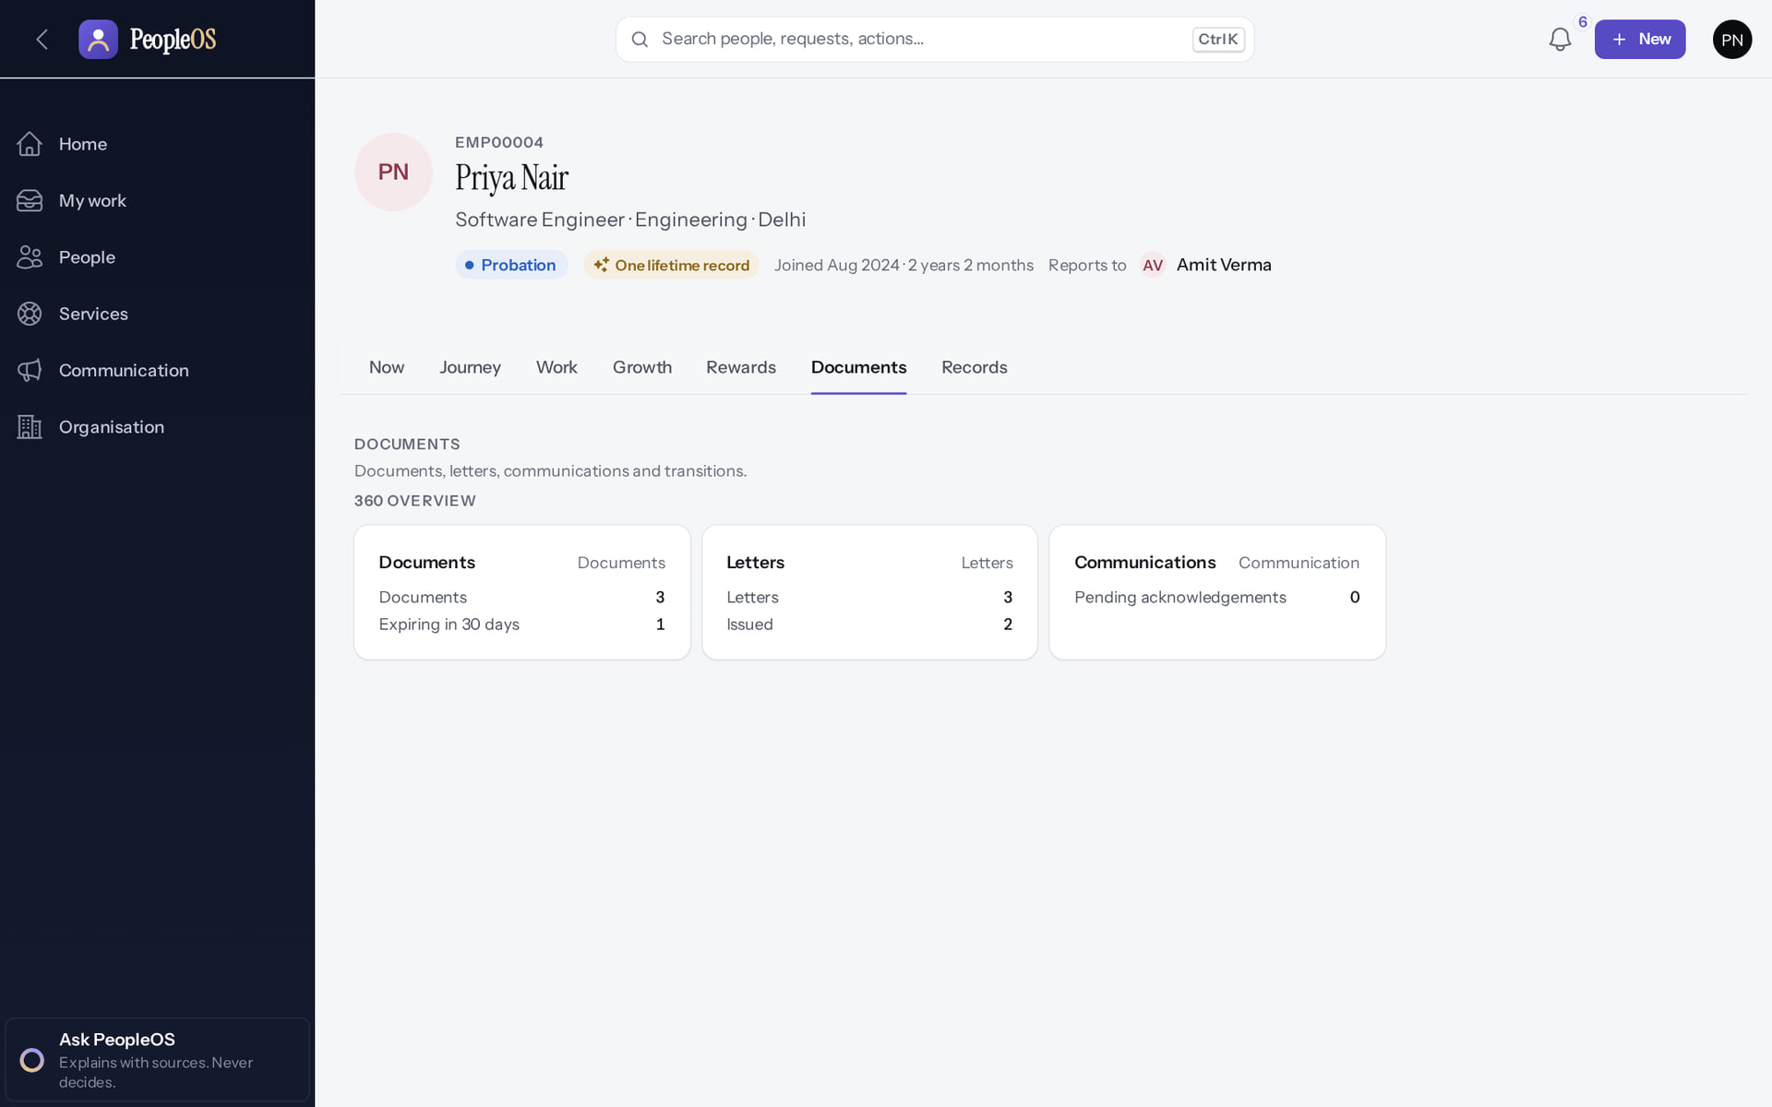
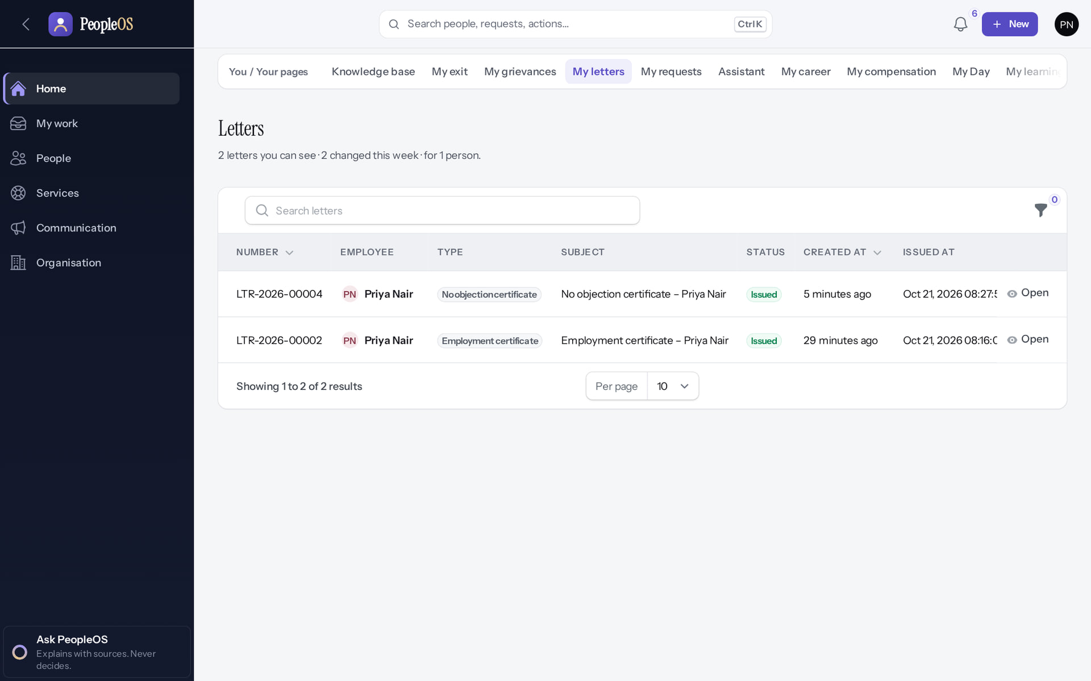
Documents and letters
YOUR RECORD
Documents
Verified
My letters
Verified
Your documents with status and expiry. HR uploads them; send renewals to HR.
Letters HR issued to you; open one to read or download it.
Real screen · Priya Nair (Employee) · Your record › Documents
Real screen · Priya Nair (Employee) · You › My letters
Notes:
SAY: Documents and letters.
LEFT, Documents: Your documents with status and expiry. HR uploads them; send renewals to HR.
RIGHT, My letters: Letters HR issued to you; open one to read or download it.
OBSERVE: point out what differs between the two screens.
EVIDENCE: left = employee/30-self-18-my-documents [Priya Nair (Employee), Your record › Documents]; right = employee/30-self-19-my-letters [Priya Nair (Employee), You › My letters]. Real screens, fictional data (SCREENSHOT-INVENTORY.md).

Slide 20
Leave
03
Request leave, follow it, and see your balance change.
Notes:
TRANSITION: Section 3, Leave. Request leave, follow it, and see your balance change.
SAY: Tell learners what they will be able to do by the end of this section, then move on.
ASK: "What questions do you have before we start this section?"

Slide 21
Request leave and follow it to a decision
LEAVE
Ask for time off, see your balance before and after, and follow the request until your manager decides.
Verified in the running application
WHO
WHERE
BEFORE YOU START
Any employee with a PeopleOS account. Your line manager decides.
Home › Request leave (or + New › Request leave). Status: People › Time & leave › Leave requests.
Know your dates and the leave type. Some types are not allowed during probation.
START
Home
ACTION
Request leave form
REVIEW
Before → After preview
APPROVAL
Manager decides
RESULT
Status and balance
Conceptual diagram: sequence summary
Notes:
SAY: Ask for time off, see your balance before and after, and follow the request until your manager decides.
WHO: Any employee with a PeopleOS account. Your line manager decides.
WHERE: Home › Request leave (or + New › Request leave). Status: People › Time & leave › Leave requests.
BEFORE YOU START: Know your dates and the leave type. Some types are not allowed during probation.
SEQUENCE: START Home → ACTION Request leave form → REVIEW Before → After preview → APPROVAL Manager decides → RESULT Status and balance
SAY: This is the most common thing employees do in PeopleOS. We will follow one real request from start to finish.
EVIDENCE: Executed on the training database on 21 Oct 2026 (tools/capture/10-leave-flow.mjs): Priya Nair (Employee) requested Casual leave 14–15 Dec 2026; Amit Verma (Manager) approved it; Amit rejected Rohan Pillai's request with a reason.
DEMO LIVE: Only on a practice tenant. In a shared environment do not submit real leave.

Slide 22
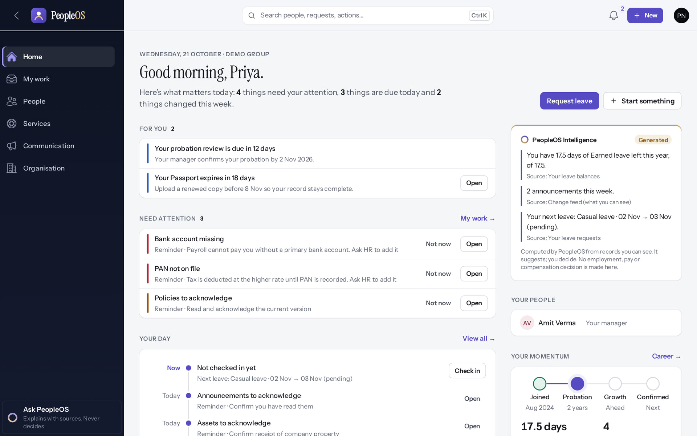
Start from Home
LEAVE
Verified in the running application
1
Select Request leave: it is the main button on your Home.
1
2
PeopleOS Intelligence reminds you of your next leave and its status.
RESULT The Request leave dialog opens.
2
Real screen · Priya Nair (Employee) · Home
Notes:
SAY: Request leave is always the first button on an employee Home.
OBSERVE: The panel on the right says "Your next leave: Casual leave · 02 Nov → 03 Nov (pending)".
ASK: "Where else could you start?" (Answer: + New, or Ctrl K and type "leave".)
EVIDENCE: Executed on the training database on 21 Oct 2026 (tools/capture/10-leave-flow.mjs): Priya Nair (Employee) requested Casual leave 14–15 Dec 2026; Amit Verma (Manager) approved it; Amit rejected Rohan Pillai's request with a reason.

Slide 23
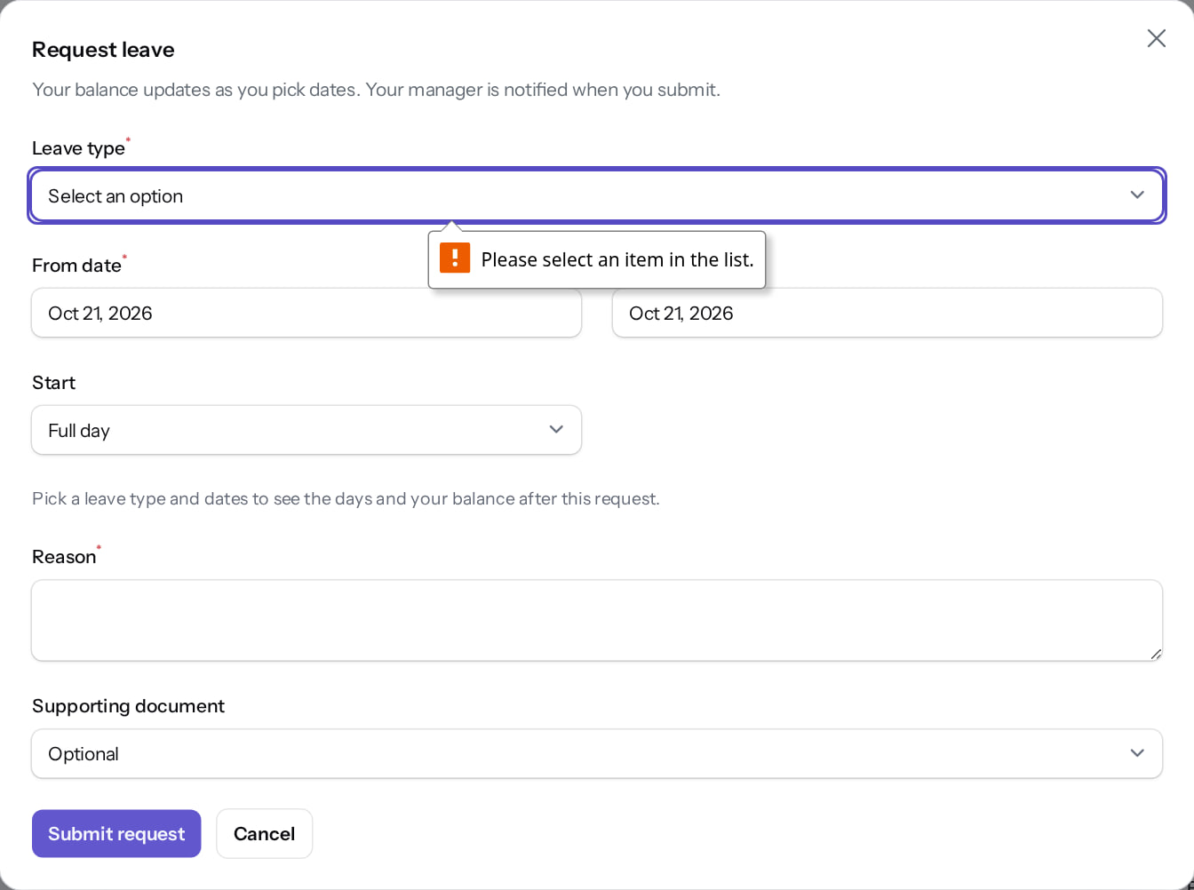
Required fields are checked before anything is sent
LEAVE
Verified in the running application
1
Submitting with no leave type stops at the first empty required field.
1
RESULT Nothing is submitted until Leave type, dates and Reason are filled in.
Real screen · Priya Nair (Employee) · Request leave (dialog)
Notes:
SAY: Fields with a red asterisk are required. The browser points to the first one that is missing.
OBSERVE: "Please select an item in the list." under Leave type.

Slide 24
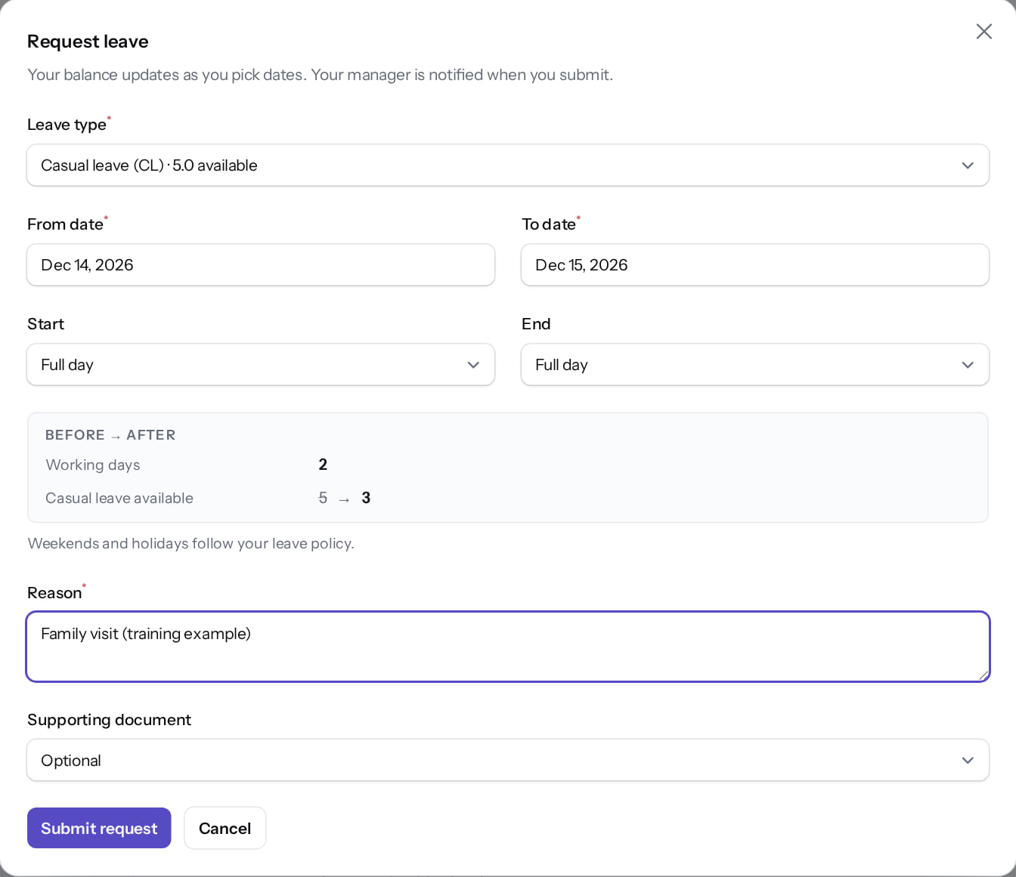
Complete the request
LEAVE
Verified in the running application
1
Leave type (shows what is available).
1
2
First day.
2
3
3
Last day.
Before → After panel: working days and balance left.
4
Reason (your manager sees it).
5
Submit request.
4
RESULT Weekends and holidays are not counted. Here: 2 working days; Casual leave 5 → 3.
5
Real screen · Priya Nair (Employee) · Request leave (dialog)
Notes:
SAY: Read the Before → After box before you submit. It shows how many working days the request uses and what will be left.
OBSERVE: 14–15 Dec 2026 = 2 working days; Casual leave available 5 → 3.
COMMON QUESTION: Half days use Start and End (Full day, First half, Second half).
EVIDENCE: Executed on the training database on 21 Oct 2026 (tools/capture/10-leave-flow.mjs): Priya Nair (Employee) requested Casual leave 14–15 Dec 2026; Amit Verma (Manager) approved it; Amit rejected Rohan Pillai's request with a reason.

Slide 25
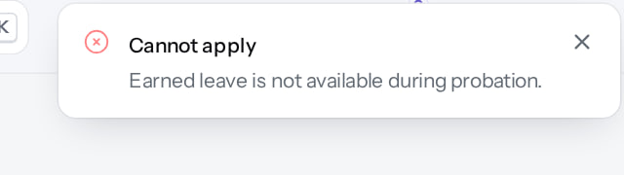
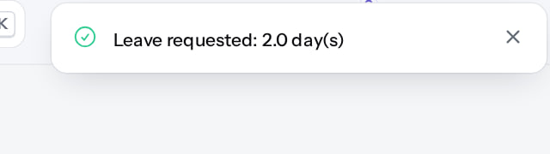
Refused or accepted: read the message
LEAVE
Refused by your leave policy (the message)
Verified
Accepted (the message)
Verified
"Cannot apply. Earned leave is not available during probation." The list still offers Earned leave; the policy refuses it when you submit. Choose another type.
"Leave requested: 2.0 day(s)." The request now waits for your manager.
Real screen (cropped) · Priya Nair (Employee) · Request leave (dialog) with policy message
Real screen (cropped) · Priya Nair (Employee) · Home (after submitting)
Notes:
SAY: If PeopleOS refuses a request, the message says why. The most common reason is a type you are not eligible for yet.
OBSERVE (real behaviour): Earned leave is listed with "17.5 available" during probation, but submitting it is refused. Tell learners this so they are not surprised.
EVIDENCE: Executed on the training database on 21 Oct 2026 (tools/capture/10-leave-flow.mjs): Priya Nair (Employee) requested Casual leave 14–15 Dec 2026; Amit Verma (Manager) approved it; Amit rejected Rohan Pillai's request with a reason.
SAY: Refused or accepted: read the message.
LEFT, Refused by your leave policy (the message): "Cannot apply. Earned leave is not available during probation." The list still offers Earned leave; the policy refuses it when you submit. Choose another type.
RIGHT, Accepted (the message): "Leave requested: 2.0 day(s)." The request now waits for your manager.
OBSERVE: point out what differs between the two screens.
EVIDENCE: left = employee/10-leave-03-policy-refusal [Priya Nair (Employee), Request leave (dialog) with policy message]; right = employee/10-leave-05-submitted [Priya Nair (Employee), Home (after submitting)]. Real screens, fictional data (SCREENSHOT-INVENTORY.md).

Slide 26
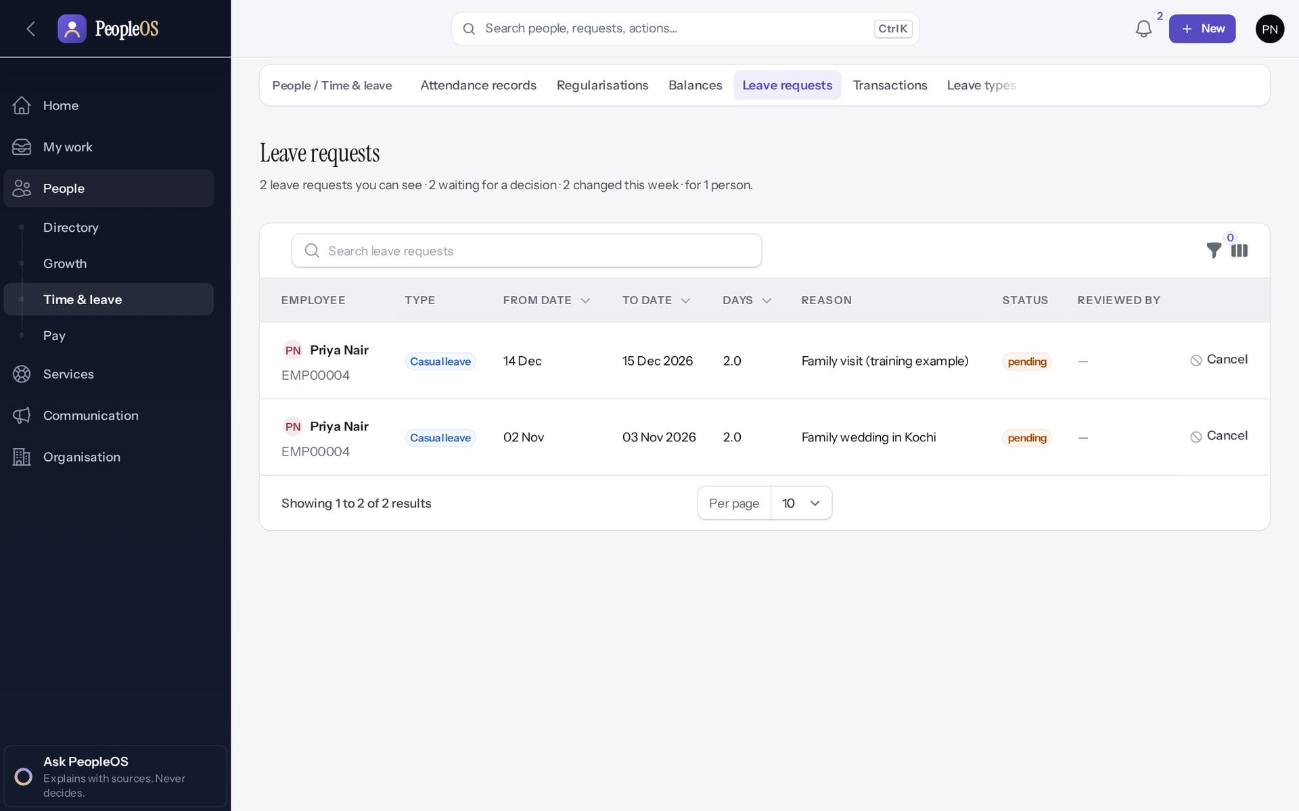
Check the status while you wait
LEAVE
Verified in the running application
1
Your new request is listed under Leave requests.
Status shows pending until your manager decides; Cancel is on the right of the row while it is pending.
1
RESULT You cannot edit a submitted request. Cancel it and submit a new one if something is wrong.
Real screen · Priya Nair (Employee) · Leave requests (own)
Notes:
SAY: Open People › Time & leave › Leave requests. Each row shows type, dates, days, reason, status and who reviewed it.
AVOID: telling learners they will get an e-mail. E-mail and in-app notices depend on notification rules set by HR.

Slide 27
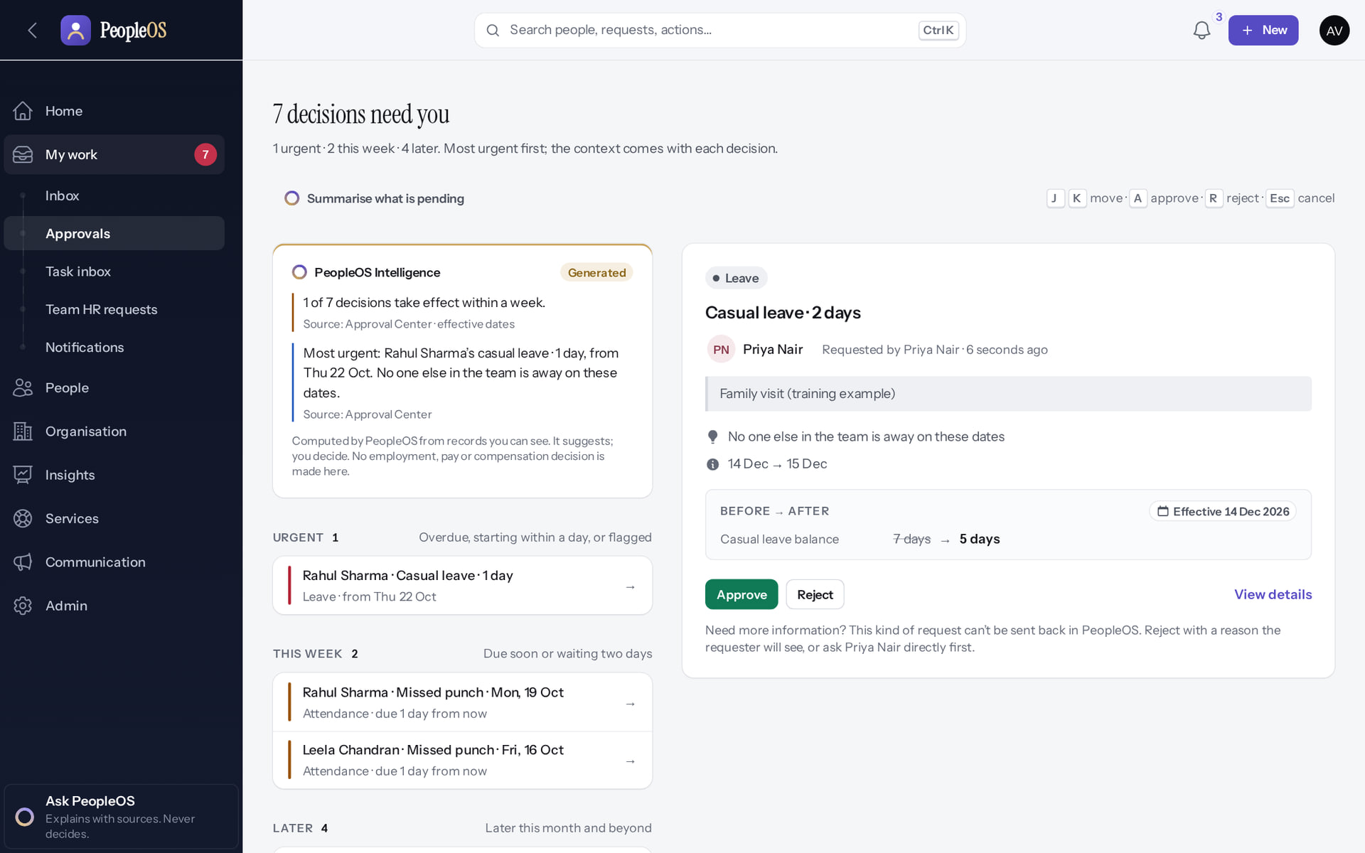
Meanwhile, your manager decides
LEAVE
Verified in the running application
1
Your manager sees your reason,
whether anyone else in the team is away,
2
and can Approve…
3
…or Reject (a reason is required).
1
RESULT Deck 2 shows the manager side in full.
2
3
Real screen · Amit Verma (Manager + Employee) · Approval Center › decision card
Notes:
SAY: Your manager sees the same Before → After balance you saw, plus whether others in the team are away on those dates.

Slide 28
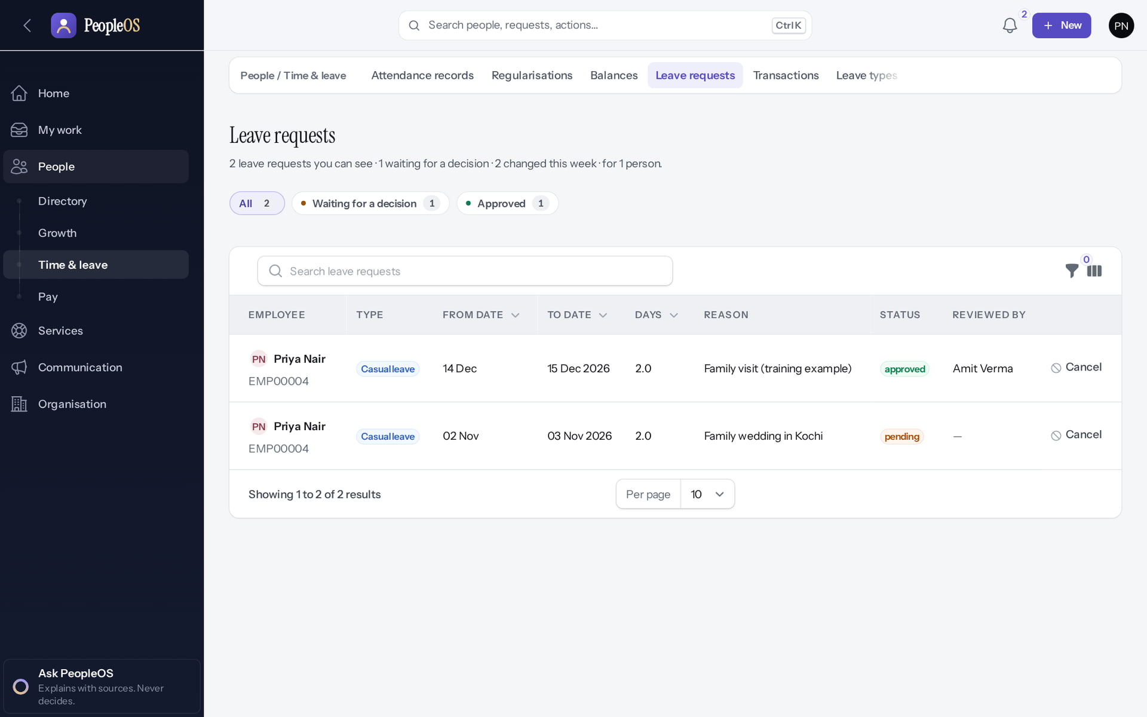
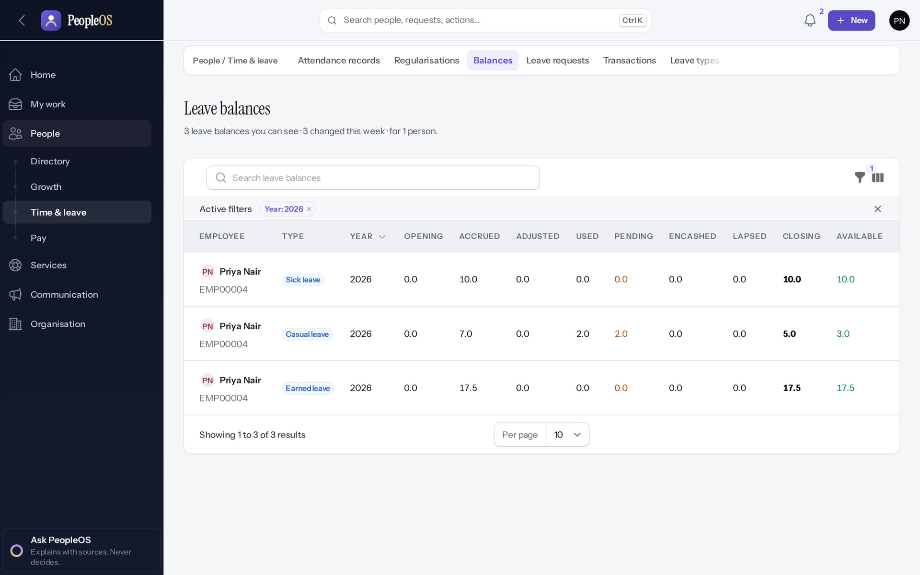
See the decision and your new balance
LEAVE
Leave requests: approved
Verified
Balances
Verified
Status approved; Reviewed by Amit Verma.
Casual leave: Used 2.0, Pending 2.0 (another request), Available 3.0.
Real screen · Priya Nair (Employee) · Leave requests (own)
Real screen · Priya Nair (Employee) · Leave balances (own)
Notes:
SAY: After the decision, check Leave requests for the status and Balances for what is left. Pending days are already held back from Available.
EVIDENCE: Executed on the training database on 21 Oct 2026 (tools/capture/10-leave-flow.mjs): Priya Nair (Employee) requested Casual leave 14–15 Dec 2026; Amit Verma (Manager) approved it; Amit rejected Rohan Pillai's request with a reason.
SAY: See the decision and your new balance.
LEFT, Leave requests: approved: Status approved; Reviewed by Amit Verma.
RIGHT, Balances: Casual leave: Used 2.0, Pending 2.0 (another request), Available 3.0.
OBSERVE: point out what differs between the two screens.
EVIDENCE: left = employee/10-leave-13-status-approved [Priya Nair (Employee), Leave requests (own)]; right = employee/10-leave-14-balances [Priya Nair (Employee), Leave balances (own)]. Real screens, fictional data (SCREENSHOT-INVENTORY.md).

Slide 29
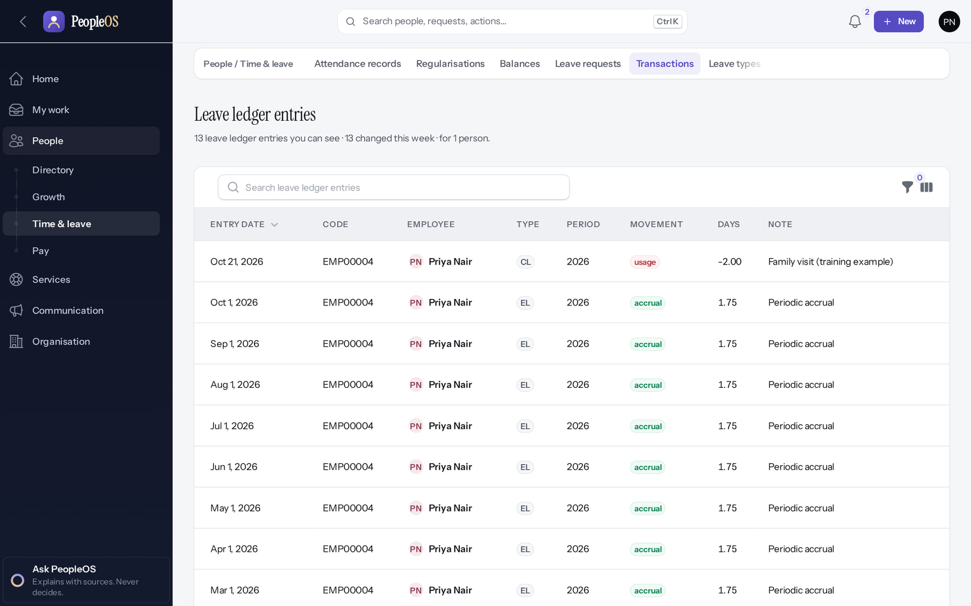
Every balance movement is recorded
LEAVE
Verified in the running application
1
The newest entry: usage −2.00 for the approved request, with its note.
RESULT Monthly accruals and every usage appear as separate entries. Nobody edits this ledger; corrections are new entries.
1
Real screen · Priya Nair (Employee) · Leave ledger entries (own)
Notes:
SAY: If your balance looks wrong, open Transactions (heading "Leave ledger entries") before asking HR: it explains every change.

Slide 30
Attendance
04
Check in, and correct a day when a punch is missing.
Notes:
TRANSITION: Section 4, Attendance. Check in, and correct a day when a punch is missing.
SAY: Tell learners what they will be able to do by the end of this section, then move on.
ASK: "What questions do you have before we start this section?"

Slide 31
Check in and correct a missed punch
ATTENDANCE
Record your day from Home and fix it when a punch is missing or wrong.
Verified in the running application
WHO
WHERE
BEFORE YOU START
Employees whose attendance is tracked. Corrections go to your manager.
Home › Your day › Check in. Home › Start something › Fix my attendance. People › Time & leave.
Your organisation decides whether web check-in is used; devices may record punches instead.
START
Home › Your day
ACTION
Check in / Fix
REVIEW
Manager approves
PROCESS
Day reprocessed
RESULT
Attendance record
Conceptual diagram: sequence summary
Notes:
SAY: Record your day from Home and fix it when a punch is missing or wrong.
WHO: Employees whose attendance is tracked. Corrections go to your manager.
WHERE: Home › Your day › Check in. Home › Start something › Fix my attendance. People › Time & leave.
BEFORE YOU START: Your organisation decides whether web check-in is used; devices may record punches instead.
SEQUENCE: START Home › Your day → ACTION Check in / Fix → REVIEW Manager approves → PROCESS Day reprocessed → RESULT Attendance record
EVIDENCE: Executed on the training database on 21 Oct 2026 (tools/capture/20-attendance-flow.mjs): Priya checked in, corrected a missed punch for 20 Oct, Amit approved it, Kavya Menon (Tenant HR Admin) recorded a manual punch and processed the day.

Slide 32
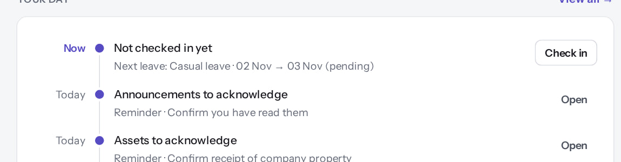
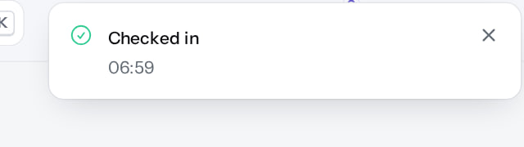
Check in from Home
ATTENDANCE
Before: Your day panel
Verified
After: the message
Verified
Your day says "Not checked in yet". Select Check in.
"Checked in" with the time. The button changes to Check out.
Real screen (cropped) · Priya Nair (Employee) · Home › Your day
Real screen (cropped) · Priya Nair (Employee) · Home › Your day (after Check in)
Notes:
SAY: A web check-in records a punch. Attendance records are built when the day is processed.
AVOID: checking in on behalf of someone else.
SAY: Check in from Home.
LEFT, Before: Your day panel: Your day says "Not checked in yet". Select Check in.
RIGHT, After: the message: "Checked in" with the time. The button changes to Check out.
OBSERVE: point out what differs between the two screens.
EVIDENCE: left = employee/20-att-01-your-day-check-in [Priya Nair (Employee), Home › Your day]; right = employee/20-att-02-checked-in [Priya Nair (Employee), Home › Your day (after Check in)]. Real screens, fictional data (SCREENSHOT-INVENTORY.md).

Slide 33
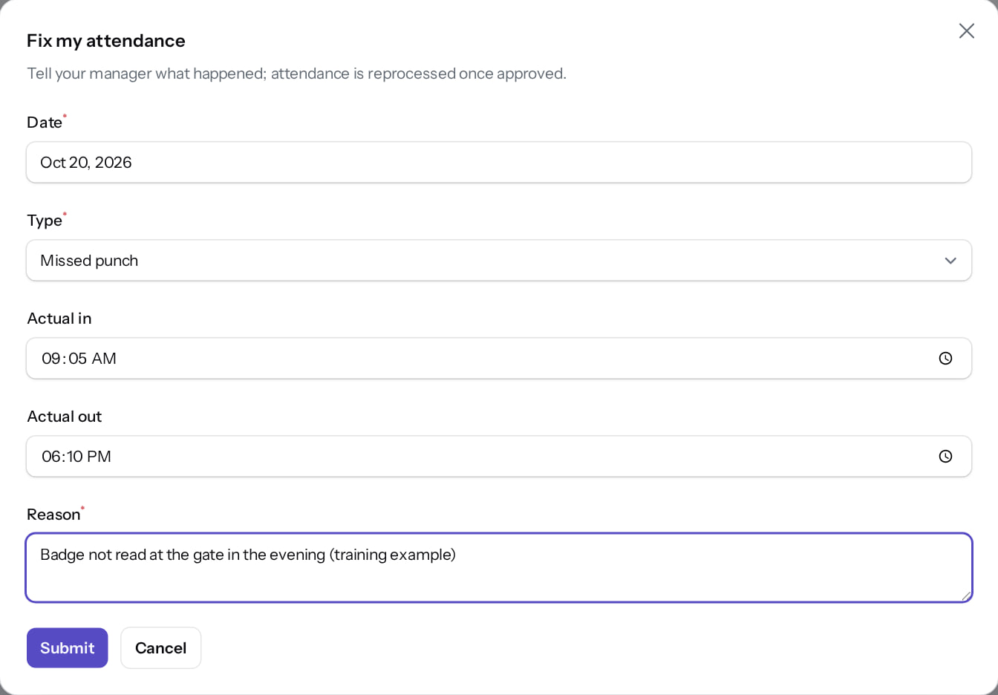
Fix my attendance
ATTENDANCE
Verified in the running application
1
Date of the day to correct (today or earlier).
1
2
Type, for example Missed punch.
3
Actual in time.
2
4
Actual out time.
3
5
Reason.
6
Submit.
4
RESULT The correction goes to your manager. Once approved, the day is reprocessed.
5
6
Real screen · Priya Nair (Employee) · Fix my attendance (dialog)
Notes:
OBSERVE: 20 Oct 2026, Missed punch, 09:05–18:10, "Badge not read at the gate in the evening".
KNOWN LIMIT: you cannot withdraw a correction after submitting (finding F42).
EVIDENCE: Executed on the training database on 21 Oct 2026 (tools/capture/20-attendance-flow.mjs): Priya checked in, corrected a missed punch for 20 Oct, Amit approved it, Kavya Menon (Tenant HR Admin) recorded a manual punch and processed the day.

Slide 34
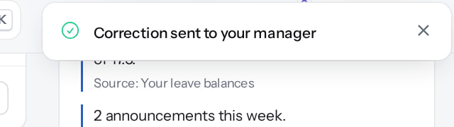
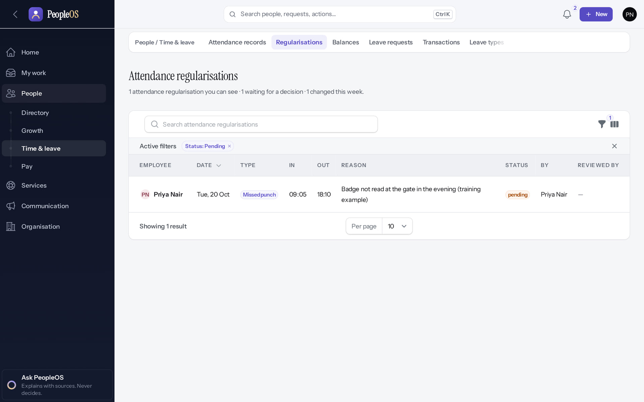
Submitted, then waiting
ATTENDANCE
Confirmation
Verified
Regularisations
Verified
"Correction sent to your manager".
People › Time & leave › Regularisations: the correction is pending.
Real screen (cropped) · Priya Nair (Employee) · Home (after submitting)
Real screen · Priya Nair (Employee) · Regularisations (own)
Notes:
SAY: Submitted, then waiting.
LEFT, Confirmation: "Correction sent to your manager".
RIGHT, Regularisations: People › Time & leave › Regularisations: the correction is pending.
OBSERVE: point out what differs between the two screens.
EVIDENCE: left = employee/20-att-04-correction-submitted [Priya Nair (Employee), Home (after submitting)]; right = employee/20-att-05-regularisation-pending [Priya Nair (Employee), Regularisations (own)]. Real screens, fictional data (SCREENSHOT-INVENTORY.md).

Slide 35
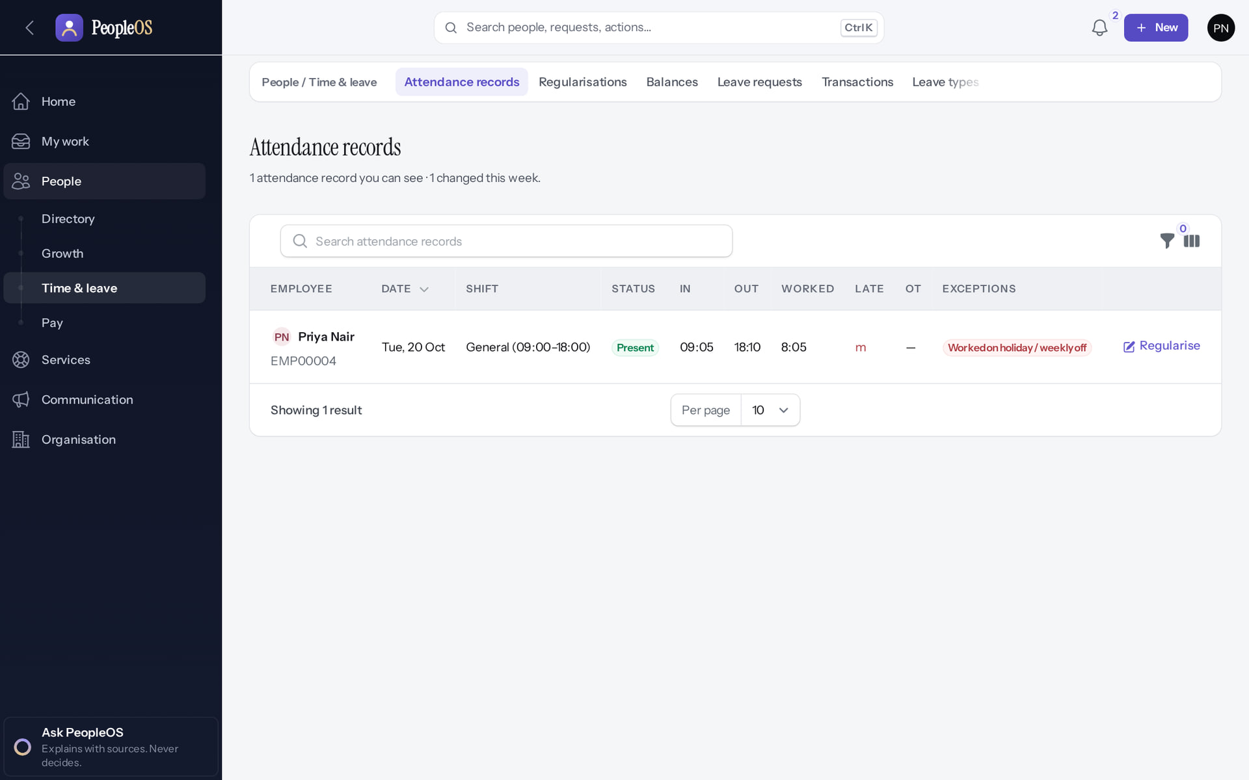
After approval: your corrected day
ATTENDANCE
Verified in the running application
The corrected day with shift, in/out, worked time and any exception.
RESULT Here 20 Oct shows Present, 09:05–18:10, flagged "Worked on holiday / weekly off" because 20 Oct is Dussehra in the demonstration holiday calendar.
Real screen · Priya Nair (Employee) · Attendance records (own)
Notes:
EVIDENCE: Executed on the training database on 21 Oct 2026 (tools/capture/20-attendance-flow.mjs): Priya checked in, corrected a missed punch for 20 Oct, Amit approved it, Kavya Menon (Tenant HR Admin) recorded a manual punch and processed the day.
SAY: Exceptions such as late, missing punch or worked on holiday are calculated; HR sees them in the Exception centre.

Slide 36
Help from HR
05
Ask a question, read policies, follow announcements.
Notes:
TRANSITION: Section 5, Help from HR. Ask a question, read policies, follow announcements.
SAY: Tell learners what they will be able to do by the end of this section, then move on.
ASK: "What questions do you have before we start this section?"

Slide 37
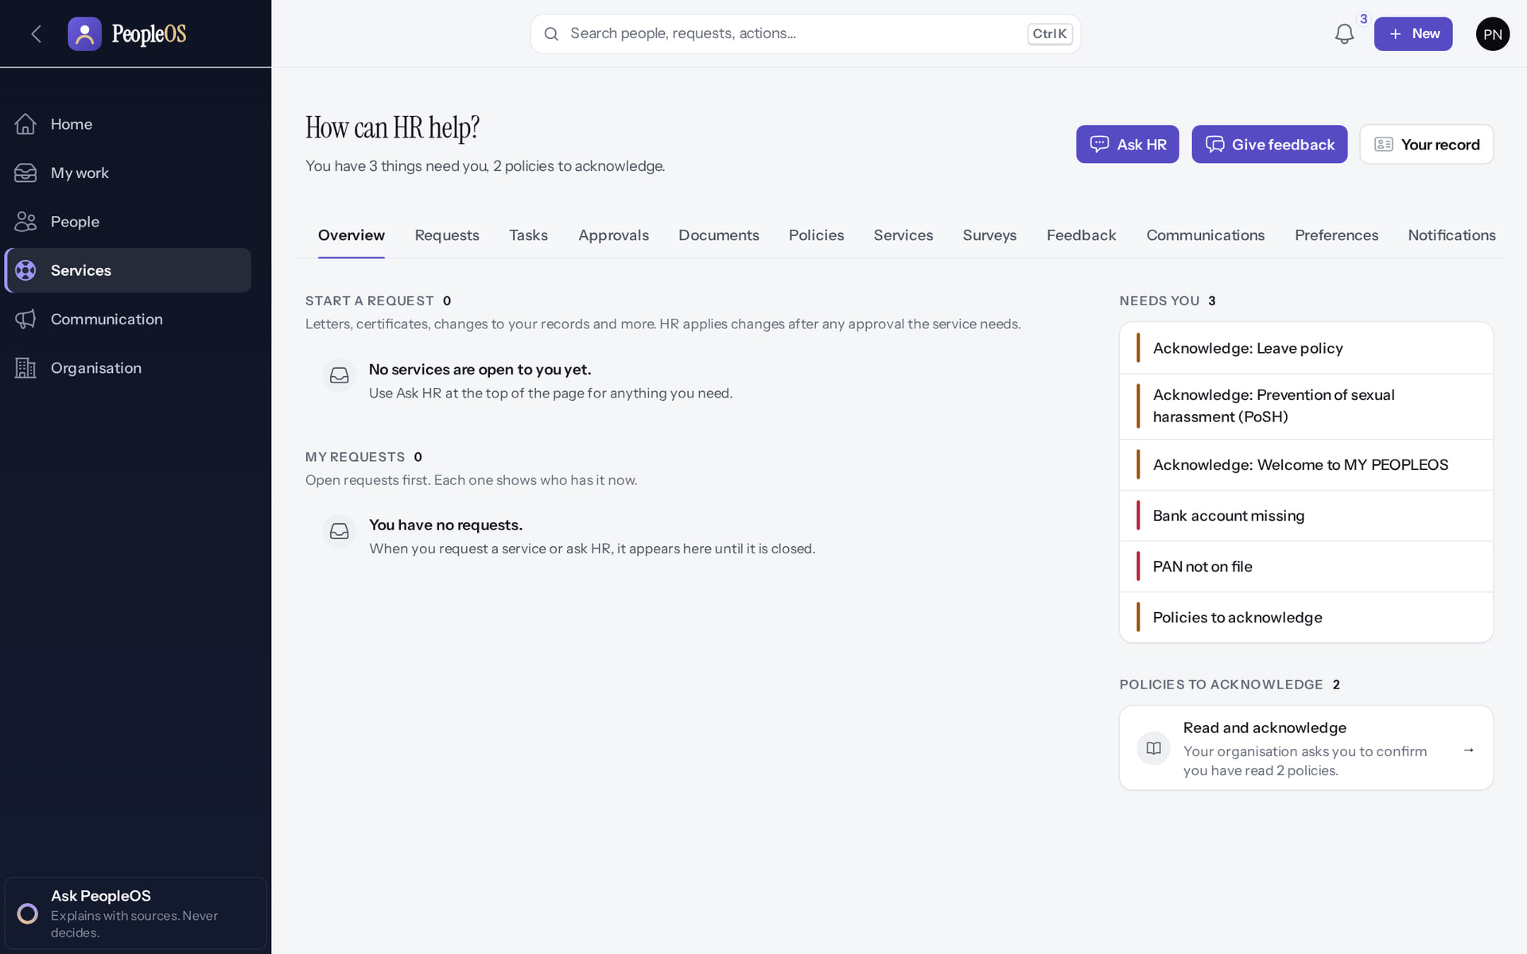
My HR
HELP FROM HR
Verified in the running application
1
1
Ask HR.
2
2
Tabs: requests, tasks, documents, policies, services, surveys…
RESULT Services › My HR is where you start anything with HR.
Real screen · Priya Nair (Employee) · Services › My HR
Notes:
SAY: Services › My HR is where you start anything with HR.
ON SCREEN: Open Services (My HR).
WALK THROUGH: (1) Ask HR. (2) Tabs: requests, tasks, documents, policies, services, surveys…
LEARNERS SHOULD SEE: Ask HR, Give feedback, Your record; tabs Requests, Tasks, Documents, Policies, Services, Surveys…; Needs you
SCREEN: Services › My HR. Signed in as Priya Nair (Employee).
EVIDENCE: screenshot screenshots/employee/30-self-35-my-hr.png, captured 2026-10-21 on the disposable training database (fictional people).

Slide 38
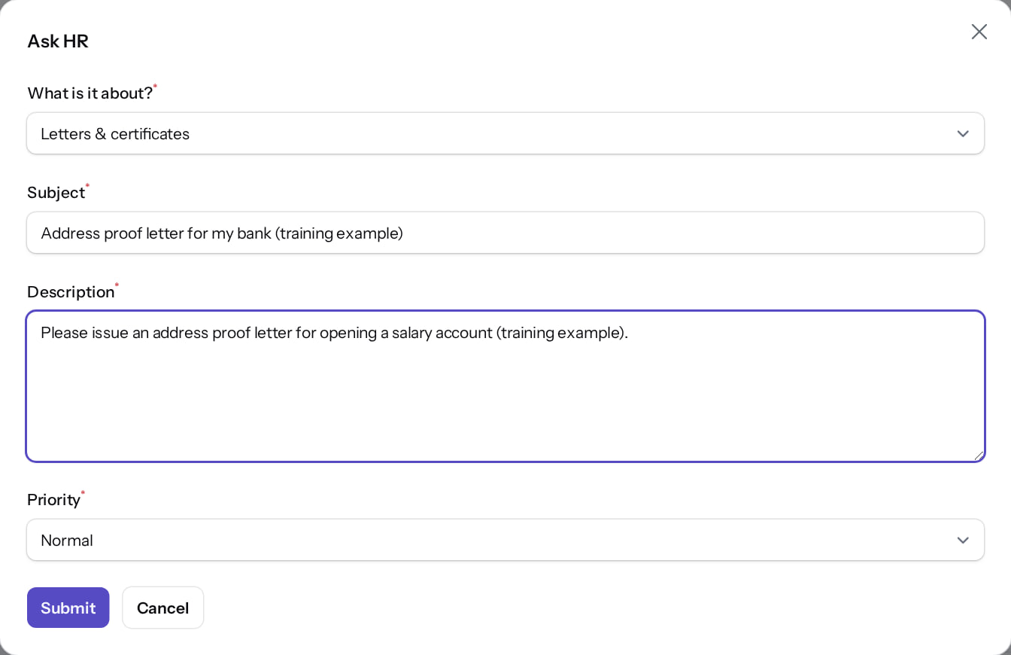
Ask HR
HELP FROM HR
Verified in the running application
1
Category.
1
2
Subject.
3
Description.
2
4
Priority.
5
Submit.
RESULT Do not put bank numbers or ID numbers in the text: HR will ask through a secure route.
3
4
5
Real screen · Priya Nair (Employee) · My HR › Ask HR (dialog)
Notes:
SAY: Do not put bank numbers or ID numbers in the text: HR will ask through a secure route.
ON SCREEN: Choose a category, write a subject and description, set the priority.
WALK THROUGH: (1) Category. (2) Subject. (3) Description. (4) Priority. (5) Submit.
LEARNERS SHOULD SEE: Submit raises a numbered request with an SLA
SCREEN: My HR › Ask HR (dialog). Signed in as Priya Nair (Employee).
EVIDENCE: screenshot screenshots/employee/30-self-36-ask-hr-form.png, captured 2026-10-21 on the disposable training database (fictional people).

Slide 39
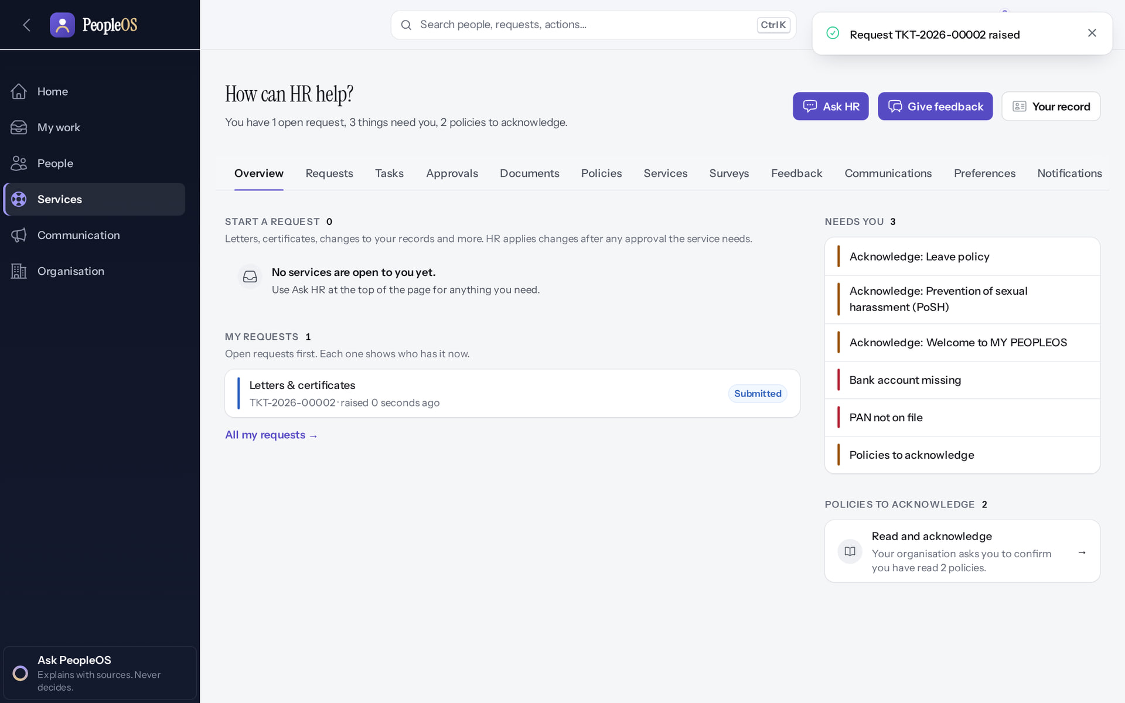
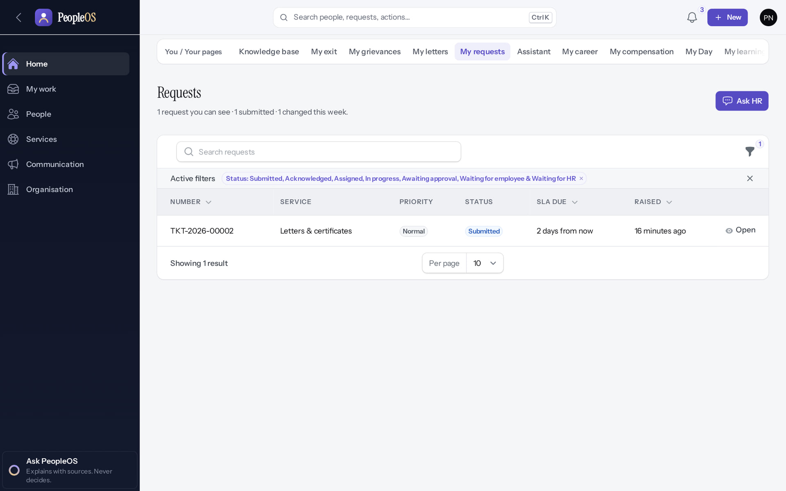
Your request gets a number
HELP FROM HR
Submitted
Verified
My requests
Verified
Confirmation with the request number (here TKT-2026-00002).
Status Submitted and the date HR aims to answer by.
Real screen · Priya Nair (Employee) · My HR (after submitting)
Real screen · Priya Nair (Employee) · You › My requests
Notes:
SAY: Your request gets a number.
LEFT, Submitted: Confirmation with the request number (here TKT-2026-00002).
RIGHT, My requests: Status Submitted and the date HR aims to answer by.
OBSERVE: point out what differs between the two screens.
EVIDENCE: left = employee/30-self-37-ask-hr-submitted [Priya Nair (Employee), My HR (after submitting)]; right = employee/30-self-38-my-requests [Priya Nair (Employee), You › My requests]. Real screens, fictional data (SCREENSHOT-INVENTORY.md).

Slide 40
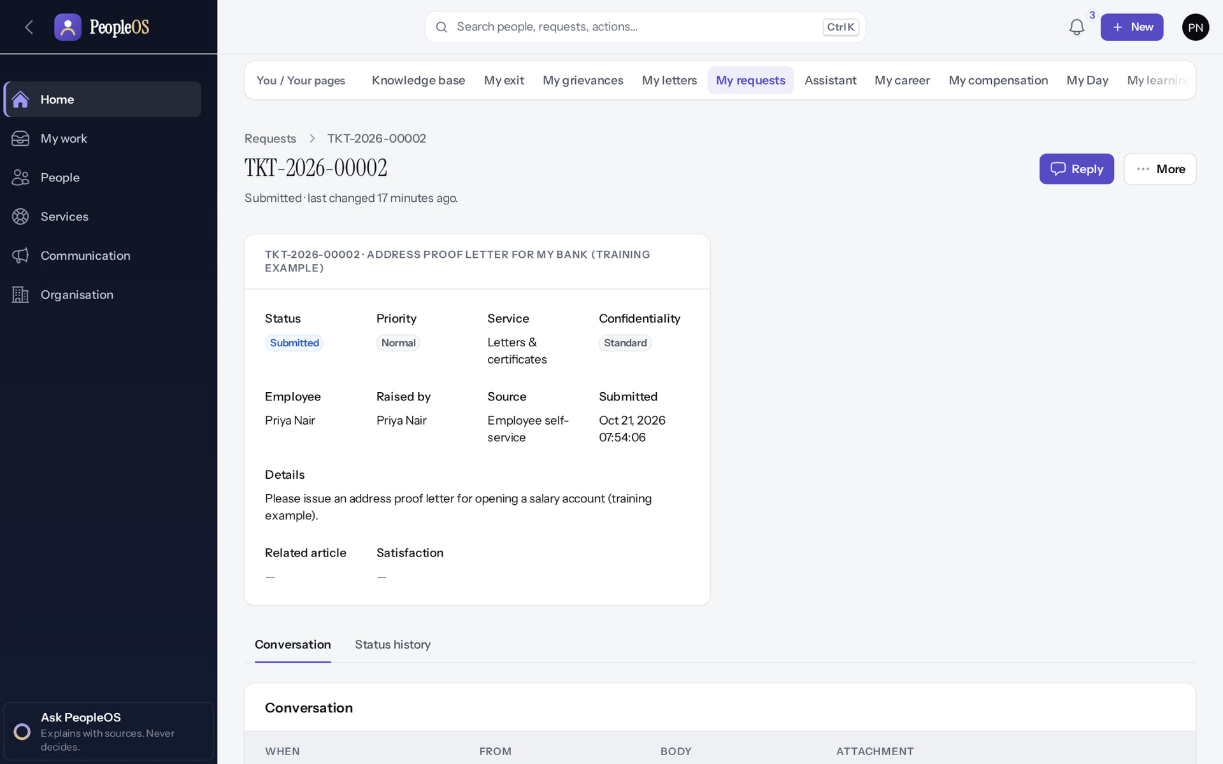
Follow the conversation
HELP FROM HR
Verified in the running application
1
Your request.
RESULT Status, target date and messages with HR in one place.
1
Real screen · Priya Nair (Employee) · My requests › request
Notes:
SAY: Status, target date and messages with HR in one place.
ON SCREEN: Open the request.
WALK THROUGH: (1) Your request.
LEARNERS SHOULD SEE: Status, SLA and the conversation with HR
SCREEN: My requests › request. Signed in as Priya Nair (Employee).
EVIDENCE: screenshot screenshots/employee/30-self-39-request-detail.png, captured 2026-10-21 on the disposable training database (fictional people).

Slide 41
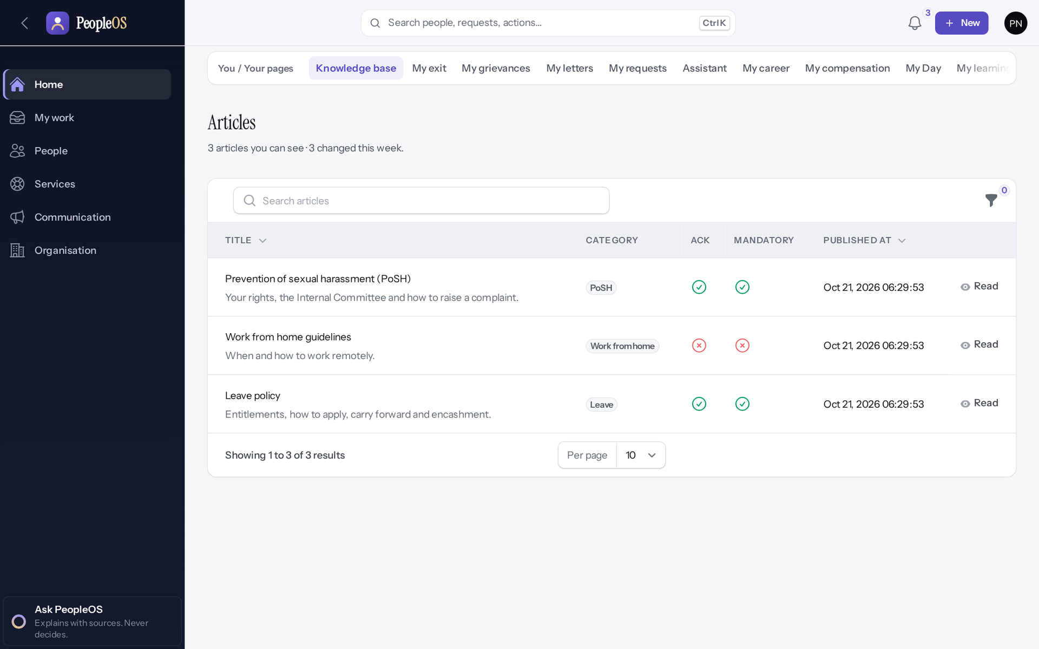
Knowledge base
HELP FROM HR
Verified in the running application
1
A published article.
RESULT HR articles; those you must acknowledge are marked.
1
Real screen · Priya Nair (Employee) · You › Knowledge base
Notes:
SAY: HR articles; those you must acknowledge are marked.
ON SCREEN: Open the Knowledge base.
WALK THROUGH: (1) A published article.
LEARNERS SHOULD SEE: Published HR articles; those that need acknowledgement are marked
SCREEN: You › Knowledge base. Signed in as Priya Nair (Employee).
EVIDENCE: screenshot screenshots/employee/30-self-40-knowledge-base.png, captured 2026-10-21 on the disposable training database (fictional people).

Slide 42
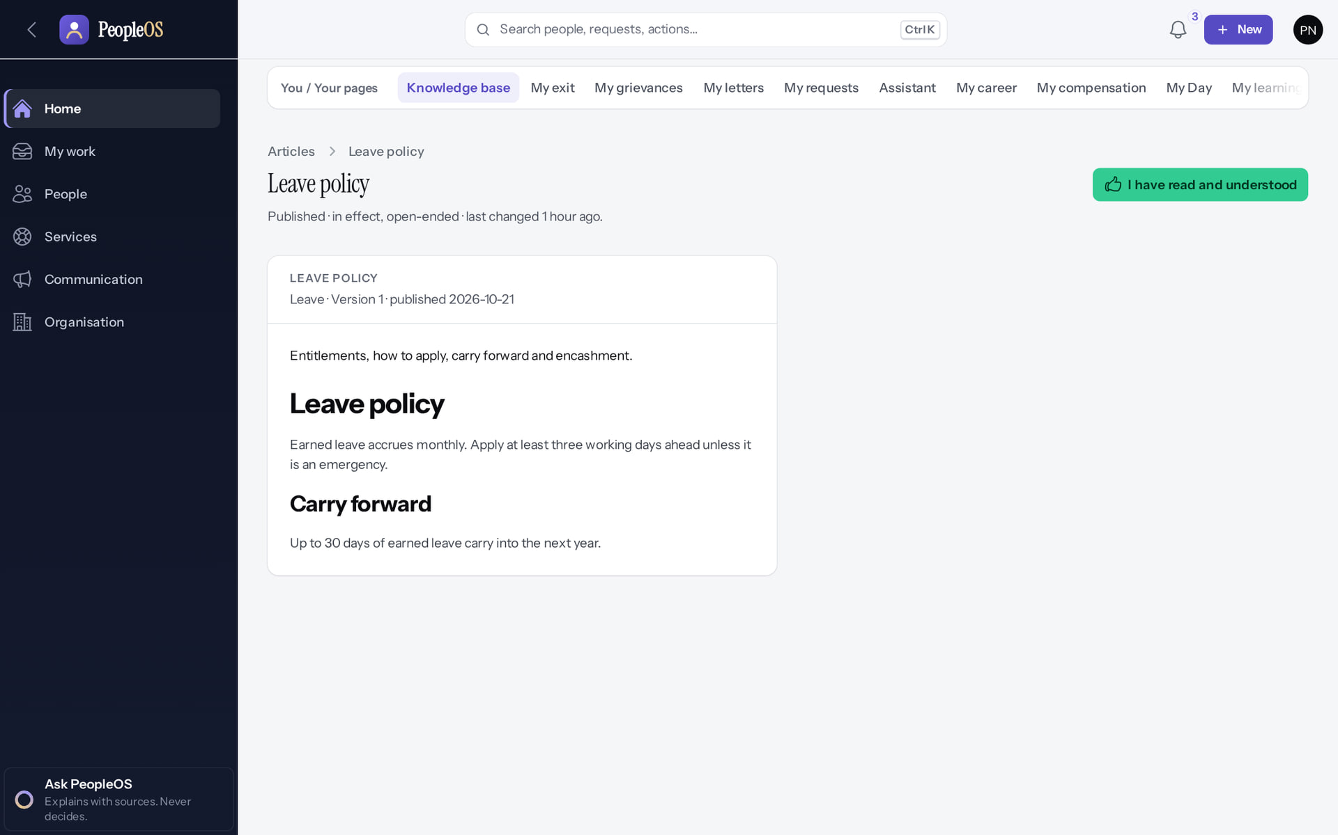
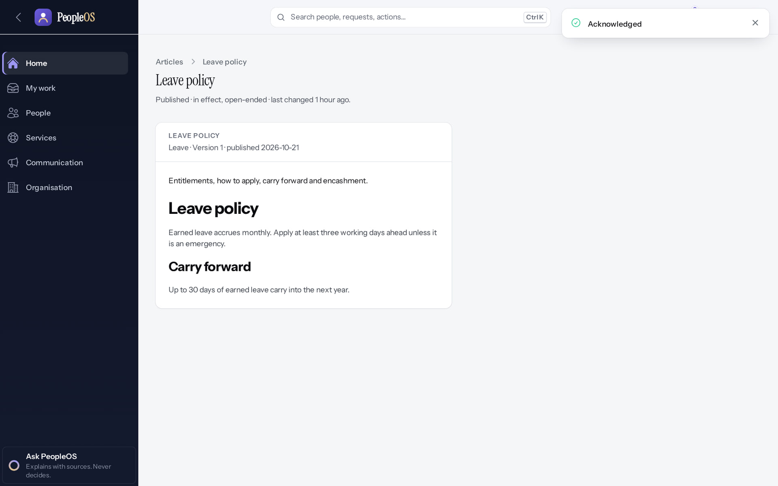
Acknowledge a policy
HELP FROM HR
Leave policy
Verified
Acknowledged
Verified
"I have read and understood" records your acknowledgement of this version.
Confirmation; the policy leaves "Policies to acknowledge".
Real screen · Priya Nair (Employee) · Knowledge base › Leave policy
Real screen · Priya Nair (Employee) · Knowledge base › Leave policy (acknowledged)
Notes:
SAY: Acknowledge a policy.
LEFT, Leave policy: "I have read and understood" records your acknowledgement of this version.
RIGHT, Acknowledged: Confirmation; the policy leaves "Policies to acknowledge".
OBSERVE: point out what differs between the two screens.
EVIDENCE: left = employee/30-self-41-policy-acknowledge [Priya Nair (Employee), Knowledge base › Leave policy]; right = employee/30-self-42-policy-acknowledged [Priya Nair (Employee), Knowledge base › Leave policy (acknowledged)]. Real screens, fictional data (SCREENSHOT-INVENTORY.md).

Slide 43
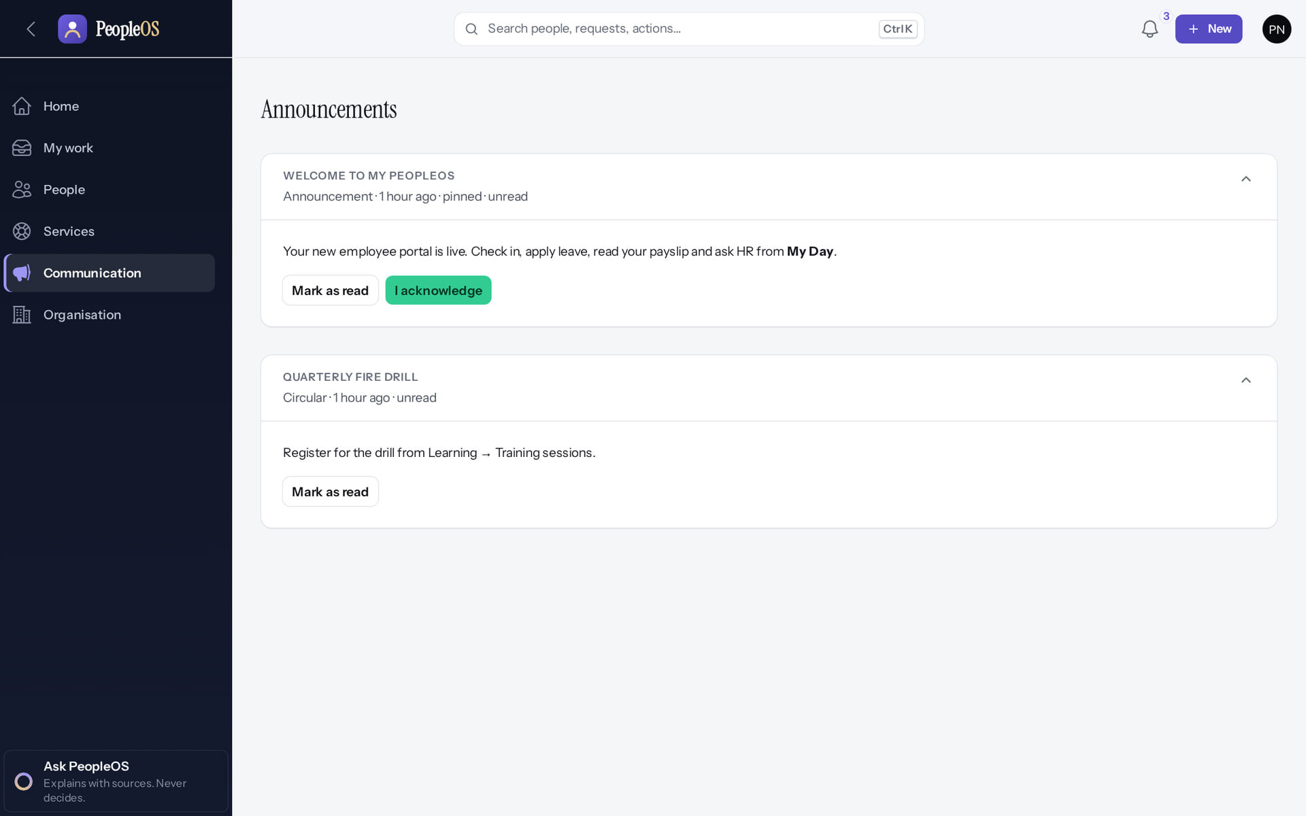
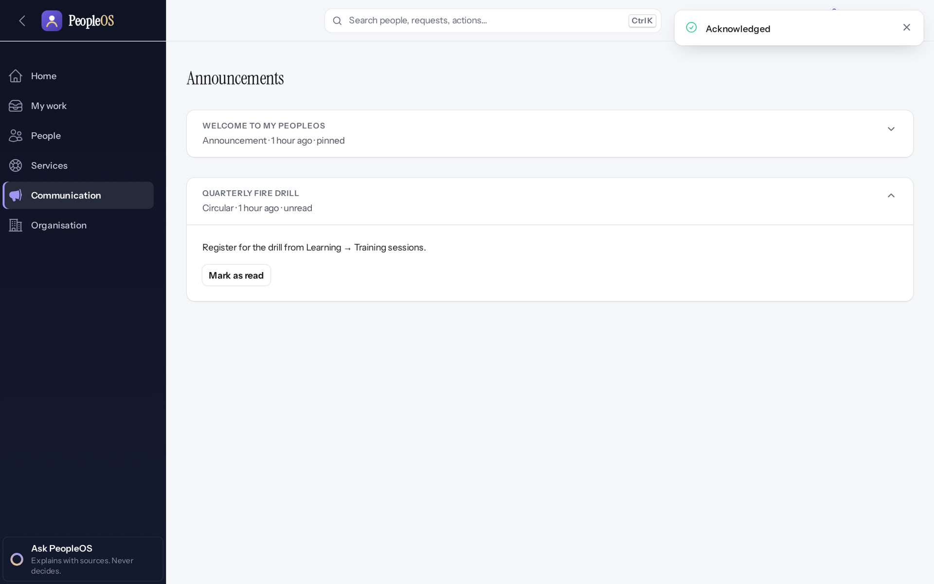
Announcements
HELP FROM HR
Announcements
Verified
Acknowledged
Verified
Some ask you to acknowledge them.
Confirmation; the announcement shows it is acknowledged.
Real screen · Priya Nair (Employee) · Communication › Announcements
Real screen · Priya Nair (Employee) · Communication › Announcements (acknowledged)
Notes:
SAY: Announcements.
LEFT, Announcements: Some ask you to acknowledge them.
RIGHT, Acknowledged: Confirmation; the announcement shows it is acknowledged.
OBSERVE: point out what differs between the two screens.
EVIDENCE: left = employee/30-self-46-announcements [Priya Nair (Employee), Communication › Announcements]; right = employee/30-self-47-announcement-acknowledged [Priya Nair (Employee), Communication › Announcements (acknowledged)]. Real screens, fictional data (SCREENSHOT-INVENTORY.md).

Slide 44
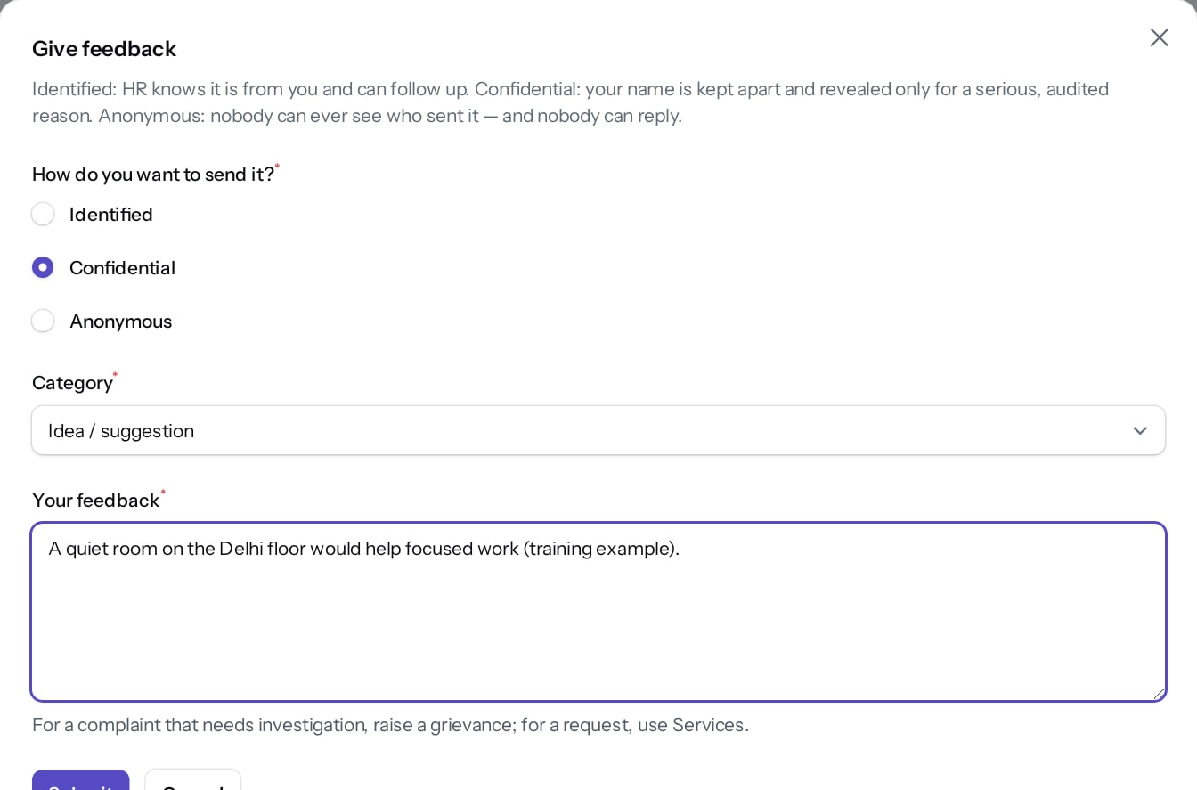
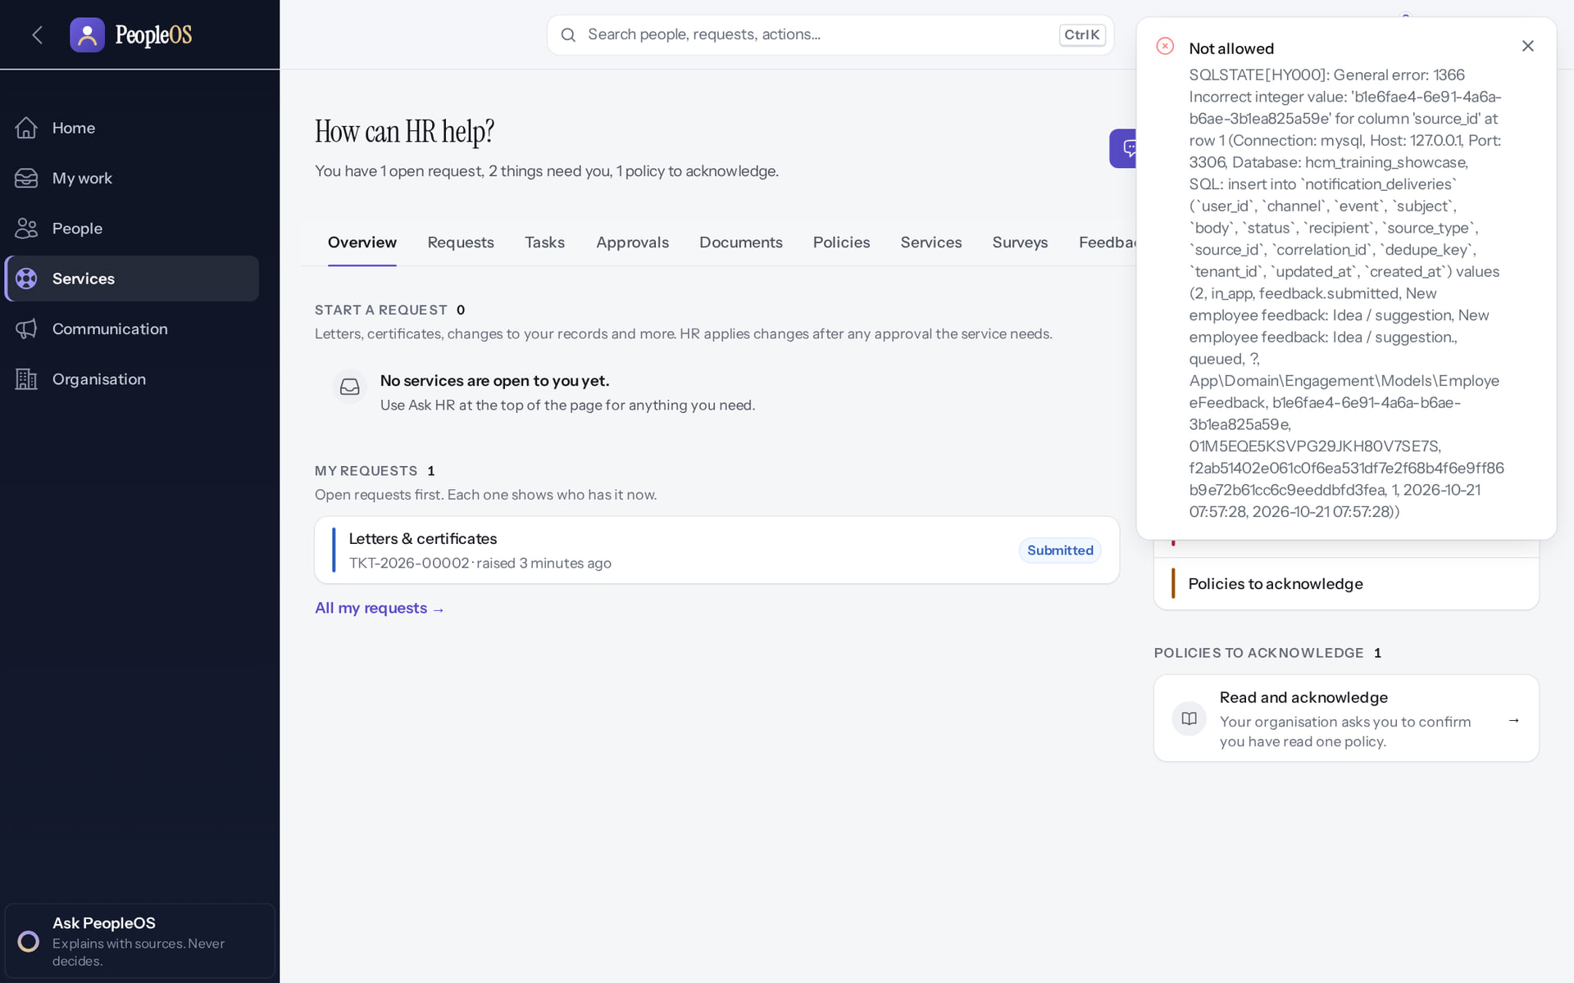
Give feedback: a known problem
HELP FROM HR
Give feedback
Verified
After Submit
Incomplete
Mode, category and your feedback.
An error appears, but your feedback is saved. HR is not notified automatically (F17): tell HR if it is urgent.
Real screen (cropped) · Priya Nair (Employee) · My HR › Give feedback (dialog)
Real screen · Priya Nair (Employee) · My HR › Give feedback (after Submit)
Notes:
KNOWN DEFECT F17: on MySQL, the notification to HR fails and the employee sees "Not allowed" with a technical database message. The feedback itself is stored in the HR Feedback inbox.
AVOID: asking employees to resubmit; it creates duplicates.
SAY: Give feedback: a known problem.
LEFT, Give feedback: Mode, category and your feedback.
RIGHT, After Submit: An error appears, but your feedback is saved. HR is not notified automatically (F17): tell HR if it is urgent.
OBSERVE: point out what differs between the two screens.
EVIDENCE: left = employee/30-self-44-give-feedback-form [Priya Nair (Employee), My HR › Give feedback (dialog)]; right = employee/30-self-45-give-feedback-error [Priya Nair (Employee), My HR › Give feedback (after Submit)]. Real screens, fictional data (SCREENSHOT-INVENTORY.md).

Slide 45
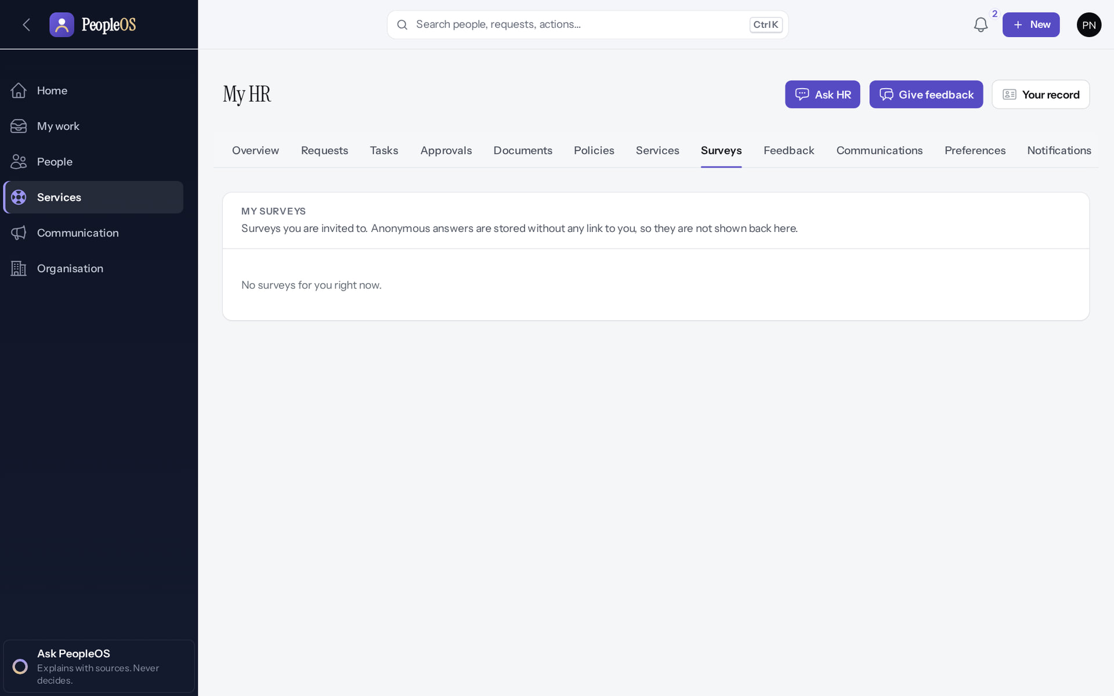
Surveys
HELP FROM HR
Verified in the running application
1
Surveys tab.
1
RESULT Surveys open to you appear here (none were open in the training data).
Real screen · Priya Nair (Employee) · My HR › Surveys
Notes:
SAY: Surveys open to you appear here (none were open in the training data).
ON SCREEN: Open the Surveys tab.
WALK THROUGH: (1) Surveys tab.
LEARNERS SHOULD SEE: Surveys open to you (none open in the demonstration)
SCREEN: My HR › Surveys. Signed in as Priya Nair (Employee).
EVIDENCE: screenshot screenshots/employee/30-self-43-surveys.png, captured 2026-10-21 on the disposable training database (fictional people).

Slide 46
Pay and tax
06
What you can see today, and what is not available yet.
Notes:
TRANSITION: Section 6, Pay and tax. What you can see today, and what is not available yet.
SAY: Tell learners what they will be able to do by the end of this section, then move on.
ASK: "What questions do you have before we start this section?"

Slide 47
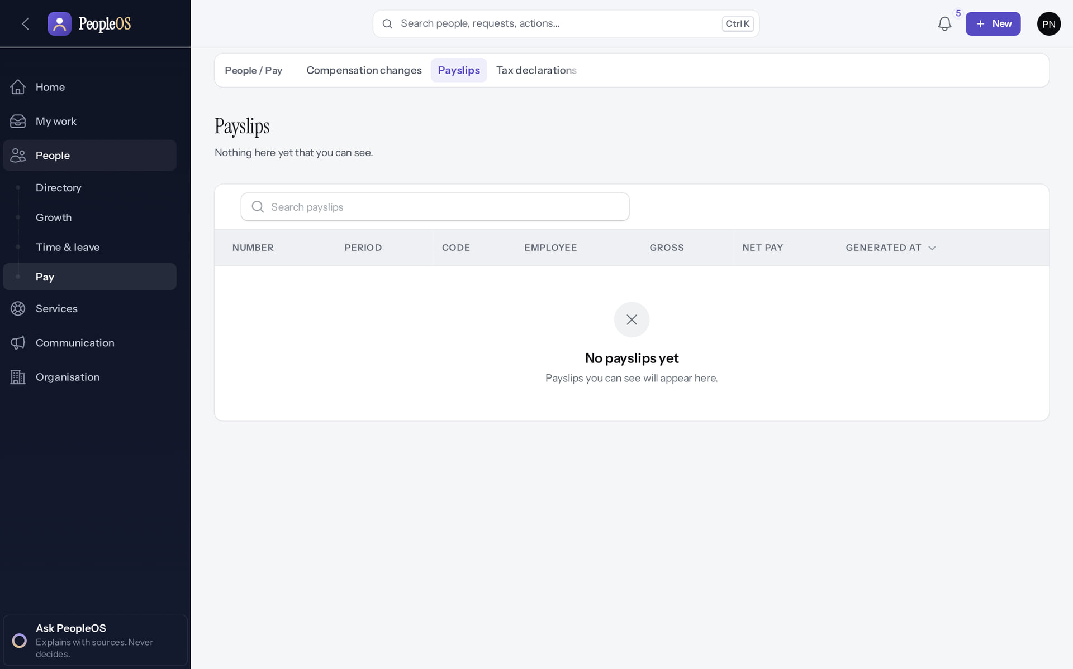
Payslips: not yet
PAY AND TAX
Available only after configuration
1
Empty state.
RESULT "No payslips yet". Payslips appear only after a payroll run is finalised, and that is blocked until statutory rules are verified.
1
Real screen · Priya Nair (Employee) · People › Pay › Payslips
Notes:
SAY: "No payslips yet". Payslips appear only after a payroll run is finalised, and that is blocked until statutory rules are verified.
ON SCREEN: Open Payslips.
WALK THROUGH: (1) Empty state.
LEARNERS SHOULD SEE: "No payslips yet": payslips are generated only when a payroll run is finalised, and finalisation is blocked until the statutory rules are verified
SCREEN: People › Pay › Payslips. Signed in as Priya Nair (Employee). Prerequisite: A finalised payroll run (blocked: 0 of 24 statutory rules verified).
EVIDENCE: screenshot screenshots/employee/30-self-20-payslips-none.png, captured 2026-10-21 on the disposable training database (fictional people).

Slide 48
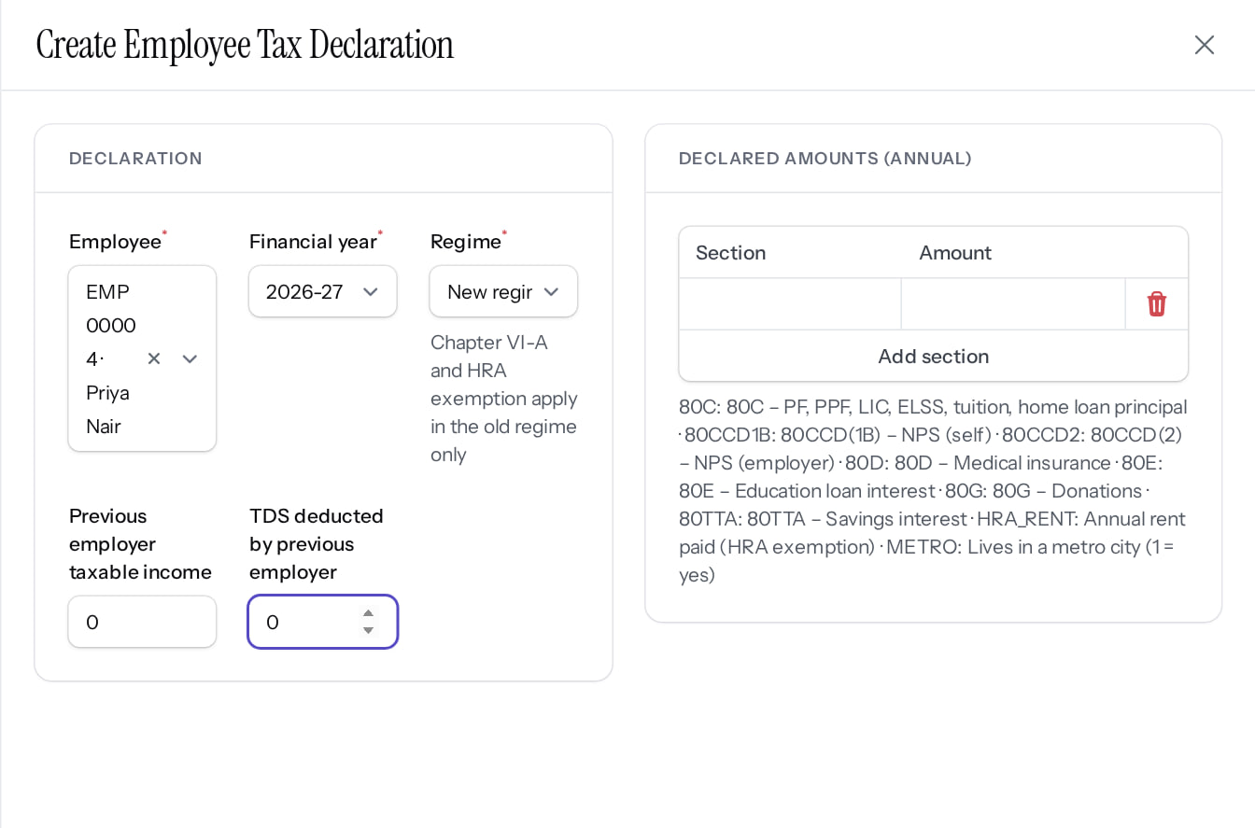

Tax declaration
PAY AND TAX
New declaration
Verified
Saved as Draft
Incomplete
Financial year, tax regime and declared amounts; Create.
It stays Draft: there is no Submit for employees yet (F13). Tell payroll when it is complete.
Real screen (cropped) · Priya Nair (Employee) · Tax declarations › New employee tax declaration
Real screen · Priya Nair (Employee) · Tax declarations (own)
Notes:
SAY: Tax declaration.
LEFT, New declaration: Financial year, tax regime and declared amounts; Create.
RIGHT, Saved as Draft: It stays Draft: there is no Submit for employees yet (F13). Tell payroll when it is complete.
OBSERVE: point out what differs between the two screens.
EVIDENCE: left = employee/30-self-21-tax-declaration-form [Priya Nair (Employee), Tax declarations › New employee tax declaration]; right = employee/30-self-22-tax-declaration-saved [Priya Nair (Employee), Tax declarations (own)]. Real screens, fictional data (SCREENSHOT-INVENTORY.md).

Slide 49

My compensation
PAY AND TAX
Verified in the running application
1
Pay in force today.
2
History of approved changes.
1
RESULT Read only (figures are fictional). Every view is recorded.
2
Real screen · Priya Nair (Employee) · You › My compensation
Notes:
SAY: Read only (figures are fictional). Every view is recorded.
ON SCREEN: Avatar menu › My compensation.
WALK THROUGH: (1) Pay in force today. (2) History of approved changes.
LEARNERS SHOULD SEE: Pay in force today and the history of approved changes (fictional figures); viewing is audited
SCREEN: You › My compensation. Signed in as Priya Nair (Employee).
EVIDENCE: screenshot screenshots/employee/30-self-23-my-compensation.png, captured 2026-10-21 on the disposable training database (fictional people).

Slide 50
Goals, reviews, career and learning
07
Keep your goals current, complete your review, grow your skills.
Notes:
TRANSITION: Section 7, Goals, reviews, career and learning. Keep your goals current, complete your review, grow your skills.
SAY: Tell learners what they will be able to do by the end of this section, then move on.
ASK: "What questions do you have before we start this section?"

Slide 51

Your goals
GOALS
Verified in the running application
A goal linked to a team goal.
1
Check in.
RESULT Weight, progress and the goal each one supports.
1
Real screen · Priya Nair (Employee) · People › Growth › Goals
Notes:
SAY: Weight, progress and the goal each one supports.
ON SCREEN: Open Goals.
WALK THROUGH: (1) A goal linked to a team goal. (2) Check in.
LEARNERS SHOULD SEE: Your goals with weight, progress and the parent goal they support; Check in on each goal
SCREEN: People › Growth › Goals. Signed in as Priya Nair (Employee).
EVIDENCE: screenshot screenshots/employee/30-self-24-goals.png, captured 2026-10-21 on the disposable training database (fictional people).

Slide 52

Check in on a goal
GOALS
Verified in the running application
1
Key result.
1
2
Current value.
3
Confidence.
2
4
Note.
RESULT Progress is recalculated from the key result (here 40 → 80 target; 68 = 70%).
3
4
Real screen · Priya Nair (Employee) · Goals › Check in (dialog)
Notes:
SAY: Progress is recalculated from the key result (here 40 → 80 target; 68 = 70%).
ON SCREEN: Choose the key result, enter its current value, your confidence and a note.
WALK THROUGH: (1) Key result. (2) Current value. (3) Confidence. (4) Note.
LEARNERS SHOULD SEE: Submit records the check-in and recalculates progress from the key result (40 → 80; 68 = 70 %)
SCREEN: Goals › Check in (dialog). Signed in as Priya Nair (Employee).
EVIDENCE: screenshot screenshots/employee/30-self-25-goal-check-in.png, captured 2026-10-21 on the disposable training database (fictional people).

Slide 53

Progress updated
GOALS
1
Verified in the running application
1
Confirmation.
New progress.
RESULT "Progress updated": 55% → 70%. Tip: check in on the key result; a check-in on the goal itself does not change progress when it has key results.
Real screen · Priya Nair (Employee) · People › Growth › Goals (after check-in)
Notes:
SAY: "Progress updated": 55% → 70%. Tip: check in on the key result; a check-in on the goal itself does not change progress when it has key results.
ON SCREEN: Submit.
WALK THROUGH: (1) Confirmation. (2) New progress.
LEARNERS SHOULD SEE: Confirmation; the goal shows the new progress
SCREEN: People › Growth › Goals (after check-in). Signed in as Priya Nair (Employee).
EVIDENCE: screenshot screenshots/employee/30-self-26-goal-updated.png, captured 2026-10-21 on the disposable training database (fictional people).

Slide 54

Your appraisal
REVIEWS
Verified in the running application
1
Cycle stage: Self review.
2
2
Self review.
RESULT Complete your self review before the stage closes.
1
Real screen · Priya Nair (Employee) · People › Growth › Appraisals › View
Notes:
SAY: Complete your self review before the stage closes.
ON SCREEN: Open your appraisal for FY 2026-27.
WALK THROUGH: (1) Cycle stage: Self review. (2) Self review.
LEARNERS SHOULD SEE: Cycle stage Self review; reviews pending; Self review button
SCREEN: People › Growth › Appraisals › View. Signed in as Priya Nair (Employee).
EVIDENCE: screenshot screenshots/employee/30-self-27-appraisal.png, captured 2026-10-21 on the disposable training database (fictional people).

Slide 55

Self review
REVIEWS
Verified in the running application
1
Overall rating.
2
Submit.
RESULT Then your manager reviews.
1
2
Real screen · Priya Nair (Employee) · Appraisal › Self review (dialog)
Notes:
SAY: Then your manager reviews.
ON SCREEN: Rate each goal and competency, choose an overall rating, add strengths and improvements.
WALK THROUGH: (1) Overall rating. (2) Submit.
LEARNERS SHOULD SEE: Submit sends the self review; the manager review follows
SCREEN: Appraisal › Self review (dialog). Signed in as Priya Nair (Employee).
EVIDENCE: screenshot screenshots/employee/30-self-28-self-review-form.png, captured 2026-10-21 on the disposable training database (fictional people).

Slide 56

Self review submitted
REVIEWS
Verified in the running application
1
Self: submitted, overall 4.00.
RESULT You see your own review; your manager's review is not shown to you here.
1
Real screen (cropped) · Priya Nair (Employee) · Appraisal (after the self review)
Notes:
SAY: You see your own review; your manager's review is not shown to you here.
ON SCREEN: Submit the self review (confirmation "Review submitted"), then open the appraisal again.
WALK THROUGH: (1) Self: submitted, overall 4.00.
LEARNERS SHOULD SEE: Reviews: Self — submitted, overall 4.00, with the submission time. The employee sees only their own review row (the manager review is not listed for the employee)
SCREEN: Appraisal (after the self review). Signed in as Priya Nair (Employee).
EVIDENCE: screenshot screenshots/employee/30-self-29-self-review-submitted.png, captured 2026-10-21 on the disposable training database (fictional people).

Slide 57


Your career
CAREER
Career passport
Verified
My career
Verified
Skills, certifications, performance history, aspirations and next step.
Choose what to share, record aspirations and mobility interest.
Real screen · Priya Nair (Employee) · People › Growth › Career passport
Real screen · Priya Nair (Employee) · You › My career
Notes:
SAY: Your career.
LEFT, Career passport: Skills, certifications, performance history, aspirations and next step.
RIGHT, My career: Choose what to share, record aspirations and mobility interest.
OBSERVE: point out what differs between the two screens.
EVIDENCE: left = employee/30-self-30-career-passport [Priya Nair (Employee), People › Growth › Career passport]; right = employee/30-self-31-my-career [Priya Nair (Employee), You › My career]. Real screens, fictional data (SCREENSHOT-INVENTORY.md).

Slide 58

My learning
LEARNING
Verified in the running application
2
1
An assigned course.
2
Request learning.
RESULT Assigned learning, certificates, skills and development plans.
1
Real screen · Priya Nair (Employee) · You › My learning
Notes:
SAY: Assigned learning, certificates, skills and development plans.
ON SCREEN: Avatar menu › My learning.
WALK THROUGH: (1) An assigned course. (2) Request learning.
LEARNERS SHOULD SEE: Assigned learning, certificates, skills, assessments and development plans; Request learning
SCREEN: You › My learning. Signed in as Priya Nair (Employee).
EVIDENCE: screenshot screenshots/employee/30-self-32-my-learning.png, captured 2026-10-21 on the disposable training database (fictional people).

Slide 59


Start a course
LEARNING
Enrolment
Verified
Started
Verified
Status Assigned, due date and modules; Start.
"Started": In progress; mark modules complete as you go.
Real screen · Priya Nair (Employee) · My learning › enrolment
Real screen · Priya Nair (Employee) · My learning › enrolment (started)
Notes:
SAY: Start a course.
LEFT, Enrolment: Status Assigned, due date and modules; Start.
RIGHT, Started: "Started": In progress; mark modules complete as you go.
OBSERVE: point out what differs between the two screens.
EVIDENCE: left = employee/30-self-33-enrolment [Priya Nair (Employee), My learning › enrolment]; right = employee/30-self-34-enrolment-started [Priya Nair (Employee), My learning › enrolment (started)]. Real screens, fictional data (SCREENSHOT-INVENTORY.md).

Slide 60
Your account
08
Security, preferences, devices and limits.
Notes:
TRANSITION: Section 8, Your account. Security, preferences, devices and limits.
SAY: Tell learners what they will be able to do by the end of this section, then move on.
ASK: "What questions do you have before we start this section?"

Slide 61


Account security and preferences
YOUR ACCOUNT
Account security
Verified
Preferences
Verified
Change your password; set up an authenticator app (2FA).
Density, pinned people, Home and notification preferences.
Real screen · Priya Nair (Employee) · Avatar menu › Account security
Real screen · Priya Nair (Employee) · Avatar menu › Preferences
Notes:
SAY: Never share your password or authenticator codes, not even with HR or support.
SAY: Account security and preferences.
LEFT, Account security: Change your password; set up an authenticator app (2FA).
RIGHT, Preferences: Density, pinned people, Home and notification preferences.
OBSERVE: point out what differs between the two screens.
EVIDENCE: left = employee/30-self-48-account-security [Priya Nair (Employee), Avatar menu › Account security]; right = employee/30-self-49-preferences [Priya Nair (Employee), Avatar menu › Preferences]. Real screens, fictional data (SCREENSHOT-INVENTORY.md).

Slide 62


Phone and dark mode
YOUR ACCOUNT
Phone
Verified
Dark theme
Verified
The same Home with a bottom bar. Use your phone's browser (there is no app).
Avatar menu › theme: light, dark or system.
Real screen · Priya Nair (Employee) · Home on a phone (390 × 844)
Real screen · Priya Nair (Employee) · Home (dark theme)
Notes:
SAY: Phone and dark mode.
LEFT, Phone: The same Home with a bottom bar. Use your phone's browser (there is no app).
RIGHT, Dark theme: Avatar menu › theme: light, dark or system.
OBSERVE: point out what differs between the two screens.
EVIDENCE: left = employee/30-self-50-phone-home [Priya Nair (Employee), Home on a phone (390 × 844)]; right = employee/30-self-51-dark-home [Priya Nair (Employee), Home (dark theme)]. Real screens, fictional data (SCREENSHOT-INVENTORY.md).

Slide 63

Pages you cannot open
YOUR ACCOUNT
Verified in the running application
1
Not available.
2
Go to Home.
1
RESULT "This page is not available to you" means the page is for another role, not that something is broken.
2
Real screen (cropped) · Priya Nair (Employee) · People › Lifecycle › Employees (HR register) as an employee
Notes:
SAY: "This page is not available to you" means the page is for another role, not that something is broken.
ON SCREEN: Open an HR-only address directly.
WALK THROUGH: (1) Not available. (2) Go to Home.
LEARNERS SHOULD SEE: HTTP 403: "This page is not available to you", with Go to Home and Go back
SCREEN: People › Lifecycle › Employees (HR register) as an employee. Signed in as Priya Nair (Employee).
EVIDENCE: screenshot screenshots/employee/30-self-52-restricted-page.png, captured 2026-10-21 on the disposable training database (fictional people).

Slide 64


If you resign
YOUR ACCOUNT
My exit
Verified
Resign (shown, then cancelled)
Verified
You › My exit shows any exit case and Resign.
Reason and requested last day, then Confirm. HR takes it from there.
Real screen · Priya Nair (Employee) · You › My exit
Real screen · Priya Nair (Employee) · My exit › Resign (dialog)
Notes:
AVOID: submitting this in a shared training tenant. In the capture the form was cancelled.
SAY: If you resign.
LEFT, My exit: You › My exit shows any exit case and Resign.
RIGHT, Resign (shown, then cancelled): Reason and requested last day, then Confirm. HR takes it from there.
OBSERVE: point out what differs between the two screens.
EVIDENCE: left = employee/30-self-53-my-exit [Priya Nair (Employee), You › My exit]; right = employee/30-self-54-resign-form [Priya Nair (Employee), My exit › Resign (dialog)]. Real screens, fictional data (SCREENSHOT-INVENTORY.md).

Slide 65
Common mistakes and how to avoid them
TIPS
Leave type not allowed
Editing a submitted request
Waiting for an e-mail
Some types are refused during probation even if a balance shows. Read the message and pick another type.
You cannot edit it. Cancel while it is pending and submit a new one.
Check My work and Leave requests instead; e-mails depend on your organisation's settings.
Personal data in messages
Wrong details on your record
A page says not available
Never type bank or ID numbers into Ask HR or feedback.
It belongs to another role. Ask your manager or HR if you think you need it.
Use Ask HR; you cannot edit your record yourself.
Notes:
SAY: Common mistakes and how to avoid them.
- Leave type not allowed: Some types are refused during probation even if a balance shows. Read the message and pick another type.
- Editing a submitted request: You cannot edit it. Cancel while it is pending and submit a new one.
- Waiting for an e-mail: Check My work and Leave requests instead; e-mails depend on your organisation's settings.
- Personal data in messages: Never type bank or ID numbers into Ask HR or feedback.
- Wrong details on your record: Use Ask HR; you cannot edit your record yourself.
- A page says not available: It belongs to another role. Ask your manager or HR if you think you need it.
ASK: "Which of these points needs more explanation for your team?"

Slide 66
Try it yourself (practice tenant only)
PRACTICE
Find your Casual leave balance and how many days are pending.
1
Request one day of Casual leave next month, then cancel it while it is pending.
2
Raise an HR request asking where to find the holiday list. Note the request number.
3
Check in on one of your goals and see the new progress.
4
Answer key: on the next slide, and in the speaker notes.
Notes:
RUN: give learners about 10 minutes in a practice tenant (never a live one). Walk around and help.
SUCCESS: each learner can show the result on screen.
ANSWER KEY: (1) People › Time & leave › Balances, Casual leave row: Pending and Available. (2) Home › Request leave; then Leave requests › Cancel on the pending row. (3) Services › My HR › Ask HR; number shown in the confirmation and in My requests. (4) People › Growth › Goals › Check in on the key result.

Slide 67
Answer key
PRACTICE
# | Where and how
1 | People › Time & leave › Balances: the Casual leave row shows Pending and Available.
2 | Home › Request leave › Casual leave, one day, reason, Submit request. Then Leave requests › Cancel on that row.
3 | Services › My HR › Ask HR: category, subject, description, Submit. The number appears in the confirmation and in My requests.
4 | People › Growth › Goals › Check in: choose the key result, enter the current value and confidence. Progress updates.
Notes:
SAY: Answer key.
- 1 | People › Time & leave › Balances: the Casual leave row shows Pending and Available.
- 2 | Home › Request leave › Casual leave, one day, reason, Submit request. Then Leave requests › Cancel on that row.
- 3 | Services › My HR › Ask HR: category, subject, description, Submit. The number appears in the confirmation and in My requests.
- 4 | People › Growth › Goals › Check in: choose the key result, enter the current value and confidence. Progress updates.

Slide 68
Summary
Home and My work show what needs you, with the reason.
Request leave and fix attendance from Home; your manager decides.
Ask HR from My HR; follow the request number.
Payslips appear once payroll is live; tax declarations stay Draft for now.
Keep goals current and finish your self review on time.
NEXT STEPS & HELP
Your HR team: My HR › Ask HR
Your manager, for approvals
Ask PeopleOS (sidebar): explains with sources, never decides
Your organisation's support contacts (shared at go-live)
Release gate: NO-GO (10 of 14 gates blocked, re-verified 13 Oct 2026). Not yet generally available.
Notes:
SAY: Recap the key points:
- Home and My work show what needs you, with the reason.
- Request leave and fix attendance from Home; your manager decides.
- Ask HR from My HR; follow the request number.
- Payslips appear once payroll is live; tax declarations stay Draft for now.
- Keep goals current and finish your self review on time.
POINT TO: Your HR team: My HR › Ask HR; Your manager, for approvals; Ask PeopleOS (sidebar): explains with sources, never decides; Your organisation's support contacts (shared at go-live)
ASK: "What will you do first in PeopleOS?" Collect questions you cannot answer and send them to the PeopleOS team.

