Slide 1
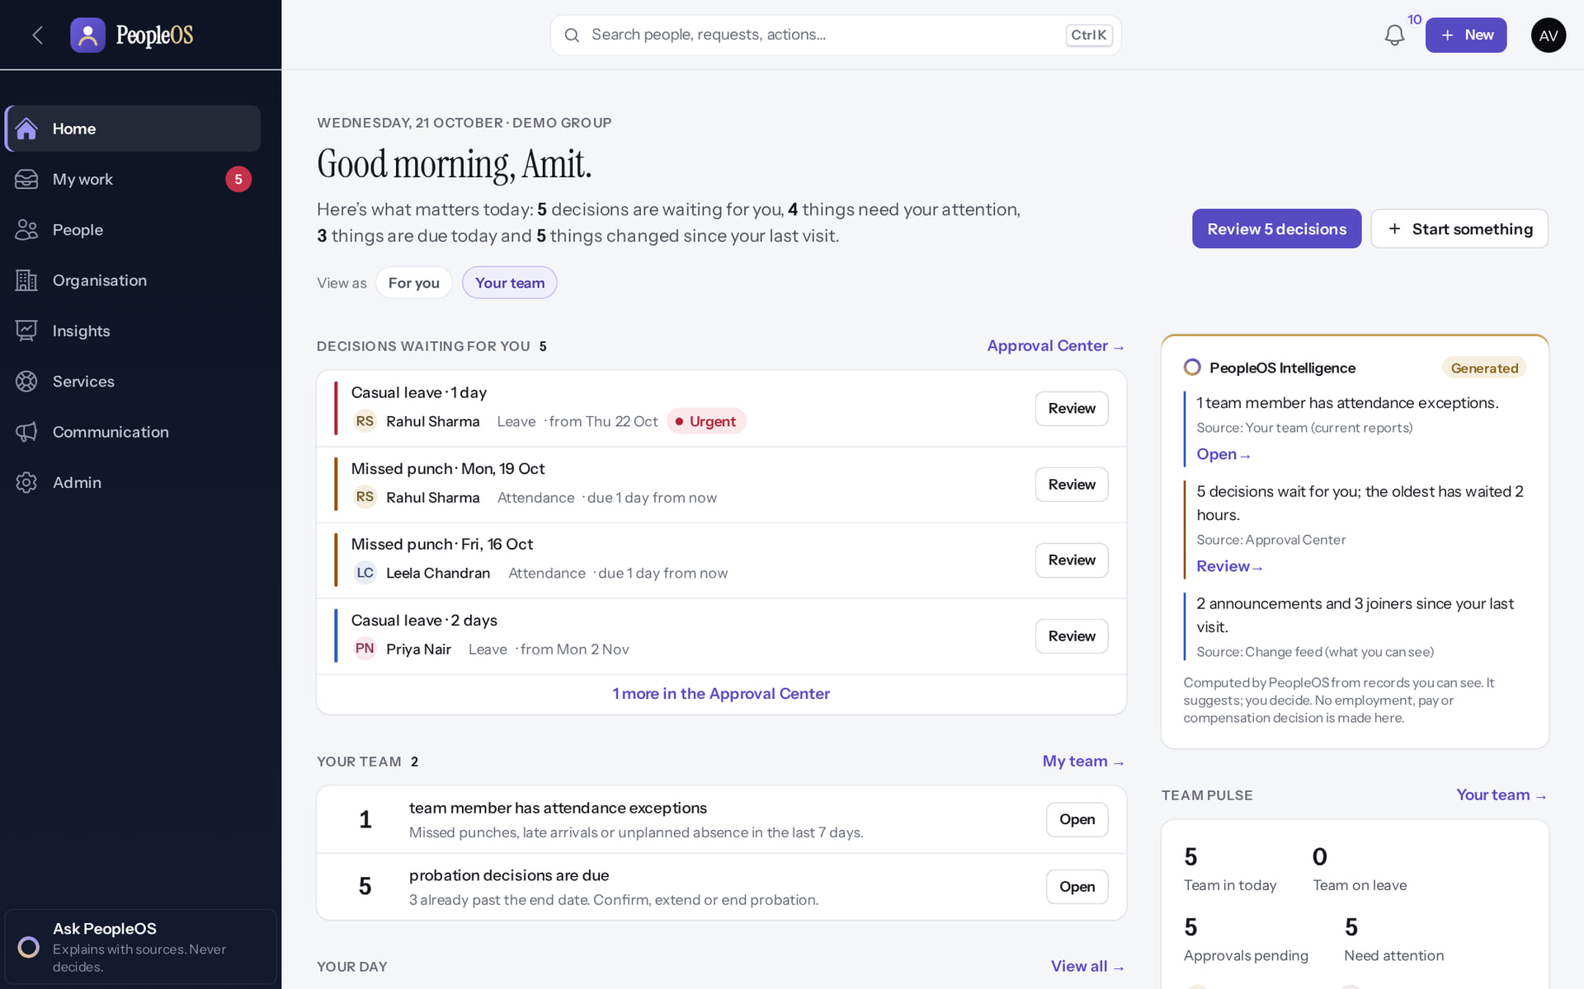
Manager Self-Service Training
MARKEDGE PEOPLEOS · TRAINING LIBRARY
Deck 02 of 12
See your team, decide requests with context, support goals and growth, and know exactly what you can and cannot see.
For: Line managers and team leads
Built from the running application (local, disposable database, fictional people) · 21 October 2026
Real screen, fictional data
Notes:
SAY: Managers make most of the day-to-day decisions in PeopleOS. This session shows where they appear, what context you get, and where your access stops.
EVIDENCE: Captured on the training database on 21 Oct 2026 as Amit Verma, fictional manager of the Platform team at the fictional Demo Group (tools/capture/40-manager.mjs, 10-leave-flow.mjs, 20-attendance-flow.mjs).

Slide 2
How to read this deck
BEFORE YOU START
Verified in the running application
We ran it on the training database and captured each step.
1
Numbered markers on a screenshot match the numbered steps beside it.
Implemented · not verified end to end
The screen exists; the last steps need data or a second party we could not provide.
Every screenshot is a real capture of PeopleOS. The people and companies in it are fictional.
Available only after configuration
Works once an administrator or Markedge has set it up.
Disabled by safety or commercial gates
Switched off on purpose until owner decisions and approvals arrive.
Diagrams are marked "Conceptual diagram". They explain ideas; they are not screens.
Incomplete · known defect or gap
Partly working: a known defect or gap is stated on the slide.
Release gate: NO-GO (10 of 14 gates blocked, re-verified 13 Oct 2026). Not yet generally available.
Not implemented
Not in the product today.
Unable to verify
Could not be checked in this environment.
Notes:
Explain the seven status labels. Every screenshot slide carries one of them in its top-right corner. Stress that "Verified in the running application" means we ran it on a disposable demonstration database, not that the feature is released.

Slide 3
Where PeopleOS stands today
BEFORE YOU START
This training uses the real application on a practice database with invented people. PeopleOS is not yet generally available.
What works today
Payroll is not live yet
Known issues are named
The screens in this deck were run end to end on the practice database: you will see exactly what you will use.
Payslips appear only after a payroll run is finalised. Finalising is blocked until statutory rules are verified (0 of 24 today).
Where something does not work as it should, the slide says so and shows the workaround.
Notes:
SAY: We trained on the real PeopleOS screens, not mock-ups. The practice database contains invented people only.
AVOID: promising dates for general availability or payroll. The release gate is NO-GO (docs/saas/SaaS-Final-Release-Gate.md (decision NO-GO, re-verified 13 October 2026 at 7314f7d)).
ASK: "Who has used an HR self-service portal before?"
SAY: Where PeopleOS stands today. This training uses the real application on a practice database with invented people. PeopleOS is not yet generally available.
- What works today: The screens in this deck were run end to end on the practice database: you will see exactly what you will use.
- Payroll is not live yet: Payslips appear only after a payroll run is finalised. Finalising is blocked until statutory rules are verified (0 of 24 today).
- Known issues are named: Where something does not work as it should, the slide says so and shows the workaround.
ASK: "Which of these points needs more explanation for your team?"

Slide 4
What you will be able to do
LEARNING OBJECTIVES
See your team at a glance
Home lenses, My team, Directory
Support goals and reviews
check-ins, one-on-ones, feedback, appraisals
1
4
Read a team member's record
and know what is not shown to managers
Develop your team
learning, career, HR requests, onboarding tasks
2
5
Decide leave and attendance
with reason, overlap and balance
Use team insights
within your scope
3
6
Notes:
SAY: What you will be able to do:
1. See your team at a glance: Home lenses, My team, Directory
2. Read a team member's record: and know what is not shown to managers
3. Decide leave and attendance: with reason, overlap and balance
4. Support goals and reviews: check-ins, one-on-ones, feedback, appraisals
5. Develop your team: learning, career, HR requests, onboarding tasks
6. Use team insights: within your scope
ASK: "Which of these matters most to you?" Return to the answer in the summary.

Slide 5
Your reach as a manager
ACCESS
Who you see
What you see
Yourself and everyone who reports to you today (any reporting type), plus any team scope your administrator gave you.
Timeline, employment, time, growth and personal details your role allows. Pay (Rewards) and Operations are not shown to managers.
What you cannot do
Broader visibility
Edit employee records, hire, change pay or open people outside your reach. Ask HR.
Only if your administrator adds organisation scope or HR permissions to your account.
Notes:
SOURCE: architecture contract §6 relationship scope; captures 40-team-05, 40-team-07, 40-team-09. Amit's Platform-team scope is a team dimension assigned by the administrator.
SAY: Your reach as a manager.
- Who you see: Yourself and everyone who reports to you today (any reporting type), plus any team scope your administrator gave you.
- What you see: Timeline, employment, time, growth and personal details your role allows. Pay (Rewards) and Operations are not shown to managers.
- What you cannot do: Edit employee records, hire, change pay or open people outside your reach. Ask HR.
- Broader visibility: Only if your administrator adds organisation scope or HR permissions to your account.
ASK: "Which of these points needs more explanation for your team?"

Slide 6
Your team
01
Home, My team, the Directory and the employee register.
Notes:
TRANSITION: Section 1, Your team. Home, My team, the Directory and the employee register.
SAY: Tell learners what they will be able to do by the end of this section, then move on.
ASK: "What questions do you have before we start this section?"

Slide 7
Home: the Your team lens
YOUR TEAM
Verified in the running application
1
Team pulse.
RESULT View as chips switch Home between For you and Your team. Your team shows who is in today, on leave, approvals pending and who needs attention.
1
Real screen · Amit Verma (Manager + Employee) · Home › View as: Your team
Notes:
SAY: View as chips switch Home between For you and Your team. Your team shows who is in today, on leave, approvals pending and who needs attention.
ON SCREEN: Choose View as › Your team.
WALK THROUGH: (1) Team pulse.
LEARNERS SHOULD SEE: Team in today, on leave, approvals pending, need attention; team actions
SCREEN: Home › View as: Your team. Signed in as Amit Verma (Manager + Employee).
EVIDENCE: screenshot screenshots/manager/40-team-02-home-team-lens.png, captured 2026-10-21 on the disposable training database (fictional people).

Slide 8
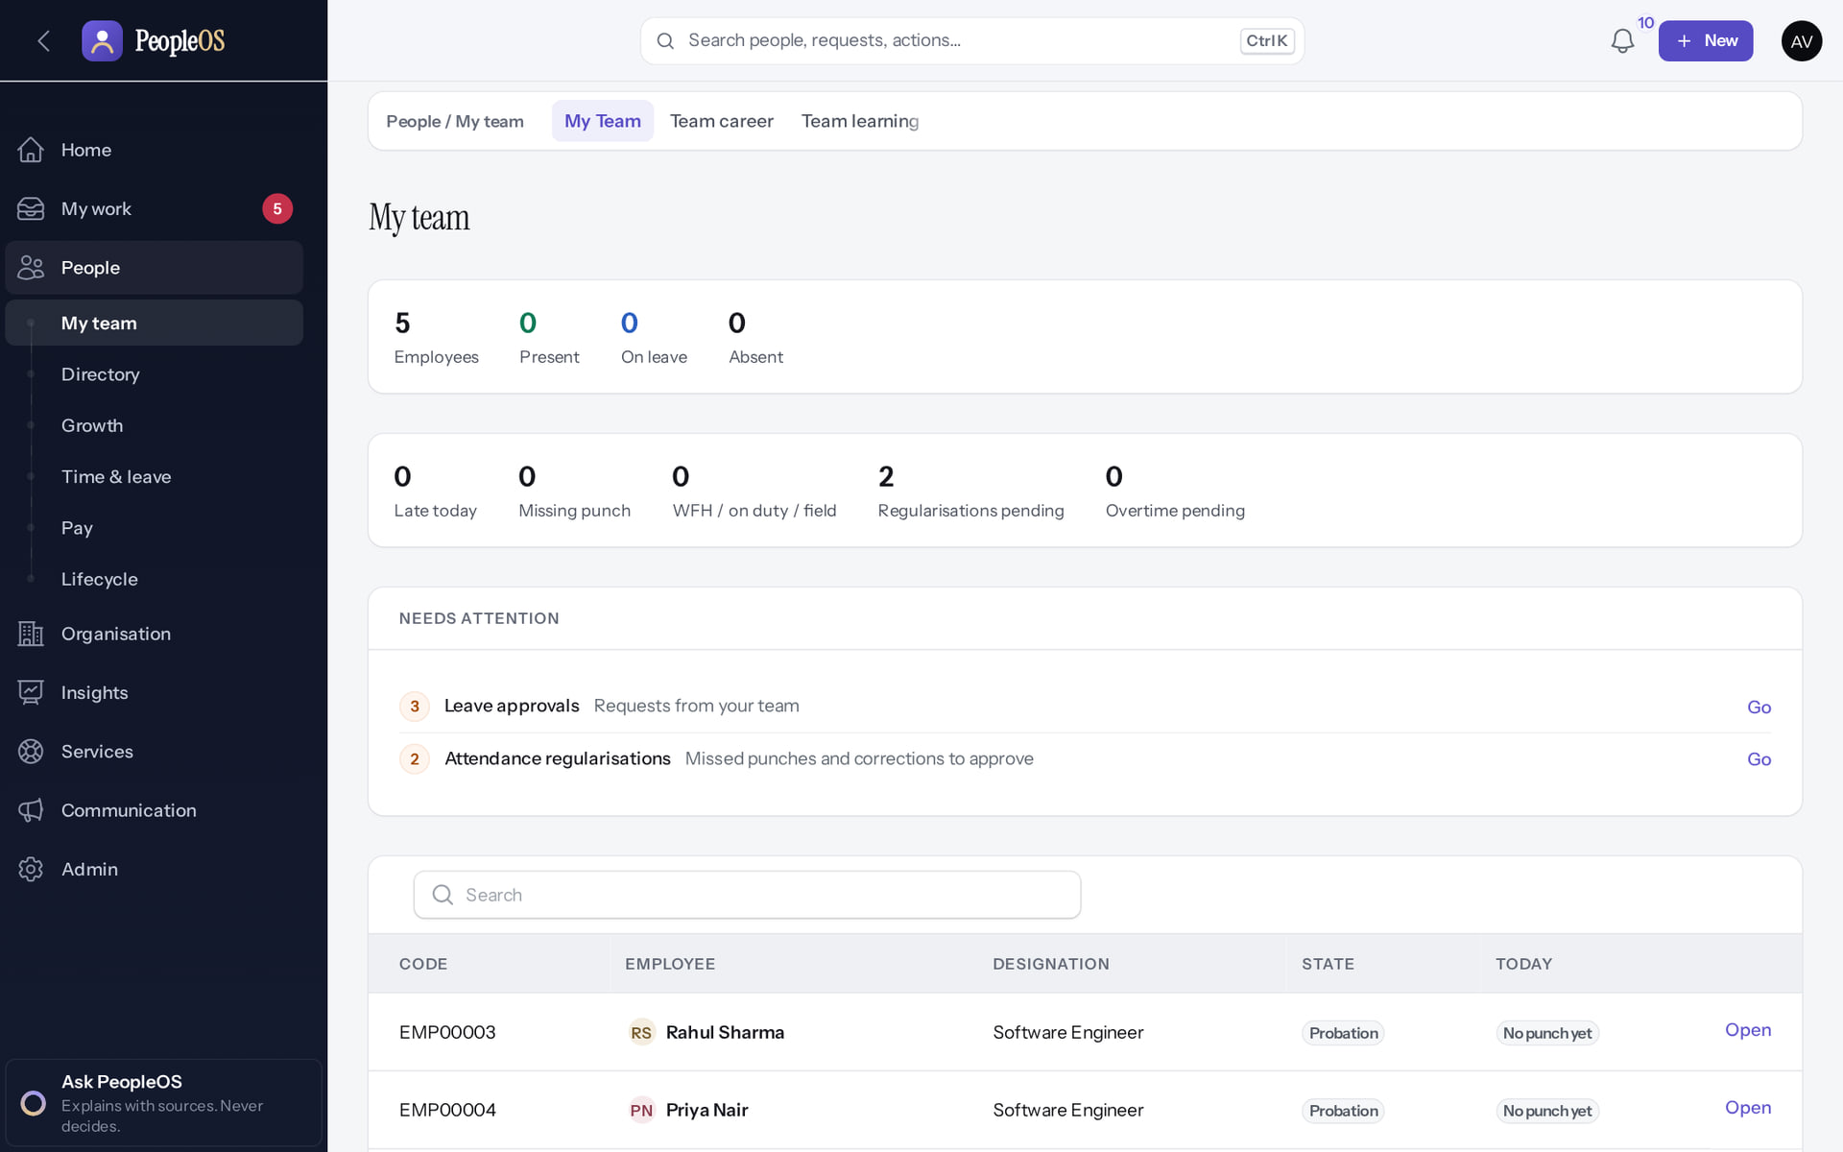
My team
YOUR TEAM
1
2
Verified in the running application
1
Team career.
2
Team learning.
RESULT Direct reports with today's status and what needs attention.
Real screen · Amit Verma (Manager + Employee) · People › My team
Notes:
SAY: Direct reports with today's status and what needs attention.
ON SCREEN: Open People › My team.
WALK THROUGH: (1) Team career. (2) Team learning.
LEARNERS SHOULD SEE: Direct reports with status today and what needs attention; Team career and Team learning tabs
SCREEN: People › My team. Signed in as Amit Verma (Manager + Employee).
EVIDENCE: screenshot screenshots/manager/40-team-03-my-team.png, captured 2026-10-21 on the disposable training database (fictional people).

Slide 9
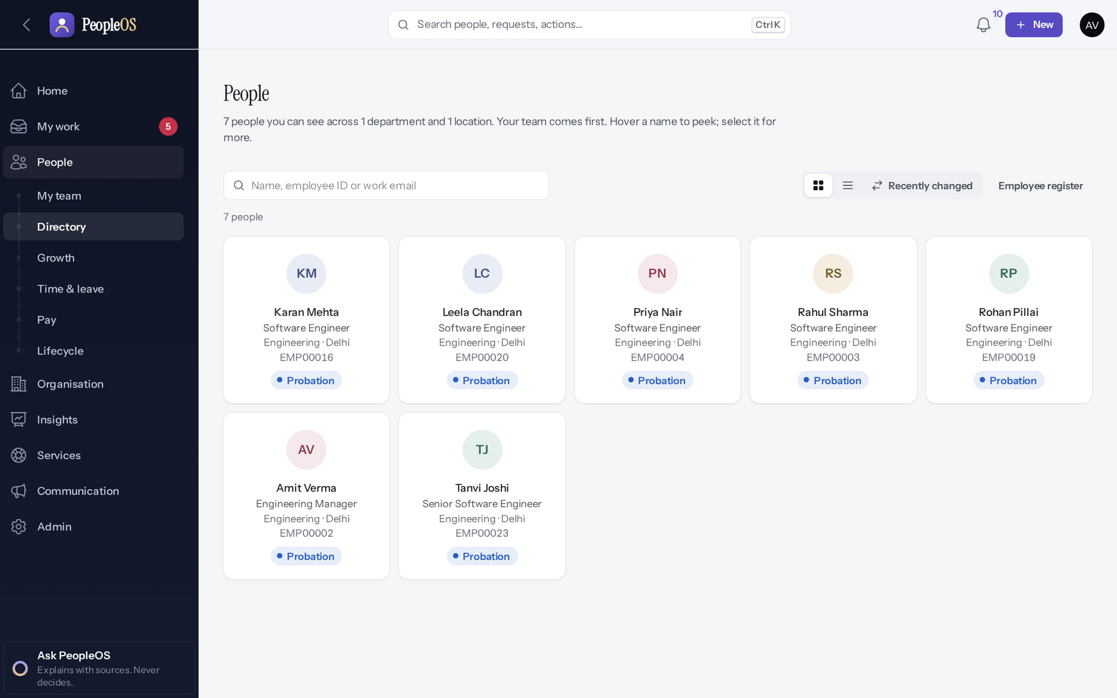
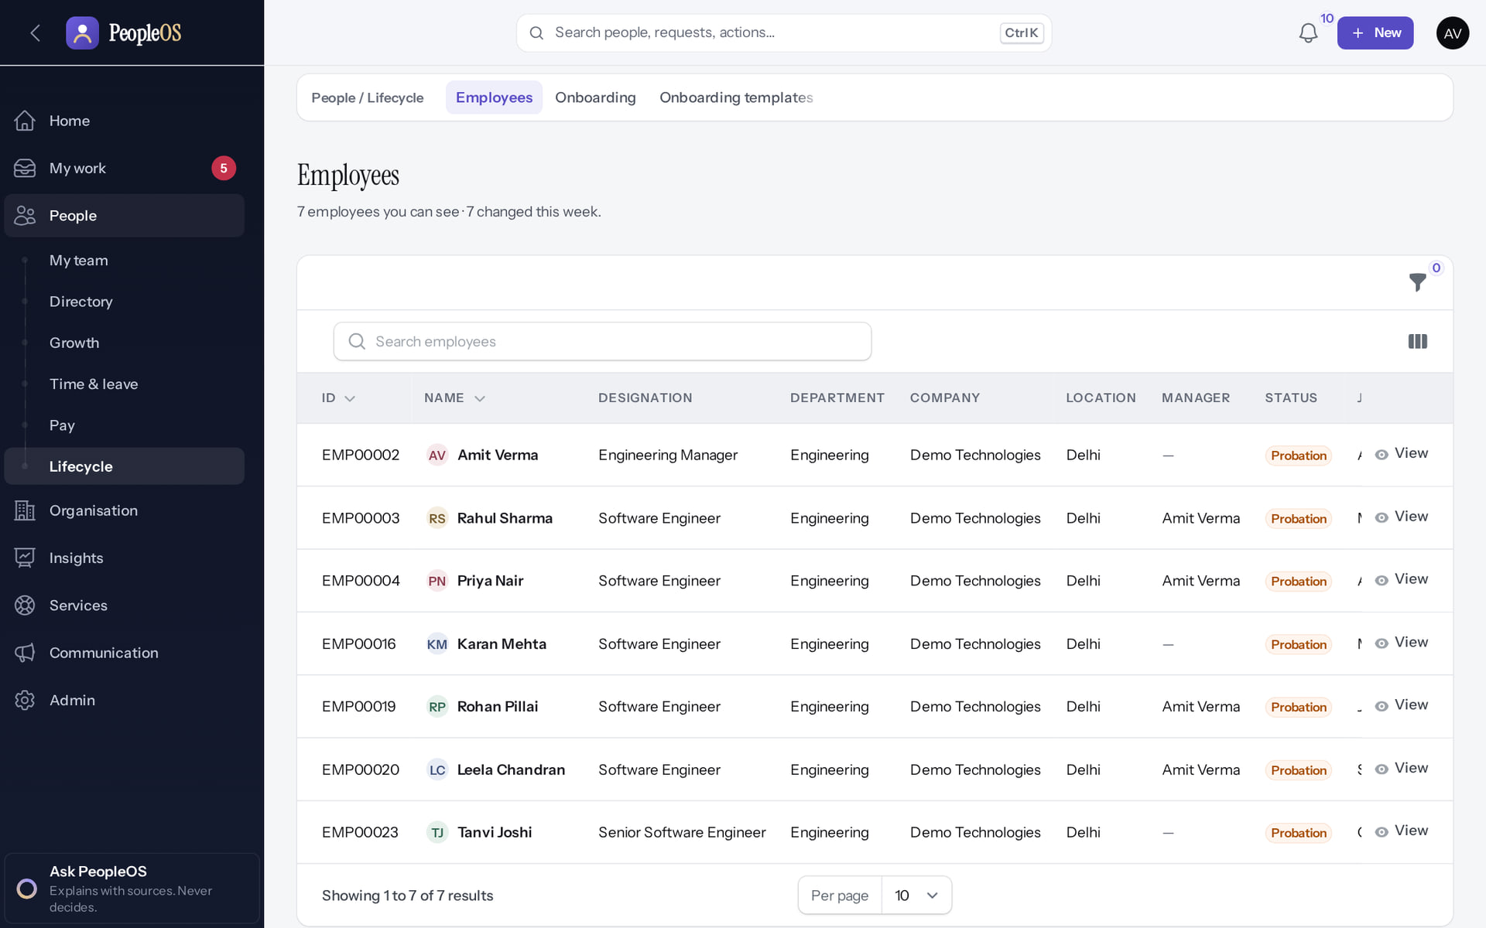
Directory and register
YOUR TEAM
Directory
Verified
Employees register
Verified
Only the people you may see: your team and your own line.
Seven people in scope, View only: no Edit, no Hire employee.
Real screen · Amit Verma (Manager + Employee) · People › Directory (manager scope)
Real screen · Amit Verma (Manager + Employee) · People › Lifecycle › Employees (manager)
Notes:
SAY: Directory and register.
LEFT, Directory: Only the people you may see: your team and your own line.
RIGHT, Employees register: Seven people in scope, View only: no Edit, no Hire employee.
OBSERVE: point out what differs between the two screens.
EVIDENCE: left = manager/40-team-04-directory [Amit Verma (Manager + Employee), People › Directory (manager scope)]; right = manager/40-team-05-employee-register [Amit Verma (Manager + Employee), People › Lifecycle › Employees (manager)]. Real screens, fictional data (SCREENSHOT-INVENTORY.md).

Slide 10
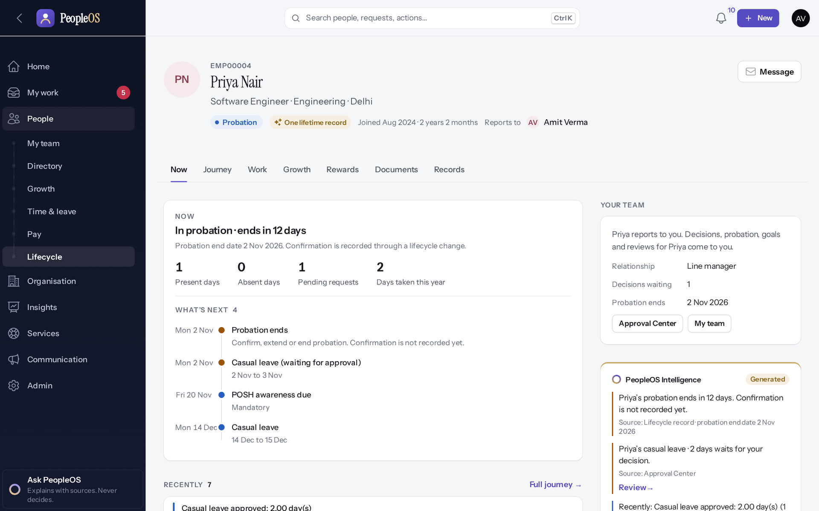
A team member's record
YOUR TEAM
Verified in the running application
1
1
Message.
2
Views.
2
RESULT Status, probation end, what is next and recent changes.
Real screen · Amit Verma (Manager + Employee) · Employee 360 › Now (Priya Nair, as her manager)
Notes:
SAY: Status, probation end, what is next and recent changes.
ON SCREEN: Open a direct report from My team or the Directory.
WALK THROUGH: (1) Message. (2) Views.
LEARNERS SHOULD SEE: Status, probation end, what is next, recent changes; Message
SCREEN: Employee 360 › Now (Priya Nair, as her manager). Signed in as Amit Verma (Manager + Employee).
EVIDENCE: screenshot screenshots/manager/40-team-06-member-360.png, captured 2026-10-21 on the disposable training database (fictional people).

Slide 11
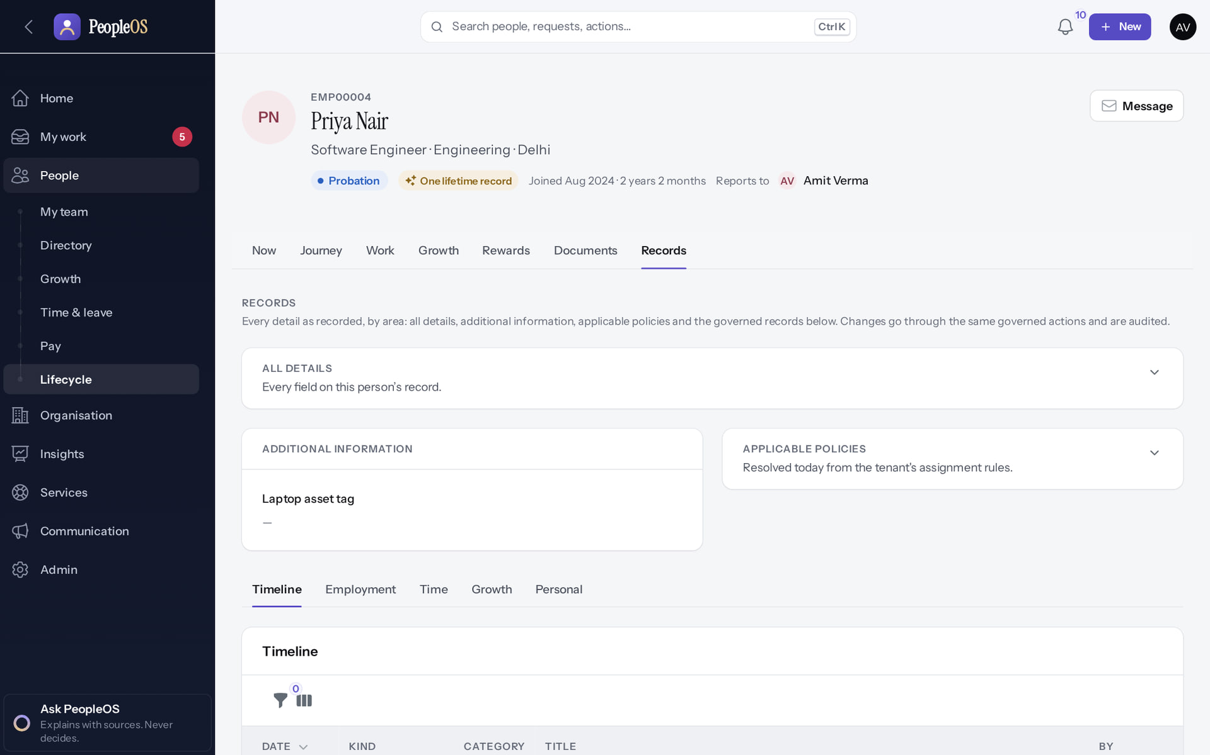
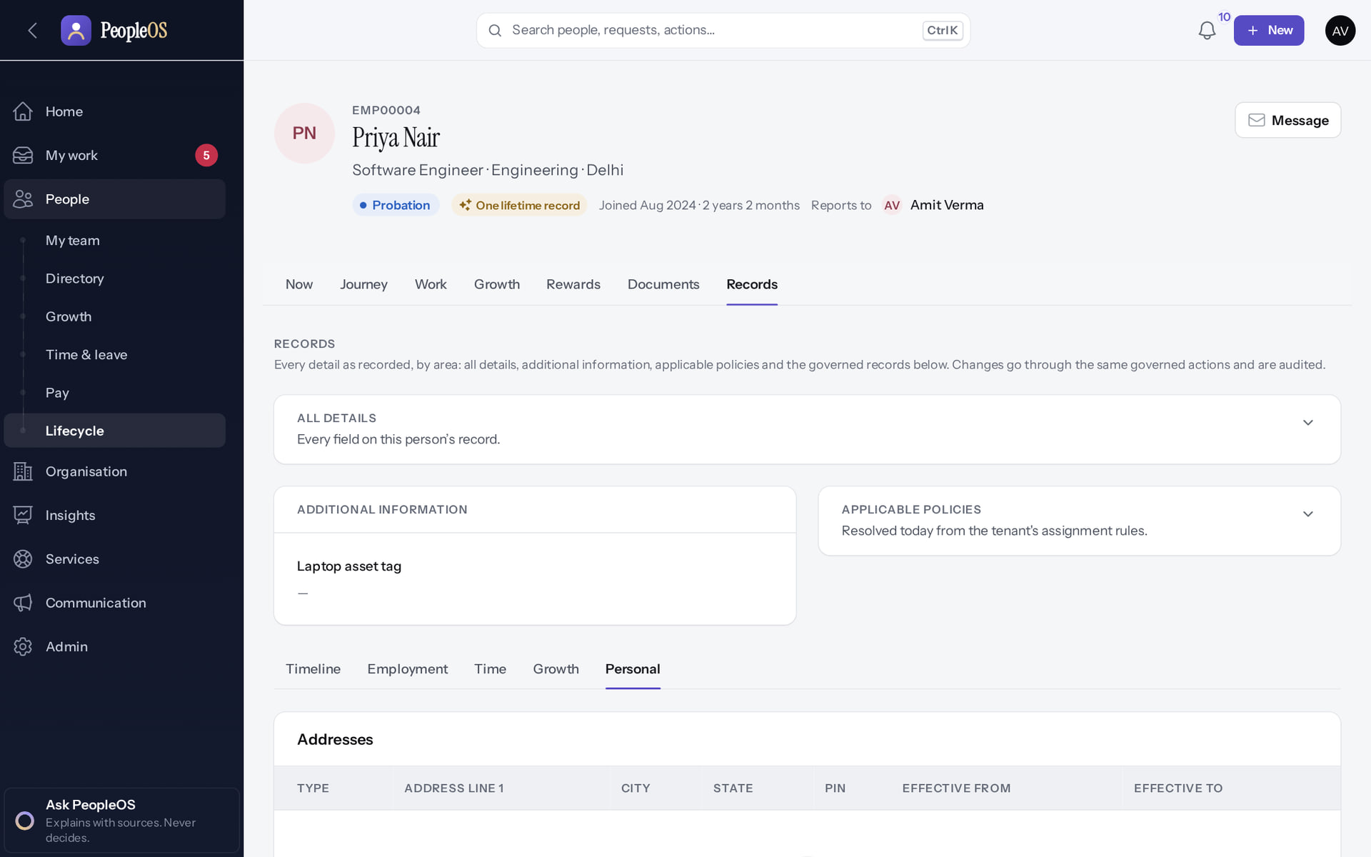
What a manager sees in Records
YOUR TEAM
Record tabs
Verified
Personal
Verified
Timeline, Employment, Time, Growth, Personal. Rewards and Operations are not offered.
Personal details a manager may see; HR additionally sees bank and identity details.
Real screen · Amit Verma (Manager + Employee) · Employee 360 › Records (as manager)
Real screen · Amit Verma (Manager + Employee) · Employee 360 › Records › Personal (as manager)
Notes:
KNOWN ISSUE: Records › Employment may show a server error when its lower tables load (new finding, 21 Oct 2026). Use Timeline for history.
SAY: What a manager sees in Records.
LEFT, Record tabs: Timeline, Employment, Time, Growth, Personal. Rewards and Operations are not offered.
RIGHT, Personal: Personal details a manager may see; HR additionally sees bank and identity details.
OBSERVE: point out what differs between the two screens.
EVIDENCE: left = manager/40-team-07-member-records [Amit Verma (Manager + Employee), Employee 360 › Records (as manager)]; right = manager/40-team-08-member-personal [Amit Verma (Manager + Employee), Employee 360 › Records › Personal (as manager)]. Real screens, fictional data (SCREENSHOT-INVENTORY.md).

Slide 12
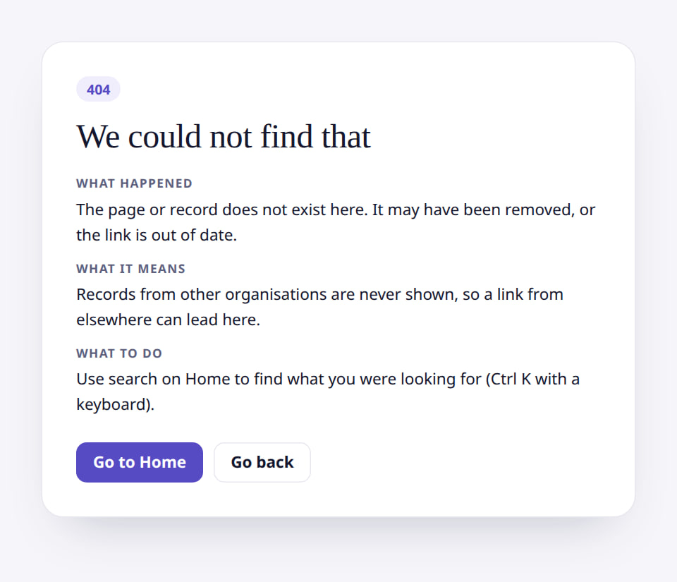
Someone outside your team
YOUR TEAM
Verified in the running application
1
Not found.
1
RESULT "We could not find that" (404): records outside your reach are not revealed, not even that they exist.
Real screen (cropped) · Amit Verma (Manager + Employee) · Employee 360 of someone outside the team
Notes:
SAY: "We could not find that" (404): records outside your reach are not revealed, not even that they exist.
ON SCREEN: Open the address of an employee outside the manager’s scope (Neha Kapoor, HR).
WALK THROUGH: (1) Not found.
LEARNERS SHOULD SEE: HTTP 404 "We could not find that": records outside the scope are not revealed
SCREEN: Employee 360 of someone outside the team. Signed in as Amit Verma (Manager + Employee).
EVIDENCE: screenshot screenshots/manager/40-team-09-outside-team.png, captured 2026-10-21 on the disposable training database (fictional people).

Slide 13
Approvals
02
Leave and attendance decisions with the context you need.
Notes:
TRANSITION: Section 2, Approvals. Leave and attendance decisions with the context you need.
SAY: Tell learners what they will be able to do by the end of this section, then move on.
ASK: "What questions do you have before we start this section?"

Slide 14
Decide leave requests
APPROVALS
Approve or reject your team's leave with the context you need: reason, overlap with others, and the balance after.
Verified in the running application
WHO
WHERE
BEFORE YOU START
Line managers (any reporting type effective today).
My work › Approvals (the Approval Center). Home shows how many decisions wait.
Nothing to configure. E-mail notices depend on notification rules set by HR.
START
My work › Approvals
REVIEW
Decision card
DECIDE
Approve or Reject
CONFIRM
Note or reason
RESULT
Requester sees status
Conceptual diagram: sequence summary
Notes:
SAY: Approve or reject your team's leave with the context you need: reason, overlap with others, and the balance after.
WHO: Line managers (any reporting type effective today).
WHERE: My work › Approvals (the Approval Center). Home shows how many decisions wait.
BEFORE YOU START: Nothing to configure. E-mail notices depend on notification rules set by HR.
SEQUENCE: START My work › Approvals → REVIEW Decision card → DECIDE Approve or Reject → CONFIRM Note or reason → RESULT Requester sees status
EVIDENCE: Executed on the training database on 21 Oct 2026 (tools/capture/10-leave-flow.mjs): Priya Nair (Employee) requested Casual leave 14–15 Dec 2026; Amit Verma (Manager) approved it; Amit rejected Rohan Pillai's request with a reason.
SAY: One place for every decision: leave, cancellations, attendance corrections, letters, workflow steps.

Slide 15
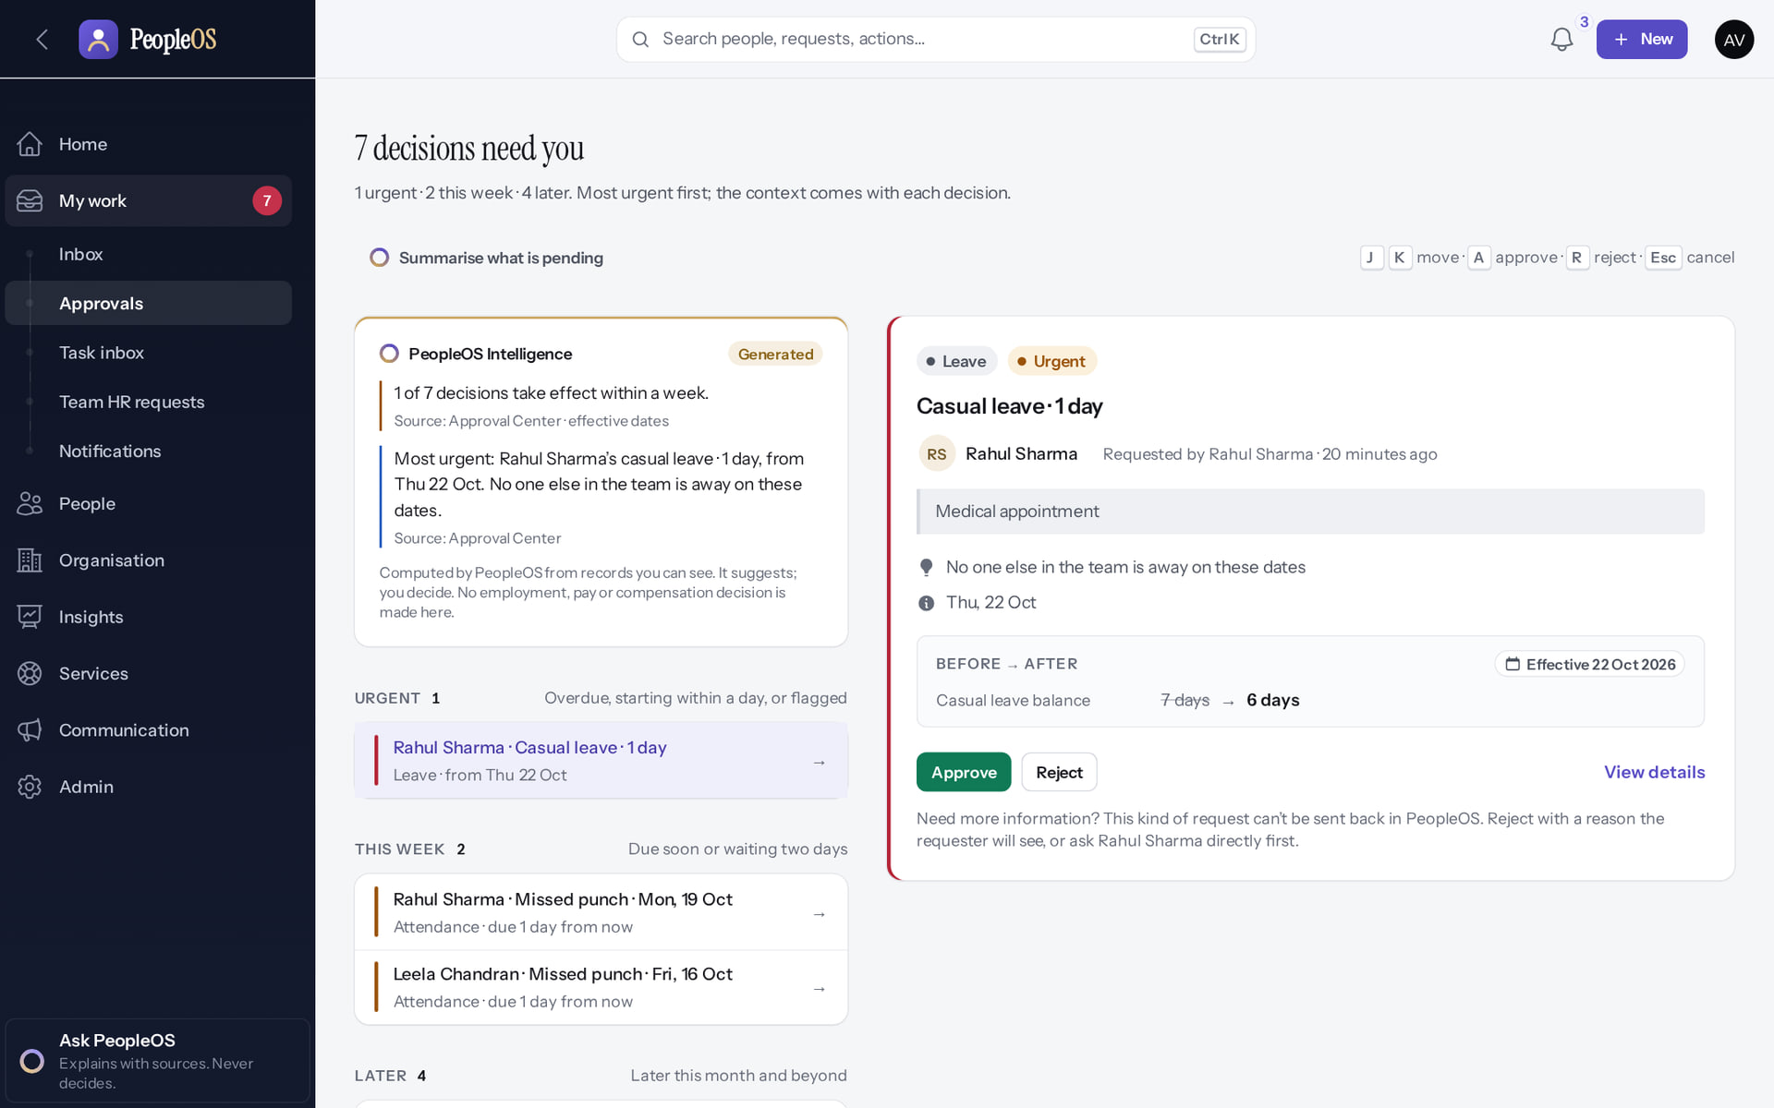
The Approval Center
APPROVALS
Verified in the running application
1
1
How many decisions wait
2
2
Summarise what is pending
Decisions are grouped Urgent, This week and Later, most urgent first; the new request is further down under Later. Keyboard: J/K move, A approve, R reject.
Real screen · Amit Verma (Manager + Employee) · My work › Approvals (Approval Center)
Notes:
SAY: Urgent means overdue, starting within a day, or flagged.
OBSERVE: 7 decisions at the time of capture.
AVOID: using A or R without reading the card: they only open the confirm box; nothing is decided without Confirm.

Slide 16
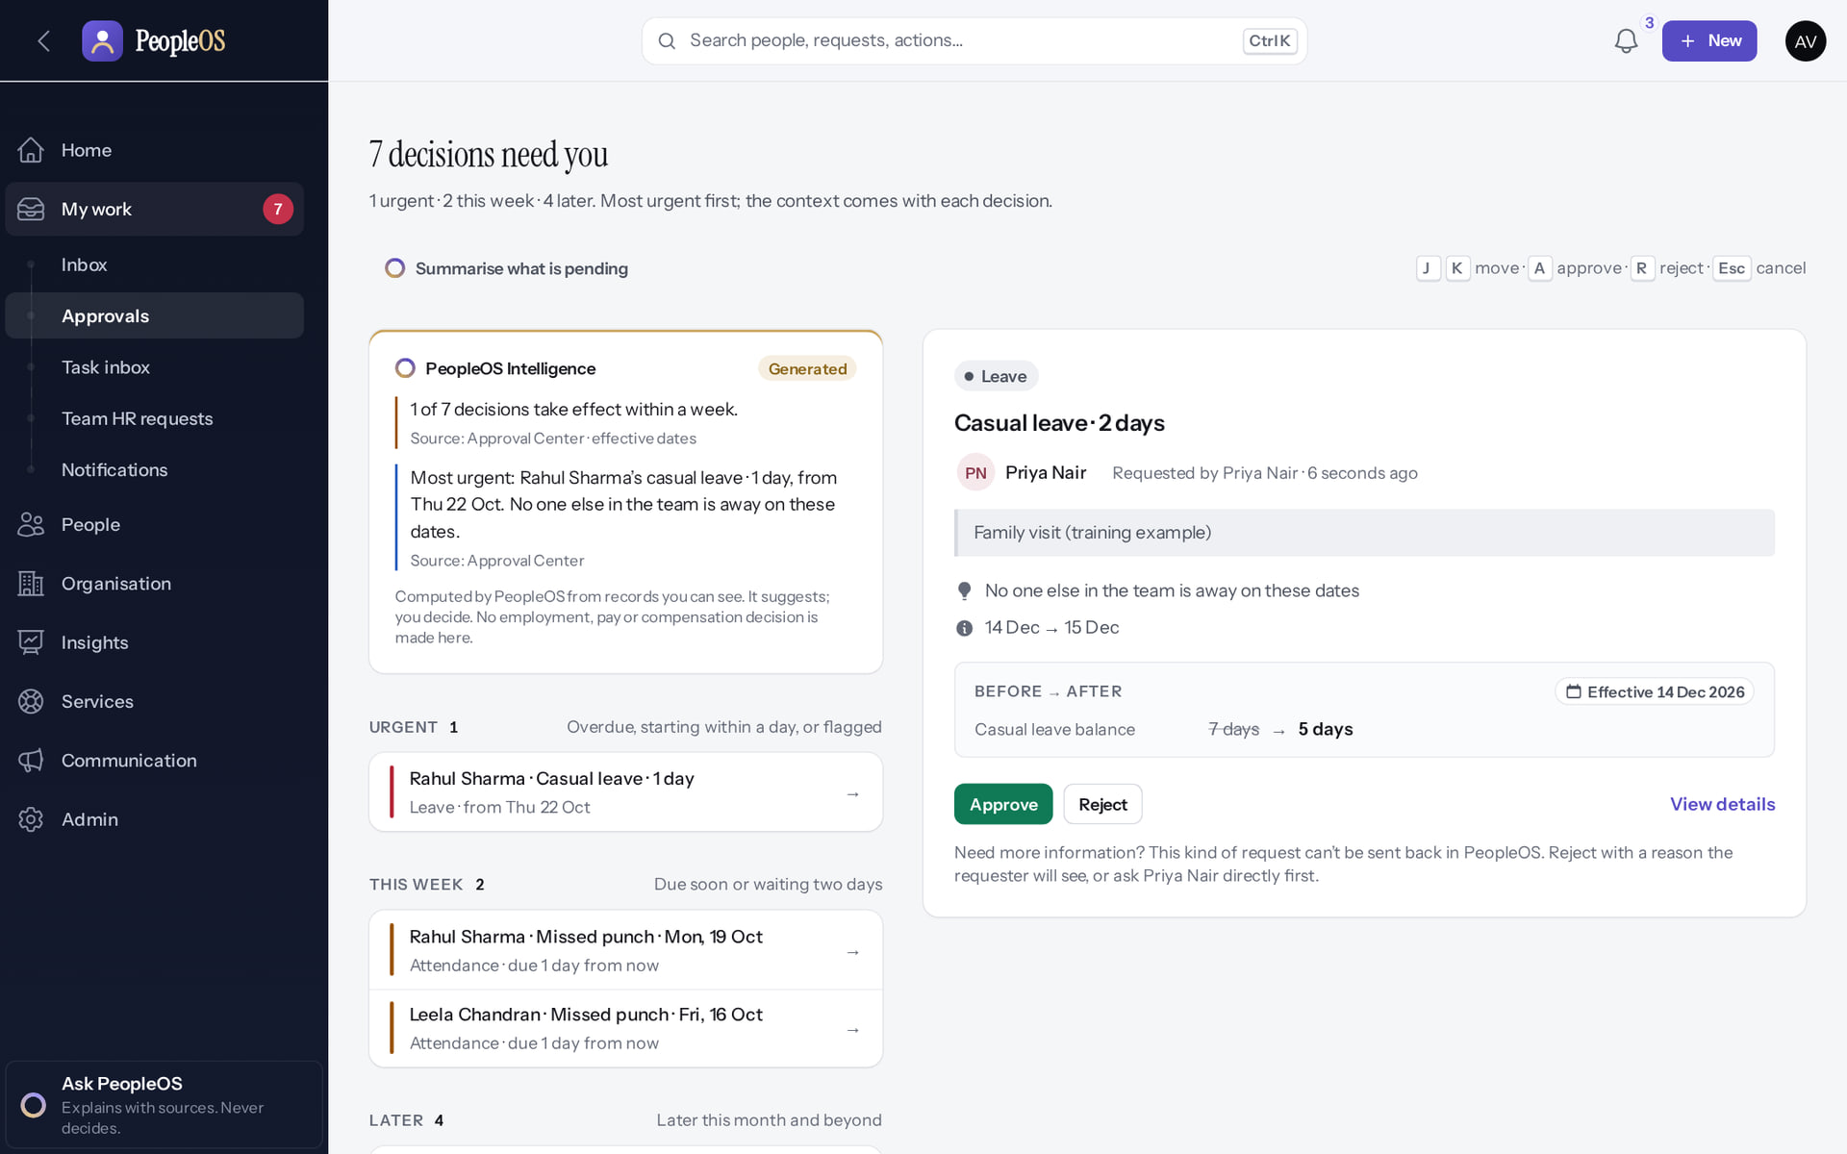
Read the context before you decide
APPROVALS
Verified in the running application
1
The employee's reason.
Team overlap, under the reason: "No one else in the team is away on these dates".
2
Approve.
1
3
Reject.
RESULT The card also shows the dates and the balance before → after (Casual leave 7 → 5).
2
3
Real screen · Amit Verma (Manager + Employee) · Approval Center › decision card
Notes:
SAY: Leave cannot be "sent back" for changes. If you need more information, ask the employee first, or reject with a reason they will see.

Slide 17
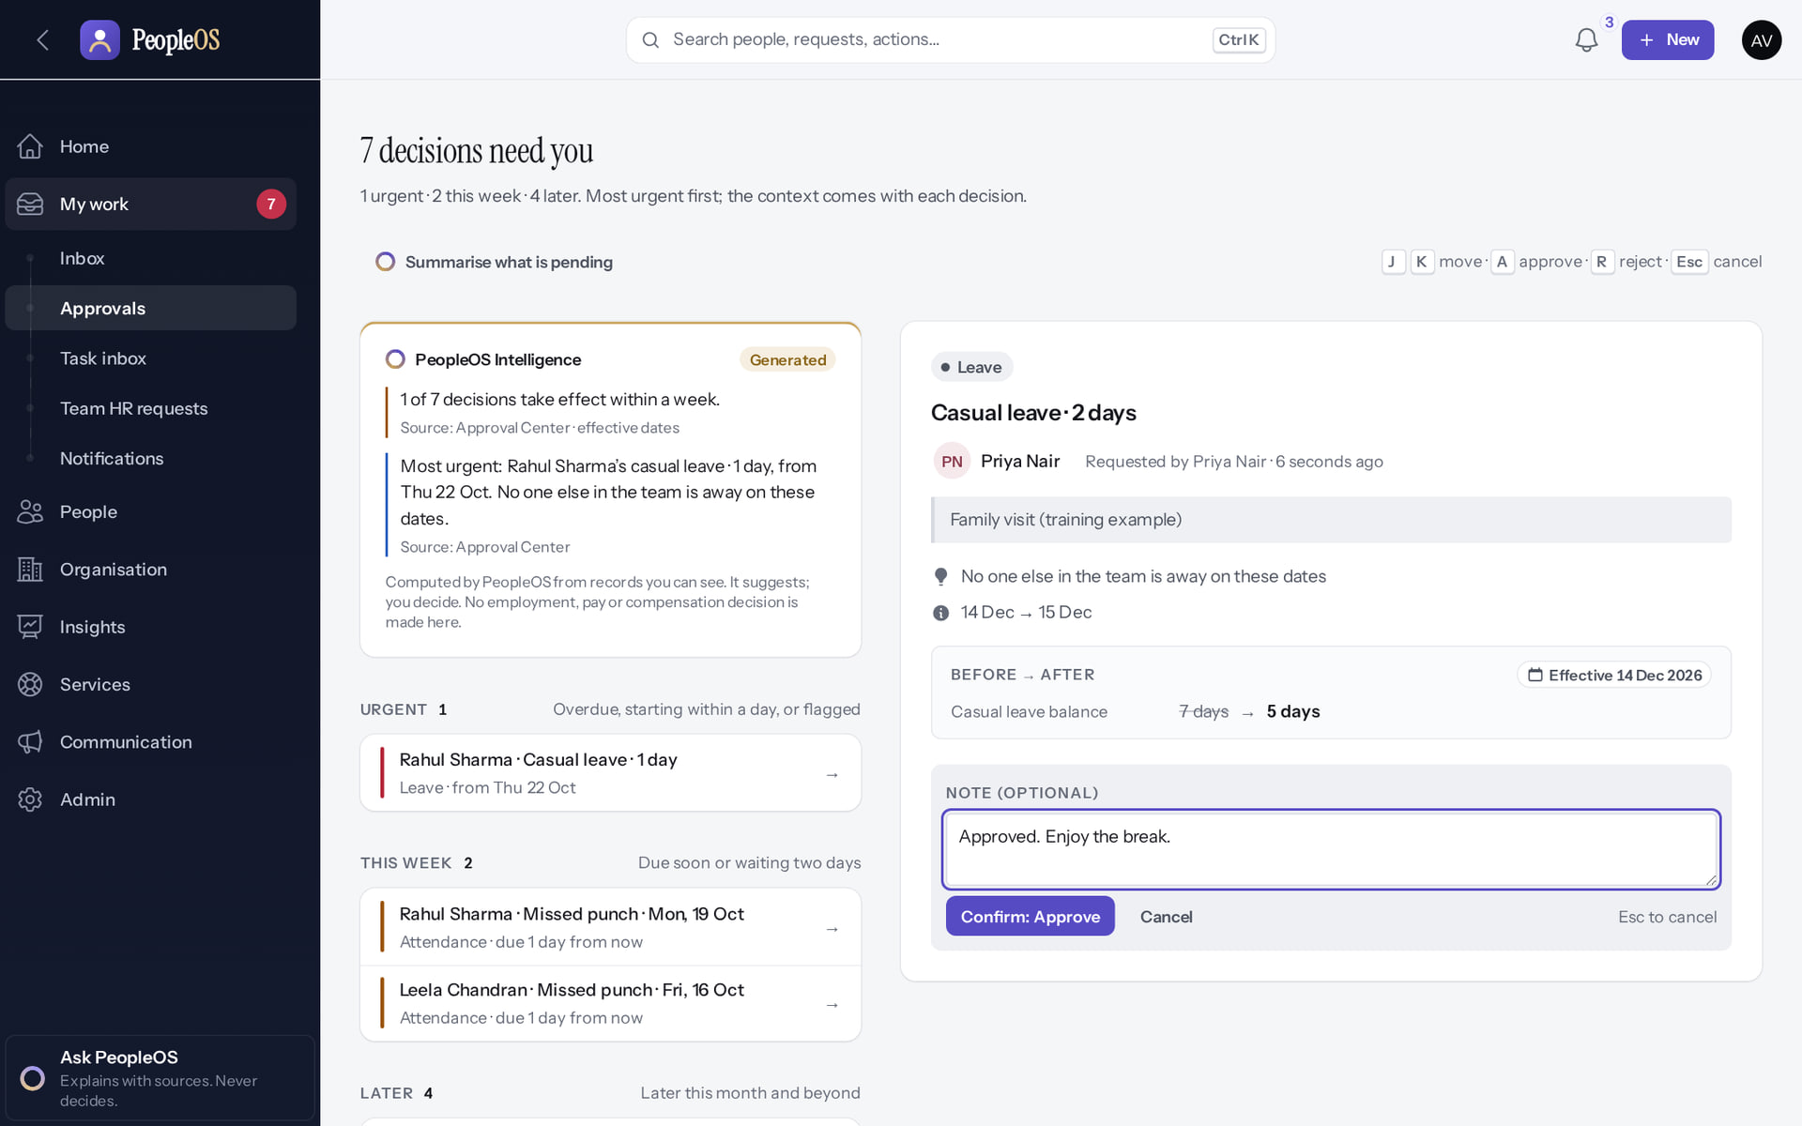
Approve: add an optional note, then Confirm
APPROVALS
Verified in the running application
1
Write an optional note.
2
Select Confirm: Approve.
RESULT Nothing is decided until you confirm. Esc cancels.
1
2
Real screen · Amit Verma (Manager + Employee) · Approval Center › Approve
Notes:
SAY: Nothing is decided until you confirm. Esc cancels.
ON SCREEN: Approve opens a confirmation with an optional note.
WALK THROUGH: (1) Write an optional note. (2) Select Confirm: Approve.
LEARNERS SHOULD SEE: Nothing is decided until Confirm
SCREEN: Approval Center › Approve. Signed in as Amit Verma (Manager + Employee).
EVIDENCE: screenshot screenshots/manager/10-leave-09-approve-confirm.png, captured 2026-10-21 on the disposable training database (fictional people).

Slide 18
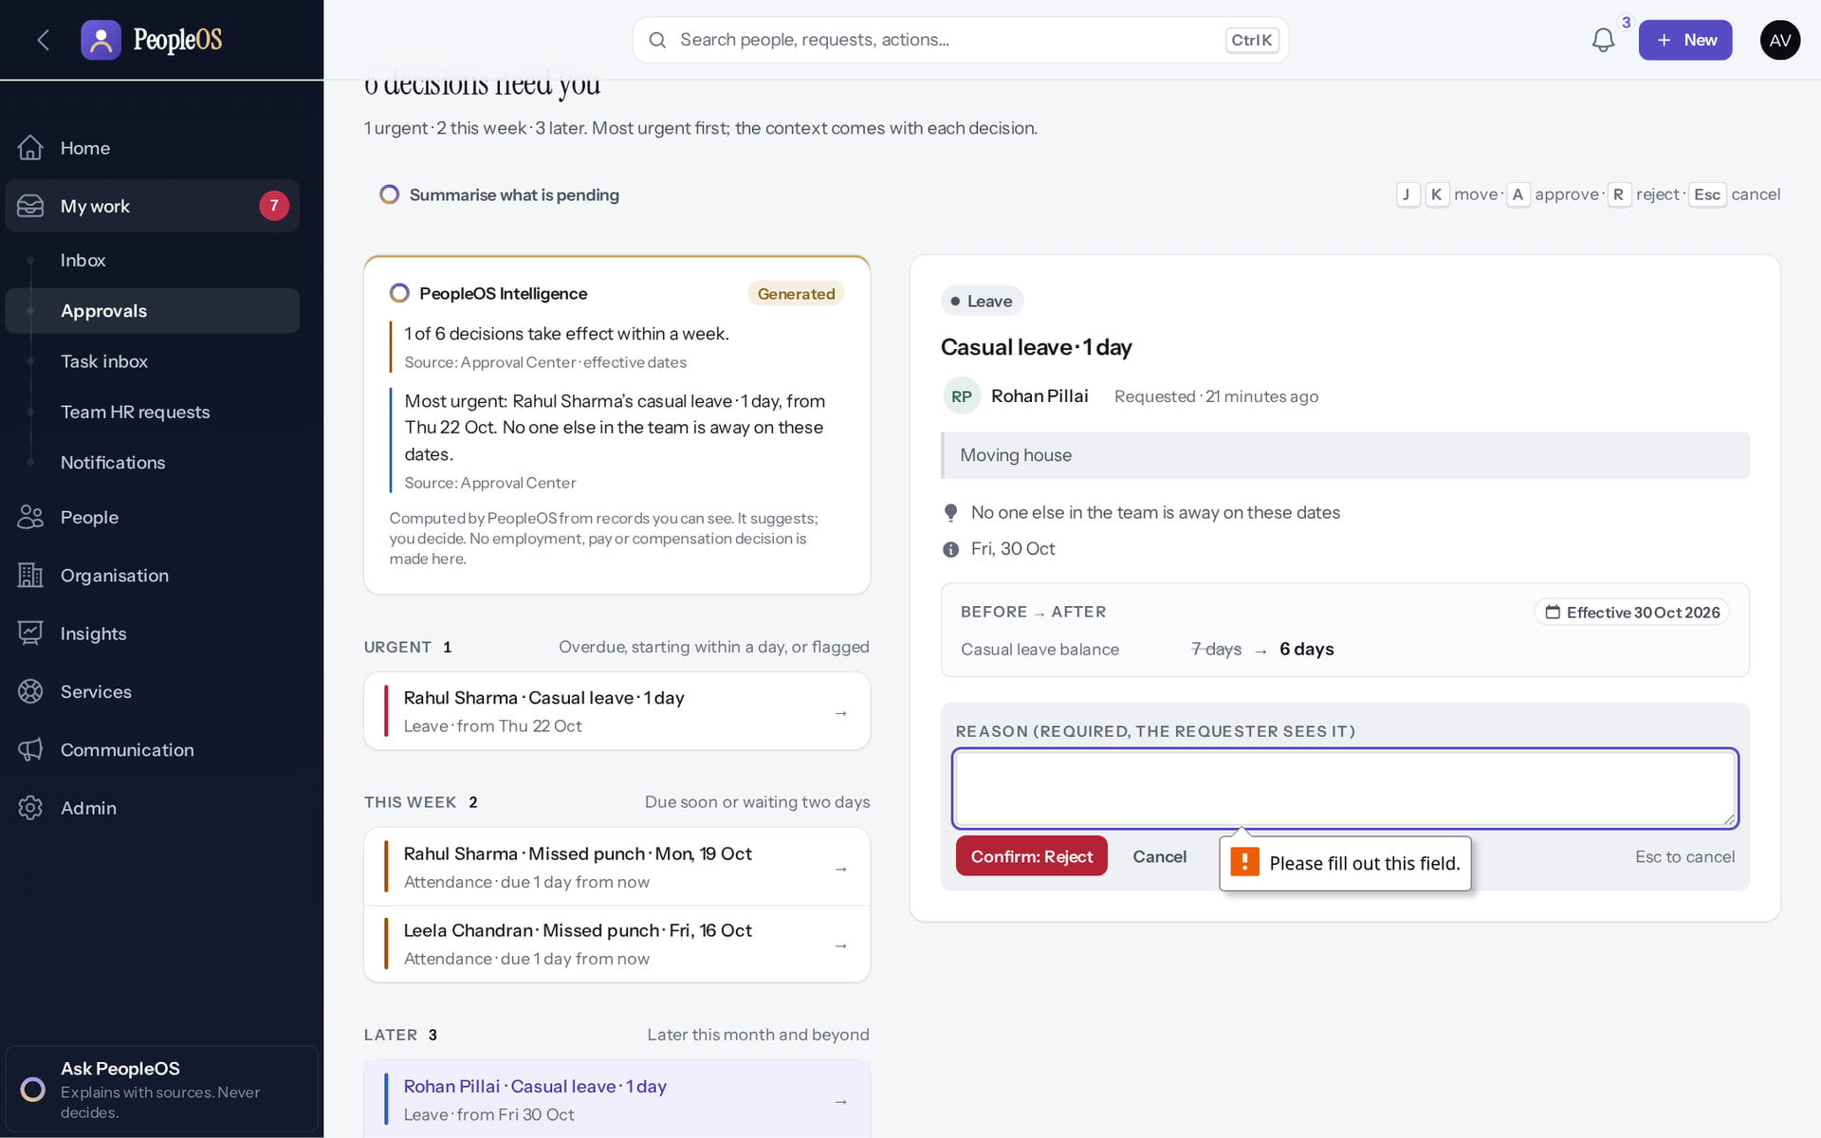
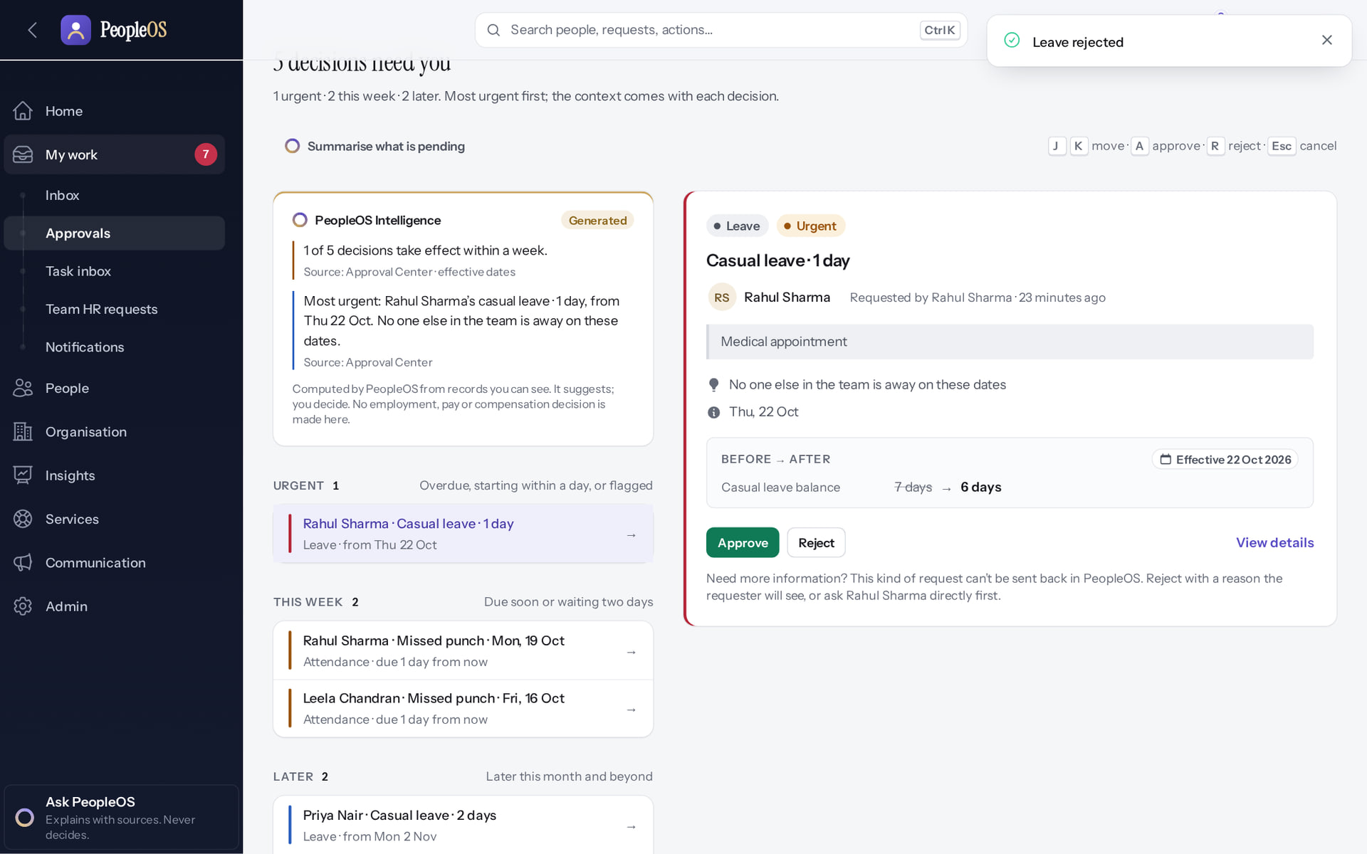
Rejecting needs a reason the employee will see
APPROVALS
Reason missing
Verified
Rejected with a reason
Verified
Confirm: Reject without a reason is stopped: "Please fill out this field."
"Leave rejected." The item leaves your queue; the employee sees your reason.
Real screen · Amit Verma (Manager + Employee) · Approval Center › Reject
Real screen · Amit Verma (Manager + Employee) · Approval Center (after rejecting)
Notes:
EVIDENCE: Executed on the training database on 21 Oct 2026 (tools/capture/10-leave-flow.mjs): Priya Nair (Employee) requested Casual leave 14–15 Dec 2026; Amit Verma (Manager) approved it; Amit rejected Rohan Pillai's request with a reason.
SAY: Write the reason for the employee, not for HR: what should they do next?
SAY: Rejecting needs a reason the employee will see.
LEFT, Reason missing: Confirm: Reject without a reason is stopped: "Please fill out this field."
RIGHT, Rejected with a reason: "Leave rejected." The item leaves your queue; the employee sees your reason.
OBSERVE: point out what differs between the two screens.
EVIDENCE: left = manager/10-leave-11-reject-reason-required [Amit Verma (Manager + Employee), Approval Center › Reject]; right = manager/10-leave-12-rejected [Amit Verma (Manager + Employee), Approval Center (after rejecting)]. Real screens, fictional data (SCREENSHOT-INVENTORY.md).

Slide 19
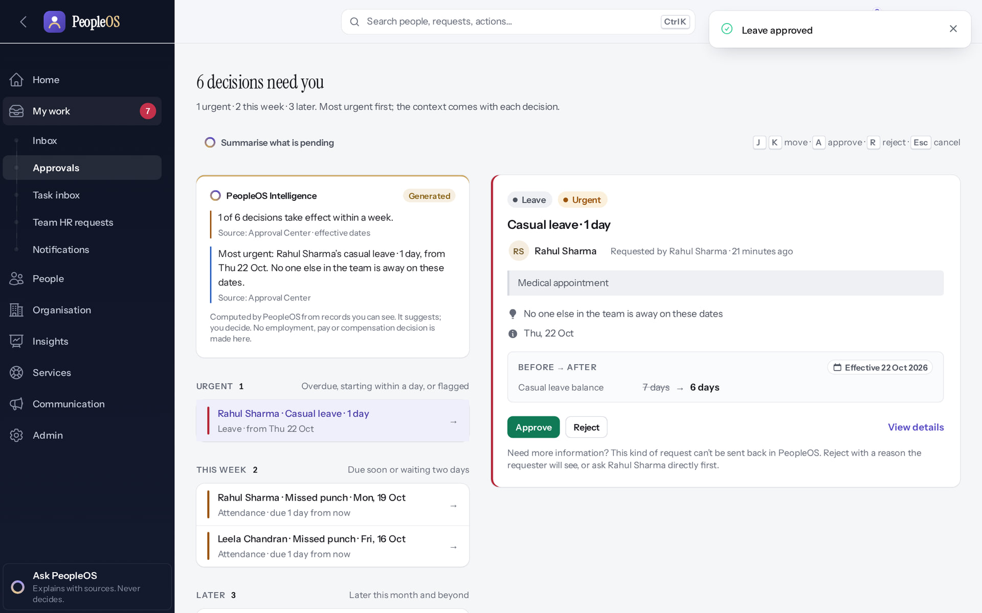
After the decision
APPROVALS
1
Verified in the running application
2
1
"Leave approved" confirms the decision.
2
The count of decisions waiting drops.
RESULT The employee sees Approved and "Reviewed by" your name on their Leave requests.
Real screen · Amit Verma (Manager + Employee) · Approval Center (after the decision)
Notes:
AVOID: telling the requester "you have been notified": notification depends on rules configured by HR (finding F6).

Slide 20
Team attendance and leave
03
Corrections, exceptions and who is away.
Notes:
TRANSITION: Section 3, Team attendance and leave. Corrections, exceptions and who is away.
SAY: Tell learners what they will be able to do by the end of this section, then move on.
ASK: "What questions do you have before we start this section?"

Slide 21
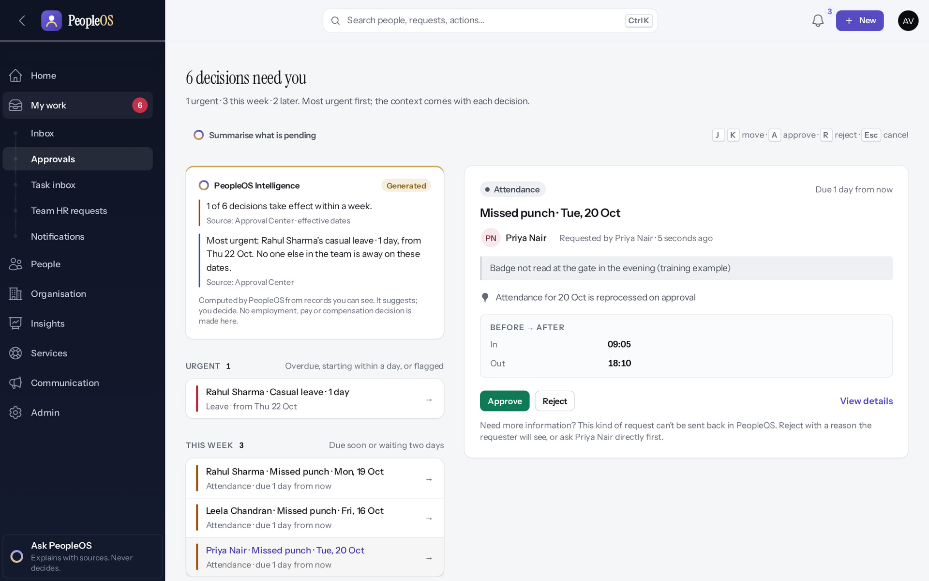
Approve an attendance correction
TEAM ATTENDANCE
Verified in the running application
1
Read the reason; the Before → After box shows the requested in/out times.
2
Approve, then Confirm.
RESULT "Approved and attendance reprocessed": the day is recalculated straight away.
1
2
Real screen · Amit Verma (Manager + Employee) · Approval Center › attendance correction
Notes:
EVIDENCE: Executed on the training database on 21 Oct 2026 (tools/capture/20-attendance-flow.mjs): Priya checked in, corrected a missed punch for 20 Oct, Amit approved it, Kavya Menon (Tenant HR Admin) recorded a manual punch and processed the day.

Slide 22
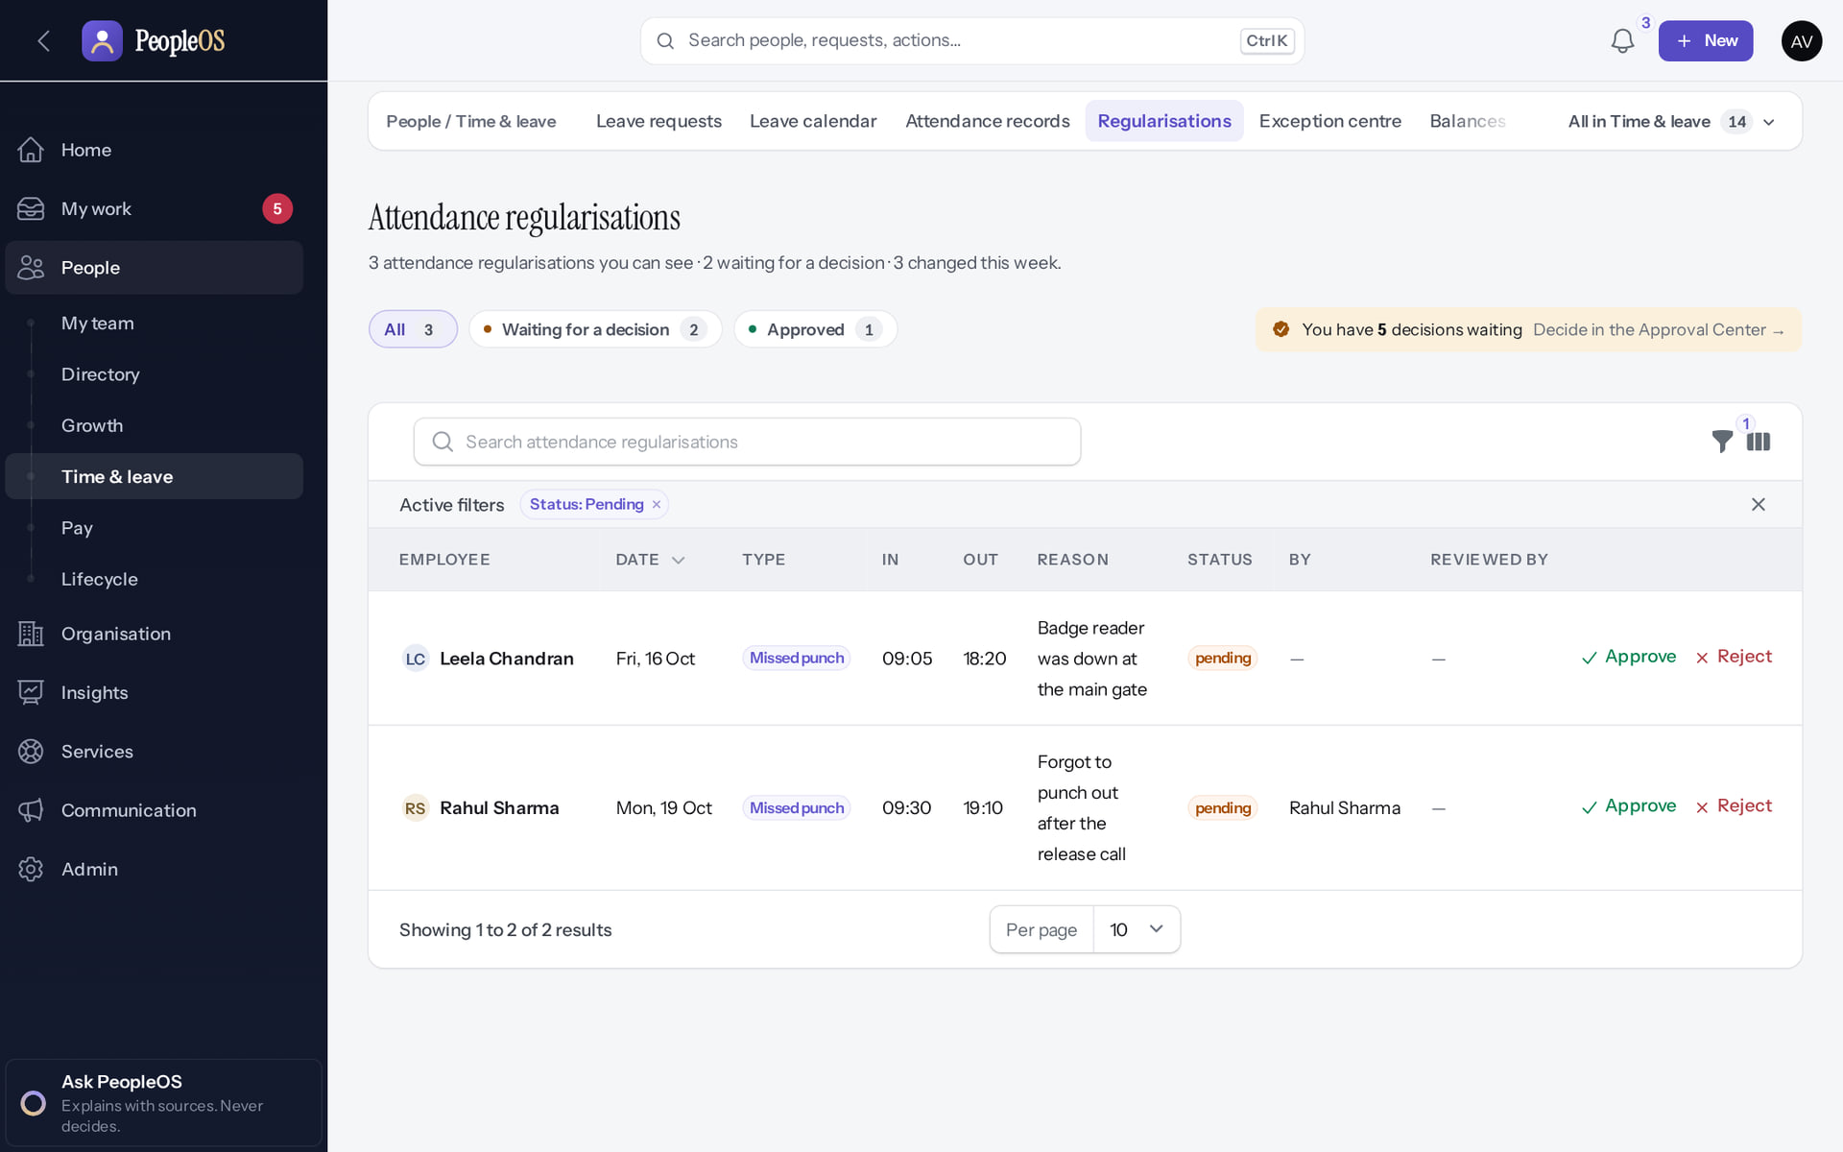
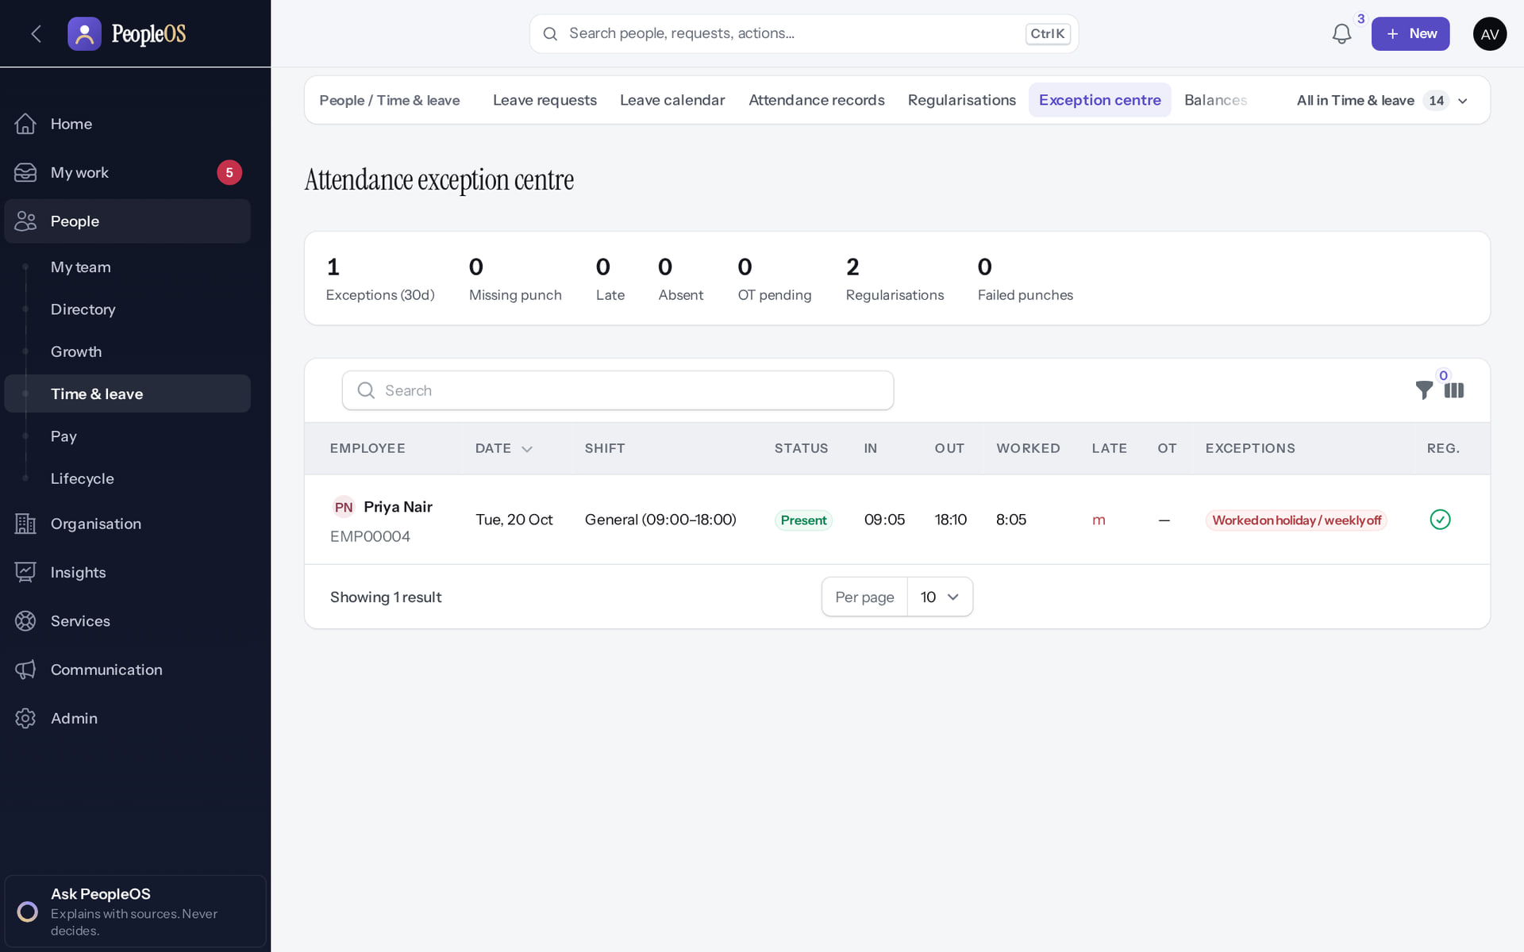
Your team's corrections and exceptions
TEAM ATTENDANCE
Regularisations (team)
Verified
Exception centre
Verified
Filter by status; pending ones can be decided here or in the Approval Center.
Missing punch, late, absent and overtime counts for the last 30 days.
Real screen · Amit Verma (Manager + Employee) · Regularisations (team)
Real screen · Amit Verma (Manager + Employee) · Exception centre
Notes:
SAY: Use the Exception centre weekly to spot missing punches before payroll cut-off.
SAY: Your team's corrections and exceptions.
LEFT, Regularisations (team): Filter by status; pending ones can be decided here or in the Approval Center.
RIGHT, Exception centre: Missing punch, late, absent and overtime counts for the last 30 days.
OBSERVE: point out what differs between the two screens.
EVIDENCE: left = manager/20-att-08-team-regularisations [Amit Verma (Manager + Employee), Regularisations (team)]; right = manager/20-att-09-exception-centre [Amit Verma (Manager + Employee), Exception centre]. Real screens, fictional data (SCREENSHOT-INVENTORY.md).

Slide 23
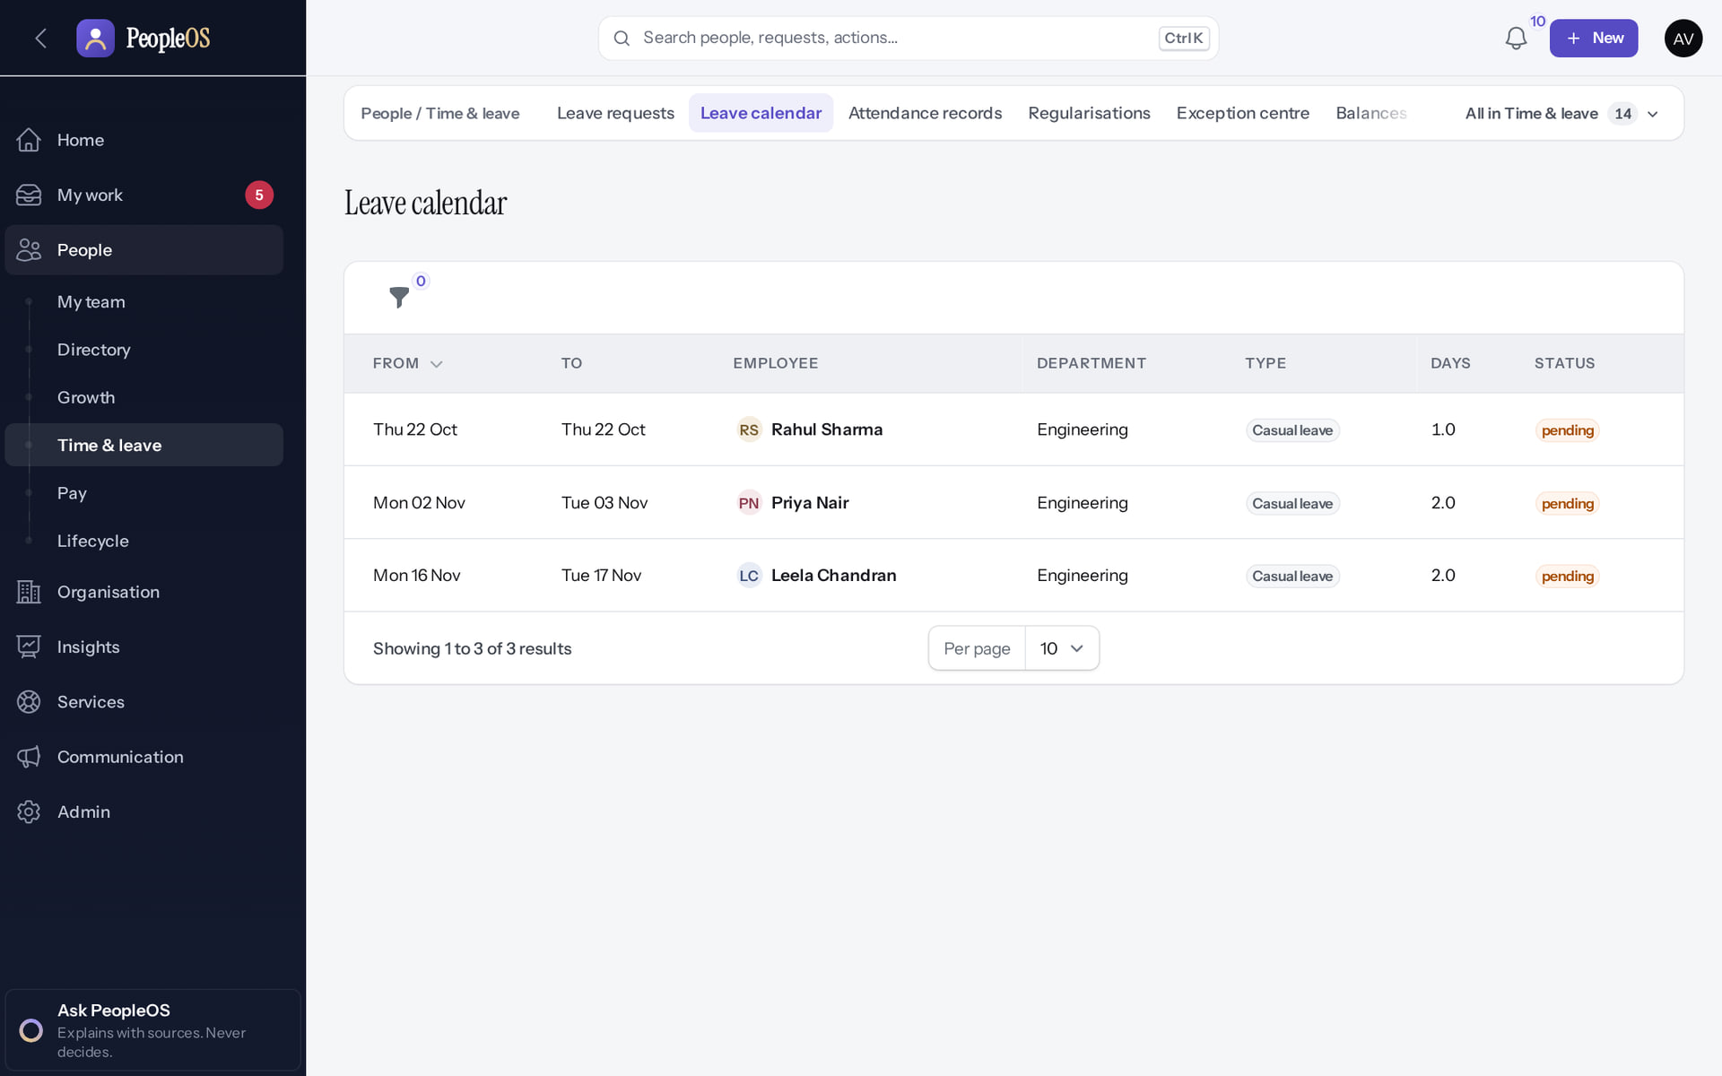
Leave calendar
TEAM ATTENDANCE
Verified in the running application
1
Team leave.
RESULT Who is away and when, approved and pending (this month to the end of next; the rows here are pending). Reasons are never shown here.
1
Real screen · Amit Verma (Manager + Employee) · People › Time & leave › Leave calendar
Notes:
SAY: Who is away and when, approved and pending (this month to the end of next; the rows here are pending). Reasons are never shown here.
ON SCREEN: Open the Leave calendar.
WALK THROUGH: (1) Team leave.
LEARNERS SHOULD SEE: Who in the team is away and when (approved and pending); reasons are never shown here
SCREEN: People › Time & leave › Leave calendar. Signed in as Amit Verma (Manager + Employee).
EVIDENCE: screenshot screenshots/manager/40-team-10-leave-calendar.png, captured 2026-10-21 on the disposable training database (fictional people).

Slide 24
Goals and performance
04
Goals, reviews, one-on-ones and feedback.
Notes:
TRANSITION: Section 4, Goals and performance. Goals, reviews, one-on-ones and feedback.
SAY: Tell learners what they will be able to do by the end of this section, then move on.
ASK: "What questions do you have before we start this section?"

Slide 25
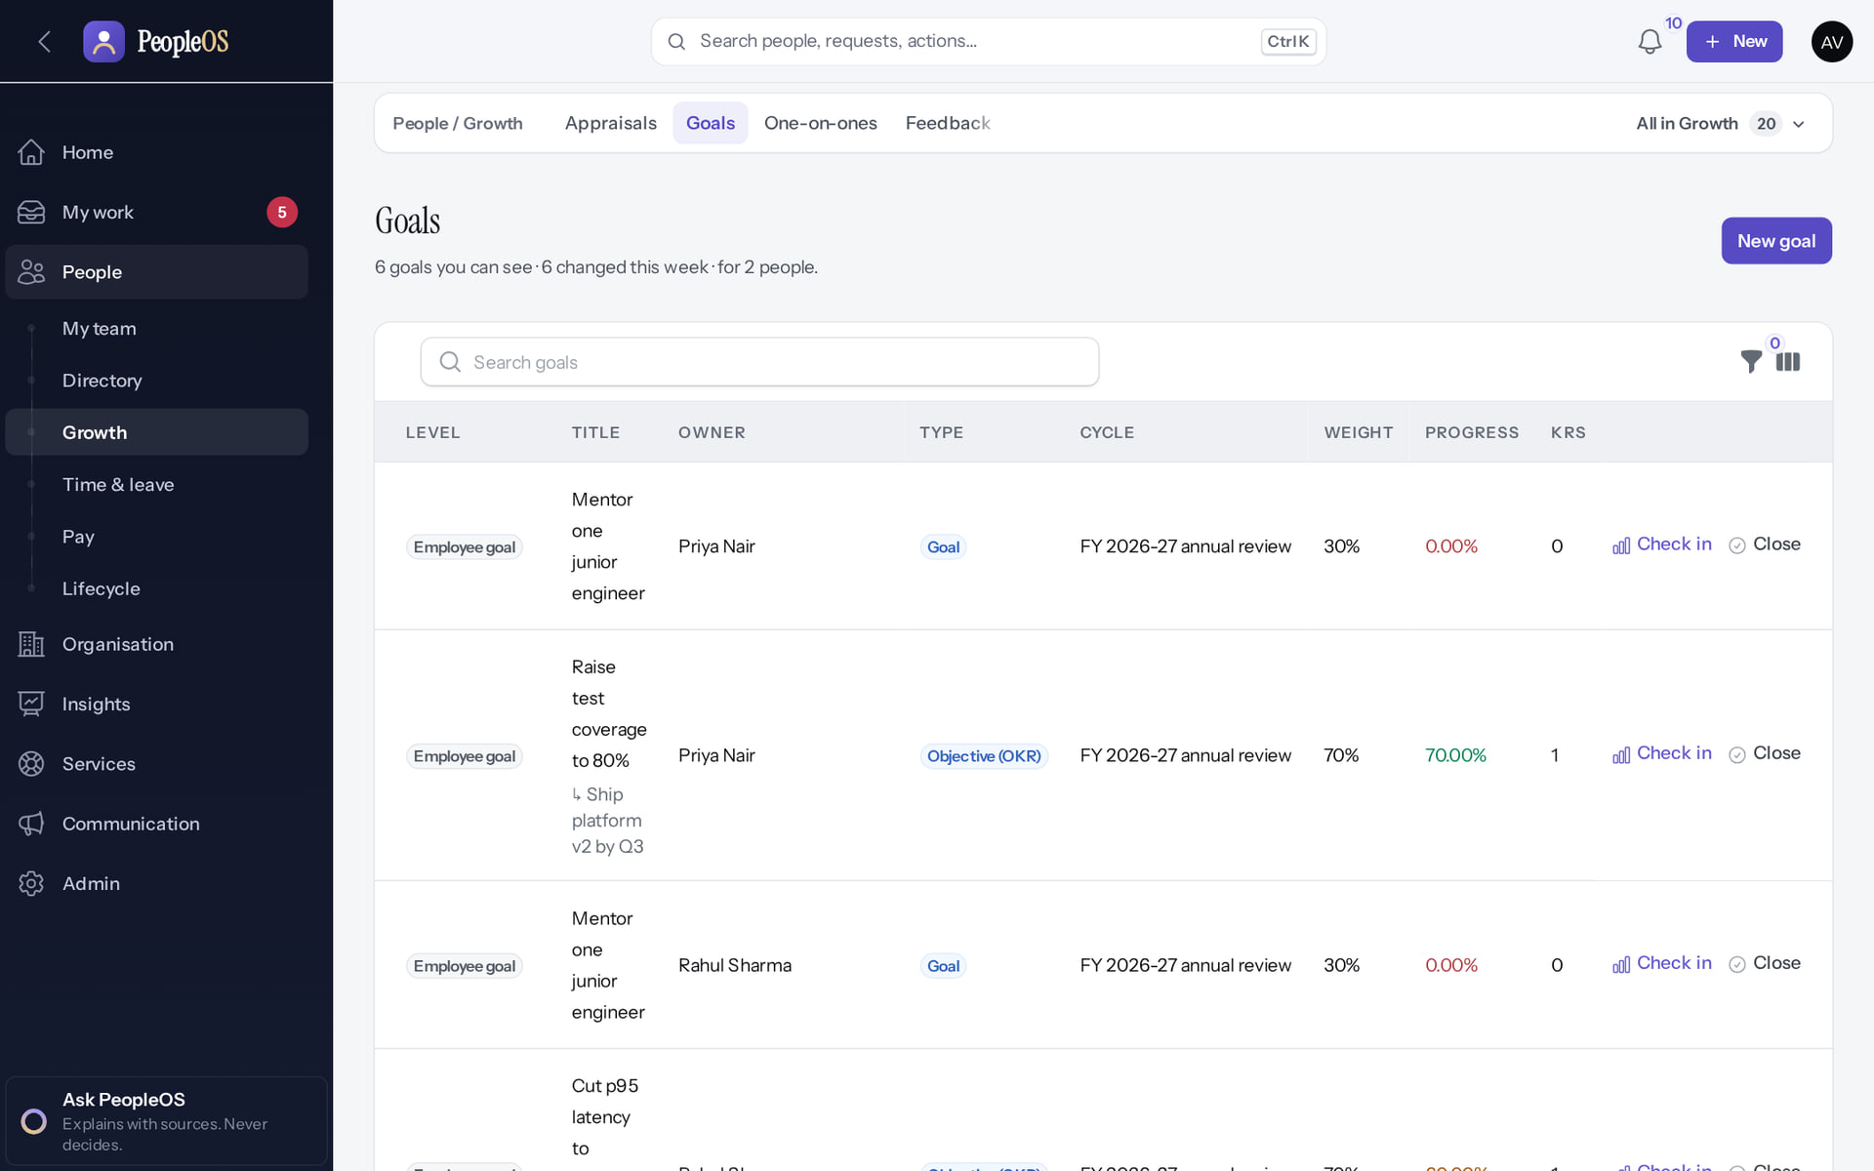
Team goals
PERFORMANCE
Verified in the running application
A team member's goal.
RESULT Progress linked to the department goal (Priya's goal at 70% after her check-in).
Real screen · Amit Verma (Manager + Employee) · People › Growth › Goals (manager)
Notes:
SAY: Progress linked to the department goal (Priya's goal at 70% after her check-in).
ON SCREEN: Open Goals.
WALK THROUGH: (1) A team member's goal.
LEARNERS SHOULD SEE: The team’s goals and their progress, linked to the department goal
SCREEN: People › Growth › Goals (manager). Signed in as Amit Verma (Manager + Employee).
EVIDENCE: screenshot screenshots/manager/40-team-11-team-goals.png, captured 2026-10-21 on the disposable training database (fictional people).

Slide 26
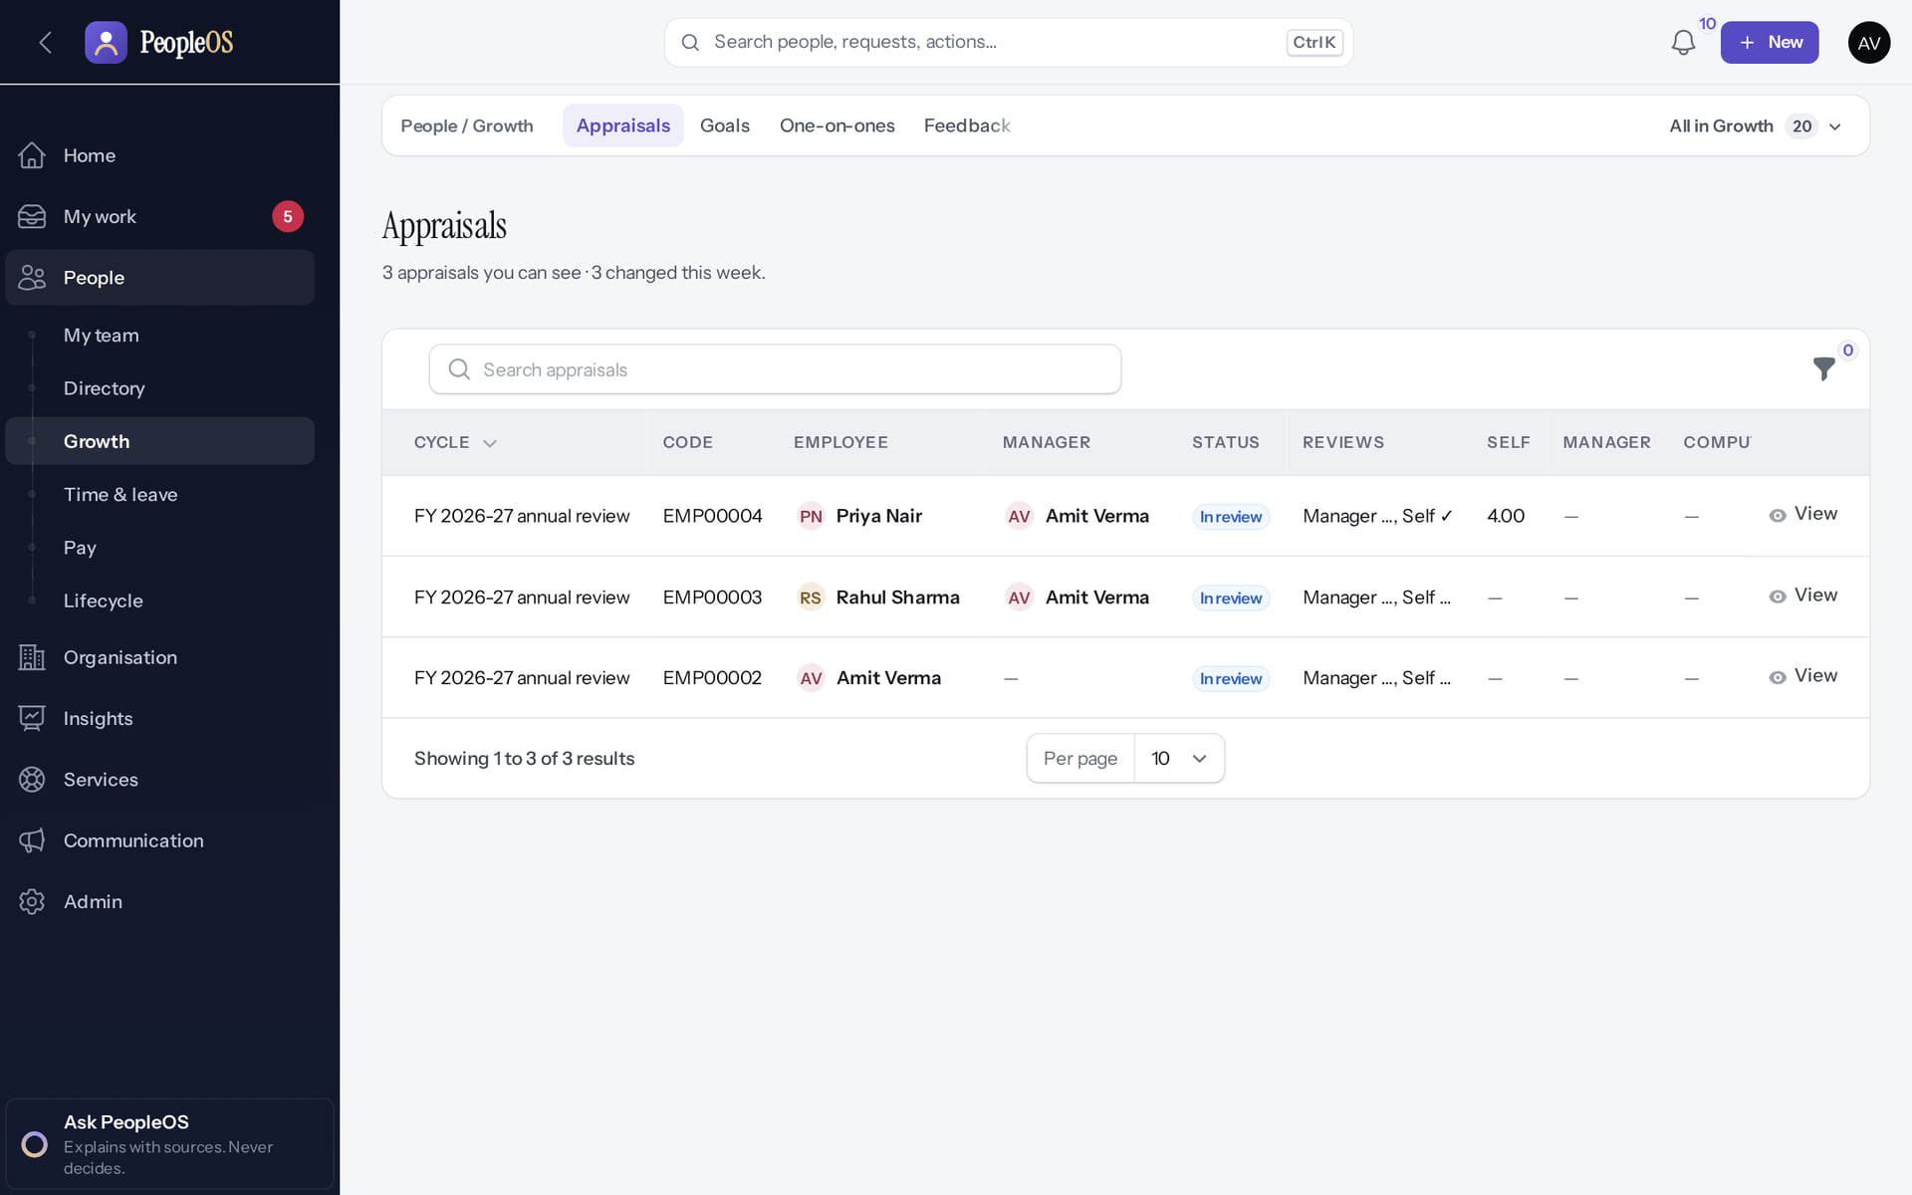
Team appraisals
PERFORMANCE
Verified in the running application
Priya's appraisal.
RESULT The manager review opens once the self review is in and HR opens the stage.
Real screen · Amit Verma (Manager + Employee) · People › Growth › Appraisals (manager)
Notes:
SAY: The manager review opens once the self review is in and HR opens the stage.
ON SCREEN: Open Appraisals.
WALK THROUGH: (1) Priya's appraisal.
LEARNERS SHOULD SEE: Team appraisals with their stage; the manager review opens once the self review is in
SCREEN: People › Growth › Appraisals (manager). Signed in as Amit Verma (Manager + Employee).
EVIDENCE: screenshot screenshots/manager/40-team-12-team-appraisals.png, captured 2026-10-21 on the disposable training database (fictional people).

Slide 27
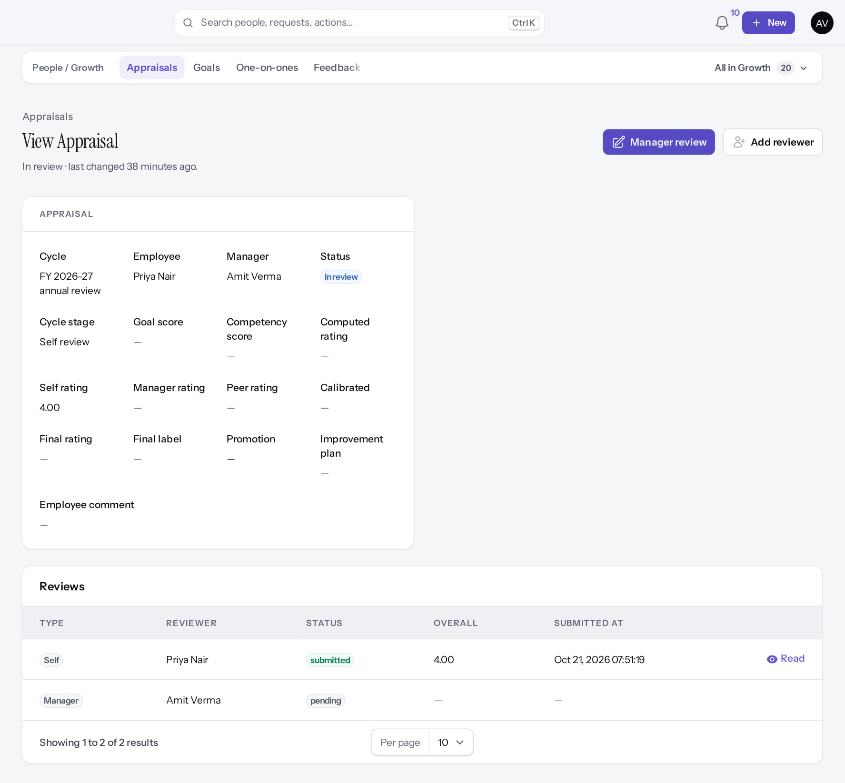
Read the self review
PERFORMANCE
Verified in the running application
1
2
1
Manager review.
2
Add reviewer (peer).
3
Self review (submitted).
3
Real screen (cropped) · Amit Verma (Manager + Employee) · Appraisals › Priya Nair (as manager)
Notes:
SAY: Self review submitted; Manager review and Add reviewer (peer) are available
ON SCREEN: Open the team member’s appraisal after the self review is submitted.
WALK THROUGH: (1) Manager review. (2) Add reviewer (peer). (3) Self review (submitted).
LEARNERS SHOULD SEE: Self review submitted; Manager review and Add reviewer (peer) are available
SCREEN: Appraisals › Priya Nair (as manager). Signed in as Amit Verma (Manager + Employee).
EVIDENCE: screenshot screenshots/manager/40-team-23-appraisal-manager-view.png, captured 2026-10-21 on the disposable training database (fictional people).

Slide 28
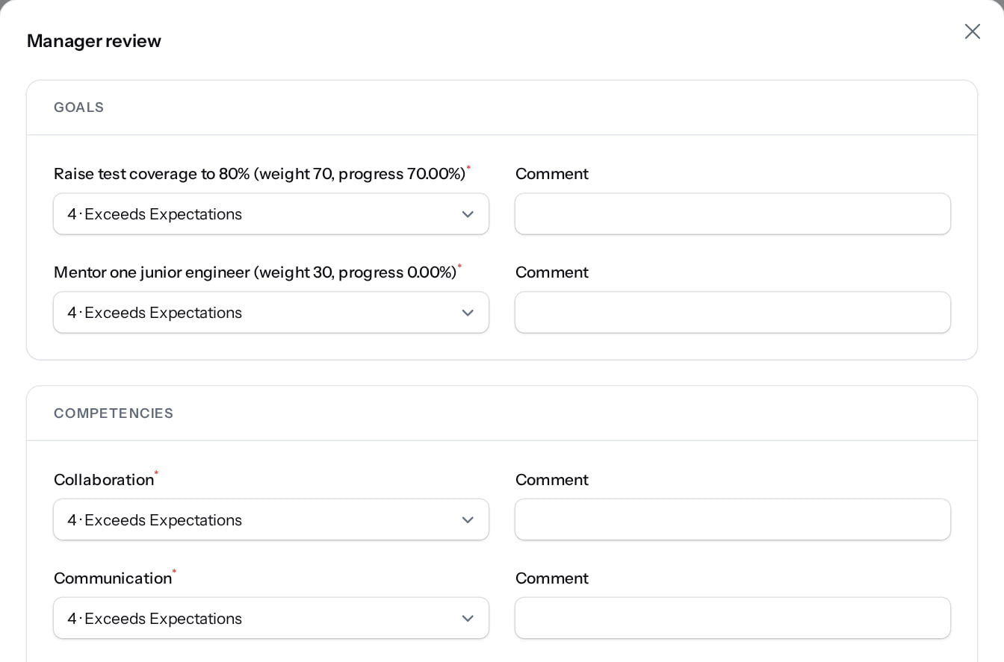
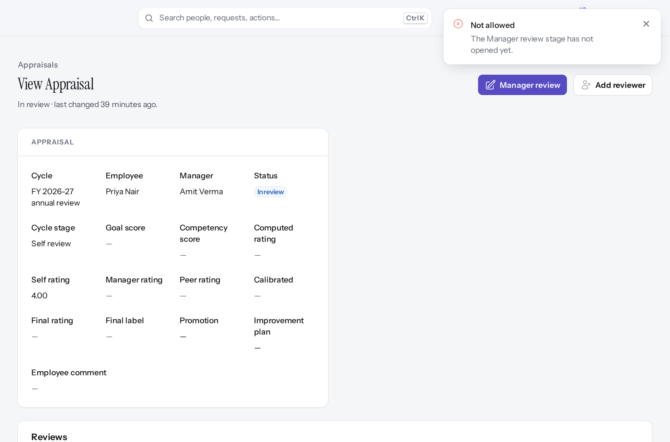
Manager review: wait for the stage
PERFORMANCE
Manager review form
Verified
Refused
After configuration
Goals, overall rating, comments. The button is offered before the stage opens.
"Not allowed: The Manager review stage has not opened yet." HR must advance the cycle; stages do not advance by date (F21).
Real screen (cropped) · Amit Verma (Manager + Employee) · Appraisal › Manager review (dialog)
Real screen (cropped) · Amit Verma (Manager + Employee) · Appraisal (manager review refused)
Notes:
SAY: Manager review: wait for the stage.
LEFT, Manager review form: Goals, overall rating, comments. The button is offered before the stage opens.
RIGHT, Refused: "Not allowed: The Manager review stage has not opened yet." HR must advance the cycle; stages do not advance by date (F21).
OBSERVE: point out what differs between the two screens.
EVIDENCE: left = manager/40-team-24-manager-review-form [Amit Verma (Manager + Employee), Appraisal › Manager review (dialog)]; right = manager/40-team-25-manager-review-stage-closed [Amit Verma (Manager + Employee), Appraisal (manager review refused)]. Real screens, fictional data (SCREENSHOT-INVENTORY.md).

Slide 29
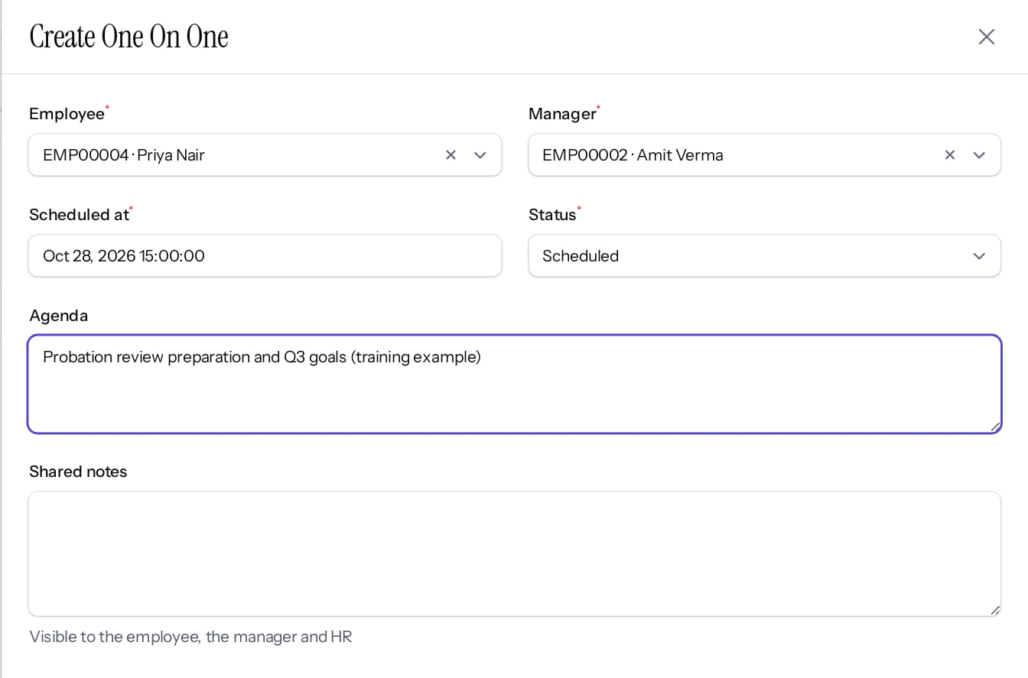
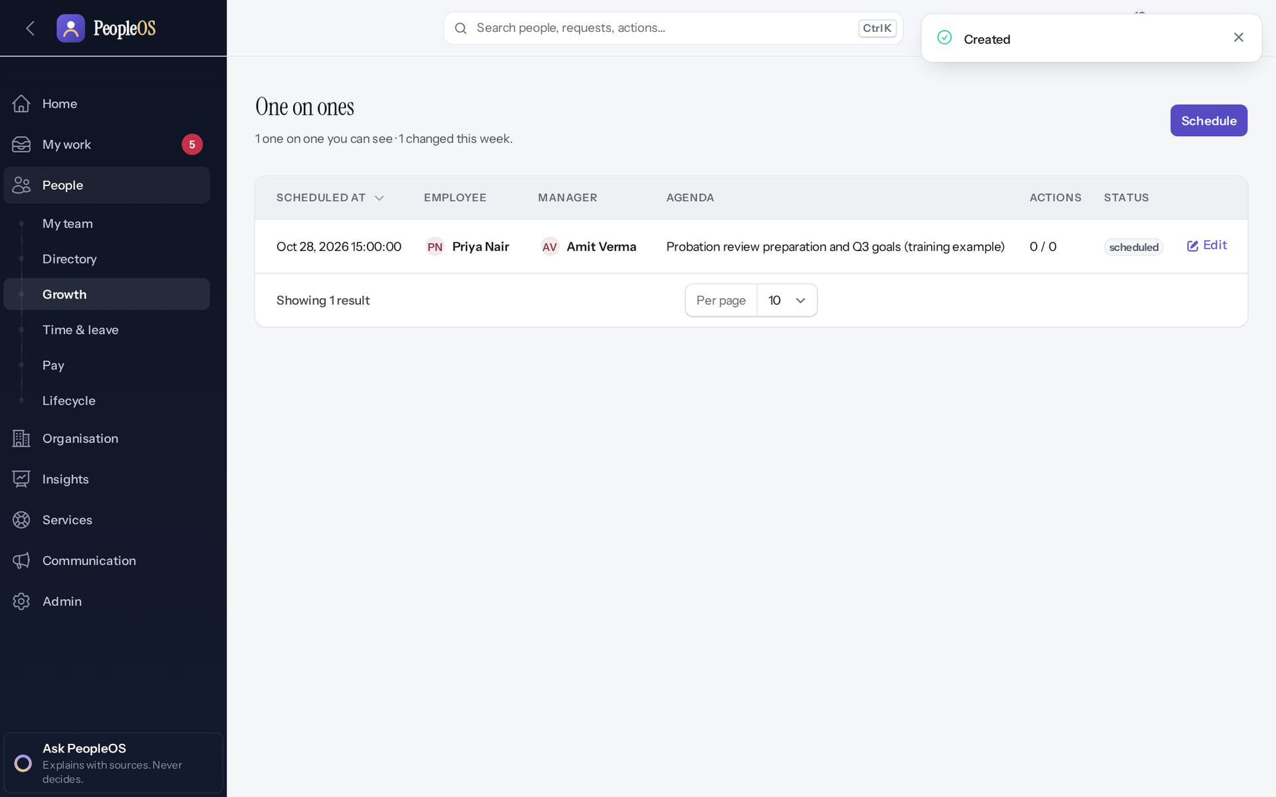
One-on-ones
PERFORMANCE
Schedule
Verified
Scheduled
Verified
When and agenda; notes and action items are added on the meeting.
"Created": 28 Oct, 15:00, with Priya.
Real screen (cropped) · Amit Verma (Manager + Employee) · One-on-ones › Schedule (dialog)
Real screen · Amit Verma (Manager + Employee) · People › Growth › One-on-ones
Notes:
SAY: One-on-ones.
LEFT, Schedule: When and agenda; notes and action items are added on the meeting.
RIGHT, Scheduled: "Created": 28 Oct, 15:00, with Priya.
OBSERVE: point out what differs between the two screens.
EVIDENCE: left = manager/40-team-13-schedule-one-on-one [Amit Verma (Manager + Employee), One-on-ones › Schedule (dialog)]; right = manager/40-team-14-one-on-one-scheduled [Amit Verma (Manager + Employee), People › Growth › One-on-ones]. Real screens, fictional data (SCREENSHOT-INVENTORY.md).

Slide 30
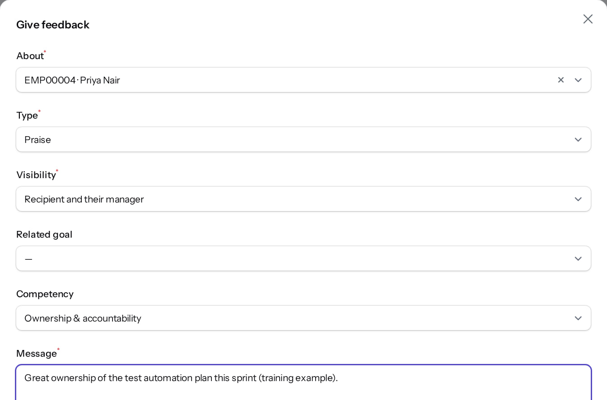
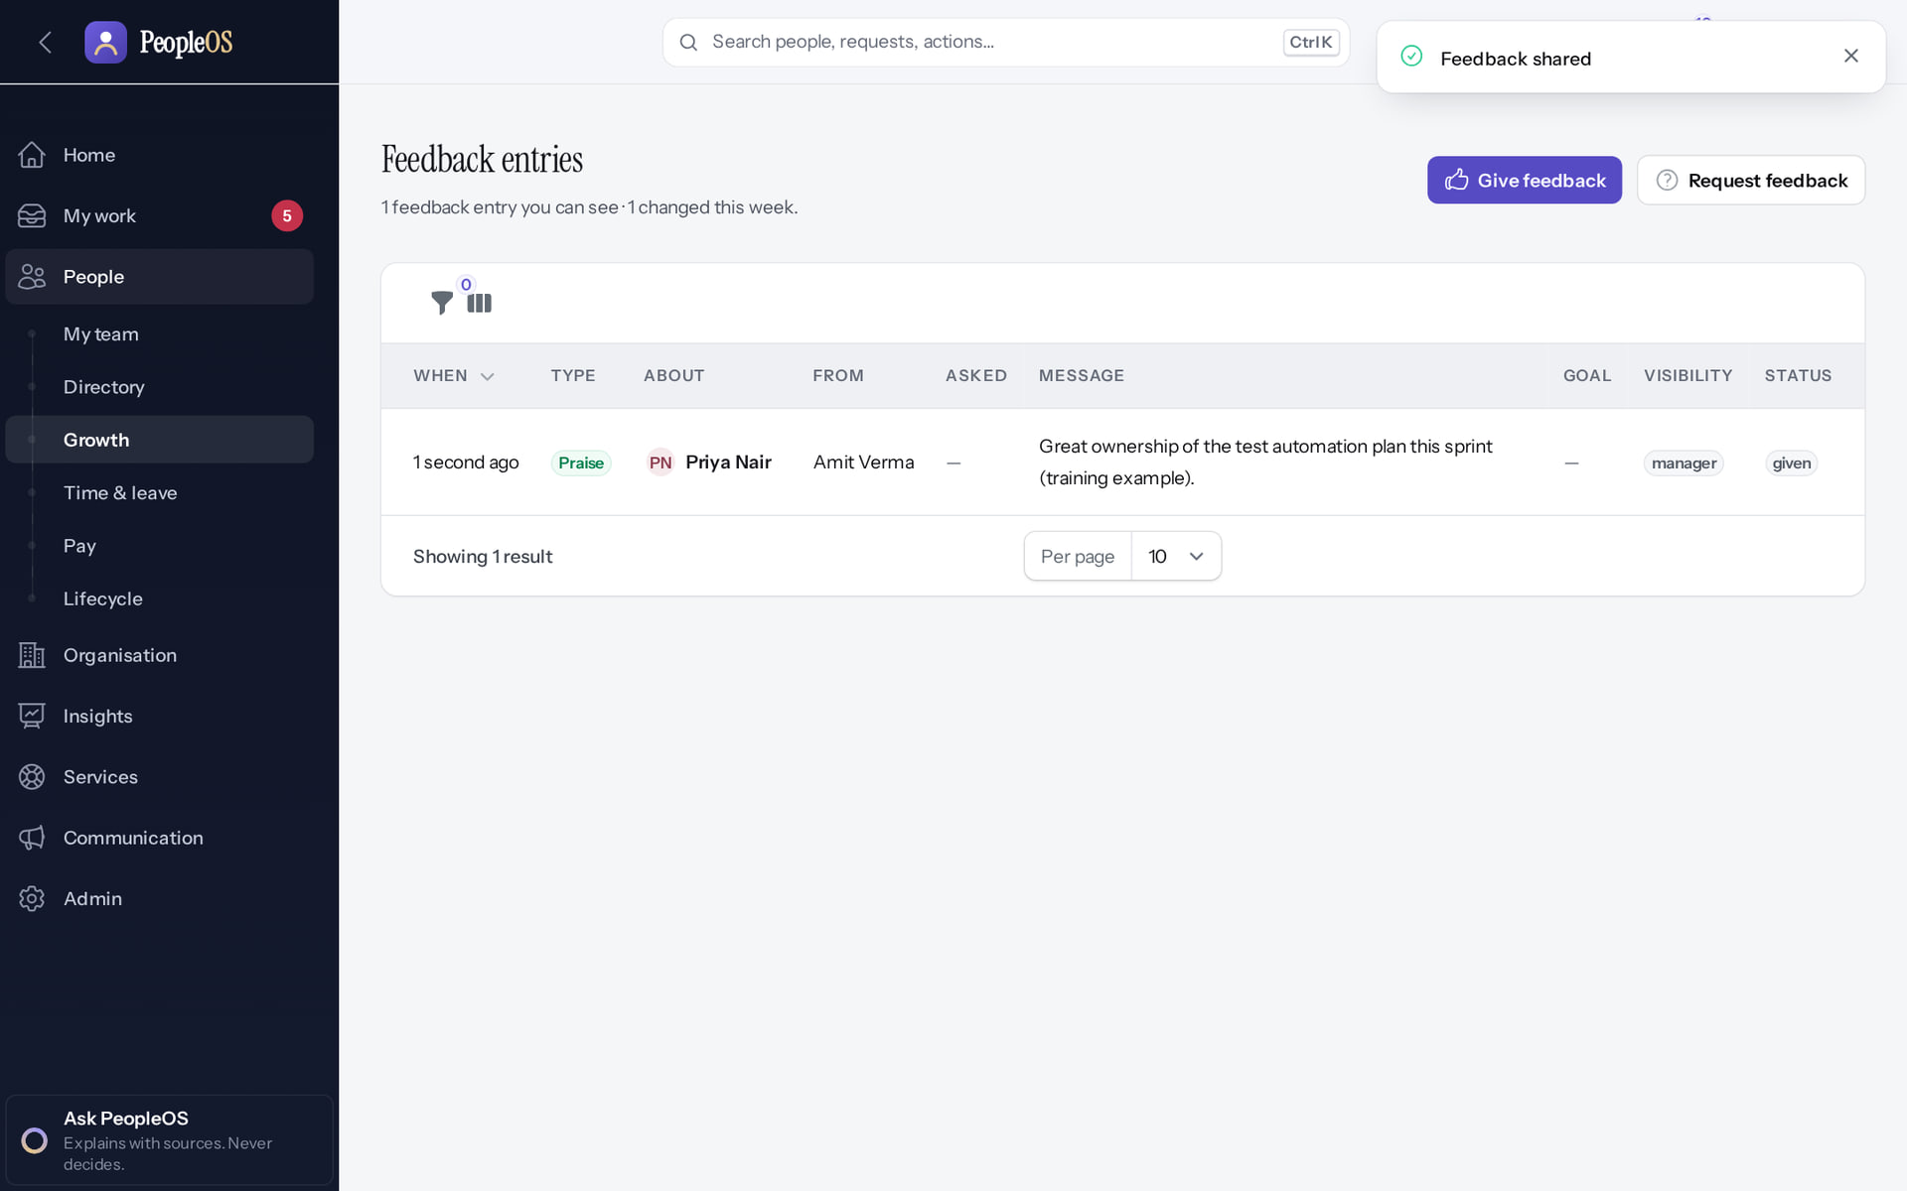
Give feedback
PERFORMANCE
Give feedback
Verified
Shared
Verified
Type, visibility, message.
"Feedback shared"; Priya is notified.
Real screen (cropped) · Amit Verma (Manager + Employee) · Feedback › Give feedback (dialog)
Real screen · Amit Verma (Manager + Employee) · People › Growth › Feedback
Notes:
SAY: Give feedback.
LEFT, Give feedback: Type, visibility, message.
RIGHT, Shared: "Feedback shared"; Priya is notified.
OBSERVE: point out what differs between the two screens.
EVIDENCE: left = manager/40-team-15-give-feedback [Amit Verma (Manager + Employee), Feedback › Give feedback (dialog)]; right = manager/40-team-16-feedback-given [Amit Verma (Manager + Employee), People › Growth › Feedback]. Real screens, fictional data (SCREENSHOT-INVENTORY.md).

Slide 31
Development and support
05
Learning, career, HR requests, onboarding tasks and insights.
Notes:
TRANSITION: Section 5, Development and support. Learning, career, HR requests, onboarding tasks and insights.
SAY: Tell learners what they will be able to do by the end of this section, then move on.
ASK: "What questions do you have before we start this section?"

Slide 32
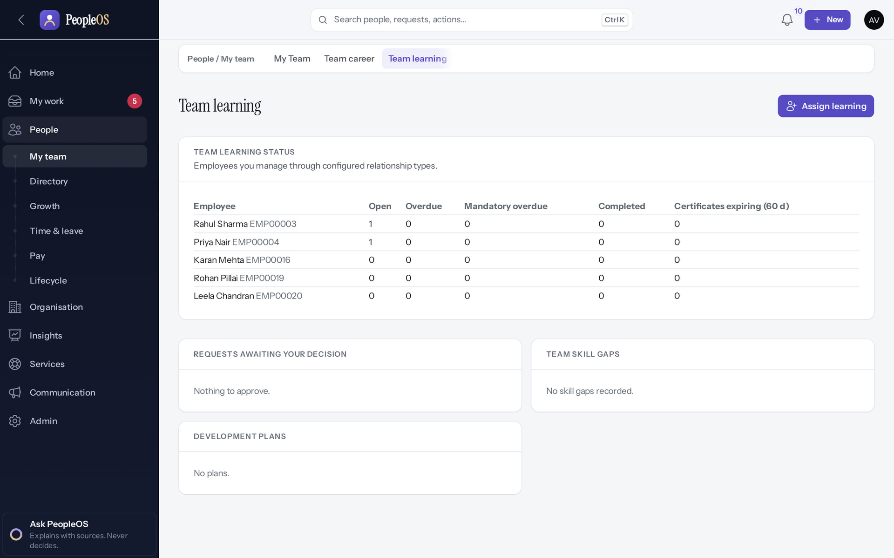
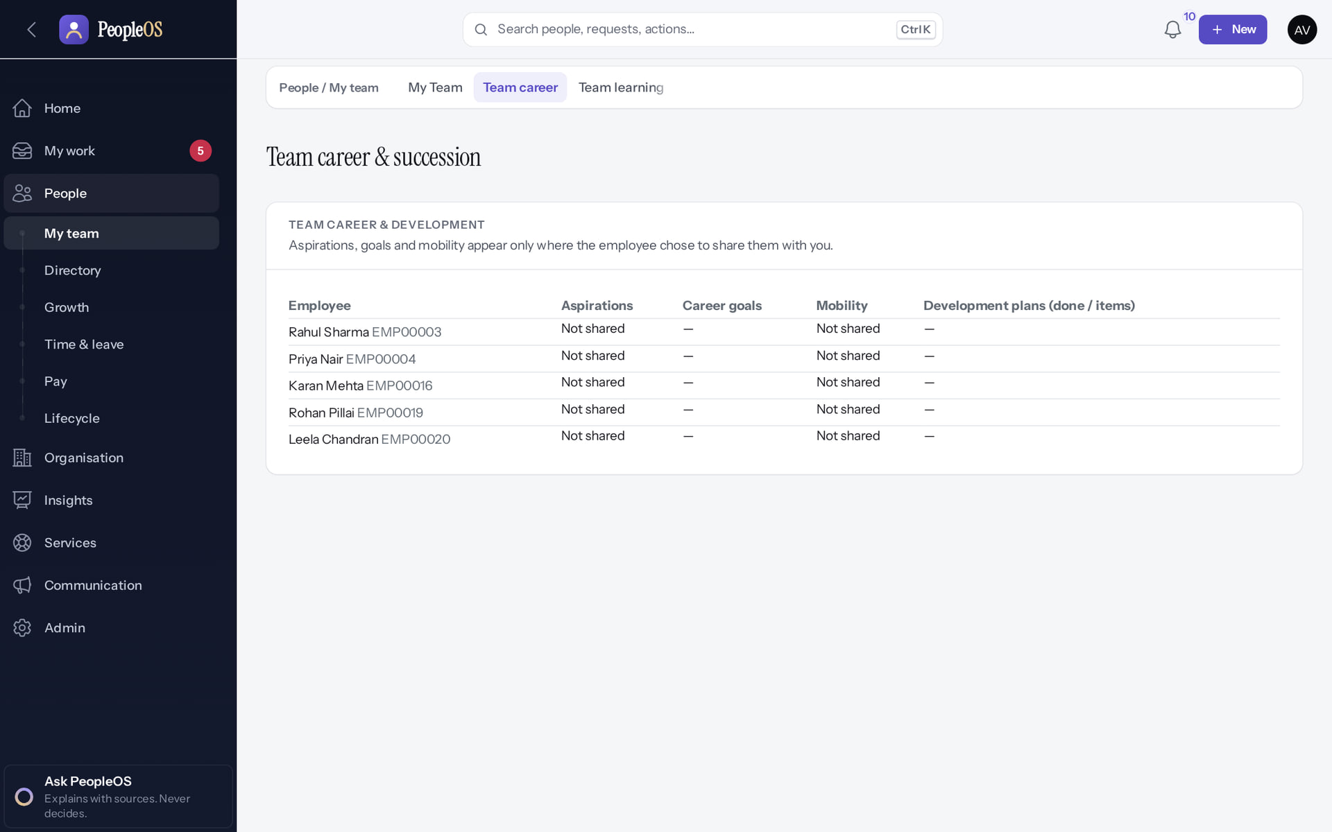
Team learning and career
DEVELOPMENT
Team learning
Verified
Team career
Verified
Status, requests to decide, skill gaps; Assign learning.
What each person chose to share about aspirations.
Real screen · Amit Verma (Manager + Employee) · People › My team › Team learning
Real screen · Amit Verma (Manager + Employee) · People › My team › Team career
Notes:
SAY: Team learning and career.
LEFT, Team learning: Status, requests to decide, skill gaps; Assign learning.
RIGHT, Team career: What each person chose to share about aspirations.
OBSERVE: point out what differs between the two screens.
EVIDENCE: left = manager/40-team-17-team-learning [Amit Verma (Manager + Employee), People › My team › Team learning]; right = manager/40-team-18-team-career [Amit Verma (Manager + Employee), People › My team › Team career]. Real screens, fictional data (SCREENSHOT-INVENTORY.md).

Slide 33
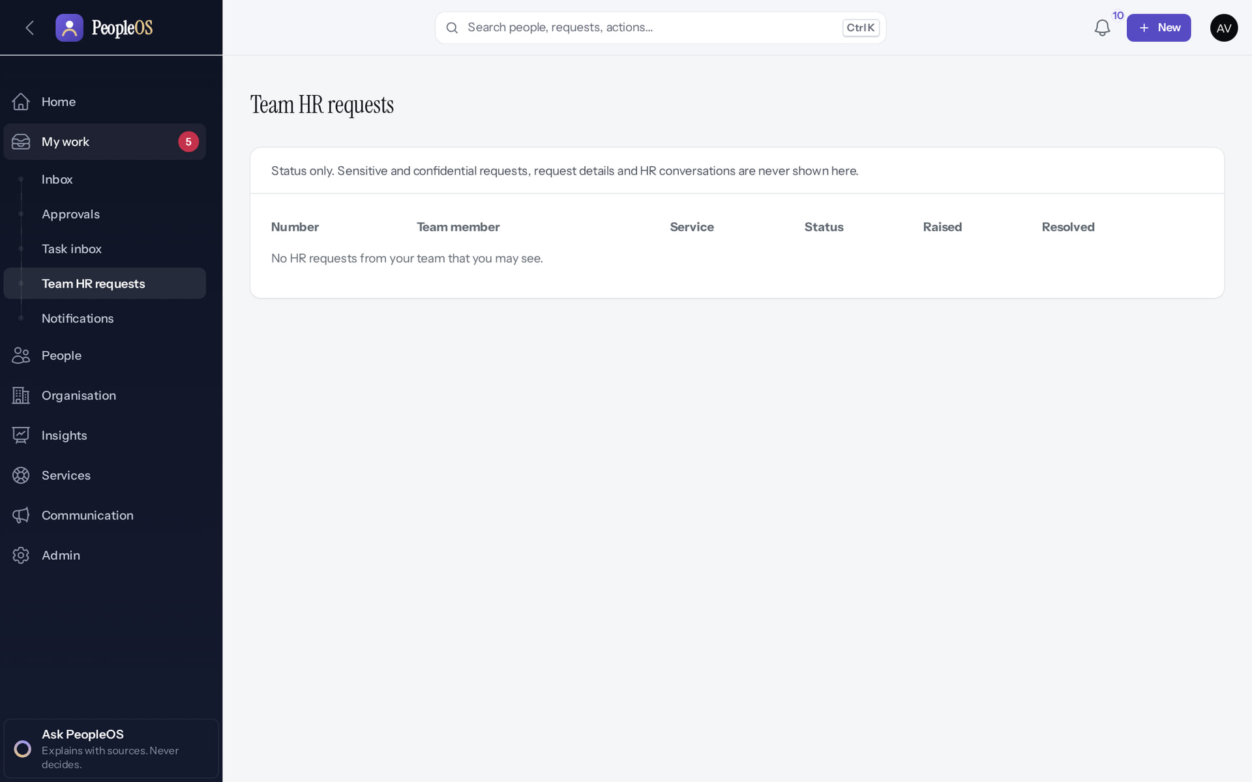
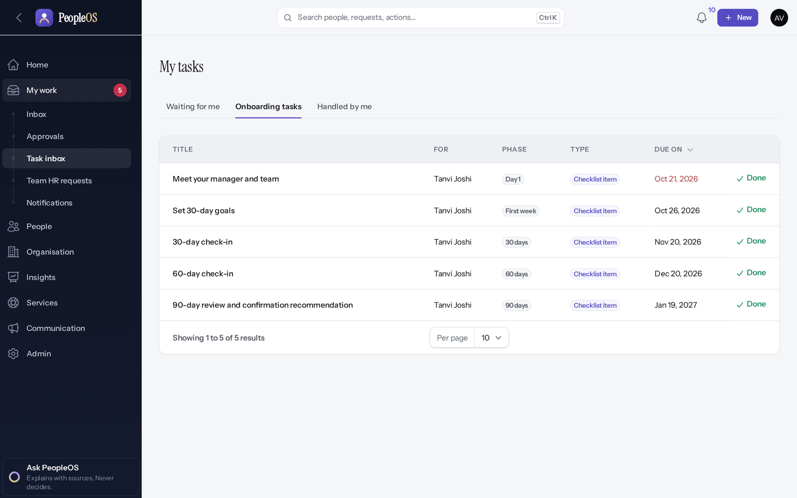
HR requests and tasks
DEVELOPMENT
Team HR requests
Unable to verify
Onboarding tasks
Verified
Empty at capture although Priya had an open request; which requests appear here was not verified. Confidential cases are never shown.
Tasks for a new joiner in your team (Tanvi Joshi), with Done (and Skip where allowed).
Real screen · Amit Verma (Manager + Employee) · My work › Team HR requests
Real screen · Amit Verma (Manager + Employee) · My work › Task inbox › Onboarding tasks
Notes:
SAY: HR requests and tasks.
LEFT, Team HR requests: Empty at capture although Priya had an open request; which requests appear here was not verified. Confidential cases are never shown.
RIGHT, Onboarding tasks: Tasks for a new joiner in your team (Tanvi Joshi), with Done (and Skip where allowed).
OBSERVE: point out what differs between the two screens.
EVIDENCE: left = manager/40-team-19-team-hr-requests [Amit Verma (Manager + Employee), My work › Team HR requests]; right = manager/40-team-26-onboarding-tasks [Amit Verma (Manager + Employee), My work › Task inbox › Onboarding tasks]. Real screens, fictional data (SCREENSHOT-INVENTORY.md).

Slide 34
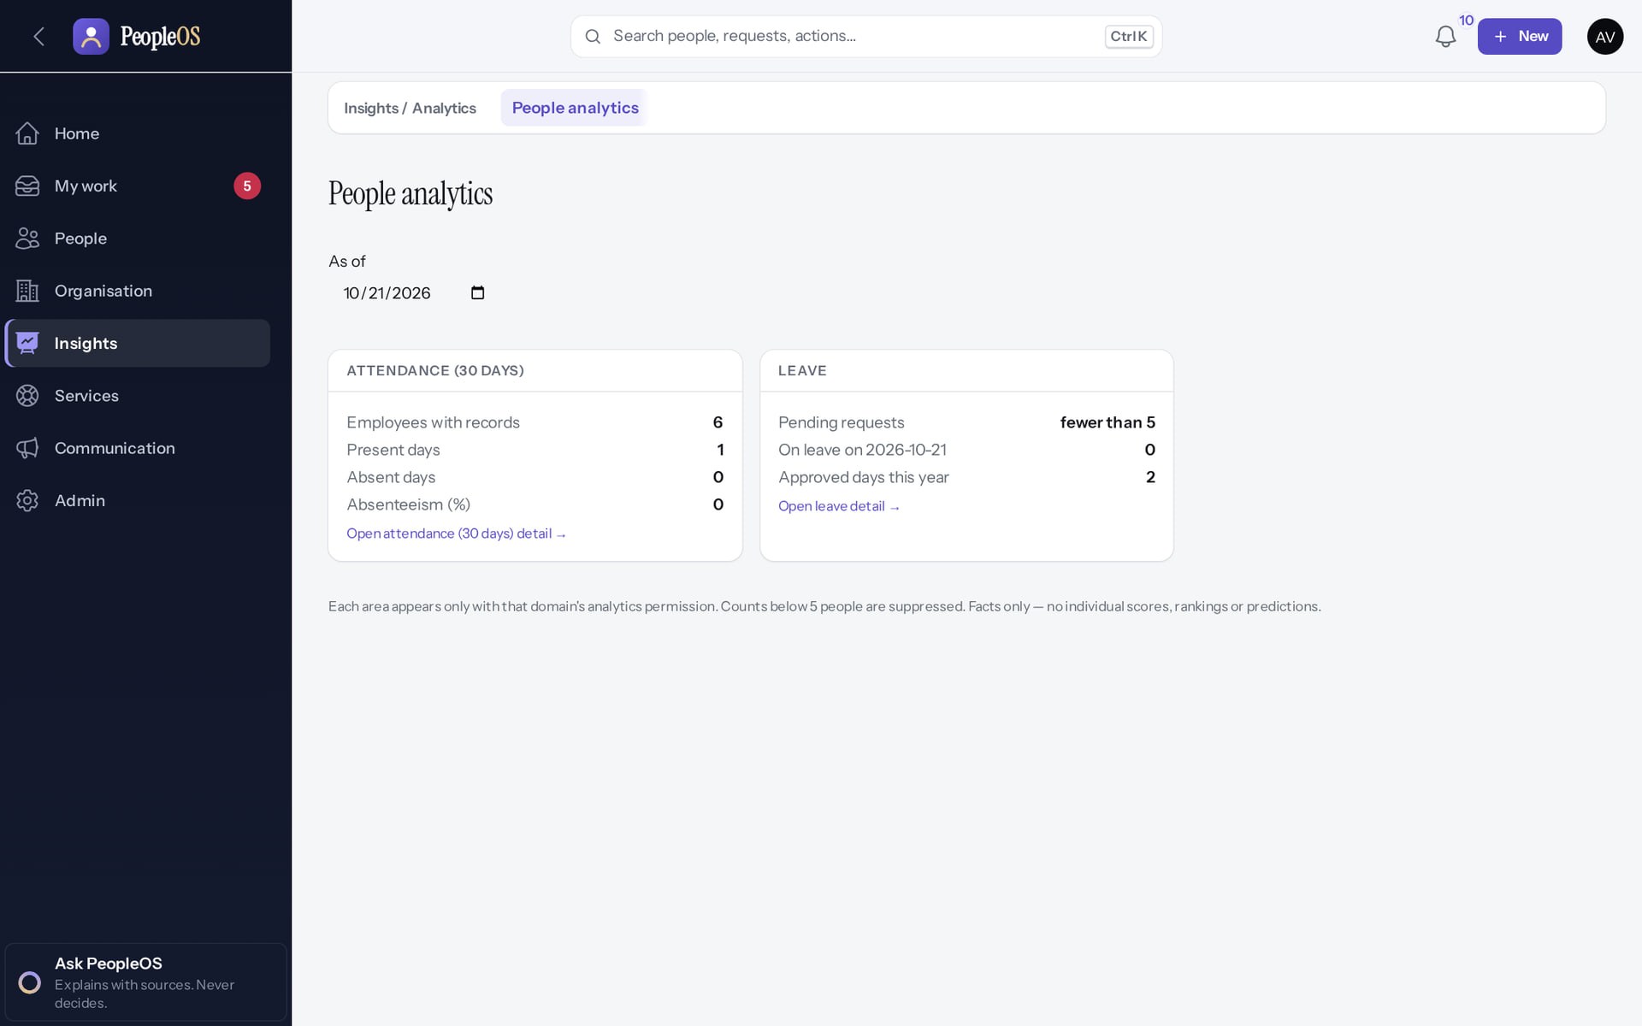
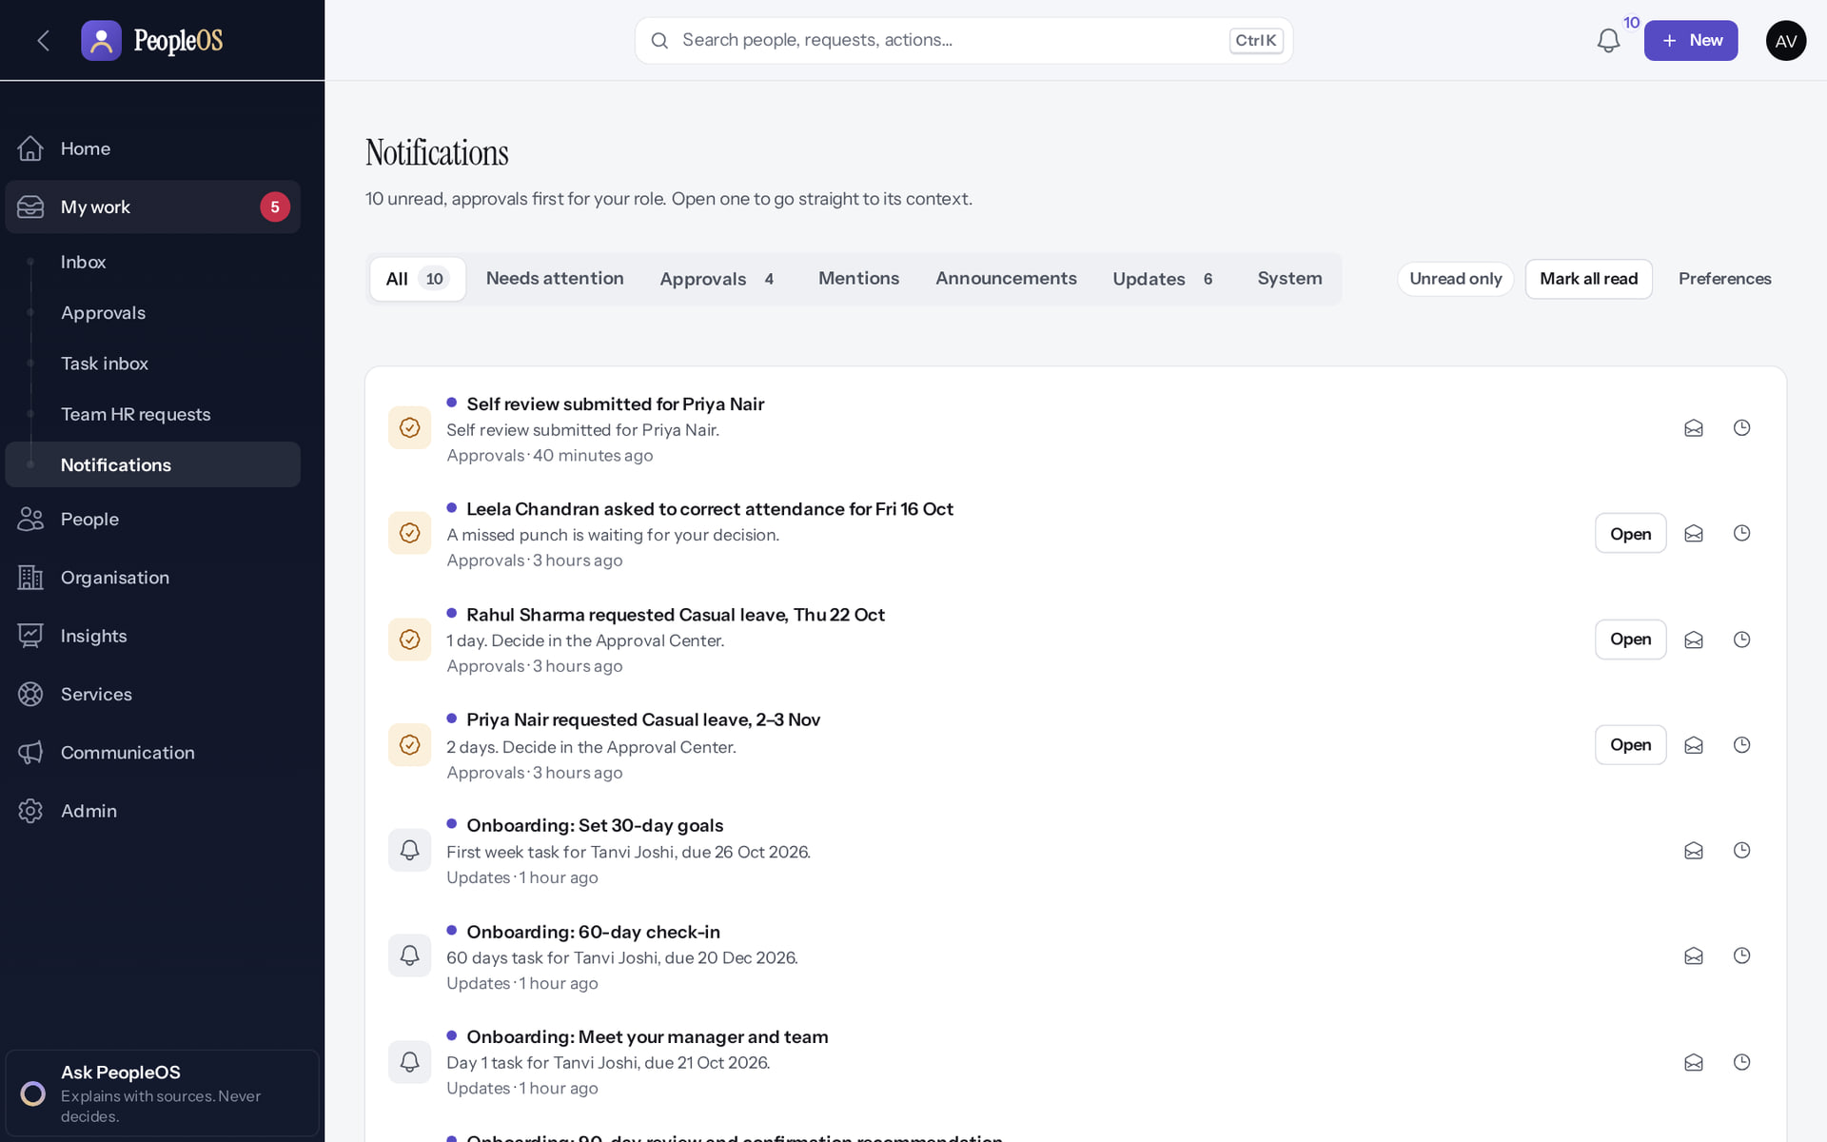
Team insights and notifications
DEVELOPMENT
People analytics
Verified
Notifications
Verified
Attendance and leave for people in your scope only; small groups hidden.
Approvals and team updates, grouped.
Real screen · Amit Verma (Manager + Employee) · Insights › People analytics (manager scope)
Real screen · Amit Verma (Manager + Employee) · My work › Notifications (manager)
Notes:
SAY: Team insights and notifications.
LEFT, People analytics: Attendance and leave for people in your scope only; small groups hidden.
RIGHT, Notifications: Approvals and team updates, grouped.
OBSERVE: point out what differs between the two screens.
EVIDENCE: left = manager/40-team-22-people-analytics [Amit Verma (Manager + Employee), Insights › People analytics (manager scope)]; right = manager/40-team-21-notifications [Amit Verma (Manager + Employee), My work › Notifications (manager)]. Real screens, fictional data (SCREENSHOT-INVENTORY.md).

Slide 35
Common mistakes
TIPS
Approving without reading
Vague rejection reasons
Expecting to edit records
A and R only open the confirm box. Read reason, overlap and balance first.
The employee sees your reason. Say what to do next.
Managers view; HR edits. Raise team requests from My work › Team HR requests.
Missing a request
Manager review refused
Sharing screenshots
If a request goes elsewhere, the reporting line may be wrong: ask HR to check it.
The stage is not open yet; HR advances the cycle.
Do not share team members' personal details outside PeopleOS.
Notes:
SAY: Common mistakes.
- Approving without reading: A and R only open the confirm box. Read reason, overlap and balance first.
- Vague rejection reasons: The employee sees your reason. Say what to do next.
- Expecting to edit records: Managers view; HR edits. Raise team requests from My work › Team HR requests.
- Missing a request: If a request goes elsewhere, the reporting line may be wrong: ask HR to check it.
- Manager review refused: The stage is not open yet; HR advances the cycle.
- Sharing screenshots: Do not share team members' personal details outside PeopleOS.
ASK: "Which of these points needs more explanation for your team?"

Slide 36
Practice (practice tenant only)
PRACTICE
Open the Approval Center. Which request is most urgent, and why?
1
Reject a test request without a reason. What happens? Then reject it properly.
2
Open a person outside your team from a link. What do you see?
3
Schedule a one-on-one with a team member for next week.
4
Answer key: on the next slide, and in the speaker notes.
Notes:
RUN: give learners about 10 minutes in a practice tenant (never a live one). Walk around and help.
SUCCESS: each learner can show the result on screen.
ANSWERS: (1) Top of Urgent; the card says why (starts within a day or overdue). (2) "Please fill out this field."; with a reason, "Leave rejected". (3) "We could not find that". (4) People › Growth › One-on-ones › Schedule.

Slide 37
Answer key
PRACTICE
# | Answer
1 | The first item under Urgent; its card explains why (overdue, starting within a day, or flagged).
2 | The browser stops it ("Please fill out this field."). With a reason, "Leave rejected" and the employee sees your reason.
3 | "We could not find that" (404): records outside your reach are not revealed.
4 | People › Growth › One-on-ones › Schedule: date and time, agenda, Create.
Notes:
SAY: Answer key.
- 1 | The first item under Urgent; its card explains why (overdue, starting within a day, or flagged).
- 2 | The browser stops it ("Please fill out this field."). With a reason, "Leave rejected" and the employee sees your reason.
- 3 | "We could not find that" (404): records outside your reach are not revealed.
- 4 | People › Growth › One-on-ones › Schedule: date and time, agenda, Create.

Slide 38
Summary
Home and My work bring decisions to you, most urgent first.
Every decision card shows reason, overlap and balance; rejections need a reason.
You see your reports, not their pay; outside your team returns "not found".
Reviews follow the cycle stages HR opens.
NEXT STEPS & HELP
Ask PeopleOS (sidebar) explains with sources
Your HR partner for access or reporting-line changes
Deck 01: what your team sees
Release gate: NO-GO (10 of 14 gates blocked, re-verified 13 Oct 2026). Not yet generally available.
Notes:
SAY: Recap the key points:
- Home and My work bring decisions to you, most urgent first.
- Every decision card shows reason, overlap and balance; rejections need a reason.
- You see your reports, not their pay; outside your team returns "not found".
- Reviews follow the cycle stages HR opens.
POINT TO: Ask PeopleOS (sidebar) explains with sources; Your HR partner for access or reporting-line changes; Deck 01: what your team sees
ASK: "What will you do first in PeopleOS?" Collect questions you cannot answer and send them to the PeopleOS team.

