Slide 1
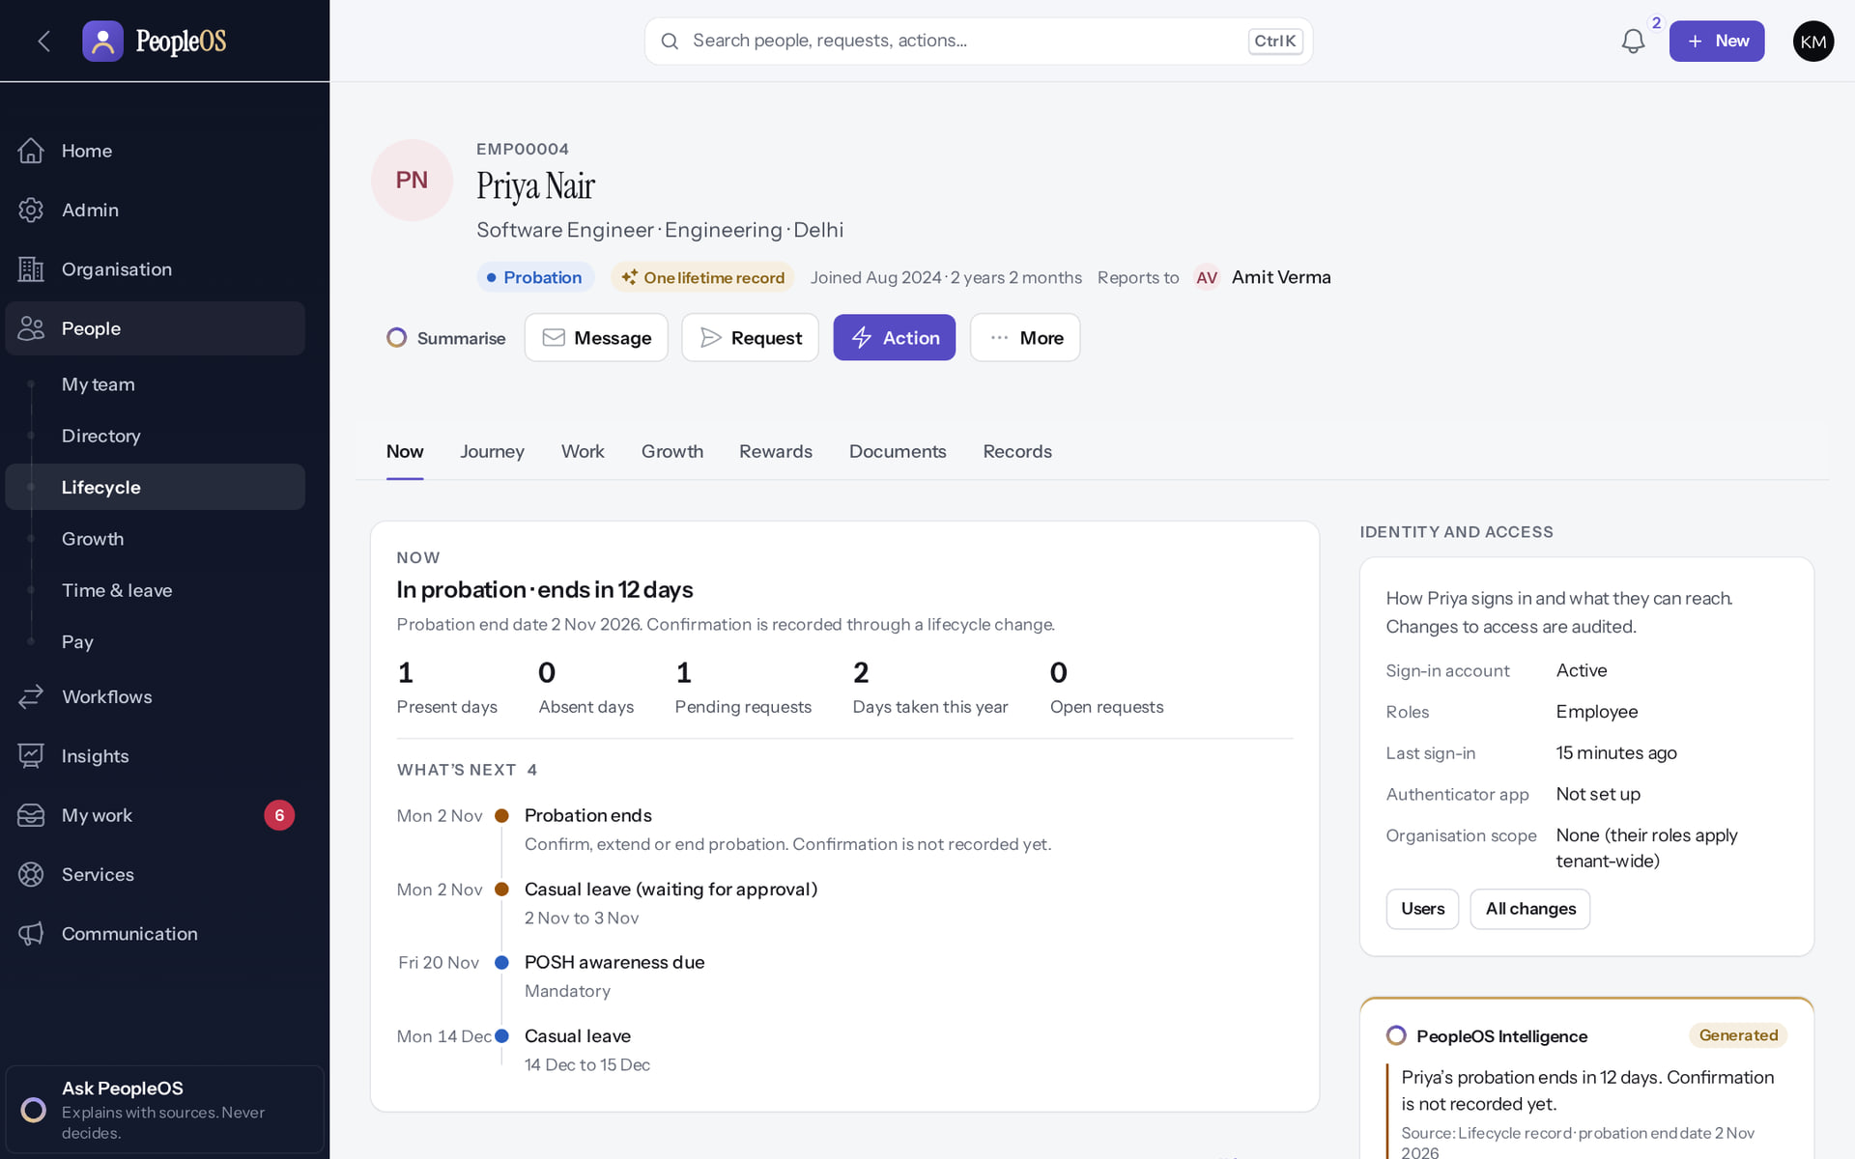
HR Administrator Training
MARKEDGE PEOPLEOS · TRAINING LIBRARY
Deck 03 of 12
Run people operations: records, hiring, changes, documents, time and leave, payroll inputs, growth, compensation, letters, requests, exits and audit.
For: HR administrators, HR managers and payroll administrators of a customer tenant
Built from the running application (local, disposable database, fictional people) · 21 October 2026
Real screen, fictional data
Notes:
SAY: This deck is for the people who run HR operations day to day. Every step was performed in a practice tenant with invented people.
EVIDENCE: Executed on the training database on 21 Oct 2026 as Kavya Menon (Tenant HR Admin), Neha Kapoor (HR Manager) and Arjun Bose (Payroll Admin), fictional people at the fictional Demo Group (tools/capture/20-, 50-, 55-, 60-, 62-, 65-, 70-, 75-).

Slide 2
How to read this deck
BEFORE YOU START
Verified in the running application
We ran it on the training database and captured each step.
1
Numbered markers on a screenshot match the numbered steps beside it.
Implemented · not verified end to end
The screen exists; the last steps need data or a second party we could not provide.
Every screenshot is a real capture of PeopleOS. The people and companies in it are fictional.
Available only after configuration
Works once an administrator or Markedge has set it up.
Disabled by safety or commercial gates
Switched off on purpose until owner decisions and approvals arrive.
Diagrams are marked "Conceptual diagram". They explain ideas; they are not screens.
Incomplete · known defect or gap
Partly working: a known defect or gap is stated on the slide.
Release gate: NO-GO (10 of 14 gates blocked, re-verified 13 Oct 2026). Not yet generally available.
Not implemented
Not in the product today.
Unable to verify
Could not be checked in this environment.
Notes:
Explain the seven status labels. Every screenshot slide carries one of them in its top-right corner. Stress that "Verified in the running application" means we ran it on a disposable demonstration database, not that the feature is released.

Slide 3
Release gate: NO-GO until these are resolved (1 of 2)
RELEASE STATUS
Status as written in the release gate document. Ten of fourteen gates are blocked by owner decisions, external parties or missing infrastructure.
# | Gate | Gate status | Remaining dependency
1 | Application and architecture integrity | PASS (workstation) | Repeat the full suites in staging
2 | Credential exposure and repository remediation | BLOCKED | Owner: rotation confirmation, repository visibility (O-1 to O-3)
3 | Authentication and operator MFA | BLOCKED | Operators enrol MFA in the target environment (O-14, O-7)
4 | Independent security review | BLOCKED | Engage a reviewer; triage and retest findings (O-4)
5 | Statutory verification and gratuity | BLOCKED | 0 of 24 rules verified; gratuity not implemented (O-5, O-12, O-18)
6 | Data protection, retention, legal holds | PASS (controls) / BLOCKED (policy) | Retention decisions with counsel (D8); privacy review
7 | Backup, restore and disaster recovery | BLOCKED | Recovery objectives and an isolated target (O-6, O-7)
Notes:
SOURCE: docs/saas/SaaS-Final-Release-Gate.md (decision NO-GO, re-verified 13 October 2026 at 7314f7d); owner actions in docs/saas/SaaS-Final-Owner-Action-Register.md.
SAY: The application passes its automated suites on the workstation, but release is blocked by decisions and infrastructure, not by code alone.
AVOID: describing any gate as resolved. Nothing in this training changes a gate.
SAY: Release gate: NO-GO until these are resolved (part 1 of 2). Status as written in the release gate document. Ten of fourteen gates are blocked by owner decisions, external parties or missing infrastructure.
- 1 | Application and architecture integrity | PASS (workstation) | Repeat the full suites in staging
- 2 | Credential exposure and repository remediation | BLOCKED | Owner: rotation confirmation, repository visibility (O-1 to O-3)
- 3 | Authentication and operator MFA | BLOCKED | Operators enrol MFA in the target environment (O-14, O-7)
- 4 | Independent security review | BLOCKED | Engage a reviewer; triage and retest findings (O-4)
- 5 | Statutory verification and gratuity | BLOCKED | 0 of 24 rules verified; gratuity not implemented (O-5, O-12, O-18)
- 6 | Data protection, retention, legal holds | PASS (controls) / BLOCKED (policy) | Retention decisions with counsel (D8); privacy review
- 7 | Backup, restore and disaster recovery | BLOCKED | Recovery objectives and an isolated target (O-6, O-7)

Slide 4
Release gate: NO-GO until these are resolved (2 of 2)
RELEASE STATUS
# | Gate | Gate status | Remaining dependency
8 | Hosting, monitoring and on-call | BLOCKED | Environment, alerting, on-call (O-7, O-10, O-11)
9 | Signup and tenant provisioning | PASS (disabled) / BLOCKED (activation) | Only if self-service signup is wanted at launch (D10)
10 | Billing, tax and payment controls | PASS (disabled) / BLOCKED (activation) | Only for paid billing (B-4, B-7, B-8, B-9)
11 | Tenant deletion and offboarding | PASS (disabled) / BLOCKED (activation) | Retention decisions, register disk, review (D8)
12 | Regression and target-environment testing | BLOCKED | A staging environment (O-7, O-8)
13 | Owner decisions and written approvals | BLOCKED | All owner action items
14 | Deployment, rollback, post-deployment checks | BLOCKED | Rehearse in staging; authorise (O-7 to O-9)
Notes:
SOURCE: docs/saas/SaaS-Final-Release-Gate.md (decision NO-GO, re-verified 13 October 2026 at 7314f7d); owner actions in docs/saas/SaaS-Final-Owner-Action-Register.md.
SAY: The application passes its automated suites on the workstation, but release is blocked by decisions and infrastructure, not by code alone.
AVOID: describing any gate as resolved. Nothing in this training changes a gate.
SAY: Release gate: NO-GO until these are resolved (part 2 of 2). Status as written in the release gate document. Ten of fourteen gates are blocked by owner decisions, external parties or missing infrastructure.
- 8 | Hosting, monitoring and on-call | BLOCKED | Environment, alerting, on-call (O-7, O-10, O-11)
- 9 | Signup and tenant provisioning | PASS (disabled) / BLOCKED (activation) | Only if self-service signup is wanted at launch (D10)
- 10 | Billing, tax and payment controls | PASS (disabled) / BLOCKED (activation) | Only for paid billing (B-4, B-7, B-8, B-9)
- 11 | Tenant deletion and offboarding | PASS (disabled) / BLOCKED (activation) | Retention decisions, register disk, review (D8)
- 12 | Regression and target-environment testing | BLOCKED | A staging environment (O-7, O-8)
- 13 | Owner decisions and written approvals | BLOCKED | All owner action items
- 14 | Deployment, rollback, post-deployment checks | BLOCKED | Rehearse in staging; authorise (O-7 to O-9)

Slide 5
What you will be able to do
LEARNING OBJECTIVES
Find and read any employee record
Directory, register, Employee 360
Administer attendance and leave
processing, balances, policies, known defects
1
4
Hire without duplicates; change jobs and managers
guided, effective-dated, audited
Prepare payroll and statutory inputs
and understand why finalising is blocked
2
5
Run onboarding and verify documents
with separation of duties
Handle growth, compensation, letters, requests and exits
and prove it in the audit trail
3
6
Notes:
SAY: HR administrators do not automatically see every field: sensitive data and some modules need specific permissions. When a menu is missing, it is usually the role, not a fault.

Slide 6
Who can do what in HR (system roles)
ROLES
Task | Tenant HR Admin | HR Manager | Payroll Admin
Hire, change job or manager, lifecycle state | Yes | Yes | No
Upload / verify documents | Yes / Yes (not own upload) | Yes / Yes (not own upload) | No
Process attendance, manual punches | Yes | No | No
Payroll runs, components, adjustments | Yes | View structures only | Yes
Statutory returns screens (EPF, ESI, PT, LWF, TDS) | Yes | No | No (F15)
Propose / review / approve / execute compensation | Propose, review, approve | Propose, review | Execute
Employee imports | Yes | No (page not available) | No
Edit role permissions | No (F5) | No | No
Notes:
SOURCE: config/peopleos.php role templates as summarised in docs/reports/feature-inventory.md and implementation-status.md; F5, F15 from documentation-gaps.md. Only a Tenant Super Admin edits role permissions. Customers can change role templates.
SAY: Who can do what in HR (system roles).
- Hire, change job or manager, lifecycle state | Yes | Yes | No
- Upload / verify documents | Yes / Yes (not own upload) | Yes / Yes (not own upload) | No
- Process attendance, manual punches | Yes | No | No
- Payroll runs, components, adjustments | Yes | View structures only | Yes
- Statutory returns screens (EPF, ESI, PT, LWF, TDS) | Yes | No | No (F15)
- Propose / review / approve / execute compensation | Propose, review, approve | Propose, review | Execute
- Employee imports | Yes | No (page not available) | No
- Edit role permissions | No (F5) | No | No

Slide 7
People records
01
Directory, register and the Employee 360: one lifetime record per person.
Notes:
TRANSITION: Section 1, People records. Directory, register and the Employee 360: one lifetime record per person.
SAY: Tell learners what they will be able to do by the end of this section, then move on.
ASK: "What questions do you have before we start this section?"

Slide 8
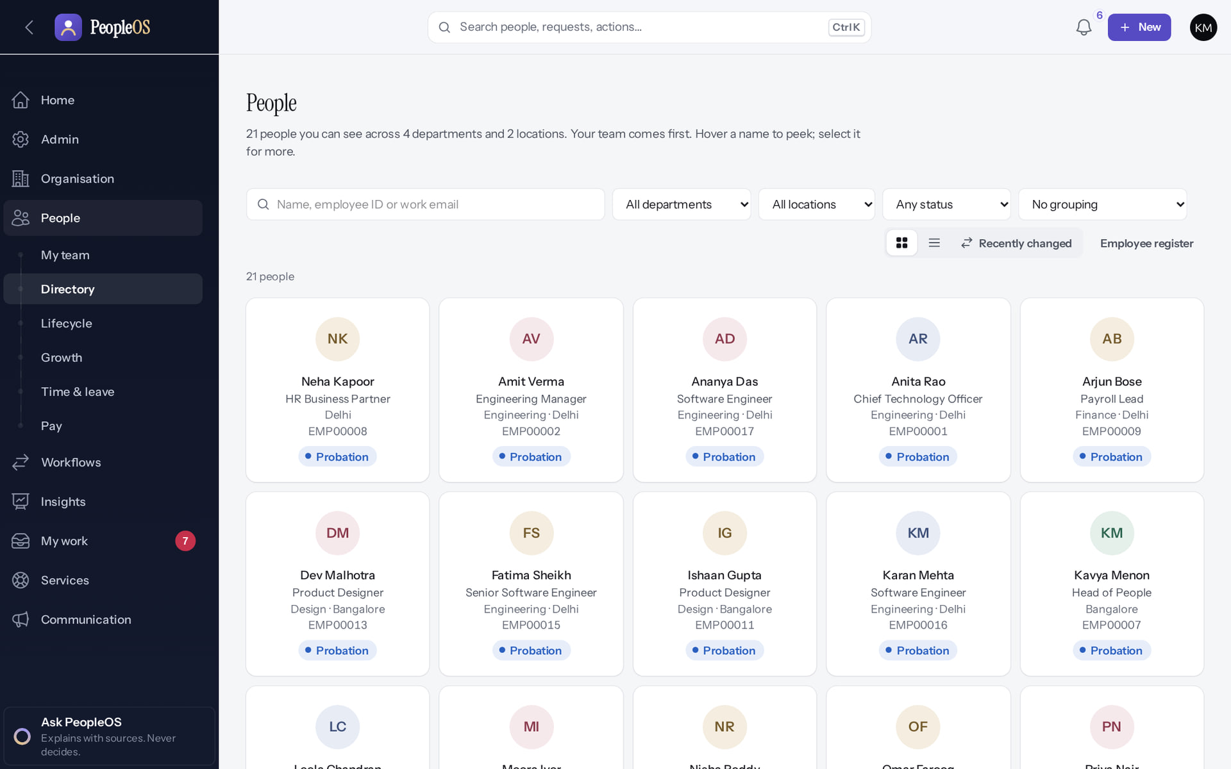
People Directory
PEOPLE RECORDS
Verified in the running application
1
Search.
2
2
Filters.
1
3
4
3
Cards / Table.
4
Employee register.
RESULT Everyone you may see, with department, location, status and grouping filters.
Real screen · Kavya Menon (Tenant HR Admin + Employee) · People › Directory (Cards)
Notes:
SAY: Everyone you may see, with department, location, status and grouping filters.
ON SCREEN: Open People › Directory.
WALK THROUGH: (1) Search. (2) Filters. (3) Cards / Table. (4) Employee register.
LEARNERS SHOULD SEE: Everyone the HR user can see, with search, department, location, status and grouping filters
SCREEN: People › Directory (Cards). Signed in as Kavya Menon (Tenant HR Admin + Employee). Prerequisite: employee.view (HR roles); scope applies.
EVIDENCE: screenshot screenshots/hr-admin/50-dir-01-directory-cards.png, captured 2026-10-21 on the disposable training database (fictional people).

Slide 9
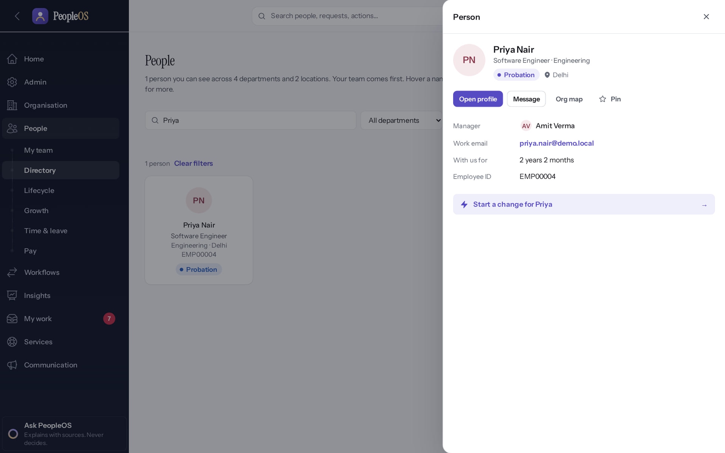
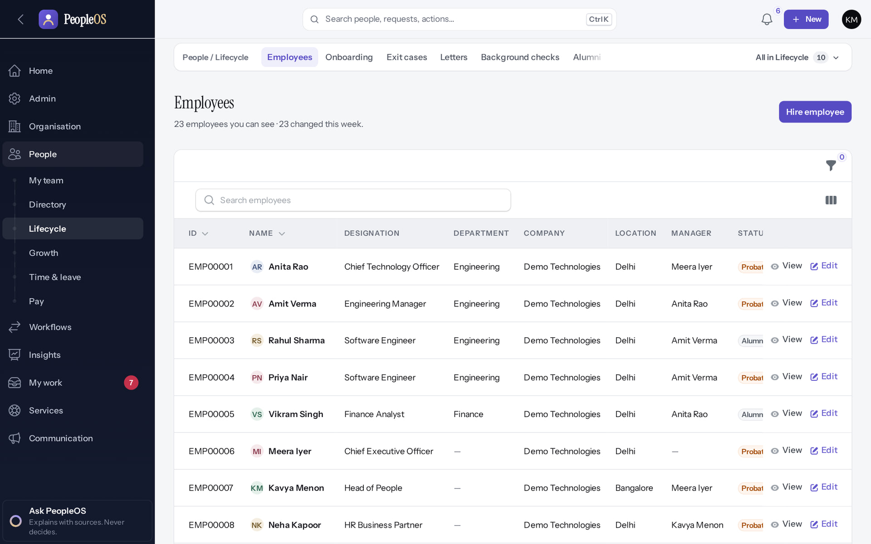
Preview and register
PEOPLE RECORDS
Person preview
Verified
Employees register
Verified
Role, manager and quick actions: Open profile, Message, Org map, Start a change.
Table with ID, designation, department, manager, status; Hire employee; View and Edit.
Real screen · Kavya Menon (Tenant HR Admin + Employee) · People › Directory › person preview
Real screen · Kavya Menon (Tenant HR Admin + Employee) · People › Lifecycle › Employees
Notes:
SAY: Preview and register.
LEFT, Person preview: Role, manager and quick actions: Open profile, Message, Org map, Start a change.
RIGHT, Employees register: Table with ID, designation, department, manager, status; Hire employee; View and Edit.
OBSERVE: point out what differs between the two screens.
EVIDENCE: left = hr-admin/50-dir-02-person-preview [Kavya Menon (Tenant HR Admin + Employee), People › Directory › person preview]; right = hr-admin/50-dir-03-employee-register [Kavya Menon (Tenant HR Admin + Employee), People › Lifecycle › Employees]. Real screens, fictional data (SCREENSHOT-INVENTORY.md).

Slide 10
Employee 360: the header and Now
EMPLOYEE 360
Verified in the running application
RESULT Status, tenure, manager; Summarise, Message, Request, Action and More; views Now, Journey, Work, Growth, Rewards, Documents and Records. Now shows what is next for the person.
Real screen · Kavya Menon (Tenant HR Admin + Employee) · Employee 360 › Now
Notes:
OBSERVE: Priya Nair, Probation, "One lifetime record", reports to Amit Verma. Identity and access panel shows sign-in status and organisation scope.

Slide 11
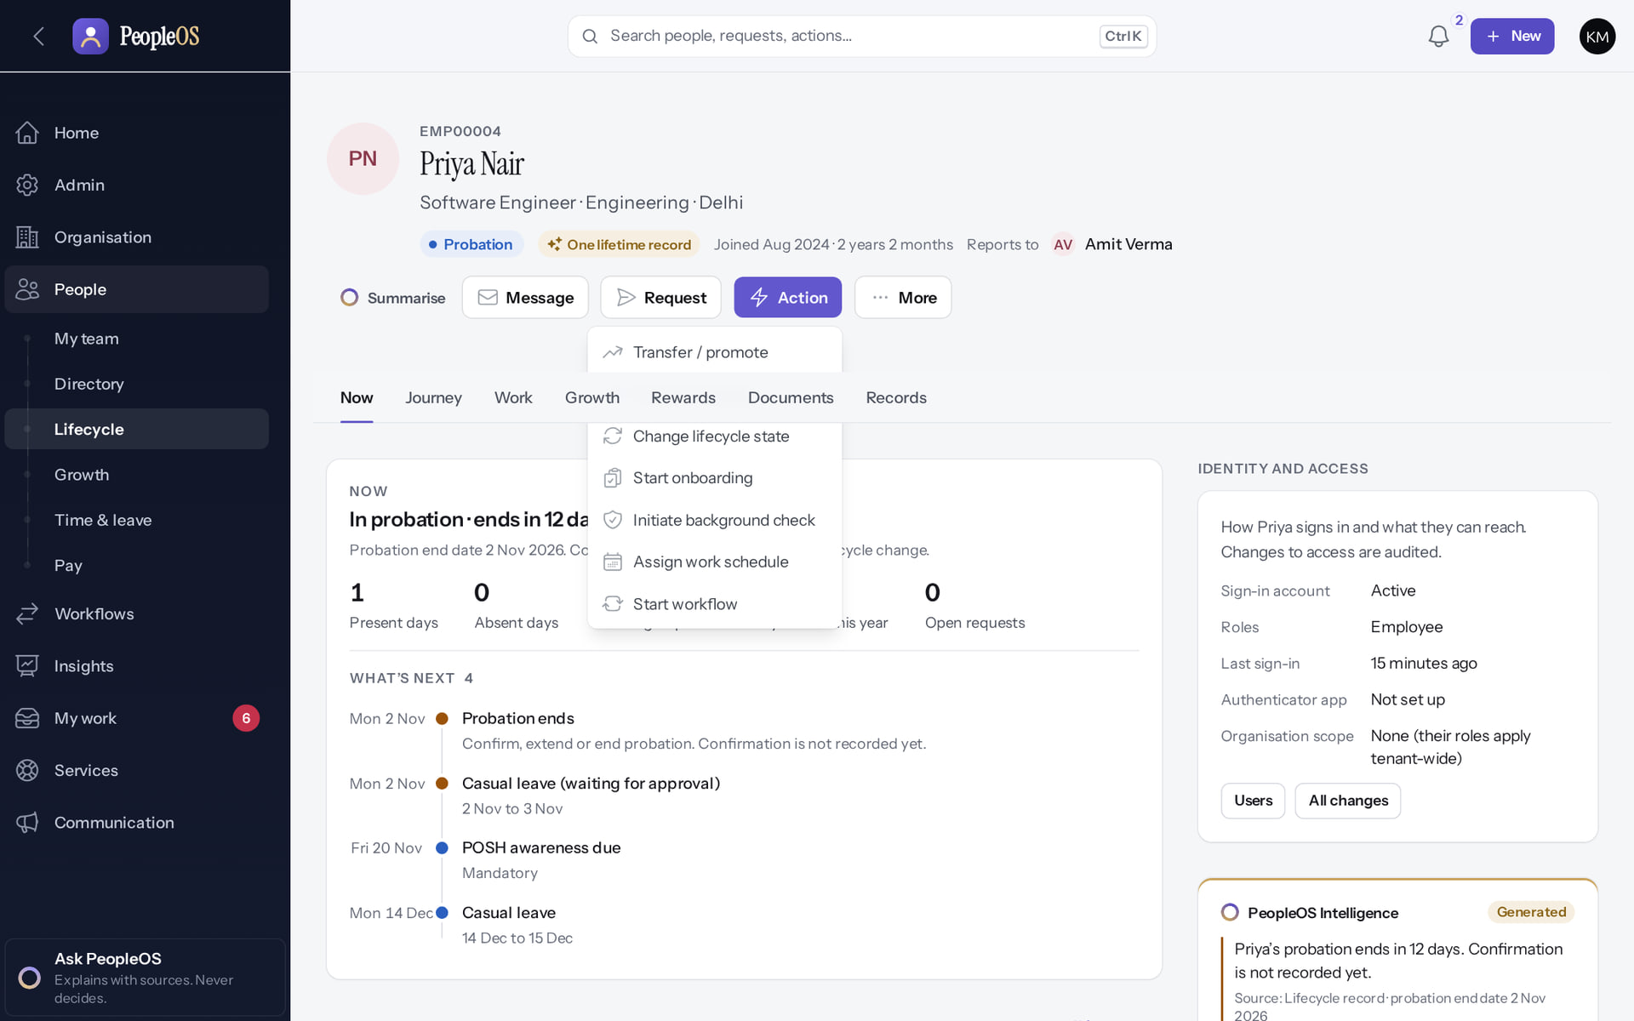
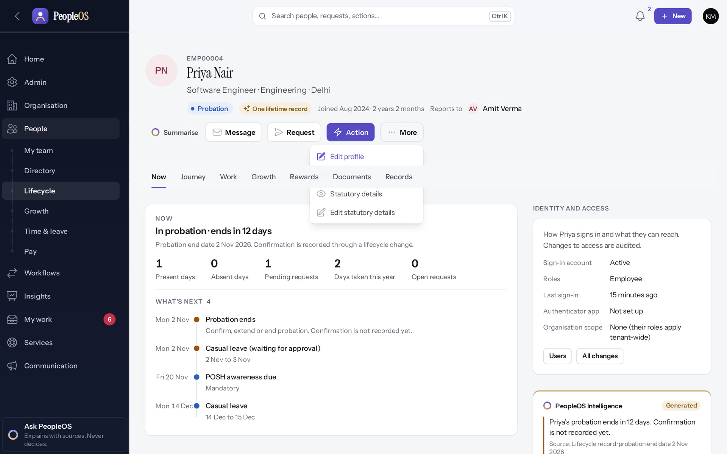
Action and More menus
EMPLOYEE 360
Action
Verified
More
Verified
Transfer / promote, Change manager, Change lifecycle state, Start onboarding, Initiate background check, Assign work schedule, Start workflow.
Edit profile, All changes, Statutory details, Edit statutory details. Menus depend on your permissions.
Real screen · Kavya Menon (Tenant HR Admin + Employee) · Employee 360 › Action menu
Real screen · Kavya Menon (Tenant HR Admin + Employee) · Employee 360 › More menu
Notes:
KNOWN VISUAL ISSUE F27: the dropdown can open under the sticky view bar; scroll slightly if an item is hidden.
SAY: Action and More menus.
LEFT, Action: Transfer / promote, Change manager, Change lifecycle state, Start onboarding, Initiate background check, Assign work schedule, Start workflow.
RIGHT, More: Edit profile, All changes, Statutory details, Edit statutory details. Menus depend on your permissions.
OBSERVE: point out what differs between the two screens.
EVIDENCE: left = hr-admin/50-360-02-action-menu [Kavya Menon (Tenant HR Admin + Employee), Employee 360 › Action menu]; right = hr-admin/50-360-03-more-menu [Kavya Menon (Tenant HR Admin + Employee), Employee 360 › More menu]. Real screens, fictional data (SCREENSHOT-INVENTORY.md).

Slide 12
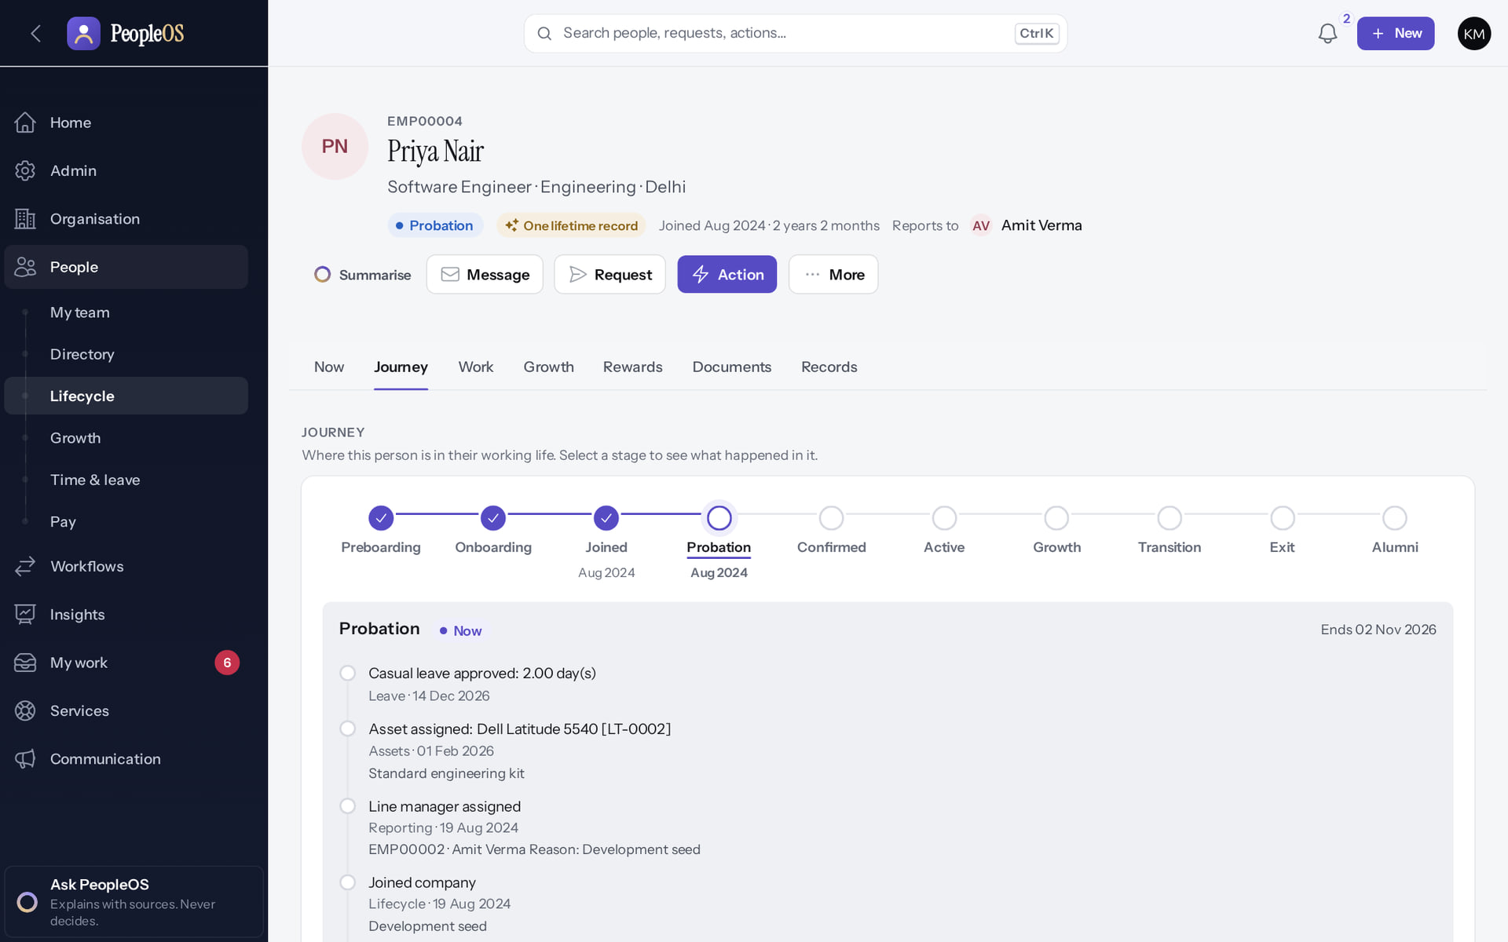
Journey: the effective-dated history
EMPLOYEE 360
Verified in the running application
1
Journey.
RESULT Joining, onboarding, probation, assets, leave and manager assignment in order. Select a stage to see what happened in it.
1
Real screen · Kavya Menon (Tenant HR Admin + Employee) · Employee 360 › Journey
Notes:
SAY: Joining, onboarding, probation, assets, leave and manager assignment in order. Select a stage to see what happened in it.
ON SCREEN: Open the Journey view.
LEARNERS SHOULD SEE: Effective-dated history of the person: joining, changes, lifecycle
SCREEN: Employee 360 › Journey. Signed in as Kavya Menon (Tenant HR Admin + Employee). Prerequisite: employee.view; sensitive tabs need their own permissions.
EVIDENCE: screenshot screenshots/hr-admin/50-360-04-journey.png, captured 2026-10-21 on the disposable training database (fictional people).

Slide 13
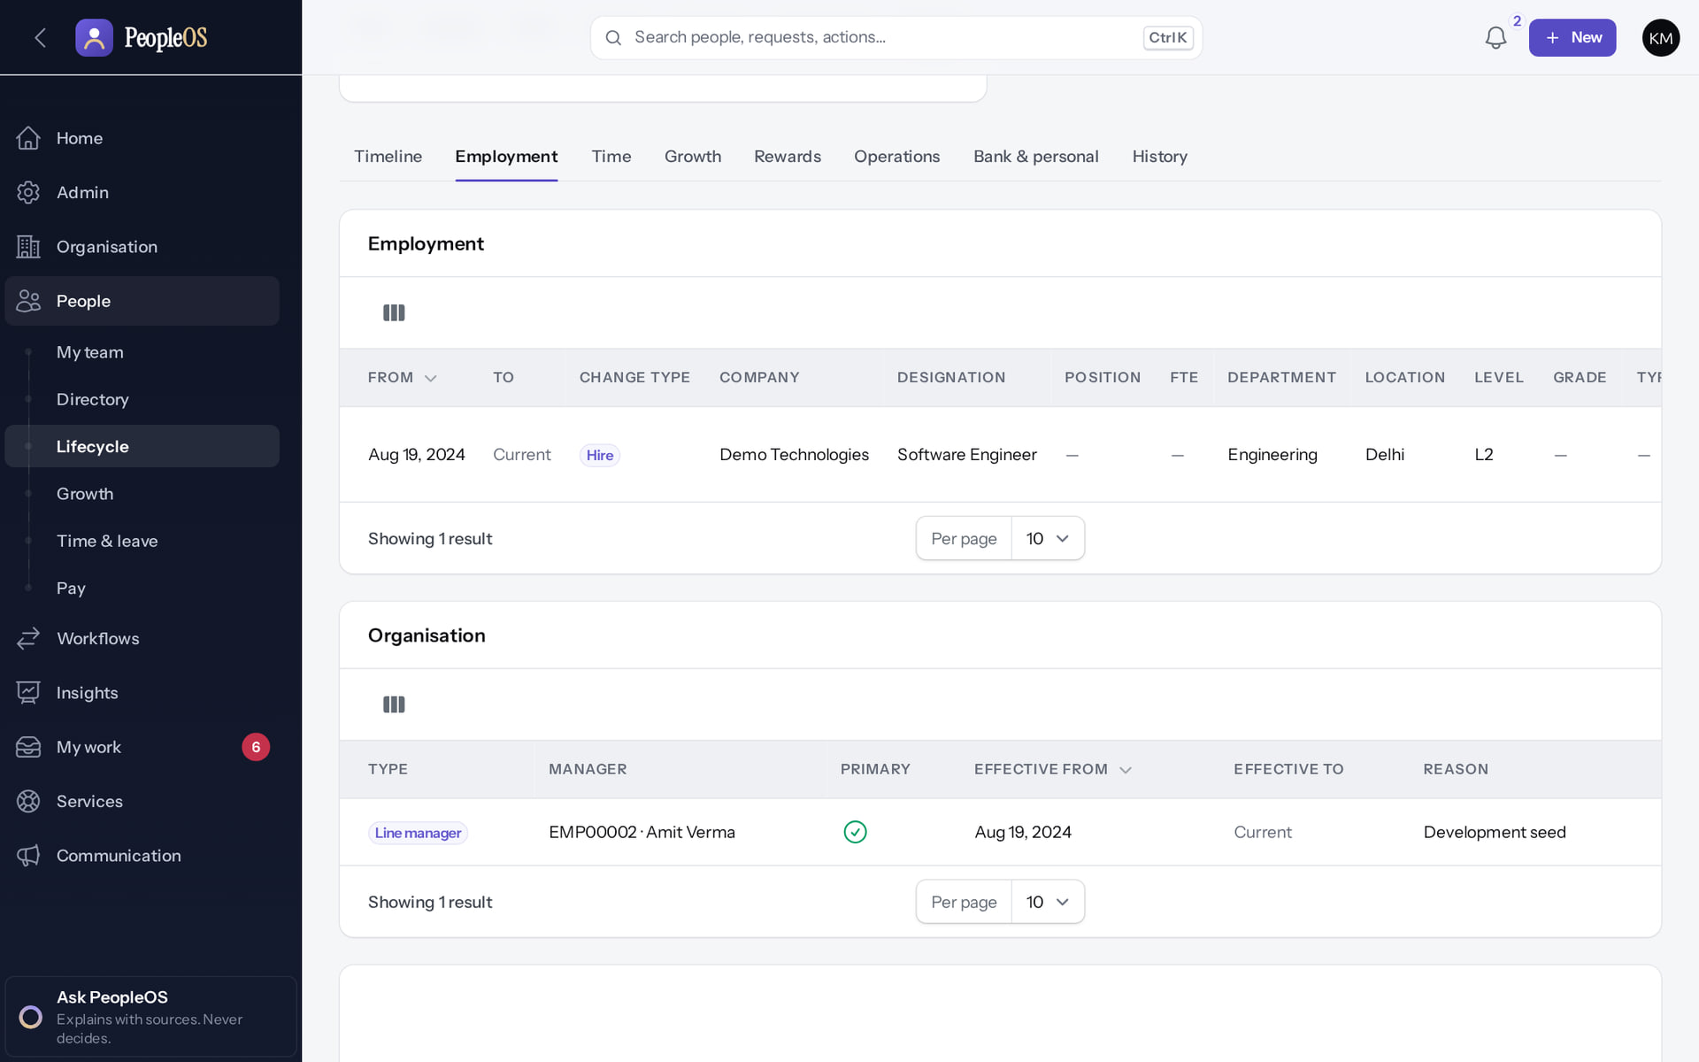
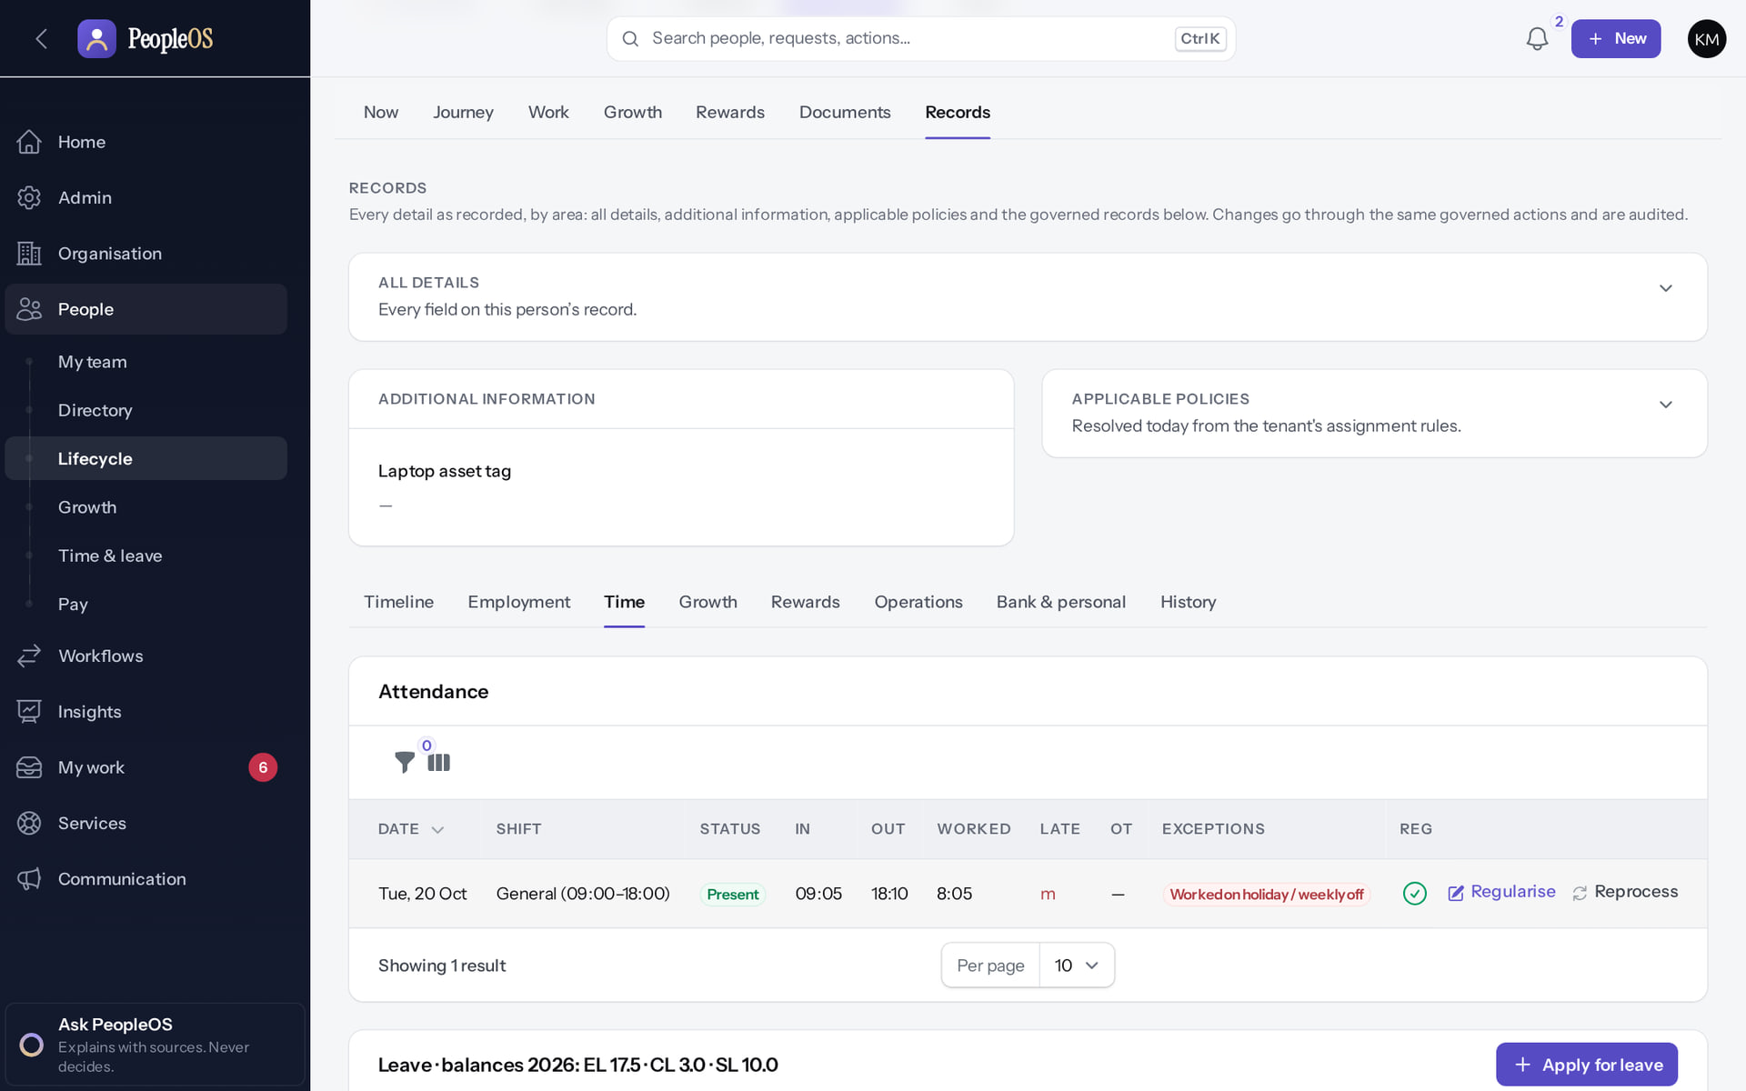
Records: employment and time
EMPLOYEE 360
Employment
Verified
Time
Verified
Position assignments and reporting lines, each with from/to dates and change type.
Attendance and leave for this person; Apply for leave on their behalf.
Real screen · Kavya Menon (Tenant HR Admin + Employee) · Employee 360 › Records › Employment
Real screen · Kavya Menon (Tenant HR Admin + Employee) · Employee 360 › Records › Time
Notes:
SAY: Records: employment and time.
LEFT, Employment: Position assignments and reporting lines, each with from/to dates and change type.
RIGHT, Time: Attendance and leave for this person; Apply for leave on their behalf.
OBSERVE: point out what differs between the two screens.
EVIDENCE: left = hr-admin/50-360-05-records-employment [Kavya Menon (Tenant HR Admin + Employee), Employee 360 › Records › Employment]; right = hr-admin/50-360-06-records-time [Kavya Menon (Tenant HR Admin + Employee), Employee 360 › Records › Time]. Real screens, fictional data (SCREENSHOT-INVENTORY.md).

Slide 14
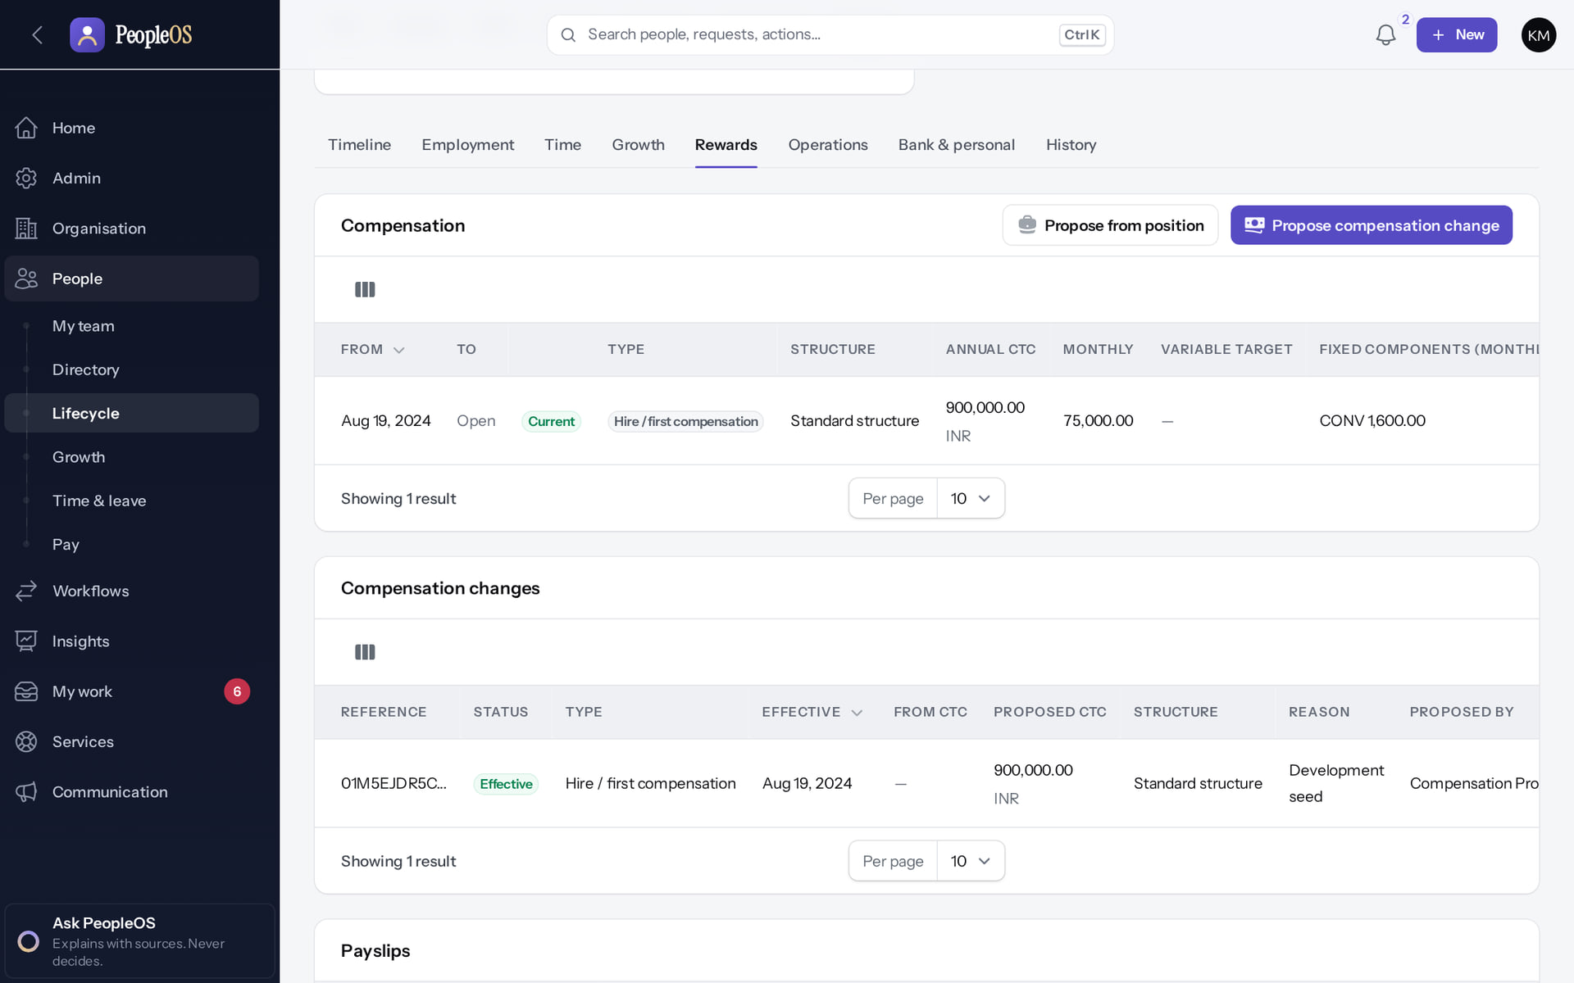
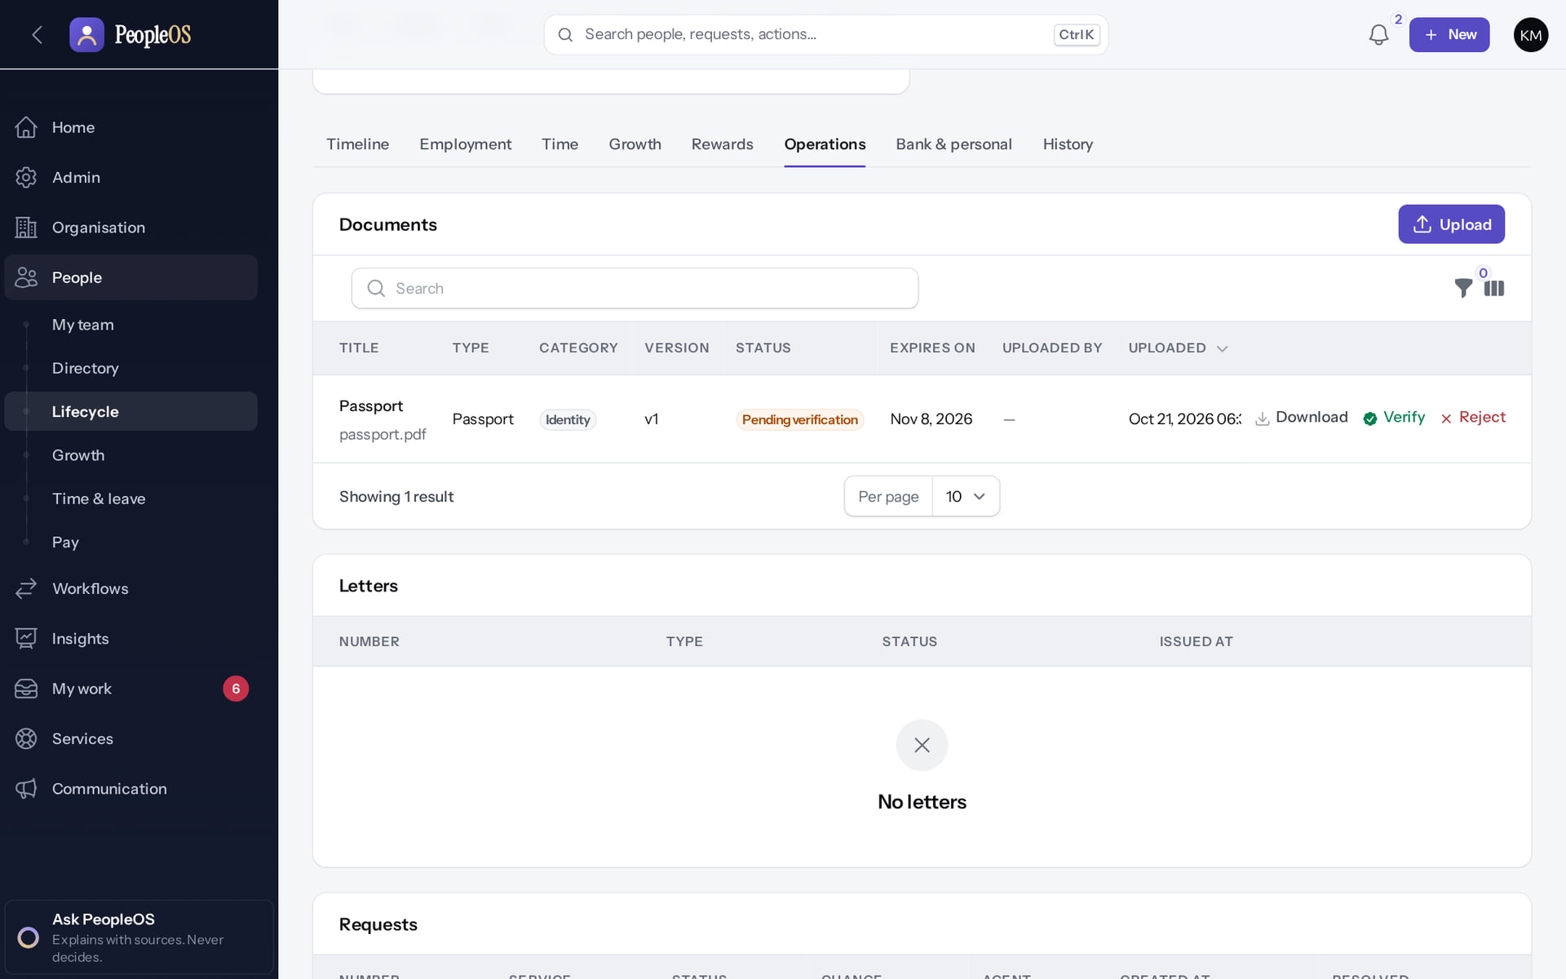
Records: rewards and operations
EMPLOYEE 360
Rewards
Verified
Operations
Verified
Compensation, compensation changes and payslips, only with the matching permission.
Documents (Upload, Verify, Reject), letters and requests.
Real screen · Kavya Menon (Tenant HR Admin + Employee) · Employee 360 › Records › Rewards
Real screen · Kavya Menon (Tenant HR Admin + Employee) · Employee 360 › Records › Operations
Notes:
SAY: Records: rewards and operations.
LEFT, Rewards: Compensation, compensation changes and payslips, only with the matching permission.
RIGHT, Operations: Documents (Upload, Verify, Reject), letters and requests.
OBSERVE: point out what differs between the two screens.
EVIDENCE: left = hr-admin/50-360-07-records-rewards [Kavya Menon (Tenant HR Admin + Employee), Employee 360 › Records › Rewards]; right = hr-admin/50-360-08-records-operations [Kavya Menon (Tenant HR Admin + Employee), Employee 360 › Records › Operations]. Real screens, fictional data (SCREENSHOT-INVENTORY.md).

Slide 15
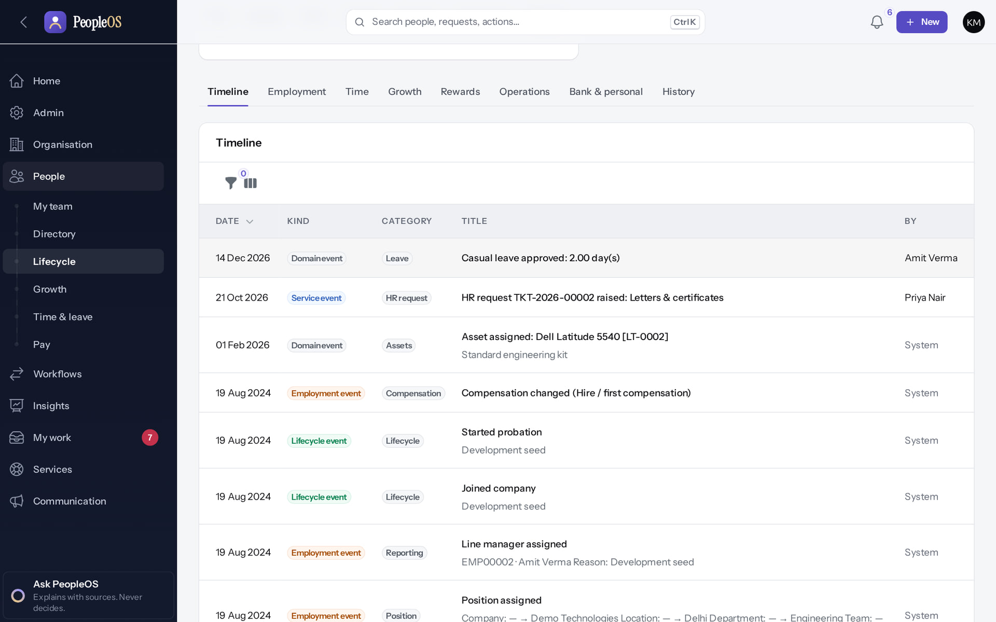
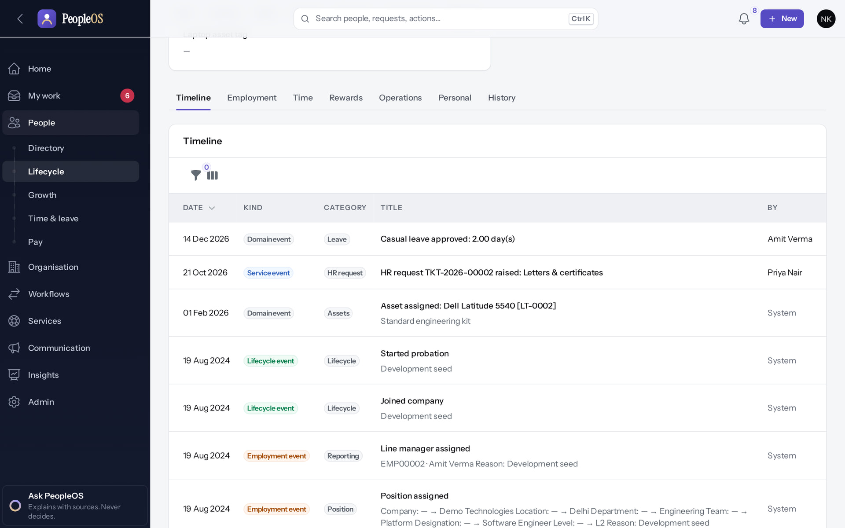
Different HR roles, different record tabs
EMPLOYEE 360
Tenant HR Admin
Verified
HR Manager
Verified
Timeline, Employment, Time, Growth, Rewards, Operations, Bank & personal, History.
No Growth; Personal instead of Bank & personal: no bank or identity details.
Real screen · Kavya Menon (Tenant HR Admin + Employee) · Employee 360 › Records (as Tenant HR Admin (Kavya))
Real screen · Neha Kapoor (HR Manager + Employee) · Employee 360 › Records (as HR Manager (Neha))
Notes:
SAY: HR administrators do not all see the same fields. Sensitive data needs the sensitive permission.
SAY: Different HR roles, different record tabs.
LEFT, Tenant HR Admin: Timeline, Employment, Time, Growth, Rewards, Operations, Bank & personal, History.
RIGHT, HR Manager: No Growth; Personal instead of Bank & personal: no bank or identity details.
OBSERVE: point out what differs between the two screens.
EVIDENCE: left = security-compliance/50-sec-01-360-records-tenant-hr-admin [Kavya Menon (Tenant HR Admin + Employee), Employee 360 › Records (as Tenant HR Admin (Kavya))]; right = security-compliance/50-sec-02-360-records-hr-manager [Neha Kapoor (HR Manager + Employee), Employee 360 › Records (as HR Manager (Neha))]. Real screens, fictional data (SCREENSHOT-INVENTORY.md).

Slide 16
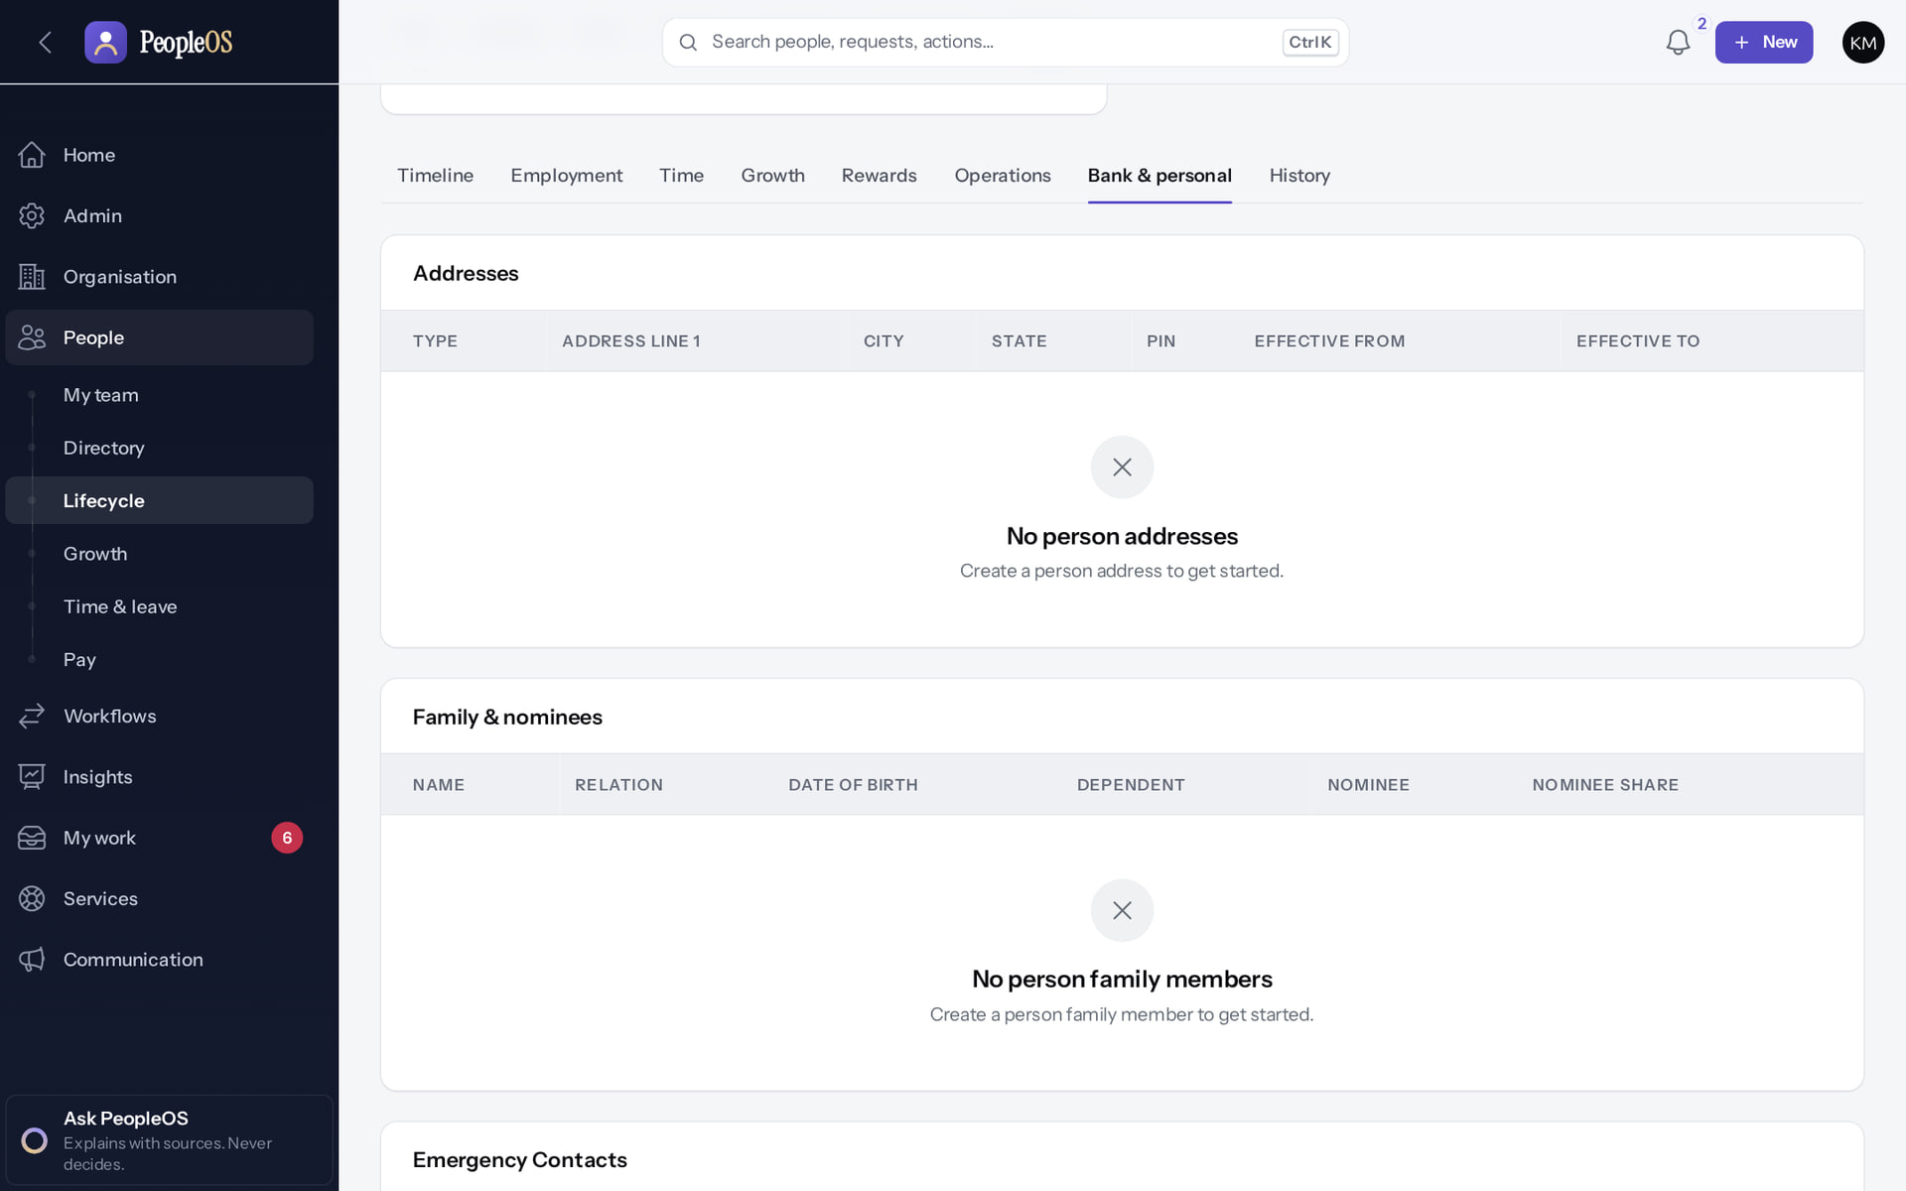
Bank & personal: sensitive and permission-controlled
EMPLOYEE 360
Verified in the running application
1
1
Bank & personal.
RESULT Sections for addresses, family and nominees, emergency contacts, bank accounts and identifiers (empty for this fictional employee). Sensitive fields need *.sensitive.* permissions and are masked otherwise.
Real screen · Kavya Menon (Tenant HR Admin + Employee) · Employee 360 › Records › Bank & personal
Notes:
SAY: Sections for addresses, family and nominees, emergency contacts, bank accounts and identifiers (empty for this fictional employee). Sensitive fields need *.sensitive.* permissions and are masked otherwise.
ON SCREEN: Records › Bank & personal.
LEARNERS SHOULD SEE: Bank accounts, identifiers and personal details (sensitive; permission-controlled)
SCREEN: Employee 360 › Records › Bank & personal. Signed in as Kavya Menon (Tenant HR Admin + Employee). Prerequisite: employee.view; sensitive tabs need their own permissions.
EVIDENCE: screenshot screenshots/hr-admin/50-360-09-records-bank-personal.png, captured 2026-10-21 on the disposable training database (fictional people).

Slide 17
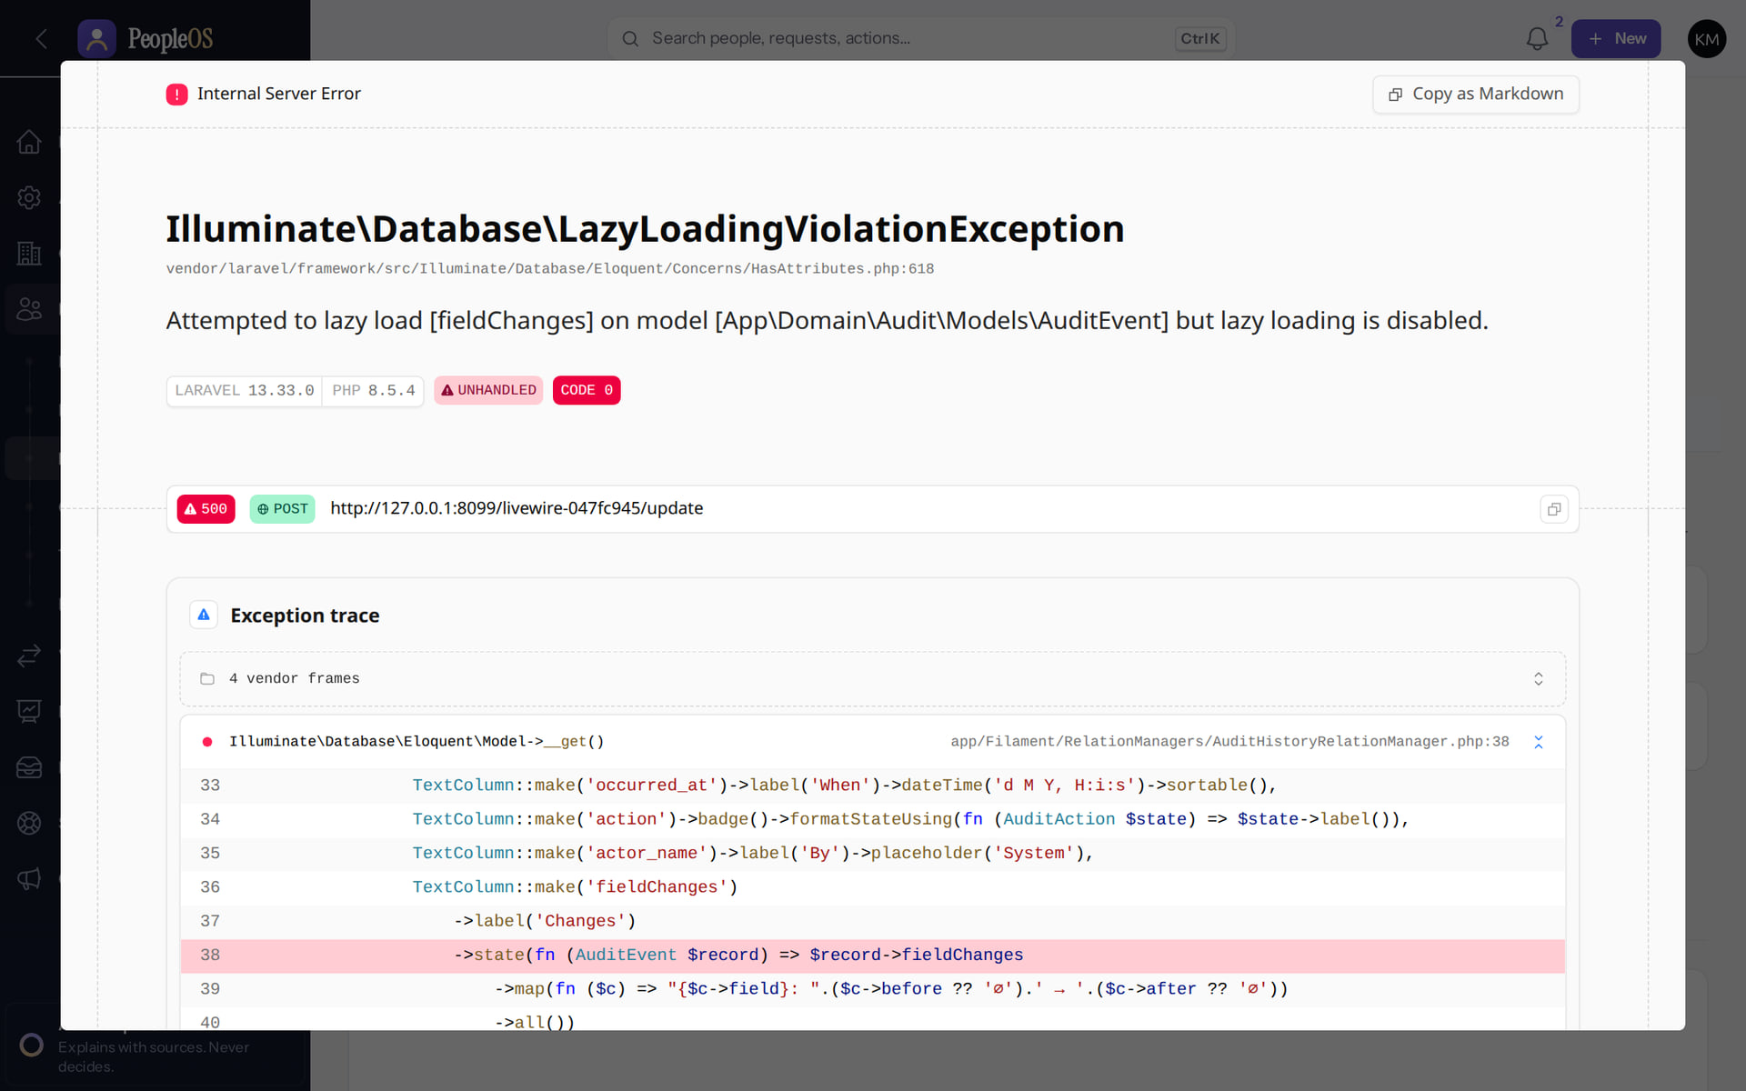
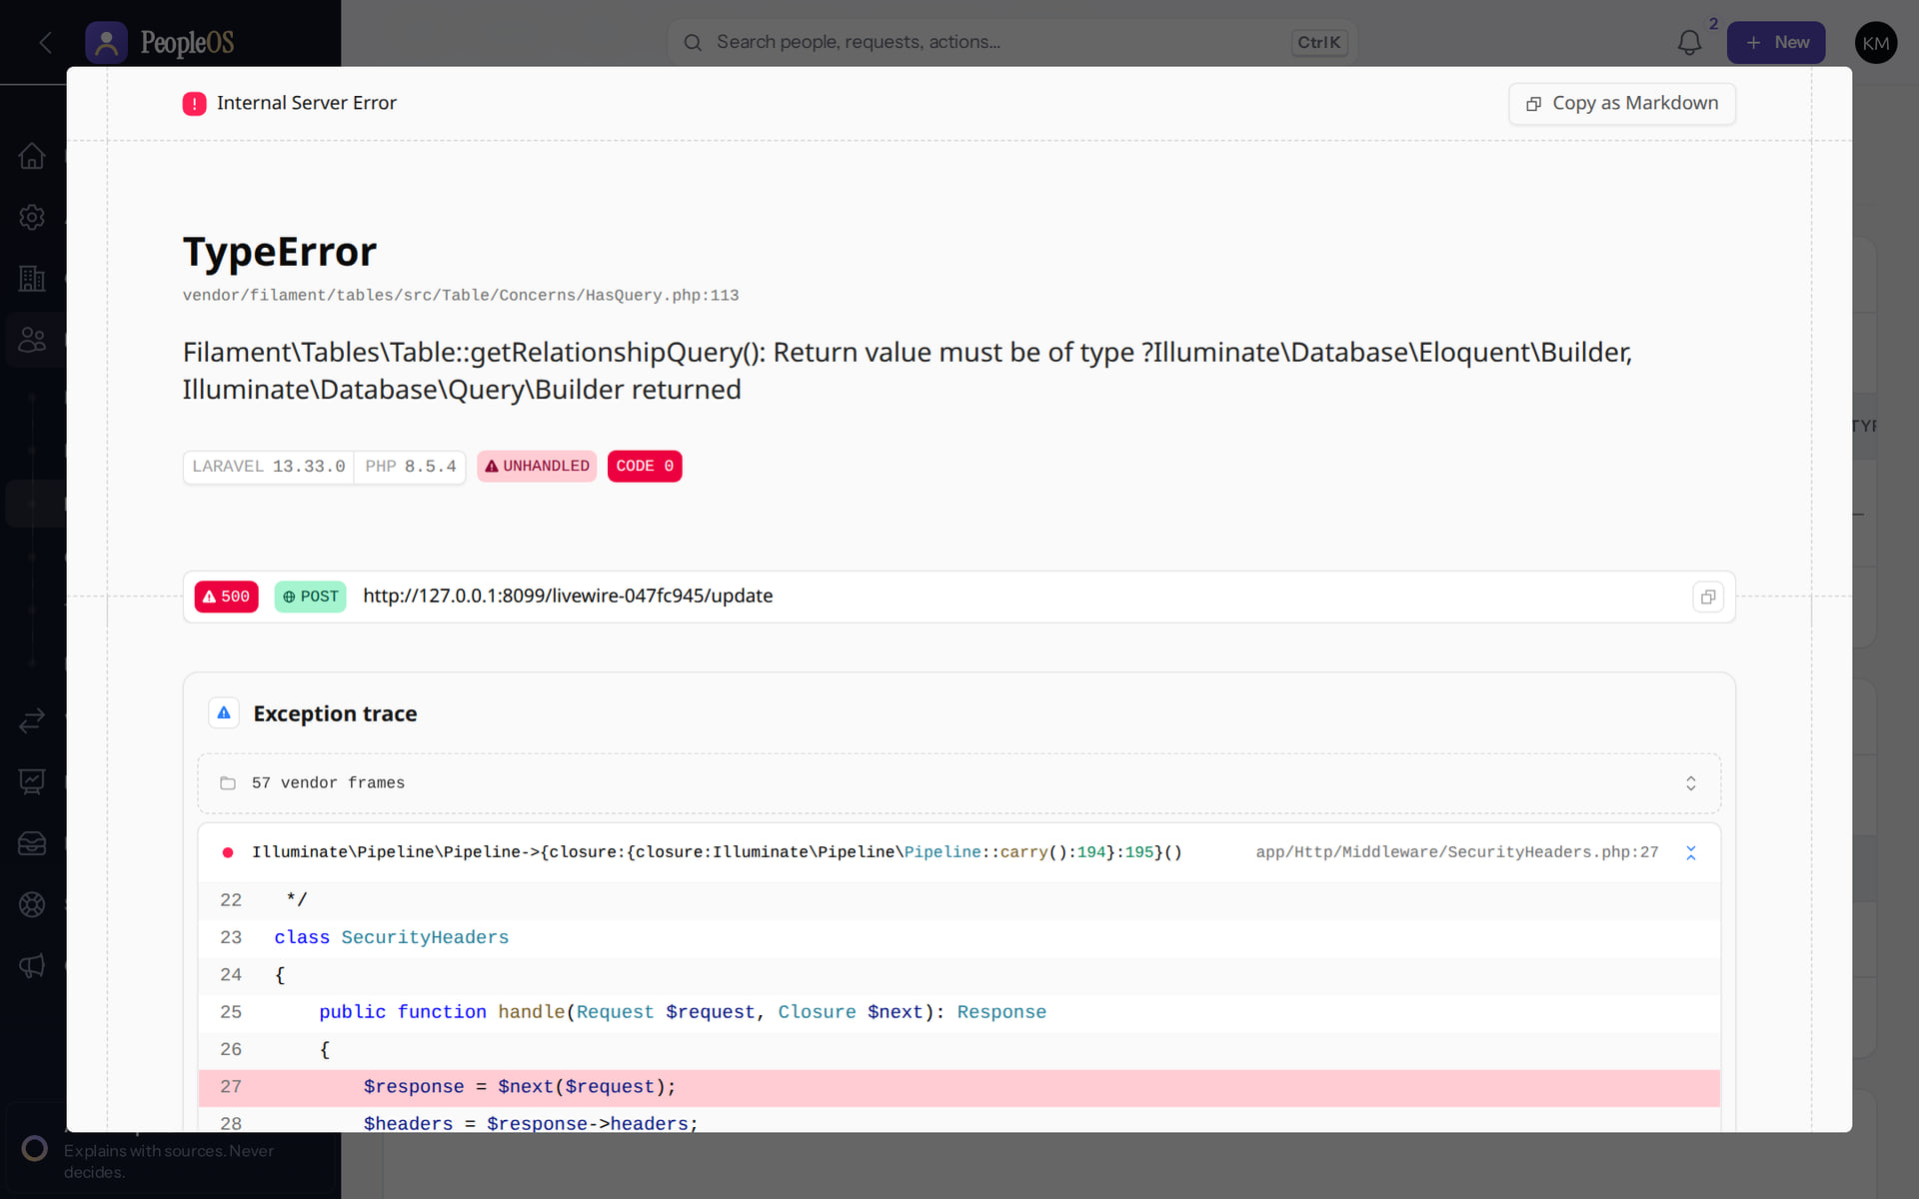
Two errors you may meet on the 360 (development mode)
EMPLOYEE 360
History tab
Incomplete
Employment section on scroll
Incomplete
LazyLoadingViolationException (F26) in non-production strict mode. Use Insights › Audit › Change history instead.
TypeError in a lazily loaded section (new finding, 21 Oct 2026).
Real screen · Kavya Menon (Tenant HR Admin + Employee) · Employee 360 › Records › History
Real screen · Kavya Menon (Tenant HR Admin + Employee) · Employee 360 › Records › Employment
Notes:
Shown here as the local debug page (development mode). In production the user sees a generic server-error dialog; the cause is the same.
FINDINGS: F26 (documented) and a new TypeError in the Records › Employment lower section, observed live; both recorded in the accuracy register.
SAY: Two errors you may meet on the 360 (development mode).
LEFT, History tab: LazyLoadingViolationException (F26) in non-production strict mode. Use Insights › Audit › Change history instead.
RIGHT, Employment section on scroll: TypeError in a lazily loaded section (new finding, 21 Oct 2026).
OBSERVE: point out what differs between the two screens.
EVIDENCE: left = hr-admin/50-360-10-records-history [Kavya Menon (Tenant HR Admin + Employee), Employee 360 › Records › History]; right = support/50-360-err-01-records-employment [Kavya Menon (Tenant HR Admin + Employee), Employee 360 › Records › Employment]. Real screens, fictional data (SCREENSHOT-INVENTORY.md).

Slide 18
Hire and person matching
02
Four guided steps; the person is matched before anything is created.
Notes:
TRANSITION: Section 2, Hire and person matching. Four guided steps; the person is matched before anything is created.
SAY: Tell learners what they will be able to do by the end of this section, then move on.
ASK: "What questions do you have before we start this section?"

Slide 19
Hire an employee
HIRE
Create one lifetime record for a new joiner, placed in the organisation with a manager, without duplicating a person who already exists.
Verified in the running application
WHO
WHERE
BEFORE YOU START
Tenant HR Admin, HR Manager, HR Executive (employee.create)
People › Lifecycle › Employees › Hire employee
Organisation, designations and the manager's record exist (Deck 4, stages 4–8).
START
Employees
PERSON
duplicate check
EMPLOYMENT
dates, code
POSITION
placement
MANAGER
reason → create
Conceptual diagram: sequence summary
Notes:
SAY: Create one lifetime record for a new joiner, placed in the organisation with a manager, without duplicating a person who already exists.
WHO: Tenant HR Admin, HR Manager, HR Executive (employee.create)
WHERE: People › Lifecycle › Employees › Hire employee
BEFORE YOU START: Organisation, designations and the manager's record exist (Deck 4, stages 4–8).
SEQUENCE: START Employees → PERSON duplicate check → EMPLOYMENT dates, code → POSITION placement → MANAGER reason → create

Slide 20
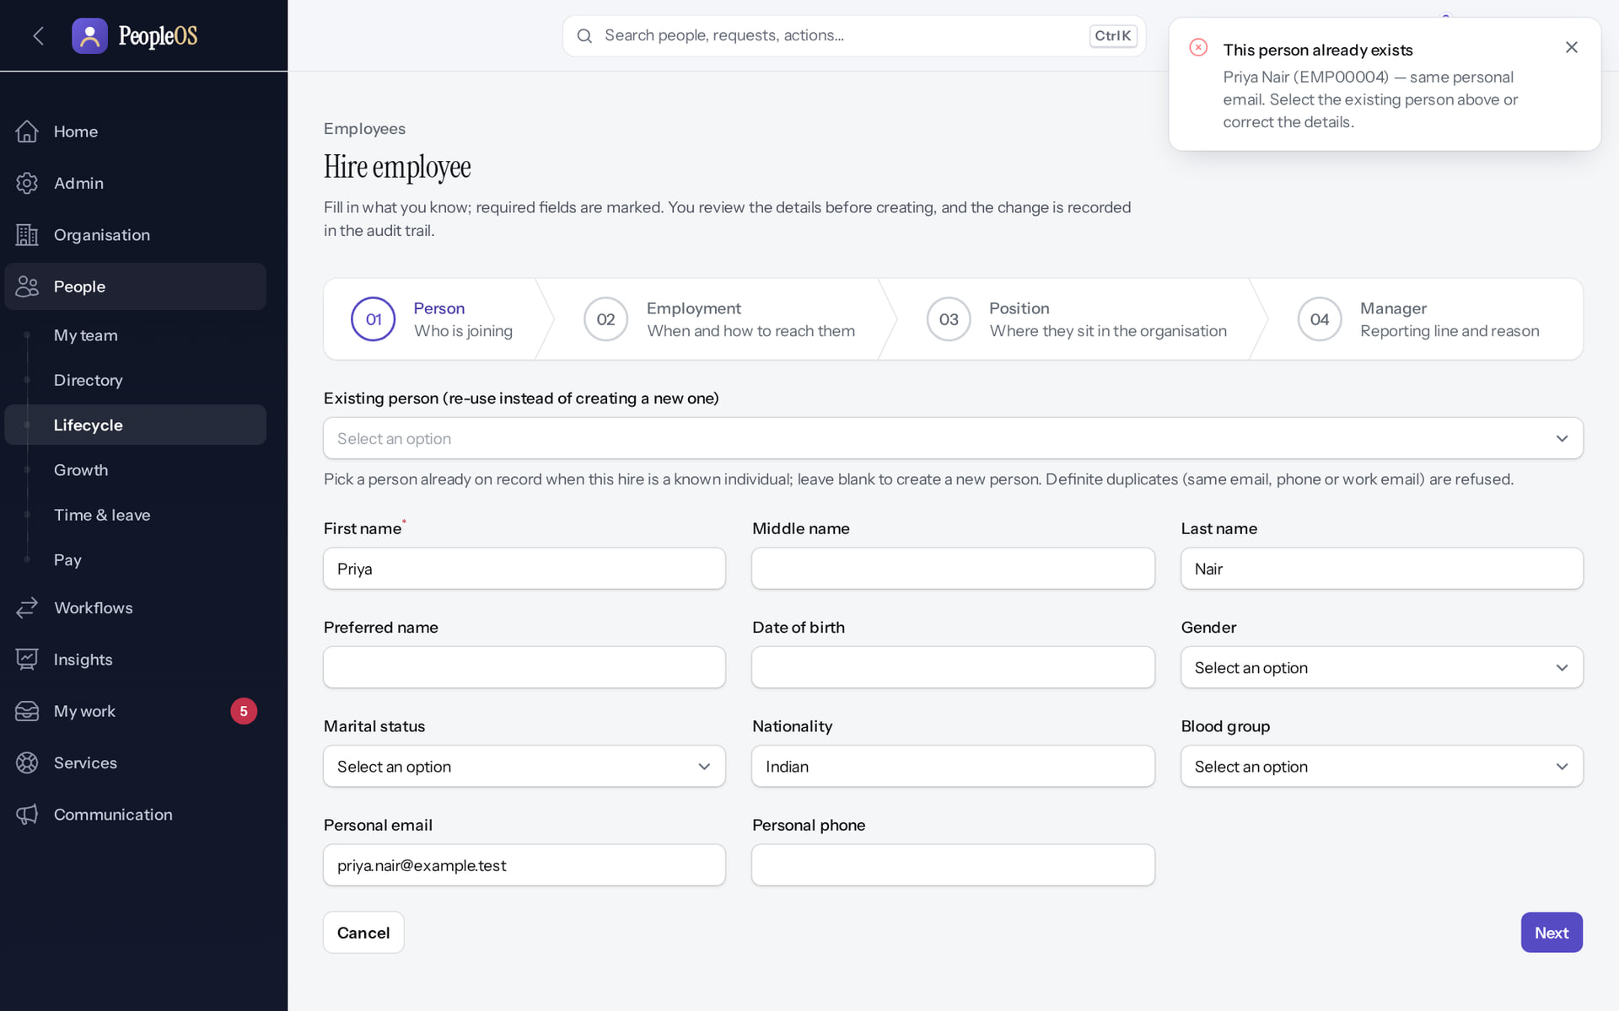
The duplicate check stops a second record
HIRE
Verified in the running application
1
1
Duplicate refused.
2
Matching field.
RESULT "This person already exists: Priya Nair (EMP00004), same personal email." The wizard does not move on. Re-use the existing person or correct the details.
2
Real screen (cropped) · Kavya Menon (Tenant HR Admin + Employee) · Hire employee › Person
Notes:
SAY: Definite duplicates (same e-mail, phone or work e-mail) are refused; possible duplicates are warned. One person, one lifetime record.

Slide 21
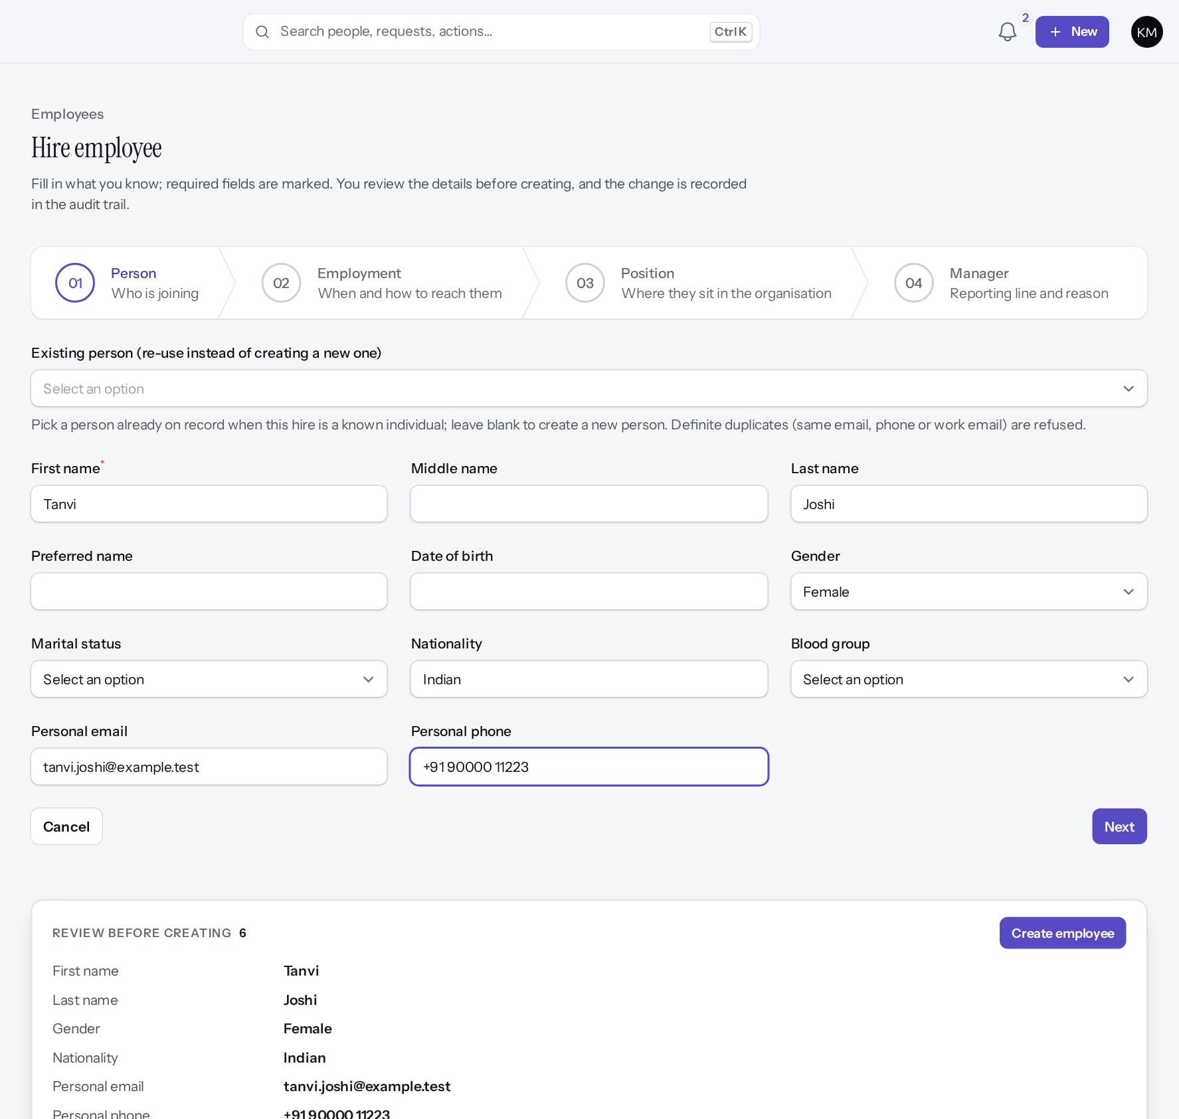
Step 1: Person
HIRE
Verified in the running application
1
First name (required)
2
Personal e-mail (matched)
3
Next
RESULT Name, personal e-mail and phone; no duplicate found
1
2
3
Real screen (cropped) · Kavya Menon (Tenant HR Admin + Employee) · Hire employee › 01 Person
Notes:
SAY: Name, personal e-mail and phone; no duplicate found
ON SCREEN: Enter the new joiner’s personal details (fictional).
WALK THROUGH: (1) First name (required) (2) Personal e-mail (matched) (3) Next
LEARNERS SHOULD SEE: Name, personal e-mail and phone; no duplicate found
SCREEN: Hire employee › 01 Person. Signed in as Kavya Menon (Tenant HR Admin + Employee). Prerequisite: employee.create (Tenant HR Admin, HR Manager, HR Executive, Account Owner).
EVIDENCE: screenshot screenshots/hr-admin/50-hire-02-person-step.png, captured 2026-10-21 on the disposable training database (fictional people).

Slide 22
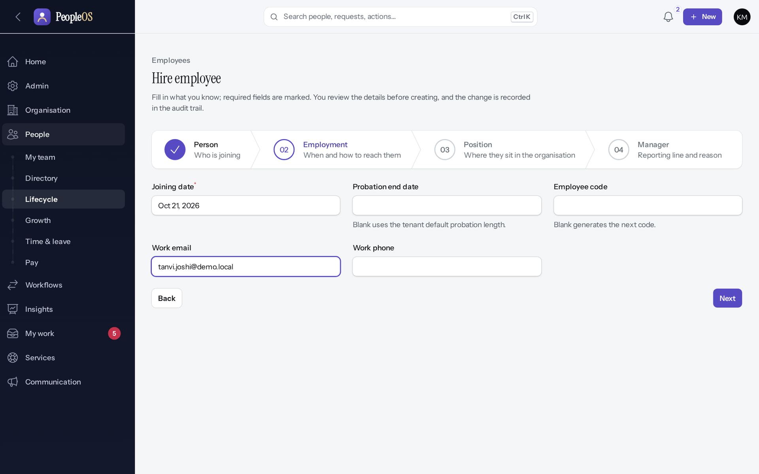
Step 2: Employment
HIRE
Verified in the running application
1
Joining date
2
Code (auto if blank)
3
Work e-mail
RESULT Employment details completed
1
2
3
Real screen (cropped) · Kavya Menon (Tenant HR Admin + Employee) · Hire employee › 02 Employment
Notes:
SAY: Employment details completed
ON SCREEN: Joining date, probation end (blank = tenant default), employee code (blank = next code), work e-mail.
WALK THROUGH: (1) Joining date (2) Code (auto if blank) (3) Work e-mail
LEARNERS SHOULD SEE: Employment details completed
SCREEN: Hire employee › 02 Employment. Signed in as Kavya Menon (Tenant HR Admin + Employee). Prerequisite: employee.create (Tenant HR Admin, HR Manager, HR Executive, Account Owner).
EVIDENCE: screenshot screenshots/hr-admin/50-hire-03-employment-step.png, captured 2026-10-21 on the disposable training database (fictional people).

Slide 23
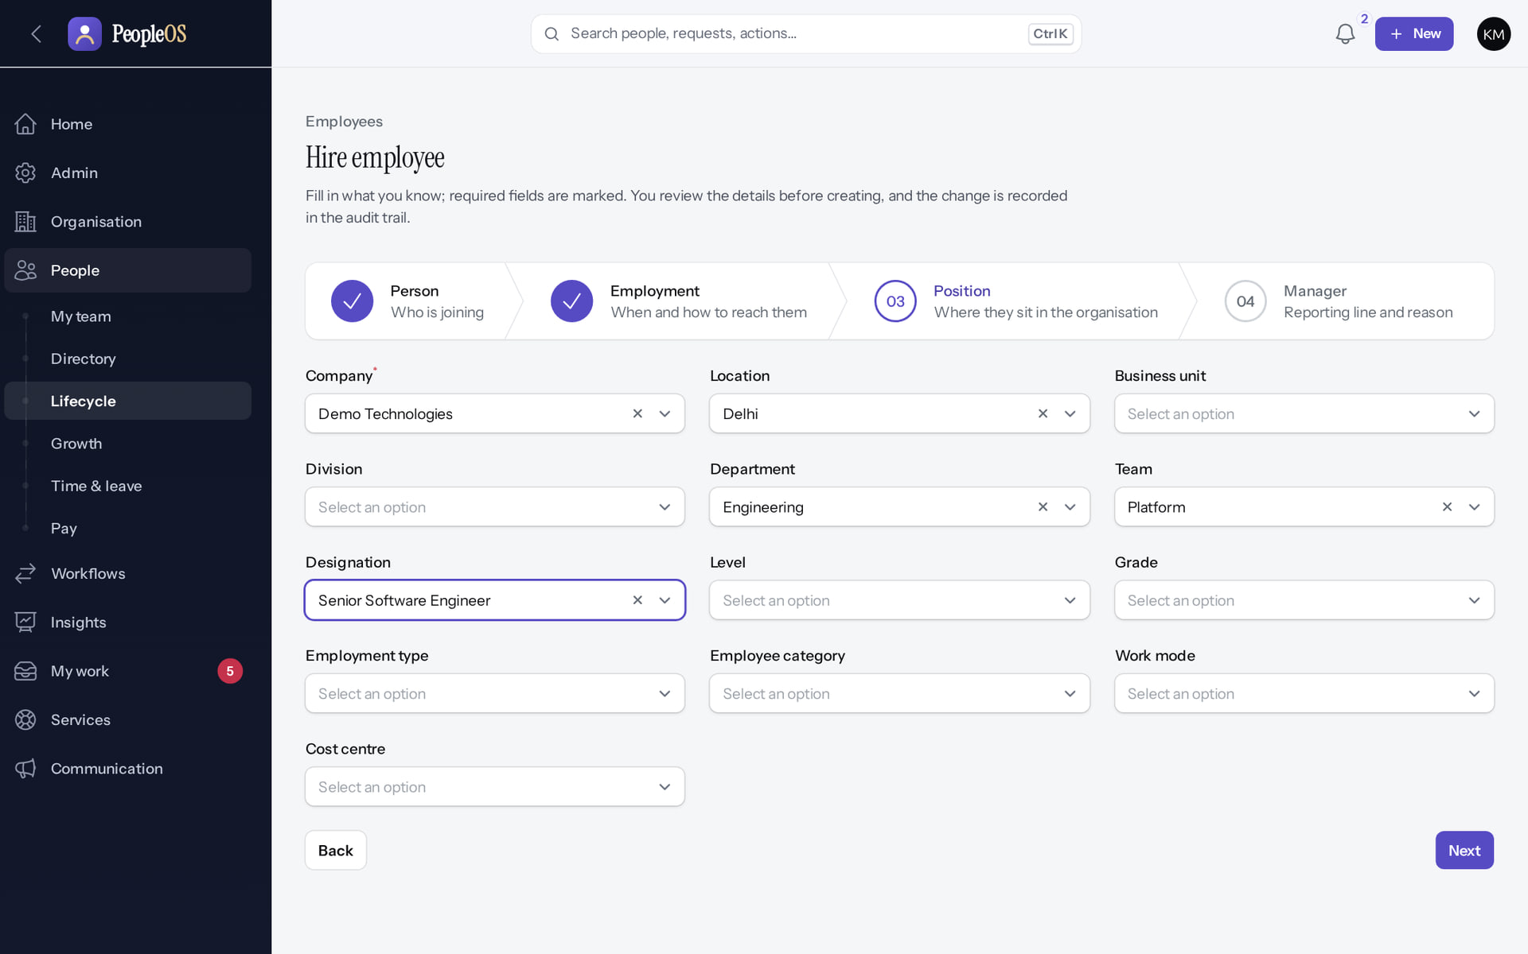
Step 3: Position
HIRE
Verified in the running application
1
Company (required)
2
Department
3
Team
4
Designation
1
RESULT Organisation placement chosen from the configured structure
2
3
4
Real screen (cropped) · Kavya Menon (Tenant HR Admin + Employee) · Hire employee › 03 Position
Notes:
SAY: Organisation placement chosen from the configured structure
ON SCREEN: Place the person: company (required), location, department, team, designation ….
WALK THROUGH: (1) Company (required) (2) Department (3) Team (4) Designation
LEARNERS SHOULD SEE: Organisation placement chosen from the configured structure
SCREEN: Hire employee › 03 Position. Signed in as Kavya Menon (Tenant HR Admin + Employee). Prerequisite: employee.create (Tenant HR Admin, HR Manager, HR Executive, Account Owner).
EVIDENCE: screenshot screenshots/hr-admin/50-hire-04-position-step.png, captured 2026-10-21 on the disposable training database (fictional people).

Slide 24
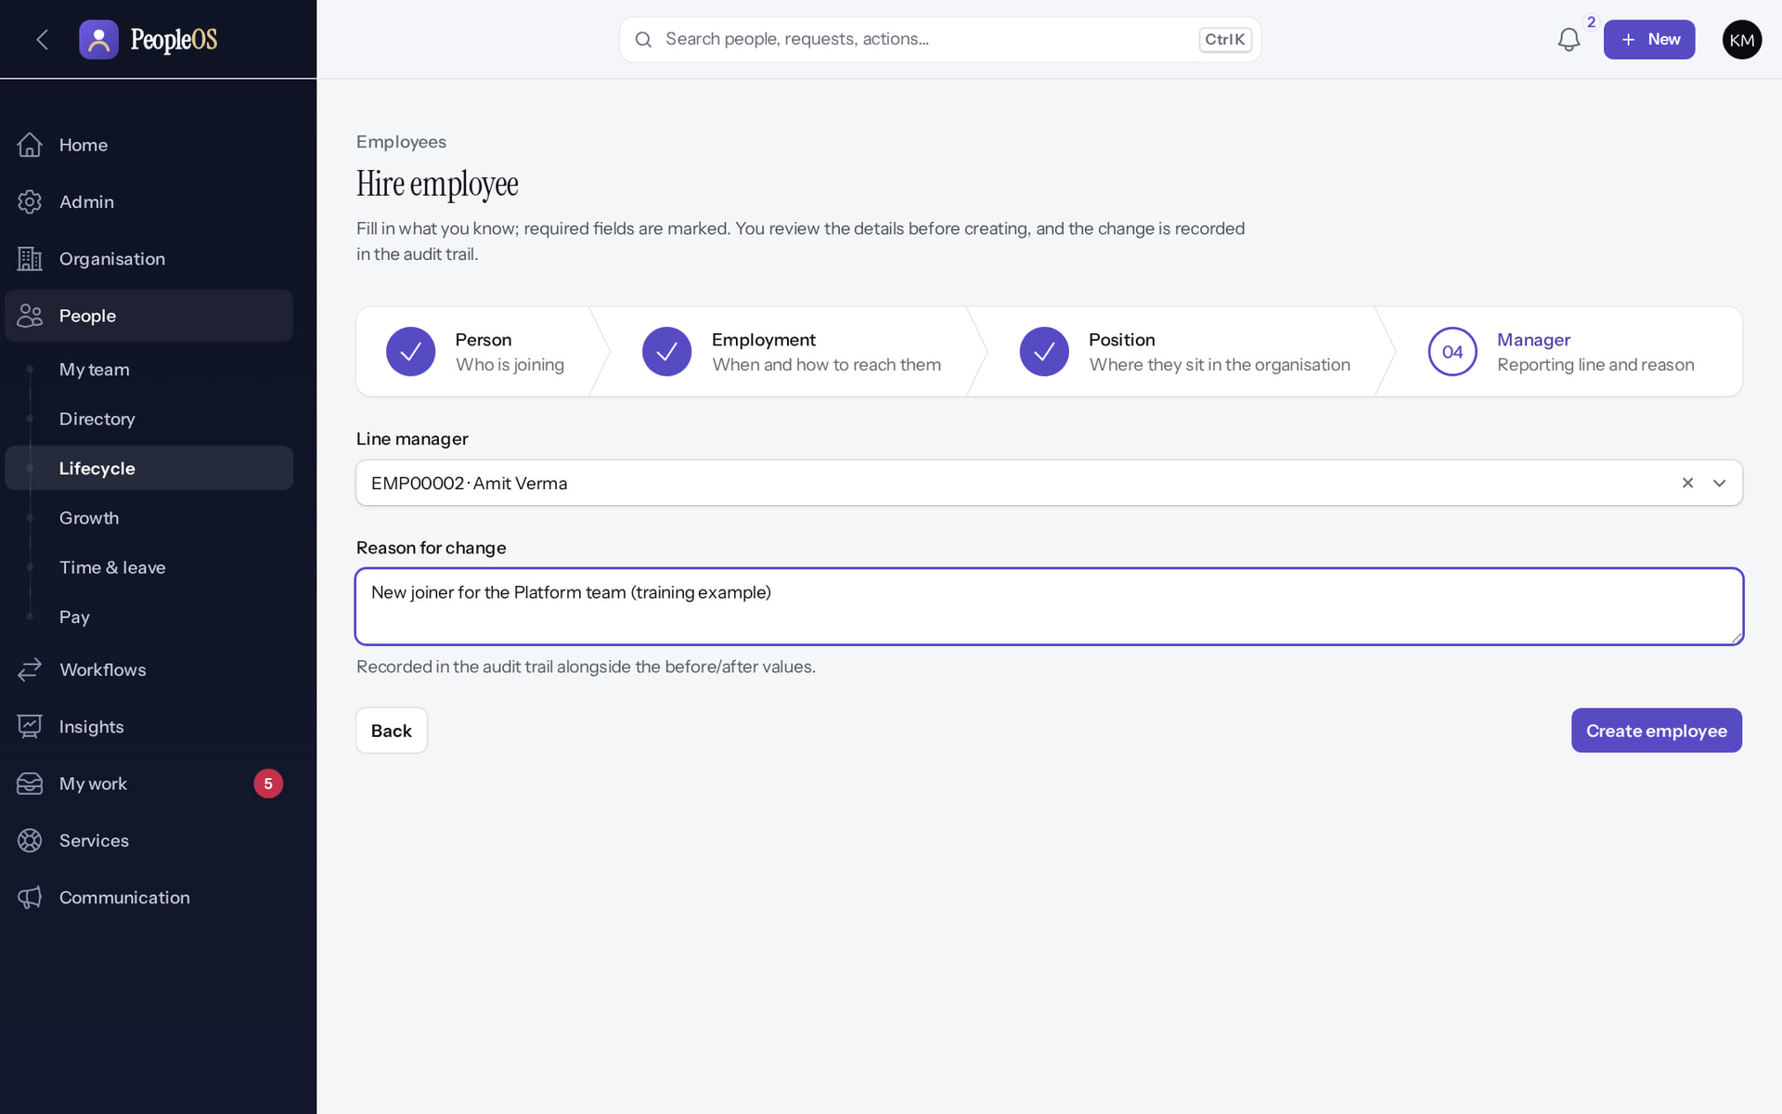
Step 4: Manager
HIRE
Verified in the running application
1
Line manager
2
Reason (audited)
3
Create
RESULT Manager and reason entered; review and create
1
2
3
Real screen (cropped) · Kavya Menon (Tenant HR Admin + Employee) · Hire employee › 04 Manager
Notes:
SAY: Manager and reason entered; review and create
ON SCREEN: Choose the line manager and give a reason (recorded in the audit trail).
WALK THROUGH: (1) Line manager (2) Reason (audited) (3) Create
LEARNERS SHOULD SEE: Manager and reason entered; review and create
SCREEN: Hire employee › 04 Manager. Signed in as Kavya Menon (Tenant HR Admin + Employee). Prerequisite: employee.create (Tenant HR Admin, HR Manager, HR Executive, Account Owner).
EVIDENCE: screenshot screenshots/hr-admin/50-hire-05-manager-step.png, captured 2026-10-21 on the disposable training database (fictional people).

Slide 25
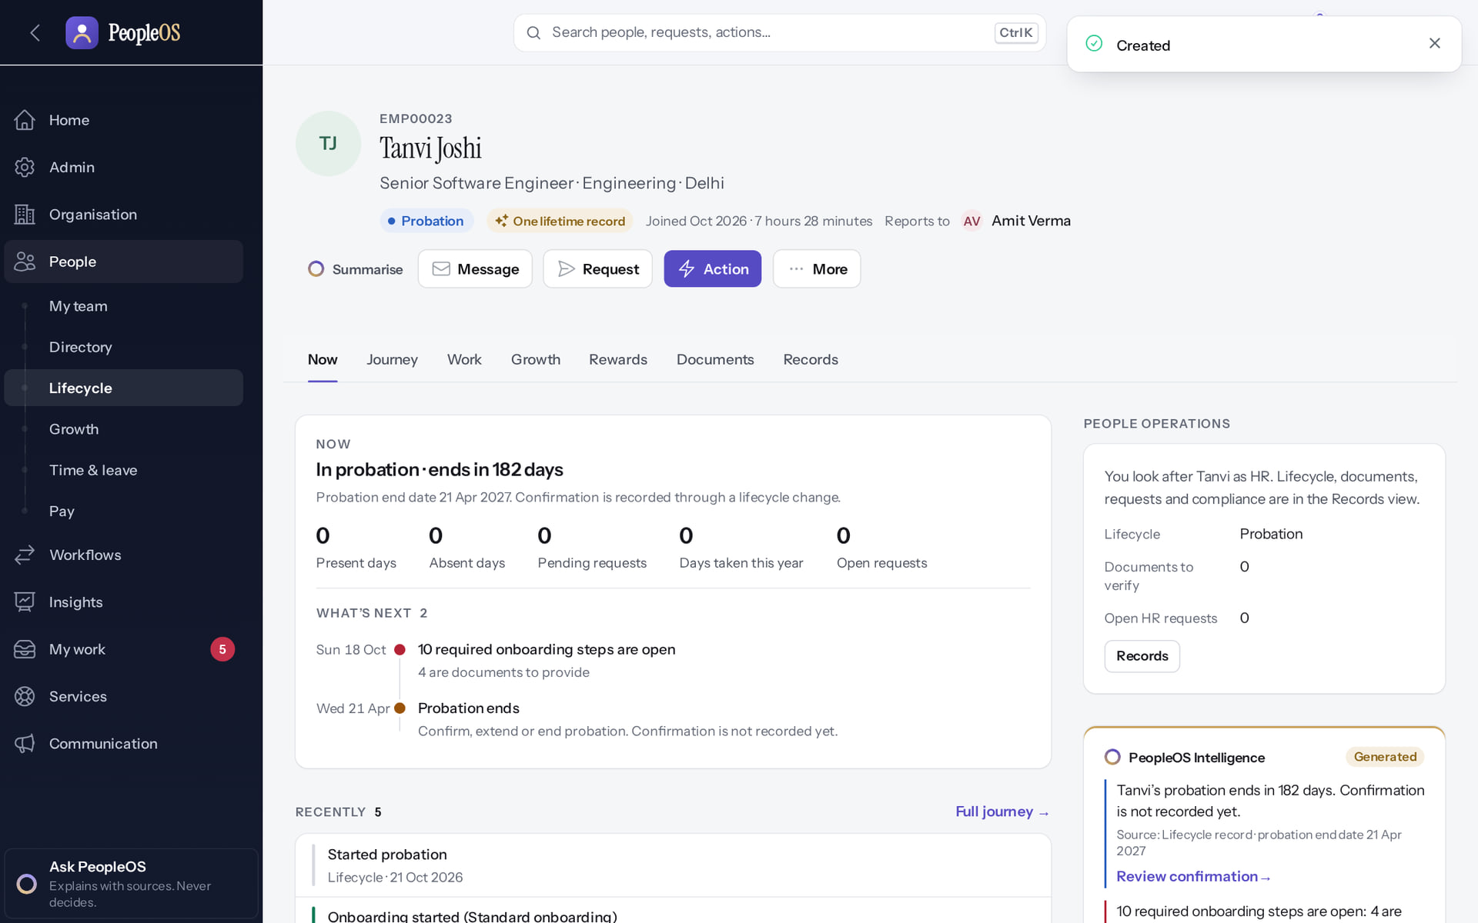
Created: the new Employee 360
HIRE
1
Verified in the running application
1
Created.
2
2
New record.
3
3
Manager.
RESULT Tanvi Joshi (EMP00023), Senior Software Engineer, Probation; onboarding started automatically and the hire is audited.
Real screen · Kavya Menon (Tenant HR Admin + Employee) · Employee 360 (new hire)
Notes:
SAY: Tanvi Joshi (EMP00023), Senior Software Engineer, Probation; onboarding started automatically and the hire is audited.
ON SCREEN: Create.
LEARNERS SHOULD SEE: The new Employee 360 opens: code generated, status, manager; the hire is audited
SCREEN: Employee 360 (new hire). Signed in as Kavya Menon (Tenant HR Admin + Employee). Prerequisite: employee.create (Tenant HR Admin, HR Manager, HR Executive, Account Owner).
EVIDENCE: screenshot screenshots/hr-admin/50-hire-07-created-record.png, captured 2026-10-21 on the disposable training database (fictional people).

Slide 26
Job, manager and lifecycle changes
03
Guided changes with Before → After, an effective date and a reason.
Notes:
TRANSITION: Section 3, Job, manager and lifecycle changes. Guided changes with Before → After, an effective date and a reason.
SAY: Tell learners what they will be able to do by the end of this section, then move on.
ASK: "What questions do you have before we start this section?"

Slide 27
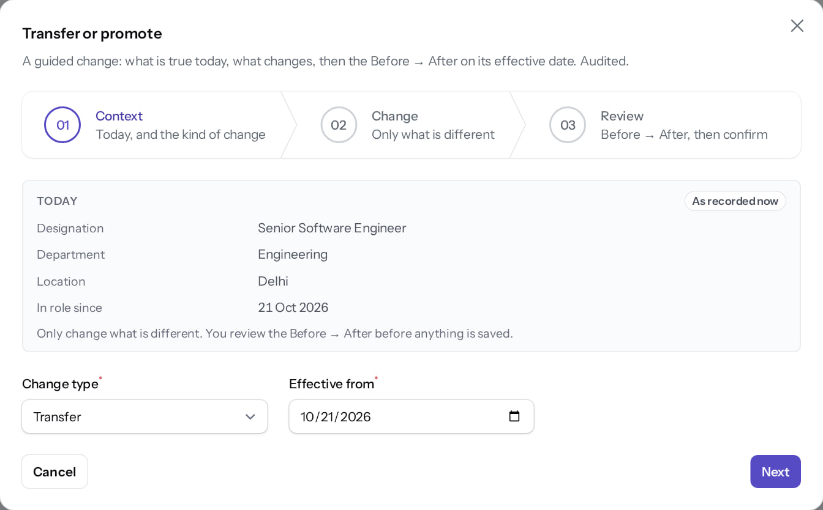
Transfer / promote: 1 Context
CHANGES
Verified in the running application
1
Kind of change.
2
Effective from.
3
Next.
RESULT Three guided steps: Context, Change, Review. This first attempt used today's date (21 Oct) and is refused at the end; the retry with 22 Oct succeeded.
1
2
3
Real screen · Kavya Menon (Tenant HR Admin + Employee) · Employee 360 › Action › Transfer or promote › 01 Context
Notes:
SAY: Three guided steps: Context, Change, Review. This first attempt used today's date (21 Oct) and is refused at the end; the retry with 22 Oct succeeded.
ON SCREEN: Choose the kind of change and the effective date.
WALK THROUGH: (1) Kind of change. (2) Effective from. (3) Next.
LEARNERS SHOULD SEE: Today’s position is shown; three guided steps: Context, Change, Review
SCREEN: Employee 360 › Action › Transfer or promote › 01 Context. Signed in as Kavya Menon (Tenant HR Admin + Employee). Prerequisite: employee.position (Tenant HR Admin, HR Manager).
EVIDENCE: screenshot screenshots/hr-admin/50-chg-01-transfer-context.png, captured 2026-10-21 on the disposable training database (fictional people).

Slide 28
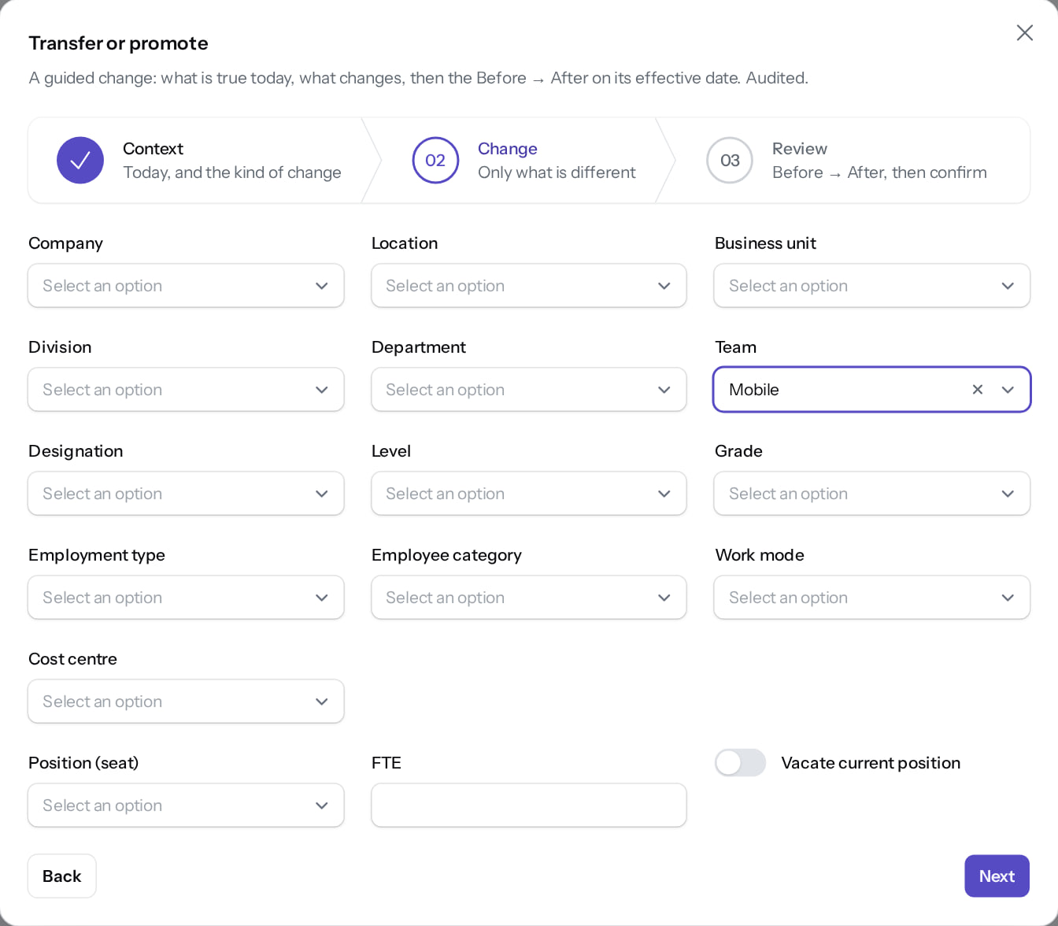
Transfer / promote: 2 Change
CHANGES
Verified in the running application
1
New team.
RESULT Only the field that changes is edited.
1
Real screen · Kavya Menon (Tenant HR Admin + Employee) · Transfer or promote › 02 Change
Notes:
SAY: Only the field that changes is edited.
ON SCREEN: Change only what is different: team Platform → Mobile.
WALK THROUGH: (1) New team.
LEARNERS SHOULD SEE: Only the changed field is edited
SCREEN: Transfer or promote › 02 Change. Signed in as Kavya Menon (Tenant HR Admin + Employee). Prerequisite: employee.position (Tenant HR Admin, HR Manager).
EVIDENCE: screenshot screenshots/hr-admin/50-chg-02-transfer-change.png, captured 2026-10-21 on the disposable training database (fictional people).

Slide 29
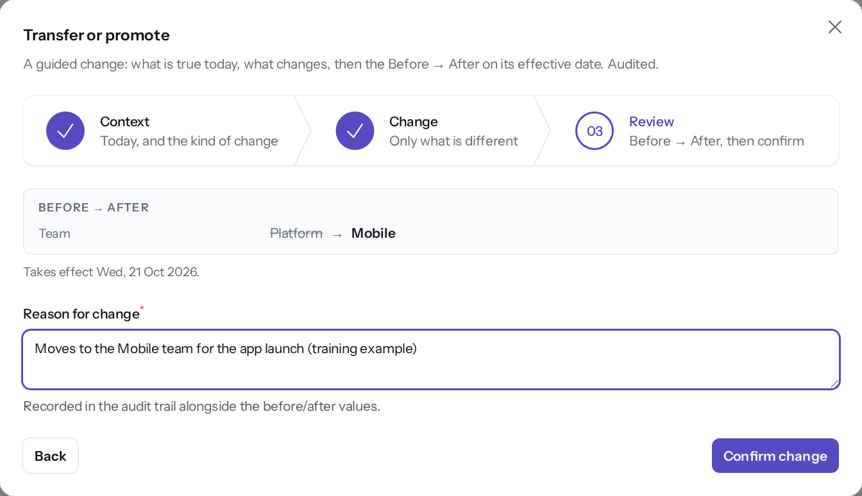
Transfer / promote: 3 Review
CHANGES
Verified in the running application
Before → After panel: today's team and the new team.
1
Reason (audited).
2
Confirm.
RESULT Confirming with today's date is refused (next slide).
1
2
Real screen · Kavya Menon (Tenant HR Admin + Employee) · Transfer or promote › 03 Review
Notes:
SAY: Confirming with today's date is refused (next slide).
ON SCREEN: Review Before → After and give a reason.
WALK THROUGH: (·) Before → After panel: today's team and the new team. (1) Reason (audited). (2) Confirm.
LEARNERS SHOULD SEE: Before → After comparison and the effective date; the reason is stored in the audit trail
SCREEN: Transfer or promote › 03 Review. Signed in as Kavya Menon (Tenant HR Admin + Employee). Prerequisite: employee.position (Tenant HR Admin, HR Manager).
EVIDENCE: screenshot screenshots/hr-admin/50-chg-03-transfer-review.png, captured 2026-10-21 on the disposable training database (fictional people).

Slide 30
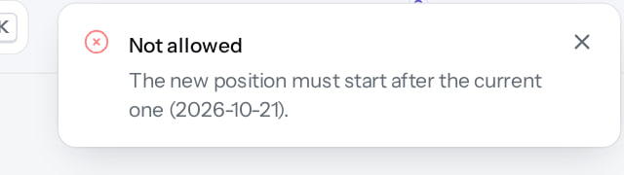
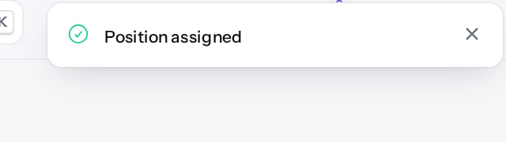
Same-day changes are refused
CHANGES
Effective today (the message)
Verified
Effective tomorrow (the message)
Verified
"Not allowed: The new position must start after the current one (2026-10-21)." Nothing changes.
"Position assigned": scheduled for 22 Oct and shown on the Journey.
Real screen (cropped) · Kavya Menon (Tenant HR Admin + Employee) · Employee 360 (after Confirm change)
Real screen (cropped) · Kavya Menon (Tenant HR Admin + Employee) · Employee 360 (after the transfer)
Notes:
SAY: Same-day changes are refused.
LEFT, Effective today (the message): "Not allowed: The new position must start after the current one (2026-10-21)." Nothing changes.
RIGHT, Effective tomorrow (the message): "Position assigned": scheduled for 22 Oct and shown on the Journey.
OBSERVE: point out what differs between the two screens.
EVIDENCE: left = hr-admin/50-chg-04-transfer-refused-same-day [Kavya Menon (Tenant HR Admin + Employee), Employee 360 (after Confirm change)]; right = hr-admin/50-chg-04b-transfer-done [Kavya Menon (Tenant HR Admin + Employee), Employee 360 (after the transfer)]. Real screens, fictional data (SCREENSHOT-INVENTORY.md).

Slide 31
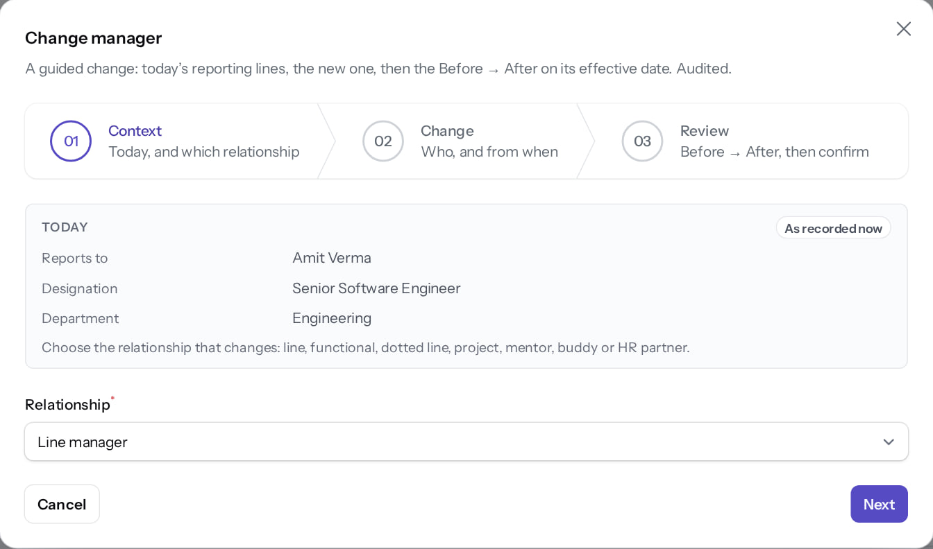
Change manager: 1 Context
CHANGES
Verified in the running application
1
Relationship
RESULT Choose which relationship changes: line, dotted, project, mentor…
1
Real screen · Kavya Menon (Tenant HR Admin + Employee) · Employee 360 › Action › Change manager › 01 Context
Notes:
SAY: Choose which relationship changes: line, dotted, project, mentor…
ON SCREEN: Choose which relationship changes (line, functional, dotted line, HR business partner, mentor …).
WALK THROUGH: (1) Relationship
LEARNERS SHOULD SEE: Relationship type chosen
SCREEN: Employee 360 › Action › Change manager › 01 Context. Signed in as Kavya Menon (Tenant HR Admin + Employee). Prerequisite: employee.position (Tenant HR Admin, HR Manager).
EVIDENCE: screenshot screenshots/hr-admin/50-chg-05-manager-context.png, captured 2026-10-21 on the disposable training database (fictional people).

Slide 32
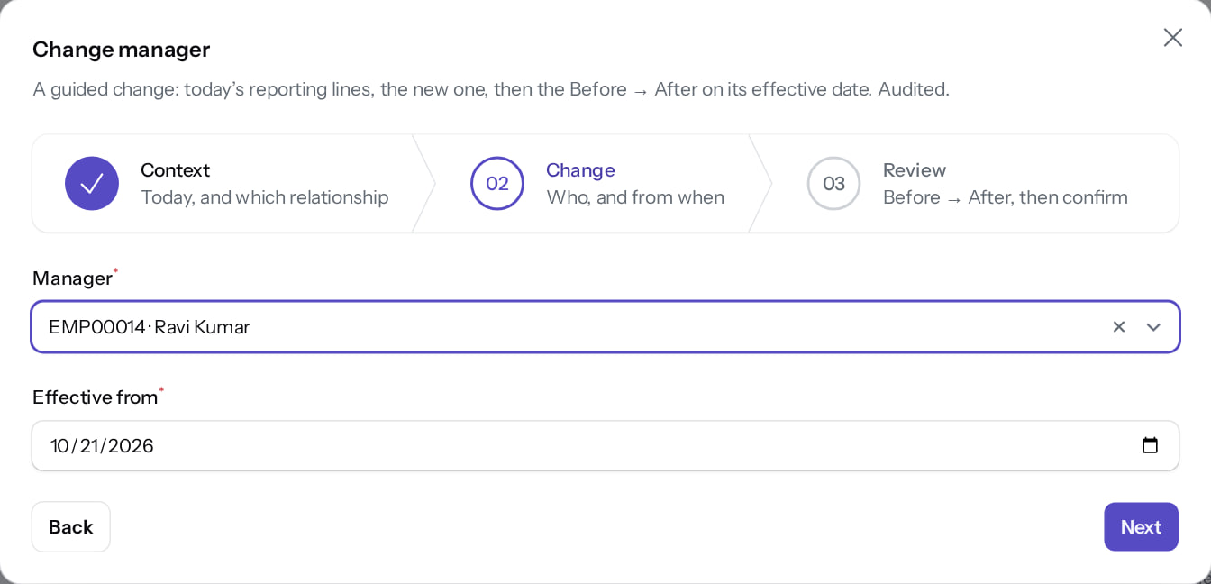
Change manager: 2 Change
CHANGES
Verified in the running application
1
New manager.
RESULT New line manager Ravi Kumar and the date it takes effect. Only employed people are offered.
1
Real screen · Kavya Menon (Tenant HR Admin + Employee) · Change manager › 02 Change
Notes:
SAY: New line manager Ravi Kumar and the date it takes effect. Only employed people are offered.
ON SCREEN: Choose the new manager and the date.
LEARNERS SHOULD SEE: New line manager Ravi Kumar
SCREEN: Change manager › 02 Change. Signed in as Kavya Menon (Tenant HR Admin + Employee). Prerequisite: employee.position (Tenant HR Admin, HR Manager).
EVIDENCE: screenshot screenshots/hr-admin/50-chg-06-manager-change.png, captured 2026-10-21 on the disposable training database (fictional people).

Slide 33
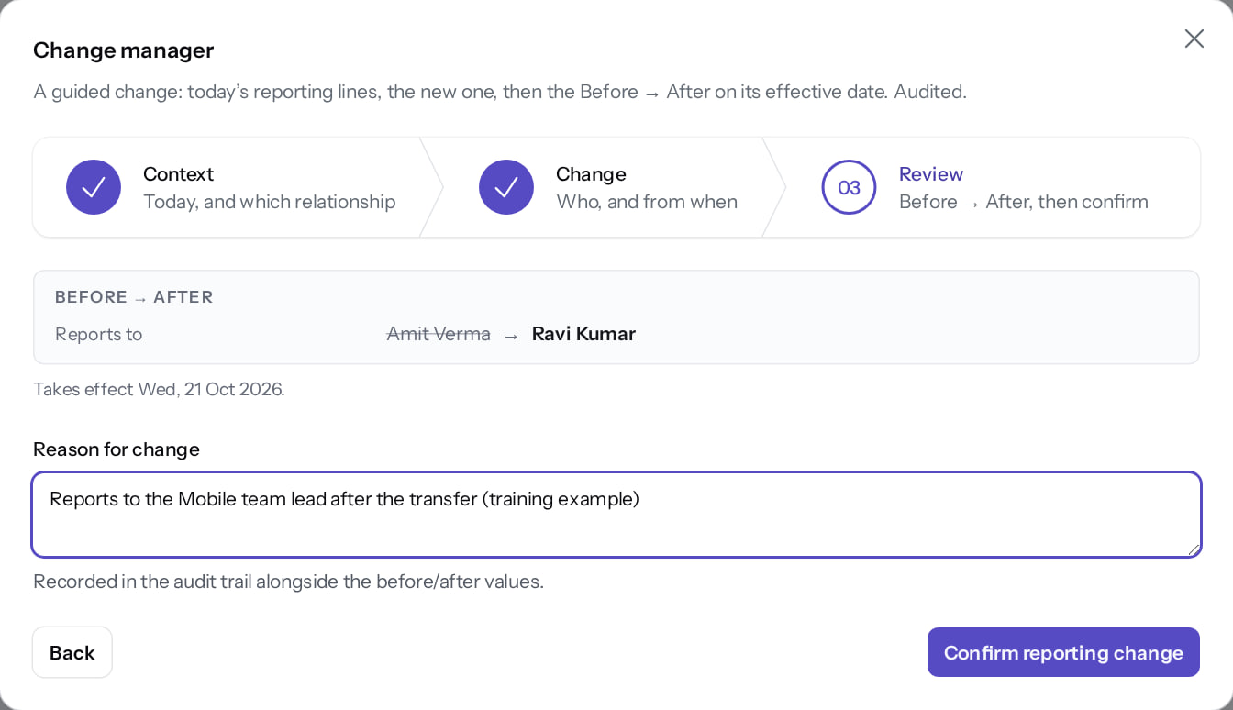
Change manager: 3 Review
CHANGES
Verified in the running application
1
Reason (audited).
2
Confirm.
RESULT Amit Verma → Ravi Kumar, with the reason. Confirm reporting change.
1
2
Real screen · Kavya Menon (Tenant HR Admin + Employee) · Change manager › 03 Review
Notes:
SAY: Amit Verma → Ravi Kumar, with the reason. Confirm reporting change.
ON SCREEN: Review Before → After and give a reason.
LEARNERS SHOULD SEE: Amit Verma → Ravi Kumar, with the reason
SCREEN: Change manager › 03 Review. Signed in as Kavya Menon (Tenant HR Admin + Employee). Prerequisite: employee.position (Tenant HR Admin, HR Manager).
EVIDENCE: screenshot screenshots/hr-admin/50-chg-07-manager-review.png, captured 2026-10-21 on the disposable training database (fictional people).

Slide 34
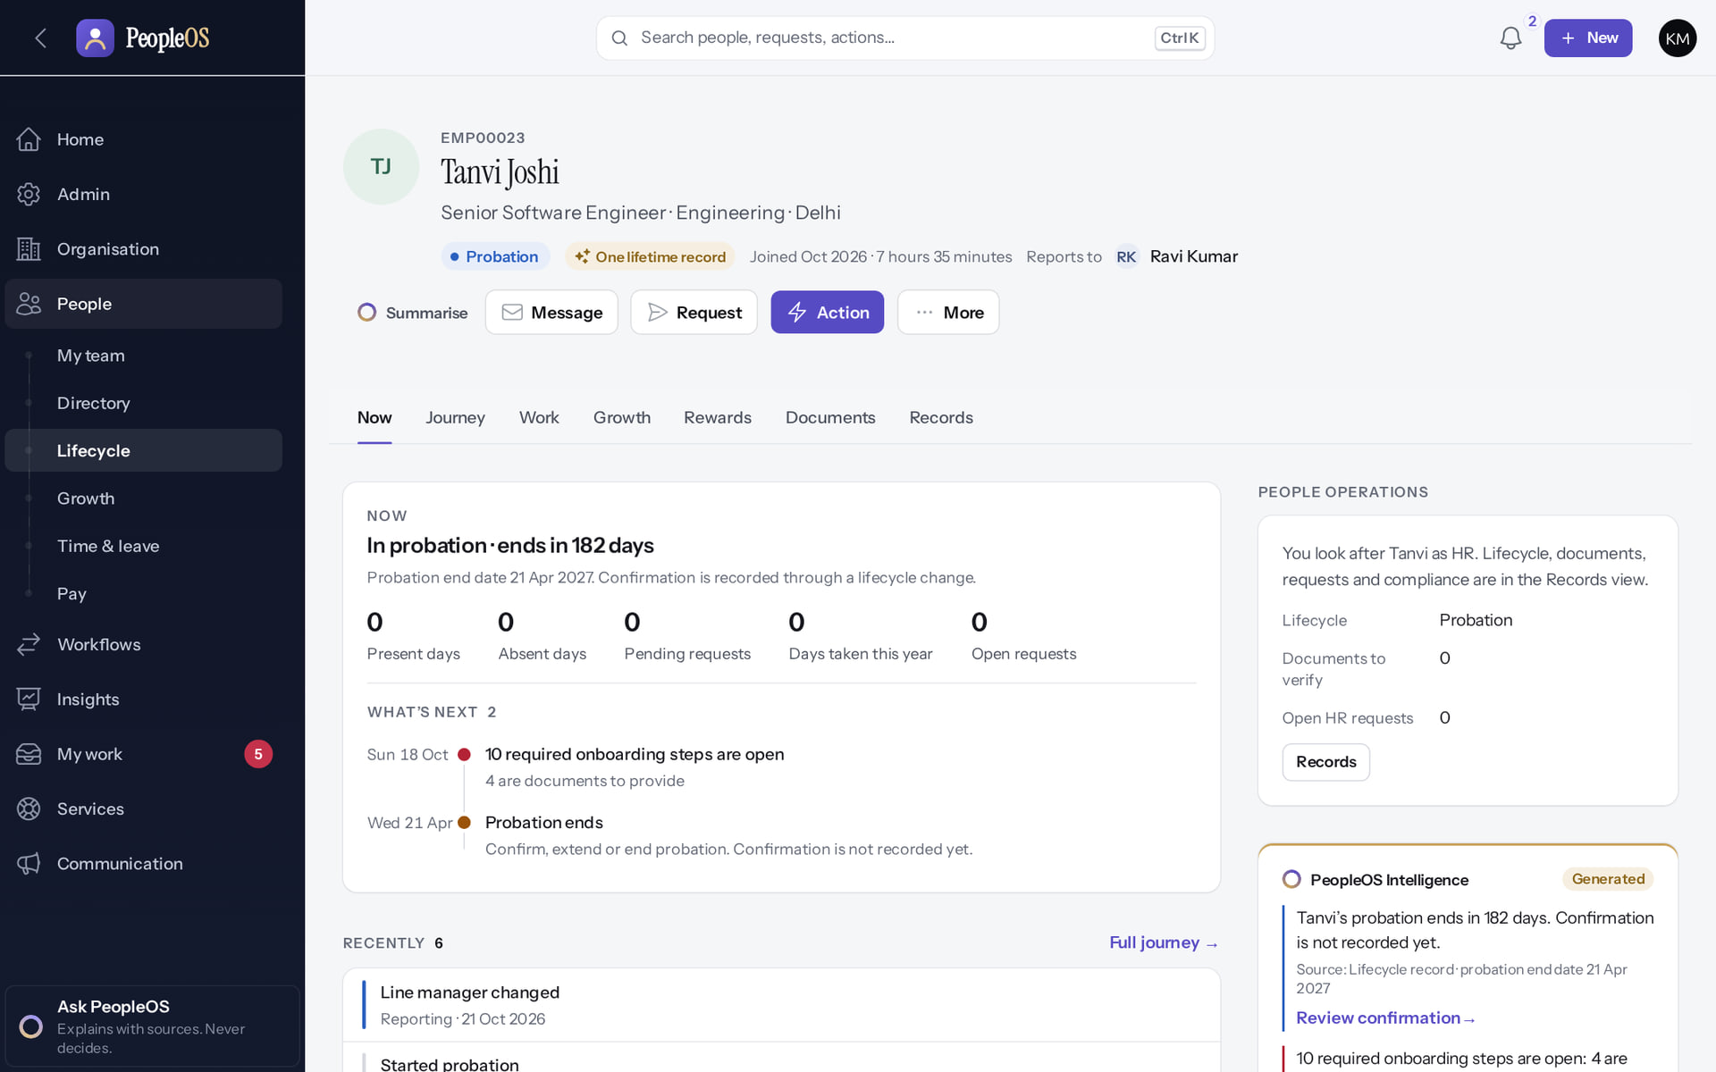
Recorded on the record
CHANGES
Verified in the running application
RESULT Header: Reports to Ravi Kumar. History is never overwritten: the previous line stays with its end date.
Real screen · Kavya Menon (Tenant HR Admin + Employee) · Employee 360 (after the change)
Notes:
SAY: Header: Reports to Ravi Kumar. History is never overwritten: the previous line stays with its end date.
ON SCREEN: Confirm reporting change.
LEARNERS SHOULD SEE: Header: Reports to Ravi Kumar; the change is on the Journey and in History
SCREEN: Employee 360 (after the change). Signed in as Kavya Menon (Tenant HR Admin + Employee). Prerequisite: employee.position (Tenant HR Admin, HR Manager).
EVIDENCE: screenshot screenshots/hr-admin/50-chg-08-manager-done.png, captured 2026-10-21 on the disposable training database (fictional people).

Slide 35
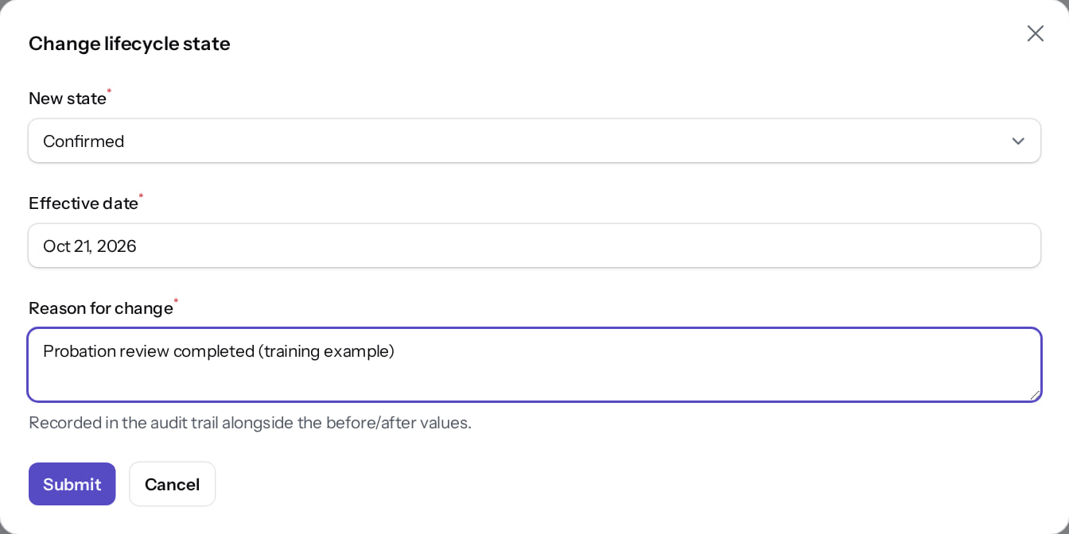
Change lifecycle state
CHANGES
Verified in the running application
1
Allowed next states.
1
2
Effective date.
3
Reason (required).
2
RESULT Only allowed next states; effective date and reason required. Opened and cancelled here. Exit uses the exit case, not this dialog.
3
Real screen · Kavya Menon (Tenant HR Admin + Employee) · Employee 360 › Action › Change lifecycle state
Notes:
SAY: Only allowed next states; effective date and reason required. Opened and cancelled here. Exit uses the exit case, not this dialog.
ON SCREEN: Choose the new state (only allowed next states are offered), the effective date and a reason.
LEARNERS SHOULD SEE: Opened and filled; cancelled in this demonstration
SCREEN: Employee 360 › Action › Change lifecycle state. Signed in as Kavya Menon (Tenant HR Admin + Employee). Prerequisite: employee.lifecycle (Tenant HR Admin, HR Manager).
EVIDENCE: screenshot screenshots/hr-admin/50-chg-09-lifecycle-modal.png, captured 2026-10-21 on the disposable training database (fictional people).

Slide 36
Onboarding
04
A plan starts on hire; tasks go to HR, the manager and the new joiner.
Notes:
TRANSITION: Section 4, Onboarding. A plan starts on hire; tasks go to HR, the manager and the new joiner.
SAY: Tell learners what they will be able to do by the end of this section, then move on.
ASK: "What questions do you have before we start this section?"

Slide 37
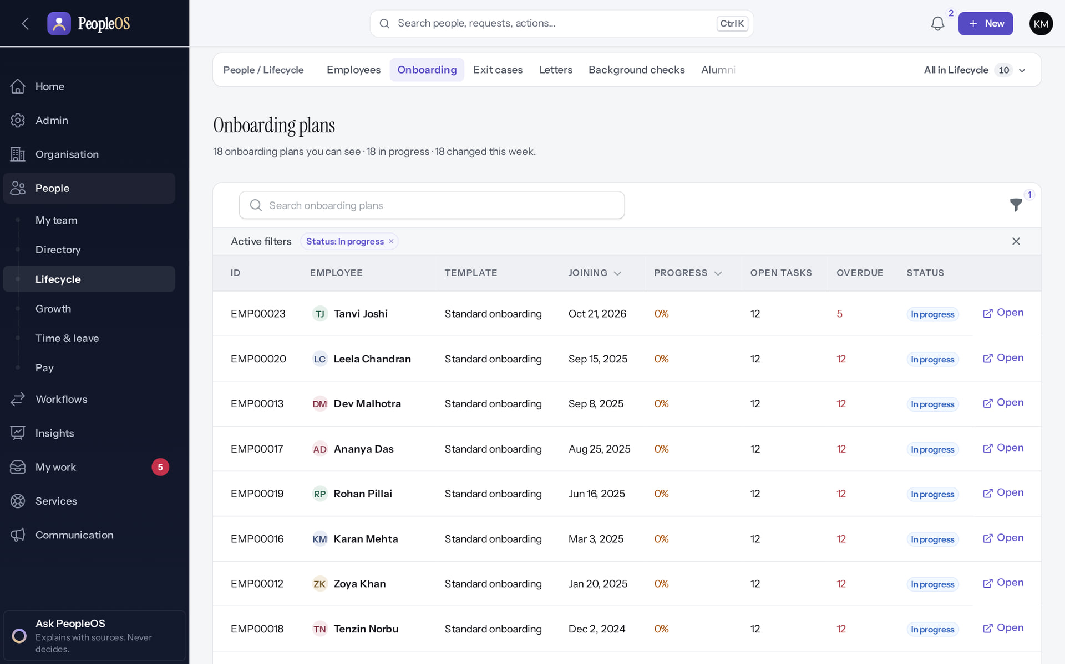
Onboarding plans
ONBOARDING
Verified in the running application
1
Auto-started plan.
2
Progress.
RESULT Plans in progress with joining date, progress, open and overdue tasks. The new hire's plan started automatically.
2
1
Real screen · Kavya Menon (Tenant HR Admin + Employee) · People › Lifecycle › Onboarding
Notes:
SAY: Plans in progress with joining date, progress, open and overdue tasks. The new hire's plan started automatically.
ON SCREEN: Open Onboarding.
LEARNERS SHOULD SEE: Plans in progress with joining date, progress, open and overdue tasks; the new hire’s plan started automatically
SCREEN: People › Lifecycle › Onboarding. Signed in as Kavya Menon (Tenant HR Admin + Employee). Prerequisite: onboarding.view / onboarding.manage; plans start automatically on hire (template conditions).
EVIDENCE: screenshot screenshots/hr-admin/50-onb-01-plans.png, captured 2026-10-21 on the disposable training database (fictional people).

Slide 38
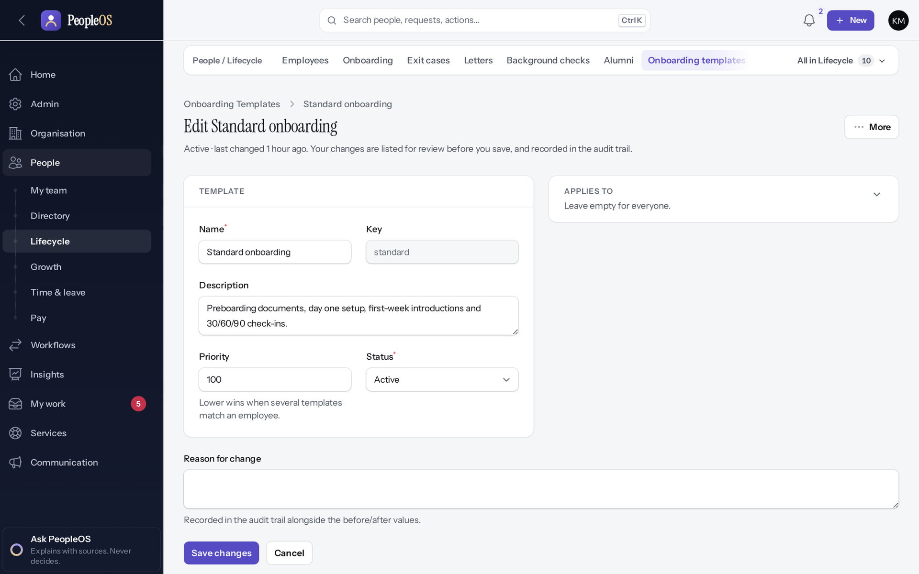
Onboarding template
ONBOARDING
Verified in the running application
1
Priority.
2
Applies to.
2
RESULT Name, priority (lower wins), status and Applies to conditions; checklist items with phase, owner and due days.
1
Real screen · Kavya Menon (Tenant HR Admin + Employee) · People › Lifecycle › Onboarding templates › Edit Standard onboarding
Notes:
SAY: Name, priority (lower wins), status and Applies to conditions; checklist items with phase, owner and due days.
ON SCREEN: Open the template.
LEARNERS SHOULD SEE: Name, key, description, priority (lower wins), status, Applies to conditions, reason for change; Checklist items and History tabs below
SCREEN: People › Lifecycle › Onboarding templates › Edit Standard onboarding. Signed in as Kavya Menon (Tenant HR Admin + Employee). Prerequisite: onboarding.manage.
EVIDENCE: screenshot screenshots/hr-admin/50-onb-02-template.png, captured 2026-10-21 on the disposable training database (fictional people).

Slide 39
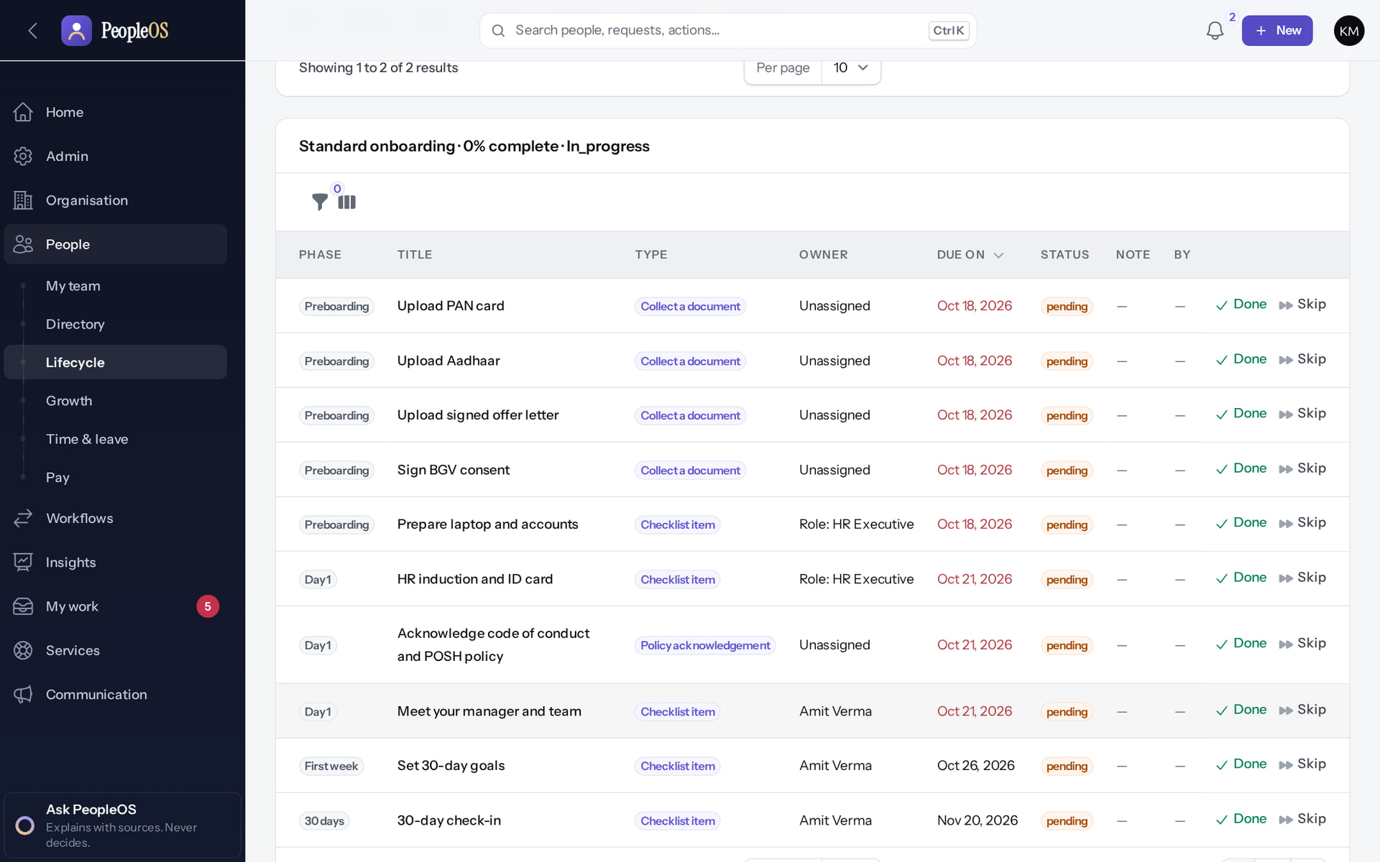
Tasks on the plan
ONBOARDING
Verified in the running application
1
Task.
2
Done.
3
Skip (note required).
RESULT By phase (Preboarding, Day 1, First week, 30 days), with owner, due date and status; Done or Skip per task.
2
3
1
Real screen · Kavya Menon (Tenant HR Admin + Employee) · Employee 360 › Records › Employment › Onboarding
Notes:
SAY: By phase (Preboarding, Day 1, First week, 30 days), with owner, due date and status; Done or Skip per task.
ON SCREEN: Open the new hire’s onboarding plan.
LEARNERS SHOULD SEE: Tasks by phase (Preboarding, Day 1, First week, 30 days), type, owner, due date, status; Done / Skip per task
SCREEN: Employee 360 › Records › Employment › Onboarding. Signed in as Kavya Menon (Tenant HR Admin + Employee). Prerequisite: onboarding.view / onboarding.manage; plans start automatically on hire (template conditions).
EVIDENCE: screenshot screenshots/hr-admin/50-onb-03-plan-tasks.png, captured 2026-10-21 on the disposable training database (fictional people).

Slide 40
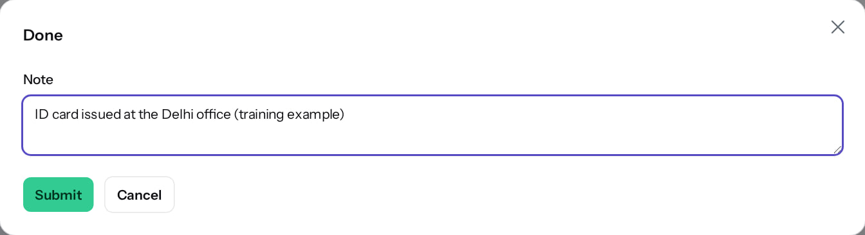
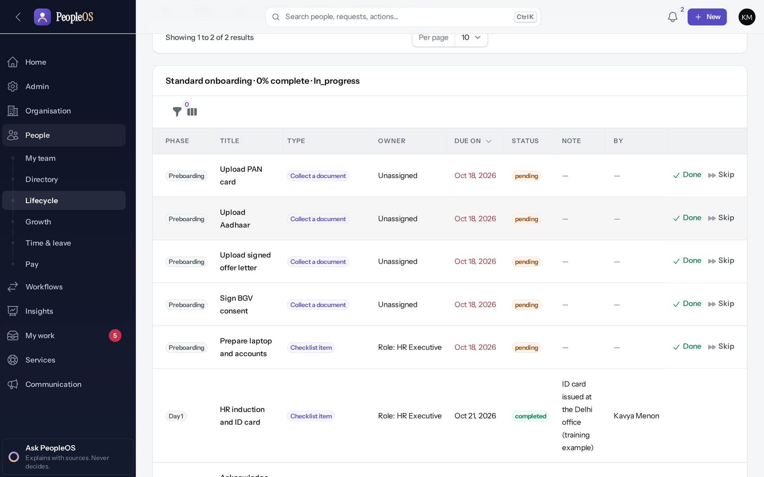
Complete a task
ONBOARDING
Done
Verified
Completed
Verified
Confirm completion; document tasks require the document.
Status done with who and when (the plan's progress figure updates after a refresh).
Real screen · Kavya Menon (Tenant HR Admin + Employee) · Onboarding task › Done
Real screen · Kavya Menon (Tenant HR Admin + Employee) · Employee 360 › Records › Employment › Onboarding (after Done)
Notes:
SAY: Complete a task.
LEFT, Done: Confirm completion; document tasks require the document.
RIGHT, Completed: Status done with who and when (the plan's progress figure updates after a refresh).
OBSERVE: point out what differs between the two screens.
EVIDENCE: left = hr-admin/50-onb-04-task-done-confirm [Kavya Menon (Tenant HR Admin + Employee), Onboarding task › Done]; right = hr-admin/50-onb-05-task-completed [Kavya Menon (Tenant HR Admin + Employee), Employee 360 › Records › Employment › Onboarding (after Done)]. Real screens, fictional data (SCREENSHOT-INVENTORY.md).

Slide 41
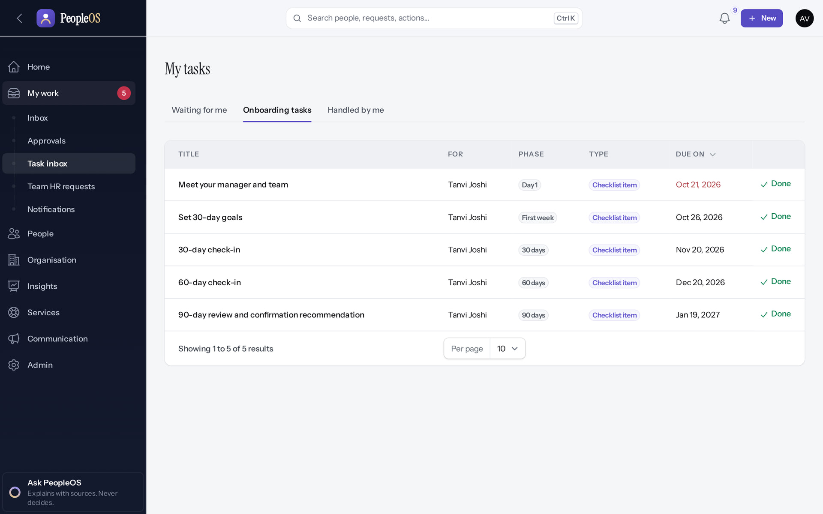
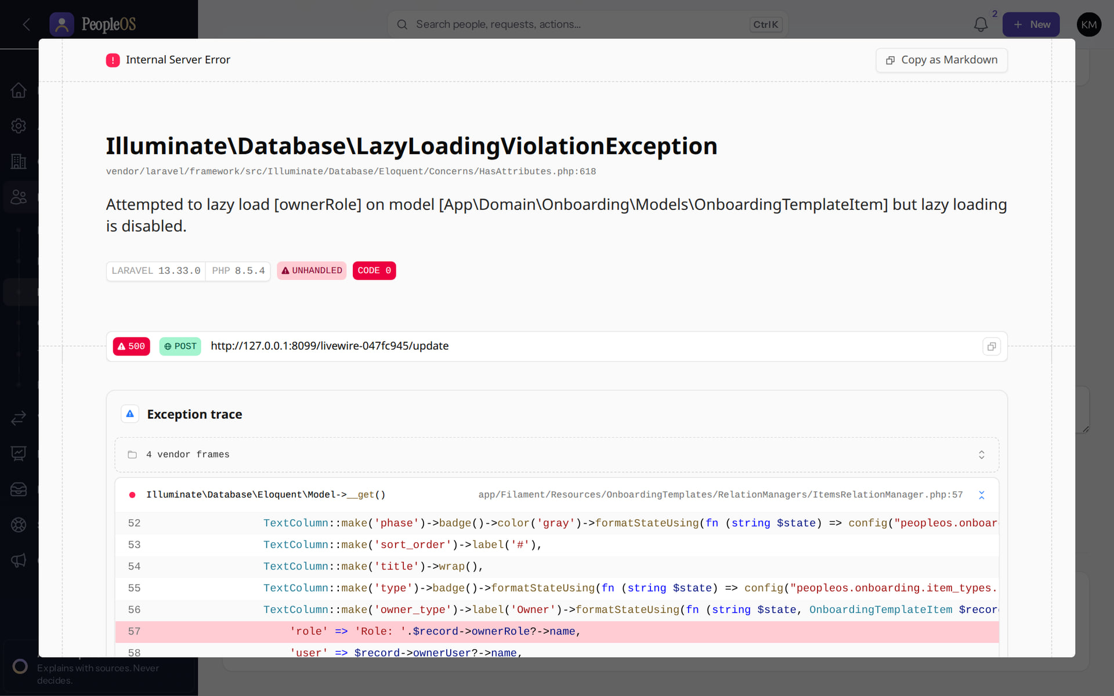
Manager tasks, and a template error
ONBOARDING
Manager's Task inbox
Verified
Template › Checklist items
Incomplete
Tasks assigned to the manager: meet the team, 30-day goals, check-in; Done / Skip.
LazyLoadingViolationException in development mode (new finding). Items were edited before this error appeared in the demo.
Real screen · Amit Verma (Manager + Employee) · My work › Task inbox › Onboarding tasks
Real screen · Kavya Menon (Tenant HR Admin + Employee) · Onboarding templates › Edit › Checklist items
Notes:
Shown here as the local debug page (development mode). In production the user sees a generic server-error dialog; the cause is the same.
SAY: Manager tasks, and a template error.
LEFT, Manager's Task inbox: Tasks assigned to the manager: meet the team, 30-day goals, check-in; Done / Skip.
RIGHT, Template › Checklist items: LazyLoadingViolationException in development mode (new finding). Items were edited before this error appeared in the demo.
OBSERVE: point out what differs between the two screens.
EVIDENCE: left = manager/50-onb-06-manager-onboarding-tasks [Amit Verma (Manager + Employee), My work › Task inbox › Onboarding tasks]; right = support/50-onb-err-01-template-items-lazy-loading [Kavya Menon (Tenant HR Admin + Employee), Onboarding templates › Edit › Checklist items]. Real screens, fictional data (SCREENSHOT-INVENTORY.md).

Slide 42
Employee documents
05
Upload by one person, verification by another.
Notes:
TRANSITION: Section 5, Employee documents. Upload by one person, verification by another.
SAY: Tell learners what they will be able to do by the end of this section, then move on.
ASK: "What questions do you have before we start this section?"

Slide 43
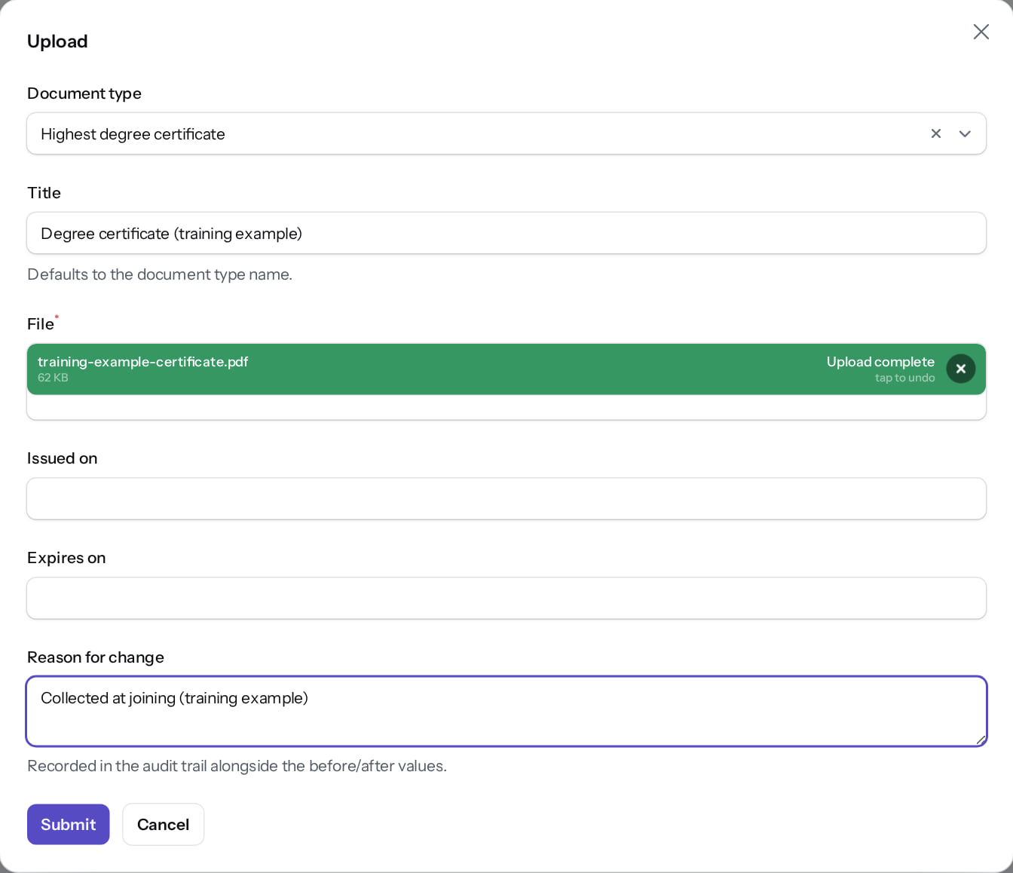
Upload a document
DOCUMENTS
Verified in the running application
1
Document type.
1
2
Title.
2
3
File.
4
Reason.
3
RESULT PDF, JPEG, PNG or Word, up to 10 MB. Saved as Pending verification.
4
Real screen · Kavya Menon (Tenant HR Admin + Employee) · Employee 360 › Records › Operations › Documents › Upload
Notes:
SAY: PDF, JPEG, PNG or Word, up to 10 MB. Saved as Pending verification.
ON SCREEN: Upload a document for the employee: type, title, file (PDF/JPEG/PNG/Word, max 10 MB), dates, reason.
LEARNERS SHOULD SEE: File attached; Submit saves it as Pending verification
SCREEN: Employee 360 › Records › Operations › Documents › Upload. Signed in as Kavya Menon (Tenant HR Admin + Employee). Prerequisite: document.upload (Tenant HR Admin, HR Manager, HR Executive); document.verify (Tenant HR Admin, HR Manager); the uploader cannot verify.
EVIDENCE: screenshot screenshots/hr-admin/50-doc-01-upload-form.png, captured 2026-10-21 on the disposable training database (fictional people).

Slide 44
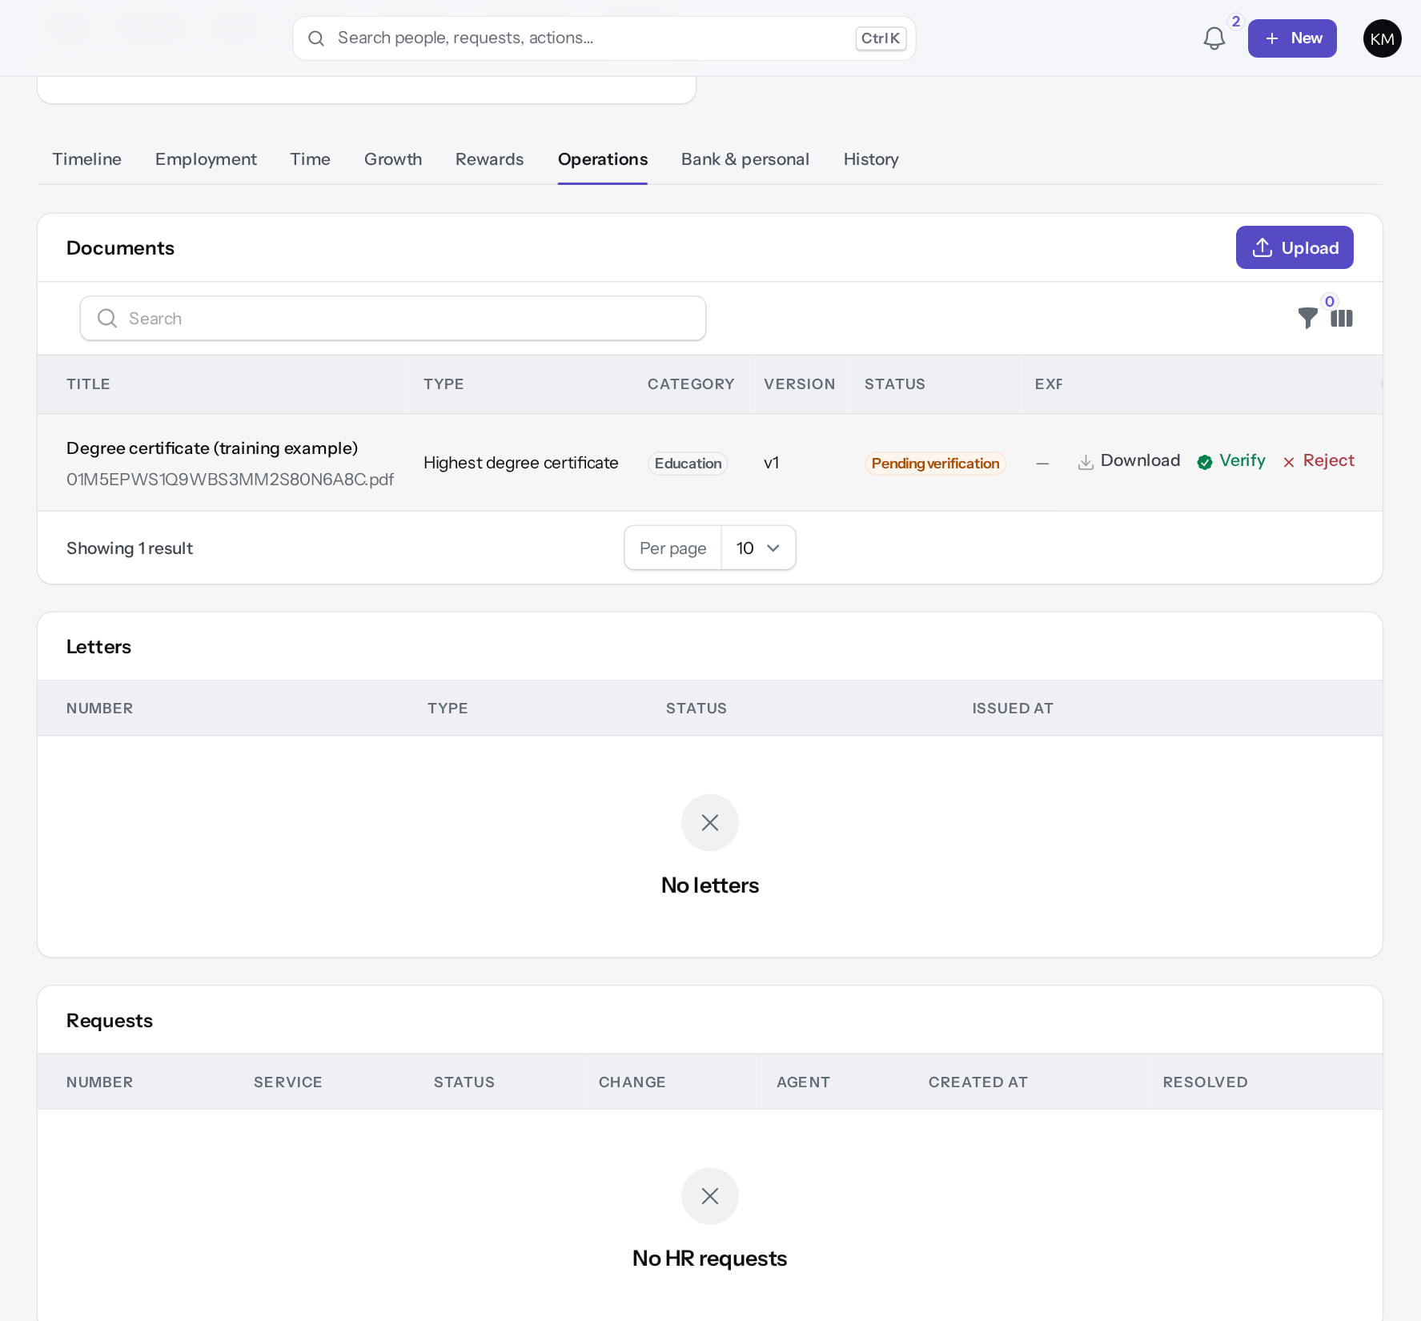
Pending verification
DOCUMENTS
Verified in the running application
RESULT Download (10-minute link), Verify and Reject.
Real screen (cropped) · Kavya Menon (Tenant HR Admin + Employee) · Employee 360 › Records › Operations › Documents
Notes:
SAY: Download (10-minute link), Verify and Reject.
ON SCREEN: Submit.
LEARNERS SHOULD SEE: The document is listed as Pending verification with Download, Verify and Reject
SCREEN: Employee 360 › Records › Operations › Documents. Signed in as Kavya Menon (Tenant HR Admin + Employee). Prerequisite: document.upload (Tenant HR Admin, HR Manager, HR Executive); document.verify (Tenant HR Admin, HR Manager); the uploader cannot verify.
EVIDENCE: screenshot screenshots/hr-admin/50-doc-02-uploaded-pending.png, captured 2026-10-21 on the disposable training database (fictional people).

Slide 45
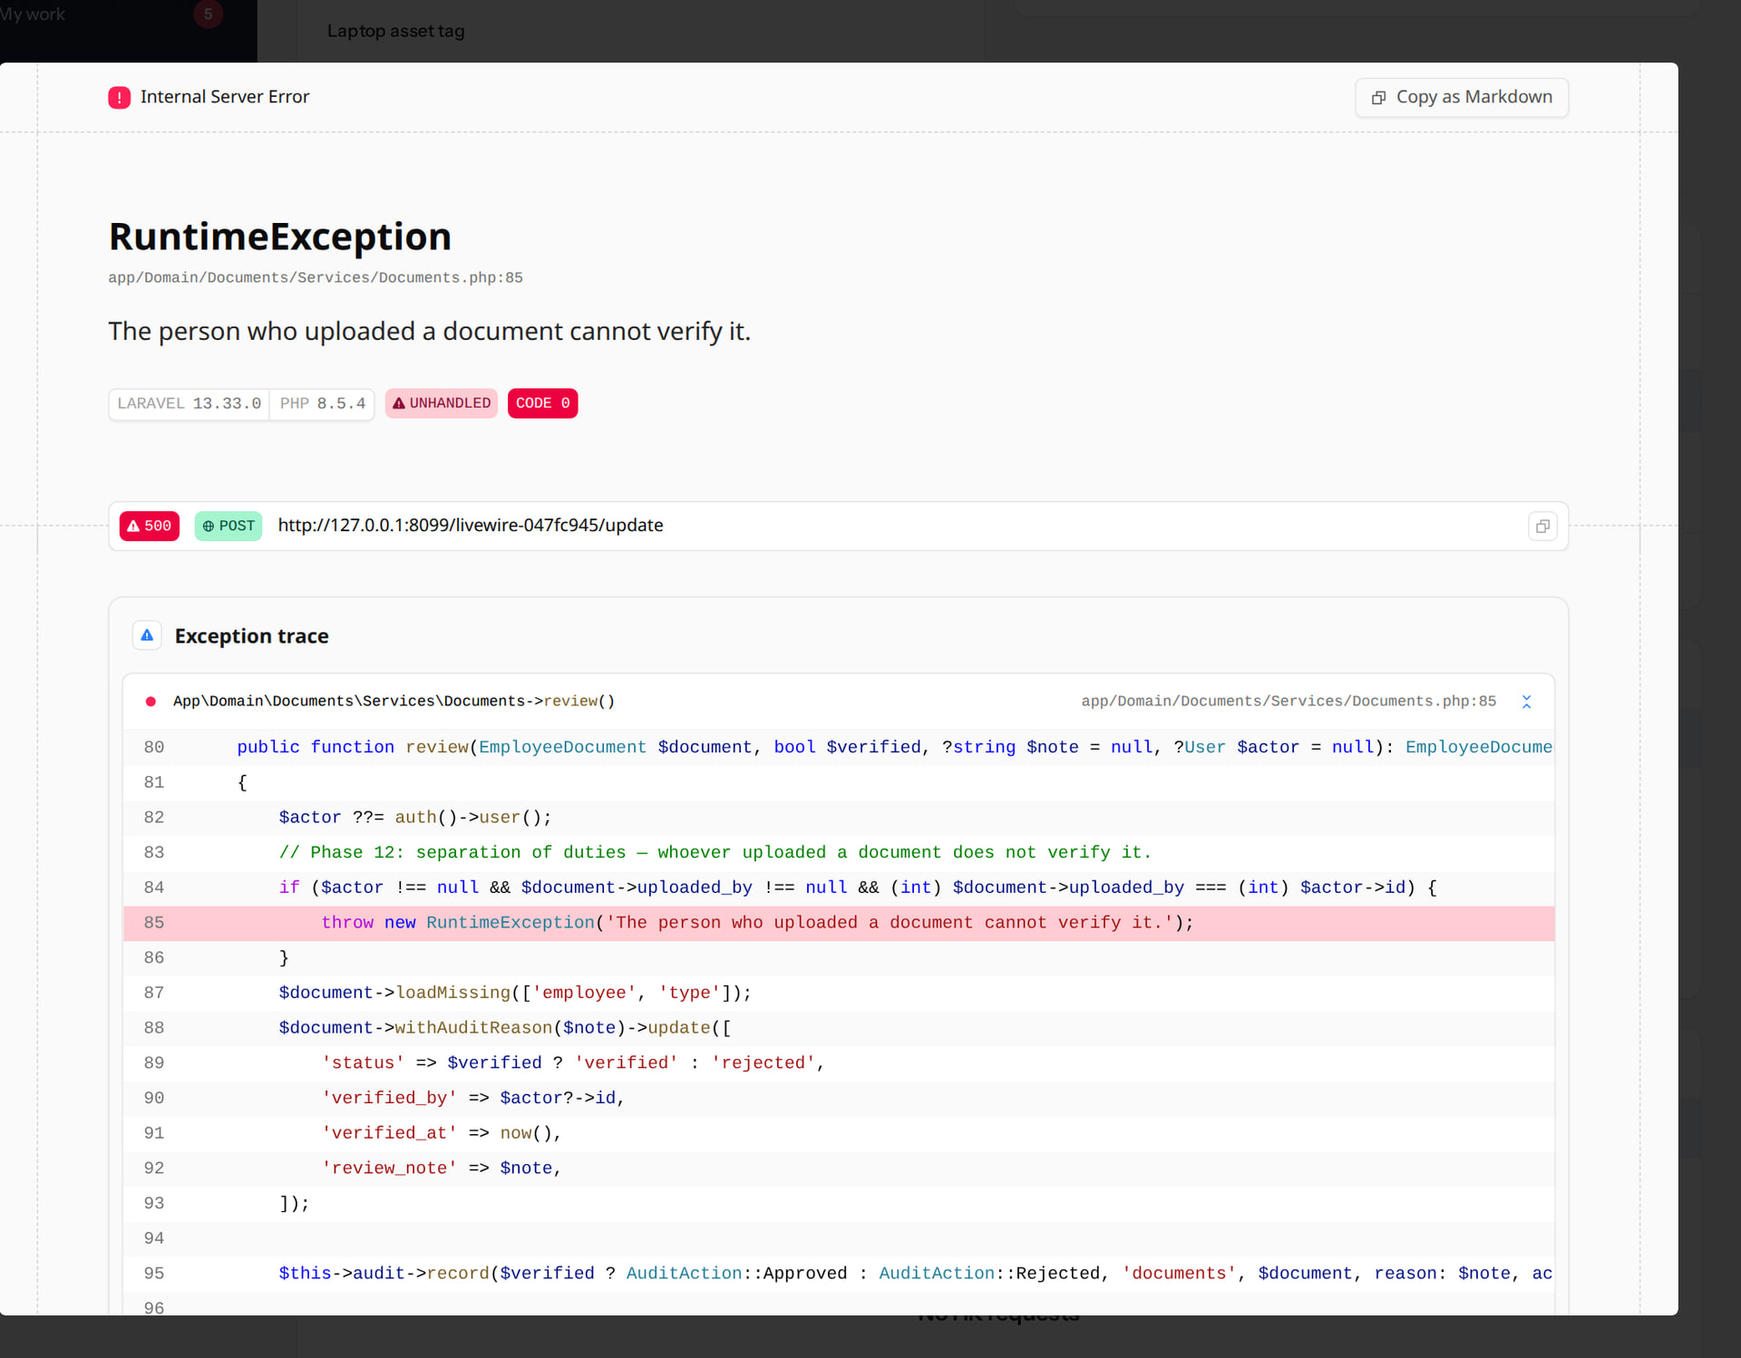
The uploader cannot verify
DOCUMENTS
Incomplete · known defect or gap
RESULT The rule holds ("The person who uploaded a document cannot verify it.") but it surfaces as a server error instead of a message. Nothing is changed. Ask a second HR person to verify.
Real screen (cropped) · Kavya Menon (Tenant HR Admin + Employee) · Employee 360 › Records › Operations › Documents
Notes:
Shown here as the local debug page (development mode). In production the user sees a generic server-error dialog; the cause is the same.
NEW FINDING (21 Oct 2026): separation of duties works, but the refusal is an unhandled RuntimeException rather than a notification.

Slide 46

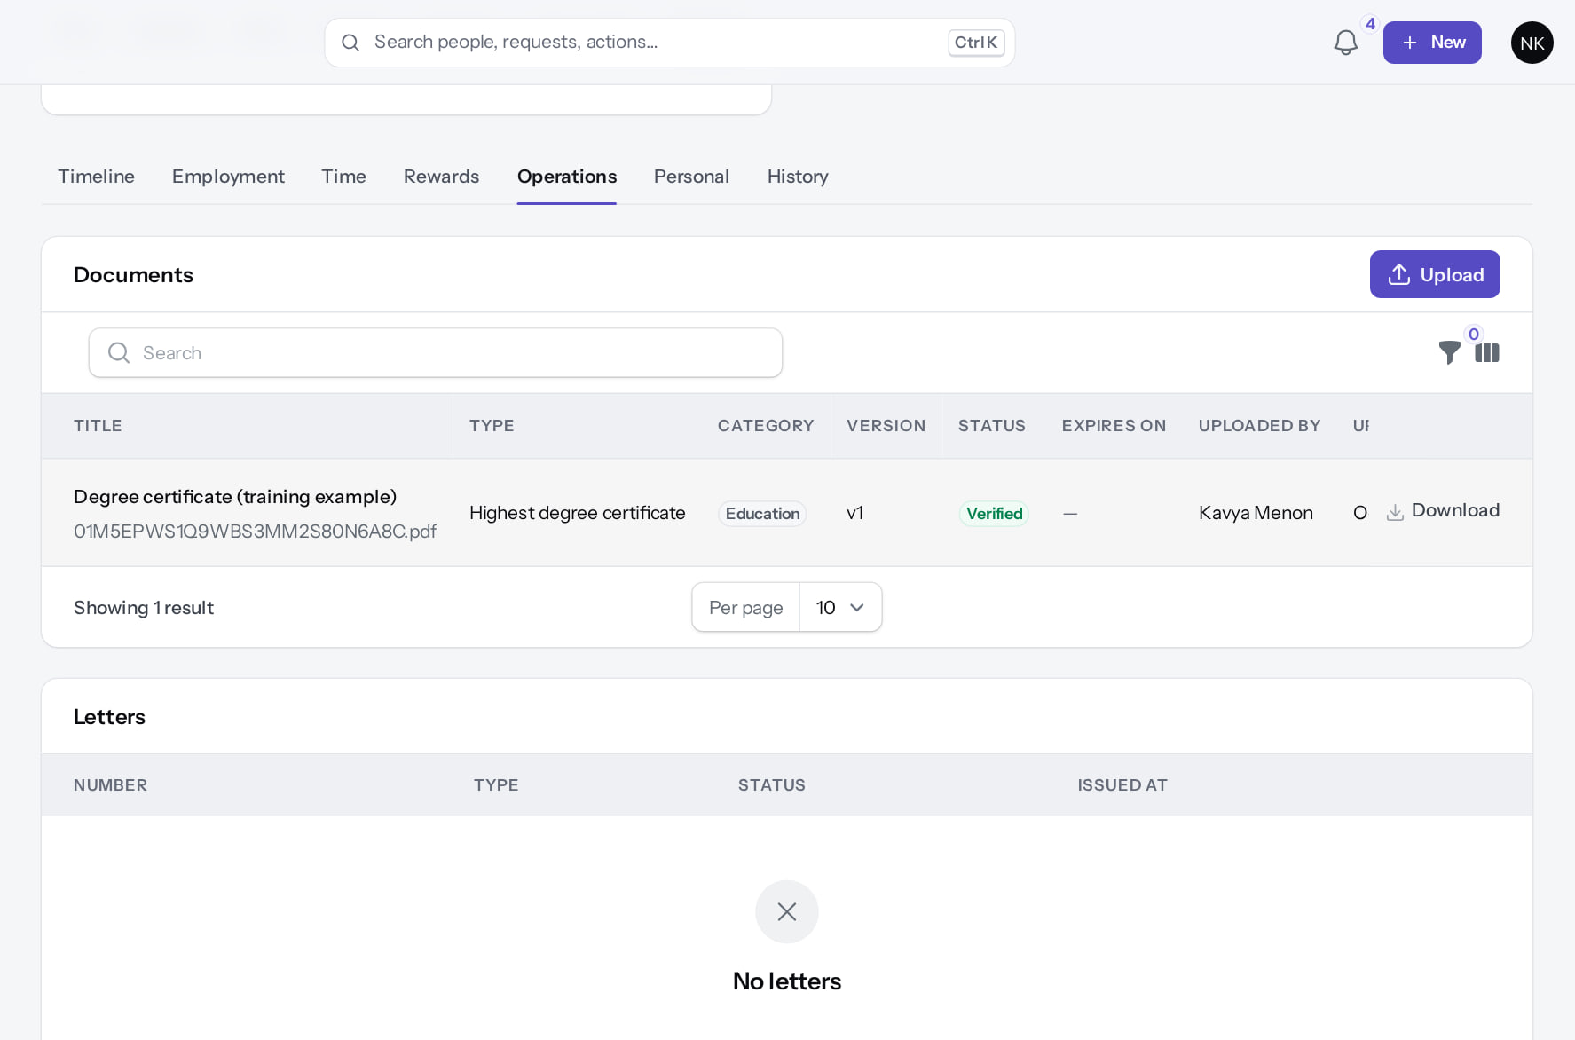
A second HR person verifies
DOCUMENTS
Verify
Verified
Verified
Verified
Neha Kapoor (HR Manager) verifies a document Kavya uploaded.
Status Verified, with who verified it.
Real screen · Neha Kapoor (HR Manager + Employee) · Documents › Verify (second HR person)
Real screen (cropped) · Neha Kapoor (HR Manager + Employee) · Employee 360 › Records › Operations › Documents (after Verify)
Notes:
SAY: A second HR person verifies.
LEFT, Verify: Neha Kapoor (HR Manager) verifies a document Kavya uploaded.
RIGHT, Verified: Status Verified, with who verified it.
OBSERVE: point out what differs between the two screens.
EVIDENCE: left = hr-admin/50-doc-04-verify-confirm [Neha Kapoor (HR Manager + Employee), Documents › Verify (second HR person)]; right = hr-admin/50-doc-05-verified [Neha Kapoor (HR Manager + Employee), Employee 360 › Records › Operations › Documents (after Verify)]. Real screens, fictional data (SCREENSHOT-INVENTORY.md).

Slide 47
Attendance administration
06
Punches become records when the day is processed.
Notes:
TRANSITION: Section 6, Attendance administration. Punches become records when the day is processed.
SAY: Tell learners what they will be able to do by the end of this section, then move on.
ASK: "What questions do you have before we start this section?"

Slide 48
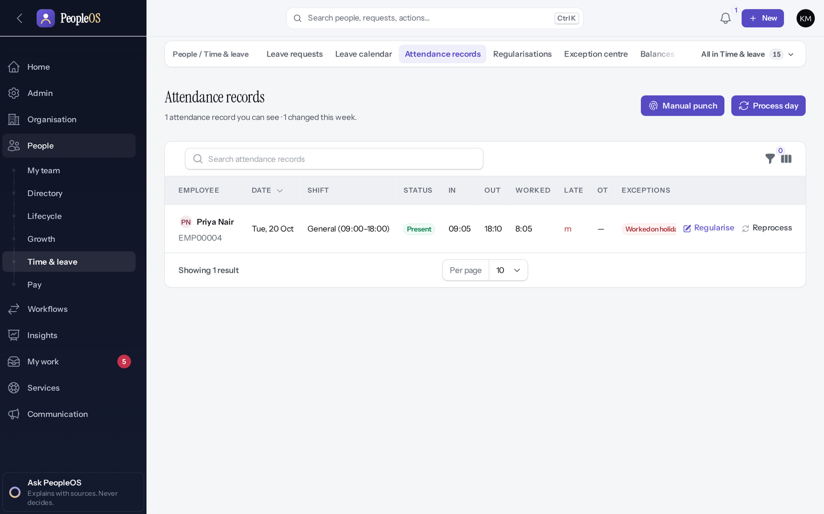
Attendance records and the two HR actions
ATTENDANCE ADMINISTRATION
Verified in the running application
1
2
1
Manual punch: record a punch when a device was offline.
2
Process day: turn punches and approved corrections into attendance records.
RESULT Both need the attendance.manage permission (Tenant HR Admin, Attendance Admin).
Real screen · Kavya Menon (Tenant HR Admin + Employee) · Attendance records
Notes:
SAY: Both need the attendance.manage permission (Tenant HR Admin, Attendance Admin).
ON SCREEN: People › Time & leave › Attendance records.
WALK THROUGH: (1) Manual punch: record a punch when a device was offline. (2) Process day: turn punches and approved corrections into attendance records.
LEARNERS SHOULD SEE: Header actions Manual punch and Process day
SCREEN: Attendance records. Signed in as Kavya Menon (Tenant HR Admin + Employee).
EVIDENCE: screenshot screenshots/hr-admin/20-att-10-records-before.png, captured 2026-10-21 on the disposable training database (fictional people).

Slide 49
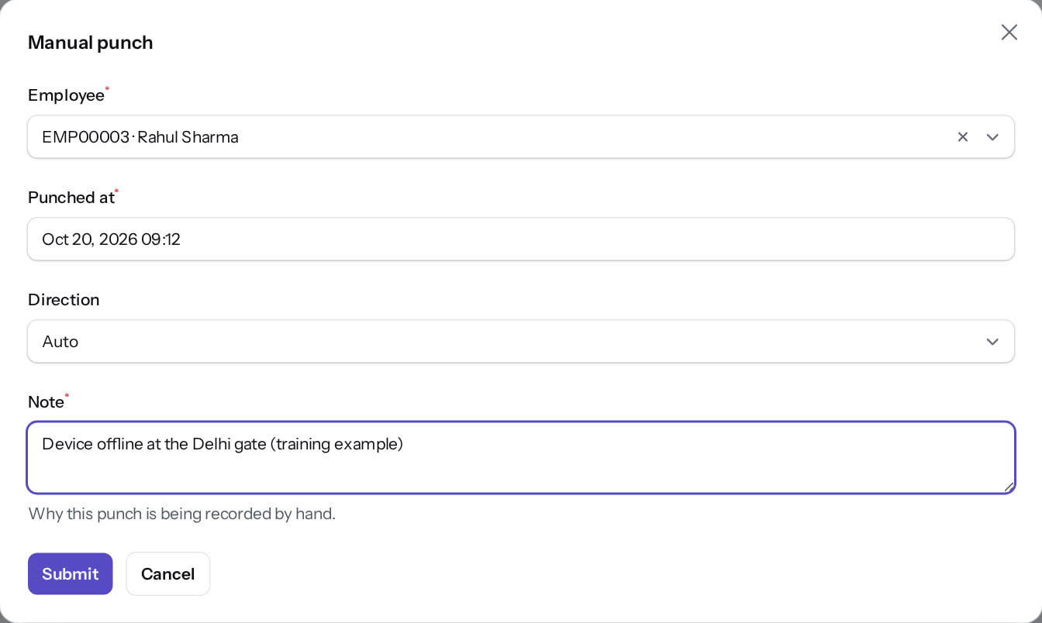
Record a manual punch
ATTENDANCE ADMINISTRATION
Verified in the running application
1
When the punch happened.
2
Direction (Auto, In or Out).
3
A note explaining why.
1
RESULT "Punch recorded and day reprocessed". The punch is stored with source "manual".
2
3
Real screen · Kavya Menon (Tenant HR Admin + Employee) · Manual punch (dialog)
Notes:
EVIDENCE: Executed on the training database on 21 Oct 2026 (tools/capture/20-attendance-flow.mjs): Priya checked in, corrected a missed punch for 20 Oct, Amit approved it, Kavya Menon (Tenant HR Admin) recorded a manual punch and processed the day.
AVOID: using manual punches to fix systematic device problems; raise those with your administrator.

Slide 50
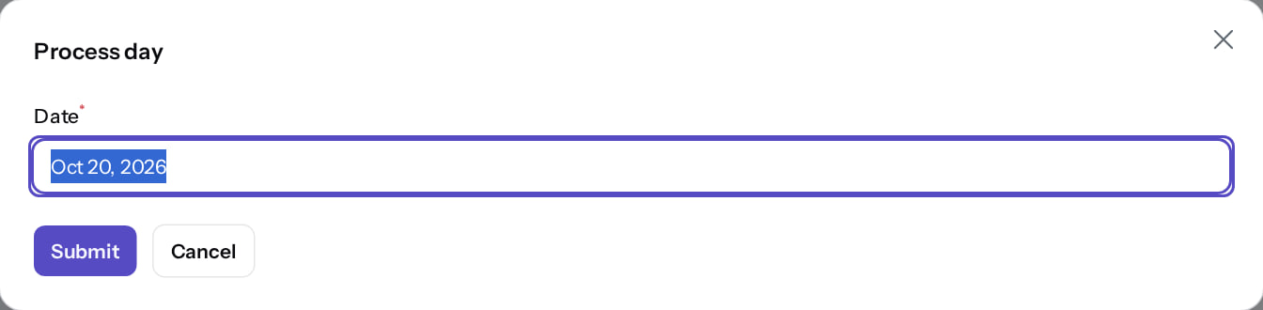
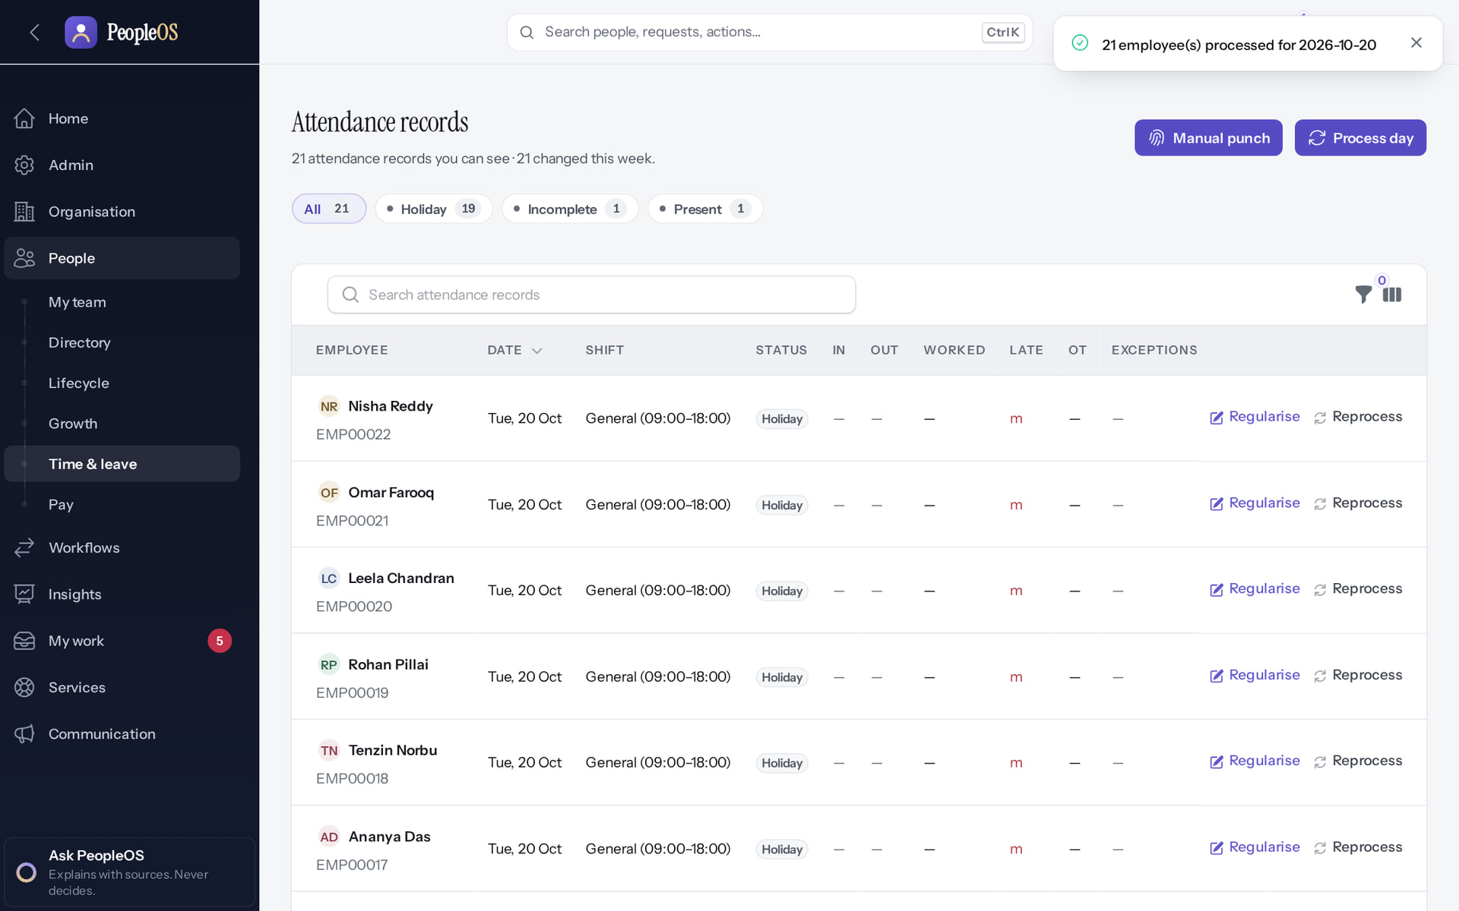
Process a day
ATTENDANCE ADMINISTRATION
Process day dialog
Verified
Result
Verified
Choose the date and Submit.
"21 employee(s) processed for 2026-10-20". Records show shift, status, in/out, worked time and exceptions.
Real screen · Kavya Menon (Tenant HR Admin + Employee) · Process day (dialog)
Real screen · Kavya Menon (Tenant HR Admin + Employee) · Attendance records (after Process day)
Notes:
EVIDENCE: Executed on the training database on 21 Oct 2026 (tools/capture/20-attendance-flow.mjs): Priya checked in, corrected a missed punch for 20 Oct, Amit approved it, Kavya Menon (Tenant HR Admin) recorded a manual punch and processed the day.
SAY: Process a day.
LEFT, Process day dialog: Choose the date and Submit.
RIGHT, Result: "21 employee(s) processed for 2026-10-20". Records show shift, status, in/out, worked time and exceptions.
OBSERVE: point out what differs between the two screens.
EVIDENCE: left = hr-admin/20-att-12-process-day [Kavya Menon (Tenant HR Admin + Employee), Process day (dialog)]; right = hr-admin/20-att-13-day-processed [Kavya Menon (Tenant HR Admin + Employee), Attendance records (after Process day)]. Real screens, fictional data (SCREENSHOT-INVENTORY.md).

Slide 51
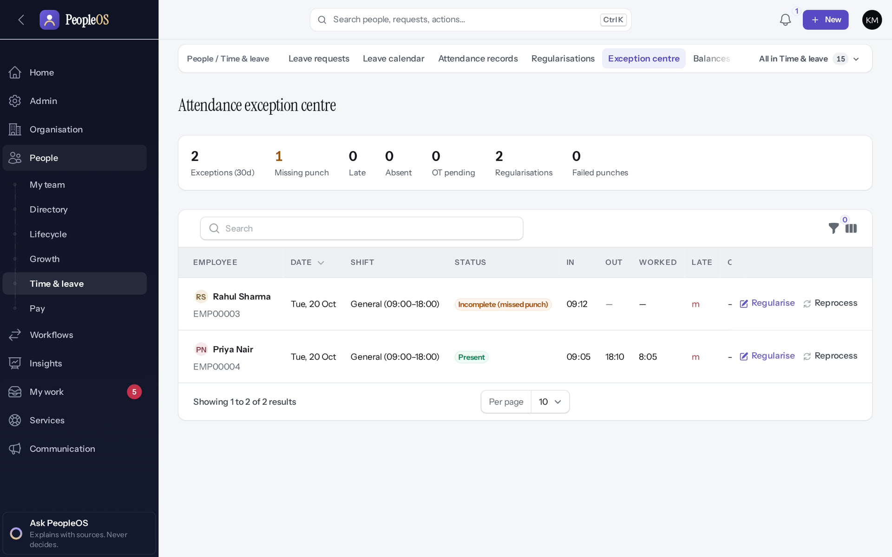
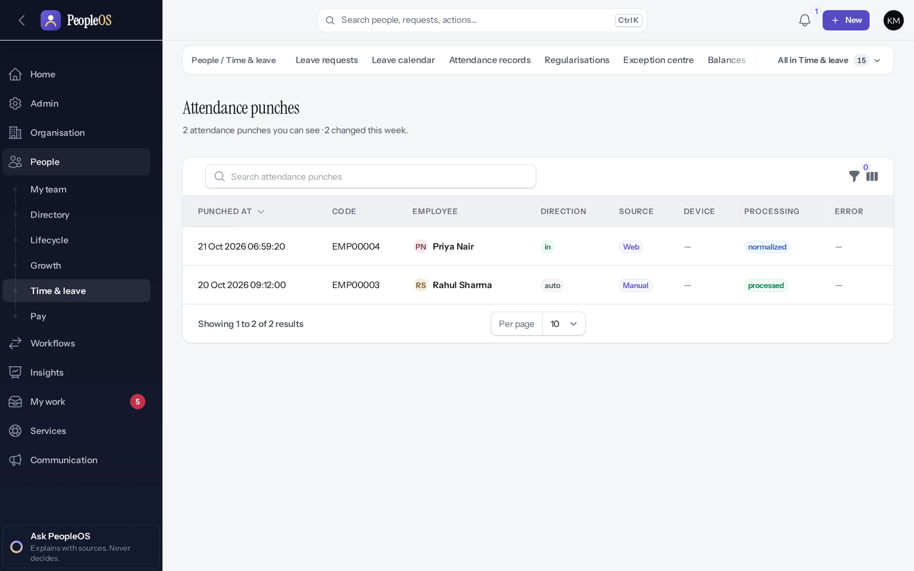
Check exceptions and raw punches
ATTENDANCE ADMINISTRATION
Exception centre
Verified
Punches
Verified
Counts for 30 days; rows that need action.
Every punch with its source (web, manual, device) and processing status.
Real screen · Kavya Menon (Tenant HR Admin + Employee) · Exception centre
Real screen · Kavya Menon (Tenant HR Admin + Employee) · Punches
Notes:
SAY: Check exceptions and raw punches.
LEFT, Exception centre: Counts for 30 days; rows that need action.
RIGHT, Punches: Every punch with its source (web, manual, device) and processing status.
OBSERVE: point out what differs between the two screens.
EVIDENCE: left = hr-admin/20-att-14-exception-centre [Kavya Menon (Tenant HR Admin + Employee), Exception centre]; right = hr-admin/20-att-15-punches [Kavya Menon (Tenant HR Admin + Employee), Punches]. Real screens, fictional data (SCREENSHOT-INVENTORY.md).

Slide 52
Leave administration
07
Balances, ledger, types, policies, requests, and the workaround for Apply on behalf.
Notes:
TRANSITION: Section 7, Leave administration. Balances, ledger, types, policies, requests, and the workaround for Apply on behalf.
SAY: Tell learners what they will be able to do by the end of this section, then move on.
ASK: "What questions do you have before we start this section?"

Slide 53
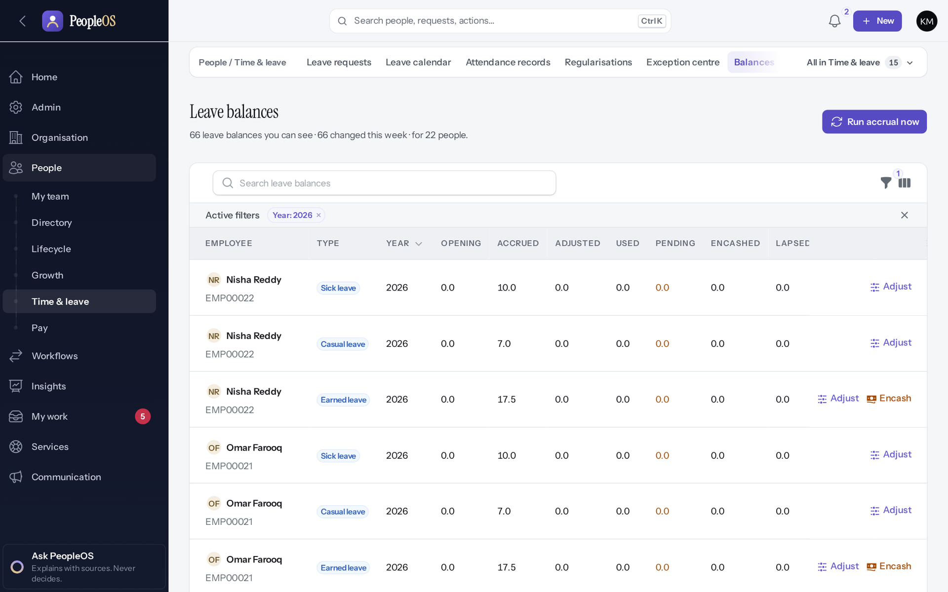
Balances
LEAVE
Verified in the running application
1
1
Run accrual now.
2
Adjust.
3
Encash.
RESULT Per person, type and year: opening, accrued, adjusted, used, pending, encashed, lapsed, closing, available. Adjust, Encash and Run accrual now.
2
3
Real screen · Kavya Menon (Tenant HR Admin + Employee) · People › Time & leave › Balances
Notes:
SAY: Per person, type and year: opening, accrued, adjusted, used, pending, encashed, lapsed, closing, available. Adjust, Encash and Run accrual now.
ON SCREEN: Open Balances.
LEARNERS SHOULD SEE: Per person, type and year: opening, accrued, adjusted, used, pending, encashed, lapsed, closing, available; Run accrual now; Adjust / Encash per row
SCREEN: People › Time & leave › Balances. Signed in as Kavya Menon (Tenant HR Admin + Employee). Prerequisite: leave.manage (Tenant HR Admin, HR Manager, Attendance Admin …).
EVIDENCE: screenshot screenshots/hr-admin/55-lv-01-balances.png, captured 2026-10-21 on the disposable training database (fictional people).

Slide 54


Adjust a balance
LEAVE
Adjust
Verified
Adjusted
Verified
Days (+ or −) and a note; posted to the ledger.
Casual leave: adjusted 1.0; Available updated.
Real screen · Kavya Menon (Tenant HR Admin + Employee) · Balances › Adjust
Real screen · Kavya Menon (Tenant HR Admin + Employee) · Balances (after Adjust)
Notes:
SAY: Adjust a balance.
LEFT, Adjust: Days (+ or −) and a note; posted to the ledger.
RIGHT, Adjusted: Casual leave: adjusted 1.0; Available updated.
OBSERVE: point out what differs between the two screens.
EVIDENCE: left = hr-admin/55-lv-02-adjust-form [Kavya Menon (Tenant HR Admin + Employee), Balances › Adjust]; right = hr-admin/55-lv-03-adjusted [Kavya Menon (Tenant HR Admin + Employee), Balances (after Adjust)]. Real screens, fictional data (SCREENSHOT-INVENTORY.md).

Slide 55

The ledger records the adjustment
LEAVE
Verified in the running application
1
Adjustment entry.
RESULT Append-only: the adjustment is its own entry with the note. Nobody edits past entries.
1
Real screen · Kavya Menon (Tenant HR Admin + Employee) · People › Time & leave › Transactions (Leave ledger entries)
Notes:
SAY: Append-only: the adjustment is its own entry with the note. Nobody edits past entries.
ON SCREEN: Open the leave ledger.
LEARNERS SHOULD SEE: Append-only ledger: the adjustment appears as its own entry with the note
SCREEN: People › Time & leave › Transactions (Leave ledger entries). Signed in as Kavya Menon (Tenant HR Admin + Employee). Prerequisite: leave.manage (Tenant HR Admin, HR Manager, Attendance Admin …).
EVIDENCE: screenshot screenshots/hr-admin/55-lv-04-ledger.png, captured 2026-10-21 on the disposable training database (fictional people).

Slide 56


Leave types
LEAVE
Leave types
Verified
Edit Casual leave
Verified
Category, paid, half day, encashable, unit, approval, eligibility.
Code locked on edit; a reason is required for changes.
Real screen · Kavya Menon (Tenant HR Admin + Employee) · People › Time & leave › All in Time & leave › Leave types
Real screen (cropped) · Kavya Menon (Tenant HR Admin + Employee) · Leave types › Edit Casual leave
Notes:
SAY: Leave types.
LEFT, Leave types: Category, paid, half day, encashable, unit, approval, eligibility.
RIGHT, Edit Casual leave: Code locked on edit; a reason is required for changes.
OBSERVE: point out what differs between the two screens.
EVIDENCE: left = hr-admin/55-lv-05-leave-types [Kavya Menon (Tenant HR Admin + Employee), People › Time & leave › All in Time & leave › Leave types]; right = hr-admin/55-lv-06-leave-type-edit [Kavya Menon (Tenant HR Admin + Employee), Leave types › Edit Casual leave]. Real screens, fictional data (SCREENSHOT-INVENTORY.md).

Slide 57


Policies and the leave policy
LEAVE
Policies
Verified
Standard leave
Verified
Versioned policies (exit, attendance, working hours, leave) with effective dates.
Entitlements per type live in the version settings.
Real screen · Kavya Menon (Tenant HR Admin + Employee) · Workflows › Policies
Real screen · Kavya Menon (Tenant HR Admin + Employee) · Policies › Standard leave
Notes:
SAY: Policies and the leave policy.
LEFT, Policies: Versioned policies (exit, attendance, working hours, leave) with effective dates.
RIGHT, Standard leave: Entitlements per type live in the version settings.
OBSERVE: point out what differs between the two screens.
EVIDENCE: left = hr-admin/55-lv-07-policies [Kavya Menon (Tenant HR Admin + Employee), Workflows › Policies]; right = hr-admin/55-lv-08-leave-policy [Kavya Menon (Tenant HR Admin + Employee), Policies › Standard leave]. Real screens, fictional data (SCREENSHOT-INVENTORY.md).

Slide 58

Everyone's leave requests
LEAVE
Verified in the running application
1
1
Apply on behalf.
2
Status tabs.
2
3
3
Approval Center.
RESULT Status tabs; Approve, Reject, Cancel per row; Apply on behalf; a link to the Approval Center.
Real screen · Kavya Menon (Tenant HR Admin + Employee) · People › Time & leave › Leave requests (HR view)
Notes:
SAY: Status tabs; Approve, Reject, Cancel per row; Apply on behalf; a link to the Approval Center.
ON SCREEN: Open Leave requests.
LEARNERS SHOULD SEE: Everyone’s requests with status tabs; Apply on behalf; Approve / Reject / Cancel per row; link to the Approval Center
SCREEN: People › Time & leave › Leave requests (HR view). Signed in as Kavya Menon (Tenant HR Admin + Employee). Prerequisite: leave.manage (Tenant HR Admin, HR Manager, Attendance Admin …).
EVIDENCE: screenshot screenshots/hr-admin/55-lv-09-requests-hr.png, captured 2026-10-21 on the disposable training database (fictional people).

Slide 59

Apply on behalf fails: use the 360 instead
LEAVE
Incomplete · known defect or gap
RESULT Defect F38: "Call to a member function getFormData() on array" when the dialog opens.
Real screen · Kavya Menon (Tenant HR Admin + Employee) · Leave requests › Apply on behalf
Notes:
Shown here as the local debug page (development mode). In production the user sees a generic server-error dialog; the cause is the same.

Slide 60

Workaround: Employee 360 › Records › Time
LEAVE
Verified in the running application
1
Apply for leave.
2
Balances.
RESULT The Leave section shows balances and Apply for leave.
1
2
Real screen (cropped) · Kavya Menon (Tenant HR Admin + Employee) · Employee 360 › Records › Time
Notes:
SAY: The Leave section shows balances and Apply for leave.
ON SCREEN: Open the person’s Records › Time.
LEARNERS SHOULD SEE: Attendance and leave for the person; the Leave section shows balances and Apply for leave
SCREEN: Employee 360 › Records › Time. Signed in as Kavya Menon (Tenant HR Admin + Employee). Prerequisite: leave.manage (Tenant HR Admin, HR Manager, Attendance Admin …).
EVIDENCE: screenshot screenshots/hr-admin/55-lv-10-360-time-apply.png, captured 2026-10-21 on the disposable training database (fictional people).

Slide 61


Apply for leave on the employee's behalf
LEAVE
Apply for leave
Verified
Applied
Verified
The same form and Before → After preview as the employee's own request.
The request goes to the employee's approver like any other.
Real screen (cropped) · Kavya Menon (Tenant HR Admin + Employee) · Employee 360 › Records › Time › Apply for leave
Real screen · Kavya Menon (Tenant HR Admin + Employee) · Employee 360 (after applying)
Notes:
SAY: Apply for leave on the employee's behalf.
LEFT, Apply for leave: The same form and Before → After preview as the employee's own request.
RIGHT, Applied: The request goes to the employee's approver like any other.
OBSERVE: point out what differs between the two screens.
EVIDENCE: left = hr-admin/55-lv-11-apply-form [Kavya Menon (Tenant HR Admin + Employee), Employee 360 › Records › Time › Apply for leave]; right = hr-admin/55-lv-12-applied [Kavya Menon (Tenant HR Admin + Employee), Employee 360 (after applying)]. Real screens, fictional data (SCREENSHOT-INVENTORY.md).

Slide 62


Leave calendar and a search defect
LEAVE
Leave calendar
Verified
Balances search
Incomplete
Approved and pending leave this month to the end of next; reasons never shown.
Typing a name in the Balances search box fails with a database error (new finding). Use the filters instead.
Real screen · Kavya Menon (Tenant HR Admin + Employee) · People › Time & leave › Leave calendar
Real screen · Kavya Menon (Tenant HR Admin + Employee) · People › Time & leave › Balances (search box)
Notes:
Shown here as the local debug page (development mode). In production the user sees a generic server-error dialog; the cause is the same.
SAY: Leave calendar and a search defect.
LEFT, Leave calendar: Approved and pending leave this month to the end of next; reasons never shown.
RIGHT, Balances search: Typing a name in the Balances search box fails with a database error (new finding). Use the filters instead.
OBSERVE: point out what differs between the two screens.
EVIDENCE: left = hr-admin/55-lv-13-leave-calendar [Kavya Menon (Tenant HR Admin + Employee), People › Time & leave › Leave calendar]; right = support/55-lv-err-02-balances-search [Kavya Menon (Tenant HR Admin + Employee), People › Time & leave › Balances (search box)]. Real screens, fictional data (SCREENSHOT-INVENTORY.md).

Slide 63
Payroll operations
08
Configure, calculate and check runs. Finalising is blocked until statutory rules are verified.
Notes:
TRANSITION: Section 8, Payroll operations. Configure, calculate and check runs. Finalising is blocked until statutory rules are verified.
SAY: Tell learners what they will be able to do by the end of this section, then move on.
ASK: "What questions do you have before we start this section?"

Slide 64

Payroll control room
PAYROLL
Verified in the running application
Readiness figures, the company card and the run register. The subheading lists statutory rules that are not verified: runs cannot be finalised.
Real screen · Arjun Bose (Payroll Admin + Employee) · People › Pay › Control room (Payroll control room)
Notes:
SAY: Readiness figures, the company card and the run register. The subheading lists statutory rules that are not verified: runs cannot be finalised.
ON SCREEN: Open the payroll control room.
LEARNERS SHOULD SEE: Readiness figures, the company card and the run register; the subheading lists statutory rules that are not verified, so runs cannot be finalised
SCREEN: People › Pay › Control room (Payroll control room). Signed in as Arjun Bose (Payroll Admin + Employee). Prerequisite: Payroll Admin role (payroll.*); salary assigned to employees.
EVIDENCE: screenshot screenshots/hr-admin/60-pay-01-control-room.png, captured 2026-10-21 on the disposable training database (fictional people).

Slide 65


Runs and opening a run
PAYROLL
Payroll runs
Verified
Open payroll run
Verified
One run per company and month.
Company, year, month (cancelled here; the October run already exists).
Real screen · Arjun Bose (Payroll Admin + Employee) · People › Pay › Payroll runs
Real screen · Arjun Bose (Payroll Admin + Employee) · Open payroll run (dialog)
Notes:
SAY: Runs and opening a run.
LEFT, Payroll runs: One run per company and month.
RIGHT, Open payroll run: Company, year, month (cancelled here; the October run already exists).
OBSERVE: point out what differs between the two screens.
EVIDENCE: left = hr-admin/60-pay-02-runs-list [Arjun Bose (Payroll Admin + Employee), People › Pay › Payroll runs]; right = hr-admin/60-pay-03-open-run-form [Arjun Bose (Payroll Admin + Employee), Open payroll run (dialog)]. Real screens, fictional data (SCREENSHOT-INVENTORY.md).

Slide 66

The run
PAYROLL
Verified in the running application
1
Run status.
2
3
2
Recalculate.
1
3
Validate.
4
4
Totals.
RESULT Totals, status and actions: Calculate / Recalculate, Validate; Approve and Finalize appear only when allowed.
Real screen · Arjun Bose (Payroll Admin + Employee) · Payroll run (Oct 2026, Demo Technologies)
Notes:
SAY: Totals, status and actions: Calculate / Recalculate, Validate; Approve and Finalize appear only when allowed.
ON SCREEN: Open the run.
LEARNERS SHOULD SEE: Status Calculated; totals (gross, deductions, net, PF, PT, TDS, employer cost); actions Recalculate, Validate, Set payment date
SCREEN: Payroll run (Oct 2026, Demo Technologies). Signed in as Arjun Bose (Payroll Admin + Employee). Prerequisite: Payroll Admin role (payroll.*); salary assigned to employees.
EVIDENCE: screenshot screenshots/hr-admin/60-pay-04-run-view.png, captured 2026-10-21 on the disposable training database (fictional people).

Slide 67


Issues and the breakdown
PAYROLL
Employees tab: Issues
Verified
Breakdown
Verified
Issue codes appear raw, e.g. unverified_statutory_rule (F12).
Earnings and deductions; statutory lines are exceptions while rules are unverified.
Real screen · Arjun Bose (Payroll Admin + Employee) · Payroll run › Employees tab
Real screen · Arjun Bose (Payroll Admin + Employee) · Payroll run › Breakdown (dialog)
Notes:
SAY: Issues and the breakdown.
LEFT, Employees tab: Issues: Issue codes appear raw, e.g. unverified_statutory_rule (F12).
RIGHT, Breakdown: Earnings and deductions; statutory lines are exceptions while rules are unverified.
OBSERVE: point out what differs between the two screens.
EVIDENCE: left = hr-admin/60-pay-05-employee-issues [Arjun Bose (Payroll Admin + Employee), Payroll run › Employees tab]; right = hr-admin/60-pay-06-breakdown [Arjun Bose (Payroll Admin + Employee), Payroll run › Breakdown (dialog)]. Real screens, fictional data (SCREENSHOT-INVENTORY.md).

Slide 68


Recalculate
PAYROLL
Confirm
Verified
Recalculated
Verified
Recalculate re-reads attendance, leave, salary and adjustments.
"Calculated for 19 employee(s); 19 with exceptions." Every salaried employee of the company is included.
Real screen · Arjun Bose (Payroll Admin + Employee) · Recalculate (confirmation)
Real screen · Arjun Bose (Payroll Admin + Employee) · Payroll run (after Recalculate)
Notes:
SAY: Recalculate.
LEFT, Confirm: Recalculate re-reads attendance, leave, salary and adjustments.
RIGHT, Recalculated: "Calculated for 19 employee(s); 19 with exceptions." Every salaried employee of the company is included.
OBSERVE: point out what differs between the two screens.
EVIDENCE: left = hr-admin/60-pay-07-recalculate-confirm [Arjun Bose (Payroll Admin + Employee), Recalculate (confirmation)]; right = hr-admin/60-pay-08-recalculated [Arjun Bose (Payroll Admin + Employee), Payroll run (after Recalculate)]. Real screens, fictional data (SCREENSHOT-INVENTORY.md).

Slide 69

Validate is refused: blocking exceptions
PAYROLL
Disabled by safety or commercial gates
1
1
Blocking message.
RESULT "Not allowed: 19 employee(s) have blocking exceptions. Fix the inputs and recalculate." The exceptions are the unverified statutory rules (Issues column: unverified_statutory_rule). Approve, Finalize, payslips and bank files are not reachable.
Real screen · Arjun Bose (Payroll Admin + Employee) · Payroll run › Validate
Notes:
SAY: This is the payroll safeguard working, not a fault. It lifts only when platform administrators verify the statutory rules (release gate 5).

Slide 70

Payroll Auditor
PAYROLL
Verified in the running application
1
1
Choose run.
2
Findings.
RESULT Findings with severity and evidence for the run. Rule-based (despite the "AI" label); some findings show raw technical text.
2
Real screen · Arjun Bose (Payroll Admin + Employee) · People › Pay › Payroll Auditor
Notes:
SAY: Findings with severity and evidence for the run. Rule-based (despite the "AI" label); some findings show raw technical text.
ON SCREEN: Open the Payroll Auditor for the October run.
LEARNERS SHOULD SEE: Findings with severity and evidence (deterministic rules; read only)
SCREEN: People › Pay › Payroll Auditor. Signed in as Arjun Bose (Payroll Admin + Employee). Prerequisite: Payroll Admin role (payroll.*); salary assigned to employees.
EVIDENCE: screenshot screenshots/hr-admin/60-pay-11-payroll-auditor.png, captured 2026-10-21 on the disposable training database (fictional people).

Slide 71


Salary components
PAYROLL
Components
Verified
New component
Verified
Formula, order and flags; statutory codes are reserved.
Formula validated on save (not saved here).
Real screen · Arjun Bose (Payroll Admin + Employee) · People › Pay › Salary components
Real screen · Arjun Bose (Payroll Admin + Employee) · New salary component
Notes:
SAY: Salary components.
LEFT, Components: Formula, order and flags; statutory codes are reserved.
RIGHT, New component: Formula validated on save (not saved here).
OBSERVE: point out what differs between the two screens.
EVIDENCE: left = hr-admin/60-pay-12-salary-components [Arjun Bose (Payroll Admin + Employee), People › Pay › Salary components]; right = hr-admin/60-pay-13-new-component-form [Arjun Bose (Payroll Admin + Employee), New salary component]. Real screens, fictional data (SCREENSHOT-INVENTORY.md).

Slide 72


Salary structures and versions
PAYROLL
Structures
Verified
Versions
Verified
Standard structure.
Draft → submit → approve; versions cannot start inside a finalised period.
Real screen · Kavya Menon (Tenant HR Admin + Employee) · People › Pay › Salary structures
Real screen (cropped) · Kavya Menon (Tenant HR Admin + Employee) · Edit salary structure › Versions
Notes:
SAY: Salary structures and versions.
LEFT, Structures: Standard structure.
RIGHT, Versions: Draft → submit → approve; versions cannot start inside a finalised period.
OBSERVE: point out what differs between the two screens.
EVIDENCE: left = hr-admin/60-pay-14-salary-structures [Kavya Menon (Tenant HR Admin + Employee), People › Pay › Salary structures]; right = hr-admin/60-pay-15-structure-versions [Kavya Menon (Tenant HR Admin + Employee), Edit salary structure › Versions]. Real screens, fictional data (SCREENSHOT-INVENTORY.md).

Slide 73


Adjustments and tax declarations
PAYROLL
New payroll adjustment
Verified
Tax declarations
Incomplete
Employee, period, type, component, amount or days, taxable (cancelled).
Empty here. Employees cannot submit a declaration themselves (F13).
Real screen (cropped) · Arjun Bose (Payroll Admin + Employee) · New payroll adjustment
Real screen · Arjun Bose (Payroll Admin + Employee) · People › Pay › Tax declarations
Notes:
SAY: Adjustments and tax declarations.
LEFT, New payroll adjustment: Employee, period, type, component, amount or days, taxable (cancelled).
RIGHT, Tax declarations: Empty here. Employees cannot submit a declaration themselves (F13).
OBSERVE: point out what differs between the two screens.
EVIDENCE: left = hr-admin/60-pay-16-new-adjustment [Arjun Bose (Payroll Admin + Employee), New payroll adjustment]; right = hr-admin/60-pay-17-tax-declarations [Arjun Bose (Payroll Admin + Employee), People › Pay › Tax declarations]. Real screens, fictional data (SCREENSHOT-INVENTORY.md).

Slide 74

Run History tab error (development mode)
PAYROLL
Incomplete · known defect or gap
RESULT LazyLoadingViolationException (F26) on the run's History tab outside production. Use Change history.
Real screen · Arjun Bose (Payroll Admin + Employee) · Payroll run › History tab (error)
Notes:
Shown here as the local debug page (development mode). In production the user sees a generic server-error dialog; the cause is the same.

Slide 75
Statutory configuration
09
The tenant records registrations; the platform verifies rules.
Notes:
TRANSITION: Section 9, Statutory configuration. The tenant records registrations; the platform verifies rules.
SAY: Tell learners what they will be able to do by the end of this section, then move on.
ASK: "What questions do you have before we start this section?"

Slide 76

Compliance control room
STATUTORY
Disabled by safety or commercial gates
0 of 24 rule versions verified; required rules, open notices and missing registrations (ESI, LWF, PT) per establishment.
Real screen (cropped) · Arjun Bose (Payroll Admin + Employee) · People › Pay › Control room (Compliance control room)
Notes:
SAY: 0 of 24 rule versions verified; required rules, open notices and missing registrations (ESI, LWF, PT) per establishment.
ON SCREEN: Open the compliance control room.
LEARNERS SHOULD SEE: Rules this tenant needs and their verification state, establishments, returns; nothing can be exported while rules are unverified
SCREEN: People › Pay › Control room (Compliance control room). Signed in as Arjun Bose (Payroll Admin + Employee). Prerequisite: Tenant HR Admin or Payroll Admin; statutory rules verified by two platform administrators.
EVIDENCE: screenshot screenshots/hr-admin/60-stat-01-compliance-control-room.png, captured 2026-10-21 on the disposable training database (fictional people).

Slide 77


Rules and verification
STATUTORY
Compliance rules
Verified
Rule verification
Disabled (gate)
Rule versions shipped by the platform; read only for tenants.
None verified. Two platform administrators verify each rule with official evidence.
Real screen · Arjun Bose (Payroll Admin + Employee) · People › Pay › Compliance rules
Real screen · Arjun Bose (Payroll Admin + Employee) · People › Pay › Rule verification
Notes:
SAY: Rules and verification.
LEFT, Compliance rules: Rule versions shipped by the platform; read only for tenants.
RIGHT, Rule verification: None verified. Two platform administrators verify each rule with official evidence.
OBSERVE: point out what differs between the two screens.
EVIDENCE: left = hr-admin/60-stat-02-compliance-rules [Arjun Bose (Payroll Admin + Employee), People › Pay › Compliance rules]; right = hr-admin/60-stat-03-rule-verifications [Arjun Bose (Payroll Admin + Employee), People › Pay › Rule verification]. Real screens, fictional data (SCREENSHOT-INVENTORY.md).

Slide 78


Registrations and establishment profiles
STATUTORY
Statutory registrations
Verified
Statutory profiles
Verified
EPF, ESIC, PT, LWF, TAN numbers with Verify / Correct / New number.
Which statutes apply at each establishment.
Real screen · Kavya Menon (Tenant HR Admin + Employee) · People › Pay › Statutory registrations
Real screen · Kavya Menon (Tenant HR Admin + Employee) · People › Pay › Statutory profiles
Notes:
SAY: Registrations and establishment profiles.
LEFT, Statutory registrations: EPF, ESIC, PT, LWF, TAN numbers with Verify / Correct / New number.
RIGHT, Statutory profiles: Which statutes apply at each establishment.
OBSERVE: point out what differs between the two screens.
EVIDENCE: left = hr-admin/60-stat-05-statutory-registrations [Kavya Menon (Tenant HR Admin + Employee), People › Pay › Statutory registrations]; right = hr-admin/60-stat-06-establishment-profiles [Kavya Menon (Tenant HR Admin + Employee), People › Pay › Statutory profiles]. Real screens, fictional data (SCREENSHOT-INVENTORY.md).

Slide 79


Notices and returns
STATUTORY
Regulatory notices
Verified
EPF returns
Disabled (gate)
5 open notices about statutory changes to resolve.
Empty: returns need finalised payroll.
Real screen · Arjun Bose (Payroll Admin + Employee) · People › Pay › Regulatory notices
Real screen · Kavya Menon (Tenant HR Admin + Employee) · People › Pay › EPF returns (ECR)
Notes:
SAY: Notices and returns.
LEFT, Regulatory notices: 5 open notices about statutory changes to resolve.
RIGHT, EPF returns: Empty: returns need finalised payroll.
OBSERVE: point out what differs between the two screens.
EVIDENCE: left = hr-admin/60-stat-04-rule-notices [Arjun Bose (Payroll Admin + Employee), People › Pay › Regulatory notices]; right = hr-admin/60-stat-07-epf-returns-empty [Kavya Menon (Tenant HR Admin + Employee), People › Pay › EPF returns (ECR)]. Real screens, fictional data (SCREENSHOT-INVENTORY.md).

Slide 80
Performance, learning and workforce
10
Cycles, appraisals, calibration, courses and positions.
Notes:
TRANSITION: Section 10, Performance, learning and workforce. Cycles, appraisals, calibration, courses and positions.
SAY: Tell learners what they will be able to do by the end of this section, then move on.
ASK: "What questions do you have before we start this section?"

Slide 81


Performance cycles
GROWTH
Cycles
Verified
New cycle
Verified
FY 2026-27 annual review in the Self review stage.
Stages, eligibility rules and options (not saved). Scheduled cycles do not launch on their own (F21).
Real screen · Kavya Menon (Tenant HR Admin + Employee) · People › Growth › All in Growth › Cycles
Real screen (cropped) · Kavya Menon (Tenant HR Admin + Employee) · New performance cycle
Notes:
SAY: Performance cycles.
LEFT, Cycles: FY 2026-27 annual review in the Self review stage.
RIGHT, New cycle: Stages, eligibility rules and options (not saved). Scheduled cycles do not launch on their own (F21).
OBSERVE: point out what differs between the two screens.
EVIDENCE: left = hr-admin/65-grow-01-performance-cycles [Kavya Menon (Tenant HR Admin + Employee), People › Growth › All in Growth › Cycles]; right = hr-admin/65-grow-02-new-cycle-form [Kavya Menon (Tenant HR Admin + Employee), New performance cycle]. Real screens, fictional data (SCREENSHOT-INVENTORY.md).

Slide 82


Appraisals and calibration
GROWTH
Appraisals
Verified
Calibration board
Verified
Each employee's appraisal with stage and status.
Rating distribution and adjustments before finalising.
Real screen · Kavya Menon (Tenant HR Admin + Employee) · People › Growth › Appraisals
Real screen (cropped) · Kavya Menon (Tenant HR Admin + Employee) · People › Growth › Calibration
Notes:
SAY: Appraisals and calibration.
LEFT, Appraisals: Each employee's appraisal with stage and status.
RIGHT, Calibration board: Rating distribution and adjustments before finalising.
OBSERVE: point out what differs between the two screens.
EVIDENCE: left = hr-admin/65-grow-03-appraisals [Kavya Menon (Tenant HR Admin + Employee), People › Growth › Appraisals]; right = hr-admin/65-grow-04-calibration-board [Kavya Menon (Tenant HR Admin + Employee), People › Growth › Calibration]. Real screens, fictional data (SCREENSHOT-INVENTORY.md).

Slide 83


Goals and learning
GROWTH
Goals (HR view)
Verified
Learning assignments
Verified
Company → department → individual cascade with progress.
PoSH for everyone (annual, mandatory).
Real screen · Kavya Menon (Tenant HR Admin + Employee) · People › Growth › Goals (HR view)
Real screen · Kavya Menon (Tenant HR Admin + Employee) · People › Growth › All in Growth › Assignments
Notes:
SAY: Goals and learning.
LEFT, Goals (HR view): Company → department → individual cascade with progress.
RIGHT, Learning assignments: PoSH for everyone (annual, mandatory).
OBSERVE: point out what differs between the two screens.
EVIDENCE: left = hr-admin/65-grow-05-goals-hr-view [Kavya Menon (Tenant HR Admin + Employee), People › Growth › Goals (HR view)]; right = hr-admin/65-learn-02-assignments [Kavya Menon (Tenant HR Admin + Employee), People › Growth › All in Growth › Assignments]. Real screens, fictional data (SCREENSHOT-INVENTORY.md).

Slide 84


Positions
WORKFORCE
New position
Verified
Created as a draft
Verified
Code, title, designation, company, unit, grade. FTE left blank (F8).
"Position POS-TRN-001 created as a draft."
Real screen (cropped) · Kavya Menon (Tenant HR Admin + Employee) · New position (dialog, top half)
Real screen · Kavya Menon (Tenant HR Admin + Employee) · Positions (after Submit)
Notes:
SAY: Positions.
LEFT, New position: Code, title, designation, company, unit, grade. FTE left blank (F8).
RIGHT, Created as a draft: "Position POS-TRN-001 created as a draft."
OBSERVE: point out what differs between the two screens.
EVIDENCE: left = hr-admin/65-wf-02-new-position-form [Kavya Menon (Tenant HR Admin + Employee), New position (dialog, top half)]; right = hr-admin/65-wf-03-position-created [Kavya Menon (Tenant HR Admin + Employee), Positions (after Submit)]. Real screens, fictional data (SCREENSHOT-INVENTORY.md).

Slide 85


Org map and position hierarchy
WORKFORCE
Org map
Verified
Position hierarchy
Verified
Units and people by primary reporting line.
Positions by reporting position.
Real screen (cropped) · Kavya Menon (Tenant HR Admin + Employee) · Organisation › Org map
Real screen · Kavya Menon (Tenant HR Admin + Employee) · Organisation › Workforce › Position hierarchy
Notes:
SAY: Org map and position hierarchy.
LEFT, Org map: Units and people by primary reporting line.
RIGHT, Position hierarchy: Positions by reporting position.
OBSERVE: point out what differs between the two screens.
EVIDENCE: left = hr-admin/65-wf-05-org-map [Kavya Menon (Tenant HR Admin + Employee), Organisation › Org map]; right = hr-admin/65-wf-07-position-hierarchy [Kavya Menon (Tenant HR Admin + Employee), Organisation › Workforce › Position hierarchy]. Real screens, fictional data (SCREENSHOT-INVENTORY.md).

Slide 86
Compensation changes
11
Four different people: propose, review, approve, execute.
Notes:
TRANSITION: Section 11, Compensation changes. Four different people: propose, review, approve, execute.
SAY: Tell learners what they will be able to do by the end of this section, then move on.
ASK: "What questions do you have before we start this section?"

Slide 87
Change an employee's pay
COMPENSATION
Propose a pay change with a reason and take it through review, approval and execution by four different people.
Verified in the running application
WHO
WHERE
BEFORE YOU START
Propose, review: HR Manager or Tenant HR Admin. Approve: a third person (Tenant HR or Super Admin). Execute: Payroll Admin.
Employee 360 › Records › Rewards › Propose compensation change; People › Pay › Compensation changes
The employee is employed (not alumni) and has a salary structure.
PROPOSE
Neha (HR Manager)
REVIEW
Kavya (Tenant HR Admin)
APPROVE
Demo Admin
EXECUTE
Arjun (Payroll Admin)
RESULT
Scheduled
Conceptual diagram: sequence summary
Notes:
SAY: Propose a pay change with a reason and take it through review, approval and execution by four different people.
WHO: Propose, review: HR Manager or Tenant HR Admin. Approve: a third person (Tenant HR or Super Admin). Execute: Payroll Admin.
WHERE: Employee 360 › Records › Rewards › Propose compensation change; People › Pay › Compensation changes
BEFORE YOU START: The employee is employed (not alumni) and has a salary structure.
SEQUENCE: PROPOSE Neha (HR Manager) → REVIEW Kavya (Tenant HR Admin) → APPROVE Demo Admin → EXECUTE Arjun (Payroll Admin) → RESULT Scheduled
EVIDENCE: Executed on the training database on 21 Oct 2026 as Kavya Menon (Tenant HR Admin), Neha Kapoor (HR Manager) and Arjun Bose (Payroll Admin), fictional people at the fictional Demo Group (tools/capture/20-, 50-, 55-, 60-, 62-, 65-, 70-, 75-). Amit Verma's CTC 24,00,000 → 26,40,000 was taken through all four steps.

Slide 88

Refused for someone who has left
COMPENSATION
Verified in the running application
1
1
Confirmation.
RESULT "Cannot propose: An employee who is alumni cannot receive future compensation."
Real screen · Neha Kapoor (HR Manager + Employee) · Employee 360 (after proposing for an exited employee)
Notes:
SAY: "Cannot propose: An employee who is alumni cannot receive future compensation."
ON SCREEN: Propose a compensation change for Vikram Singh, who has exited (alumni).
LEARNERS SHOULD SEE: Refused: "Cannot propose — An employee who is alumni cannot receive future compensation."
SCREEN: Employee 360 (after proposing for an exited employee). Signed in as Neha Kapoor (HR Manager + Employee). Prerequisite: Four different people: proposer (compensation.propose), reviewer (compensation.review), approver (compensation.approve), executor (compensation.execute).
EVIDENCE: screenshot screenshots/hr-admin/62-comp-00-refused-alumni.png, captured 2026-10-21 on the disposable training database (fictional people).

Slide 89


Propose
COMPENSATION
Rewards tab
Verified
Propose compensation change
Verified
Current compensation and earlier changes.
Change type, effective date, structure, new annual CTC, reason; Submit for review now.
Real screen · Neha Kapoor (HR Manager + Employee) · Employee 360 › Records › Rewards › Compensation
Real screen (cropped) · Neha Kapoor (HR Manager + Employee) · Propose compensation change (dialog)
Notes:
SAY: Propose.
LEFT, Rewards tab: Current compensation and earlier changes.
RIGHT, Propose compensation change: Change type, effective date, structure, new annual CTC, reason; Submit for review now.
OBSERVE: point out what differs between the two screens.
EVIDENCE: left = hr-admin/62-comp-01-employee-compensation [Neha Kapoor (HR Manager + Employee), Employee 360 › Records › Rewards › Compensation]; right = hr-admin/62-comp-02-propose-form [Neha Kapoor (HR Manager + Employee), Propose compensation change (dialog)]. Real screens, fictional data (SCREENSHOT-INVENTORY.md).

Slide 90


Submitted, then reviewed
COMPENSATION
Submitted
Verified
Reviewed
Verified
Listed as submitted for review.
Mark reviewed → Confirm (Kavya).
Real screen · Neha Kapoor (HR Manager + Employee) · People › Pay › Compensation changes
Real screen · Kavya Menon (Tenant HR Admin + Employee) · Compensation changes (after review)
Notes:
SAY: Submitted, then reviewed.
LEFT, Submitted: Listed as submitted for review.
RIGHT, Reviewed: Mark reviewed → Confirm (Kavya).
OBSERVE: point out what differs between the two screens.
EVIDENCE: left = hr-admin/62-comp-04-list-submitted [Neha Kapoor (HR Manager + Employee), People › Pay › Compensation changes]; right = hr-admin/62-comp-06-reviewed [Kavya Menon (Tenant HR Admin + Employee), Compensation changes (after review)]. Real screens, fictional data (SCREENSHOT-INVENTORY.md).

Slide 91

The reviewer cannot also approve
COMPENSATION
Verified in the running application
1
No Approve for the reviewer.
RESULT After reviewing, Kavya's menu offers only Reject, Return to proposer and Cancel: no Approve, although her role holds the approve permission.
1
Real screen · Kavya Menon (Tenant HR Admin + Employee) · Compensation changes › row actions (after reviewing)
Notes:
SAY: After reviewing, Kavya's menu offers only Reject, Return to proposer and Cancel: no Approve, although her role holds the approve permission.
ON SCREEN: The reviewer (who holds compensation.approve) opens the actions again.
LEARNERS SHOULD SEE: No Approve action: a person who already acted on the change cannot approve it (four different people required)
SCREEN: Compensation changes › row actions (after reviewing). Signed in as Kavya Menon (Tenant HR Admin + Employee). Prerequisite: Four different people: proposer (compensation.propose), reviewer (compensation.review), approver (compensation.approve), executor (compensation.execute).
EVIDENCE: screenshot screenshots/security-compliance/62-comp-07-reviewer-cannot-approve.png, captured 2026-10-21 on the disposable training database (fictional people).

Slide 92


Approve, then execute
COMPENSATION
Approved (third person)
Verified
Executed (fourth person)
Verified
Demo Admin (Tenant Super Admin) approves.
Arjun (Payroll Admin) executes: status Scheduled for the effective date.
Real screen · Demo Admin (Tenant Super Admin) · Compensation changes (after approval)
Real screen · Arjun Bose (Payroll Admin + Employee) · Compensation changes (after execution)
Notes:
SAY: Approve, then execute.
LEFT, Approved (third person): Demo Admin (Tenant Super Admin) approves.
RIGHT, Executed (fourth person): Arjun (Payroll Admin) executes: status Scheduled for the effective date.
OBSERVE: point out what differs between the two screens.
EVIDENCE: left = hr-admin/62-comp-09-approved [Demo Admin (Tenant Super Admin), Compensation changes (after approval)]; right = hr-admin/62-comp-10-executed [Arjun Bose (Payroll Admin + Employee), Compensation changes (after execution)]. Real screens, fictional data (SCREENSHOT-INVENTORY.md).

Slide 93
Letters, assets and HR requests
12
Issue letters with approval where needed, track assets, answer employees.
Notes:
TRANSITION: Section 12, Letters, assets and HR requests. Issue letters with approval where needed, track assets, answer employees.
SAY: Tell learners what they will be able to do by the end of this section, then move on.
ASK: "What questions do you have before we start this section?"

Slide 94

Letters
LETTERS
Verified in the running application
1
1
Generate letter.
RESULT Generated letters with number, employee, type and status.
Real screen · Neha Kapoor (HR Manager + Employee) · People › Lifecycle › Letters
Notes:
SAY: Generated letters with number, employee, type and status.
ON SCREEN: Open Letters.
WALK THROUGH: (1) Generate letter.
LEARNERS SHOULD SEE: Generated letters with number, employee, type, status; Generate letter
SCREEN: People › Lifecycle › Letters. Signed in as Neha Kapoor (HR Manager + Employee). Prerequisite: letter.issue (HR Manager, Tenant HR Admin); the requester cannot approve.
EVIDENCE: screenshot screenshots/hr-admin/52-let-01-letters.png, captured 2026-10-21 on the disposable training database (fictional people).

Slide 95

Generate a letter
LETTERS
Verified in the running application
1
Employee.
1
2
Template.
3
Extra fields.
2
4
Submit.
RESULT Merge fields come from the employee record. Templates marked "needs approval" go to Pending approval; others are ready to issue.
3
4
Real screen · Neha Kapoor (HR Manager + Employee) · Letters › Generate letter
Notes:
SAY: Merge fields come from the employee record. Templates marked "needs approval" go to Pending approval; others are ready to issue.
ON SCREEN: Choose the employee and the template (No objection certificate); add extra fields.
WALK THROUGH: (1) Employee. (2) Template. (3) Extra fields. (4) Submit.
LEARNERS SHOULD SEE: Template merge fields come from the employee record; templates marked "needs approval" go to Pending approval
SCREEN: Letters › Generate letter. Signed in as Neha Kapoor (HR Manager + Employee). Prerequisite: letter.issue (HR Manager, Tenant HR Admin).
EVIDENCE: screenshot screenshots/hr-admin/52-let-02-generate-form.png, captured 2026-10-21 on the disposable training database (fictional people).

Slide 96

Pending approval and issued
LETTERS
Verified in the running application
Pending approval (a no-objection certificate).
1
Status tabs.
1
RESULT An employment certificate (no approval needed) was issued straight away.
Real screen · Neha Kapoor (HR Manager + Employee) · Letters (list)
Notes:
SAY: An employment certificate (no approval needed) was issued straight away.
ON SCREEN: Check the list after generating.
WALK THROUGH: (1) Pending approval (a no-objection certificate). (2) Status tabs.
LEARNERS SHOULD SEE: Letters by status: Pending approval (NOC), Issued (employment certificate, NOC)
SCREEN: Letters (list). Signed in as Neha Kapoor (HR Manager + Employee). Prerequisite: letter.issue (HR Manager, Tenant HR Admin).
EVIDENCE: screenshot screenshots/hr-admin/52-let-03-pending.png, captured 2026-10-21 on the disposable training database (fictional people).

Slide 97
The requester cannot approve
LETTERS
Requester tries to approve
Verified
A second HR person approves
Verified
"Not allowed: The person who requested a letter cannot approve it."
Preview with Approve / Reject.
Real screen · Neha Kapoor (HR Manager + Employee) · Letters › Approve (by the requester)
Real screen · Kavya Menon (Tenant HR Admin + Employee) · Letters › letter (second HR person)
Notes:
SAY: The requester cannot approve.
LEFT, Requester tries to approve: "Not allowed: The person who requested a letter cannot approve it."
RIGHT, A second HR person approves: Preview with Approve / Reject.
OBSERVE: point out what differs between the two screens.
EVIDENCE: left = security-compliance/52-let-04-requester-cannot-approve [Neha Kapoor (HR Manager + Employee), Letters › Approve (by the requester)]; right = hr-admin/52-let-05-approver-view [Kavya Menon (Tenant HR Admin + Employee), Letters › letter (second HR person)]. Real screens, fictional data (SCREENSHOT-INVENTORY.md).

Slide 98
Issued, and the employee's copy
LETTERS
Issued
Verified
My letters (employee)
Verified
Issued; Download available.
The employee sees only their own issued letters. HTML only: no PDF or e-signature yet.
Real screen · Kavya Menon (Tenant HR Admin + Employee) · Letters › letter (after Approve and Issue)
Real screen · Priya Nair (Employee) · My letters
Notes:
KNOWN ISSUE F26: opening a letter page can show a lazy-loading error in non-production (support/52-let-err-01). Use Change history for its audit trail.
SAY: Issued, and the employee's copy.
LEFT, Issued: Issued; Download available.
RIGHT, My letters (employee): The employee sees only their own issued letters. HTML only: no PDF or e-signature yet.
OBSERVE: point out what differs between the two screens.
EVIDENCE: left = hr-admin/52-let-06-issued [Kavya Menon (Tenant HR Admin + Employee), Letters › letter (after Approve and Issue)]; right = employee/52-let-07-my-letters [Priya Nair (Employee), My letters]. Real screens, fictional data (SCREENSHOT-INVENTORY.md).

Slide 99
Asset register
ASSETS
Verified in the running application
1
1
Receive asset.
A spare laptop in stock.
2
2
Status tabs.
RESULT Tag, category, serial, status, custodian, location and warranty.
Real screen · Kavya Menon (Tenant HR Admin + Employee) · Organisation › Assets › Asset register
Notes:
SAY: Tag, category, serial, status, custodian, location and warranty.
ON SCREEN: Open the asset register.
WALK THROUGH: (1) Receive asset. (2) A spare laptop in stock. (3) Status tabs.
LEARNERS SHOULD SEE: Assets with tag, category, serial, status (In stock / Assigned), custodian, location, warranty; Receive asset
SCREEN: Organisation › Assets › Asset register. Signed in as Kavya Menon (Tenant HR Admin + Employee). Prerequisite: asset.manage (Asset Admin, Tenant HR Admin).
EVIDENCE: screenshot screenshots/hr-admin/52-ast-01-register.png, captured 2026-10-21 on the disposable training database (fictional people).

Slide 100

Assign an asset
ASSETS
Assign
Verified
Assigned
Verified
Employee, condition and a note: custody is recorded.
"Asset assigned": LT-0004 to Tanvi Joshi; custody history from today.
Real screen (cropped) · Kavya Menon (Tenant HR Admin + Employee) · Asset register › LT-0004 › Assign
Real screen · Kavya Menon (Tenant HR Admin + Employee) · Asset register › LT-0004 (after Assign)
Notes:
SAY: Assign an asset.
LEFT, Assign: Employee, condition and a note: custody is recorded.
RIGHT, Assigned: "Asset assigned": LT-0004 to Tanvi Joshi; custody history from today.
OBSERVE: point out what differs between the two screens.
EVIDENCE: left = hr-admin/52-ast-02-assign [Kavya Menon (Tenant HR Admin + Employee), Asset register › LT-0004 › Assign]; right = hr-admin/52-ast-03-assigned [Kavya Menon (Tenant HR Admin + Employee), Asset register › LT-0004 (after Assign)]. Real screens, fictional data (SCREENSHOT-INVENTORY.md).

Slide 101
The employee's My assets
ASSETS
Verified in the running application
1
My laptop.
RESULT Only the assets in their custody; the employee acknowledges receipt.
1
Real screen · Priya Nair (Employee) · My assets
Notes:
SAY: Only the assets in their custody; the employee acknowledges receipt.
ON SCREEN: The employee opens My assets.
WALK THROUGH: (1) My laptop.
LEARNERS SHOULD SEE: Only the assets in their custody; the employee acknowledges receipt
SCREEN: My assets. Signed in as Priya Nair (Employee). Prerequisite: asset.manage (Asset Admin, Tenant HR Admin).
EVIDENCE: screenshot screenshots/employee/52-ast-04-my-assets.png, captured 2026-10-21 on the disposable training database (fictional people).

Slide 102
An employee raises a request
HR REQUESTS
Ask HR
Verified
Raised
Verified
The request goes to the HR queue with an SLA from its category.
"Request TKT-2026-00003 raised"; listed as Submitted.
Real screen · Rahul Sharma (Employee) · My HR › Ask HR
Real screen · Rahul Sharma (Employee) · My HR (after submitting)
Notes:
SAY: An employee raises a request.
LEFT, Ask HR: The request goes to the HR queue with an SLA from its category.
RIGHT, Raised: "Request TKT-2026-00003 raised"; listed as Submitted.
OBSERVE: point out what differs between the two screens.
EVIDENCE: left = employee/52-tkt-01-ask-hr [Rahul Sharma (Employee), My HR › Ask HR]; right = employee/52-tkt-02-raised [Rahul Sharma (Employee), My HR (after submitting)]. Real screens, fictional data (SCREENSHOT-INVENTORY.md).

Slide 103
The HR queue
HR REQUESTS
Verified in the running application
New request.
1
SLA due.
RESULT Category, requester, priority, status, assignee and SLA due date.
1
Real screen · Neha Kapoor (HR Manager + Employee) · Services › Service Desk › HR queue
Notes:
SAY: Category, requester, priority, status, assignee and SLA due date.
ON SCREEN: HR opens the queue.
WALK THROUGH: (1) New request. (2) SLA due.
LEARNERS SHOULD SEE: New requests with category, requester, priority, status, assignee and SLA due
SCREEN: Services › Service Desk › HR queue. Signed in as Neha Kapoor (HR Manager + Employee). Prerequisite: Employees: ticket.create (My HR); HR: ticket.manage (HR Manager, Tenant HR Admin).
EVIDENCE: screenshot screenshots/hr-admin/52-tkt-03-hr-queue.png, captured 2026-10-21 on the disposable training database (fictional people).

Slide 104
Take it, reply, resolve
HR REQUESTS
Reply
Verified
Resolved
Verified
The reply is added to the conversation the employee sees.
Assignee, SLA and conversation kept on the request.
Real screen · Neha Kapoor (HR Manager + Employee) · HR queue › request › Reply
Real screen · Neha Kapoor (HR Manager + Employee) · HR queue › request (after Take it, Reply, Resolve)
Notes:
SAY: Take it, reply, resolve.
LEFT, Reply: The reply is added to the conversation the employee sees.
RIGHT, Resolved: Assignee, SLA and conversation kept on the request.
OBSERVE: point out what differs between the two screens.
EVIDENCE: left = hr-admin/52-tkt-04-reply [Neha Kapoor (HR Manager + Employee), HR queue › request › Reply]; right = hr-admin/52-tkt-05-resolved [Neha Kapoor (HR Manager + Employee), HR queue › request (after Take it, Reply, Resolve)]. Real screens, fictional data (SCREENSHOT-INVENTORY.md).

Slide 105
What the employee sees
HR REQUESTS
My requests (Resolved tab)
Verified
The answer
Verified
Tip: My requests opens with a status filter that hides Resolved; clear it to see answered requests.
HR's resolution and the conversation; the employee can close and rate, or reopen.
Real screen · Rahul Sharma (Employee) · My requests (filter cleared, Resolved tab)
Real screen · Rahul Sharma (Employee) · My requests › TKT request
Notes:
SAY: What the employee sees.
LEFT, My requests (Resolved tab): Tip: My requests opens with a status filter that hides Resolved; clear it to see answered requests.
RIGHT, The answer: HR's resolution and the conversation; the employee can close and rate, or reopen.
OBSERVE: point out what differs between the two screens.
EVIDENCE: left = employee/52-tkt-06-my-requests [Rahul Sharma (Employee), My requests (filter cleared, Resolved tab)]; right = employee/52-tkt-07-request-answer [Rahul Sharma (Employee), My requests › TKT request]. Real screens, fictional data (SCREENSHOT-INVENTORY.md).

Slide 106
Exit, full & final, alumni
13
From resignation to a lifetime alumni record.
Notes:
TRANSITION: Section 13, Exit, full & final, alumni. From resignation to a lifetime alumni record.
SAY: Tell learners what they will be able to do by the end of this section, then move on.
ASK: "What questions do you have before we start this section?"

Slide 107
Take a leaver through exit
EXIT
Record the resignation, clear every stage, settle full & final, complete the exit and keep the person as an alumnus.
Verified in the running application
WHO
WHERE
BEFORE YOU START
The employee resigns; the manager and HR clear stages; HR settles and completes.
You › My exit; People › Lifecycle › Exit cases; Alumni
Assets in the leaver's custody must be taken back first.
RESIGN
employee
CLEAR
manager, assets, HR
SETTLE
full & final
COMPLETE
Exited
ALUMNI
portal
Conceptual diagram: sequence summary
Notes:
SAY: Record the resignation, clear every stage, settle full & final, complete the exit and keep the person as an alumnus.
WHO: The employee resigns; the manager and HR clear stages; HR settles and completes.
WHERE: You › My exit; People › Lifecycle › Exit cases; Alumni
BEFORE YOU START: Assets in the leaver's custody must be taken back first.
SEQUENCE: RESIGN employee → CLEAR manager, assets, HR → SETTLE full & final → COMPLETE Exited → ALUMNI portal
EVIDENCE: Executed on the training database on 21 Oct 2026 as Kavya Menon (Tenant HR Admin), Neha Kapoor (HR Manager) and Arjun Bose (Payroll Admin), fictional people at the fictional Demo Group (tools/capture/20-, 50-, 55-, 60-, 62-, 65-, 70-, 75-). Rahul Sharma (fictional) resigned and was taken through every step on 21 Oct 2026.

Slide 108
The employee resigns
EXIT
Resign
Verified
My exit
Verified
Reason and requested last day; blank = end of the notice period.
The exit case with its status and last working day.
Real screen · Rahul Sharma (Employee) · My exit › Resign
Real screen · Rahul Sharma (Employee) · My exit
Notes:
OBSERVATION: the requested last day (18 Dec) was not applied; the case used the end of notice (20 Nov). Check the last working day on the case.
SAY: The employee resigns.
LEFT, Resign: Reason and requested last day; blank = end of the notice period.
RIGHT, My exit: The exit case with its status and last working day.
OBSERVE: point out what differs between the two screens.
EVIDENCE: left = employee/70-exit-01-resign [Rahul Sharma (Employee), My exit › Resign]; right = employee/70-exit-02-my-exit [Rahul Sharma (Employee), My exit]. Real screens, fictional data (SCREENSHOT-INVENTORY.md).

Slide 109
Check the last working day
EXIT
Observed in training
What to do
Rahul asked for 18 Dec as his last day; the exit case used the end of his notice period (20 Nov) instead.
Check the last working day on the exit case and correct it before clearance if it differs from the agreed date.
Notes:
SAY: Check the last working day.
- Observed in training: Rahul asked for 18 Dec as his last day; the exit case used the end of his notice period (20 Nov) instead.
- What to do: Check the last working day on the exit case and correct it before clearance if it differs from the agreed date.
ASK: "Which of these points needs more explanation for your team?"

Slide 110
HR picks up the case
EXIT
Exit cases
Verified
The case
Verified
The resignation appears as a new case; HR can also initiate an exit.
Status, dates, notice; start clearance, record the interview, generate letters, complete.
Real screen · Neha Kapoor (HR Manager + Employee) · People › Lifecycle › Exit cases
Real screen · Neha Kapoor (HR Manager + Employee) · Exit case (HR view)
Notes:
SAY: HR picks up the case.
LEFT, Exit cases: The resignation appears as a new case; HR can also initiate an exit.
RIGHT, The case: Status, dates, notice; start clearance, record the interview, generate letters, complete.
OBSERVE: point out what differs between the two screens.
EVIDENCE: left = hr-admin/70-exit-03-exit-cases [Neha Kapoor (HR Manager + Employee), People › Lifecycle › Exit cases]; right = hr-admin/70-exit-04-case [Neha Kapoor (HR Manager + Employee), Exit case (HR view)]. Real screens, fictional data (SCREENSHOT-INVENTORY.md).

Slide 111
Clearance
EXIT
Started
Verified
Stages
Verified
Stages created from the exit checklist; owners notified.
Manager, IT, finance, assets, HR: Clear, Block or Not applicable.
Real screen · Neha Kapoor (HR Manager + Employee) · Exit case › Clearance
Real screen · Neha Kapoor (HR Manager + Employee) · Exit case › Clearance (stages)
Notes:
SAY: Clearance.
LEFT, Started: Stages created from the exit checklist; owners notified.
RIGHT, Stages: Manager, IT, finance, assets, HR: Clear, Block or Not applicable.
OBSERVE: point out what differs between the two screens.
EVIDENCE: left = hr-admin/70-exit-05-clearance-started [Neha Kapoor (HR Manager + Employee), Exit case › Clearance]; right = hr-admin/70-exit-06-clearance-stages [Neha Kapoor (HR Manager + Employee), Exit case › Clearance (stages)]. Real screens, fictional data (SCREENSHOT-INVENTORY.md).

Slide 112
Assets block clearance until returned
EXIT
Asset stage refused
Verified
Take back
Verified
"Not allowed: Assets still in custody: LT-0001. Take them back, or record a recoverable amount."
Custody ends; the laptop returns to stock.
Real screen · Neha Kapoor (HR Manager + Employee) · Exit case › Clearance › Asset clearance › Clear
Real screen · Kavya Menon (Tenant HR Admin + Employee) · Asset register › LT-0001 › Take back
Notes:
SAY: Assets block clearance until returned.
LEFT, Asset stage refused: "Not allowed: Assets still in custody: LT-0001. Take them back, or record a recoverable amount."
RIGHT, Take back: Custody ends; the laptop returns to stock.
OBSERVE: point out what differs between the two screens.
EVIDENCE: left = hr-admin/70-exit-08a-asset-stage-blocked [Neha Kapoor (HR Manager + Employee), Exit case › Clearance › Asset clearance › Clear]; right = hr-admin/70-exit-08b-take-back-asset [Kavya Menon (Tenant HR Admin + Employee), Asset register › LT-0001 › Take back]. Real screens, fictional data (SCREENSHOT-INVENTORY.md).

Slide 113
All stages cleared; exit interview
EXIT
Cleared
Verified
Record exit interview
Verified
Every stage cleared, with who and when (the manager cleared his own stage).
Answers feed Exit insights; averages use employee answers only.
Real screen · Neha Kapoor (HR Manager + Employee) · Exit case › Clearance (all stages cleared)
Real screen (cropped) · Neha Kapoor (HR Manager + Employee) · Exit case › Record exit interview
Notes:
SAY: All stages cleared; exit interview.
LEFT, Cleared: Every stage cleared, with who and when (the manager cleared his own stage).
RIGHT, Record exit interview: Answers feed Exit insights; averages use employee answers only.
OBSERVE: point out what differs between the two screens.
EVIDENCE: left = hr-admin/70-exit-08-clearance-done [Neha Kapoor (HR Manager + Employee), Exit case › Clearance (all stages cleared)]; right = hr-admin/70-exit-09-exit-interview [Neha Kapoor (HR Manager + Employee), Exit case › Record exit interview]. Real screens, fictional data (SCREENSHOT-INVENTORY.md).

Slide 114
Full & final settlement
EXIT
Settlement
Verified
Breakdown
Verified
Earnings 43,400.06, deductions 5,146.00, net 38,254.06; Paid with reference.
Each line with its basis (shown as raw technical values). Gratuity is not calculated.
Real screen (cropped) · Neha Kapoor (HR Manager + Employee) · Exit case › Full & final
Real screen (cropped) · Neha Kapoor (HR Manager + Employee) · Full & final › Breakdown
Notes:
OBSERVATIONS: the same HR person calculated and approved the settlement (no separation of duties enforced here); gratuity is not implemented (stored rule only); statutory deductions use unverified rules.
SAY: Full & final settlement.
LEFT, Settlement: Earnings 43,400.06, deductions 5,146.00, net 38,254.06; Paid with reference.
RIGHT, Breakdown: Each line with its basis (shown as raw technical values). Gratuity is not calculated.
OBSERVE: point out what differs between the two screens.
EVIDENCE: left = hr-admin/70-exit-11-ff-settlement [Neha Kapoor (HR Manager + Employee), Exit case › Full & final]; right = hr-admin/70-exit-12-ff-breakdown [Neha Kapoor (HR Manager + Employee), Full & final › Breakdown]. Real screens, fictional data (SCREENSHOT-INVENTORY.md).

Slide 115
Complete the exit
EXIT
Complete exit
Verified
Completed
Verified
The employee becomes Exited on the last working day.
"Exit completed".
Real screen (cropped) · Neha Kapoor (HR Manager + Employee) · Exit case › Complete exit
Real screen · Neha Kapoor (HR Manager + Employee) · Exit case (after Complete exit)
Notes:
SAY: Complete the exit.
LEFT, Complete exit: The employee becomes Exited on the last working day.
RIGHT, Completed: "Exit completed".
OBSERVE: point out what differs between the two screens.
EVIDENCE: left = hr-admin/70-exit-14-complete-exit [Neha Kapoor (HR Manager + Employee), Exit case › Complete exit]; right = hr-admin/70-exit-15-completed [Neha Kapoor (HR Manager + Employee), Exit case (after Complete exit)]. Real screens, fictional data (SCREENSHOT-INVENTORY.md).

Slide 116
Alumni: the record continues
ALUMNI
Alumni list
Verified
Employee 360 after exit
Verified
The new alumni profile.
Exited / Alumni; one lifetime record keeps the whole journey.
Real screen · Neha Kapoor (HR Manager + Employee) · People › Lifecycle › Alumni
Real screen · Neha Kapoor (HR Manager + Employee) · Employee 360 (after the exit)
Notes:
SAY: Alumni: the record continues.
LEFT, Alumni list: The new alumni profile.
RIGHT, Employee 360 after exit: Exited / Alumni; one lifetime record keeps the whole journey.
OBSERVE: point out what differs between the two screens.
EVIDENCE: left = hr-admin/70-exit-17-alumni-list [Neha Kapoor (HR Manager + Employee), People › Lifecycle › Alumni]; right = hr-admin/70-exit-18-employee-exited [Neha Kapoor (HR Manager + Employee), Employee 360 (after the exit)]. Real screens, fictional data (SCREENSHOT-INVENTORY.md).

Slide 117
Alumni portal (verified live)
ALUMNI
Former employee signs in
Verified
HR receives the request
Verified
My requests, My documents, Payslips; Request a document or reference.
Verify identity, Approve & generate, Mark delivered, Reject.
Real screen · Rahul Sharma (Employee) · Alumni portal (former employee)
Real screen · Neha Kapoor (HR Manager + Employee) · Alumni › Rahul Sharma › Requests
Notes:
First live verification of the alumni portal (previous documentation could only describe it from code). OBSERVATION: the alumnus's Home still shows "Bank account missing" and "PAN not on file" reminders.
SAY: Alumni portal (verified live).
LEFT, Former employee signs in: My requests, My documents, Payslips; Request a document or reference.
RIGHT, HR receives the request: Verify identity, Approve & generate, Mark delivered, Reject.
OBSERVE: point out what differs between the two screens.
EVIDENCE: left = employee/70-alumni-01-portal [Rahul Sharma (Employee), Alumni portal (former employee)]; right = hr-admin/70-alumni-04-hr-requests [Neha Kapoor (HR Manager + Employee), Alumni › Rahul Sharma › Requests]. Real screens, fictional data (SCREENSHOT-INVENTORY.md).

Slide 118
Employee imports
14
Upload, inspect, map, validate, approve, run: blocked today at Map columns.
Notes:
TRANSITION: Section 14, Employee imports. Upload, inspect, map, validate, approve, run: blocked today at Map columns.
SAY: Tell learners what they will be able to do by the end of this section, then move on.
ASK: "What questions do you have before we start this section?"

Slide 119
Employee imports
IMPORTS
Incomplete · known defect or gap
1
1
Upload CSV.
RESULT Import batches with their status (Tenant HR Admin and Account Owner only). The list works; imports are blocked at Map columns (F25).
Real screen · Kavya Menon (Tenant HR Admin + Employee) · People › Lifecycle › All in Lifecycle › Employee imports
Notes:
SAY: Import batches with their status (Tenant HR Admin and Account Owner only). The list works; imports are blocked at Map columns (F25).
ON SCREEN: Open Employee imports.
WALK THROUGH: (1) Upload CSV.
LEARNERS SHOULD SEE: Import batches with their status; Upload CSV
SCREEN: People › Lifecycle › All in Lifecycle › Employee imports. Signed in as Kavya Menon (Tenant HR Admin + Employee). Prerequisite: employee.import (Tenant HR Admin, Account Owner, Tenant Super Admin).
EVIDENCE: screenshot screenshots/hr-admin/75-imp-01-imports.png, captured 2026-10-21 on the disposable training database (fictional people).

Slide 120
Upload and inspect
IMPORTS
Uploaded
Verified
Inspected
Verified
Status Uploaded; next: Inspect file.
"3 row(s) staged; 5 column(s) mapped automatically"; next: Map columns.
Real screen · Kavya Menon (Tenant HR Admin + Employee) · Employee import (batch)
Real screen · Kavya Menon (Tenant HR Admin + Employee) · Employee import (after Inspect file)
Notes:
SAY: Upload and inspect.
LEFT, Uploaded: Status Uploaded; next: Inspect file.
RIGHT, Inspected: "3 row(s) staged; 5 column(s) mapped automatically"; next: Map columns.
OBSERVE: point out what differs between the two screens.
EVIDENCE: left = hr-admin/75-imp-03-uploaded [Kavya Menon (Tenant HR Admin + Employee), Employee import (batch)]; right = hr-admin/75-imp-04-inspected [Kavya Menon (Tenant HR Admin + Employee), Employee import (after Inspect file)]. Real screens, fictional data (SCREENSHOT-INVENTORY.md).

Slide 121
Map columns fails (F25)
IMPORTS
Map columns
Verified
Submit
Incomplete
Column → field; what to do when the person exists.
"Failed: Undefined variable $svc". The batch stays Inspected; Validate, Approve and Run never become available.
Real screen (cropped) · Kavya Menon (Tenant HR Admin + Employee) · Employee import › Map columns
Real screen · Kavya Menon (Tenant HR Admin + Employee) · Employee import (after Map columns › Submit)
Notes:
WORKAROUND: Discard the batch; hire people with the wizard, or ask Markedge for an API load (POST /api/v1/employees, not exercised in this training). Defect F25.
SAY: Map columns fails (F25).
LEFT, Map columns: Column → field; what to do when the person exists.
RIGHT, Submit: "Failed: Undefined variable $svc". The batch stays Inspected; Validate, Approve and Run never become available.
OBSERVE: point out what differs between the two screens.
EVIDENCE: left = hr-admin/75-imp-05-map-columns [Kavya Menon (Tenant HR Admin + Employee), Employee import › Map columns]; right = support/75-imp-06-map-columns-fails-f25 [Kavya Menon (Tenant HR Admin + Employee), Employee import (after Map columns › Submit)]. Real screens, fictional data (SCREENSHOT-INVENTORY.md).

Slide 122
Discard, and who may import
IMPORTS
Discarded
Verified
HR Manager
Verified
Nothing was imported.
403 "This page is not available to you": employee.import is not in the HR Manager role.
Real screen · Kavya Menon (Tenant HR Admin + Employee) · Employee import (after Discard)
Real screen (cropped) · Neha Kapoor (HR Manager + Employee) · Employee imports (as HR Manager)
Notes:
SAY: Discard, and who may import.
LEFT, Discarded: Nothing was imported.
RIGHT, HR Manager: 403 "This page is not available to you": employee.import is not in the HR Manager role.
OBSERVE: point out what differs between the two screens.
EVIDENCE: left = hr-admin/75-imp-07-discarded [Kavya Menon (Tenant HR Admin + Employee), Employee import (after Discard)]; right = security-compliance/75-imp-08-hr-manager-not-available [Neha Kapoor (HR Manager + Employee), Employee imports (as HR Manager)]. Real screens, fictional data (SCREENSHOT-INVENTORY.md).

Slide 123
Audit history
15
Prove who changed what, when and why.
Notes:
TRANSITION: Section 15, Audit history. Prove who changed what, when and why.
SAY: Tell learners what they will be able to do by the end of this section, then move on.
ASK: "What questions do you have before we start this section?"

Slide 124
Change history
AUDIT
Verified in the running application
RESULT Every audited event, newest first, with action, module, record, who and reason.
Real screen · Kavya Menon (Tenant HR Admin + Employee) · Insights › Audit › Change history (Audit events)
Notes:
SAY: Every audited event, newest first, with action, module, record, who and reason.
ON SCREEN: Open Change history.
LEARNERS SHOULD SEE: Every audited event: when, action, module, record, who, reason; newest first; filters
SCREEN: Insights › Audit › Change history (Audit events). Signed in as Kavya Menon (Tenant HR Admin + Employee). Prerequisite: audit.view (Tenant HR Admin, HR Manager, Payroll Admin, Auditor, Account Owner).
EVIDENCE: screenshot screenshots/hr-admin/50-aud-01-change-history.png, captured 2026-10-21 on the disposable training database (fictional people).

Slide 125
One event: the transfer
AUDIT
Verified in the running application
RESULT Action Transferred, reason, effective date 22 Oct 2026; field change team Platform → Mobile; who and where; integrity hash.
Real screen · Kavya Menon (Tenant HR Admin + Employee) · Change history › event
Notes:
SAY: Action Transferred, reason, effective date 22 Oct 2026; field change team Platform → Mobile; who and where; integrity hash.
ON SCREEN: Open one event: the transfer of Tanvi Joshi.
LEARNERS SHOULD SEE: What happened (action Transferred, module, record, reason, effective date 22 Oct 2026), Field changes (team Platform → Mobile), Who and where, Integrity (tamper-evident hash chain)
SCREEN: Change history › event. Signed in as Kavya Menon (Tenant HR Admin + Employee). Prerequisite: audit.view (Tenant HR Admin, HR Manager, Payroll Admin, Auditor, Account Owner).
EVIDENCE: screenshot screenshots/hr-admin/50-aud-02-event-detail.png, captured 2026-10-21 on the disposable training database (fictional people).

Slide 126
All changes for one person
AUDIT
Verified in the running application
RESULT Employee 360 › More › All changes opens Change intelligence for that person: hire, documents, transfer, reporting change, onboarding, each with Explain.
Real screen · Kavya Menon (Tenant HR Admin + Employee) · Employee 360 › More › All changes (opens Change intelligence)
Notes:
SAY: Employee 360 › More › All changes opens Change intelligence for that person: hire, documents, transfer, reporting change, onboarding, each with Explain.
ON SCREEN: Open All changes for one person.
LEARNERS SHOULD SEE: Change intelligence filtered to this person: hire, documents, transfer, reporting change, onboarding task …, each with who, why and Explain; sensitive values are masked unless you may see them
SCREEN: Employee 360 › More › All changes (opens Change intelligence). Signed in as Kavya Menon (Tenant HR Admin + Employee). Prerequisite: audit.view (Tenant HR Admin, HR Manager, Payroll Admin, Auditor, Account Owner).
EVIDENCE: screenshot screenshots/hr-admin/50-aud-03-all-changes-person.png, captured 2026-10-21 on the disposable training database (fictional people).

Slide 127
Common mistakes in HR operations
TIPS
Same-day changes
One person doing two steps
Exits with assets out
A transfer effective today is refused ("must start after the current one"): use tomorrow's date.
Letters, documents and pay need a second person; plan who holds each role.
Take assets back first; clearance refuses otherwise.
Onboarding after a manager change
Imports
Errors in development mode
Blocked by F25: do not retry; hire individually or ask Markedge.
History tabs and some lower sections error outside production; use Change history.
Open onboarding tasks stay with the previous manager: reassign them.
Notes:
SOURCE: observations during the 21 Oct 2026 capture (fork B report): transfer refusal, onboarding tasks kept by the previous manager, F&F calculated and approved by the same person.
SAY: Common mistakes in HR operations.
- Same-day changes: A transfer effective today is refused ("must start after the current one"): use tomorrow's date.
- One person doing two steps: Letters, documents and pay need a second person; plan who holds each role.
- Exits with assets out: Take assets back first; clearance refuses otherwise.
- Onboarding after a manager change: Open onboarding tasks stay with the previous manager: reassign them.
- Imports: Blocked by F25: do not retry; hire individually or ask Markedge.
- Errors in development mode: History tabs and some lower sections error outside production; use Change history.
ASK: "Which of these points needs more explanation for your team?"

Slide 128
Practice (practice tenant only)
PRACTICE
Hire a fictional employee; first try an existing person's e-mail and read the message.
1
Change the new hire's manager effective tomorrow. Where does the change appear?
2
Generate a letter that needs approval. Try to approve it yourself, then ask a colleague.
3
Run an exit for a fictional employee with a laptop assigned. What blocks clearance?
4
Answer key: on the next slide, and in the speaker notes.
Notes:
RUN: give learners about 10 minutes in a practice tenant (never a live one). Walk around and help.
SUCCESS: each learner can show the result on screen.
ANSWERS: (1) "This person already exists…". (2) Header Reports to, the Journey, Records › Employment and Change history. (3) "The person who requested a letter cannot approve it."; a second HR person approves and issues. (4) The asset stage: "Assets still in custody…"; take the laptop back first.

Slide 129
Answer key
PRACTICE
# | Answer
1 | The wizard stops: "This person already exists… same personal email." Re-use the person or correct the details.
2 | Header (Reports to), Journey, Records › Employment and Insights › Audit › Change history.
3 | "Not allowed: The person who requested a letter cannot approve it." A second HR person approves, then Issue.
4 | Asset clearance: "Assets still in custody: … Take them back, or record a recoverable amount."
Notes:
SAY: Answer key.
- 1 | The wizard stops: "This person already exists… same personal email." Re-use the person or correct the details.
- 2 | Header (Reports to), Journey, Records › Employment and Insights › Audit › Change history.
- 3 | "Not allowed: The person who requested a letter cannot approve it." A second HR person approves, then Issue.
- 4 | Asset clearance: "Assets still in custody: … Take them back, or record a recoverable amount."

Slide 130
Summary
The Employee 360 is the record; every change is effective-dated and audited.
Duplicates are stopped at hire; managers and jobs change through guided steps.
Documents, letters and pay changes need a second person.
Payroll can be calculated and checked; finalising waits for statutory verification.
Known defects have workarounds: Apply on behalf (F38) → use the Employee 360; imports (F25) → hire wizard; History tabs (F26) → Change history.
NEXT STEPS & HELP
Deck 07: troubleshooting
Deck 08: access and audit controls
Deck 12: reports and analytics
Your Tenant Super Admin for role changes
Release gate: NO-GO (10 of 14 gates blocked, re-verified 13 Oct 2026). Not yet generally available.
Notes:
SAY: Recap the key points:
- The Employee 360 is the record; every change is effective-dated and audited.
- Duplicates are stopped at hire; managers and jobs change through guided steps.
- Documents, letters and pay changes need a second person.
- Payroll can be calculated and checked; finalising waits for statutory verification.
- Known defects have workarounds: Apply on behalf (F38) → use the Employee 360; imports (F25) → hire wizard; History tabs (F26) → Change history.
POINT TO: Deck 07: troubleshooting; Deck 08: access and audit controls; Deck 12: reports and analytics; Your Tenant Super Admin for role changes
ASK: "What will you do first in PeopleOS?" Collect questions you cannot answer and send them to the PeopleOS team.

