Slide 1
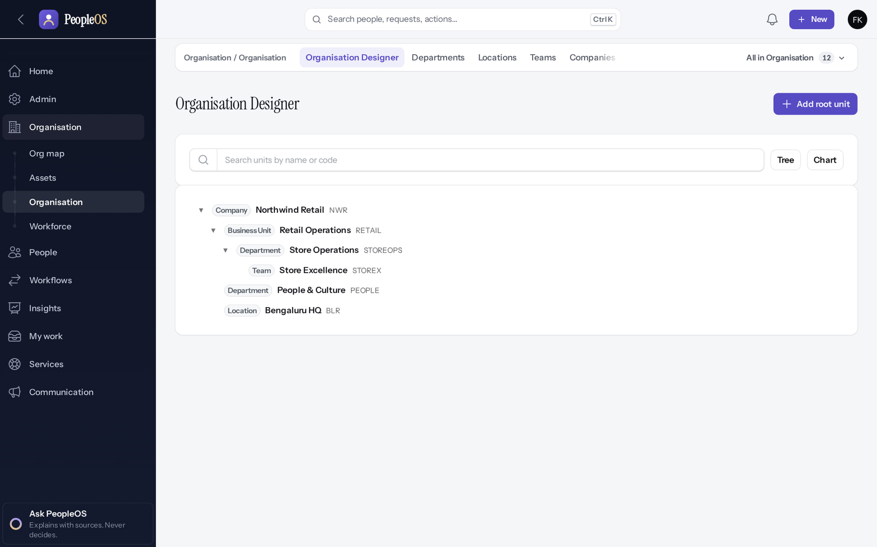
Client Onboarding and Implementation Playbook
MARKEDGE PEOPLEOS · TRAINING LIBRARY
Deck 04 of 12
How Markedge takes a new corporate customer from kickoff to an operating PeopleOS tenant, stage by stage, on the real screens.
For: Markedge implementation specialists, the customer's implementation team, and Markedge platform operators
Built from the running application (local, disposable database, fictional people) · 21 October 2026
Real screen, fictional data
Notes:
SAY: This is the playbook for taking a new customer live on PeopleOS. Every screen was produced by doing the work in a fresh tenant for a fictional customer, Northwind Retail.
EVIDENCE: Executed on the training database on 21 Oct 2026: tenant "Northwind Retail Pvt Ltd" (fictional) provisioned by the platform operator and configured by its first administrator, Farah Khan (fictional).
AUDIENCE: Markedge implementation specialists and the customer's implementation team. Operator steps are for Markedge platform operators only.

Slide 2
How to read this deck
BEFORE YOU START
Verified in the running application
We ran it on the training database and captured each step.
1
Numbered markers on a screenshot match the numbered steps beside it.
Implemented · not verified end to end
The screen exists; the last steps need data or a second party we could not provide.
Every screenshot is a real capture of PeopleOS. The people and companies in it are fictional.
Available only after configuration
Works once an administrator or Markedge has set it up.
Disabled by safety or commercial gates
Switched off on purpose until owner decisions and approvals arrive.
Diagrams are marked "Conceptual diagram". They explain ideas; they are not screens.
Incomplete · known defect or gap
Partly working: a known defect or gap is stated on the slide.
Release gate: NO-GO (10 of 14 gates blocked, re-verified 13 Oct 2026). Not yet generally available.
Not implemented
Not in the product today.
Unable to verify
Could not be checked in this environment.
Notes:
Explain the seven status labels. Every screenshot slide carries one of them in its top-right corner. Stress that "Verified in the running application" means we ran it on a disposable demonstration database, not that the feature is released.

Slide 3
Release gate: NO-GO until these are resolved (1 of 2)
RELEASE STATUS
Status as written in the release gate document. Ten of fourteen gates are blocked by owner decisions, external parties or missing infrastructure.
# | Gate | Gate status | Remaining dependency
1 | Application and architecture integrity | PASS (workstation) | Repeat the full suites in staging
2 | Credential exposure and repository remediation | BLOCKED | Owner: rotation confirmation, repository visibility (O-1 to O-3)
3 | Authentication and operator MFA | BLOCKED | Operators enrol MFA in the target environment (O-14, O-7)
4 | Independent security review | BLOCKED | Engage a reviewer; triage and retest findings (O-4)
5 | Statutory verification and gratuity | BLOCKED | 0 of 24 rules verified; gratuity not implemented (O-5, O-12, O-18)
6 | Data protection, retention, legal holds | PASS (controls) / BLOCKED (policy) | Retention decisions with counsel (D8); privacy review
7 | Backup, restore and disaster recovery | BLOCKED | Recovery objectives and an isolated target (O-6, O-7)
Notes:
SOURCE: docs/saas/SaaS-Final-Release-Gate.md (decision NO-GO, re-verified 13 October 2026 at 7314f7d); owner actions in docs/saas/SaaS-Final-Owner-Action-Register.md.
SAY: The application passes its automated suites on the workstation, but release is blocked by decisions and infrastructure, not by code alone.
AVOID: describing any gate as resolved. Nothing in this training changes a gate.
SAY: Release gate: NO-GO until these are resolved (part 1 of 2). Status as written in the release gate document. Ten of fourteen gates are blocked by owner decisions, external parties or missing infrastructure.
- 1 | Application and architecture integrity | PASS (workstation) | Repeat the full suites in staging
- 2 | Credential exposure and repository remediation | BLOCKED | Owner: rotation confirmation, repository visibility (O-1 to O-3)
- 3 | Authentication and operator MFA | BLOCKED | Operators enrol MFA in the target environment (O-14, O-7)
- 4 | Independent security review | BLOCKED | Engage a reviewer; triage and retest findings (O-4)
- 5 | Statutory verification and gratuity | BLOCKED | 0 of 24 rules verified; gratuity not implemented (O-5, O-12, O-18)
- 6 | Data protection, retention, legal holds | PASS (controls) / BLOCKED (policy) | Retention decisions with counsel (D8); privacy review
- 7 | Backup, restore and disaster recovery | BLOCKED | Recovery objectives and an isolated target (O-6, O-7)

Slide 4
Release gate: NO-GO until these are resolved (2 of 2)
RELEASE STATUS
# | Gate | Gate status | Remaining dependency
8 | Hosting, monitoring and on-call | BLOCKED | Environment, alerting, on-call (O-7, O-10, O-11)
9 | Signup and tenant provisioning | PASS (disabled) / BLOCKED (activation) | Only if self-service signup is wanted at launch (D10)
10 | Billing, tax and payment controls | PASS (disabled) / BLOCKED (activation) | Only for paid billing (B-4, B-7, B-8, B-9)
11 | Tenant deletion and offboarding | PASS (disabled) / BLOCKED (activation) | Retention decisions, register disk, review (D8)
12 | Regression and target-environment testing | BLOCKED | A staging environment (O-7, O-8)
13 | Owner decisions and written approvals | BLOCKED | All owner action items
14 | Deployment, rollback, post-deployment checks | BLOCKED | Rehearse in staging; authorise (O-7 to O-9)
Notes:
SOURCE: docs/saas/SaaS-Final-Release-Gate.md (decision NO-GO, re-verified 13 October 2026 at 7314f7d); owner actions in docs/saas/SaaS-Final-Owner-Action-Register.md.
SAY: The application passes its automated suites on the workstation, but release is blocked by decisions and infrastructure, not by code alone.
AVOID: describing any gate as resolved. Nothing in this training changes a gate.
SAY: Release gate: NO-GO until these are resolved (part 2 of 2). Status as written in the release gate document. Ten of fourteen gates are blocked by owner decisions, external parties or missing infrastructure.
- 8 | Hosting, monitoring and on-call | BLOCKED | Environment, alerting, on-call (O-7, O-10, O-11)
- 9 | Signup and tenant provisioning | PASS (disabled) / BLOCKED (activation) | Only if self-service signup is wanted at launch (D10)
- 10 | Billing, tax and payment controls | PASS (disabled) / BLOCKED (activation) | Only for paid billing (B-4, B-7, B-8, B-9)
- 11 | Tenant deletion and offboarding | PASS (disabled) / BLOCKED (activation) | Retention decisions, register disk, review (D8)
- 12 | Regression and target-environment testing | BLOCKED | A staging environment (O-7, O-8)
- 13 | Owner decisions and written approvals | BLOCKED | All owner action items
- 14 | Deployment, rollback, post-deployment checks | BLOCKED | Rehearse in staging; authorise (O-7 to O-9)

Slide 5
How these screens were produced
ABOUT THIS TRAINING
Real application
Disposable database
PeopleOS at commit 72c96a73, run locally. No application file or setting was changed for the training.
hcm_training_showcase: the fictional Demo Group plus a fictional customer, Northwind Retail, provisioned and configured from empty during this training.
Workflows executed
Nothing switched on
Requests were submitted, approved, rejected and processed so that every state shown really happened.
Public signup, live payments and tenant deletion stayed off. The operator used MFA. No secret is shown.
Notes:
SAY: Every screenshot is a genuine capture from the running application on a disposable database. The full list, with what each one shows, is in SCREENSHOT-INVENTORY.md.
EVIDENCE: docs/presentations/peopleos/SCREENSHOT-INVENTORY.md and PEOPLEOS-PRESENTATION-ACCURACY-REGISTER.md.
SAY: How these screens were produced.
- Real application: PeopleOS at commit 72c96a73, run locally. No application file or setting was changed for the training.
- Disposable database: hcm_training_showcase: the fictional Demo Group plus a fictional customer, Northwind Retail, provisioned and configured from empty during this training.
- Workflows executed: Requests were submitted, approved, rejected and processed so that every state shown really happened.
- Nothing switched on: Public signup, live payments and tenant deletion stayed off. The operator used MFA. No secret is shown.
ASK: "Which of these points needs more explanation for your team?"

Slide 6
What you will be able to do
LEARNING OBJECTIVES
Separate the two administrator roles
Markedge platform operator versus the customer's tenant administrator
Load people safely
hire wizard, duplicate check, reporting lines; import status
1
4
Provision and hand over a tenant
operator workflow, invitation, first sign-in
Configure policies and payroll inputs
attendance, leave, pay, statutory, workflows, security
2
5
Build the organisation
company, legal entity, establishment, location, units, job architecture
Validate, test and go live
reconciliation, UAT, access checks, go/no-go, handover
3
6
Notes:
SAY: The order of the stages matters: structure before people, people before policies, everything before UAT.
RESOURCES: supporting/PeopleOS-Customer-Implementation-Checklist.xlsx (one row per stage) and supporting/PeopleOS-Go-Live-Handover-Checklist.xlsx.

Slide 7
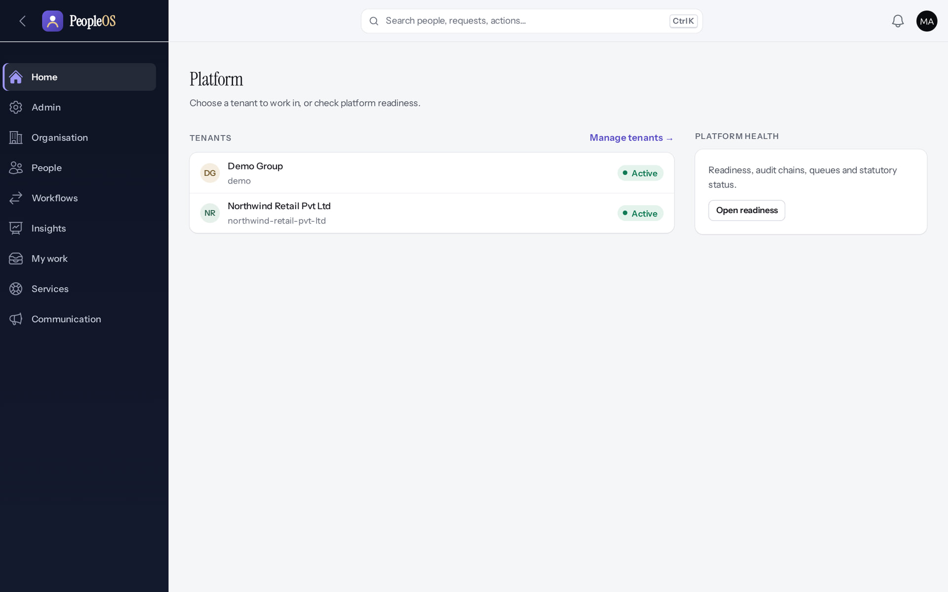
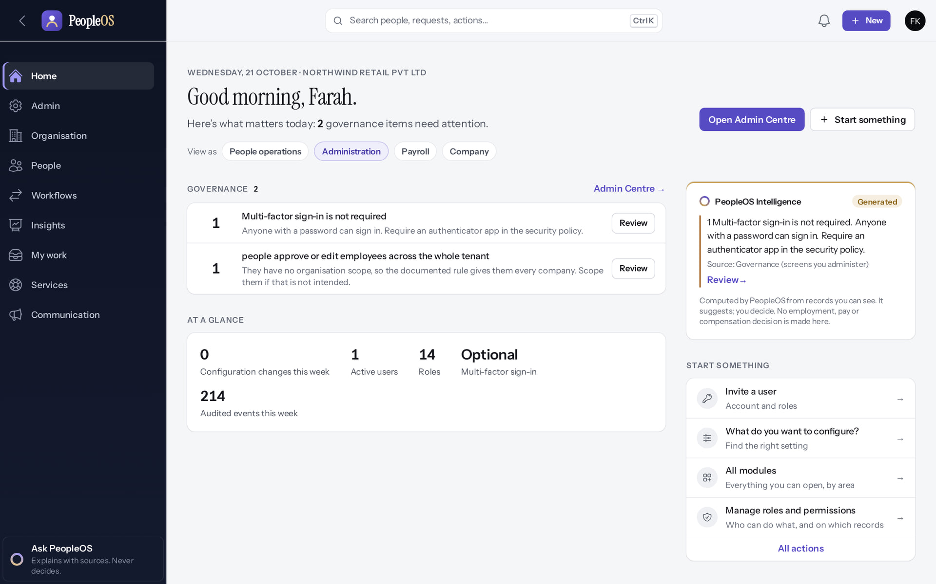
Two administrators, two different jobs
ROLES
Markedge platform operator
Verified
Customer tenant administrator
Verified
Signs in with MFA, works outside any tenant: creates tenants, watches platform health. Never configures the customer's HR data.
Invited by the operator; configures the organisation, people, policies and access inside one tenant.
Real screen · Markedge Platform Admin (Platform operator) · Platform home (operator)
Real screen · Farah Khan (Tenant Super Admin (Northwind Retail, first administrator)) · Home (new tenant, administration lens)
Notes:
SAY: The operator console and the customer's tenant are the same application, but different accounts with different permissions. Operators enter a tenant only explicitly, and every action is audited.
EVIDENCE: Executed on the training database on 21 Oct 2026: tenant "Northwind Retail Pvt Ltd" (fictional) provisioned by the platform operator and configured by its first administrator, Farah Khan (fictional).
SAY: Two administrators, two different jobs.
LEFT, Markedge platform operator: Signs in with MFA, works outside any tenant: creates tenants, watches platform health. Never configures the customer's HR data.
RIGHT, Customer tenant administrator: Invited by the operator; configures the organisation, people, policies and access inside one tenant.
OBSERVE: point out what differs between the two screens.
EVIDENCE: left = client-onboarding/90-onb-01-platform-home [Markedge Platform Admin (Platform operator), Platform home (operator)]; right = client-onboarding/90-onb-12-empty-tenant-home [Farah Khan (Tenant Super Admin (Northwind Retail, first administrator)), Home (new tenant, administration lens)]. Real screens, fictional data (SCREENSHOT-INVENTORY.md).

Slide 8
28 stages in seven phases
THE JOURNEY
Plan
Provision
Structure
People data
1. Discovery and implementation plan
2. Tenant provisioning
4. Company set-up
9. Employee data preparation
3. First administrator activation
5. Legal entities
10. Data load
6. Establishments and locations
11. Person matching and duplicates
7. Organisation structure
12. Roles, users and access scope
8. Job architecture and positions
13. Reporting relationships
Light blue = configured in PeopleOS · lilac = Markedge operator action · green = automated · grey = manual, outside PeopleOS · red = blocked.
Conceptual diagram, not a screenshot
Notes:
SAY: This slide and the next show all 28 stages. Red stages cannot be completed today: data import (defect F25), statutory verification (0 of 24 rules) and go-live approval (release gate NO-GO).
SAY: 28 stages in seven phases. Light blue = configured in PeopleOS · lilac = Markedge operator action · green = automated · grey = manual, outside PeopleOS · red = blocked.
Plan: 1. Discovery and implementation plan
Provision: 2. Tenant provisioning, 3. First administrator activation
Structure: 4. Company set-up, 5. Legal entities, 6. Establishments and locations, 7. Organisation structure, 8. Job architecture and positions
People data: 9. Employee data preparation, 10. Data load, 11. Person matching and duplicates, 12. Roles, users and access scope, 13. Reporting relationships

Slide 9
28 stages in seven phases (continued)
THE JOURNEY
Policies and pay
Validate
Go live
14. Attendance and shifts
21. Employee and manager readiness
26. Go-live readiness and approval
15. Leave policies
22. Data validation and reconciliation
27. Post-go-live monitoring and support handover
16. Payroll components and structures
23. User acceptance testing
28. Customer training and ongoing governance
17. Statutory configuration and verification
24. Defect logging and resolution
18. Workflows and approvals
25. Security and access validation
19. Notifications and communication
20. Security policy and sign-in
Every stage has a card in this deck with: responsible party, inputs, navigation, what to configure, expected outcome, verification, evidence, common errors, dependencies and acceptance criteria.
Conceptual diagram, not a screenshot
Notes:
SAY: 28 stages in seven phases (continued). Every stage has a card in this deck with: responsible party, inputs, navigation, what to configure, expected outcome, verification, evidence, common errors, dependencies and acceptance criteria.
Policies and pay: 14. Attendance and shifts, 15. Leave policies, 16. Payroll components and structures, 17. Statutory configuration and verification, 18. Workflows and approvals, 19. Notifications and communication, 20. Security policy and sign-in
Validate: 21. Employee and manager readiness, 22. Data validation and reconciliation, 23. User acceptance testing, 24. Defect logging and resolution, 25. Security and access validation
Go live: 26. Go-live readiness and approval, 27. Post-go-live monitoring and support handover, 28. Customer training and ongoing governance

Slide 10
Plan
01
Agree scope, data owners and the timeline before anything is configured.
Notes:
TRANSITION: Section 1, Plan. Agree scope, data owners and the timeline before anything is configured.
SAY: Tell learners what they will be able to do by the end of this section, then move on.
ASK: "What questions do you have before we start this section?"

Slide 11
Stage 1 · Discovery and implementation plan
IMPLEMENTATION STAGE
Manual (outside PeopleOS)
RESPONSIBLE
Markedge implementation lead with the customer HR lead
REQUIRED INPUTS
Org charts, entity list, policies (leave, attendance, payroll), headcount, integrations, go-live date
WHERE IN PEOPLEOS
Outside PeopleOS (workshops, plan)
WHAT TO CONFIGURE
Agree scope (modules, countries, payroll in or out), roles, data owners, timeline
EXPECTED OUTCOME
Signed scope and plan
HOW TO VERIFY
Customer sign-off on the scope document
EVIDENCE TO RETAIN
Scope and plan, signed
COMMON ERRORS AND LIMITS
Promising payroll go-live while statutory rules are unverified
DEPENDENCIES AND BLOCKERS
Release gate NO-GO: general availability not yet declared
ACCEPTANCE CRITERIA
Scope lists every module and whether payroll statutory processing is in scope
Notes:
RESPONSIBLE: Markedge implementation lead with the customer HR lead.
SAY: Agree scope (modules, countries, payroll in or out), roles, data owners, timeline.
VERIFY: Customer sign-off on the scope document. EVIDENCE TO KEEP: Scope and plan, signed.
WATCH FOR: Promising payroll go-live while statutory rules are unverified.

Slide 12
Ask the customer for these before kickoff
STAGE 1 · DISCOVERY
Organisation
Jobs and people
Policies
Companies and legal employers, registered establishments, sites, business units, departments, teams, cost centres.
Designations, levels, grades, employment types; the employee master with managers; who the HR, payroll and IT owners are.
Leave types and rules, shifts and weekly patterns, holiday lists per location, approval chains, notification needs.
Pay and statutory
Access
Integrations
Salary components and structures, registrations (PF, ESI, PT, LWF, TAN). Decide in writing whether payroll is in scope while rules are unverified.
Who administers, who approves, which HR users cover which companies; MFA and SSO (OIDC) decisions.
Attendance devices, identity provider, API/SCIM consumers, webhooks. Recruitment systems connect only through the Integration Hub.
Notes:
SAY: Collect personal data through the customer's secure channel, never by e-mail.
AVOID: committing to a payroll go-live date: statutory verification is a release gate (0 of 24 rules verified).
SAY: Ask the customer for these before kickoff.
- Organisation: Companies and legal employers, registered establishments, sites, business units, departments, teams, cost centres.
- Jobs and people: Designations, levels, grades, employment types; the employee master with managers; who the HR, payroll and IT owners are.
- Policies: Leave types and rules, shifts and weekly patterns, holiday lists per location, approval chains, notification needs.
- Pay and statutory: Salary components and structures, registrations (PF, ESI, PT, LWF, TAN). Decide in writing whether payroll is in scope while rules are unverified.
- Access: Who administers, who approves, which HR users cover which companies; MFA and SSO (OIDC) decisions.
- Integrations: Attendance devices, identity provider, API/SCIM consumers, webhooks. Recruitment systems connect only through the Integration Hub.
ASK: "Which of these points needs more explanation for your team?"

Slide 13
Provision
02
A Markedge operator creates the tenant; the customer's first administrator activates it.
Notes:
TRANSITION: Section 2, Provision. A Markedge operator creates the tenant; the customer's first administrator activates it.
SAY: Tell learners what they will be able to do by the end of this section, then move on.
ASK: "What questions do you have before we start this section?"

Slide 14
Stage 2 · Tenant provisioning
IMPLEMENTATION STAGE
Operator action in PeopleOS
RESPONSIBLE
Markedge platform operator (MFA required)
REQUIRED INPUTS
Customer name, slug, country, time zone, currency, first administrator name and e-mail, reason
WHERE IN PEOPLEOS
Platform home › Manage tenants › New tenant
WHAT TO CONFIGURE
Tier, data region (metadata), name, slug (suggested from the name; check it before saving), status, locale, currency, first administrator; audit reason
EXPECTED OUTCOME
Tenant created with default organisation set-up; invitation e-mailed to the first administrator
HOW TO VERIFY
Tenant row is Active; invitation sent (or resend from the Tenants list)
EVIDENCE TO RETAIN
Tenants list screenshot; audit entry
COMMON ERRORS AND LIMITS
Mail not configured: "Tenant created, but the invitation e-mail was not sent"
DEPENDENCIES AND BLOCKERS
Production mail transport (gate 8)
ACCEPTANCE CRITERIA
Tenant exists, first administrator invited
Notes:
RESPONSIBLE: Markedge platform operator (MFA required).
SAY: Tier, data region (metadata), name, slug (suggested from the name; check it before saving), status, locale, currency, first administrator; audit reason.
VERIFY: Tenant row is Active; invitation sent (or resend from the Tenants list). EVIDENCE TO KEEP: Tenants list screenshot; audit entry.
WATCH FOR: Mail not configured: "Tenant created, but the invitation e-mail was not sent".

Slide 15
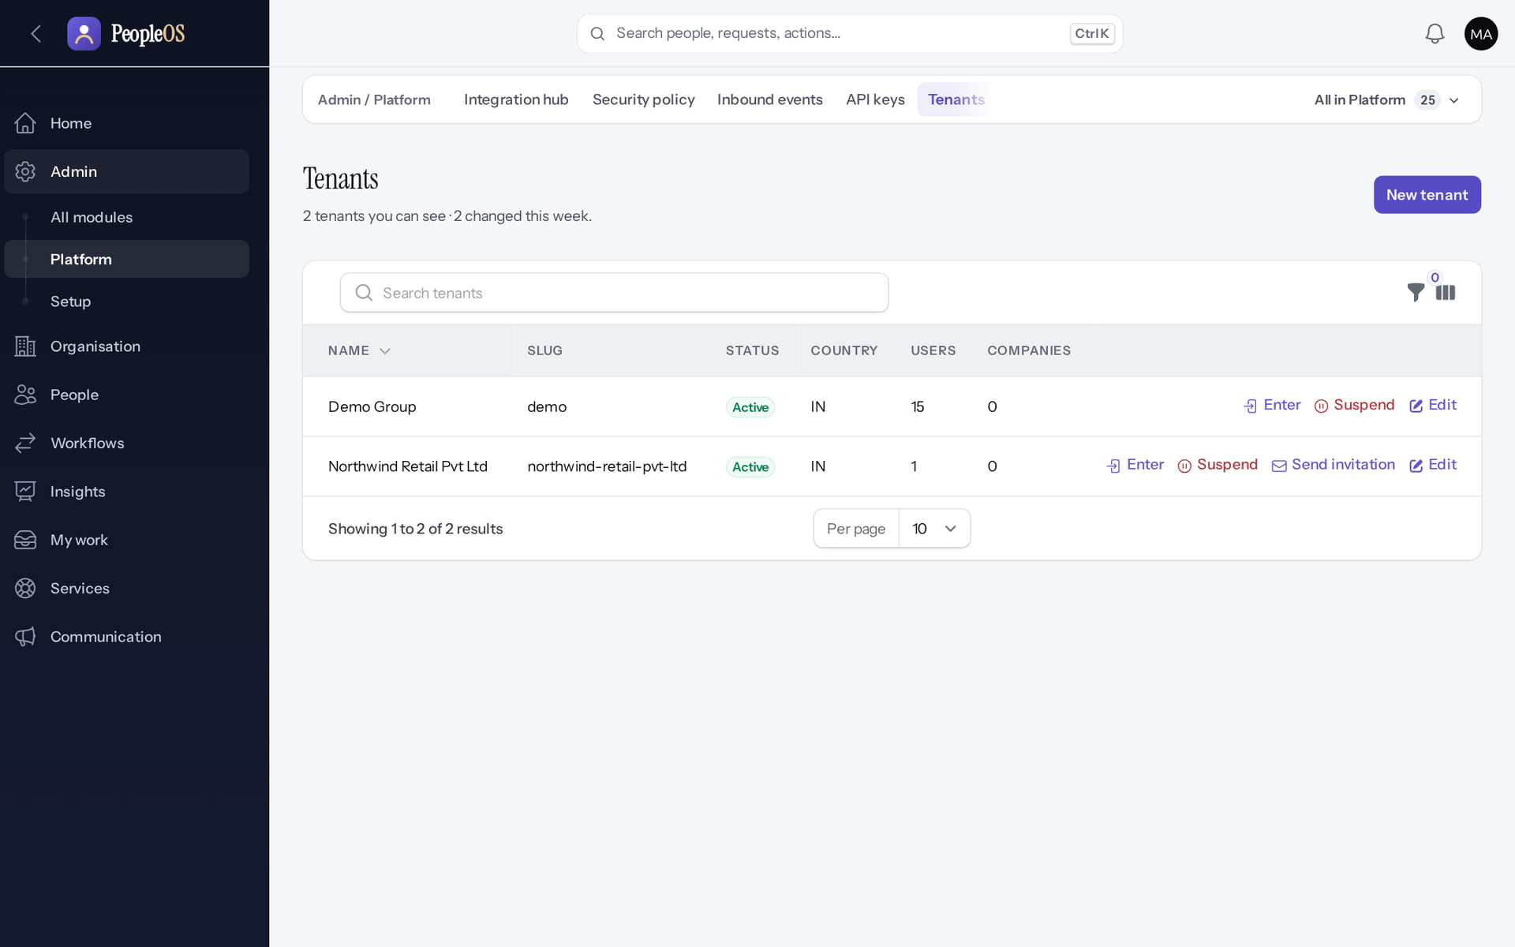
The operator's Tenants list
STAGE 2 · PROVISIONING
Verified in the running application
1
1
New tenant starts provisioning.
2
Enter works inside a tenant (audited).
3
Suspend blocks a tenant's sign-ins.
2
3
RESULT Admin › Platform › Tenants lists every tenant with slug, status, country and users.
Real screen · Markedge Platform Admin (Platform operator) · Admin › Platform › Tenants
Notes:
SAY: Only platform operators see this page. Operators must use an authenticator app (MFA) to get here.
EVIDENCE: Executed on the training database on 21 Oct 2026: tenant "Northwind Retail Pvt Ltd" (fictional) provisioned by the platform operator and configured by its first administrator, Farah Khan (fictional).

Slide 16
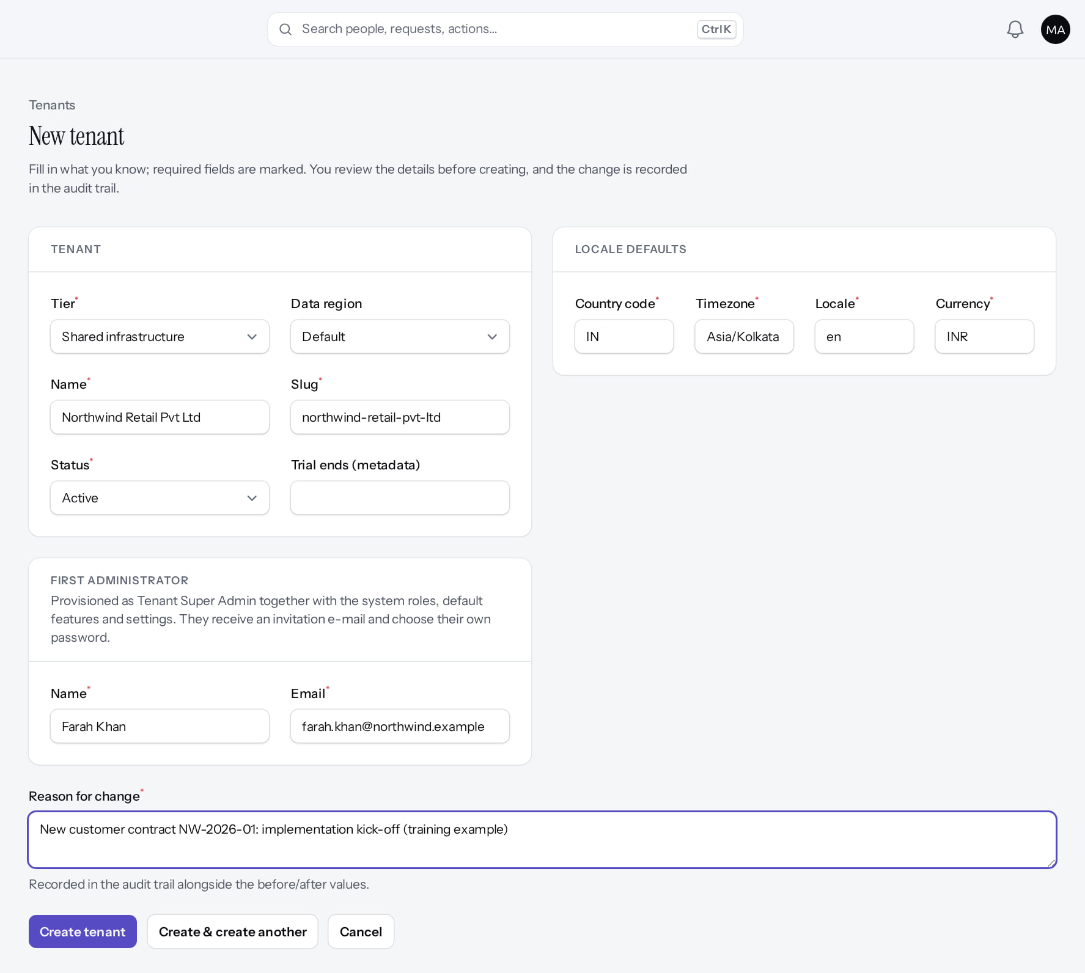
Create the tenant
STAGE 2 · PROVISIONING
Verified in the running application
1
Tier (shared infrastructure).
2
Data region (metadata today).
4
3
Slug: unique; suggested from the name.
1
2
Locale defaults: country, zone, currency.
4
3
5
First administrator: name, e-mail.
6
Reason for change (audited).
RESULT The first administrator is invited as Tenant Super Admin; operators never see passwords.
5
6
Real screen (cropped) · Markedge Platform Admin (Platform operator) · Tenants › New tenant
Notes:
OBSERVE: Northwind Retail Pvt Ltd, IN, Asia/Kolkata, INR; first administrator Farah Khan (fictional). The slug is suggested from the name and replaced the typed "northwind" with "northwind-retail-pvt-ltd": check it before saving.
SAY: Tier and region are recorded but do not route data to a separate database today (deferred).
EVIDENCE: Executed on the training database on 21 Oct 2026: tenant "Northwind Retail Pvt Ltd" (fictional) provisioned by the platform operator and configured by its first administrator, Farah Khan (fictional).

Slide 17
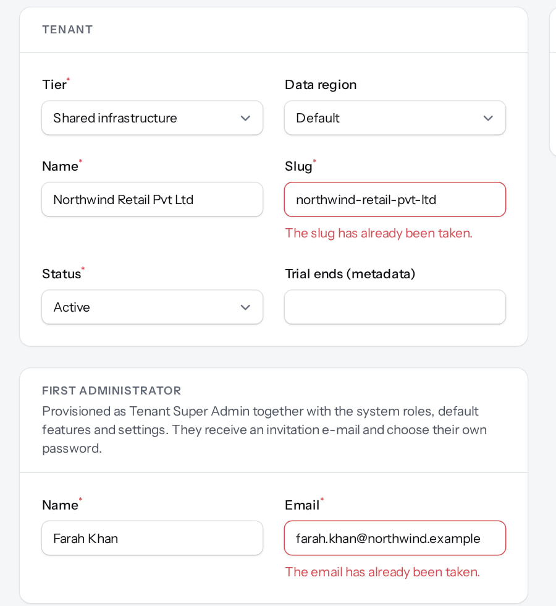
Duplicates are refused; the new tenant appears
STAGE 2 · PROVISIONING
Same tenant submitted again
Verified
Tenants list
Verified
"The slug has already been taken." and "The email has already been taken." Nothing is created.
Northwind Retail is Active with 1 user (the invited administrator). Send invitation re-sends the e-mail.
Real screen (cropped) · Markedge Platform Admin (Platform operator) · Tenants › New tenant (validation)
Real screen · Markedge Platform Admin (Platform operator) · Admin › Platform › Tenants
Notes:
SAY: One e-mail address can belong to only one organisation (owner decision D-17 is still open). Use the customer administrator's company address.
SAY: Duplicates are refused; the new tenant appears.
LEFT, Same tenant submitted again: "The slug has already been taken." and "The email has already been taken." Nothing is created.
RIGHT, Tenants list: Northwind Retail is Active with 1 user (the invited administrator). Send invitation re-sends the e-mail.
OBSERVE: point out what differs between the two screens.
EVIDENCE: left = client-onboarding/90-onb-04-duplicate-tenant-refused [Markedge Platform Admin (Platform operator), Tenants › New tenant (validation)]; right = client-onboarding/90-onb-05-tenants-with-northwind [Markedge Platform Admin (Platform operator), Admin › Platform › Tenants]. Real screens, fictional data (SCREENSHOT-INVENTORY.md).

Slide 18
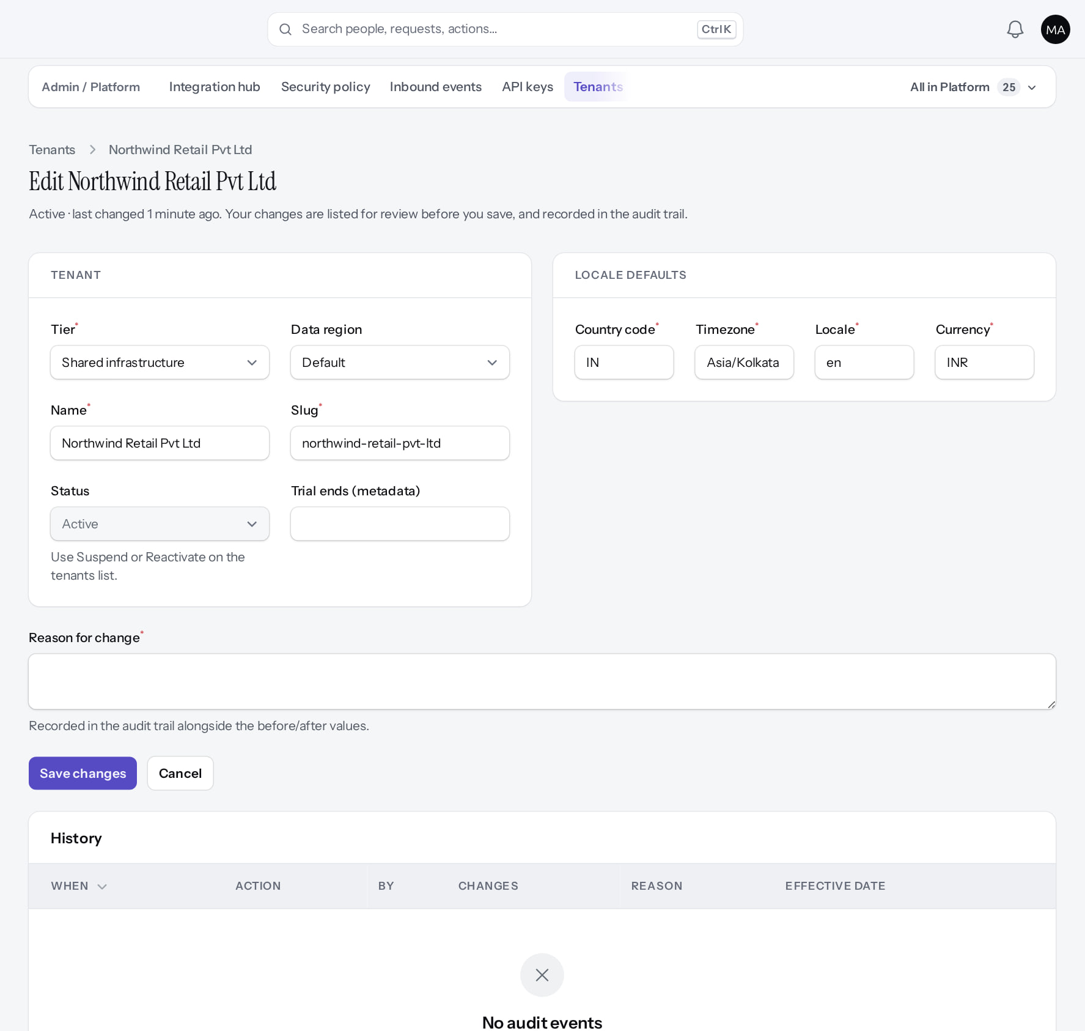
Operator-only tenant settings
STAGE 2 · PROVISIONING
Verified in the running application
1
Status is read-only here.
2
Lifecycle changes use Suspend / Reactivate on the list.
3
3
Tier and region metadata.
RESULT Every save asks for a reason and is listed in the tenant's History.
1
2
Real screen (cropped) · Markedge Platform Admin (Platform operator) · Tenants › Edit tenant
Notes:
SAY: Every save asks for a reason and is listed in the tenant's History.
ON SCREEN: Open the tenant record.
WALK THROUGH: (1) Status is read-only here. (2) Lifecycle changes use Suspend / Reactivate on the list. (3) Tier and region metadata.
LEARNERS SHOULD SEE: Operator-only settings: tier, data region, status, trial metadata, locale defaults
SCREEN: Tenants › Edit tenant. Signed in as Markedge Platform Admin (Platform operator). Prerequisite: Platform operator account with MFA.
EVIDENCE: screenshot screenshots/client-onboarding/90-onb-06-tenant-edit.png, captured 2026-10-21 on the disposable training database (fictional people).

Slide 19
Stage 3 · First administrator activation
IMPLEMENTATION STAGE
Configuration in PeopleOS
RESPONSIBLE
Customer administrator
REQUIRED INPUTS
Invitation e-mail (link valid 72 hours, single use)
WHERE IN PEOPLEOS
Invitation link › Accept your invitation › Activate my account
WHAT TO CONFIGURE
Choose a password; sign in
EXPECTED OUTCOME
Administrator signed in to an empty tenant
HOW TO VERIFY
Users list shows the administrator Active
EVIDENCE TO RETAIN
Users list
COMMON ERRORS AND LIMITS
Expired or used link; one e-mail address can belong to only one organisation
DEPENDENCIES AND BLOCKERS
Stage 2
ACCEPTANCE CRITERIA
Administrator can sign in
Notes:
RESPONSIBLE: Customer administrator.
SAY: Choose a password; sign in.
VERIFY: Users list shows the administrator Active. EVIDENCE TO KEEP: Users list.
WATCH FOR: Expired or used link; one e-mail address can belong to only one organisation.

Slide 20
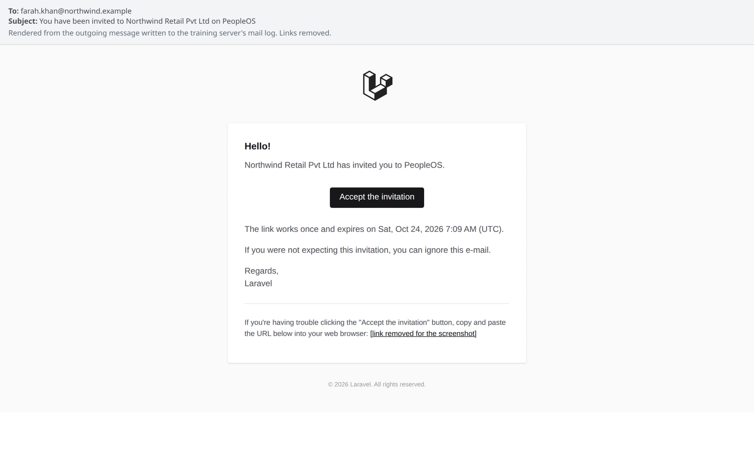
The invitation e-mail
STAGE 3 · ACTIVATION
Verified in the running application
1
Accept the invitation opens the activation page.
2
The link works once and expires (72 hours by default).
1
RESULT Shown here: the outgoing message rendered in a browser, link removed. The sender appears as "Laravel" because the application name and mail sender are not set in this development environment: set APP_NAME and MAIL_FROM_NAME in production.
2
E-mail sent by PeopleOS, rendered from the outgoing message (link removed). Not an application screen.
Notes:
NOTE: This is the e-mail PeopleOS sent, rendered from the training server's mail log; it is not an application screen.
ACTION FOR MARKEDGE: production mail configuration (sender name, domain) is part of hosting readiness.

Slide 21
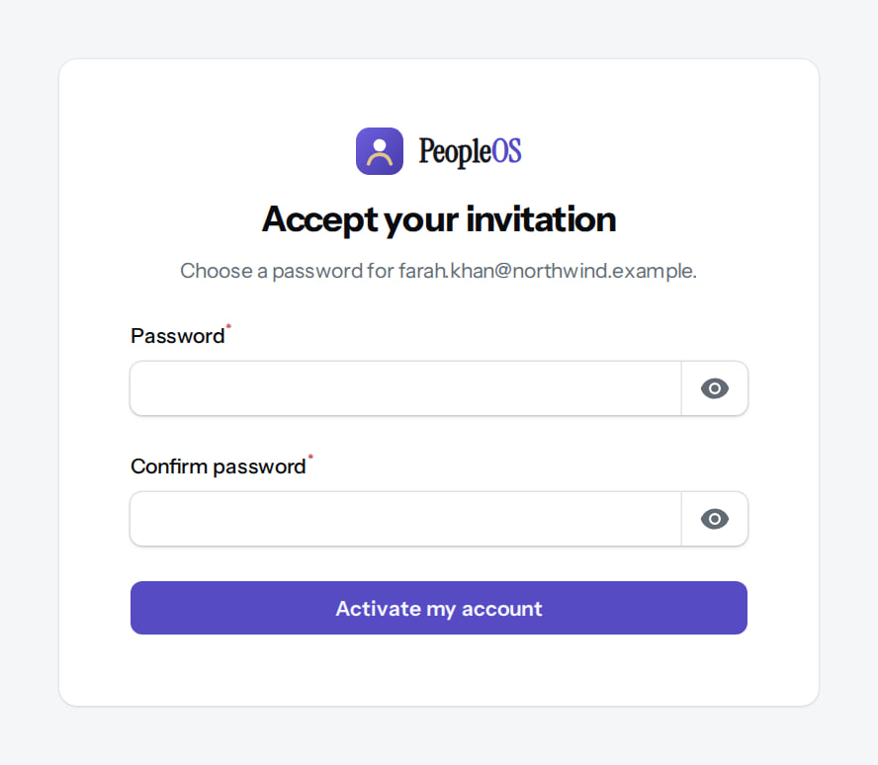
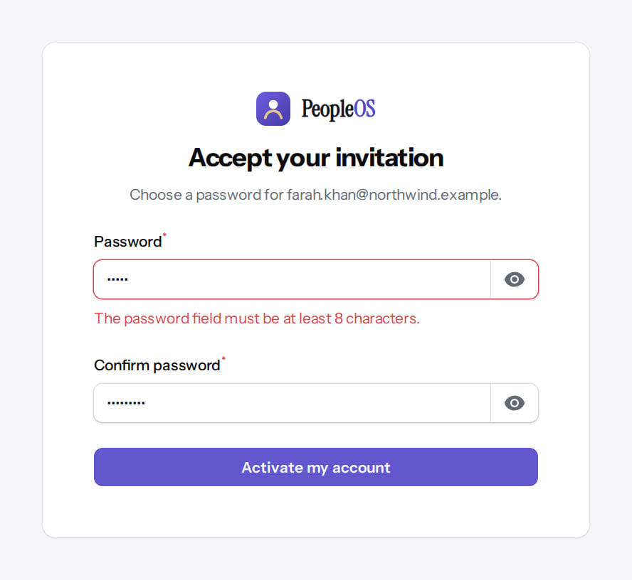
Activate the account
STAGE 3 · ACTIVATION
Accept your invitation
Verified
Password rules
Verified
Choose a password, confirm it, then Activate my account.
"The password field must be at least 8 characters." The account stays invited until a valid password is set.
Real screen (cropped) · Farah Khan (invited, not yet active) (Invited first administrator) · Accept your invitation (/admin/invitation/…)
Real screen (cropped) · Farah Khan (invited, not yet active) (Invited first administrator) · Accept your invitation (validation)
Notes:
SAY: Activate the account.
LEFT, Accept your invitation: Choose a password, confirm it, then Activate my account.
RIGHT, Password rules: "The password field must be at least 8 characters." The account stays invited until a valid password is set.
OBSERVE: point out what differs between the two screens.
EVIDENCE: left = client-onboarding/90-onb-08-accept-invitation [Farah Khan (invited, not yet active) (Invited first administrator), Accept your invitation (/admin/invitation/…)]; right = client-onboarding/90-onb-09-password-rules [Farah Khan (invited, not yet active) (Invited first administrator), Accept your invitation (validation)]. Real screens, fictional data (SCREENSHOT-INVENTORY.md).

Slide 22
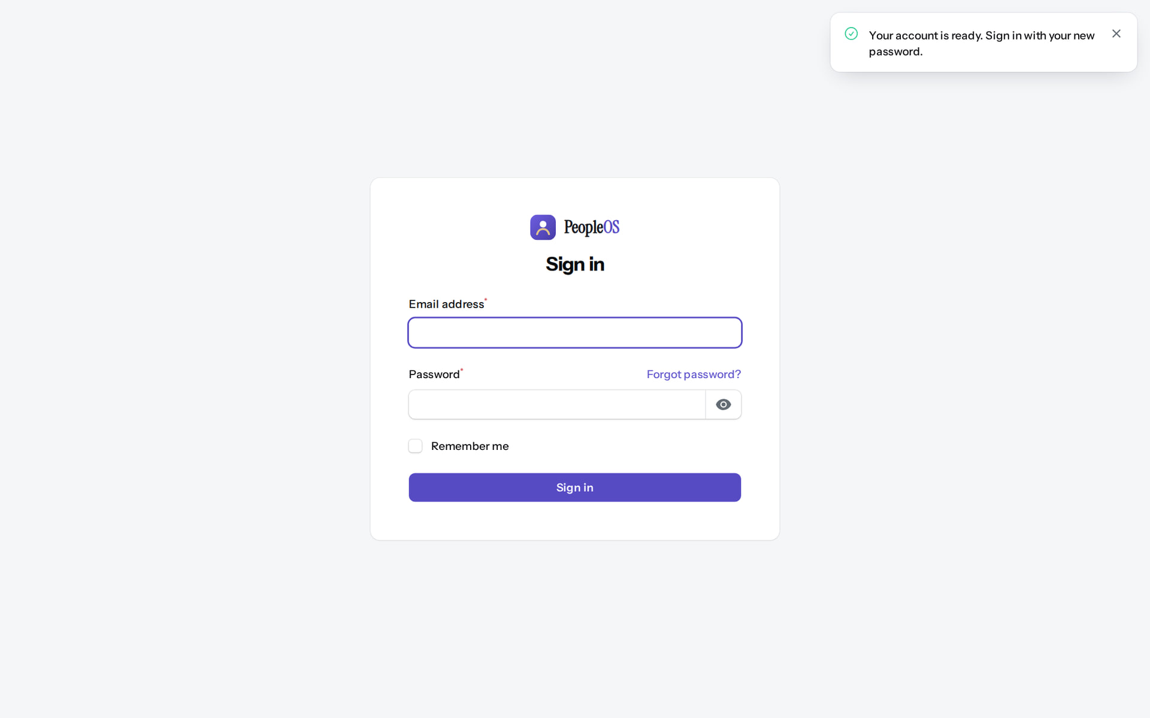
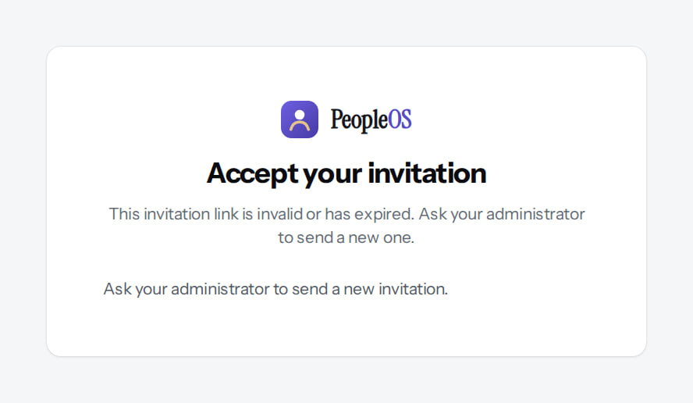
Ready to sign in; the link cannot be reused
STAGE 3 · ACTIVATION
After activation
Verified
Same link opened again
Verified
"Your account is ready. Sign in with your new password."
"This invitation link is invalid or has expired. Ask your administrator to send a new one."
Real screen · Farah Khan (Tenant Super Admin (Northwind Retail, first administrator)) · Sign in (after activation)
Real screen (cropped) · Signed out (Visitor) · Accept your invitation (used link)
Notes:
SUPPORT: if a customer reports an expired link, the operator uses Send invitation on the Tenants list (stage 2).
SAY: Ready to sign in; the link cannot be reused.
LEFT, After activation: "Your account is ready. Sign in with your new password."
RIGHT, Same link opened again: "This invitation link is invalid or has expired. Ask your administrator to send a new one."
OBSERVE: point out what differs between the two screens.
EVIDENCE: left = client-onboarding/90-onb-10-account-ready-sign-in [Farah Khan (Tenant Super Admin (Northwind Retail, first administrator)), Sign in (after activation)]; right = client-onboarding/90-onb-11-invitation-used [Signed out (Visitor), Accept your invitation (used link)]. Real screens, fictional data (SCREENSHOT-INVENTORY.md).

Slide 23
First sign-in: an empty tenant
STAGE 3 · ACTIVATION
Verified in the running application
1
1
Open Admin Centre: the administrator's starting point.
2
2
Governance warnings to act on (MFA not required; unscoped approvers).
3
At a glance: 1 active user, 14 system roles.
3
RESULT The tenant comes with system roles, default settings, starter policies and seeded reference lists, but no organisation or people.
Real screen · Farah Khan (Tenant Super Admin (Northwind Retail, first administrator)) · Home (new tenant, administration lens)
Notes:
SAY: Act on the governance items before inviting anyone else: require MFA (stage 20) and plan HR scope (stage 12).

Slide 24
Structure
03
Build the organisation the people will sit in: companies, legal employers, sites, units and jobs.
Notes:
TRANSITION: Section 3, Structure. Build the organisation the people will sit in: companies, legal employers, sites, units and jobs.
SAY: Tell learners what they will be able to do by the end of this section, then move on.
ASK: "What questions do you have before we start this section?"

Slide 25
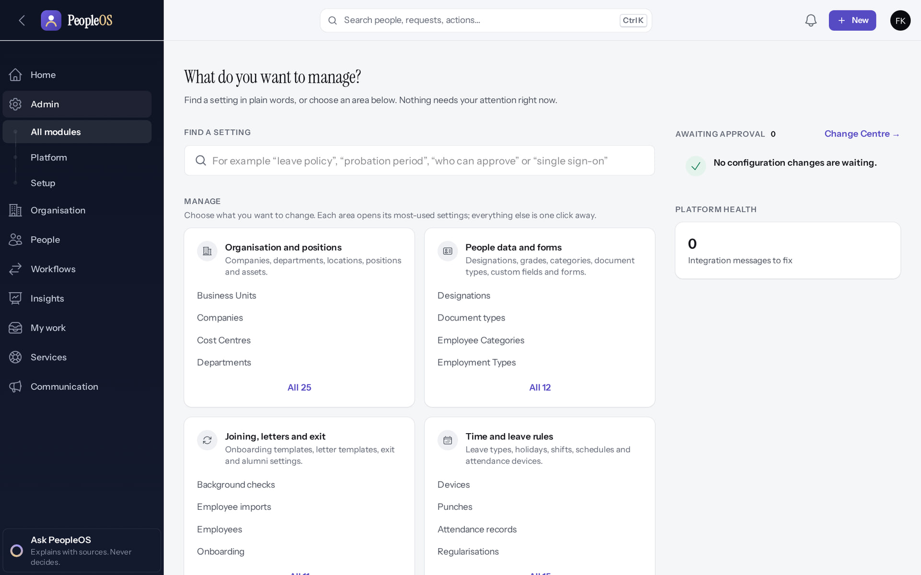
Admin Centre: every module by area
WHERE CONFIGURATION LIVES
Verified in the running application
1
Organisation and positions.
2
Access and security.
2
Change Centre (governed changes).
1
RESULT Admin › All modules. Search finds a module by name.
Real screen · Farah Khan (Tenant Super Admin (Northwind Retail, first administrator)) · Admin › All modules (Admin Centre)
Notes:
SAY: Admin › All modules. Search finds a module by name.
ON SCREEN: Open Admin Centre.
WALK THROUGH: (1) Organisation and positions. (2) Access and security. (3) Change Centre (governed changes).
LEARNERS SHOULD SEE: Every module grouped by area, with a search box and the Change Centre
SCREEN: Admin › All modules (Admin Centre). Signed in as Farah Khan (Tenant Super Admin (Northwind Retail, first administrator)). Prerequisite: Signed in as the tenant administrator (Tenant Super Admin of Northwind Retail).
EVIDENCE: screenshot screenshots/client-onboarding/90-onb-13-admin-centre.png, captured 2026-10-21 on the disposable training database (fictional people).

Slide 26
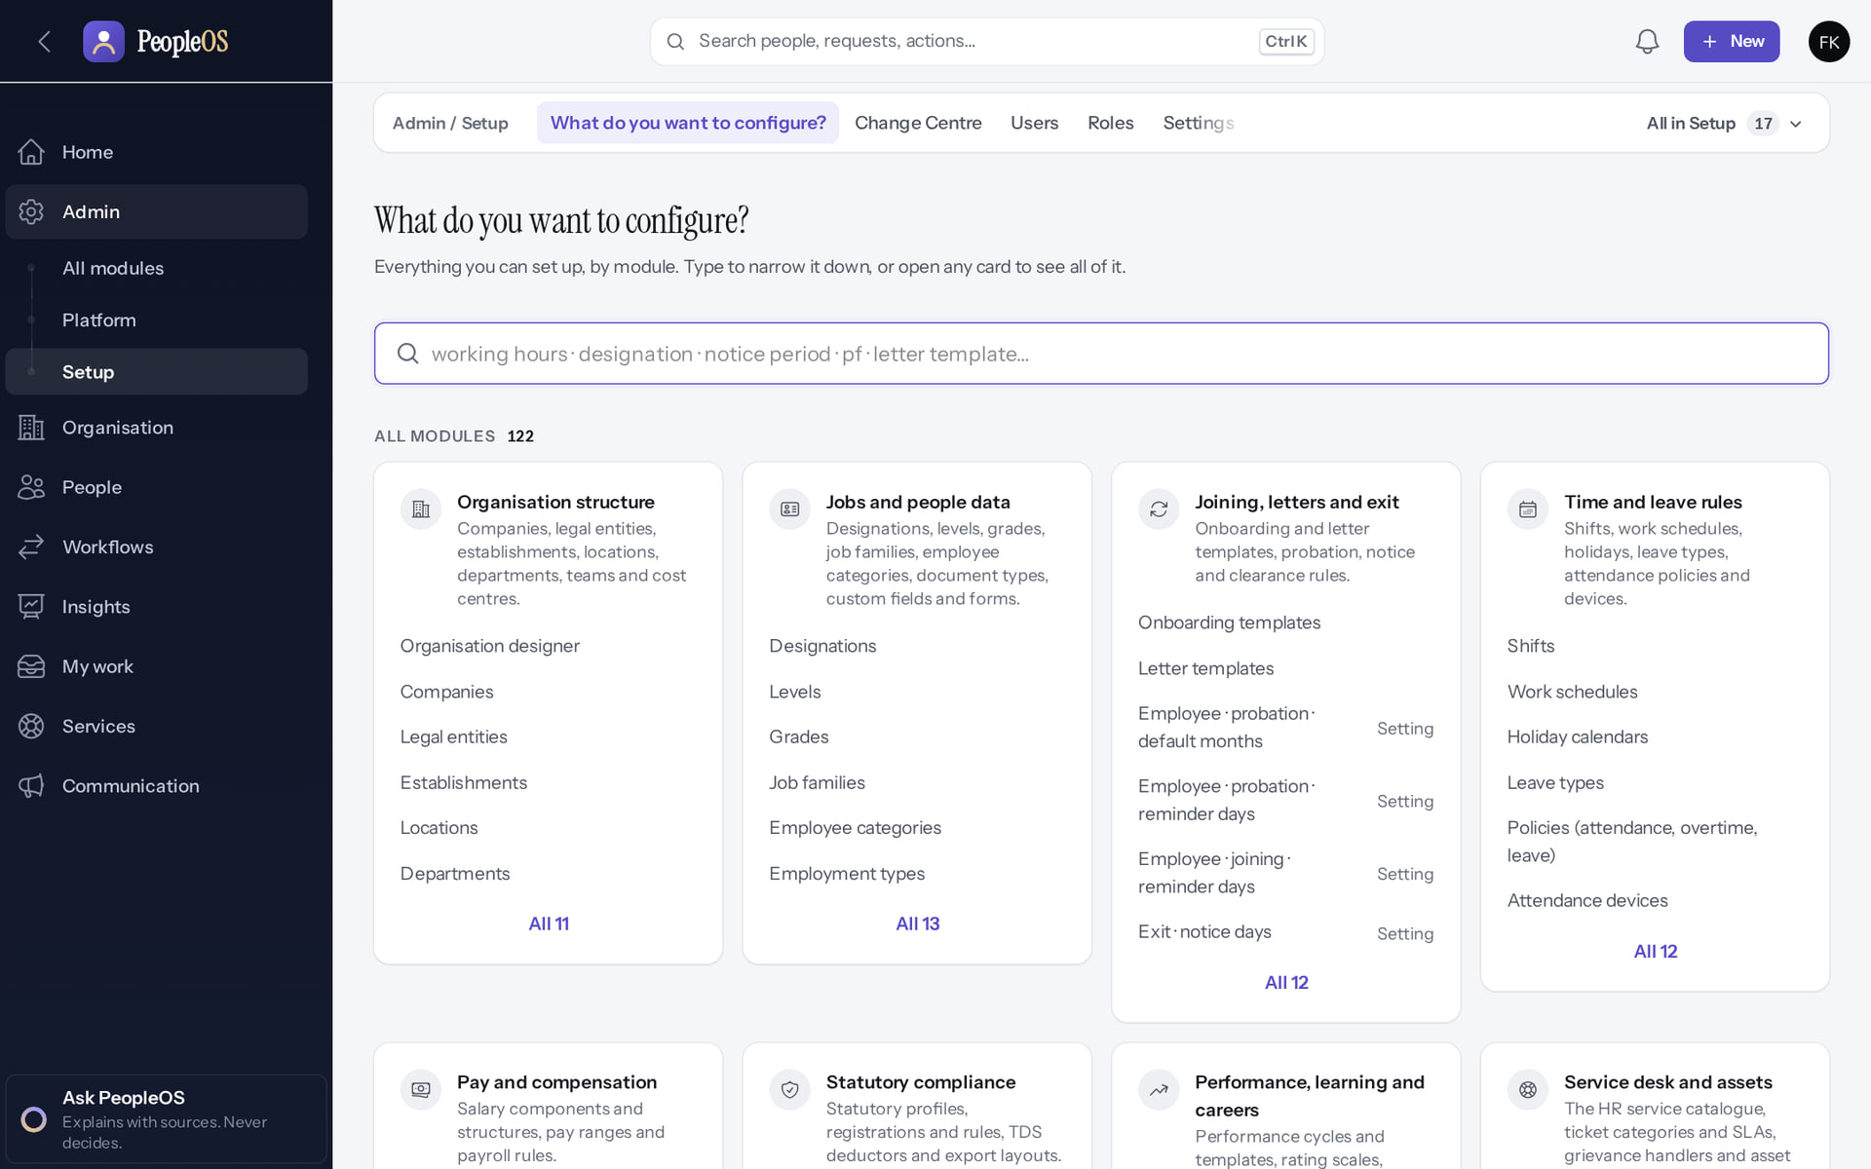
Not sure where a setting is? Ask the finder
WHERE CONFIGURATION LIVES
Verified in the running application
1
Organisation structure.
2
Statutory compliance.
Access and security.
RESULT Admin › Setup › What do you want to configure? groups set-up screens and individual settings by topic.
1
2
Real screen · Farah Khan (Tenant Super Admin (Northwind Retail, first administrator)) · Admin › Setup › What do you want to configure?
Notes:
SAY: Admin › Setup › What do you want to configure? groups set-up screens and individual settings by topic.
ON SCREEN: Open the configuration finder.
WALK THROUGH: (1) Organisation structure. (2) Statutory compliance. (3) Access and security.
LEARNERS SHOULD SEE: Set-up screens and individual settings grouped by topic (organisation, time and leave, pay, statutory, access …)
SCREEN: Admin › Setup › What do you want to configure?. Signed in as Farah Khan (Tenant Super Admin (Northwind Retail, first administrator)). Prerequisite: Signed in as the tenant administrator (Tenant Super Admin of Northwind Retail).
EVIDENCE: screenshot screenshots/client-onboarding/90-onb-14-configuration-finder.png, captured 2026-10-21 on the disposable training database (fictional people).

Slide 27
Stage 4 · Company set-up
IMPLEMENTATION STAGE
Configuration in PeopleOS
RESPONSIBLE
Customer administrator
REQUIRED INPUTS
Company names, legal names, codes, effective dates
WHERE IN PEOPLEOS
Organisation › Organisation › Companies
WHAT TO CONFIGURE
Company name, legal name, code, effective from
EXPECTED OUTCOME
Company listed; PeopleOS also creates a primary legal entity and a principal establishment for it automatically
HOW TO VERIFY
Companies, Legal Entities and Establishments lists
EVIDENCE TO RETAIN
Companies list
COMMON ERRORS AND LIMITS
Duplicate codes (unique within the tenant)
DEPENDENCIES AND BLOCKERS
Stage 3
ACCEPTANCE CRITERIA
Every employing company exists
Notes:
RESPONSIBLE: Customer administrator.
SAY: Company name, legal name, code, effective from.
VERIFY: Companies, Legal Entities and Establishments lists. EVIDENCE TO KEEP: Companies list.
WATCH FOR: Duplicate codes (unique within the tenant).

Slide 28
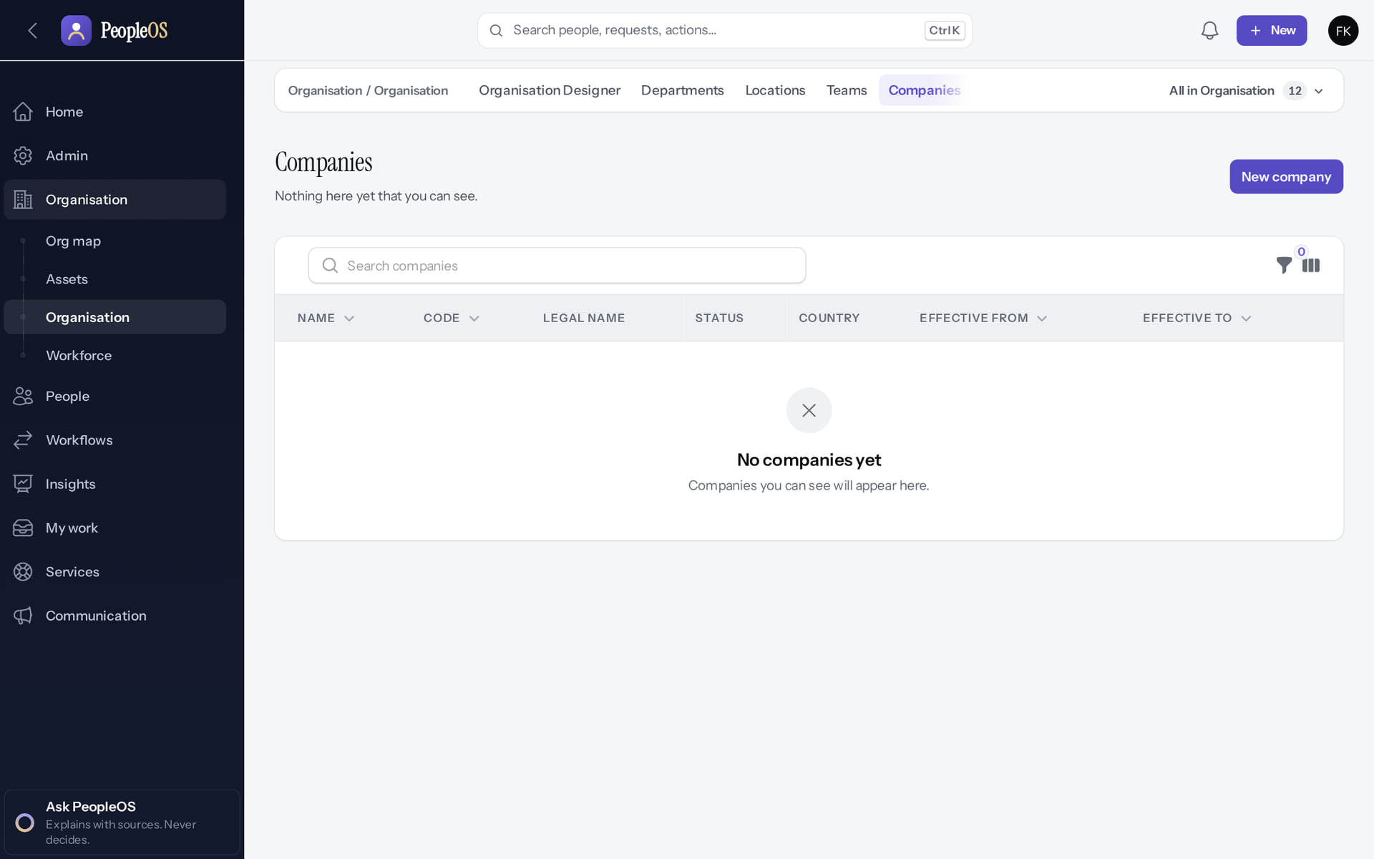
An empty Companies list
STAGE 4 · COMPANY
Verified in the running application
Start here: New company.
RESULT A new tenant has no company yet.
Real screen · Farah Khan (Tenant Super Admin (Northwind Retail, first administrator)) · Organisation › Companies (empty)
Notes:
SAY: A new tenant has no company yet.
ON SCREEN: Open Organisation › Companies in the new tenant.
WALK THROUGH: (1) Start here: New company.
LEARNERS SHOULD SEE: "No companies yet"; New company
SCREEN: Organisation › Companies (empty). Signed in as Farah Khan (Tenant Super Admin (Northwind Retail, first administrator)). Prerequisite: Signed in as the tenant administrator (Tenant Super Admin of Northwind Retail).
EVIDENCE: screenshot screenshots/client-onboarding/90-onb-15-companies-empty.png, captured 2026-10-21 on the disposable training database (fictional people).

Slide 29
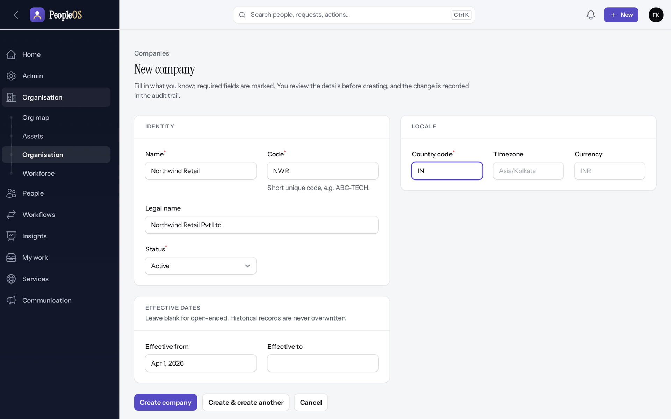
Create the company
STAGE 4 · COMPANY
Verified in the running application
1
Company details.
RESULT Company name, legal name, code and effective date.
1
Real screen (cropped) · Farah Khan (Tenant Super Admin (Northwind Retail, first administrator)) · Companies › New company
Notes:
SAY: Company name, legal name, code and effective date.
ON SCREEN: Name, code, legal name, status, locale and the effective-from date.
WALK THROUGH: (1) Company details.
LEARNERS SHOULD SEE: Company record effective from 1 Apr 2026
SCREEN: Companies › New company. Signed in as Farah Khan (Tenant Super Admin (Northwind Retail, first administrator)). Prerequisite: Signed in as the tenant administrator (Tenant Super Admin of Northwind Retail).
EVIDENCE: screenshot screenshots/client-onboarding/90-onb-16-new-company.png, captured 2026-10-21 on the disposable training database (fictional people).

Slide 30
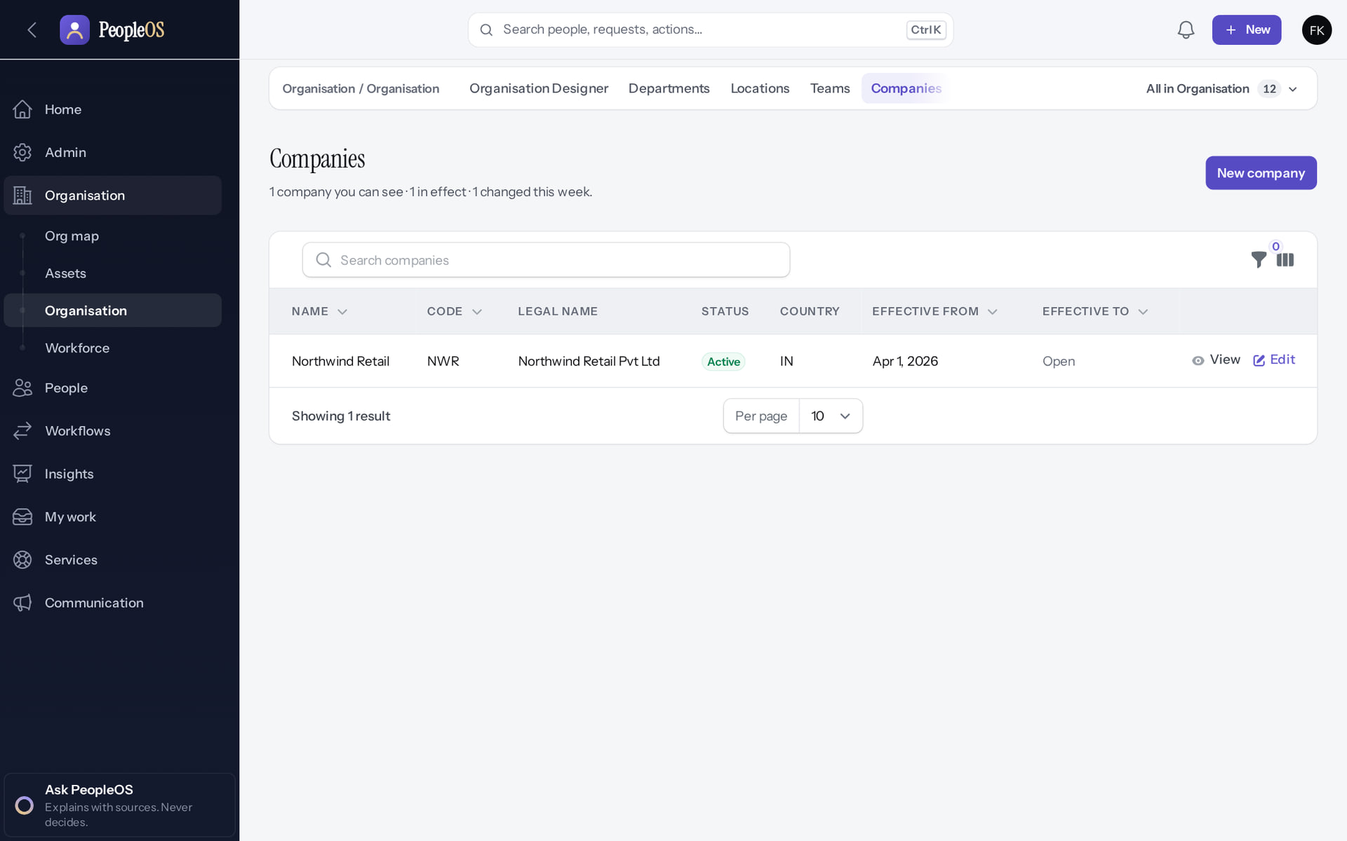
Company saved
STAGE 4 · COMPANY
Verified in the running application
1
The new company with its code and effective date.
RESULT Northwind Retail (NWR), effective 01 Apr 2026.
1
Real screen · Farah Khan (Tenant Super Admin (Northwind Retail, first administrator)) · Organisation › Companies
Notes:
SAY: Northwind Retail (NWR), effective 01 Apr 2026.
ON SCREEN: Back to the list.
WALK THROUGH: (1) The new company with its code and effective date.
LEARNERS SHOULD SEE: Northwind Retail (NWR) effective from 01 Apr 2026
SCREEN: Organisation › Companies. Signed in as Farah Khan (Tenant Super Admin (Northwind Retail, first administrator)). Prerequisite: Signed in as the tenant administrator (Tenant Super Admin of Northwind Retail).
EVIDENCE: screenshot screenshots/client-onboarding/90-onb-17-company-saved.png, captured 2026-10-21 on the disposable training database (fictional people).

Slide 31
Stage 5 · Legal entities
IMPLEMENTATION STAGE
Configuration in PeopleOS
RESPONSIBLE
Customer administrator with finance
REQUIRED INPUTS
Legal employer details (PAN, TAN, CIN where applicable)
WHERE IN PEOPLEOS
Organisation › All in Organisation › Legal Entities
WHAT TO CONFIGURE
Review and complete the primary legal entity created with the company; add more only for additional legal employers
EXPECTED OUTCOME
Legal entities recorded
HOW TO VERIFY
List shows each entity and its status
EVIDENCE TO RETAIN
Legal entities list
COMMON ERRORS AND LIMITS
Treating a location as a legal identity
DEPENDENCIES AND BLOCKERS
Stage 4
ACCEPTANCE CRITERIA
Each legal employer recorded
Notes:
RESPONSIBLE: Customer administrator with finance.
SAY: Review and complete the primary legal entity created with the company; add more only for additional legal employers.
VERIFY: List shows each entity and its status. EVIDENCE TO KEEP: Legal entities list.
WATCH FOR: Treating a location as a legal identity.

Slide 32
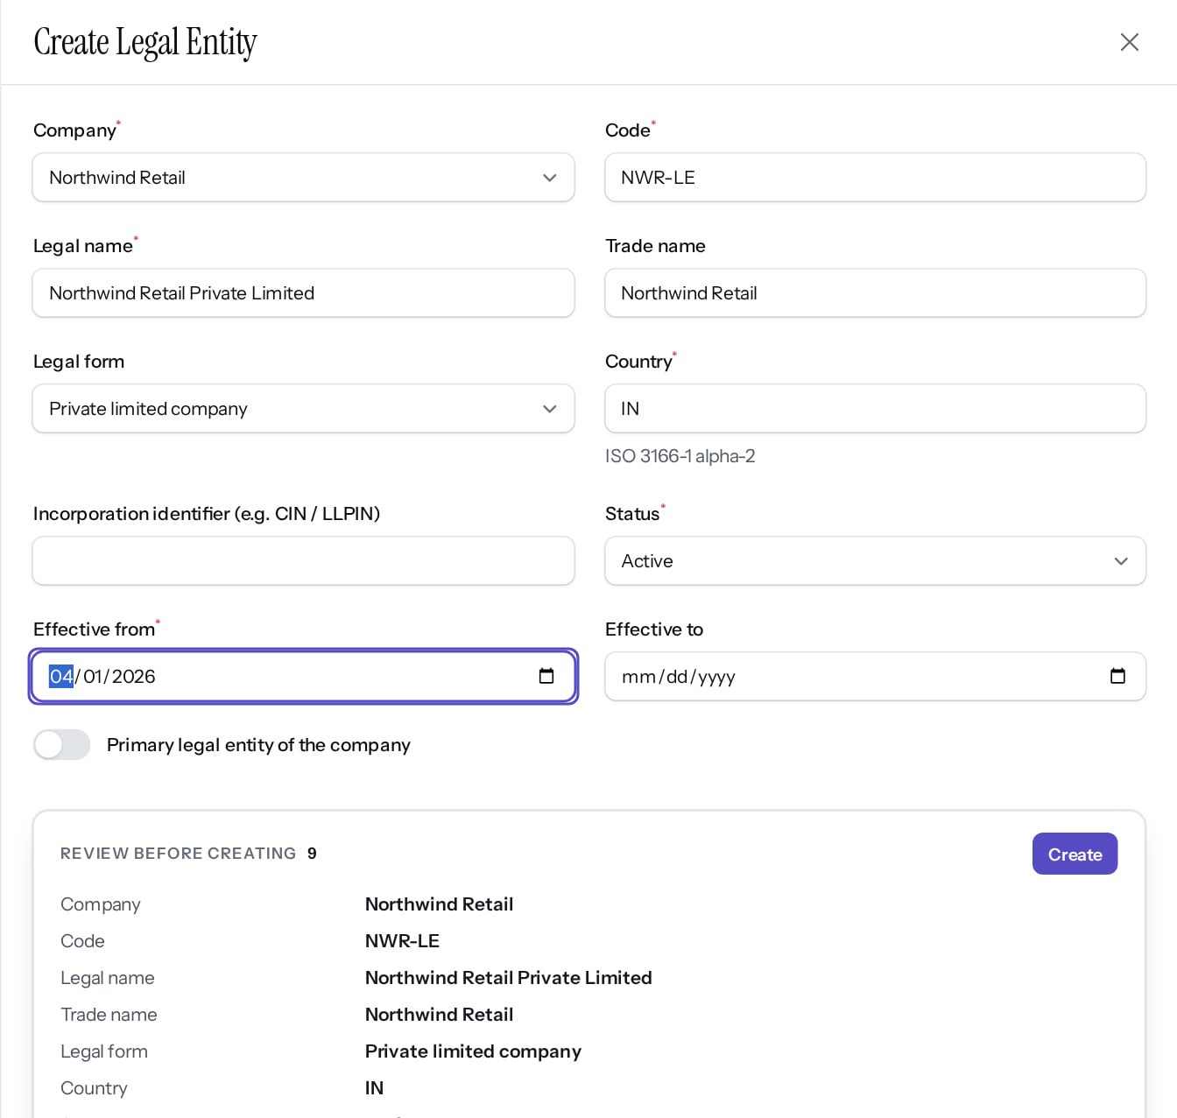
Add a further legal employer (only if needed)
STAGE 5 · LEGAL ENTITY
Verified in the running application
1
Company.
1
2
Legal name.
2
3
Legal form.
3
4
Status.
RESULT Creating the company already created a primary legal entity; complete it, and add another only for an additional legal employer. A review of the values appears before Create.
4
Real screen (cropped) · Farah Khan (Tenant Super Admin (Northwind Retail, first administrator)) · Organisation › Legal entities › New legal entity
Notes:
SAY: Creating the company already created a primary legal entity; complete it, and add another only for an additional legal employer. A review of the values appears before Create.
ON SCREEN: Company, code, legal name, trade name, legal form, country, incorporation identifier, status and effective dates.
LEARNERS SHOULD SEE: The statutory employer behind the company; a review of the values appears before Create
SCREEN: Organisation › Legal entities › New legal entity. Signed in as Farah Khan (Tenant Super Admin (Northwind Retail, first administrator)). Prerequisite: Signed in as the tenant administrator (Tenant Super Admin of Northwind Retail).
EVIDENCE: screenshot screenshots/client-onboarding/90-onb-18-new-legal-entity.png, captured 2026-10-21 on the disposable training database (fictional people).

Slide 33
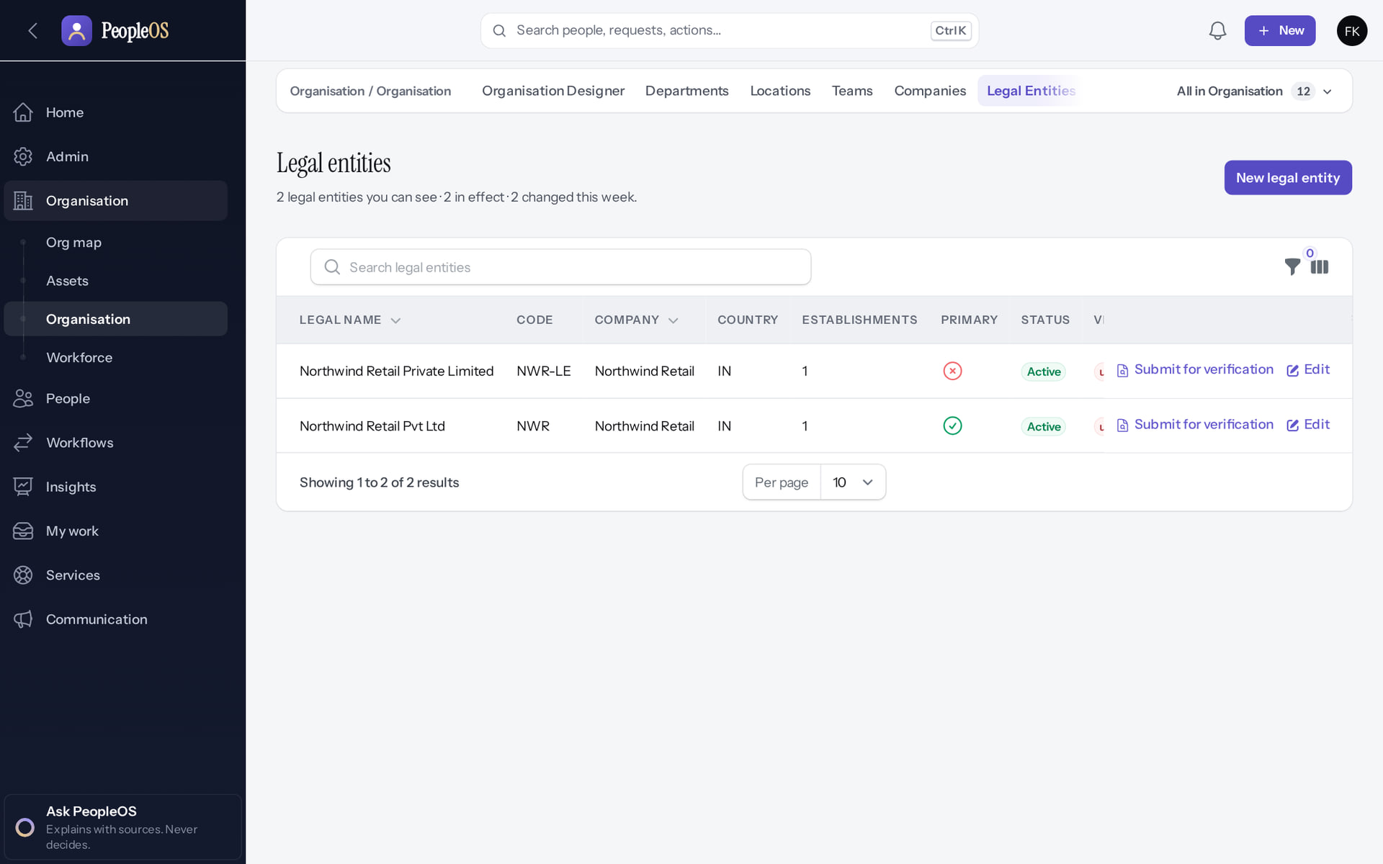
Legal entities listed
STAGE 5 · LEGAL ENTITY
Verified in the running application
The legal entity with its company and status.
RESULT The training run shows the automatic primary entity and one added by hand (the establishment that follows hangs off the added one). For a single employer, complete the automatic entity instead.
Real screen · Farah Khan (Tenant Super Admin (Northwind Retail, first administrator)) · Organisation › Legal entities
Notes:
SAY: The training run shows the automatic primary entity and one added by hand (the establishment that follows hangs off the added one). For a single employer, complete the automatic entity instead.
ON SCREEN: Back to the list.
WALK THROUGH: (1) The legal entity with its company and status.
LEARNERS SHOULD SEE: Two legal entities: the primary one created automatically with the company (Northwind Retail Pvt Ltd, NWR) and the one added here; each with Submit for verification
SCREEN: Organisation › Legal entities. Signed in as Farah Khan (Tenant Super Admin (Northwind Retail, first administrator)). Prerequisite: Signed in as the tenant administrator (Tenant Super Admin of Northwind Retail).
EVIDENCE: screenshot screenshots/client-onboarding/90-onb-19-legal-entity-saved.png, captured 2026-10-21 on the disposable training database (fictional people).

Slide 34
Stage 6 · Establishments and locations
IMPLEMENTATION STAGE
Configuration in PeopleOS
RESPONSIBLE
Customer administrator
REQUIRED INPUTS
Registered places of work (PF/ESI codes, PT/LWF state); physical sites
WHERE IN PEOPLEOS
Organisation › All in Organisation › Establishments; Organisation › Locations
WHAT TO CONFIGURE
Complete the principal establishment created with the company; add further registered places of work; locations with state
EXPECTED OUTCOME
Establishments and locations listed
HOW TO VERIFY
Locations appear in hire and position forms
EVIDENCE TO RETAIN
Lists
COMMON ERRORS AND LIMITS
Locations cannot be linked to an establishment on screen (F10); the state list holds 13 Indian states
DEPENDENCIES AND BLOCKERS
Stage 5
ACCEPTANCE CRITERIA
Every site where people work exists
Notes:
RESPONSIBLE: Customer administrator.
SAY: Complete the principal establishment created with the company; add further registered places of work; locations with state.
VERIFY: Locations appear in hire and position forms. EVIDENCE TO KEEP: Lists.
WATCH FOR: Locations cannot be linked to an establishment on screen (F10); the state list holds 13 Indian states.

Slide 35
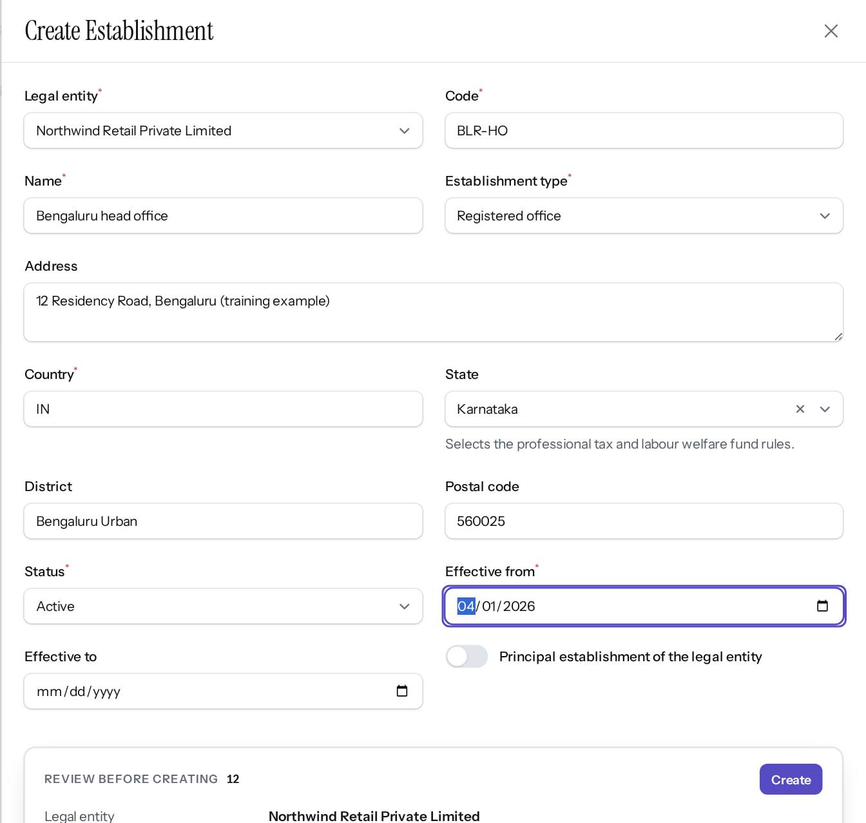
Add a registered establishment
STAGE 6 · ESTABLISHMENTS
Verified in the running application
1
Legal entity.
1
2
Type.
2
3
District.
RESULT A registered place of work; its state drives state-level rules (professional tax, labour welfare fund). A principal establishment already exists for the company.
3
Real screen (cropped) · Farah Khan (Tenant Super Admin (Northwind Retail, first administrator)) · Organisation › Establishments › New establishment
Notes:
SAY: A registered place of work; its state drives state-level rules (professional tax, labour welfare fund). A principal establishment already exists for the company.
ON SCREEN: Legal entity, code, name, type, address, state, district, postal code, status and dates.
LEARNERS SHOULD SEE: A registered place of work; the state drives state-level statutory rules (professional tax, labour welfare fund)
SCREEN: Organisation › Establishments › New establishment. Signed in as Farah Khan (Tenant Super Admin (Northwind Retail, first administrator)). Prerequisite: Signed in as the tenant administrator (Tenant Super Admin of Northwind Retail).
EVIDENCE: screenshot screenshots/client-onboarding/90-onb-20-new-establishment.png, captured 2026-10-21 on the disposable training database (fictional people).

Slide 36
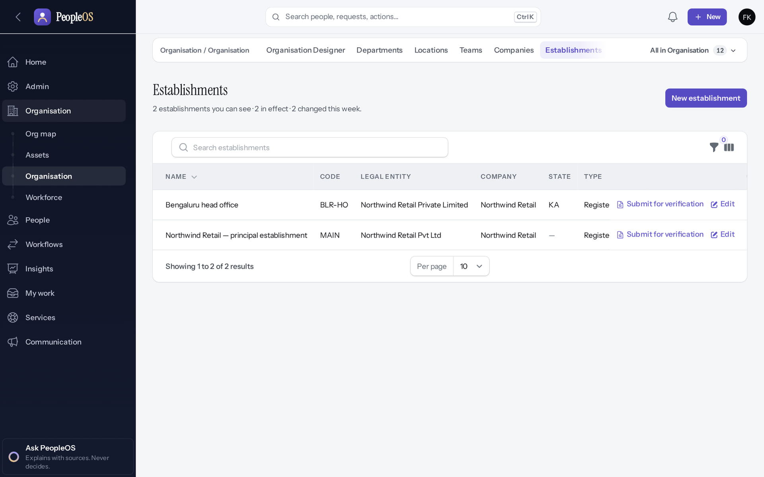
Establishment listed
STAGE 6 · ESTABLISHMENTS
Verified in the running application
Bengaluru head office under the legal entity.
RESULT Statutory profiles attach to establishments (stage 17).
Real screen · Farah Khan (Tenant Super Admin (Northwind Retail, first administrator)) · Organisation › Establishments
Notes:
SAY: Statutory profiles attach to establishments (stage 17).
ON SCREEN: Back to the list.
WALK THROUGH: (1) Bengaluru head office under the legal entity.
LEARNERS SHOULD SEE: Two establishments: the principal establishment created automatically for the primary legal entity and Bengaluru head office added here
SCREEN: Organisation › Establishments. Signed in as Farah Khan (Tenant Super Admin (Northwind Retail, first administrator)). Prerequisite: Signed in as the tenant administrator (Tenant Super Admin of Northwind Retail).
EVIDENCE: screenshot screenshots/client-onboarding/90-onb-21-establishment-saved.png, captured 2026-10-21 on the disposable training database (fictional people).

Slide 37
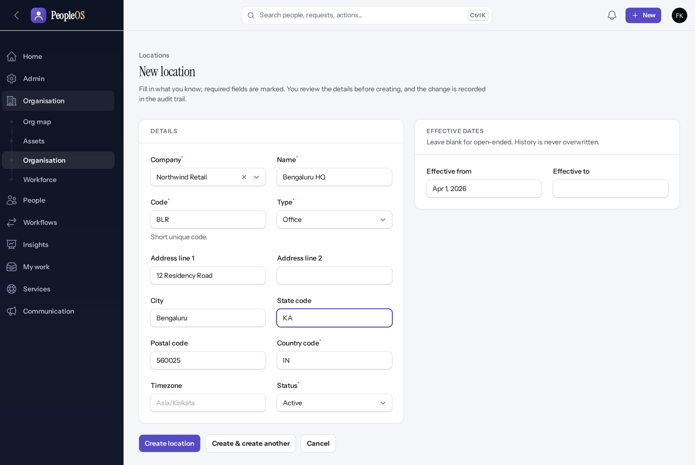
Add the physical location
STAGE 6 · LOCATIONS
Verified in the running application
RESULT A physical site for people, assets and attendance; used in the hire wizard and in holiday and schedule rules.
Real screen (cropped) · Farah Khan (Tenant Super Admin (Northwind Retail, first administrator)) · Organisation › Locations › New location
Notes:
SAY: A physical site for people, assets and attendance; used in the hire wizard and in holiday and schedule rules.
ON SCREEN: Company, name, code, type, address, state, postal code, country, time zone and dates.
LEARNERS SHOULD SEE: A physical site for people, assets and attendance
SCREEN: Organisation › Locations › New location. Signed in as Farah Khan (Tenant Super Admin (Northwind Retail, first administrator)). Prerequisite: Signed in as the tenant administrator (Tenant Super Admin of Northwind Retail).
EVIDENCE: screenshot screenshots/client-onboarding/90-onb-22-new-location.png, captured 2026-10-21 on the disposable training database (fictional people).

Slide 38

Location listed
STAGE 6 · LOCATIONS
Verified in the running application
1
Bengaluru HQ (BLR) for the company.
RESULT Known limit: a location cannot be linked to an establishment on screen (F10).
1
Real screen · Farah Khan (Tenant Super Admin (Northwind Retail, first administrator)) · Organisation › Locations
Notes:
SAY: Known limit: a location cannot be linked to an establishment on screen (F10).
ON SCREEN: Back to the list.
WALK THROUGH: (1) Bengaluru HQ (BLR) for the company.
LEARNERS SHOULD SEE: Bengaluru HQ (BLR) for the company
SCREEN: Organisation › Locations. Signed in as Farah Khan (Tenant Super Admin (Northwind Retail, first administrator)). Prerequisite: Signed in as the tenant administrator (Tenant Super Admin of Northwind Retail).
EVIDENCE: screenshot screenshots/client-onboarding/90-onb-23-location-saved.png, captured 2026-10-21 on the disposable training database (fictional people).

Slide 39
Stage 7 · Organisation structure
IMPLEMENTATION STAGE
Configuration in PeopleOS
RESPONSIBLE
Customer HR lead
REQUIRED INPUTS
Business units, divisions, departments, teams, cost and profit centres
WHERE IN PEOPLEOS
Organisation › Departments / Teams; Organisation Designer; Org map
WHAT TO CONFIGURE
Create units under their parents
EXPECTED OUTCOME
Organisation tree
HOW TO VERIFY
Org map shows the tree
EVIDENCE TO RETAIN
Org map screenshot
COMMON ERRORS AND LIMITS
Mixing financial and reporting units
DEPENDENCIES AND BLOCKERS
Stage 4
ACCEPTANCE CRITERIA
Tree matches the agreed org chart
Notes:
RESPONSIBLE: Customer HR lead.
SAY: Create units under their parents.
VERIFY: Org map shows the tree. EVIDENCE TO KEEP: Org map screenshot.
WATCH FOR: Mixing financial and reporting units.

Slide 40
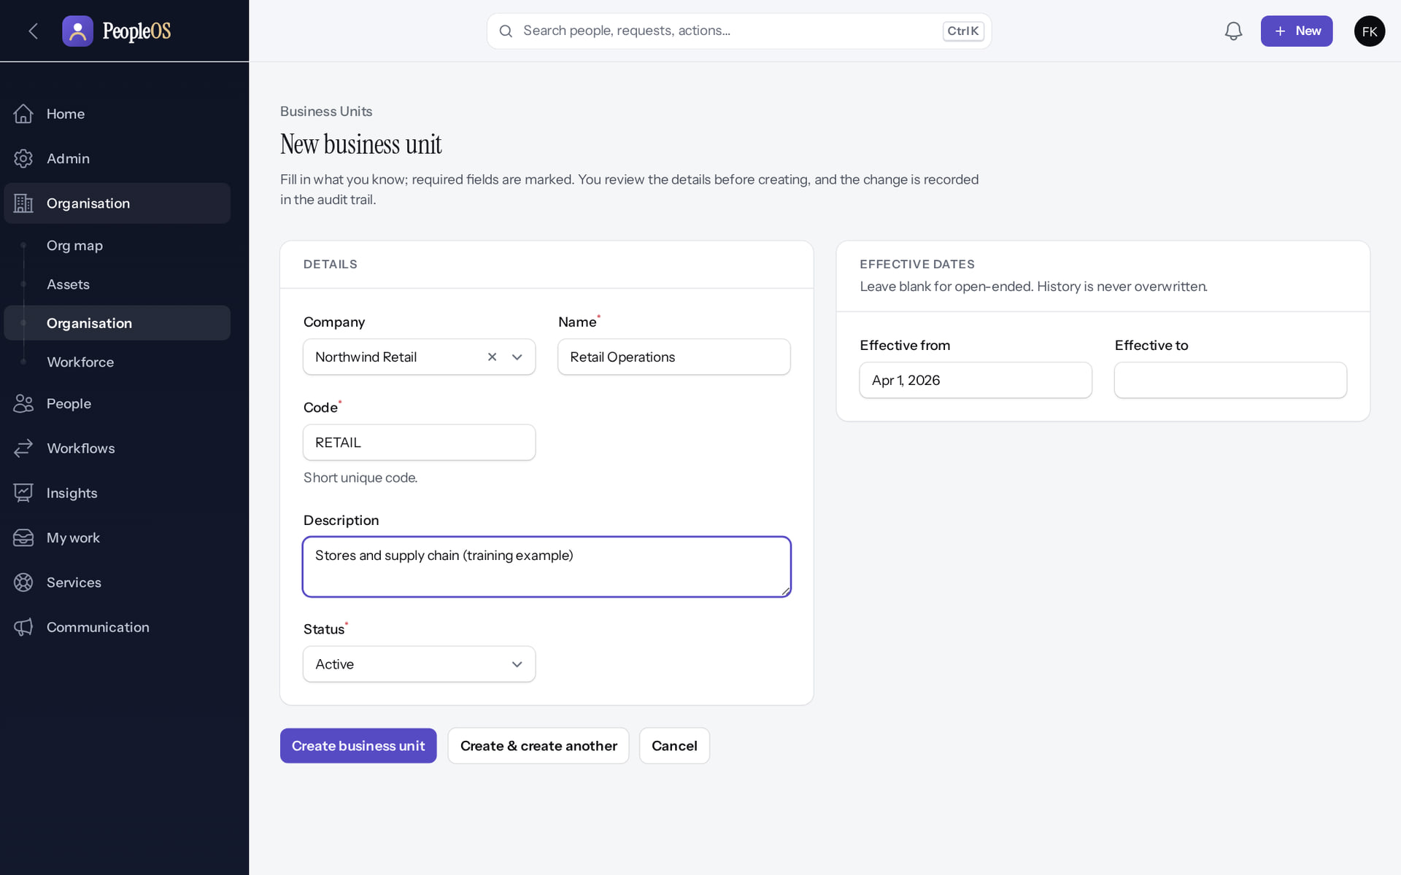
Create a business unit
STAGE 7 · STRUCTURE
Verified in the running application
1
Business unit details for the company.
RESULT Retail Operations: the parent of the store departments.
1
Real screen (cropped) · Farah Khan (Tenant Super Admin (Northwind Retail, first administrator)) · Business units › New
Notes:
SAY: Retail Operations: the parent of the store departments.
ON SCREEN: Company, name, code, description, status and effective date.
WALK THROUGH: (1) Business unit details for the company.
LEARNERS SHOULD SEE: An effective-dated unit of the company; where it sits in the hierarchy is arranged in the Organisation Designer
SCREEN: Business units › New. Signed in as Farah Khan (Tenant Super Admin (Northwind Retail, first administrator)). Prerequisite: Signed in as the tenant administrator (Tenant Super Admin of Northwind Retail).
EVIDENCE: screenshot screenshots/client-onboarding/90-onb-24-new-business-unit.png, captured 2026-10-21 on the disposable training database (fictional people).

Slide 41
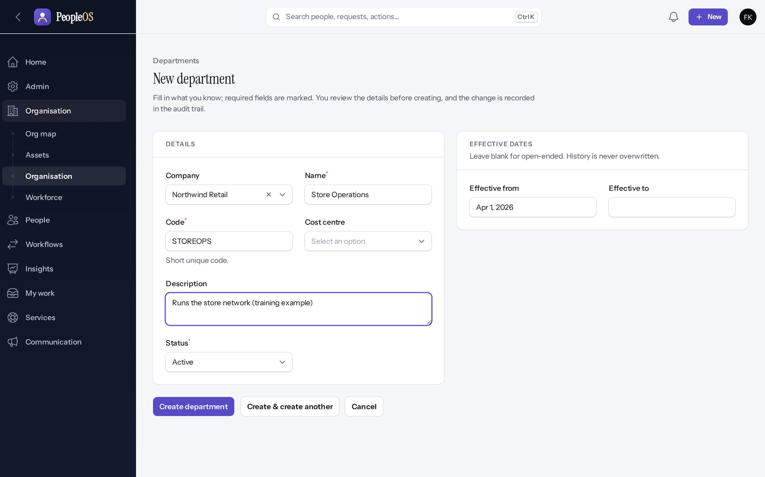
Create organisation units
STAGE 7 · STRUCTURE
Verified in the running application
1
Company.
2
Name.
3
Effective from.
1
2
RESULT Units are effective-dated; their place in the hierarchy is set in the Organisation Designer.
3
Real screen (cropped) · Farah Khan (Tenant Super Admin (Northwind Retail, first administrator)) · Departments › New
Notes:
SAY: Units are effective-dated; their place in the hierarchy is set in the Organisation Designer.
ON SCREEN: Company, name, code, description, status and effective date.
WALK THROUGH: (1) Company. (2) Name. (3) Effective from.
LEARNERS SHOULD SEE: An effective-dated unit of the company; where it sits in the hierarchy is arranged in the Organisation Designer
SCREEN: Departments › New. Signed in as Farah Khan (Tenant Super Admin (Northwind Retail, first administrator)). Prerequisite: Signed in as the tenant administrator (Tenant Super Admin of Northwind Retail).
EVIDENCE: screenshot screenshots/client-onboarding/90-onb-25-new-department.png, captured 2026-10-21 on the disposable training database (fictional people).

Slide 42
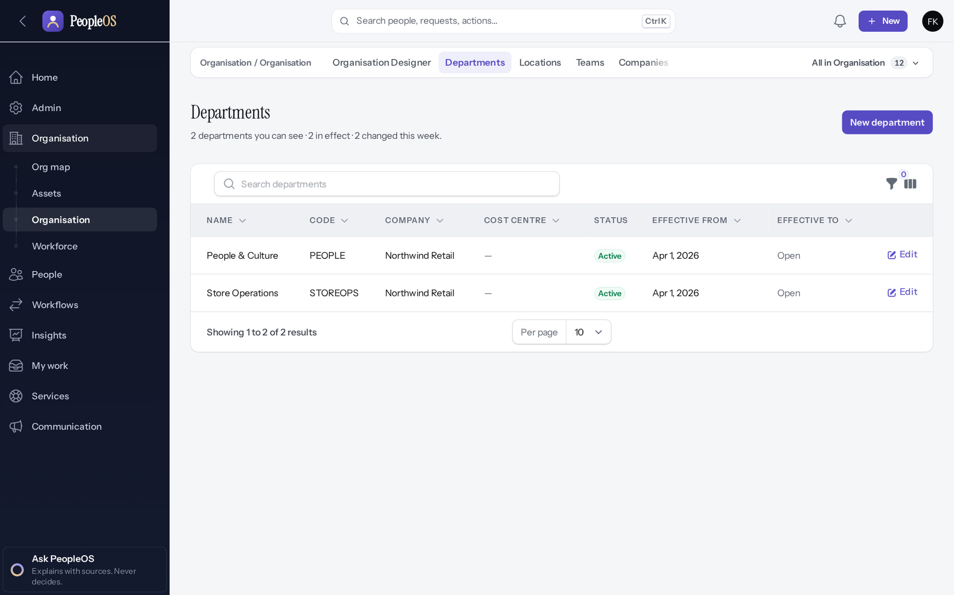
Departments listed
STAGE 7 · STRUCTURE
Verified in the running application
1
Store Operations and People & Culture with their dates.
RESULT Business units, divisions, teams, cost and profit centres follow the same pattern.
1
Real screen · Farah Khan (Tenant Super Admin (Northwind Retail, first administrator)) · Organisation › Departments
Notes:
SAY: Business units, divisions, teams, cost and profit centres follow the same pattern.
ON SCREEN: Open Departments.
WALK THROUGH: (1) Store Operations and People & Culture with their dates.
LEARNERS SHOULD SEE: Store Operations and People & Culture with their parents and dates
SCREEN: Organisation › Departments. Signed in as Farah Khan (Tenant Super Admin (Northwind Retail, first administrator)). Prerequisite: Signed in as the tenant administrator (Tenant Super Admin of Northwind Retail).
EVIDENCE: screenshot screenshots/client-onboarding/90-onb-26-departments.png, captured 2026-10-21 on the disposable training database (fictional people).

Slide 43
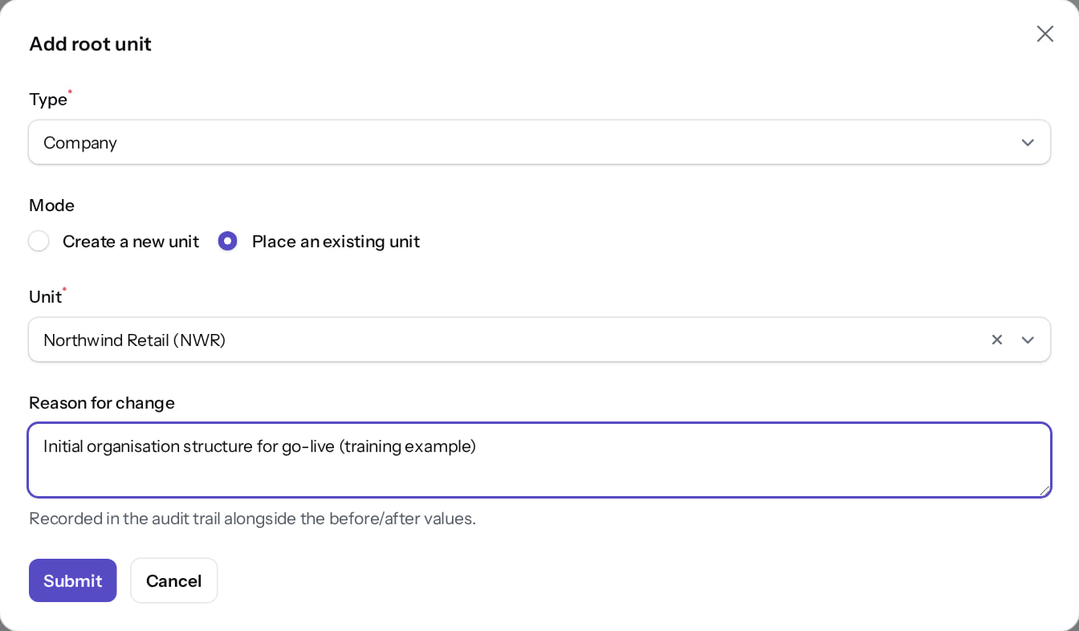
Organisation Designer: add the root
STAGE 7 · STRUCTURE
Verified in the running application
1
Unit type: Company.
1
2
Use an existing unit.
3
Reason for change.
2
RESULT The tree starts from the company.
3
Real screen · Farah Khan (Tenant Super Admin (Northwind Retail, first administrator)) · Organisation Designer › Add root unit
Notes:
SAY: The tree starts from the company.
ON SCREEN: Add the company as the root: type Company, use an existing unit, reason for change.
WALK THROUGH: (1) Unit type: Company. (2) Use an existing unit. (3) Reason for change.
LEARNERS SHOULD SEE: The tree starts from the company
SCREEN: Organisation Designer › Add root unit. Signed in as Farah Khan (Tenant Super Admin (Northwind Retail, first administrator)). Prerequisite: Company and units created; signed in as the tenant administrator.
EVIDENCE: screenshot screenshots/client-onboarding/90-onb-29-designer-add-root.png, captured 2026-10-21 on the disposable training database (fictional people).

Slide 44
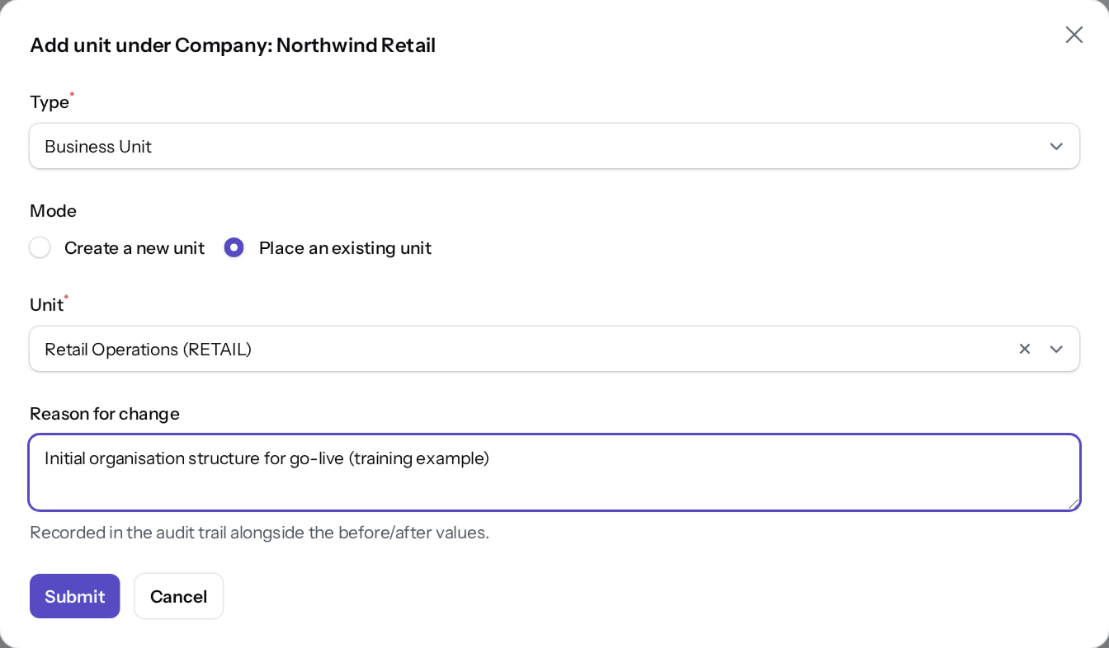
Add units under their parents
STAGE 7 · STRUCTURE
Verified in the running application
1
Unit type: Business Unit.
1
2
Existing unit: Retail Operations.
3
Reason for change.
RESULT Each placement is recorded in the audit trail.
2
3
Real screen · Farah Khan (Tenant Super Admin (Northwind Retail, first administrator)) · Organisation Designer › Add unit under Northwind Retail
Notes:
SAY: Each placement is recorded in the audit trail.
ON SCREEN: Add child under Northwind Retail: type Business Unit, use the existing unit "Retail Operations", reason for change.
WALK THROUGH: (1) Unit type: Business Unit. (2) Existing unit: Retail Operations. (3) Reason for change.
LEARNERS SHOULD SEE: The unit is placed under its parent; the change is recorded in the audit trail
SCREEN: Organisation Designer › Add unit under Northwind Retail. Signed in as Farah Khan (Tenant Super Admin (Northwind Retail, first administrator)). Prerequisite: Company and units created; signed in as the tenant administrator.
EVIDENCE: screenshot screenshots/client-onboarding/90-onb-30-designer-add-child.png, captured 2026-10-21 on the disposable training database (fictional people).

Slide 45
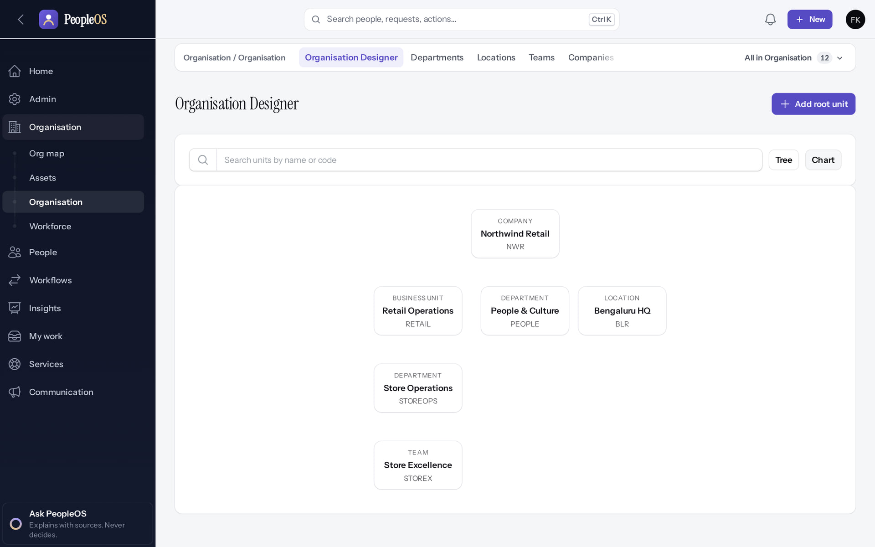
Check the tree and the chart
STAGE 7 · STRUCTURE
Tree
Verified
Chart
Verified
Company → business unit → department → team. Each node: Add child, Rename, Move, Deactivate, Remove from tree.
The same structure as a chart. The Org map adds people once they are hired.
Real screen · Farah Khan (Tenant Super Admin (Northwind Retail, first administrator)) · Organisation Designer (tree)
Real screen · Farah Khan (Tenant Super Admin (Northwind Retail, first administrator)) · Organisation Designer (chart)
Notes:
SAY: Check the tree and the chart.
LEFT, Tree: Company → business unit → department → team. Each node: Add child, Rename, Move, Deactivate, Remove from tree.
RIGHT, Chart: The same structure as a chart. The Org map adds people once they are hired.
OBSERVE: point out what differs between the two screens.
EVIDENCE: left = client-onboarding/90-onb-31-designer-tree [Farah Khan (Tenant Super Admin (Northwind Retail, first administrator)), Organisation Designer (tree)]; right = client-onboarding/90-onb-32-designer-chart [Farah Khan (Tenant Super Admin (Northwind Retail, first administrator)), Organisation Designer (chart)]. Real screens, fictional data (SCREENSHOT-INVENTORY.md).

Slide 46
Stage 8 · Job architecture and positions
IMPLEMENTATION STAGE
Configuration in PeopleOS
RESPONSIBLE
Customer HR lead
REQUIRED INPUTS
Designations, levels, grades, job families, employment types, categories, work modes; positions if used
WHERE IN PEOPLEOS
Admin › Setup › All in Setup › Designations, Grades, Levels…; Organisation › Workforce › Positions
WHAT TO CONFIGURE
Reference lists; draft positions
EXPECTED OUTCOME
Lists available in the hire wizard
HOW TO VERIFY
Hire wizard drop-downs show the values
EVIDENCE TO RETAIN
Lists
COMMON ERRORS AND LIMITS
FTE fields refuse whole numbers such as 1 (F8): leave blank
DEPENDENCIES AND BLOCKERS
Stage 7
ACCEPTANCE CRITERIA
Every designation and grade in the data file exists
Notes:
RESPONSIBLE: Customer HR lead.
SAY: Reference lists; draft positions.
VERIFY: Hire wizard drop-downs show the values. EVIDENCE TO KEEP: Lists.
WATCH FOR: FTE fields refuse whole numbers such as 1 (F8): leave blank.

Slide 47
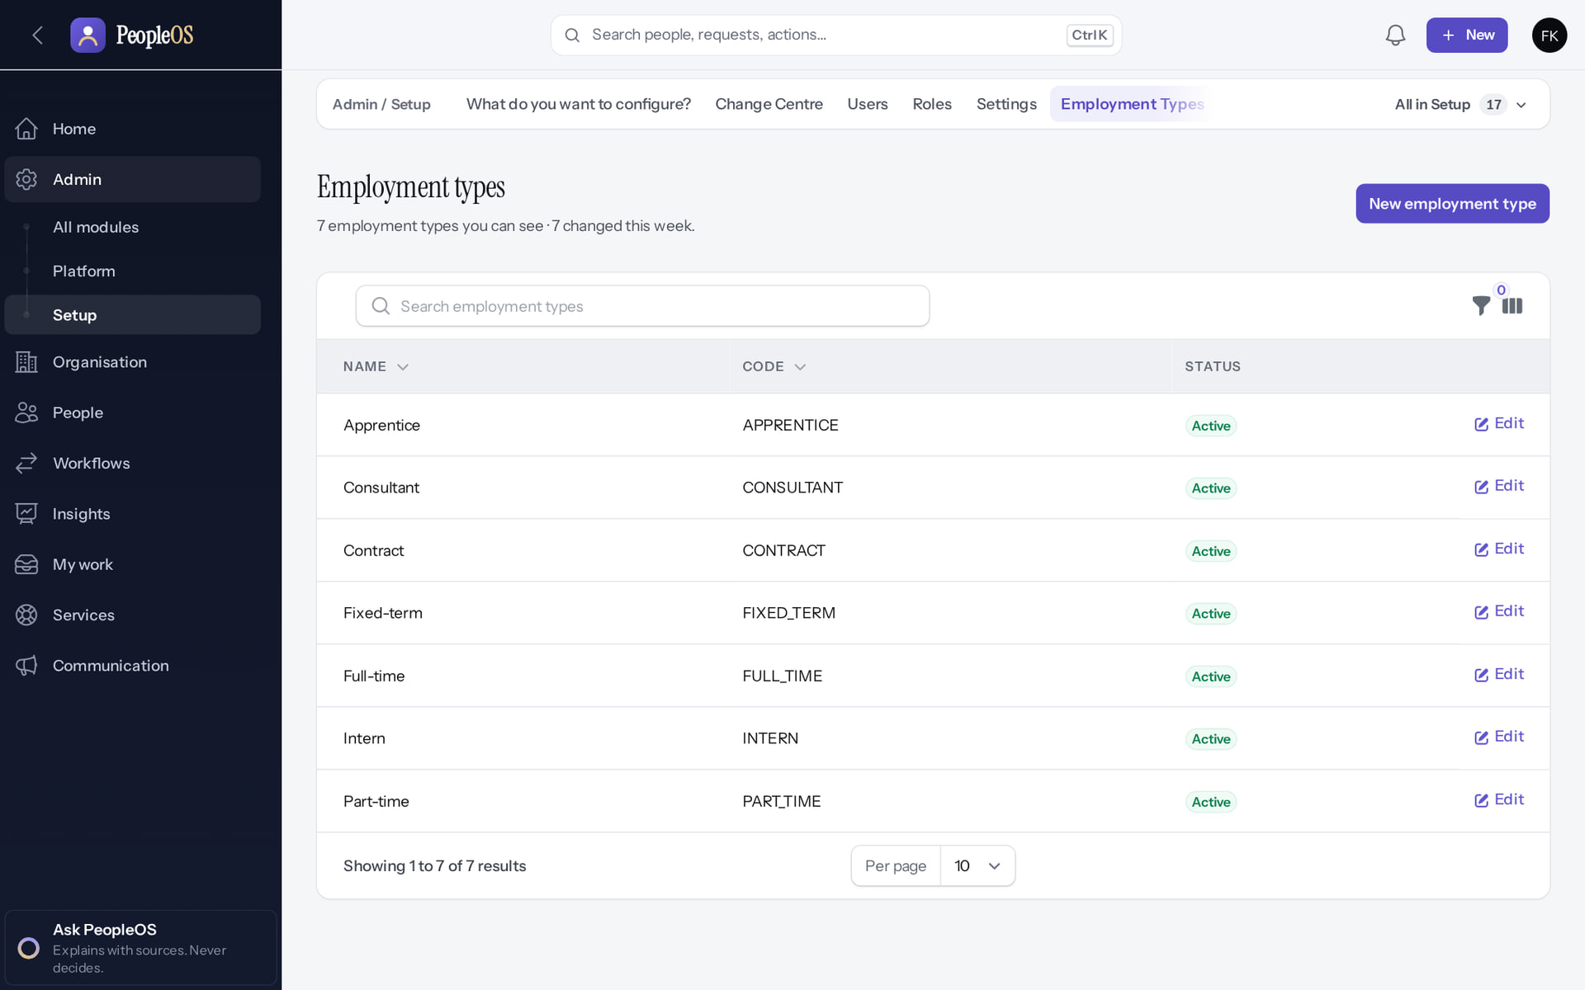
Start from the seeded reference lists
STAGE 8 · JOB ARCHITECTURE
Verified in the running application
1
Seeded value.
2
2
Add your own.
RESULT Employment types, categories, work modes and levels L1–L6 are seeded; designations, grades and job families start empty.
1
Real screen · Farah Khan (Tenant Super Admin (Northwind Retail, first administrator)) · Admin › Setup › Employment types
Notes:
SAY: Employment types, categories, work modes and levels L1–L6 are seeded; designations, grades and job families start empty.
ON SCREEN: Review the starting values every new tenant receives.
WALK THROUGH: (1) Seeded value. (2) Add your own.
LEARNERS SHOULD SEE: Employment types (Full-time, Part-time, Contract, Intern …), employee categories, work modes and levels L1–L6 are seeded; designations, grades and job families start empty
SCREEN: Admin › Setup › Employment types. Signed in as Farah Khan (Tenant Super Admin (Northwind Retail, first administrator)). Prerequisite: Organisation set up; signed in as the tenant administrator.
EVIDENCE: screenshot screenshots/client-onboarding/90-onb-33-seeded-employment-types.png, captured 2026-10-21 on the disposable training database (fictional people).

Slide 48
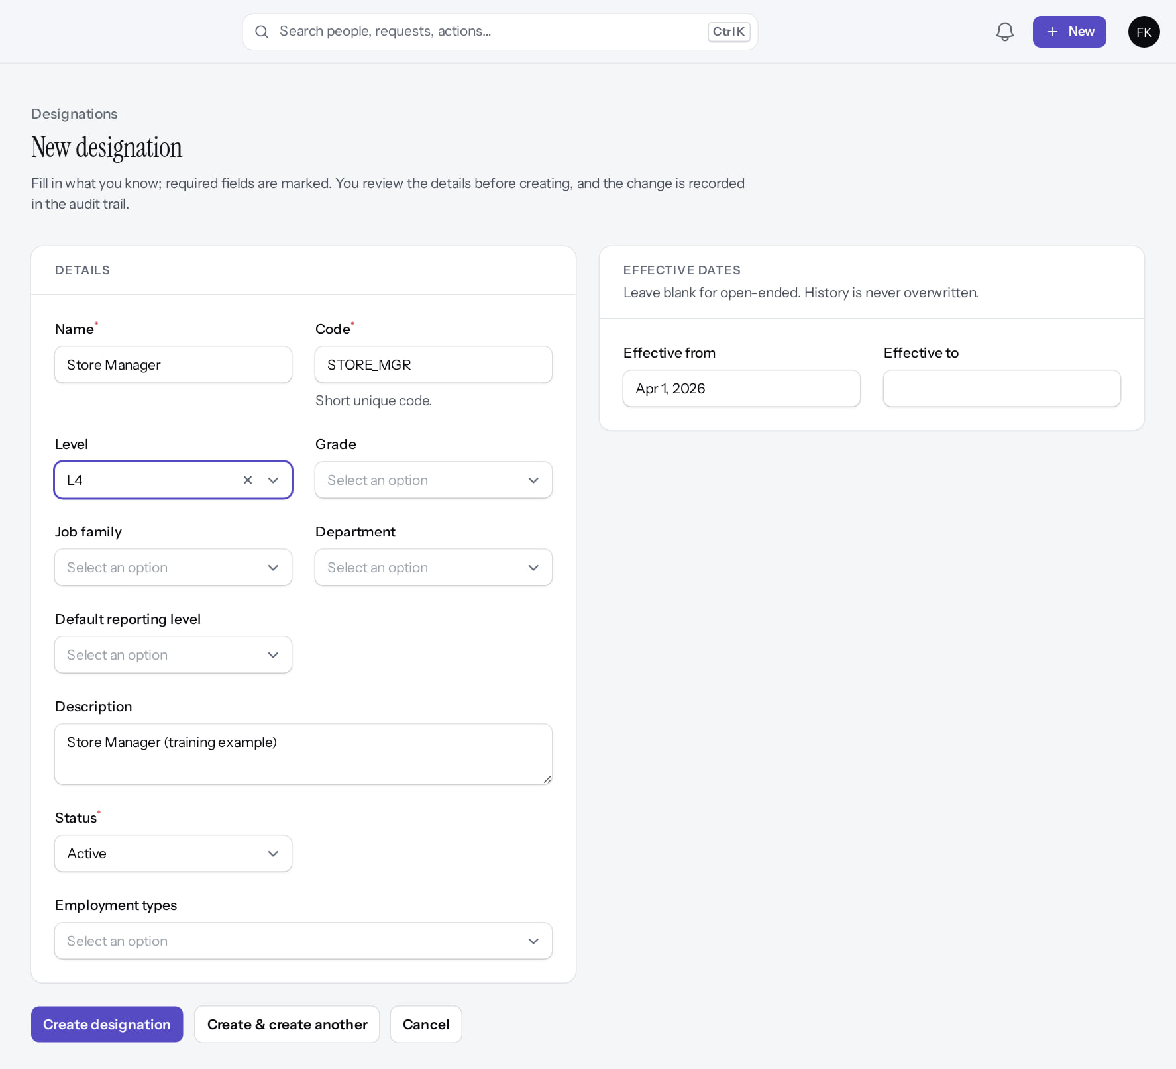
Add designations
STAGE 8 · JOB ARCHITECTURE
Verified in the running application
1
Name.
2
Code.
3
Level.
1
2
4
4
Effective from.
3
RESULT Designations carry the job attributes used on hire.
Real screen (cropped) · Farah Khan (Tenant Super Admin (Northwind Retail, first administrator)) · Admin › Setup › Designations › New designation
Notes:
SAY: Designations carry the job attributes used on hire.
ON SCREEN: Name, code, level and other job attributes, effective date.
WALK THROUGH: (1) Name. (2) Code. (3) Level. (4) Effective from.
LEARNERS SHOULD SEE: Designations are effective-dated and carry the job attributes used on hire
SCREEN: Admin › Setup › Designations › New designation. Signed in as Farah Khan (Tenant Super Admin (Northwind Retail, first administrator)). Prerequisite: Organisation set up; signed in as the tenant administrator.
EVIDENCE: screenshot screenshots/client-onboarding/90-onb-34-new-designation.png, captured 2026-10-21 on the disposable training database (fictional people).

Slide 49
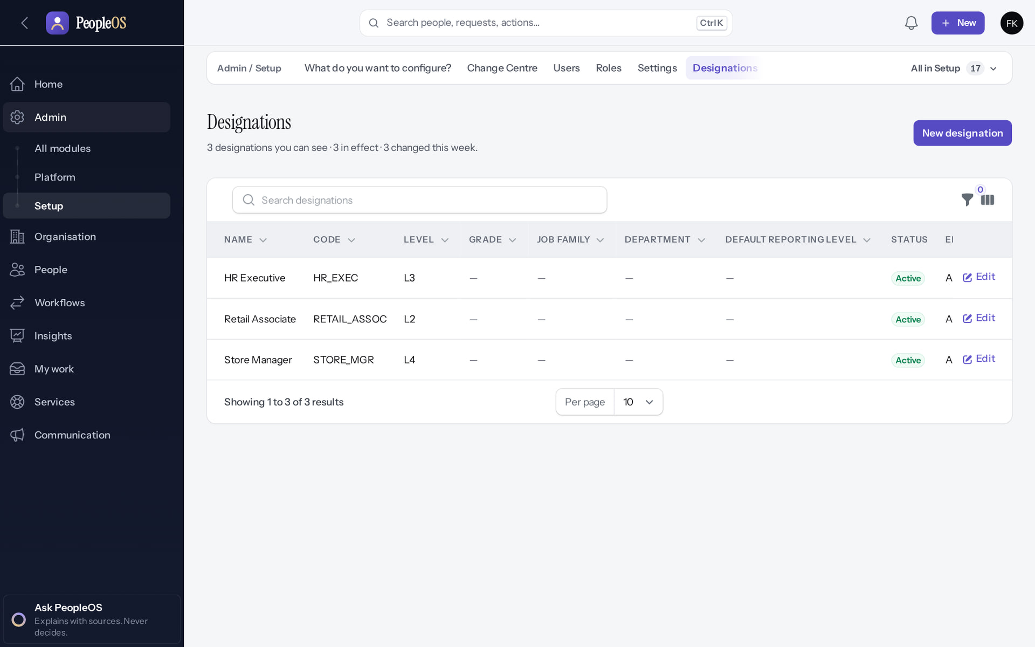
Designations listed
STAGE 8 · JOB ARCHITECTURE
Verified in the running application
Store Manager (L4), Retail Associate (L2), HR Executive (L3).
RESULT These appear in the hire wizard's Position step.
Real screen · Farah Khan (Tenant Super Admin (Northwind Retail, first administrator)) · Admin › Setup › Designations
Notes:
SAY: These appear in the hire wizard's Position step.
ON SCREEN: Back to the list.
WALK THROUGH: (1) Store Manager (L4), Retail Associate (L2), HR Executive (L3).
LEARNERS SHOULD SEE: Store Manager (L4), Retail Associate (L2), HR Executive (L3)
SCREEN: Admin › Setup › Designations. Signed in as Farah Khan (Tenant Super Admin (Northwind Retail, first administrator)). Prerequisite: Organisation set up; signed in as the tenant administrator.
EVIDENCE: screenshot screenshots/client-onboarding/90-onb-35-designations.png, captured 2026-10-21 on the disposable training database (fictional people).

Slide 50
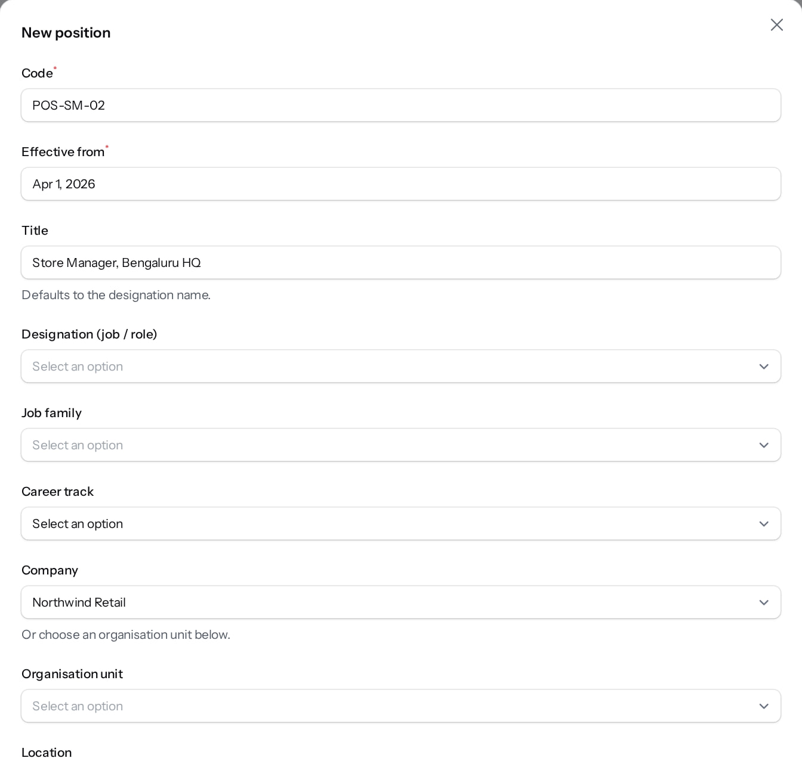
Positions (optional)
STAGE 8 · POSITIONS
Verified in the running application
1
1
Code.
2
Title.
Grade.
2
Seats.
FTE: leave blank (defect F8 refuses whole numbers).
RESULT A draft position; it is proposed, approved and opened before it is filled.
Real screen (cropped) · Farah Khan (Tenant Super Admin (Northwind Retail, first administrator)) · Organisation › Workforce › Positions › New position
Notes:
SAY: A draft position; it is proposed, approved and opened before it is filled.
ON SCREEN: Code, effective date, title, company, employment type, worker type, grade, occupancy, headcount, reason.
WALK THROUGH: (1) Code. (2) Title. (3) Grade. (4) Seats. (5) FTE: leave blank (defect F8 refuses whole numbers).
LEARNERS SHOULD SEE: A draft position; it goes through propose → approve → open before it is filled
SCREEN: Organisation › Workforce › Positions › New position. Signed in as Farah Khan (Tenant Super Admin (Northwind Retail, first administrator)). Prerequisite: Organisation set up; signed in as the tenant administrator.
EVIDENCE: screenshot screenshots/client-onboarding/90-onb-36-new-position.png, captured 2026-10-21 on the disposable training database (fictional people).

Slide 51
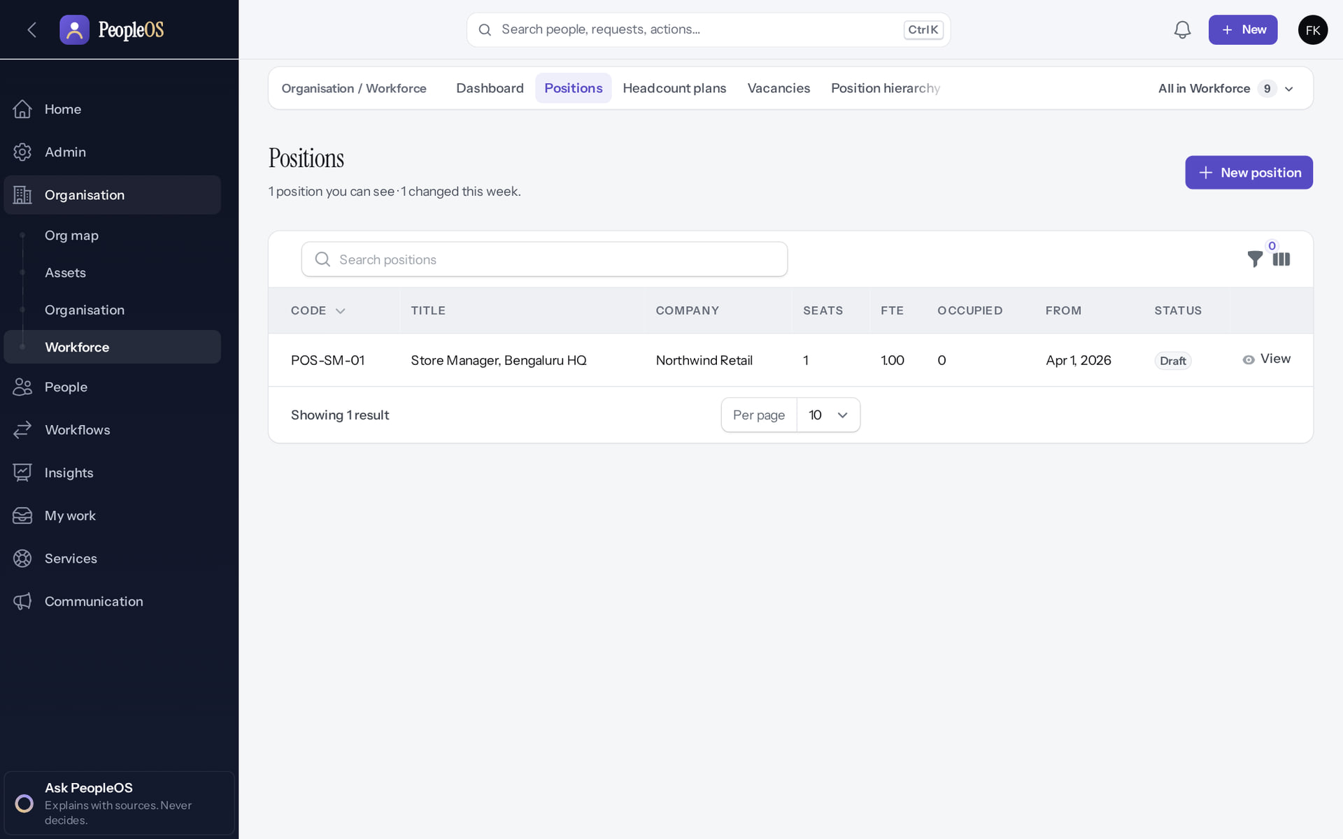
Draft position listed
STAGE 8 · POSITIONS
Verified in the running application
1
POS-SM-01 in Draft (the form on the previous slide was re-shot later with another code and cancelled).
RESULT Use positions when the customer manages headcount by seat; otherwise skip.
1
Real screen · Farah Khan (Tenant Super Admin (Northwind Retail, first administrator)) · Organisation › Workforce › Positions
Notes:
SAY: Use positions when the customer manages headcount by seat; otherwise skip.
ON SCREEN: Back to the list.
WALK THROUGH: (1) POS-SM-01 in Draft (the form on the previous slide was re-shot later with another code and cancelled).
LEARNERS SHOULD SEE: POS-SM-01 in Draft
SCREEN: Organisation › Workforce › Positions. Signed in as Farah Khan (Tenant Super Admin (Northwind Retail, first administrator)). Prerequisite: Organisation set up; signed in as the tenant administrator.
EVIDENCE: screenshot screenshots/client-onboarding/90-onb-37-positions.png, captured 2026-10-21 on the disposable training database (fictional people).

Slide 52
People data
04
Prepare the data, load people once, set managers, invite users with the right reach.
Notes:
TRANSITION: Section 4, People data. Prepare the data, load people once, set managers, invite users with the right reach.
SAY: Tell learners what they will be able to do by the end of this section, then move on.
ASK: "What questions do you have before we start this section?"

Slide 53
Stage 9 · Employee data preparation
IMPLEMENTATION STAGE
Manual (outside PeopleOS)
RESPONSIBLE
Customer HR data owner
REQUIRED INPUTS
Current employee master
WHERE IN PEOPLEOS
Outside PeopleOS (spreadsheet)
WHAT TO CONFIGURE
Clean names, e-mails, joining dates, managers, units; one row per person
EXPECTED OUTCOME
Validated data file
HOW TO VERIFY
Row counts reconcile with payroll headcount
EVIDENCE TO RETAIN
Data file and reconciliation sheet
COMMON ERRORS AND LIMITS
Personal identifiers sent by e-mail; duplicate people
DEPENDENCIES AND BLOCKERS
Stages 4–8
ACCEPTANCE CRITERIA
Data owner signs off the file
Notes:
RESPONSIBLE: Customer HR data owner.
SAY: Clean names, e-mails, joining dates, managers, units; one row per person.
VERIFY: Row counts reconcile with payroll headcount. EVIDENCE TO KEEP: Data file and reconciliation sheet.
WATCH FOR: Personal identifiers sent by e-mail; duplicate people.

Slide 54
Stage 10 · Data load
IMPLEMENTATION STAGE
Blocked (defect or gate)
RESPONSIBLE
Customer administrator with Markedge
REQUIRED INPUTS
Validated data file
WHERE IN PEOPLEOS
People › Lifecycle › All in Lifecycle › Employee imports (Upload → Inspect → Map columns → Validate → Approve → Run)
WHAT TO CONFIGURE
Upload works; Map columns fails with "Undefined variable $svc" (F25)
EXPECTED OUTCOME
Import cannot progress past "inspected" from the screen
HOW TO VERIFY
Import status
EVIDENCE TO RETAIN
Import record and error message
COMMON ERRORS AND LIMITS
F25 defect. Workarounds: the Hire employee wizard per person (verified in this training), or POST /api/v1/employees with an API key (in the OpenAPI specification; not exercised in this training)
DEPENDENCIES AND BLOCKERS
Engineering fix for F25
ACCEPTANCE CRITERIA
Every row loaded once; counts reconcile
Notes:
RESPONSIBLE: Customer administrator with Markedge.
SAY: Upload works; Map columns fails with "Undefined variable $svc" (F25).
VERIFY: Import status. EVIDENCE TO KEEP: Import record and error message.
WATCH FOR: F25 defect. Workarounds: the Hire employee wizard per person (verified in this training), or POST /api/v1/employees with an API key (in the OpenAPI specification; not exercised in this training).

Slide 55
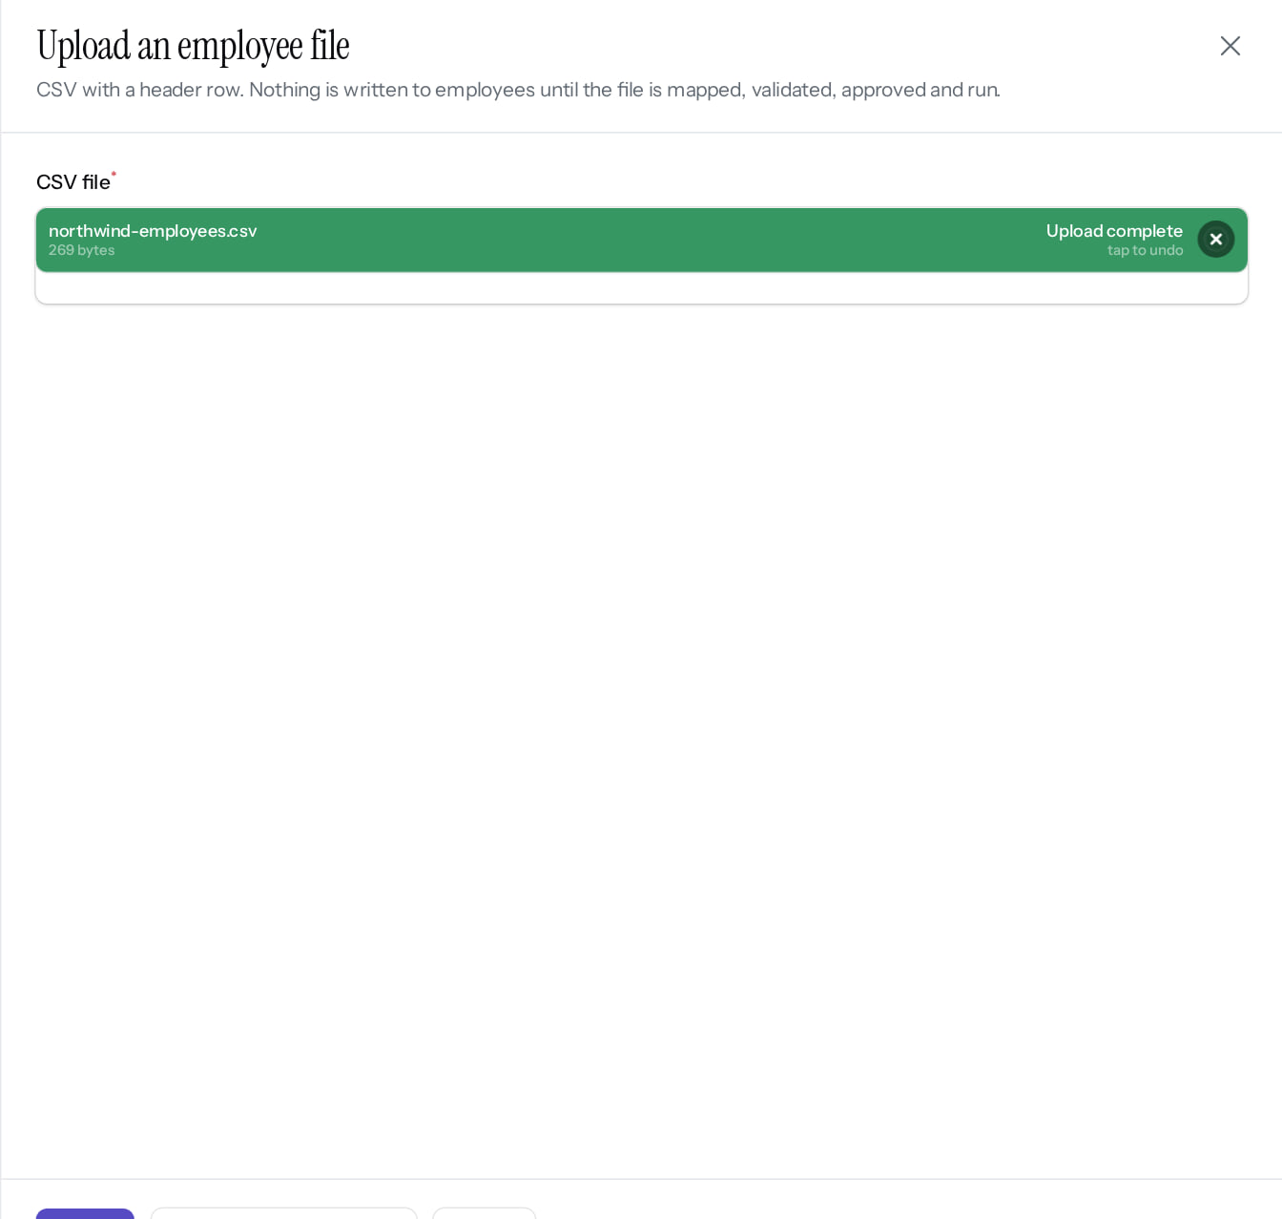
Employee import: upload the file
STAGE 10 · DATA LOAD
Verified in the running application
Upload CSV.
RESULT The import then goes Inspect → Map columns → Validate → Approve → Run.
Real screen (cropped) · Farah Khan (Tenant Super Admin (Northwind Retail, first administrator)) · People › Lifecycle › Employee imports › Upload CSV
Notes:
SAY: The import then goes Inspect → Map columns → Validate → Approve → Run.
ON SCREEN: Upload a CSV prepared from the customer’s data (fictional rows).
WALK THROUGH: (1) Upload CSV.
LEARNERS SHOULD SEE: The file is stored; the import then goes Inspect → Map columns → Validate → Approve → Run
SCREEN: People › Lifecycle › Employee imports › Upload CSV. Signed in as Farah Khan (Tenant Super Admin (Northwind Retail, first administrator)). Prerequisite: Signed in as the tenant administrator.
EVIDENCE: screenshot screenshots/client-onboarding/90-onb-91-import-upload.png, captured 2026-10-21 on the disposable training database (fictional people).

Slide 56
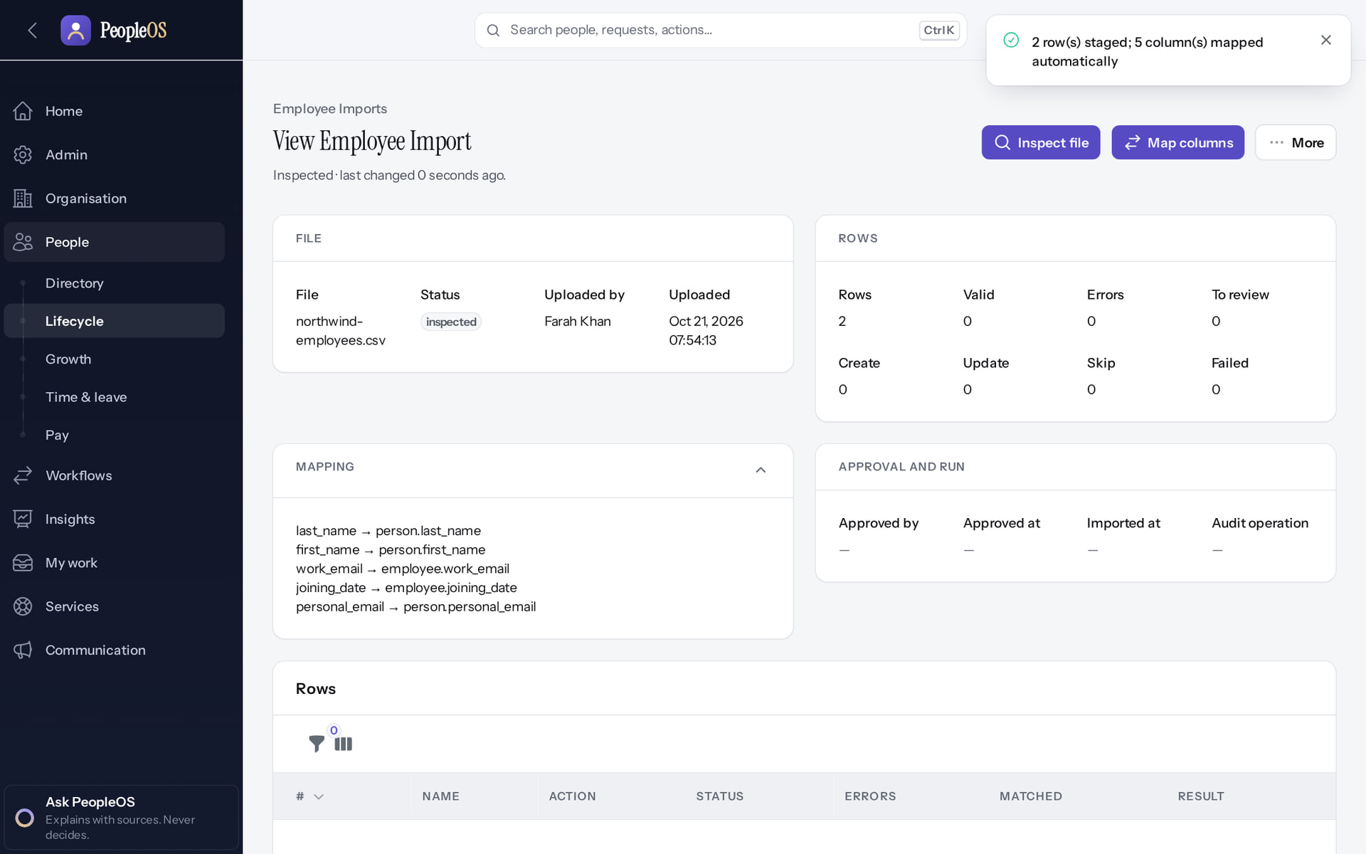
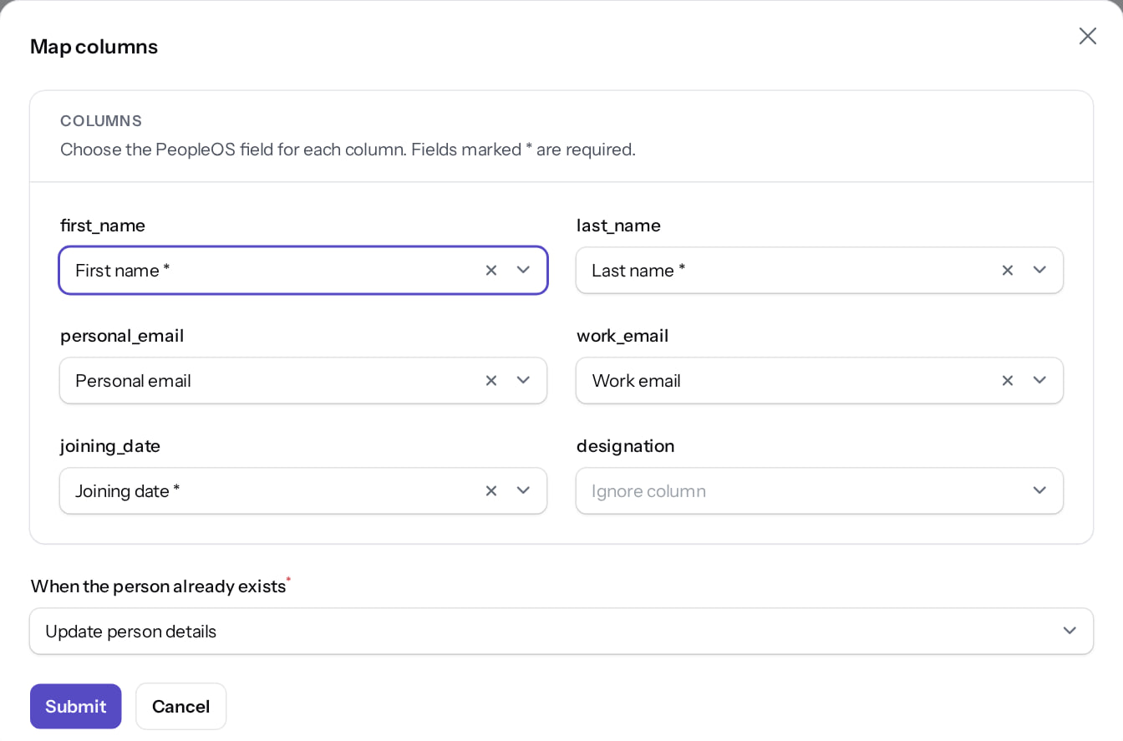
Inspect, then map the columns
STAGE 10 · DATA LOAD
Inspected
Verified
Map columns
Verified
Headers and row count read from the file; status inspected.
Each CSV column mapped to a PeopleOS field; on duplicates: update or skip.
Real screen · Farah Khan (Tenant Super Admin (Northwind Retail, first administrator)) · Employee import (after Inspect file)
Real screen (cropped) · Farah Khan (Tenant Super Admin (Northwind Retail, first administrator)) · Employee import › Map columns
Notes:
SAY: Inspect, then map the columns.
LEFT, Inspected: Headers and row count read from the file; status inspected.
RIGHT, Map columns: Each CSV column mapped to a PeopleOS field; on duplicates: update or skip.
OBSERVE: point out what differs between the two screens.
EVIDENCE: left = client-onboarding/90-onb-92a-import-inspected [Farah Khan (Tenant Super Admin (Northwind Retail, first administrator)), Employee import (after Inspect file)]; right = client-onboarding/90-onb-92-import-map-columns [Farah Khan (Tenant Super Admin (Northwind Retail, first administrator)), Employee import › Map columns]. Real screens, fictional data (SCREENSHOT-INVENTORY.md).

Slide 57
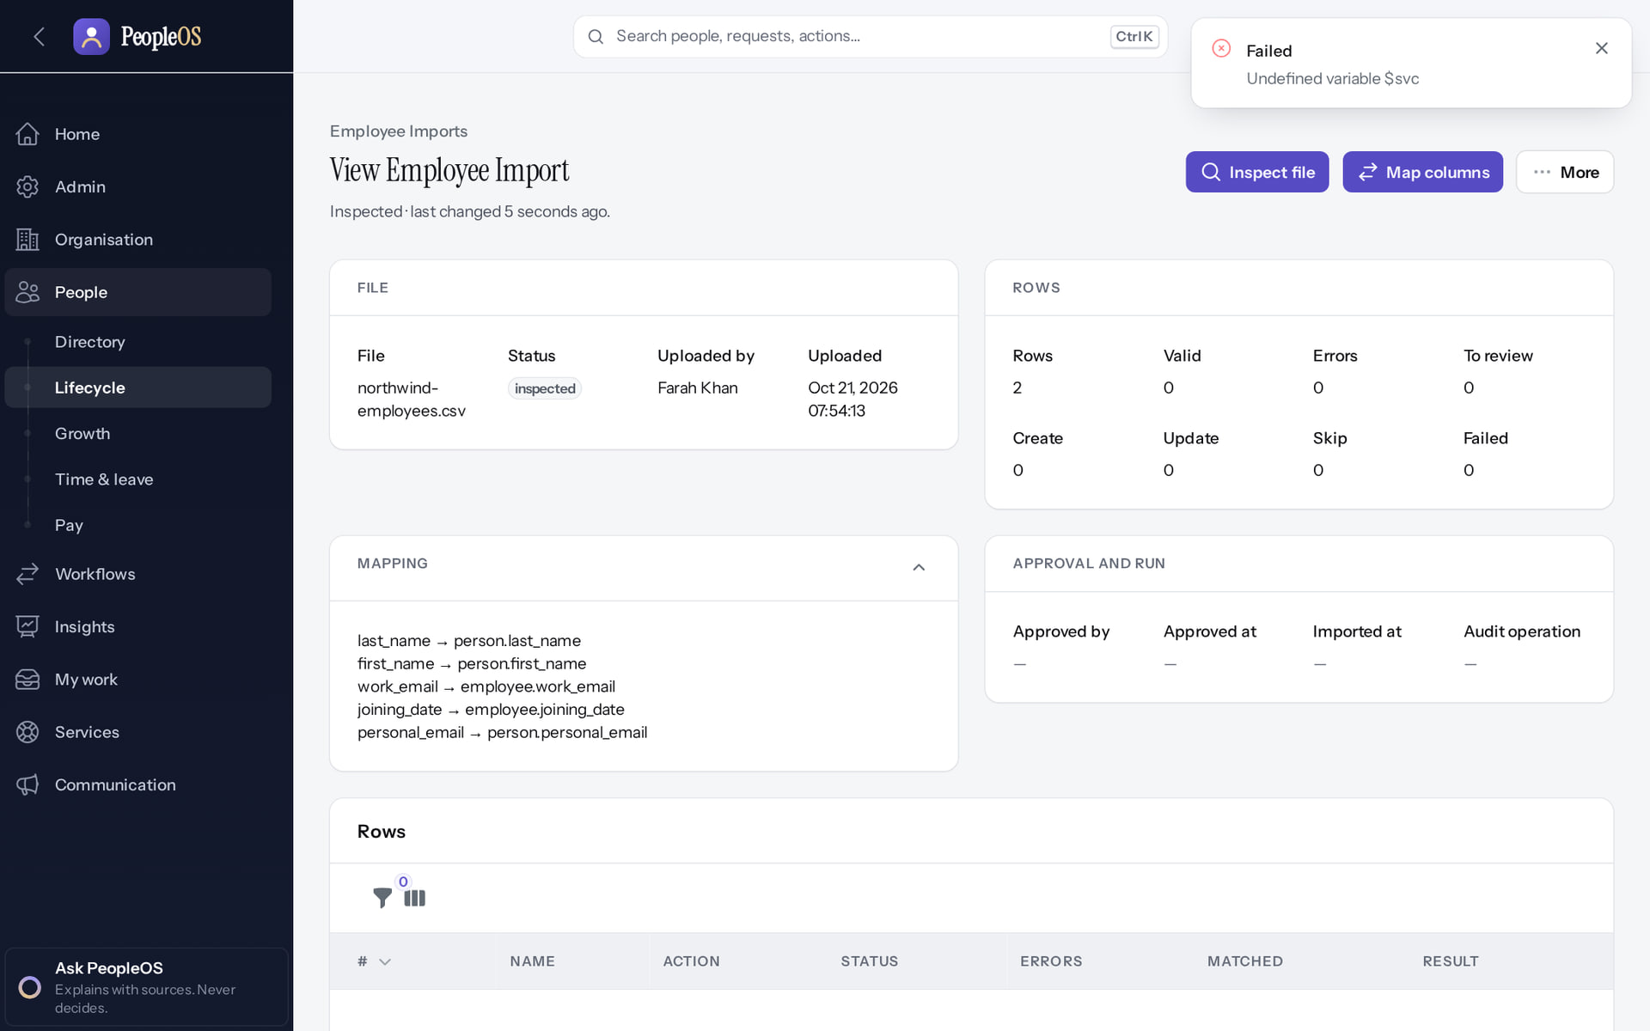
Data import today: blocked at Map columns
STAGE 10 · DATA LOAD
Incomplete · known defect or gap
1
1
Map columns fails with "Undefined variable $svc".
RESULT Imports cannot pass "inspected" from the screen (defect F25). Load people with the Hire employee wizard, or through POST /api/v1/employees (not exercised in this training) until fixed.
Real screen · Farah Khan (Tenant Super Admin (Northwind Retail, first administrator)) · Employee import (after Map columns)
Notes:
SAY: Imports cannot pass "inspected" from the screen (defect F25). Load people with the Hire employee wizard, or through POST /api/v1/employees (not exercised in this training) until fixed.
ON SCREEN: Submit the column mapping.
WALK THROUGH: (1) Map columns fails with "Undefined variable $svc".
LEARNERS SHOULD SEE: Observed: "Failed
Undefined variable $svc" — the mapping is not saved, so the import cannot pass "inspected" from the screen (known defect F25)
SCREEN: Employee import (after Map columns). Signed in as Farah Khan (Tenant Super Admin (Northwind Retail, first administrator)). Prerequisite: Signed in as the tenant administrator.
EVIDENCE: screenshot screenshots/client-onboarding/90-onb-93-import-map-fails.png, captured 2026-10-21 on the disposable training database (fictional people).

Slide 58
Stage 11 · Person matching and duplicates
IMPLEMENTATION STAGE
Automated by PeopleOS
RESPONSIBLE
Customer HR
REQUIRED INPUTS
Person details at hire
WHERE IN PEOPLEOS
People › Lifecycle › Employees › Hire employee (Person step)
WHAT TO CONFIGURE
Nothing: the wizard checks for an existing person
EXPECTED OUTCOME
Definite duplicates refused; possible duplicates warned
HOW TO VERIFY
Directory shows one record per person
EVIDENCE TO RETAIN
Wizard warning screenshot
COMMON ERRORS AND LIMITS
Ignoring a "possible duplicate" warning
DEPENDENCIES AND BLOCKERS
Stage 10
ACCEPTANCE CRITERIA
No duplicate person records
Notes:
RESPONSIBLE: Customer HR.
SAY: Nothing: the wizard checks for an existing person.
VERIFY: Directory shows one record per person. EVIDENCE TO KEEP: Wizard warning screenshot.
WATCH FOR: Ignoring a "possible duplicate" warning.

Slide 59
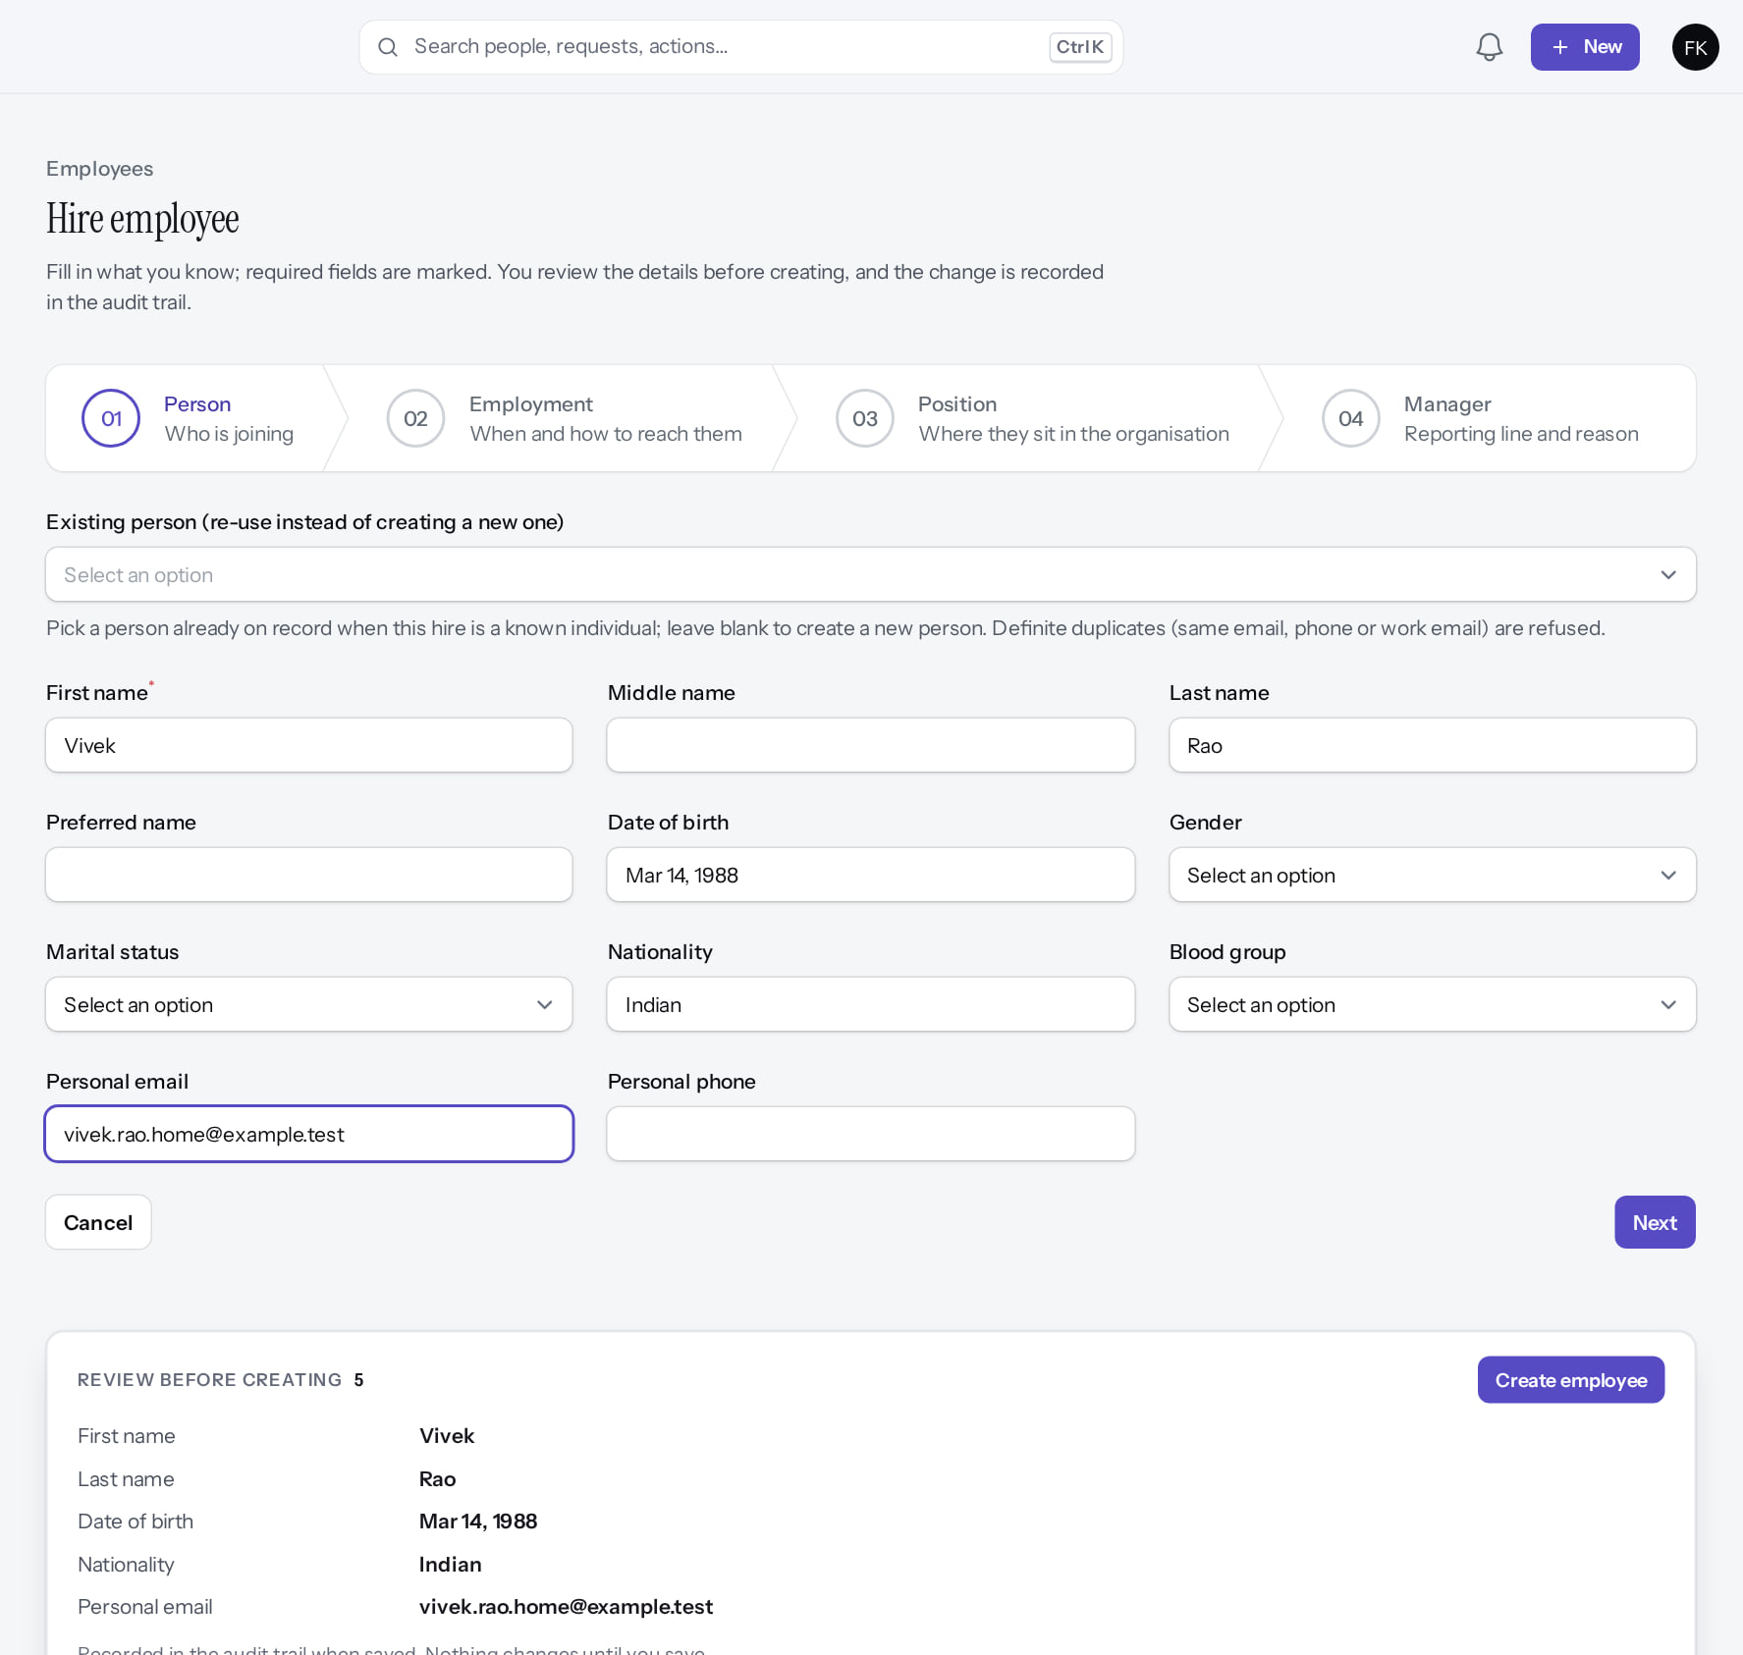
Hire employee: 1 Person
STAGE 10–11 · HIRE WIZARD
Verified in the running application
1
Step 1 of 4.
1
2
Name.
3
Personal e-mail.
RESULT The person is checked against existing people before you continue.
2
3
Real screen (cropped) · Farah Khan (Tenant Super Admin (Northwind Retail, first administrator)) · Hire employee › 01 Person
Notes:
SAY: The person is checked against existing people before you continue.
ON SCREEN: Name, date of birth, personal details and personal e-mail.
WALK THROUGH: (1) Step 1 of 4. (2) Name. (3) Personal e-mail.
LEARNERS SHOULD SEE: The person is checked against existing people before you continue
SCREEN: Hire employee › 01 Person. Signed in as Farah Khan (Tenant Super Admin (Northwind Retail, first administrator)). Prerequisite: Organisation, designations and levels configured; employee.create permission.
EVIDENCE: screenshot screenshots/client-onboarding/90-onb-38-hire-person.png, captured 2026-10-21 on the disposable training database (fictional people).

Slide 60
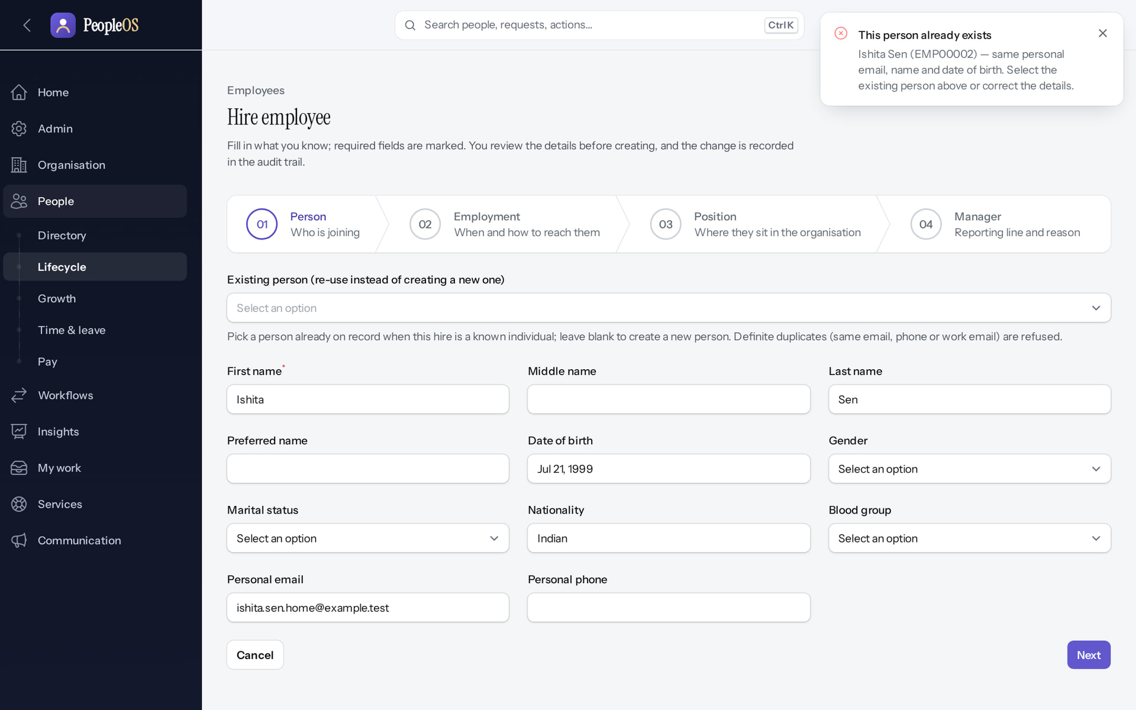
Duplicate check before anything is created
STAGE 11 · PERSON MATCHING
Verified in the running application
1
1
"This person already exists".
2
Re-use the existing person.
RESULT Definite matches are refused; possible matches are warned. One person, one lifetime record.
2
Real screen (cropped) · Farah Khan (Tenant Super Admin (Northwind Retail, first administrator)) · Hire employee › 01 Person (duplicate check)
Notes:
SAY: Definite matches are refused; possible matches are warned. One person, one lifetime record.
ON SCREEN: Enter a person who already exists (same name, date of birth and personal e-mail) and press Next.
WALK THROUGH: (1) "This person already exists". (2) Re-use the existing person.
LEARNERS SHOULD SEE: PeopleOS matches the existing person and stops or warns before a duplicate is created
SCREEN: Hire employee › 01 Person (duplicate check). Signed in as Farah Khan (Tenant Super Admin (Northwind Retail, first administrator)). Prerequisite: Organisation, designations and levels configured; employee.create permission.
EVIDENCE: screenshot screenshots/client-onboarding/90-onb-45-duplicate-person.png, captured 2026-10-21 on the disposable training database (fictional people).

Slide 61
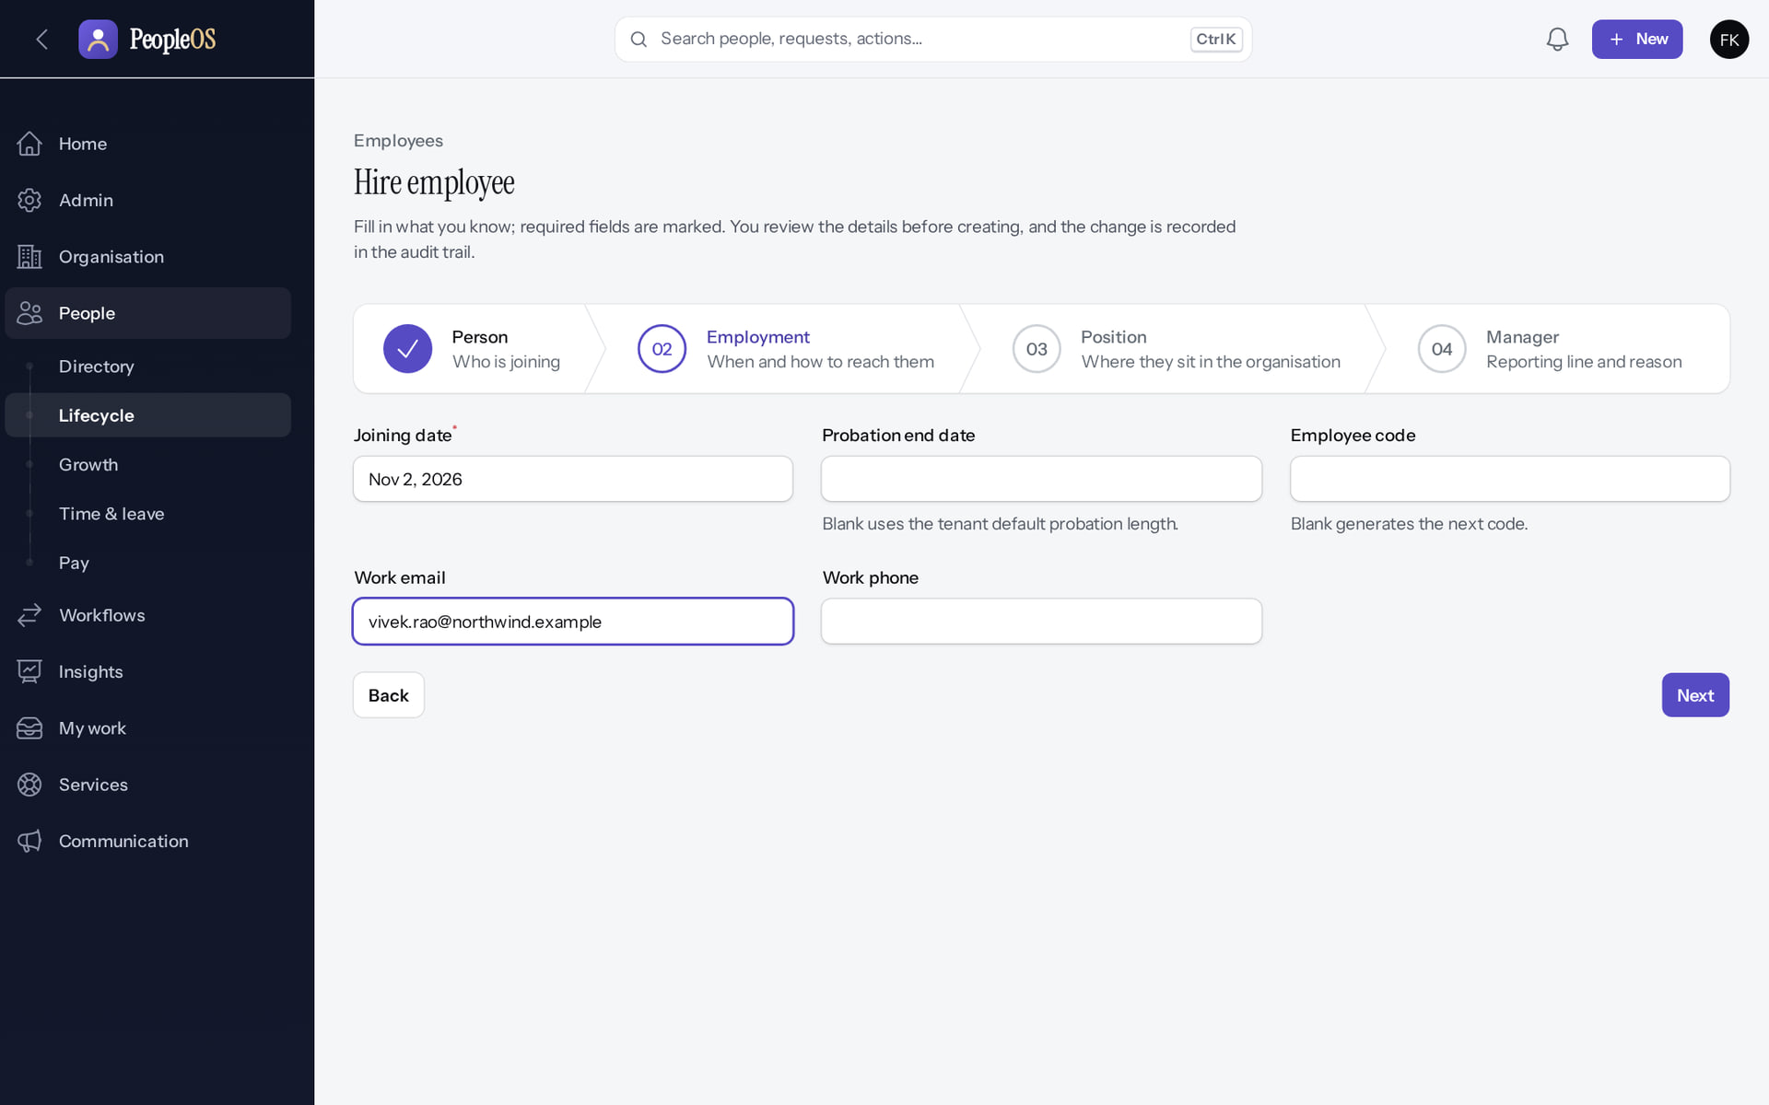
Hire employee: 2 Employment
STAGE 10 · HIRE WIZARD
Verified in the running application
1
Joining date.
2
Employee code (generated when blank).
3
Work e-mail.
1
2
3
Real screen (cropped) · Farah Khan (Tenant Super Admin (Northwind Retail, first administrator)) · Hire employee › 02 Employment
Notes:
SAY: Employee code is generated when left blank
ON SCREEN: Joining date, probation end, employee code, work e-mail and phone.
WALK THROUGH: (1) Joining date. (2) Employee code (generated when blank). (3) Work e-mail.
LEARNERS SHOULD SEE: Employee code is generated when left blank
SCREEN: Hire employee › 02 Employment. Signed in as Farah Khan (Tenant Super Admin (Northwind Retail, first administrator)). Prerequisite: Organisation, designations and levels configured; employee.create permission.
EVIDENCE: screenshot screenshots/client-onboarding/90-onb-39-hire-employment.png, captured 2026-10-21 on the disposable training database (fictional people).

Slide 62
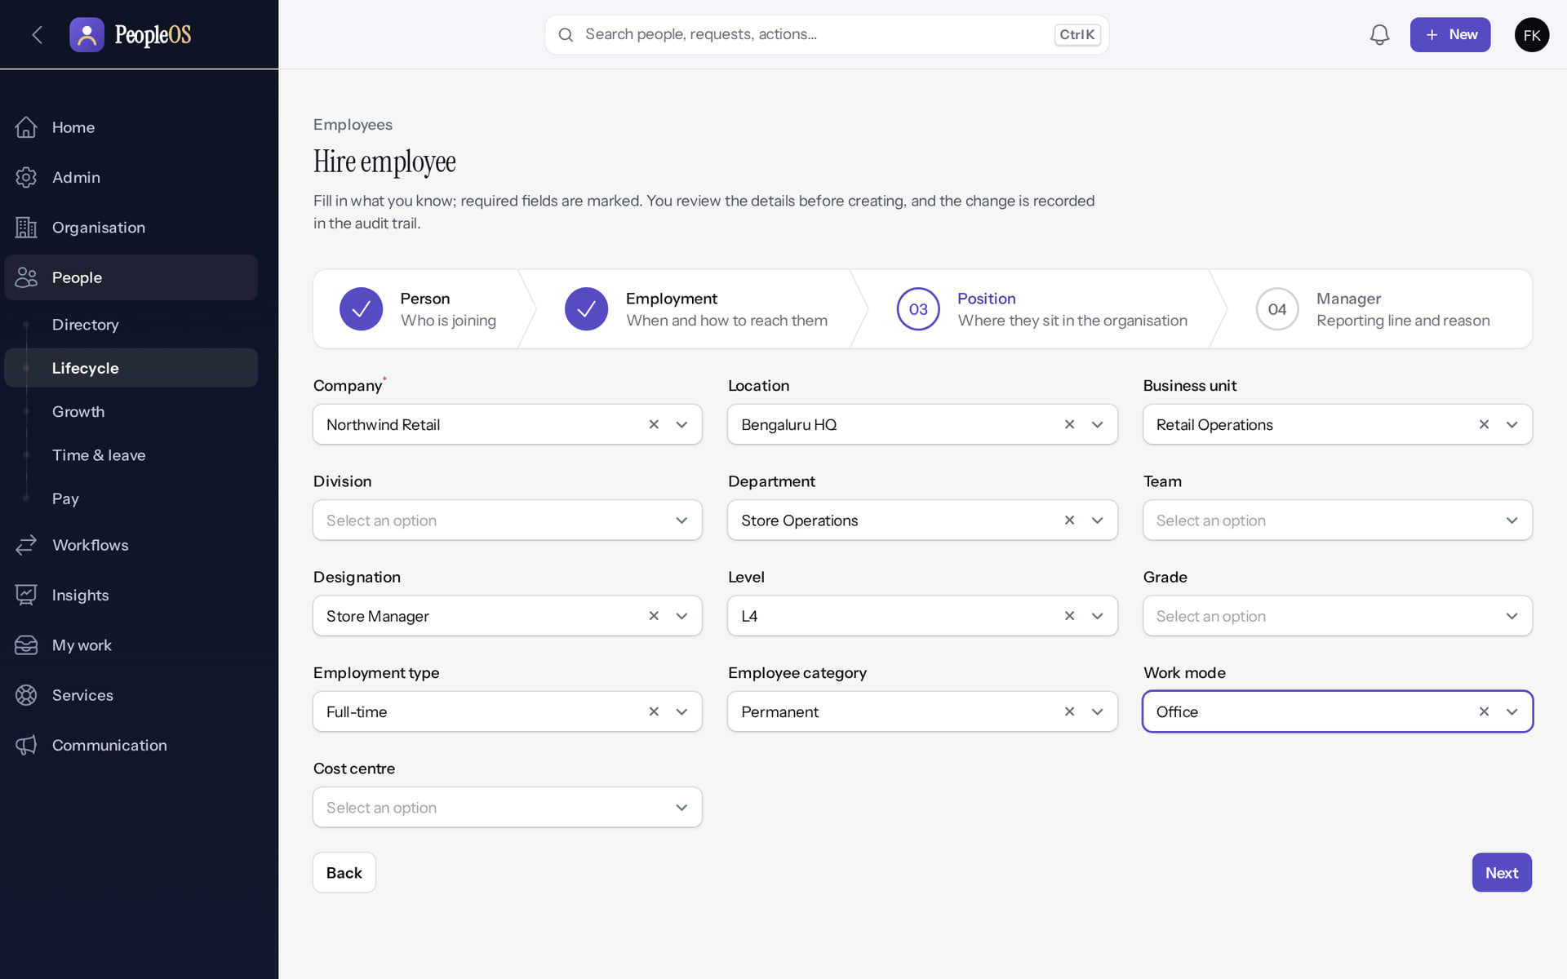
Hire employee: 3 Position
STAGE 10 · HIRE WIZARD
Verified in the running application
1
Company (the only required field).
2
Department.
3
Designation.
4
Employment type.
1
2
RESULT Values come from the structure built in stages 4–8.
3
4
Real screen (cropped) · Farah Khan (Tenant Super Admin (Northwind Retail, first administrator)) · Hire employee › 03 Position
Notes:
SAY: Values come from the structure built in stages 4–8.
ON SCREEN: Company, location, business unit, department, team, designation, level, employment type, category, work mode.
WALK THROUGH: (1) Company (the only required field). (2) Department. (3) Designation. (4) Employment type.
LEARNERS SHOULD SEE: Only Company is required; the rest place the person in the structure built earlier
SCREEN: Hire employee › 03 Position. Signed in as Farah Khan (Tenant Super Admin (Northwind Retail, first administrator)). Prerequisite: Organisation, designations and levels configured; employee.create permission.
EVIDENCE: screenshot screenshots/client-onboarding/90-onb-40-hire-position.png, captured 2026-10-21 on the disposable training database (fictional people).

Slide 63
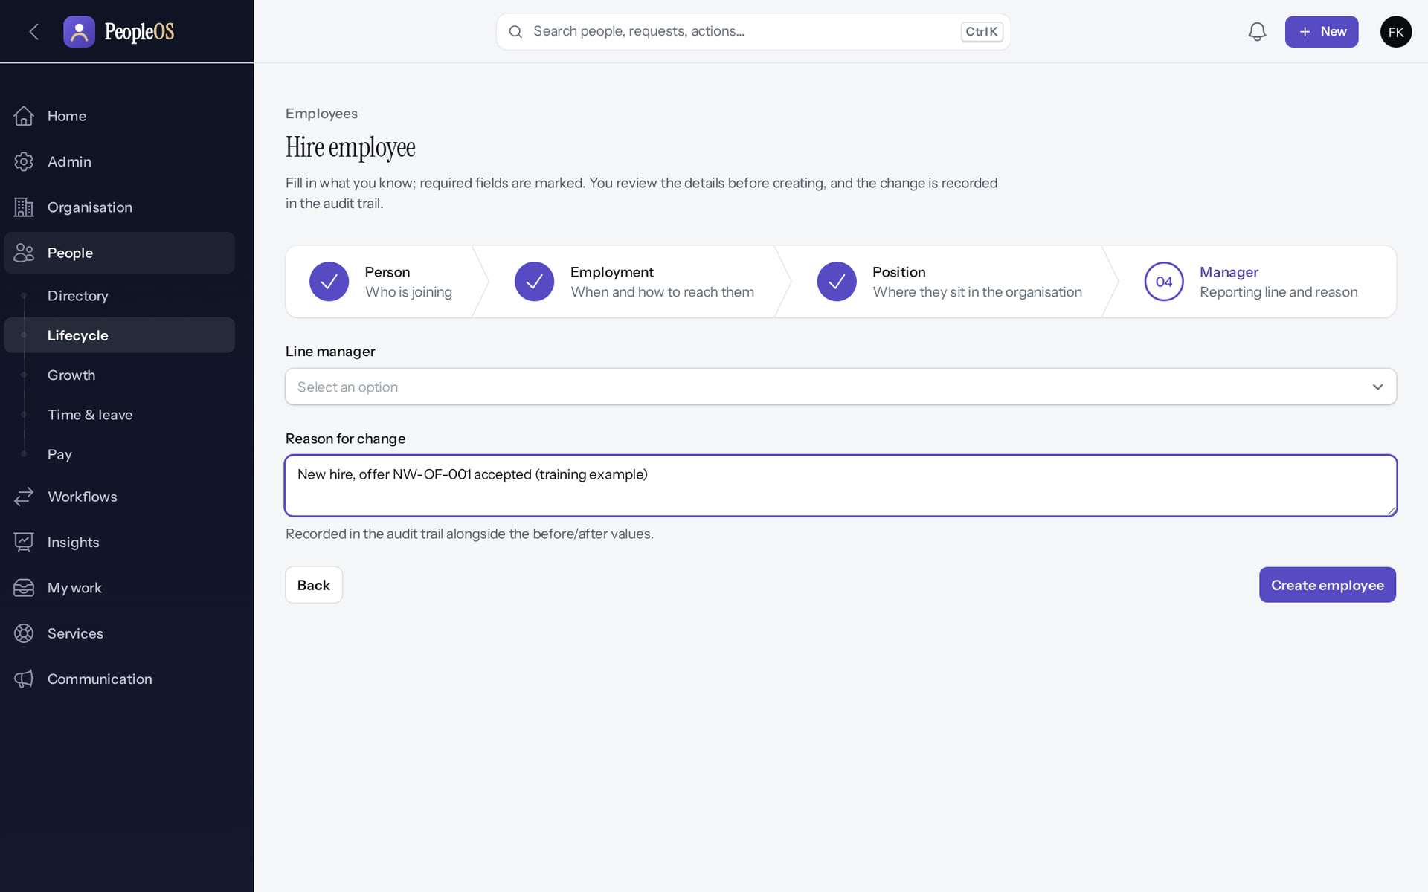
Hire employee: 4 Manager
STAGE 10 · HIRE WIZARD
Verified in the running application
1
Line manager (none for the first manager).
2
Reason for change.
3
Create employee.
1
2
3
Real screen (cropped) · Farah Khan (Tenant Super Admin (Northwind Retail, first administrator)) · Hire employee › 04 Manager
Notes:
SAY: The reason is recorded in the audit trail
ON SCREEN: Reporting line (none for the first manager) and the reason.
WALK THROUGH: (1) Line manager (none for the first manager). (2) Reason for change. (3) Create employee.
LEARNERS SHOULD SEE: The reason is recorded in the audit trail
SCREEN: Hire employee › 04 Manager. Signed in as Farah Khan (Tenant Super Admin (Northwind Retail, first administrator)). Prerequisite: Organisation, designations and levels configured; employee.create permission.
EVIDENCE: screenshot screenshots/client-onboarding/90-onb-41-hire-manager.png, captured 2026-10-21 on the disposable training database (fictional people).

Slide 64
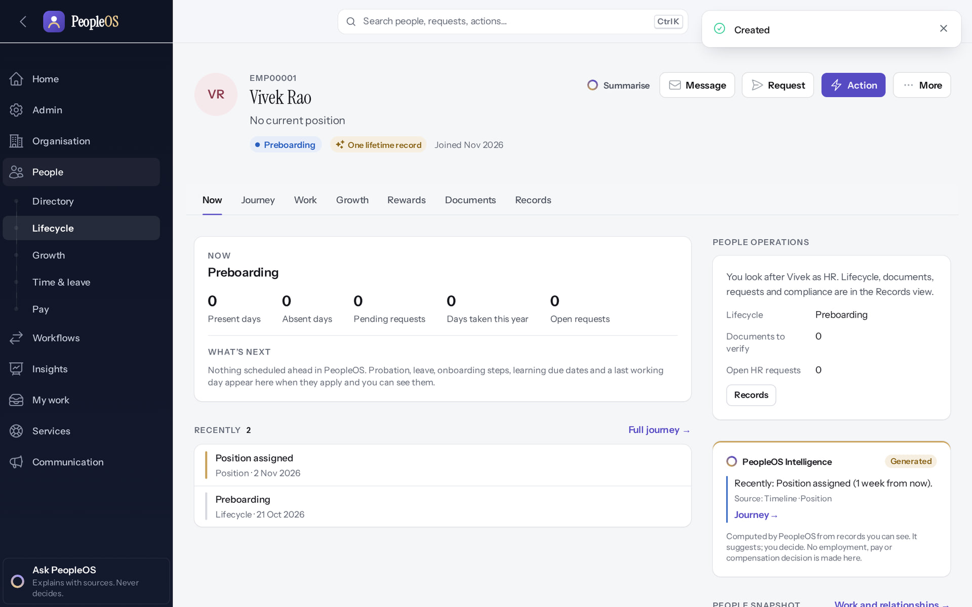
Employee created
STAGE 10 · HIRE WIZARD
1
Verified in the running application
1
Confirmation.
2
2
The new Employee 360: Preboarding, one lifetime record.
RESULT Vivek Rao (EMP00001), joins Nov 2026.
Real screen · Farah Khan (Tenant Super Admin (Northwind Retail, first administrator)) · Employee record (after Create employee)
Notes:
SAY: Vivek Rao (EMP00001), joins Nov 2026.
ON SCREEN: Create employee.
WALK THROUGH: (1) Confirmation. (2) The new Employee 360: Preboarding, one lifetime record.
LEARNERS SHOULD SEE: Vivek Rao (EMP00001) opens in Employee 360: Preboarding, One lifetime record, joins Nov 2026
SCREEN: Employee record (after Create employee). Signed in as Farah Khan (Tenant Super Admin (Northwind Retail, first administrator)). Prerequisite: Organisation, designations and levels configured; employee.create permission.
EVIDENCE: screenshot screenshots/client-onboarding/90-onb-43-hire-created.png, captured 2026-10-21 on the disposable training database (fictional people).

Slide 65
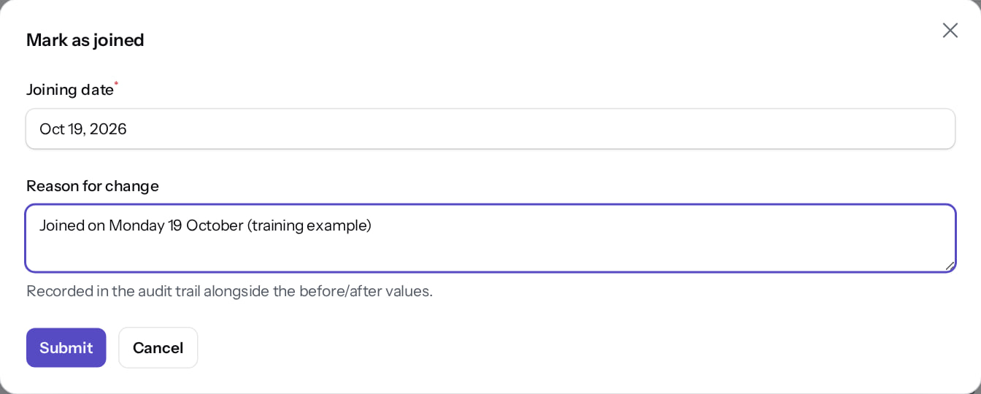
Mark as joined on the first day
STAGE 10 · LIFECYCLE
Verified in the running application
Reason for change.
RESULT Records the actual joining date (here earlier than the planned date) and moves Preboarding → Joined → Probation.
Real screen · Farah Khan (Tenant Super Admin (Northwind Retail, first administrator)) · Employee 360 › Action › Mark as joined
Notes:
SAY: Records the actual joining date (here earlier than the planned date) and moves Preboarding → Joined → Probation.
ON SCREEN: Confirm the actual joining date with a reason.
WALK THROUGH: (1) Reason for change.
LEARNERS SHOULD SEE: Lifecycle moves Preboarding → Joined → Probation
SCREEN: Employee 360 › Action › Mark as joined. Signed in as Farah Khan (Tenant Super Admin (Northwind Retail, first administrator)). Prerequisite: Employees hired; employee.lifecycle / employee.position permissions.
EVIDENCE: screenshot screenshots/client-onboarding/90-onb-46-mark-as-joined.png, captured 2026-10-21 on the disposable training database (fictional people).

Slide 66
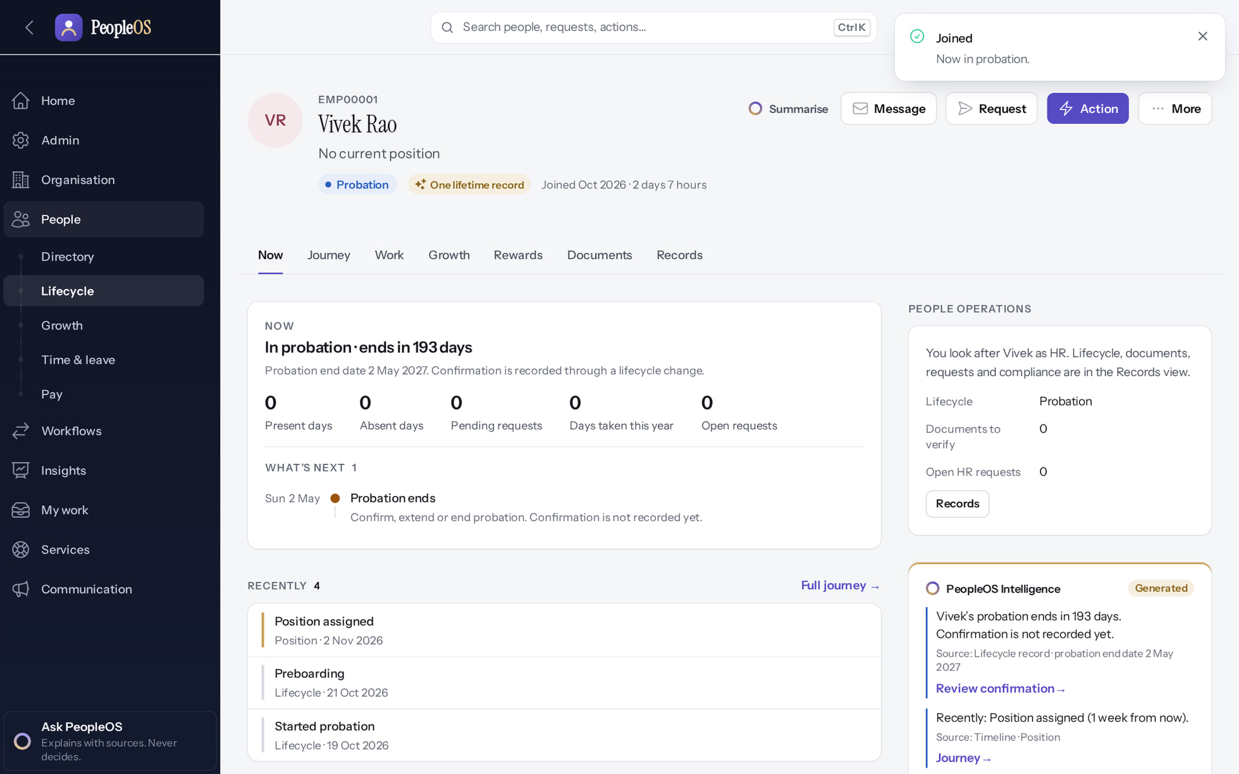
Now in probation
STAGE 10 · LIFECYCLE
Verified in the running application
1
1
"Joined — Now in probation."
RESULT Load managers first and mark them as joined, so they can be chosen as line managers.
Real screen · Farah Khan (Tenant Super Admin (Northwind Retail, first administrator)) · Employee 360 (after Mark as joined)
Notes:
SAY: Load managers first and mark them as joined, so they can be chosen as line managers.
ON SCREEN: Submit.
WALK THROUGH: (1) "Joined — Now in probation."
LEARNERS SHOULD SEE: "Joined — Now in probation."; the status badge shows Probation
SCREEN: Employee 360 (after Mark as joined). Signed in as Farah Khan (Tenant Super Admin (Northwind Retail, first administrator)). Prerequisite: Employees hired; employee.lifecycle / employee.position permissions.
EVIDENCE: screenshot screenshots/client-onboarding/90-onb-47-joined-probation.png, captured 2026-10-21 on the disposable training database (fictional people).

Slide 67
Stage 12 · Roles, users and access scope
IMPLEMENTATION STAGE
Configuration in PeopleOS
RESPONSIBLE
Customer administrator
REQUIRED INPUTS
Who does what; which companies or units each HR user covers
WHERE IN PEOPLEOS
Admin › Setup › Users (New user = invitation); Admin › Setup › Roles
WHAT TO CONFIGURE
Invite users with roles; set organisation scope for HR users
EXPECTED OUTCOME
Users invited and active
HOW TO VERIFY
Sign in as each role (test accounts) and check the menus
EVIDENCE TO RETAIN
Users list; role matrix
COMMON ERRORS AND LIMITS
Leaving HR users without scope gives them the whole tenant (Home warns); Tenant HR Admin cannot edit role permissions (F5)
DEPENDENCIES AND BLOCKERS
Stage 3
ACCEPTANCE CRITERIA
Each user sees only what the role matrix says
Notes:
RESPONSIBLE: Customer administrator.
SAY: Invite users with roles; set organisation scope for HR users.
VERIFY: Sign in as each role (test accounts) and check the menus. EVIDENCE TO KEEP: Users list; role matrix.
WATCH FOR: Leaving HR users without scope gives them the whole tenant (Home warns); Tenant HR Admin cannot edit role permissions (F5).

Slide 68
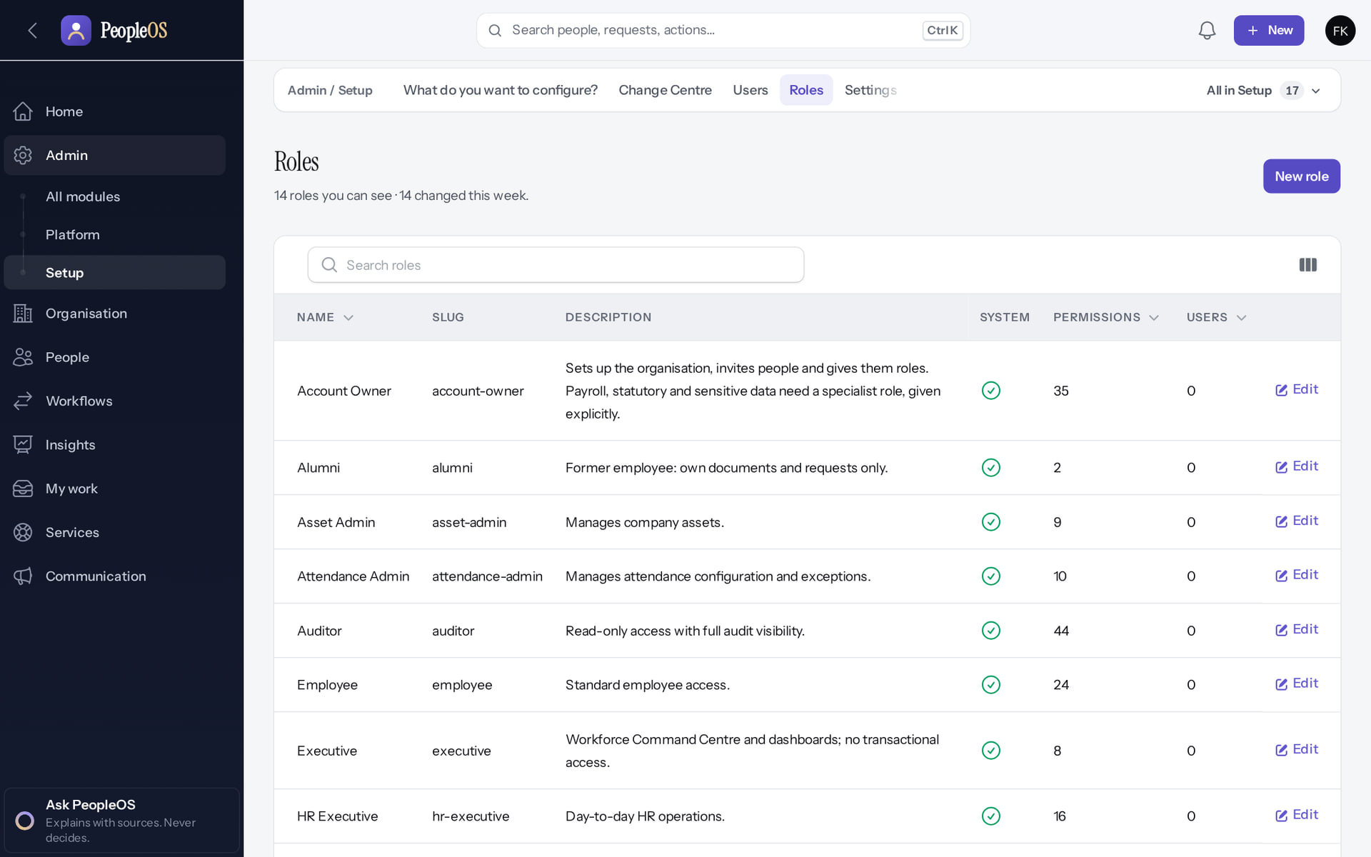
Roles: 14 system roles arrive with the tenant
STAGE 12 · ACCESS
Verified in the running application
2
1
A system role with its permission and user counts.
2
New role (custom roles).
RESULT 14 roles, from Account Owner to Tenant Super Admin. Only a Tenant Super Admin edits role permissions.
Real screen · Farah Khan (Tenant Super Admin (Northwind Retail, first administrator)) · Admin › Setup › Roles
1
Notes:
SAY: 14 roles, from Account Owner to Tenant Super Admin. Only a Tenant Super Admin edits role permissions.
ON SCREEN: Open Roles.
WALK THROUGH: (1) A system role with its permission and user counts. (2) New role (custom roles).
LEARNERS SHOULD SEE: 14 system roles provisioned with the tenant (Account Owner … Tenant Super Admin), each with its permission count and users; New role
SCREEN: Admin › Setup › Roles. Signed in as Farah Khan (Tenant Super Admin (Northwind Retail, first administrator)). Prerequisite: Signed in as the tenant administrator (user.manage, role.view).
EVIDENCE: screenshot screenshots/client-onboarding/90-onb-54-roles.png, captured 2026-10-21 on the disposable training database (fictional people).

Slide 69
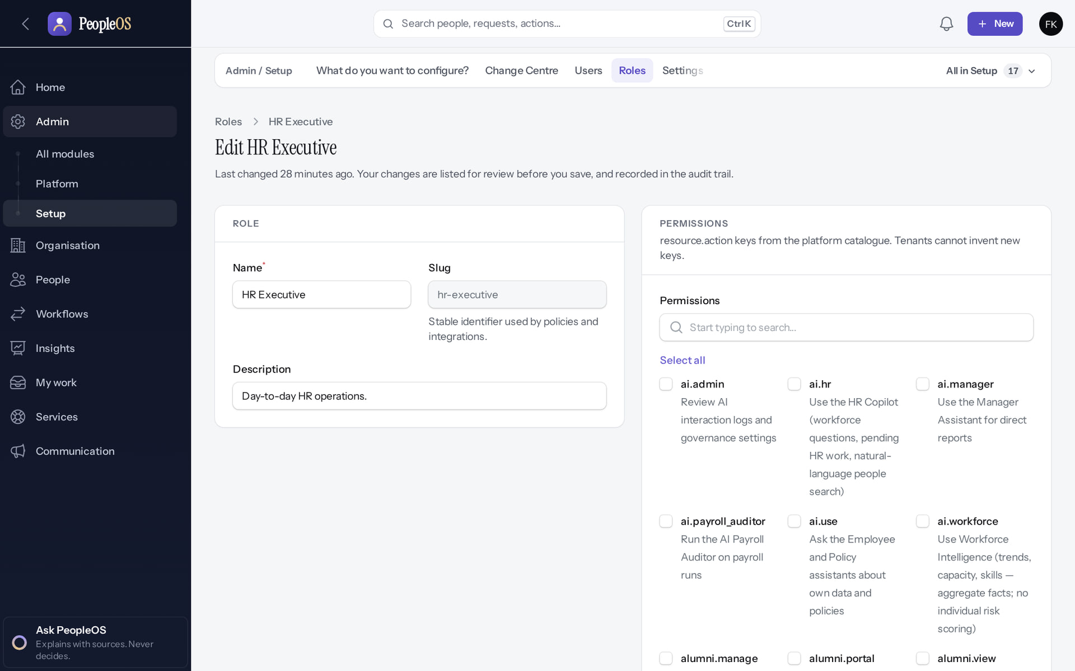
What a role may do
STAGE 12 · ACCESS
Verified in the running application
RESULT Permission keys grouped by module. Changes are audited with the keys granted and removed.
Real screen · Farah Khan (Tenant Super Admin (Northwind Retail, first administrator)) · Roles › HR Executive (edit)
Notes:
SAY: Permission keys grouped by module. Changes are audited with the keys granted and removed.
ON SCREEN: Open a role to see its permissions.
LEARNERS SHOULD SEE: Permission keys grouped by module; only a Tenant Super Admin edits role permissions
SCREEN: Roles › HR Executive (edit). Signed in as Farah Khan (Tenant Super Admin (Northwind Retail, first administrator)). Prerequisite: Signed in as the tenant administrator (user.manage, role.view).
EVIDENCE: screenshot screenshots/client-onboarding/90-onb-55-role-permissions.png, captured 2026-10-21 on the disposable training database (fictional people).

Slide 70
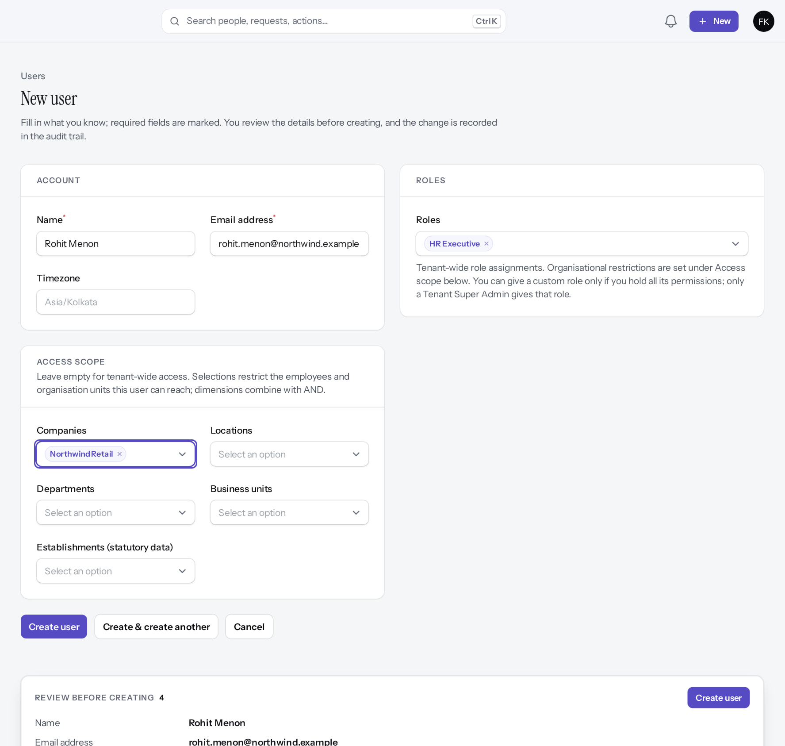
Invite a user with a role and a scope
STAGE 12 · ACCESS
Verified in the running application
1
Work e-mail.
2
Roles.
3
Access scope: company.
1
2
4
Create user.
RESULT The user receives an invitation e-mail and chooses a password; nobody else ever sees it.
3
4
Real screen (cropped) · Farah Khan (Tenant Super Admin (Northwind Retail, first administrator)) · Admin › Setup › Users › New user
Notes:
SAY: The user receives an invitation e-mail and chooses a password; nobody else ever sees it.
ON SCREEN: Name, e-mail, role HR Executive, access scope limited to the Northwind Retail company.
WALK THROUGH: (1) Work e-mail. (2) Roles. (3) Access scope: company. (4) Create user.
LEARNERS SHOULD SEE: The user is invited by e-mail; the scope restricts which employees and units they can reach (dimensions combine with AND)
SCREEN: Admin › Setup › Users › New user. Signed in as Farah Khan (Tenant Super Admin (Northwind Retail, first administrator)). Prerequisite: Signed in as the tenant administrator (user.manage, role.view).
EVIDENCE: screenshot screenshots/client-onboarding/90-onb-56-new-user.png, captured 2026-10-21 on the disposable training database (fictional people).

Slide 71
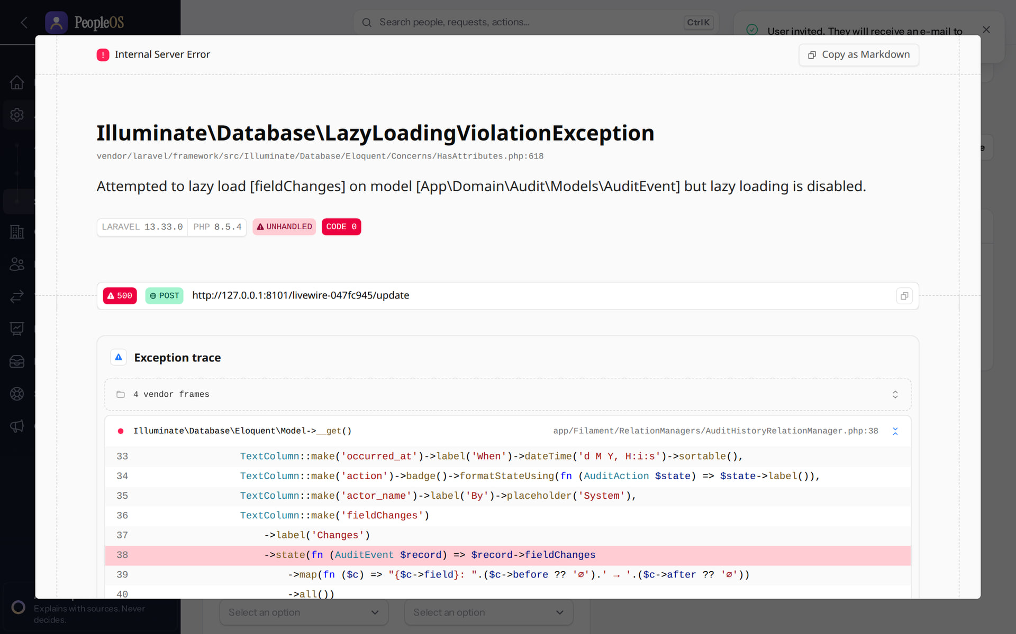
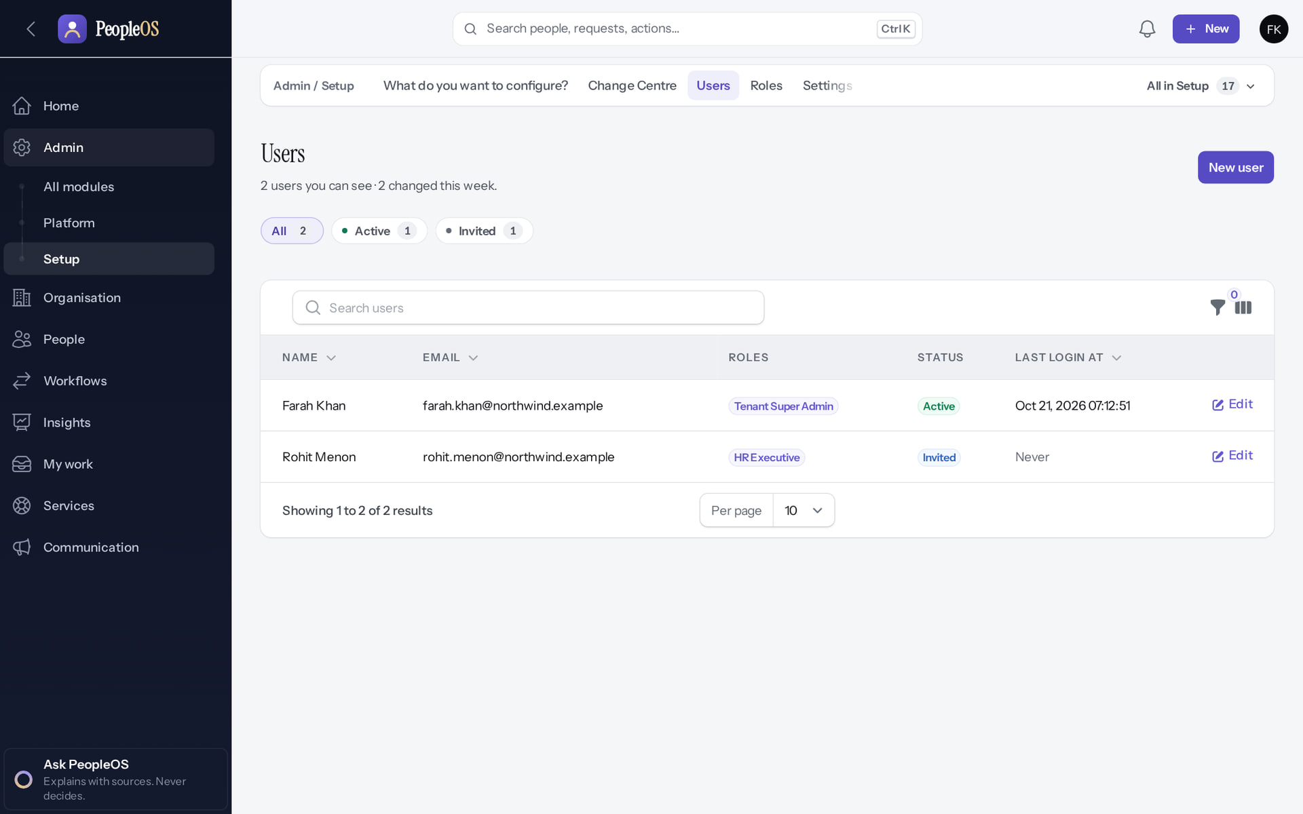
Invited, then listed
STAGE 12 · ACCESS
After Create user (development mode)
Incomplete
Users
Verified
The History panel errors (F26, non-production strict mode). The user was still created and invited, as the list shows.
Farah Khan (Tenant Super Admin, Active) and Rohit Menon (HR Executive, Invited).
Real screen · Farah Khan (Tenant Super Admin (Northwind Retail, first administrator)) · Users › Edit user (opened after Create user)
Real screen · Farah Khan (Tenant Super Admin (Northwind Retail, first administrator)) · Admin › Setup › Users
Notes:
SAY: Invited, then listed.
LEFT, After Create user (development mode): The History panel errors (F26, non-production strict mode). The user was still created and invited, as the list shows.
RIGHT, Users: Farah Khan (Tenant Super Admin, Active) and Rohit Menon (HR Executive, Invited).
OBSERVE: point out what differs between the two screens.
EVIDENCE: left = client-onboarding/90-onb-57-user-created [Farah Khan (Tenant Super Admin (Northwind Retail, first administrator)), Users › Edit user (opened after Create user)]; right = client-onboarding/90-onb-58-users [Farah Khan (Tenant Super Admin (Northwind Retail, first administrator)), Admin › Setup › Users]. Real screens, fictional data (SCREENSHOT-INVENTORY.md).

Slide 72


Check what the role really sees
STAGE 12 · ACCESS
HR Executive Home
Verified
Roles, as an HR Executive
Verified
A narrower menu than the administrator; Home shows people operations.
Refused: the HR Executive role does not include role.view.
Real screen · Rohit Menon (HR Executive (Northwind Retail)) · Home (HR Executive, Northwind Retail)
Real screen (cropped) · Rohit Menon (HR Executive (Northwind Retail)) · Roles (as HR Executive)
Notes:
SAY: Always test access by signing in as each role (with test accounts in UAT), not only as the super administrator.
SAY: Check what the role really sees.
LEFT, HR Executive Home: A narrower menu than the administrator; Home shows people operations.
RIGHT, Roles, as an HR Executive: Refused: the HR Executive role does not include role.view.
OBSERVE: point out what differs between the two screens.
EVIDENCE: left = client-onboarding/90-onb-59-hr-executive-home [Rohit Menon (HR Executive (Northwind Retail)), Home (HR Executive, Northwind Retail)]; right = client-onboarding/90-onb-60-hr-executive-roles-denied [Rohit Menon (HR Executive (Northwind Retail)), Roles (as HR Executive)]. Real screens, fictional data (SCREENSHOT-INVENTORY.md).

Slide 73
Stage 13 · Reporting relationships
IMPLEMENTATION STAGE
Configuration in PeopleOS
RESPONSIBLE
Customer HR
REQUIRED INPUTS
Manager of each employee
WHERE IN PEOPLEOS
Hire employee (Manager step) or Employee 360 › Action › Change manager
WHAT TO CONFIGURE
Primary line manager; functional, dotted, mentor etc. where used. Only employed people can be chosen: hire and Mark as joined the managers first
EXPECTED OUTCOME
Org chart and approvals route to managers
HOW TO VERIFY
Org map; a test leave request reaches the manager
EVIDENCE TO RETAIN
Org map
COMMON ERRORS AND LIMITS
Missing managers: approvals have nobody to route to
DEPENDENCIES AND BLOCKERS
Stage 10
ACCEPTANCE CRITERIA
Every active employee has a primary manager (except the top)
Notes:
RESPONSIBLE: Customer HR.
SAY: Primary line manager; functional, dotted, mentor etc. where used. Only employed people can be chosen: hire and Mark as joined the managers first.
VERIFY: Org map; a test leave request reaches the manager. EVIDENCE TO KEEP: Org map.
WATCH FOR: Missing managers: approvals have nobody to route to.

Slide 74

Only employed people can be managers
STAGE 13 · REPORTING LINES
Verified in the running application
1
Line manager search finds nobody.
"No options match your search."
RESULT "No options match your search": Vivek Rao was still Preboarding. Hire without a manager, then use Change manager.
1
Real screen (cropped) · Farah Khan (Tenant Super Admin (Northwind Retail, first administrator)) · Hire employee › 04 Manager (Line manager search)
Notes:
SAY: "No options match your search": Vivek Rao was still Preboarding. Hire without a manager, then use Change manager.
ON SCREEN: Hire Ishita Sen and search for Vivek Rao as her line manager.
WALK THROUGH: (1) Line manager search finds nobody. (·) "No options match your search."
LEARNERS SHOULD SEE: "No options match your search": only employed people (joined, probation, confirmed …) can be line managers; Vivek is still Preboarding. Ishita was created without a manager and linked later with Change manager
SCREEN: Hire employee › 04 Manager (Line manager search). Signed in as Farah Khan (Tenant Super Admin (Northwind Retail, first administrator)). Prerequisite: Organisation, designations and levels configured; employee.create permission.
EVIDENCE: screenshot screenshots/client-onboarding/90-onb-44-hire-with-manager.png, captured 2026-10-21 on the disposable training database (fictional people).

Slide 75

Change manager: 1 Context
STAGE 13 · REPORTING LINES
Verified in the running application
1
Which relationship changes (line, dotted, project…).
2
Next.
1
2
Real screen · Farah Khan (Tenant Super Admin (Northwind Retail, first administrator)) · Employee 360 › Action › Change manager (01 Context)
Notes:
SAY: Step 1 of 3 shows today’s reporting lines
ON SCREEN: Choose which relationship changes (line manager, dotted line, project …).
WALK THROUGH: (1) Which relationship changes (line, dotted, project…). (2) Next.
LEARNERS SHOULD SEE: Step 1 of 3 shows today’s reporting lines
SCREEN: Employee 360 › Action › Change manager (01 Context). Signed in as Farah Khan (Tenant Super Admin (Northwind Retail, first administrator)). Prerequisite: Employees hired; employee.lifecycle / employee.position permissions.
EVIDENCE: screenshot screenshots/client-onboarding/90-onb-48-change-manager-context.png, captured 2026-10-21 on the disposable training database (fictional people).

Slide 76

Change manager: 2 Change
STAGE 13 · REPORTING LINES
Verified in the running application
1
New manager.
2
Effective from.
1
2
Real screen · Farah Khan (Tenant Super Admin (Northwind Retail, first administrator)) · Change manager (02 Change)
Notes:
SAY: Only employed people are offered as managers
ON SCREEN: Pick the new manager and the date the change takes effect.
WALK THROUGH: (1) New manager. (2) Effective from.
LEARNERS SHOULD SEE: Only employed people are offered as managers
SCREEN: Change manager (02 Change). Signed in as Farah Khan (Tenant Super Admin (Northwind Retail, first administrator)). Prerequisite: Employees hired; employee.lifecycle / employee.position permissions.
EVIDENCE: screenshot screenshots/client-onboarding/90-onb-49-change-manager-change.png, captured 2026-10-21 on the disposable training database (fictional people).

Slide 77

Change manager: 3 Review
STAGE 13 · REPORTING LINES
Verified in the running application
1
Reason for change.
2
Confirm reporting change.
RESULT Before → After shown side by side.
1
2
Real screen · Farah Khan (Tenant Super Admin (Northwind Retail, first administrator)) · Change manager (03 Review)
Notes:
SAY: Before → After shown side by side.
ON SCREEN: Review Before → After and give the reason.
WALK THROUGH: (1) Reason for change. (2) Confirm reporting change.
LEARNERS SHOULD SEE: The old and new reporting line side by side; Confirm reporting change
SCREEN: Change manager (03 Review). Signed in as Farah Khan (Tenant Super Admin (Northwind Retail, first administrator)). Prerequisite: Employees hired; employee.lifecycle / employee.position permissions.
EVIDENCE: screenshot screenshots/client-onboarding/90-onb-50-change-manager-review.png, captured 2026-10-21 on the disposable training database (fictional people).

Slide 78

Reporting line recorded
STAGE 13 · REPORTING LINES
1
Verified in the running application
1
Confirmation.
2
2
Reports to.
RESULT Ishita Sen now reports to Vivek Rao; the change is in her history.
Real screen · Farah Khan (Tenant Super Admin (Northwind Retail, first administrator)) · Employee 360 (after the change)
Notes:
SAY: Ishita Sen now reports to Vivek Rao; the change is in her history.
ON SCREEN: Confirm reporting change.
WALK THROUGH: (1) Confirmation. (2) Reports to.
LEARNERS SHOULD SEE: Ishita Sen now reports to Vivek Rao; the change is in her history
SCREEN: Employee 360 (after the change). Signed in as Farah Khan (Tenant Super Admin (Northwind Retail, first administrator)). Prerequisite: Employees hired; employee.lifecycle / employee.position permissions.
EVIDENCE: screenshot screenshots/client-onboarding/90-onb-51-reporting-changed.png, captured 2026-10-21 on the disposable training database (fictional people).

Slide 79


Verify: org map and directory
STAGE 13 · REPORTING LINES
Org map
Verified
Directory
Verified
Vivek Rao with Ishita Sen reporting to him.
The three Northwind employees and their manager. Role, department and location show "—": these hires were placed with the company only.
Real screen · Farah Khan (Tenant Super Admin (Northwind Retail, first administrator)) · Organisation › Org map
Real screen · Farah Khan (Tenant Super Admin (Northwind Retail, first administrator)) · People › Directory
Notes:
SAY: Verify: org map and directory.
LEFT, Org map: Vivek Rao with Ishita Sen reporting to him.
RIGHT, Directory: The three Northwind employees and their manager. Role, department and location show "—": these hires were placed with the company only.
OBSERVE: point out what differs between the two screens.
EVIDENCE: left = client-onboarding/90-onb-52-org-map-with-people [Farah Khan (Tenant Super Admin (Northwind Retail, first administrator)), Organisation › Org map]; right = client-onboarding/90-onb-53-directory [Farah Khan (Tenant Super Admin (Northwind Retail, first administrator)), People › Directory]. Real screens, fictional data (SCREENSHOT-INVENTORY.md).

Slide 80
Policies and pay
05
Time, leave, pay, statutory, workflows, notifications and sign-in security.
Notes:
TRANSITION: Section 5, Policies and pay. Time, leave, pay, statutory, workflows, notifications and sign-in security.
SAY: Tell learners what they will be able to do by the end of this section, then move on.
ASK: "What questions do you have before we start this section?"

Slide 81
Stage 14 · Attendance and shifts
IMPLEMENTATION STAGE
Configuration in PeopleOS
RESPONSIBLE
Customer HR (attendance)
REQUIRED INPUTS
Shifts, weekly patterns, holiday list, devices
WHERE IN PEOPLEOS
People › Time & leave › All in Time & leave › Shifts, Work Schedules, Holiday Calendars, Devices
WHAT TO CONFIGURE
Shifts, schedules with rules, holiday calendars with rules, devices
EXPECTED OUTCOME
Attendance processes per schedule
HOW TO VERIFY
Process a test day; check records
EVIDENCE TO RETAIN
Attendance records
COMMON ERRORS AND LIMITS
Holiday type and half-day are ignored: every holiday is a full day (F39); late-mark actions not applied (F40)
DEPENDENCIES AND BLOCKERS
Stage 7
ACCEPTANCE CRITERIA
A sample week processes as expected
Notes:
RESPONSIBLE: Customer HR (attendance).
SAY: Shifts, schedules with rules, holiday calendars with rules, devices.
VERIFY: Process a test day; check records. EVIDENCE TO KEEP: Attendance records.
WATCH FOR: Holiday type and half-day are ignored: every holiday is a full day (F39); late-mark actions not applied (F40).

Slide 82

Define shifts
STAGE 14 · ATTENDANCE
Verified in the running application
1
Start / end.
2
Full / half day.
2
3
Grace.
1
4
Overtime.
3
RESULT Start and end times, breaks and grace rules; a review panel shows the shift before it is created.
4
Real screen (cropped) · Farah Khan (Tenant Super Admin (Northwind Retail, first administrator)) · Time & leave › Shifts › New shift
Notes:
SAY: Start and end times, breaks and grace rules; a review panel shows the shift before it is created.
ON SCREEN: Name, code, type, start and end, full/half-day minutes, breaks, grace and overtime thresholds, effective date.
LEARNERS SHOULD SEE: Attendance status, late marks and overtime are computed from these values
SCREEN: Time & leave › Shifts › New shift. Signed in as Farah Khan (Tenant Super Admin (Northwind Retail, first administrator)). Prerequisite: Signed in as the tenant administrator (attendance.manage).
EVIDENCE: screenshot screenshots/client-onboarding/90-onb-61-new-shift.png, captured 2026-10-21 on the disposable training database (fictional people).

Slide 83

Create a work schedule
STAGE 14 · ATTENDANCE
Verified in the running application
RESULT The weekly pattern of shifts and weekly offs.
Real screen (cropped) · Farah Khan (Tenant Super Admin (Northwind Retail, first administrator)) · Time & leave › Work schedules › New work schedule
Notes:
SAY: The weekly pattern of shifts and weekly offs.
ON SCREEN: A weekly pattern: the general shift Monday to Friday, weekly off at the weekend.
LEARNERS SHOULD SEE: Schedules can rotate over several weeks (Add to weeks); rules on the saved schedule decide who it applies to
SCREEN: Time & leave › Work schedules › New work schedule. Signed in as Farah Khan (Tenant Super Admin (Northwind Retail, first administrator)). Prerequisite: Signed in as the tenant administrator (attendance.manage).
EVIDENCE: screenshot screenshots/client-onboarding/90-onb-62-new-work-schedule.png, captured 2026-10-21 on the disposable training database (fictional people).

Slide 84

Schedule saved: assign it by rule
STAGE 14 · ATTENDANCE
Verified in the running application
RESULT Applies-to rules decide who works the schedule; individuals can be assigned from the Employee 360.
Real screen (cropped) · Farah Khan (Tenant Super Admin (Northwind Retail, first administrator)) · Work schedule (edit page)
Notes:
SAY: Applies-to rules decide who works the schedule; individuals can be assigned from the Employee 360.
ON SCREEN: Open the saved schedule.
LEARNERS SHOULD SEE: Weekly pattern, "Applies to" rules (who follows the schedule) and History
SCREEN: Work schedule (edit page). Signed in as Farah Khan (Tenant Super Admin (Northwind Retail, first administrator)). Prerequisite: Signed in as the tenant administrator (attendance.manage).
EVIDENCE: screenshot screenshots/client-onboarding/90-onb-63-work-schedule-saved.png, captured 2026-10-21 on the disposable training database (fictional people).

Slide 85

Create a holiday calendar
STAGE 14 · ATTENDANCE
Verified in the running application
1
Name.
2
Year.
RESULT One calendar per location or group; assigned by rule.
1
2
Real screen (cropped) · Farah Khan (Tenant Super Admin (Northwind Retail, first administrator)) · Time & leave › Holiday calendars › New holiday calendar
Notes:
SAY: One calendar per location or group; assigned by rule.
ON SCREEN: Name, code, year, status.
LEARNERS SHOULD SEE: Holidays and the "Applies to" rules are added on the saved calendar
SCREEN: Time & leave › Holiday calendars › New holiday calendar. Signed in as Farah Khan (Tenant Super Admin (Northwind Retail, first administrator)). Prerequisite: Signed in as the tenant administrator (attendance.manage).
EVIDENCE: screenshot screenshots/client-onboarding/90-onb-64-new-holiday-calendar.png, captured 2026-10-21 on the disposable training database (fictional people).

Slide 86


Add holidays and assign the calendar
STAGE 14 · ATTENDANCE
New holiday
Verified
Calendar saved
Verified
The date counts as a holiday for everyone the calendar applies to.
Holidays Kannada Rajyotsava (1 Nov) and Christmas; Applies to and History tabs.
Real screen (cropped) · Farah Khan (Tenant Super Admin (Northwind Retail, first administrator)) · Holiday calendar › Holidays › New holiday
Real screen (cropped) · Farah Khan (Tenant Super Admin (Northwind Retail, first administrator)) · Holiday calendar (edit page)
Notes:
KNOWN LIMIT F39: holiday type and the half-day switch are stored but ignored; every calendar date counts as a full holiday. Tell the customer before they enter half days.
SAY: Add holidays and assign the calendar.
LEFT, New holiday: The date counts as a holiday for everyone the calendar applies to.
RIGHT, Calendar saved: Holidays Kannada Rajyotsava (1 Nov) and Christmas; Applies to and History tabs.
OBSERVE: point out what differs between the two screens.
EVIDENCE: left = client-onboarding/90-onb-65-new-holiday [Farah Khan (Tenant Super Admin (Northwind Retail, first administrator)), Holiday calendar › Holidays › New holiday]; right = client-onboarding/90-onb-66-holiday-calendar-saved [Farah Khan (Tenant Super Admin (Northwind Retail, first administrator)), Holiday calendar (edit page)]. Real screens, fictional data (SCREENSHOT-INVENTORY.md).

Slide 87
Stage 15 · Leave policies
IMPLEMENTATION STAGE
Configuration in PeopleOS
RESPONSIBLE
Customer HR
REQUIRED INPUTS
Leave types and entitlements
WHERE IN PEOPLEOS
People › Time & leave › All in Time & leave › Leave types; Workflows › Policies (Leave policy)
WHAT TO CONFIGURE
Types; policy versions (accrual, probation, notice, carry forward, encashment)
EXPECTED OUTCOME
Balances accrue
HOW TO VERIFY
Balances for sample employees
EVIDENCE TO RETAIN
Balances list
COMMON ERRORS AND LIMITS
Hourly leave and sandwich rules not available (F43); encashment has no amount or payroll posting (F41)
DEPENDENCIES AND BLOCKERS
Stage 10
ACCEPTANCE CRITERIA
Sample balances match the customer's policy
Notes:
RESPONSIBLE: Customer HR.
SAY: Types; policy versions (accrual, probation, notice, carry forward, encashment).
VERIFY: Balances for sample employees. EVIDENCE TO KEEP: Balances list.
WATCH FOR: Hourly leave and sandwich rules not available (F43); encashment has no amount or payroll posting (F41).

Slide 88

Leave types arrive seeded
STAGE 15 · LEAVE
Verified in the running application
1
A seeded type with its flags.
1
New leave type.
RESULT Earned, Casual, Sick, Maternity, Paternity, Bereavement, Compensatory off, Restricted holiday, Leave without pay.
Real screen · Farah Khan (Tenant Super Admin (Northwind Retail, first administrator)) · Time & leave › Leave types
Notes:
SAY: Earned, Casual, Sick, Maternity, Paternity, Bereavement, Compensatory off, Restricted holiday, Leave without pay.
ON SCREEN: Review the leave types every new tenant receives.
WALK THROUGH: (1) A seeded type with its flags. (2) New leave type.
LEARNERS SHOULD SEE: Earned, Casual, Sick, Maternity, Paternity, Bereavement, Compensatory off, Restricted holiday and Leave without pay — paid / half day / encashable flags and who they apply to
SCREEN: Time & leave › Leave types. Signed in as Farah Khan (Tenant Super Admin (Northwind Retail, first administrator)). Prerequisite: Signed in as the tenant administrator (attendance.manage, leave.manage, policy.manage).
EVIDENCE: screenshot screenshots/client-onboarding/90-onb-67-leave-types.png, captured 2026-10-21 on the disposable training database (fictional people).

Slide 89

Create the leave policy
STAGE 15 · LEAVE
Verified in the running application
1
Policy type: Leave policy.
2
Name.
RESULT The rules go on a draft version of the saved policy, which is then published.
1
2
Real screen · Farah Khan (Tenant Super Admin (Northwind Retail, first administrator)) · Workflows › Policies › New policy
Notes:
SAY: The rules go on a draft version of the saved policy, which is then published.
ON SCREEN: Type Leave policy, name, code, description.
WALK THROUGH: (1) Policy type: Leave policy. (2) Name.
LEARNERS SHOULD SEE: The rules themselves are set on a draft version of the saved policy, then published
SCREEN: Workflows › Policies › New policy. Signed in as Farah Khan (Tenant Super Admin (Northwind Retail, first administrator)). Prerequisite: Signed in as the tenant administrator (attendance.manage, leave.manage, policy.manage).
EVIDENCE: screenshot screenshots/client-onboarding/90-onb-68-new-leave-policy.png, captured 2026-10-21 on the disposable training database (fictional people).

Slide 90

Set the entitlements on the draft version
STAGE 15 · LEAVE
Verified in the running application
1
Leave type.
2
Days per year.
1
2
3
3
Accrual.
4
Carry-forward.
4
RESULT Nothing applies until the version is published.
Real screen (cropped) · Farah Khan (Tenant Super Admin (Northwind Retail, first administrator)) · Policy › Versions & settings › Edit draft
Notes:
SAY: Nothing applies until the version is published.
ON SCREEN: For each leave type: days per year, accrual, pro-ration, eligibility, carry-forward, encashment, notice and limits.
WALK THROUGH: (1) Leave type. (2) Days per year. (3) Accrual. (4) Carry-forward.
LEARNERS SHOULD SEE: The draft version holds the rules; nothing applies until it is published
SCREEN: Policy › Versions & settings › Edit draft. Signed in as Farah Khan (Tenant Super Admin (Northwind Retail, first administrator)). Prerequisite: Leave policy created (draft v1); policy.manage.
EVIDENCE: screenshot screenshots/client-onboarding/90-onb-70-leave-entitlements.png, captured 2026-10-21 on the disposable training database (fictional people).

Slide 91


Publish the version
STAGE 15 · LEAVE
Publish draft
Verified
Published
Verified
The version becomes active from its effective date; earlier versions are kept.
v1 Published by Farah Khan, effective 21 Oct 2026. Assignment rules decide who it applies to.
Real screen · Farah Khan (Tenant Super Admin (Northwind Retail, first administrator)) · Policy › Publish draft
Real screen (cropped) · Farah Khan (Tenant Super Admin (Northwind Retail, first administrator)) · Workflows › Policies › Northwind leave policy (after publishing)
Notes:
VERIFY: after publishing, check Balances for two sample employees (accruals run monthly; Run accrual now is on the Balances page).
SAY: Publish the version.
LEFT, Publish draft: The version becomes active from its effective date; earlier versions are kept.
RIGHT, Published: v1 Published by Farah Khan, effective 21 Oct 2026. Assignment rules decide who it applies to.
OBSERVE: point out what differs between the two screens.
EVIDENCE: left = client-onboarding/90-onb-71-publish-policy [Farah Khan (Tenant Super Admin (Northwind Retail, first administrator)), Policy › Publish draft]; right = client-onboarding/90-onb-72-policy-published [Farah Khan (Tenant Super Admin (Northwind Retail, first administrator)), Workflows › Policies › Northwind leave policy (after publishing)]. Real screens, fictional data (SCREENSHOT-INVENTORY.md).

Slide 92
Stage 16 · Payroll components and structures
IMPLEMENTATION STAGE
Configuration in PeopleOS
RESPONSIBLE
Customer payroll lead
REQUIRED INPUTS
Salary components, structures, CTC per employee
WHERE IN PEOPLEOS
People › Pay › All in Pay › Salary components, Salary structures
WHAT TO CONFIGURE
Components with formulas; structure versions (approval)
EXPECTED OUTCOME
Runs can be calculated
HOW TO VERIFY
Calculate a test run; Payroll Auditor
EVIDENCE TO RETAIN
Run breakdown
COMMON ERRORS AND LIMITS
Statutory components are reserved; monthly frequency only
DEPENDENCIES AND BLOCKERS
Stage 10
ACCEPTANCE CRITERIA
Test run gross and net match a reference calculation
Notes:
RESPONSIBLE: Customer payroll lead.
SAY: Components with formulas; structure versions (approval).
VERIFY: Calculate a test run; Payroll Auditor. EVIDENCE TO KEEP: Run breakdown.
WATCH FOR: Statutory components are reserved; monthly frequency only.

Slide 93

Salary components arrive seeded
STAGE 16 · PAY
Verified in the running application
A formula-based component.
1
1
New salary component.
RESULT Basic (40% of monthly CTC), HRA (50% of basic), Conveyance, Special allowance (balancing), Bonus…; statutory lines are never configured here.
Real screen · Farah Khan (Tenant Super Admin (Northwind Retail, first administrator)) · People › Pay › Salary components
Notes:
SAY: Basic (40% of monthly CTC), HRA (50% of basic), Conveyance, Special allowance (balancing), Bonus…; statutory lines are never configured here.
ON SCREEN: Review the starting components every new tenant receives.
WALK THROUGH: (1) A formula-based component. (2) New salary component.
LEARNERS SHOULD SEE: Basic (40 % of monthly CTC), HRA (50 % of basic), Conveyance, Special allowance (balancing), Bonus …; each with a formula, order and flags; statutory lines are never configured here
SCREEN: People › Pay › Salary components. Signed in as Farah Khan (Tenant Super Admin (Northwind Retail, first administrator)). Prerequisite: Signed in as the tenant administrator (payroll.manage, compliance.manage).
EVIDENCE: screenshot screenshots/client-onboarding/90-onb-73-salary-components.png, captured 2026-10-21 on the disposable training database (fictional people).

Slide 94


Edit a component; review the structure
STAGE 16 · PAY
Basic (edit)
Verified
Salary structures
Verified
The formula is validated on save; a reason is required and approval may apply (Change Centre).
Standard structure v1 is seeded; new versions are drafted, submitted and approved.
Real screen (cropped) · Farah Khan (Tenant Super Admin (Northwind Retail, first administrator)) · Salary components › Basic (edit)
Real screen · Farah Khan (Tenant Super Admin (Northwind Retail, first administrator)) · People › Pay › Salary structures
Notes:
SAY: Edit a component; review the structure.
LEFT, Basic (edit): The formula is validated on save; a reason is required and approval may apply (Change Centre).
RIGHT, Salary structures: Standard structure v1 is seeded; new versions are drafted, submitted and approved.
OBSERVE: point out what differs between the two screens.
EVIDENCE: left = client-onboarding/90-onb-74-salary-component-edit [Farah Khan (Tenant Super Admin (Northwind Retail, first administrator)), Salary components › Basic (edit)]; right = client-onboarding/90-onb-75-salary-structures [Farah Khan (Tenant Super Admin (Northwind Retail, first administrator)), People › Pay › Salary structures]. Real screens, fictional data (SCREENSHOT-INVENTORY.md).

Slide 95
Stage 17 · Statutory configuration and verification
IMPLEMENTATION STAGE
Blocked (defect or gate)
RESPONSIBLE
Customer payroll (registrations); Markedge (rule verification)
REQUIRED INPUTS
Registrations (PF, ESI, PT, LWF, TAN), establishment profiles; official rule evidence
WHERE IN PEOPLEOS
People › Pay › All in Pay › Statutory registrations, Statutory profiles; Compliance control room; Rule verification
WHAT TO CONFIGURE
Customer records registrations against an establishment first, then establishment statutory profiles; two platform administrators verify each rule with evidence
EXPECTED OUTCOME
Finalisation allowed only when rules are verified
HOW TO VERIFY
Compliance control room shows no unverified rule
EVIDENCE TO RETAIN
Verification register
COMMON ERRORS AND LIMITS
0 of 24 rules verified today; gratuity not calculated; no rules for USA, UK, EU; a profile recorded before its registration has no registration linked
DEPENDENCIES AND BLOCKERS
Owner decisions O-5, O-12, O-18
ACCEPTANCE CRITERIA
All rules in scope verified, or payroll excluded from scope in writing
Notes:
RESPONSIBLE: Customer payroll (registrations); Markedge (rule verification).
SAY: Customer records registrations against an establishment first, then establishment statutory profiles; two platform administrators verify each rule with evidence.
VERIFY: Compliance control room shows no unverified rule. EVIDENCE TO KEEP: Verification register.
WATCH FOR: 0 of 24 rules verified today; gratuity not calculated; no rules for USA, UK, EU; a profile recorded before its registration has no registration linked.

Slide 96

Registrations belong to an establishment
STAGE 17 · STATUTORY
Verified in the running application
1
1
The rule message.
RESULT "A EPF establishment code registration belongs to an establishment." Nothing is saved. Create establishments first (stage 6).
Real screen (cropped) · Farah Khan (Tenant Super Admin (Northwind Retail, first administrator)) · Statutory registrations › New registration (refused)
Notes:
SAY: "A EPF establishment code registration belongs to an establishment." Nothing is saved. Create establishments first (stage 6).
ON SCREEN: Submit an EPF establishment code at entity level (no establishment chosen).
WALK THROUGH: (1) The rule message.
LEARNERS SHOULD SEE: "A EPF establishment code registration belongs to an establishment." Nothing is saved
SCREEN: Statutory registrations › New registration (refused). Signed in as Farah Khan (Tenant Super Admin (Northwind Retail, first administrator)). Prerequisite: Signed in as the tenant administrator (payroll.manage, compliance.manage).
EVIDENCE: screenshot screenshots/client-onboarding/90-onb-76a-registration-needs-establishment.png, captured 2026-10-21 on the disposable training database (fictional people).

Slide 97

Record a statutory registration
STAGE 17 · STATUTORY
Verified in the running application
1
1
Legal entity.
2
Establishment.
2
3
Registration type.
3
4
Number.
4
RESULT EPF, ESIC, PT, LWF and TAN registrations are effective-dated records.
Real screen (cropped) · Farah Khan (Tenant Super Admin (Northwind Retail, first administrator)) · People › Pay › Statutory registrations › New registration
Notes:
SAY: EPF, ESIC, PT, LWF and TAN registrations are effective-dated records.
ON SCREEN: Legal entity, establishment, registration type, number, name, jurisdiction, state, effective date, reason.
WALK THROUGH: (1) Legal entity. (2) Establishment. (3) Registration type. (4) Number.
LEARNERS SHOULD SEE: The employer’s EPF / ESIC / PT / LWF / TAN registrations held as effective-dated records
SCREEN: People › Pay › Statutory registrations › New registration. Signed in as Farah Khan (Tenant Super Admin (Northwind Retail, first administrator)). Prerequisite: Signed in as the tenant administrator (payroll.manage, compliance.manage).
EVIDENCE: screenshot screenshots/client-onboarding/90-onb-76-new-statutory-registration.png, captured 2026-10-21 on the disposable training database (fictional people).

Slide 98


Registrations and statutory profiles
STAGE 17 · STATUTORY
Statutory registrations
Verified
New statutory profile
Verified
The EPF establishment code with its state and effective date.
Tells payroll which statutes apply where. Record the registration first: a profile saved earlier has no registration linked.
Real screen · Farah Khan (Tenant Super Admin (Northwind Retail, first administrator)) · People › Pay › Statutory registrations
Real screen (cropped) · Farah Khan (Tenant Super Admin (Northwind Retail, first administrator)) · People › Pay › Statutory profiles › New profile
Notes:
SAY: Registrations and statutory profiles.
LEFT, Statutory registrations: The EPF establishment code with its state and effective date.
RIGHT, New statutory profile: Tells payroll which statutes apply where. Record the registration first: a profile saved earlier has no registration linked.
OBSERVE: point out what differs between the two screens.
EVIDENCE: left = client-onboarding/90-onb-77-statutory-registrations [Farah Khan (Tenant Super Admin (Northwind Retail, first administrator)), People › Pay › Statutory registrations]; right = client-onboarding/90-onb-78-new-establishment-statutory-profile [Farah Khan (Tenant Super Admin (Northwind Retail, first administrator)), People › Pay › Statutory profiles › New profile]. Real screens, fictional data (SCREENSHOT-INVENTORY.md).

Slide 99


Rule verification is Markedge's job, and it is not done
STAGE 17 · STATUTORY
Compliance control room
After configuration
Compliance rules (read only)
Disabled (gate)
Rules this tenant needs per establishment and whether each is verified; the production gate.
Rule versions shipped by the platform with their verification status: 0 of 24 verified.
Real screen (cropped) · Farah Khan (Tenant Super Admin (Northwind Retail, first administrator)) · People › Pay › Control room (compliance)
Real screen · Farah Khan (Tenant Super Admin (Northwind Retail, first administrator)) · People › Pay › Compliance rules (read only for the tenant)
Notes:
SAY: Payroll can be configured and calculated, but not finalised, until two platform administrators verify each rule against official evidence. This is release gate 5 (owner decisions O-5, O-12, O-18). Agree in writing whether payroll is in the customer's first go-live.
SAY: Rule verification is Markedge's job, and it is not done.
LEFT, Compliance control room: Rules this tenant needs per establishment and whether each is verified; the production gate.
RIGHT, Compliance rules (read only): Rule versions shipped by the platform with their verification status: 0 of 24 verified.
OBSERVE: point out what differs between the two screens.
EVIDENCE: left = client-onboarding/90-onb-80-compliance-control-room [Farah Khan (Tenant Super Admin (Northwind Retail, first administrator)), People › Pay › Control room (compliance)]; right = client-onboarding/90-onb-81-compliance-rules [Farah Khan (Tenant Super Admin (Northwind Retail, first administrator)), People › Pay › Compliance rules (read only for the tenant)]. Real screens, fictional data (SCREENSHOT-INVENTORY.md).

Slide 100
Stage 18 · Workflows and approvals
IMPLEMENTATION STAGE
Configuration in PeopleOS
RESPONSIBLE
Customer HR with Markedge
REQUIRED INPUTS
Approval chains per request type
WHERE IN PEOPLEOS
Workflows › Workflows (builder, versions); Workflows › Policies
WHAT TO CONFIGURE
Publish workflow versions; leave/attendance approvals go to the line manager by default
EXPECTED OUTCOME
Requests route correctly
HOW TO VERIFY
Run each request type once in UAT
EVIDENCE TO RETAIN
Workflow runs
COMMON ERRORS AND LIMITS
"Generate document" step skipped (F33)
DEPENDENCIES AND BLOCKERS
Stage 13
ACCEPTANCE CRITERIA
Every request type reaches the right approver
Notes:
RESPONSIBLE: Customer HR with Markedge.
SAY: Publish workflow versions; leave/attendance approvals go to the line manager by default.
VERIFY: Run each request type once in UAT. EVIDENCE TO KEEP: Workflow runs.
WATCH FOR: "Generate document" step skipped (F33).

Slide 101


Create a workflow
STAGE 18 · WORKFLOWS
New workflow
Verified
Workflow saved
Verified
Name, trigger event (here: probation ending soon) and subject.
Versions, the step builder and history.
Real screen (cropped) · Farah Khan (Tenant Super Admin (Northwind Retail, first administrator)) · Workflows › Workflows › New workflow
Real screen (cropped) · Farah Khan (Tenant Super Admin (Northwind Retail, first administrator)) · Workflow (after creating)
Notes:
SAY: Create a workflow.
LEFT, New workflow: Name, trigger event (here: probation ending soon) and subject.
RIGHT, Workflow saved: Versions, the step builder and history.
OBSERVE: point out what differs between the two screens.
EVIDENCE: left = client-onboarding/90-onb-82-new-workflow [Farah Khan (Tenant Super Admin (Northwind Retail, first administrator)), Workflows › Workflows › New workflow]; right = client-onboarding/90-onb-83-workflow-saved [Farah Khan (Tenant Super Admin (Northwind Retail, first administrator)), Workflow (after creating)]. Real screens, fictional data (SCREENSHOT-INVENTORY.md).

Slide 102

Add steps in the builder, then publish
STAGE 18 · WORKFLOWS
Verified in the running application
RESULT Start → End; approval, task, notification and condition steps go between them. Running instances keep the version they started on. Known limit: "Generate document" steps are skipped (F33).
Real screen · Farah Khan (Tenant Super Admin (Northwind Retail, first administrator)) · Workflow › Versions & builder › Open builder
Notes:
SAY: Start → End; approval, task, notification and condition steps go between them. Running instances keep the version they started on. Known limit: "Generate document" steps are skipped (F33).
ON SCREEN: Open the builder of the draft version.
LEARNERS SHOULD SEE: Start → End nodes; steps (approval, task, notification, condition …) are added between them, then the version is checked and published
SCREEN: Workflow › Versions & builder › Open builder. Signed in as Farah Khan (Tenant Super Admin (Northwind Retail, first administrator)). Prerequisite: Workflow created; workflow.manage.
EVIDENCE: screenshot screenshots/client-onboarding/90-onb-94-workflow-builder.png, captured 2026-10-21 on the disposable training database (fictional people).

Slide 103

A published workflow (Demo tenant)
STAGE 18 · WORKFLOWS
Verified in the running application
RESULT Probation confirmation v1 in the Demo tenant: 6 nodes, manager then HR approval.
Real screen (cropped) · Kavya Menon (Tenant HR Admin + Employee) · Workflow › Versions & builder
Notes:
SAY: Probation confirmation v1 in the Demo tenant: 6 nodes, manager then HR approval.
ON SCREEN: Open Versions & builder.
LEARNERS SHOULD SEE: Versioned definitions: a published version is immutable; changes are made in a new draft and published; running instances keep their version
SCREEN: Workflow › Versions & builder. Signed in as Kavya Menon (Tenant HR Admin + Employee). Prerequisite: workflow.manage / policy.manage / notification.manage.
EVIDENCE: screenshot screenshots/client-onboarding/85-wf-03-workflow-versions.png, captured 2026-10-21 on the disposable training database (fictional people).

Slide 104
Stage 19 · Notifications and communication
IMPLEMENTATION STAGE
Configuration in PeopleOS
RESPONSIBLE
Customer HR
REQUIRED INPUTS
Which events notify whom
WHERE IN PEOPLEOS
Communication › Notification rules, Notification templates, Delivery log
WHAT TO CONFIGURE
Edit starter rules and templates
EXPECTED OUTCOME
E-mail and in-app notices sent
HOW TO VERIFY
Delivery log shows sent items
EVIDENCE TO RETAIN
Delivery log
COMMON ERRORS AND LIMITS
No role can create or delete rules (F18); SMS, WhatsApp, push send nothing (F19)
DEPENDENCIES AND BLOCKERS
Production mail transport
ACCEPTANCE CRITERIA
Agreed notifications appear in the delivery log
Notes:
RESPONSIBLE: Customer HR.
SAY: Edit starter rules and templates.
VERIFY: Delivery log shows sent items. EVIDENCE TO KEEP: Delivery log.
WATCH FOR: No role can create or delete rules (F18); SMS, WhatsApp, push send nothing (F19).

Slide 105

Notification rules: none, and none can be created
STAGE 19 · NOTIFICATIONS
Incomplete · known defect or gap
RESULT No rules and no New action (F18). E-mail notices for leave and approvals are not sent unless a rule exists. Markedge must seed or enable rules until this is fixed.
Real screen · Farah Khan (Tenant Super Admin (Northwind Retail, first administrator)) · Communication › Notification rules
Notes:
SAY: No rules and no New action (F18). E-mail notices for leave and approvals are not sent unless a rule exists. Markedge must seed or enable rules until this is fixed.
ON SCREEN: Open Notification rules in a new tenant.
LEARNERS SHOULD SEE: No rules and no "New" action: rules cannot be created or deleted from the screen (known limitation F18), so e-mail notices for leave and approvals are not sent unless a rule exists
SCREEN: Communication › Notification rules. Signed in as Farah Khan (Tenant Super Admin (Northwind Retail, first administrator)). Prerequisite: Signed in as the tenant administrator.
EVIDENCE: screenshot screenshots/client-onboarding/90-onb-84-notification-rules.png, captured 2026-10-21 on the disposable training database (fictional people).

Slide 106

Delivery log (Demo tenant)
STAGE 19 · NOTIFICATIONS
Verified in the running application
1
Queued.
1
RESULT Each delivery with channel and status. SMS, WhatsApp and push send nothing (F19). Queued items need a queue worker.
Real screen · Kavya Menon (Tenant HR Admin + Employee) · Communication › Delivery log
Notes:
SAY: Each delivery with channel and status. SMS, WhatsApp and push send nothing (F19). Queued items need a queue worker.
ON SCREEN: Open the Delivery log.
LEARNERS SHOULD SEE: Every notification delivery with channel, event, status (sent / queued / failed) and View; failed deliveries can be sent again
SCREEN: Communication › Delivery log. Signed in as Kavya Menon (Tenant HR Admin + Employee). Prerequisite: workflow.manage / policy.manage / notification.manage.
EVIDENCE: screenshot screenshots/client-onboarding/85-wf-09-delivery-log.png, captured 2026-10-21 on the disposable training database (fictional people).

Slide 107
Stage 20 · Security policy and sign-in
IMPLEMENTATION STAGE
Configuration in PeopleOS
RESPONSIBLE
Customer administrator
REQUIRED INPUTS
MFA decision, password and session rules, SSO (OIDC)
WHERE IN PEOPLEOS
Admin › Platform › Security policy; Single sign-on
WHAT TO CONFIGURE
Require MFA (recommended); idle timeout; OIDC connection
EXPECTED OUTCOME
Policy enforced at sign-in
HOW TO VERIFY
Sign in as a test user
EVIDENCE TO RETAIN
Security policy screenshot
COMMON ERRORS AND LIMITS
Password expiry is stored but not enforced (F2); SAML not supported
DEPENDENCIES AND BLOCKERS
Stage 12
ACCEPTANCE CRITERIA
MFA required for administrators at least
Notes:
RESPONSIBLE: Customer administrator.
SAY: Require MFA (recommended); idle timeout; OIDC connection.
VERIFY: Sign in as a test user. EVIDENCE TO KEEP: Security policy screenshot.
WATCH FOR: Password expiry is stored but not enforced (F2); SAML not supported.

Slide 108

Security policy
STAGE 20 · SECURITY
Verified in the running application
1
1
Save policy
RESULT Require MFA, session and idle timeouts, password rules, retention days. Recommend MFA required for all administrators. Password expiry is stored but not enforced (F2).
Real screen (cropped) · Farah Khan (Tenant Super Admin (Northwind Retail, first administrator)) · Admin › Platform › Security policy
Notes:
SAY: Require MFA, session and idle timeouts, password rules, retention days. Recommend MFA required for all administrators. Password expiry is stored but not enforced (F2).
ON SCREEN: Review access, password, retention and data-warehouse settings.
WALK THROUGH: (3) Save policy
LEARNERS SHOULD SEE: Require MFA, session and idle timeouts, password rules, retention days; Save policy. Shown only, not changed in this walkthrough
SCREEN: Admin › Platform › Security policy. Signed in as Farah Khan (Tenant Super Admin (Northwind Retail, first administrator)). Prerequisite: Signed in as the tenant administrator.
EVIDENCE: screenshot screenshots/client-onboarding/90-onb-85-security-policy.png, captured 2026-10-21 on the disposable training database (fictional people).

Slide 109


Settings and feature flags
STAGE 20 · CONFIGURATION
Settings
Verified
Feature flags
Verified
Seeded keys (attendance windows, probation months, code padding…). Several keys have no effect (F30).
AI assistants on; external language model off; configuration approval off by default.
Real screen · Farah Khan (Tenant Super Admin (Northwind Retail, first administrator)) · Admin › Setup › Settings
Real screen · Farah Khan (Tenant Super Admin (Northwind Retail, first administrator)) · Admin › Setup › Feature flags
Notes:
SAY: Settings and feature flags.
LEFT, Settings: Seeded keys (attendance windows, probation months, code padding…). Several keys have no effect (F30).
RIGHT, Feature flags: AI assistants on; external language model off; configuration approval off by default.
OBSERVE: point out what differs between the two screens.
EVIDENCE: left = client-onboarding/90-onb-86-settings [Farah Khan (Tenant Super Admin (Northwind Retail, first administrator)), Admin › Setup › Settings]; right = client-onboarding/90-onb-87-feature-flags [Farah Khan (Tenant Super Admin (Northwind Retail, first administrator)), Admin › Setup › Feature flags]. Real screens, fictional data (SCREENSHOT-INVENTORY.md).

Slide 110
Validate
06
Train pilot users, reconcile data, run UAT, fix defects and test access.
Notes:
TRANSITION: Section 6, Validate. Train pilot users, reconcile data, run UAT, fix defects and test access.
SAY: Tell learners what they will be able to do by the end of this section, then move on.
ASK: "What questions do you have before we start this section?"

Slide 111
Stage 21 · Employee and manager readiness
IMPLEMENTATION STAGE
Manual (outside PeopleOS)
RESPONSIBLE
Customer HR with Markedge trainer
REQUIRED INPUTS
Decks 1 and 2
WHERE IN PEOPLEOS
Training sessions; Home of each persona
WHAT TO CONFIGURE
Invite pilot users; run the exercises
EXPECTED OUTCOME
Pilot users trained
HOW TO VERIFY
Exercise completion
EVIDENCE TO RETAIN
Attendance list
COMMON ERRORS AND LIMITS
Training before data is final
DEPENDENCIES AND BLOCKERS
Stages 10–15
ACCEPTANCE CRITERIA
Pilot group completes the exercises
Notes:
RESPONSIBLE: Customer HR with Markedge trainer.
SAY: Invite pilot users; run the exercises.
VERIFY: Exercise completion. EVIDENCE TO KEEP: Attendance list.
WATCH FOR: Training before data is final.

Slide 112
Stage 22 · Data validation and reconciliation
IMPLEMENTATION STAGE
Configuration in PeopleOS
RESPONSIBLE
Customer data owner
REQUIRED INPUTS
Source counts by company, unit, status
WHERE IN PEOPLEOS
Insights › Reports (starter reports, Export CSV); People analytics; Employees register filters
WHAT TO CONFIGURE
Run headcount reports and compare
EXPECTED OUTCOME
Counts reconcile
HOW TO VERIFY
Signed reconciliation
EVIDENCE TO RETAIN
Export and reconciliation sheet
COMMON ERRORS AND LIMITS
Report builder filter/group lists empty (F44): use starter reports and filters
DEPENDENCIES AND BLOCKERS
Stage 10
ACCEPTANCE CRITERIA
Zero unexplained differences
Notes:
RESPONSIBLE: Customer data owner.
SAY: Run headcount reports and compare.
VERIFY: Signed reconciliation. EVIDENCE TO KEEP: Export and reconciliation sheet.
WATCH FOR: Report builder filter/group lists empty (F44): use starter reports and filters.

Slide 113

Reconcile with a starter report (Demo tenant)
STAGE 22 · RECONCILIATION
Verified in the running application
2
1
Grouped results.
2
Export CSV.
RESULT Compare counts by department with the customer's source file. A "—" group means records without a department.
1
Real screen · Kavya Menon (Tenant HR Admin + Employee) · Report: Headcount by department
Notes:
SAY: Compare counts by department with the customer's source file. A "—" group means records without a department.
ON SCREEN: Run the starter report.
WALK THROUGH: (1) Grouped results. (2) Export CSV.
LEARNERS SHOULD SEE: Chart and grouped results computed from the records this user may see; Export CSV
SCREEN: Report: Headcount by department. Signed in as Kavya Menon (Tenant HR Admin + Employee). Prerequisite: report.view / report.manage and permission on the report’s dataset.
EVIDENCE: screenshot screenshots/analytics/80-ins-06-report-result.png, captured 2026-10-21 on the disposable training database (fictional people).

Slide 114
Stage 23 · User acceptance testing
IMPLEMENTATION STAGE
Manual (outside PeopleOS)
RESPONSIBLE
Customer UAT lead
REQUIRED INPUTS
UAT test cases (supporting workbook)
WHERE IN PEOPLEOS
Each module as the tester's role
WHAT TO CONFIGURE
Execute cases, record actual results and evidence
EXPECTED OUTCOME
UAT log
HOW TO VERIFY
Pass rate and open defects
EVIDENCE TO RETAIN
UAT workbook with screenshots
COMMON ERRORS AND LIMITS
Testing with real personal data in a shared environment
DEPENDENCIES AND BLOCKERS
Stages 2–22
ACCEPTANCE CRITERIA
All critical cases pass; no open critical defect
Notes:
RESPONSIBLE: Customer UAT lead.
SAY: Execute cases, record actual results and evidence.
VERIFY: Pass rate and open defects. EVIDENCE TO KEEP: UAT workbook with screenshots.
WATCH FOR: Testing with real personal data in a shared environment.

Slide 115
UAT: what to test, with what
STAGE 23 · UAT
Test cases
Test accounts
supporting/PeopleOS-UAT-Test-Cases.xlsx: steps, expected result, and what Markedge observed in the training environment.
One test user per role; never test only as the super administrator.
Synthetic data
Evidence
Use invented people in a UAT tenant. Never real personal identifiers in a shared environment.
A screenshot per step that changes the screen; record actual results and defect references.
Notes:
Deck 11 covers UAT execution and go-live criteria in detail.
SAY: UAT: what to test, with what.
- Test cases: supporting/PeopleOS-UAT-Test-Cases.xlsx: steps, expected result, and what Markedge observed in the training environment.
- Test accounts: One test user per role; never test only as the super administrator.
- Synthetic data: Use invented people in a UAT tenant. Never real personal identifiers in a shared environment.
- Evidence: A screenshot per step that changes the screen; record actual results and defect references.
ASK: "Which of these points needs more explanation for your team?"

Slide 116
Stage 24 · Defect logging and resolution
IMPLEMENTATION STAGE
Manual (outside PeopleOS)
RESPONSIBLE
Markedge support and engineering
REQUIRED INPUTS
Failed test cases
WHERE IN PEOPLEOS
Outside PeopleOS (defect tracker)
WHAT TO CONFIGURE
Log, triage, fix, retest
EXPECTED OUTCOME
Defects closed or accepted
HOW TO VERIFY
Retest evidence
EVIDENCE TO RETAIN
Defect log
COMMON ERRORS AND LIMITS
Closing without retest
DEPENDENCIES AND BLOCKERS
Stage 23
ACCEPTANCE CRITERIA
Known defects (F25, F38, F44, F17…) fixed or accepted in writing
Notes:
RESPONSIBLE: Markedge support and engineering.
SAY: Log, triage, fix, retest.
VERIFY: Retest evidence. EVIDENCE TO KEEP: Defect log.
WATCH FOR: Closing without retest.

Slide 117
Known defects to log before UAT starts
STAGE 24 · DEFECTS
Ref | Defect | Effect on implementation | Workaround
F25 | Employee / punch import: Map columns fails | Bulk load impossible from the screen | Hire wizard per person; API (not exercised here)
F38 | Leave requests › Apply on behalf: server error | HR cannot apply leave from the list | Employee 360 › Records › Time › Leave › Apply for leave
F44 | Report builder field lists empty | No new grouped reports | Starter reports; People analytics
F18 | Notification rules cannot be created | No e-mail for leave and approvals | Markedge seeds rules
F17 | Give feedback errors on MySQL | Employee sees an error; HR not notified | None on screen
F26 | History tab errors outside production | Seen in UAT if not production mode | Use Change history
Notes:
SOURCE: docs/reports/documentation-gaps.md; each re-observed or confirmed in code on 21 Oct 2026 (F25, F38, F44 live in this training).
SAY: Known defects to log before UAT starts.
- F25 | Employee / punch import: Map columns fails | Bulk load impossible from the screen | Hire wizard per person; API (not exercised here)
- F38 | Leave requests › Apply on behalf: server error | HR cannot apply leave from the list | Employee 360 › Records › Time › Leave › Apply for leave
- F44 | Report builder field lists empty | No new grouped reports | Starter reports; People analytics
- F18 | Notification rules cannot be created | No e-mail for leave and approvals | Markedge seeds rules
- F17 | Give feedback errors on MySQL | Employee sees an error; HR not notified | None on screen
- F26 | History tab errors outside production | Seen in UAT if not production mode | Use Change history

Slide 118
Stage 25 · Security and access validation
IMPLEMENTATION STAGE
Configuration in PeopleOS
RESPONSIBLE
Customer administrator with Markedge
REQUIRED INPUTS
Role matrix
WHERE IN PEOPLEOS
Admin › Setup › Roles, Users; Insights › Audit › Change history
WHAT TO CONFIGURE
Sign in as each role; try restricted pages
EXPECTED OUTCOME
Access matches the matrix
HOW TO VERIFY
Restricted pages show "not available"
EVIDENCE TO RETAIN
Access test log
COMMON ERRORS AND LIMITS
Testing only as a super administrator
DEPENDENCIES AND BLOCKERS
Stage 12
ACCEPTANCE CRITERIA
No role sees more than agreed
Notes:
RESPONSIBLE: Customer administrator with Markedge.
SAY: Sign in as each role; try restricted pages.
VERIFY: Restricted pages show "not available". EVIDENCE TO KEEP: Access test log.
WATCH FOR: Testing only as a super administrator.

Slide 119
Access test: a refusal is a pass
STAGE 25 · ACCESS VALIDATION
Verified in the running application
1
Access refused.
1
RESULT "This page is not available to you." A Tenant HR Admin cannot edit role permissions; only a Tenant Super Admin can.
Real screen (cropped) · Kavya Menon (Tenant HR Admin + Employee) · Roles › HR Manager › Edit (as Tenant HR Admin)
Notes:
SAY: "This page is not available to you." A Tenant HR Admin cannot edit role permissions; only a Tenant Super Admin can.
ON SCREEN: Tenant HR Admin opens /admin/roles/4/edit (the HR Manager role).
WALK THROUGH: (1) Access refused.
LEARNERS SHOULD SEE: HTTP 403 "This page is not available to you": the Tenant HR Admin holds role.view only and cannot change role permissions (finding F5); the Tenant Super Admin can
SCREEN: Roles › HR Manager › Edit (as Tenant HR Admin). Signed in as Kavya Menon (Tenant HR Admin + Employee). Prerequisite: role.manage (Tenant Super Admin only by default, F5).
EVIDENCE: screenshot screenshots/security-compliance/85-acc-08-role-edit-denied-hr-admin.png, captured 2026-10-21 on the disposable training database (fictional people).

Slide 120
Go live and govern
07
Decide together, monitor, hand over to support, and keep governing.
Notes:
TRANSITION: Section 7, Go live and govern. Decide together, monitor, hand over to support, and keep governing.
SAY: Tell learners what they will be able to do by the end of this section, then move on.
ASK: "What questions do you have before we start this section?"

Slide 121
Stage 26 · Go-live readiness and approval
IMPLEMENTATION STAGE
Blocked (defect or gate)
RESPONSIBLE
Customer sponsor and Markedge
REQUIRED INPUTS
UAT sign-off, reconciliation, open defects, release gate
WHERE IN PEOPLEOS
Platform readiness (operator); outside PeopleOS (approval)
WHAT TO CONFIGURE
Go/no-go meeting
EXPECTED OUTCOME
Written go-live approval
HOW TO VERIFY
Release gate GO and customer sign-off
EVIDENCE TO RETAIN
Signed approval
COMMON ERRORS AND LIMITS
Going live while the release gate is NO-GO
DEPENDENCIES AND BLOCKERS
Release gate (10 of 14 gates blocked today)
ACCEPTANCE CRITERIA
GO decision recorded by both parties
Notes:
RESPONSIBLE: Customer sponsor and Markedge.
SAY: Go/no-go meeting.
VERIFY: Release gate GO and customer sign-off. EVIDENCE TO KEEP: Signed approval.
WATCH FOR: Going live while the release gate is NO-GO.

Slide 122

Platform readiness (operator)
STAGE 26 · GO-LIVE READINESS
Verified in the running application
RESULT Operators check readiness before any go-live: statutory status, operator MFA, demo accounts, backup and DR evidence.
Real screen (cropped) · Markedge Platform Admin (Platform operator) · Admin › Platform › Platform readiness
Notes:
SAY: Operators check readiness before any go-live: statutory status, operator MFA, demo accounts, backup and DR evidence.
ON SCREEN: Open Platform readiness.
LEARNERS SHOULD SEE: Each check with PASS / WARN / FAIL / BLOCKED (statutory rules, MFA, demo accounts, backups, scheduler …)
SCREEN: Admin › Platform › Platform readiness. Signed in as Markedge Platform Admin (Platform operator). Prerequisite: Platform operator (is_platform_admin) signed in with MFA.
EVIDENCE: screenshot screenshots/platform-admin/95-pl-23-readiness.png, captured 2026-10-21 on the disposable training database (fictional people).

Slide 123
Stage 27 · Post-go-live monitoring and support handover
IMPLEMENTATION STAGE
Operator action in PeopleOS
RESPONSIBLE
Markedge support and platform operations
REQUIRED INPUTS
Hypercare plan, contacts
WHERE IN PEOPLEOS
Platform › Operations (queues, failed jobs); Platform audit trail; Delivery log
WHAT TO CONFIGURE
Daily checks during hypercare; hand over to support
EXPECTED OUTCOME
Stable operation
HOW TO VERIFY
No failed jobs; tickets within SLA
EVIDENCE TO RETAIN
Hypercare log, handover checklist
COMMON ERRORS AND LIMITS
No scheduler or queue worker running
DEPENDENCIES AND BLOCKERS
Hosting and on-call (gate 8)
ACCEPTANCE CRITERIA
Handover checklist signed
Notes:
RESPONSIBLE: Markedge support and platform operations.
SAY: Daily checks during hypercare; hand over to support.
VERIFY: No failed jobs; tickets within SLA. EVIDENCE TO KEEP: Hypercare log, handover checklist.
WATCH FOR: No scheduler or queue worker running.

Slide 124

Monitor queues and failed jobs
STAGE 27 · HYPERCARE
Verified in the running application
RESULT Platform › Operations: queues, failed jobs and scheduled commands. Requires a running queue worker and scheduler (hosting gate 8).
Real screen (cropped) · Markedge Platform Admin (Platform operator) · Admin › Platform › Operations
Notes:
SAY: Platform › Operations: queues, failed jobs and scheduled commands. Requires a running queue worker and scheduler (hosting gate 8).
ON SCREEN: Open Operations.
LEARNERS SHOULD SEE: Platform health, queue depth, failed jobs by job, scheduler heartbeat, per-tenant status
SCREEN: Admin › Platform › Operations. Signed in as Markedge Platform Admin (Platform operator). Prerequisite: Platform operator (is_platform_admin) signed in with MFA.
EVIDENCE: screenshot screenshots/platform-admin/95-pl-21-operations.png, captured 2026-10-21 on the disposable training database (fictional people).

Slide 125
Stage 28 · Customer training and ongoing governance
IMPLEMENTATION STAGE
Manual (outside PeopleOS)
RESPONSIBLE
Customer HR with Markedge
REQUIRED INPUTS
Training library; governance calendar
WHERE IN PEOPLEOS
Change Centre; Change history; Reports
WHAT TO CONFIGURE
Quarterly access review; policy version reviews; release notes
EXPECTED OUTCOME
Governance rhythm
HOW TO VERIFY
Review minutes; Change history › Verify integrity reports "Chain intact"
EVIDENCE TO RETAIN
Access review records
COMMON ERRORS AND LIMITS
Unreviewed tenant-wide HR access
DEPENDENCIES AND BLOCKERS
Stage 27
ACCEPTANCE CRITERIA
First quarterly review held
Notes:
RESPONSIBLE: Customer HR with Markedge.
SAY: Quarterly access review; policy version reviews; release notes.
VERIFY: Review minutes; Change history › Verify integrity reports "Chain intact". EVIDENCE TO KEEP: Access review records.
WATCH FOR: Unreviewed tenant-wide HR access.

Slide 126


Govern changes after go-live
STAGE 28 · GOVERNANCE
Change Centre
Verified
Change history
Verified
Pending approval, scheduled, published, rejected. Empty here: configuration approval is off and creates apply immediately (F29).
Every create, change, invitation, sign-in and role change of the implementation, newest first.
Real screen · Farah Khan (Tenant Super Admin (Northwind Retail, first administrator)) · Admin › Setup › Change Centre
Real screen · Farah Khan (Tenant Super Admin (Northwind Retail, first administrator)) · Insights › Audit › Change history (Audit events)
Notes:
SAY: Govern changes after go-live.
LEFT, Change Centre: Pending approval, scheduled, published, rejected. Empty here: configuration approval is off and creates apply immediately (F29).
RIGHT, Change history: Every create, change, invitation, sign-in and role change of the implementation, newest first.
OBSERVE: point out what differs between the two screens.
EVIDENCE: left = client-onboarding/90-onb-88-change-centre [Farah Khan (Tenant Super Admin (Northwind Retail, first administrator)), Admin › Setup › Change Centre]; right = client-onboarding/90-onb-89-audit-trail [Farah Khan (Tenant Super Admin (Northwind Retail, first administrator)), Insights › Audit › Change history (Audit events)]. Real screens, fictional data (SCREENSHOT-INVENTORY.md).

Slide 127

Verify the audit chain
STAGE 28 · GOVERNANCE
1
Verified in the running application
1
The result.
RESULT "Chain intact: 287 events verified" for the whole Northwind implementation. Keep this as evidence at handover and at each quarterly review.
Real screen · Farah Khan (Tenant Super Admin (Northwind Retail, first administrator)) · Change history › Verify integrity
Notes:
SAY: "Chain intact: 287 events verified" for the whole Northwind implementation. Keep this as evidence at handover and at each quarterly review.
ON SCREEN: Verify integrity.
WALK THROUGH: (1) The result.
LEARNERS SHOULD SEE: The tenant’s audit hash chain is checked and the result shown
SCREEN: Change history › Verify integrity. Signed in as Farah Khan (Tenant Super Admin (Northwind Retail, first administrator)). Prerequisite: Signed in as the tenant administrator.
EVIDENCE: screenshot screenshots/client-onboarding/90-onb-90-audit-verified.png, captured 2026-10-21 on the disposable training database (fictional people).

Slide 128
What Markedge still does by hand
MANUAL WORK
Bulk data load
Notification rules
Statutory verification
Until F25 is fixed: hire wizard per person, or an API load by Markedge.
Seed or enable rules for the customer (F18).
Two platform administrators verify each rule with official evidence (0 of 24 today).
Mail and branding
Hosting and support
Commercial terms
Production sender name and domain (invitations show "Laravel" in development).
Environment, monitoring, on-call, backup and restore tests: release gates 7 and 8.
Plans, prices and billing are switched off (shadow mode); contracts handled outside PeopleOS.
Notes:
SAY: Be explicit with customers about these items in the plan and the statement of work.
SAY: What Markedge still does by hand.
- Bulk data load: Until F25 is fixed: hire wizard per person, or an API load by Markedge.
- Notification rules: Seed or enable rules for the customer (F18).
- Statutory verification: Two platform administrators verify each rule with official evidence (0 of 24 today).
- Mail and branding: Production sender name and domain (invitations show "Laravel" in development).
- Hosting and support: Environment, monitoring, on-call, backup and restore tests: release gates 7 and 8.
- Commercial terms: Plans, prices and billing are switched off (shadow mode); contracts handled outside PeopleOS.
ASK: "Which of these points needs more explanation for your team?"

Slide 129
Summary
Operators provision and invite; customer administrators configure.
Build structure first, then people, then policies.
Most screens were executed on a fictional tenant built from empty; a few come from the Demo tenant and say so.
Import, statutory verification and go-live are blocked today; plan around them.
Use the implementation and handover checklists as the record of each stage.
NEXT STEPS & HELP
supporting/PeopleOS-Customer-Implementation-Checklist.xlsx
supporting/PeopleOS-Go-Live-Handover-Checklist.xlsx
Deck 11: UAT and go-live
Deck 05: platform operator tasks
Release gate: NO-GO (10 of 14 gates blocked, re-verified 13 Oct 2026). Not yet generally available.
Notes:
EVIDENCE: Executed on the training database on 21 Oct 2026: tenant "Northwind Retail Pvt Ltd" (fictional) provisioned by the platform operator and configured by its first administrator, Farah Khan (fictional).
SAY: Recap the key points:
- Operators provision and invite; customer administrators configure.
- Build structure first, then people, then policies.
- Most screens were executed on a fictional tenant built from empty; a few come from the Demo tenant and say so.
- Import, statutory verification and go-live are blocked today; plan around them.
- Use the implementation and handover checklists as the record of each stage.
POINT TO: supporting/PeopleOS-Customer-Implementation-Checklist.xlsx; supporting/PeopleOS-Go-Live-Handover-Checklist.xlsx; Deck 11: UAT and go-live; Deck 05: platform operator tasks
ASK: "What will you do first in PeopleOS?" Collect questions you cannot answer and send them to the PeopleOS team.

