Slide 1
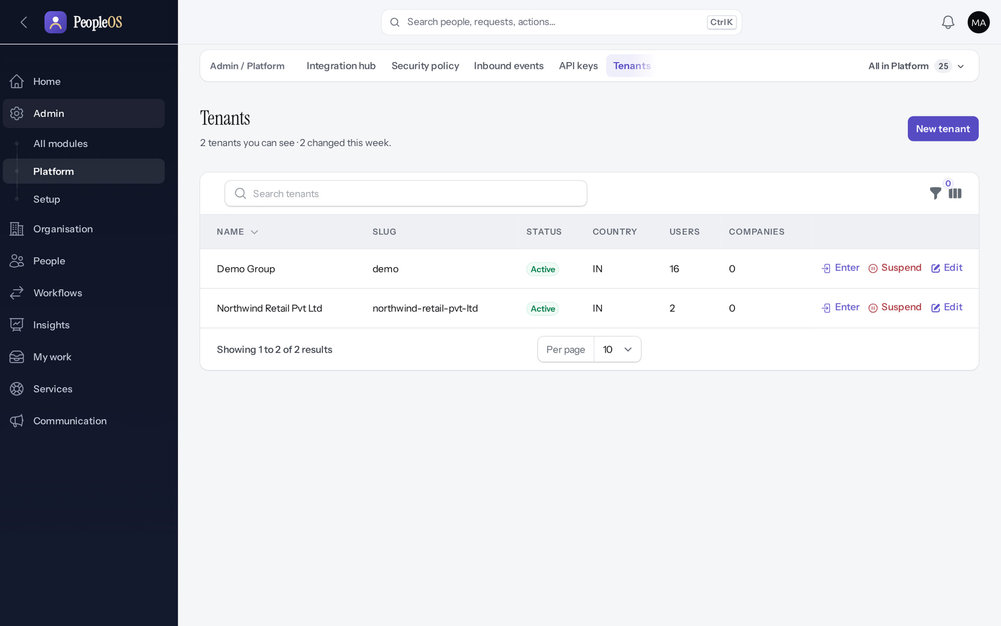
Platform Administrator Training
MARKEDGE PEOPLEOS · TRAINING LIBRARY
Deck 05 of 12
Operate PeopleOS as a SaaS platform: operator sign-in, tenant lifecycle, shadow-mode commercial pages, operations, audit, readiness and offboarding.
For: Markedge platform operators (not customer HR administrators)
Built from the running application (local, disposable database, fictional people) · 21 October 2026
Real screen, fictional data
Notes:
SAY: This deck is for Markedge platform operators only. Operators look after the platform and its tenants; they do not run customers' HR.
EVIDENCE: Executed on the training database on 21 Oct 2026 as the fictional operator platform@markedge.local (MFA enrolled through the real set-up screen), acting only on the fictional tenants Northwind Retail and Markedge Technologies (internal workforce); tools/capture/00-operator-mfa.mjs, 90-onboarding-a, 95-platform.mjs, 95b-platform-extra.mjs.

Slide 2
How to read this deck
BEFORE YOU START
Verified in the running application
We ran it on the training database and captured each step.
1
Numbered markers on a screenshot match the numbered steps beside it.
Implemented · not verified end to end
The screen exists; the last steps need data or a second party we could not provide.
Every screenshot is a real capture of PeopleOS. The people and companies in it are fictional.
Available only after configuration
Works once an administrator or Markedge has set it up.
Disabled by safety or commercial gates
Switched off on purpose until owner decisions and approvals arrive.
Diagrams are marked "Conceptual diagram". They explain ideas; they are not screens.
Incomplete · known defect or gap
Partly working: a known defect or gap is stated on the slide.
Release gate: NO-GO (10 of 14 gates blocked, re-verified 13 Oct 2026). Not yet generally available.
Not implemented
Not in the product today.
Unable to verify
Could not be checked in this environment.
Notes:
Explain the seven status labels. Every screenshot slide carries one of them in its top-right corner. Stress that "Verified in the running application" means we ran it on a disposable demonstration database, not that the feature is released.

Slide 3
Release gate: NO-GO until these are resolved (1 of 2)
RELEASE STATUS
Status as written in the release gate document. Ten of fourteen gates are blocked by owner decisions, external parties or missing infrastructure.
# | Gate | Gate status | Remaining dependency
1 | Application and architecture integrity | PASS (workstation) | Repeat the full suites in staging
2 | Credential exposure and repository remediation | BLOCKED | Owner: rotation confirmation, repository visibility (O-1 to O-3)
3 | Authentication and operator MFA | BLOCKED | Operators enrol MFA in the target environment (O-14, O-7)
4 | Independent security review | BLOCKED | Engage a reviewer; triage and retest findings (O-4)
5 | Statutory verification and gratuity | BLOCKED | 0 of 24 rules verified; gratuity not implemented (O-5, O-12, O-18)
6 | Data protection, retention, legal holds | PASS (controls) / BLOCKED (policy) | Retention decisions with counsel (D8); privacy review
7 | Backup, restore and disaster recovery | BLOCKED | Recovery objectives and an isolated target (O-6, O-7)
Notes:
SOURCE: docs/saas/SaaS-Final-Release-Gate.md (decision NO-GO, re-verified 13 October 2026 at 7314f7d); owner actions in docs/saas/SaaS-Final-Owner-Action-Register.md.
SAY: The application passes its automated suites on the workstation, but release is blocked by decisions and infrastructure, not by code alone.
AVOID: describing any gate as resolved. Nothing in this training changes a gate.
SAY: Release gate: NO-GO until these are resolved (part 1 of 2). Status as written in the release gate document. Ten of fourteen gates are blocked by owner decisions, external parties or missing infrastructure.
- 1 | Application and architecture integrity | PASS (workstation) | Repeat the full suites in staging
- 2 | Credential exposure and repository remediation | BLOCKED | Owner: rotation confirmation, repository visibility (O-1 to O-3)
- 3 | Authentication and operator MFA | BLOCKED | Operators enrol MFA in the target environment (O-14, O-7)
- 4 | Independent security review | BLOCKED | Engage a reviewer; triage and retest findings (O-4)
- 5 | Statutory verification and gratuity | BLOCKED | 0 of 24 rules verified; gratuity not implemented (O-5, O-12, O-18)
- 6 | Data protection, retention, legal holds | PASS (controls) / BLOCKED (policy) | Retention decisions with counsel (D8); privacy review
- 7 | Backup, restore and disaster recovery | BLOCKED | Recovery objectives and an isolated target (O-6, O-7)

Slide 4
Release gate: NO-GO until these are resolved (2 of 2)
RELEASE STATUS
# | Gate | Gate status | Remaining dependency
8 | Hosting, monitoring and on-call | BLOCKED | Environment, alerting, on-call (O-7, O-10, O-11)
9 | Signup and tenant provisioning | PASS (disabled) / BLOCKED (activation) | Only if self-service signup is wanted at launch (D10)
10 | Billing, tax and payment controls | PASS (disabled) / BLOCKED (activation) | Only for paid billing (B-4, B-7, B-8, B-9)
11 | Tenant deletion and offboarding | PASS (disabled) / BLOCKED (activation) | Retention decisions, register disk, review (D8)
12 | Regression and target-environment testing | BLOCKED | A staging environment (O-7, O-8)
13 | Owner decisions and written approvals | BLOCKED | All owner action items
14 | Deployment, rollback, post-deployment checks | BLOCKED | Rehearse in staging; authorise (O-7 to O-9)
Notes:
SOURCE: docs/saas/SaaS-Final-Release-Gate.md (decision NO-GO, re-verified 13 October 2026 at 7314f7d); owner actions in docs/saas/SaaS-Final-Owner-Action-Register.md.
SAY: The application passes its automated suites on the workstation, but release is blocked by decisions and infrastructure, not by code alone.
AVOID: describing any gate as resolved. Nothing in this training changes a gate.
SAY: Release gate: NO-GO until these are resolved (part 2 of 2). Status as written in the release gate document. Ten of fourteen gates are blocked by owner decisions, external parties or missing infrastructure.
- 8 | Hosting, monitoring and on-call | BLOCKED | Environment, alerting, on-call (O-7, O-10, O-11)
- 9 | Signup and tenant provisioning | PASS (disabled) / BLOCKED (activation) | Only if self-service signup is wanted at launch (D10)
- 10 | Billing, tax and payment controls | PASS (disabled) / BLOCKED (activation) | Only for paid billing (B-4, B-7, B-8, B-9)
- 11 | Tenant deletion and offboarding | PASS (disabled) / BLOCKED (activation) | Retention decisions, register disk, review (D8)
- 12 | Regression and target-environment testing | BLOCKED | A staging environment (O-7, O-8)
- 13 | Owner decisions and written approvals | BLOCKED | All owner action items
- 14 | Deployment, rollback, post-deployment checks | BLOCKED | Rehearse in staging; authorise (O-7 to O-9)

Slide 5
What you will be able to do
LEARNING OBJECTIVES
Sign in as an operator with MFA
and know why it is enforced
Watch operations and readiness
queues, failed jobs, scheduler, release checks
1
4
Provision, suspend, reactivate and enter tenants
with reasons, all audited
Use offboarding safeguards
exports, legal holds, retention, deletion off
2
5
Read the commercial pages correctly
shadow mode: nothing is enforced or billed
Know what you must never do
and when a second operator is required
3
6
Notes:
SAY: What you will be able to do:
1. Sign in as an operator with MFA: and know why it is enforced
2. Provision, suspend, reactivate and enter tenants: with reasons, all audited
3. Read the commercial pages correctly: shadow mode: nothing is enforced or billed
4. Watch operations and readiness: queues, failed jobs, scheduler, release checks
5. Use offboarding safeguards: exports, legal holds, retention, deletion off
6. Know what you must never do: and when a second operator is required
ASK: "Which of these matters most to you?" Return to the answer in the summary.

Slide 6
Platform operator versus tenant administrator
ROLES
Platform operator (Markedge)
Tenant administrator (customer)
An account flagged as platform administrator, with no tenant. Works on the Platform pages: tenants, readiness, operations, audit, commercial set-up, offboarding, statutory rule verification.
Tenant Super Admin or Tenant HR Admin inside one tenant. Configures the organisation, people, policies and access. Cannot open Platform pages.
Entering a tenant
Markedge HR is a tenant
An operator works inside a tenant only through Enter, with a reason and a ticket reference; access ends after 60 minutes and is audited.
Markedge's own HR runs in an ordinary tenant (Deck 6). Its HR staff cannot open the Platform pages.
Notes:
SOURCE: architecture contract §1 and §6 (platform admins act on a tenant only by explicitly entering it); captures 95-pl-35/36 and internal-operations/96-int-08.
SAY: Platform operator versus tenant administrator.
- Platform operator (Markedge): An account flagged as platform administrator, with no tenant. Works on the Platform pages: tenants, readiness, operations, audit, commercial set-up, offboarding, statutory rule verification.
- Tenant administrator (customer): Tenant Super Admin or Tenant HR Admin inside one tenant. Configures the organisation, people, policies and access. Cannot open Platform pages.
- Entering a tenant: An operator works inside a tenant only through Enter, with a reason and a ticket reference; access ends after 60 minutes and is audited.
- Markedge HR is a tenant: Markedge's own HR runs in an ordinary tenant (Deck 6). Its HR staff cannot open the Platform pages.
ASK: "Which of these points needs more explanation for your team?"

Slide 7
Operator sign-in
01
Password, then an authenticator code, every time.
Notes:
TRANSITION: Section 1, Operator sign-in. Password, then an authenticator code, every time.
SAY: Tell learners what they will be able to do by the end of this section, then move on.
ASK: "What questions do you have before we start this section?"

Slide 8
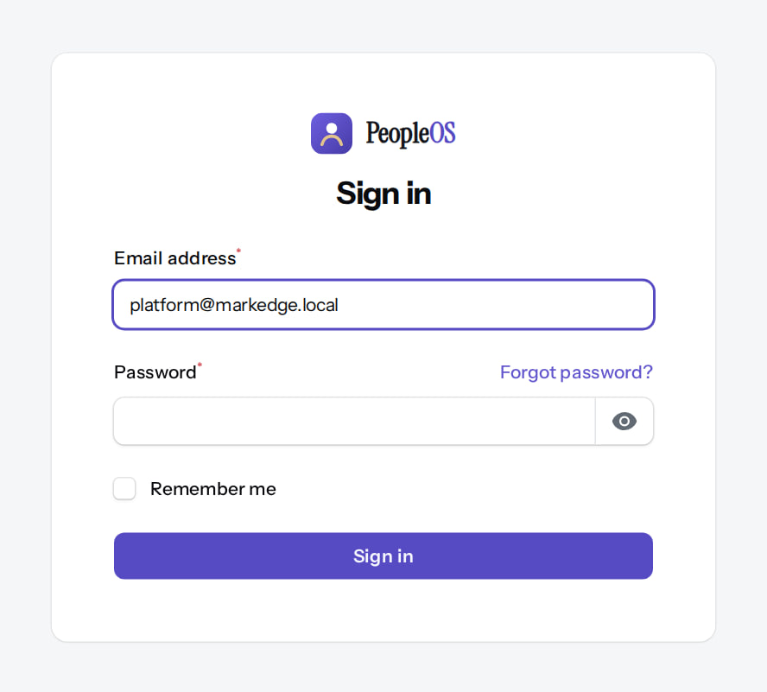
The same sign-in page as everyone
SIGN-IN
Verified in the running application
1
Operator e-mail.
2
Password.
3
Sign in.
RESULT Operators then need their authenticator app.
1
2
3
Real screen (cropped) · Markedge Platform Admin (Platform operator) · Sign in (/admin/login)
Notes:
SAY: Operators then need their authenticator app.
ON SCREEN: The platform operator signs in on the same sign-in page as tenant users.
WALK THROUGH: (1) Operator e-mail. (2) Password. (3) Sign in.
LEARNERS SHOULD SEE: E-mail and password fields; Forgot password?
SCREEN: Sign in (/admin/login). Signed in as Markedge Platform Admin (Platform operator).
EVIDENCE: screenshot screenshots/platform-admin/01-operator-sign-in.png, captured 2026-10-21 on the disposable training database (fictional people).

Slide 9
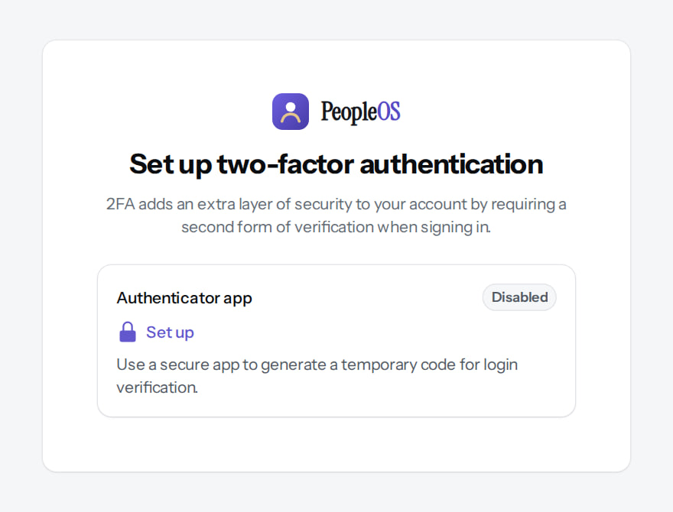
No authenticator yet: set-up is forced
SIGN-IN
Verified in the running application
1
Set up.
RESULT Nothing else opens until an authenticator app is set up. This is a platform setting, on by default.
1
Real screen (cropped) · Markedge Platform Admin (Platform operator) · Set up two-factor authentication (forced)
Notes:
SAY: The setting is PEOPLEOS_PLATFORM_MFA_REQUIRED (default true). Readiness fails in production while any active operator has no MFA (release gate 3).

Slide 10
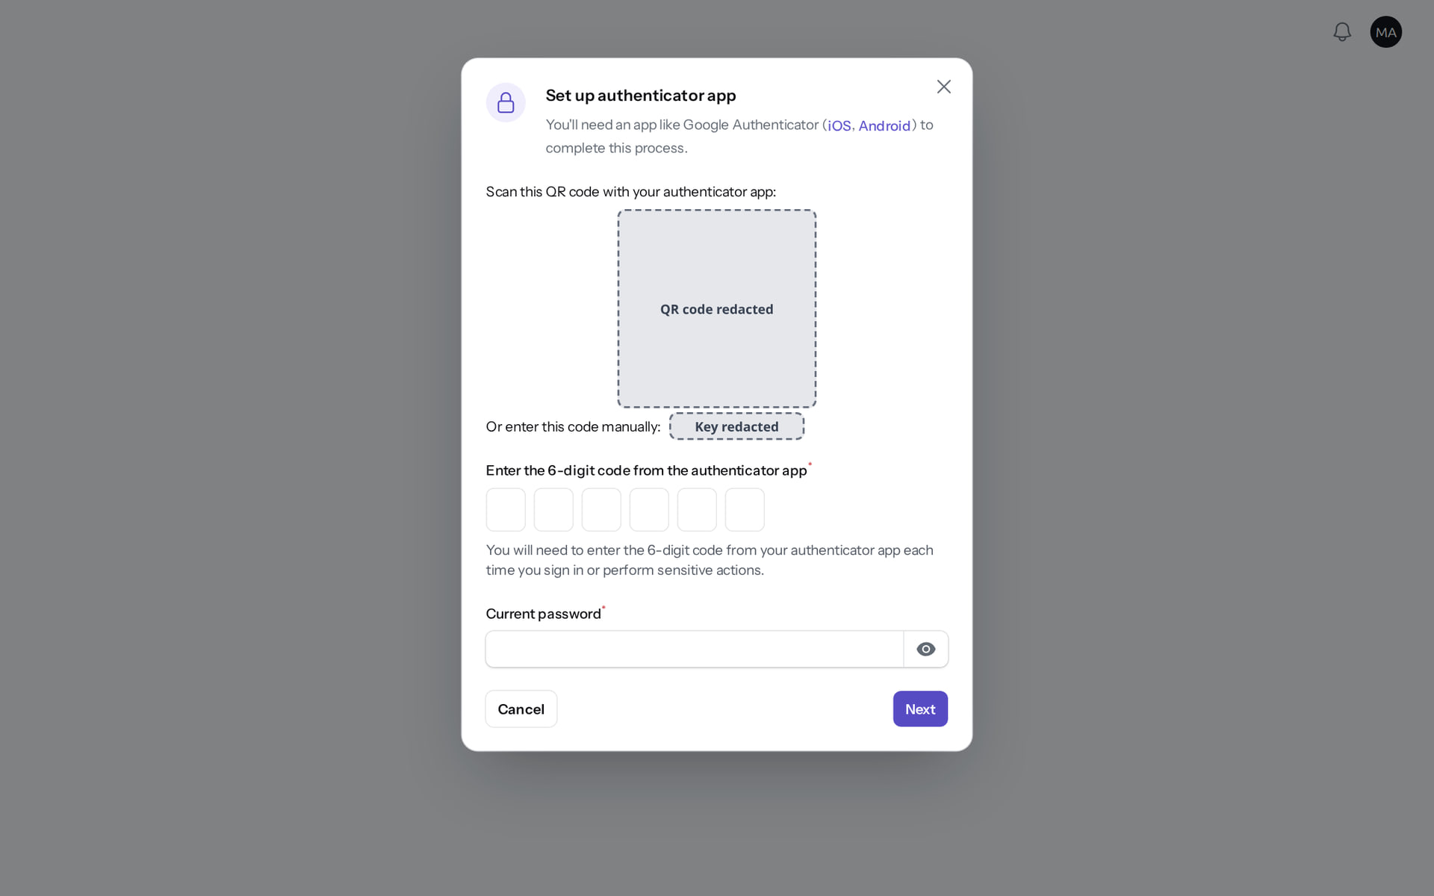
Set up the authenticator app
SIGN-IN
Verified in the running application
Type the 6-digit code from the app into the boxes.
1
Current password.
2
Next.
RESULT Recovery codes are shown once afterwards: store them in the Markedge password manager. The QR code and key were covered for this screenshot.
1
2
Real screen · Markedge Platform Admin (operator) · QR code and key covered before capture (secret).
Notes:
SAY: Recovery codes are shown once afterwards: store them in the Markedge password manager. The QR code and key were covered for this screenshot.
ON SCREEN: Scan the QR code (or type the key) in an authenticator app, enter the 6-digit code and the current password, then Next.
WALK THROUGH: (·) Type the 6-digit code from the app into the boxes. (1) Current password. (2) Next.
LEARNERS SHOULD SEE: Set-up completes only with a valid code and the current password
SCREEN: Set up authenticator app (modal). Signed in as Markedge Platform Admin (Platform operator).
EVIDENCE: screenshot screenshots/platform-admin/03-mfa-setup-modal-redacted.png, captured 2026-10-21 on the disposable training database (fictional people).

Slide 11
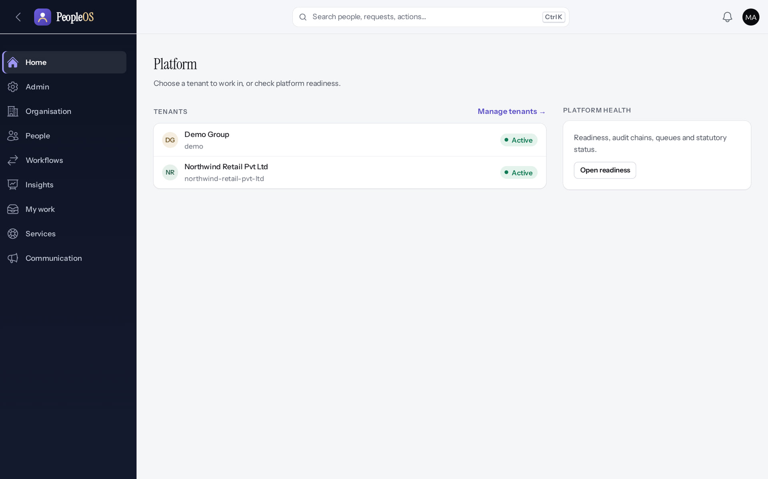
The Platform home
SIGN-IN
Verified in the running application
1
Manage tenants.
2
Open readiness.
1
2
RESULT Operators work outside any tenant until they deliberately enter one.
Real screen · Markedge Platform Admin (Platform operator) · Platform home (operator)
Notes:
SAY: Operators work outside any tenant until they deliberately enter one.
ON SCREEN: Sign in as an operator.
WALK THROUGH: (1) Manage tenants. (2) Open readiness.
LEARNERS SHOULD SEE: Tenants with status; Platform health → readiness
SCREEN: Platform home (operator). Signed in as Markedge Platform Admin (Platform operator). Prerequisite: Platform operator (is_platform_admin) signed in with MFA.
EVIDENCE: screenshot screenshots/platform-admin/95-pl-04-platform-home.png, captured 2026-10-21 on the disposable training database (fictional people).

Slide 12
Tenant lifecycle
02
Provision, suspend, reactivate and enter: every action needs a reason.
Notes:
TRANSITION: Section 2, Tenant lifecycle. Provision, suspend, reactivate and enter: every action needs a reason.
SAY: Tell learners what they will be able to do by the end of this section, then move on.
ASK: "What questions do you have before we start this section?"

Slide 13
Provisioning is covered in Deck 4
TENANTS
New tenant
Send invitation
Duplicates
Platform › Tenants › New tenant: tier, region (metadata), name and slug, locale defaults, first administrator, reason. The administrator is invited; operators never set passwords.
On the Tenants list when a first administrator's link expired or the e-mail failed.
"The slug has already been taken" and "The email has already been taken": one e-mail belongs to one organisation.
Notes:
See Deck 4, stages 2 and 3, for the full provisioning walkthrough on Northwind Retail.
SAY: Provisioning is covered in Deck 4.
- New tenant: Platform › Tenants › New tenant: tier, region (metadata), name and slug, locale defaults, first administrator, reason. The administrator is invited; operators never set passwords.
- Send invitation: On the Tenants list when a first administrator's link expired or the e-mail failed.
- Duplicates: "The slug has already been taken" and "The email has already been taken": one e-mail belongs to one organisation.
ASK: "Which of these points needs more explanation for your team?"

Slide 14
Tenants
TENANTS
Verified in the running application
1
Suspend.
2
Enter.
RESULT Name, slug, status, country, users, companies; Enter, Suspend and Edit (Send invitation appears while a first administrator's invitation is pending).
2
1
Real screen · Markedge Platform Admin (Platform operator) · Admin › Platform › Tenants
Notes:
SAY: Name, slug, status, country, users, companies; Enter, Suspend and Edit (Send invitation appears while a first administrator's invitation is pending).
ON SCREEN: Open Tenants.
WALK THROUGH: (1) Suspend. (2) Enter.
LEARNERS SHOULD SEE: Name, slug, status, country, users, companies; Enter, Suspend, Send invitation, Edit
SCREEN: Admin › Platform › Tenants. Signed in as Markedge Platform Admin (Platform operator). Prerequisite: Platform operator (is_platform_admin) signed in with MFA.
EVIDENCE: screenshot screenshots/platform-admin/95-pl-05-tenants.png, captured 2026-10-21 on the disposable training database (fictional people).

Slide 15
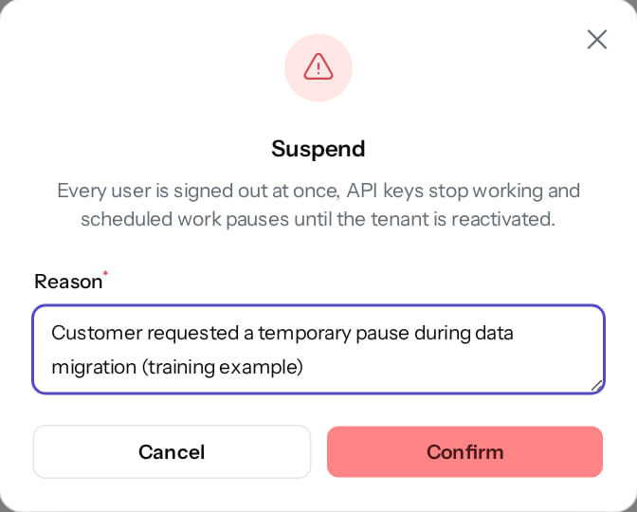
Suspend a tenant
TENANTS
Verified in the running application
1
Reason (goes to the platform audit trail).
2
Confirm.
RESULT Every user is signed out at once, API keys stop working and scheduled work pauses.
1
2
Real screen · Markedge Platform Admin (Platform operator) · Tenants › Suspend
Notes:
AVOID: suspending a live customer without the documented approval. In this training only the fictional Northwind tenant was suspended.

Slide 16
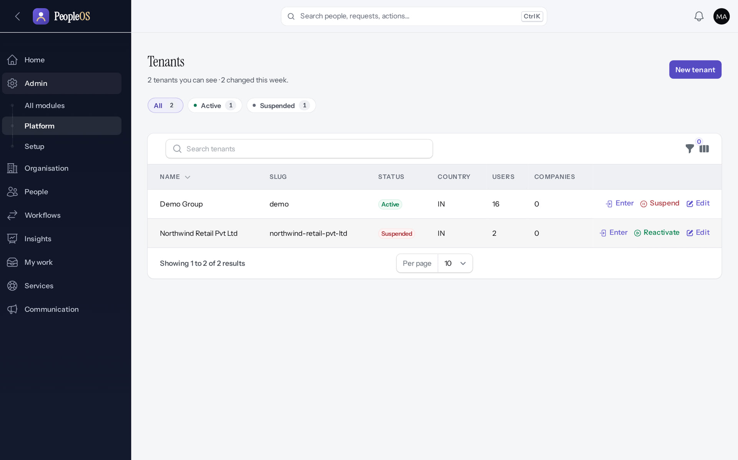
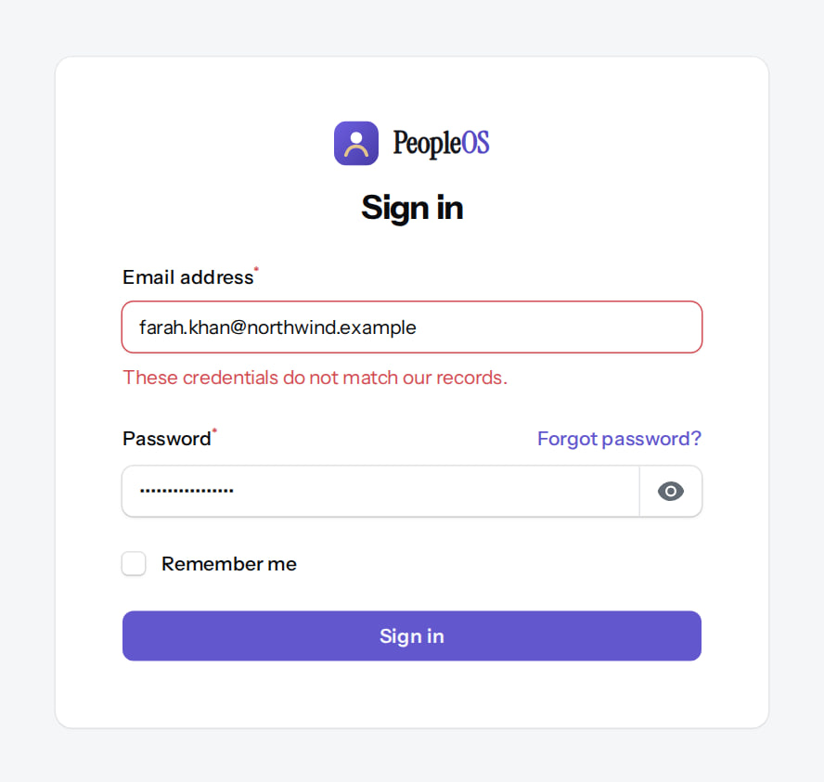
Suspended: the customer cannot sign in
TENANTS
Tenants list
Verified
Customer administrator signing in
Verified
Northwind shows Suspended; Reactivate replaces Suspend.
"These credentials do not match our records." The generic message gives no hint that the tenant is suspended.
Real screen · Markedge Platform Admin (Platform operator) · Tenants (after Suspend)
Real screen (cropped) · Farah Khan (Tenant Super Admin (Northwind Retail, first administrator)) · Sign in (tenant suspended)
Notes:
SUPPORT: a whole customer unable to sign in, with correct passwords, may be a suspended tenant. Check the Tenants list first (Deck 7).
SAY: Suspended: the customer cannot sign in.
LEFT, Tenants list: Northwind shows Suspended; Reactivate replaces Suspend.
RIGHT, Customer administrator signing in: "These credentials do not match our records." The generic message gives no hint that the tenant is suspended.
OBSERVE: point out what differs between the two screens.
EVIDENCE: left = platform-admin/95-pl-07-suspended [Markedge Platform Admin (Platform operator), Tenants (after Suspend)]; right = platform-admin/95-pl-08-suspended-sign-in [Farah Khan (Tenant Super Admin (Northwind Retail, first administrator)), Sign in (tenant suspended)]. Real screens, fictional data (SCREENSHOT-INVENTORY.md).

Slide 17
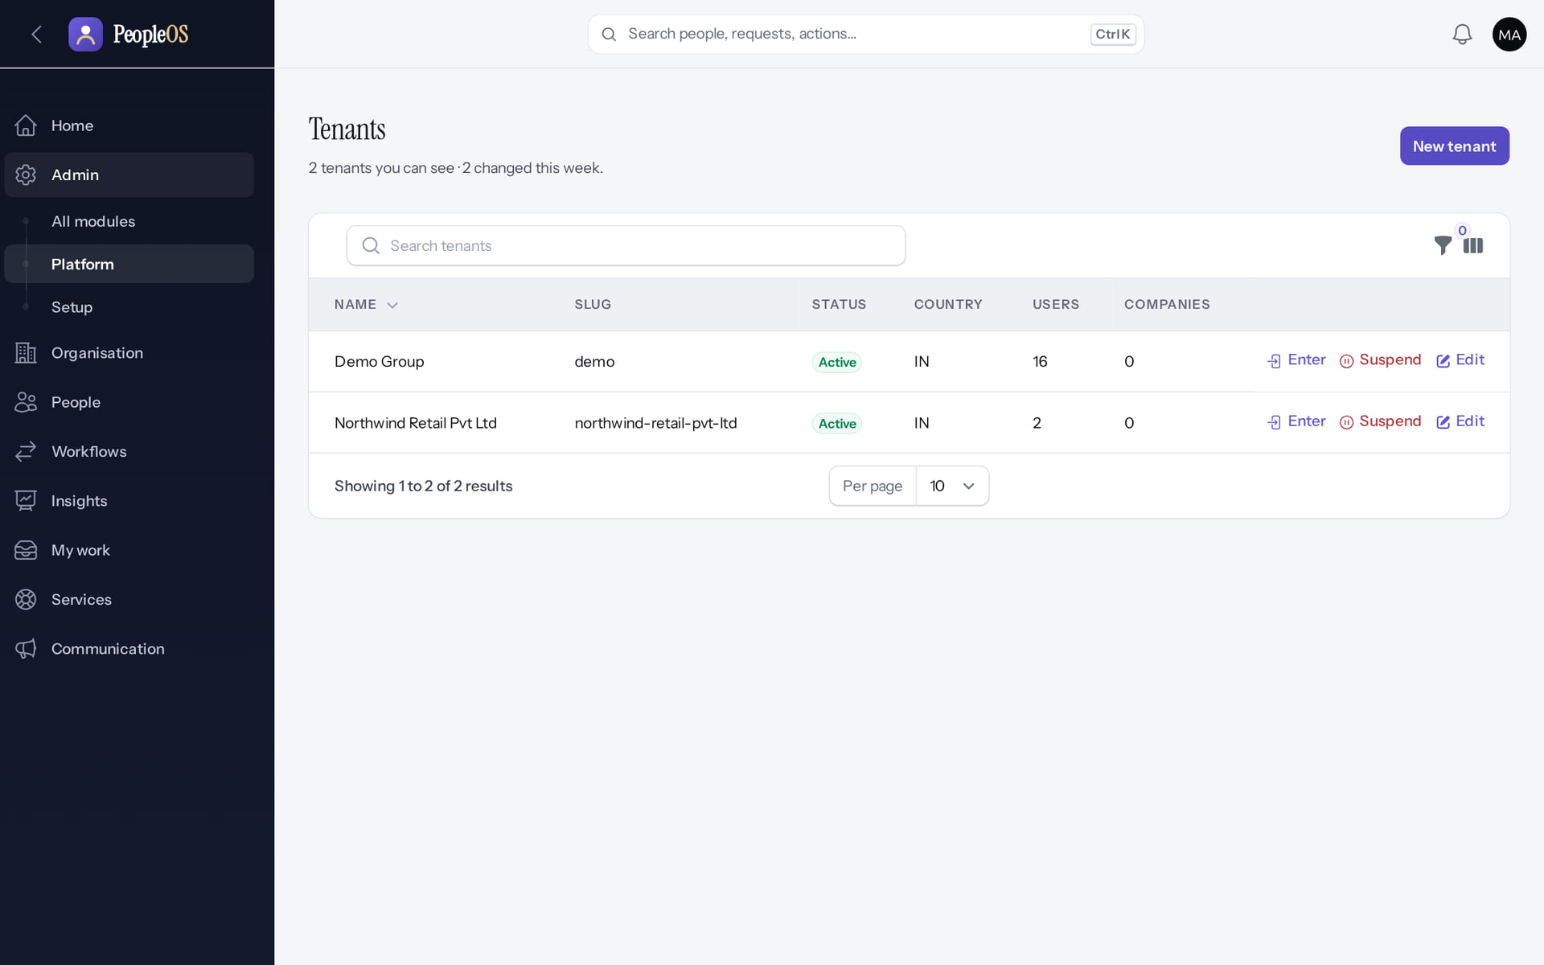
Reactivate
TENANTS
Verified in the running application
1
Active again.
RESULT Northwind is Active and its users can sign in. Both actions are in the platform audit trail with their reasons.
1
Real screen · Markedge Platform Admin (Platform operator) · Tenants (after Reactivate)
Notes:
SAY: Northwind is Active and its users can sign in. Both actions are in the platform audit trail with their reasons.
ON SCREEN: Reactivate with a reason.
WALK THROUGH: (1) Active again.
LEARNERS SHOULD SEE: Northwind Active again; its users can sign in
SCREEN: Tenants (after Reactivate). Signed in as Markedge Platform Admin (Platform operator). Prerequisite: Platform operator (is_platform_admin) signed in with MFA.
EVIDENCE: screenshot screenshots/platform-admin/95-pl-09-reactivated.png, captured 2026-10-21 on the disposable training database (fictional people).

Slide 18
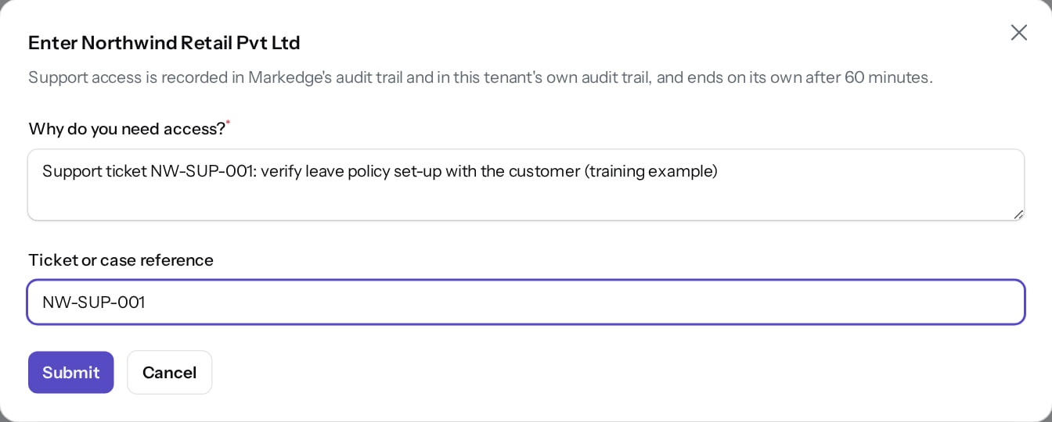
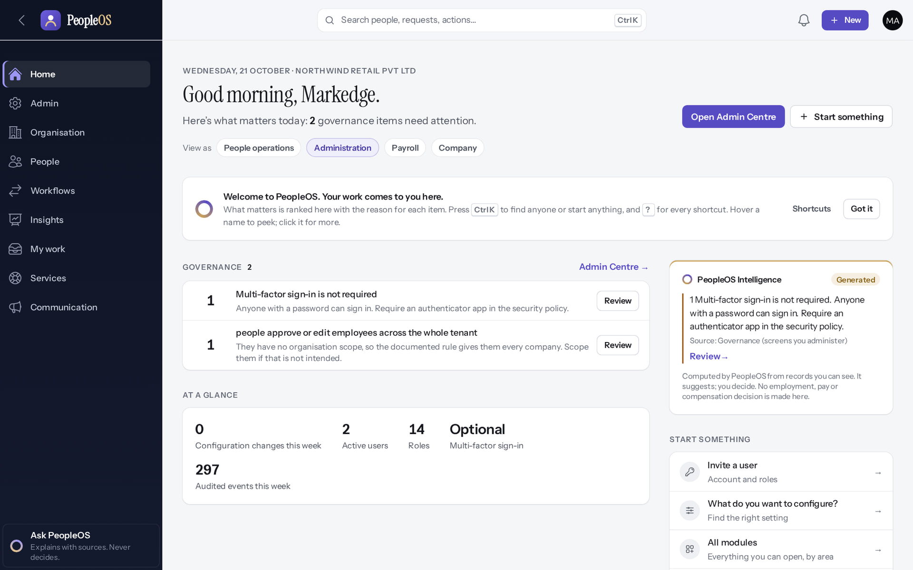
Entering a tenant for support
TENANTS
Enter
Verified
Inside the tenant
Verified
Reason and ticket reference required; access ends on its own after 60 minutes.
The operator works with the administration lens; the tenant name shows in the date line.
Real screen · Markedge Platform Admin (Platform operator) · Tenants › Enter
Real screen · Markedge Platform Admin (Platform operator) · Home inside Northwind Retail (operator support access)
Notes:
OBSERVATION (not verified as a defect): nothing else on screen marks the session as support access. Be explicit with the customer when you enter their tenant.
SAY: Entering a tenant for support.
LEFT, Enter: Reason and ticket reference required; access ends on its own after 60 minutes.
RIGHT, Inside the tenant: The operator works with the administration lens; the tenant name shows in the date line.
OBSERVE: point out what differs between the two screens.
EVIDENCE: left = platform-admin/95-pl-35-enter-tenant-dialog [Markedge Platform Admin (Platform operator), Tenants › Enter]; right = platform-admin/95-pl-36-operator-in-tenant [Markedge Platform Admin (Platform operator), Home inside Northwind Retail (operator support access)]. Real screens, fictional data (SCREENSHOT-INVENTORY.md).

Slide 19
Commercial pages (shadow mode)
03
Plans, subscriptions, entitlements, billing, tax and payments exist, but nothing is enforced, priced or billed.
Notes:
TRANSITION: Section 3, Commercial pages (shadow mode). Plans, subscriptions, entitlements, billing, tax and payments exist, but nothing is enforced, priced or billed.
SAY: Tell learners what they will be able to do by the end of this section, then move on.
ASK: "What questions do you have before we start this section?"

Slide 20
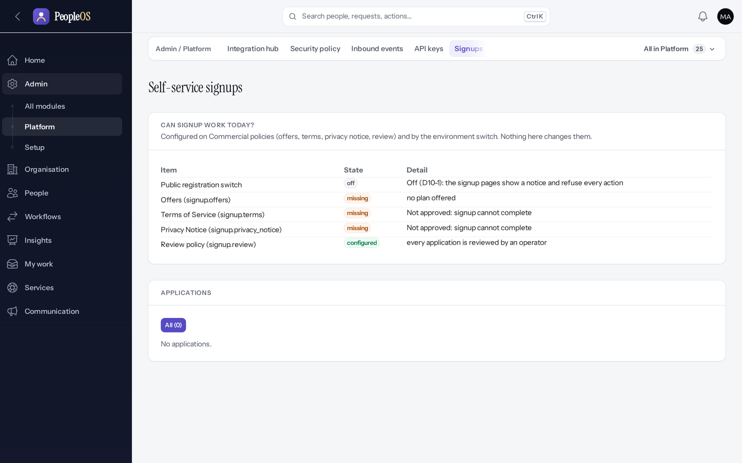
Signups: public registration is off
COMMERCIAL
Disabled by safety or commercial gates
RESULT "Can signup work today?" lists each prerequisite (switch, offers, terms, privacy notice, review policy) and its state. No applications.
Real screen (cropped) · Markedge Platform Admin (Platform operator) · Admin › Platform › Signups
Notes:
NEVER switch signup on to demonstrate it. It needs owner decisions D10-1…D10-11 and production authorisation.

Slide 21
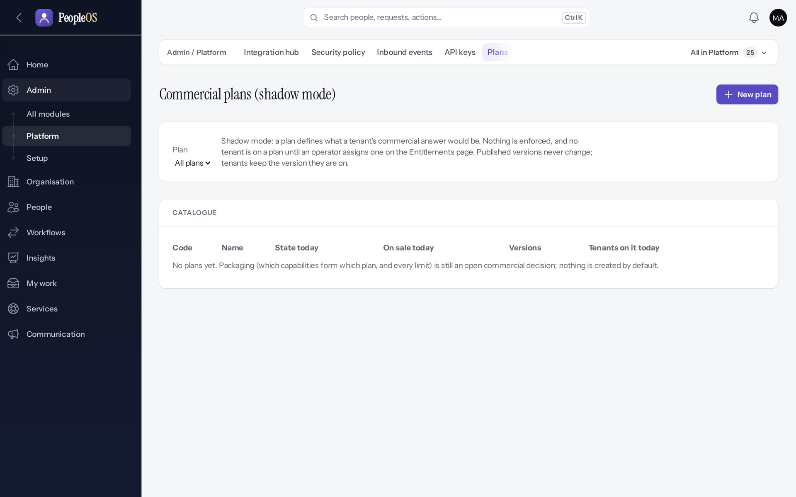
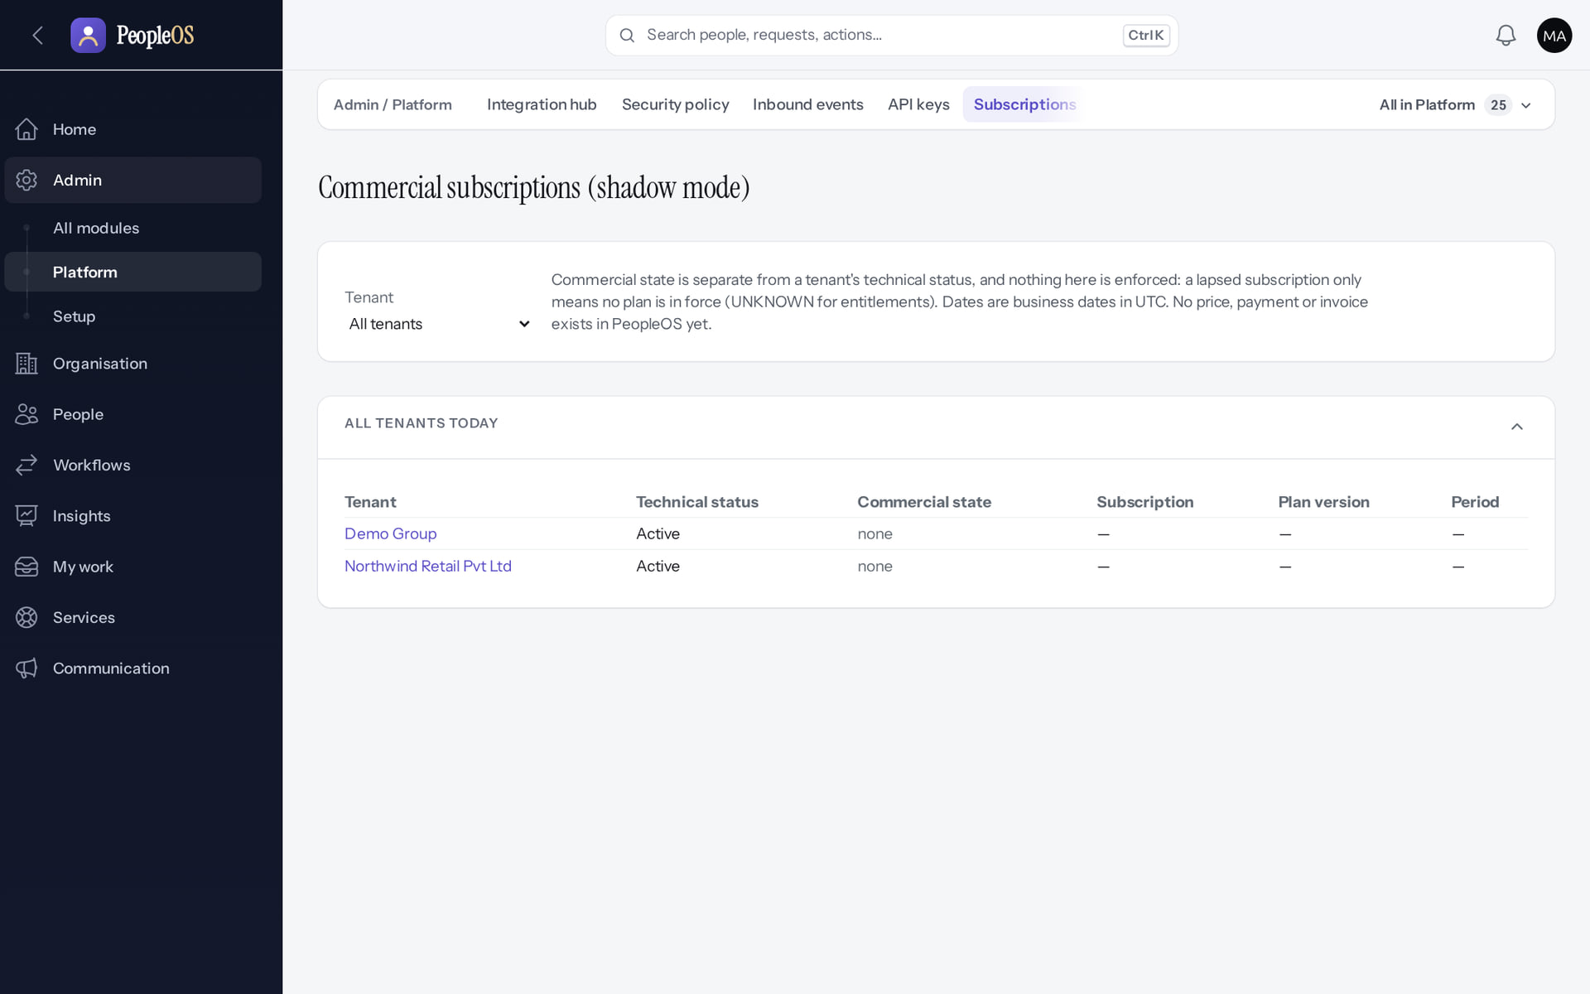
Plans and subscriptions
COMMERCIAL
Plans
Disabled (gate)
Subscriptions
Disabled (gate)
Shadow mode; no plan, price or default plan is shipped (decision D-1).
All tenants listed; nothing is enforced or billed.
Real screen · Markedge Platform Admin (Platform operator) · Admin › Platform › Plans
Real screen (cropped) · Markedge Platform Admin (Platform operator) · Admin › Platform › Subscriptions
Notes:
SAY: Plans and subscriptions.
LEFT, Plans: Shadow mode; no plan, price or default plan is shipped (decision D-1).
RIGHT, Subscriptions: All tenants listed; nothing is enforced or billed.
OBSERVE: point out what differs between the two screens.
EVIDENCE: left = platform-admin/95-pl-11-plans [Markedge Platform Admin (Platform operator), Admin › Platform › Plans]; right = platform-admin/95-pl-12-subscriptions [Markedge Platform Admin (Platform operator), Admin › Platform › Subscriptions]. Real screens, fictional data (SCREENSHOT-INVENTORY.md).

Slide 22
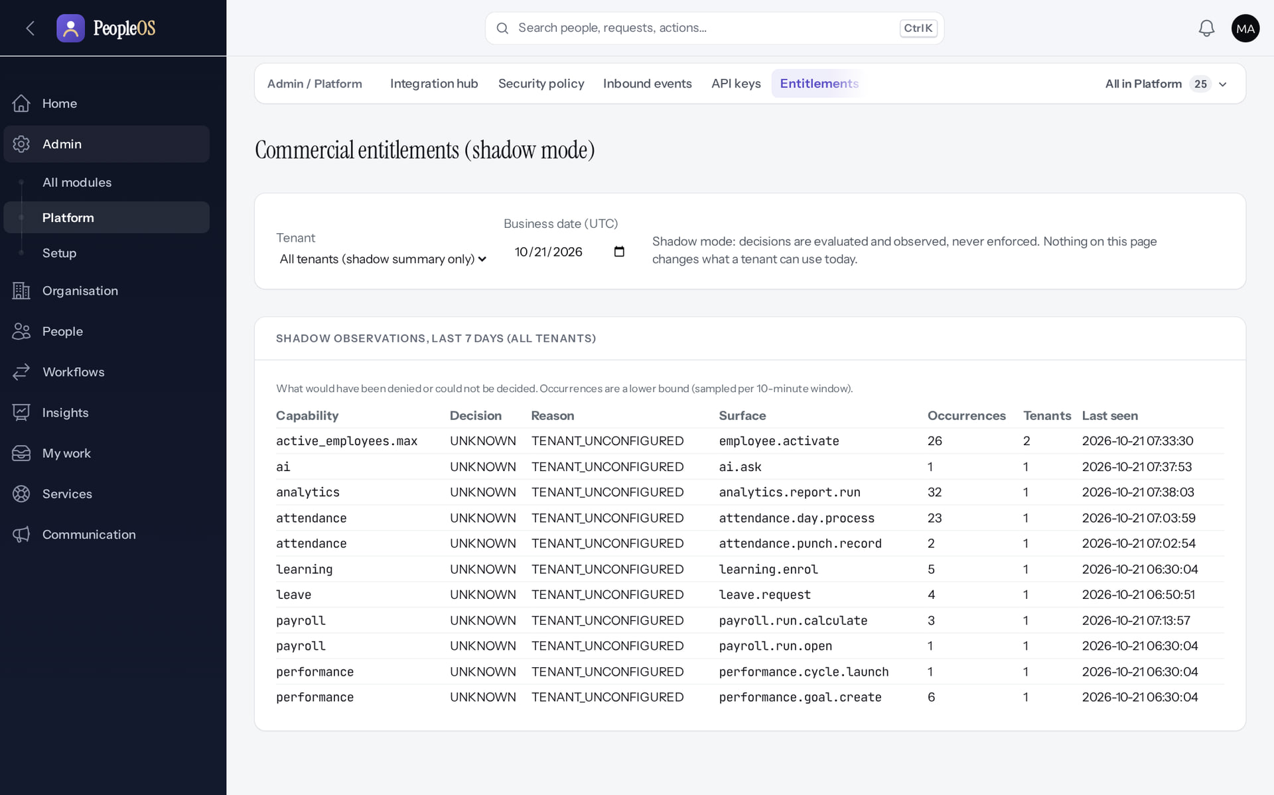
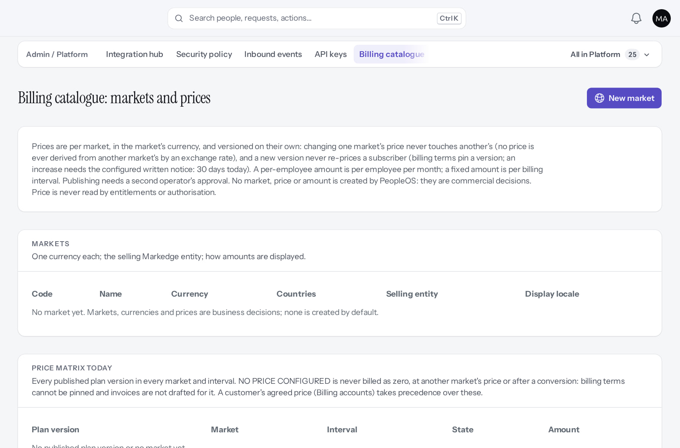
Entitlements and billing catalogue
COMMERCIAL
Entitlements
Disabled (gate)
Billing catalogue
Disabled (gate)
Shadow observations: what would have been blocked if entitlements were enforced.
Markets, prices, currencies; changes need a second operator's approval.
Real screen · Markedge Platform Admin (Platform operator) · Admin › Platform › Entitlements
Real screen (cropped) · Markedge Platform Admin (Platform operator) · Admin › Platform › Billing catalogue
Notes:
SAY: Entitlements and billing catalogue.
LEFT, Entitlements: Shadow observations: what would have been blocked if entitlements were enforced.
RIGHT, Billing catalogue: Markets, prices, currencies; changes need a second operator's approval.
OBSERVE: point out what differs between the two screens.
EVIDENCE: left = platform-admin/95-pl-13-entitlements [Markedge Platform Admin (Platform operator), Admin › Platform › Entitlements]; right = platform-admin/95-pl-14-billing-catalogue [Markedge Platform Admin (Platform operator), Admin › Platform › Billing catalogue]. Real screens, fictional data (SCREENSHOT-INVENTORY.md).

Slide 23
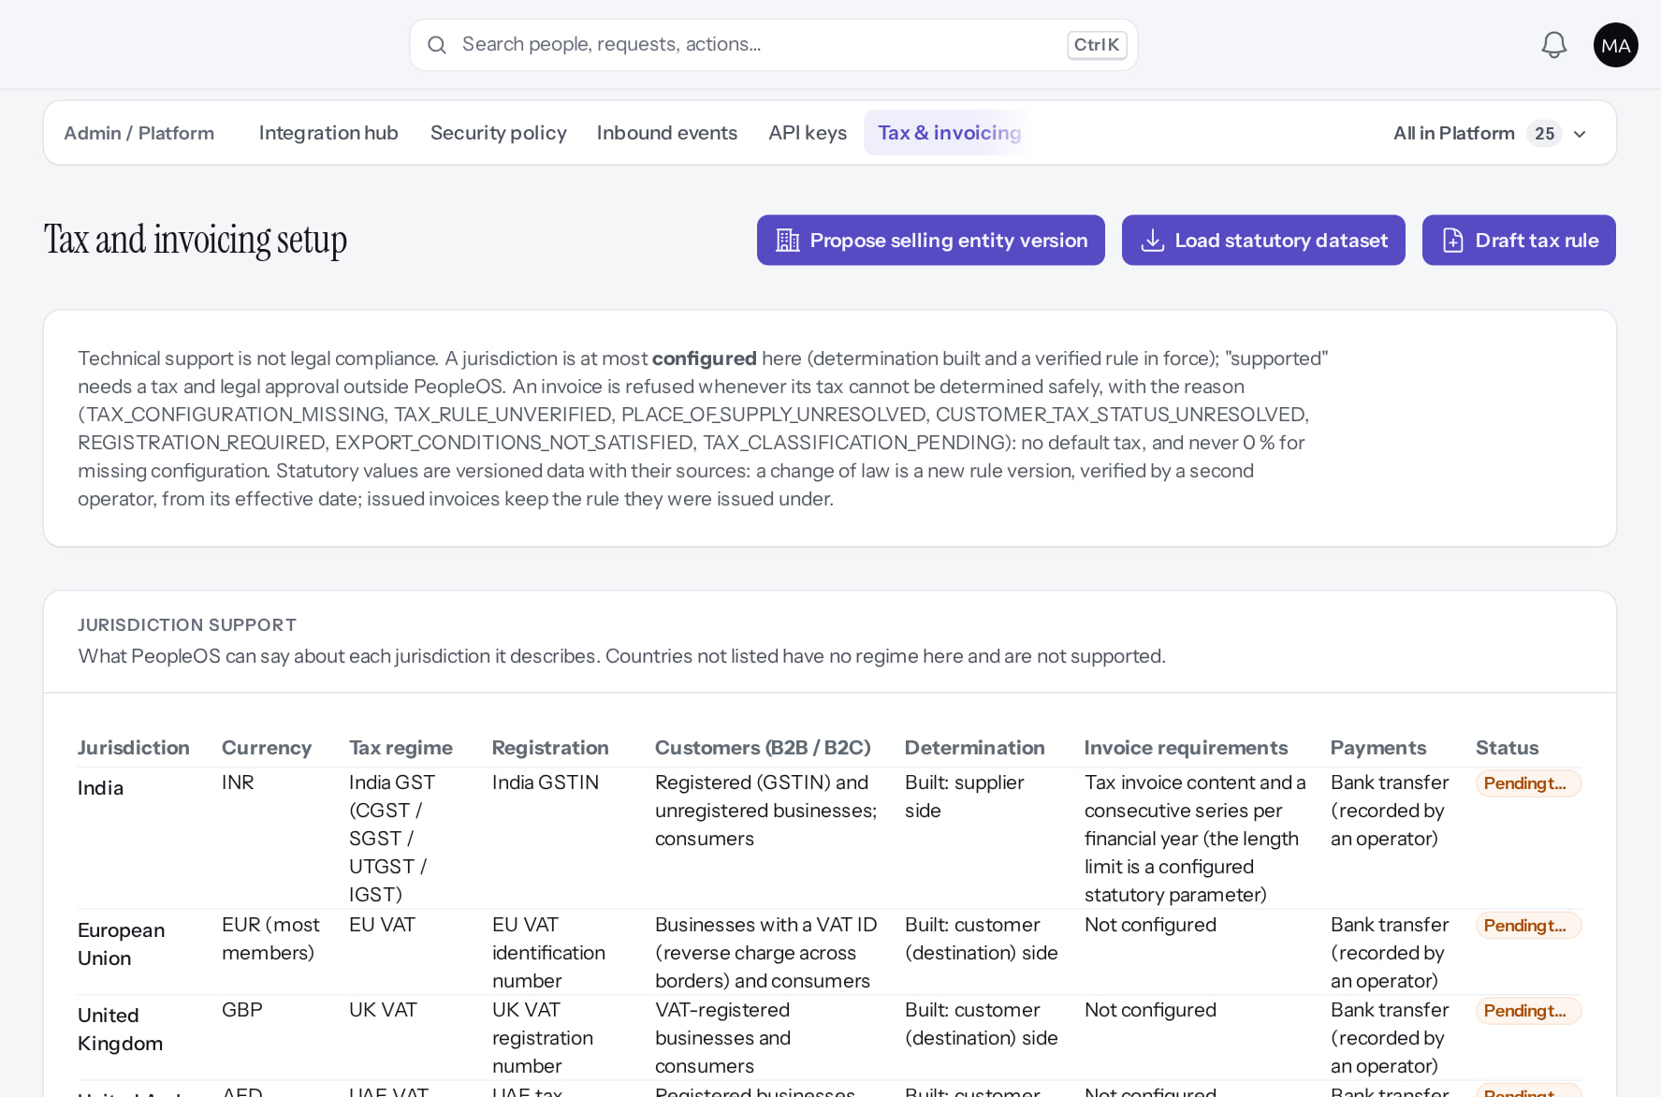
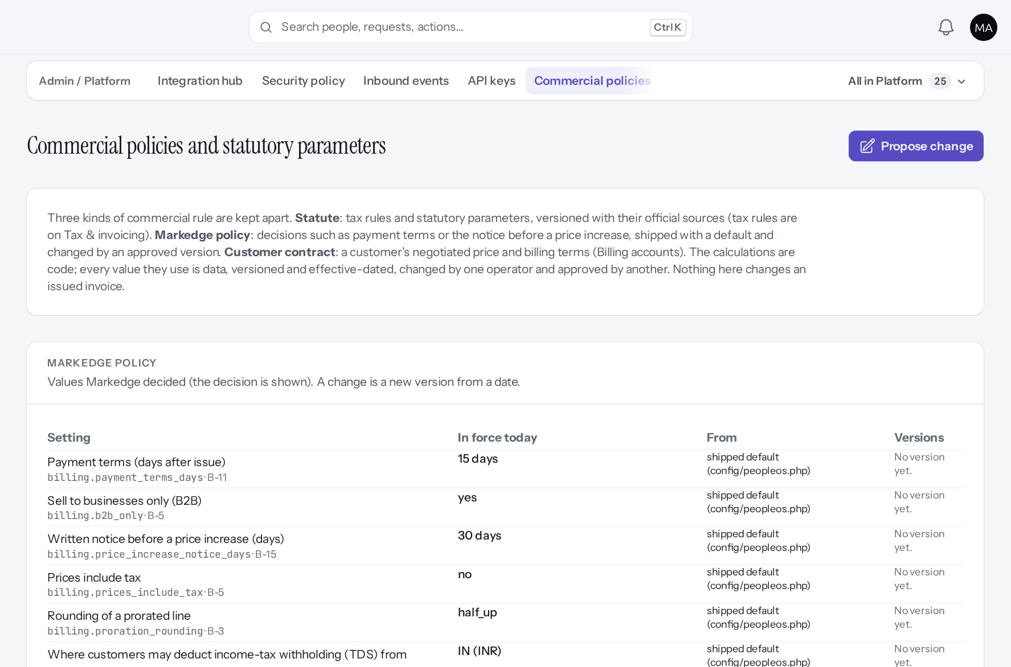
Tax and commercial policies
COMMERCIAL
Tax & invoicing
Disabled (gate)
Commercial policies
Disabled (gate)
Jurisdiction support, selling entities, statutory dataset (load = maker, verify = second operator).
Markedge policy values and statutory parameters; Propose change (maker-checker).
Real screen (cropped) · Markedge Platform Admin (Platform operator) · Admin › Platform › Tax & invoicing
Real screen (cropped) · Markedge Platform Admin (Platform operator) · Admin › Platform › Commercial policies
Notes:
SAY: Tax and commercial policies.
LEFT, Tax & invoicing: Jurisdiction support, selling entities, statutory dataset (load = maker, verify = second operator).
RIGHT, Commercial policies: Markedge policy values and statutory parameters; Propose change (maker-checker).
OBSERVE: point out what differs between the two screens.
EVIDENCE: left = platform-admin/95-pl-15-tax-invoicing [Markedge Platform Admin (Platform operator), Admin › Platform › Tax & invoicing]; right = platform-admin/95-pl-16-commercial-policies [Markedge Platform Admin (Platform operator), Admin › Platform › Commercial policies]. Real screens, fictional data (SCREENSHOT-INVENTORY.md).

Slide 24
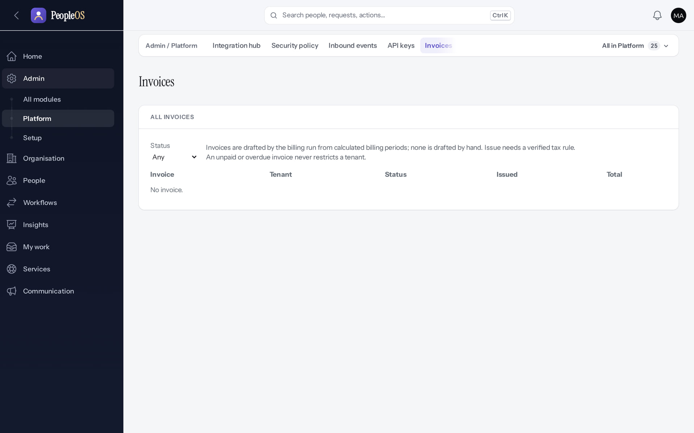
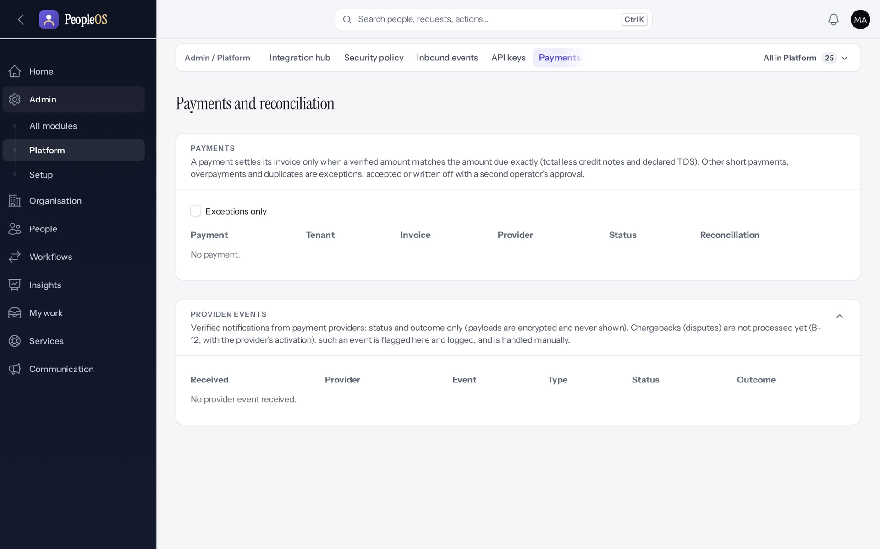
Billing accounts, invoices, payments
COMMERCIAL
Invoices
Disabled (gate)
Payments
Disabled (gate)
None: real invoicing waits for owner inputs (B-4, B-7, B-8, B-9).
Live payments are refused in production; no provider configured.
Real screen · Markedge Platform Admin (Platform operator) · Admin › Platform › Invoices
Real screen · Markedge Platform Admin (Platform operator) · Admin › Platform › Payments
Notes:
SAY: Billing accounts, invoices, payments.
LEFT, Invoices: None: real invoicing waits for owner inputs (B-4, B-7, B-8, B-9).
RIGHT, Payments: Live payments are refused in production; no provider configured.
OBSERVE: point out what differs between the two screens.
EVIDENCE: left = platform-admin/95-pl-18-invoices [Markedge Platform Admin (Platform operator), Admin › Platform › Invoices]; right = platform-admin/95-pl-19-payments [Markedge Platform Admin (Platform operator), Admin › Platform › Payments]. Real screens, fictional data (SCREENSHOT-INVENTORY.md).

Slide 25
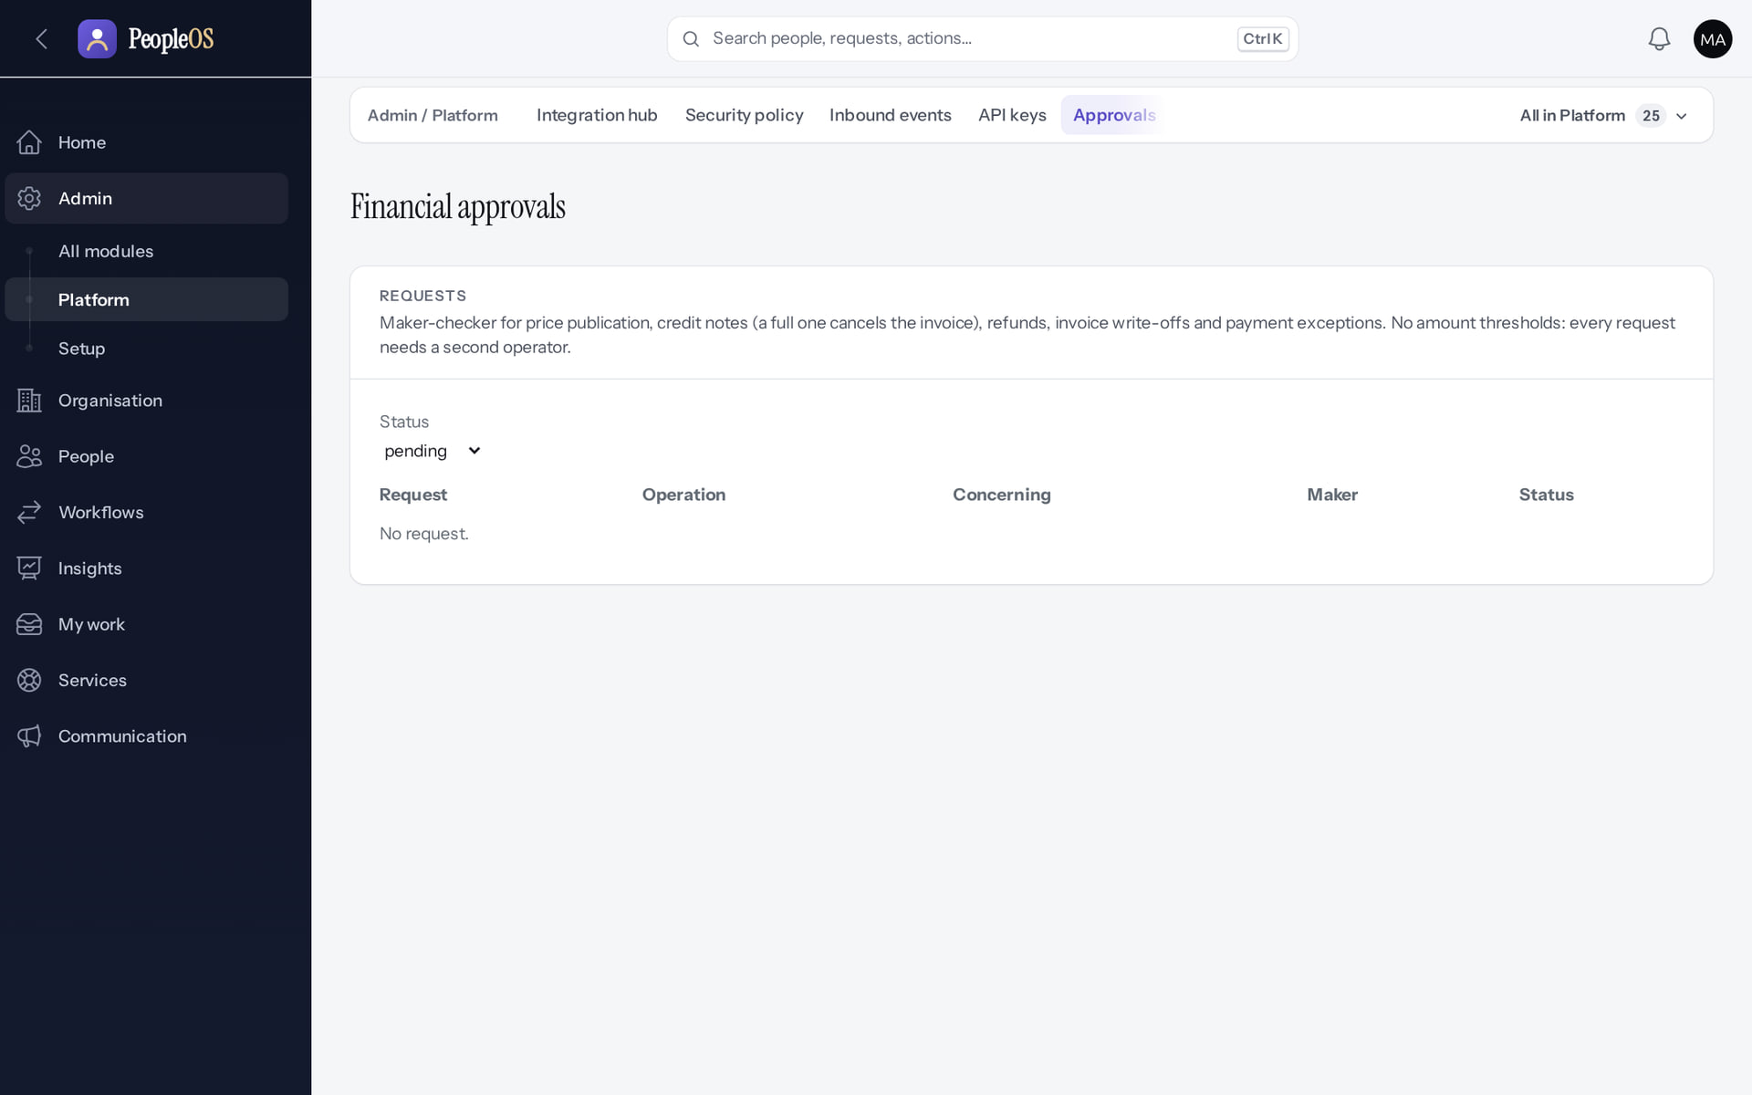
Financial approvals (maker-checker)
COMMERCIAL
Disabled by safety or commercial gates
RESULT Requests that wait for a second operator. A single operator can never both propose and approve a financial change.
Real screen · Markedge Platform Admin (Platform operator) · Admin › Platform › Approvals (financial)
Notes:
SAY: Requests that wait for a second operator. A single operator can never both propose and approve a financial change.
ON SCREEN: Open Financial approvals.
LEARNERS SHOULD SEE: Maker-checker requests waiting for a second operator
SCREEN: Admin › Platform › Approvals (financial). Signed in as Markedge Platform Admin (Platform operator). Prerequisite: Owner decisions (signup D10, plans and prices B-4, payments B-7/B-8/B-9) before activation.
EVIDENCE: screenshot screenshots/platform-admin/95-pl-20-financial-approvals.png, captured 2026-10-21 on the disposable training database (fictional people).

Slide 26
Operations, audit and readiness
04
Watch the platform, prove what operators did, and know whether it can go live.
Notes:
TRANSITION: Section 4, Operations, audit and readiness. Watch the platform, prove what operators did, and know whether it can go live.
SAY: Tell learners what they will be able to do by the end of this section, then move on.
ASK: "What questions do you have before we start this section?"

Slide 27
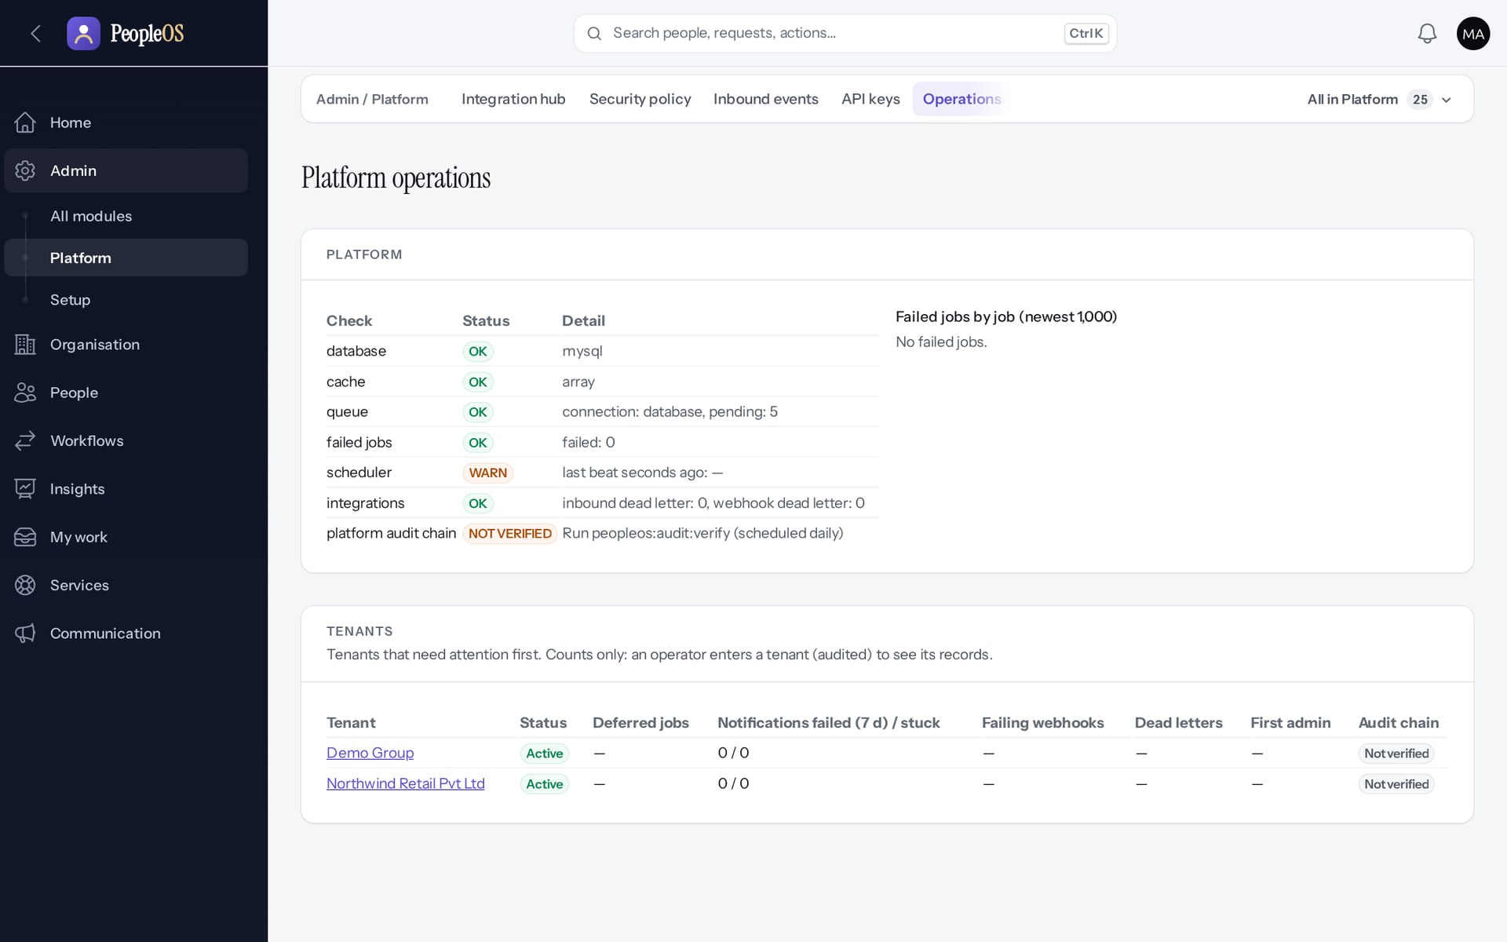
Platform operations
OPERATIONS
Verified in the running application
Database, cache, queue, failed jobs, scheduler heartbeat, integrations and audit chains, with per-tenant status.
Real screen (cropped) · Markedge Platform Admin (Platform operator) · Admin › Platform › Operations
Notes:
OBSERVE: the scheduler heartbeat is not recent because no scheduler runs in the local environment; in production a stale heartbeat is an incident.

Slide 28
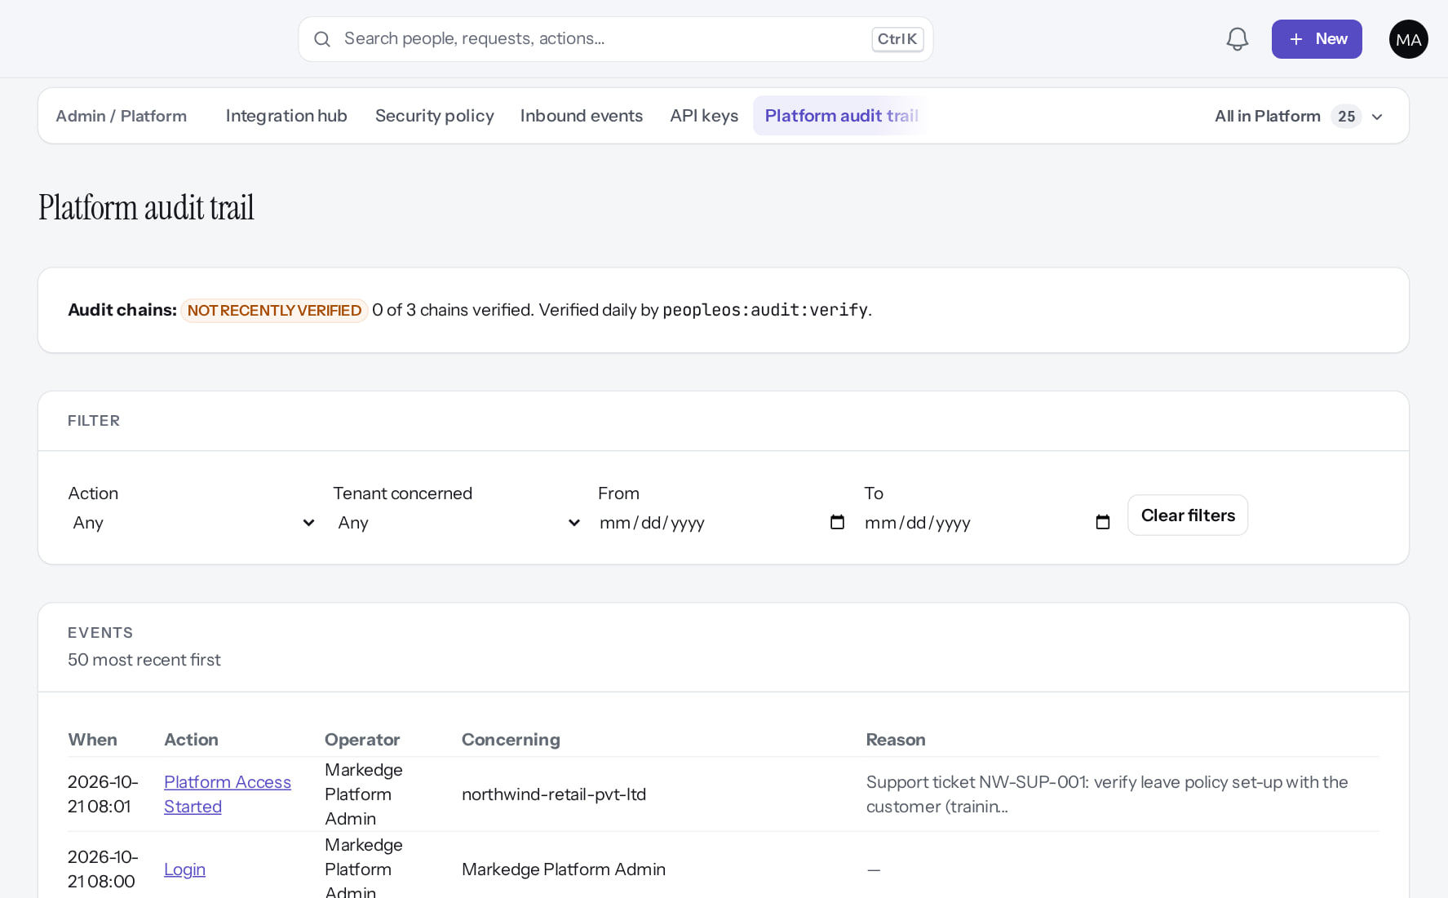
Platform audit trail
AUDIT
Verified in the running application
RESULT Operator actions across tenants, newest first, each with actor and reason (the top rows here: platform access started and sign-in; the suspend, reactivate and legal-hold events follow further down). Header: "NOT RECENTLY VERIFIED: 0 of 3 chains verified" until scheduled verification runs.
Real screen (cropped) · Markedge Platform Admin (Platform operator) · Admin › Platform › Platform audit trail
Notes:
SAY: Operator actions across tenants, newest first, each with actor and reason (the top rows here: platform access started and sign-in; the suspend, reactivate and legal-hold events follow further down). Header: "NOT RECENTLY VERIFIED: 0 of 3 chains verified" until scheduled verification runs.
ON SCREEN: Review what the operator did.
LEARNERS SHOULD SEE: Tenant suspended / reactivated, legal hold placed, release requested and tenant entered, with actor and reason
SCREEN: Admin › Platform › Platform audit trail. Signed in as Markedge Platform Admin (Platform operator). Prerequisite: Platform operator with MFA.
EVIDENCE: screenshot screenshots/platform-admin/95-pl-37-platform-audit-after.png, captured 2026-10-21 on the disposable training database (fictional people).

Slide 29
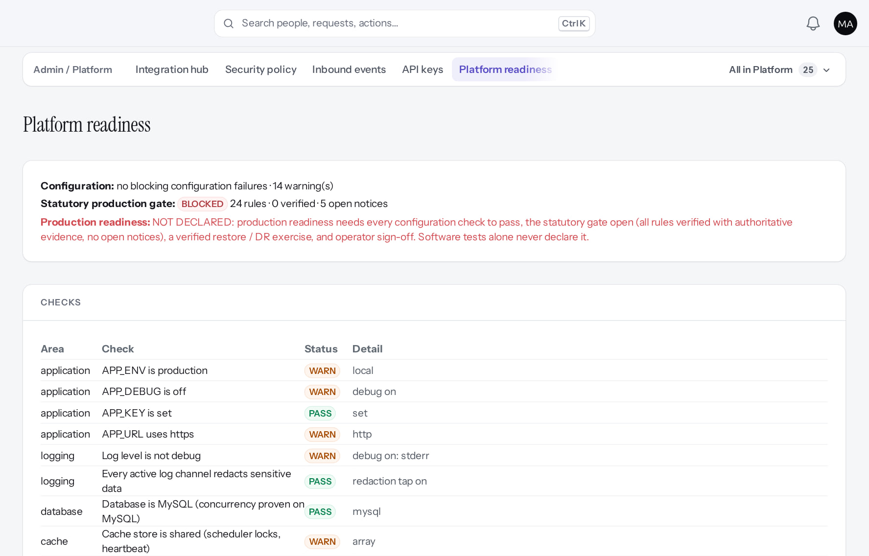
Platform readiness
READINESS
Verified in the running application
Every check with PASS, WARN, FAIL or BLOCKED: configuration, statutory production gate (blocked), operator MFA, demo accounts, backups, scheduler, disaster recovery.
Real screen (cropped) · Markedge Platform Admin (Platform operator) · Admin › Platform › Platform readiness
Notes:
SAY: Readiness is the operator's go-live checklist. Several checks are WARN locally that become FAIL in production. php artisan peopleos:readiness prints the same.

Slide 30
Offboarding and data protection
05
Exports, legal holds and retention; deletion is switched off.
Notes:
TRANSITION: Section 5, Offboarding and data protection. Exports, legal holds and retention; deletion is switched off.
SAY: Tell learners what they will be able to do by the end of this section, then move on.
ASK: "What questions do you have before we start this section?"

Slide 31
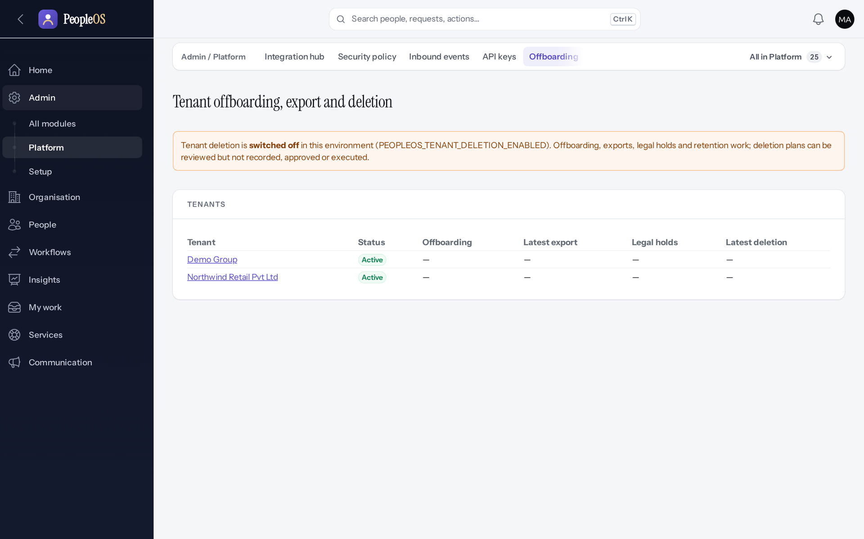
Offboarding: deletion is off
OFFBOARDING
Disabled by safety or commercial gates
1
Deletion switched off.
1
RESULT "Tenant deletion is switched off in this environment (PEOPLEOS_TENANT_DELETION_ENABLED)." No deletion action exists.
Real screen · Markedge Platform Admin (Platform operator) · Admin › Platform › Offboarding
Notes:
SAY: "Tenant deletion is switched off in this environment (PEOPLEOS_TENANT_DELETION_ENABLED)." No deletion action exists.
ON SCREEN: Open Offboarding.
WALK THROUGH: (1) Deletion switched off.
LEARNERS SHOULD SEE: "Tenant deletion is switched off in this environment (PEOPLEOS_TENANT_DELETION_ENABLED)." Offboarding, exports, legal holds and retention work
SCREEN: Admin › Platform › Offboarding. Signed in as Markedge Platform Admin (Platform operator). Prerequisite: Platform operator (is_platform_admin) signed in with MFA.
EVIDENCE: screenshot screenshots/platform-admin/95-pl-24-offboarding.png, captured 2026-10-21 on the disposable training database (fictional people).

Slide 32
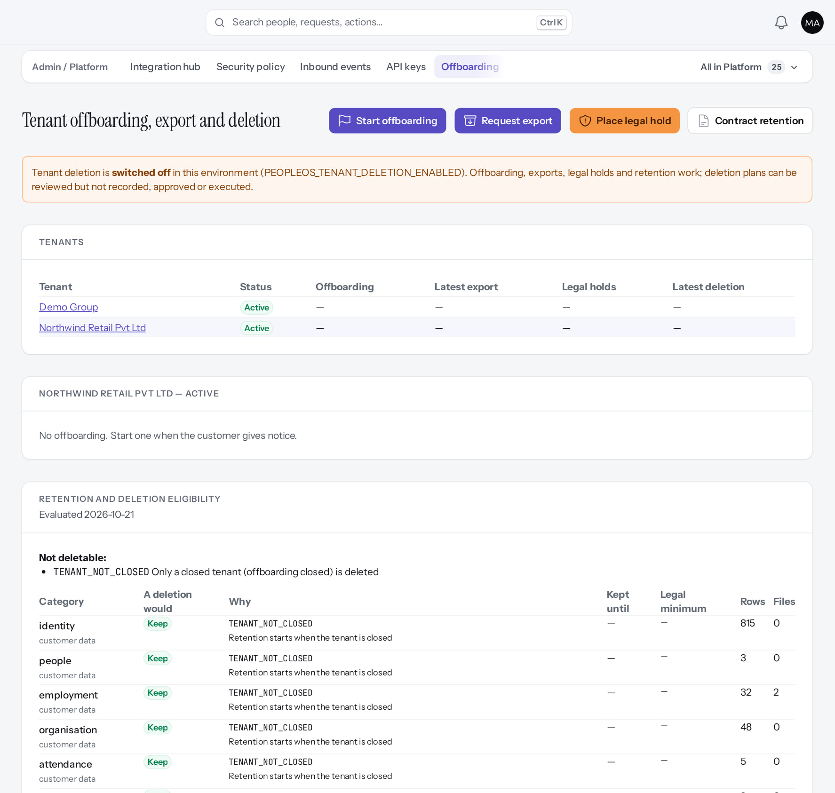
One tenant's offboarding record
OFFBOARDING
Verified in the running application
3
2
1
1
Place legal hold.
2
Request export.
3
Start offboarding.
RESULT Retention and deletion eligibility, exports, contract retention, legal holds.
Real screen (cropped) · Markedge Platform Admin (Platform operator) · Offboarding › Northwind Retail
Notes:
SAY: Retention and deletion eligibility, exports, contract retention, legal holds.
ON SCREEN: Open a tenant.
WALK THROUGH: (1) Place legal hold. (2) Request export. (3) Start offboarding.
LEARNERS SHOULD SEE: Retention and deletion eligibility, exports, contract retention, legal holds, deletions; Start offboarding, Request export, Place legal hold, Contract retention — and no deletion action
SCREEN: Offboarding › Northwind Retail. Signed in as Markedge Platform Admin (Platform operator). Prerequisite: Platform operator (is_platform_admin) signed in with MFA.
EVIDENCE: screenshot screenshots/platform-admin/95-pl-25-offboarding-tenant.png, captured 2026-10-21 on the disposable training database (fictional people).

Slide 33
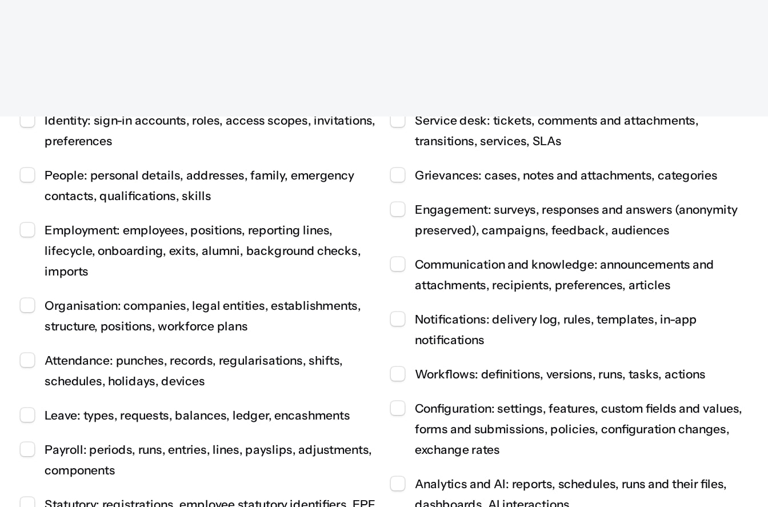
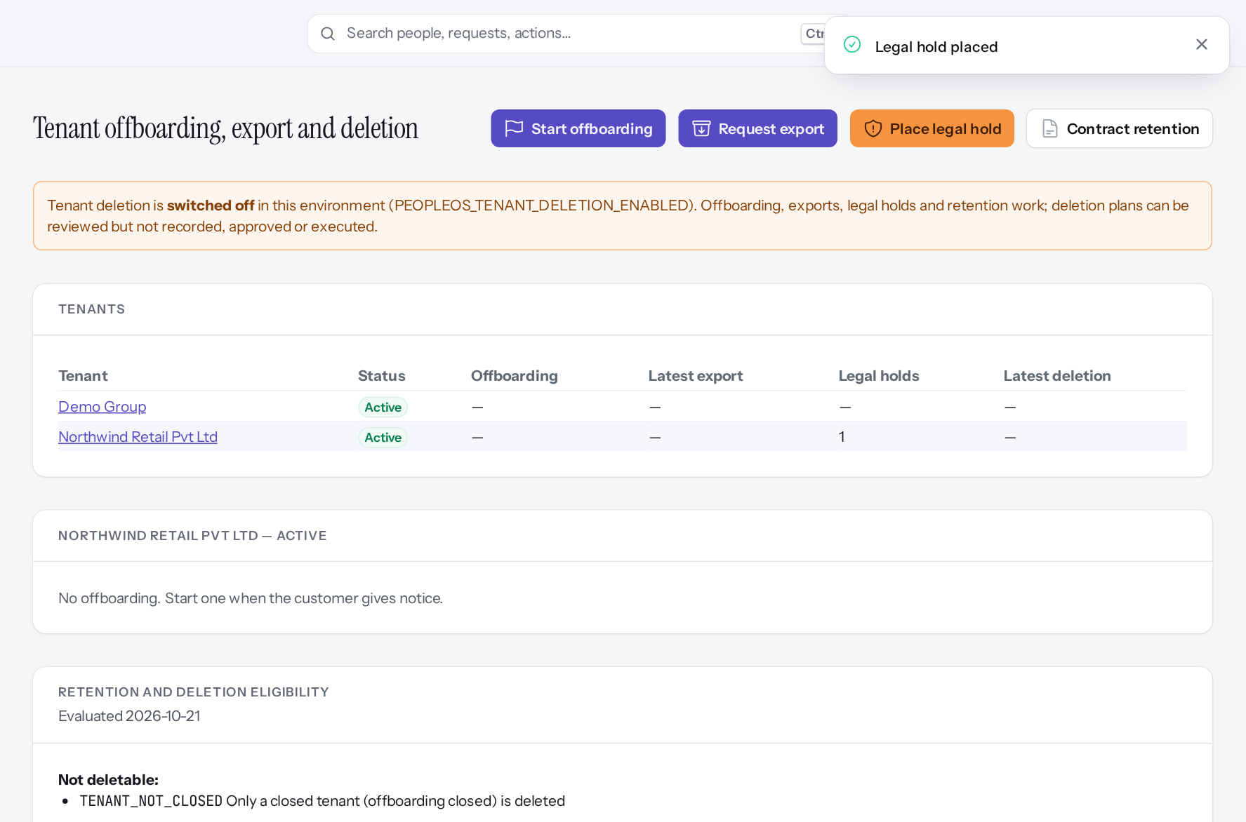
Place a legal hold
OFFBOARDING
Place legal hold
Verified
Hold active
Verified
Confirm placing the hold. While active, nothing it covers can be deleted.
"Legal hold placed"; the tenant now shows one active hold (LH-2026-01 in the platform audit trail).
Real screen (cropped) · Markedge Platform Admin (Platform operator) · Offboarding › Place legal hold
Real screen (cropped) · Markedge Platform Admin (Platform operator) · Offboarding › Northwind Retail (hold active)
Notes:
SAY: Place a legal hold.
LEFT, Place legal hold: Confirm placing the hold. While active, nothing it covers can be deleted.
RIGHT, Hold active: "Legal hold placed"; the tenant now shows one active hold (LH-2026-01 in the platform audit trail).
OBSERVE: point out what differs between the two screens.
EVIDENCE: left = platform-admin/95-pl-26-legal-hold-dialog [Markedge Platform Admin (Platform operator), Offboarding › Place legal hold]; right = platform-admin/95-pl-27-legal-hold-active [Markedge Platform Admin (Platform operator), Offboarding › Northwind Retail (hold active)]. Real screens, fictional data (SCREENSHOT-INVENTORY.md).

Slide 34
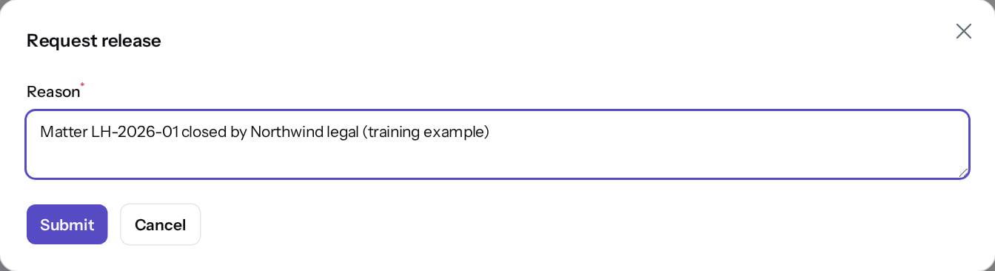
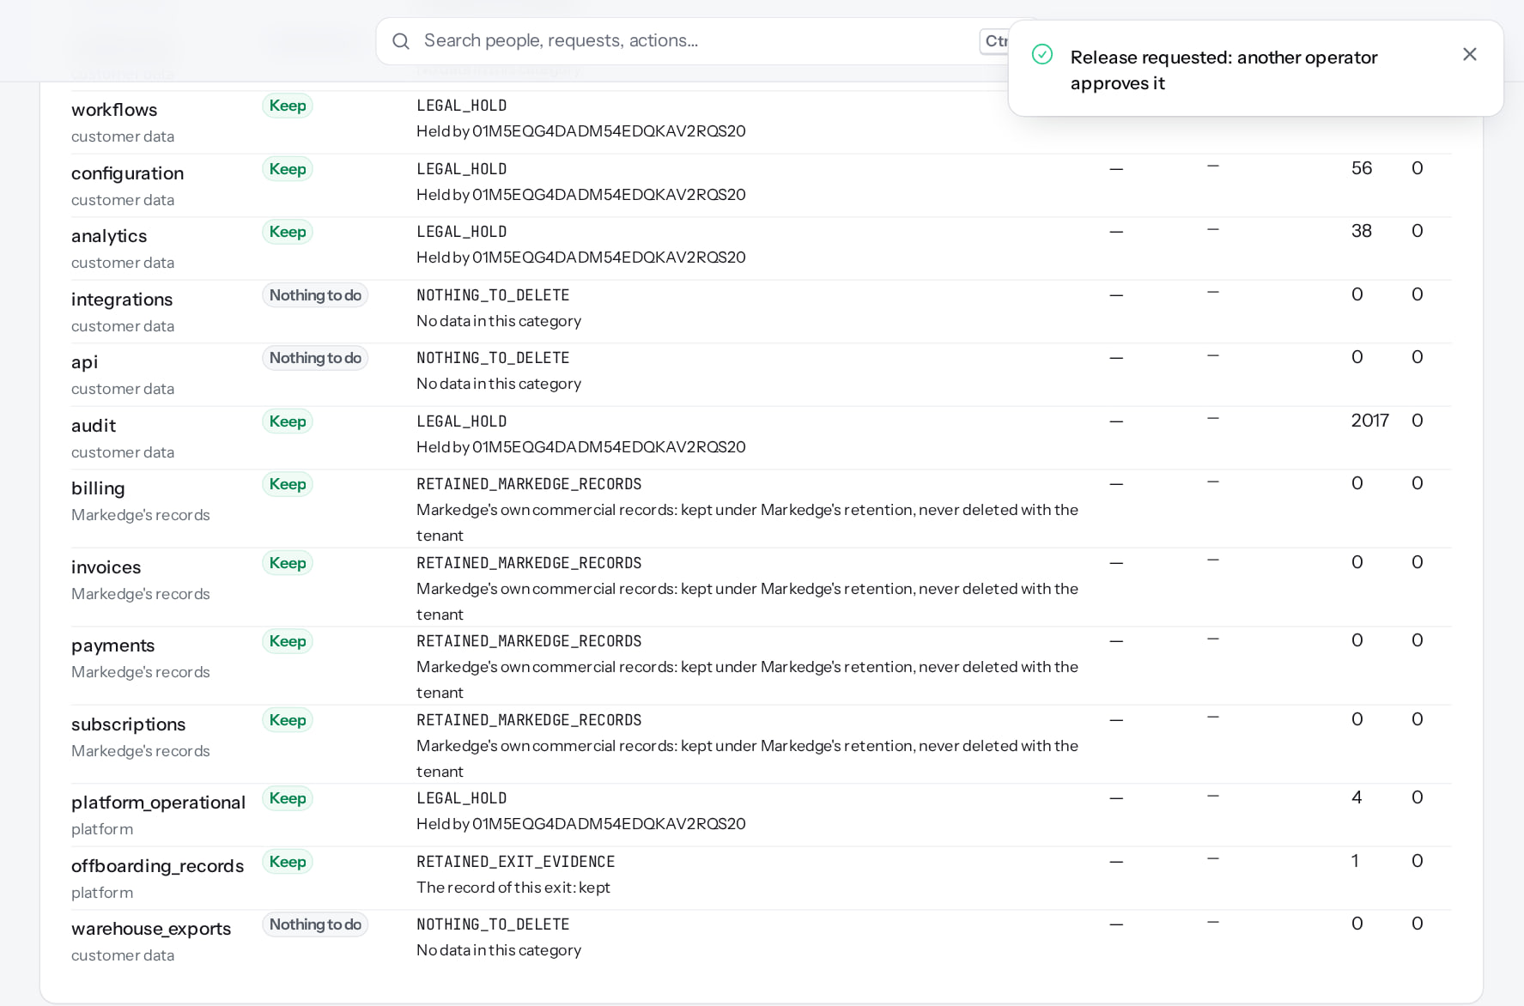
Releasing a hold needs a second operator
OFFBOARDING
Request release
Verified
Release pending
After configuration
"Release requested: another operator approves it."
The hold stays active until a different operator approves. Only one operator exists here, so it stays pending.
Real screen · Markedge Platform Admin (Platform operator) · Offboarding › Legal holds › Request release
Real screen (cropped) · Markedge Platform Admin (Platform operator) · Offboarding › Legal holds (release requested)
Notes:
SAY: Releasing a hold needs a second operator.
LEFT, Request release: "Release requested: another operator approves it."
RIGHT, Release pending: The hold stays active until a different operator approves. Only one operator exists here, so it stays pending.
OBSERVE: point out what differs between the two screens.
EVIDENCE: left = platform-admin/95-pl-33-request-release [Markedge Platform Admin (Platform operator), Offboarding › Legal holds › Request release]; right = platform-admin/95-pl-34-release-pending [Markedge Platform Admin (Platform operator), Offboarding › Legal holds (release requested)]. Real screens, fictional data (SCREENSHOT-INVENTORY.md).

Slide 35
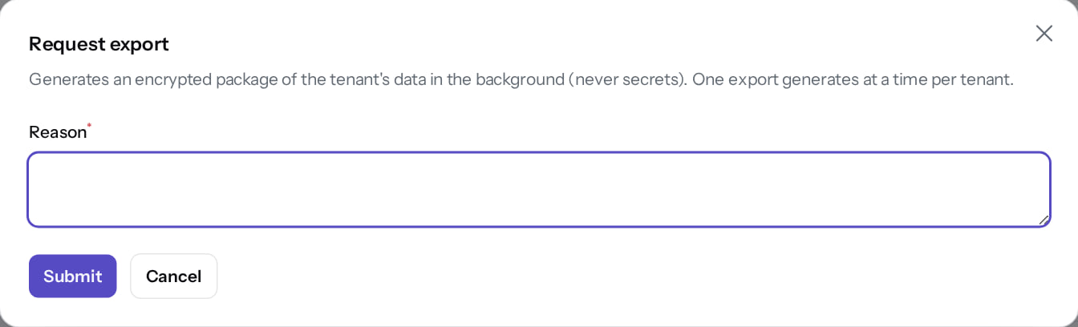
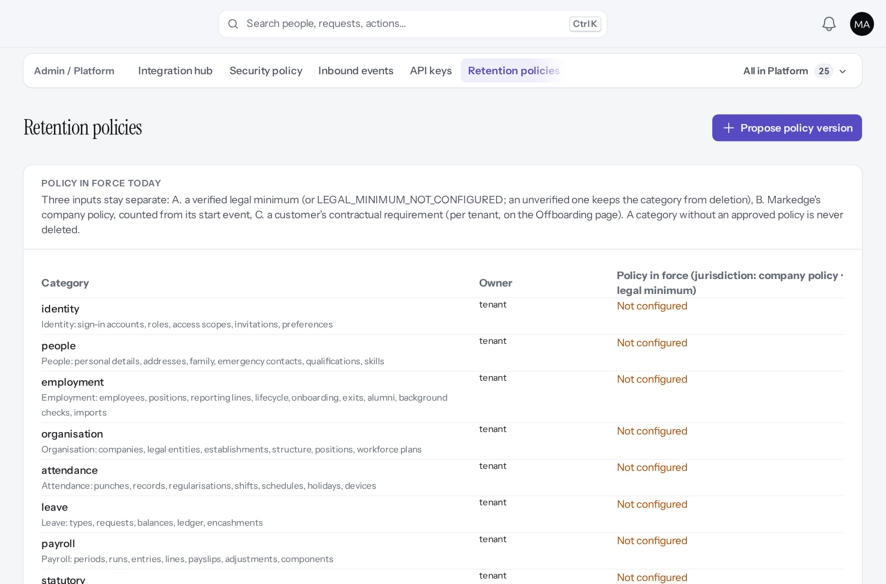
Exports and retention
OFFBOARDING
Request export
Not verified end to end
Retention policies
After configuration
Scope and reason; produced in the background (needs a queue worker) and protected by a passphrase. Opened, not submitted.
None in force: nothing is deletable until Markedge decides (D-8). New versions are maker-checker.
Real screen · Markedge Platform Admin (Platform operator) · Offboarding › Request export
Real screen (cropped) · Markedge Platform Admin (Platform operator) · Admin › Platform › Retention policies
Notes:
SAY: Exports and retention.
LEFT, Request export: Scope and reason; produced in the background (needs a queue worker) and protected by a passphrase. Opened, not submitted.
RIGHT, Retention policies: None in force: nothing is deletable until Markedge decides (D-8). New versions are maker-checker.
OBSERVE: point out what differs between the two screens.
EVIDENCE: left = platform-admin/95-pl-32-request-export-dialog [Markedge Platform Admin (Platform operator), Offboarding › Request export]; right = platform-admin/95-pl-28-retention-policies [Markedge Platform Admin (Platform operator), Admin › Platform › Retention policies]. Real screens, fictional data (SCREENSHOT-INVENTORY.md).

Slide 36
Statutory rule stewardship
06
Markedge verifies the rules payroll depends on: two operators and official evidence.
Notes:
TRANSITION: Section 6, Statutory rule stewardship. Markedge verifies the rules payroll depends on: two operators and official evidence.
SAY: Tell learners what they will be able to do by the end of this section, then move on.
ASK: "What questions do you have before we start this section?"

Slide 37
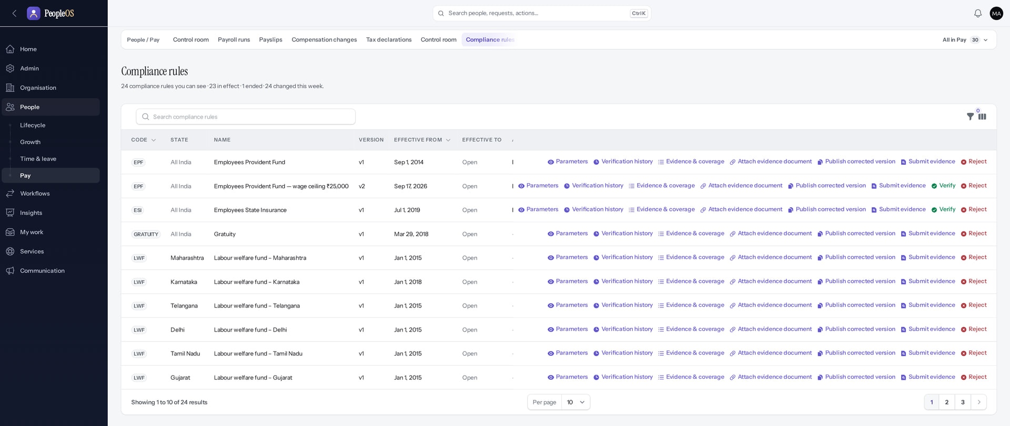
Compliance rules (operator view)
STATUTORY
Implemented · not verified end to end
RESULT Each rule version with parameters, verification history, evidence and coverage; Attach evidence and Submit for verification. 0 of 24 verified.
Real screen (cropped) · Markedge Platform Admin (Platform operator) · People › Pay › Compliance rules (operator view)
Notes:
SAY: Verification needs official evidence and a second operator. It was not exercised in this training (no evidence available). Release gate 5.

Slide 38
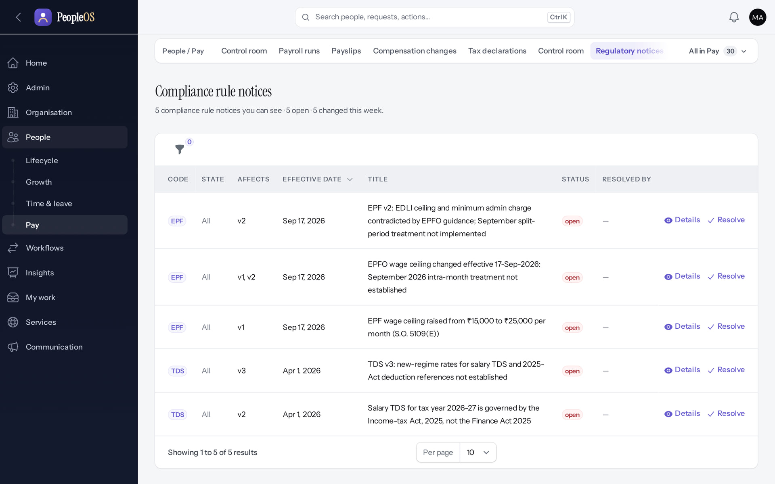
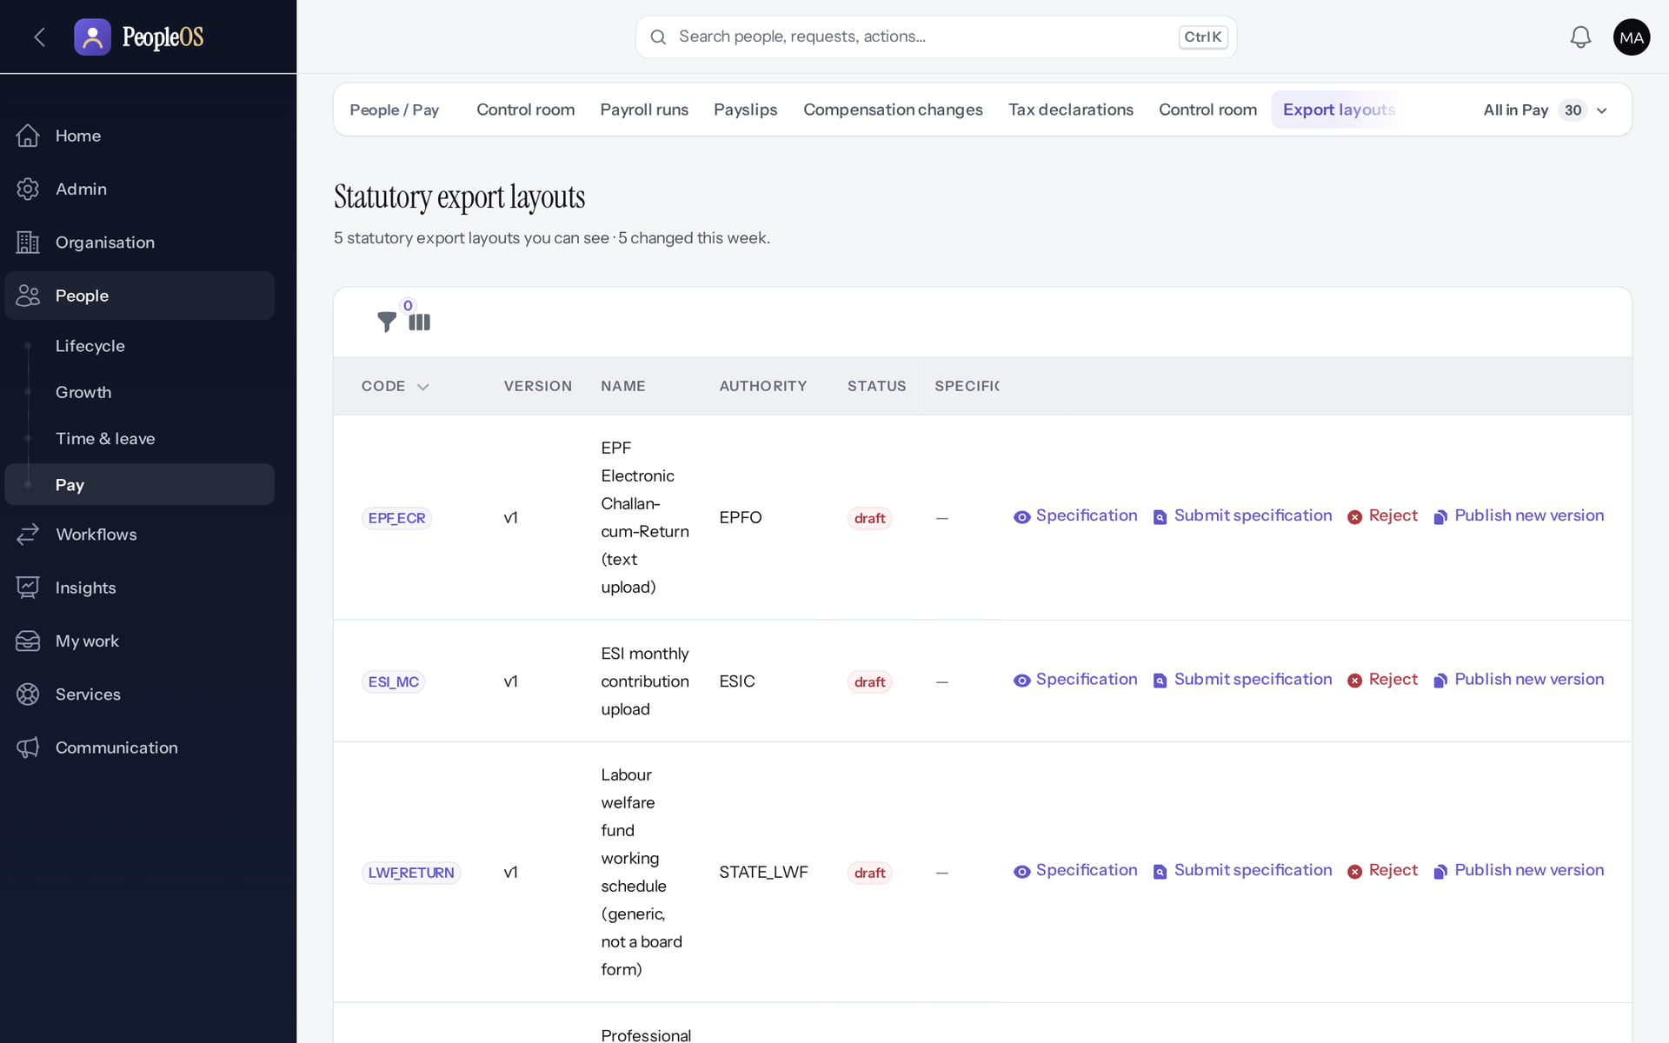
Notices and export layouts
STATUTORY
Regulatory notices
Not verified end to end
Export layouts
Not verified end to end
Open notices about statutory changes, each to be resolved.
Return file layouts with their specification and approval actions.
Real screen · Markedge Platform Admin (Platform operator) · People › Pay › Regulatory notices
Real screen · Markedge Platform Admin (Platform operator) · People › Pay › Export layouts
Notes:
SAY: Notices and export layouts.
LEFT, Regulatory notices: Open notices about statutory changes, each to be resolved.
RIGHT, Export layouts: Return file layouts with their specification and approval actions.
OBSERVE: point out what differs between the two screens.
EVIDENCE: left = platform-admin/95-pl-30-rule-notices [Markedge Platform Admin (Platform operator), People › Pay › Regulatory notices]; right = platform-admin/95-pl-31-export-layouts [Markedge Platform Admin (Platform operator), People › Pay › Export layouts]. Real screens, fictional data (SCREENSHOT-INVENTORY.md).

Slide 39
Operators must never…
SAFETY RULES
Switch on gated features
Share or skip MFA
Act without a reason
Public signup, live payments, tenant deletion or their environment switches, to "test" them.
Every operator has their own account and authenticator; recovery codes stay in the password manager.
Suspend, enter, hold or export without the customer reference in the reason field.
Approve their own change
Edit customer HR data
Bypass a gate
Financial changes, legal-hold releases and rule verification need a second operator.
Entering a tenant is for support; changes belong to the customer's administrators.
Payroll finalisation, release gates and readiness FAILs are fixed at the source, never worked around.
Notes:
SAY: Operators must never….
- Switch on gated features: Public signup, live payments, tenant deletion or their environment switches, to "test" them.
- Share or skip MFA: Every operator has their own account and authenticator; recovery codes stay in the password manager.
- Act without a reason: Suspend, enter, hold or export without the customer reference in the reason field.
- Approve their own change: Financial changes, legal-hold releases and rule verification need a second operator.
- Edit customer HR data: Entering a tenant is for support; changes belong to the customer's administrators.
- Bypass a gate: Payroll finalisation, release gates and readiness FAILs are fixed at the source, never worked around.
ASK: "Which of these points needs more explanation for your team?"

Slide 40
Practice (on a training environment only)
PRACTICE
A customer says nobody can sign in, although passwords are correct. Where do you look first?
1
You placed a legal hold by mistake. Can you release it yourself?
2
Where do you see that an operator entered a customer's tenant, and why?
3
The Readiness page shows "Statutory production gate: BLOCKED". Who resolves it?
4
Answer key: on the next slide, and in the speaker notes.
Notes:
RUN: give learners about 10 minutes in a practice tenant (never a live one). Walk around and help.
SUCCESS: each learner can show the result on screen.
ANSWERS: (1) Platform › Tenants: is the tenant Suspended? (generic sign-in message hides it). (2) No: request release; a different operator approves. (3) Platform audit trail: "Tenant entered" with actor, reason and ticket. (4) Two platform administrators verifying each statutory rule with official evidence (owner decisions O-5, O-12, O-18).

Slide 41
Answer key
PRACTICE
# | Answer
1 | Platform › Tenants: check whether the tenant is Suspended. The sign-in page deliberately shows the generic message.
2 | No. Request release; a different operator must approve it (two-person rule).
3 | Platform audit trail: "Tenant entered" with the operator, the reason and the ticket reference.
4 | Markedge: two platform administrators verify each rule with official evidence, after the owner decisions on scope (O-5, O-12, O-18).
Notes:
SAY: Answer key.
- 1 | Platform › Tenants: check whether the tenant is Suspended. The sign-in page deliberately shows the generic message.
- 2 | No. Request release; a different operator must approve it (two-person rule).
- 3 | Platform audit trail: "Tenant entered" with the operator, the reason and the ticket reference.
- 4 | Markedge: two platform administrators verify each rule with official evidence, after the owner decisions on scope (O-5, O-12, O-18).

Slide 42
Summary
Operators sign in with MFA and work outside tenants by default.
Suspend, reactivate, enter, hold and export always carry a reason and are audited.
Commercial pages are in shadow mode: nothing is enforced, priced or billed.
Readiness and operations tell you whether the platform can be trusted today.
Deletion is off; holds and releases follow the two-person rule.
NEXT STEPS & HELP
docs/saas/SaaS-Final-Release-Gate.md
docs/saas/SaaS-Final-Owner-Action-Register.md
Deck 04: provisioning a customer
Deck 08: security and compliance
Release gate: NO-GO (10 of 14 gates blocked, re-verified 13 Oct 2026). Not yet generally available.
Notes:
EVIDENCE: Executed on the training database on 21 Oct 2026 as the fictional operator platform@markedge.local (MFA enrolled through the real set-up screen), acting only on the fictional tenants Northwind Retail and Markedge Technologies (internal workforce); tools/capture/00-operator-mfa.mjs, 90-onboarding-a, 95-platform.mjs, 95b-platform-extra.mjs.
SAY: Recap the key points:
- Operators sign in with MFA and work outside tenants by default.
- Suspend, reactivate, enter, hold and export always carry a reason and are audited.
- Commercial pages are in shadow mode: nothing is enforced, priced or billed.
- Readiness and operations tell you whether the platform can be trusted today.
- Deletion is off; holds and releases follow the two-person rule.
POINT TO: docs/saas/SaaS-Final-Release-Gate.md; docs/saas/SaaS-Final-Owner-Action-Register.md; Deck 04: provisioning a customer; Deck 08: security and compliance
ASK: "What will you do first in PeopleOS?" Collect questions you cannot answer and send them to the PeopleOS team.

