Slide 1
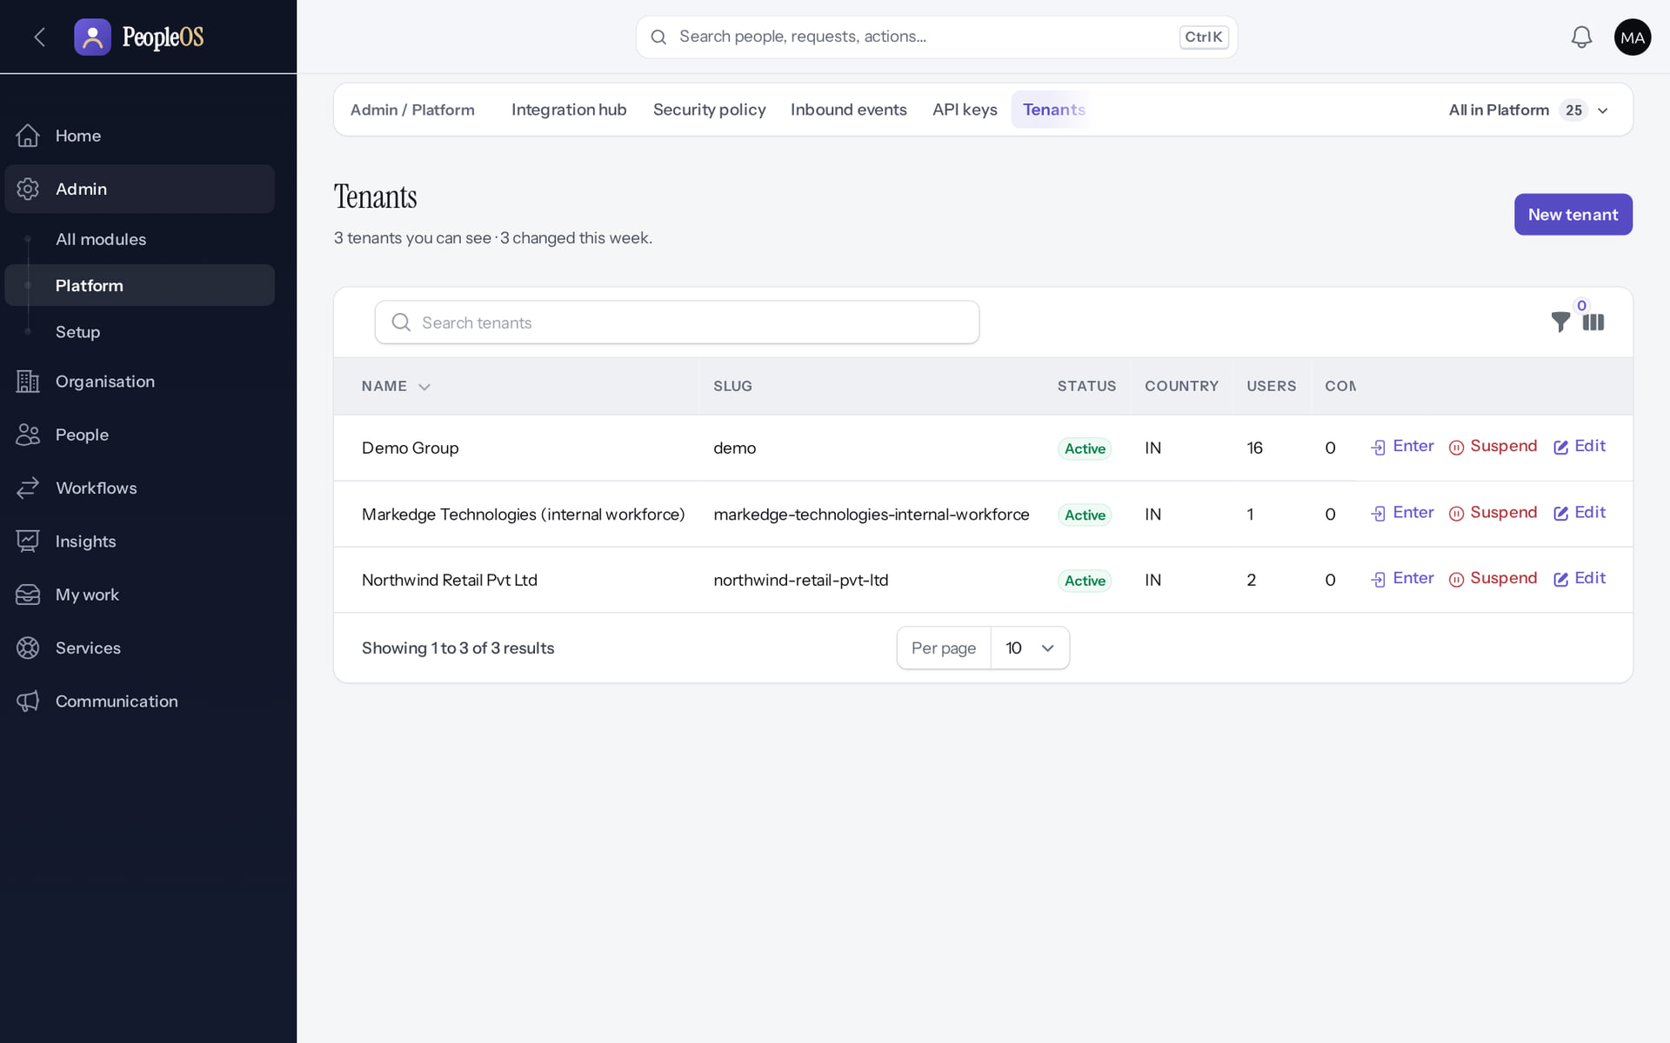
Markedge Internal PeopleOS Operations
MARKEDGE PEOPLEOS · TRAINING LIBRARY
Deck 06 of 12
How Markedge runs its own workforce on PeopleOS as an ordinary tenant, and how that work stays separate from operating the SaaS platform.
For: Markedge internal HR, payroll and people managers; Markedge leadership; SaaS operations staff
Built from the running application (local, disposable database, fictional people) · 21 October 2026
Real screen, fictional data
Notes:
SAY: Markedge uses PeopleOS for its own people exactly like a customer does: in its own tenant. The platform operators who run the SaaS do not get HR access by being Markedge staff, and Markedge HR gets no platform access.
EVIDENCE: Executed on the training database on 21 Oct 2026: the operator provisioned "Markedge Technologies (internal workforce)" (fictional), its administrator Sana Qureshi (fictional) activated it, created a company, departments and designations, and hired three fictional employees (tools/capture/96-internal.mjs).

Slide 2
How to read this deck
BEFORE YOU START
Verified in the running application
We ran it on the training database and captured each step.
1
Numbered markers on a screenshot match the numbered steps beside it.
Implemented · not verified end to end
The screen exists; the last steps need data or a second party we could not provide.
Every screenshot is a real capture of PeopleOS. The people and companies in it are fictional.
Available only after configuration
Works once an administrator or Markedge has set it up.
Disabled by safety or commercial gates
Switched off on purpose until owner decisions and approvals arrive.
Diagrams are marked "Conceptual diagram". They explain ideas; they are not screens.
Incomplete · known defect or gap
Partly working: a known defect or gap is stated on the slide.
Release gate: NO-GO (10 of 14 gates blocked, re-verified 13 Oct 2026). Not yet generally available.
Not implemented
Not in the product today.
Unable to verify
Could not be checked in this environment.
Notes:
Explain the seven status labels. Every screenshot slide carries one of them in its top-right corner. Stress that "Verified in the running application" means we ran it on a disposable demonstration database, not that the feature is released.

Slide 3
Where PeopleOS stands today
BEFORE YOU START
This training uses the real application on a practice database with invented people. PeopleOS is not yet generally available.
What works today
Payroll is not live yet
The screens in this deck were run end to end on the practice database: you will see exactly what you will use.
Payslips appear only after a payroll run is finalised. Finalising is blocked until statutory rules are verified (0 of 24 today).
Known issues are named
Fictional internal tenant
Where something does not work as it should, the slide says so and shows the workaround.
The Markedge tenant shown here is a training copy with invented employees. No real Markedge staff data was used.
Notes:
SAY: We trained on the real PeopleOS screens, not mock-ups. The practice database contains invented people only.
AVOID: promising dates for general availability or payroll. The release gate is NO-GO (docs/saas/SaaS-Final-Release-Gate.md (decision NO-GO, re-verified 13 October 2026 at 7314f7d)).
ASK: "Which of your HR tasks still run outside PeopleOS today?"
SAY: Where PeopleOS stands today. This training uses the real application on a practice database with invented people. PeopleOS is not yet generally available.
- What works today: The screens in this deck were run end to end on the practice database: you will see exactly what you will use.
- Payroll is not live yet: Payslips appear only after a payroll run is finalised. Finalising is blocked until statutory rules are verified (0 of 24 today).
- Known issues are named: Where something does not work as it should, the slide says so and shows the workaround.
- Fictional internal tenant: The Markedge tenant shown here is a training copy with invented employees. No real Markedge staff data was used.
ASK: "Which of these points needs more explanation for your team?"

Slide 4
What you will be able to explain
LEARNING OBJECTIVES
Two hats at Markedge
employer (internal HR) and SaaS provider (platform operations)
Where the boundary is enforced
HR cannot open the platform; operators enter tenants only with a reason
1
4
How the internal tenant is created
by an operator, like any customer
What still runs outside PeopleOS
payroll finalisation, statutory verification, hosting
2
5
What internal HR does in PeopleOS
people, time, leave, payroll inputs, growth, services, exits
3
Notes:
SAY: What you will be able to explain:
1. Two hats at Markedge: employer (internal HR) and SaaS provider (platform operations)
2. How the internal tenant is created: by an operator, like any customer
3. What internal HR does in PeopleOS: people, time, leave, payroll inputs, growth, services, exits
4. Where the boundary is enforced: HR cannot open the platform; operators enter tenants only with a reason
5. What still runs outside PeopleOS: payroll finalisation, statutory verification, hosting
ASK: "Which of these matters most to you?" Return to the answer in the summary.

Slide 5
Who does what at Markedge
RESPONSIBILITIES
Activity | Markedge internal HR (tenant users) | PeopleOS SaaS operations (platform operators)
Employee records, hiring, exits | Yes, in the internal tenant | No
Leave, attendance, approvals | Yes (managers decide) | No
Payroll inputs and runs | Yes; finalisation blocked like every tenant | No
Statutory rule verification | No | Yes: two operators with evidence
Tenant creation, suspension, offboarding | No | Yes, with reasons, audited
Entering another tenant for support | Never | Only via Enter: reason, ticket, 60 minutes
Platform readiness, operations, billing set-up | No | Yes
Notes:
SOURCE: platform-operator flag (is_platform_admin) versus tenant roles; captures 96-int-08 (HR refused on Tenants) and 95-pl-35 (operator Enter).
SAY: Who does what at Markedge.
- Employee records, hiring, exits | Yes, in the internal tenant | No
- Leave, attendance, approvals | Yes (managers decide) | No
- Payroll inputs and runs | Yes; finalisation blocked like every tenant | No
- Statutory rule verification | No | Yes: two operators with evidence
- Tenant creation, suspension, offboarding | No | Yes, with reasons, audited
- Entering another tenant for support | Never | Only via Enter: reason, ticket, 60 minutes
- Platform readiness, operations, billing set-up | No | Yes

Slide 6
An ordinary tenant for Markedge
01
Provisioned by an operator, administered by Markedge HR.
Notes:
TRANSITION: Section 1, An ordinary tenant for Markedge. Provisioned by an operator, administered by Markedge HR.
SAY: Tell learners what they will be able to do by the end of this section, then move on.
ASK: "What questions do you have before we start this section?"

Slide 7
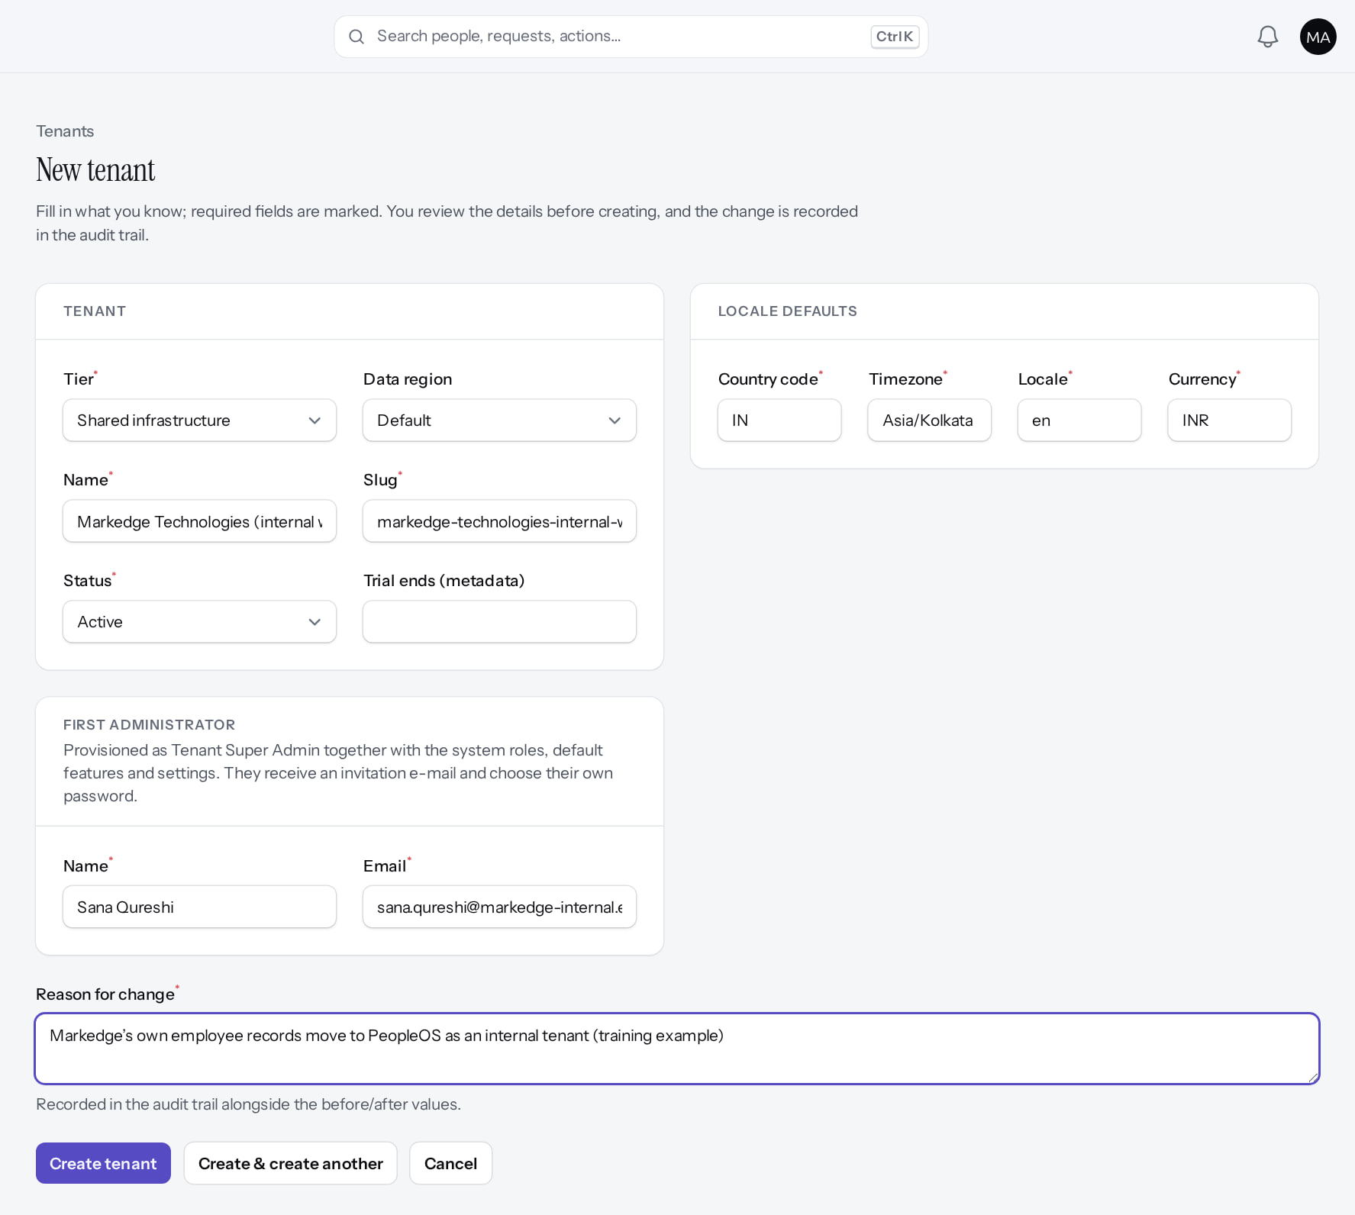
The operator provisions the internal tenant
SET-UP
Verified in the running application
1
Internal tenant name.
2
Markedge HR administrator.
3
Reason for change.
RESULT A separate tenant: Markedge employee data never sits in the operator console.
1
2
3
Real screen (cropped) · Markedge Platform Admin (Platform operator) · Tenants › New tenant
Notes:
SAY: A separate tenant: Markedge employee data never sits in the operator console.
ON SCREEN: The operator provisions the internal tenant exactly like a customer tenant, with Markedge HR’s administrator as first administrator (slug suggested from the name).
WALK THROUGH: (1) Internal tenant name. (2) Markedge HR administrator. (3) Reason for change.
LEARNERS SHOULD SEE: A separate tenant: Markedge employee data never sits in the operator console
SCREEN: Tenants › New tenant. Signed in as Markedge Platform Admin (Platform operator). Prerequisite: Platform operator with MFA.
EVIDENCE: screenshot screenshots/internal-operations/96-int-01-provision-internal-tenant.png, captured 2026-10-21 on the disposable training database (fictional people).

Slide 8
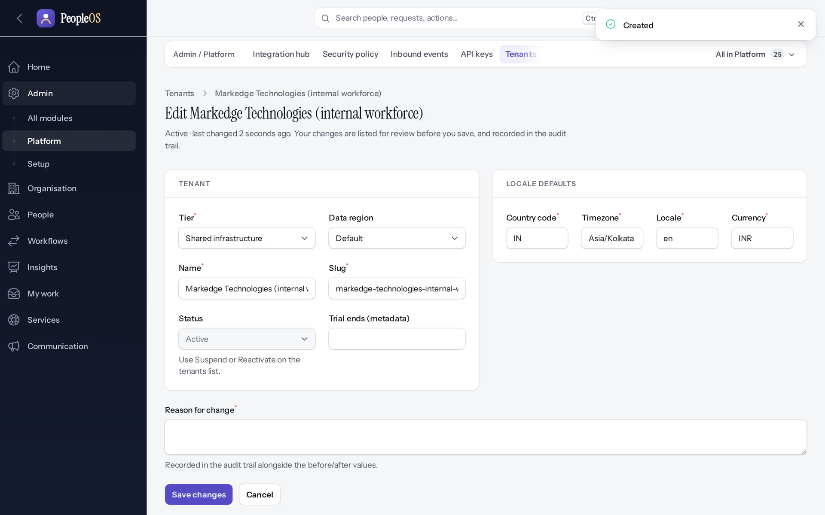
Created like any customer
SET-UP
Verified in the running application
RESULT The "Created" confirmation and the tenant record. As for any customer, provisioning also adds the system roles, default settings and the administrator's invitation (Deck 4, stage 2).
Real screen · Markedge Platform Admin (Platform operator) · Tenant (after Create tenant)
Notes:
SAY: The "Created" confirmation and the tenant record. As for any customer, provisioning also adds the system roles, default settings and the administrator's invitation (Deck 4, stage 2).
ON SCREEN: Create tenant.
LEARNERS SHOULD SEE: "Created": the tenant record opens; system roles, default features and settings are provisioned and the invitation e-mail is sent to the first administrator
SCREEN: Tenant (after Create tenant). Signed in as Markedge Platform Admin (Platform operator). Prerequisite: Platform operator with MFA.
EVIDENCE: screenshot screenshots/internal-operations/96-int-02-tenant-created.png, captured 2026-10-21 on the disposable training database (fictional people).

Slide 9
Three tenants, all peers
SET-UP
Verified in the running application
Markedge's own tenant.
A customer tenant.
RESULT Demo Group, Northwind Retail and Markedge Technologies (internal workforce) have the same standing: the internal tenant has no special access.
Real screen · Markedge Platform Admin (Platform operator) · Admin › Platform › Tenants
Notes:
SAY: Demo Group, Northwind Retail and Markedge Technologies (internal workforce) have the same standing: the internal tenant has no special access.
ON SCREEN: Operator view of all tenants.
WALK THROUGH: (1) Markedge's own tenant. (2) A customer tenant.
LEARNERS SHOULD SEE: Demo Group, Northwind Retail and Markedge Technologies (internal workforce) are peers: the internal tenant has no special access
SCREEN: Admin › Platform › Tenants. Signed in as Markedge Platform Admin (Platform operator). Prerequisite: Platform operator provisions the internal tenant; Markedge HR administers it.
EVIDENCE: screenshot screenshots/internal-operations/96-int-03-tenants-side-by-side.png, captured 2026-10-21 on the disposable training database (fictional people).

Slide 10
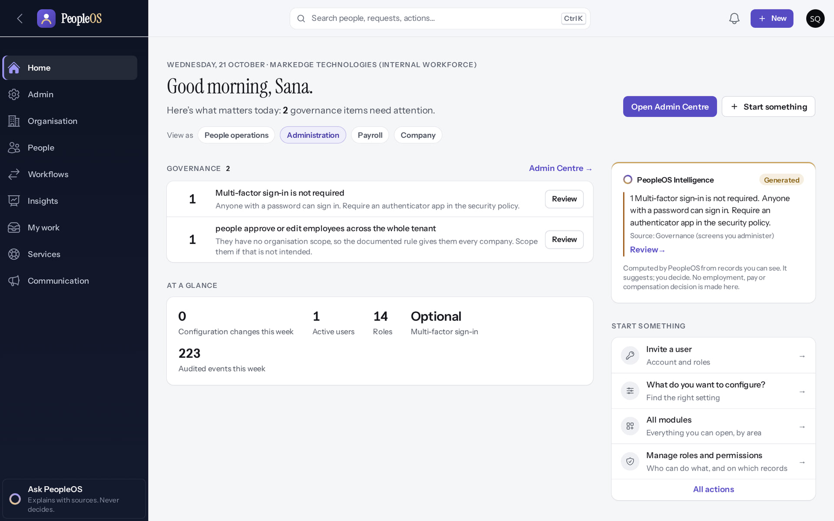
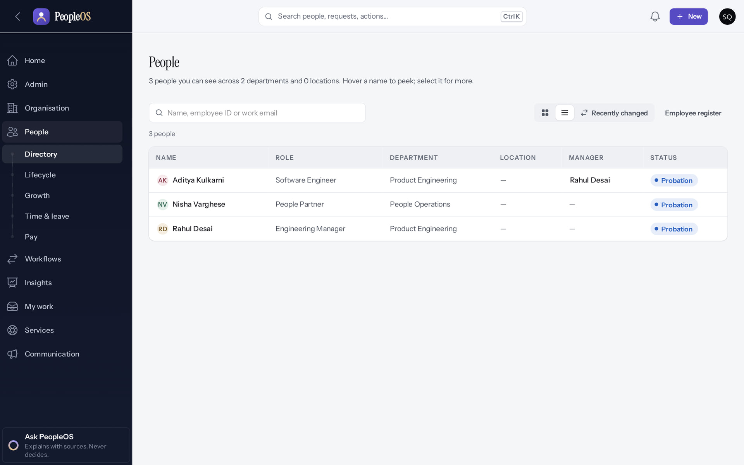
Inside the internal tenant
SET-UP
Home (internal administrator)
Verified
Directory
Verified
The same Home as any customer: administration lens and governance items.
Only Markedge's own (fictional) employees; no customer data is visible.
Real screen · Sana Qureshi (Tenant Super Admin (Markedge internal HR)) · Home (Markedge internal tenant)
Real screen · Sana Qureshi (Tenant Super Admin (Markedge internal HR)) · People › Directory (Markedge internal tenant)
Notes:
SAY: Inside the internal tenant.
LEFT, Home (internal administrator): The same Home as any customer: administration lens and governance items.
RIGHT, Directory: Only Markedge's own (fictional) employees; no customer data is visible.
OBSERVE: point out what differs between the two screens.
EVIDENCE: left = internal-operations/96-int-04-internal-home [Sana Qureshi (Tenant Super Admin (Markedge internal HR)), Home (Markedge internal tenant)]; right = internal-operations/96-int-05-internal-directory [Sana Qureshi (Tenant Super Admin (Markedge internal HR)), People › Directory (Markedge internal tenant)]. Real screens, fictional data (SCREENSHOT-INVENTORY.md).

Slide 11
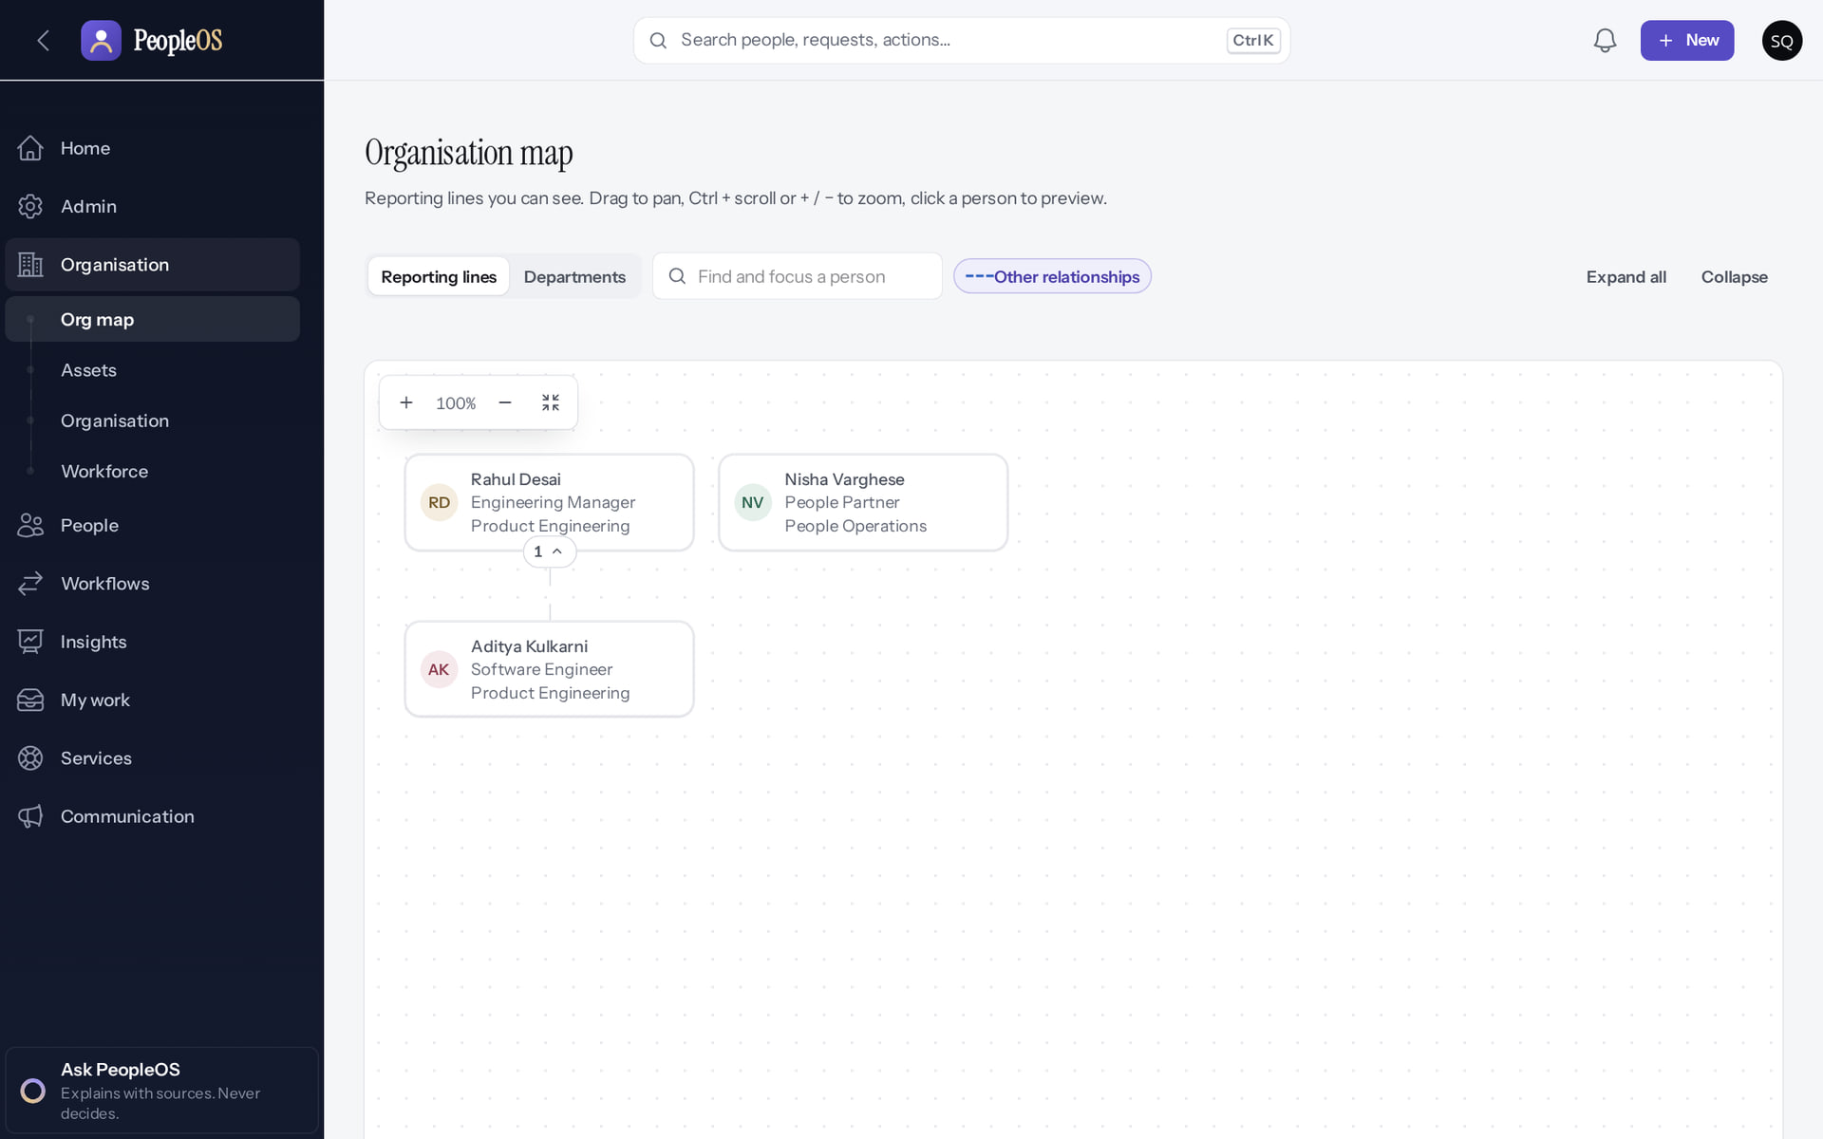
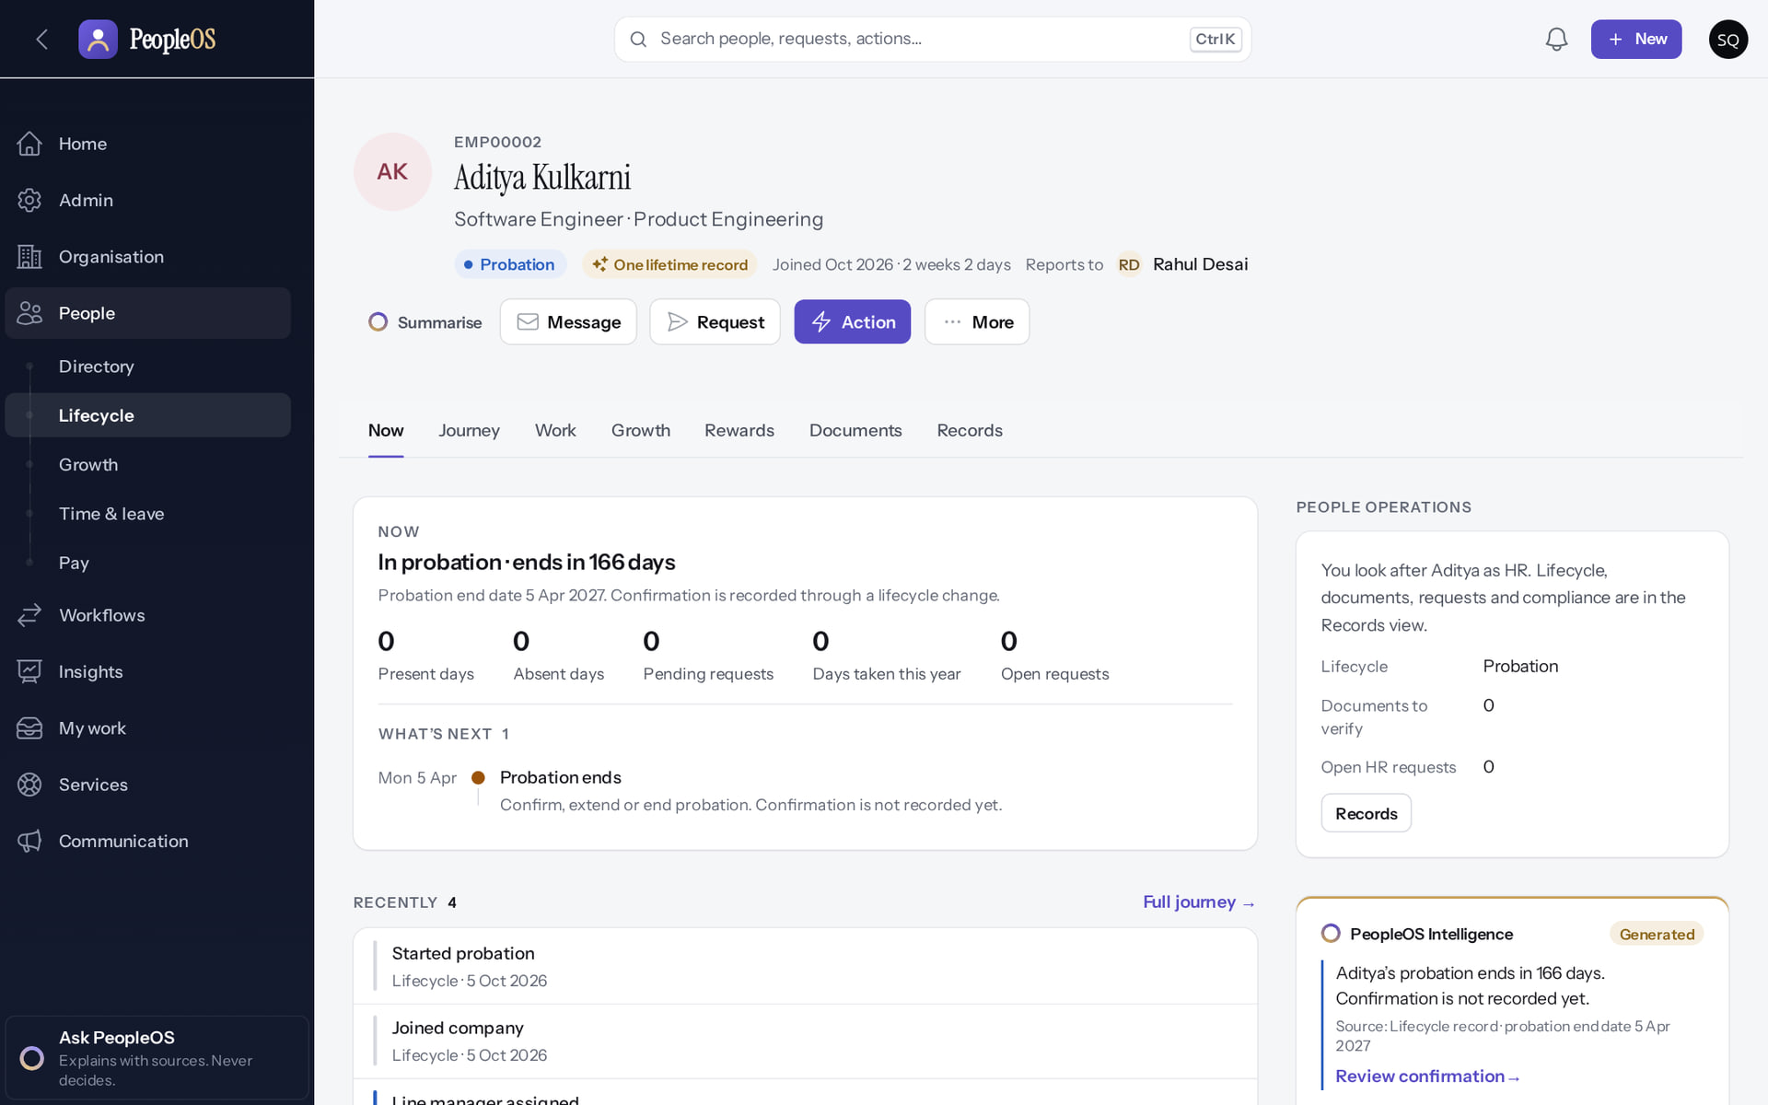
People and reporting lines
SET-UP
Org map
Verified
Employee 360
Verified
Aditya Kulkarni reports to Rahul Desai.
The same Employee 360 customers use: status, manager, journey, records.
Real screen · Sana Qureshi (Tenant Super Admin (Markedge internal HR)) · Organisation › Org map (Markedge internal tenant)
Real screen · Sana Qureshi (Tenant Super Admin (Markedge internal HR)) · Employee 360 (Markedge internal tenant)
Notes:
SAY: People and reporting lines.
LEFT, Org map: Aditya Kulkarni reports to Rahul Desai.
RIGHT, Employee 360: The same Employee 360 customers use: status, manager, journey, records.
OBSERVE: point out what differs between the two screens.
EVIDENCE: left = internal-operations/96-int-06-internal-org-map [Sana Qureshi (Tenant Super Admin (Markedge internal HR)), Organisation › Org map (Markedge internal tenant)]; right = internal-operations/96-int-07-internal-employee-360 [Sana Qureshi (Tenant Super Admin (Markedge internal HR)), Employee 360 (Markedge internal tenant)]. Real screens, fictional data (SCREENSHOT-INVENTORY.md).

Slide 12
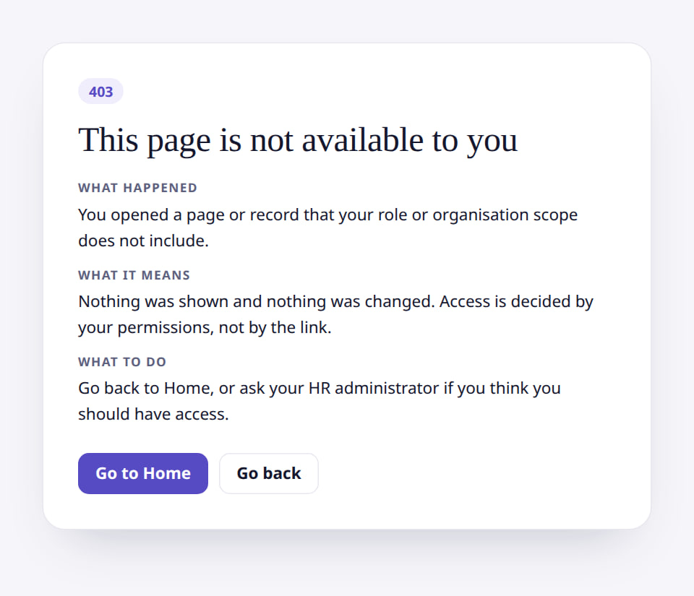
Markedge HR cannot open the platform
BOUNDARY
Verified in the running application
RESULT Refused: being Markedge staff in HR does not grant platform-operator access. Operator accounts are separate accounts.
Real screen (cropped) · Sana Qureshi (Tenant Super Admin (Markedge internal HR)) · Tenants (as Markedge HR administrator)
Notes:
SAY: Refused: being Markedge staff in HR does not grant platform-operator access. Operator accounts are separate accounts.
ON SCREEN: Markedge HR’s administrator opens the operator’s Tenants screen directly.
LEARNERS SHOULD SEE: Refused: being Markedge staff in HR does not grant platform-operator access
SCREEN: Tenants (as Markedge HR administrator). Signed in as Sana Qureshi (Tenant Super Admin (Markedge internal HR)). Prerequisite: Platform operator provisions the internal tenant; Markedge HR administers it.
EVIDENCE: screenshot screenshots/internal-operations/96-int-08-hr-cannot-open-tenants.png, captured 2026-10-21 on the disposable training database (fictional people).

Slide 13
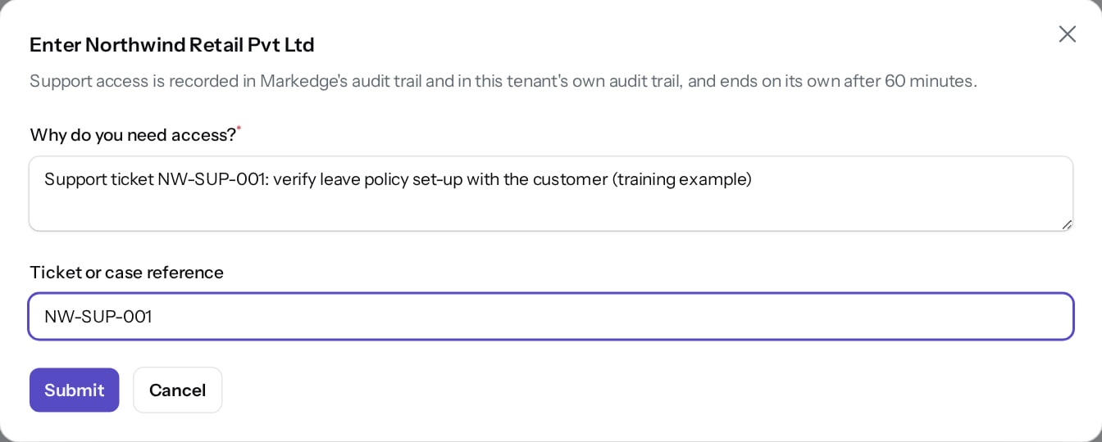
And operators enter tenants only deliberately
BOUNDARY
Verified in the running application
RESULT A reason and a ticket reference; access ends after 60 minutes; recorded in the platform audit trail. The same applies to Markedge's own tenant.
Real screen · Markedge Platform Admin (Platform operator) · Tenants › Enter
Notes:
SAY: A reason and a ticket reference; access ends after 60 minutes; recorded in the platform audit trail. The same applies to Markedge's own tenant.
ON SCREEN: Enter a customer tenant with a reason.
LEARNERS SHOULD SEE: Operator access is deliberate, explained and audited
SCREEN: Tenants › Enter. Signed in as Markedge Platform Admin (Platform operator). Prerequisite: Platform operator with MFA.
EVIDENCE: screenshot screenshots/platform-admin/95-pl-35-enter-tenant-dialog.png, captured 2026-10-21 on the disposable training database (fictional people).

Slide 14
Internal HR operations
02
The work Markedge HR does every month, on the same screens customers use.
Notes:
TRANSITION: Section 2, Internal HR operations. The work Markedge HR does every month, on the same screens customers use.
SAY: Tell learners what they will be able to do by the end of this section, then move on.
ASK: "What questions do you have before we start this section?"

Slide 15
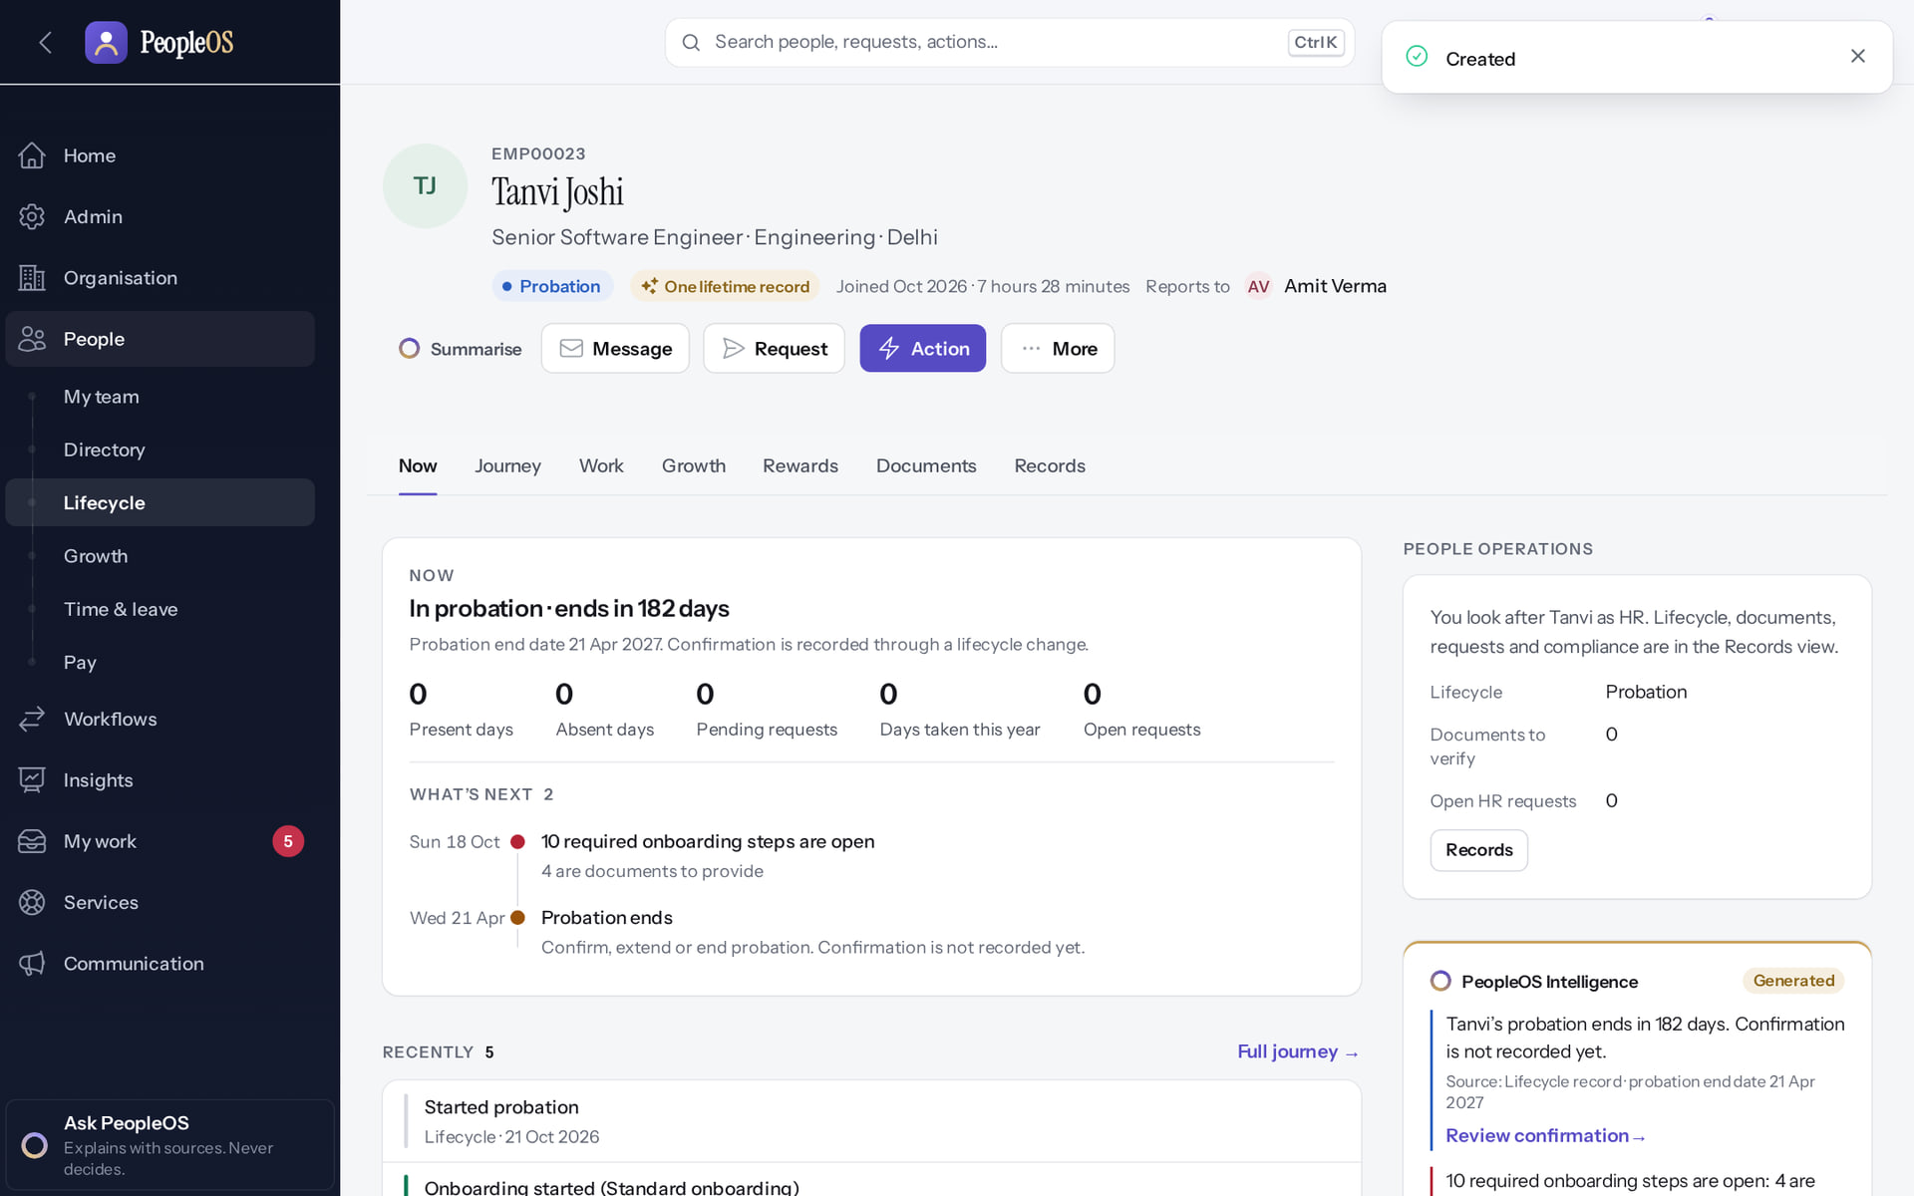
Hire a Markedge employee
INTERNAL HR
Verified in the running application
RESULT Hire employee wizard with the duplicate check; onboarding starts automatically. Deck 3 shows every step.
Real screen · Same screen in Markedge's internal tenant; shown here from the demonstration tenant (fictional Demo Group), where the workflow was executed.
Notes:
SAY: Hire employee wizard with the duplicate check; onboarding starts automatically. Deck 3 shows every step.
ON SCREEN: Create.
LEARNERS SHOULD SEE: The new Employee 360 opens: code generated, status, manager; the hire is audited
SCREEN: Employee 360 (new hire). Signed in as Kavya Menon (Tenant HR Admin + Employee). Prerequisite: employee.create (Tenant HR Admin, HR Manager, HR Executive, Account Owner).
EVIDENCE: screenshot screenshots/hr-admin/50-hire-07-created-record.png, captured 2026-10-21 on the disposable training database (fictional people).

Slide 16
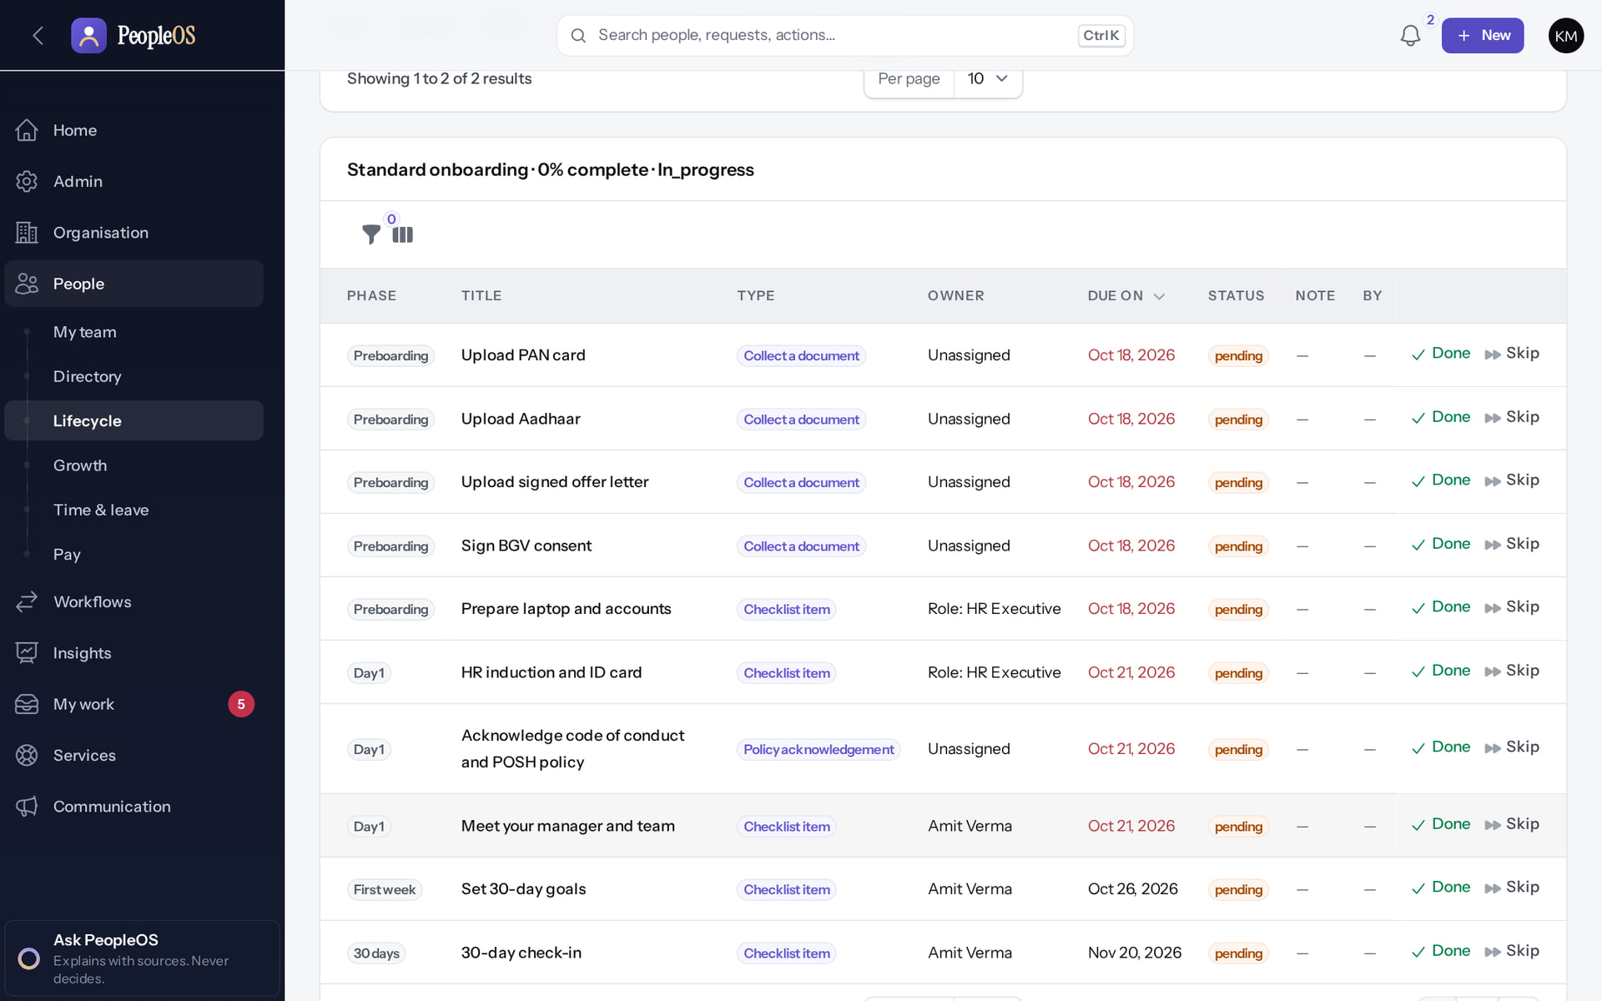
Onboarding new joiners
INTERNAL HR
Verified in the running application
1
Task.
2
Done.
3
Skip (note required).
RESULT Tasks for HR, IT, the manager and the joiner by phase, with Done and Skip.
2
3
1
Real screen · Same screen in Markedge's internal tenant; shown here from the demonstration tenant (fictional Demo Group), where the workflow was executed.
Notes:
SAY: Tasks for HR, IT, the manager and the joiner by phase, with Done and Skip.
ON SCREEN: Open the new hire’s onboarding plan.
LEARNERS SHOULD SEE: Tasks by phase (Preboarding, Day 1, First week, 30 days), type, owner, due date, status; Done / Skip per task
SCREEN: Employee 360 › Records › Employment › Onboarding. Signed in as Kavya Menon (Tenant HR Admin + Employee). Prerequisite: onboarding.view / onboarding.manage; plans start automatically on hire (template conditions).
EVIDENCE: screenshot screenshots/hr-admin/50-onb-03-plan-tasks.png, captured 2026-10-21 on the disposable training database (fictional people).

Slide 17
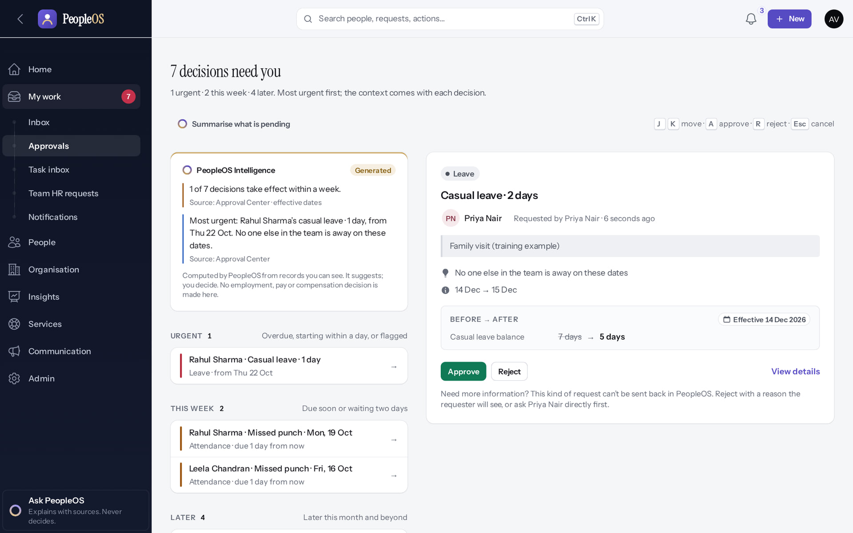
Managers approve leave and corrections
INTERNAL HR
Verified in the running application
1
Reason.
2
Approve.
3
Reject.
RESULT My work › Approvals shows reason, team overlap and balance before → after.
1
2
3
Real screen · Same screen in Markedge's internal tenant; shown here from the demonstration tenant (fictional Demo Group), where the workflow was executed.
Notes:
SAY: My work › Approvals shows reason, team overlap and balance before → after.
ON SCREEN: Select the request to see its context.
WALK THROUGH: (1) Reason. (2) Approve. (3) Reject.
LEARNERS SHOULD SEE: Reason, team overlap, dates and the balance before → after
SCREEN: Approval Center › decision card. Signed in as Amit Verma (Manager + Employee).
EVIDENCE: screenshot screenshots/manager/10-leave-08-decision-card.png, captured 2026-10-21 on the disposable training database (fictional people).

Slide 18
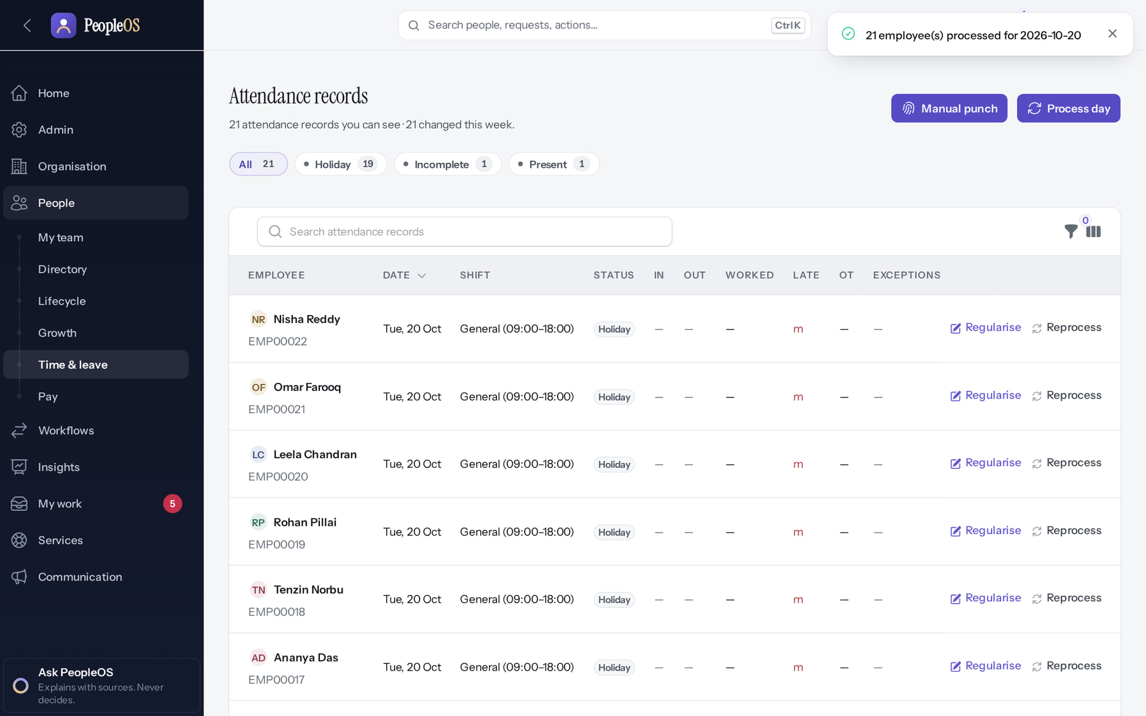
Attendance processing
INTERNAL HR
1
Verified in the running application
1
Confirmation.
RESULT Process day turns punches and approved corrections into attendance records.
Real screen · Same screen in Markedge's internal tenant; shown here from the demonstration tenant (fictional Demo Group), where the workflow was executed.
Notes:
SAY: Process day turns punches and approved corrections into attendance records.
ON SCREEN: Submit.
LEARNERS SHOULD SEE: Confirmation; records for 20 Oct with status, in/out, worked hours and exceptions
SCREEN: Attendance records (after Process day). Signed in as Kavya Menon (Tenant HR Admin + Employee).
EVIDENCE: screenshot screenshots/hr-admin/20-att-13-day-processed.png, captured 2026-10-21 on the disposable training database (fictional people).

Slide 19
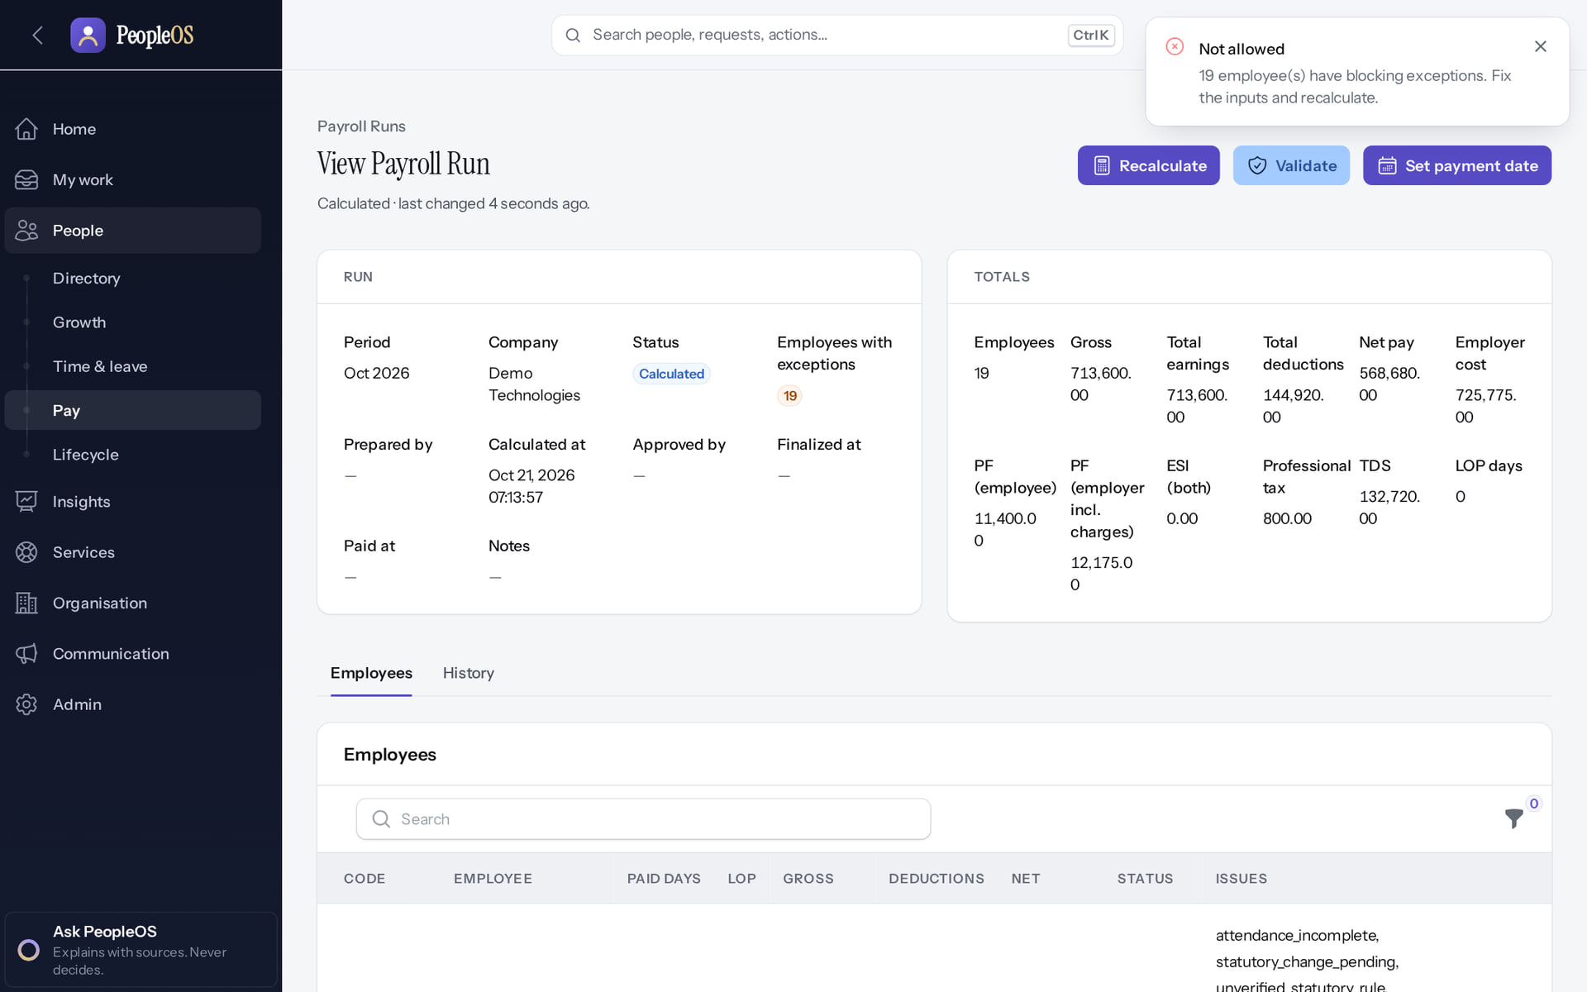
Payroll: calculated, not finalised
INTERNAL HR
Disabled by safety or commercial gates
1
1
Blocking message.
RESULT "19 employee(s) have blocking exceptions": the unverified statutory rules. Markedge's own payroll has the same safeguard; run it outside PeopleOS until the rules are verified.
Real screen · Same screen in Markedge's internal tenant; shown here from the demonstration tenant (fictional Demo Group), where the workflow was executed.
Notes:
SAY: "19 employee(s) have blocking exceptions": the unverified statutory rules. Markedge's own payroll has the same safeguard; run it outside PeopleOS until the rules are verified.
ON SCREEN: Validate (executed).
LEARNERS SHOULD SEE: Refused: "Not allowed — N employee(s) have blocking exceptions. Fix the inputs and recalculate." Approve and Finalize never appear while blocking exceptions remain
SCREEN: Payroll run › Validate. Signed in as Arjun Bose (Payroll Admin + Employee). Prerequisite: Statutory rules verified (0 of 24 today); PAN, bank account and attendance inputs complete.
EVIDENCE: screenshot screenshots/hr-admin/60-pay-09-validate-blocked.png, captured 2026-10-21 on the disposable training database (fictional people).

Slide 20
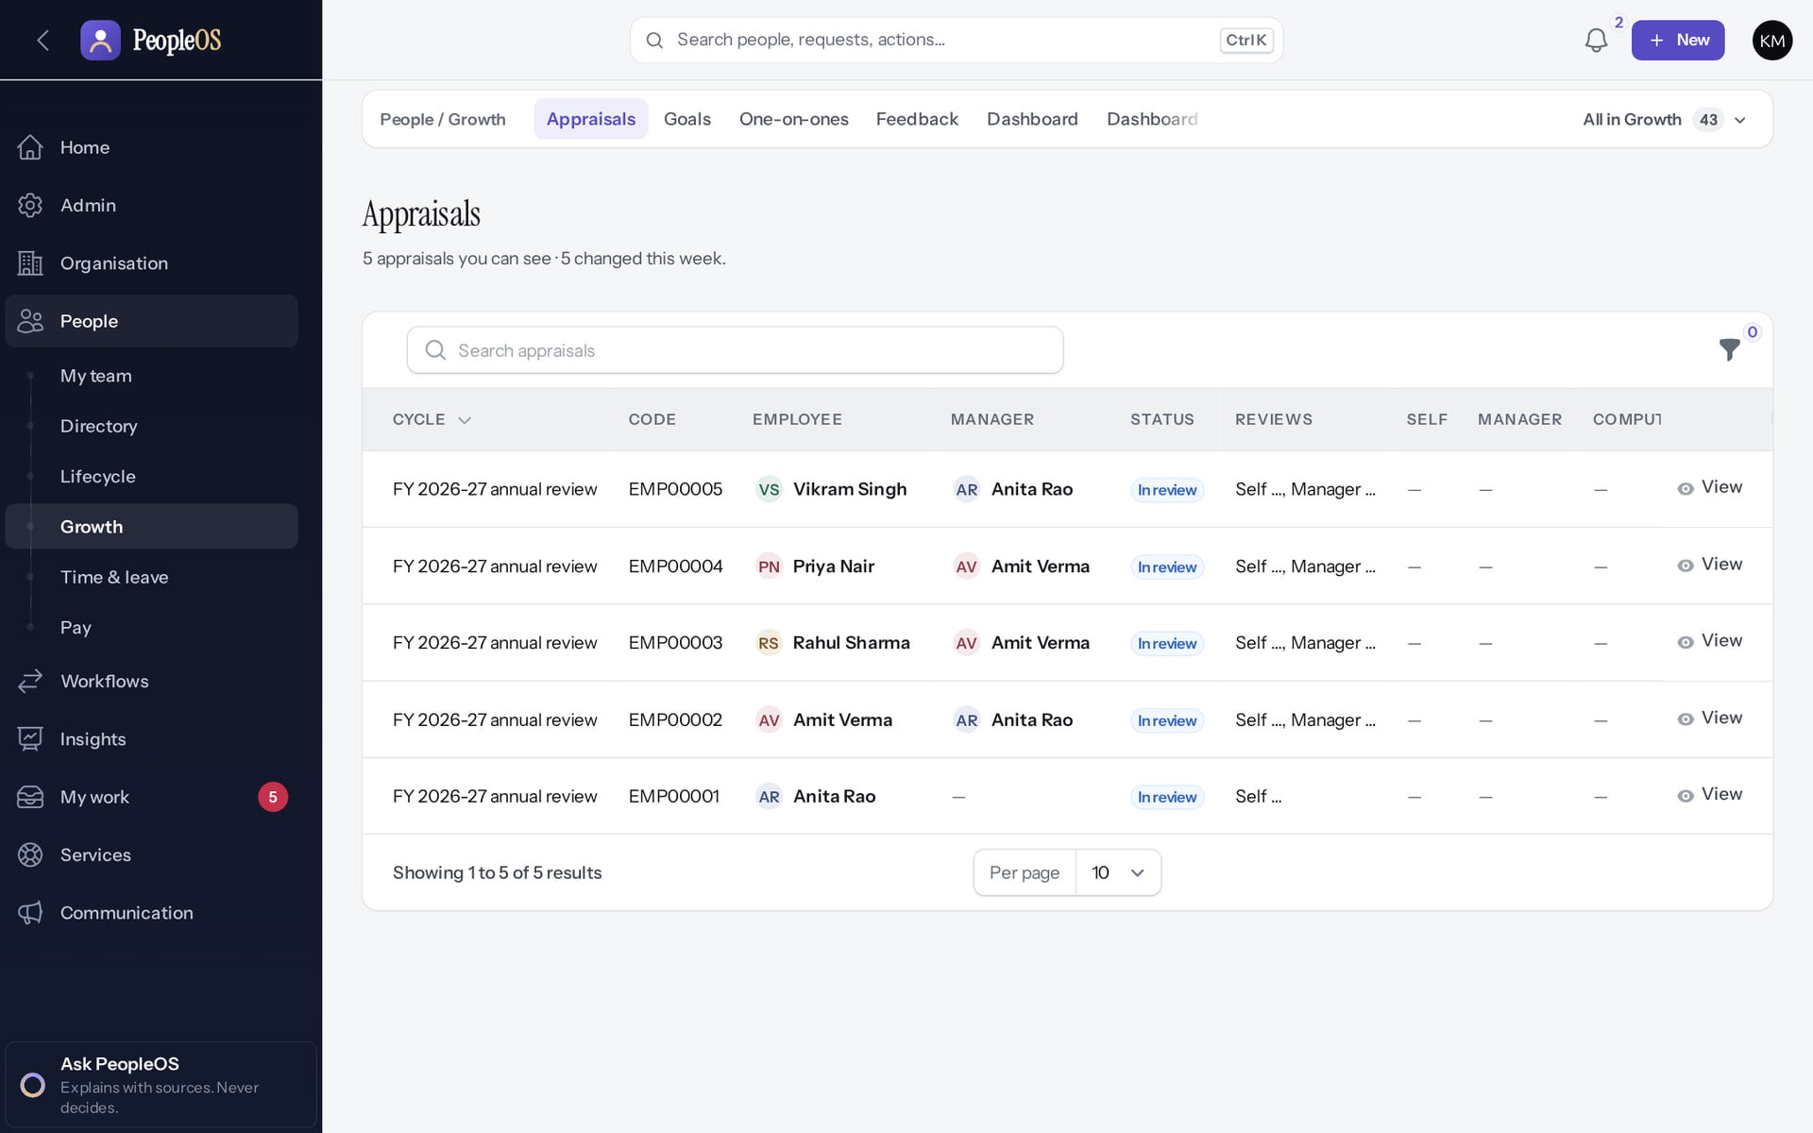
Performance reviews
INTERNAL HR
Verified in the running application
1
Stage.
RESULT Appraisals for the current cycle with their stage. Goals, calibration and learning are covered in Deck 3.
1
Real screen · Same screen in Markedge's internal tenant; shown here from the demonstration tenant (fictional Demo Group), where the workflow was executed.
Notes:
SAY: Appraisals for the current cycle with their stage. Goals, calibration and learning are covered in Deck 3.
ON SCREEN: Open Appraisals.
LEARNERS SHOULD SEE: One appraisal per employee in the cycle, with reviewer, stage and review progress
SCREEN: People › Growth › Appraisals. Signed in as Kavya Menon (Tenant HR Admin + Employee). Prerequisite: Tenant HR Admin (performance.*); the Performance Admin role template lacks these permissions (F3).
EVIDENCE: screenshot screenshots/hr-admin/65-grow-03-appraisals.png, captured 2026-10-21 on the disposable training database (fictional people).

Slide 21
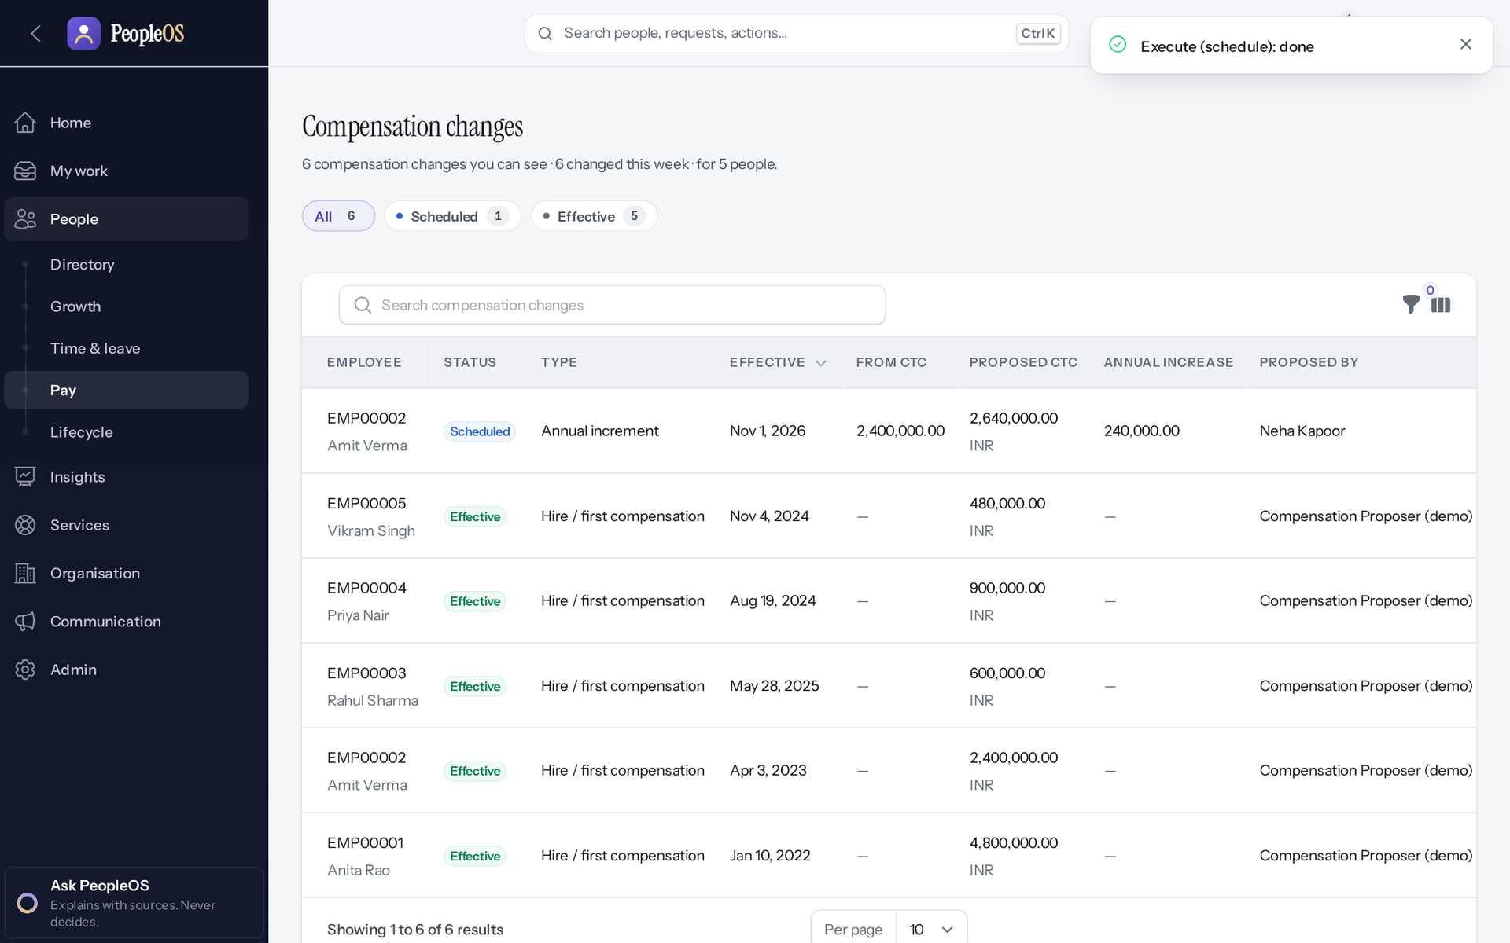
Compensation changes
INTERNAL HR
1
Verified in the running application
1
Result.
RESULT Four different people propose, review, approve and execute. Plan who holds each role at Markedge.
Real screen · Same screen in Markedge's internal tenant; shown here from the demonstration tenant (fictional Demo Group), where the workflow was executed.
Notes:
SAY: Four different people propose, review, approve and execute. Plan who holds each role at Markedge.
ON SCREEN: Payroll Admin (a fourth person): Execute (schedule) → Confirm.
LEARNERS SHOULD SEE: Status scheduled; the new salary takes effect on the effective date and is used by payroll from then
SCREEN: Compensation changes (after execution). Signed in as Arjun Bose (Payroll Admin + Employee). Prerequisite: Four different people: proposer (compensation.propose), reviewer (compensation.review), approver (compensation.approve), executor (compensation.execute).
EVIDENCE: screenshot screenshots/hr-admin/62-comp-10-executed.png, captured 2026-10-21 on the disposable training database (fictional people).

Slide 22
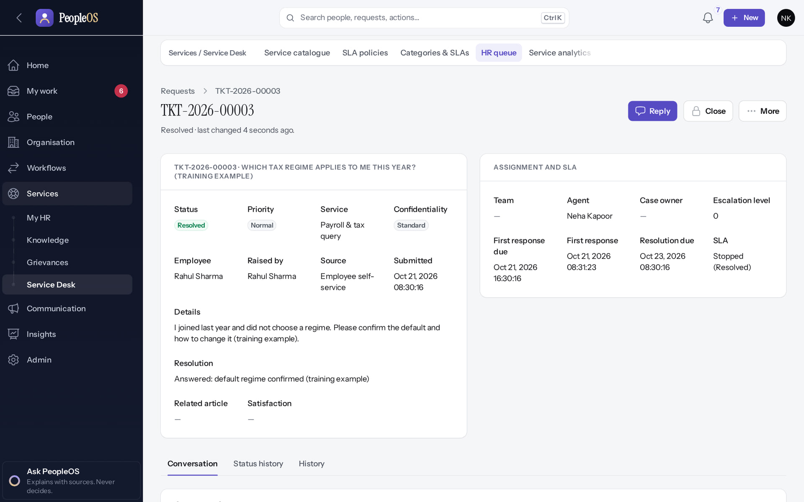
HR service requests
INTERNAL HR
Verified in the running application
1
Assignment and SLA.
2
Conversation.
1
RESULT Employees ask HR from My HR; HR handles the queue with SLAs.
2
Real screen · Same screen in Markedge's internal tenant; shown here from the demonstration tenant (fictional Demo Group), where the workflow was executed.
Notes:
SAY: Employees ask HR from My HR; HR handles the queue with SLAs.
ON SCREEN: Resolve.
LEARNERS SHOULD SEE: Status Resolved; assignee, SLA and the conversation are kept on the request
SCREEN: HR queue › request (after Take it, Reply, Resolve). Signed in as Neha Kapoor (HR Manager + Employee). Prerequisite: Employees: ticket.create (My HR); HR: ticket.manage (HR Manager, Tenant HR Admin).
EVIDENCE: screenshot screenshots/hr-admin/52-tkt-05-resolved.png, captured 2026-10-21 on the disposable training database (fictional people).

Slide 23
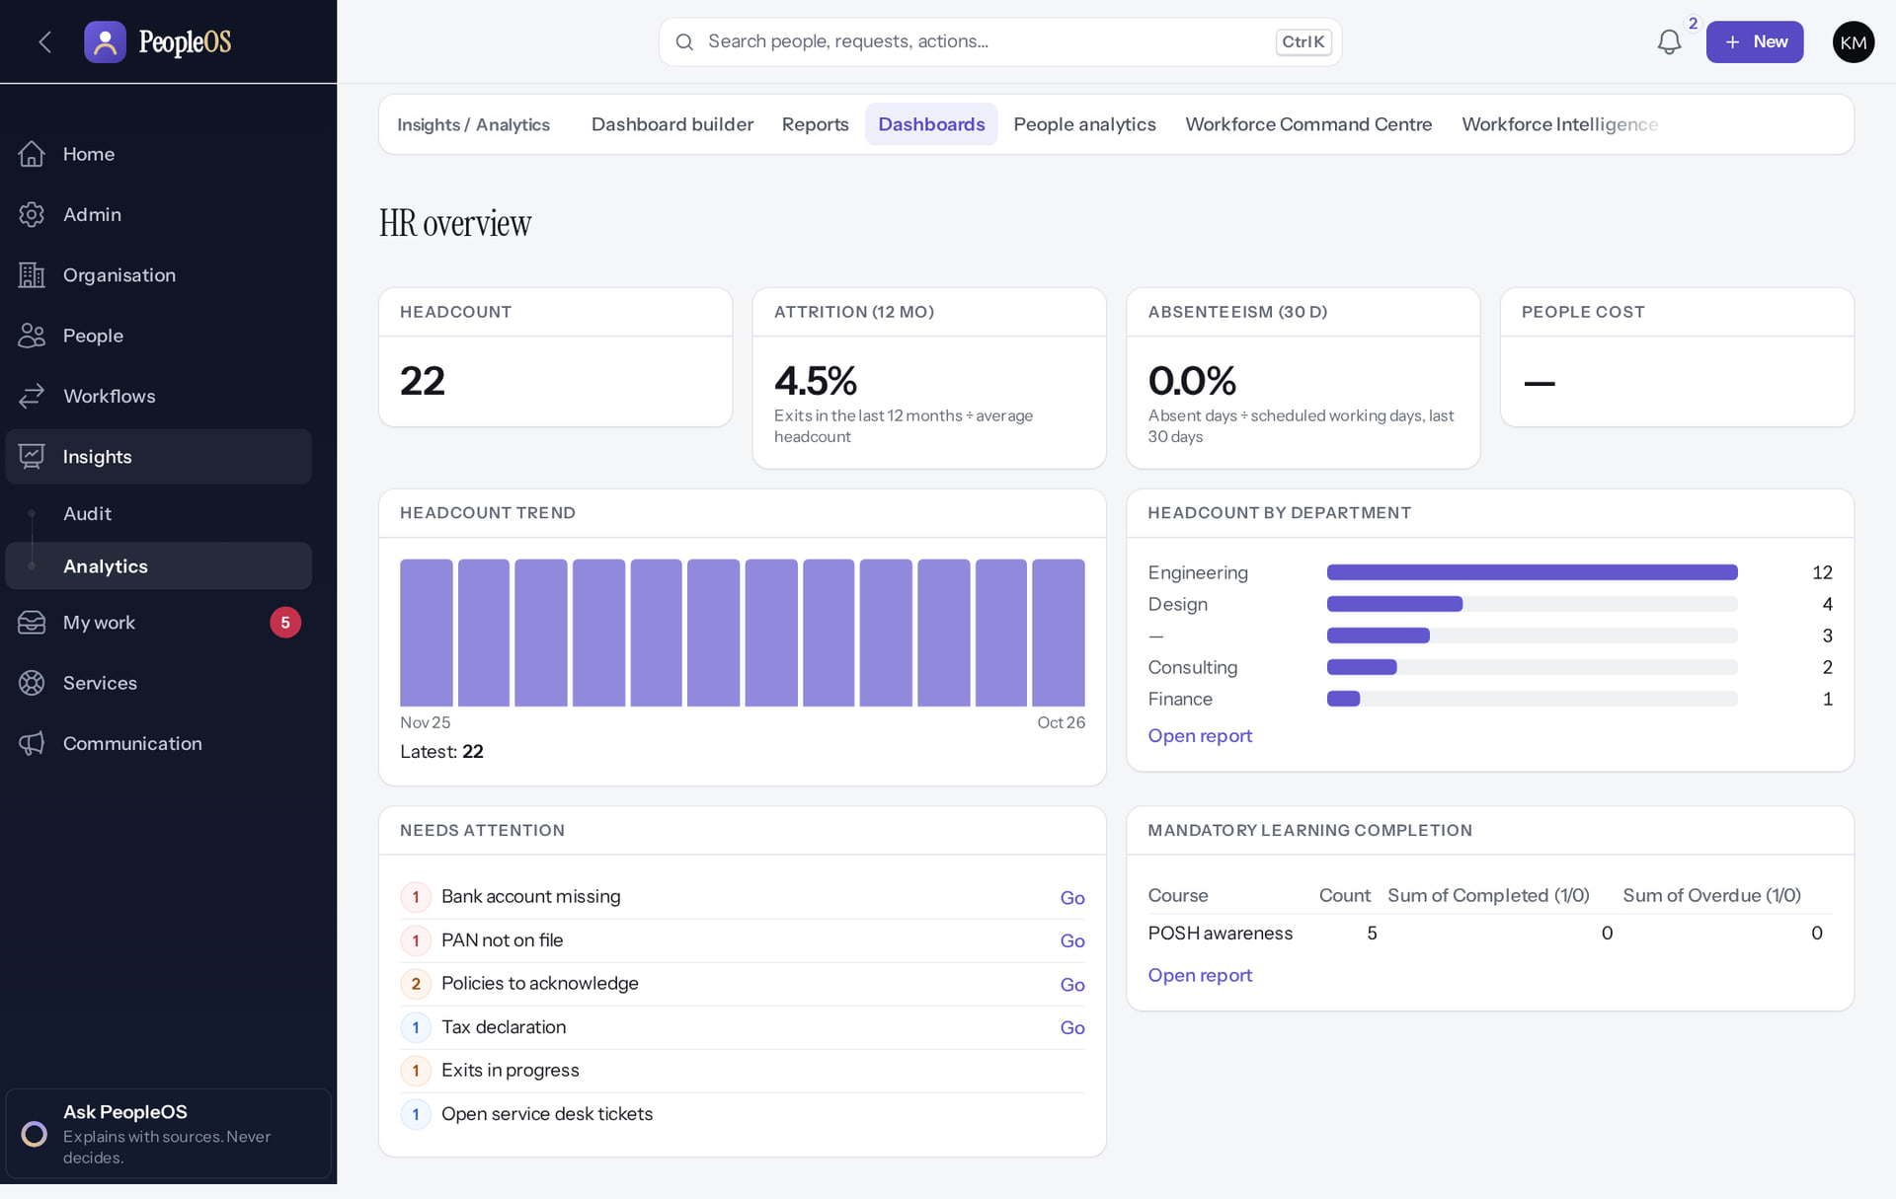
Reporting for Markedge leadership
INTERNAL HR
Verified in the running application
RESULT The HR overview dashboard. Workforce pulse and People analytics are in Deck 12; executives need extra dataset permissions for some widgets.
Real screen · Same screen in Markedge's internal tenant; shown here from the demonstration tenant (fictional Demo Group), where the workflow was executed.
Notes:
SAY: The HR overview dashboard. Workforce pulse and People analytics are in Deck 12; executives need extra dataset permissions for some widgets.
ON SCREEN: Open Dashboards.
LEARNERS SHOULD SEE: Tiles: headcount, attrition (12 months), absenteeism (30 days), people cost, headcount trend and by department, needs attention, mandatory learning
SCREEN: Insights › Analytics › Dashboards (HR overview). Signed in as Kavya Menon (Tenant HR Admin + Employee). Prerequisite: Analytics permissions per dataset; privacy minimum group size.
EVIDENCE: screenshot screenshots/analytics/80-ins-04-hr-overview-dashboard.png, captured 2026-10-21 on the disposable training database (fictional people).

Slide 24
Running Markedge HR on PeopleOS today
PRACTICALITIES
Use it for
Keep outside for now
Records, hiring, onboarding, leave, attendance, documents, letters, performance, learning, service requests and exits.
Payroll finalisation and payslips (statutory rules unverified), bulk employee imports and custom grouped reports (both have known defects).
Separate accounts
Same rules as customers
Staff who are both Markedge employees and platform operators use two accounts: an employee account in the internal tenant and an operator account with MFA.
Release gate NO-GO applies to Markedge's own use too: no production hosting, DR or on-call yet.
Notes:
SAY: Markedge should be its own first customer, but with the same caution: the release gate is NO-GO.
SAY: Running Markedge HR on PeopleOS today.
- Use it for: Records, hiring, onboarding, leave, attendance, documents, letters, performance, learning, service requests and exits.
- Keep outside for now: Payroll finalisation and payslips (statutory rules unverified), bulk employee imports and custom grouped reports (both have known defects).
- Separate accounts: Staff who are both Markedge employees and platform operators use two accounts: an employee account in the internal tenant and an operator account with MFA.
- Same rules as customers: Release gate NO-GO applies to Markedge's own use too: no production hosting, DR or on-call yet.
ASK: "Which of these points needs more explanation for your team?"

Slide 25
Summary
Markedge's workforce lives in an ordinary tenant, provisioned like a customer's.
Internal HR and platform operations are different accounts with different permissions.
Operators enter any tenant, including Markedge's, only with a reason, for 60 minutes, audited.
Internal HR uses the same screens and has the same limits as customers.
NEXT STEPS & HELP
Deck 03: HR operations in detail
Deck 05: platform operator duties
Deck 08: access boundaries
Release gate: NO-GO (10 of 14 gates blocked, re-verified 13 Oct 2026). Not yet generally available.
Notes:
EVIDENCE: Executed on the training database on 21 Oct 2026: the operator provisioned "Markedge Technologies (internal workforce)" (fictional), its administrator Sana Qureshi (fictional) activated it, created a company, departments and designations, and hired three fictional employees (tools/capture/96-internal.mjs).
SAY: Recap the key points:
- Markedge's workforce lives in an ordinary tenant, provisioned like a customer's.
- Internal HR and platform operations are different accounts with different permissions.
- Operators enter any tenant, including Markedge's, only with a reason, for 60 minutes, audited.
- Internal HR uses the same screens and has the same limits as customers.
POINT TO: Deck 03: HR operations in detail; Deck 05: platform operator duties; Deck 08: access boundaries
ASK: "What will you do first in PeopleOS?" Collect questions you cannot answer and send them to the PeopleOS team.

