Slide 1
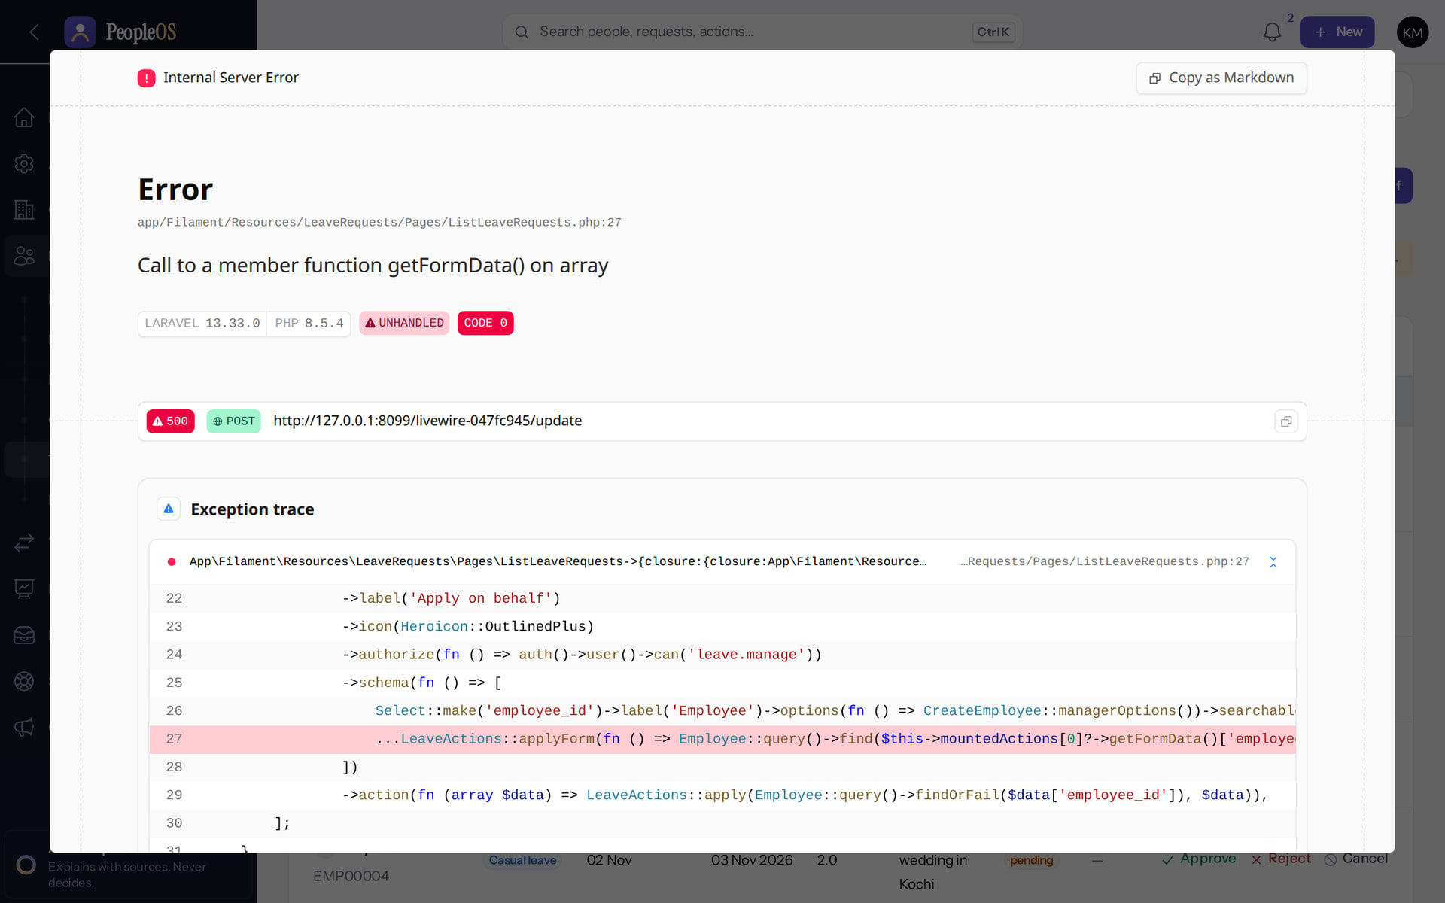
Troubleshooting and Support Playbook
MARKEDGE PEOPLEOS · TRAINING LIBRARY
Deck 07 of 12
Recognise real PeopleOS symptoms, diagnose them safely, fix what support may fix, and escalate the rest with the right evidence.
For: Markedge support staff and customer HR helpdesk leads
Built from the running application (local, disposable database, fictional people) · 21 October 2026
Real screen, fictional data
Notes:
SAY: Every symptom in this deck was reproduced in the running application on a training database. Where we could not reproduce something, the slide says so.
AVOID: inventing error messages for customers. Quote what the screen says.

Slide 2
How to read this deck
BEFORE YOU START
Verified in the running application
We ran it on the training database and captured each step.
1
Numbered markers on a screenshot match the numbered steps beside it.
Implemented · not verified end to end
The screen exists; the last steps need data or a second party we could not provide.
Every screenshot is a real capture of PeopleOS. The people and companies in it are fictional.
Available only after configuration
Works once an administrator or Markedge has set it up.
Disabled by safety or commercial gates
Switched off on purpose until owner decisions and approvals arrive.
Diagrams are marked "Conceptual diagram". They explain ideas; they are not screens.
Incomplete · known defect or gap
Partly working: a known defect or gap is stated on the slide.
Release gate: NO-GO (10 of 14 gates blocked, re-verified 13 Oct 2026). Not yet generally available.
Not implemented
Not in the product today.
Unable to verify
Could not be checked in this environment.
Notes:
Explain the seven status labels. Every screenshot slide carries one of them in its top-right corner. Stress that "Verified in the running application" means we ran it on a disposable demonstration database, not that the feature is released.

Slide 3
Release gate: NO-GO until these are resolved (1 of 2)
RELEASE STATUS
Status as written in the release gate document. Ten of fourteen gates are blocked by owner decisions, external parties or missing infrastructure.
# | Gate | Gate status | Remaining dependency
1 | Application and architecture integrity | PASS (workstation) | Repeat the full suites in staging
2 | Credential exposure and repository remediation | BLOCKED | Owner: rotation confirmation, repository visibility (O-1 to O-3)
3 | Authentication and operator MFA | BLOCKED | Operators enrol MFA in the target environment (O-14, O-7)
4 | Independent security review | BLOCKED | Engage a reviewer; triage and retest findings (O-4)
5 | Statutory verification and gratuity | BLOCKED | 0 of 24 rules verified; gratuity not implemented (O-5, O-12, O-18)
6 | Data protection, retention, legal holds | PASS (controls) / BLOCKED (policy) | Retention decisions with counsel (D8); privacy review
7 | Backup, restore and disaster recovery | BLOCKED | Recovery objectives and an isolated target (O-6, O-7)
Notes:
SOURCE: docs/saas/SaaS-Final-Release-Gate.md (decision NO-GO, re-verified 13 October 2026 at 7314f7d); owner actions in docs/saas/SaaS-Final-Owner-Action-Register.md.
SAY: The application passes its automated suites on the workstation, but release is blocked by decisions and infrastructure, not by code alone.
AVOID: describing any gate as resolved. Nothing in this training changes a gate.
SAY: Release gate: NO-GO until these are resolved (part 1 of 2). Status as written in the release gate document. Ten of fourteen gates are blocked by owner decisions, external parties or missing infrastructure.
- 1 | Application and architecture integrity | PASS (workstation) | Repeat the full suites in staging
- 2 | Credential exposure and repository remediation | BLOCKED | Owner: rotation confirmation, repository visibility (O-1 to O-3)
- 3 | Authentication and operator MFA | BLOCKED | Operators enrol MFA in the target environment (O-14, O-7)
- 4 | Independent security review | BLOCKED | Engage a reviewer; triage and retest findings (O-4)
- 5 | Statutory verification and gratuity | BLOCKED | 0 of 24 rules verified; gratuity not implemented (O-5, O-12, O-18)
- 6 | Data protection, retention, legal holds | PASS (controls) / BLOCKED (policy) | Retention decisions with counsel (D8); privacy review
- 7 | Backup, restore and disaster recovery | BLOCKED | Recovery objectives and an isolated target (O-6, O-7)

Slide 4
Release gate: NO-GO until these are resolved (2 of 2)
RELEASE STATUS
# | Gate | Gate status | Remaining dependency
8 | Hosting, monitoring and on-call | BLOCKED | Environment, alerting, on-call (O-7, O-10, O-11)
9 | Signup and tenant provisioning | PASS (disabled) / BLOCKED (activation) | Only if self-service signup is wanted at launch (D10)
10 | Billing, tax and payment controls | PASS (disabled) / BLOCKED (activation) | Only for paid billing (B-4, B-7, B-8, B-9)
11 | Tenant deletion and offboarding | PASS (disabled) / BLOCKED (activation) | Retention decisions, register disk, review (D8)
12 | Regression and target-environment testing | BLOCKED | A staging environment (O-7, O-8)
13 | Owner decisions and written approvals | BLOCKED | All owner action items
14 | Deployment, rollback, post-deployment checks | BLOCKED | Rehearse in staging; authorise (O-7 to O-9)
Notes:
SOURCE: docs/saas/SaaS-Final-Release-Gate.md (decision NO-GO, re-verified 13 October 2026 at 7314f7d); owner actions in docs/saas/SaaS-Final-Owner-Action-Register.md.
SAY: The application passes its automated suites on the workstation, but release is blocked by decisions and infrastructure, not by code alone.
AVOID: describing any gate as resolved. Nothing in this training changes a gate.
SAY: Release gate: NO-GO until these are resolved (part 2 of 2). Status as written in the release gate document. Ten of fourteen gates are blocked by owner decisions, external parties or missing infrastructure.
- 8 | Hosting, monitoring and on-call | BLOCKED | Environment, alerting, on-call (O-7, O-10, O-11)
- 9 | Signup and tenant provisioning | PASS (disabled) / BLOCKED (activation) | Only if self-service signup is wanted at launch (D10)
- 10 | Billing, tax and payment controls | PASS (disabled) / BLOCKED (activation) | Only for paid billing (B-4, B-7, B-8, B-9)
- 11 | Tenant deletion and offboarding | PASS (disabled) / BLOCKED (activation) | Retention decisions, register disk, review (D8)
- 12 | Regression and target-environment testing | BLOCKED | A staging environment (O-7, O-8)
- 13 | Owner decisions and written approvals | BLOCKED | All owner action items
- 14 | Deployment, rollback, post-deployment checks | BLOCKED | Rehearse in staging; authorise (O-7 to O-9)

Slide 5
What you will be able to do
LEARNING OBJECTIVES
Triage by symptom
sign-in, access, data, time and leave, payroll, notifications, platform
Escalate correctly
customer administrator, Markedge support, engineering, platform operator
1
4
Collect the right evidence
without exposing personal data or secrets
Recognise known defects
F25, F38, F44, F17, F26 and new findings
2
5
Apply safe fixes
resend invitations, scope checks, documented workarounds
3
Notes:
SAY: What you will be able to do:
1. Triage by symptom: sign-in, access, data, time and leave, payroll, notifications, platform
2. Collect the right evidence: without exposing personal data or secrets
3. Apply safe fixes: resend invitations, scope checks, documented workarounds
4. Escalate correctly: customer administrator, Markedge support, engineering, platform operator
5. Recognise known defects: F25, F38, F44, F17, F26 and new findings
ASK: "Which of these matters most to you?" Return to the answer in the summary.

Slide 6
Ground rules for every ticket
SUPPORT
Ask for the exact message
Never ask for passwords
Personal data stays in PeopleOS
Screenshot plus time, user e-mail and the page address. Most sign-in messages are deliberately generic.
Not for MFA codes, recovery codes or reset links either. Resend an invitation or reset instead.
Do not copy PAN, Aadhaar, bank or salary into tickets or chat; reference the employee code.
Check the role first
Look for a known defect
Operators act with reasons
A missing menu is usually a role or scope question, not a fault.
Compare with the known-defects slide before escalating.
Entering a tenant needs a ticket reference; it is audited and ends after 60 minutes.
Notes:
SAY: Ground rules for every ticket.
- Ask for the exact message: Screenshot plus time, user e-mail and the page address. Most sign-in messages are deliberately generic.
- Never ask for passwords: Not for MFA codes, recovery codes or reset links either. Resend an invitation or reset instead.
- Personal data stays in PeopleOS: Do not copy PAN, Aadhaar, bank or salary into tickets or chat; reference the employee code.
- Check the role first: A missing menu is usually a role or scope question, not a fault.
- Look for a known defect: Compare with the known-defects slide before escalating.
- Operators act with reasons: Entering a tenant needs a ticket reference; it is audited and ends after 60 minutes.
ASK: "Which of these points needs more explanation for your team?"

Slide 7
Sign-in and account activation
01
Generic messages by design: diagnose from the account, not the screen.
Notes:
TRANSITION: Section 1, Sign-in and account activation. Generic messages by design: diagnose from the account, not the screen.
SAY: Tell learners what they will be able to do by the end of this section, then move on.
ASK: "What questions do you have before we start this section?"

Slide 8
Cannot sign in
ISSUE
USER SYMPTOMS
"These credentials do not match our records." after entering e-mail and password.
DIAGNOSTIC STEPS
Admin › Setup › Users: is the account Active, Invited or Suspended? Platform › Tenants (operator): is the tenant Suspended? Was the e-mail changed recently (verification)?
EXPECTED VERSUS ACTUAL
The message is the same for a wrong password, an unknown e-mail, an invited (never activated) account and a suspended account or tenant. It never says which.
SAFE CORRECTIVE ACTION
Wrong password: the user selects Forgot password? on the sign-in page. Invited: resend the invitation. Suspended user: the customer administrator reactivates. Suspended tenant: operator decision only.
ESCALATE TO
Customer administrator (user status); Markedge platform operator (tenant status).
EVIDENCE TO COLLECT
User e-mail, time of attempt, Users list status, tenant status.
NEVER Never reset a password on the user's behalf by setting one, never read the database to "check" a password, never reactivate a tenant without the documented approval.
Notes:
SYMPTOM: "These credentials do not match our records." after entering e-mail and password.
DIAGNOSE: Admin › Setup › Users: is the account Active, Invited or Suspended? Platform › Tenants (operator): is the tenant Suspended? Was the e-mail changed recently (verification)?
EXPECTED VS ACTUAL: The message is the same for a wrong password, an unknown e-mail, an invited (never activated) account and a suspended account or tenant. It never says which.
SAFE FIX: Wrong password: the user selects Forgot password? on the sign-in page. Invited: resend the invitation. Suspended user: the customer administrator reactivates. Suspended tenant: operator decision only.
ESCALATE: Customer administrator (user status); Markedge platform operator (tenant status).
EVIDENCE: User e-mail, time of attempt, Users list status, tenant status.
NEVER: Never reset a password on the user's behalf by setting one, never read the database to "check" a password, never reactivate a tenant without the documented approval.
ASK: "What would you check first?"

Slide 9
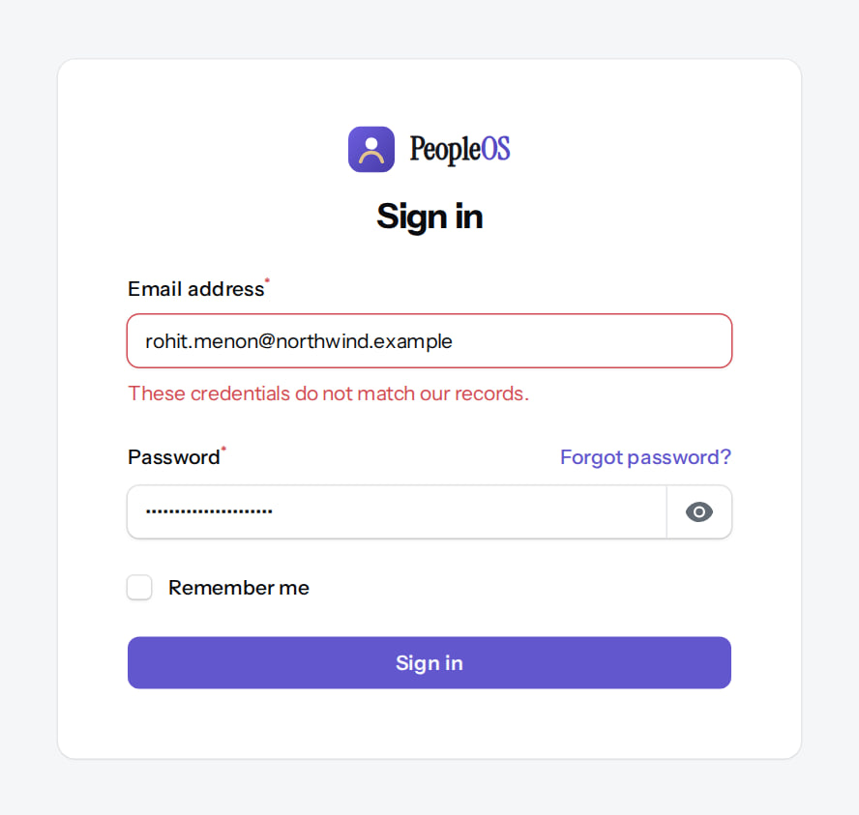
The generic sign-in message
ISSUE
Verified in the running application
1
Generic message.
2
Forgot password?
RESULT Identical for every cause: protects accounts from probing.
1
2
Real screen (cropped) · Signed out (Visitor) · Sign in (failed)
Notes:
SAY: Identical for every cause: protects accounts from probing.
ON SCREEN: Sign in with a wrong password.
WALK THROUGH: (1) Generic message. (2) Forgot password?
LEARNERS SHOULD SEE: "These credentials do not match our records." — the same message for a wrong password, an unknown e-mail, an invited (not activated) or a suspended account
SCREEN: Sign in (failed). Signed in as Signed out (Visitor). Prerequisite: None (public pages).
EVIDENCE: screenshot screenshots/support/99-sup-01-wrong-password.png, captured 2026-10-21 on the disposable training database (fictional people).

Slide 10
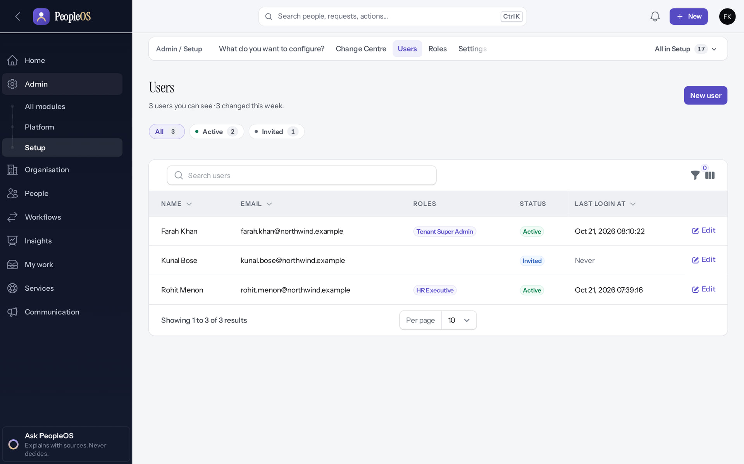

Invited, never activated
SIGN-IN
Users list
Verified
Their sign-in attempt
Verified
Status Invited, last login Never: the invitation link (72 hours) was not used.
Generic message. Fix: resend the invitation (Users for staff; Tenants › Send invitation for a first administrator).
Real screen · Farah Khan (Tenant Super Admin (Northwind Retail, first administrator)) · Admin › Setup › Users
Real screen (cropped) · Signed out (Visitor) · Sign in (invited user)
Notes:
SAY: Invited, never activated.
LEFT, Users list: Status Invited, last login Never: the invitation link (72 hours) was not used.
RIGHT, Their sign-in attempt: Generic message. Fix: resend the invitation (Users for staff; Tenants › Send invitation for a first administrator).
OBSERVE: point out what differs between the two screens.
EVIDENCE: left = support/99-sup-07-user-invited [Farah Khan (Tenant Super Admin (Northwind Retail, first administrator)), Admin › Setup › Users]; right = support/99-sup-08-invited-cannot-sign-in [Signed out (Visitor), Sign in (invited user)]. Real screens, fictional data (SCREENSHOT-INVENTORY.md).

Slide 11
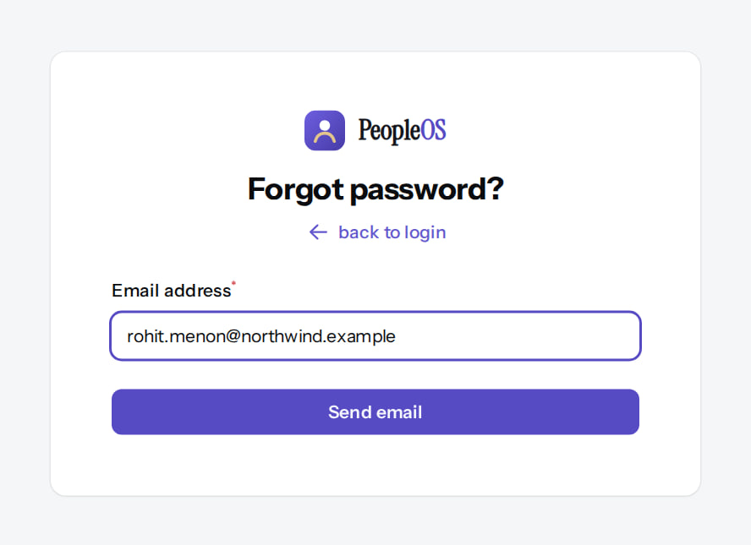
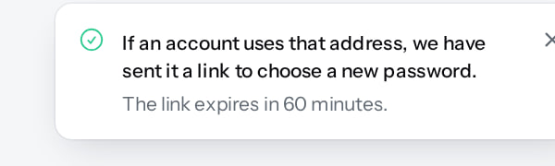
Password reset: request
SIGN-IN
Forgot password?
Verified
Neutral answer (the toast)
Verified
E-mail address and Send email.
"If an account uses that address, we have sent it a link…" The link expires in 60 minutes; requests are rate-limited.
Real screen (cropped) · Signed out (Visitor) · Forgot password?
Real screen (cropped) · Signed out (Visitor) · Forgot password? (after Send email)
Notes:
SAY: Password reset: request.
LEFT, Forgot password?: E-mail address and Send email.
RIGHT, Neutral answer (the toast): "If an account uses that address, we have sent it a link…" The link expires in 60 minutes; requests are rate-limited.
OBSERVE: point out what differs between the two screens.
EVIDENCE: left = support/99-sup-02-forgot-password [Signed out (Visitor), Forgot password?]; right = support/99-sup-03-reset-requested [Signed out (Visitor), Forgot password? (after Send email)]. Real screens, fictional data (SCREENSHOT-INVENTORY.md).

Slide 12
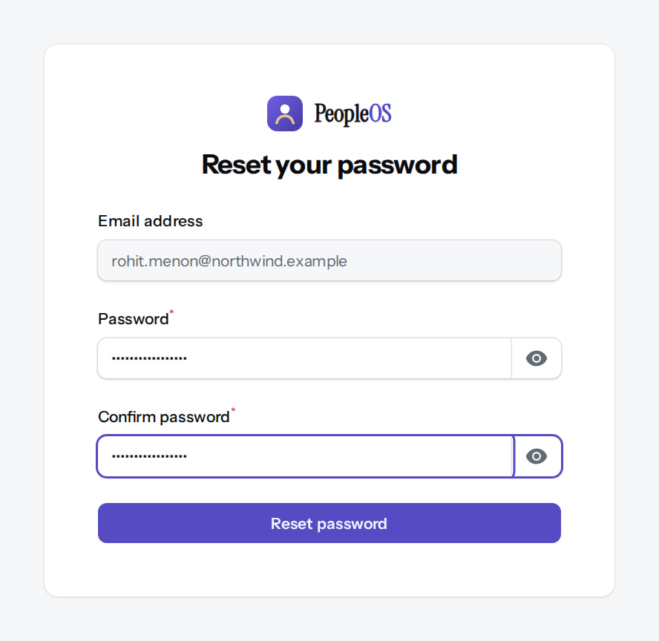
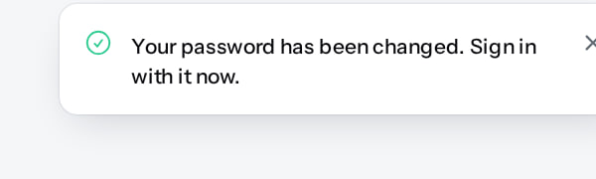
Password reset: complete
SIGN-IN
Reset form (from the e-mail link)
Verified
Done (the toast)
Verified
New password, confirmation, Reset password.
"Your password has been changed. Sign in with it now." Other sessions end.
Real screen (cropped) · Signed out (Visitor) · Reset your password (link from the e-mail)
Real screen (cropped) · Signed out (Visitor) · Sign in (after the reset)
Notes:
SAY: Password reset: complete.
LEFT, Reset form (from the e-mail link): New password, confirmation, Reset password.
RIGHT, Done (the toast): "Your password has been changed. Sign in with it now." Other sessions end.
OBSERVE: point out what differs between the two screens.
EVIDENCE: left = support/99-sup-04-reset-form [Signed out (Visitor), Reset your password (link from the e-mail)]; right = support/99-sup-05-reset-done [Signed out (Visitor), Sign in (after the reset)]. Real screens, fictional data (SCREENSHOT-INVENTORY.md).

Slide 13
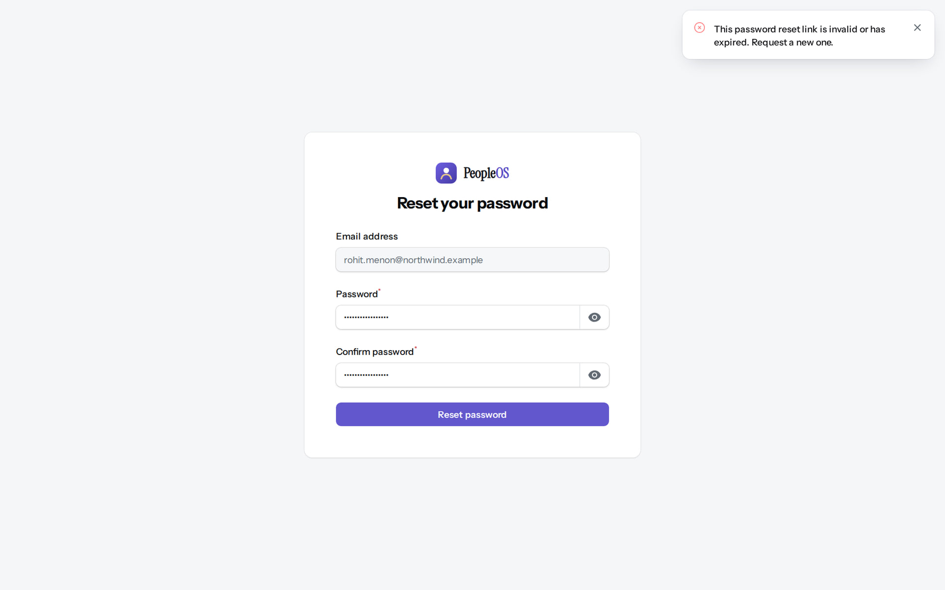
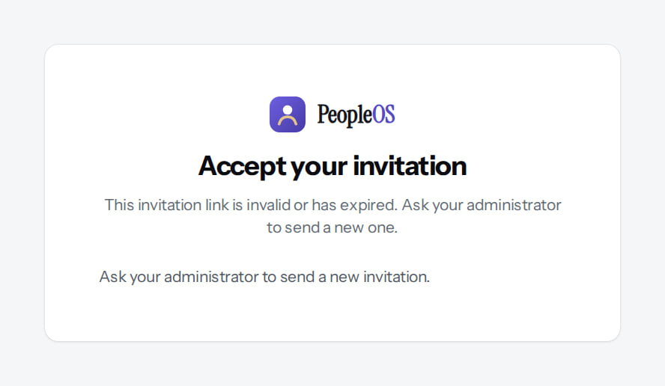
Used or expired links
SIGN-IN
Reset link used twice
Verified
Invitation used twice
Verified
One message for any bad, used or expired reset link: request a new one.
"This invitation link is invalid or has expired. Ask your administrator to send a new one."
Real screen · Signed out (Visitor) · Reset your password (used link)
Real screen (cropped) · Signed out (Visitor) · Accept your invitation (used link)
Notes:
SAY: Used or expired links.
LEFT, Reset link used twice: One message for any bad, used or expired reset link: request a new one.
RIGHT, Invitation used twice: "This invitation link is invalid or has expired. Ask your administrator to send a new one."
OBSERVE: point out what differs between the two screens.
EVIDENCE: left = support/99-sup-06-reset-link-used [Signed out (Visitor), Reset your password (used link)]; right = client-onboarding/90-onb-11-invitation-used [Signed out (Visitor), Accept your invitation (used link)]. Real screens, fictional data (SCREENSHOT-INVENTORY.md).

Slide 14

A whole organisation cannot sign in
SIGN-IN
Verified in the running application
1
The generic message.
RESULT Every user of a suspended tenant gets the generic message. Operator: check Platform › Tenants; reactivation needs the documented approval and a reason.
1
Real screen (cropped) · Farah Khan (Tenant Super Admin (Northwind Retail, first administrator)) · Sign in (tenant suspended)
Notes:
SAY: Every user of a suspended tenant gets the generic message. Operator: check Platform › Tenants; reactivation needs the documented approval and a reason.
ON SCREEN: The Northwind administrator signs in with the correct password while the tenant is suspended.
WALK THROUGH: (1) The generic message.
LEARNERS SHOULD SEE: Sign-in refused with the generic credentials message (by design, no hint that the tenant is suspended)
SCREEN: Sign in (tenant suspended). Signed in as Farah Khan (Tenant Super Admin (Northwind Retail, first administrator)). Prerequisite: Platform operator (is_platform_admin) signed in with MFA.
EVIDENCE: screenshot screenshots/platform-admin/95-pl-08-suspended-sign-in.png, captured 2026-10-21 on the disposable training database (fictional people).

Slide 15
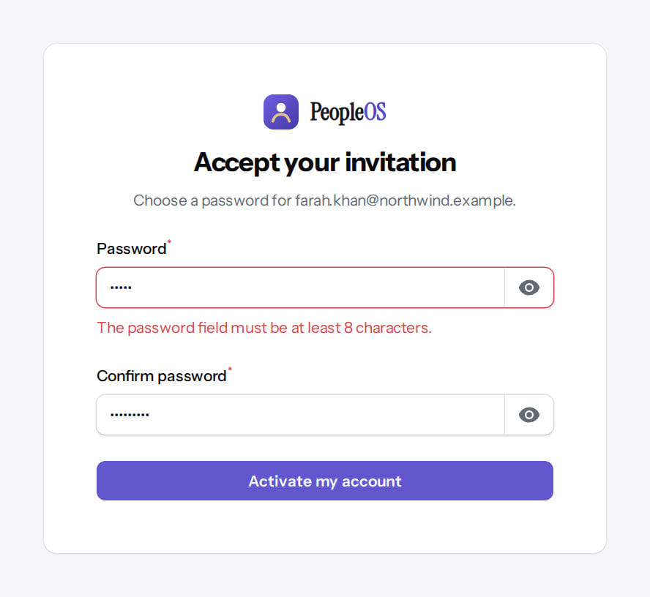
Activation refused: password rules
SIGN-IN
Verified in the running application
1
Validation message.
RESULT "The password field must be at least 8 characters." The account stays invited until a valid password is set.
1
Real screen (cropped) · Farah Khan (invited, not yet active) (Invited first administrator) · Accept your invitation (validation)
Notes:
SAY: "The password field must be at least 8 characters." The account stays invited until a valid password is set.
ON SCREEN: Submit a short password that does not match its confirmation.
WALK THROUGH: (1) Validation message.
LEARNERS SHOULD SEE: "The password field must be at least 8 characters."; the account stays invited
SCREEN: Accept your invitation (validation). Signed in as Farah Khan (invited, not yet active) (Invited first administrator). Prerequisite: Tenant provisioned by the operator; invitation e-mail delivered.
EVIDENCE: screenshot screenshots/client-onboarding/90-onb-09-password-rules.png, captured 2026-10-21 on the disposable training database (fictional people).

Slide 16
Missing menus and restricted pages
02
Role, scope and relationship decide what each person sees.
Notes:
TRANSITION: Section 2, Missing menus and restricted pages. Role, scope and relationship decide what each person sees.
SAY: Tell learners what they will be able to do by the end of this section, then move on.
ASK: "What questions do you have before we start this section?"

Slide 17
A menu or page is missing, or "not available"
ISSUE
USER SYMPTOMS
A menu item a colleague has is not shown, or a page says "This page is not available to you".
DIAGNOSTIC STEPS
Admin › Setup › Users › the user: roles and access scope. Compare with the role table in Deck 3. For managers: is the person a direct report effective today?
EXPECTED VERSUS ACTUAL
Pages appear only with the permission; records only within scope or reporting line. A 403 page is the control working.
SAFE CORRECTIVE ACTION
If the access is intended, the customer administrator changes the role or scope (Tenant Super Admin for role permissions). Otherwise explain the boundary.
ESCALATE TO
Customer administrator for roles and scope; Markedge support only if the role table says the access should exist.
EVIDENCE TO COLLECT
User e-mail, page address, roles and scope screenshot.
NEVER Never grant Tenant Super Admin to "make it work", and never ask an operator to enter the tenant to show someone data they are not allowed to see.
Notes:
SYMPTOM: A menu item a colleague has is not shown, or a page says "This page is not available to you".
DIAGNOSE: Admin › Setup › Users › the user: roles and access scope. Compare with the role table in Deck 3. For managers: is the person a direct report effective today?
EXPECTED VS ACTUAL: Pages appear only with the permission; records only within scope or reporting line. A 403 page is the control working.
SAFE FIX: If the access is intended, the customer administrator changes the role or scope (Tenant Super Admin for role permissions). Otherwise explain the boundary.
ESCALATE: Customer administrator for roles and scope; Markedge support only if the role table says the access should exist.
EVIDENCE: User e-mail, page address, roles and scope screenshot.
NEVER: Never grant Tenant Super Admin to "make it work", and never ask an operator to enter the tenant to show someone data they are not allowed to see.
ASK: "What would you check first?"

Slide 18
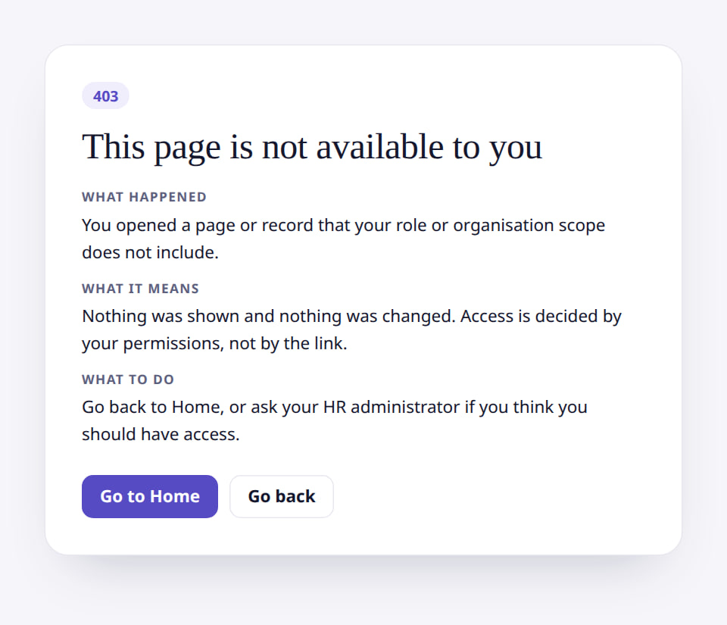
Example: Tenant HR Admin opening role edit
ISSUE
Verified in the running application
1
Access refused.
1
RESULT HTTP 403 "This page is not available to you": only a Tenant Super Admin edits role permissions (F5).
Real screen (cropped) · Kavya Menon (Tenant HR Admin + Employee) · Roles › HR Manager › Edit (as Tenant HR Admin)
Notes:
SAY: HTTP 403 "This page is not available to you": only a Tenant Super Admin edits role permissions (F5).
ON SCREEN: Tenant HR Admin opens /admin/roles/4/edit (the HR Manager role).
WALK THROUGH: (1) Access refused.
LEARNERS SHOULD SEE: HTTP 403 "This page is not available to you": the Tenant HR Admin holds role.view only and cannot change role permissions (finding F5); the Tenant Super Admin can
SCREEN: Roles › HR Manager › Edit (as Tenant HR Admin). Signed in as Kavya Menon (Tenant HR Admin + Employee). Prerequisite: role.manage (Tenant Super Admin only by default, F5).
EVIDENCE: screenshot screenshots/security-compliance/85-acc-08-role-edit-denied-hr-admin.png, captured 2026-10-21 on the disposable training database (fictional people).

Slide 19
Example: employee opening an HR page
ISSUE
Verified in the running application
1
Not available.
2
Go to Home.
1
RESULT HTTP 403 "This page is not available to you" with Go to Home and Go back.
2
Real screen (cropped) · Priya Nair (Employee) · People › Lifecycle › Employees (HR register) as an employee
Notes:
SAY: HTTP 403 "This page is not available to you" with Go to Home and Go back.
ON SCREEN: Open an HR-only address directly.
WALK THROUGH: (1) Not available. (2) Go to Home.
LEARNERS SHOULD SEE: HTTP 403: "This page is not available to you", with Go to Home and Go back
SCREEN: People › Lifecycle › Employees (HR register) as an employee. Signed in as Priya Nair (Employee).
EVIDENCE: screenshot screenshots/employee/30-self-52-restricted-page.png, captured 2026-10-21 on the disposable training database (fictional people).

Slide 20
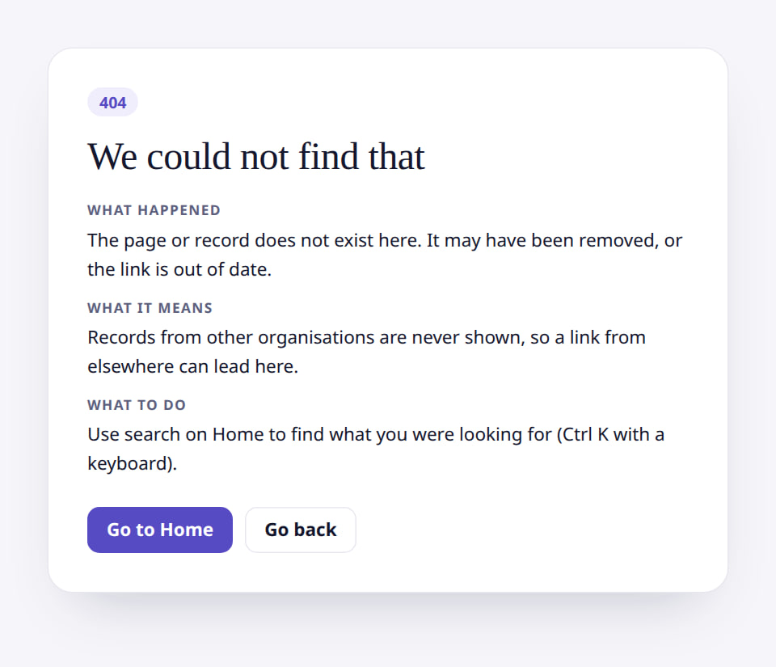
Incorrect employee visibility: outside the team
ACCESS
Verified in the running application
1
Not found.
1
RESULT "We could not find that" (404), not 403: records outside a manager's reach are not revealed. If they should report to the manager, fix the reporting line (Change manager), not the role.
Real screen (cropped) · Amit Verma (Manager + Employee) · Employee 360 of someone outside the team
Notes:
SAY: "We could not find that" (404), not 403: records outside a manager's reach are not revealed. If they should report to the manager, fix the reporting line (Change manager), not the role.
ON SCREEN: Open the address of an employee outside the manager’s scope (Neha Kapoor, HR).
LEARNERS SHOULD SEE: HTTP 404 "We could not find that": records outside the scope are not revealed
SCREEN: Employee 360 of someone outside the team. Signed in as Amit Verma (Manager + Employee).
EVIDENCE: screenshot screenshots/manager/40-team-09-outside-team.png, captured 2026-10-21 on the disposable training database (fictional people).

Slide 21
HR Executive and the Roles page
ACCESS
Verified in the running application
RESULT Refused: the HR Executive role does not include role.view. Expected behaviour.
Real screen (cropped) · Rohit Menon (HR Executive (Northwind Retail)) · Roles (as HR Executive)
Notes:
SAY: Refused: the HR Executive role does not include role.view. Expected behaviour.
ON SCREEN: The HR Executive opens the Roles screen directly.
LEARNERS SHOULD SEE: Refused: the role does not include role.view
SCREEN: Roles (as HR Executive). Signed in as Rohit Menon (HR Executive (Northwind Retail)). Prerequisite: Signed in as the tenant administrator (user.manage, role.view).
EVIDENCE: screenshot screenshots/client-onboarding/90-onb-60-hr-executive-roles-denied.png, captured 2026-10-21 on the disposable training database (fictional people).

Slide 22
Employee data problems
03
Imports, duplicates and record errors.
Notes:
TRANSITION: Section 3, Employee data problems. Imports, duplicates and record errors.
SAY: Tell learners what they will be able to do by the end of this section, then move on.
ASK: "What questions do you have before we start this section?"

Slide 23
Employee import stops at "inspected"
ISSUE
USER SYMPTOMS
After Upload and Inspect, Map columns shows "Failed — Undefined variable $svc"; the import stays inspected.
DIAGNOSTIC STEPS
People › Lifecycle › Employee imports › the import: status inspected; reproduce once with a 2-row file.
EXPECTED VERSUS ACTUAL
Expected: mapping saved, then Validate, Approve, Run. Actual: known defect F25 (same code serves punch imports).
SAFE CORRECTIVE ACTION
Discard the import. Load people with the Hire employee wizard, or have Markedge load them through POST /api/v1/employees (documented; not exercised in the training).
ESCALATE TO
Markedge engineering: defect F25 (app/Filament/Support/ImportActions.php map action).
EVIDENCE TO COLLECT
Import number, screenshot of the failure, row count.
NEVER Never edit import data in the database or bypass validation to push rows in.
Notes:
SYMPTOM: After Upload and Inspect, Map columns shows "Failed — Undefined variable $svc"; the import stays inspected.
DIAGNOSE: People › Lifecycle › Employee imports › the import: status inspected; reproduce once with a 2-row file.
EXPECTED VS ACTUAL: Expected: mapping saved, then Validate, Approve, Run. Actual: known defect F25 (same code serves punch imports).
SAFE FIX: Discard the import. Load people with the Hire employee wizard, or have Markedge load them through POST /api/v1/employees (documented; not exercised in the training).
ESCALATE: Markedge engineering: defect F25 (app/Filament/Support/ImportActions.php map action).
EVIDENCE: Import number, screenshot of the failure, row count.
NEVER: Never edit import data in the database or bypass validation to push rows in.
ASK: "What would you check first?"

Slide 24
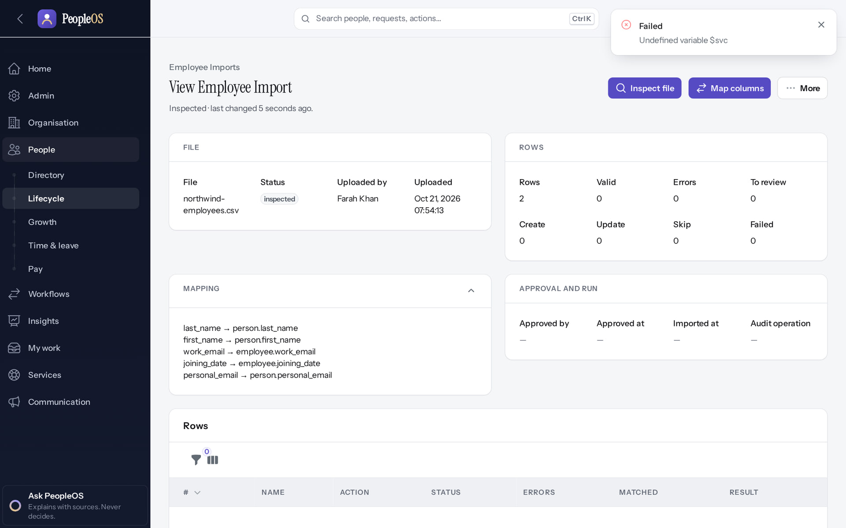
F25 reproduced in a new tenant
ISSUE
Incomplete · known defect or gap
1
1
Error.
RESULT Observed in two tenants on 21 Oct 2026.
Real screen · Farah Khan (Tenant Super Admin (Northwind Retail, first administrator)) · Employee import (after Map columns)
Notes:
SAY: Observed in two tenants on 21 Oct 2026.
ON SCREEN: Submit the column mapping.
WALK THROUGH: (1) Error.
LEARNERS SHOULD SEE: Observed: "Failed
Undefined variable $svc" — the mapping is not saved, so the import cannot pass "inspected" from the screen (known defect F25)
SCREEN: Employee import (after Map columns). Signed in as Farah Khan (Tenant Super Admin (Northwind Retail, first administrator)). Prerequisite: Signed in as the tenant administrator.
EVIDENCE: screenshot screenshots/client-onboarding/90-onb-93-import-map-fails.png, captured 2026-10-21 on the disposable training database (fictional people).

Slide 25
Duplicate person or employee
ISSUE
USER SYMPTOMS
Hire employee refuses to continue: "This person already exists".
DIAGNOSTIC STEPS
Search the Directory by name, employee code and personal e-mail. Check whether the existing person is alumni (re-employment).
EXPECTED VERSUS ACTUAL
Definite duplicates (same personal e-mail, phone or work e-mail) are refused; possible duplicates are warned.
SAFE CORRECTIVE ACTION
Re-use the existing person in the wizard, or correct the typo. For a returning employee use Change lifecycle state (alumni → active); a dedicated rehire screen does not exist.
ESCALATE TO
Customer HR lead; Markedge support if a real duplicate already exists (merge is not available on screen).
EVIDENCE TO COLLECT
Both employee codes and the wizard message.
NEVER Never change someone's personal e-mail just to get past the duplicate check.
Notes:
SYMPTOM: Hire employee refuses to continue: "This person already exists".
DIAGNOSE: Search the Directory by name, employee code and personal e-mail. Check whether the existing person is alumni (re-employment).
EXPECTED VS ACTUAL: Definite duplicates (same personal e-mail, phone or work e-mail) are refused; possible duplicates are warned.
SAFE FIX: Re-use the existing person in the wizard, or correct the typo. For a returning employee use Change lifecycle state (alumni → active); a dedicated rehire screen does not exist.
ESCALATE: Customer HR lead; Markedge support if a real duplicate already exists (merge is not available on screen).
EVIDENCE: Both employee codes and the wizard message.
NEVER: Never change someone's personal e-mail just to get past the duplicate check.
ASK: "What would you check first?"

Slide 26
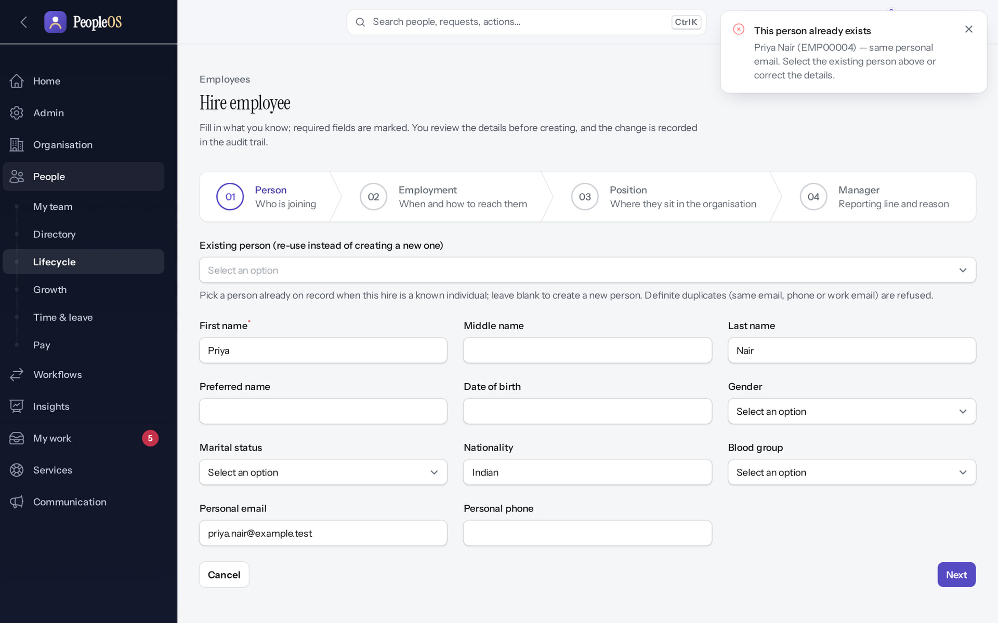
The duplicate check
ISSUE
Verified in the running application
1
1
Duplicate refused.
2
Matching field.
RESULT "This person already exists: Priya Nair (EMP00004), same personal email."
2
Real screen (cropped) · Kavya Menon (Tenant HR Admin + Employee) · Hire employee › Person
Notes:
SAY: "This person already exists: Priya Nair (EMP00004), same personal email."
ON SCREEN: Enter a person whose personal e-mail already exists and press Next.
LEARNERS SHOULD SEE: "This person already exists — Priya Nair (EMP00004) — same personal email." The wizard does not move on
SCREEN: Hire employee › Person. Signed in as Kavya Menon (Tenant HR Admin + Employee). Prerequisite: employee.create (Tenant HR Admin, HR Manager, HR Executive, Account Owner).
EVIDENCE: screenshot screenshots/hr-admin/50-hire-01-duplicate-refused.png, captured 2026-10-21 on the disposable training database (fictional people).

Slide 27
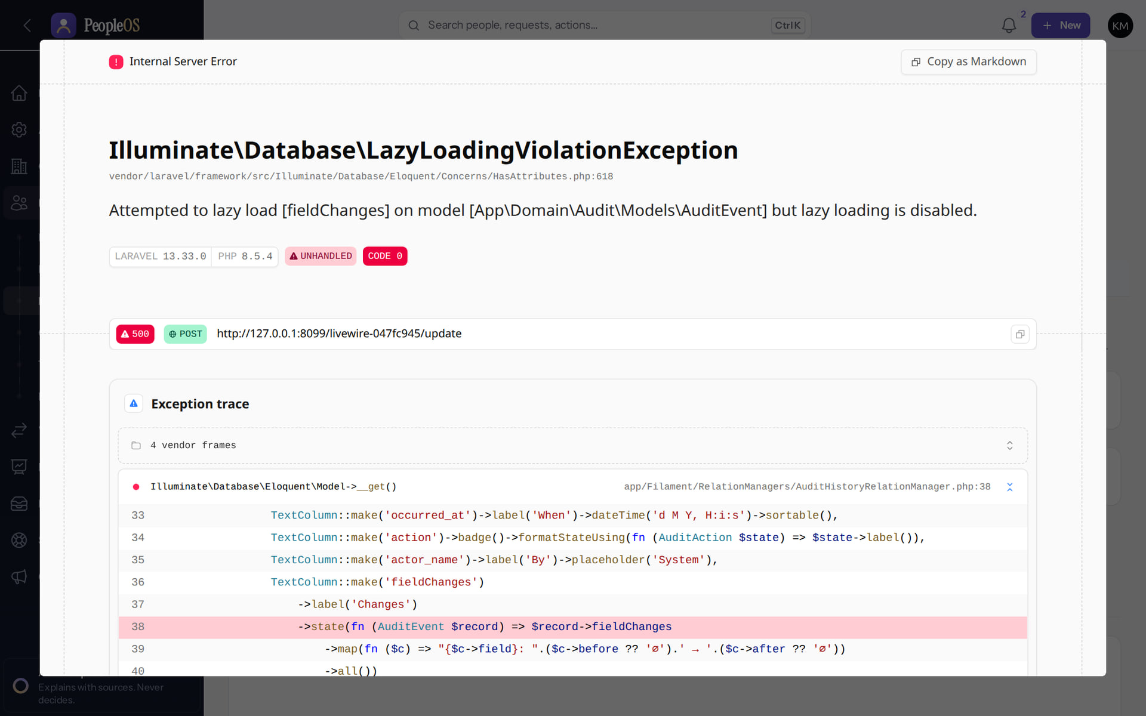
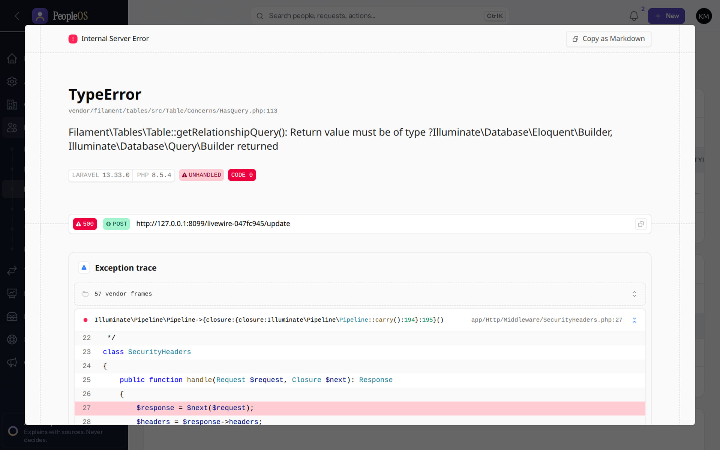
Server errors on record screens (development mode)
DATA
History tab (F26)
Incomplete
Records › Employment (new)
Incomplete
LazyLoadingViolationException. Seen on Employee 360, payroll run, letters and users in non-production.
TypeError in a lazily loaded section on scroll.
Real screen · Kavya Menon (Tenant HR Admin + Employee) · Employee 360 › Records › History
Real screen · Kavya Menon (Tenant HR Admin + Employee) · Employee 360 › Records › Employment
Notes:
Development-mode debug page, as captured. In production the user sees a generic server-error dialog; the support diagnosis is the same.
WORKAROUND: use Insights › Audit › Change history for history. Report the page address and time to engineering.
SAY: Server errors on record screens (development mode).
LEFT, History tab (F26): LazyLoadingViolationException. Seen on Employee 360, payroll run, letters and users in non-production.
RIGHT, Records › Employment (new): TypeError in a lazily loaded section on scroll.
OBSERVE: point out what differs between the two screens.
EVIDENCE: left = hr-admin/50-360-10-records-history [Kavya Menon (Tenant HR Admin + Employee), Employee 360 › Records › History]; right = support/50-360-err-01-records-employment [Kavya Menon (Tenant HR Admin + Employee), Employee 360 › Records › Employment]. Real screens, fictional data (SCREENSHOT-INVENTORY.md).

Slide 28
Attendance and leave
04
Discrepancies, failures and approvals that do not appear.
Notes:
TRANSITION: Section 4, Attendance and leave. Discrepancies, failures and approvals that do not appear.
SAY: Tell learners what they will be able to do by the end of this section, then move on.
ASK: "What questions do you have before we start this section?"

Slide 29
Leave request refused or failing
ISSUE
USER SYMPTOMS
"Cannot apply" with a reason, or a server error when HR uses Apply on behalf.
DIAGNOSTIC STEPS
Read the reason: policy (probation, notice, maximum days, balance). For HR: was it Leave requests › Apply on behalf?
EXPECTED VERSUS ACTUAL
Policy refusals are intended (e.g. "Earned leave is not available during probation."). Apply on behalf failing is defect F38.
SAFE CORRECTIVE ACTION
Policy: choose an eligible type or dates. F38: use Employee 360 › Records › Time › Leave › Apply for leave.
ESCALATE TO
Customer HR for policy questions; Markedge engineering for F38.
EVIDENCE TO COLLECT
Leave type, dates, message, employee code.
NEVER Never adjust a balance to get around a policy refusal without HR approval; adjustments are ledger entries and audited.
Notes:
SYMPTOM: "Cannot apply" with a reason, or a server error when HR uses Apply on behalf.
DIAGNOSE: Read the reason: policy (probation, notice, maximum days, balance). For HR: was it Leave requests › Apply on behalf?
EXPECTED VS ACTUAL: Policy refusals are intended (e.g. "Earned leave is not available during probation."). Apply on behalf failing is defect F38.
SAFE FIX: Policy: choose an eligible type or dates. F38: use Employee 360 › Records › Time › Leave › Apply for leave.
ESCALATE: Customer HR for policy questions; Markedge engineering for F38.
EVIDENCE: Leave type, dates, message, employee code.
NEVER: Never adjust a balance to get around a policy refusal without HR approval; adjustments are ledger entries and audited.
ASK: "What would you check first?"

Slide 30
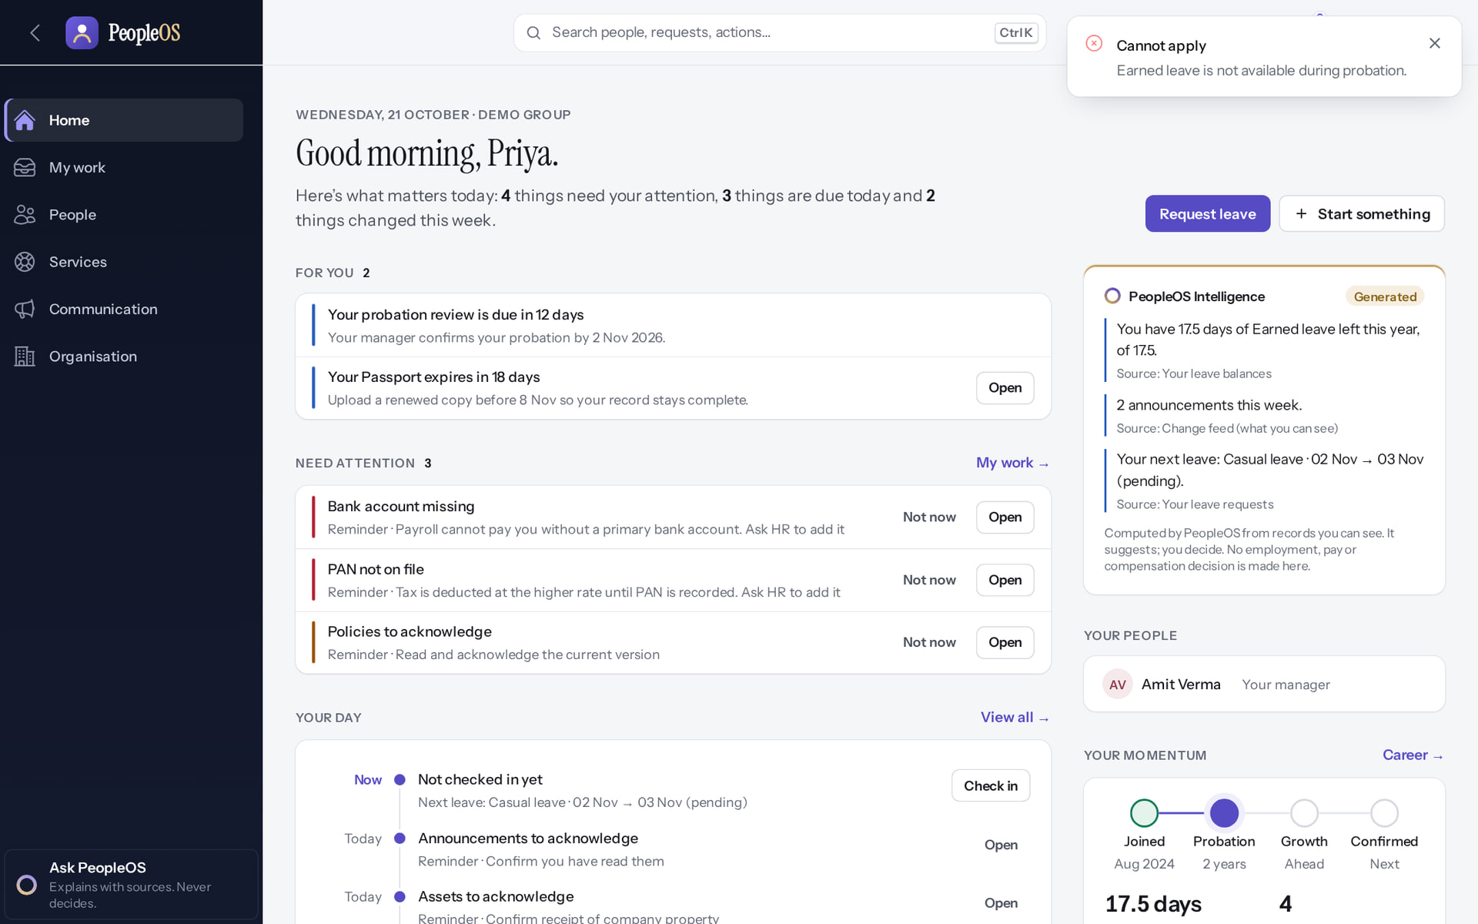
A policy refusal
ISSUE
Verified in the running application
1
1
Policy message.
RESULT Intended behaviour: the leave policy refuses Earned leave during probation.
Real screen · Priya Nair (Employee) · Request leave (dialog) with policy message
Notes:
SAY: Intended behaviour: the leave policy refuses Earned leave during probation.
ON SCREEN: Submit Earned leave while still on probation.
WALK THROUGH: (1) Policy message.
LEARNERS SHOULD SEE: Refused by the leave policy: "Earned leave is not available during probation."
SCREEN: Request leave (dialog) with policy message. Signed in as Priya Nair (Employee).
EVIDENCE: screenshot screenshots/employee/10-leave-03-policy-refusal.png, captured 2026-10-21 on the disposable training database (fictional people).

Slide 31
Apply on behalf: F38
ISSUE
Incomplete · known defect or gap
RESULT "Call to a member function getFormData() on array" when the dialog opens.
Real screen · Kavya Menon (Tenant HR Admin + Employee) · Leave requests › Apply on behalf
Notes:
Development-mode debug page, as captured. In production the user sees a generic server-error dialog; the support diagnosis is the same.

Slide 32
Approval not appearing
ISSUE
USER SYMPTOMS
An employee submitted a request but their manager does not see it in Approvals.
DIAGNOSTIC STEPS
Employee 360 › Records › Employment: who is the primary line manager effective today? Is a workflow running for the request (Workflows › Runs, then Task inbox)?
EXPECTED VERSUS ACTUAL
Leave and attendance corrections go to the primary line manager effective on the request date. Requests with a running workflow are decided in the Task inbox.
SAFE CORRECTIVE ACTION
Fix the reporting line with Change manager (effective date). Ask the approver to check My work › Task inbox.
ESCALATE TO
Customer HR (reporting lines); Markedge support for workflow configuration.
EVIDENCE TO COLLECT
Request date, employee code, manager history.
NEVER Never approve on someone else's behalf by signing in as them.
Notes:
SYMPTOM: An employee submitted a request but their manager does not see it in Approvals.
DIAGNOSE: Employee 360 › Records › Employment: who is the primary line manager effective today? Is a workflow running for the request (Workflows › Runs, then Task inbox)?
EXPECTED VS ACTUAL: Leave and attendance corrections go to the primary line manager effective on the request date. Requests with a running workflow are decided in the Task inbox.
SAFE FIX: Fix the reporting line with Change manager (effective date). Ask the approver to check My work › Task inbox.
ESCALATE: Customer HR (reporting lines); Markedge support for workflow configuration.
EVIDENCE: Request date, employee code, manager history.
NEVER: Never approve on someone else's behalf by signing in as them.
ASK: "What would you check first?"

Slide 33
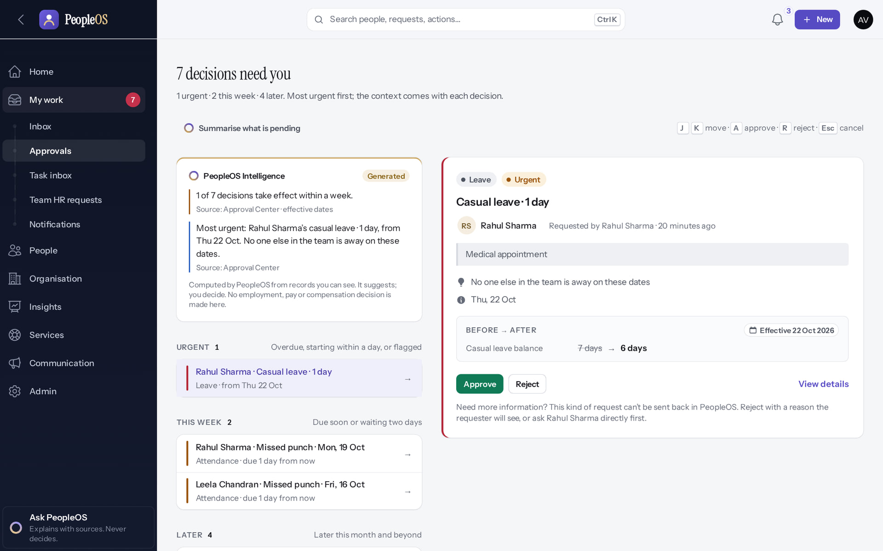
Where approvals should appear
ISSUE
Verified in the running application
1
1
Decisions waiting.
2
Summarise.
2
RESULT My work › Approvals groups decisions Urgent, This week and Later.
Real screen · Amit Verma (Manager + Employee) · My work › Approvals (Approval Center)
Notes:
SAY: My work › Approvals groups decisions Urgent, This week and Later.
ON SCREEN: Open My work › Approvals.
LEARNERS SHOULD SEE: Decisions grouped Urgent / This week / Later, most urgent first
SCREEN: My work › Approvals (Approval Center). Signed in as Amit Verma (Manager + Employee).
EVIDENCE: screenshot screenshots/manager/10-leave-07-approval-center.png, captured 2026-10-21 on the disposable training database (fictional people).

Slide 34
Attendance discrepancy
ISSUE
USER SYMPTOMS
A day shows absent, missing punch or "worked on holiday" although the employee worked normally.
DIAGNOSTIC STEPS
Attendance records for the date; Punches (source and status); holiday calendar and work schedule assigned; was the day processed after a correction?
EXPECTED VERSUS ACTUAL
Records are computed from punches, schedule and calendar when the day is processed; approved corrections reprocess the day.
SAFE CORRECTIVE ACTION
Employee: Fix my attendance. HR: Manual punch, then Process day. Note: holiday half-days are ignored (F39); late-mark actions are not applied (F40).
ESCALATE TO
Customer attendance admin; Markedge support for device or calendar issues.
EVIDENCE TO COLLECT
Date, employee code, punches list, schedule and calendar names.
NEVER Never delete punches; corrections are added, the history stays.
Notes:
SYMPTOM: A day shows absent, missing punch or "worked on holiday" although the employee worked normally.
DIAGNOSE: Attendance records for the date; Punches (source and status); holiday calendar and work schedule assigned; was the day processed after a correction?
EXPECTED VS ACTUAL: Records are computed from punches, schedule and calendar when the day is processed; approved corrections reprocess the day.
SAFE FIX: Employee: Fix my attendance. HR: Manual punch, then Process day. Note: holiday half-days are ignored (F39); late-mark actions are not applied (F40).
ESCALATE: Customer attendance admin; Markedge support for device or calendar issues.
EVIDENCE: Date, employee code, punches list, schedule and calendar names.
NEVER: Never delete punches; corrections are added, the history stays.
ASK: "What would you check first?"

Slide 35
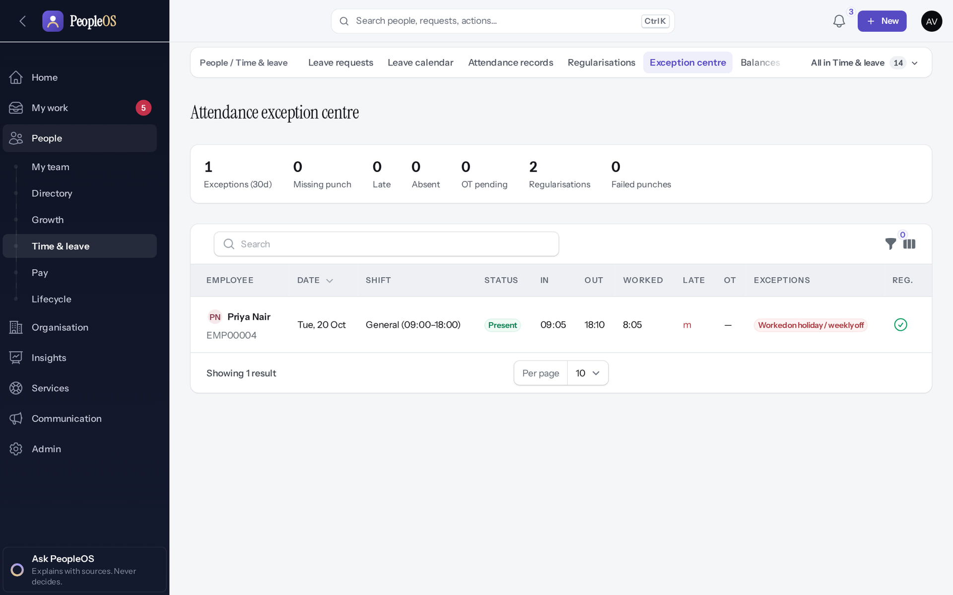
Start from the Exception centre
ISSUE
Verified in the running application
Exception counts at the top; each row shows its exceptions.
RESULT Priya's 20 Oct row: Present 09:05–18:10 with the exception "Worked on holiday / weekly off": 20 Oct is Dussehra in the demonstration calendar.
Real screen · Amit Verma (Manager + Employee) · Exception centre
Notes:
SAY: Priya's 20 Oct row: Present 09:05–18:10 with the exception "Worked on holiday / weekly off": 20 Oct is Dussehra in the demonstration calendar.
ON SCREEN: People › Time & leave › Exception centre.
WALK THROUGH: (·) Exception counts at the top; each row shows its exceptions.
LEARNERS SHOULD SEE: Missing punches, late, absent and overtime for the last 30 days
SCREEN: Exception centre. Signed in as Amit Verma (Manager + Employee).
EVIDENCE: screenshot screenshots/manager/20-att-09-exception-centre.png, captured 2026-10-21 on the disposable training database (fictional people).

Slide 36
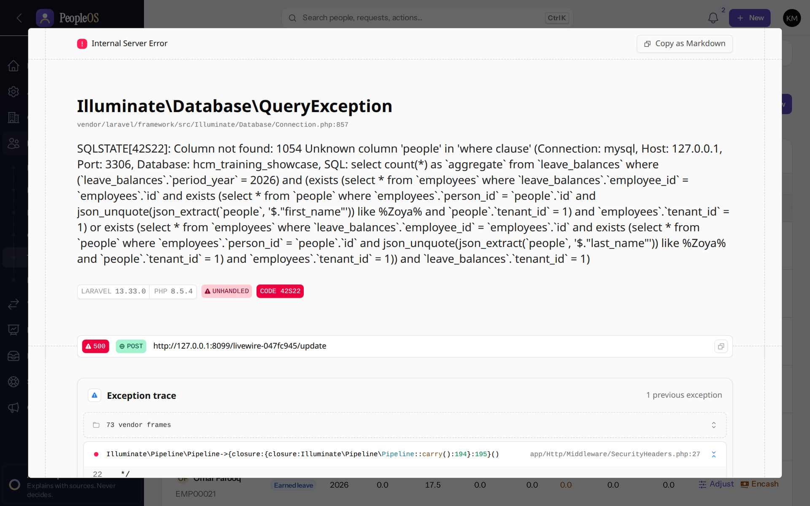
Balances search fails (new finding)
LEAVE
Incomplete · known defect or gap
RESULT Typing a name in the Balances search box gives a database error. Use the Employee and Type filters instead.
Real screen · Kavya Menon (Tenant HR Admin + Employee) · People › Time & leave › Balances (search box)
Notes:
Development-mode debug page, as captured. In production the user sees a generic server-error dialog; the support diagnosis is the same.

Slide 37
Payroll
05
Blocked by design until statutory rules are verified.
Notes:
TRANSITION: Section 5, Payroll. Blocked by design until statutory rules are verified.
SAY: Tell learners what they will be able to do by the end of this section, then move on.
ASK: "What questions do you have before we start this section?"

Slide 38
Payroll cannot be validated or finalised
ISSUE
USER SYMPTOMS
Validate says "Not allowed"; Approve and Finalize never appear; no payslips.
DIAGNOSTIC STEPS
Payroll run › Employees tab › Issues (unverified_statutory_rule…). Compliance control room: rules verified?
EXPECTED VERSUS ACTUAL
Intended: finalisation is blocked while statutory rules are unverified (0 of 24). Runs in jurisdictions without rules are blocked.
SAFE CORRECTIVE ACTION
Nothing to fix in the tenant. Calculate and check runs; pay outside PeopleOS until verification. Explain the release gate.
ESCALATE TO
Markedge platform operators (rule verification) and the owner (O-5, O-12, O-18).
EVIDENCE TO COLLECT
Run, Issues column, control-room screenshot.
NEVER Never ask engineering to switch enforcement off, and never mark a rule verified without official evidence and a second operator.
Notes:
SYMPTOM: Validate says "Not allowed"; Approve and Finalize never appear; no payslips.
DIAGNOSE: Payroll run › Employees tab › Issues (unverified_statutory_rule…). Compliance control room: rules verified?
EXPECTED VS ACTUAL: Intended: finalisation is blocked while statutory rules are unverified (0 of 24). Runs in jurisdictions without rules are blocked.
SAFE FIX: Nothing to fix in the tenant. Calculate and check runs; pay outside PeopleOS until verification. Explain the release gate.
ESCALATE: Markedge platform operators (rule verification) and the owner (O-5, O-12, O-18).
EVIDENCE: Run, Issues column, control-room screenshot.
NEVER: Never ask engineering to switch enforcement off, and never mark a rule verified without official evidence and a second operator.
ASK: "What would you check first?"

Slide 39
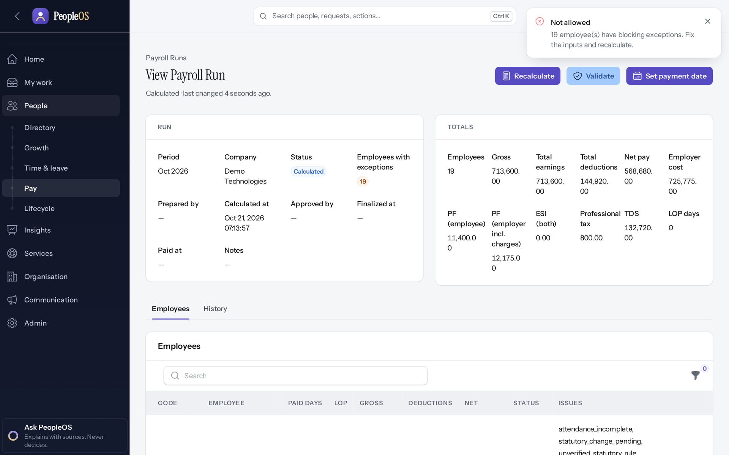
Validate refused
ISSUE
Disabled by safety or commercial gates
1
1
Blocking message.
RESULT "Not allowed": 19 employee(s) have blocking exceptions. Fix the inputs and recalculate.
Real screen · Arjun Bose (Payroll Admin + Employee) · Payroll run › Validate
Notes:
SAY: "Not allowed": 19 employee(s) have blocking exceptions. Fix the inputs and recalculate.
ON SCREEN: Validate (executed).
LEARNERS SHOULD SEE: Refused: "Not allowed — N employee(s) have blocking exceptions. Fix the inputs and recalculate." Approve and Finalize never appear while blocking exceptions remain
SCREEN: Payroll run › Validate. Signed in as Arjun Bose (Payroll Admin + Employee). Prerequisite: Statutory rules verified (0 of 24 today); PAN, bank account and attendance inputs complete.
EVIDENCE: screenshot screenshots/hr-admin/60-pay-09-validate-blocked.png, captured 2026-10-21 on the disposable training database (fictional people).

Slide 40
Platform, notifications and offboarding
06
Background work, notifications and the safeguards around leaving.
Notes:
TRANSITION: Section 6, Platform, notifications and offboarding. Background work, notifications and the safeguards around leaving.
SAY: Tell learners what they will be able to do by the end of this section, then move on.
ASK: "What questions do you have before we start this section?"

Slide 41
Notifications not received
ISSUE
USER SYMPTOMS
Users expect an e-mail for leave or approvals and receive nothing; an SMS or WhatsApp never arrives.
DIAGNOSTIC STEPS
Communication › Notification rules: is there a rule for the event? Delivery log: queued, sent or failed? Is the queue worker running (Platform › Operations)?
EXPECTED VERSUS ACTUAL
Notices go only where a rule exists. No role can create or delete rules on screen (F18). SMS, WhatsApp and push send nothing (F19).
SAFE CORRECTIVE ACTION
Customer: edit existing rules and templates. Markedge: seed missing rules; ensure the worker runs; Send again on failed deliveries.
ESCALATE TO
Markedge support (rules, F18/F19); platform operations (queue).
EVIDENCE TO COLLECT
Event, time, delivery log row.
NEVER Never promise e-mail for an event that has no rule.
Notes:
SYMPTOM: Users expect an e-mail for leave or approvals and receive nothing; an SMS or WhatsApp never arrives.
DIAGNOSE: Communication › Notification rules: is there a rule for the event? Delivery log: queued, sent or failed? Is the queue worker running (Platform › Operations)?
EXPECTED VS ACTUAL: Notices go only where a rule exists. No role can create or delete rules on screen (F18). SMS, WhatsApp and push send nothing (F19).
SAFE FIX: Customer: edit existing rules and templates. Markedge: seed missing rules; ensure the worker runs; Send again on failed deliveries.
ESCALATE: Markedge support (rules, F18/F19); platform operations (queue).
EVIDENCE: Event, time, delivery log row.
NEVER: Never promise e-mail for an event that has no rule.
ASK: "What would you check first?"

Slide 42
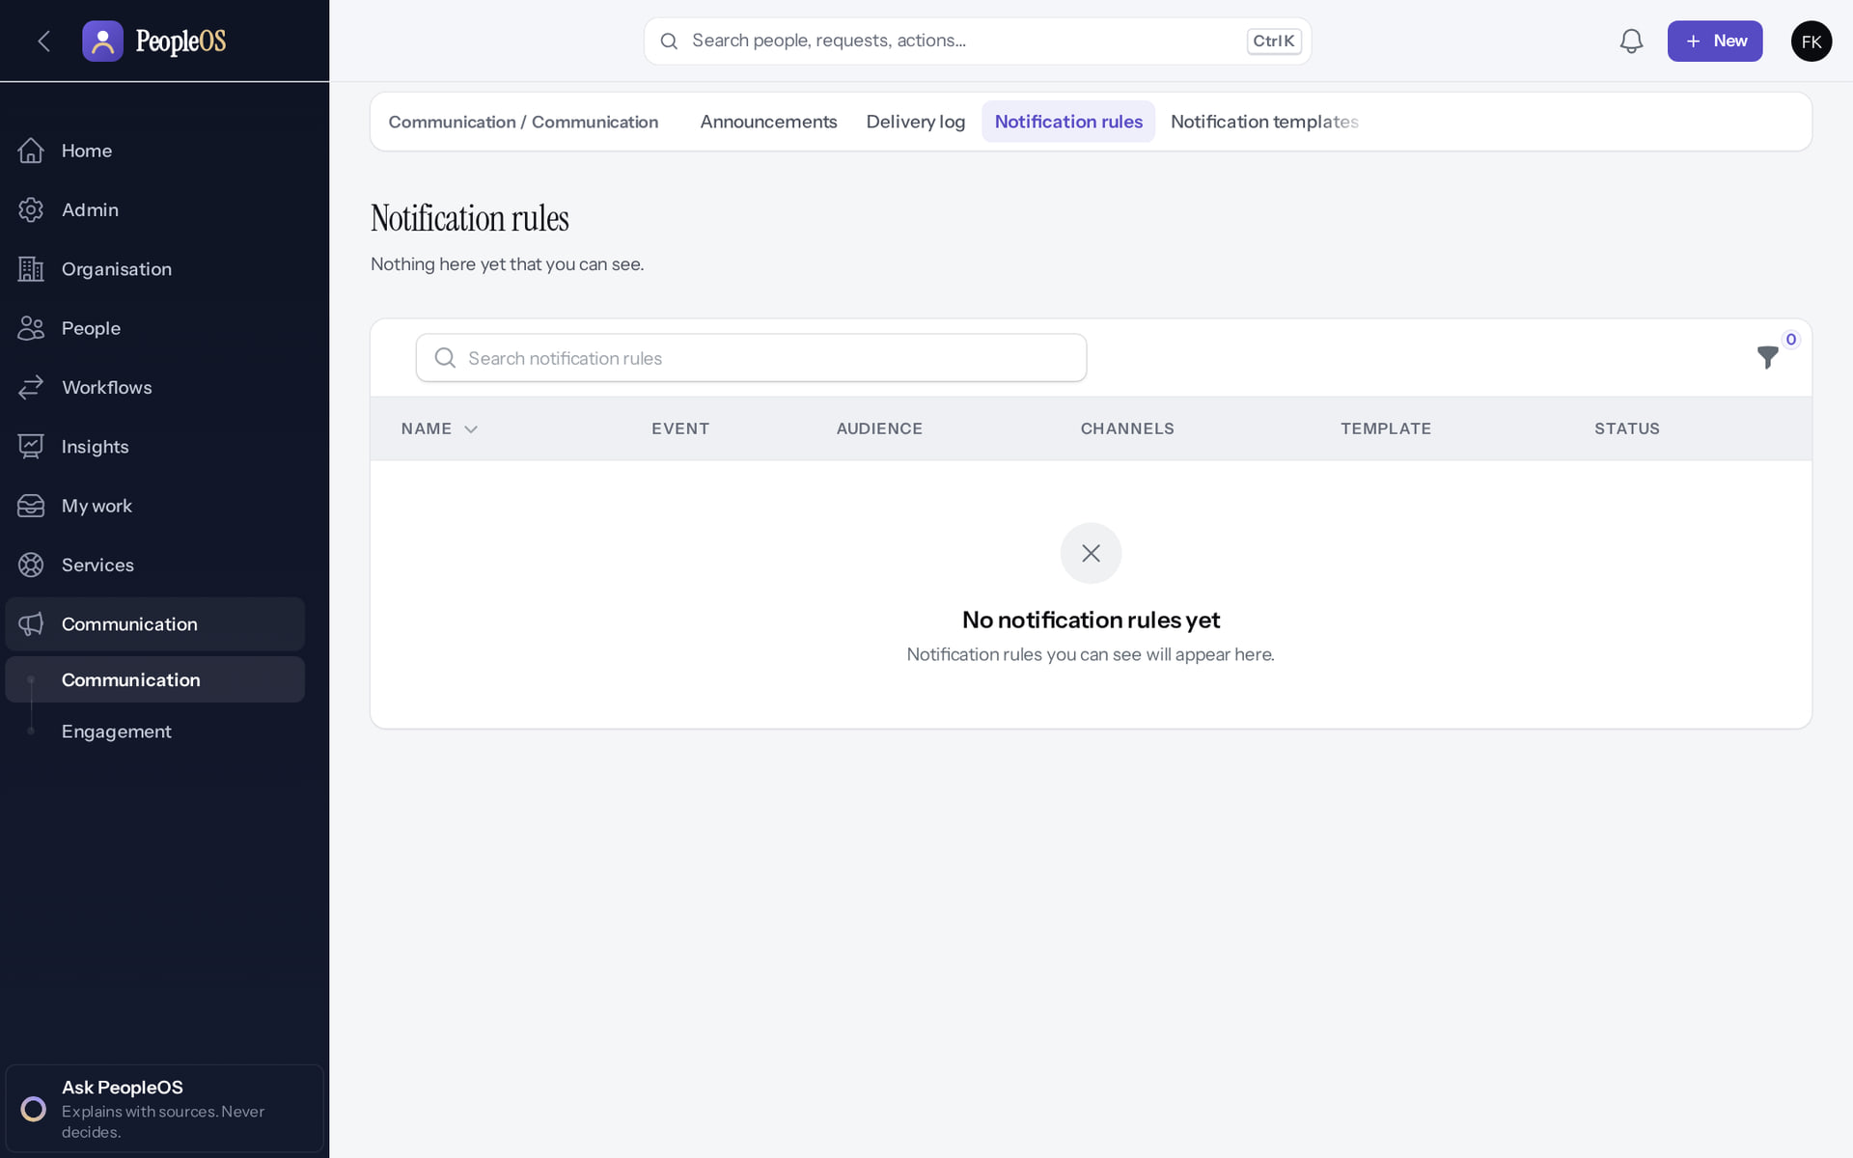
No rules, no New action
ISSUE
Incomplete · known defect or gap
RESULT An empty Notification rules list in a new tenant (F18).
Real screen · Farah Khan (Tenant Super Admin (Northwind Retail, first administrator)) · Communication › Notification rules
Notes:
SAY: An empty Notification rules list in a new tenant (F18).
ON SCREEN: Open Notification rules in a new tenant.
LEARNERS SHOULD SEE: No rules and no "New" action: rules cannot be created or deleted from the screen (known limitation F18), so e-mail notices for leave and approvals are not sent unless a rule exists
SCREEN: Communication › Notification rules. Signed in as Farah Khan (Tenant Super Admin (Northwind Retail, first administrator)). Prerequisite: Signed in as the tenant administrator.
EVIDENCE: screenshot screenshots/client-onboarding/90-onb-84-notification-rules.png, captured 2026-10-21 on the disposable training database (fictional people).

Slide 43
Failed or stuck background jobs
ISSUE
USER SYMPTOMS
Exports never finish, scheduled reports do not run, deliveries stay queued, audit chains "not recently verified".
DIAGNOSTIC STEPS
Platform › Operations: queue depth, failed jobs by job, scheduler heartbeat. Platform readiness for WARN/FAIL lines.
EXPECTED VERSUS ACTUAL
A worker and the scheduler run in production; every job carries its tenant. Locally none runs, so queued work waits.
SAFE CORRECTIVE ACTION
Operations restarts the worker or scheduler and retries failed jobs once the cause is fixed.
ESCALATE TO
Platform operations / on-call (gate 8: not yet in place).
EVIDENCE TO COLLECT
Operations screenshot, failed job name and time.
NEVER Never delete failed jobs before recording them; never run a tenant job without its tenant context.
Notes:
SYMPTOM: Exports never finish, scheduled reports do not run, deliveries stay queued, audit chains "not recently verified".
DIAGNOSE: Platform › Operations: queue depth, failed jobs by job, scheduler heartbeat. Platform readiness for WARN/FAIL lines.
EXPECTED VS ACTUAL: A worker and the scheduler run in production; every job carries its tenant. Locally none runs, so queued work waits.
SAFE FIX: Operations restarts the worker or scheduler and retries failed jobs once the cause is fixed.
ESCALATE: Platform operations / on-call (gate 8: not yet in place).
EVIDENCE: Operations screenshot, failed job name and time.
NEVER: Never delete failed jobs before recording them; never run a tenant job without its tenant context.
ASK: "What would you check first?"

Slide 44
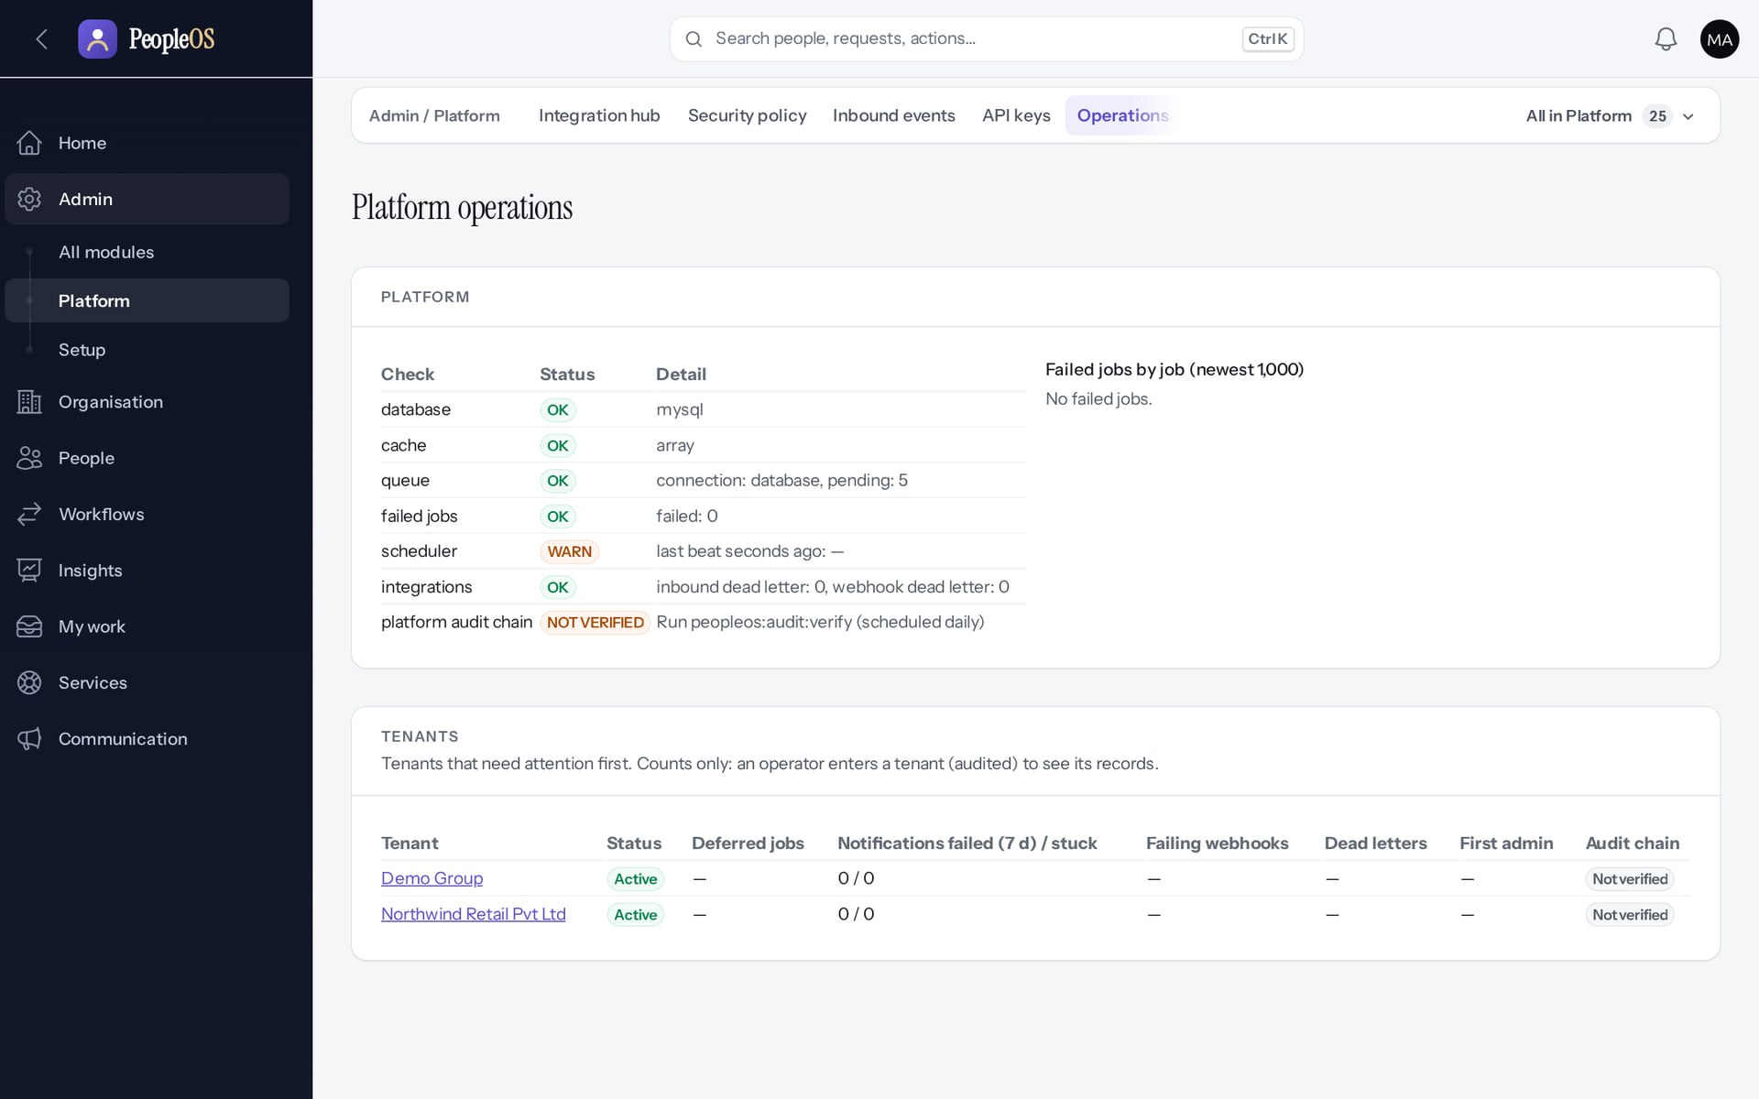
Platform operations
ISSUE
Verified in the running application
RESULT Queue, failed jobs, scheduler heartbeat and per-tenant status.
Real screen (cropped) · Markedge Platform Admin (Platform operator) · Admin › Platform › Operations
Notes:
SAY: Queue, failed jobs, scheduler heartbeat and per-tenant status.
ON SCREEN: Open Operations.
LEARNERS SHOULD SEE: Platform health, queue depth, failed jobs by job, scheduler heartbeat, per-tenant status
SCREEN: Admin › Platform › Operations. Signed in as Markedge Platform Admin (Platform operator). Prerequisite: Platform operator (is_platform_admin) signed in with MFA.
EVIDENCE: screenshot screenshots/platform-admin/95-pl-21-operations.png, captured 2026-10-21 on the disposable training database (fictional people).

Slide 45
Export or offboarding blocked
ISSUE
USER SYMPTOMS
A customer asks to delete their tenant; an export does not complete; a legal hold cannot be released.
DIAGNOSTIC STEPS
Platform › Offboarding › tenant: holds, retention eligibility, export status.
EXPECTED VERSUS ACTUAL
Deletion is switched off. Exports run in the background (worker). Releasing a hold needs a second operator. No retention policy exists yet.
SAFE CORRECTIVE ACTION
Explain the safeguards; provide the export when the worker is available; a second operator approves releases.
ESCALATE TO
Markedge platform operator and the owner (D8 retention decisions).
EVIDENCE TO COLLECT
Tenant, hold reference (e.g. LH-2026-01), export request time.
NEVER Never enable deletion or remove a legal hold to satisfy a request.
Notes:
SYMPTOM: A customer asks to delete their tenant; an export does not complete; a legal hold cannot be released.
DIAGNOSE: Platform › Offboarding › tenant: holds, retention eligibility, export status.
EXPECTED VS ACTUAL: Deletion is switched off. Exports run in the background (worker). Releasing a hold needs a second operator. No retention policy exists yet.
SAFE FIX: Explain the safeguards; provide the export when the worker is available; a second operator approves releases.
ESCALATE: Markedge platform operator and the owner (D8 retention decisions).
EVIDENCE: Tenant, hold reference (e.g. LH-2026-01), export request time.
NEVER: Never enable deletion or remove a legal hold to satisfy a request.
ASK: "What would you check first?"

Slide 46
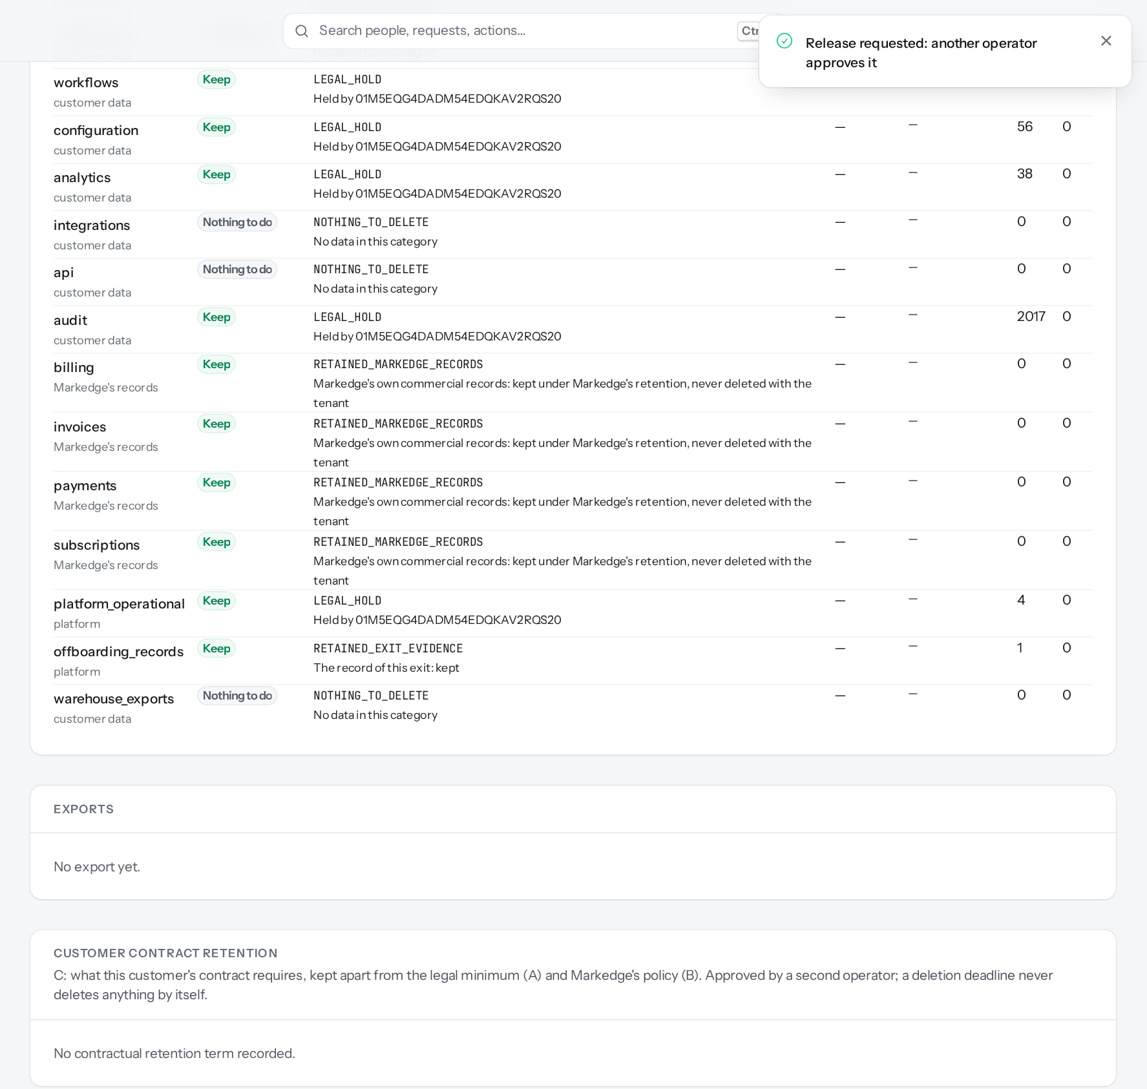
Hold release waits for a second operator
ISSUE
1
Available only after configuration
1
The result.
RESULT Release requested; the hold stays active until another operator approves.
Real screen (cropped) · Markedge Platform Admin (Platform operator) · Offboarding › Legal holds (release requested)
Notes:
SAY: Release requested; the hold stays active until another operator approves.
ON SCREEN: Submit the release request.
WALK THROUGH: (1) The result.
LEARNERS SHOULD SEE: The hold stays active until a second operator approves the release; only one operator exists in this environment, so it stays pending
SCREEN: Offboarding › Legal holds (release requested). Signed in as Markedge Platform Admin (Platform operator). Prerequisite: Platform operator with MFA.
EVIDENCE: screenshot screenshots/platform-admin/95-pl-34-release-pending.png, captured 2026-10-21 on the disposable training database (fictional people).

Slide 47
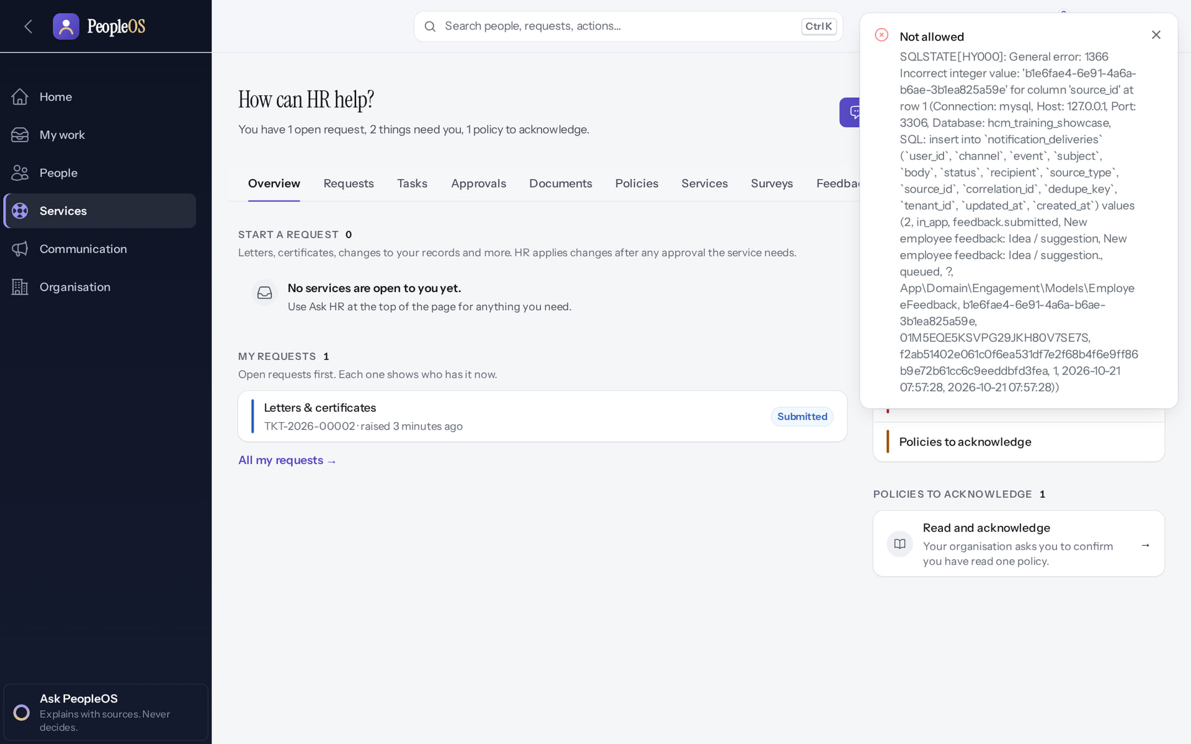
Give feedback shows an error (F17)
KNOWN DEFECTS
Incomplete · known defect or gap
1
Message shown.
RESULT The employee sees "Not allowed" with a raw database message (including server details) although the feedback is saved; HR is not notified. Ask HR to check the Feedback inbox. Escalate: the toast exposes technical details.
1
Real screen · Priya Nair (Employee) · My HR › Give feedback (after Submit)
Notes:
SAY: The employee sees "Not allowed" with a raw database message (including server details) although the feedback is saved; HR is not notified. Ask HR to check the Feedback inbox. Escalate: the toast exposes technical details.
ON SCREEN: Submit.
LEARNERS SHOULD SEE: Observed: Not allowed SQLSTATE[HY000]: General error: 1366 Incorrect integer value: 'b1e6fae4-6e91-4a6a-b6ae-3b1ea825a59e' for column 'source_id' at row 1 (Connection: my
SCREEN: My HR › Give feedback (after Submit). Signed in as Priya Nair (Employee).
EVIDENCE: screenshot screenshots/employee/30-self-45-give-feedback-error.png, captured 2026-10-21 on the disposable training database (fictional people).

Slide 48
Known defects and their workarounds
KNOWN DEFECTS
Ref | Symptom | Workaround | Escalation
F25 | Import Map columns: "Undefined variable $svc" | Hire wizard; API load by Markedge | Engineering
F38 | Apply on behalf: server error | Employee 360 › Records › Time › Apply for leave | Engineering
F44 | Report builder field lists empty | Starter reports; People analytics | Engineering
F17 | Give feedback: error, HR not notified | HR checks the Feedback inbox | Engineering
F26 | History tabs error (non-production) | Change history | Engineering
New | Uploader verifying own document: server error | A second HR person verifies | Engineering
New | Balances name search: database error | Use filters | Engineering
New | Employee 360 Records › Employment section error; onboarding template items error | Upper sections and Change history | Engineering
Notes:
SOURCE: docs/reports/documentation-gaps.md and the 21 Oct 2026 captures (support/*, security-compliance/50-doc-03).
SAY: Known defects and their workarounds.
- F25 | Import Map columns: "Undefined variable $svc" | Hire wizard; API load by Markedge | Engineering
- F38 | Apply on behalf: server error | Employee 360 › Records › Time › Apply for leave | Engineering
- F44 | Report builder field lists empty | Starter reports; People analytics | Engineering
- F17 | Give feedback: error, HR not notified | HR checks the Feedback inbox | Engineering
- F26 | History tabs error (non-production) | Change history | Engineering
- New | Uploader verifying own document: server error | A second HR person verifies | Engineering
- New | Balances name search: database error | Use filters | Engineering
- New | Employee 360 Records › Employment section error; onboarding template items error | Upper sections and Change history | Engineering

Slide 49
Practice: triage these tickets
PRACTICE
"All 40 people at our company get the credentials message since this morning."
1
"I am a manager and Leave requests from my new team member never reach me."
2
"Our import of 300 employees is stuck at inspected."
3
"Payroll says Not allowed and we need payslips on Friday."
4
Answer key: on the next slide, and in the speaker notes.
Notes:
RUN: give learners about 10 minutes in a practice tenant (never a live one). Walk around and help.
SUCCESS: each learner can show the result on screen.
ANSWERS: (1) Likely a suspended tenant: operator checks Platform › Tenants. (2) Check the reporting line effective today; Change manager. (3) F25: discard; hire wizard or Markedge API load. (4) Statutory gate: cannot be bypassed; pay outside PeopleOS; escalate to Markedge.

Slide 50
Answer key
PRACTICE
# | Answer
1 | Likely a suspended tenant (generic message for everyone). The operator checks Platform › Tenants and follows the reactivation approval.
2 | The approver is the primary line manager effective on the request date: fix the reporting line with Change manager.
3 | Known defect F25: discard the import; load with the Hire employee wizard or a Markedge API load; escalate to engineering.
4 | The statutory safeguard: finalisation is blocked until rules are verified. It cannot be bypassed; pay outside PeopleOS and escalate.
Notes:
SAY: Answer key.
- 1 | Likely a suspended tenant (generic message for everyone). The operator checks Platform › Tenants and follows the reactivation approval.
- 2 | The approver is the primary line manager effective on the request date: fix the reporting line with Change manager.
- 3 | Known defect F25: discard the import; load with the Hire employee wizard or a Markedge API load; escalate to engineering.
- 4 | The statutory safeguard: finalisation is blocked until rules are verified. It cannot be bypassed; pay outside PeopleOS and escalate.

Slide 51
Summary
Quote the screen; many messages are deliberately generic.
Check status, role, scope and reporting line before anything else.
Use documented workarounds for known defects; escalate with evidence.
Never handle passwords, codes or personal data in tickets.
Never weaken a safeguard to close a ticket.
NEXT STEPS & HELP
Deck 03: HR screens
Deck 05: operator actions
Deck 08: security boundaries
Release gate: NO-GO (10 of 14 gates blocked, re-verified 13 Oct 2026). Not yet generally available.
Notes:
SAY: Recap the key points:
- Quote the screen; many messages are deliberately generic.
- Check status, role, scope and reporting line before anything else.
- Use documented workarounds for known defects; escalate with evidence.
- Never handle passwords, codes or personal data in tickets.
- Never weaken a safeguard to close a ticket.
POINT TO: Deck 03: HR screens; Deck 05: operator actions; Deck 08: security boundaries
ASK: "What will you do first in PeopleOS?" Collect questions you cannot answer and send them to the PeopleOS team.

