Slide 1
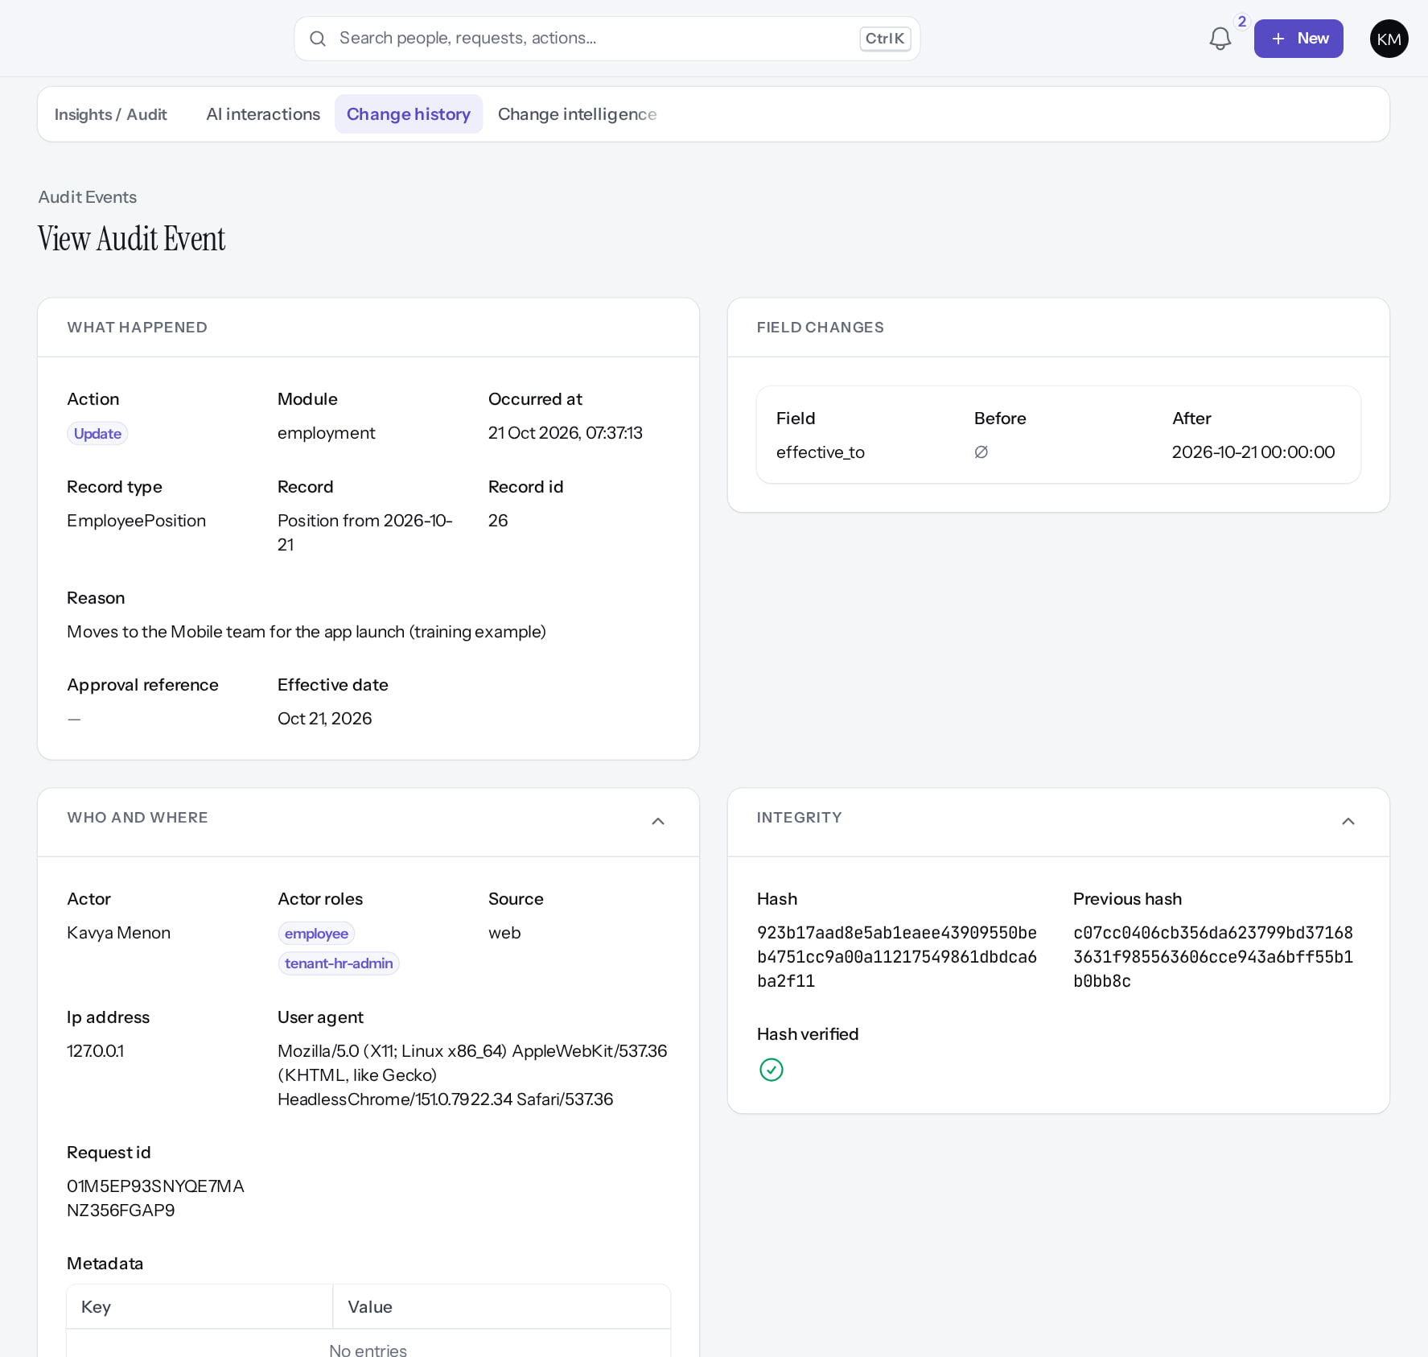
Security, Governance and Compliance
MARKEDGE PEOPLEOS · TRAINING LIBRARY
Deck 08 of 12
The controls PeopleOS enforces, how they look on screen, what each customer must configure, what operations must provide, and which risks remain open.
For: Security and compliance reviewers, customer IT and HR governance leads, Markedge operators
Built from the running application (local, disposable database, fictional people) · 21 October 2026
Real screen, fictional data
Notes:
SAY: A control is only as good as its configuration and the environment that runs it. This deck separates the four: implemented in code, configured in a tenant, operational prerequisite, unresolved risk.
SOURCES: docs/architecture/security-invariants.md, peopleos-architecture-contract.md §6 and §9, docs/saas/SaaS-Final-Security-Evidence.md, docs/reports/documentation-gaps.md, captures listed per slide.

Slide 2
How to read this deck
BEFORE YOU START
Verified in the running application
We ran it on the training database and captured each step.
1
Numbered markers on a screenshot match the numbered steps beside it.
Implemented · not verified end to end
The screen exists; the last steps need data or a second party we could not provide.
Every screenshot is a real capture of PeopleOS. The people and companies in it are fictional.
Available only after configuration
Works once an administrator or Markedge has set it up.
Disabled by safety or commercial gates
Switched off on purpose until owner decisions and approvals arrive.
Diagrams are marked "Conceptual diagram". They explain ideas; they are not screens.
Incomplete · known defect or gap
Partly working: a known defect or gap is stated on the slide.
Release gate: NO-GO (10 of 14 gates blocked, re-verified 13 Oct 2026). Not yet generally available.
Not implemented
Not in the product today.
Unable to verify
Could not be checked in this environment.
Notes:
Explain the seven status labels. Every screenshot slide carries one of them in its top-right corner. Stress that "Verified in the running application" means we ran it on a disposable demonstration database, not that the feature is released.

Slide 3
Release gate: NO-GO until these are resolved (1 of 2)
RELEASE STATUS
Status as written in the release gate document. Ten of fourteen gates are blocked by owner decisions, external parties or missing infrastructure.
# | Gate | Gate status | Remaining dependency
1 | Application and architecture integrity | PASS (workstation) | Repeat the full suites in staging
2 | Credential exposure and repository remediation | BLOCKED | Owner: rotation confirmation, repository visibility (O-1 to O-3)
3 | Authentication and operator MFA | BLOCKED | Operators enrol MFA in the target environment (O-14, O-7)
4 | Independent security review | BLOCKED | Engage a reviewer; triage and retest findings (O-4)
5 | Statutory verification and gratuity | BLOCKED | 0 of 24 rules verified; gratuity not implemented (O-5, O-12, O-18)
6 | Data protection, retention, legal holds | PASS (controls) / BLOCKED (policy) | Retention decisions with counsel (D8); privacy review
7 | Backup, restore and disaster recovery | BLOCKED | Recovery objectives and an isolated target (O-6, O-7)
Notes:
SOURCE: docs/saas/SaaS-Final-Release-Gate.md (decision NO-GO, re-verified 13 October 2026 at 7314f7d); owner actions in docs/saas/SaaS-Final-Owner-Action-Register.md.
SAY: The application passes its automated suites on the workstation, but release is blocked by decisions and infrastructure, not by code alone.
AVOID: describing any gate as resolved. Nothing in this training changes a gate.
SAY: Release gate: NO-GO until these are resolved (part 1 of 2). Status as written in the release gate document. Ten of fourteen gates are blocked by owner decisions, external parties or missing infrastructure.
- 1 | Application and architecture integrity | PASS (workstation) | Repeat the full suites in staging
- 2 | Credential exposure and repository remediation | BLOCKED | Owner: rotation confirmation, repository visibility (O-1 to O-3)
- 3 | Authentication and operator MFA | BLOCKED | Operators enrol MFA in the target environment (O-14, O-7)
- 4 | Independent security review | BLOCKED | Engage a reviewer; triage and retest findings (O-4)
- 5 | Statutory verification and gratuity | BLOCKED | 0 of 24 rules verified; gratuity not implemented (O-5, O-12, O-18)
- 6 | Data protection, retention, legal holds | PASS (controls) / BLOCKED (policy) | Retention decisions with counsel (D8); privacy review
- 7 | Backup, restore and disaster recovery | BLOCKED | Recovery objectives and an isolated target (O-6, O-7)

Slide 4
Release gate: NO-GO until these are resolved (2 of 2)
RELEASE STATUS
# | Gate | Gate status | Remaining dependency
8 | Hosting, monitoring and on-call | BLOCKED | Environment, alerting, on-call (O-7, O-10, O-11)
9 | Signup and tenant provisioning | PASS (disabled) / BLOCKED (activation) | Only if self-service signup is wanted at launch (D10)
10 | Billing, tax and payment controls | PASS (disabled) / BLOCKED (activation) | Only for paid billing (B-4, B-7, B-8, B-9)
11 | Tenant deletion and offboarding | PASS (disabled) / BLOCKED (activation) | Retention decisions, register disk, review (D8)
12 | Regression and target-environment testing | BLOCKED | A staging environment (O-7, O-8)
13 | Owner decisions and written approvals | BLOCKED | All owner action items
14 | Deployment, rollback, post-deployment checks | BLOCKED | Rehearse in staging; authorise (O-7 to O-9)
Notes:
SOURCE: docs/saas/SaaS-Final-Release-Gate.md (decision NO-GO, re-verified 13 October 2026 at 7314f7d); owner actions in docs/saas/SaaS-Final-Owner-Action-Register.md.
SAY: The application passes its automated suites on the workstation, but release is blocked by decisions and infrastructure, not by code alone.
AVOID: describing any gate as resolved. Nothing in this training changes a gate.
SAY: Release gate: NO-GO until these are resolved (part 2 of 2). Status as written in the release gate document. Ten of fourteen gates are blocked by owner decisions, external parties or missing infrastructure.
- 8 | Hosting, monitoring and on-call | BLOCKED | Environment, alerting, on-call (O-7, O-10, O-11)
- 9 | Signup and tenant provisioning | PASS (disabled) / BLOCKED (activation) | Only if self-service signup is wanted at launch (D10)
- 10 | Billing, tax and payment controls | PASS (disabled) / BLOCKED (activation) | Only for paid billing (B-4, B-7, B-8, B-9)
- 11 | Tenant deletion and offboarding | PASS (disabled) / BLOCKED (activation) | Retention decisions, register disk, review (D8)
- 12 | Regression and target-environment testing | BLOCKED | A staging environment (O-7, O-8)
- 13 | Owner decisions and written approvals | BLOCKED | All owner action items
- 14 | Deployment, rollback, post-deployment checks | BLOCKED | Rehearse in staging; authorise (O-7 to O-9)

Slide 5
What you will be able to assess
LEARNING OBJECTIVES
Who can do what
roles, permissions, scope, relationship reach
How changes are proven
append-only audit with a verified hash chain
1
4
How tenants are isolated
fail-closed scoping; operator entry is deliberate and audited
Where separation of duties applies
documents, letters, compensation, payroll, holds, finance
2
5
How sensitive data is protected
field permissions, masking, encryption
What remains open
findings, gates and operational prerequisites
3
6
Notes:
SAY: What you will be able to assess:
1. Who can do what: roles, permissions, scope, relationship reach
2. How tenants are isolated: fail-closed scoping; operator entry is deliberate and audited
3. How sensitive data is protected: field permissions, masking, encryption
4. How changes are proven: append-only audit with a verified hash chain
5. Where separation of duties applies: documents, letters, compensation, payroll, holds, finance
6. What remains open: findings, gates and operational prerequisites
ASK: "Which of these matters most to you?" Return to the answer in the summary.

Slide 6
Control map: built, configured, operated, open
OVERVIEW
Control | Implemented in code | Configured per tenant | Operational prerequisite | Open risk
Tenant isolation | Fail-closed tenant scope; architecture tests | — | Single database; monitoring | Independent review not engaged (gate 4)
Roles and scope | 14 system roles; org and relationship scope | Role templates; HR scope | Quarterly access review | Unscoped HR users reach the whole tenant
Field protection | Sensitive permissions, masking, encryption | Who gets *.sensitive.* | Key management | Custom-field visibility switches have no effect (F32)
MFA | Authenticator app; operators forced | Tenant policy (Optional by default) | Operators enrol in production | MFA optional for tenant users unless set
Audit | Append-only, hash chain, verifier | — | Scheduled verification | Chains "not recently verified" without a scheduler
Separation of duties | Documents, letters, compensation, payroll, holds, finance | Enough distinct people per role | Second operator | Change Centre: no self-approval guard (F29)
Integrations | Signed webhooks, scoped keys, idempotency | Keys, endpoints, SSO (OIDC) | Secret storage, rotation | Key scopes not limited by issuer (F37)
Export, retention, deletion | Encrypted export, holds, deletion executor | Retention policies (none) | Register disk, backup, DR | Deletion off; DR not verified (gate 7)
Notes:
SOURCE: architecture contract §1, §6, §9, §10; security-invariants.md; documentation-gaps F29, F32, F37; release gate rows 3, 4, 6, 7, 11.
SAY: Control map: built, configured, operated, open.
- Tenant isolation | Fail-closed tenant scope; architecture tests | — | Single database; monitoring | Independent review not engaged (gate 4)
- Roles and scope | 14 system roles; org and relationship scope | Role templates; HR scope | Quarterly access review | Unscoped HR users reach the whole tenant
- Field protection | Sensitive permissions, masking, encryption | Who gets *.sensitive.* | Key management | Custom-field visibility switches have no effect (F32)
- MFA | Authenticator app; operators forced | Tenant policy (Optional by default) | Operators enrol in production | MFA optional for tenant users unless set
- Audit | Append-only, hash chain, verifier | — | Scheduled verification | Chains "not recently verified" without a scheduler
- Separation of duties | Documents, letters, compensation, payroll, holds, finance | Enough distinct people per role | Second operator | Change Centre: no self-approval guard (F29)
- Integrations | Signed webhooks, scoped keys, idempotency | Keys, endpoints, SSO (OIDC) | Secret storage, rotation | Key scopes not limited by issuer (F37)
- Export, retention, deletion | Encrypted export, holds, deletion executor | Retention policies (none) | Register disk, backup, DR | Deletion off; DR not verified (gate 7)

Slide 7
Roles and permissions
01
Permission keys are declared in code; roles are templates a tenant can adjust.
Notes:
TRANSITION: Section 1, Roles and permissions. Permission keys are declared in code; roles are templates a tenant can adjust.
SAY: Tell learners what they will be able to do by the end of this section, then move on.
ASK: "What questions do you have before we start this section?"

Slide 8
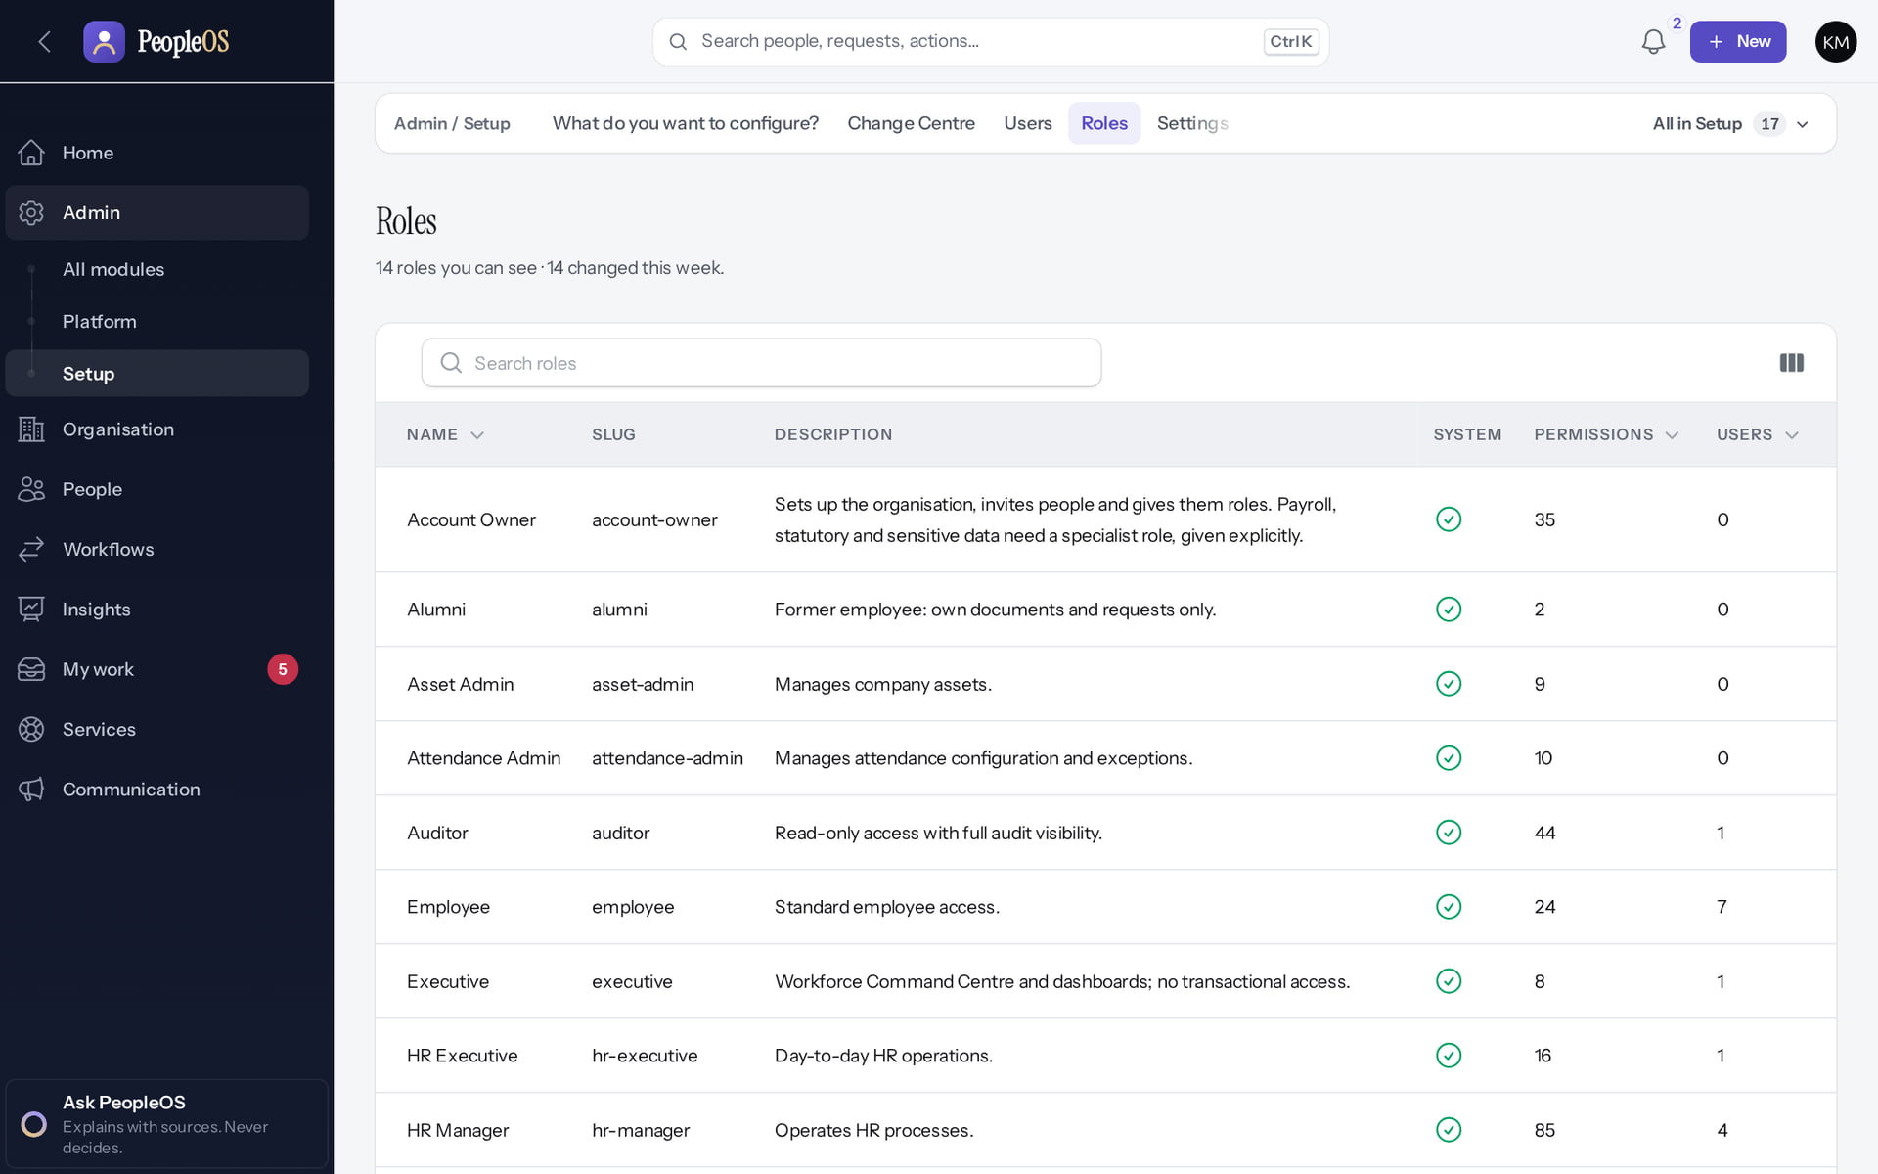
Fourteen system roles
ROLES
Verified in the running application
1
Permission counts.
2
User counts.
1
2
RESULT The first 9 of 14 are visible. All 14: Account Owner, Tenant Super Admin, Tenant HR Admin, HR Manager, HR Executive, Payroll Admin, Attendance Admin, Performance Admin, Asset Admin, Manager, Employee, Executive, Alumni, Auditor.
Real screen · Kavya Menon (Tenant HR Admin + Employee) · Admin › Setup › Roles
Notes:
SAY: The first 9 of 14 are visible. All 14: Account Owner, Tenant Super Admin, Tenant HR Admin, HR Manager, HR Executive, Payroll Admin, Attendance Admin, Performance Admin, Asset Admin, Manager, Employee, Executive, Alumni, Auditor.
ON SCREEN: Open Roles.
WALK THROUGH: (1) Permission counts. (2) User counts.
LEARNERS SHOULD SEE: 14 system roles (and any custom roles) with permission and user counts
SCREEN: Admin › Setup › Roles. Signed in as Kavya Menon (Tenant HR Admin + Employee). Prerequisite: user.manage / role.view (role editing: Tenant Super Admin only, F5).
EVIDENCE: screenshot screenshots/security-compliance/85-acc-07-roles.png, captured 2026-10-21 on the disposable training database (fictional people).

Slide 9
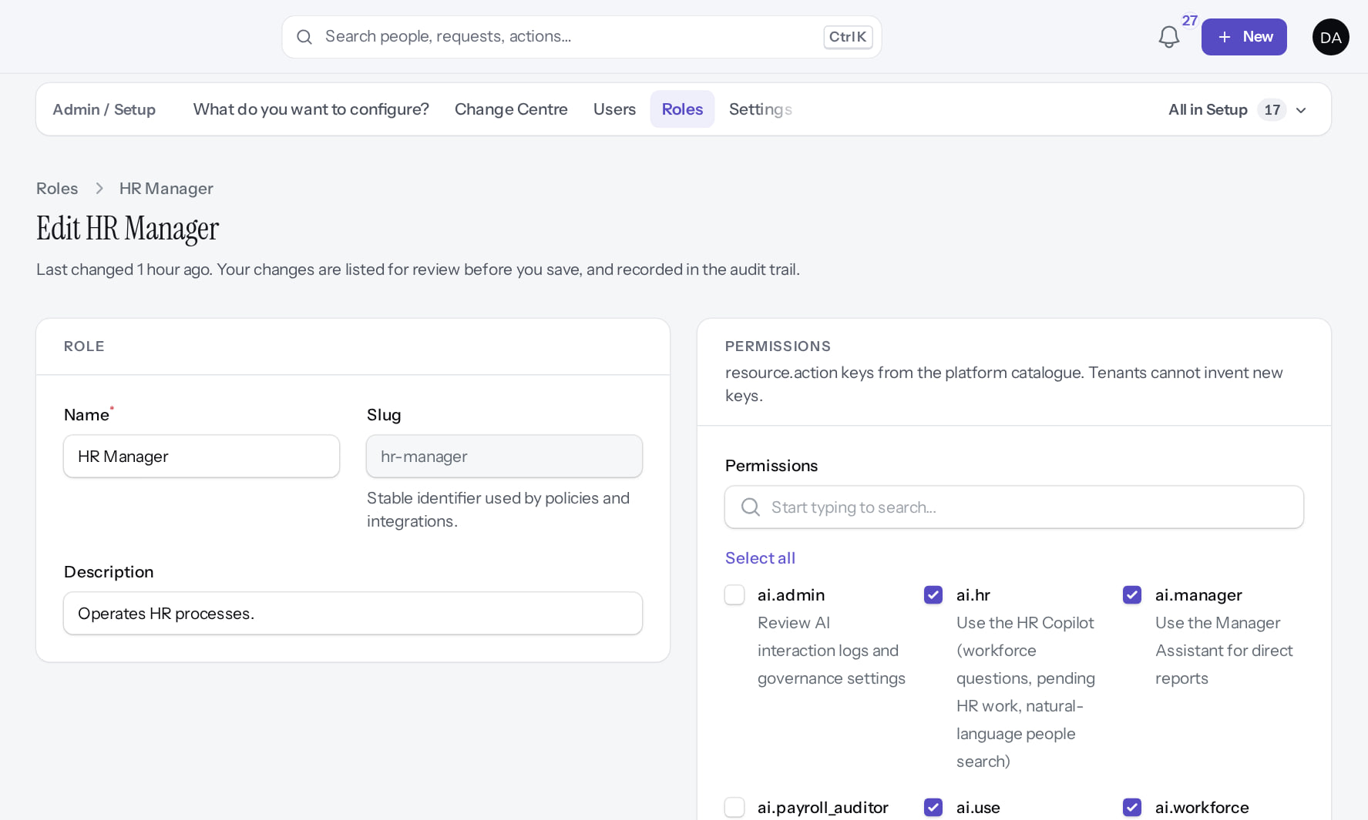
What a role may do
ROLES
Verified in the running application
RESULT Permission catalogue grouped by module. Changes are audited (ROLE_CHANGED with granted and removed keys). A role can be given only by someone who holds all its permissions.
Real screen (cropped) · Demo Admin (Tenant Super Admin) · Roles › HR Manager (as Tenant Super Admin)
Notes:
SOURCE: SaaS.10 RoleGrants delegation ceiling; SaaS.11 role permission change audit.

Slide 10
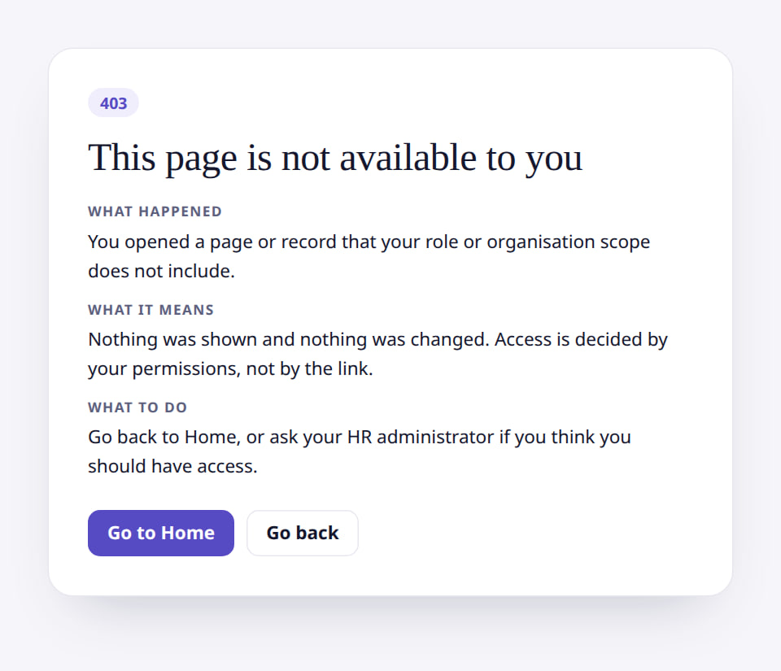
Only a Tenant Super Admin edits roles
ROLES
Verified in the running application
1
Access refused.
1
RESULT A Tenant HR Admin opening a role's edit page gets "This page is not available to you" (403). Intended or not, record it in your role design (F5).
Real screen (cropped) · Kavya Menon (Tenant HR Admin + Employee) · Roles › HR Manager › Edit (as Tenant HR Admin)
Notes:
SAY: A Tenant HR Admin opening a role's edit page gets "This page is not available to you" (403). Intended or not, record it in your role design (F5).
ON SCREEN: Tenant HR Admin opens /admin/roles/4/edit (the HR Manager role).
WALK THROUGH: (1) Access refused.
LEARNERS SHOULD SEE: HTTP 403 "This page is not available to you": the Tenant HR Admin holds role.view only and cannot change role permissions (finding F5); the Tenant Super Admin can
SCREEN: Roles › HR Manager › Edit (as Tenant HR Admin). Signed in as Kavya Menon (Tenant HR Admin + Employee). Prerequisite: role.manage (Tenant Super Admin only by default, F5).
EVIDENCE: screenshot screenshots/security-compliance/85-acc-08-role-edit-denied-hr-admin.png, captured 2026-10-21 on the disposable training database (fictional people).

Slide 11
Role-template findings to review
ROLES
Ref | Finding | Effect
F3 | Performance Admin template has only view permissions | Cannot administer cycles as the name suggests
F4 | Auditor ("read-only") includes webhook.manage | A read-only role can change integrations
F5 | Tenant HR Admin has role.view only | Only the Tenant Super Admin can change permissions
F15 | Payroll Admin cannot open statutory return screens | Returns need a Tenant HR Admin
F24 | HR Manager has no performance, learning or talent admin | Growth administration sits with Tenant HR Admin
F45 | Executive role has no analytics dataset permission | Executive dashboards are empty
Notes:
SOURCE: docs/reports/documentation-gaps.md (config/peopleos.php role templates). Customers can adjust templates; fixes to the shipped templates go through the template_keys mechanism (SaaS.12).
SAY: Role-template findings to review.
- F3 | Performance Admin template has only view permissions | Cannot administer cycles as the name suggests
- F4 | Auditor ("read-only") includes webhook.manage | A read-only role can change integrations
- F5 | Tenant HR Admin has role.view only | Only the Tenant Super Admin can change permissions
- F15 | Payroll Admin cannot open statutory return screens | Returns need a Tenant HR Admin
- F24 | HR Manager has no performance, learning or talent admin | Growth administration sits with Tenant HR Admin
- F45 | Executive role has no analytics dataset permission | Executive dashboards are empty

Slide 12
Tenant isolation
02
Data from one organisation never appears in another; operators cross only deliberately.
Notes:
TRANSITION: Section 2, Tenant isolation. Data from one organisation never appears in another; operators cross only deliberately.
SAY: Tell learners what they will be able to do by the end of this section, then move on.
ASK: "What questions do you have before we start this section?"

Slide 13
Isolation by default
TENANT ISOLATION
Signed-in user
belongs to one tenant
Tenant context
bound per request
Every query
filtered; no tenant → no rows
Writes
stamped and checked
Conceptual diagram, not a screenshot
One e-mail address belongs to one organisation. Platform operators have no tenant; they enter one explicitly with a reason and a ticket, for at most 60 minutes, and every action is recorded in the platform audit trail. Architecture tests fail the build if a model escapes tenant scoping or a service bypasses it outside the allow-list.
Notes:
SOURCE: architecture contract §1; ArchitectureTest (tenant scoping, bypass allow-list). Isolation has been tested on the workstation (189 isolation/authorisation tests at SaaS.11); an independent review has not been engaged (gate 4).
SAY: Isolation by default. One e-mail address belongs to one organisation. Platform operators have no tenant; they enter one explicitly with a reason and a ticket, for at most 60 minutes, and every action is recorded in the platform audit trail. Architecture tests fail the build if a model escapes tenant scoping or a service bypasses it outside the allow-list.
SEQUENCE: Signed-in user (belongs to one tenant) → Tenant context (bound per request) → Every query (filtered; no tenant → no rows) → Writes (stamped and checked)
LABEL: conceptual diagram, not a screenshot.

Slide 14
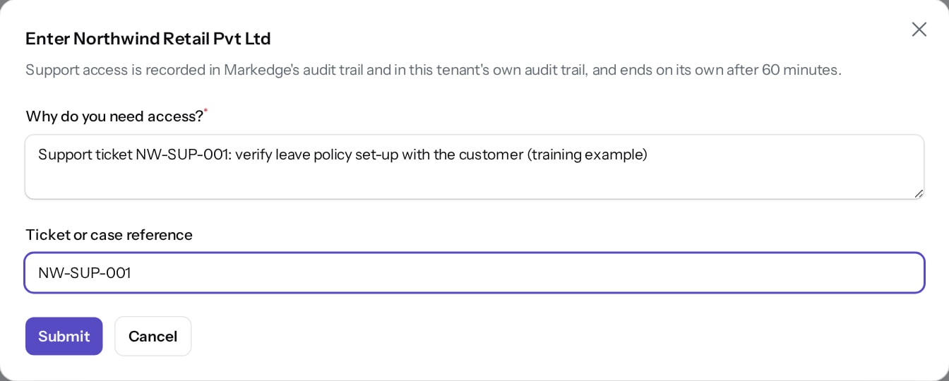
Boundaries in practice
TENANT ISOLATION
Operator enters a tenant
Verified
Markedge HR opening Tenants
Verified
Reason and ticket reference; ends after 60 minutes; audited.
Refused: tenant users, even Markedge's own HR, cannot reach the platform.
Real screen · Markedge Platform Admin (Platform operator) · Tenants › Enter
Real screen (cropped) · Sana Qureshi (Tenant Super Admin (Markedge internal HR)) · Tenants (as Markedge HR administrator)
Notes:
SAY: Boundaries in practice.
LEFT, Operator enters a tenant: Reason and ticket reference; ends after 60 minutes; audited.
RIGHT, Markedge HR opening Tenants: Refused: tenant users, even Markedge's own HR, cannot reach the platform.
OBSERVE: point out what differs between the two screens.
EVIDENCE: left = platform-admin/95-pl-35-enter-tenant-dialog [Markedge Platform Admin (Platform operator), Tenants › Enter]; right = internal-operations/96-int-08-hr-cannot-open-tenants [Sana Qureshi (Tenant Super Admin (Markedge internal HR)), Tenants (as Markedge HR administrator)]. Real screens, fictional data (SCREENSHOT-INVENTORY.md).

Slide 15
Organisation and relationship scope
03
HR reach can be limited to companies or units; managers reach their reports.
Notes:
TRANSITION: Section 3, Organisation and relationship scope. HR reach can be limited to companies or units; managers reach their reports.
SAY: Tell learners what they will be able to do by the end of this section, then move on.
ASK: "What questions do you have before we start this section?"

Slide 16
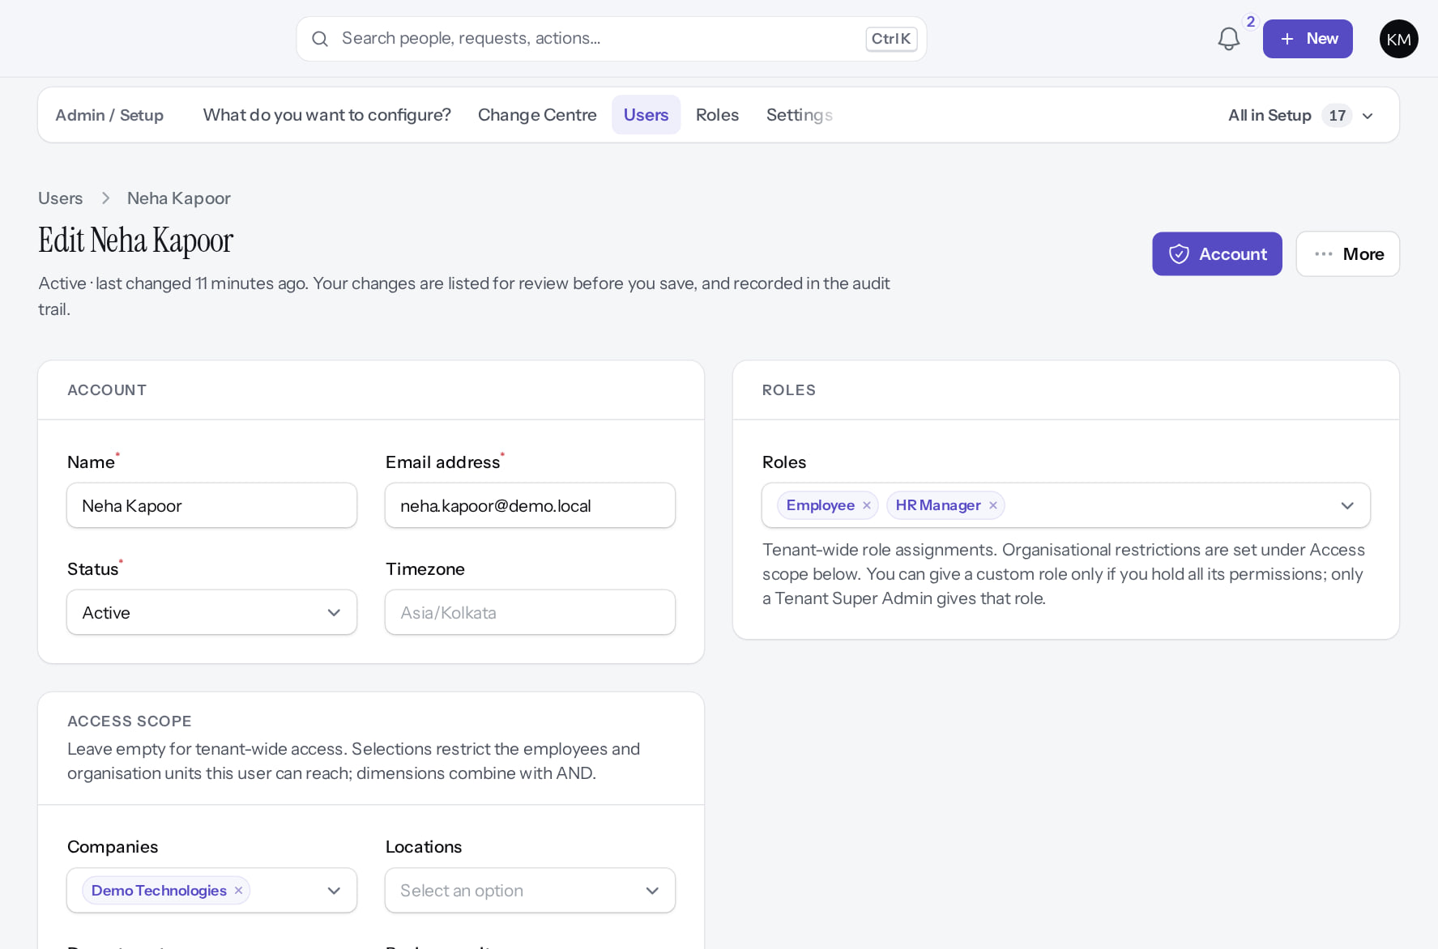
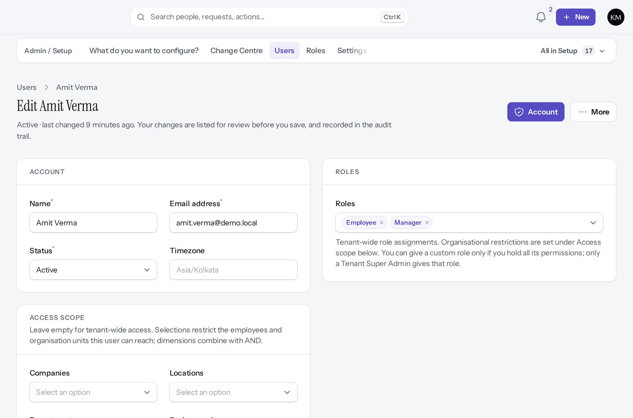
Scope on the user record
SCOPE
HR Manager limited to one company
Verified
Manager
Verified
Access scope › Companies = Demo Technologies: she reaches only that company's people and units. Dimensions combine with AND.
Employee + Manager roles; organisation scope empty. His Platform-team scope is a team dimension the form does not display.
Real screen (cropped) · Kavya Menon (Tenant HR Admin + Employee) · Admin › Setup › Users › Edit (Neha Kapoor)
Real screen (cropped) · Kavya Menon (Tenant HR Admin + Employee) · Admin › Setup › Users › Edit (Amit Verma)
Notes:
RISK: HR users with no scope rows reach the whole tenant by design; Home warns "people approve or edit employees across the whole tenant". Review scope at every access review.
SAY: Scope on the user record.
LEFT, HR Manager limited to one company: Access scope › Companies = Demo Technologies: she reaches only that company's people and units. Dimensions combine with AND.
RIGHT, Manager: Employee + Manager roles; organisation scope empty. His Platform-team scope is a team dimension the form does not display.
OBSERVE: point out what differs between the two screens.
EVIDENCE: left = security-compliance/85-acc-06b-user-company-scope [Kavya Menon (Tenant HR Admin + Employee), Admin › Setup › Users › Edit (Neha Kapoor)]; right = security-compliance/85-acc-06-user-roles-scope [Kavya Menon (Tenant HR Admin + Employee), Admin › Setup › Users › Edit (Amit Verma)]. Real screens, fictional data (SCREENSHOT-INVENTORY.md).

Slide 17
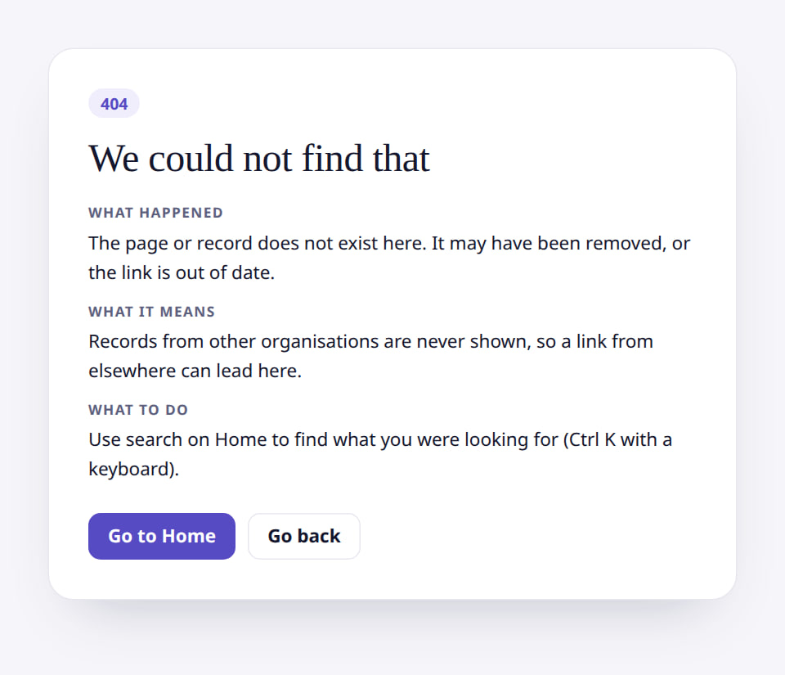
Restricted pages for managers and employees
SCOPE
Manager: someone outside the team
Verified
Employee: an HR page
Verified
"We could not find that" (404): a manager cannot open, or even confirm, a record outside their reach.
Employees see "This page is not available to you" on HR-only pages.
Real screen (cropped) · Amit Verma (Manager + Employee) · Employee 360 of someone outside the team
Real screen (cropped) · Priya Nair (Employee) · People › Lifecycle › Employees (HR register) as an employee
Notes:
SAY: Restricted pages for managers and employees.
LEFT, Manager: someone outside the team: "We could not find that" (404): a manager cannot open, or even confirm, a record outside their reach.
RIGHT, Employee: an HR page: Employees see "This page is not available to you" on HR-only pages.
OBSERVE: point out what differs between the two screens.
EVIDENCE: left = manager/40-team-09-outside-team [Amit Verma (Manager + Employee), Employee 360 of someone outside the team]; right = employee/30-self-52-restricted-page [Priya Nair (Employee), People › Lifecycle › Employees (HR register) as an employee]. Real screens, fictional data (SCREENSHOT-INVENTORY.md).

Slide 18
Sensitive data
04
Bank, identifiers, salary and confidential records need separate permissions.
Notes:
TRANSITION: Section 4, Sensitive data. Bank, identifiers, salary and confidential records need separate permissions.
SAY: Tell learners what they will be able to do by the end of this section, then move on.
ASK: "What questions do you have before we start this section?"

Slide 19
Data classification (from configuration)
SENSITIVE DATA
Class | Examples | Protection
Highly sensitive | Bank account, PAN, Aadhaar reference, UAN, PF, ESIC, secrets | Encrypted at rest; masked; *.sensitive.* to view, edit, export or search
Financial | Salary, payroll entries, payslips, settlements | Domain permissions; payslip views audited
Statutory | Tax declarations, statutory profiles | Payroll and HR permissions
Confidential | Grievances, improvement plans, one-on-ones, background checks, documents | Relationship and domain permissions; documents via 10-minute signed links
Notes:
SOURCE: config/peopleos.php data_classification; architecture contract §6 field-level security; ArchitectureTest "masks every highly sensitive attribute". A Tenant Administrator does not automatically hold *.sensitive.* permissions.
SAY: Data classification (from configuration).
- Highly sensitive | Bank account, PAN, Aadhaar reference, UAN, PF, ESIC, secrets | Encrypted at rest; masked; *.sensitive.* to view, edit, export or search
- Financial | Salary, payroll entries, payslips, settlements | Domain permissions; payslip views audited
- Statutory | Tax declarations, statutory profiles | Payroll and HR permissions
- Confidential | Grievances, improvement plans, one-on-ones, background checks, documents | Relationship and domain permissions; documents via 10-minute signed links

Slide 20
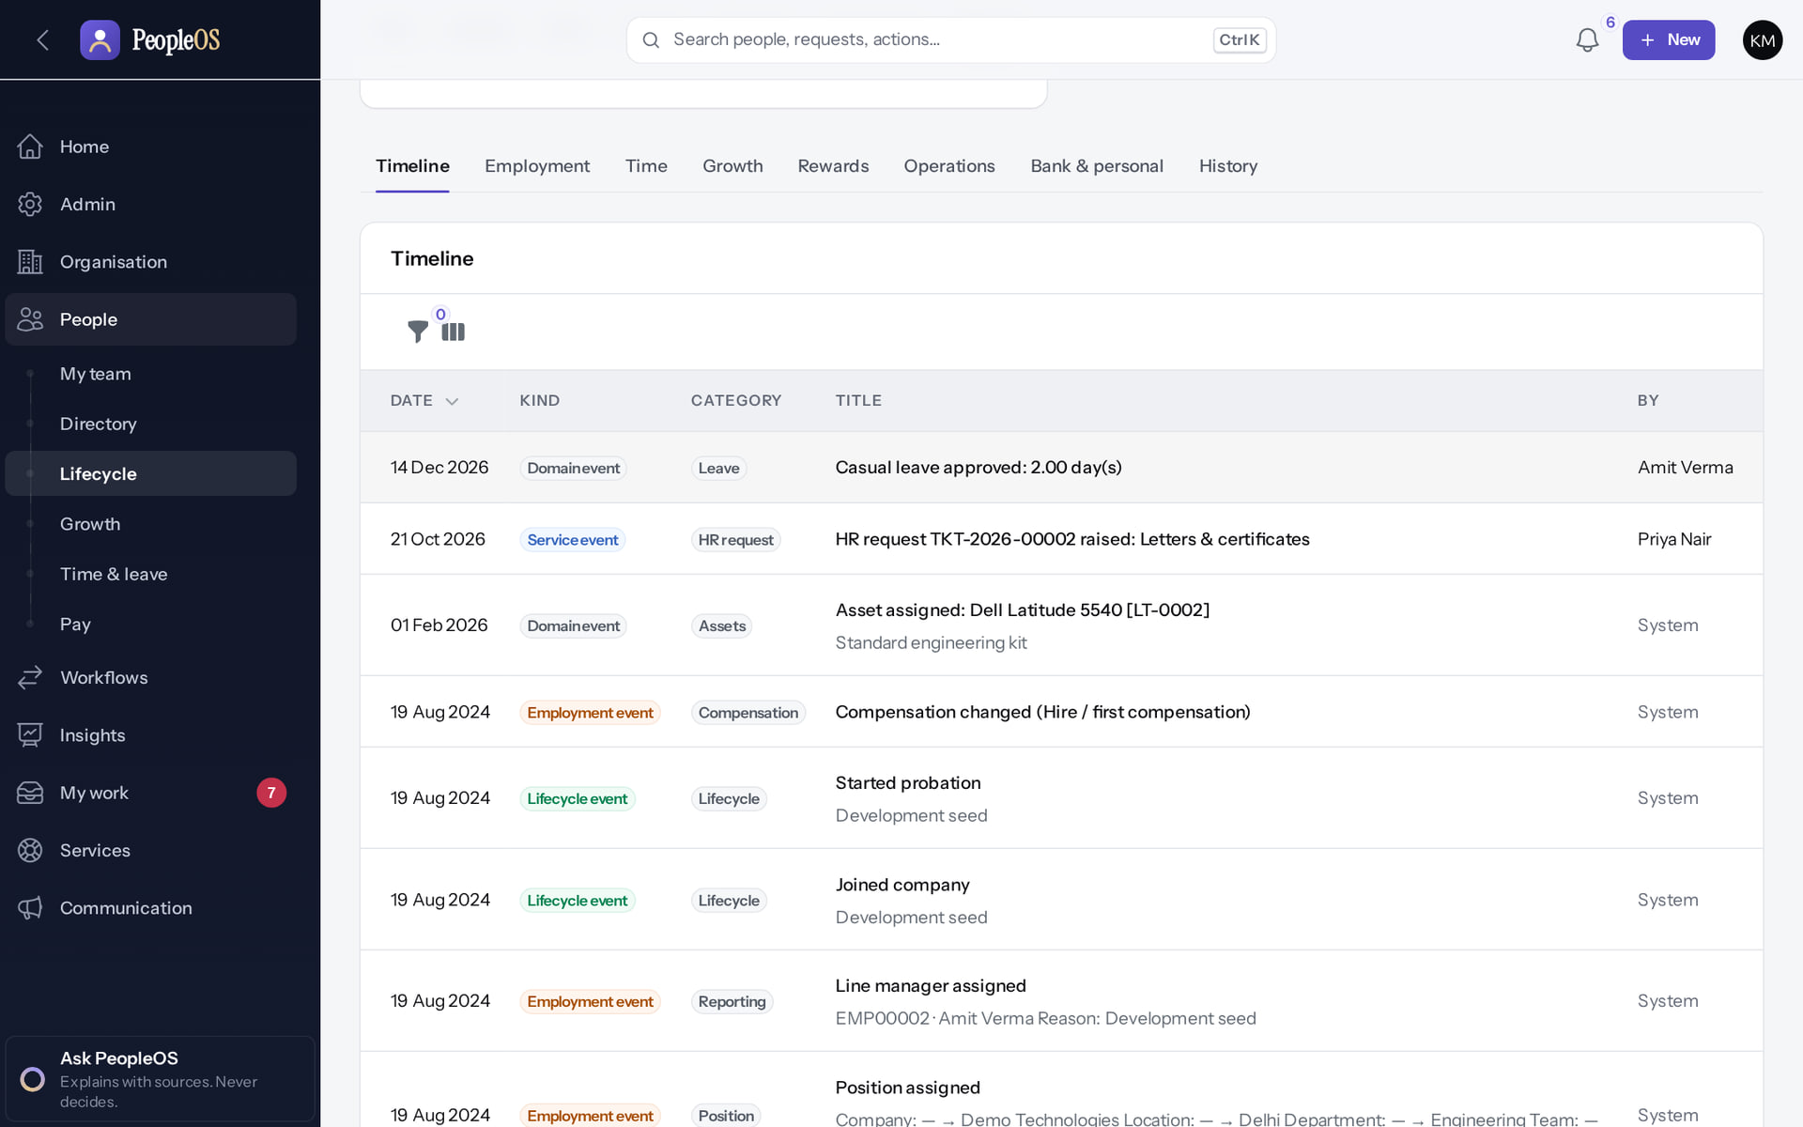
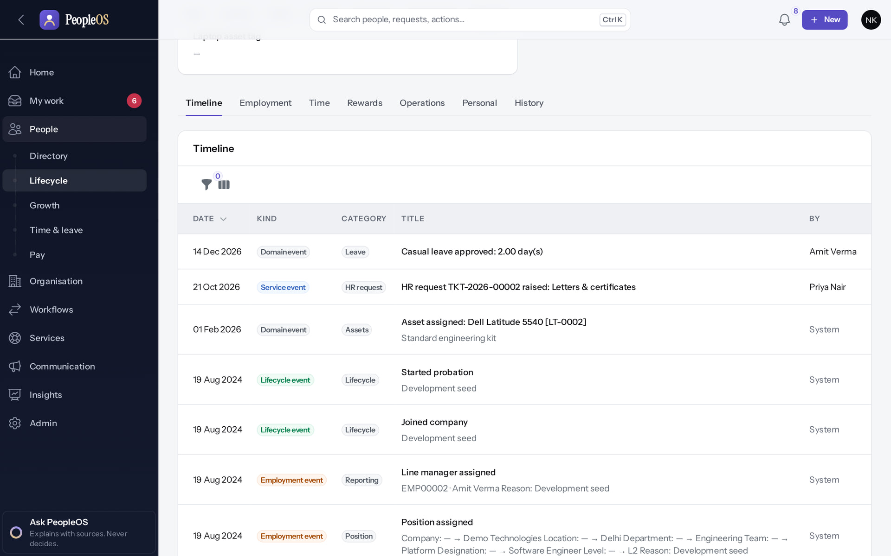
Two HR roles, two sets of record tabs
SENSITIVE DATA
Tenant HR Admin
Verified
HR Manager
Verified
Includes Growth and Bank & personal.
No Growth; Personal instead of Bank & personal.
Real screen · Kavya Menon (Tenant HR Admin + Employee) · Employee 360 › Records (as Tenant HR Admin (Kavya))
Real screen · Neha Kapoor (HR Manager + Employee) · Employee 360 › Records (as HR Manager (Neha))
Notes:
SAY: Two HR roles, two sets of record tabs.
LEFT, Tenant HR Admin: Includes Growth and Bank & personal.
RIGHT, HR Manager: No Growth; Personal instead of Bank & personal.
OBSERVE: point out what differs between the two screens.
EVIDENCE: left = security-compliance/50-sec-01-360-records-tenant-hr-admin [Kavya Menon (Tenant HR Admin + Employee), Employee 360 › Records (as Tenant HR Admin (Kavya))]; right = security-compliance/50-sec-02-360-records-hr-manager [Neha Kapoor (HR Manager + Employee), Employee 360 › Records (as HR Manager (Neha))]. Real screens, fictional data (SCREENSHOT-INVENTORY.md).

Slide 21
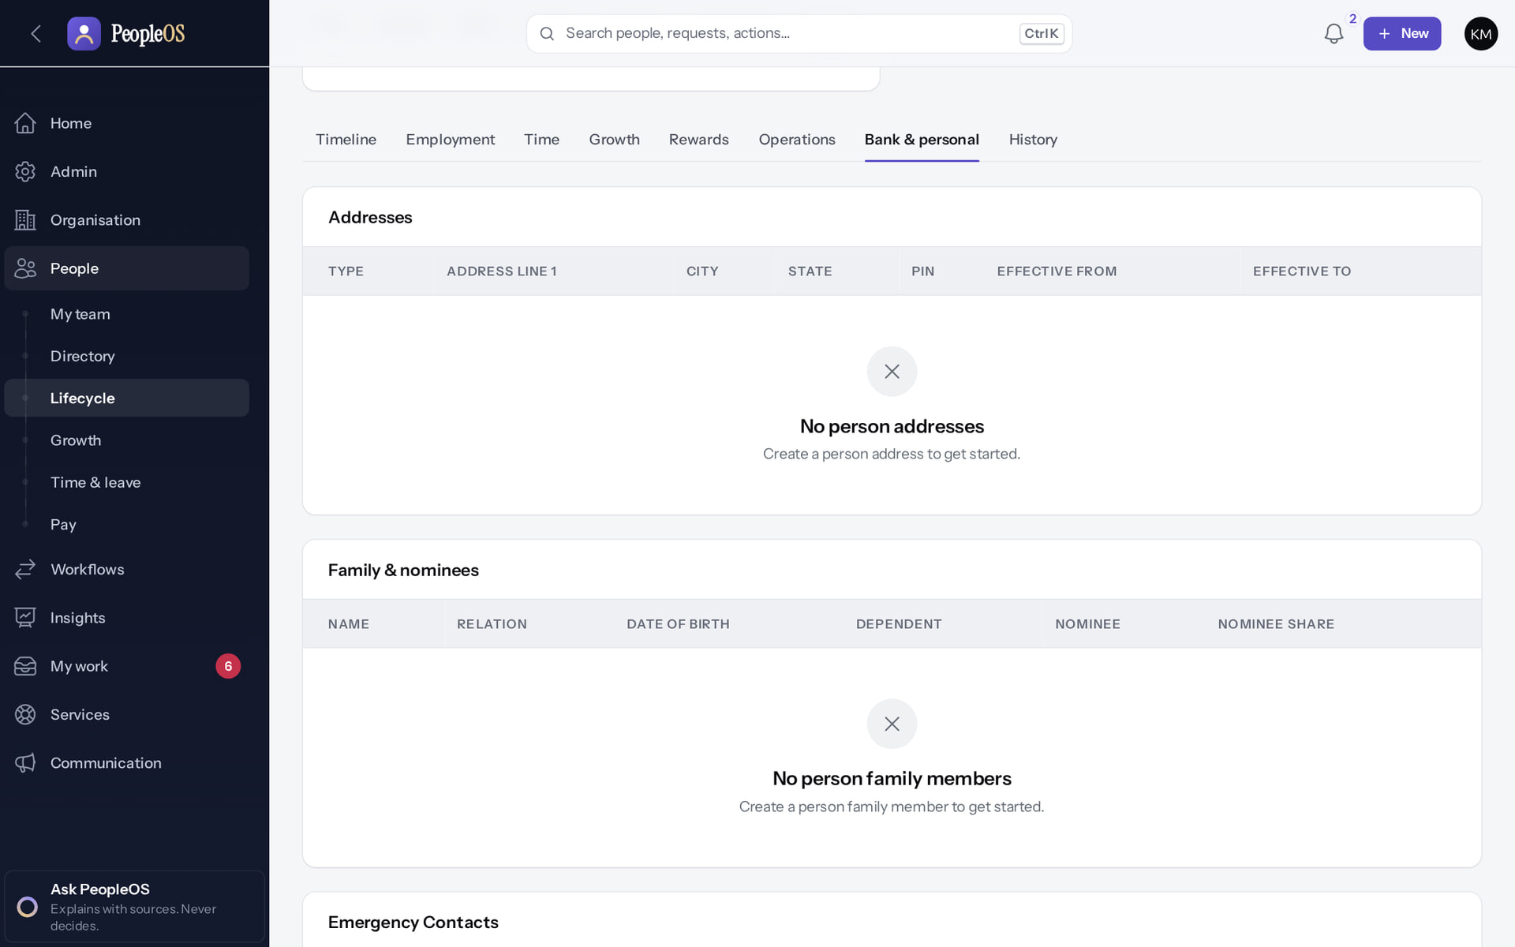
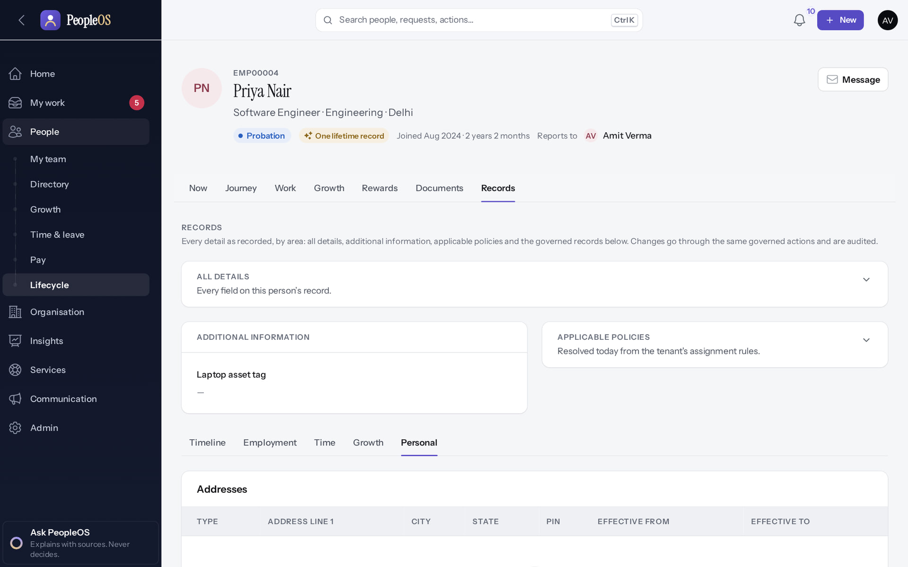
Same person, different reach
SENSITIVE DATA
HR view: Bank & personal
Verified
Manager view
Verified
HR with the sensitive permission sees the Bank & personal records tab.
The manager's Personal tab: no bank or identity details; the Records sub-tabs omit Rewards and Operations.
Real screen · Kavya Menon (Tenant HR Admin + Employee) · Employee 360 › Records › Bank & personal
Real screen · Amit Verma (Manager + Employee) · Employee 360 › Records › Personal (as manager)
Notes:
SAY: Same person, different reach.
LEFT, HR view: Bank & personal: HR with the sensitive permission sees the Bank & personal records tab.
RIGHT, Manager view: The manager's Personal tab: no bank or identity details; the Records sub-tabs omit Rewards and Operations.
OBSERVE: point out what differs between the two screens.
EVIDENCE: left = hr-admin/50-360-09-records-bank-personal [Kavya Menon (Tenant HR Admin + Employee), Employee 360 › Records › Bank & personal]; right = manager/40-team-08-member-personal [Amit Verma (Manager + Employee), Employee 360 › Records › Personal (as manager)]. Real screens, fictional data (SCREENSHOT-INVENTORY.md).

Slide 22
Audit and change history
05
Append-only events, chained per tenant, verified on demand.
Notes:
TRANSITION: Section 5, Audit and change history. Append-only events, chained per tenant, verified on demand.
SAY: Tell learners what they will be able to do by the end of this section, then move on.
ASK: "What questions do you have before we start this section?"

Slide 23
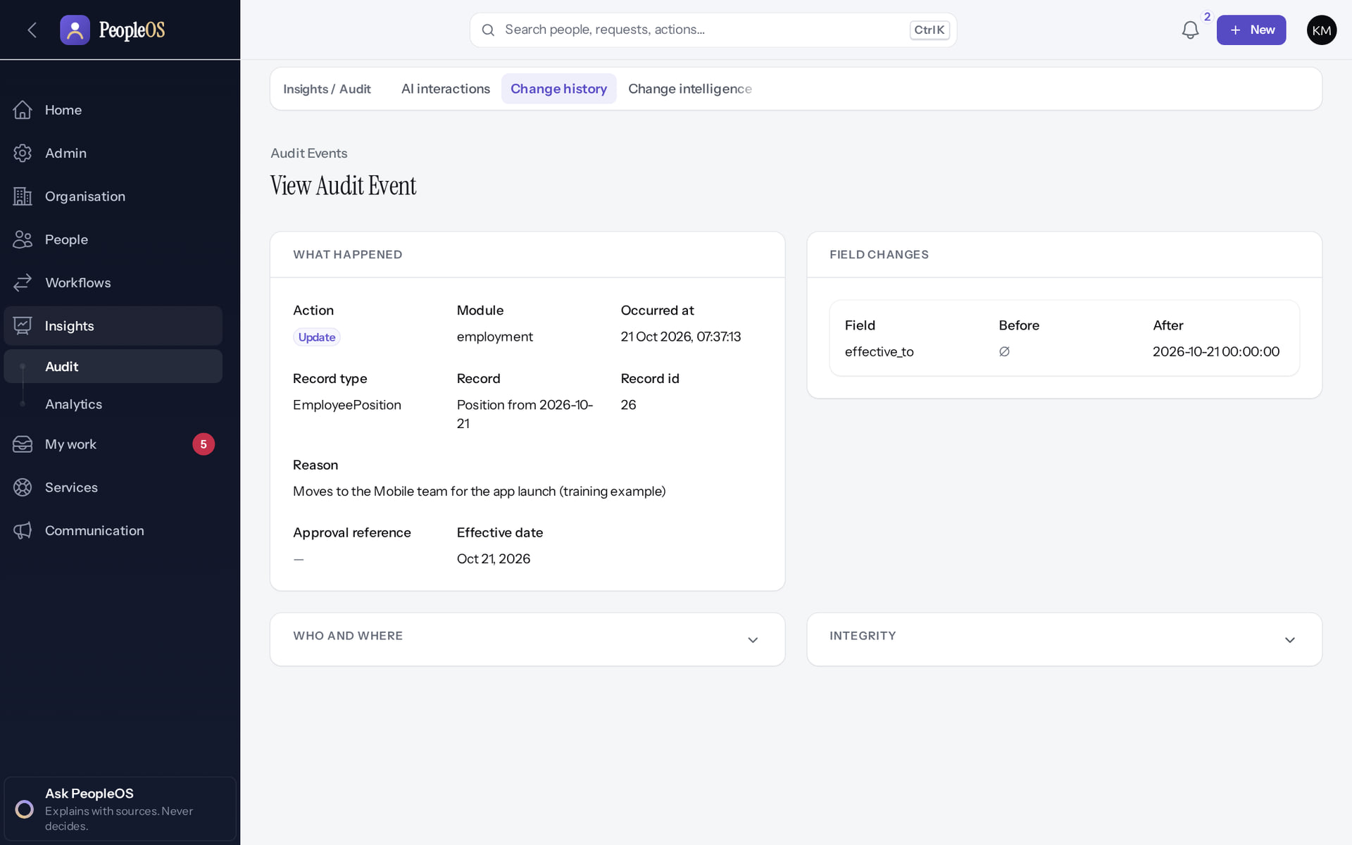
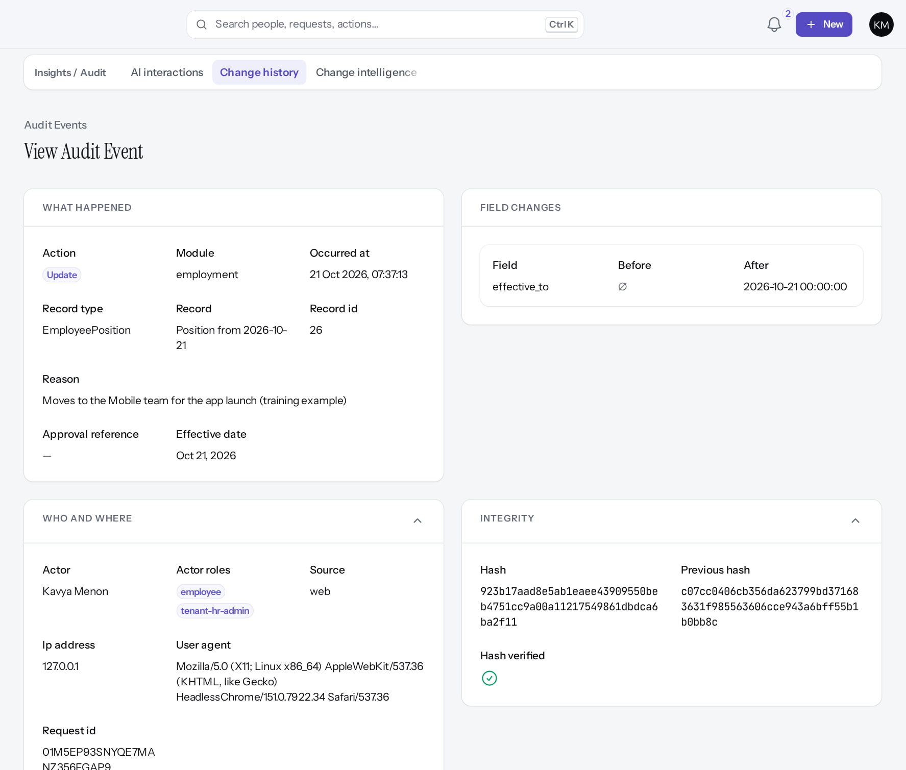
An audit event and its integrity
AUDIT
Event detail
Verified
Integrity
Verified
Who, when, action, reason and field-level before → after (masked when sensitive).
Actor, roles, source, IP, user agent, request id; Hash, Previous hash, "Hash verified ✓".
Real screen · Kavya Menon (Tenant HR Admin + Employee) · Change history › event
Real screen (cropped) · Kavya Menon (Tenant HR Admin + Employee) · Change history › event (Who and where, Integrity expanded)
Notes:
SAY: An audit event and its integrity.
LEFT, Event detail: Who, when, action, reason and field-level before → after (masked when sensitive).
RIGHT, Integrity: Actor, roles, source, IP, user agent, request id; Hash, Previous hash, "Hash verified ✓".
OBSERVE: point out what differs between the two screens.
EVIDENCE: left = security-compliance/80-ins-11-audit-event-detail [Kavya Menon (Tenant HR Admin + Employee), Change history › event]; right = security-compliance/80-ins-11b-audit-integrity [Kavya Menon (Tenant HR Admin + Employee), Change history › event (Who and where, Integrity expanded)]. Real screens, fictional data (SCREENSHOT-INVENTORY.md).

Slide 24
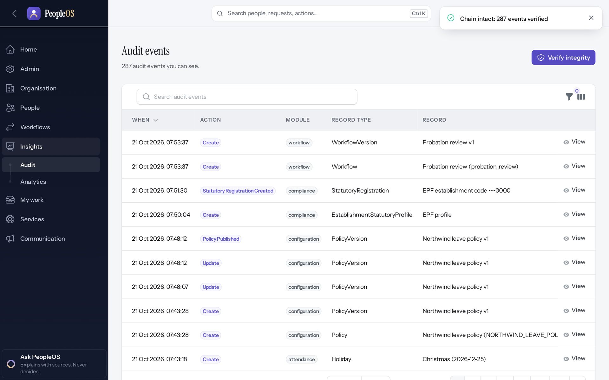
Verify the whole chain
AUDIT
1
Verified in the running application
1
The result.
RESULT "Chain intact: 287 events verified" for the Northwind tenant after its full implementation.
Real screen · Farah Khan (Tenant Super Admin (Northwind Retail, first administrator)) · Change history › Verify integrity
Notes:
SAY: "Chain intact: 287 events verified" for the Northwind tenant after its full implementation.
ON SCREEN: Verify integrity.
WALK THROUGH: (1) The result.
LEARNERS SHOULD SEE: The tenant’s audit hash chain is checked and the result shown
SCREEN: Change history › Verify integrity. Signed in as Farah Khan (Tenant Super Admin (Northwind Retail, first administrator)). Prerequisite: Signed in as the tenant administrator.
EVIDENCE: screenshot screenshots/client-onboarding/90-onb-90-audit-verified.png, captured 2026-10-21 on the disposable training database (fictional people).

Slide 25
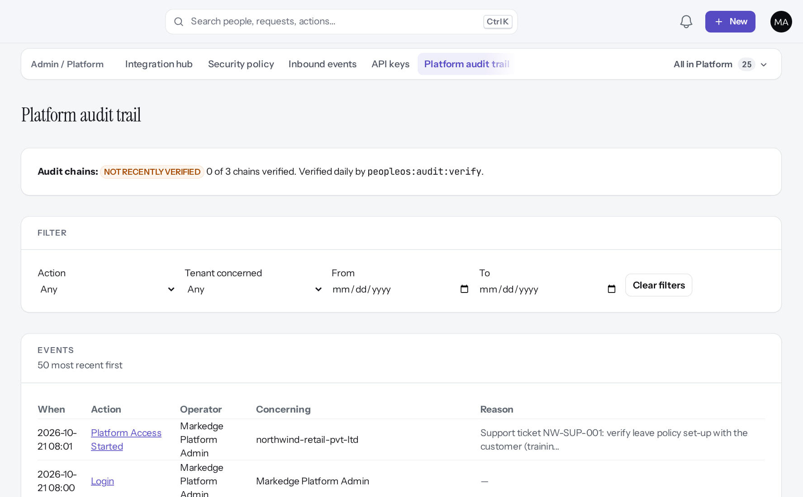
Operators are audited too
AUDIT
Verified in the running application
RESULT Platform audit trail, newest first, each with actor and reason (top rows: platform access started and sign-in; suspend, reactivate, legal hold and release request further down). Header: "NOT RECENTLY VERIFIED: 0 of 3 chains verified" until the scheduler runs verification.
Real screen (cropped) · Markedge Platform Admin (Platform operator) · Admin › Platform › Platform audit trail
Notes:
SAY: Platform audit trail, newest first, each with actor and reason (top rows: platform access started and sign-in; suspend, reactivate, legal hold and release request further down). Header: "NOT RECENTLY VERIFIED: 0 of 3 chains verified" until the scheduler runs verification.
ON SCREEN: Review what the operator did.
LEARNERS SHOULD SEE: Tenant suspended / reactivated, legal hold placed, release requested and tenant entered, with actor and reason
SCREEN: Admin › Platform › Platform audit trail. Signed in as Markedge Platform Admin (Platform operator). Prerequisite: Platform operator with MFA.
EVIDENCE: screenshot screenshots/platform-admin/95-pl-37-platform-audit-after.png, captured 2026-10-21 on the disposable training database (fictional people).

Slide 26
Authentication and MFA
06
Authenticator apps for everyone who opts in or is required; operators always.
Notes:
TRANSITION: Section 6, Authentication and MFA. Authenticator apps for everyone who opts in or is required; operators always.
SAY: Tell learners what they will be able to do by the end of this section, then move on.
ASK: "What questions do you have before we start this section?"

Slide 27
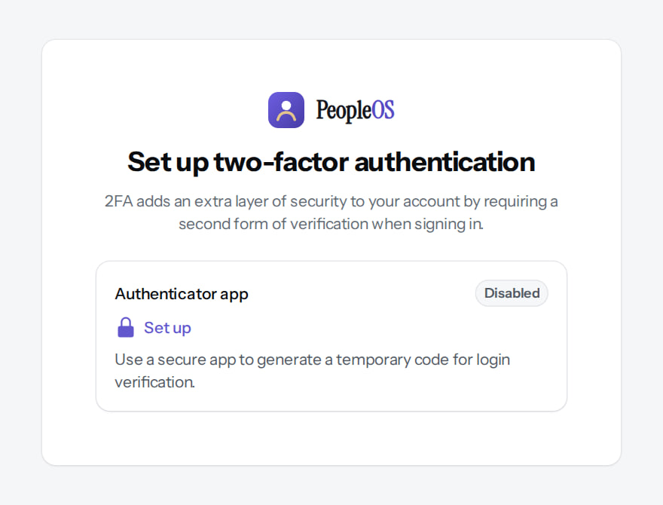
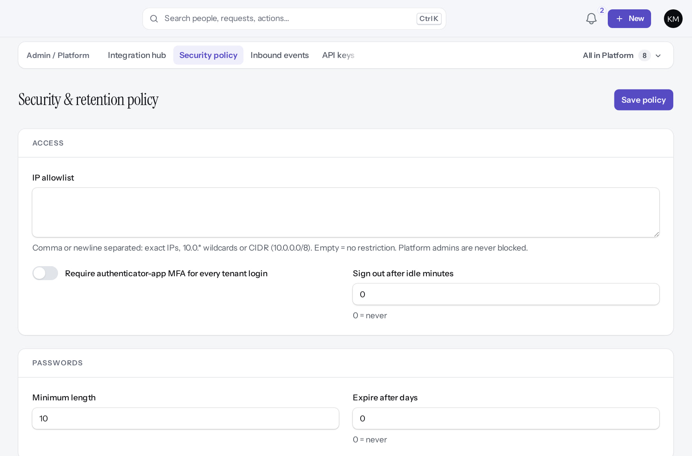
Operators are forced; tenants choose
MFA
Operator without MFA
Verified
Tenant security policy
Verified
Held on set-up until an authenticator is enrolled (platform policy, on by default).
MFA is optional in the demonstration tenant. Switch on "Require authenticator-app MFA for every tenant login".
Real screen (cropped) · Markedge Platform Admin (Platform operator) · Set up two-factor authentication (forced)
Real screen (cropped) · Kavya Menon (Tenant HR Admin + Employee) · Admin › Platform › Security policy
Notes:
FINDINGS: password expiry is stored but not enforced (F2); the security.mfa feature flag has no effect (F31); SSO users must also use a local authenticator when MFA is required. Only authenticator apps are supported (no SMS or e-mail codes).
SAY: Operators are forced; tenants choose.
LEFT, Operator without MFA: Held on set-up until an authenticator is enrolled (platform policy, on by default).
RIGHT, Tenant security policy: MFA is optional in the demonstration tenant. Switch on "Require authenticator-app MFA for every tenant login".
OBSERVE: point out what differs between the two screens.
EVIDENCE: left = platform-admin/02-mfa-setup-required [Markedge Platform Admin (Platform operator), Set up two-factor authentication (forced)]; right = security-compliance/85-sec-01-security-policy [Kavya Menon (Tenant HR Admin + Employee), Admin › Platform › Security policy]. Real screens, fictional data (SCREENSHOT-INVENTORY.md).

Slide 28
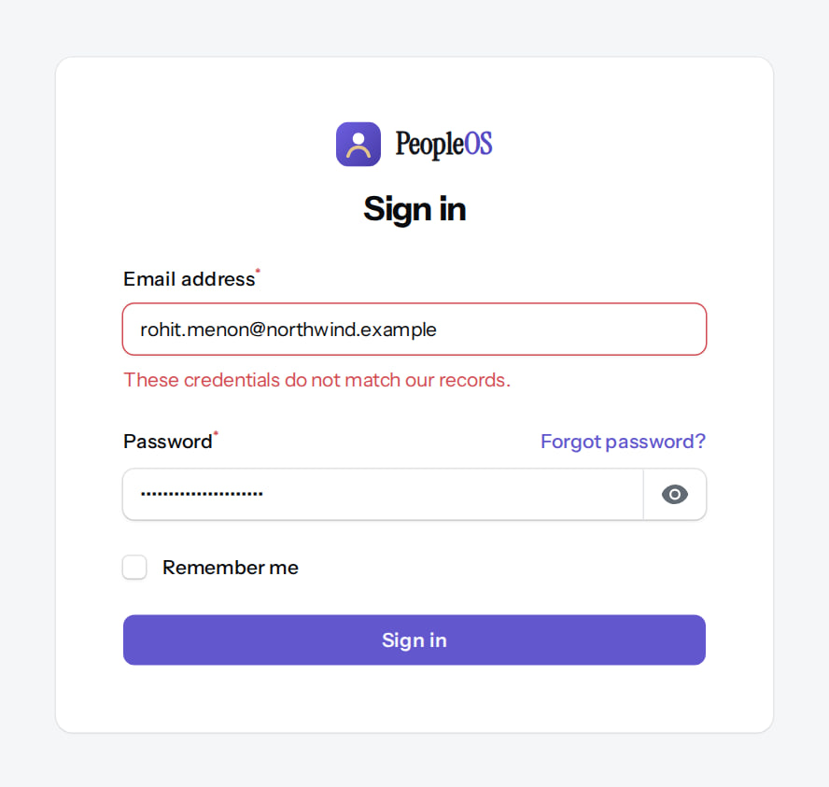
Sign-in failures reveal nothing
AUTHENTICATION
Verified in the running application
1
Generic message.
2
Forgot password?
RESULT The same "These credentials do not match our records." for a wrong password, an unknown e-mail, an invited or a suspended account. Password reset answers neutrally and is rate-limited.
1
2
Real screen (cropped) · Signed out (Visitor) · Sign in (failed)
Notes:
SAY: The same "These credentials do not match our records." for a wrong password, an unknown e-mail, an invited or a suspended account. Password reset answers neutrally and is rate-limited.
ON SCREEN: Sign in with a wrong password.
WALK THROUGH: (1) Generic message. (2) Forgot password?
LEARNERS SHOULD SEE: "These credentials do not match our records." — the same message for a wrong password, an unknown e-mail, an invited (not activated) or a suspended account
SCREEN: Sign in (failed). Signed in as Signed out (Visitor). Prerequisite: None (public pages).
EVIDENCE: screenshot screenshots/support/99-sup-01-wrong-password.png, captured 2026-10-21 on the disposable training database (fictional people).

Slide 29
Separation of duties
07
Sensitive outcomes need more than one person.
Notes:
TRANSITION: Section 7, Separation of duties. Sensitive outcomes need more than one person.
SAY: Tell learners what they will be able to do by the end of this section, then move on.
ASK: "What questions do you have before we start this section?"

Slide 30
Where a second person is required
SEPARATION OF DUTIES
Process | Rule | Seen in this training
Employee documents | The uploader cannot verify | Yes (shown as a server error, new finding)
Letters | The requester cannot approve | Yes: "The person who requested a letter cannot approve it."
Compensation change | Four different people: propose, review, approve, execute | Yes: reviewer had no Approve
Payroll run | Approver must differ from the creator | Not reached: validation blocked (statutory)
Full & final settlement | None enforced | Observed: the same HR person calculated and approved
Legal hold release | A different operator approves | Yes: release pending
Financial and commercial changes | Maker-checker between operators | Pages seen; no change proposed
Configuration changes | Change Centre approval when on | Off by default; no self-approval guard (F29)
Notes:
SOURCE: captures 50-doc-03, 62-comp-07, 95-pl-34, 95-pl-20; documentation-gaps F29; PayrollRunPolicy (approver ≠ creator).
SAY: Where a second person is required.
- Employee documents | The uploader cannot verify | Yes (shown as a server error, new finding)
- Letters | The requester cannot approve | Yes: "The person who requested a letter cannot approve it."
- Compensation change | Four different people: propose, review, approve, execute | Yes: reviewer had no Approve
- Payroll run | Approver must differ from the creator | Not reached: validation blocked (statutory)
- Full & final settlement | None enforced | Observed: the same HR person calculated and approved
- Legal hold release | A different operator approves | Yes: release pending
- Financial and commercial changes | Maker-checker between operators | Pages seen; no change proposed
- Configuration changes | Change Centre approval when on | Off by default; no self-approval guard (F29)

Slide 31
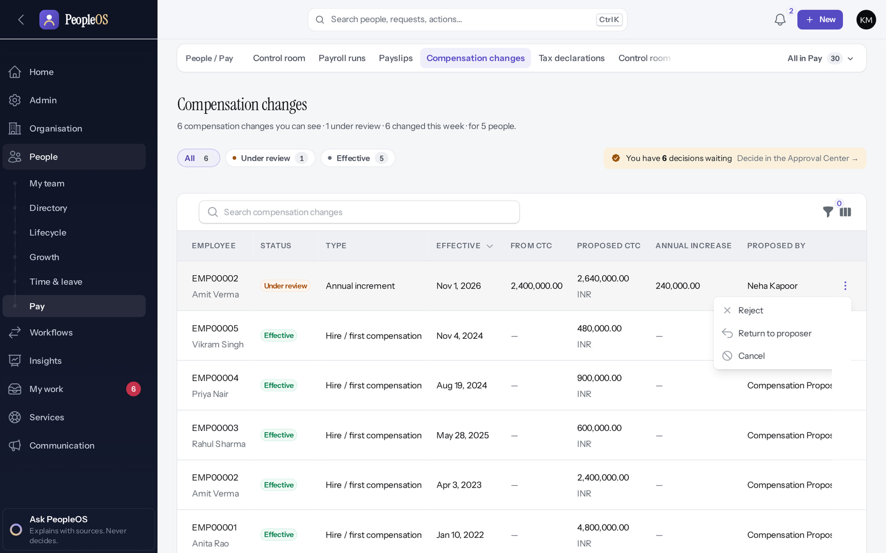
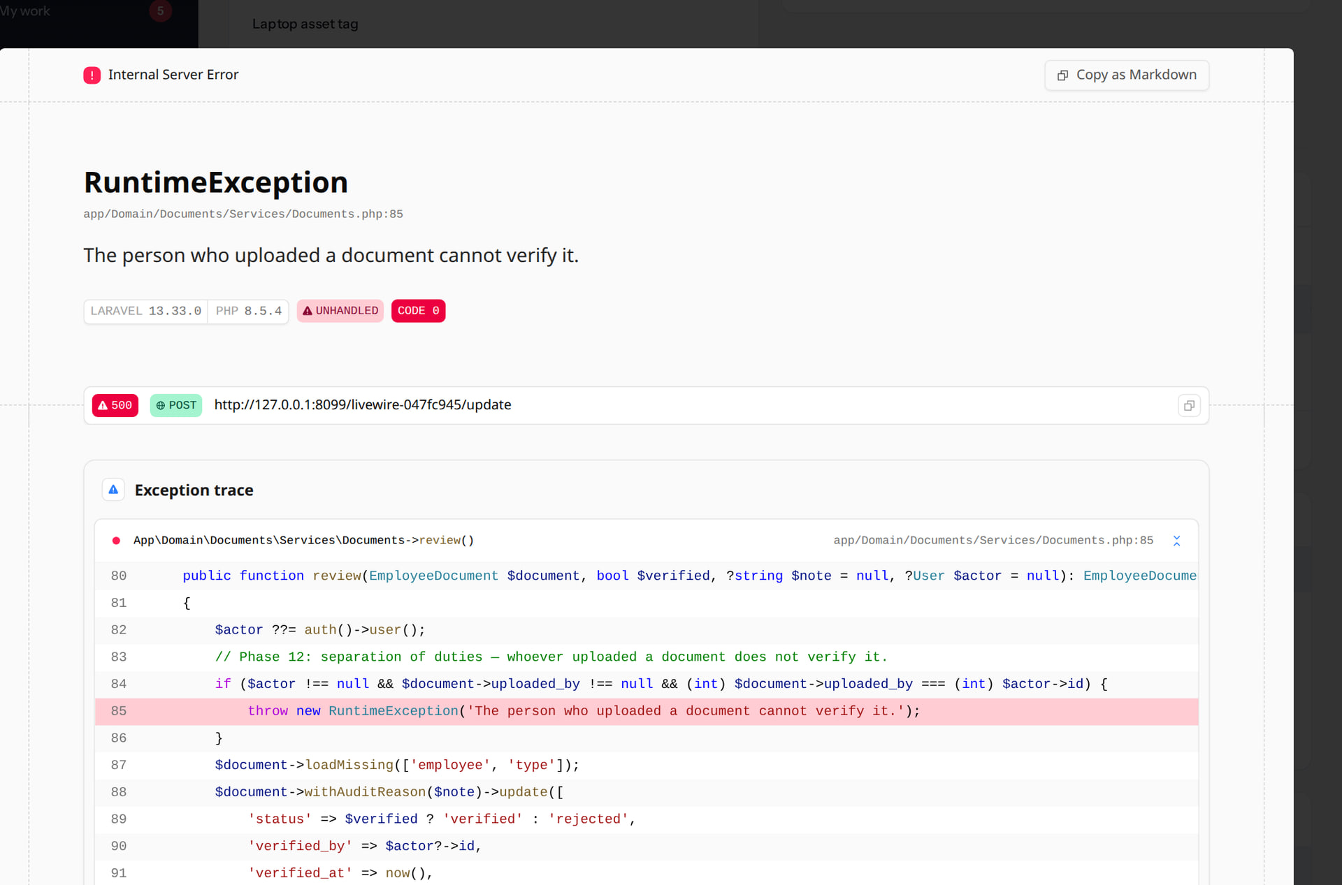
Two refusals that protect people
SEPARATION OF DUTIES
Reviewer cannot approve
Verified
Uploader cannot verify
Verified
After reviewing a pay change, Kavya sees Reject, Return to proposer and Cancel: no Approve.
"The person who uploaded a document cannot verify it." Correct rule, but shown as a server error page (development mode).
Real screen · Kavya Menon (Tenant HR Admin + Employee) · Compensation changes › row actions (after reviewing)
Real screen (cropped) · Kavya Menon (Tenant HR Admin + Employee) · Employee 360 › Records › Operations › Documents
Notes:
SAY: Two refusals that protect people.
LEFT, Reviewer cannot approve: After reviewing a pay change, Kavya sees Reject, Return to proposer and Cancel: no Approve.
RIGHT, Uploader cannot verify: "The person who uploaded a document cannot verify it." Correct rule, but shown as a server error page (development mode).
OBSERVE: point out what differs between the two screens.
EVIDENCE: left = security-compliance/62-comp-07-reviewer-cannot-approve [Kavya Menon (Tenant HR Admin + Employee), Compensation changes › row actions (after reviewing)]; right = security-compliance/50-doc-03-uploader-cannot-verify [Kavya Menon (Tenant HR Admin + Employee), Employee 360 › Records › Operations › Documents]. Real screens, fictional data (SCREENSHOT-INVENTORY.md).

Slide 32
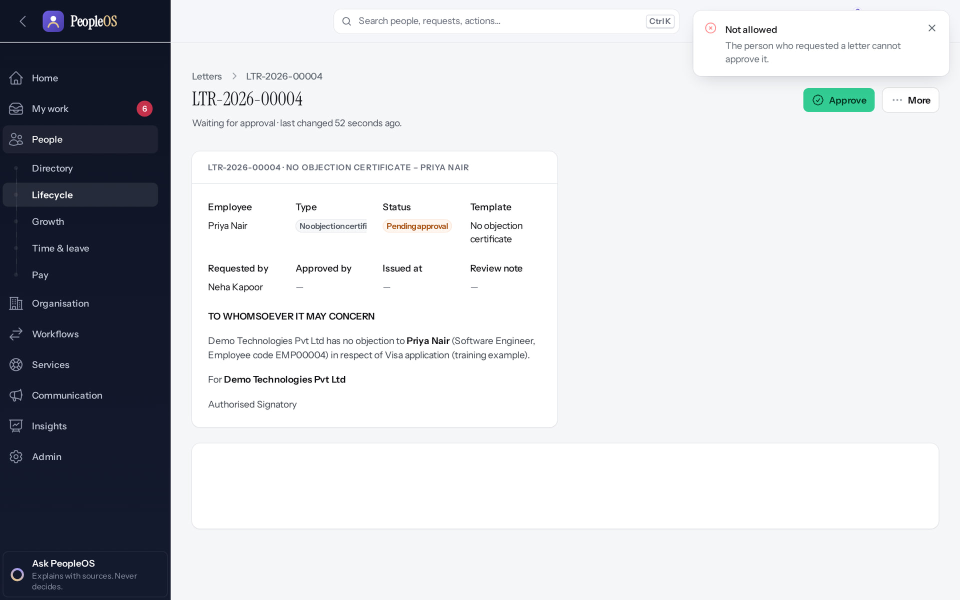
Letters and HR roles
SEPARATION OF DUTIES
Requester cannot approve a letter
Verified
HR Manager cannot import
Verified
"Not allowed: The person who requested a letter cannot approve it."
403: employee.import is not in the HR Manager role.
Real screen · Neha Kapoor (HR Manager + Employee) · Letters › Approve (by the requester)
Real screen (cropped) · Neha Kapoor (HR Manager + Employee) · Employee imports (as HR Manager)
Notes:
SAY: Letters and HR roles.
LEFT, Requester cannot approve a letter: "Not allowed: The person who requested a letter cannot approve it."
RIGHT, HR Manager cannot import: 403: employee.import is not in the HR Manager role.
OBSERVE: point out what differs between the two screens.
EVIDENCE: left = security-compliance/52-let-04-requester-cannot-approve [Neha Kapoor (HR Manager + Employee), Letters › Approve (by the requester)]; right = security-compliance/75-imp-08-hr-manager-not-available [Neha Kapoor (HR Manager + Employee), Employee imports (as HR Manager)]. Real screens, fictional data (SCREENSHOT-INVENTORY.md).

Slide 33
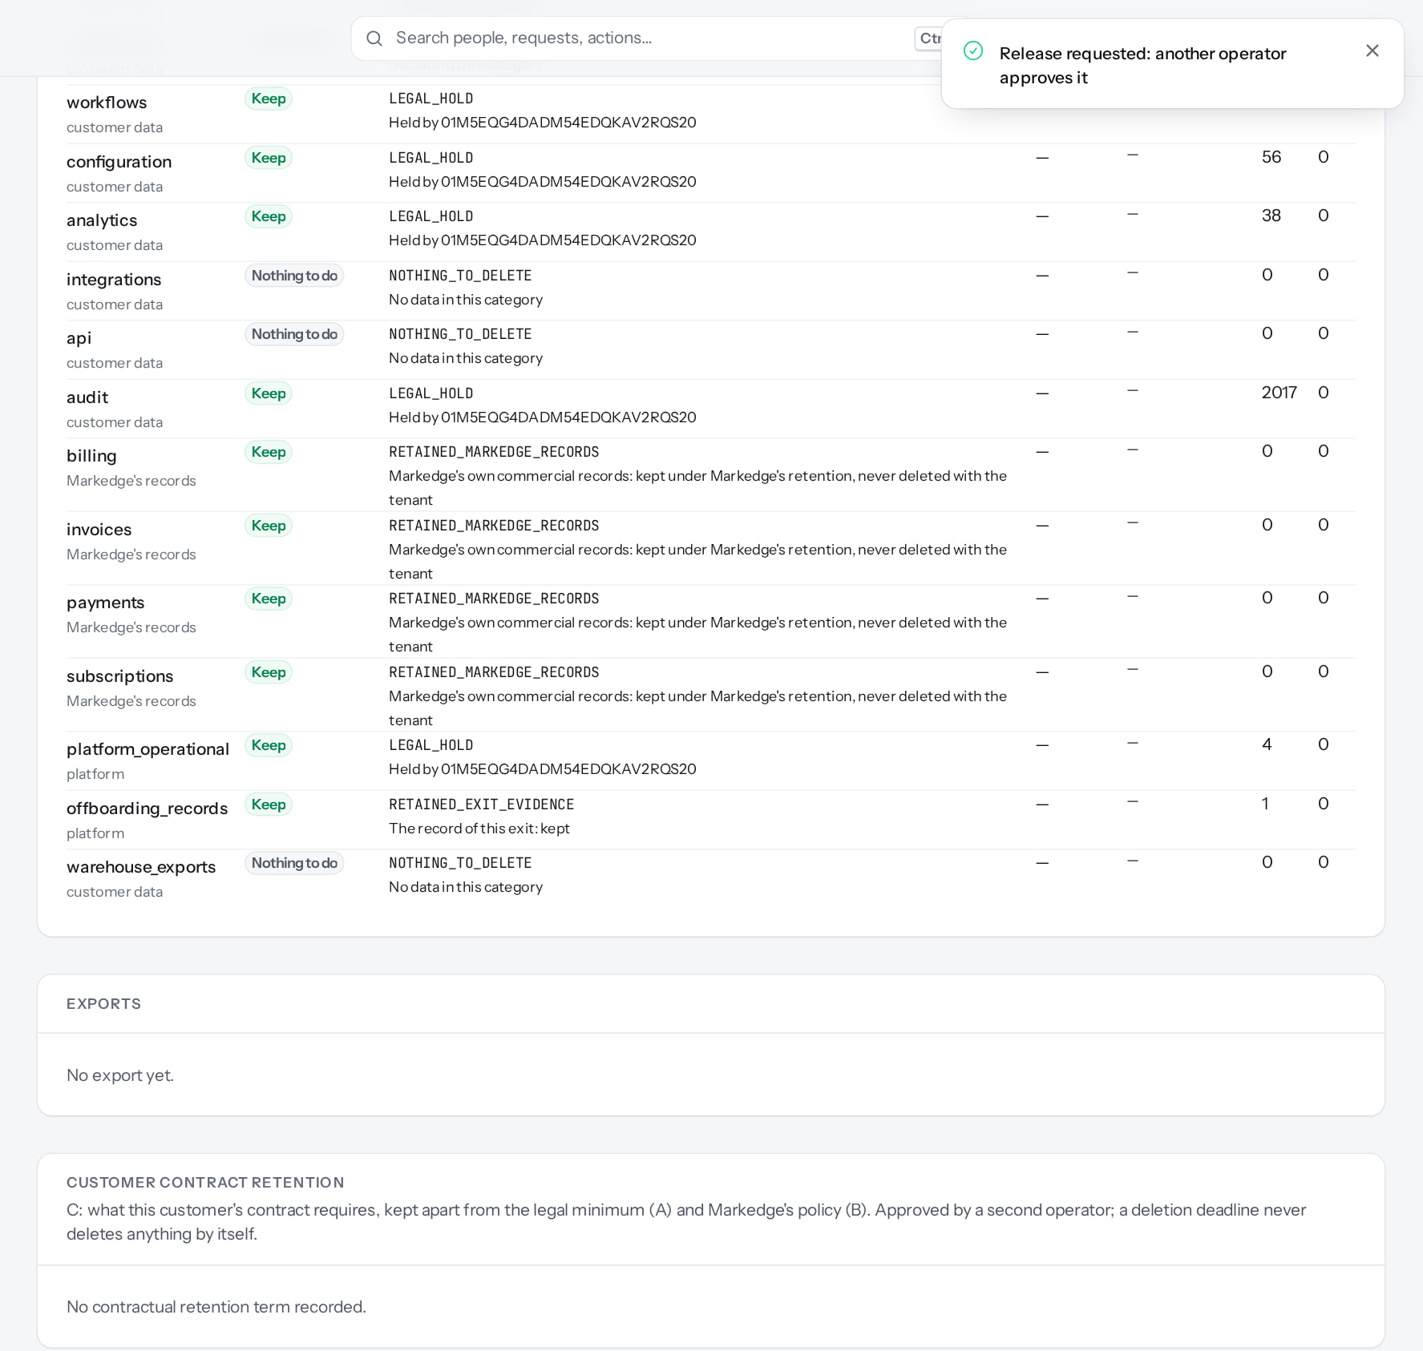
Operators: two-person release
SEPARATION OF DUTIES
1
Available only after configuration
1
The result.
RESULT A legal hold stays active until a different operator approves its release.
Real screen (cropped) · Markedge Platform Admin (Platform operator) · Offboarding › Legal holds (release requested)
Notes:
SAY: A legal hold stays active until a different operator approves its release.
ON SCREEN: Submit the release request.
WALK THROUGH: (1) The result.
LEARNERS SHOULD SEE: The hold stays active until a second operator approves the release; only one operator exists in this environment, so it stays pending
SCREEN: Offboarding › Legal holds (release requested). Signed in as Markedge Platform Admin (Platform operator). Prerequisite: Platform operator with MFA.
EVIDENCE: screenshot screenshots/platform-admin/95-pl-34-release-pending.png, captured 2026-10-21 on the disposable training database (fictional people).

Slide 34
Integration security
08
Keys, webhooks, SSO and inbound events.
Notes:
TRANSITION: Section 8, Integration security. Keys, webhooks, SSO and inbound events.
SAY: Tell learners what they will be able to do by the end of this section, then move on.
ASK: "What questions do you have before we start this section?"

Slide 35
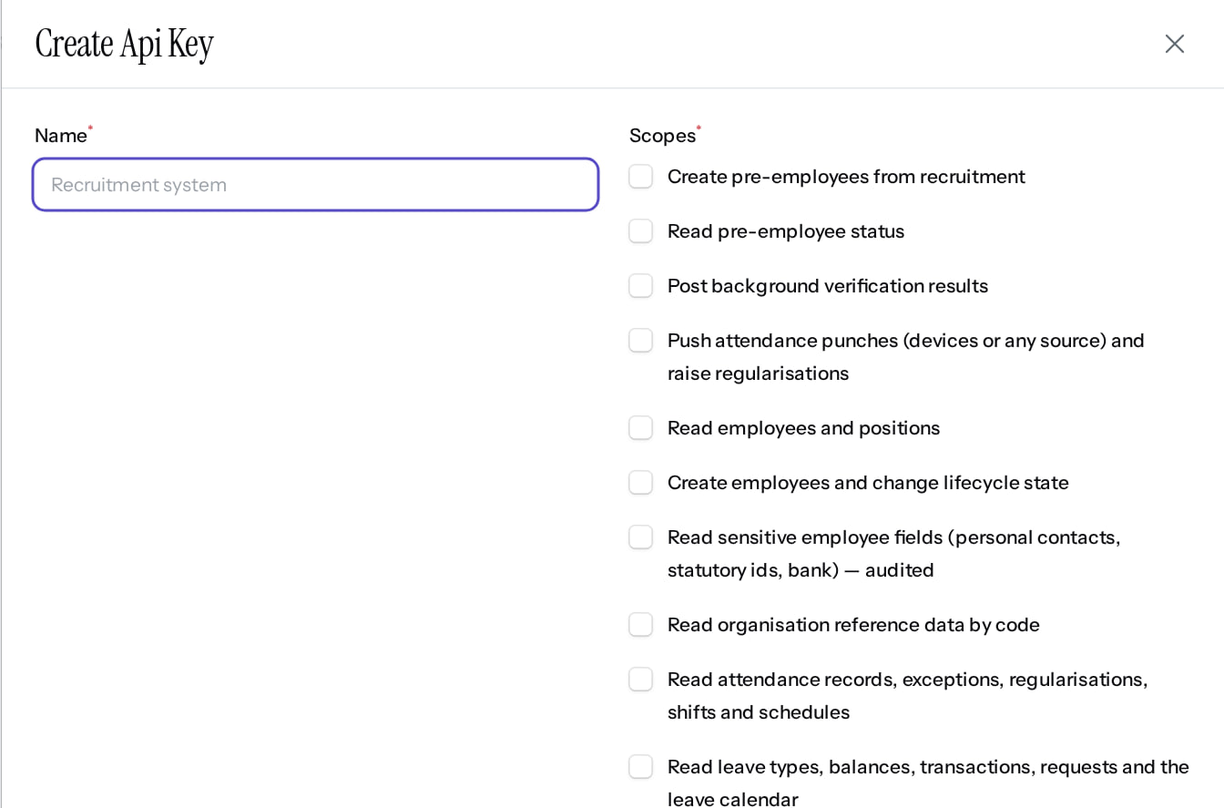
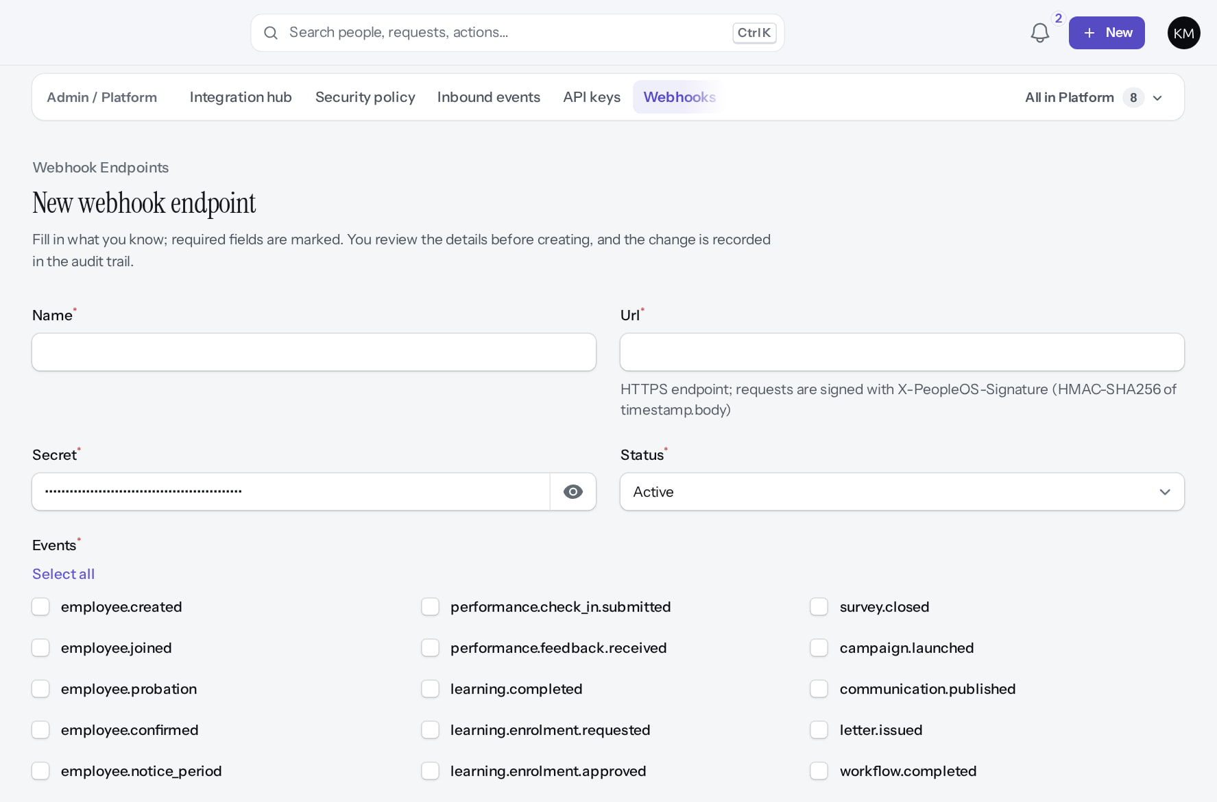
API keys and webhooks
INTEGRATIONS
Issue API key (cancelled)
Verified
New webhook
Verified
Name, scopes, expiry; the token is shown once. Scopes are not limited to the issuer's own permissions (F37).
Deliveries are HMAC-signed (timestamp.body) so the receiver can verify them; retries and audited replay.
Real screen (cropped) · Kavya Menon (Tenant HR Admin + Employee) · Admin › Platform › API keys › Issue key
Real screen (cropped) · Kavya Menon (Tenant HR Admin + Employee) · Admin › Platform › Webhooks › New
Notes:
SAY: API keys and webhooks.
LEFT, Issue API key (cancelled): Name, scopes, expiry; the token is shown once. Scopes are not limited to the issuer's own permissions (F37).
RIGHT, New webhook: Deliveries are HMAC-signed (timestamp.body) so the receiver can verify them; retries and audited replay.
OBSERVE: point out what differs between the two screens.
EVIDENCE: left = security-compliance/85-sec-03-api-key-form [Kavya Menon (Tenant HR Admin + Employee), Admin › Platform › API keys › Issue key]; right = security-compliance/85-sec-04-webhook-form [Kavya Menon (Tenant HR Admin + Employee), Admin › Platform › Webhooks › New]. Real screens, fictional data (SCREENSHOT-INVENTORY.md).

Slide 36
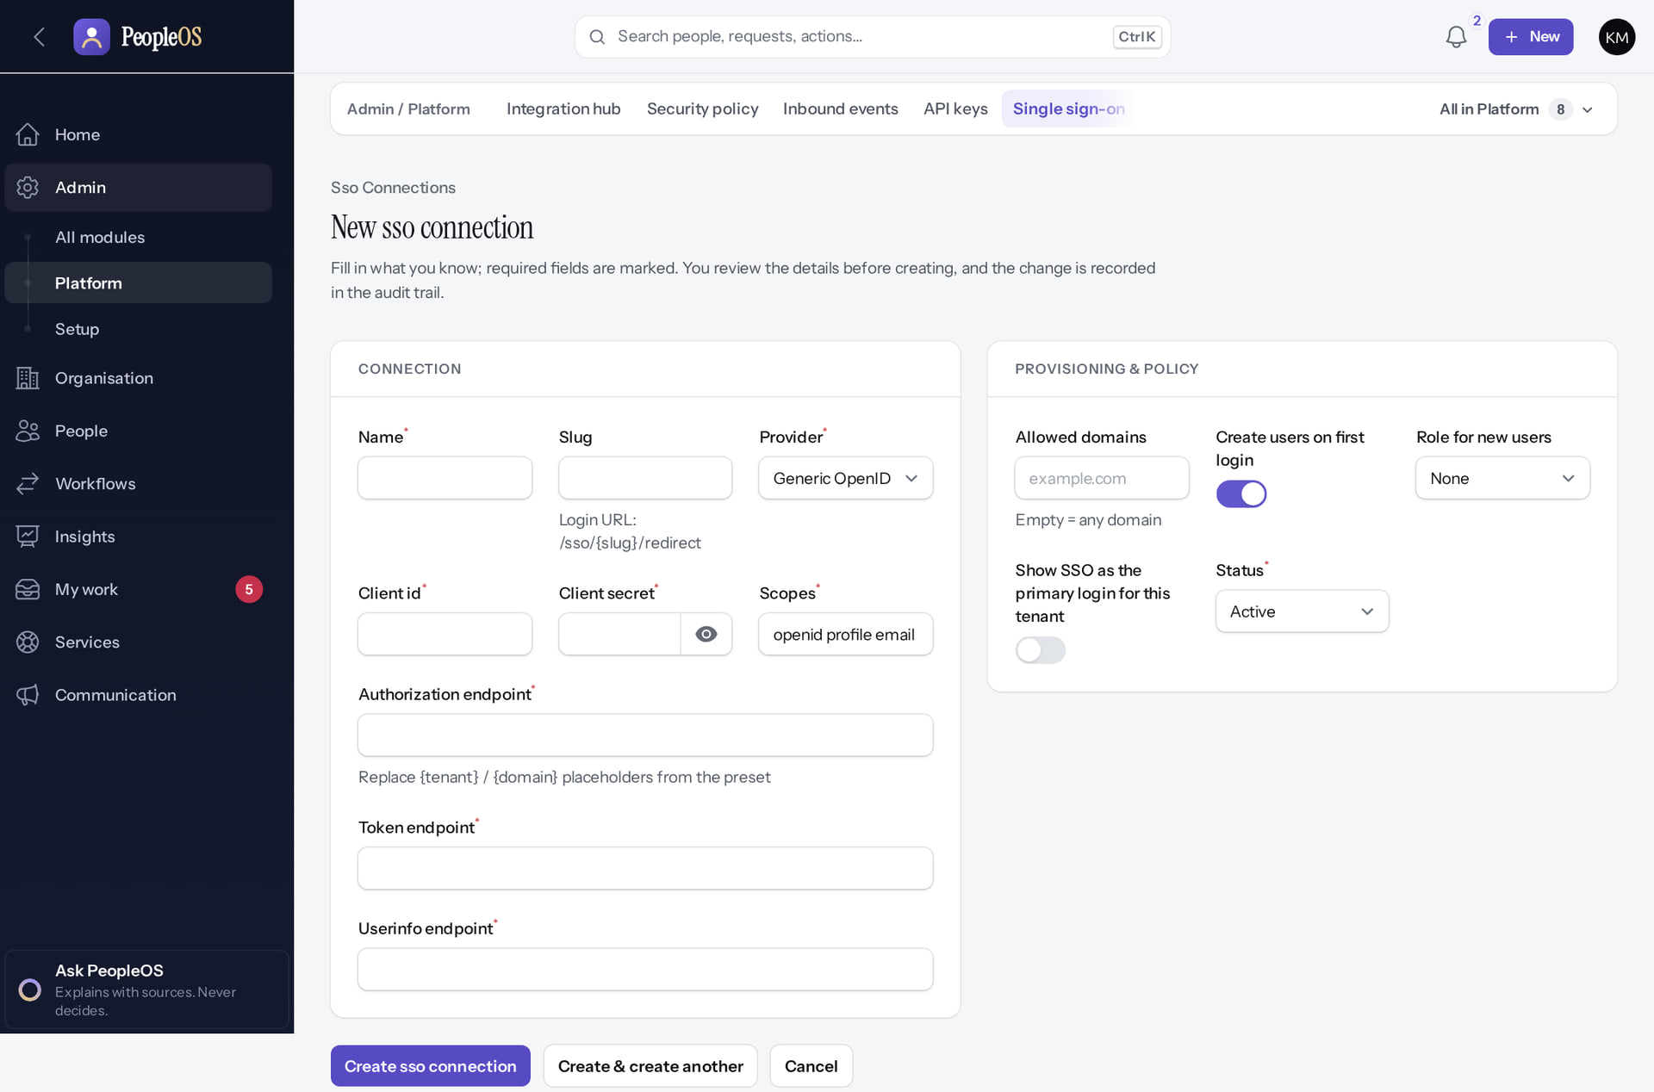
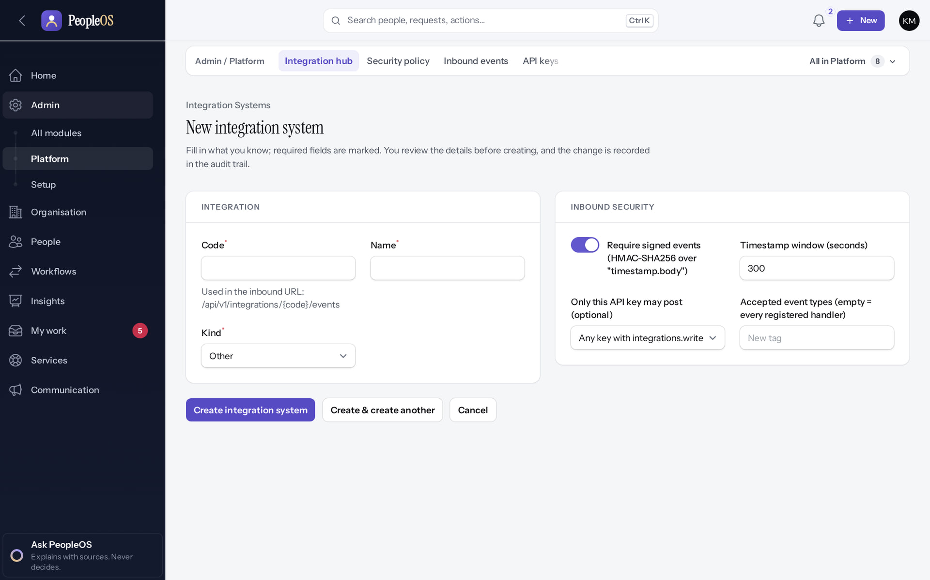
Single sign-on and the Integration Hub
INTEGRATIONS
New SSO connection
Verified
Integration hub
Verified
OpenID Connect only (no SAML). "Show SSO as the primary login" has no visible effect (F34).
External systems registered with identifiers and signing; the only boundary to other products.
Real screen (cropped) · Kavya Menon (Tenant HR Admin + Employee) · Admin › Platform › Single sign-on › New
Real screen · Kavya Menon (Tenant HR Admin + Employee) · Admin › Platform › Integration hub › New
Notes:
SAY: Single sign-on and the Integration Hub.
LEFT, New SSO connection: OpenID Connect only (no SAML). "Show SSO as the primary login" has no visible effect (F34).
RIGHT, Integration hub: External systems registered with identifiers and signing; the only boundary to other products.
OBSERVE: point out what differs between the two screens.
EVIDENCE: left = security-compliance/85-sec-02-sso-form [Kavya Menon (Tenant HR Admin + Employee), Admin › Platform › Single sign-on › New]; right = security-compliance/85-sec-05-integration-hub-form [Kavya Menon (Tenant HR Admin + Employee), Admin › Platform › Integration hub › New]. Real screens, fictional data (SCREENSHOT-INVENTORY.md).

Slide 37
Export, retention, holds and deletion
09
Customers can leave with their data; nothing is deleted until policies exist.
Notes:
TRANSITION: Section 9, Export, retention, holds and deletion. Customers can leave with their data; nothing is deleted until policies exist.
SAY: Tell learners what they will be able to do by the end of this section, then move on.
ASK: "What questions do you have before we start this section?"

Slide 38
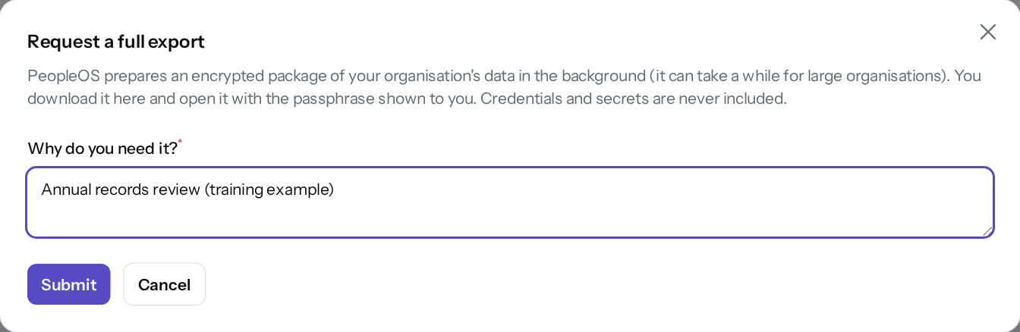
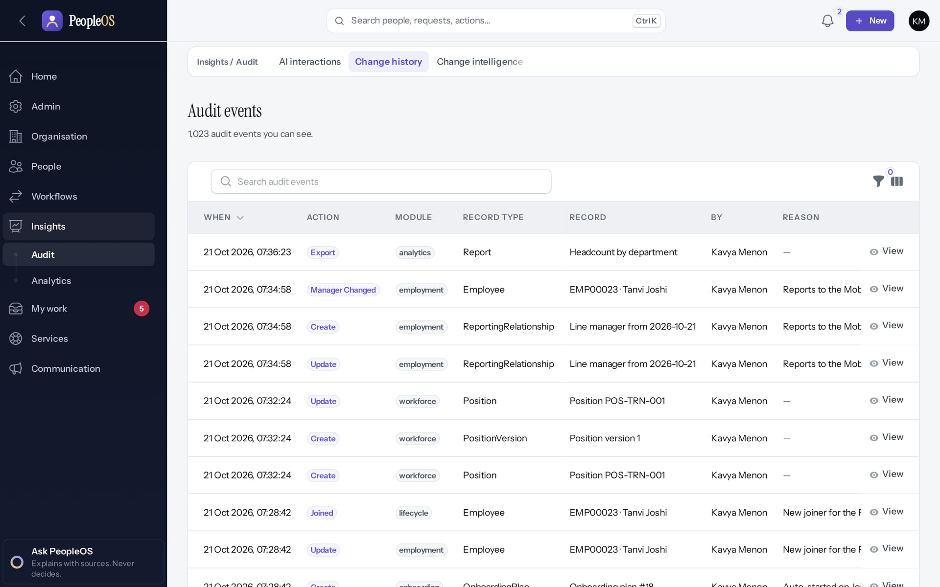
Data export
EXPORT
Tenant: request a full export
Verified
Every report export is audited
Verified
Encrypted package, background job, passphrase shown once; credentials never included. Dialog shown; no export was generated in training.
Change history: the CSV export of "Headcount by department" with user and time.
Real screen · Demo Admin (Tenant Super Admin) · Admin › Platform › Data export › Request a full export
Real screen · Kavya Menon (Tenant HR Admin + Employee) · Insights › Audit › Change history (Audit events)
Notes:
STATUS: tenant data export is implemented; generation was not exercised (it displays a one-time passphrase and needs a queue worker).
SAY: Data export.
LEFT, Tenant: request a full export: Encrypted package, background job, passphrase shown once; credentials never included. Dialog shown; no export was generated in training.
RIGHT, Every report export is audited: Change history: the CSV export of "Headcount by department" with user and time.
OBSERVE: point out what differs between the two screens.
EVIDENCE: left = security-compliance/85-sec-07-data-export-request [Demo Admin (Tenant Super Admin), Admin › Platform › Data export › Request a full export]; right = analytics/80-ins-10-change-history [Kavya Menon (Tenant HR Admin + Employee), Insights › Audit › Change history (Audit events)]. Real screens, fictional data (SCREENSHOT-INVENTORY.md).

Slide 39
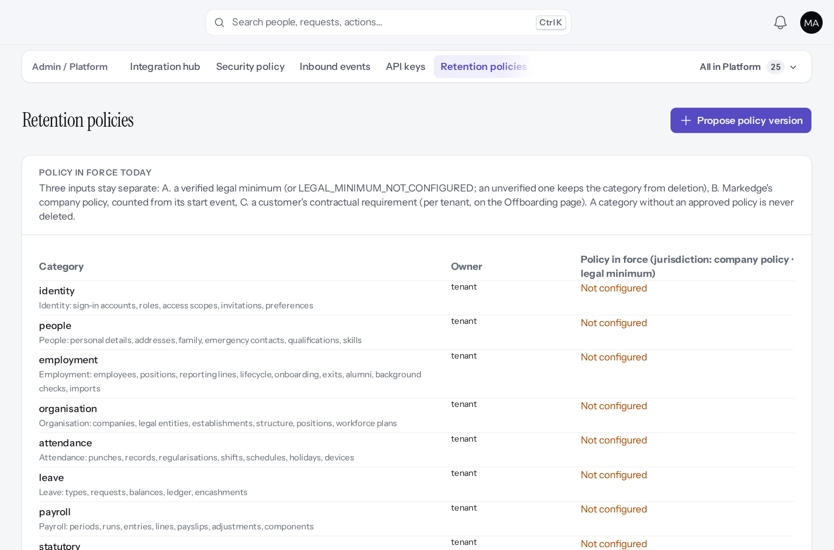
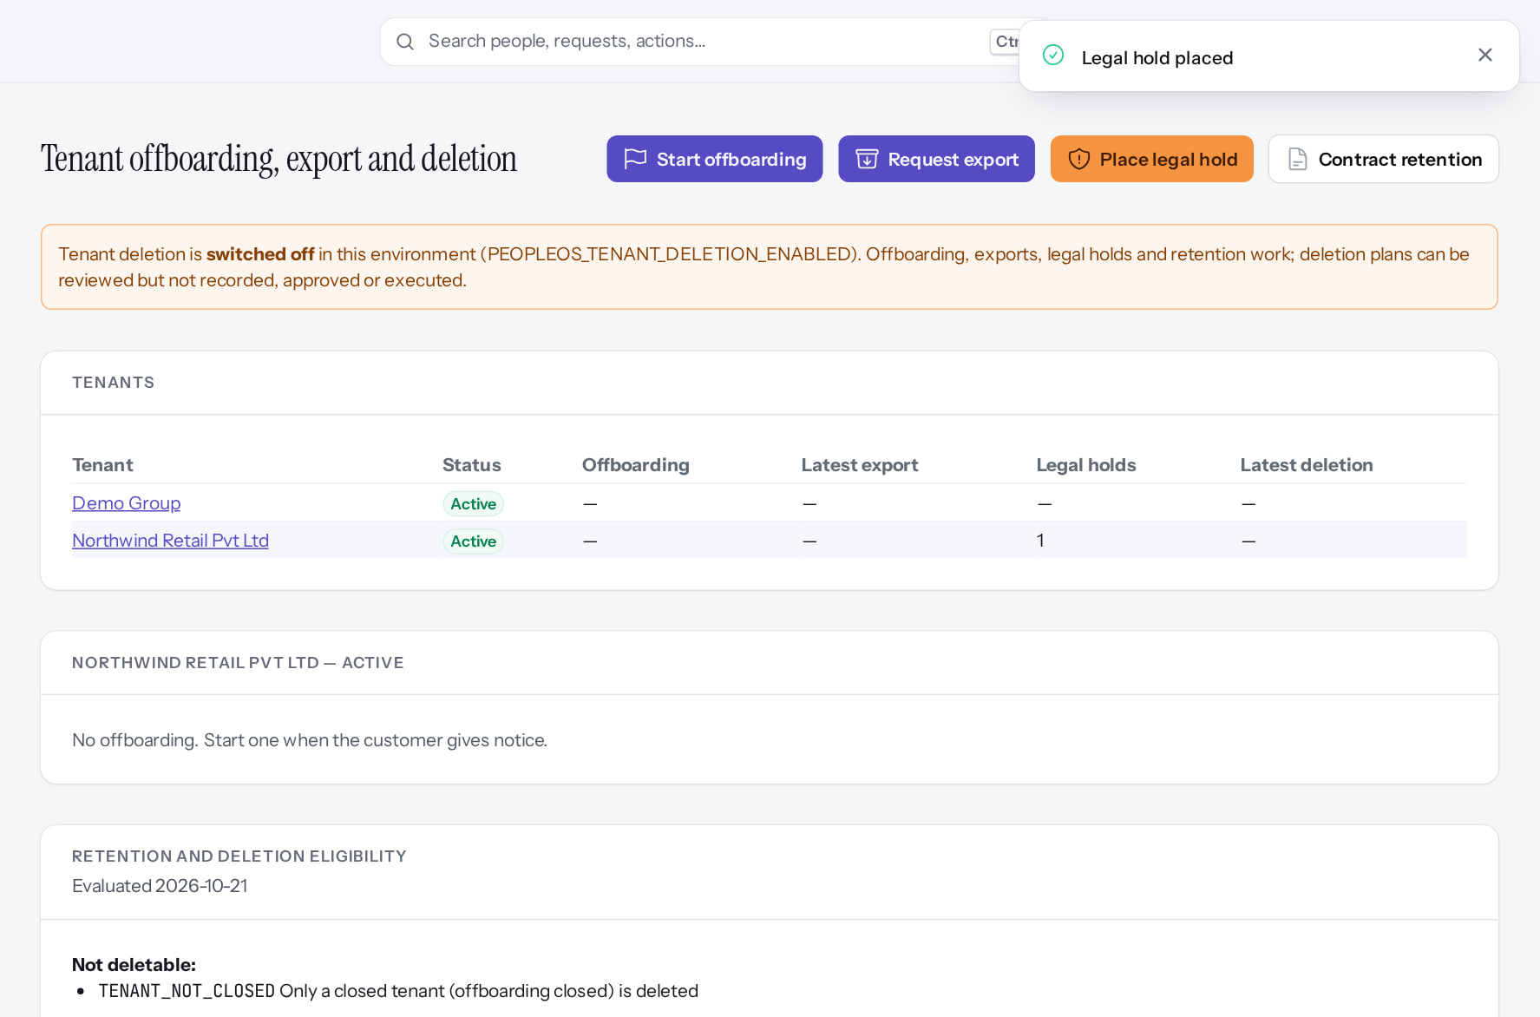
Retention and legal holds
RETENTION
Retention policies
After configuration
Legal hold active
Verified
None shipped and none in force: nothing is deletable until Markedge decides (D-8).
While a hold is active nothing it covers can be deleted.
Real screen (cropped) · Markedge Platform Admin (Platform operator) · Admin › Platform › Retention policies
Real screen (cropped) · Markedge Platform Admin (Platform operator) · Offboarding › Northwind Retail (hold active)
Notes:
SAY: Retention and legal holds.
LEFT, Retention policies: None shipped and none in force: nothing is deletable until Markedge decides (D-8).
RIGHT, Legal hold active: While a hold is active nothing it covers can be deleted.
OBSERVE: point out what differs between the two screens.
EVIDENCE: left = platform-admin/95-pl-28-retention-policies [Markedge Platform Admin (Platform operator), Admin › Platform › Retention policies]; right = platform-admin/95-pl-27-legal-hold-active [Markedge Platform Admin (Platform operator), Offboarding › Northwind Retail (hold active)]. Real screens, fictional data (SCREENSHOT-INVENTORY.md).

Slide 40
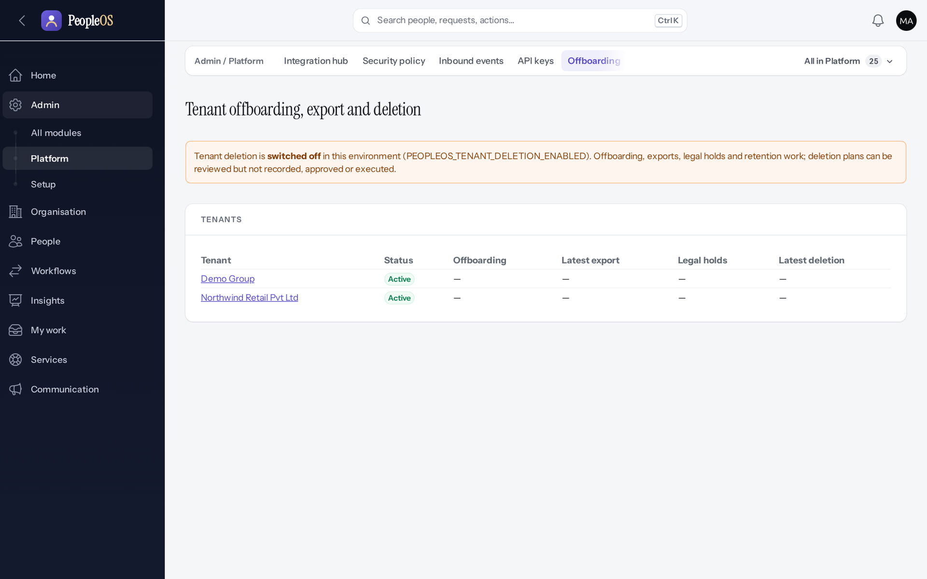
Deletion is switched off
DELETION
Disabled by safety or commercial gates
1
Deletion switched off.
1
RESULT When enabled (owner decision), deletion requires a maker-checker plan, cooling-off, a write-once register on a separate disk, a signed certificate, and reconciliation after any restore.
Real screen · Markedge Platform Admin (Platform operator) · Admin › Platform › Offboarding
Notes:
SAY: When enabled (owner decision), deletion requires a maker-checker plan, cooling-off, a write-once register on a separate disk, a signed certificate, and reconciliation after any restore.
ON SCREEN: Open Offboarding.
WALK THROUGH: (1) Deletion switched off.
LEARNERS SHOULD SEE: "Tenant deletion is switched off in this environment (PEOPLEOS_TENANT_DELETION_ENABLED)." Offboarding, exports, legal holds and retention work
SCREEN: Admin › Platform › Offboarding. Signed in as Markedge Platform Admin (Platform operator). Prerequisite: Platform operator (is_platform_admin) signed in with MFA.
EVIDENCE: screenshot screenshots/platform-admin/95-pl-24-offboarding.png, captured 2026-10-21 on the disposable training database (fictional people).

Slide 41
Recovery: what is and is not proven
RECOVERY
Proven locally
Not proven
Backup, restore and deletion reconciliation rehearsed on a development workstation with fictional data.
Backup frequency, RPO/RTO and a restore test in the target environment: release gate 7 (O-6, O-7).
After a restore
Never purged
Run deletion reconciliation: a restored tenant that had been deleted is contained (suspended), never silently revived.
Audit events are never purged; other retention needs owner decisions with counsel (D8).
Notes:
SOURCE: docs/saas/SaaS-11-Backup-and-DR-Test-Report.md, SaaS-12 DeletionReconciliation, SaaS-Final-Production-Recovery-Runbook.md, release gate 7.
SAY: Recovery: what is and is not proven.
- Proven locally: Backup, restore and deletion reconciliation rehearsed on a development workstation with fictional data.
- Not proven: Backup frequency, RPO/RTO and a restore test in the target environment: release gate 7 (O-6, O-7).
- After a restore: Run deletion reconciliation: a restored tenant that had been deleted is contained (suspended), never silently revived.
- Never purged: Audit events are never purged; other retention needs owner decisions with counsel (D8).
ASK: "Which of these points needs more explanation for your team?"

Slide 42
Open risks to carry into any review
OPEN RISKS
Risk | Status | Owner
Credential exposure remediation and repository visibility (gate 2) | BLOCKED | Owner
Independent security review not engaged (gate 4) | BLOCKED | Owner
API key scopes broader than the issuer (F37) | Incomplete | Engineering
Change Centre covers only some edits; no self-approval guard (F29) | Incomplete | Engineering
Separation-of-duties refusals shown as server errors (documents, new) | Incomplete | Engineering
Password expiry not enforced (F2); custom-field visibility ignored (F32) | Incomplete | Engineering
Backup, DR, hosting and on-call not in place (gates 7, 8) | BLOCKED | Owner, infrastructure
Notes:
SOURCE: SaaS-Final-Release-Gate.md; documentation-gaps.md; findings observed live on 21 Oct 2026. Do not present any of these as resolved.
SAY: Open risks to carry into any review.
- Credential exposure remediation and repository visibility (gate 2) | BLOCKED | Owner
- Independent security review not engaged (gate 4) | BLOCKED | Owner
- API key scopes broader than the issuer (F37) | Incomplete · known defect or gap | Engineering
- Change Centre covers only some edits; no self-approval guard (F29) | Incomplete · known defect or gap | Engineering
- Separation-of-duties refusals shown as server errors (documents, new) | Incomplete · known defect or gap | Engineering
- Password expiry not enforced (F2); custom-field visibility ignored (F32) | Incomplete · known defect or gap | Engineering
- Backup, DR, hosting and on-call not in place (gates 7, 8) | BLOCKED | Owner, infrastructure

Slide 43
Summary
Isolation and access controls are enforced in code and tested; an independent review is still required.
Customers must configure MFA, HR scope and role templates deliberately.
Every change is audited in a verifiable chain; operators are audited too.
Separation of duties protects documents, letters, pay, holds and finance.
Deletion is off; recovery is proven only locally; several risks remain open.
NEXT STEPS & HELP
Security evidence pack (Markedge, on request)
Release gate status (Markedge)
Deck 10: architecture
Deck 05: platform operator controls
Release gate: NO-GO (10 of 14 gates blocked, re-verified 13 Oct 2026). Not yet generally available.
Notes:
SOURCES for reviewers with repository access: docs/saas/SaaS-Final-Security-Evidence.md, docs/architecture/security-invariants.md, docs/saas/SaaS-Final-Release-Gate.md.
SAY: Recap the key points:
- Isolation and access controls are enforced in code and tested; an independent review is still required.
- Customers must configure MFA, HR scope and role templates deliberately.
- Every change is audited in a verifiable chain; operators are audited too.
- Separation of duties protects documents, letters, pay, holds and finance.
- Deletion is off; recovery is proven only locally; several risks remain open.
POINT TO: Security evidence pack (Markedge, on request); Release gate status (Markedge); Deck 10: architecture; Deck 05: platform operator controls
ASK: "What will you do first in PeopleOS?" Collect questions you cannot answer and send them to the PeopleOS team.

