Slide 1
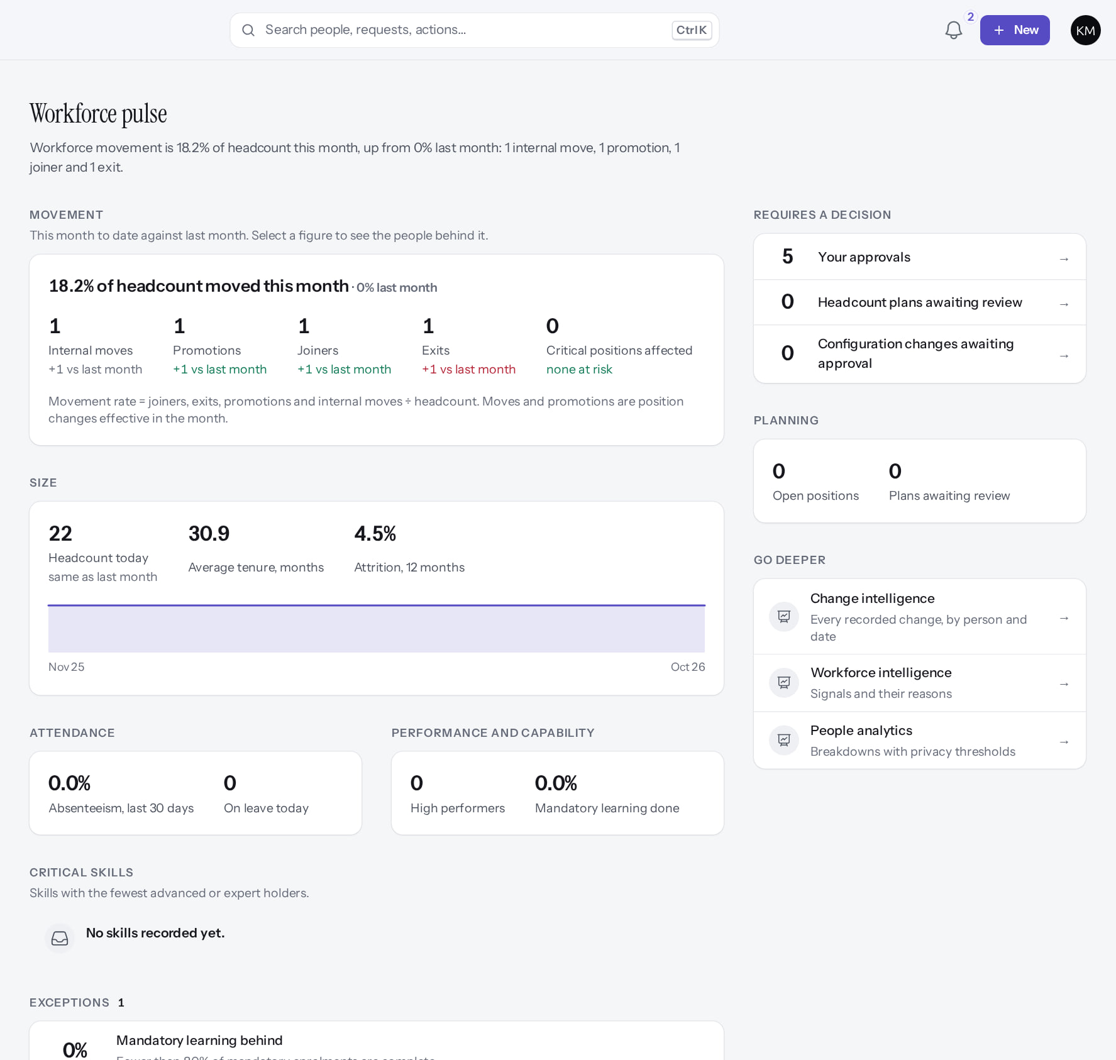
PeopleOS: Executive and Client Demo
MARKEDGE PEOPLEOS · TRAINING LIBRARY
Deck 09 of 12
One lifetime record per person, decisions with context, governance you can prove, shown on the real product, with an honest view of what is live today.
For: Customer executives and decision makers; Markedge leadership
Built from the running application (local, disposable database, fictional people) · 21 October 2026
Real screen, fictional data
Notes:
SAY: Everything you will see is the real PeopleOS, running on a demonstration database with invented people. I will also tell you exactly what is not live yet.
AVOID: promising dates, prices or service levels: none is set in the product documentation ("to be confirmed with the SaaS provider").

Slide 2
PeopleOS in one slide
OVERVIEW
One lifetime record
Work comes to people
Every person has one record from hire to alumni; every change is dated, explained and audited.
Home and the Approval Center rank what matters, with the context to decide.
Governance built in
Not yet generally available
Tenant isolation, layered access, separation of duties and a verifiable audit chain.
Release gate NO-GO: hosting, independent review, DR and statutory verification are open. Payroll finalisation is blocked until statutory rules are verified.
Notes:
SOURCE: product blueprint principles; release gate (docs/saas/SaaS-Final-Release-Gate.md). Lead with the value, then be explicit about the gate.
SAY: PeopleOS in one slide.
- One lifetime record: Every person has one record from hire to alumni; every change is dated, explained and audited.
- Work comes to people: Home and the Approval Center rank what matters, with the context to decide.
- Governance built in: Tenant isolation, layered access, separation of duties and a verifiable audit chain.
- Not yet generally available: Release gate NO-GO: hosting, independent review, DR and statutory verification are open. Payroll finalisation is blocked until statutory rules are verified.
ASK: "Which of these points needs more explanation for your team?"

Slide 3
What we will show
AGENDA
Employee experience
self-service in minutes
Workflow and approvals
versioned, multi-person
1
4
Manager experience
decisions with context
Workforce analytics
facts with sources
2
5
HR operations and lifecycle
hire to exit, governed
Security, governance and SaaS operations
proof, not promises
3
6
Notes:
SAY: What we will show:
1. Employee experience: self-service in minutes
2. Manager experience: decisions with context
3. HR operations and lifecycle: hire to exit, governed
4. Workflow and approvals: versioned, multi-person
5. Workforce analytics: facts with sources
6. Security, governance and SaaS operations: proof, not promises
ASK: "Which of these matters most to you?" Return to the answer in the summary.

Slide 4
Employee experience
01
Everything an employee needs, starting from Home.
Notes:
TRANSITION: Section 1, Employee experience. Everything an employee needs, starting from Home.
SAY: Tell learners what they will be able to do by the end of this section, then move on.
ASK: "What questions do you have before we start this section?"

Slide 5
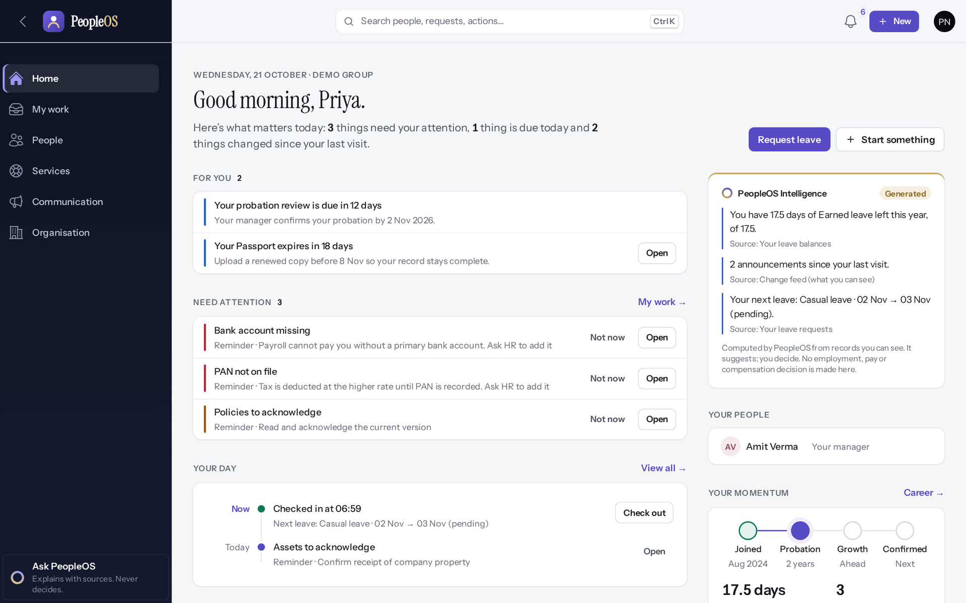
Home: what matters today, and why
EMPLOYEE
Verified in the running application
Ranked items with their reason, a one-click Request leave, and facts with sources from PeopleOS Intelligence.
Real screen · Priya Nair (Employee) · Home
Notes:
SAY: Ranked items with their reason, a one-click Request leave, and facts with sources from PeopleOS Intelligence.
ON SCREEN: Read Home from top to bottom.
LEARNERS SHOULD SEE: For you, Need attention, Your day and PeopleOS Intelligence; each item says why it is there
SCREEN: Home. Signed in as Priya Nair (Employee).
EVIDENCE: screenshot screenshots/employee/30-self-04-home.png, captured 2026-10-21 on the disposable training database (fictional people).

Slide 6
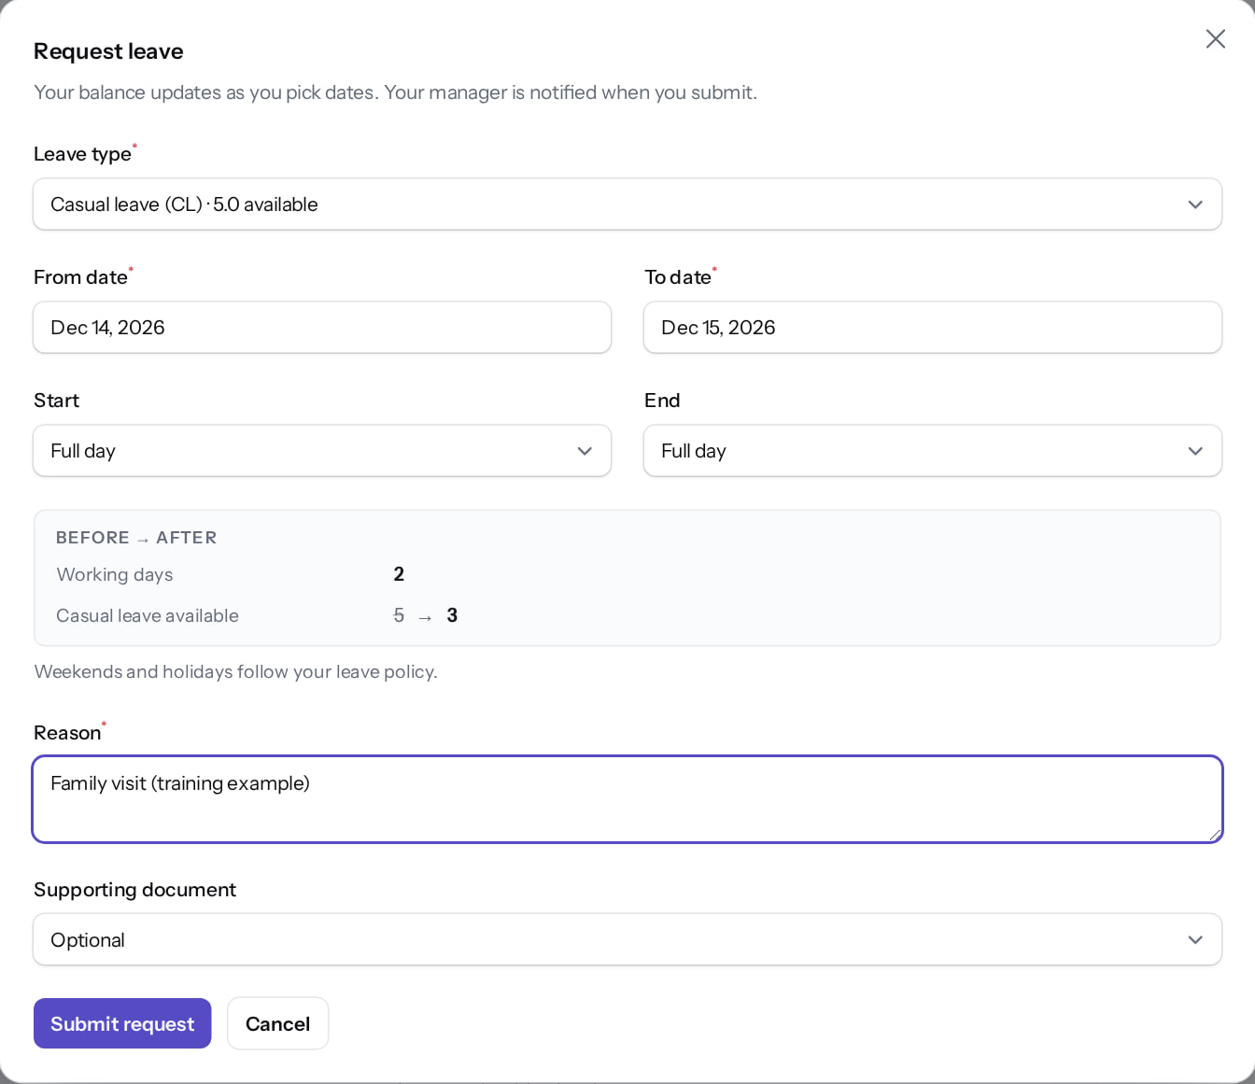
Leave in under a minute
EMPLOYEE
Verified in the running application
1
Type with balance.
1
2
From.
3
To.
2
3
Before → After preview.
4
Reason.
5
Submit.
RESULT Working days and the balance after the request, before it is sent.
4
5
Real screen · Priya Nair (Employee) · Request leave (dialog)
Notes:
SAY: Working days and the balance after the request, before it is sent.
ON SCREEN: Choose Casual leave, 14–15 Dec 2026, add a reason.
WALK THROUGH: (1) Type with balance. (2) From. (3) To. (·) Before → After preview. (4) Reason. (5) Submit.
LEARNERS SHOULD SEE: Before → After preview shows working days and the balance after approval
SCREEN: Request leave (dialog). Signed in as Priya Nair (Employee).
EVIDENCE: screenshot screenshots/employee/10-leave-04-form-completed.png, captured 2026-10-21 on the disposable training database (fictional people).

Slide 7
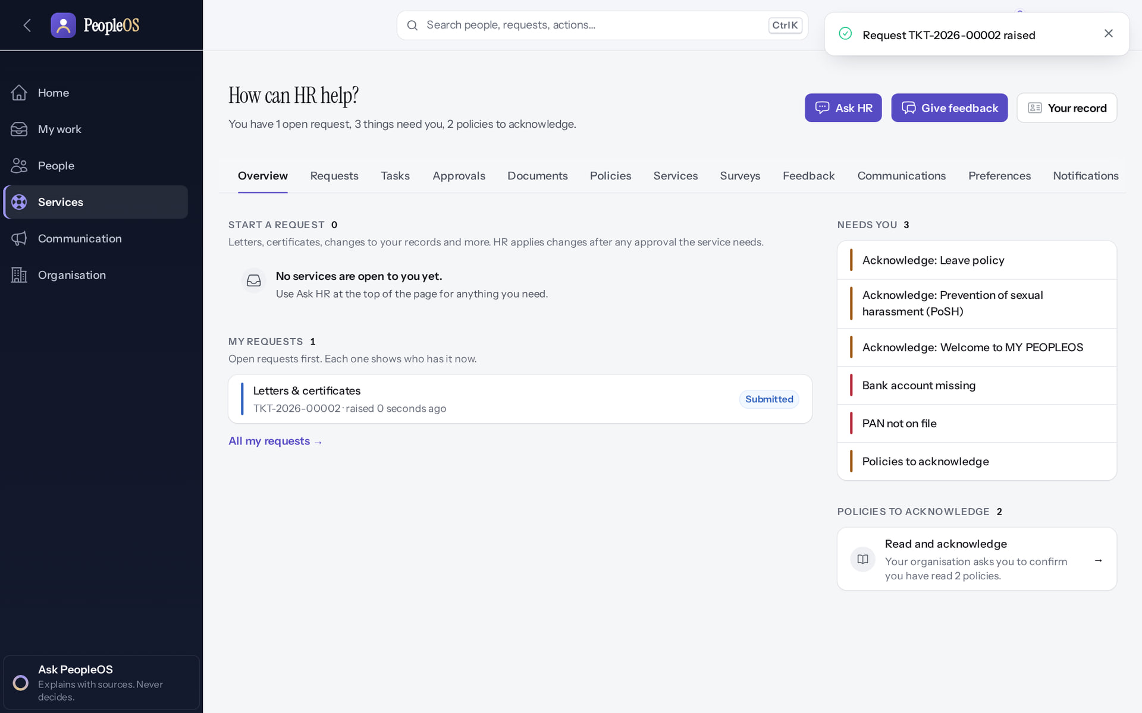
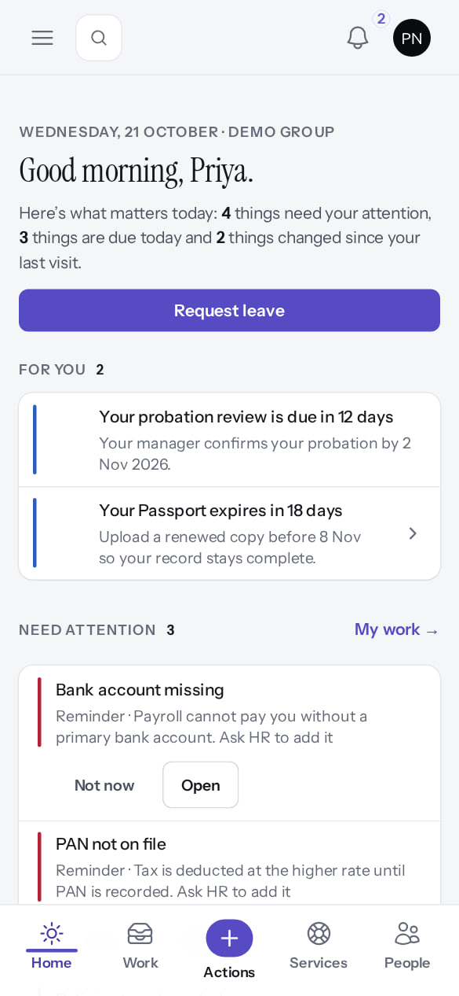
Help from HR, on any device
EMPLOYEE
Ask HR
Verified
Phone
Verified
A numbered request with a target date.
Responsive web on phones (no native app).
Real screen · Priya Nair (Employee) · My HR (after submitting)
Real screen · Priya Nair (Employee) · Home on a phone (390 × 844)
Notes:
SAY: Help from HR, on any device.
LEFT, Ask HR: A numbered request with a target date.
RIGHT, Phone: Responsive web on phones (no native app).
OBSERVE: point out what differs between the two screens.
EVIDENCE: left = employee/30-self-37-ask-hr-submitted [Priya Nair (Employee), My HR (after submitting)]; right = employee/30-self-50-phone-home [Priya Nair (Employee), Home on a phone (390 × 844)]. Real screens, fictional data (SCREENSHOT-INVENTORY.md).

Slide 8
Manager experience
02
Decide with the facts in front of you.
Notes:
TRANSITION: Section 2, Manager experience. Decide with the facts in front of you.
SAY: Tell learners what they will be able to do by the end of this section, then move on.
ASK: "What questions do you have before we start this section?"

Slide 9
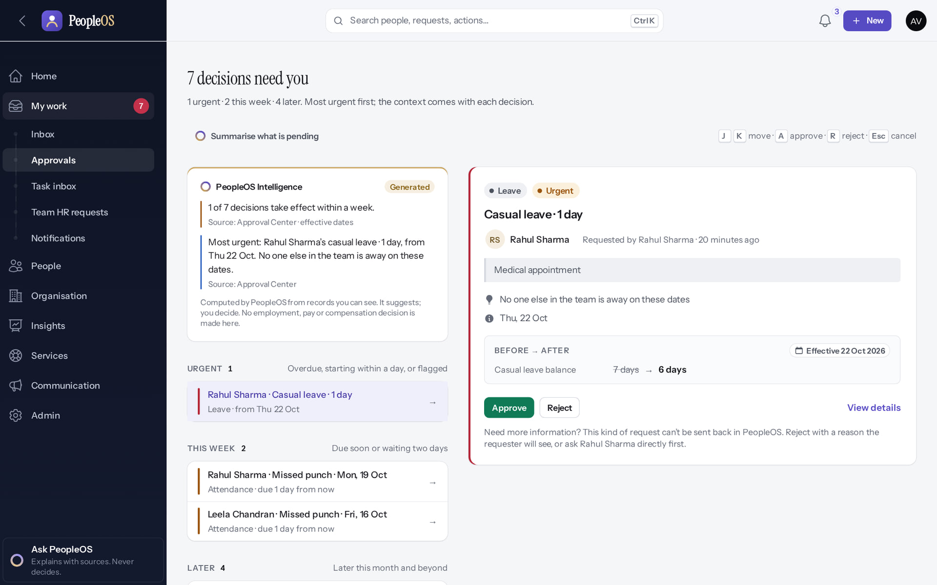
The Approval Center
MANAGER
Verified in the running application
Every decision in one place, most urgent first, with a summary that explains and never decides.
Real screen · Amit Verma (Manager + Employee) · My work › Approvals (Approval Center)
Notes:
SAY: Every decision in one place, most urgent first, with a summary that explains and never decides.
ON SCREEN: Open My work › Approvals.
LEARNERS SHOULD SEE: Decisions grouped Urgent / This week / Later, most urgent first
SCREEN: My work › Approvals (Approval Center). Signed in as Amit Verma (Manager + Employee).
EVIDENCE: screenshot screenshots/manager/10-leave-07-approval-center.png, captured 2026-10-21 on the disposable training database (fictional people).

Slide 10
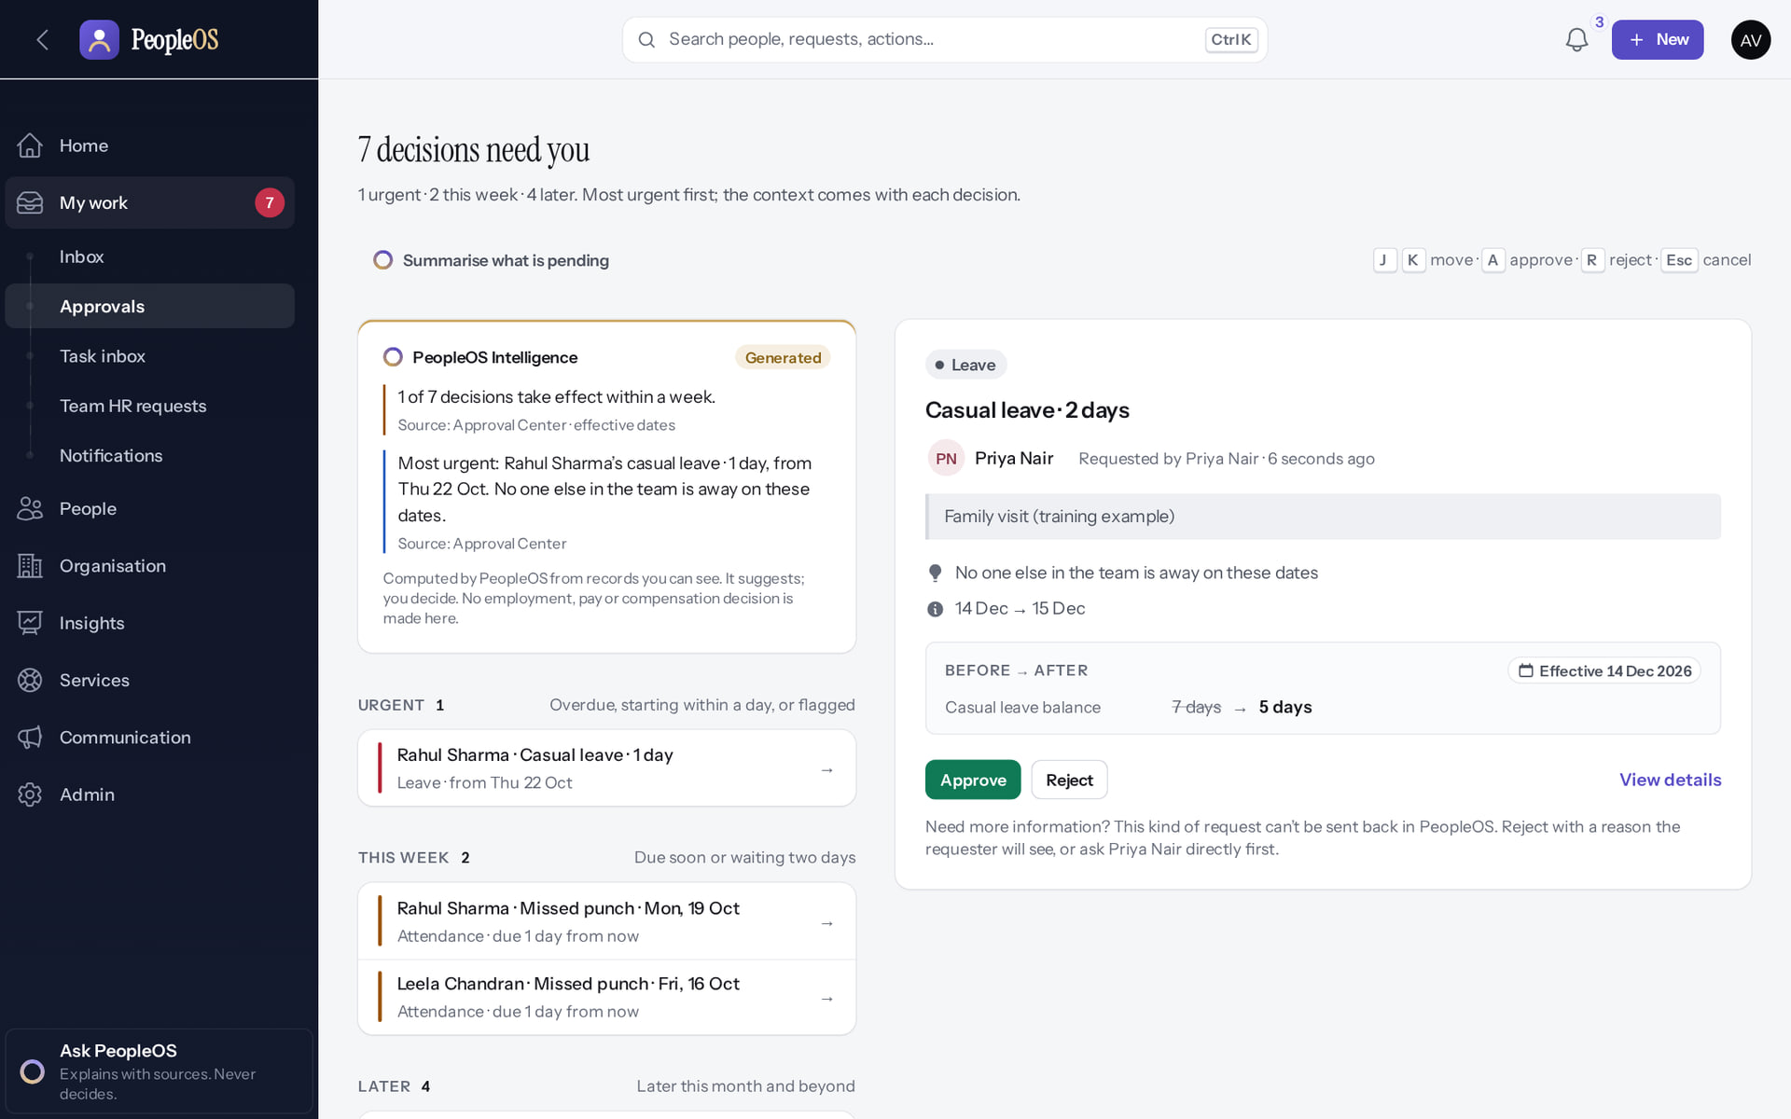
Context for every decision
MANAGER
Verified in the running application
1
Reason.
Team overlap.
2
Approve.
3
Reject (with a reason).
1
RESULT Balance before → after and the effective date on the same card.
2
3
Real screen · Amit Verma (Manager + Employee) · Approval Center › decision card
Notes:
SAY: Balance before → after and the effective date on the same card.
ON SCREEN: Select the request to see its context.
WALK THROUGH: (1) Reason. (·) Team overlap. (2) Approve. (3) Reject (with a reason).
LEARNERS SHOULD SEE: Reason, team overlap, dates and the balance before → after
SCREEN: Approval Center › decision card. Signed in as Amit Verma (Manager + Employee).
EVIDENCE: screenshot screenshots/manager/10-leave-08-decision-card.png, captured 2026-10-21 on the disposable training database (fictional people).

Slide 11
HR operations and lifecycle
03
One record, guided changes, multi-person controls.
Notes:
TRANSITION: Section 3, HR operations and lifecycle. One record, guided changes, multi-person controls.
SAY: Tell learners what they will be able to do by the end of this section, then move on.
ASK: "What questions do you have before we start this section?"

Slide 12
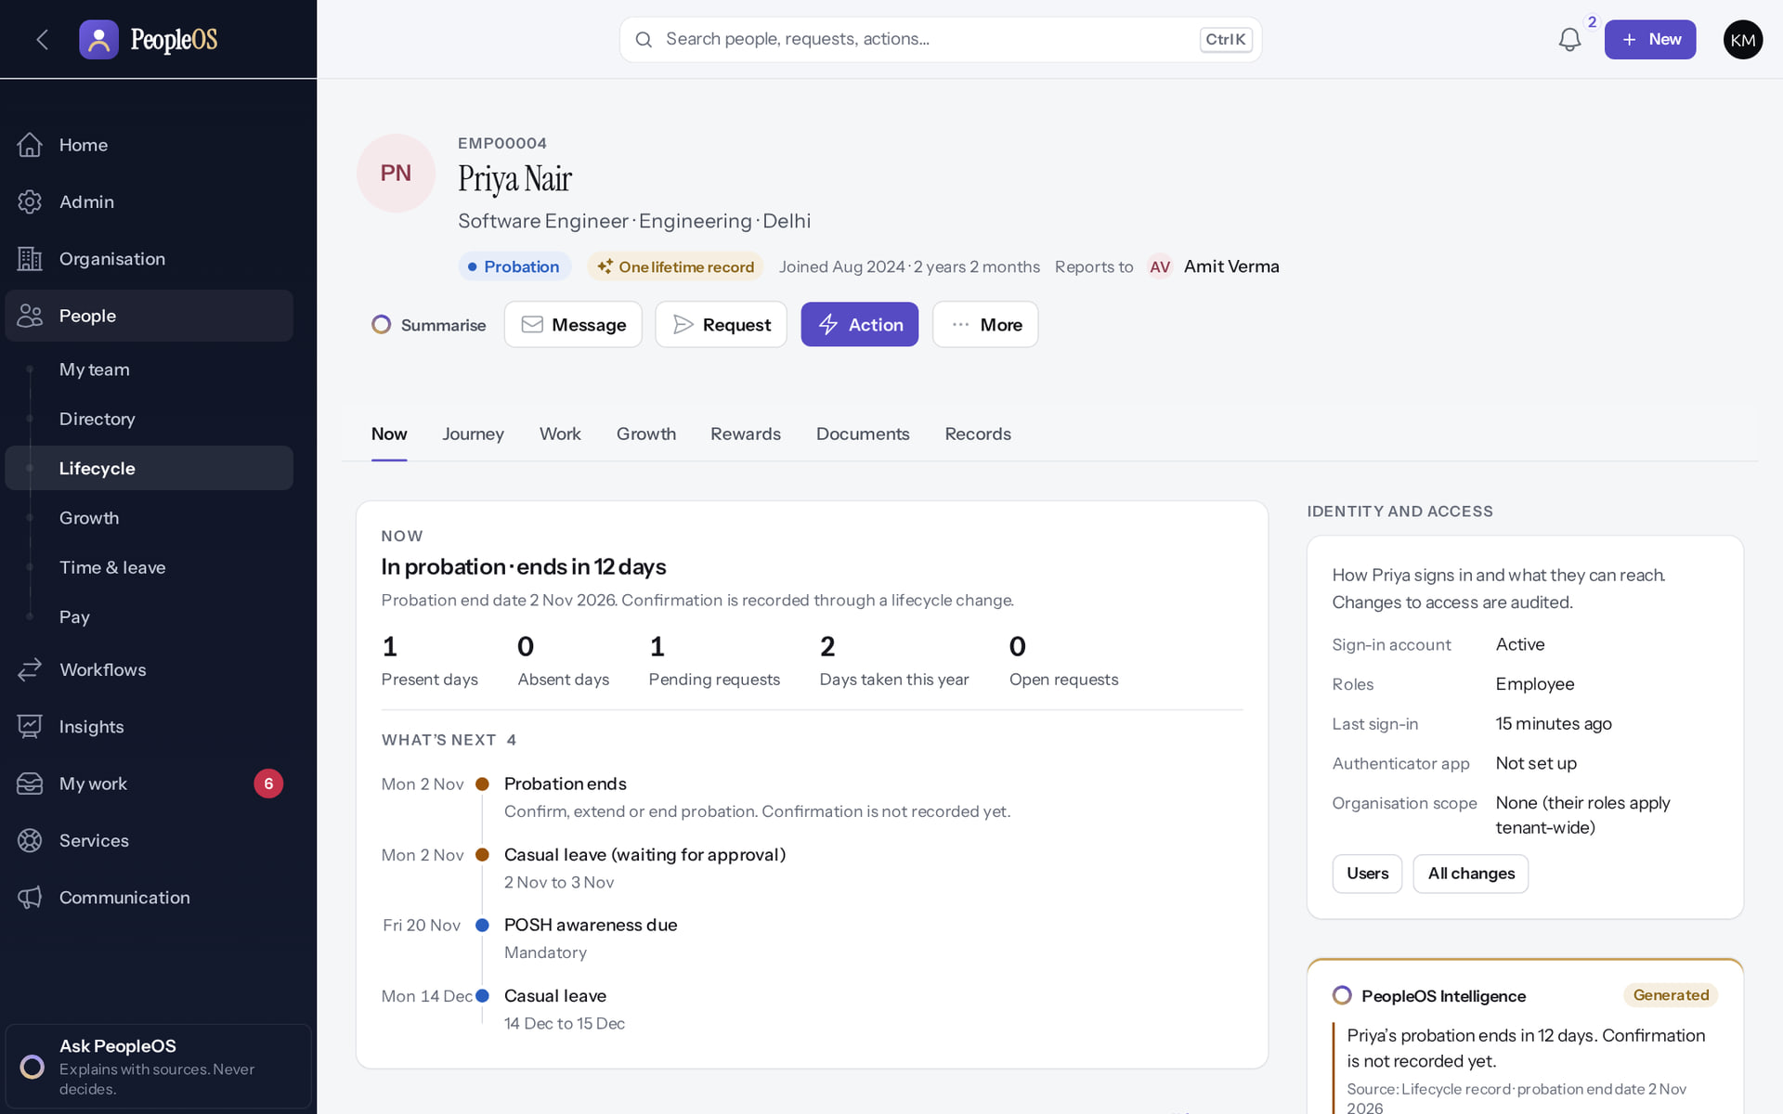
Employee 360
HR
Verified in the running application
Status, tenure and manager; actions for every lifecycle change; views from Now to Records.
Real screen · Kavya Menon (Tenant HR Admin + Employee) · Employee 360 › Now
Notes:
SAY: Status, tenure and manager; actions for every lifecycle change; views from Now to Records.
ON SCREEN: Open a person from the Directory or register.
LEARNERS SHOULD SEE: Header with status, tenure and manager; Summarise, Message, Request, Action, More; views Now … Records
SCREEN: Employee 360 › Now. Signed in as Kavya Menon (Tenant HR Admin + Employee). Prerequisite: employee.view; sensitive tabs need their own permissions.
EVIDENCE: screenshot screenshots/hr-admin/50-360-01-header-now.png, captured 2026-10-21 on the disposable training database (fictional people).

Slide 13
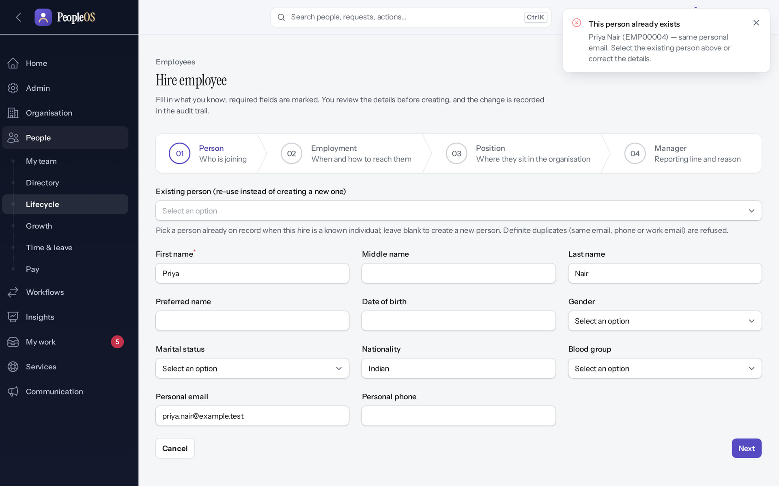
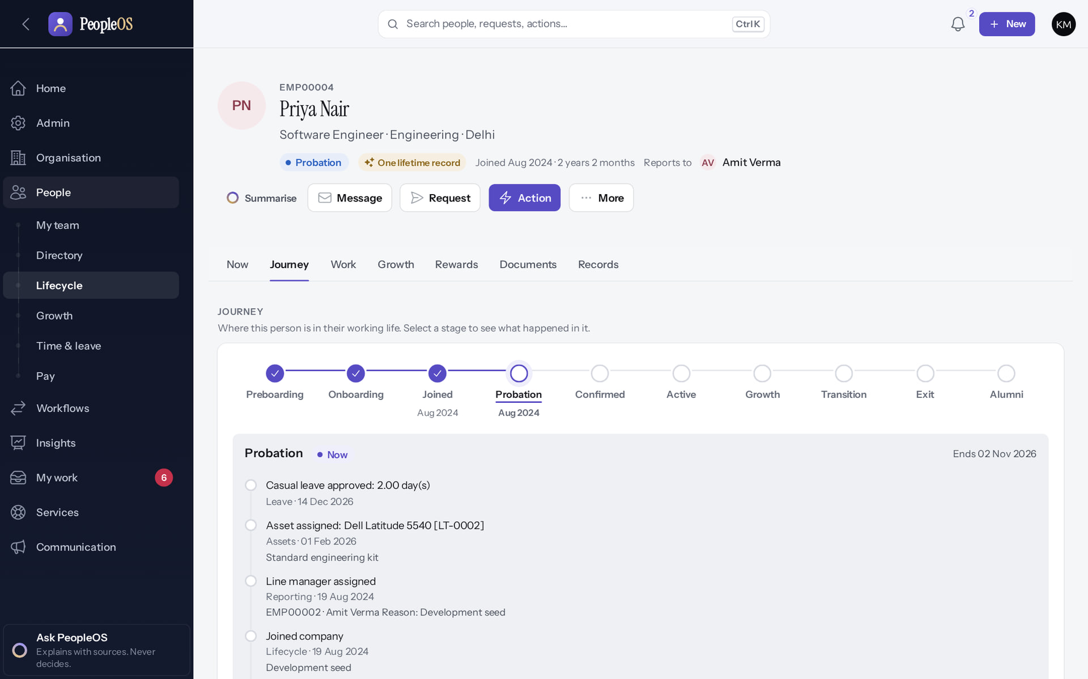
No duplicates; history kept
HR
Duplicate person refused
Verified
Journey
Verified
The hire wizard finds the existing person first.
Every dated change, from joining to today.
Real screen (cropped) · Kavya Menon (Tenant HR Admin + Employee) · Hire employee › Person
Real screen · Kavya Menon (Tenant HR Admin + Employee) · Employee 360 › Journey
Notes:
SAY: No duplicates; history kept.
LEFT, Duplicate person refused: The hire wizard finds the existing person first.
RIGHT, Journey: Every dated change, from joining to today.
OBSERVE: point out what differs between the two screens.
EVIDENCE: left = hr-admin/50-hire-01-duplicate-refused [Kavya Menon (Tenant HR Admin + Employee), Hire employee › Person]; right = hr-admin/50-360-04-journey [Kavya Menon (Tenant HR Admin + Employee), Employee 360 › Journey]. Real screens, fictional data (SCREENSHOT-INVENTORY.md).

Slide 14
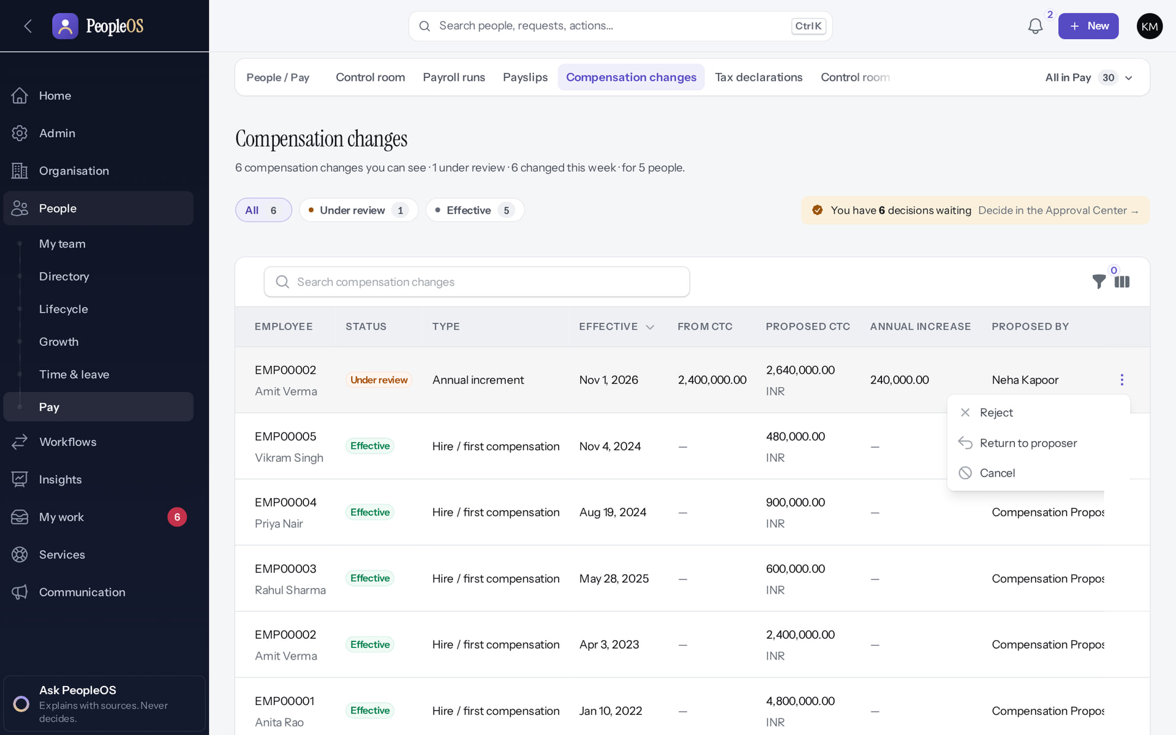
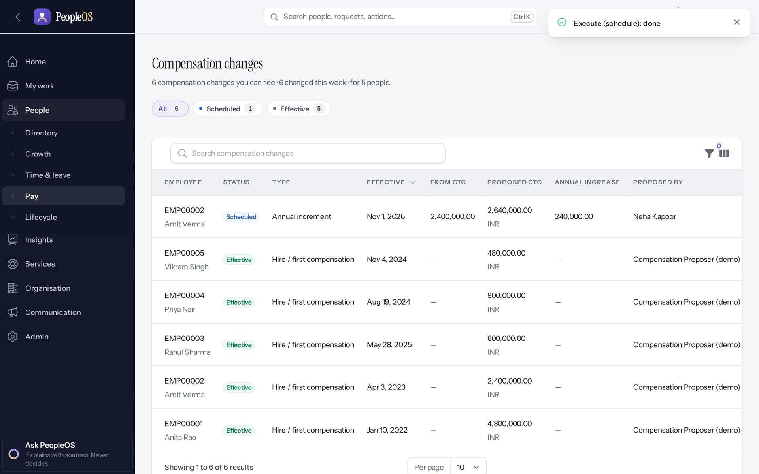
Pay changes need four people
HR
Reviewer cannot approve
Verified
Executed
Verified
Propose, review, approve and execute by four different people.
Scheduled for its effective date.
Real screen · Kavya Menon (Tenant HR Admin + Employee) · Compensation changes › row actions (after reviewing)
Real screen · Arjun Bose (Payroll Admin + Employee) · Compensation changes (after execution)
Notes:
SAY: Pay changes need four people.
LEFT, Reviewer cannot approve: Propose, review, approve and execute by four different people.
RIGHT, Executed: Scheduled for its effective date.
OBSERVE: point out what differs between the two screens.
EVIDENCE: left = security-compliance/62-comp-07-reviewer-cannot-approve [Kavya Menon (Tenant HR Admin + Employee), Compensation changes › row actions (after reviewing)]; right = hr-admin/62-comp-10-executed [Arjun Bose (Payroll Admin + Employee), Compensation changes (after execution)]. Real screens, fictional data (SCREENSHOT-INVENTORY.md).

Slide 15
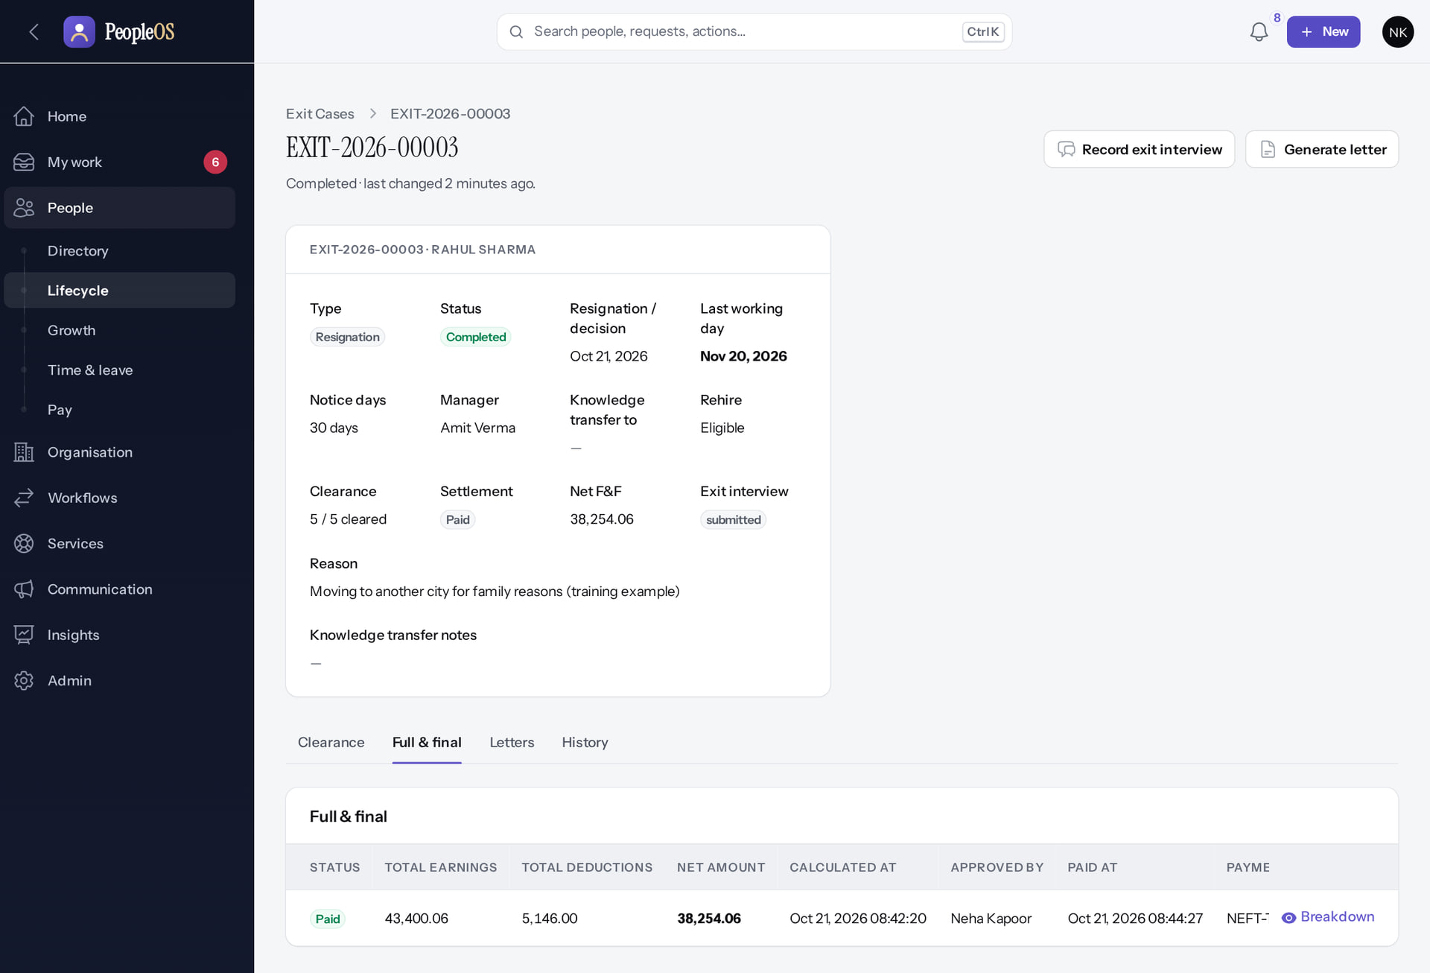
To exit and alumni
HR
Verified in the running application
1
Breakdown: each line with its basis.
RESULT Resignation, clearance, full & final settlement (net 38,254.06 in the example) and an alumni profile in one case. Gratuity is not calculated yet.
1
Real screen (cropped) · Neha Kapoor (HR Manager + Employee) · Exit case › Full & final
Notes:
SAY: Resignation, clearance, full & final settlement (net 38,254.06 in the example) and an alumni profile in one case. Gratuity is not calculated yet.
ON SCREEN: Calculate, Approve and Mark paid (executed in this order).
WALK THROUGH: (1) Breakdown: each line with its basis.
LEARNERS SHOULD SEE: Settlement: total earnings 43,400.06, deductions 5,146.00, net 38,254.06; status Paid with reference; Breakdown per line
SCREEN: Exit case › Full & final. Signed in as Neha Kapoor (HR Manager + Employee). Prerequisite: exit.settle (Tenant HR Admin, HR Manager).
EVIDENCE: screenshot screenshots/hr-admin/70-exit-11-ff-settlement.png, captured 2026-10-21 on the disposable training database (fictional people).

Slide 16
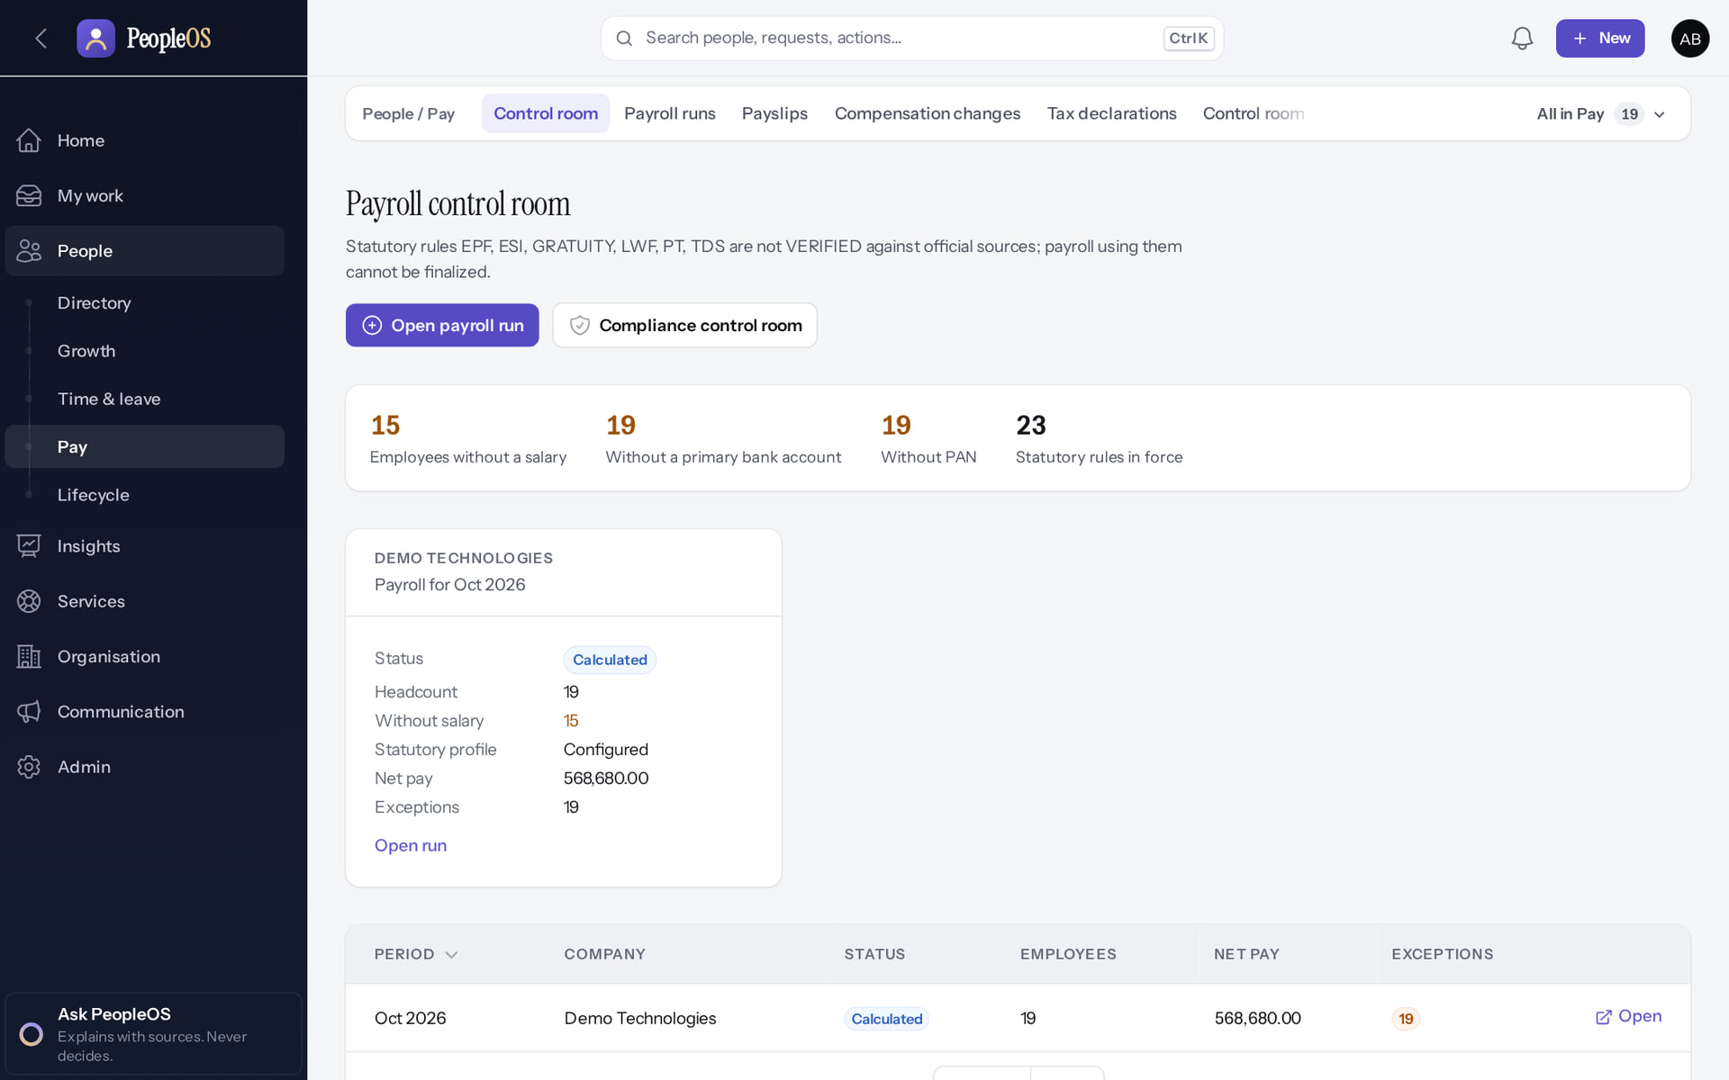
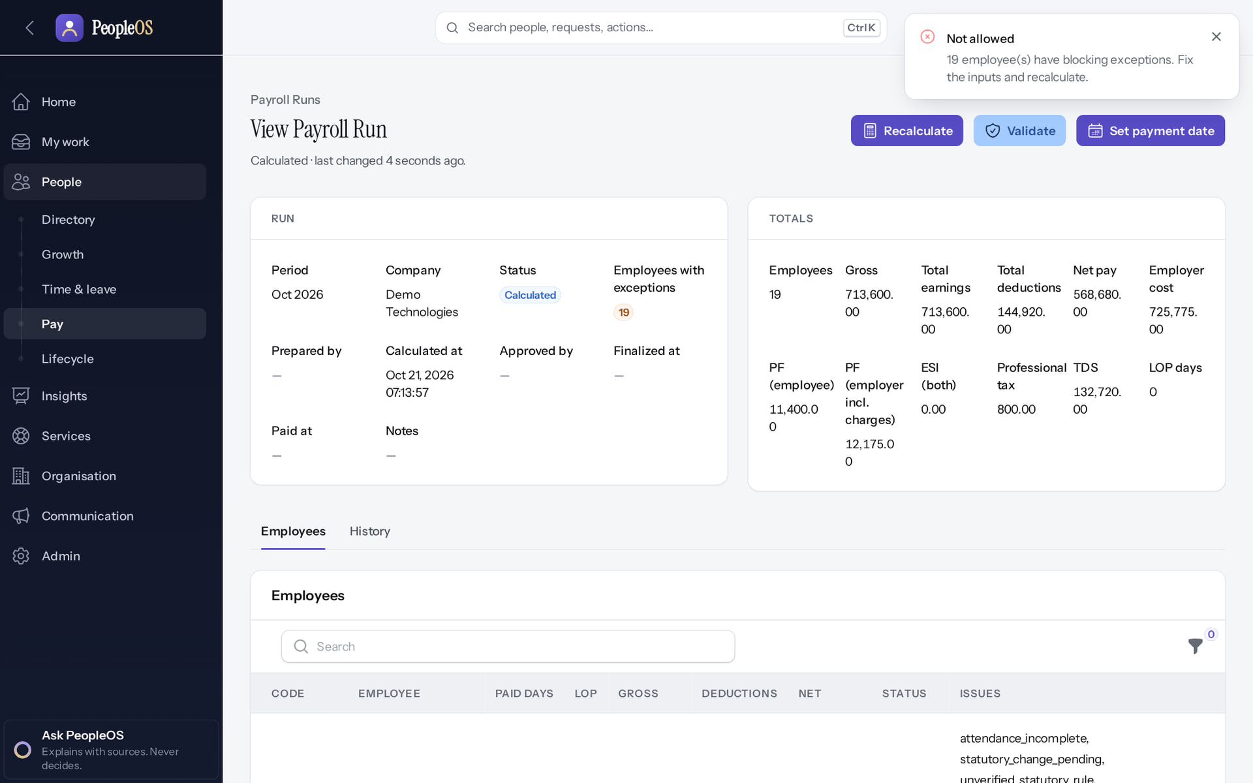
Payroll: safe by design
HR
Control room
Verified
Validation refused
Disabled (gate)
Readiness and the statutory rules that block finalisation.
No payslip on an unverified statutory rate: payroll finalisation is not live yet.
Real screen · Arjun Bose (Payroll Admin + Employee) · People › Pay › Control room (Payroll control room)
Real screen · Arjun Bose (Payroll Admin + Employee) · Payroll run › Validate
Notes:
SAY: This is the safeguard working. Payroll goes live only after statutory rules are verified (0 of 24 today) or payroll is excluded from scope in writing.
SAY: Payroll: safe by design.
LEFT, Control room: Readiness and the statutory rules that block finalisation.
RIGHT, Validation refused: No payslip on an unverified statutory rate: payroll finalisation is not live yet.
OBSERVE: point out what differs between the two screens.
EVIDENCE: left = hr-admin/60-pay-01-control-room [Arjun Bose (Payroll Admin + Employee), People › Pay › Control room (Payroll control room)]; right = hr-admin/60-pay-09-validate-blocked [Arjun Bose (Payroll Admin + Employee), Payroll run › Validate]. Real screens, fictional data (SCREENSHOT-INVENTORY.md).

Slide 17
Workflow and approvals
04
Processes as versioned data.
Notes:
TRANSITION: Section 4, Workflow and approvals. Processes as versioned data.
SAY: Tell learners what they will be able to do by the end of this section, then move on.
ASK: "What questions do you have before we start this section?"

Slide 18
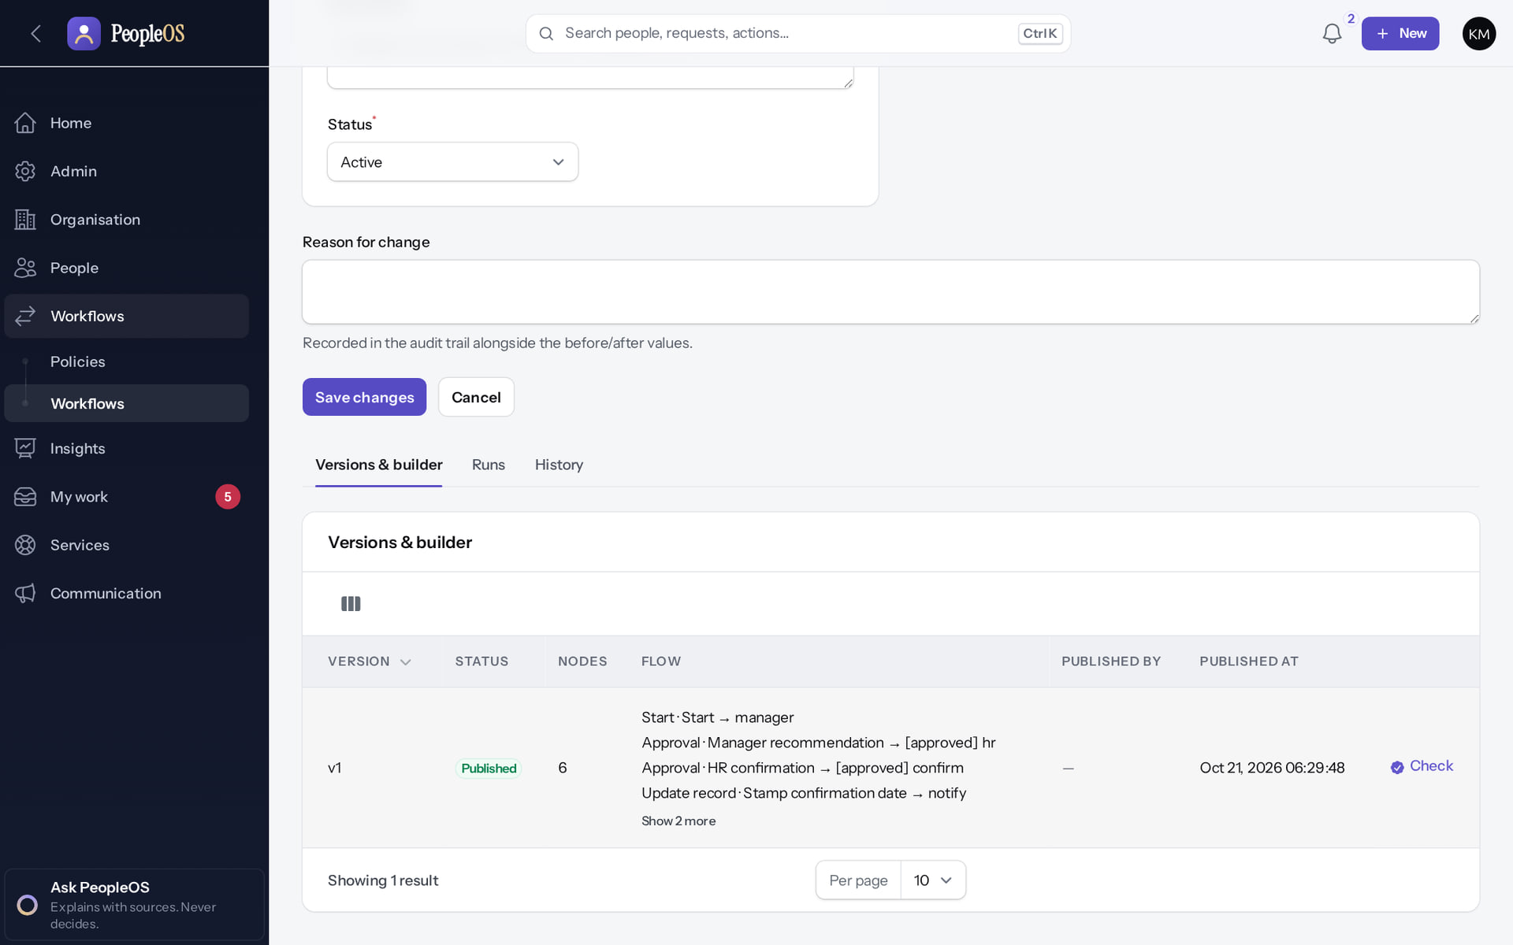
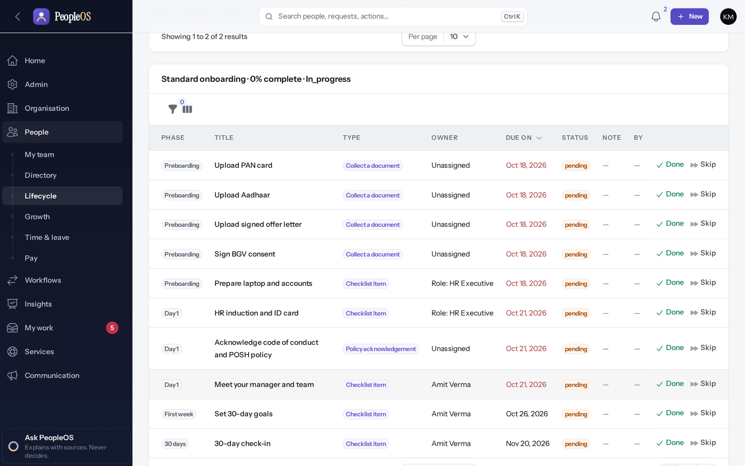
Workflows you can change safely
WORKFLOW
Versions and builder
Verified
Onboarding plan
Verified
Steps for approvals, tasks and notifications; running cases keep their version.
Tasks for HR, the manager and the joiner, started automatically on hire.
Real screen · Kavya Menon (Tenant HR Admin + Employee) · Workflow › Versions & builder
Real screen · Kavya Menon (Tenant HR Admin + Employee) · Employee 360 › Records › Employment › Onboarding
Notes:
SAY: Workflows you can change safely.
LEFT, Versions and builder: Steps for approvals, tasks and notifications; running cases keep their version.
RIGHT, Onboarding plan: Tasks for HR, the manager and the joiner, started automatically on hire.
OBSERVE: point out what differs between the two screens.
EVIDENCE: left = client-onboarding/85-wf-03-workflow-versions [Kavya Menon (Tenant HR Admin + Employee), Workflow › Versions & builder]; right = hr-admin/50-onb-03-plan-tasks [Kavya Menon (Tenant HR Admin + Employee), Employee 360 › Records › Employment › Onboarding]. Real screens, fictional data (SCREENSHOT-INVENTORY.md).

Slide 19
Workforce analytics
05
Facts from the records each viewer may see.
Notes:
TRANSITION: Section 5, Workforce analytics. Facts from the records each viewer may see.
SAY: Tell learners what they will be able to do by the end of this section, then move on.
ASK: "What questions do you have before we start this section?"

Slide 20
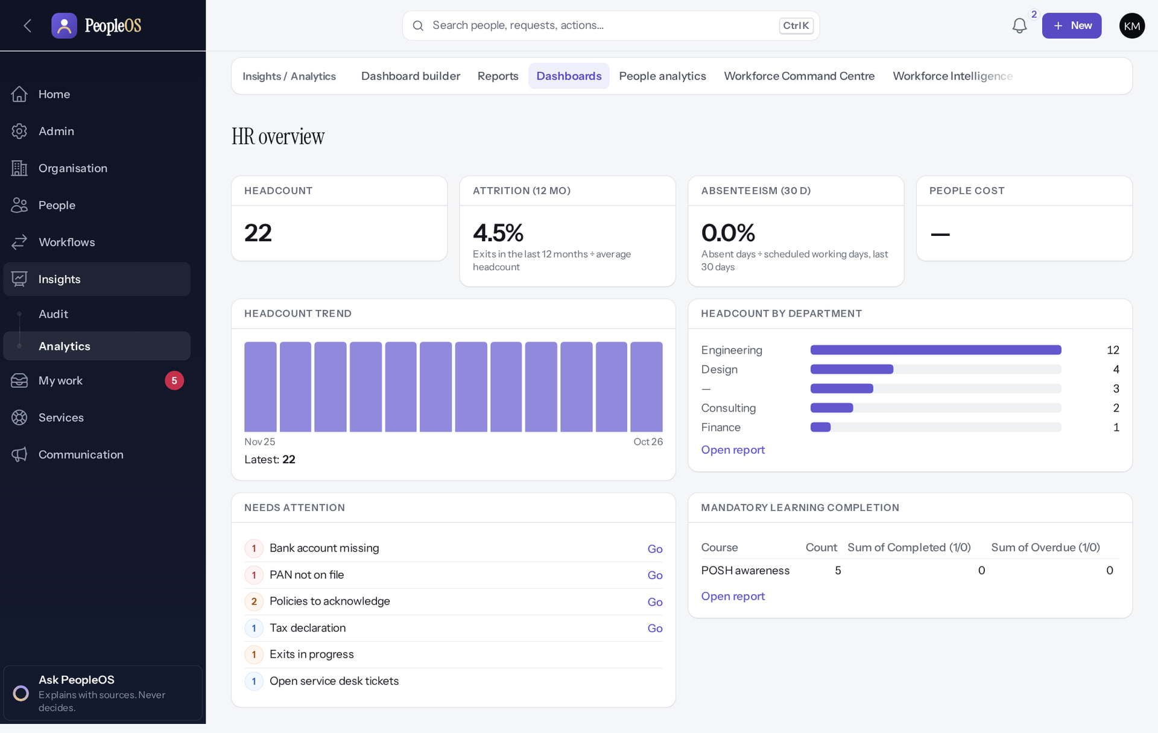
HR overview
ANALYTICS
Verified in the running application
Headcount, attrition, absenteeism, trends and what needs attention. People cost appears once payroll is finalised.
Real screen · Kavya Menon (Tenant HR Admin + Employee) · Insights › Analytics › Dashboards (HR overview)
Notes:
SAY: Headcount, attrition, absenteeism, trends and what needs attention. People cost appears once payroll is finalised.
ON SCREEN: Open Dashboards.
LEARNERS SHOULD SEE: Tiles: headcount, attrition (12 months), absenteeism (30 days), people cost, headcount trend and by department, needs attention, mandatory learning
SCREEN: Insights › Analytics › Dashboards (HR overview). Signed in as Kavya Menon (Tenant HR Admin + Employee). Prerequisite: Analytics permissions per dataset; privacy minimum group size.
EVIDENCE: screenshot screenshots/analytics/80-ins-04-hr-overview-dashboard.png, captured 2026-10-21 on the disposable training database (fictional people).

Slide 21
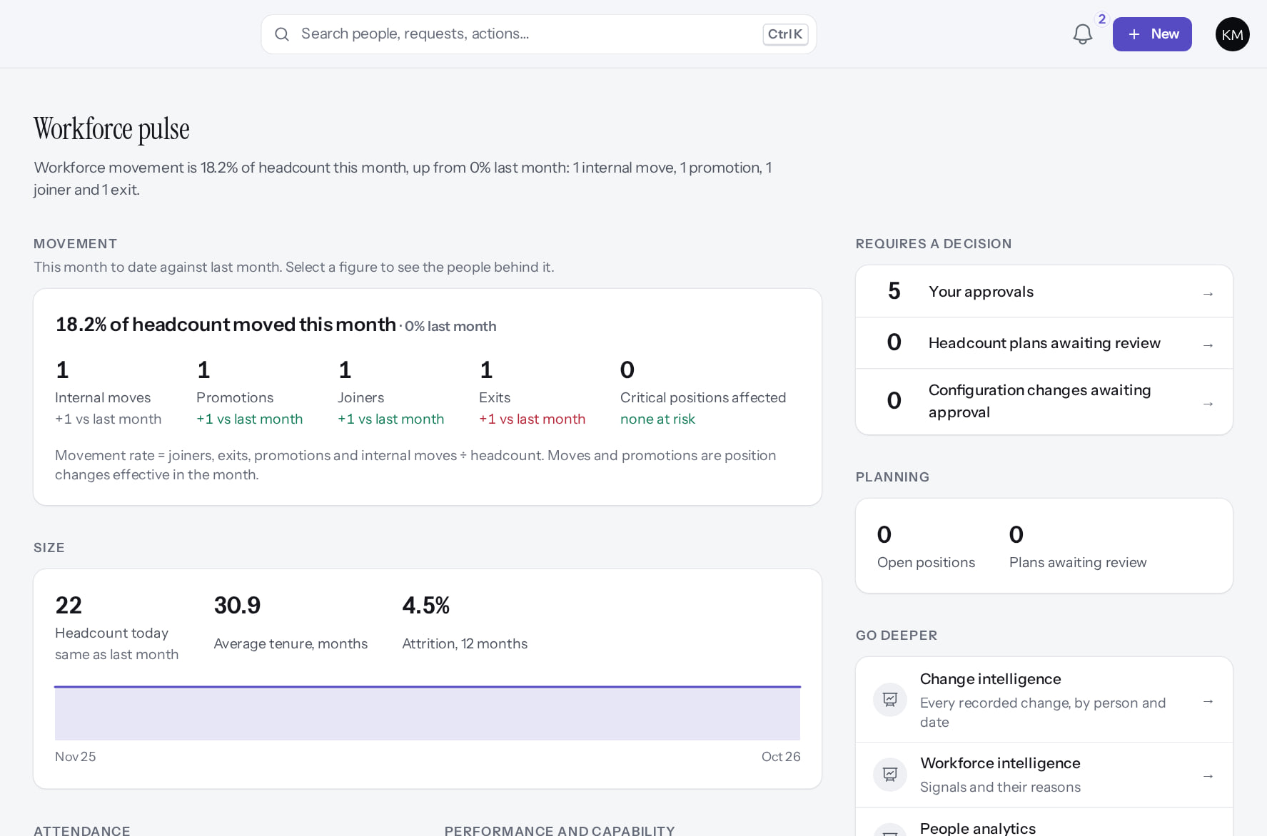
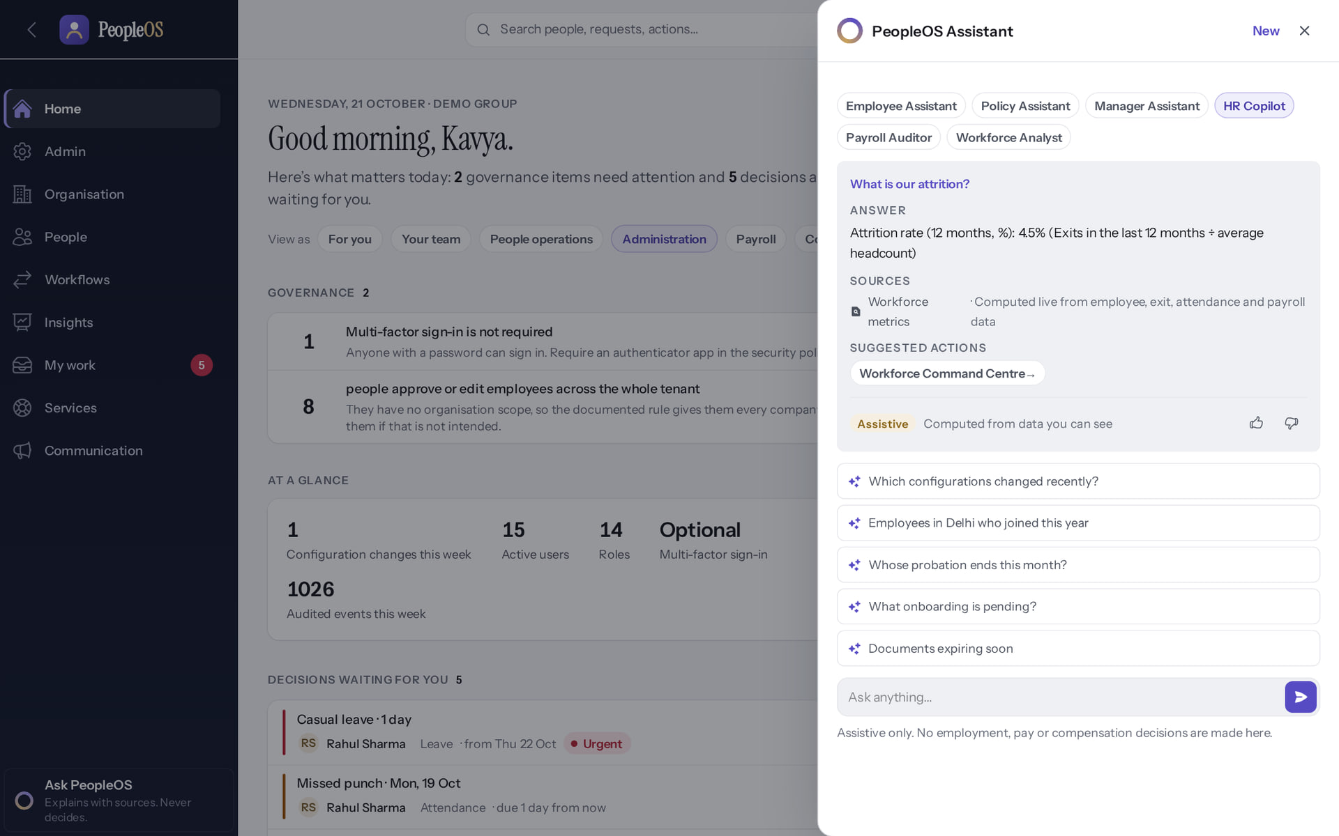
Pulse and answers with sources
ANALYTICS
Workforce pulse
Verified
Ask PeopleOS
Verified
What moved this month; select a figure to see the people behind it.
"What is our attrition?" 4.5%, with its source. Explains; never decides.
Real screen (cropped) · Kavya Menon (Tenant HR Admin + Employee) · Insights › Analytics › Workforce Command Centre (Workforce pulse)
Real screen · Kavya Menon (Tenant HR Admin + Employee) · Ask PeopleOS panel (PeopleOS Assistant)
Notes:
KNOWN GAP: executive dashboards need dataset permissions added to the Executive role (F45); custom report building has a defect (F44).
SAY: Pulse and answers with sources.
LEFT, Workforce pulse: What moved this month; select a figure to see the people behind it.
RIGHT, Ask PeopleOS: "What is our attrition?" 4.5%, with its source. Explains; never decides.
OBSERVE: point out what differs between the two screens.
EVIDENCE: left = analytics/80-ins-02-workforce-pulse [Kavya Menon (Tenant HR Admin + Employee), Insights › Analytics › Workforce Command Centre (Workforce pulse)]; right = analytics/80-ins-17-ask-peopleos [Kavya Menon (Tenant HR Admin + Employee), Ask PeopleOS panel (PeopleOS Assistant)]. Real screens, fictional data (SCREENSHOT-INVENTORY.md).

Slide 22
Security, governance and SaaS operations
06
Controls you can see and verify.
Notes:
TRANSITION: Section 6, Security, governance and SaaS operations. Controls you can see and verify.
SAY: Tell learners what they will be able to do by the end of this section, then move on.
ASK: "What questions do you have before we start this section?"

Slide 23
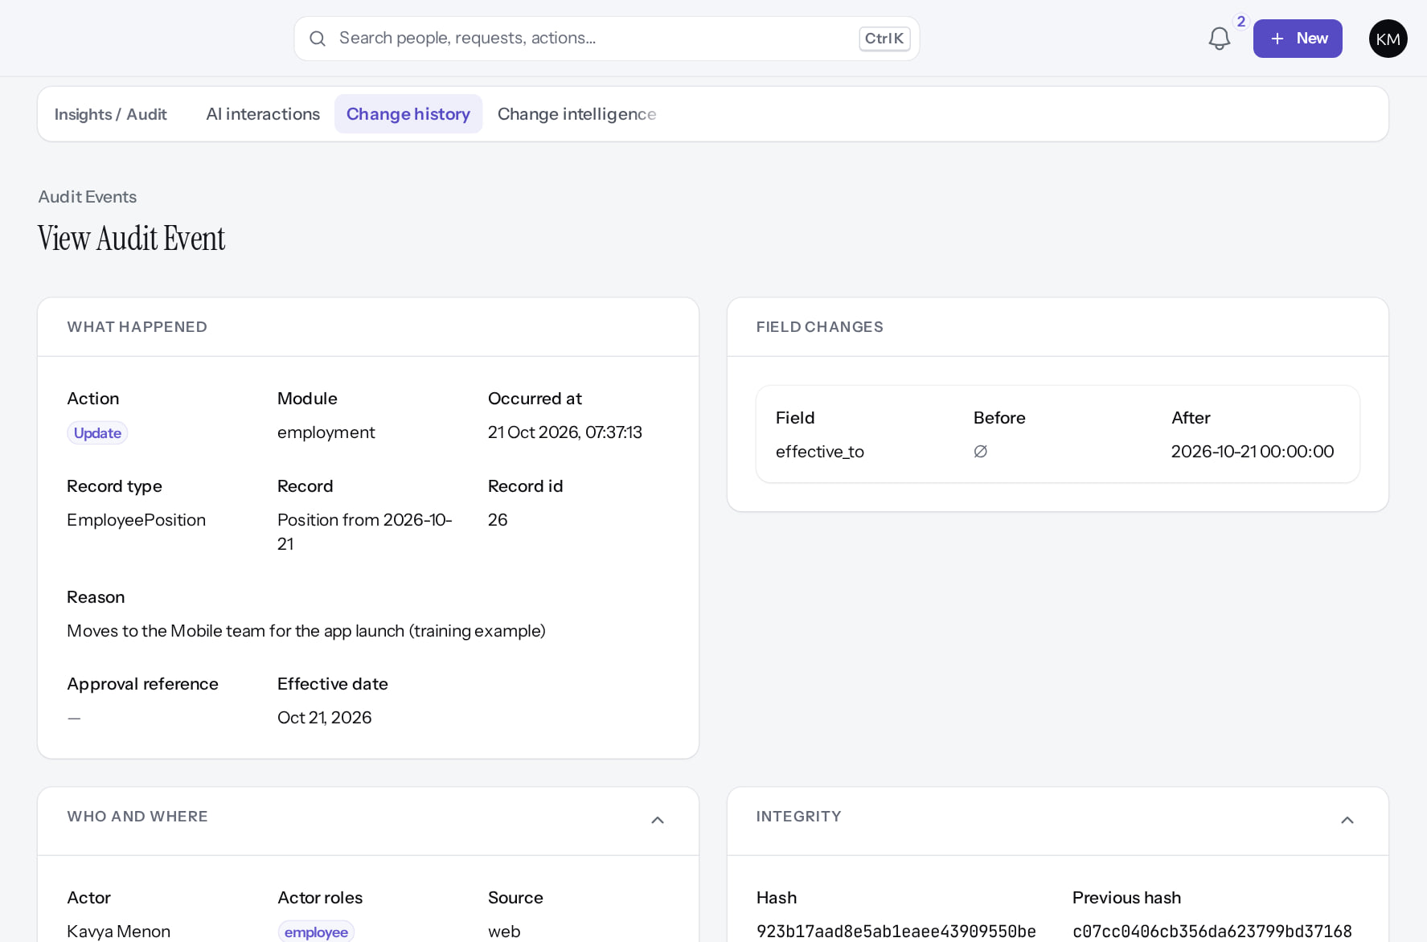
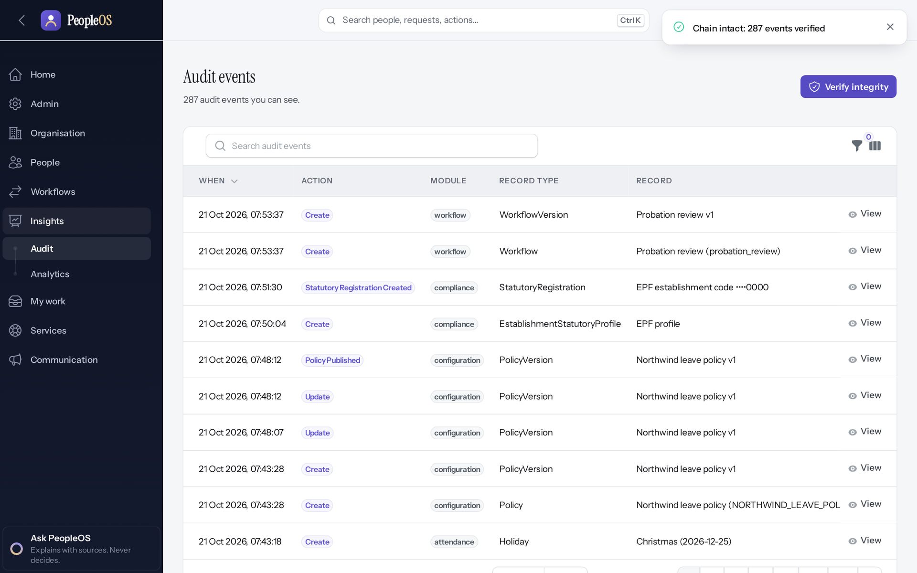
Audit you can verify
GOVERNANCE
Event integrity
Verified
Whole chain
Verified
Who, where, before → after; each event chained to the previous one.
"Chain intact: 287 events verified".
Real screen (cropped) · Kavya Menon (Tenant HR Admin + Employee) · Change history › event (Who and where, Integrity expanded)
Real screen · Farah Khan (Tenant Super Admin (Northwind Retail, first administrator)) · Change history › Verify integrity
Notes:
SAY: Audit you can verify.
LEFT, Event integrity: Who, where, before → after; each event chained to the previous one.
RIGHT, Whole chain: "Chain intact: 287 events verified".
OBSERVE: point out what differs between the two screens.
EVIDENCE: left = security-compliance/80-ins-11b-audit-integrity [Kavya Menon (Tenant HR Admin + Employee), Change history › event (Who and where, Integrity expanded)]; right = client-onboarding/90-onb-90-audit-verified [Farah Khan (Tenant Super Admin (Northwind Retail, first administrator)), Change history › Verify integrity]. Real screens, fictional data (SCREENSHOT-INVENTORY.md).

Slide 24
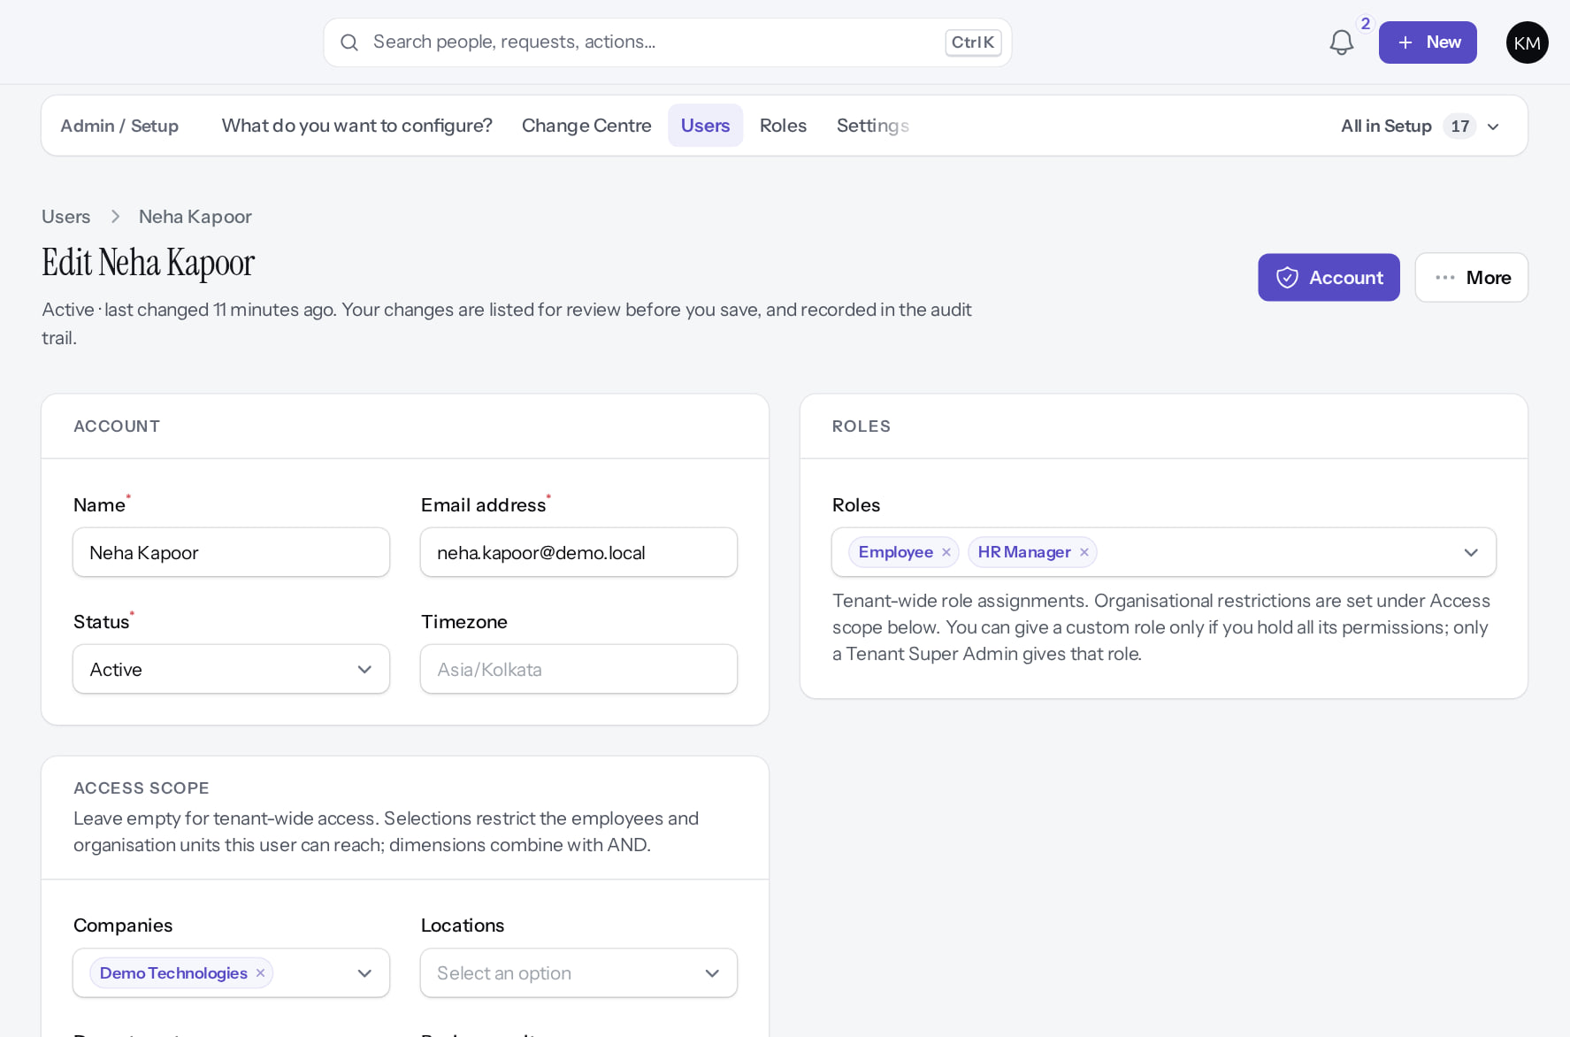
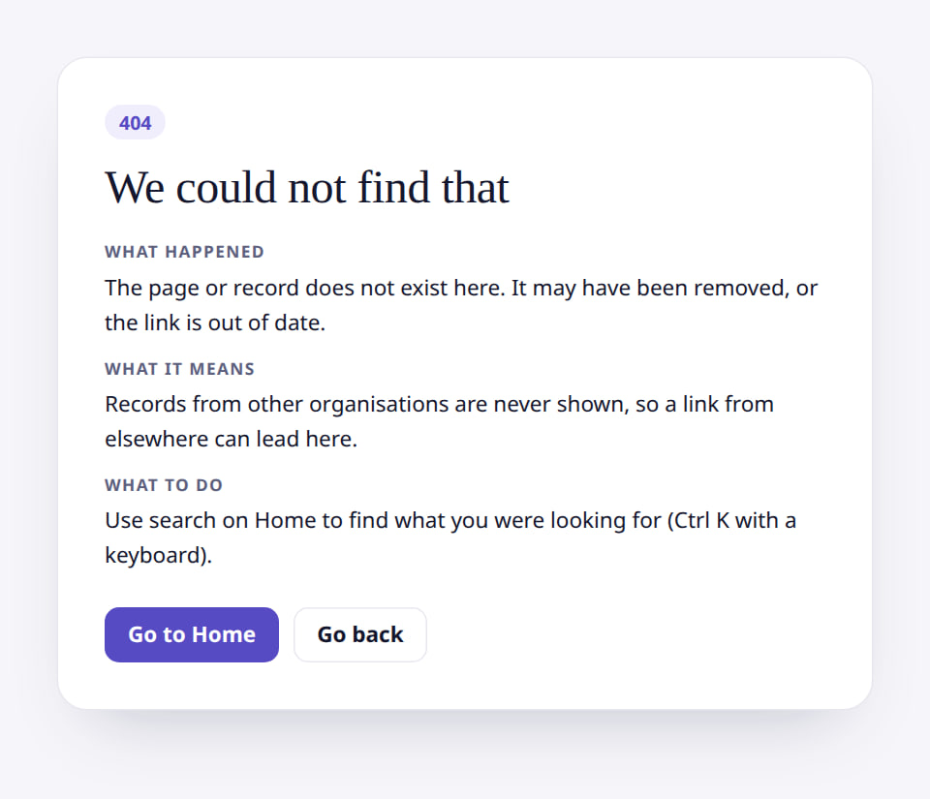
Access and isolation
GOVERNANCE
Scope on an HR account
Verified
Outside a manager's team
Verified
HR reach limited to one company.
Not found: records outside reach are not revealed.
Real screen (cropped) · Kavya Menon (Tenant HR Admin + Employee) · Admin › Setup › Users › Edit (Neha Kapoor)
Real screen (cropped) · Amit Verma (Manager + Employee) · Employee 360 of someone outside the team
Notes:
SAY: Access and isolation.
LEFT, Scope on an HR account: HR reach limited to one company.
RIGHT, Outside a manager's team: Not found: records outside reach are not revealed.
OBSERVE: point out what differs between the two screens.
EVIDENCE: left = security-compliance/85-acc-06b-user-company-scope [Kavya Menon (Tenant HR Admin + Employee), Admin › Setup › Users › Edit (Neha Kapoor)]; right = manager/40-team-09-outside-team [Amit Verma (Manager + Employee), Employee 360 of someone outside the team]. Real screens, fictional data (SCREENSHOT-INVENTORY.md).

Slide 25
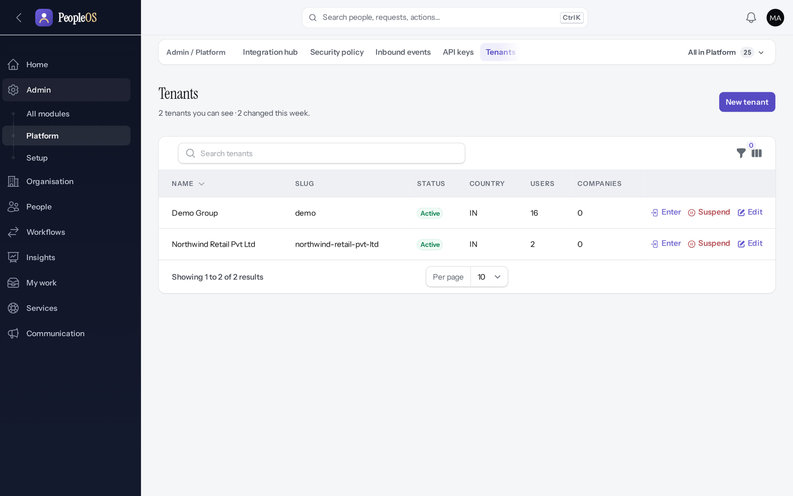
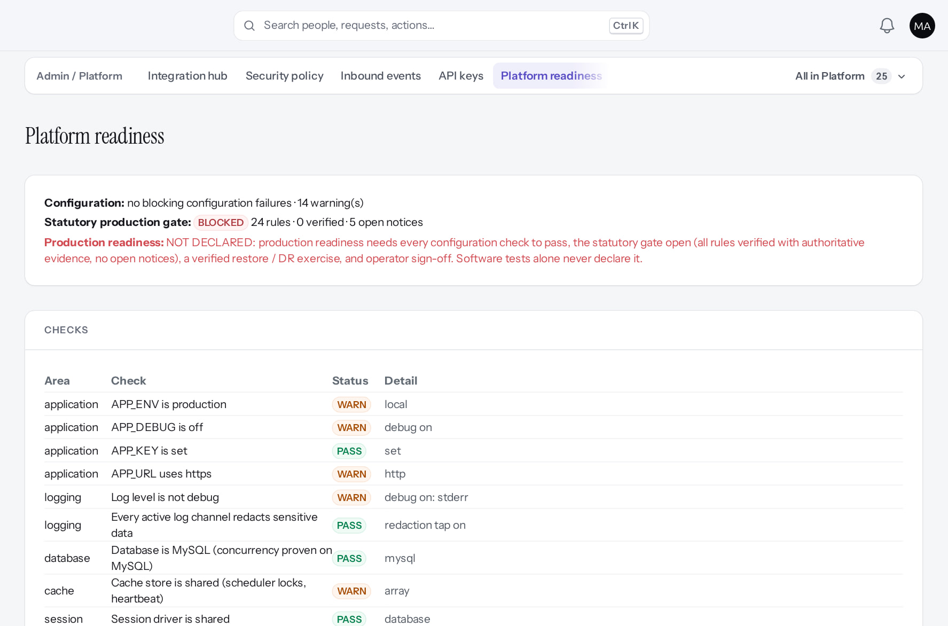
Operated as SaaS by Markedge
SAAS
Tenants
Verified
Readiness
Verified
Operators sign in with MFA; every tenant action carries a reason.
PASS / WARN / FAIL / BLOCKED checks before any go-live.
Real screen · Markedge Platform Admin (Platform operator) · Admin › Platform › Tenants
Real screen (cropped) · Markedge Platform Admin (Platform operator) · Admin › Platform › Platform readiness
Notes:
SAY: Operated as SaaS by Markedge.
LEFT, Tenants: Operators sign in with MFA; every tenant action carries a reason.
RIGHT, Readiness: PASS / WARN / FAIL / BLOCKED checks before any go-live.
OBSERVE: point out what differs between the two screens.
EVIDENCE: left = platform-admin/95-pl-05-tenants [Markedge Platform Admin (Platform operator), Admin › Platform › Tenants]; right = platform-admin/95-pl-23-readiness [Markedge Platform Admin (Platform operator), Admin › Platform › Platform readiness]. Real screens, fictional data (SCREENSHOT-INVENTORY.md).

Slide 26
What is live, and what is not yet (1 of 2)
HONEST SCOPE
Capability | Status today
Employee and manager self-service, approvals, attendance, leave | Verified
Employee lifecycle: hire, changes, onboarding, documents, letters, exit (gratuity not calculated) | Verified
Performance, learning, compensation governance, analytics, audit | Verified
Payroll finalisation, payslips, statutory returns | Disabled (gate)
Bulk employee import from the screen | Incomplete
Custom report builder (Group by, filters, sort) | Incomplete
Executive dashboard report widgets (dataset permissions) | After configuration
Self-service signup, billing, tenant deletion | Disabled (gate)
Notes:
SOURCE: this training library's captures and FEATURE-TO-PRESENTATION-MATRIX.md; release gate. "Verified" means executed on a demonstration database, not released to customers.
SAY: What is live, and what is not yet (part 1 of 2).
- Employee and manager self-service, approvals, attendance, leave | Verified in the running application
- Employee lifecycle: hire, changes, onboarding, documents, letters, exit (gratuity not calculated) | Verified in the running application
- Performance, learning, compensation governance, analytics, audit | Verified in the running application
- Payroll finalisation, payslips, statutory returns | Disabled by safety or commercial gates
- Bulk employee import from the screen | Incomplete · known defect or gap
- Custom report builder (Group by, filters, sort) | Incomplete · known defect or gap
- Executive dashboard report widgets (dataset permissions) | Available only after configuration
- Self-service signup, billing, tenant deletion | Disabled by safety or commercial gates

Slide 27
What is live, and what is not yet (2 of 2)
HONEST SCOPE
Capability | Status today
Native mobile app; SAML SSO; SMS/WhatsApp notifications | Not implemented
Notes:
SOURCE: this training library's captures and FEATURE-TO-PRESENTATION-MATRIX.md; release gate. "Verified" means executed on a demonstration database, not released to customers.
SAY: What is live, and what is not yet (part 2 of 2).
- Native mobile app; SAML SSO; SMS/WhatsApp notifications | Not implemented

Slide 28
How a customer goes live
IMPLEMENTATION
Plan
Provision
Structure
People
Policies
Validate
Go live
Scope and data owners
Tenant by Markedge
Organisation
Hire / load people
Time and leave
Reconcile
Release gate GO
Payroll scope decision
Administrator activates
Jobs and positions
Bulk import (F25)
Pay components
UAT
Hypercare
Roles and scope
Statutory rules
Access tests
Handover
Deck 04 details all 28 stages. Red items are blocked today by a defect or a release gate.
Conceptual diagram, not a screenshot
Notes:
SAY: How a customer goes live. Deck 04 details all 28 stages. Red items are blocked today by a defect or a release gate.
Plan: Scope and data owners, Payroll scope decision
Provision: Tenant by Markedge, Administrator activates
Structure: Organisation, Jobs and positions
People: Hire / load people, Bulk import (F25), Roles and scope
Policies: Time and leave, Pay components, Statutory rules
Validate: Reconcile, UAT, Access tests
Go live: Release gate GO, Hypercare, Handover

Slide 29
Release gate: NO-GO until these are resolved (1 of 2)
APPENDIX
Status as written in the release gate document. Ten of fourteen gates are blocked by owner decisions, external parties or missing infrastructure.
# | Gate | Gate status | Remaining dependency
1 | Application and architecture integrity | PASS (workstation) | Repeat the full suites in staging
2 | Credential exposure and repository remediation | BLOCKED | Owner: rotation confirmation, repository visibility (O-1 to O-3)
3 | Authentication and operator MFA | BLOCKED | Operators enrol MFA in the target environment (O-14, O-7)
4 | Independent security review | BLOCKED | Engage a reviewer; triage and retest findings (O-4)
5 | Statutory verification and gratuity | BLOCKED | 0 of 24 rules verified; gratuity not implemented (O-5, O-12, O-18)
6 | Data protection, retention, legal holds | PASS (controls) / BLOCKED (policy) | Retention decisions with counsel (D8); privacy review
7 | Backup, restore and disaster recovery | BLOCKED | Recovery objectives and an isolated target (O-6, O-7)
Notes:
SOURCE: docs/saas/SaaS-Final-Release-Gate.md (decision NO-GO, re-verified 13 October 2026 at 7314f7d); owner actions in docs/saas/SaaS-Final-Owner-Action-Register.md.
SAY: The application passes its automated suites on the workstation, but release is blocked by decisions and infrastructure, not by code alone.
AVOID: describing any gate as resolved. Nothing in this training changes a gate.
SAY: Release gate: NO-GO until these are resolved (part 1 of 2). Status as written in the release gate document. Ten of fourteen gates are blocked by owner decisions, external parties or missing infrastructure.
- 1 | Application and architecture integrity | PASS (workstation) | Repeat the full suites in staging
- 2 | Credential exposure and repository remediation | BLOCKED | Owner: rotation confirmation, repository visibility (O-1 to O-3)
- 3 | Authentication and operator MFA | BLOCKED | Operators enrol MFA in the target environment (O-14, O-7)
- 4 | Independent security review | BLOCKED | Engage a reviewer; triage and retest findings (O-4)
- 5 | Statutory verification and gratuity | BLOCKED | 0 of 24 rules verified; gratuity not implemented (O-5, O-12, O-18)
- 6 | Data protection, retention, legal holds | PASS (controls) / BLOCKED (policy) | Retention decisions with counsel (D8); privacy review
- 7 | Backup, restore and disaster recovery | BLOCKED | Recovery objectives and an isolated target (O-6, O-7)

Slide 30
Release gate: NO-GO until these are resolved (2 of 2)
APPENDIX
# | Gate | Gate status | Remaining dependency
8 | Hosting, monitoring and on-call | BLOCKED | Environment, alerting, on-call (O-7, O-10, O-11)
9 | Signup and tenant provisioning | PASS (disabled) / BLOCKED (activation) | Only if self-service signup is wanted at launch (D10)
10 | Billing, tax and payment controls | PASS (disabled) / BLOCKED (activation) | Only for paid billing (B-4, B-7, B-8, B-9)
11 | Tenant deletion and offboarding | PASS (disabled) / BLOCKED (activation) | Retention decisions, register disk, review (D8)
12 | Regression and target-environment testing | BLOCKED | A staging environment (O-7, O-8)
13 | Owner decisions and written approvals | BLOCKED | All owner action items
14 | Deployment, rollback, post-deployment checks | BLOCKED | Rehearse in staging; authorise (O-7 to O-9)
Notes:
SOURCE: docs/saas/SaaS-Final-Release-Gate.md (decision NO-GO, re-verified 13 October 2026 at 7314f7d); owner actions in docs/saas/SaaS-Final-Owner-Action-Register.md.
SAY: The application passes its automated suites on the workstation, but release is blocked by decisions and infrastructure, not by code alone.
AVOID: describing any gate as resolved. Nothing in this training changes a gate.
SAY: Release gate: NO-GO until these are resolved (part 2 of 2). Status as written in the release gate document. Ten of fourteen gates are blocked by owner decisions, external parties or missing infrastructure.
- 8 | Hosting, monitoring and on-call | BLOCKED | Environment, alerting, on-call (O-7, O-10, O-11)
- 9 | Signup and tenant provisioning | PASS (disabled) / BLOCKED (activation) | Only if self-service signup is wanted at launch (D10)
- 10 | Billing, tax and payment controls | PASS (disabled) / BLOCKED (activation) | Only for paid billing (B-4, B-7, B-8, B-9)
- 11 | Tenant deletion and offboarding | PASS (disabled) / BLOCKED (activation) | Retention decisions, register disk, review (D8)
- 12 | Regression and target-environment testing | BLOCKED | A staging environment (O-7, O-8)
- 13 | Owner decisions and written approvals | BLOCKED | All owner action items
- 14 | Deployment, rollback, post-deployment checks | BLOCKED | Rehearse in staging; authorise (O-7 to O-9)

Slide 31
Next steps
See it with your own data model in a demonstration tenant.
Agree scope, including whether payroll is in the first go-live.
Plan the implementation with the 28-stage playbook.
Release timing follows the release gate; we will not go live before it is GO.
NEXT STEPS & HELP
Commercial terms, hosting region and service levels: agreed in the customer contract (not yet set)
Deck 04: implementation playbook
Deck 08: security and compliance
Release gate: NO-GO (10 of 14 gates blocked, re-verified 13 Oct 2026). Not yet generally available.
Notes:
SAY: Recap the key points:
- See it with your own data model in a demonstration tenant.
- Agree scope, including whether payroll is in the first go-live.
- Plan the implementation with the 28-stage playbook.
- Release timing follows the release gate; we will not go live before it is GO.
POINT TO: Commercial terms, hosting region and service levels: agreed in the customer contract (not yet set); Deck 04: implementation playbook; Deck 08: security and compliance
ASK: "What will you do first in PeopleOS?" Collect questions you cannot answer and send them to the PeopleOS team.

