Slide 1
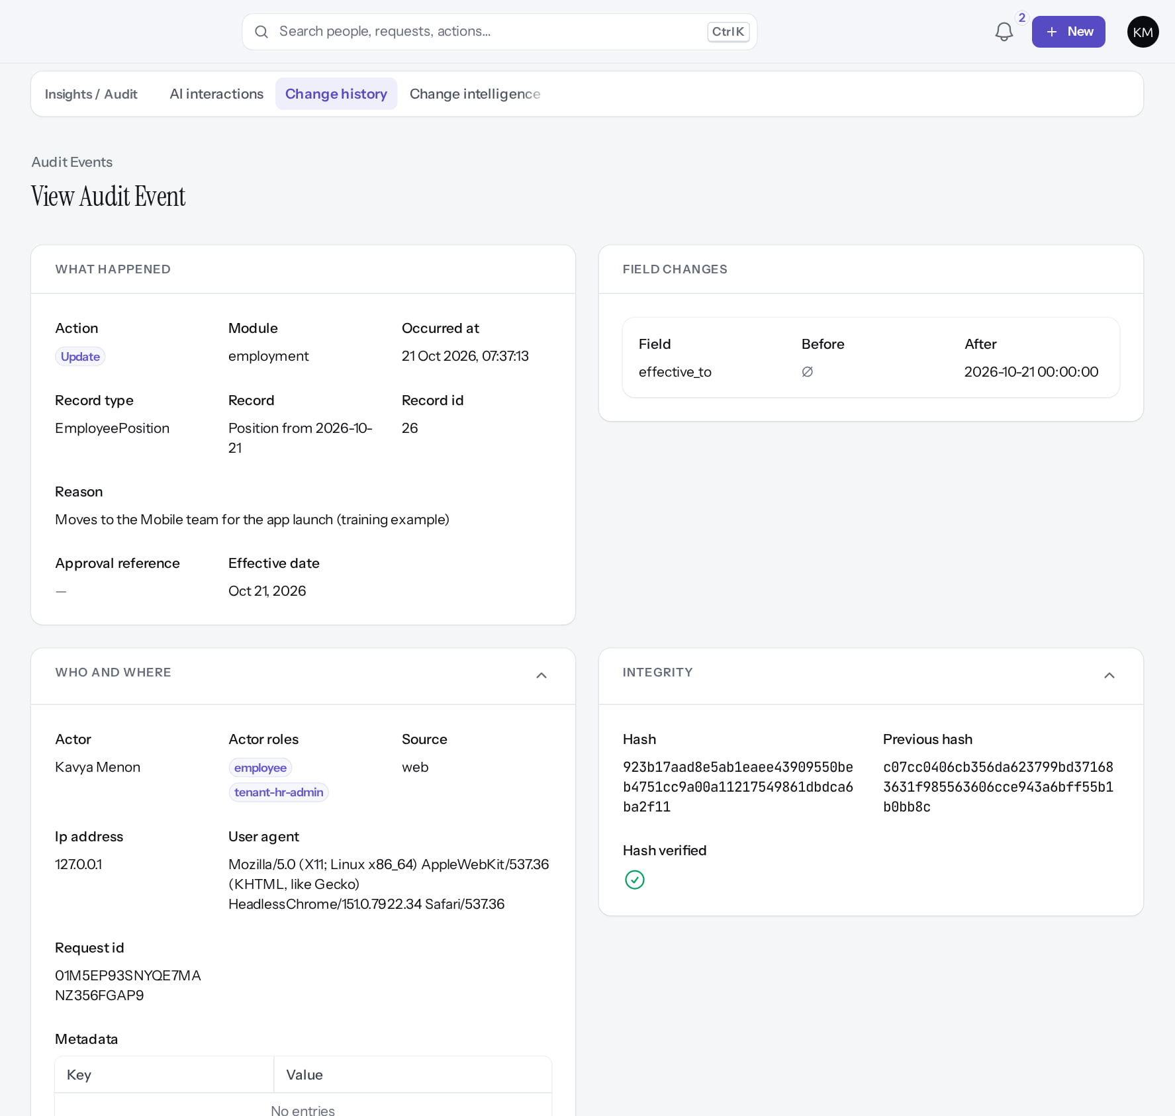
HCM System Architecture and Workflows
MARKEDGE PEOPLEOS · TRAINING LIBRARY
Deck 10 of 12
How PeopleOS is built: layers, tenancy, access control, effective dating, audit, workflows, payroll safeguards and integration boundaries.
For: Solution architects, engineers, implementation leads and technical reviewers
Built from the running application (local, disposable database, fictional people) · 21 October 2026
Real screen, fictional data
Notes:
SAY: This deck explains how PeopleOS is built, using the repository as evidence and real screens where they show the architecture at work.
AUDIENCE: architects, engineers, implementation leads.
SOURCES: docs/architecture/peopleos-architecture-contract.md, integration-contract.md, security-invariants.md, saas-9-offboarding.md, tests/Feature/Architecture/ArchitectureTest.php.

Slide 2
How to read this deck
BEFORE YOU START
Verified in the running application
We ran it on the training database and captured each step.
1
Numbered markers on a screenshot match the numbered steps beside it.
Implemented · not verified end to end
The screen exists; the last steps need data or a second party we could not provide.
Every screenshot is a real capture of PeopleOS. The people and companies in it are fictional.
Available only after configuration
Works once an administrator or Markedge has set it up.
Disabled by safety or commercial gates
Switched off on purpose until owner decisions and approvals arrive.
Diagrams are marked "Conceptual diagram". They explain ideas; they are not screens.
Incomplete · known defect or gap
Partly working: a known defect or gap is stated on the slide.
Release gate: NO-GO (10 of 14 gates blocked, re-verified 13 Oct 2026). Not yet generally available.
Not implemented
Not in the product today.
Unable to verify
Could not be checked in this environment.
Notes:
Explain the seven status labels. Every screenshot slide carries one of them in its top-right corner. Stress that "Verified in the running application" means we ran it on a disposable demonstration database, not that the feature is released.

Slide 3
How these screens were produced
ABOUT THIS TRAINING
Real application
Disposable database
PeopleOS at commit 72c96a73, run locally. No application file or setting was changed for the training.
hcm_training_showcase, seeded with the guarded showcase seeder: invented people at the fictional Demo Group.
Workflows executed
Nothing switched on
Requests were submitted, approved, rejected and processed so that every state shown really happened.
Public signup, live payments and tenant deletion stayed off. The operator used MFA. No secret is shown.
Notes:
SAY: Every screenshot is a genuine capture from the running application on a disposable database. The full list, with what each one shows, is in SCREENSHOT-INVENTORY.md.
EVIDENCE: docs/presentations/peopleos/SCREENSHOT-INVENTORY.md and PEOPLEOS-PRESENTATION-ACCURACY-REGISTER.md.
SAY: How these screens were produced.
- Real application: PeopleOS at commit 72c96a73, run locally. No application file or setting was changed for the training.
- Disposable database: hcm_training_showcase, seeded with the guarded showcase seeder: invented people at the fictional Demo Group.
- Workflows executed: Requests were submitted, approved, rejected and processed so that every state shown really happened.
- Nothing switched on: Public signup, live payments and tenant deletion stayed off. The operator used MFA. No secret is shown.
ASK: "Which of these points needs more explanation for your team?"

Slide 4
What you will be able to explain
LEARNING OBJECTIVES
The five product layers
and which modules sit where
Configuration and workflow versioning
policies, rules, pinned workflow versions
1
4
One person, one lifetime record
Person, Employee, effective-dated assignments
Audit and change history
append-only events with a hash chain
2
5
Tenant isolation and layered access
fail-closed tenancy, scopes, field protection
Safeguards and boundaries
payroll gates, offboarding, integrations, AI
3
6
Notes:
SAY: By the end you should be able to sketch the layers, explain why tenant data cannot leak by default, and say which controls are enforced in code versus which depend on operations.
ASK: "Which of these have you had to explain to a customer before?"

Slide 5
Product architecture
01
Five layers from the blueprint, realised as domain modules with thin delivery layers.
Notes:
TRANSITION: Section 1, Product architecture. Five layers from the blueprint, realised as domain modules with thin delivery layers.
SAY: Tell learners what they will be able to do by the end of this section, then move on.
ASK: "What questions do you have before we start this section?"

Slide 6
Five layers, one product
PRODUCT ARCHITECTURE
Experience
Employee
Manager
HR
Payroll
Admin
Responsive web (no native app)
Intelligence
Reports and datasets
Analytics pages
Ask PeopleOS (assistants)
Payroll Auditor (rule-based)
Configuration platform
Policies
Rules
Workflows and approvals
Forms and custom fields
Packs and blueprints
People Core
Identity
Organisation
People and employment
Time, leave, payroll
Growth, services, exit
Integration Hub
REST API v1
SCIM 2.0
OIDC single sign-on
Signed webhooks
Inbound events
Conceptual diagram, not a screenshot
Notes:
SOURCE: docs/peopleos-blueprint.md §3 (PEOPLE CORE, CONFIGURATION PLATFORM, EXPERIENCE, INTELLIGENCE, INTEGRATION HUB).
SAY: The blueprint lists more integration targets (biometric, ERP, banking, SMS, WhatsApp). Only what is on this slide is built. SMS, WhatsApp and push are offered as notification channels but send nothing (finding F19). No native mobile app exists.
AVOID: presenting blueprint targets as built.
SAY: Five layers, one product.
LAYERS: Experience: Employee, Manager, HR, Payroll, Admin, Responsive web (no native app); Intelligence: Reports and datasets, Analytics pages, Ask PeopleOS (assistants), Payroll Auditor (rule-based); Configuration platform: Policies, Rules, Workflows and approvals, Forms and custom fields, Packs and blueprints; People Core: Identity, Organisation, People and employment, Time, leave, payroll, Growth, services, exit; Integration Hub: REST API v1, SCIM 2.0, OIDC single sign-on, Signed webhooks, Inbound events
LABEL: conceptual diagram, not a screenshot.

Slide 7
Code structure and call flow
PRODUCT ARCHITECTURE
Delivery
app/Filament, app/Http: calls
Application
Services and Actions: call
Domain
Models, Policies; defines contracts
Adapters
implement domain contracts
Conceptual diagram, not a screenshot
Arrows show calls; adapters implement contracts the domain defines (the domain never imports them). Business rules live in app/Domain/{Module}/{Models,Services,Actions,Policies,Enums}. Filament pages and HTTP controllers call services; they never hold business rules. app/Support holds cross-cutting primitives (tenancy, effective dating). Domain code does not import Filament, HTTP or vendor SDKs; adapters (AI provider, BGV, attendance devices, notification channels, SSO presets) sit behind contracts.
Notes:
SOURCE: architecture contract §15. About 30 domain modules (Identity, Platform, Organisation, People, Employment, Lifecycle, … Audit).
SAY: When you look for where a rule lives, start in app/Domain, not in the screen.
SAY: Code structure and call flow. Arrows show calls; adapters implement contracts the domain defines (the domain never imports them). Business rules live in app/Domain/{Module}/{Models,Services,Actions,Policies,Enums}. Filament pages and HTTP controllers call services; they never hold business rules. app/Support holds cross-cutting primitives (tenancy, effective dating). Domain code does not import Filament, HTTP or vendor SDKs; adapters (AI provider, BGV, attendance devices, notification channels, SSO presets) sit behind contracts.
SEQUENCE: Delivery (app/Filament, app/Http: calls) → Application (Services and Actions: call) → Domain (Models, Policies; defines contracts) → Adapters (implement domain contracts)
LABEL: conceptual diagram, not a screenshot.

Slide 8
People Core
02
One person, one lifetime record; employment facts are effective-dated so any past state can be reproduced.
Notes:
TRANSITION: Section 2, People Core. One person, one lifetime record; employment facts are effective-dated so any past state can be reproduced.
SAY: Tell learners what they will be able to do by the end of this section, then move on.
ASK: "What questions do you have before we start this section?"

Slide 9
One person, one lifetime record
PEOPLE CORE
Person
Names, date of birth, contacts
Addresses (effective-dated)
Family, qualifications, skills
Employee (one per person per tenant)
Employee code, work e-mail
Lifecycle state + immutable transitions
Login (optional user)
Effective-dated facts
Positions: company … cost centre
Reporting relationships (typed)
Salary assignments
Domain records
Time, leave, payroll
Performance, learning, assets
Requests, exit, letters, alumni
Conceptual diagram, not a screenshot
Notes:
SOURCE: architecture contract §3 (ADR-0002). A unique (tenant_id, person_id) on employees prevents a second employee row for the same person. Re-employment reuses the same Employee (alumni → active); a dedicated rehire screen is not built.
SAY: This is why the hire wizard checks for an existing person before creating anyone.
SAY: One person, one lifetime record.
LAYERS: Person: Names, date of birth, contacts, Addresses (effective-dated), Family, qualifications, skills; Employee (one per person per tenant): Employee code, work e-mail, Lifecycle state + immutable transitions, Login (optional user); Effective-dated facts: Positions: company … cost centre, Reporting relationships (typed), Salary assignments; Domain records: Time, leave, payroll, Performance, learning, assets, Requests, exit, letters, alumni
LABEL: conceptual diagram, not a screenshot.

Slide 10
Lifecycle states and what each transition triggers
PEOPLE CORE
Item | Implementation
Canonical states | pre_employee → preboarding → onboarding → joined → probation → confirmed → active → on_leave / suspended / notice_period → exited → alumni; alumni → active
Where enforced | LifecycleEngine::transition(), permission employee.lifecycle, effective date and reason required; exit needs a cleared exit case
Each transition produces | Domain event → audit event → timeline entry → notification rules → workflow triggers → downstream actions
Downstream actions | Onboarding start on joining; login suspended on exit; Alumni role
Not states | Transfer and promotion are position events on the timeline (new effective-dated position row)
Notes:
SOURCE: architecture contract §7 (ADR-0007), config peopleos.lifecycle.transitions.
SAY: Lifecycle states and what each transition triggers.
- Canonical states | pre_employee → preboarding → onboarding → joined → probation → confirmed → active → on_leave / suspended / notice_period → exited → alumni; alumni → active
- Where enforced | LifecycleEngine::transition(), permission employee.lifecycle, effective date and reason required; exit needs a cleared exit case
- Each transition produces | Domain event → audit event → timeline entry → notification rules → workflow triggers → downstream actions
- Downstream actions | Onboarding start on joining; login suspended on exit; Alumni role
- Not states | Transfer and promotion are position events on the timeline (new effective-dated position row)

Slide 11
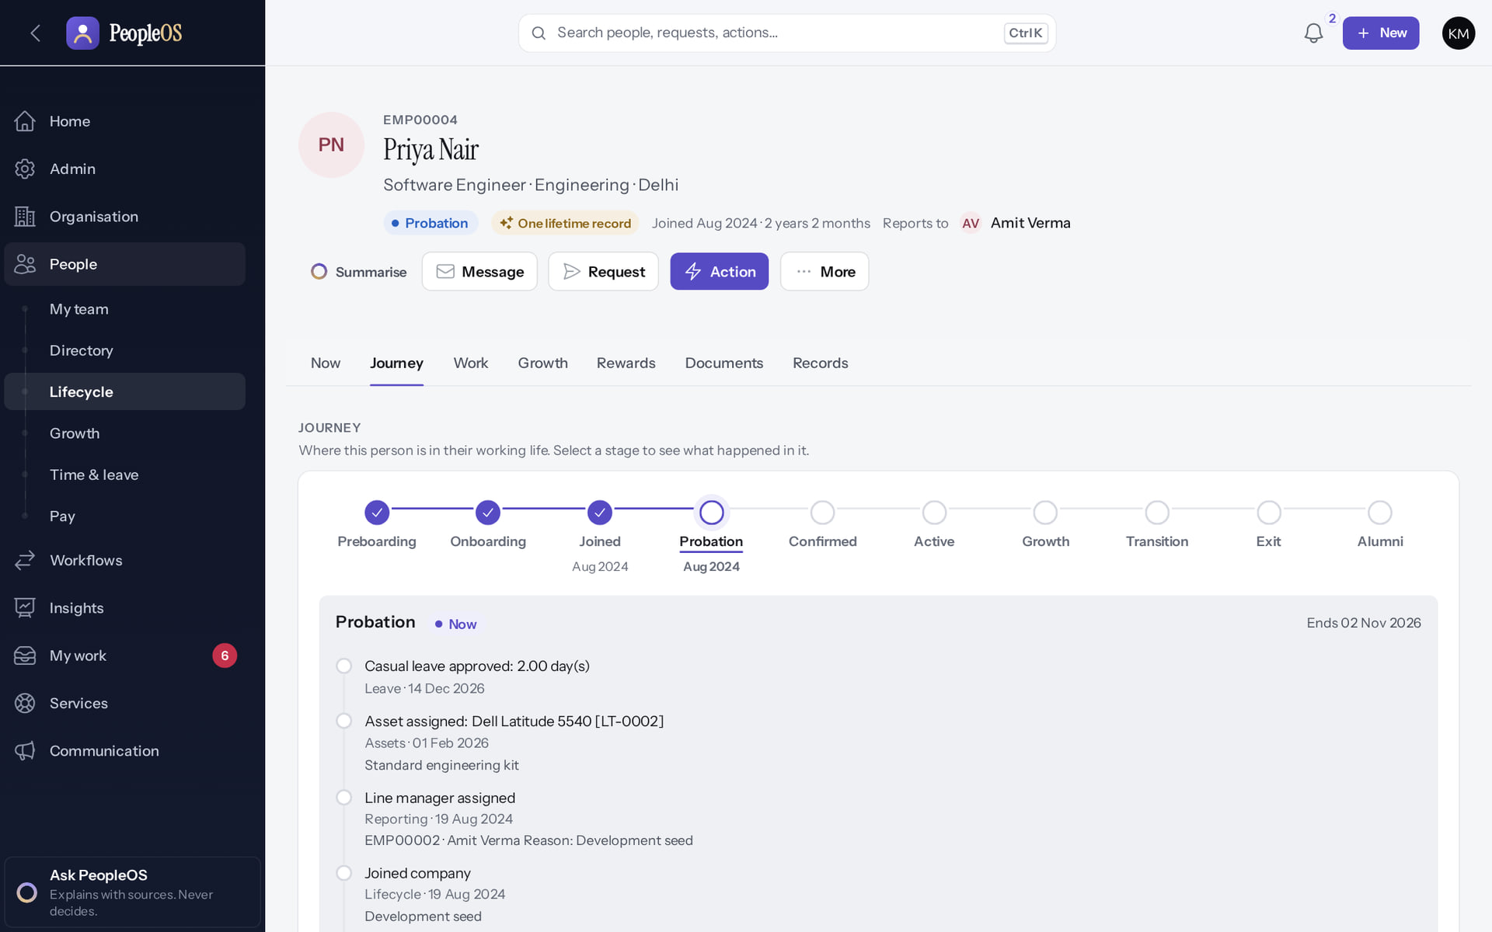
Effective dating, as the user sees it
PEOPLE CORE
Verified in the running application
1
The Journey view shows the history in order.
Each change is a dated entry, never an overwrite.
1
RESULT Past positions and managers remain reproducible.
Real screen · Kavya Menon (Tenant HR Admin + Employee) · Employee 360 › Journey
Notes:
SAY: Past positions and managers remain reproducible.
ON SCREEN: Open the Journey view.
WALK THROUGH: (1) The Journey view shows the history in order. (·) Each change is a dated entry, never an overwrite.
LEARNERS SHOULD SEE: Effective-dated history of the person: joining, changes, lifecycle
SCREEN: Employee 360 › Journey. Signed in as Kavya Menon (Tenant HR Admin + Employee). Prerequisite: employee.view; sensitive tabs need their own permissions.
EVIDENCE: screenshot screenshots/hr-admin/50-360-04-journey.png, captured 2026-10-21 on the disposable training database (fictional people).

Slide 12
Organisation model: units are not interchangeable
PEOPLE CORE
Unit | Nature | Relation
Company | Management unit | Root under the tenant
Legal entity, establishment | Legal and statutory | Legal employer; registered place of work (ADR-0001)
Location | Physical site | Company; cannot be linked to an establishment on screen (F10)
Business unit, division, department, team | Reporting and operational | Company; organisation tree for the designer
Cost centre, profit centre | Financial | Referenced by positions
Job family, designation, level, grade | Job architecture (tenant-wide) | Referenced by positions
Notes:
SOURCE: architecture contract §2 and §4; documentation-gaps F10.
SAY: Units are effective-dated and never deleted while referenced; renames and moves are audited.
SAY: Organisation model: units are not interchangeable.
- Company | Management unit | Root under the tenant
- Legal entity, establishment | Legal and statutory | Legal employer; registered place of work (ADR-0001)
- Location | Physical site | Company; cannot be linked to an establishment on screen (F10)
- Business unit, division, department, team | Reporting and operational | Company; organisation tree for the designer
- Cost centre, profit centre | Financial | Referenced by positions
- Job family, designation, level, grade | Job architecture (tenant-wide) | Referenced by positions

Slide 13
Tenant isolation and access
03
The tenant is the isolation boundary. Access is decided in layers that are never merged.
Notes:
TRANSITION: Section 3, Tenant isolation and access. The tenant is the isolation boundary. Access is decided in layers that are never merged.
SAY: Tell learners what they will be able to do by the end of this section, then move on.
ASK: "What questions do you have before we start this section?"

Slide 14
Tenant scoping fails closed
TENANT ISOLATION
Request
session or API key
ResolveTenant
user → own tenant
TenantContext
bound before model binding
TenantScope
no tenant → no rows
BelongsToTenant
stamps tenant_id, refuses cross-tenant writes
Conceptual diagram, not a screenshot
Without a bound tenant, tenant-owned queries return nothing. Platform code must call TenantContext::bypass() explicitly, and only allow-listed platform services may (architecture test "bypasses tenant scoping only in the documented platform services"). Platform operators reach a tenant only by explicitly entering it, and their actions are audited with the source.
Notes:
SOURCE: architecture contract §1; tests/Feature/Architecture/ArchitectureTest.php ("scopes every domain model to a tenant except the documented platform-level models", "bypasses tenant scoping only in the documented platform services").
SAY: The user model is deliberately not tenant-scoped because sign-in happens before a tenant is known; listings use User::forCurrentTenant().
SAY: Tenant scoping fails closed. Without a bound tenant, tenant-owned queries return nothing. Platform code must call TenantContext::bypass() explicitly, and only allow-listed platform services may (architecture test "bypasses tenant scoping only in the documented platform services"). Platform operators reach a tenant only by explicitly entering it, and their actions are audited with the source.
SEQUENCE: Request (session or API key) → ResolveTenant (user → own tenant) → TenantContext (bound before model binding) → TenantScope (no tenant → no rows) → BelongsToTenant (stamps tenant_id, refuses cross-tenant writes)
LABEL: conceptual diagram, not a screenshot.

Slide 15
Access is decided in layers
ACCESS CONTROL
Role
RBAC: what may this role do?
Organisation scope
ABAC: which records?
Relationship scope
whose records? (reports)
Field protection
sensitive permissions, masking
Record
policy allows()
Conceptual diagram, not a screenshot
Permission keys are declared in config/peopleos.php and mirrored to the database by peopleos:sync-permissions. Organisation scope (user_access_scopes) limits HR to companies or units; with no scope rows, the documented rule gives tenant-wide reach (Home warns about it). Managers reach their own record and everyone who reports to them today. Sensitive fields (bank, PAN, Aadhaar reference, UAN, salary, payslips…) need *.sensitive.* permissions and are encrypted and masked.
Notes:
SOURCE: architecture contract §6 (ADR-0004, ADR-0005); data_classification in config/peopleos.php; ArchitectureTest "masks every highly sensitive attribute in the data classification map".
SAY: A Tenant Administrator is not automatically allowed to see sensitive fields.
SAY: Access is decided in layers. Permission keys are declared in config/peopleos.php and mirrored to the database by peopleos:sync-permissions. Organisation scope (user_access_scopes) limits HR to companies or units; with no scope rows, the documented rule gives tenant-wide reach (Home warns about it). Managers reach their own record and everyone who reports to them today. Sensitive fields (bank, PAN, Aadhaar reference, UAN, salary, payslips…) need *.sensitive.* permissions and are encrypted and masked.
SEQUENCE: Role (RBAC: what may this role do?) → Organisation scope (ABAC: which records?) → Relationship scope (whose records? (reports)) → Field protection (sensitive permissions, masking) → Record (policy allows())
LABEL: conceptual diagram, not a screenshot.

Slide 16
Who sees what (decided visibility matrix)
ACCESS CONTROL
Actor | Sees
Employee | Own person and employee data, own transactions, published policies and announcements for their audience
Manager | Direct reports (any reporting type, effective today) for the abilities their permissions grant
HR roles | Every employee within their organisation scope; tenant-wide when no scope rows exist
Tenant administrator | Tenant-wide by permissions; sensitive fields only with *.sensitive.*; never another tenant
Executive | Dashboards and aggregates; record level only via scope and permissions
Platform operator | Any tenant, only after explicitly entering it; every action audited
Notes:
SOURCE: architecture contract §6 visibility matrix. Deck 8 shows the real allowed and restricted screens.
SAY: Who sees what (decided visibility matrix).
- Employee | Own person and employee data, own transactions, published policies and announcements for their audience
- Manager | Direct reports (any reporting type, effective today) for the abilities their permissions grant
- HR roles | Every employee within their organisation scope; tenant-wide when no scope rows exist
- Tenant administrator | Tenant-wide by permissions; sensitive fields only with *.sensitive.*; never another tenant
- Executive | Dashboards and aggregates; record level only via scope and permissions
- Platform operator | Any tenant, only after explicitly entering it; every action audited

Slide 17
Configuration platform
04
Policies, rules and workflows are versioned data, not code. Running work keeps the version it started with.
Notes:
TRANSITION: Section 4, Configuration platform. Policies, rules and workflows are versioned data, not code. Running work keeps the version it started with.
SAY: Tell learners what they will be able to do by the end of this section, then move on.
ASK: "What questions do you have before we start this section?"

Slide 18
Vocabulary that matters in implementation
CONFIGURATION PLATFORM
Term | Meaning in PeopleOS
Configuration | Tenant or company values and reference data: settings, features, organisation units, calendars, components
Policy | Versioned, effective-dated bundle of settings of one type (leave, attendance, overtime, probation, payroll…)
Rule | Deterministic condition over the employee context (position dimensions, lifecycle, gender, tenure)
Workflow | Versioned graph of nodes executed per subject; approvals single, sequential, parallel or majority
Change Centre | Governed edits with draft → approval → publish; covers only some edit forms today (F29)
Pack / blueprint | Starter configuration a tenant receives and then edits freely
Notes:
SOURCE: architecture contract §8 (ADR-0009, ADR-0010); documentation-gaps F29 (settings, feature flags, creates, deletes and tab edits apply immediately; no guard against approving one's own change).
SAY: Vocabulary that matters in implementation.
- Configuration | Tenant or company values and reference data: settings, features, organisation units, calendars, components
- Policy | Versioned, effective-dated bundle of settings of one type (leave, attendance, overtime, probation, payroll…)
- Rule | Deterministic condition over the employee context (position dimensions, lifecycle, gender, tenure)
- Workflow | Versioned graph of nodes executed per subject; approvals single, sequential, parallel or majority
- Change Centre | Governed edits with draft → approval → publish; covers only some edit forms today (F29)
- Pack / blueprint | Starter configuration a tenant receives and then edits freely

Slide 19
Workflow versioning rule (frozen)
CONFIGURATION PLATFORM
Version 1 published
instances start on v1
Version 2 published
new instances start on v2
Running v1 instance
stays on v1 to the end
Rollback
publish the previous version again
Conceptual diagram, not a screenshot
A workflow instance is pinned to its workflow_version_id. Escalation and timers run every five minutes; webhook nodes retry three times through the queue; other failed nodes are marked failed and resumed by an operator. Known limit: the "Generate document" step type is skipped at run time (F33).
Notes:
SOURCE: architecture contract §8 workflow versioning; documentation-gaps F33.
SAY: Workflow versioning rule (frozen). A workflow instance is pinned to its workflow_version_id. Escalation and timers run every five minutes; webhook nodes retry three times through the queue; other failed nodes are marked failed and resumed by an operator. Known limit: the "Generate document" step type is skipped at run time (F33).
SEQUENCE: Version 1 published (instances start on v1) → Version 2 published (new instances start on v2) → Running v1 instance (stays on v1 to the end) → Rollback (publish the previous version again)
LABEL: conceptual diagram, not a screenshot.

Slide 20
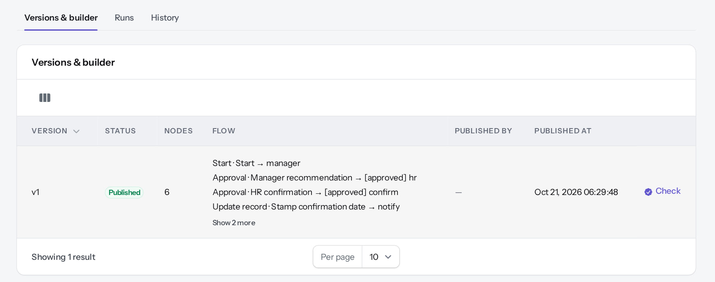
Versions as the administrator sees them
CONFIGURATION PLATFORM
Verified in the running application
RESULT Probation confirmation: v1 published, 6 nodes (manager recommendation, HR confirmation, record update, notification). A v2 would apply only to runs started after it is published (not exercised here).
Real screen (cropped) · Kavya Menon (Tenant HR Admin + Employee) · Workflow › Versions & builder
Notes:
SAY: Probation confirmation: v1 published, 6 nodes (manager recommendation, HR confirmation, record update, notification). A v2 would apply only to runs started after it is published (not exercised here).
ON SCREEN: Open Versions & builder.
LEARNERS SHOULD SEE: Versioned definitions: a published version is immutable; changes are made in a new draft and published; running instances keep their version
SCREEN: Workflow › Versions & builder. Signed in as Kavya Menon (Tenant HR Admin + Employee). Prerequisite: workflow.manage / policy.manage / notification.manage.
EVIDENCE: screenshot screenshots/client-onboarding/85-wf-03-workflow-versions.png, captured 2026-10-21 on the disposable training database (fictional people).

Slide 21
Audit and change history
05
Who changed what is recorded in append-only events chained per tenant.
Notes:
TRANSITION: Section 5, Audit and change history. Who changed what is recorded in append-only events chained per tenant.
SAY: Tell learners what they will be able to do by the end of this section, then move on.
ASK: "What questions do you have before we start this section?"

Slide 22
Audit events: append-only, chained, not purged
AUDIT
What is recorded
Tamper evidence
Tenant, actor and roles snapshot, action, module, entity, time, IP, user agent, source, request id, reason, approval reference, effective date and field-level before/after (masked when sensitive).
Each tenant has a hash chain; a verifier and export commands check it. Rows cannot be updated or deleted through the model layer.
Change history
Limits to know
Audit events per record (History tab) plus effective-dated rows make any past state reproducible.
Deletion of audit rows exists only inside the tenant-deletion executor, which is switched off. Retention of other data needs owner decisions (D8).
Notes:
SOURCE: architecture contract §9 (ADR-0008); ArchitectureTest "audits every domain model except the documented append-only or derived tables" and "deletes audit rows only in the deletion executor".
SAY: Audit events: append-only, chained, not purged.
- What is recorded: Tenant, actor and roles snapshot, action, module, entity, time, IP, user agent, source, request id, reason, approval reference, effective date and field-level before/after (masked when sensitive).
- Tamper evidence: Each tenant has a hash chain; a verifier and export commands check it. Rows cannot be updated or deleted through the model layer.
- Change history: Audit events per record (History tab) plus effective-dated rows make any past state reproducible.
- Limits to know: Deletion of audit rows exists only inside the tenant-deletion executor, which is switched off. Retention of other data needs owner decisions (D8).
ASK: "Which of these points needs more explanation for your team?"

Slide 23
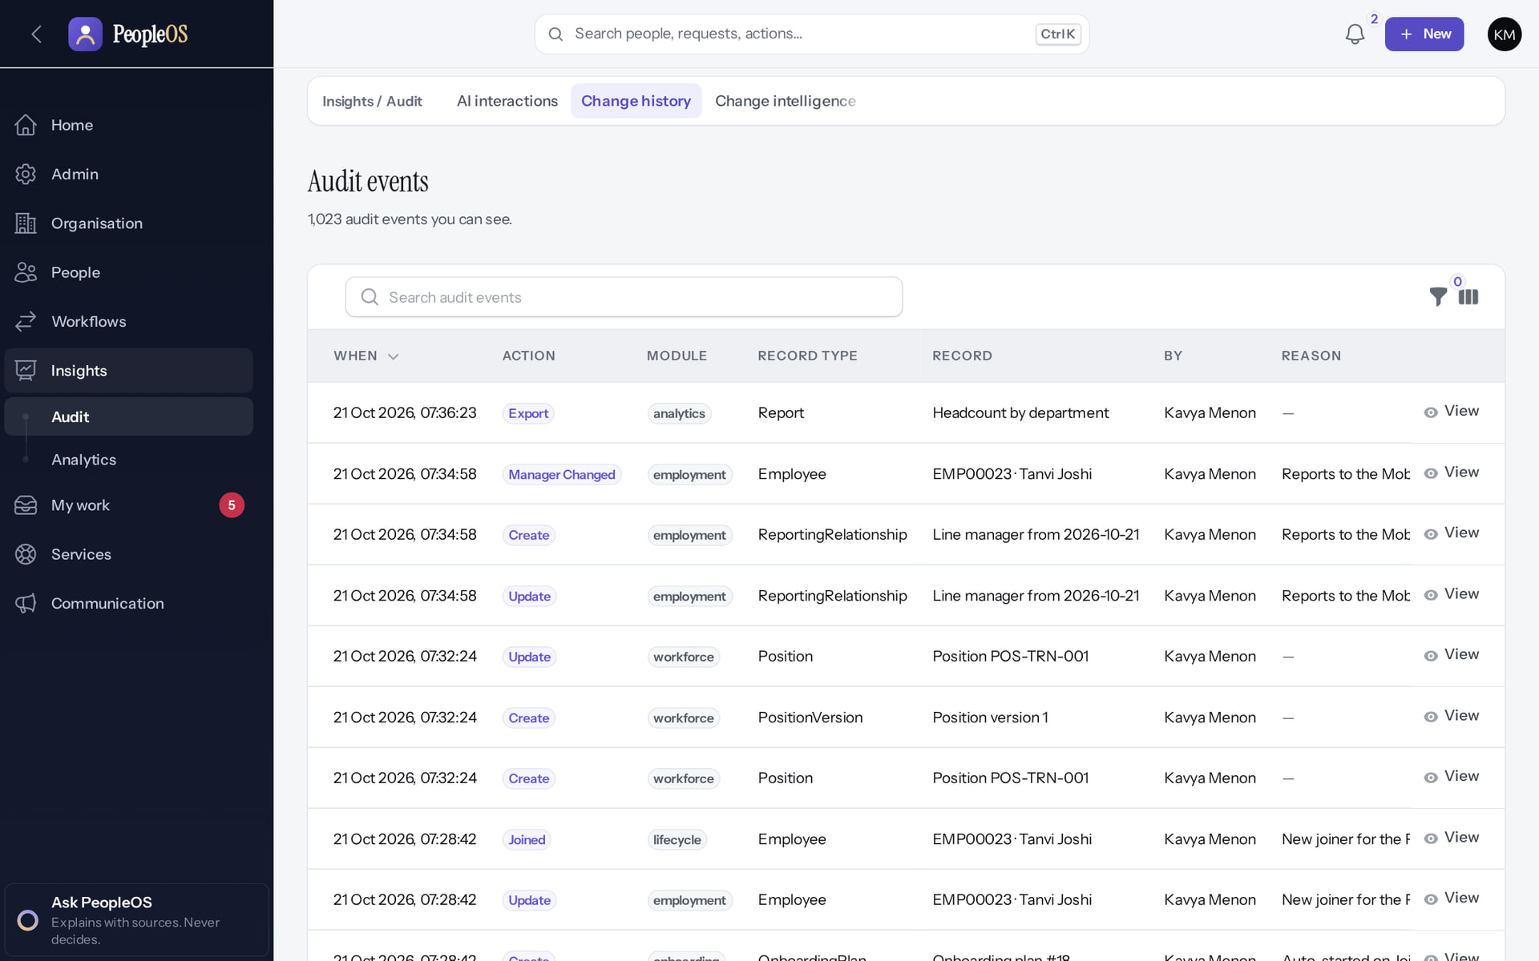
Change history in the application
AUDIT
Verified in the running application
1
When: every audited change with actor and time.
View an Update event for its field-level before and after.
1
RESULT Administrators and auditors read history; nobody edits it.
Real screen · Kavya Menon (Tenant HR Admin + Employee) · Insights › Audit › Change history (Audit events)
Notes:
SAY: Administrators and auditors read history; nobody edits it.
ON SCREEN: Open Change history.
WALK THROUGH: (1) When: every audited change with actor and time. (·) View an Update event for its field-level before and after.
LEARNERS SHOULD SEE: Every recorded change: when, action, module, record, who, reason; filter and open any event
SCREEN: Insights › Audit › Change history (Audit events). Signed in as Kavya Menon (Tenant HR Admin + Employee). Prerequisite: audit.view (Tenant HR Admin, HR Manager, Payroll Admin, Auditor, Account Owner).
EVIDENCE: screenshot screenshots/analytics/80-ins-10-change-history.png, captured 2026-10-21 on the disposable training database (fictional people).

Slide 24
The hash chain on one event
AUDIT
Verified in the running application
RESULT Who and where (actor, roles, source, IP, request id) and Integrity: Hash, Previous hash, "Hash verified ✓".
Real screen (cropped) · Kavya Menon (Tenant HR Admin + Employee) · Change history › event (Who and where, Integrity expanded)
Notes:
SAY: Who and where (actor, roles, source, IP, request id) and Integrity: Hash, Previous hash, "Hash verified ✓".
ON SCREEN: Expand Who and where and Integrity.
LEARNERS SHOULD SEE: Observed: Who and where (actor Kavya Menon, actor roles employee + tenant-hr-admin, source web, IP, user agent, request id) and Integrity (Hash, Previous hash, Hash verified ✓): each event is chained to the previous one
SCREEN: Change history › event (Who and where, Integrity expanded). Signed in as Kavya Menon (Tenant HR Admin + Employee). Prerequisite: audit.view.
EVIDENCE: screenshot screenshots/security-compliance/80-ins-11b-audit-integrity.png, captured 2026-10-21 on the disposable training database (fictional people).

Slide 25
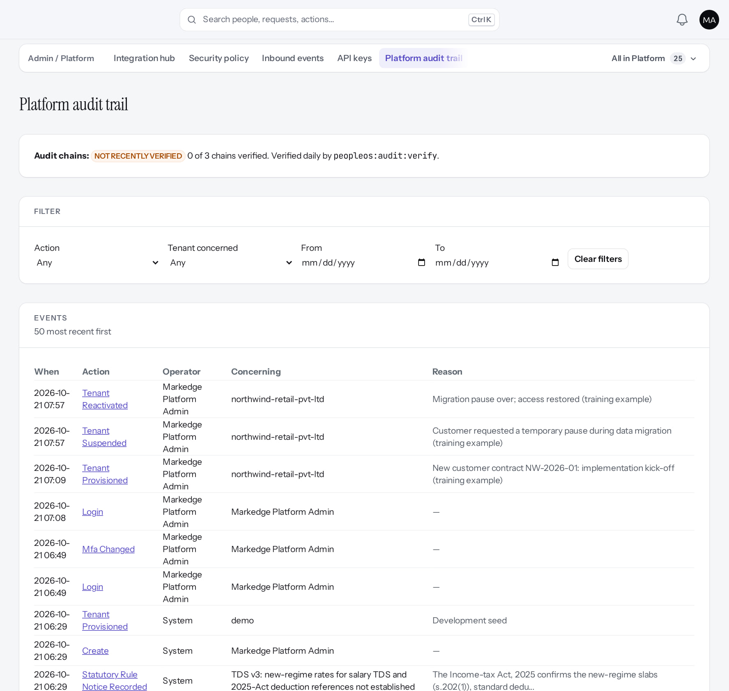
Platform audit trail
AUDIT
Verified in the running application
RESULT Operator actions are audited separately from tenants. The header shows "NOT RECENTLY VERIFIED: 0 of 3 chains verified": verification (peopleos:audit:verify) is scheduled, and no scheduler runs locally.
Real screen (cropped) · Markedge Platform Admin (Platform operator) · Admin › Platform › Platform audit trail
Notes:
SAY: Operator actions are audited separately from tenants. The header shows "NOT RECENTLY VERIFIED: 0 of 3 chains verified": verification (peopleos:audit:verify) is scheduled, and no scheduler runs locally.
ON SCREEN: Open the platform audit trail.
LEARNERS SHOULD SEE: Operator actions across tenants (tenant provisioned, suspended, reactivated, MFA changed, statutory rule events) with filters
SCREEN: Admin › Platform › Platform audit trail. Signed in as Markedge Platform Admin (Platform operator). Prerequisite: Platform operator (is_platform_admin) signed in with MFA.
EVIDENCE: screenshot screenshots/platform-admin/95-pl-22-platform-audit.png, captured 2026-10-21 on the disposable training database (fictional people).

Slide 26
Queues, scheduler and tenant context
06
Background work always runs inside one tenant.
Notes:
TRANSITION: Section 6, Queues, scheduler and tenant context. Background work always runs inside one tenant.
SAY: Tell learners what they will be able to do by the end of this section, then move on.
ASK: "What questions do you have before we start this section?"

Slide 27
Background work keeps its tenant
QUEUES AND SCHEDULER
TenantAwareJob
Scheduler
Every queued job touching tenant data captures the tenant at dispatch and binds it with BindTenantContext middleware. The architecture test enforces it for every ShouldQueue class.
routes/console.php; each entry withoutOverlapping()->onOneServer(); commands iterate tenants explicitly with runAs.
Failures
Operational prerequisite
Queued failures go to failed_jobs and the Platform › Operations page; integration failures become delivery or inbound-event states, never caller exceptions.
A queue worker and the scheduler must run in production. None runs in the local environment; hosting and on-call are blocked (gate 8).
Notes:
SOURCE: architecture contract §10 (ADR-0013); ArchitectureTest "makes every queued job tenant-aware"; release gate 8.
SAY: A control enforced in code still needs an operated environment.
SAY: Background work keeps its tenant.
- TenantAwareJob: Every queued job touching tenant data captures the tenant at dispatch and binds it with BindTenantContext middleware. The architecture test enforces it for every ShouldQueue class.
- Scheduler: routes/console.php; each entry withoutOverlapping()->onOneServer(); commands iterate tenants explicitly with runAs.
- Failures: Queued failures go to failed_jobs and the Platform › Operations page; integration failures become delivery or inbound-event states, never caller exceptions.
- Operational prerequisite: A queue worker and the scheduler must run in production. None runs in the local environment; hosting and on-call are blocked (gate 8).
ASK: "Which of these points needs more explanation for your team?"

Slide 28
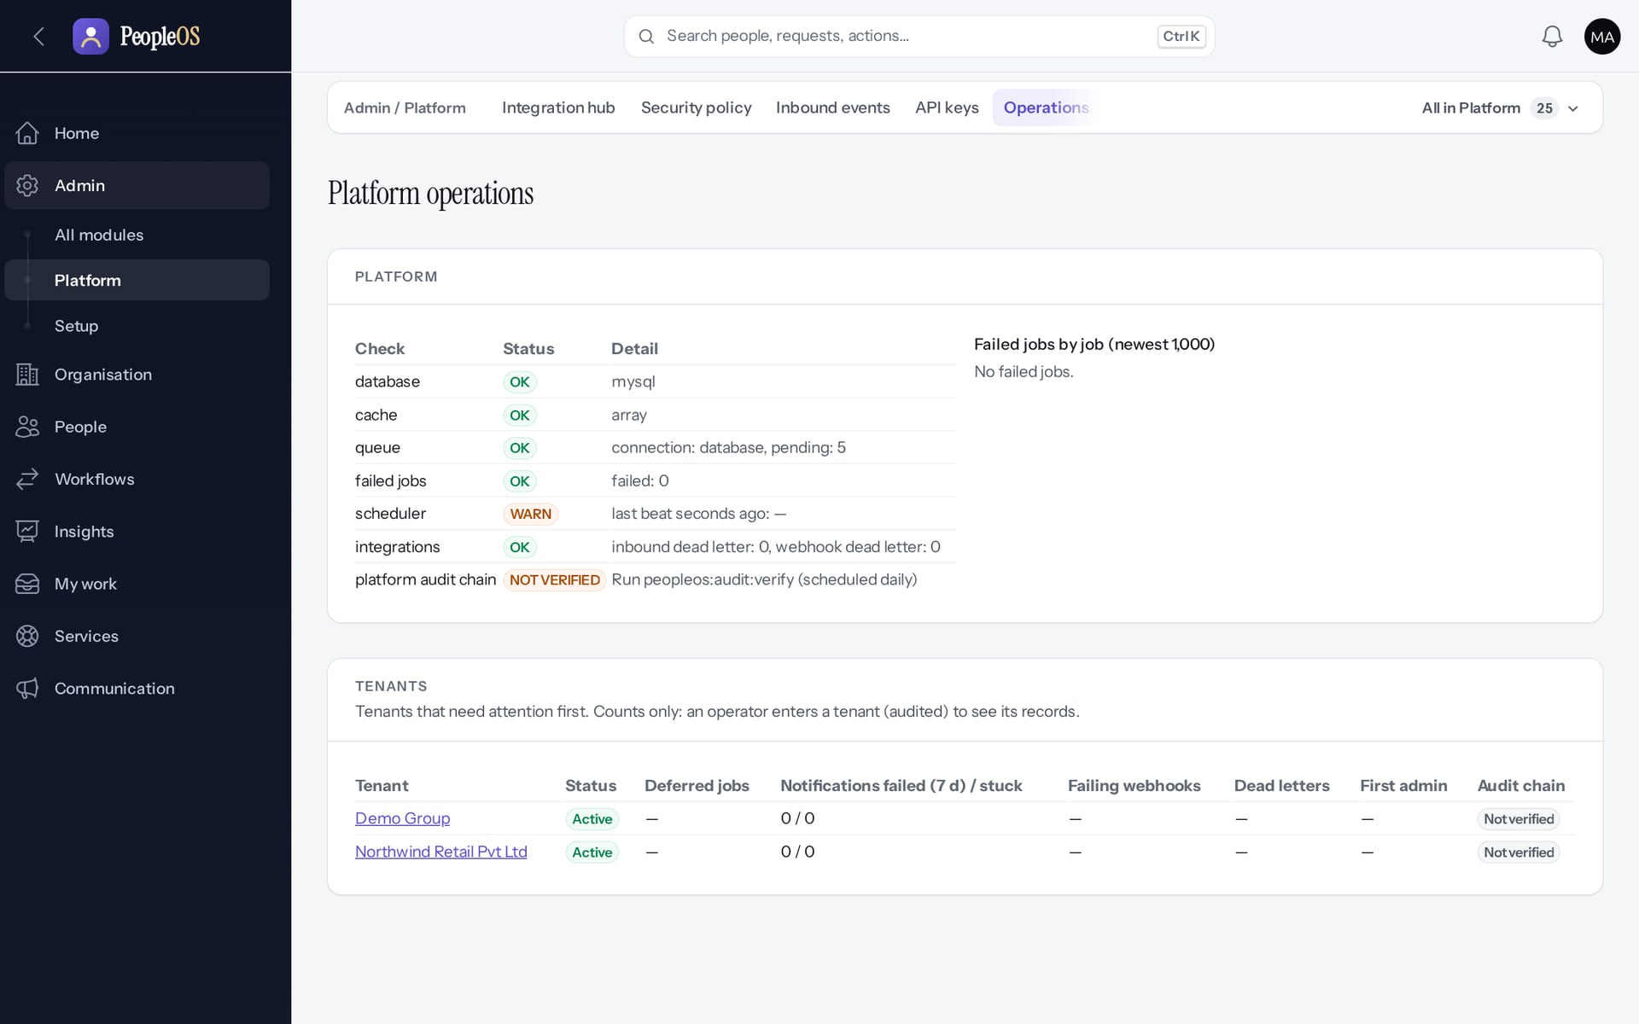
Where operators see queues and failures
QUEUES AND SCHEDULER
Verified in the running application
RESULT Database, cache, queue, failed jobs, integrations and the scheduler heartbeat (WARN here: no scheduler runs locally, release gate 8), with per-tenant status.
Real screen (cropped) · Markedge Platform Admin (Platform operator) · Admin › Platform › Operations
Notes:
SAY: Database, cache, queue, failed jobs, integrations and the scheduler heartbeat (WARN here: no scheduler runs locally, release gate 8), with per-tenant status.
ON SCREEN: Open Operations.
LEARNERS SHOULD SEE: Platform health, queue depth, failed jobs by job, scheduler heartbeat, per-tenant status
SCREEN: Admin › Platform › Operations. Signed in as Markedge Platform Admin (Platform operator). Prerequisite: Platform operator (is_platform_admin) signed in with MFA.
EVIDENCE: screenshot screenshots/platform-admin/95-pl-21-operations.png, captured 2026-10-21 on the disposable training database (fictional people).

Slide 29
Payroll and statutory safeguards
07
Statutory rules are data, verified by people; payroll refuses to finalise on unverified rules.
Notes:
TRANSITION: Section 7, Payroll and statutory safeguards. Statutory rules are data, verified by people; payroll refuses to finalise on unverified rules.
SAY: Tell learners what they will be able to do by the end of this section, then move on.
ASK: "What questions do you have before we start this section?"

Slide 30
Payroll cannot finalise on unverified rules
PAYROLL SAFEGUARDS
Rules are data
Verification
Statutory rates live in versioned compliance rules, never in PHP (architecture test). 23 India rules plus 1 UAE rule; 0 of 24 verified.
Two platform administrators verify a rule with official evidence. Until then, enforcement blocks finalisation and payslips.
No rules, no payroll
Separation of duties
A run in a jurisdiction without statutory rules is blocked (USA, UK and EU have no rules; owner decision O-18).
The approver of a run must differ from its creator; compensation changes need four different people; payroll consumes attendance and leave outputs, never their internals.
Notes:
SOURCE: ArchitectureTest "makes payroll consume attendance and leave outputs, never their internals, and keep statutory rates out of PHP"; docs/saas/SaaS-Final-Statutory-Verification-Register.md; FINAL programme commit 064c262.
SAY: Gratuity is not calculated (stored rule only; the settlement has no gratuity line).
SAY: Payroll cannot finalise on unverified rules.
- Rules are data: Statutory rates live in versioned compliance rules, never in PHP (architecture test). 23 India rules plus 1 UAE rule; 0 of 24 verified.
- Verification: Two platform administrators verify a rule with official evidence. Until then, enforcement blocks finalisation and payslips.
- No rules, no payroll: A run in a jurisdiction without statutory rules is blocked (USA, UK and EU have no rules; owner decision O-18).
- Separation of duties: The approver of a run must differ from its creator; compensation changes need four different people; payroll consumes attendance and leave outputs, never their internals.
ASK: "Which of these points needs more explanation for your team?"

Slide 31
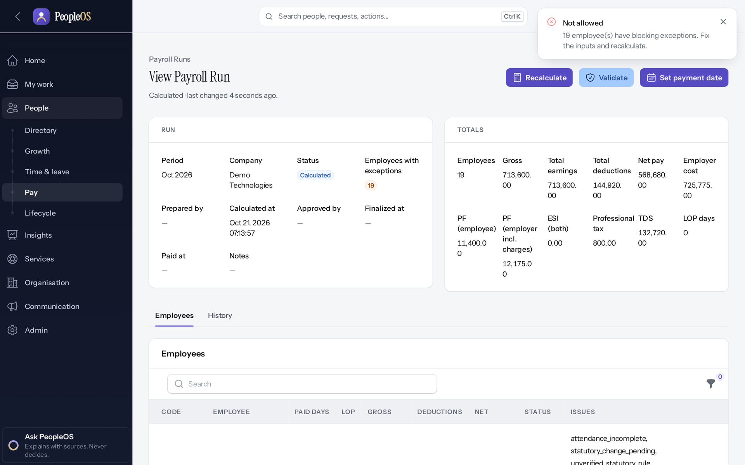
The safeguard as payroll staff see it
PAYROLL SAFEGUARDS
Disabled by safety or commercial gates
1
1
Blocking message.
RESULT Validate on the October run: "Not allowed: 19 employee(s) have blocking exceptions. Fix the inputs and recalculate." Approve and Finalize never appear. Nothing reaches a payslip on an unverified rate.
Real screen · Arjun Bose (Payroll Admin + Employee) · Payroll run › Validate
Notes:
SAY: Validate on the October run: "Not allowed: 19 employee(s) have blocking exceptions. Fix the inputs and recalculate." Approve and Finalize never appear. Nothing reaches a payslip on an unverified rate.
ON SCREEN: Validate (executed).
LEARNERS SHOULD SEE: Refused: "Not allowed — N employee(s) have blocking exceptions. Fix the inputs and recalculate." Approve and Finalize never appear while blocking exceptions remain
SCREEN: Payroll run › Validate. Signed in as Arjun Bose (Payroll Admin + Employee). Prerequisite: Statutory rules verified (0 of 24 today); PAN, bank account and attendance inputs complete.
EVIDENCE: screenshot screenshots/hr-admin/60-pay-09-validate-blocked.png, captured 2026-10-21 on the disposable training database (fictional people).

Slide 32
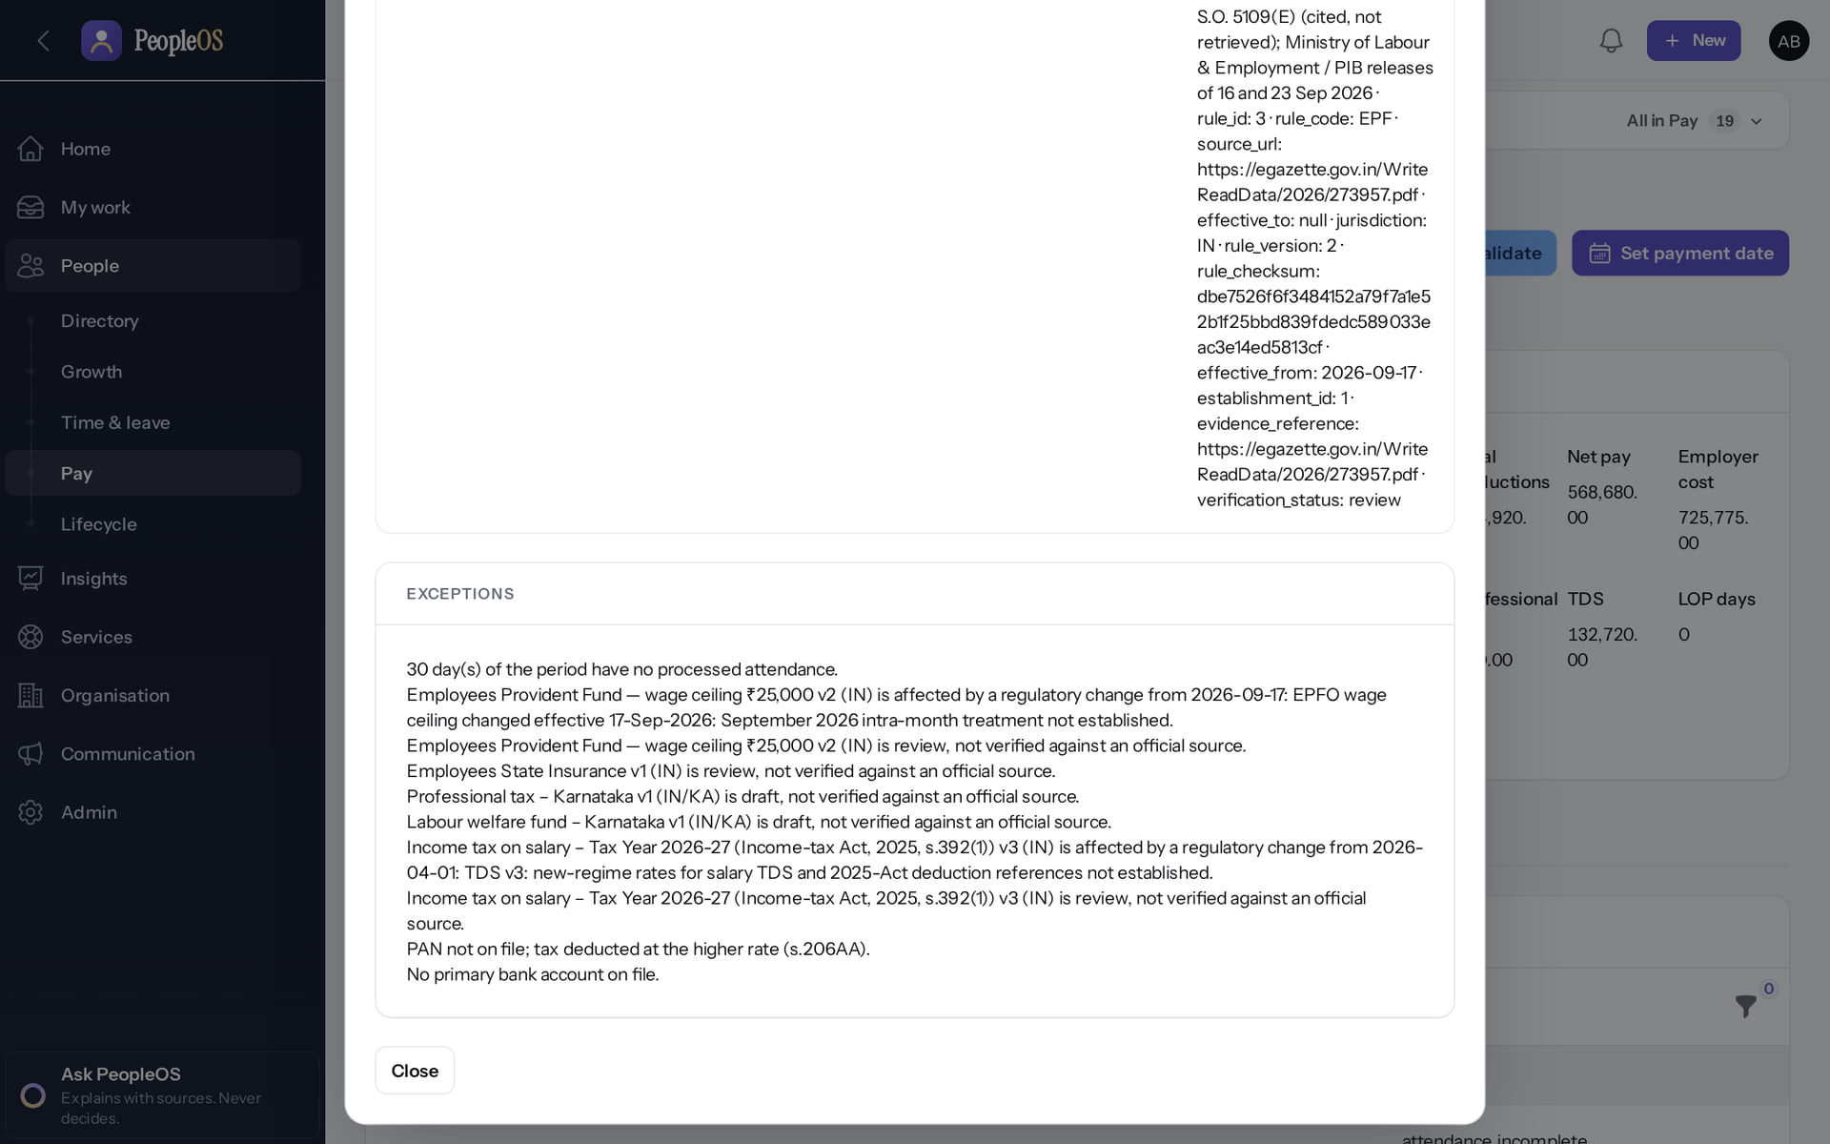
Why: statutory lines are exceptions
PAYROLL SAFEGUARDS
Verified in the running application
RESULT The breakdown shows statutory lines as exceptions because their rules are unverified.
Real screen · Arjun Bose (Payroll Admin + Employee) · Payroll run › Breakdown (dialog)
Notes:
SAY: The breakdown shows statutory lines as exceptions because their rules are unverified.
ON SCREEN: Breakdown on one employee.
LEARNERS SHOULD SEE: Breakdown dialog: each statutory line with its basis and source, then the list of exceptions (unverified rules, pending statutory change, PAN missing, no bank account)
SCREEN: Payroll run › Breakdown (dialog). Signed in as Arjun Bose (Payroll Admin + Employee). Prerequisite: Payroll Admin role (payroll.*); salary assigned to employees.
EVIDENCE: screenshot screenshots/hr-admin/60-pay-06-breakdown.png, captured 2026-10-21 on the disposable training database (fictional people).

Slide 33
Export, offboarding and deletion
08
A customer can leave with its data. Deletion exists in code and is switched off.
Notes:
TRANSITION: Section 8, Export, offboarding and deletion. A customer can leave with its data. Deletion exists in code and is switched off.
SAY: Tell learners what they will be able to do by the end of this section, then move on.
ASK: "What questions do you have before we start this section?"

Slide 34
Offboarding controls and their state
OFFBOARDING
Control | What it does | State today
Tenant data export | Encrypted, passphrase-protected package of the tenant's data, requested by the Account Owner or an operator (request dialog opened; not generated, because it shows a one-time passphrase) | Not verified end to end
Legal holds | Block deletion of a tenant while a hold is active (placed on the fictional Northwind tenant in this training) | Verified
Retention policies | Decide what may be deleted and when; none shipped (D8) | After configuration
Deletion | Maker-checker plan, cooling-off, register on a separate disk, certificate, reconciliation after restore | Disabled (gate)
Notes:
SOURCE: docs/architecture/saas-9-offboarding.md; SaaS.12 DeletionRegister and DeletionReconciliation; release gate 11.
EVIDENCE: platform-admin/95-pl-24 to 95-pl-28 (offboarding page, legal hold placed on Northwind, retention policies: none); security-compliance/85-sec-07-data-export-request (dialog only).
SAY: Offboarding controls and their state.
- Tenant data export | Encrypted, passphrase-protected package of the tenant's data, requested by the Account Owner or an operator (request dialog opened; not generated, because it shows a one-time passphrase) | Implemented · not verified end to end
- Legal holds | Block deletion of a tenant while a hold is active (placed on the fictional Northwind tenant in this training) | Verified in the running application
- Retention policies | Decide what may be deleted and when; none shipped (D8) | Available only after configuration
- Deletion | Maker-checker plan, cooling-off, register on a separate disk, certificate, reconciliation after restore | Disabled by safety or commercial gates

Slide 35
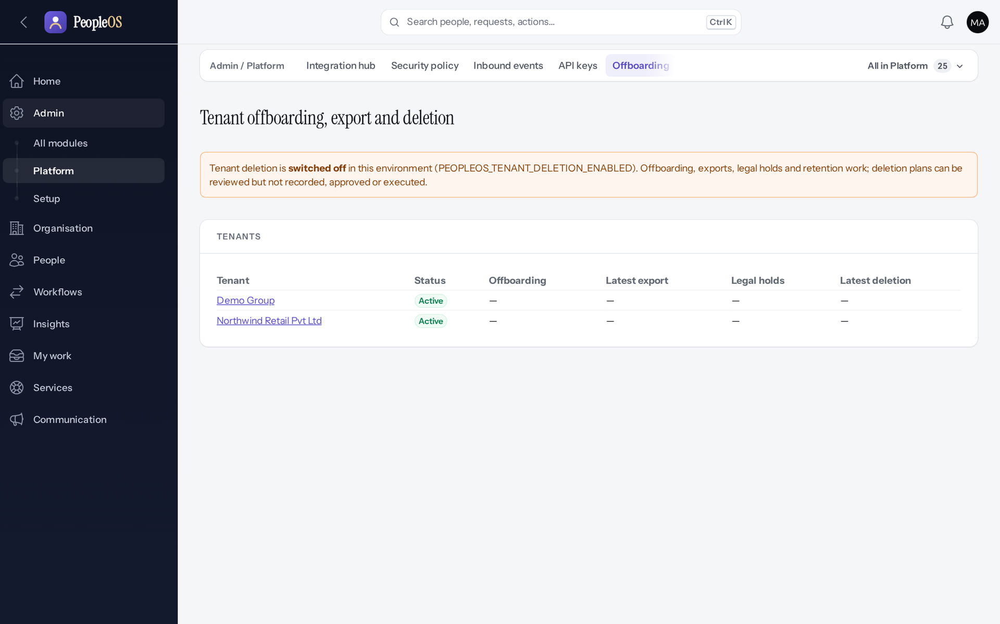
Offboarding page: deletion is switched off
OFFBOARDING
Disabled by safety or commercial gates
RESULT "Tenant deletion is switched off in this environment." Captured before the Northwind legal hold was placed (Deck 5 shows the hold).
Real screen · Markedge Platform Admin (Platform operator) · Admin › Platform › Offboarding
Notes:
SAY: "Tenant deletion is switched off in this environment." Captured before the Northwind legal hold was placed (Deck 5 shows the hold).
ON SCREEN: Open Offboarding.
LEARNERS SHOULD SEE: "Tenant deletion is switched off in this environment (PEOPLEOS_TENANT_DELETION_ENABLED)." Offboarding, exports, legal holds and retention work
SCREEN: Admin › Platform › Offboarding. Signed in as Markedge Platform Admin (Platform operator). Prerequisite: Platform operator (is_platform_admin) signed in with MFA.
EVIDENCE: screenshot screenshots/platform-admin/95-pl-24-offboarding.png, captured 2026-10-21 on the disposable training database (fictional people).

Slide 36
Integration boundaries
09
External systems connect through the Integration Hub; PeopleOS owns its keys and never depends on another product's database.
Notes:
TRANSITION: Section 9, Integration boundaries. External systems connect through the Integration Hub; PeopleOS owns its keys and never depends on another product's database.
SAY: Tell learners what they will be able to do by the end of this section, then move on.
ASK: "What questions do you have before we start this section?"

Slide 37
Integration channels
INTEGRATION HUB
Channel | Security and behaviour
REST API v1 | /api/v1, API key → tenant, JSON errors, pagination, 120/min rate limit, Idempotency-Key on writes; OpenAPI 3.1 in docs/api/openapi.json (131 operations)
SCIM 2.0 | User provisioning with an API key carrying SCIM scopes
Single sign-on | OIDC only (SAML not supported)
Outbound webhooks | HMAC-SHA256 over timestamp.body; delivery id for de-duplication; retries, dead letter and audited replay
Inbound events | Per-system secret and signature (±5 min), idempotency key, encrypted payload purged later, retry backoff, dead letter, audited reprocess
Known limit | API key scopes are not limited by the issuer's own permissions (F37, recommend review)
Notes:
SOURCE: docs/architecture/integration-contract.md; documentation-gaps F34, F37.
SAY: Integration channels.
- REST API v1 | /api/v1, API key → tenant, JSON errors, pagination, 120/min rate limit, Idempotency-Key on writes; OpenAPI 3.1 in docs/api/openapi.json (131 operations)
- SCIM 2.0 | User provisioning with an API key carrying SCIM scopes
- Single sign-on | OIDC only (SAML not supported)
- Outbound webhooks | HMAC-SHA256 over timestamp.body; delivery id for de-duplication; retries, dead letter and audited replay
- Inbound events | Per-system secret and signature (±5 min), idempotency key, encrypted payload purged later, retry backoff, dead letter, audited reprocess
- Known limit | API key scopes are not limited by the issuer's own permissions (F37, recommend review)

Slide 38
Recruitment systems stay outside
INTEGRATION HUB
External ATS / RMS
its own database
Integration Hub
auth · validate · map · idempotency · audit
PeopleOS
pre-employee with external references
Conceptual diagram, not a screenshot
PeopleOS is a standalone HCM product with no recruitment module. A future RecruitmentEdge (RMS) or any ATS would hand over a selected candidate through POST /api/v1/pre-employees (idempotent on the offer's external reference) or inbound events, mapped by external identifiers. No RMS database, table, model or primary key may enter PeopleOS: the architecture test "never acquires a hard RecruitmentEdge / RMS dependency" enforces it.
Notes:
SOURCE: integration-contract.md §5 (future recruitment boundary); ArchitectureTest line "never acquires a hard RecruitmentEdge / RMS dependency (contract §3)".
AVOID: describing recruitment features as part of PeopleOS. There is no shared database.
SAY: Recruitment systems stay outside. PeopleOS is a standalone HCM product with no recruitment module. A future RecruitmentEdge (RMS) or any ATS would hand over a selected candidate through POST /api/v1/pre-employees (idempotent on the offer's external reference) or inbound events, mapped by external identifiers. No RMS database, table, model or primary key may enter PeopleOS: the architecture test "never acquires a hard RecruitmentEdge / RMS dependency" enforces it.
SEQUENCE: External ATS / RMS (its own database) → Integration Hub (auth · validate · map · idempotency · audit) → PeopleOS (pre-employee with external references)
LABEL: conceptual diagram, not a screenshot.

Slide 39
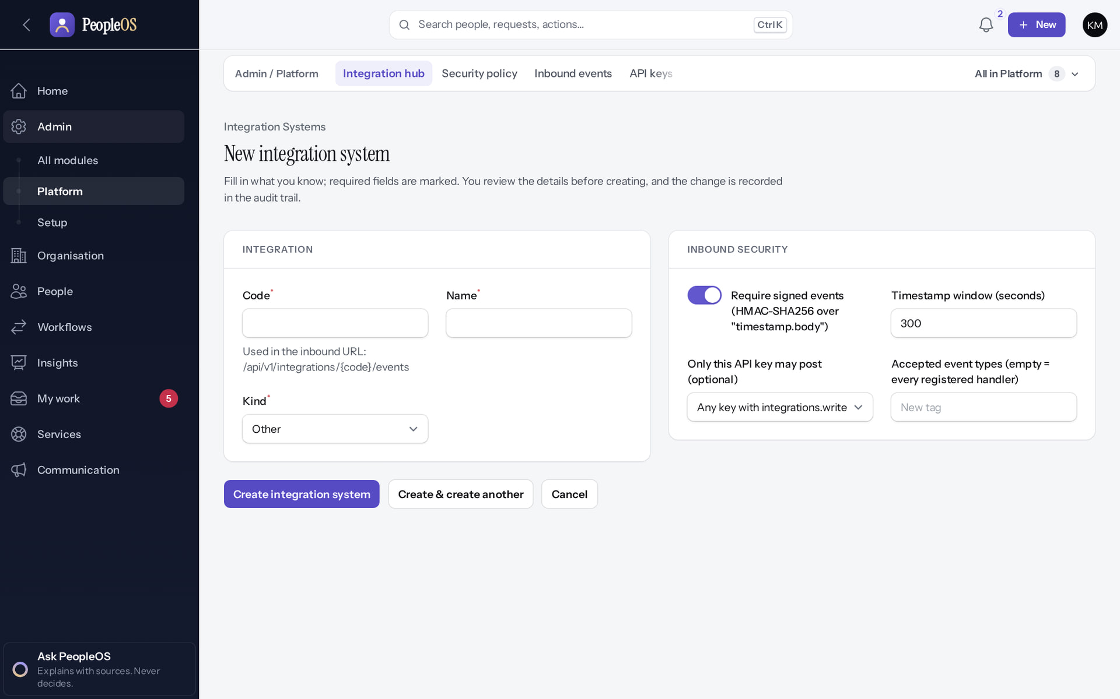
Integration hub in the application
INTEGRATION HUB
Verified in the running application
RESULT New integration system: identifiers and the inbound security settings (signed events, timestamp window). Inbound events are listed on their own page with their processing state. Opened, not saved.
Real screen · Kavya Menon (Tenant HR Admin + Employee) · Admin › Platform › Integration hub › New
Notes:
SAY: New integration system: identifiers and the inbound security settings (signed events, timestamp window). Inbound events are listed on their own page with their processing state. Opened, not saved.
ON SCREEN: Open the New integration system form (not saved).
LEARNERS SHOULD SEE: External systems are registered here with their identifiers and mappings; the Integration Hub is the only boundary to other products
SCREEN: Admin › Platform › Integration hub › New. Signed in as Kavya Menon (Tenant HR Admin + Employee). Prerequisite: Tenant HR Admin / Account Owner (security policy); Tenant HR Admin (SSO, API keys, webhooks, integration hub).
EVIDENCE: screenshot screenshots/security-compliance/85-sec-05-integration-hub-form.png, captured 2026-10-21 on the disposable training database (fictional people).

Slide 40
Analytics and AI boundary
10
Reports run on the same scoped queries as the screens. Assistants explain; they never decide or write.
Notes:
TRANSITION: Section 10, Analytics and AI boundary. Reports run on the same scoped queries as the screens. Assistants explain; they never decide or write.
SAY: Tell learners what they will be able to do by the end of this section, then move on.
ASK: "What questions do you have before we start this section?"

Slide 41
AI requests pass every access layer first
ANALYTICS AND AI
User
signed in
Permission
per assistant
Scope
queries run as the user
Field security
identifiers redacted
Model
off by default
Conceptual diagram, not a screenshot
Datasets query through the same scoped models as the UI; sensitive fields need the dataset's sensitive permission; every export is audited. Assistants never write; answers are logged with their sources; payroll and statutory rules are deterministic. The external language model (feature ai.llm) is off by default and no provider is configured, so answers are rule-based with sources.
Notes:
SOURCE: architecture contract §12 (ADR-0015) and §13; implementation-status 5.8.
SAY: The "AI Payroll Auditor" is rule-based despite its label.
SAY: AI requests pass every access layer first. Datasets query through the same scoped models as the UI; sensitive fields need the dataset's sensitive permission; every export is audited. Assistants never write; answers are logged with their sources; payroll and statutory rules are deterministic. The external language model (feature ai.llm) is off by default and no provider is configured, so answers are rule-based with sources.
SEQUENCE: User (signed in) → Permission (per assistant) → Scope (queries run as the user) → Field security (identifiers redacted) → Model (off by default)
LABEL: conceptual diagram, not a screenshot.

Slide 42
Blueprint versus what is built
HONEST SCOPE
Blueprint item | State | Evidence
Native mobile app | Not implemented | Responsive web only
SMS, WhatsApp, push notifications | Incomplete | Offered as channels; send nothing (F19)
Biometric, ERP, banking connectors | Not implemented | Generic device push (Generic JSON, eSSL) only; bank file from payroll
SAML single sign-on | Not implemented | OIDC only (F34)
Employee import from the screen | Incomplete | Map columns fails (F25)
Gratuity calculation | Not implemented | Stored rule only; no settlement line
Dedicated databases per tier | Not implemented | Tier and region are metadata; routing deferred
Notes:
SOURCE: implementation-status.md, documentation-gaps.md, architecture contract §1 (deferred connection routing).
SAY: Blueprint versus what is built.
- Native mobile app | Not implemented | Responsive web only
- SMS, WhatsApp, push notifications | Incomplete · known defect or gap | Offered as channels; send nothing (F19)
- Biometric, ERP, banking connectors | Not implemented | Generic device push (Generic JSON, eSSL) only; bank file from payroll
- SAML single sign-on | Not implemented | OIDC only (F34)
- Employee import from the screen | Incomplete · known defect or gap | Map columns fails (F25)
- Gratuity calculation | Not implemented | Stored rule only; no settlement line
- Dedicated databases per tier | Not implemented | Tier and region are metadata; routing deferred

Slide 43
Summary
Five layers; business rules in app/Domain, screens are delivery only.
Tenant scoping fails closed; access is layered: role, organisation scope, relationship scope, field protection.
Facts that change over time are effective-dated; audit events are append-only and chained.
Workflows and policies are versioned data; running work keeps its version.
Payroll refuses unverified statutory rules; deletion is off; integrations never share a database.
NEXT STEPS & HELP
Read docs/architecture/peopleos-architecture-contract.md
Run php artisan test --filter=Architecture
Deck 8 shows the controls on screen
Release gate: docs/saas/SaaS-Final-Release-Gate.md
Release gate: NO-GO (10 of 14 gates blocked, re-verified 13 Oct 2026). Not yet generally available.
Notes:
SAY: Controls in code are necessary but not sufficient: hosting, review, DR and statutory verification are still open.
SAY: Recap the key points:
- Five layers; business rules in app/Domain, screens are delivery only.
- Tenant scoping fails closed; access is layered: role, organisation scope, relationship scope, field protection.
- Facts that change over time are effective-dated; audit events are append-only and chained.
- Workflows and policies are versioned data; running work keeps its version.
- Payroll refuses unverified statutory rules; deletion is off; integrations never share a database.
POINT TO: Read docs/architecture/peopleos-architecture-contract.md; Run php artisan test --filter=Architecture; Deck 8 shows the controls on screen; Release gate: docs/saas/SaaS-Final-Release-Gate.md
ASK: "What will you do first in PeopleOS?" Collect questions you cannot answer and send them to the PeopleOS team.

