Slide 1
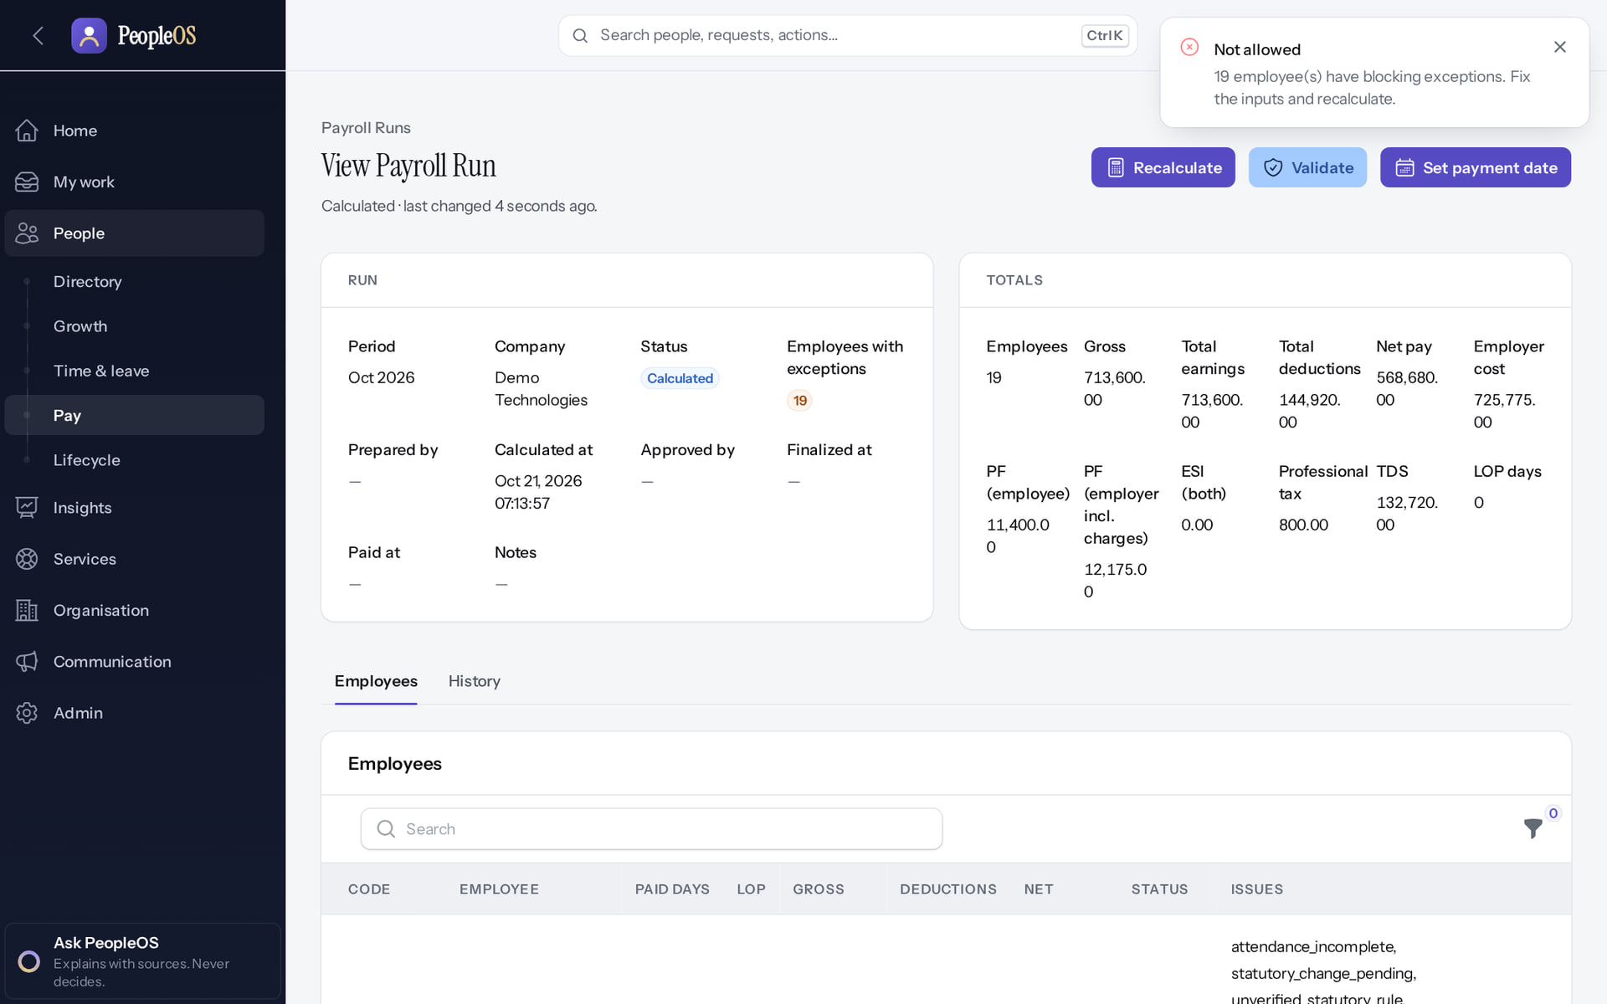
Implementation, UAT and Go-Live Checklist
MARKEDGE PEOPLEOS · TRAINING LIBRARY
Deck 11 of 12
Prepare the environment and data, test every role and process with evidence, manage defects, decide go-live, and know how to roll back.
For: Customer UAT lead and testers, Markedge implementation team, release decision makers
Built from the running application (local, disposable database, fictional people) · 21 October 2026
Real screen, fictional data
Notes:
SAY: UAT proves the customer's processes work in PeopleOS with their configuration. A test only passes when the customer executes it and sees the expected result.
RESOURCE: supporting/PeopleOS-UAT-Test-Cases.xlsx.

Slide 2
How to read this deck
BEFORE YOU START
Verified in the running application
We ran it on the training database and captured each step.
1
Numbered markers on a screenshot match the numbered steps beside it.
Implemented · not verified end to end
The screen exists; the last steps need data or a second party we could not provide.
Every screenshot is a real capture of PeopleOS. The people and companies in it are fictional.
Available only after configuration
Works once an administrator or Markedge has set it up.
Disabled by safety or commercial gates
Switched off on purpose until owner decisions and approvals arrive.
Diagrams are marked "Conceptual diagram". They explain ideas; they are not screens.
Incomplete · known defect or gap
Partly working: a known defect or gap is stated on the slide.
Release gate: NO-GO (10 of 14 gates blocked, re-verified 13 Oct 2026). Not yet generally available.
Not implemented
Not in the product today.
Unable to verify
Could not be checked in this environment.
Notes:
Explain the seven status labels. Every screenshot slide carries one of them in its top-right corner. Stress that "Verified in the running application" means we ran it on a disposable demonstration database, not that the feature is released.

Slide 3
Release gate: NO-GO until these are resolved (1 of 2)
RELEASE STATUS
Status as written in the release gate document. Ten of fourteen gates are blocked by owner decisions, external parties or missing infrastructure.
# | Gate | Gate status | Remaining dependency
1 | Application and architecture integrity | PASS (workstation) | Repeat the full suites in staging
2 | Credential exposure and repository remediation | BLOCKED | Owner: rotation confirmation, repository visibility (O-1 to O-3)
3 | Authentication and operator MFA | BLOCKED | Operators enrol MFA in the target environment (O-14, O-7)
4 | Independent security review | BLOCKED | Engage a reviewer; triage and retest findings (O-4)
5 | Statutory verification and gratuity | BLOCKED | 0 of 24 rules verified; gratuity not implemented (O-5, O-12, O-18)
6 | Data protection, retention, legal holds | PASS (controls) / BLOCKED (policy) | Retention decisions with counsel (D8); privacy review
7 | Backup, restore and disaster recovery | BLOCKED | Recovery objectives and an isolated target (O-6, O-7)
Notes:
SOURCE: docs/saas/SaaS-Final-Release-Gate.md (decision NO-GO, re-verified 13 October 2026 at 7314f7d); owner actions in docs/saas/SaaS-Final-Owner-Action-Register.md.
SAY: The application passes its automated suites on the workstation, but release is blocked by decisions and infrastructure, not by code alone.
AVOID: describing any gate as resolved. Nothing in this training changes a gate.
SAY: Release gate: NO-GO until these are resolved (part 1 of 2). Status as written in the release gate document. Ten of fourteen gates are blocked by owner decisions, external parties or missing infrastructure.
- 1 | Application and architecture integrity | PASS (workstation) | Repeat the full suites in staging
- 2 | Credential exposure and repository remediation | BLOCKED | Owner: rotation confirmation, repository visibility (O-1 to O-3)
- 3 | Authentication and operator MFA | BLOCKED | Operators enrol MFA in the target environment (O-14, O-7)
- 4 | Independent security review | BLOCKED | Engage a reviewer; triage and retest findings (O-4)
- 5 | Statutory verification and gratuity | BLOCKED | 0 of 24 rules verified; gratuity not implemented (O-5, O-12, O-18)
- 6 | Data protection, retention, legal holds | PASS (controls) / BLOCKED (policy) | Retention decisions with counsel (D8); privacy review
- 7 | Backup, restore and disaster recovery | BLOCKED | Recovery objectives and an isolated target (O-6, O-7)

Slide 4
Release gate: NO-GO until these are resolved (2 of 2)
RELEASE STATUS
# | Gate | Gate status | Remaining dependency
8 | Hosting, monitoring and on-call | BLOCKED | Environment, alerting, on-call (O-7, O-10, O-11)
9 | Signup and tenant provisioning | PASS (disabled) / BLOCKED (activation) | Only if self-service signup is wanted at launch (D10)
10 | Billing, tax and payment controls | PASS (disabled) / BLOCKED (activation) | Only for paid billing (B-4, B-7, B-8, B-9)
11 | Tenant deletion and offboarding | PASS (disabled) / BLOCKED (activation) | Retention decisions, register disk, review (D8)
12 | Regression and target-environment testing | BLOCKED | A staging environment (O-7, O-8)
13 | Owner decisions and written approvals | BLOCKED | All owner action items
14 | Deployment, rollback, post-deployment checks | BLOCKED | Rehearse in staging; authorise (O-7 to O-9)
Notes:
SOURCE: docs/saas/SaaS-Final-Release-Gate.md (decision NO-GO, re-verified 13 October 2026 at 7314f7d); owner actions in docs/saas/SaaS-Final-Owner-Action-Register.md.
SAY: The application passes its automated suites on the workstation, but release is blocked by decisions and infrastructure, not by code alone.
AVOID: describing any gate as resolved. Nothing in this training changes a gate.
SAY: Release gate: NO-GO until these are resolved (part 2 of 2). Status as written in the release gate document. Ten of fourteen gates are blocked by owner decisions, external parties or missing infrastructure.
- 8 | Hosting, monitoring and on-call | BLOCKED | Environment, alerting, on-call (O-7, O-10, O-11)
- 9 | Signup and tenant provisioning | PASS (disabled) / BLOCKED (activation) | Only if self-service signup is wanted at launch (D10)
- 10 | Billing, tax and payment controls | PASS (disabled) / BLOCKED (activation) | Only for paid billing (B-4, B-7, B-8, B-9)
- 11 | Tenant deletion and offboarding | PASS (disabled) / BLOCKED (activation) | Retention decisions, register disk, review (D8)
- 12 | Regression and target-environment testing | BLOCKED | A staging environment (O-7, O-8)
- 13 | Owner decisions and written approvals | BLOCKED | All owner action items
- 14 | Deployment, rollback, post-deployment checks | BLOCKED | Rehearse in staging; authorise (O-7 to O-9)

Slide 5
How these screens were produced
ABOUT THIS TRAINING
Real application
Disposable database
PeopleOS at commit 72c96a73, run locally. No application file or setting was changed for the training.
hcm_training_showcase, seeded with the guarded showcase seeder: invented people at the fictional Demo Group.
Workflows executed
Nothing switched on
Requests were submitted, approved, rejected and processed so that every state shown really happened.
Public signup, live payments and tenant deletion stayed off. The operator used MFA. No secret is shown.
Notes:
SAY: Every screenshot is a genuine capture from the running application on a disposable database. The full list, with what each one shows, is in SCREENSHOT-INVENTORY.md.
EVIDENCE: docs/presentations/peopleos/SCREENSHOT-INVENTORY.md and PEOPLEOS-PRESENTATION-ACCURACY-REGISTER.md.
SAY: How these screens were produced.
- Real application: PeopleOS at commit 72c96a73, run locally. No application file or setting was changed for the training.
- Disposable database: hcm_training_showcase, seeded with the guarded showcase seeder: invented people at the fictional Demo Group.
- Workflows executed: Requests were submitted, approved, rejected and processed so that every state shown really happened.
- Nothing switched on: Public signup, live payments and tenant deletion stayed off. The operator used MFA. No secret is shown.
ASK: "Which of these points needs more explanation for your team?"

Slide 6
What you will be able to do
LEARNING OBJECTIVES
Prepare a UAT environment
separate tenant, synthetic data, test accounts per role
Manage defects
log, triage, retest; know the existing ones
1
4
Run test cases with evidence
actual result, screenshot, pass/fail, defect reference
Apply go-live criteria
and the release gate that overrides them
2
5
Test roles, lifecycle, time, pay, approvals, audit, integrations
with the reference runs as a guide
Plan rollback and post-go-live checks
from the deployment runbook
3
6
Notes:
SAY: What you will be able to do:
1. Prepare a UAT environment: separate tenant, synthetic data, test accounts per role
2. Run test cases with evidence: actual result, screenshot, pass/fail, defect reference
3. Test roles, lifecycle, time, pay, approvals, audit, integrations: with the reference runs as a guide
4. Manage defects: log, triage, retest; know the existing ones
5. Apply go-live criteria: and the release gate that overrides them
6. Plan rollback and post-go-live checks: from the deployment runbook
ASK: "Which of these matters most to you?" Return to the answer in the summary.

Slide 7
Prepare
01
Environment, data and configuration readiness.
Notes:
TRANSITION: Section 1, Prepare. Environment, data and configuration readiness.
SAY: Tell learners what they will be able to do by the end of this section, then move on.
ASK: "What questions do you have before we start this section?"

Slide 8
Environment prerequisites
PREPARE
Prerequisite | Why | Who
A UAT tenant separate from the production tenant | Tests change data (approvals, hires, exits) | Markedge operator
Mail delivery to monitored mailboxes | Invitations, resets and notifications | Markedge operations
Queue worker and scheduler running | Exports, notifications, scheduled reports, accruals, audit verification | Markedge operations
One test account per role (employee, manager, HR, payroll, admin, executive) | Access must be tested as each role | Customer administrator
MFA policy decided and applied | Sign-in tests must match production | Customer administrator
Synthetic or masked data only | No real identifiers in a shared environment | Customer data owner
Known-defect list shared | Testers recognise F25, F38, F44, F17 | Markedge support
Notes:
SAY: Environment prerequisites.
- A UAT tenant separate from the production tenant | Tests change data (approvals, hires, exits) | Markedge operator
- Mail delivery to monitored mailboxes | Invitations, resets and notifications | Markedge operations
- Queue worker and scheduler running | Exports, notifications, scheduled reports, accruals, audit verification | Markedge operations
- One test account per role (employee, manager, HR, payroll, admin, executive) | Access must be tested as each role | Customer administrator
- MFA policy decided and applied | Sign-in tests must match production | Customer administrator
- Synthetic or masked data only | No real identifiers in a shared environment | Customer data owner
- Known-defect list shared | Testers recognise F25, F38, F44, F17 | Markedge support

Slide 9
Data and configuration readiness
PREPARE
Structure complete
People loaded once
Policies published
Companies, legal entities, establishments, locations, units and job architecture match the signed design (Deck 4, stages 4–8).
Hire wizard (imports blocked by F25); managers joined before their reports; no duplicates.
Leave policy versions, shifts, schedules, holiday calendars, salary components and structures.
Access configured
Reconciled
Payroll scope agreed
Roles, HR scope, MFA; Tenant Super Admin holders listed.
Headcount by company and department matches the source file; zero unexplained differences.
In writing: payroll statutory processing in or out while rules are unverified.
Notes:
SAY: Data and configuration readiness.
- Structure complete: Companies, legal entities, establishments, locations, units and job architecture match the signed design (Deck 4, stages 4–8).
- People loaded once: Hire wizard (imports blocked by F25); managers joined before their reports; no duplicates.
- Policies published: Leave policy versions, shifts, schedules, holiday calendars, salary components and structures.
- Access configured: Roles, HR scope, MFA; Tenant Super Admin holders listed.
- Reconciled: Headcount by company and department matches the source file; zero unexplained differences.
- Payroll scope agreed: In writing: payroll statutory processing in or out while rules are unverified.
ASK: "Which of these points needs more explanation for your team?"

Slide 10
Test
02
Each case: role, preconditions, steps, expected result, actual result, evidence, pass/fail, defect, sign-off.
Notes:
TRANSITION: Section 2, Test. Each case: role, preconditions, steps, expected result, actual result, evidence, pass/fail, defect, sign-off.
SAY: Tell learners what they will be able to do by the end of this section, then move on.
ASK: "What questions do you have before we start this section?"

Slide 11
Anatomy of a test case
TEST
Field | What to record
Test ID, module, role | e.g. UAT-LV-04 · Leave · Manager
Preconditions | What must exist first (a pending request, a second HR user…)
Steps | Numbered actions with the real menu path
Expected result | What the screen should show
Reference run | What Markedge observed in the training environment: guidance only, never a customer pass
Actual result · evidence | What the tester saw, with a screenshot per changing step
Pass/Fail · defect · sign-off | Pass only when executed and matching; otherwise a defect reference
Notes:
SAY: Never mark a case Pass from the reference column. The workbook leaves Pass/Fail blank on purpose.
SAY: Anatomy of a test case.
- Test ID, module, role | e.g. UAT-LV-04 · Leave · Manager
- Preconditions | What must exist first (a pending request, a second HR user…)
- Steps | Numbered actions with the real menu path
- Expected result | What the screen should show
- Reference run | What Markedge observed in the training environment: guidance only, never a customer pass
- Actual result · evidence | What the tester saw, with a screenshot per changing step
- Pass/Fail · defect · sign-off | Pass only when executed and matching; otherwise a defect reference

Slide 12
Test cases: time and leave (1 of 2)
TEST CASES
ID | Role | Expected result | Reference run (training env)
UAT-LV-01 | Employee | Preview shows working days and the balance after; "Leave requested: N day(s)"; request listed as pending with Cancel available | Executed: matched expected
UAT-LV-02 | Employee | Request refused with the policy reason; nothing is created | Executed: matched expected
UAT-LV-03 | Employee | Submission stopped at the first empty required field | Executed: matched expected
UAT-LV-04 | Manager | "Leave approved"; item leaves the queue; employee sees Approved and Reviewed by the manager; balance Used increases | Executed: matched expected
UAT-LV-05 | Manager | Rejection without a reason is stopped; with a reason it is recorded | Executed: matched expected
UAT-AT-01 | Employee | "Checked in"; Your day shows the time and offers Check out | Executed: matched expected
UAT-AT-02 | Employee → Manager | Correction pending → approved; day reprocessed with the corrected times | Executed: matched expected
Notes:
Full steps, preconditions and reference observations are in supporting/PeopleOS-UAT-Test-Cases.xlsx. "Executed: known defect" means the step was run and a documented defect appeared.
SAY: Test cases: time and leave (part 1 of 2).
- UAT-LV-01 | Employee | Preview shows working days and the balance after; "Leave requested: N day(s)"; request listed as pending with Cancel available | Executed: matched expected
- UAT-LV-02 | Employee | Request refused with the policy reason; nothing is created | Executed: matched expected
- UAT-LV-03 | Employee | Submission stopped at the first empty required field | Executed: matched expected
- UAT-LV-04 | Manager | "Leave approved"; item leaves the queue; employee sees Approved and Reviewed by the manager; balance Used increases | Executed: matched expected
- UAT-LV-05 | Manager | Rejection without a reason is stopped; with a reason it is recorded | Executed: matched expected
- UAT-AT-01 | Employee | "Checked in"; Your day shows the time and offers Check out | Executed: matched expected
- UAT-AT-02 | Employee → Manager | Correction pending → approved; day reprocessed with the corrected times | Executed: matched expected

Slide 13
Test cases: time and leave (2 of 2)
TEST CASES
ID | Role | Expected result | Reference run (training env)
UAT-AT-03 | Tenant HR Admin | Punch recorded with source manual; day processed for all employees; exceptions listed | Executed: matched expected
UAT-LV-06 | Tenant HR Admin | HR can apply leave for an employee | Executed: known defect
UAT-LV-07 | Tenant HR Admin | Adjusted and Available updated; ledger entry with the note | Executed: matched expected
Notes:
Full steps, preconditions and reference observations are in supporting/PeopleOS-UAT-Test-Cases.xlsx. "Executed: known defect" means the step was run and a documented defect appeared.
SAY: Test cases: time and leave (part 2 of 2).
- UAT-AT-03 | Tenant HR Admin | Punch recorded with source manual; day processed for all employees; exceptions listed | Executed: matched expected
- UAT-LV-06 | Tenant HR Admin | HR can apply leave for an employee | Executed: known defect
- UAT-LV-07 | Tenant HR Admin | Adjusted and Available updated; ledger entry with the note | Executed: matched expected

Slide 14
Test cases: set-up and people
TEST CASES
ID | Role | Expected result | Reference run (training env)
UAT-PR-01 | Platform operator | Tenant created and first administrator invited; duplicate slug and e-mail refused | Executed: matched expected
UAT-PR-02 | Customer administrator | Short password refused; activation succeeds; the link cannot be reused | Executed: matched expected
UAT-ORG-01 | Customer administrator | Structure visible in the designer tree, chart and org map | Executed: matched expected
UAT-HR-01 | Tenant HR Admin | Duplicate refused; new Employee 360 created with onboarding started | Executed: matched expected
UAT-HR-02 | Tenant HR Admin | Reporting line changed from the date; previous line kept in history | Executed: matched expected
UAT-HR-03 | Tenant HR Admin + HR Manager | A cannot verify own upload; B verifies; status Verified with verifier | Executed: known defect
UAT-HR-04 | Tenant HR Admin | Task done with who and when; progress increases | Executed: matched expected
Notes:
Full steps, preconditions and reference observations are in supporting/PeopleOS-UAT-Test-Cases.xlsx. "Executed: known defect" means the step was run and a documented defect appeared.
SAY: Test cases: set-up and people.
- UAT-PR-01 | Platform operator | Tenant created and first administrator invited; duplicate slug and e-mail refused | Executed: matched expected
- UAT-PR-02 | Customer administrator | Short password refused; activation succeeds; the link cannot be reused | Executed: matched expected
- UAT-ORG-01 | Customer administrator | Structure visible in the designer tree, chart and org map | Executed: matched expected
- UAT-HR-01 | Tenant HR Admin | Duplicate refused; new Employee 360 created with onboarding started | Executed: matched expected
- UAT-HR-02 | Tenant HR Admin | Reporting line changed from the date; previous line kept in history | Executed: matched expected
- UAT-HR-03 | Tenant HR Admin + HR Manager | A cannot verify own upload; B verifies; status Verified with verifier | Executed: known defect
- UAT-HR-04 | Tenant HR Admin | Task done with who and when; progress increases | Executed: matched expected

Slide 15
Test cases: pay and data load
TEST CASES
ID | Role | Expected result | Reference run (training env)
UAT-IMP-01 | Tenant HR Admin | Mapping saved; Validate available | Executed: known defect
UAT-PAY-01 | Payroll Admin | Run calculated; validation passes when rules are verified | Executed in part
UAT-PAY-02 | Payroll Admin, Tenant HR Admin | Payslips generated; employees see them | Not executed
UAT-CMP-01 | HR Manager → Tenant HR Admin → Tenant Super Admin → Payroll Admin | Each step by a different person; status Scheduled | Executed: matched expected
Notes:
Full steps, preconditions and reference observations are in supporting/PeopleOS-UAT-Test-Cases.xlsx. "Executed: known defect" means the step was run and a documented defect appeared.
SAY: Test cases: pay and data load.
- UAT-IMP-01 | Tenant HR Admin | Mapping saved; Validate available | Executed: known defect
- UAT-PAY-01 | Payroll Admin | Run calculated; validation passes when rules are verified | Executed in part
- UAT-PAY-02 | Payroll Admin, Tenant HR Admin | Payslips generated; employees see them | Not executed
- UAT-CMP-01 | HR Manager → Tenant HR Admin → Tenant Super Admin → Payroll Admin | Each step by a different person; status Scheduled | Executed: matched expected

Slide 16
Test cases: self-service and growth
TEST CASES
ID | Role | Expected result | Reference run (training env)
UAT-ESS-01 | Employee | Numbered request with SLA; listed as Submitted | Executed: matched expected
UAT-ESS-02 | Employee → HR Manager | Employee sees Resolved with HR's answer | Executed: matched expected
UAT-ESS-03 | Employee | Feedback sent to the HR inbox with a confirmation | Executed: known defect
UAT-ESS-04 | Employee | Declaration submitted to payroll | Executed: known defect
UAT-GRW-01 | Employee | Progress recalculated | Executed: matched expected
UAT-GRW-02 | Employee → Manager | Self review submitted; manager review accepted once its stage opens | Executed in part
UAT-GRW-03 | Employee | Status In progress | Executed: matched expected
Notes:
Full steps, preconditions and reference observations are in supporting/PeopleOS-UAT-Test-Cases.xlsx. "Executed: known defect" means the step was run and a documented defect appeared.
SAY: Test cases: self-service and growth.
- UAT-ESS-01 | Employee | Numbered request with SLA; listed as Submitted | Executed: matched expected
- UAT-ESS-02 | Employee → HR Manager | Employee sees Resolved with HR's answer | Executed: matched expected
- UAT-ESS-03 | Employee | Feedback sent to the HR inbox with a confirmation | Executed: known defect
- UAT-ESS-04 | Employee | Declaration submitted to payroll | Executed: known defect
- UAT-GRW-01 | Employee | Progress recalculated | Executed: matched expected
- UAT-GRW-02 | Employee → Manager | Self review submitted; manager review accepted once its stage opens | Executed in part
- UAT-GRW-03 | Employee | Status In progress | Executed: matched expected

Slide 17
Test cases: HR services, exit and alumni
TEST CASES
ID | Role | Expected result | Reference run (training env)
UAT-LTR-01 | HR Manager + Tenant HR Admin | Requester cannot approve; issued letter visible to the employee | Executed: matched expected
UAT-AST-01 | Tenant HR Admin | Status Assigned; custody history; employee sees the asset | Executed: matched expected
UAT-EXT-01 | Employee → Manager → HR | Exit completed; alumni profile; employee Exited | Executed: matched expected
UAT-EXT-02 | Alumnus → HR | Request reaches HR with identity verification | Executed: matched expected
Notes:
Full steps, preconditions and reference observations are in supporting/PeopleOS-UAT-Test-Cases.xlsx. "Executed: known defect" means the step was run and a documented defect appeared.
SAY: Test cases: HR services, exit and alumni.
- UAT-LTR-01 | HR Manager + Tenant HR Admin | Requester cannot approve; issued letter visible to the employee | Executed: matched expected
- UAT-AST-01 | Tenant HR Admin | Status Assigned; custody history; employee sees the asset | Executed: matched expected
- UAT-EXT-01 | Employee → Manager → HR | Exit completed; alumni profile; employee Exited | Executed: matched expected
- UAT-EXT-02 | Alumnus → HR | Request reaches HR with identity verification | Executed: matched expected

Slide 18
Test cases: access, audit, reports, platform
TEST CASES
ID | Role | Expected result | Reference run (training env)
UAT-ACC-01 | Tenant administrator | Narrower menu; restricted page shows "not available" | Executed: matched expected
UAT-AUD-01 | Tenant administrator | Every change listed; chain intact | Executed: matched expected
UAT-RPT-01 | Tenant HR Admin | Grouped results; CSV downloaded; export audited | Executed: matched expected
UAT-RPT-02 | Tenant HR Admin | Dataset fields offered for grouping, filters and sorting | Executed: known defect
UAT-PLT-01 | Platform operator | Sign-in refused while suspended; works after reactivation; both audited | Executed: matched expected
UAT-PLT-02 | Platform operator (two) | Hold active; release only after a second operator approves | Executed in part
UAT-SUP-01 | Any user | Neutral answer; password changed; link single-use | Executed: matched expected
Notes:
Full steps, preconditions and reference observations are in supporting/PeopleOS-UAT-Test-Cases.xlsx. "Executed: known defect" means the step was run and a documented defect appeared.
SAY: Test cases: access, audit, reports, platform.
- UAT-ACC-01 | Tenant administrator | Narrower menu; restricted page shows "not available" | Executed: matched expected
- UAT-AUD-01 | Tenant administrator | Every change listed; chain intact | Executed: matched expected
- UAT-RPT-01 | Tenant HR Admin | Grouped results; CSV downloaded; export audited | Executed: matched expected
- UAT-RPT-02 | Tenant HR Admin | Dataset fields offered for grouping, filters and sorting | Executed: known defect
- UAT-PLT-01 | Platform operator | Sign-in refused while suspended; works after reactivation; both audited | Executed: matched expected
- UAT-PLT-02 | Platform operator (two) | Hold active; release only after a second operator approves | Executed in part
- UAT-SUP-01 | Any user | Neutral answer; password changed; link single-use | Executed: matched expected

Slide 19
Major scenarios on screen
03
What the expected result looks like in the reference run.
Notes:
TRANSITION: Section 3, Major scenarios on screen. What the expected result looks like in the reference run.
SAY: Tell learners what they will be able to do by the end of this section, then move on.
ASK: "What questions do you have before we start this section?"

Slide 20
Decide leave requests
UAT-LV-04 / 05
Approve or reject your team's leave with the context you need: reason, overlap with others, and the balance after.
Verified in the running application
WHO
WHERE
BEFORE YOU START
Line managers (any reporting type effective today).
My work › Approvals (the Approval Center). Home shows how many decisions wait.
Nothing to configure. E-mail notices depend on notification rules set by HR.
START
My work › Approvals
REVIEW
Decision card
DECIDE
Approve or Reject
CONFIRM
Note or reason
RESULT
Requester sees status
Conceptual diagram: sequence summary
Notes:
SAY: Approve or reject your team's leave with the context you need: reason, overlap with others, and the balance after.
WHO: Line managers (any reporting type effective today).
WHERE: My work › Approvals (the Approval Center). Home shows how many decisions wait.
BEFORE YOU START: Nothing to configure. E-mail notices depend on notification rules set by HR.
SEQUENCE: START My work › Approvals → REVIEW Decision card → DECIDE Approve or Reject → CONFIRM Note or reason → RESULT Requester sees status
EVIDENCE: Executed on the training database on 21 Oct 2026 (tools/capture/10-leave-flow.mjs): Priya Nair (Employee) requested Casual leave 14–15 Dec 2026; Amit Verma (Manager) approved it; Amit rejected Rohan Pillai's request with a reason.
SAY: One place for every decision: leave, cancellations, attendance corrections, letters, workflow steps.

Slide 21
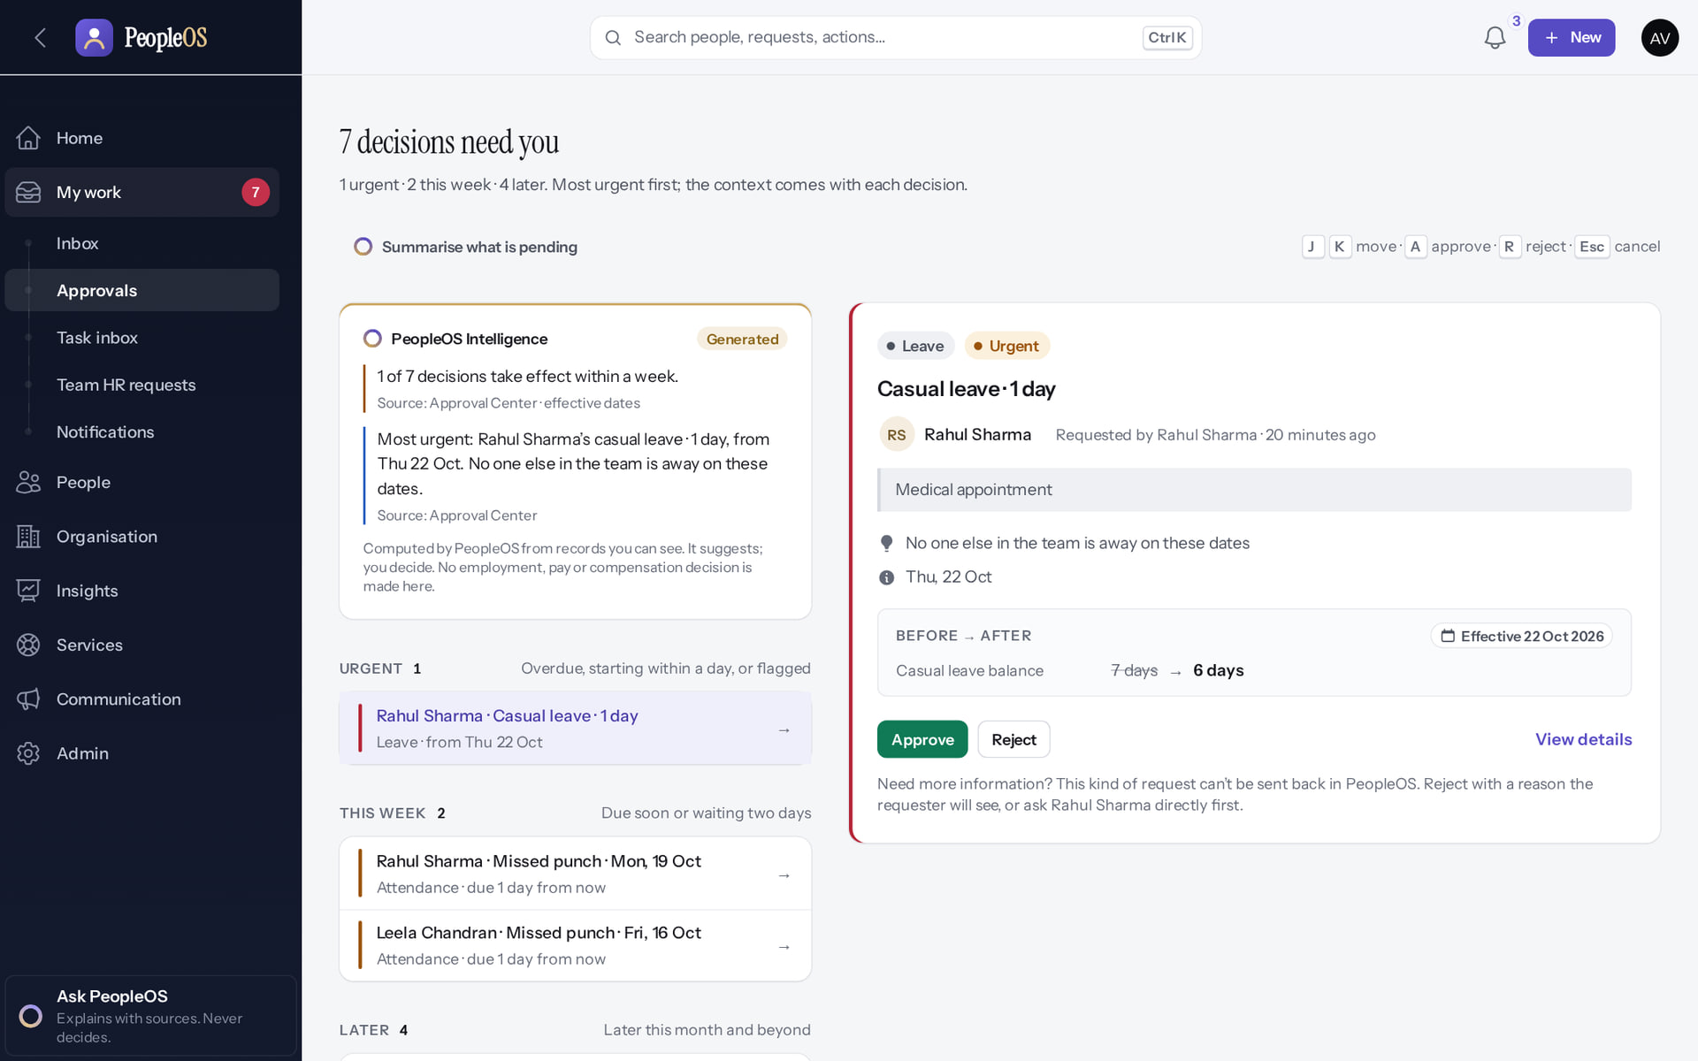
The Approval Center
UAT-LV-04 / 05
Verified in the running application
1
1
How many decisions wait
2
2
Summarise what is pending
Decisions are grouped Urgent, This week and Later, most urgent first; the new request is further down under Later. Keyboard: J/K move, A approve, R reject.
Real screen · Amit Verma (Manager + Employee) · My work › Approvals (Approval Center)
Notes:
SAY: Urgent means overdue, starting within a day, or flagged.
OBSERVE: 7 decisions at the time of capture.
AVOID: using A or R without reading the card: they only open the confirm box; nothing is decided without Confirm.

Slide 22
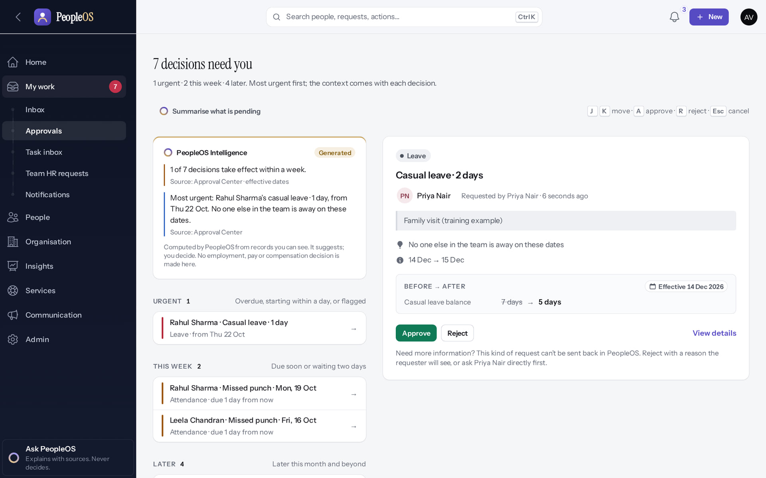
Read the context before you decide
UAT-LV-04 / 05
Verified in the running application
1
The employee's reason.
Team overlap, under the reason: "No one else in the team is away on these dates".
2
Approve.
1
3
Reject.
RESULT The card also shows the dates and the balance before → after (Casual leave 7 → 5).
2
3
Real screen · Amit Verma (Manager + Employee) · Approval Center › decision card
Notes:
SAY: Leave cannot be "sent back" for changes. If you need more information, ask the employee first, or reject with a reason they will see.

Slide 23
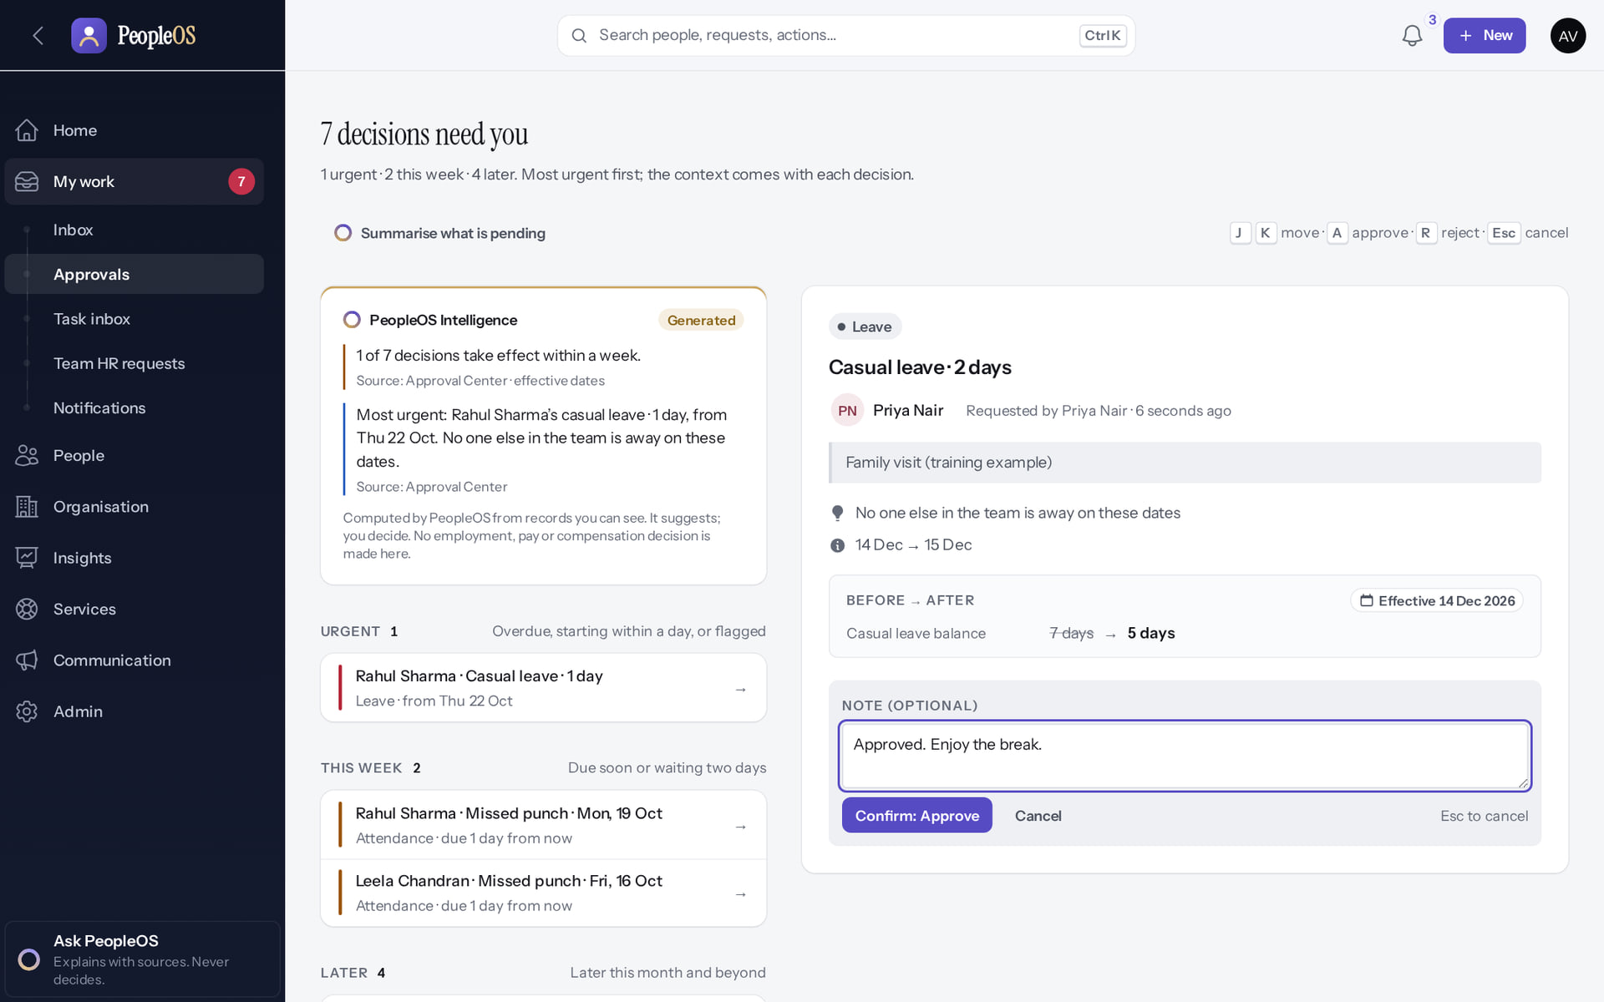
Approve: add an optional note, then Confirm
UAT-LV-04 / 05
Verified in the running application
1
Write an optional note.
2
Select Confirm: Approve.
RESULT Nothing is decided until you confirm. Esc cancels.
1
2
Real screen · Amit Verma (Manager + Employee) · Approval Center › Approve
Notes:
SAY: Nothing is decided until you confirm. Esc cancels.
ON SCREEN: Approve opens a confirmation with an optional note.
WALK THROUGH: (1) Write an optional note. (2) Select Confirm: Approve.
LEARNERS SHOULD SEE: Nothing is decided until Confirm
SCREEN: Approval Center › Approve. Signed in as Amit Verma (Manager + Employee).
EVIDENCE: screenshot screenshots/manager/10-leave-09-approve-confirm.png, captured 2026-10-21 on the disposable training database (fictional people).

Slide 24
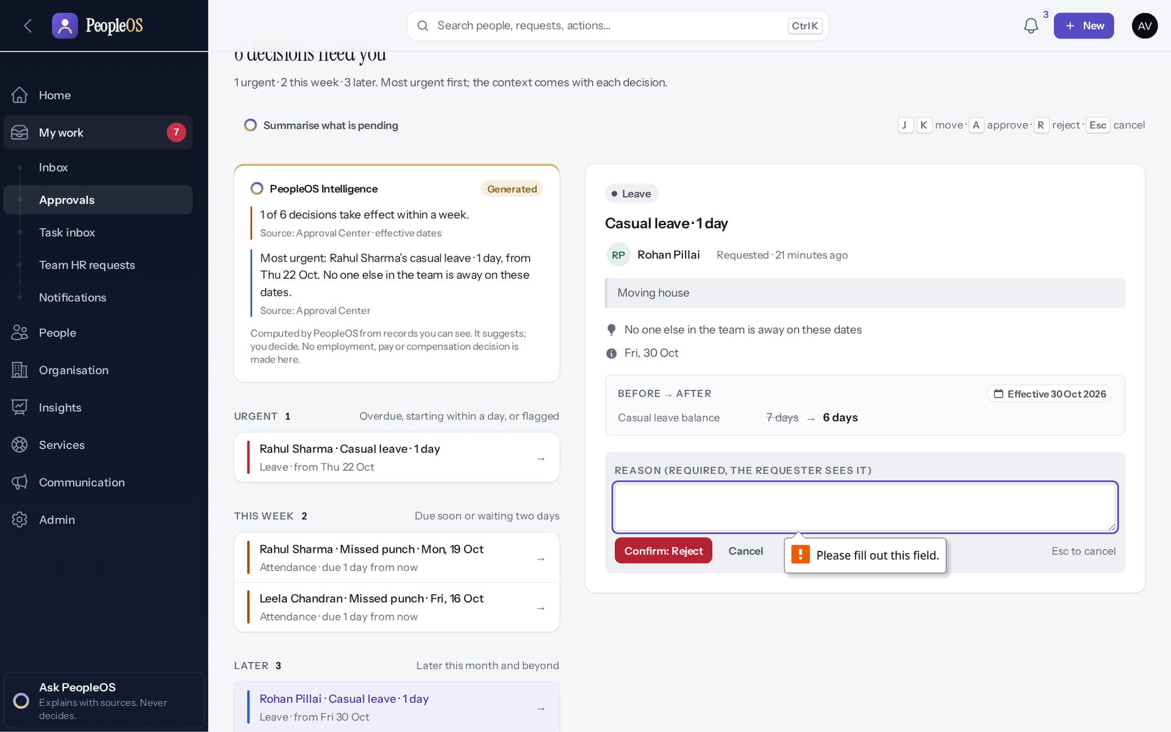
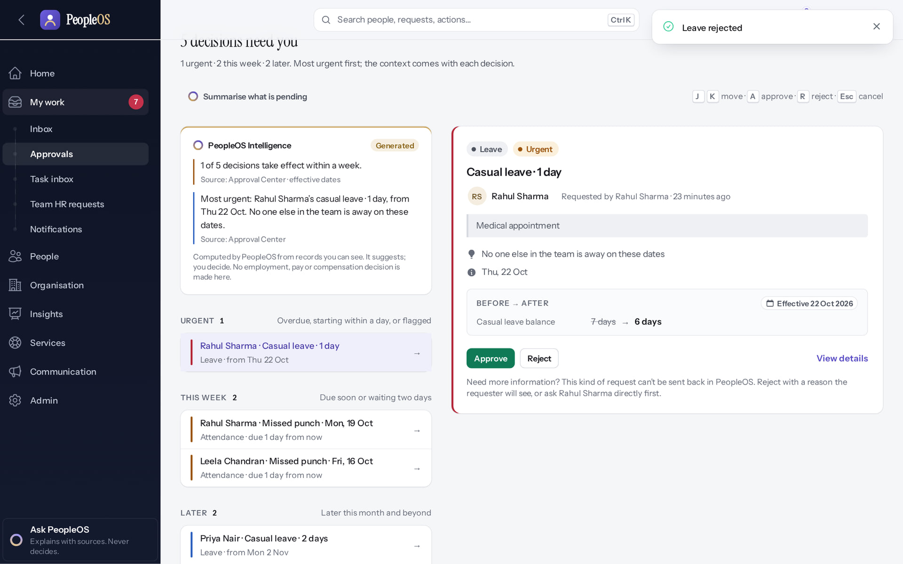
Rejecting needs a reason the employee will see
UAT-LV-04 / 05
Reason missing
Verified
Rejected with a reason
Verified
Confirm: Reject without a reason is stopped: "Please fill out this field."
"Leave rejected." The item leaves your queue; the employee sees your reason.
Real screen · Amit Verma (Manager + Employee) · Approval Center › Reject
Real screen · Amit Verma (Manager + Employee) · Approval Center (after rejecting)
Notes:
EVIDENCE: Executed on the training database on 21 Oct 2026 (tools/capture/10-leave-flow.mjs): Priya Nair (Employee) requested Casual leave 14–15 Dec 2026; Amit Verma (Manager) approved it; Amit rejected Rohan Pillai's request with a reason.
SAY: Write the reason for the employee, not for HR: what should they do next?
SAY: Rejecting needs a reason the employee will see.
LEFT, Reason missing: Confirm: Reject without a reason is stopped: "Please fill out this field."
RIGHT, Rejected with a reason: "Leave rejected." The item leaves your queue; the employee sees your reason.
OBSERVE: point out what differs between the two screens.
EVIDENCE: left = manager/10-leave-11-reject-reason-required [Amit Verma (Manager + Employee), Approval Center › Reject]; right = manager/10-leave-12-rejected [Amit Verma (Manager + Employee), Approval Center (after rejecting)]. Real screens, fictional data (SCREENSHOT-INVENTORY.md).

Slide 25
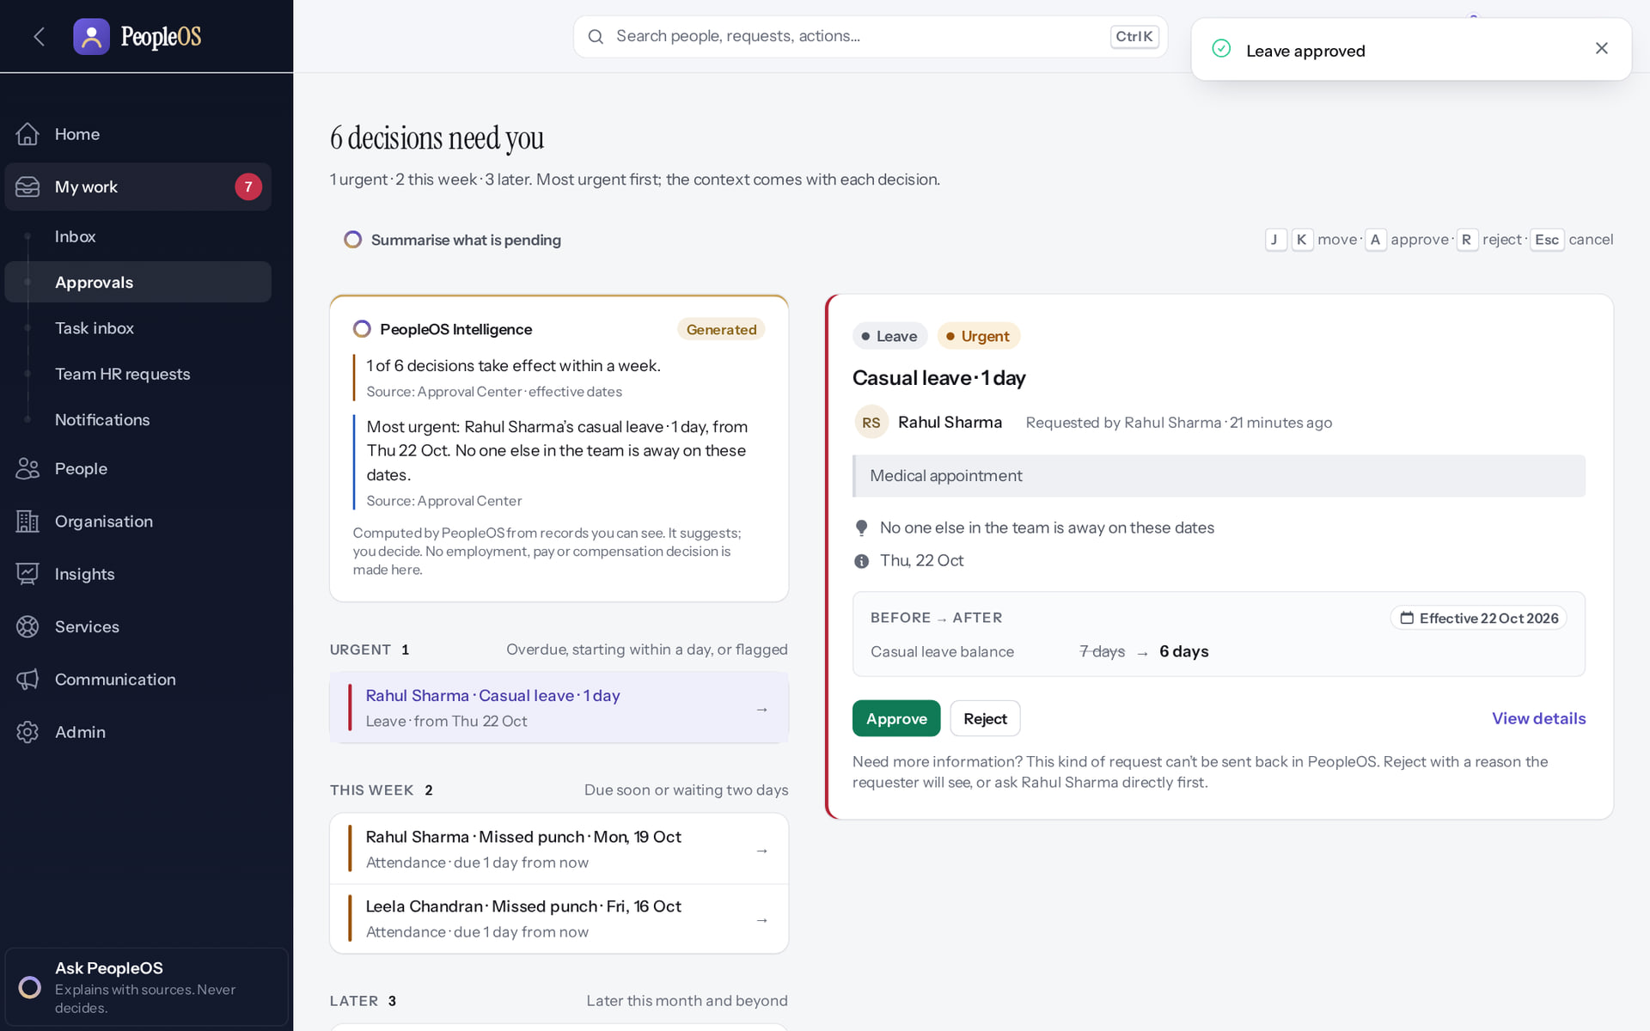
After the decision
UAT-LV-04 / 05
1
Verified in the running application
2
1
"Leave approved" confirms the decision.
2
The count of decisions waiting drops.
RESULT The employee sees Approved and "Reviewed by" your name on their Leave requests.
Real screen · Amit Verma (Manager + Employee) · Approval Center (after the decision)
Notes:
AVOID: telling the requester "you have been notified": notification depends on rules configured by HR (finding F6).

Slide 26
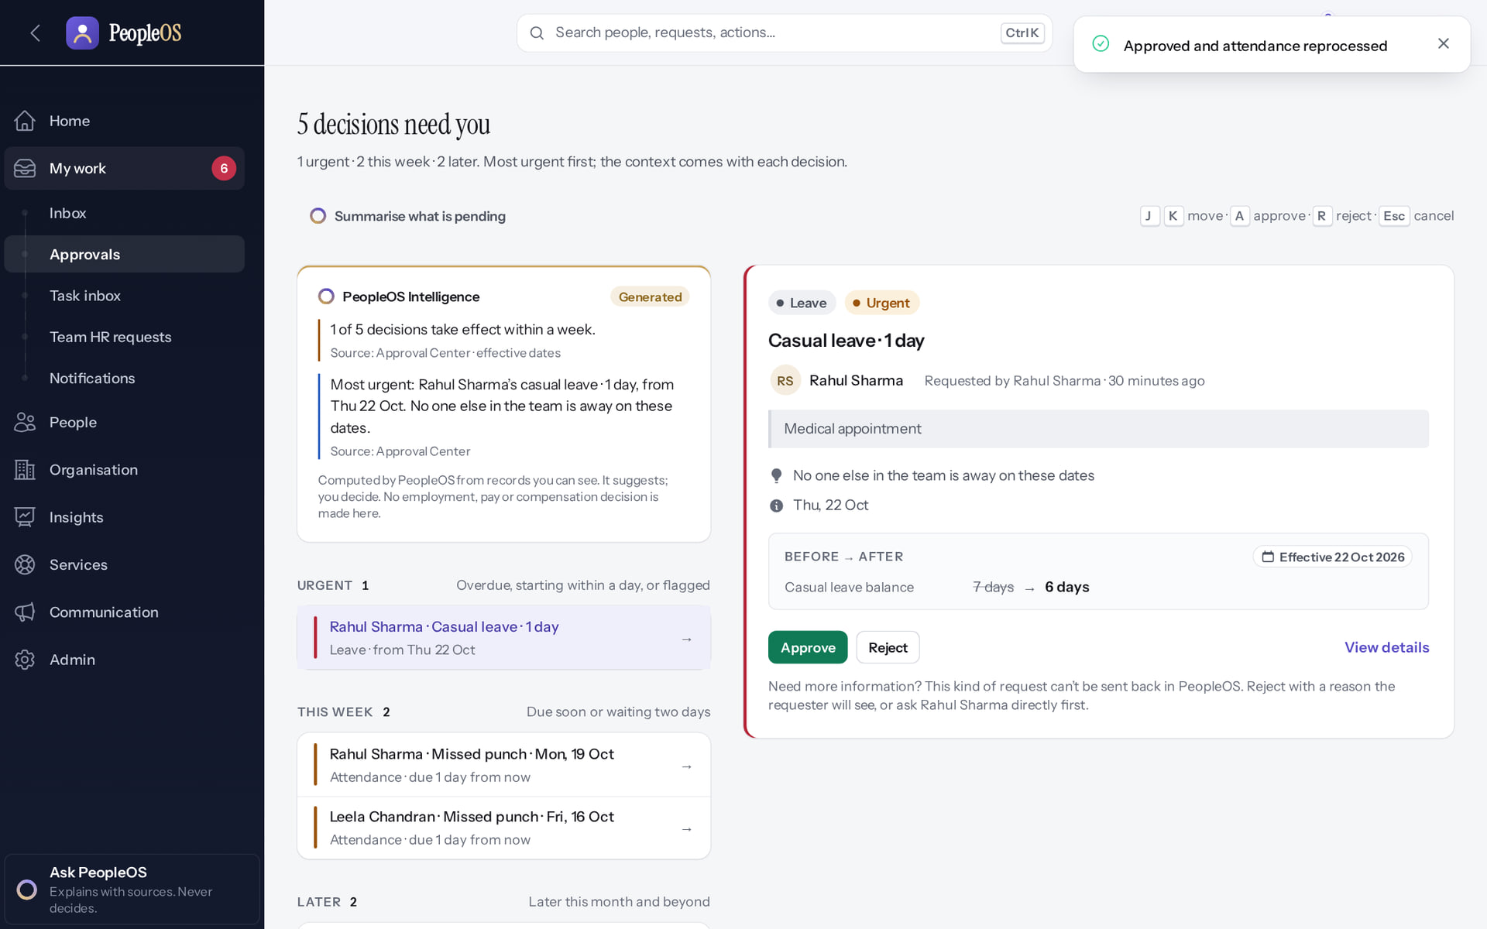
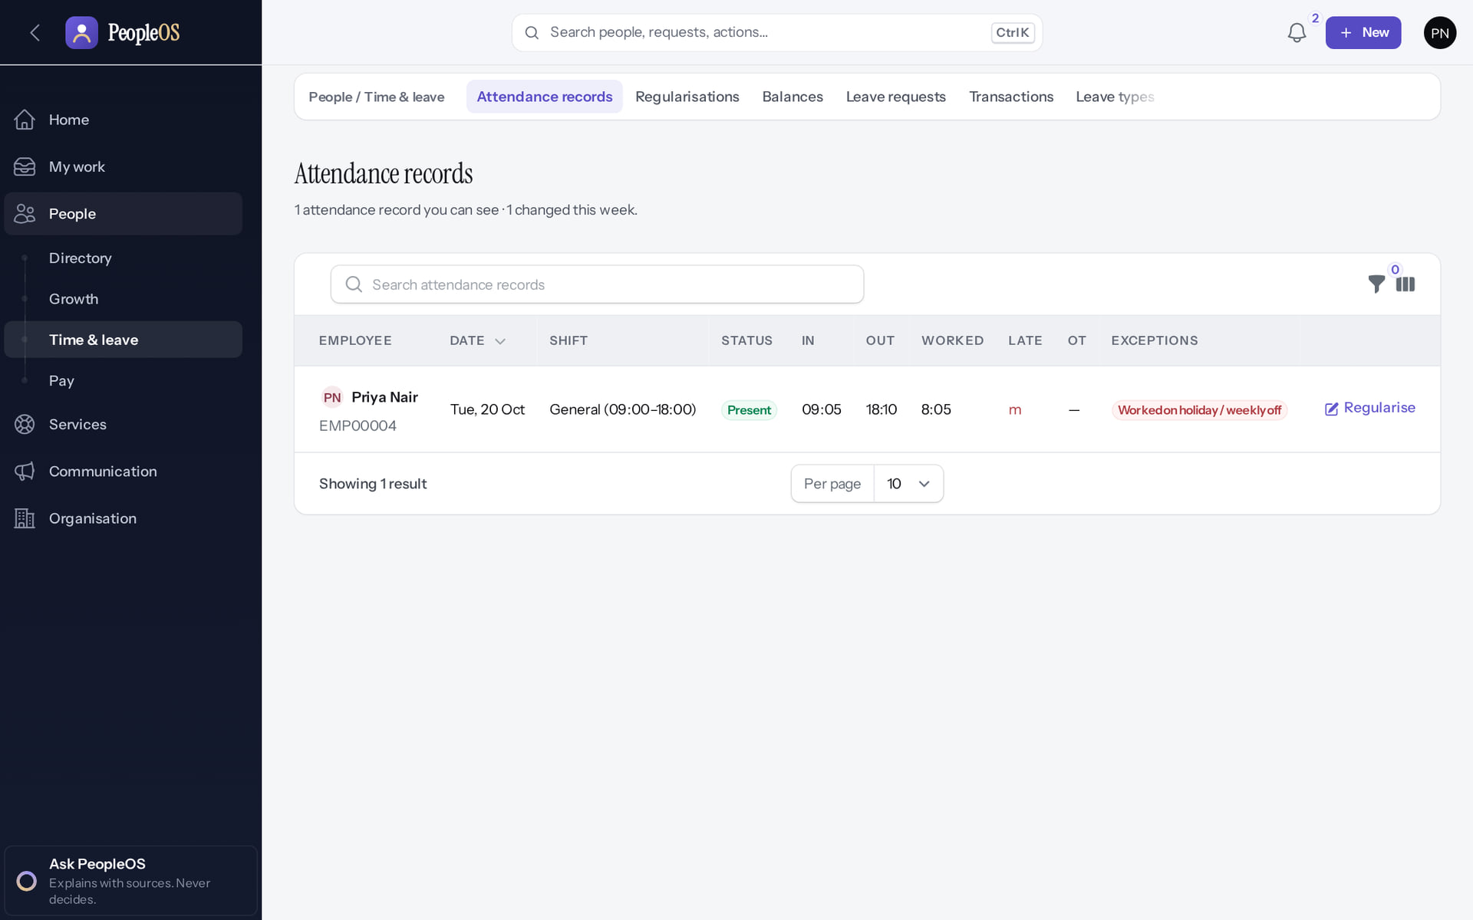
UAT-AT-02: correction approved, day reprocessed
UAT-AT-02
Manager approves
Verified
Employee sees the corrected day
Verified
"Approved and attendance reprocessed".
20 Oct: Present 09:05–18:10. "Worked on holiday" is expected: 20 Oct is a holiday in the demo calendar.
Real screen · Amit Verma (Manager + Employee) · Approval Center (after the decision)
Real screen · Priya Nair (Employee) · Attendance records (own)
Notes:
SAY: UAT-AT-02: correction approved, day reprocessed.
LEFT, Manager approves: "Approved and attendance reprocessed".
RIGHT, Employee sees the corrected day: 20 Oct: Present 09:05–18:10. "Worked on holiday" is expected: 20 Oct is a holiday in the demo calendar.
OBSERVE: point out what differs between the two screens.
EVIDENCE: left = manager/20-att-07-correction-approved [Amit Verma (Manager + Employee), Approval Center (after the decision)]; right = employee/20-att-16-my-attendance [Priya Nair (Employee), Attendance records (own)]. Real screens, fictional data (SCREENSHOT-INVENTORY.md).

Slide 27
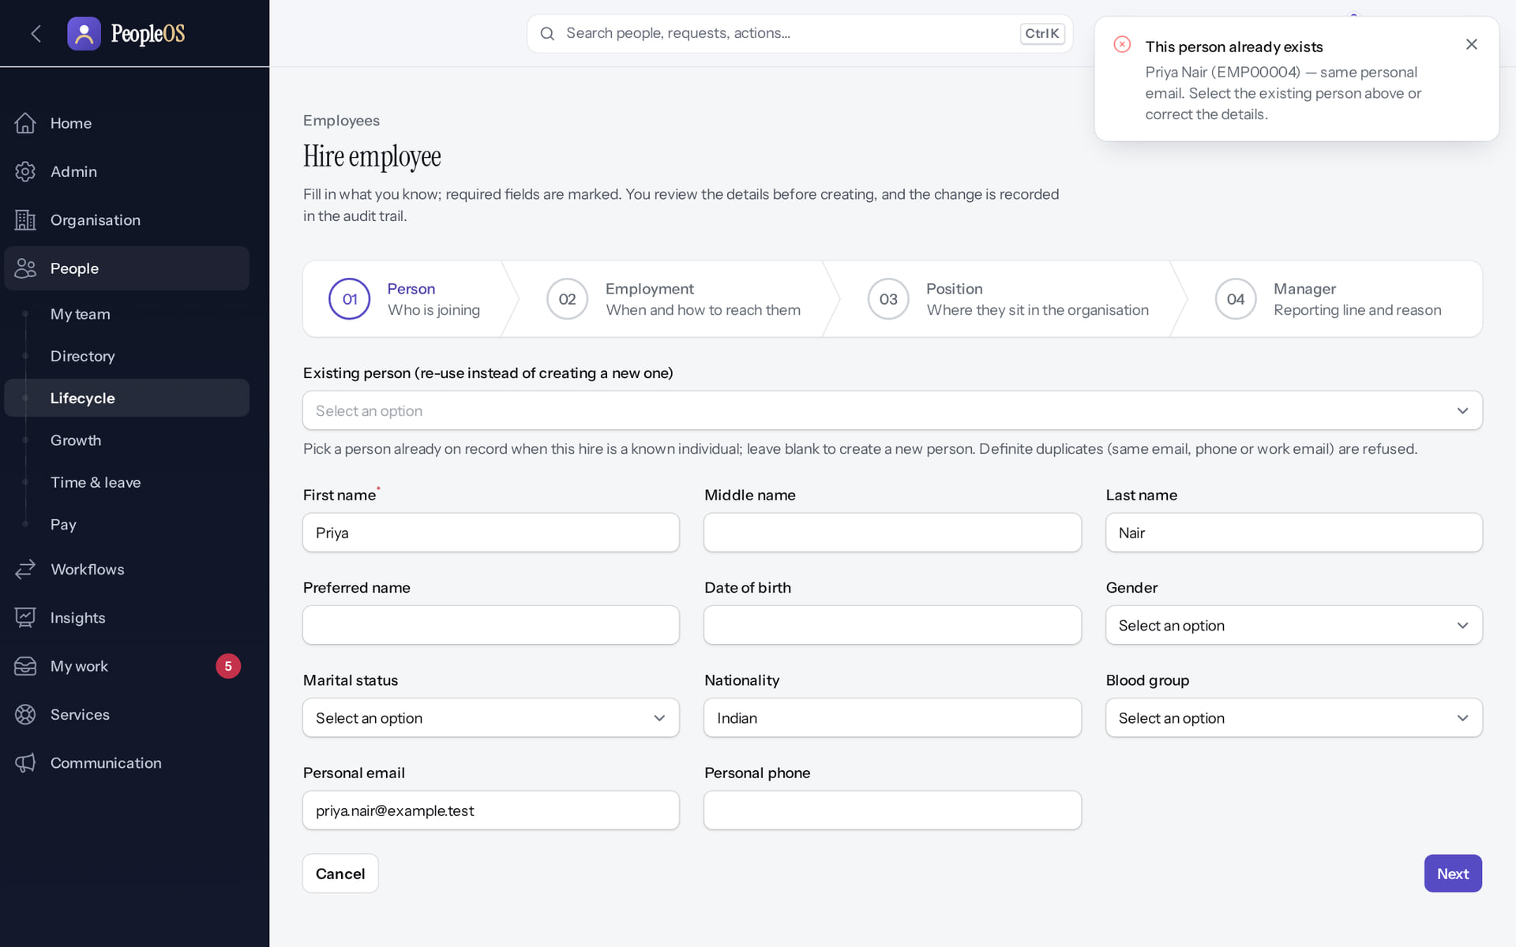
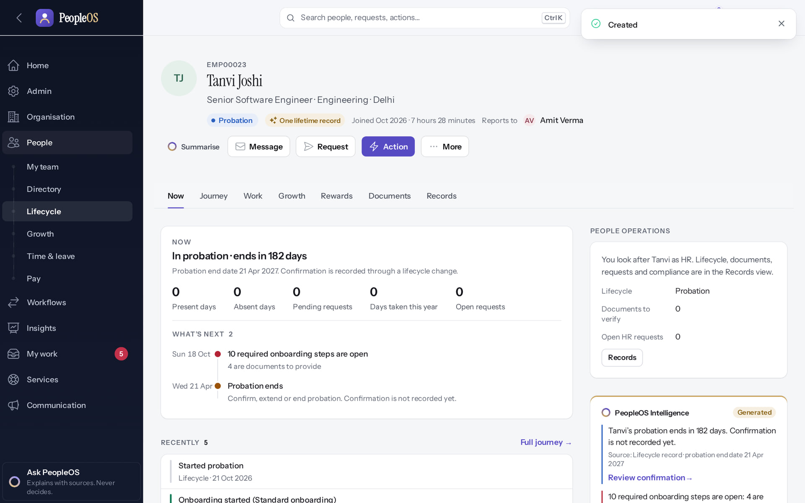
UAT-HR-01: hire with the duplicate check
UAT-HR-01
Duplicate refused
Verified
New hire created
Verified
"This person already exists: Priya Nair (EMP00004)".
Tanvi Joshi, Probation; onboarding started automatically.
Real screen (cropped) · Kavya Menon (Tenant HR Admin + Employee) · Hire employee › Person
Real screen · Kavya Menon (Tenant HR Admin + Employee) · Employee 360 (new hire)
Notes:
SAY: UAT-HR-01: hire with the duplicate check.
LEFT, Duplicate refused: "This person already exists: Priya Nair (EMP00004)".
RIGHT, New hire created: Tanvi Joshi, Probation; onboarding started automatically.
OBSERVE: point out what differs between the two screens.
EVIDENCE: left = hr-admin/50-hire-01-duplicate-refused [Kavya Menon (Tenant HR Admin + Employee), Hire employee › Person]; right = hr-admin/50-hire-07-created-record [Kavya Menon (Tenant HR Admin + Employee), Employee 360 (new hire)]. Real screens, fictional data (SCREENSHOT-INVENTORY.md).

Slide 28
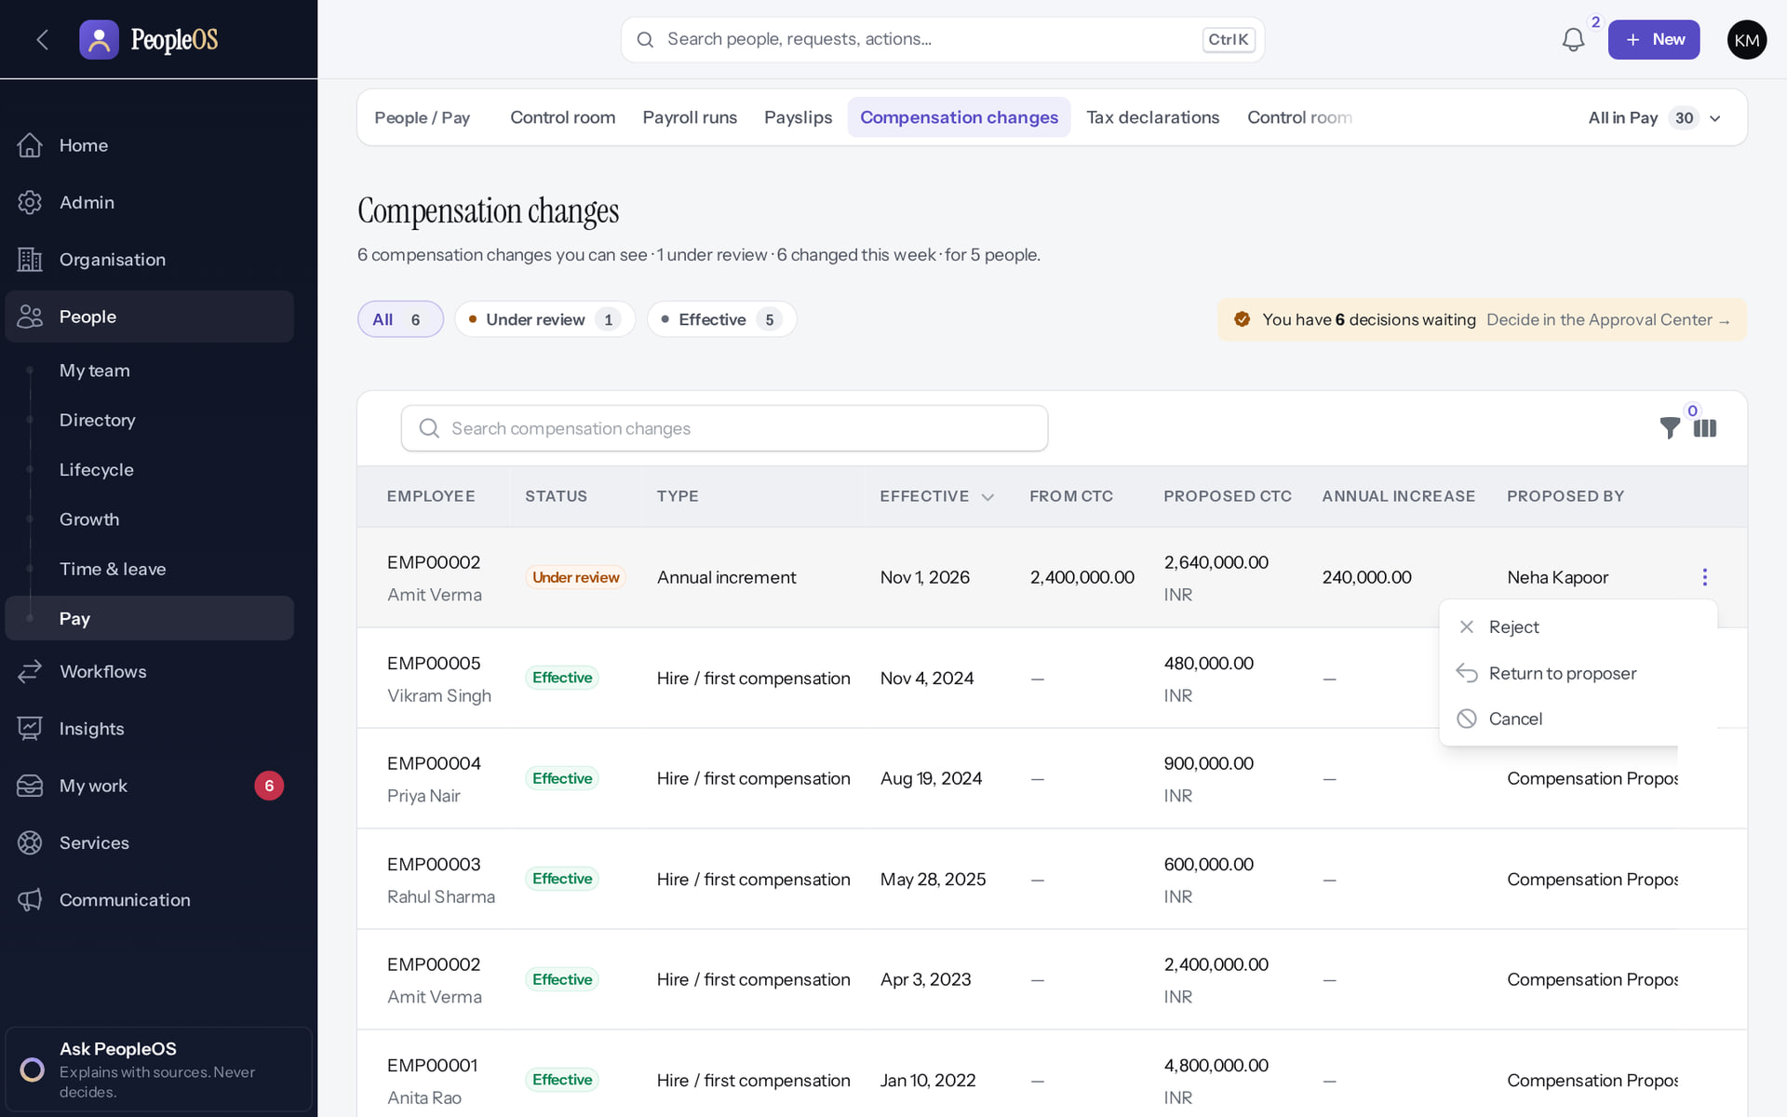
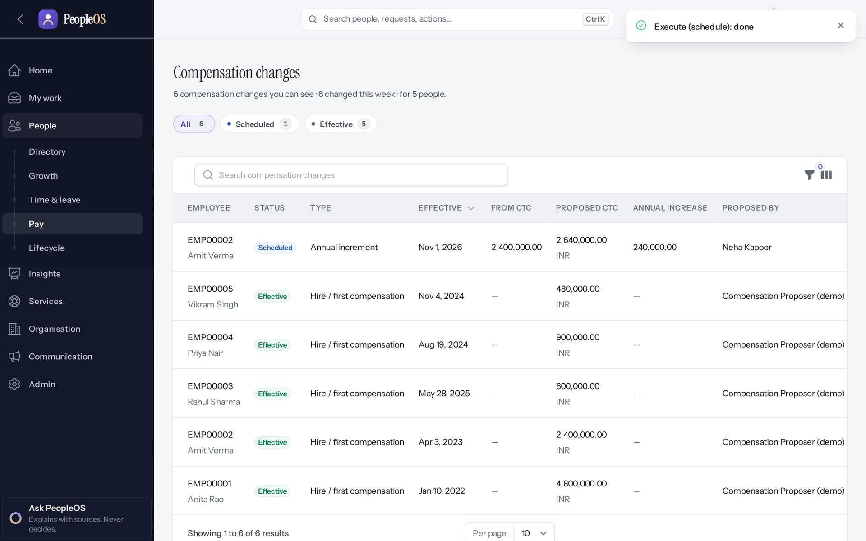
UAT-CMP-01: four people, one pay change
UAT-CMP-01
Reviewer has no Approve
Verified
Executed by the fourth person
Verified
The person who reviewed cannot also approve.
Status Scheduled for the effective date.
Real screen · Kavya Menon (Tenant HR Admin + Employee) · Compensation changes › row actions (after reviewing)
Real screen · Arjun Bose (Payroll Admin + Employee) · Compensation changes (after execution)
Notes:
SAY: UAT-CMP-01: four people, one pay change.
LEFT, Reviewer has no Approve: The person who reviewed cannot also approve.
RIGHT, Executed by the fourth person: Status Scheduled for the effective date.
OBSERVE: point out what differs between the two screens.
EVIDENCE: left = security-compliance/62-comp-07-reviewer-cannot-approve [Kavya Menon (Tenant HR Admin + Employee), Compensation changes › row actions (after reviewing)]; right = hr-admin/62-comp-10-executed [Arjun Bose (Payroll Admin + Employee), Compensation changes (after execution)]. Real screens, fictional data (SCREENSHOT-INVENTORY.md).

Slide 29
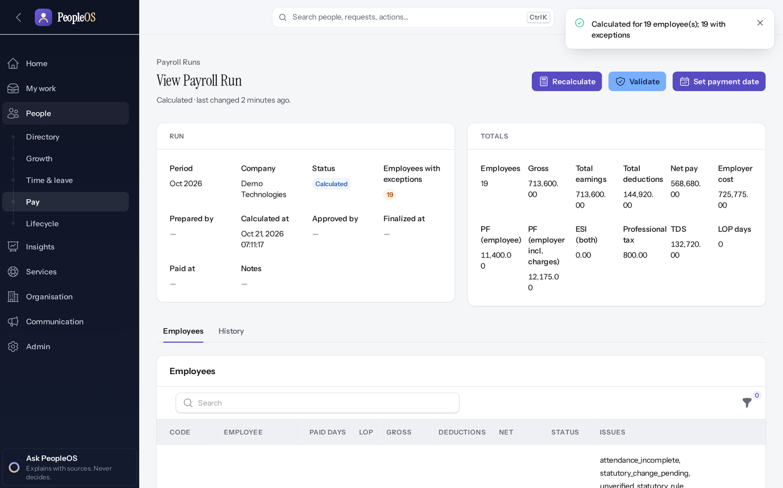
UAT-PAY-01: calculated, then blocked
UAT-PAY-01
Recalculated
Verified
Validate refused
Disabled (gate)
"Calculated for 19 employee(s); 19 with exceptions".
Blocking exceptions from unverified statutory rules: UAT-PAY-02 cannot be executed today.
Real screen · Arjun Bose (Payroll Admin + Employee) · Payroll run (after Recalculate)
Real screen · Arjun Bose (Payroll Admin + Employee) · Payroll run › Validate
Notes:
SAY: UAT-PAY-01: calculated, then blocked.
LEFT, Recalculated: "Calculated for 19 employee(s); 19 with exceptions".
RIGHT, Validate refused: Blocking exceptions from unverified statutory rules: UAT-PAY-02 cannot be executed today.
OBSERVE: point out what differs between the two screens.
EVIDENCE: left = hr-admin/60-pay-08-recalculated [Arjun Bose (Payroll Admin + Employee), Payroll run (after Recalculate)]; right = hr-admin/60-pay-09-validate-blocked [Arjun Bose (Payroll Admin + Employee), Payroll run › Validate]. Real screens, fictional data (SCREENSHOT-INVENTORY.md).

Slide 30
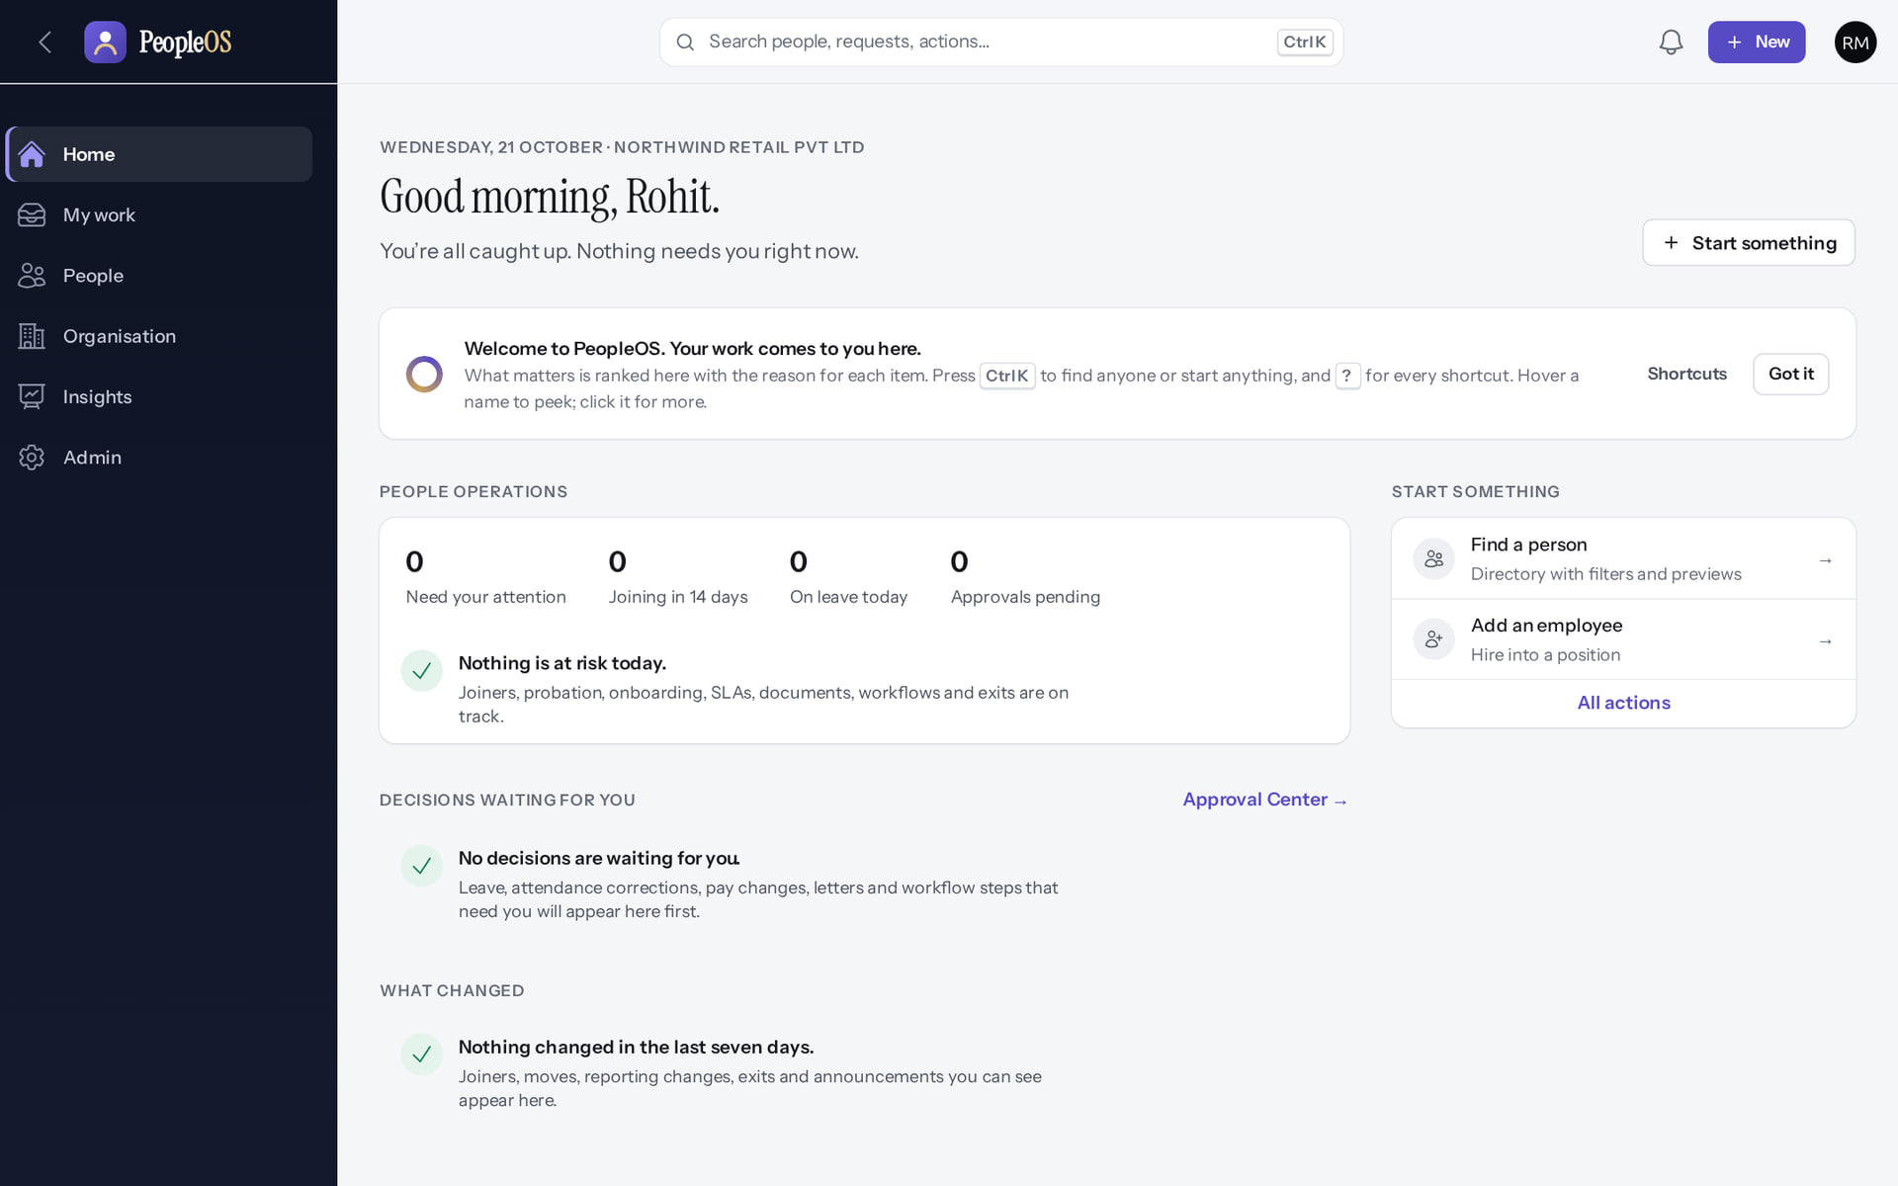
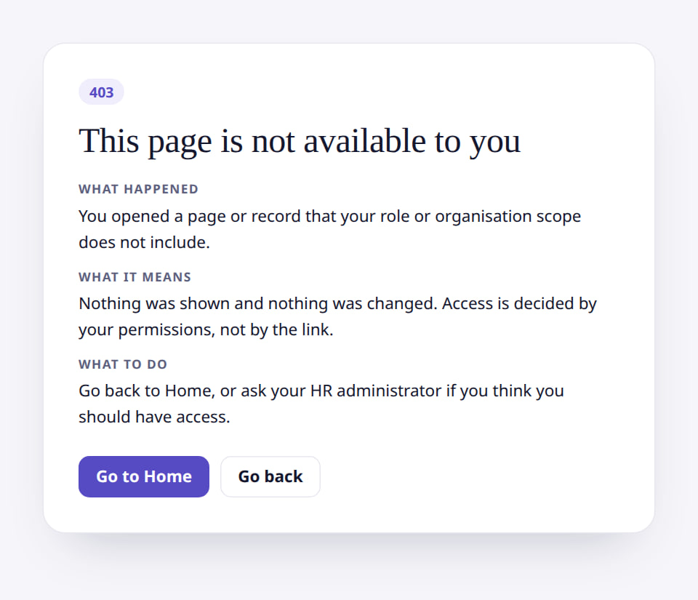
UAT-ACC-01: test access as the role
UAT-ACC-01
HR Executive Home
Verified
Roles page refused
Verified
A narrower menu than the administrator.
A refusal where the role matrix says "no" is a pass.
Real screen · Rohit Menon (HR Executive (Northwind Retail)) · Home (HR Executive, Northwind Retail)
Real screen (cropped) · Rohit Menon (HR Executive (Northwind Retail)) · Roles (as HR Executive)
Notes:
SAY: UAT-ACC-01: test access as the role.
LEFT, HR Executive Home: A narrower menu than the administrator.
RIGHT, Roles page refused: A refusal where the role matrix says "no" is a pass.
OBSERVE: point out what differs between the two screens.
EVIDENCE: left = client-onboarding/90-onb-59-hr-executive-home [Rohit Menon (HR Executive (Northwind Retail)), Home (HR Executive, Northwind Retail)]; right = client-onboarding/90-onb-60-hr-executive-roles-denied [Rohit Menon (HR Executive (Northwind Retail)), Roles (as HR Executive)]. Real screens, fictional data (SCREENSHOT-INVENTORY.md).

Slide 31
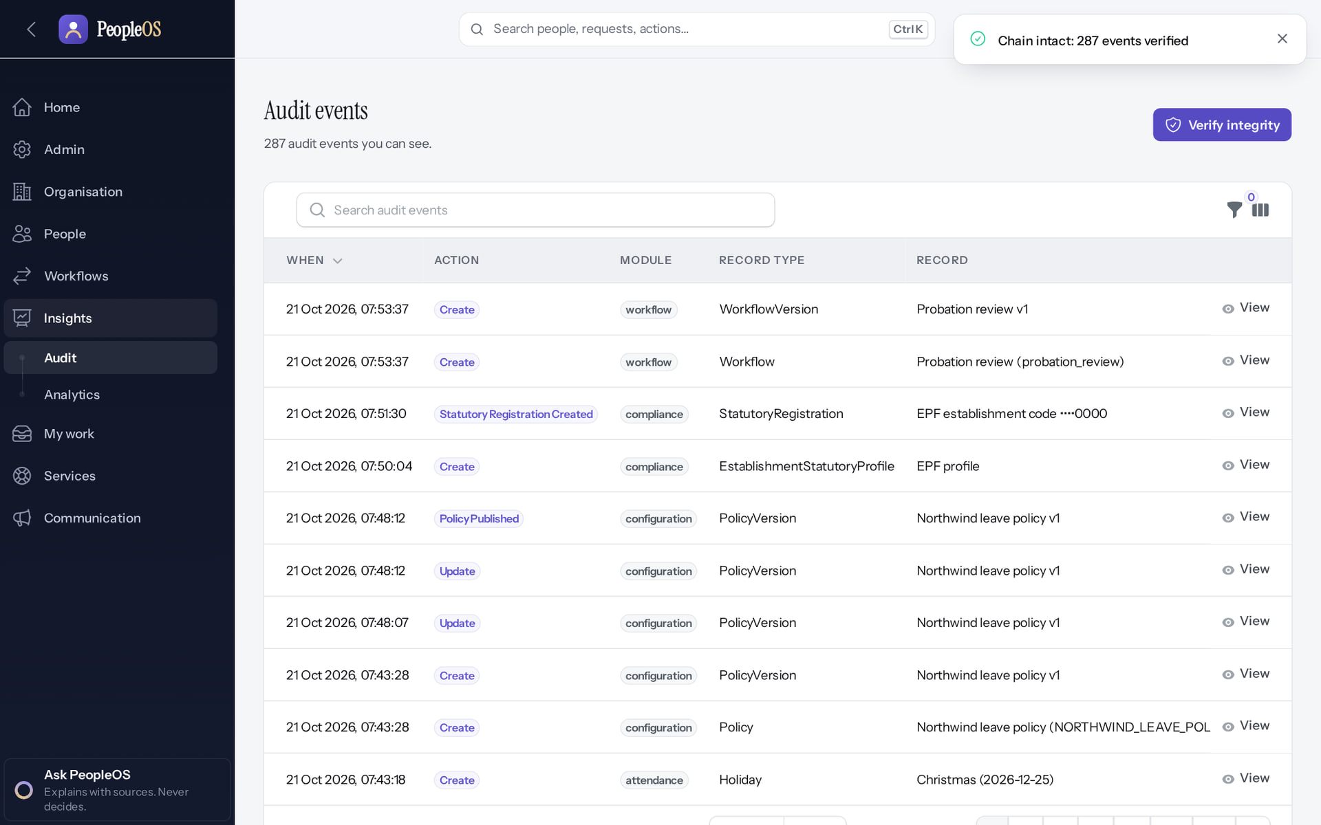
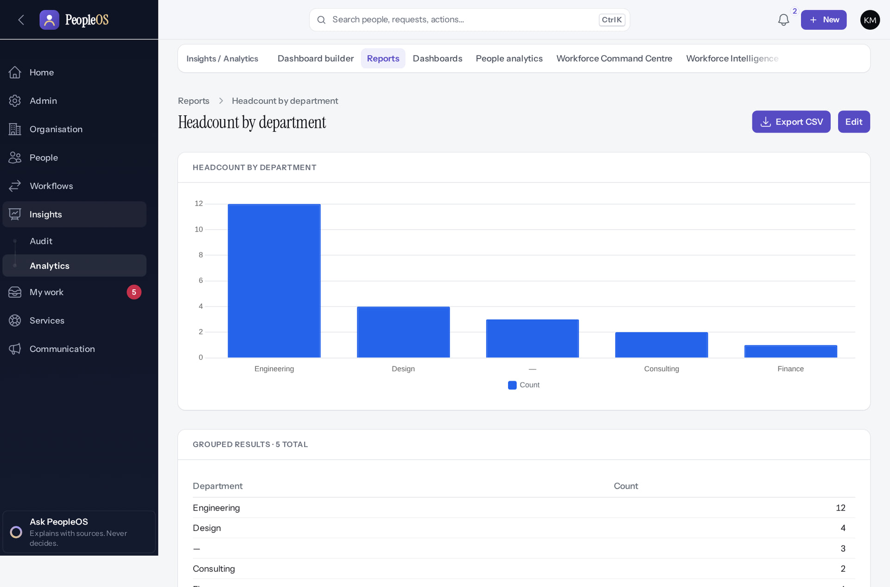
UAT-AUD-01 and UAT-RPT-01: prove it
UAT-AUD-01 / RPT-01
Audit chain verified
Verified
Report run and exported
Verified
"Chain intact: 287 events verified".
Grouped results and Export CSV; the export is audited.
Real screen · Farah Khan (Tenant Super Admin (Northwind Retail, first administrator)) · Change history › Verify integrity
Real screen (cropped) · Kavya Menon (Tenant HR Admin + Employee) · Report: Headcount by department
Notes:
SAY: UAT-AUD-01 and UAT-RPT-01: prove it.
LEFT, Audit chain verified: "Chain intact: 287 events verified".
RIGHT, Report run and exported: Grouped results and Export CSV; the export is audited.
OBSERVE: point out what differs between the two screens.
EVIDENCE: left = client-onboarding/90-onb-90-audit-verified [Farah Khan (Tenant Super Admin (Northwind Retail, first administrator)), Change history › Verify integrity]; right = analytics/80-ins-06-report-result [Kavya Menon (Tenant HR Admin + Employee), Report: Headcount by department]. Real screens, fictional data (SCREENSHOT-INVENTORY.md).

Slide 32
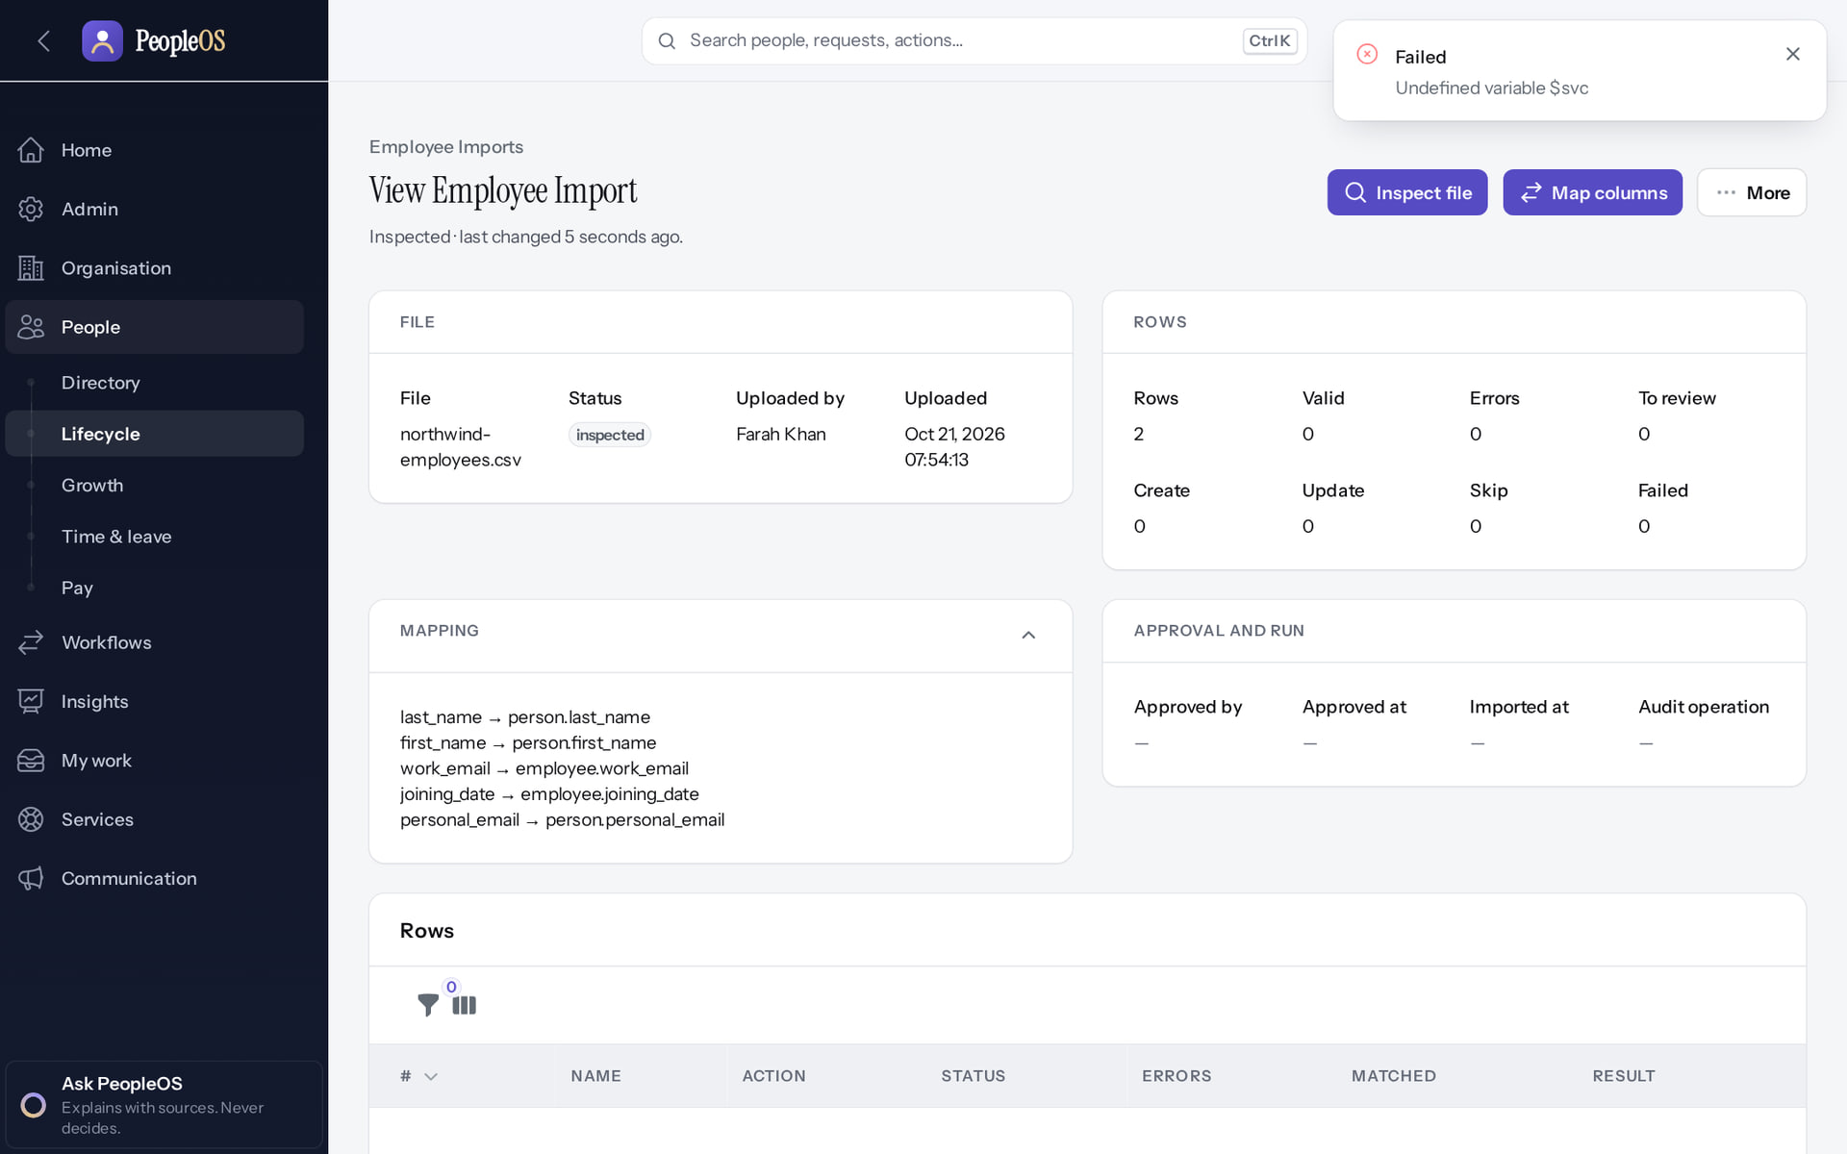
UAT-IMP-01: a defect found by a test
UAT-IMP-01
Incomplete · known defect or gap
1
1
Error.
RESULT Record it as Fail with defect F25, the screenshot and the import number. Retest only after a fix is delivered.
Real screen · Farah Khan (Tenant Super Admin (Northwind Retail, first administrator)) · Employee import (after Map columns)
Notes:
SAY: Record it as Fail with defect F25, the screenshot and the import number. Retest only after a fix is delivered.
ON SCREEN: Submit the column mapping.
WALK THROUGH: (1) Error.
LEARNERS SHOULD SEE: Observed: "Failed
Undefined variable $svc" — the mapping is not saved, so the import cannot pass "inspected" from the screen (known defect F25)
SCREEN: Employee import (after Map columns). Signed in as Farah Khan (Tenant Super Admin (Northwind Retail, first administrator)). Prerequisite: Signed in as the tenant administrator.
EVIDENCE: screenshot screenshots/client-onboarding/90-onb-93-import-map-fails.png, captured 2026-10-21 on the disposable training database (fictional people).

Slide 33
Accessibility, devices and integrations
04
What has been checked, and what the customer must still check.
Notes:
TRANSITION: Section 4, Accessibility, devices and integrations. What has been checked, and what the customer must still check.
SAY: Tell learners what they will be able to do by the end of this section, then move on.
ASK: "What questions do you have before we start this section?"

Slide 34
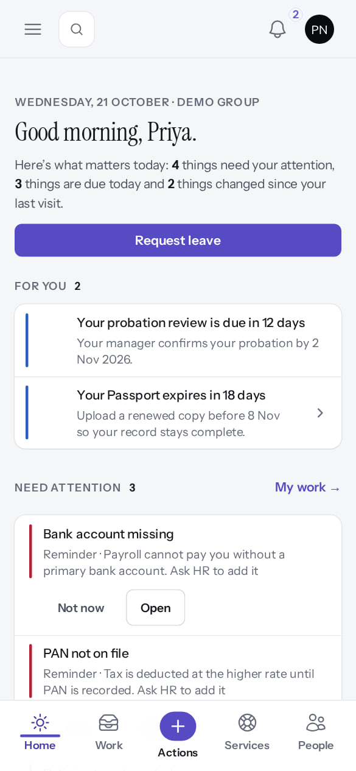
Phone layout
RESPONSIVE
Verified in the running application
RESULT The same Home at phone width (390 × 844) with a bottom bar. Safari and Android Chrome have not been tested (UX-19 §30).
Real screen · Priya Nair (Employee) · Home on a phone (390 × 844)
Notes:
SAY: The same Home at phone width (390 × 844) with a bottom bar. Safari and Android Chrome have not been tested (UX-19 §30).
ON SCREEN: Open PeopleOS in a phone browser.
LEARNERS SHOULD SEE: The same Home, with a bottom bar: Home, Work, Actions, Services, People
SCREEN: Home on a phone (390 × 844). Signed in as Priya Nair (Employee).
EVIDENCE: screenshot screenshots/employee/30-self-50-phone-home.png, captured 2026-10-21 on the disposable training database (fictional people).

Slide 35
Accessibility and device evidence
ACCESSIBILITY
Check | Evidence available | Customer UAT action
Automated accessibility (axe) | UX.18 audit: axe-core 4.13, WCAG 2.0–2.2 A/AA on the live showcase; re-runs 0 violations (58 and 78 checks); scripted keyboard, reflow and zoom review | Run a screen reader on the key employee tasks with real users
Keyboard use | Shortcuts (Ctrl K, ?, J/K, A/R with Confirm) | Complete leave and approval without a mouse
Phone and tablet | Chromium at 390 × 844 (touch) | Test on the customer's actual devices; Safari and Android Chrome untested
Dark mode | Theme switcher light / dark / system | Optional
Integrations | API, SCIM, OIDC SSO, webhooks: forms verified; no round trip executed here | Test each integration end to end with the customer's systems
Notes:
SOURCE: docs/ux/UX-18-Accessibility-Audit.md (axe runs and scripted manual review); docs/reports/implementation-status.md 5.1 (phone layout at 390 × 844, Safari and Android Chrome untested). Integration round trips were not exercised in the training environment.
SAY: Accessibility and device evidence.
- Automated accessibility (axe) | UX.18 audit: axe-core 4.13, WCAG 2.0–2.2 A/AA on the live showcase; re-runs 0 violations (58 and 78 checks); scripted keyboard, reflow and zoom review | Run a screen reader on the key employee tasks with real users
- Keyboard use | Shortcuts (Ctrl K, ?, J/K, A/R with Confirm) | Complete leave and approval without a mouse
- Phone and tablet | Chromium at 390 × 844 (touch) | Test on the customer's actual devices; Safari and Android Chrome untested
- Dark mode | Theme switcher light / dark / system | Optional
- Integrations | API, SCIM, OIDC SSO, webhooks: forms verified; no round trip executed here | Test each integration end to end with the customer's systems

Slide 36
Defects, evidence and reconciliation
05
Log, triage, retest; keep evidence; reconcile figures.
Notes:
TRANSITION: Section 5, Defects, evidence and reconciliation. Log, triage, retest; keep evidence; reconcile figures.
SAY: Tell learners what they will be able to do by the end of this section, then move on.
ASK: "What questions do you have before we start this section?"

Slide 37
Defect management
DEFECTS
Log
Triage
Test ID, steps, expected versus actual, screenshot, time, user, severity (Critical, High, Medium, Low).
Known defect? Configuration? Training? Markedge support decides with the customer UAT lead.
Fix and retest
Accept or block
Retest the same case and its neighbours; keep both screenshots.
Critical and High defects block go-live unless accepted in writing with a workaround.
Notes:
SAY: Defect management.
- Log: Test ID, steps, expected versus actual, screenshot, time, user, severity (Critical, High, Medium, Low).
- Triage: Known defect? Configuration? Training? Markedge support decides with the customer UAT lead.
- Fix and retest: Retest the same case and its neighbours; keep both screenshots.
- Accept or block: Critical and High defects block go-live unless accepted in writing with a workaround.
ASK: "Which of these points needs more explanation for your team?"

Slide 38
Evidence and reconciliation
EVIDENCE
Screenshots
Exports
One per step that changes the screen; no personal identifiers visible.
CSV exports of headcount and balances; each export is in Change history.
Audit
Reconciliation
Change history › Verify integrity: "Chain intact" at UAT end.
Counts by company, department and status versus source; balances for a sample; zero unexplained differences.
Notes:
SAY: Evidence and reconciliation.
- Screenshots: One per step that changes the screen; no personal identifiers visible.
- Exports: CSV exports of headcount and balances; each export is in Change history.
- Audit: Change history › Verify integrity: "Chain intact" at UAT end.
- Reconciliation: Counts by company, department and status versus source; balances for a sample; zero unexplained differences.
ASK: "Which of these points needs more explanation for your team?"

Slide 39
Go live, roll back, stabilise
06
Criteria, the release gate, the runbook.
Notes:
TRANSITION: Section 6, Go live, roll back, stabilise. Criteria, the release gate, the runbook.
SAY: Tell learners what they will be able to do by the end of this section, then move on.
ASK: "What questions do you have before we start this section?"

Slide 40
Go-live criteria (all required)
GO-LIVE
Criterion | Today
Every critical UAT case executed and passed by the customer | Customer to execute
No open Critical or High defect without written acceptance | F25, F38, F44 and new findings open
Data reconciled and signed | Customer to sign
Access tested for every role; MFA as decided | Customer to test
Payroll scope decided in writing | Statutory rules 0 of 24 verified
PeopleOS release gate GO | BLOCKED (NO-GO, 10 of 14 gates)
Hosting, monitoring, on-call, backup and DR evidence | BLOCKED (gates 7, 8)
Notes:
SOURCE: docs/saas/SaaS-Final-Deployment-and-Rollback-Runbook.md §8; release gate. A customer go-live cannot be approved while the product release gate is NO-GO.
SAY: Go-live criteria (all required).
- Every critical UAT case executed and passed by the customer | Customer to execute
- No open Critical or High defect without written acceptance | F25, F38, F44 and new findings open
- Data reconciled and signed | Customer to sign
- Access tested for every role; MFA as decided | Customer to test
- Payroll scope decided in writing | Statutory rules 0 of 24 verified
- PeopleOS release gate GO | BLOCKED (NO-GO, 10 of 14 gates)
- Hosting, monitoring, on-call, backup and DR evidence | BLOCKED (gates 7, 8)

Slide 41
Smoke tests after deployment (non-destructive)
GO-LIVE
# | Check
1 | Health endpoints live and ready (database, cache, queue, storage, scheduler)
2 | An operator signs in with MFA; Platform readiness has no FAIL
3 | A fictional test tenant is provisioned; its admin creates one employee; a second test tenant cannot see it
4 | Payroll on the test tenant shows statutory rules blocked; audit verify passes
5 | A notification e-mail reaches a monitored mailbox; a document uploads and downloads only through the authorised route
6 | Registration shows "not available"; deletion and payments are refused; deletion reconciliation reports nothing
7 | No demo or test accounts remain; every operator has MFA
Notes:
SOURCE: docs/saas/SaaS-Final-Deployment-and-Rollback-Runbook.md §6 (12 smoke tests, condensed).
SAY: Smoke tests after deployment (non-destructive).
- 1 | Health endpoints live and ready (database, cache, queue, storage, scheduler)
- 2 | An operator signs in with MFA; Platform readiness has no FAIL
- 3 | A fictional test tenant is provisioned; its admin creates one employee; a second test tenant cannot see it
- 4 | Payroll on the test tenant shows statutory rules blocked; audit verify passes
- 5 | A notification e-mail reaches a monitored mailbox; a document uploads and downloads only through the authorised route
- 6 | Registration shows "not available"; deletion and payments are refused; deletion reconciliation reports nothing
- 7 | No demo or test accounts remain; every operator has MFA

Slide 42
Rollback and interrupted migrations
ROLLBACK
Code defect, no migration
Migration done, release undone
Redeploy the previous artefact; restart the queue.
Restore the pre-deployment backup (or a reviewed down() tested on staging), then redeploy the previous artefact.
Migration interrupted
Rollback triggers
Do not re-run blindly: MySQL DDL is not transactional. Restore the backup, then deploy again.
Failed critical smoke test, broken audit chain, any cross-tenant exposure, sustained 5xx, unrecoverable migration.
Notes:
SOURCE: docs/saas/SaaS-Final-Deployment-and-Rollback-Runbook.md §5 and §9. On a trigger: stop rollout, follow §5, keep the logs, record the incident.
SAY: Rollback and interrupted migrations.
- Code defect, no migration: Redeploy the previous artefact; restart the queue.
- Migration done, release undone: Restore the pre-deployment backup (or a reviewed down() tested on staging), then redeploy the previous artefact.
- Migration interrupted: Do not re-run blindly: MySQL DDL is not transactional. Restore the backup, then deploy again.
- Rollback triggers: Failed critical smoke test, broken audit chain, any cross-tenant exposure, sustained 5xx, unrecoverable migration.
ASK: "Which of these points needs more explanation for your team?"

Slide 43
Post-go-live validation (each agreed interval)
STABILISE
Area | Check
Sign-in | Users sign in; operators with MFA
Isolation | A sample confirms no cross-tenant visibility
Background work | Queue depth, failed jobs, scheduler heartbeat (Platform › Operations)
Notifications | Delivery log shows sent items
Audit | Daily verification passes
Processes | Leave, attendance and approvals flow for real users; first payroll only when allowed
Backups | Backup job success; restore test on schedule
Notes:
SOURCE: docs/saas/SaaS-Final-Deployment-and-Rollback-Runbook.md §9. The stabilisation window and its owners are owner decision O-10.
SAY: Post-go-live validation (each agreed interval).
- Sign-in | Users sign in; operators with MFA
- Isolation | A sample confirms no cross-tenant visibility
- Background work | Queue depth, failed jobs, scheduler heartbeat (Platform › Operations)
- Notifications | Delivery log shows sent items
- Audit | Daily verification passes
- Processes | Leave, attendance and approvals flow for real users; first payroll only when allowed
- Backups | Backup job success; restore test on schedule

Slide 44
Practice
PRACTICE
A tester marks UAT-PAY-02 as Pass because the reference column is filled. What do you do?
1
UAT-IMP-01 fails with "Undefined variable $svc". How do you record it and what is the workaround?
2
Every UAT case passed. Can the customer go live next week?
3
Answer key: on the next slide, and in the speaker notes.
Notes:
RUN: give learners about 10 minutes in a practice tenant (never a live one). Walk around and help.
SUCCESS: each learner can show the result on screen.
ANSWERS: (1) Reject: the reference column is guidance; PAY-02 cannot be executed today. (2) Fail with defect F25 and evidence; workaround: hire wizard or Markedge API load. (3) Not while the PeopleOS release gate is NO-GO and hosting, DR and payroll scope are open.

Slide 45
Answer key
PRACTICE
# | Answer
1 | Reject the Pass: the reference column is guidance only. UAT-PAY-02 cannot be executed while statutory rules are unverified: record it as Blocked.
2 | Fail, defect F25, with the screenshot and import number. Workaround: Hire employee wizard, or a Markedge API load. Retest after the fix.
3 | No. Go-live also needs the PeopleOS release gate at GO, hosting, monitoring, backup and DR evidence, and a written payroll scope decision.
Notes:
SAY: Answer key.
- 1 | Reject the Pass: the reference column is guidance only. UAT-PAY-02 cannot be executed while statutory rules are unverified: record it as Blocked.
- 2 | Fail, defect F25, with the screenshot and import number. Workaround: Hire employee wizard, or a Markedge API load. Retest after the fix.
- 3 | No. Go-live also needs the PeopleOS release gate at GO, hosting, monitoring, backup and DR evidence, and a written payroll scope decision.

Slide 46
Summary
UAT runs in a separate tenant, with synthetic data and one account per role.
A test passes only when the customer executes it and sees the expected result.
Known defects are failures with workarounds, not passes.
Go-live needs customer criteria and the PeopleOS release gate.
Roll back by the runbook; never re-run an interrupted migration blindly.
NEXT STEPS & HELP
supporting/PeopleOS-UAT-Test-Cases.xlsx
supporting/PeopleOS-Go-Live-Handover-Checklist.xlsx
docs/saas/SaaS-Final-Deployment-and-Rollback-Runbook.md
Deck 04: implementation stages
Release gate: NO-GO (10 of 14 gates blocked, re-verified 13 Oct 2026). Not yet generally available.
Notes:
SAY: Recap the key points:
- UAT runs in a separate tenant, with synthetic data and one account per role.
- A test passes only when the customer executes it and sees the expected result.
- Known defects are failures with workarounds, not passes.
- Go-live needs customer criteria and the PeopleOS release gate.
- Roll back by the runbook; never re-run an interrupted migration blindly.
POINT TO: supporting/PeopleOS-UAT-Test-Cases.xlsx; supporting/PeopleOS-Go-Live-Handover-Checklist.xlsx; docs/saas/SaaS-Final-Deployment-and-Rollback-Runbook.md; Deck 04: implementation stages
ASK: "What will you do first in PeopleOS?" Collect questions you cannot answer and send them to the PeopleOS team.

