Slide 1
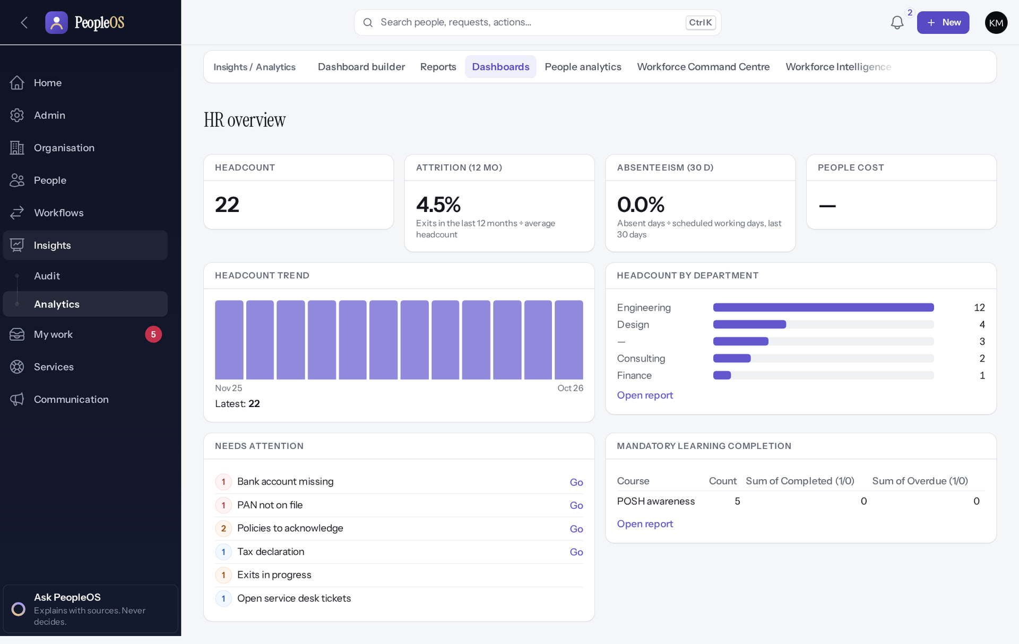
Reporting and Analytics Training
MARKEDGE PEOPLEOS · TRAINING LIBRARY
Deck 12 of 12
Read the dashboards, use the analytics pages, run and export reports, and check the audit trail, knowing what each figure means and where the gaps are.
For: HR analysts, HR leaders, executives, payroll leads and auditors
Built from the running application (local, disposable database, fictional people) · 21 October 2026
Real screen, fictional data
Notes:
SAY: Every figure in PeopleOS is computed from the records the viewer is allowed to see. This deck shows where figures live, how to read them, how to export, and what is not available yet.
EVIDENCE: Captured on the training database on 21 Oct 2026 as Kavya Menon (Tenant HR Admin) and Meera Iyer (Executive); tools/capture/80-insights.mjs. Figures reflect the fictional Demo Group after the other training workflows ran (22 people).

Slide 2
How to read this deck
BEFORE YOU START
Verified in the running application
We ran it on the training database and captured each step.
1
Numbered markers on a screenshot match the numbered steps beside it.
Implemented · not verified end to end
The screen exists; the last steps need data or a second party we could not provide.
Every screenshot is a real capture of PeopleOS. The people and companies in it are fictional.
Available only after configuration
Works once an administrator or Markedge has set it up.
Disabled by safety or commercial gates
Switched off on purpose until owner decisions and approvals arrive.
Diagrams are marked "Conceptual diagram". They explain ideas; they are not screens.
Incomplete · known defect or gap
Partly working: a known defect or gap is stated on the slide.
Release gate: NO-GO (10 of 14 gates blocked, re-verified 13 Oct 2026). Not yet generally available.
Not implemented
Not in the product today.
Unable to verify
Could not be checked in this environment.
Notes:
Explain the seven status labels. Every screenshot slide carries one of them in its top-right corner. Stress that "Verified in the running application" means we ran it on a disposable demonstration database, not that the feature is released.

Slide 3
Where PeopleOS stands today
BEFORE YOU START
This training uses the real application on a practice database with invented people. PeopleOS is not yet generally available.
What works today
Payroll is not live yet
The screens in this deck were run end to end on the practice database: you will see exactly what you will use.
Payslips appear only after a payroll run is finalised. Finalising is blocked until statutory rules are verified (0 of 24 today).
Known issues are named
Some figures hide small groups
Where something does not work as it should, the slide says so and shows the workaround.
People, performance, compensation and HR service analytics and talent pools suppress counts below 5. The HR overview, Workforce pulse, reports and exit insights show exact counts to permitted roles.
Notes:
SAY: We trained on the real PeopleOS screens, not mock-ups. The practice database contains invented people only.
AVOID: promising dates for general availability or payroll. The release gate is NO-GO (docs/saas/SaaS-Final-Release-Gate.md (decision NO-GO, re-verified 13 October 2026 at 7314f7d)).
ASK: "Which figures do you report to leadership today?"
SAY: Where PeopleOS stands today. This training uses the real application on a practice database with invented people. PeopleOS is not yet generally available.
- What works today: The screens in this deck were run end to end on the practice database: you will see exactly what you will use.
- Payroll is not live yet: Payslips appear only after a payroll run is finalised. Finalising is blocked until statutory rules are verified (0 of 24 today).
- Known issues are named: Where something does not work as it should, the slide says so and shows the workaround.
- Some figures hide small groups: People, performance, compensation and HR service analytics and talent pools suppress counts below 5. The HR overview, Workforce pulse, reports and exit insights show exact counts to permitted roles.
ASK: "Which of these points needs more explanation for your team?"

Slide 4
What you will be able to do
LEARNING OBJECTIVES
Read the HR overview and Workforce pulse
and explain how each figure is calculated
Check who changed what
Change history, event detail and integrity
1
4
Use People analytics and the area dashboards
attendance, leave, pay, performance, learning, talent, exits, service
Reconcile figures with source data
filters, "as of" dates and drill-downs
2
5
Run and export a report
and know where the export is recorded
Name the current gaps
report builder, executive datasets, payroll reports
3
6
Notes:
ASK: "Which figure do you report most often today?" Use the answer to choose which slides to dwell on.

Slide 5
Where the figures live
MAP OF INSIGHTS
Screen | Menu path | Who can open (system roles) | Status
HR overview (Dashboards) | Insights › Analytics › Dashboards | Tenant HR Admin, HR Manager, Executive, Auditor | Verified
Workforce pulse | Insights › Analytics › Workforce Command Centre | Tenant HR Admin, Executive, Auditor | Verified
Workforce Intelligence | Insights › Analytics › Workforce Intelligence | Tenant HR Admin, HR Manager, Executive | Verified
People analytics | Insights › Analytics › People analytics | HR roles, Manager, Payroll and Attendance Admin, Executive, Auditor | Verified
Reports and export | Insights › Analytics › Reports | Tenant HR Admin, HR Manager, Executive, Auditor | Incomplete
Change history | Insights › Audit › Change history | Tenant HR Admin, HR Manager, Payroll Admin, Account Owner, Auditor | Verified
Area dashboards | Pay, Growth, Workforce, Lifecycle, Service Desk menus | By area permission | Verified
Notes:
SOURCE: docs/reports/feature-inventory.md (who can open, computed from the application for each system role) and the captures in this deck. Reports is marked Incomplete because of the report-builder defect F44 and the executive dataset gap F45; running and exporting starter reports works.
SAY: Where the figures live.
- HR overview (Dashboards) | Insights › Analytics › Dashboards | Tenant HR Admin, HR Manager, Executive, Auditor | Verified in the running application
- Workforce pulse | Insights › Analytics › Workforce Command Centre | Tenant HR Admin, Executive, Auditor | Verified in the running application
- Workforce Intelligence | Insights › Analytics › Workforce Intelligence | Tenant HR Admin, HR Manager, Executive | Verified in the running application
- People analytics | Insights › Analytics › People analytics | HR roles, Manager, Payroll and Attendance Admin, Executive, Auditor | Verified in the running application
- Reports and export | Insights › Analytics › Reports | Tenant HR Admin, HR Manager, Executive, Auditor | Incomplete · known defect or gap
- Change history | Insights › Audit › Change history | Tenant HR Admin, HR Manager, Payroll Admin, Account Owner, Auditor | Verified in the running application
- Area dashboards | Pay, Growth, Workforce, Lifecycle, Service Desk menus | By area permission | Verified in the running application

Slide 6
Dashboards
01
The HR overview, the Workforce pulse and the signals behind them.
Notes:
TRANSITION: Section 1, Dashboards. The HR overview, the Workforce pulse and the signals behind them.
SAY: Tell learners what they will be able to do by the end of this section, then move on.
ASK: "What questions do you have before we start this section?"

Slide 7
HR overview dashboard
DASHBOARDS
Verified in the running application
Headcount, attrition (12 months), absenteeism (30 days), people cost, headcount trend and by department, needs attention, mandatory learning completion.
Real screen · Kavya Menon (Tenant HR Admin + Employee) · Insights › Analytics › Dashboards (HR overview)
Notes:
HOW TO READ: Headcount 22 = active employees today. Attrition 4.5% = exits in the last 12 months ÷ average headcount. Absenteeism 0.0% = absent days ÷ scheduled working days, last 30 days. People cost shows "—" because no payroll has been finalised (statutory rules unverified).
EVIDENCE: Captured on the training database on 21 Oct 2026 as Kavya Menon (Tenant HR Admin) and Meera Iyer (Executive); tools/capture/80-insights.mjs. Figures reflect the fictional Demo Group after the other training workflows ran (22 people).

Slide 8
How the headline figures are calculated
DASHBOARDS
Headcount
Attrition (12 months)
Active employees on the date, within your access scope. The trend uses month-end headcounts.
Exits in the last 12 months ÷ average headcount over the period. 4.5% in the training data.
Absenteeism (30 days)
People cost
Absent days ÷ scheduled working days over the last 30 days, from processed attendance records.
From finalised and paid payroll only. Shows "—" until a run can be finalised (statutory rules unverified).
Notes:
SOURCE: tile captions on the HR overview and Workforce Intelligence screens ("Exits in the last 12 months ÷ average headcount"; "Absent days ÷ scheduled working days, last 30 days").
AVOID: comparing people cost with finance figures today: it is empty by design until payroll is finalised.
SAY: How the headline figures are calculated.
- Headcount: Active employees on the date, within your access scope. The trend uses month-end headcounts.
- Attrition (12 months): Exits in the last 12 months ÷ average headcount over the period. 4.5% in the training data.
- Absenteeism (30 days): Absent days ÷ scheduled working days over the last 30 days, from processed attendance records.
- People cost: From finalised and paid payroll only. Shows "—" until a run can be finalised (statutory rules unverified).
ASK: "Which of these points needs more explanation for your team?"

Slide 9
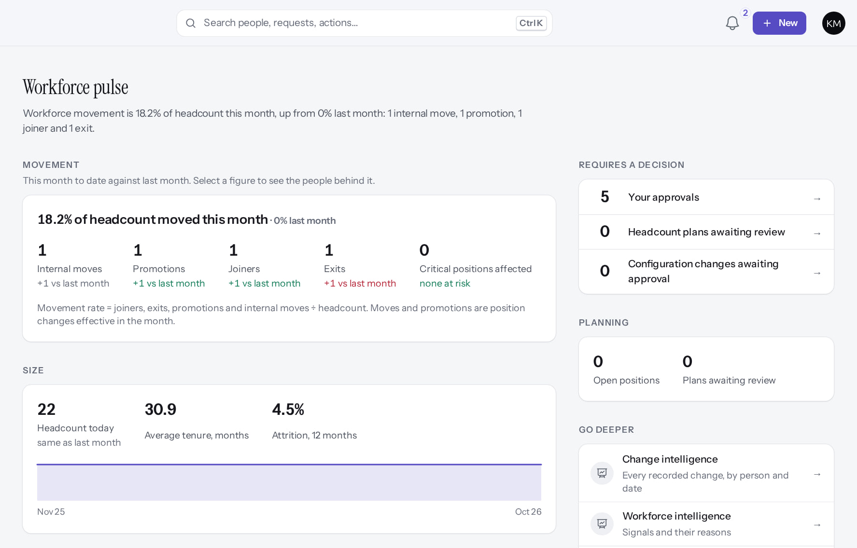
Workforce pulse: what moved this month
DASHBOARDS
Verified in the running application
Top of the page: movement (moves, promotions, joiners, exits against last month), size, decisions waiting and planning. Further down: attendance, performance, critical skills, exceptions. Select a figure to see the people behind it.
Real screen (cropped) · Kavya Menon (Tenant HR Admin + Employee) · Insights › Analytics › Workforce Command Centre (Workforce pulse)
Notes:
OBSERVE: "18.2% of headcount moved this month" reflects the training workflows (a hire, a transfer, a promotion, an exit).
SAY: Drill-down opens the people behind a figure, limited to those you may see.
EVIDENCE: Captured on the training database on 21 Oct 2026 as Kavya Menon (Tenant HR Admin) and Meera Iyer (Executive); tools/capture/80-insights.mjs. Figures reflect the fictional Demo Group after the other training workflows ran (22 people).

Slide 10
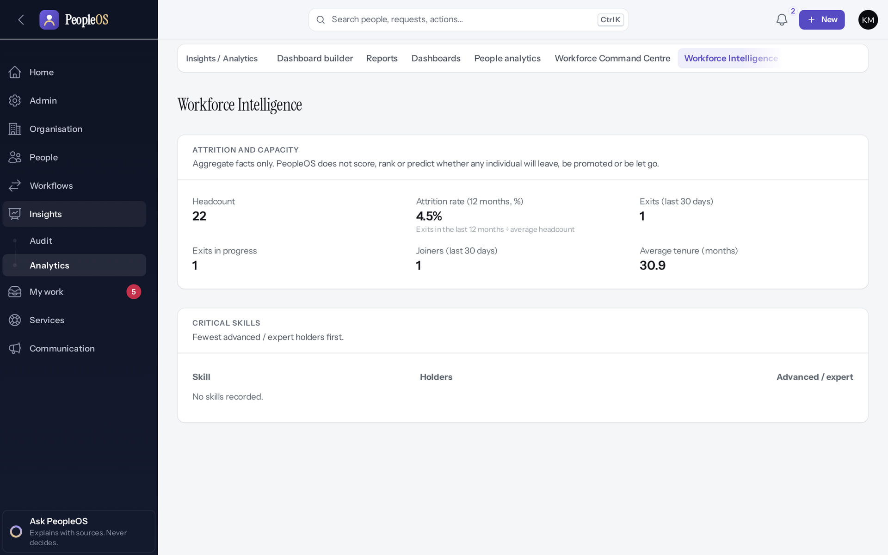
Workforce Intelligence: signals with reasons
DASHBOARDS
Verified in the running application
Attrition and capacity: aggregate facts only.
Critical skills: fewest advanced or expert holders first.
RESULT PeopleOS does not score, rank or predict whether an individual will leave or be promoted: the page says so. Critical skills is empty here: no skill levels are recorded in the training data.
Real screen · Kavya Menon (Tenant HR Admin + Employee) · Insights › Analytics › Workforce Intelligence
Notes:
SAY: Signals explain themselves; nothing here is an automated decision about a person.

Slide 11
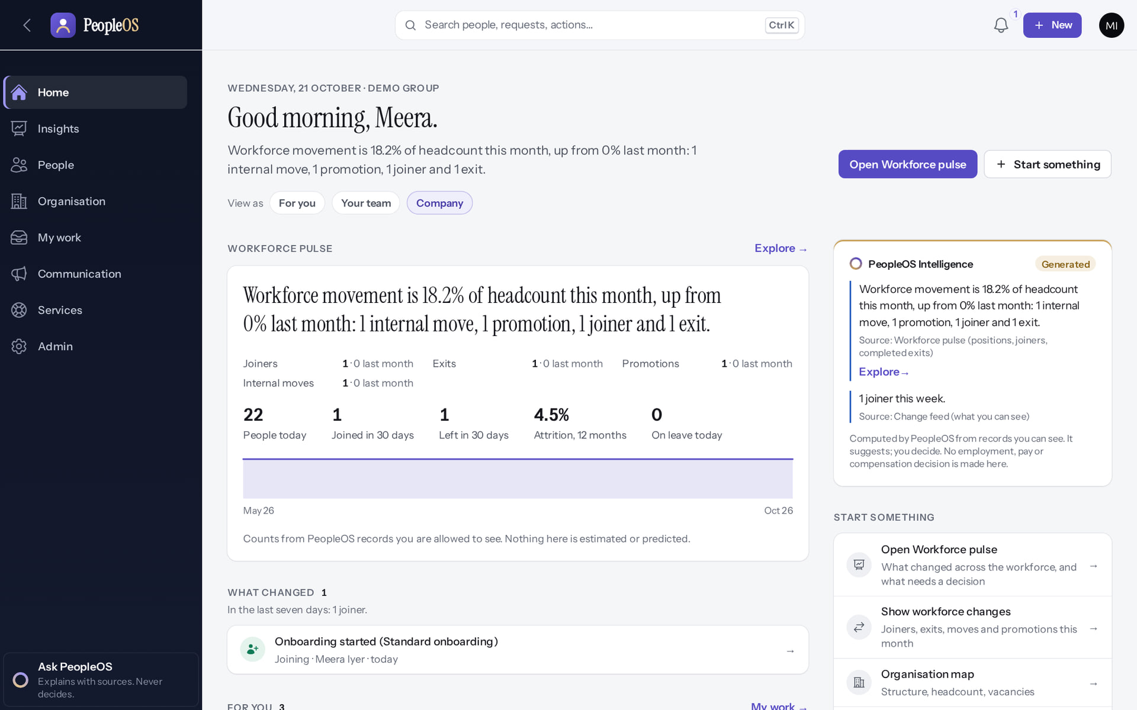
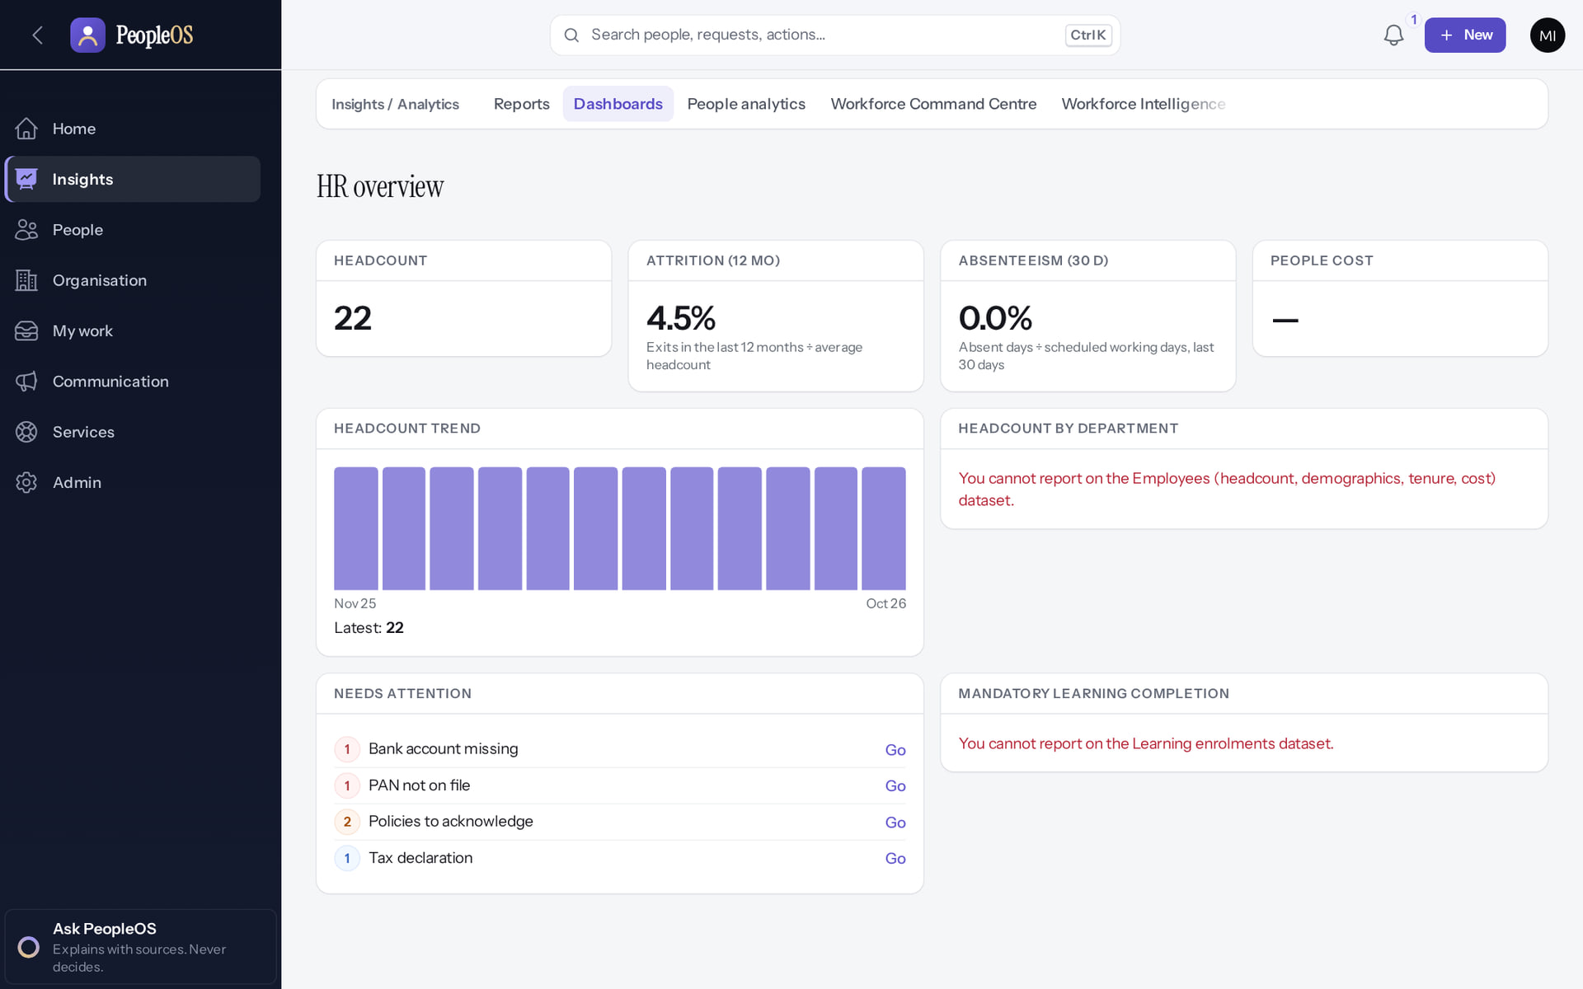
Executives: home lens and dataset access
DASHBOARDS
Executive Home
Verified
HR overview as an executive
After configuration
An executive's Home opens on the workforce lens: pulse, decisions and signals.
Headline tiles fill in, but report-based widgets show "You cannot report on the … dataset." (F45): the Executive role lacks dataset permissions.
Real screen · Meera Iyer (Executive + Employee) · Home (Executive)
Real screen · Meera Iyer (Executive + Employee) · Insights › Analytics › Dashboards (Executive)
Notes:
KNOWN GAP F45: the Executive role template lacks analytics dataset permissions, so report-based widgets and reports are empty for executives until a Tenant Super Admin extends the role. Headline tiles (headcount, attrition, absenteeism, trend) do show.
SAY: Executives: home lens and dataset access.
LEFT, Executive Home: An executive's Home opens on the workforce lens: pulse, decisions and signals.
RIGHT, HR overview as an executive: Headline tiles fill in, but report-based widgets show "You cannot report on the … dataset." (F45): the Executive role lacks dataset permissions.
OBSERVE: point out what differs between the two screens.
EVIDENCE: left = executive-demo/80-ins-18-executive-home [Meera Iyer (Executive + Employee), Home (Executive)]; right = analytics/80-ins-20-dashboard-executive-f45 [Meera Iyer (Executive + Employee), Insights › Analytics › Dashboards (Executive)]. Real screens, fictional data (SCREENSHOT-INVENTORY.md).

Slide 12
People analytics
02
One page, ten areas, each limited to what your role may see.
Notes:
TRANSITION: Section 2, People analytics. One page, ten areas, each limited to what your role may see.
SAY: Tell learners what they will be able to do by the end of this section, then move on.
ASK: "What questions do you have before we start this section?"

Slide 13
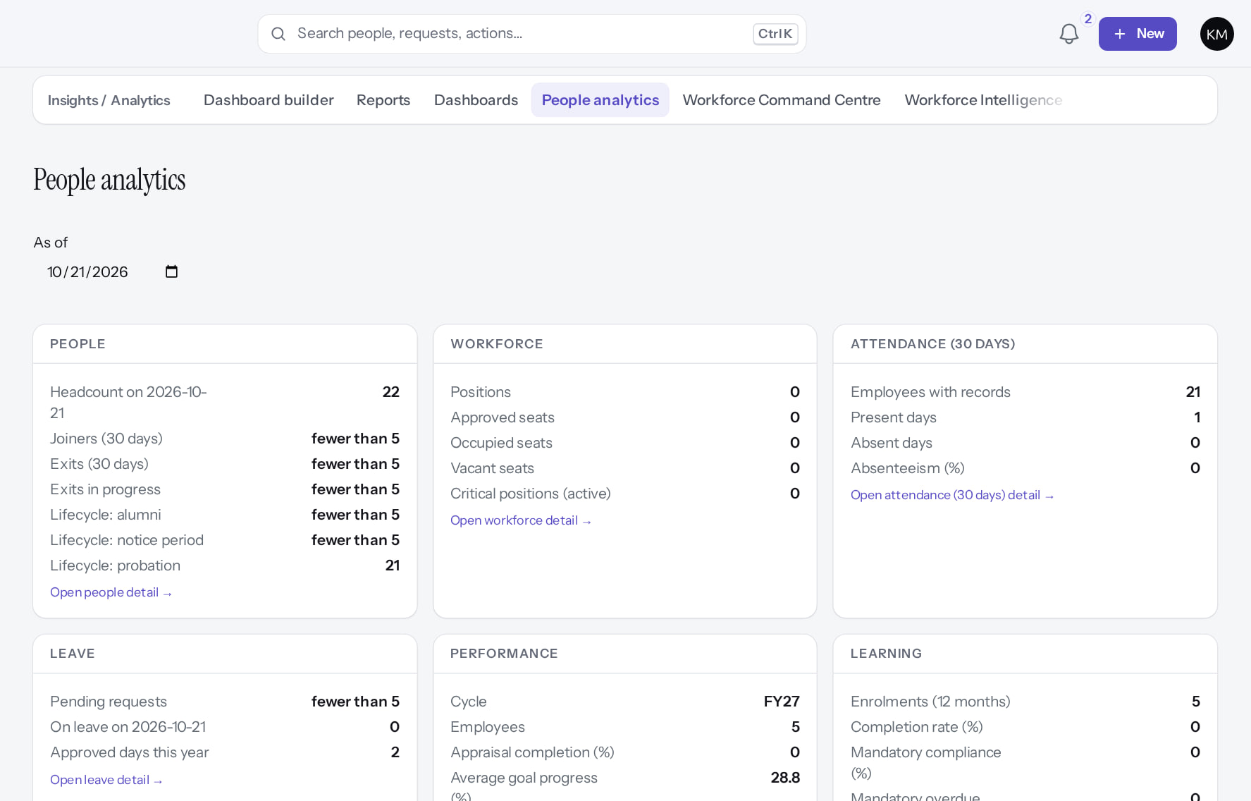
People analytics
PEOPLE ANALYTICS
Verified in the running application
Top of the page shown: People, Workforce, Attendance, Leave, Performance, Learning. Further down: Career & talent, Compensation, HR service, Engagement. "As of" reports on a past date.
Real screen (cropped) · Kavya Menon (Tenant HR Admin + Employee) · Insights › Analytics › People analytics
Notes:
SAY: Each area appears only if your role has that analytics permission. Here counts below 5 people are suppressed ("fewer than 5", e.g. joiners and exits under People, pending requests under Leave). Facts only: no individual scores, rankings or predictions.
EXERCISE: change "As of" to 1 October and compare headcount.

Slide 14
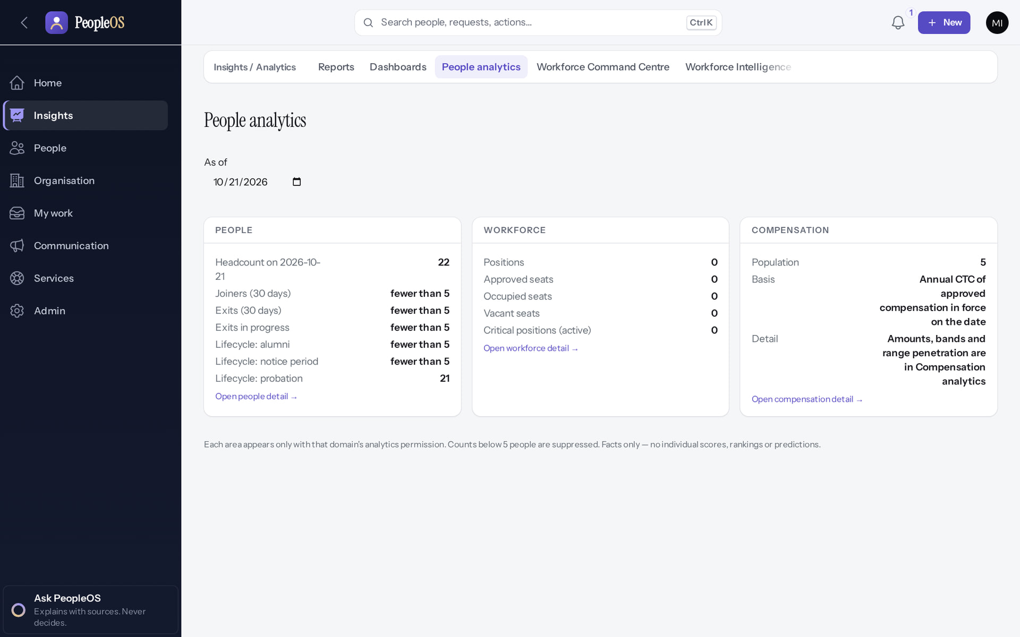
The same page for an executive
PEOPLE ANALYTICS
Verified in the running application
Aggregated figures only.
Areas without dataset permission are not shown.
RESULT What appears depends on the role, never on who asks.
Real screen · Meera Iyer (Executive + Employee) · Insights › Analytics › People analytics (Executive)
Notes:
SAY: What appears depends on the role, never on who asks.
ON SCREEN: Open People analytics as an executive.
WALK THROUGH: (1) Aggregated figures only. (2) Areas without dataset permission are not shown.
LEARNERS SHOULD SEE: Aggregated figures only; sections the role has no dataset permission for are not shown
SCREEN: Insights › Analytics › People analytics (Executive). Signed in as Meera Iyer (Executive + Employee). Prerequisite: Analytics permissions per dataset; privacy minimum group size.
EVIDENCE: screenshot screenshots/analytics/80-ins-19-people-analytics-executive.png, captured 2026-10-21 on the disposable training database (fictional people).

Slide 15
Area dashboards
03
Attendance, leave, pay, performance, learning, talent, workforce, exits and service.
Notes:
TRANSITION: Section 3, Area dashboards. Attendance, leave, pay, performance, learning, talent, workforce, exits and service.
SAY: Tell learners what they will be able to do by the end of this section, then move on.
ASK: "What questions do you have before we start this section?"

Slide 16
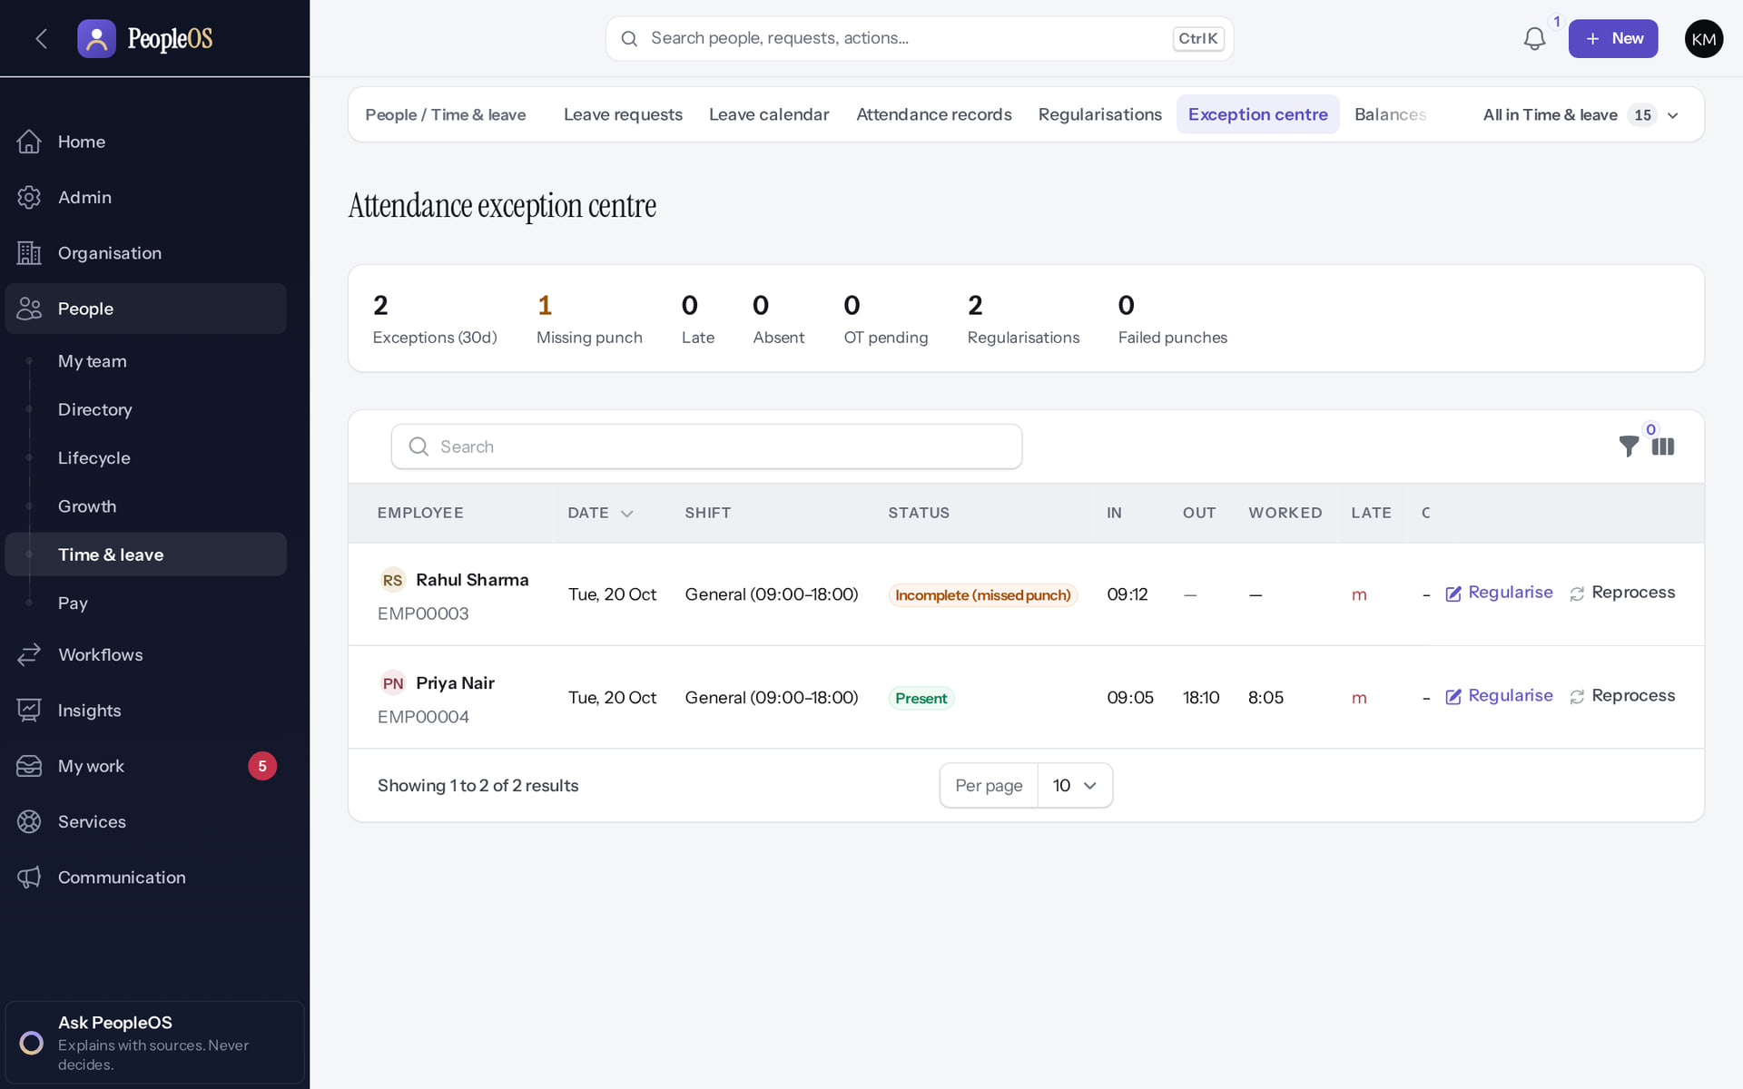
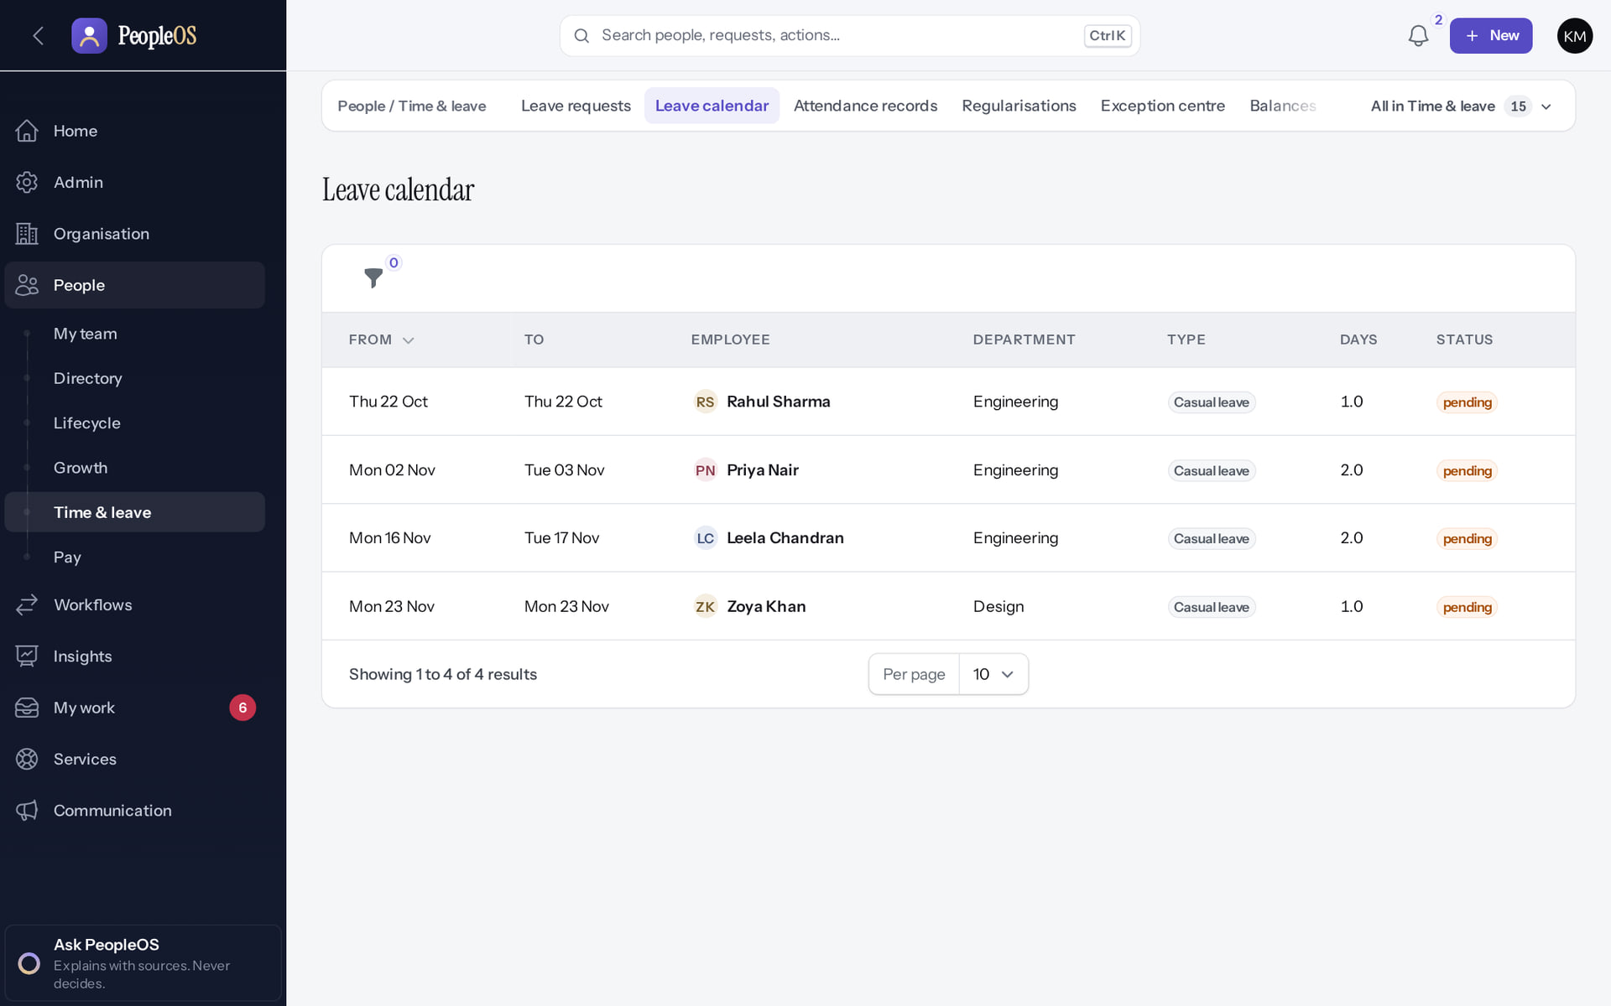
Attendance and leave
AREA DASHBOARDS
Attendance exception centre
Verified
Leave calendar
Verified
Exceptions, missing punches, late, absent, overtime pending, regularisations and failed punches (30 days).
Who is away and when (approved, pending, cancellation requested). Reasons are never shown.
Real screen · Kavya Menon (Tenant HR Admin + Employee) · Exception centre
Real screen · Kavya Menon (Tenant HR Admin + Employee) · People › Time & leave › Leave calendar
Notes:
SAY: Attendance and leave.
LEFT, Attendance exception centre: Exceptions, missing punches, late, absent, overtime pending, regularisations and failed punches (30 days).
RIGHT, Leave calendar: Who is away and when (approved, pending, cancellation requested). Reasons are never shown.
OBSERVE: point out what differs between the two screens.
EVIDENCE: left = hr-admin/20-att-14-exception-centre [Kavya Menon (Tenant HR Admin + Employee), Exception centre]; right = hr-admin/55-lv-13-leave-calendar [Kavya Menon (Tenant HR Admin + Employee), People › Time & leave › Leave calendar]. Real screens, fictional data (SCREENSHOT-INVENTORY.md).

Slide 17
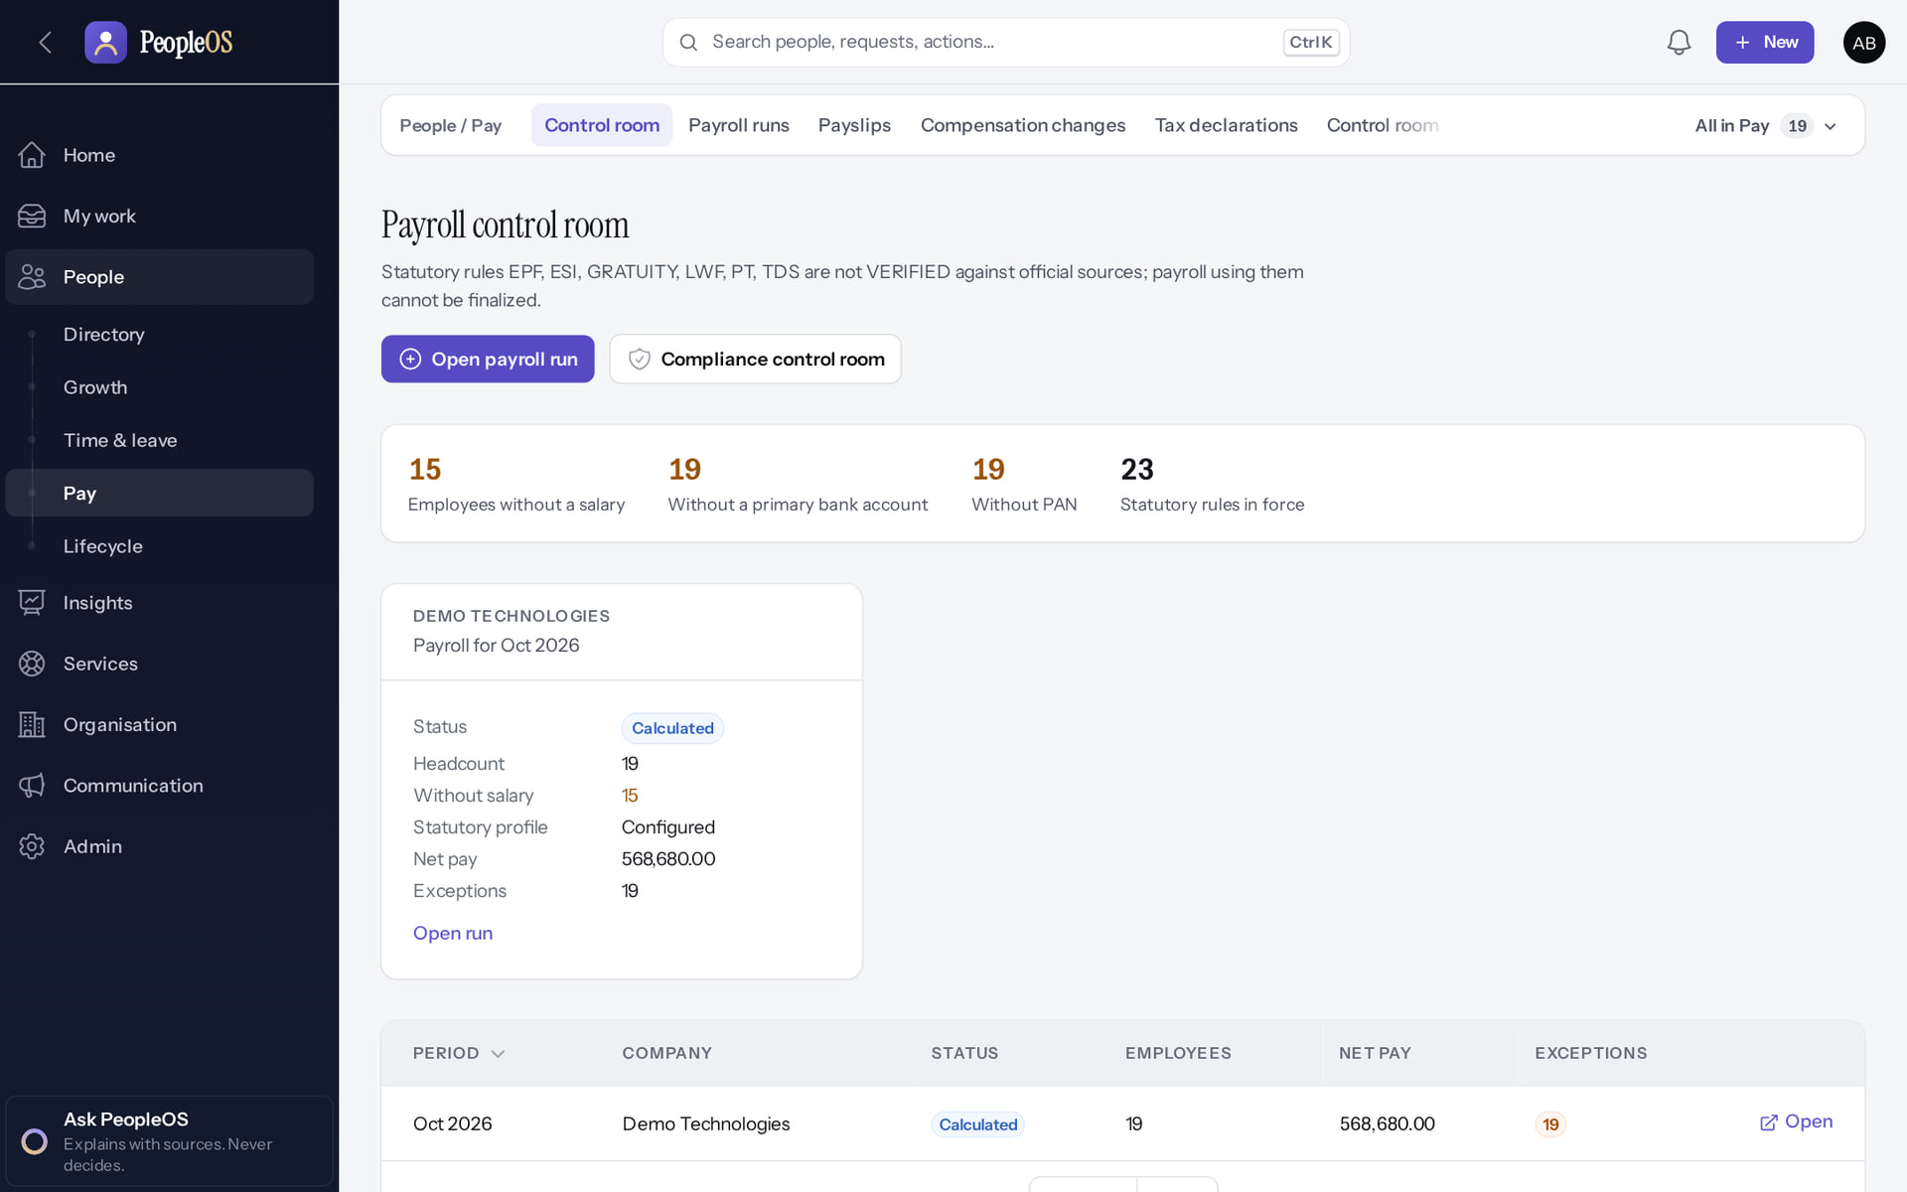
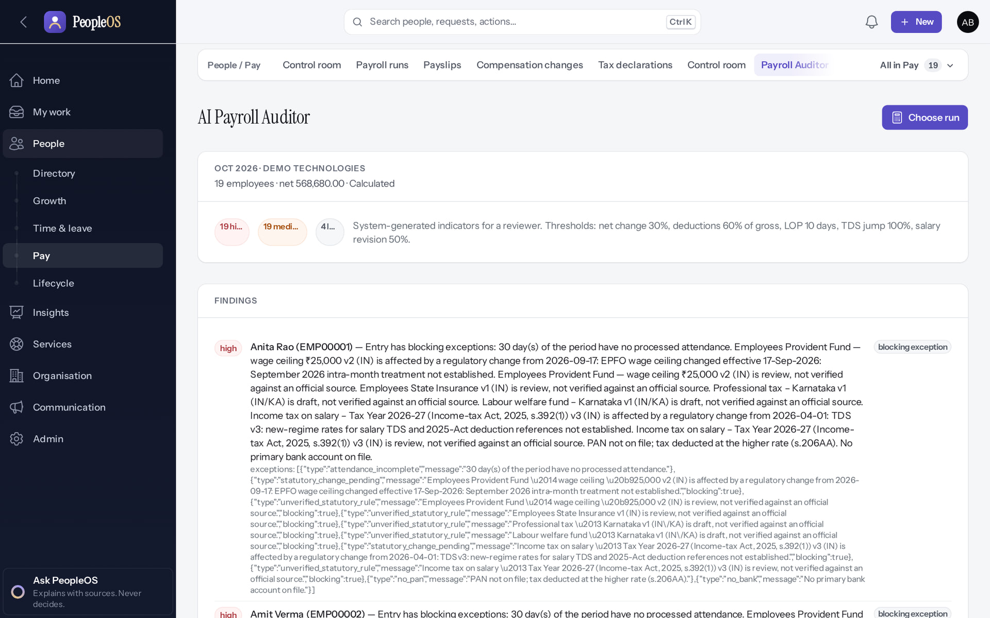
Payroll: control room and auditor
AREA DASHBOARDS
Payroll control room
Verified
Payroll Auditor
Verified
Readiness, runs and the statutory rules that block finalisation.
Findings with severity and evidence for a run; rule-based despite the "AI" label. Some findings show raw technical text (display gap).
Real screen · Arjun Bose (Payroll Admin + Employee) · People › Pay › Control room (Payroll control room)
Real screen · Arjun Bose (Payroll Admin + Employee) · People › Pay › Payroll Auditor
Notes:
GAP: payroll cost reports ("Payroll cost by period") read finalised and paid runs only; none exist while statutory rules are unverified.
SAY: Payroll: control room and auditor.
LEFT, Payroll control room: Readiness, runs and the statutory rules that block finalisation.
RIGHT, Payroll Auditor: Findings with severity and evidence for a run; rule-based despite the "AI" label. Some findings show raw technical text (display gap).
OBSERVE: point out what differs between the two screens.
EVIDENCE: left = hr-admin/60-pay-01-control-room [Arjun Bose (Payroll Admin + Employee), People › Pay › Control room (Payroll control room)]; right = hr-admin/60-pay-11-payroll-auditor [Arjun Bose (Payroll Admin + Employee), People › Pay › Payroll Auditor]. Real screens, fictional data (SCREENSHOT-INVENTORY.md).

Slide 18
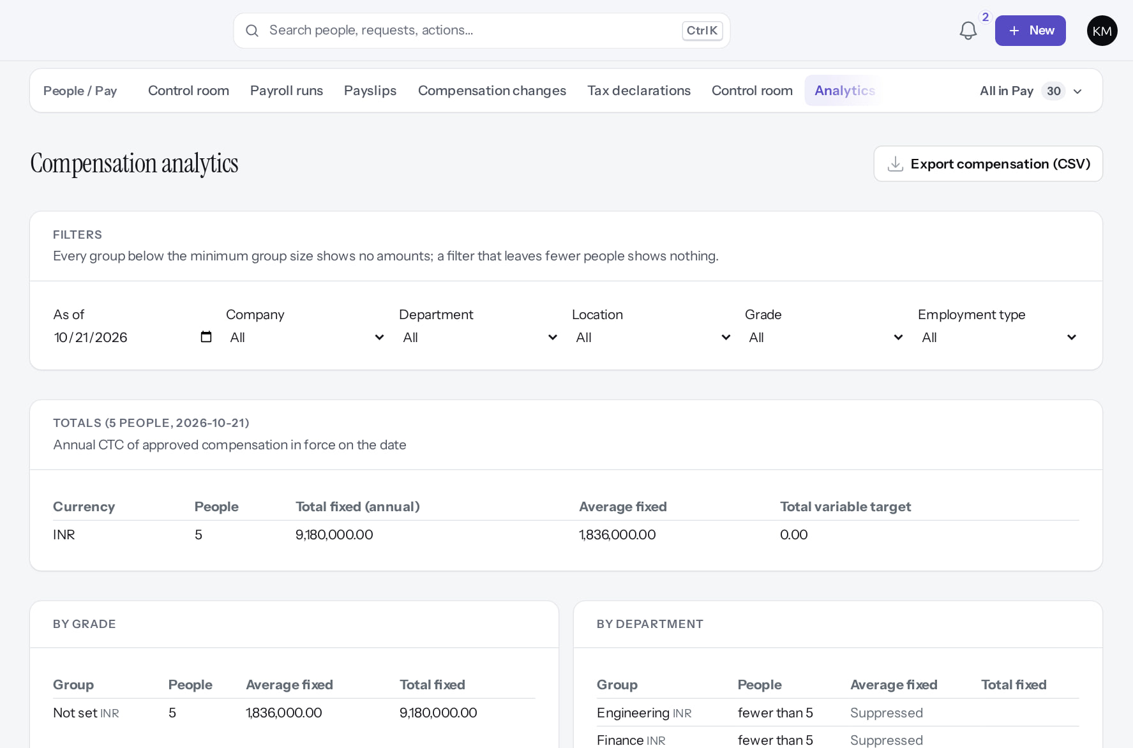
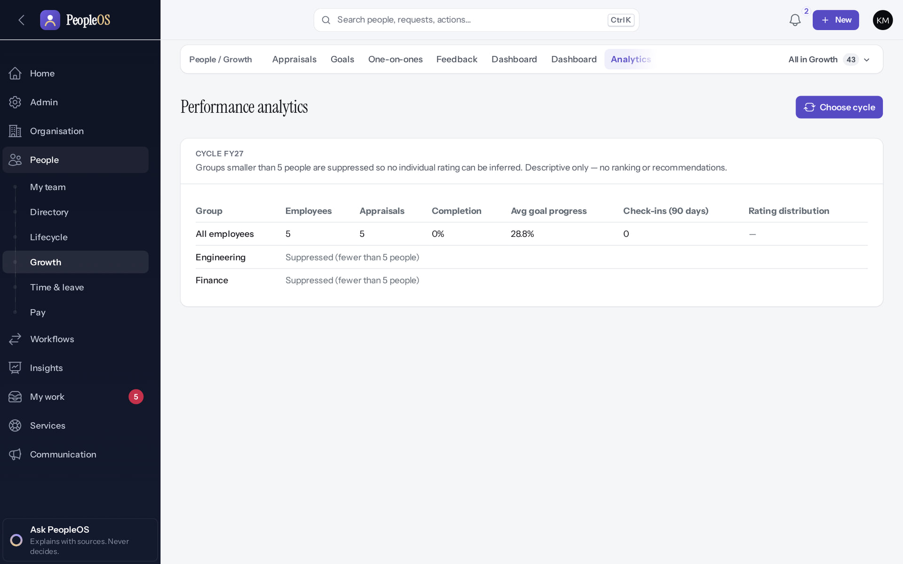
Compensation and performance
AREA DASHBOARDS
Compensation analytics
Verified
Performance analytics
Verified
Distributions and compa-ratios; groups below the minimum size are suppressed. Export compensation (CSV) is audited.
Review progress and rating distribution for a cycle (FY27).
Real screen (cropped) · Kavya Menon (Tenant HR Admin + Employee) · People › Pay › Analytics (Compensation analytics)
Real screen · Kavya Menon (Tenant HR Admin + Employee) · People › Growth › Analytics (Performance)
Notes:
SAY: Compensation and performance.
LEFT, Compensation analytics: Distributions and compa-ratios; groups below the minimum size are suppressed. Export compensation (CSV) is audited.
RIGHT, Performance analytics: Review progress and rating distribution for a cycle (FY27).
OBSERVE: point out what differs between the two screens.
EVIDENCE: left = analytics/62-comp-11-compensation-analytics [Kavya Menon (Tenant HR Admin + Employee), People › Pay › Analytics (Compensation analytics)]; right = analytics/80-ins-14-performance-analytics [Kavya Menon (Tenant HR Admin + Employee), People › Growth › Analytics (Performance)]. Real screens, fictional data (SCREENSHOT-INVENTORY.md).

Slide 19
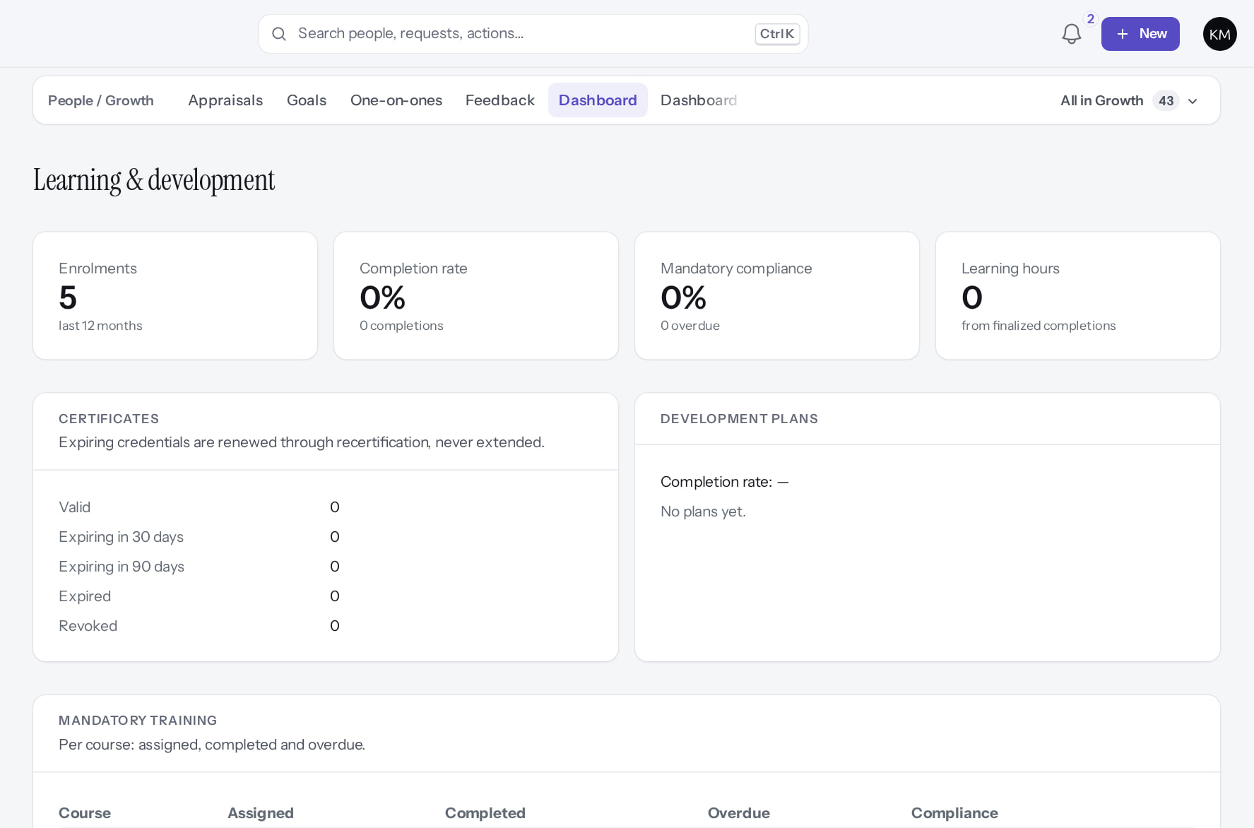
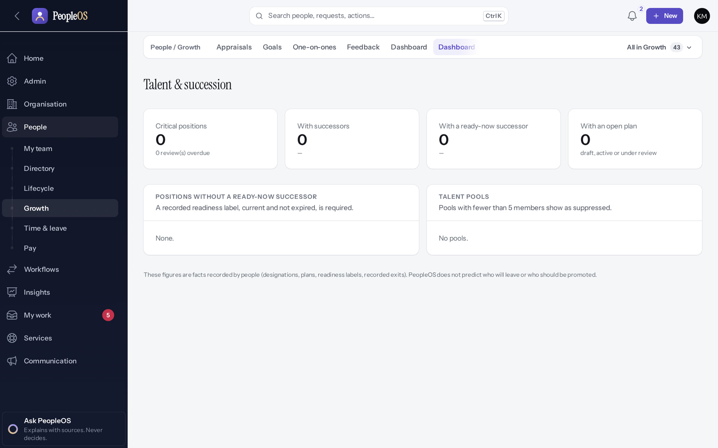
Learning and talent
AREA DASHBOARDS
Learning & development
Verified
Talent & succession
Verified
Top of the page: enrolments, completion, mandatory training. Further down: popular courses, skill gaps, providers, costs.
Positions without a ready-now successor and talent pools (empty in the training data).
Real screen (cropped) · Kavya Menon (Tenant HR Admin + Employee) · People › Growth › Dashboard (Learning & development)
Real screen · Kavya Menon (Tenant HR Admin + Employee) · People › Growth › Dashboard (Talent & succession)
Notes:
SAY: Learning and talent.
LEFT, Learning & development: Top of the page: enrolments, completion, mandatory training. Further down: popular courses, skill gaps, providers, costs.
RIGHT, Talent & succession: Positions without a ready-now successor and talent pools (empty in the training data).
OBSERVE: point out what differs between the two screens.
EVIDENCE: left = analytics/65-learn-03-learning-dashboard [Kavya Menon (Tenant HR Admin + Employee), People › Growth › Dashboard (Learning & development)]; right = analytics/65-talent-01-talent-dashboard [Kavya Menon (Tenant HR Admin + Employee), People › Growth › Dashboard (Talent & succession)]. Real screens, fictional data (SCREENSHOT-INVENTORY.md).

Slide 20
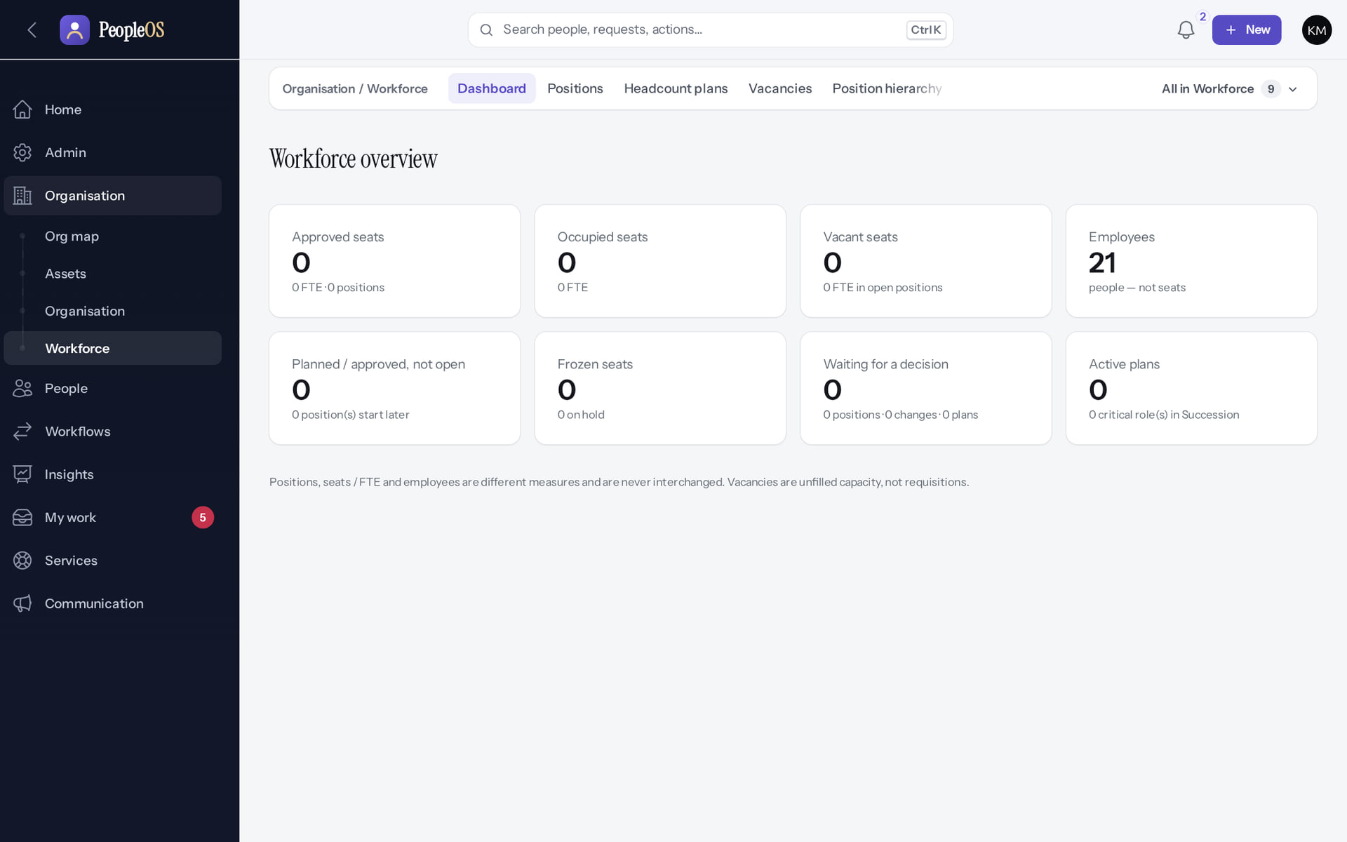
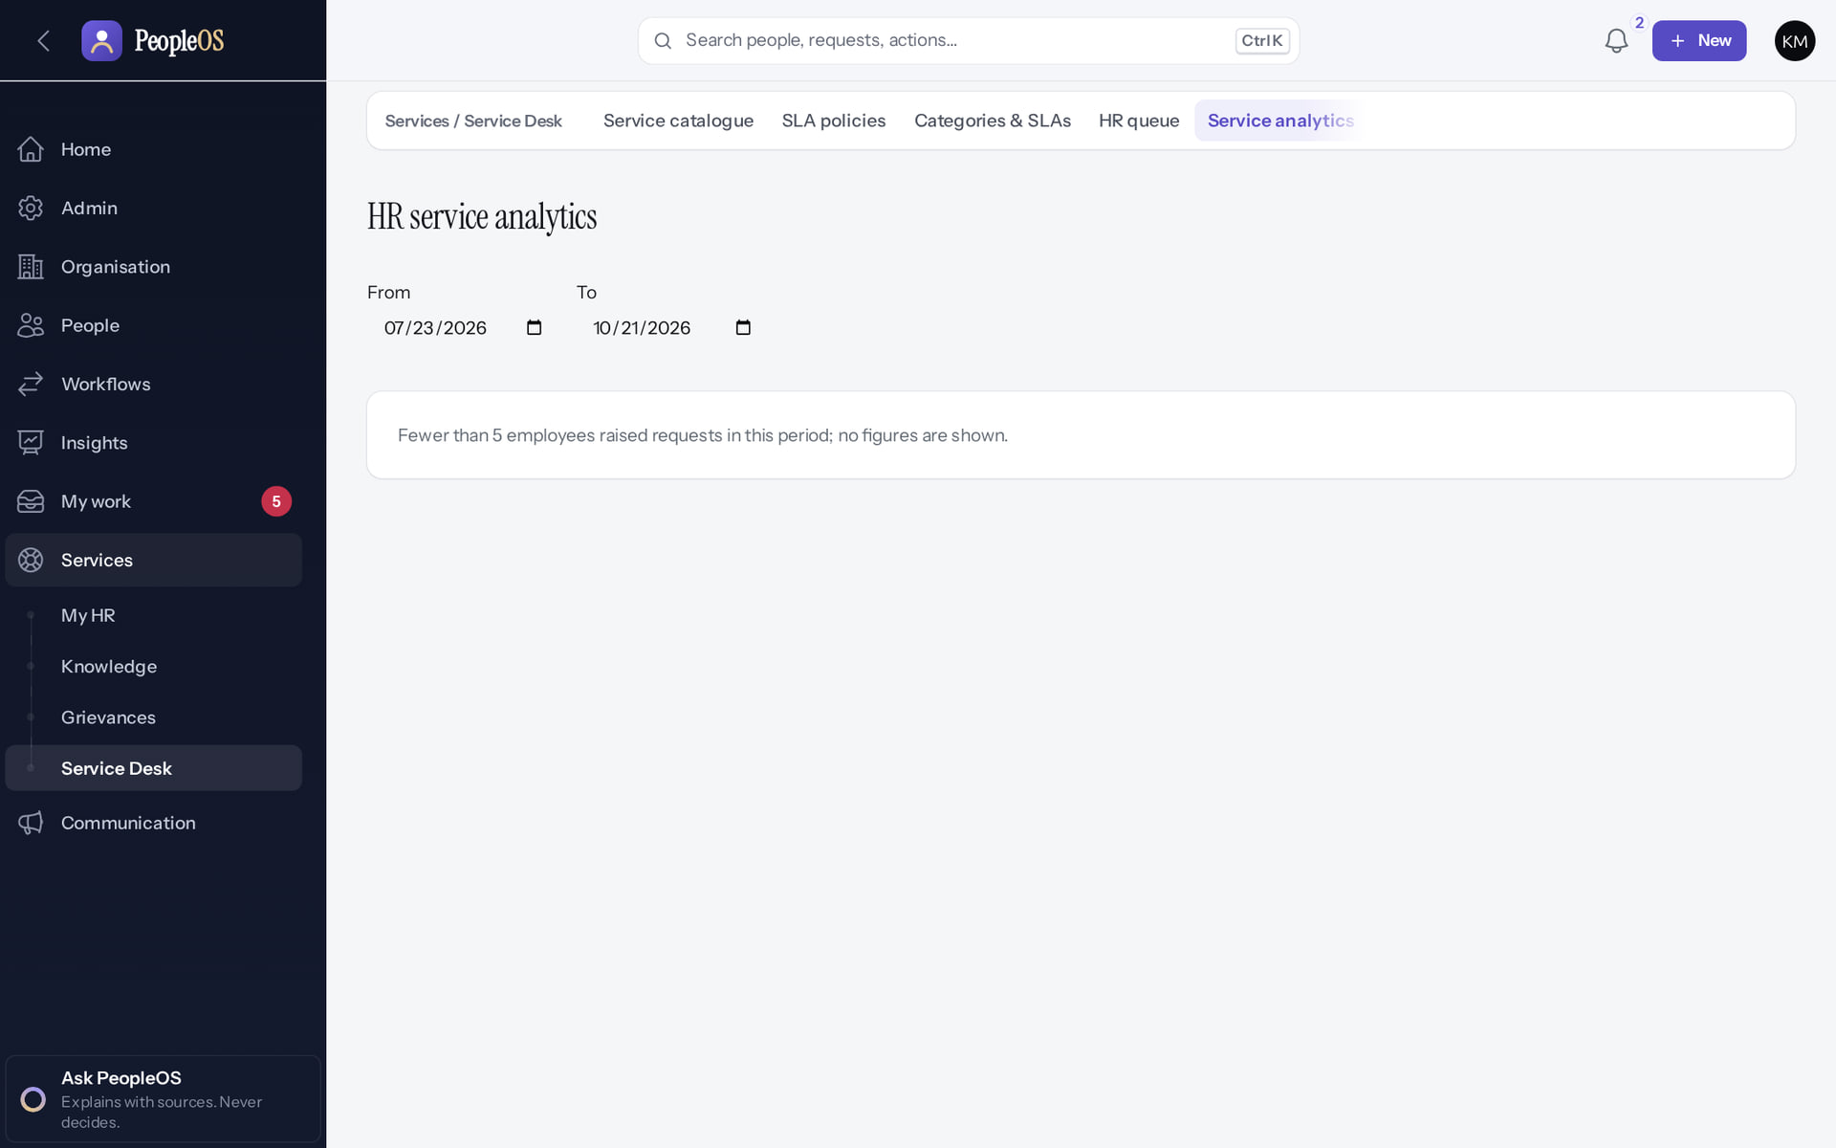
Workforce, exits and HR service
AREA DASHBOARDS
Workforce overview
Verified
HR service analytics
Verified
Positions, vacancies, budgets and plans (mostly zero). Shows 21 employees: captured 19 seconds before the training hire that makes 22 elsewhere.
"Fewer than 5 employees raised requests in this period; no figures are shown." Privacy suppression.
Real screen (cropped) · Kavya Menon (Tenant HR Admin + Employee) · Organisation › Workforce › Dashboard (Workforce overview)
Real screen · Kavya Menon (Tenant HR Admin + Employee) · Services › Service Desk › Service analytics
Notes:
SAY: Workforce, exits and HR service.
LEFT, Workforce overview: Positions, vacancies, budgets and plans (mostly zero). Shows 21 employees: captured 19 seconds before the training hire that makes 22 elsewhere.
RIGHT, HR service analytics: "Fewer than 5 employees raised requests in this period; no figures are shown." Privacy suppression.
OBSERVE: point out what differs between the two screens.
EVIDENCE: left = analytics/65-wf-06-workforce-dashboard [Kavya Menon (Tenant HR Admin + Employee), Organisation › Workforce › Dashboard (Workforce overview)]; right = analytics/80-ins-16-service-analytics [Kavya Menon (Tenant HR Admin + Employee), Services › Service Desk › Service analytics]. Real screens, fictional data (SCREENSHOT-INVENTORY.md).

Slide 21
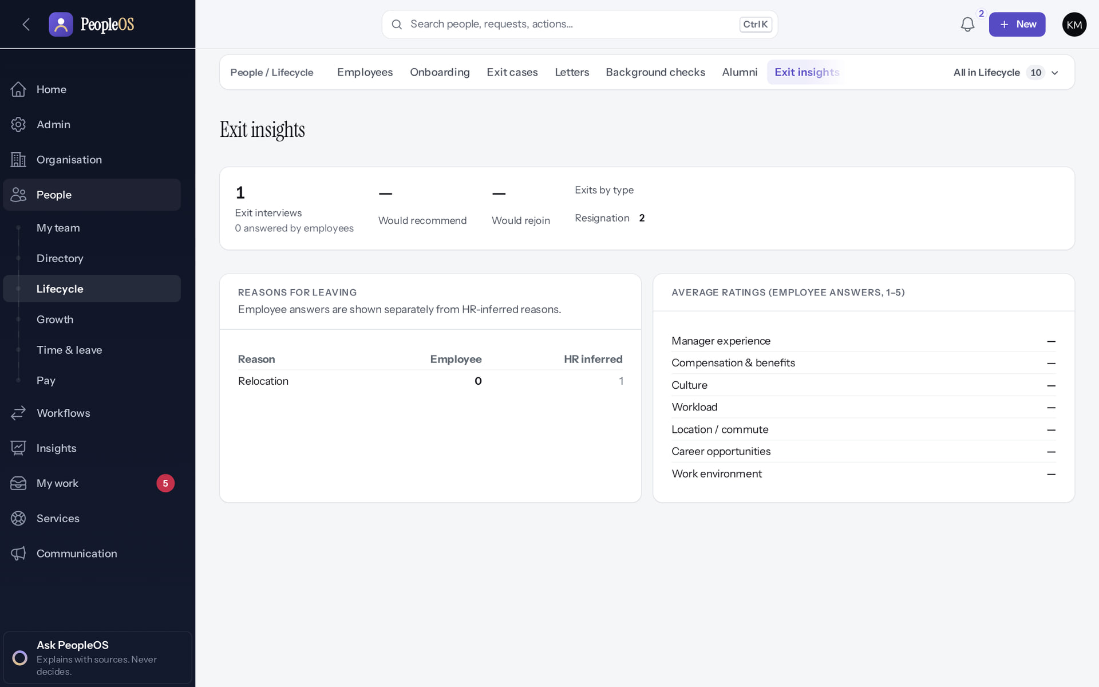
Exit insights
AREA DASHBOARDS
Verified in the running application
Reasons for leaving and average exit-interview ratings.
RESULT Averages use employee answers only.
Real screen · Kavya Menon (Tenant HR Admin + Employee) · People › Lifecycle › Exit insights
Notes:
SAY: Averages use employee answers only.
ON SCREEN: Open Exit insights.
WALK THROUGH: (1) Reasons for leaving and average exit-interview ratings.
LEARNERS SHOULD SEE: Reasons for leaving and average exit-interview ratings (employee answers only)
SCREEN: People › Lifecycle › Exit insights. Signed in as Kavya Menon (Tenant HR Admin + Employee). Prerequisite: Analytics permissions per dataset; privacy minimum group size.
EVIDENCE: screenshot screenshots/analytics/80-ins-15-exit-insights.png, captured 2026-10-21 on the disposable training database (fictional people).

Slide 22
Reports and export
04
Six starter reports run and export today; building new reports has a known defect.
Notes:
TRANSITION: Section 4, Reports and export. Six starter reports run and export today; building new reports has a known defect.
SAY: Tell learners what they will be able to do by the end of this section, then move on.
ASK: "What questions do you have before we start this section?"

Slide 23
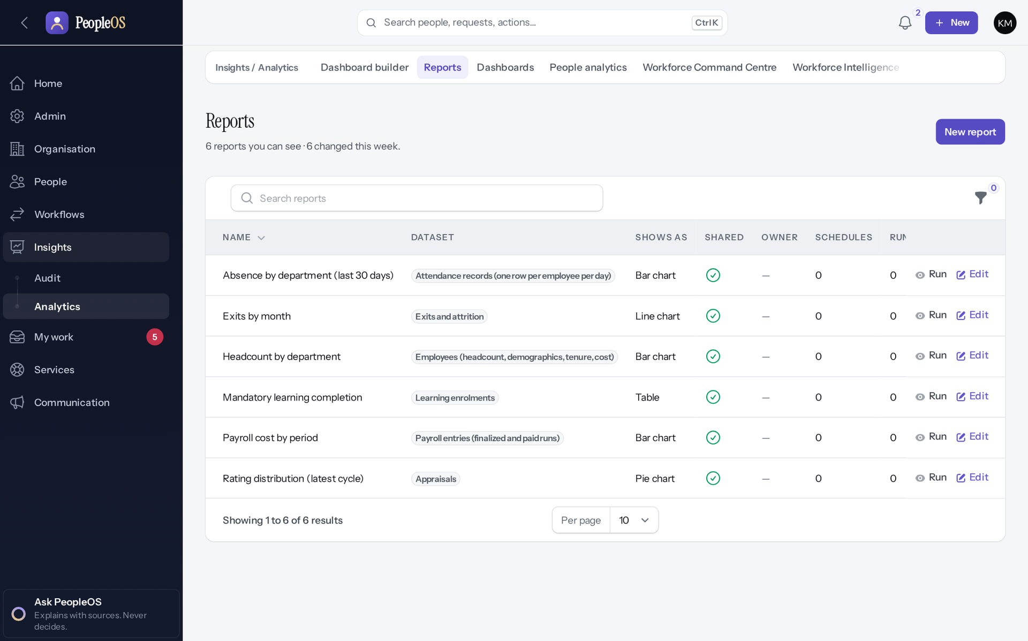
Reports
REPORTS
Verified in the running application
3
1
A starter report with its dataset and chart.
2
Run.
3
New report.
RESULT Starter reports: Absence by department (30 days), Exits by month, Headcount by department, Mandatory learning completion, Payroll cost by period, Rating distribution.
2
1
Real screen · Kavya Menon (Tenant HR Admin + Employee) · Insights › Analytics › Reports
Notes:
SAY: Starter reports: Absence by department (30 days), Exits by month, Headcount by department, Mandatory learning completion, Payroll cost by period, Rating distribution.
ON SCREEN: Open Reports.
WALK THROUGH: (1) A starter report with its dataset and chart. (2) Run. (3) New report.
LEARNERS SHOULD SEE: Six starter reports with dataset, chart type and schedule; Run and Edit per report; New report
SCREEN: Insights › Analytics › Reports. Signed in as Kavya Menon (Tenant HR Admin + Employee). Prerequisite: report.view / report.manage and permission on the report’s dataset.
EVIDENCE: screenshot screenshots/analytics/80-ins-05-reports-list.png, captured 2026-10-21 on the disposable training database (fictional people).

Slide 24
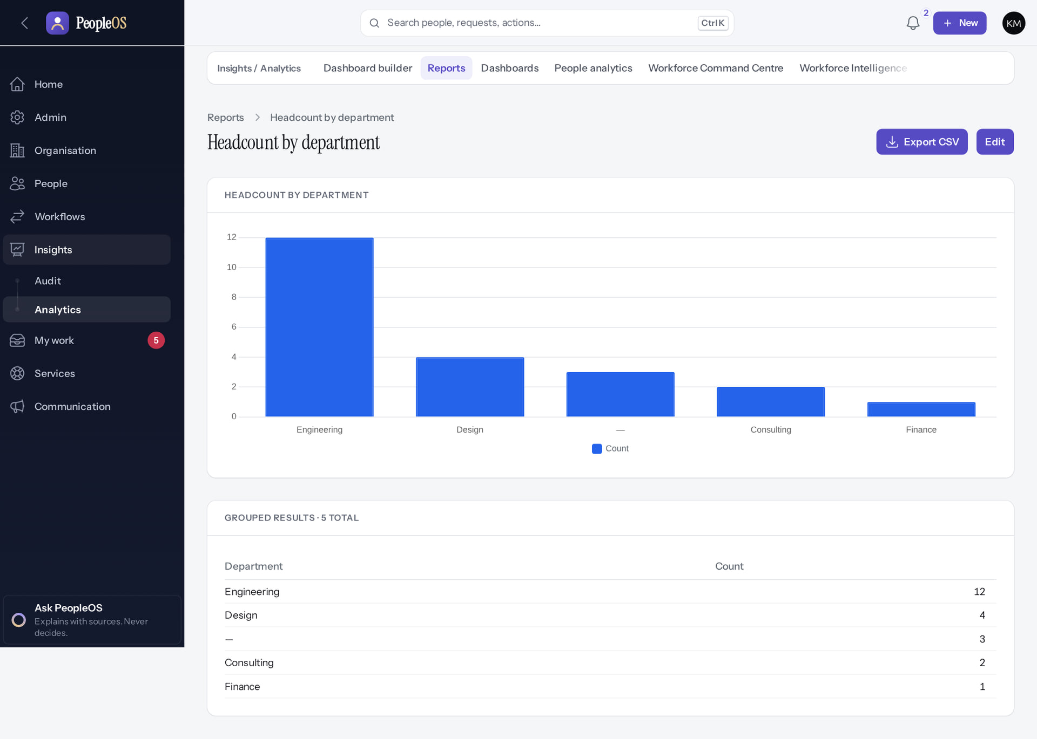
Run a report
REPORTS
Verified in the running application
2
1
Grouped results, computed from the records you may see.
2
Export CSV.
RESULT Headcount by department: Engineering 12, Design 4, (no department) 3, Consulting 2, Finance 1.
1
Real screen · Kavya Menon (Tenant HR Admin + Employee) · Report: Headcount by department
Notes:
RECONCILE: the "—" group is employees without a department; fix them in the employee register, then re-run.

Slide 25
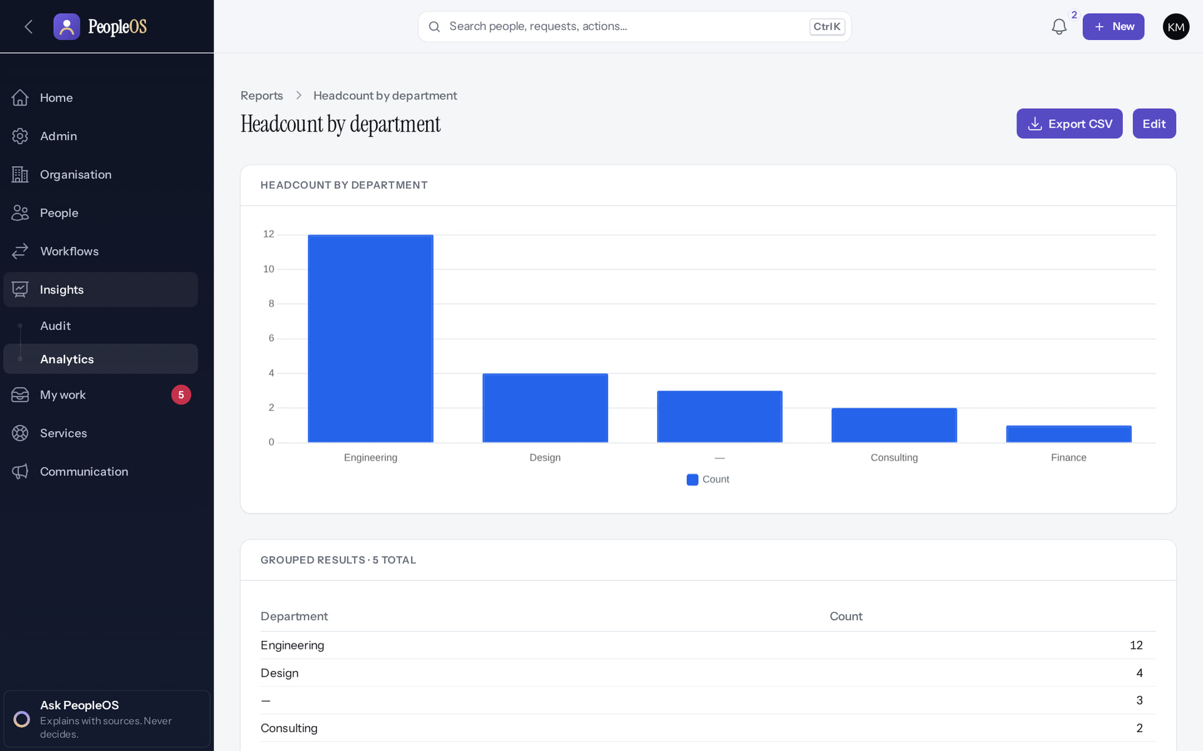
Export CSV
REPORTS
Verified in the running application
RESULT The CSV downloads immediately (observed: headcount-by-department-20261021-073623-1.csv), with no on-screen message. The export is recorded in Change history as an Export event.
Real screen · Kavya Menon (Tenant HR Admin + Employee) · Report (after Export CSV)
Notes:
SAY: Exports respect your access scope and the dataset's sensitive-field permission. Every export is audited: see the first row of the Change history slide.

Slide 26
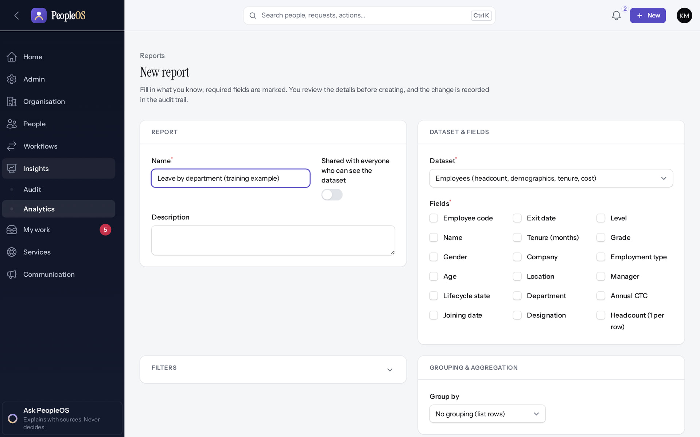
Report builder: a known defect
REPORTS
Incomplete · known defect or gap
1
Dataset chosen: Employees.
Group by (closed here) offered only "No grouping" when opened during the capture.
1
RESULT Defect F44: the Fields list fills, but Filters, Group by, chart axis and Sort by (lower on the form) offer no dataset fields, so new grouped reports cannot be built. Use the starter reports and People analytics until it is fixed.
Real screen · Kavya Menon (Tenant HR Admin + Employee) · Insights › Analytics › Reports › New report
Notes:
EVIDENCE: app/Filament/Support/ReportBuilderSchema.php resolves the dataset with an absolute path; recorded in docs/reports/documentation-gaps.md F44 and re-observed live on 21 Oct 2026.

Slide 27
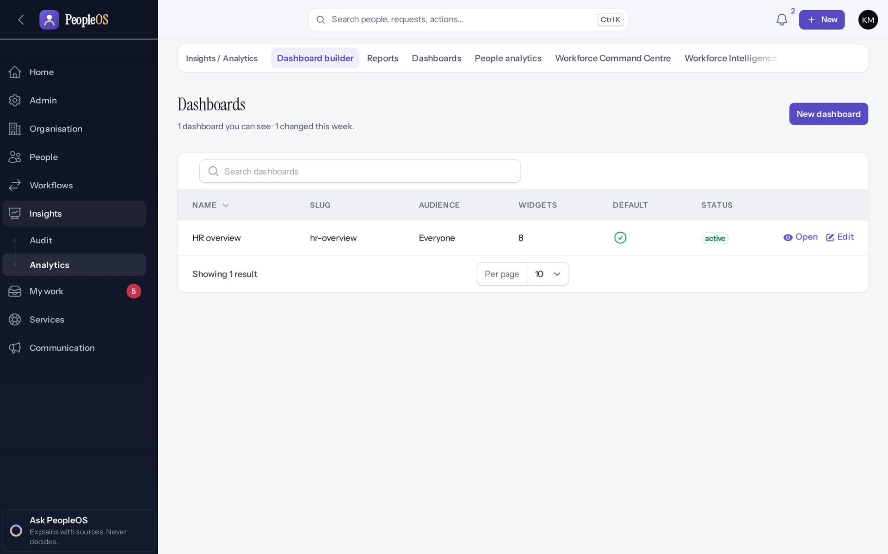
Dashboard builder
REPORTS
Verified in the running application
1
1
New dashboard.
RESULT The HR overview dashboard: audience Everyone, 8 widgets. Widgets that use report grouping are affected by F44.
Real screen · Kavya Menon (Tenant HR Admin + Employee) · Insights › Analytics › Dashboard builder
Notes:
SAY: The HR overview dashboard: audience Everyone, 8 widgets. Widgets that use report grouping are affected by F44.
ON SCREEN: Open the Dashboard builder.
WALK THROUGH: (1) New dashboard.
LEARNERS SHOULD SEE: HR overview dashboard (audience Everyone, 8 widgets); New dashboard, Open, Edit
SCREEN: Insights › Analytics › Dashboard builder. Signed in as Kavya Menon (Tenant HR Admin + Employee). Prerequisite: Analytics permissions per dataset; privacy minimum group size.
EVIDENCE: screenshot screenshots/analytics/80-ins-09-dashboard-builder.png, captured 2026-10-21 on the disposable training database (fictional people).

Slide 28
Scheduled reports: know the limits
REPORTS
Runs as the owner
Notices are in-app
Needs the scheduler
A scheduled run uses the report owner's access. Starter reports have no owner, so their schedules fail (F46).
Completed schedules notify in the application only; only the owner can download a scheduled export.
Schedules run through peopleos:reports:run-due, which needs the scheduler running in production (gate 8).
Notes:
SOURCE: documentation-gaps F46 (code); architecture contract §10. Scheduled runs were not exercised in this training (no scheduler runs locally).
SAY: Scheduled reports: know the limits.
- Runs as the owner: A scheduled run uses the report owner's access. Starter reports have no owner, so their schedules fail (F46).
- Notices are in-app: Completed schedules notify in the application only; only the owner can download a scheduled export.
- Needs the scheduler: Schedules run through peopleos:reports:run-due, which needs the scheduler running in production (gate 8).
ASK: "Which of these points needs more explanation for your team?"

Slide 29
Audit and operational reports
05
Who changed what, when, why, and proof that the record was not altered.
Notes:
TRANSITION: Section 5, Audit and operational reports. Who changed what, when, why, and proof that the record was not altered.
SAY: Tell learners what they will be able to do by the end of this section, then move on.
ASK: "What questions do you have before we start this section?"

Slide 30
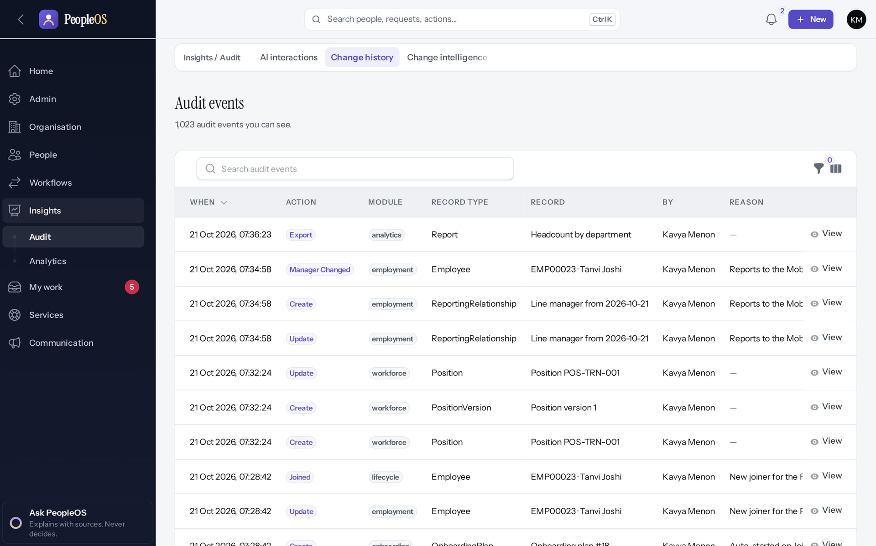
Change history
AUDIT
Verified in the running application
1
When.
The latest event: the report export above.
1
RESULT Every recorded change with action, module, record, who and reason. Filter, then View any event.
Real screen · Kavya Menon (Tenant HR Admin + Employee) · Insights › Audit › Change history (Audit events)
Notes:
OBSERVE: the export of "Headcount by department" appears as an Export event, followed by the training team's hires, manager changes and position edits.

Slide 31
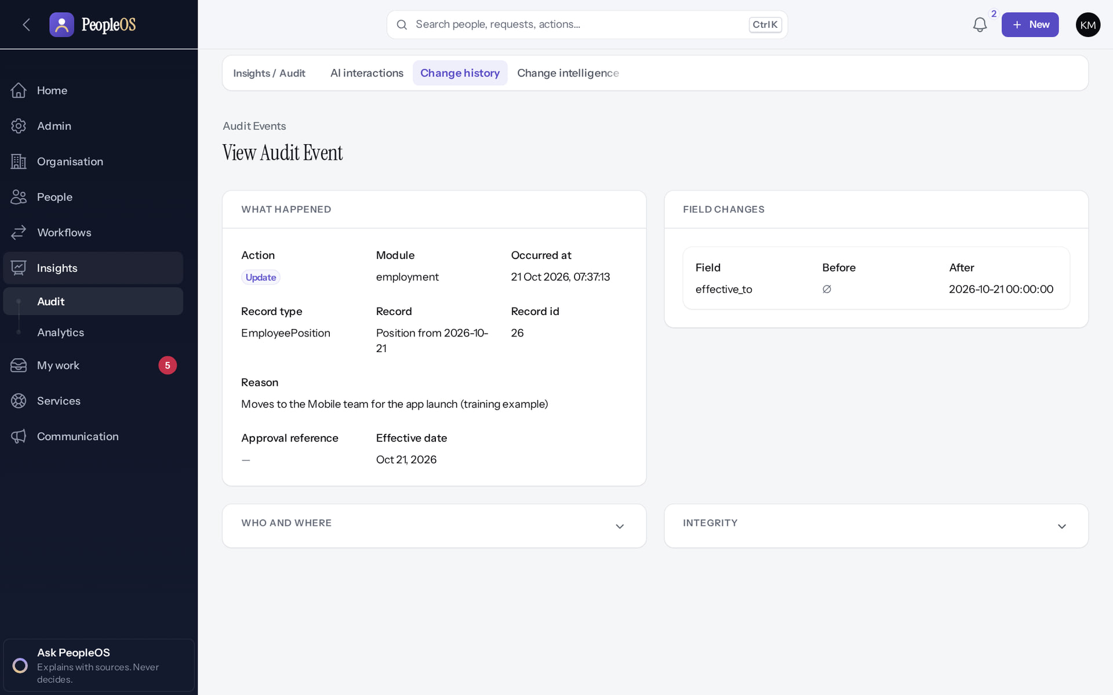
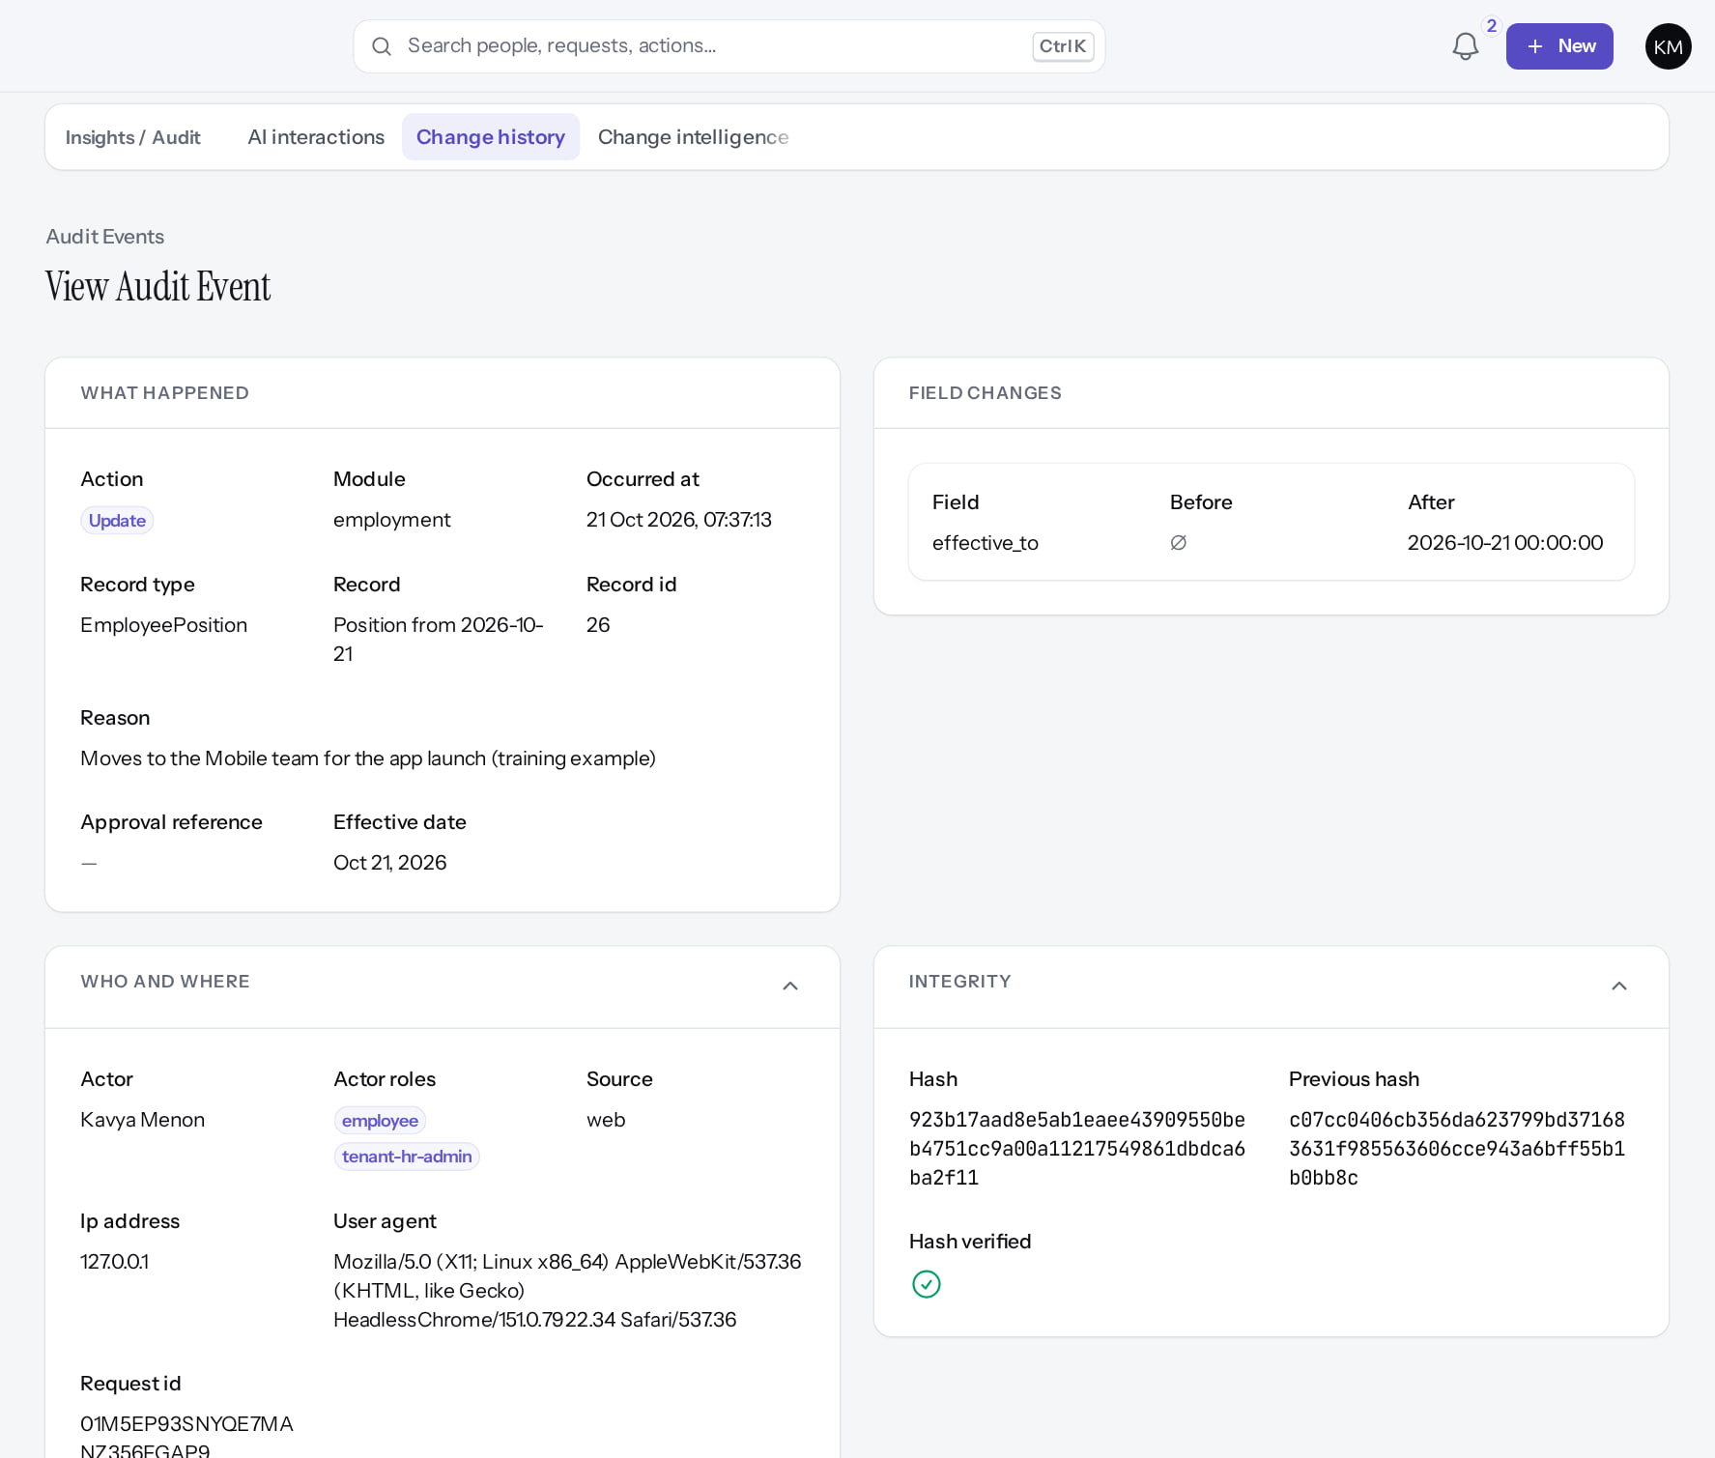
One event: details and integrity
AUDIT
Event detail
Verified
Who and where · Integrity
Verified
Who, when, action, reason and the field-level before → after values.
Actor and roles, source, IP, request id; Hash, Previous hash and "Hash verified ✓".
Real screen · Kavya Menon (Tenant HR Admin + Employee) · Change history › event
Real screen (cropped) · Kavya Menon (Tenant HR Admin + Employee) · Change history › event (Who and where, Integrity expanded)
Notes:
SAY: Each event is chained to the one before it. Editing a stored event would break the chain.
SAY: One event: details and integrity.
LEFT, Event detail: Who, when, action, reason and the field-level before → after values.
RIGHT, Who and where · Integrity: Actor and roles, source, IP, request id; Hash, Previous hash and "Hash verified ✓".
OBSERVE: point out what differs between the two screens.
EVIDENCE: left = security-compliance/80-ins-11-audit-event-detail [Kavya Menon (Tenant HR Admin + Employee), Change history › event]; right = security-compliance/80-ins-11b-audit-integrity [Kavya Menon (Tenant HR Admin + Employee), Change history › event (Who and where, Integrity expanded)]. Real screens, fictional data (SCREENSHOT-INVENTORY.md).

Slide 32
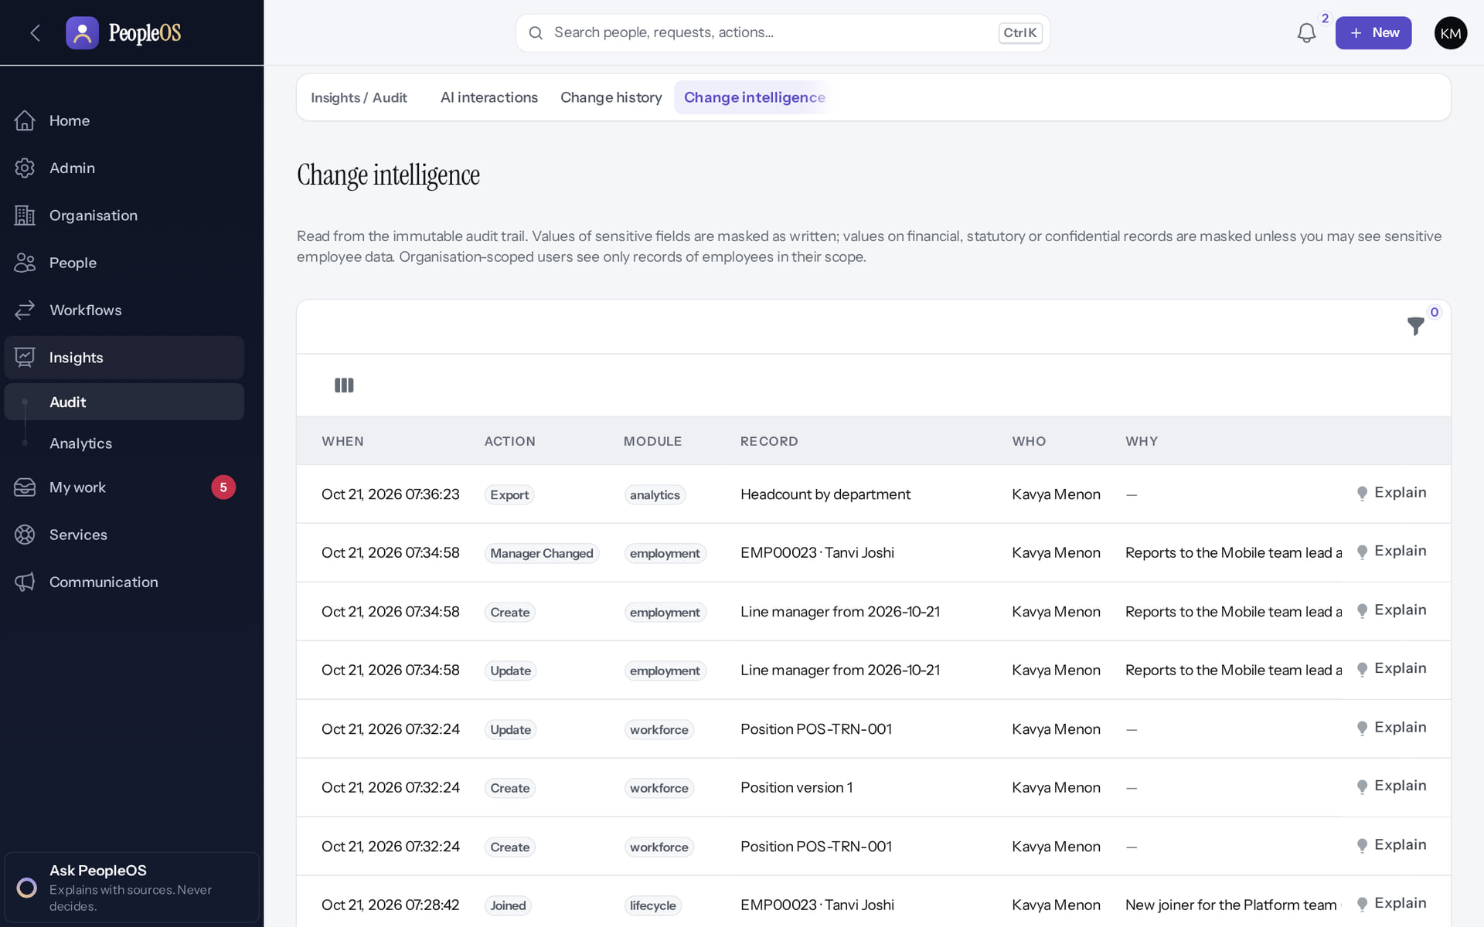
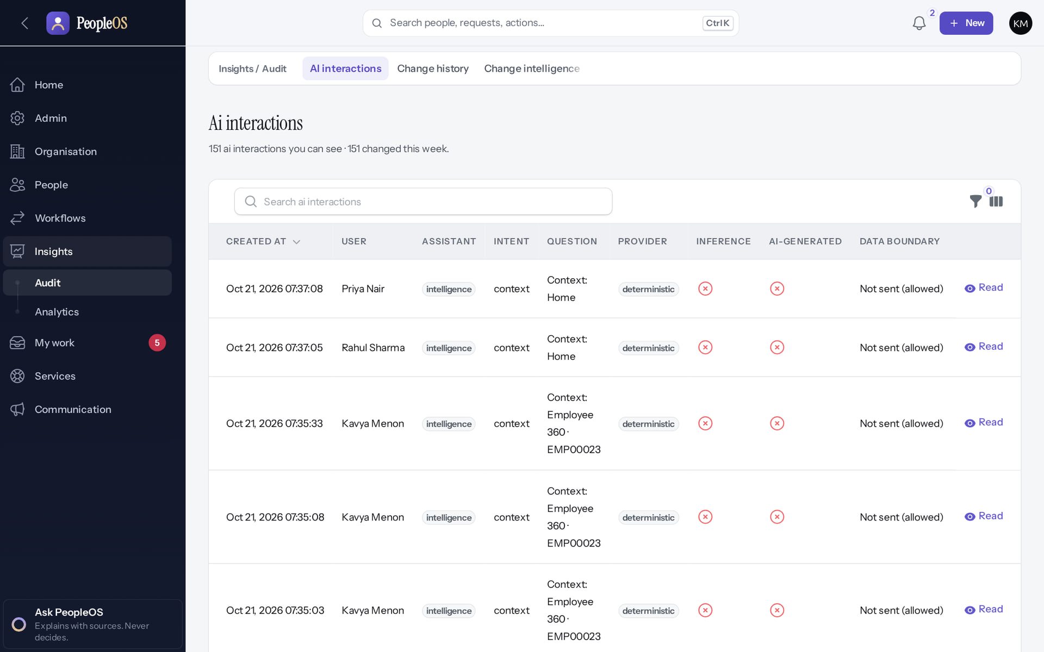
Change intelligence and AI interactions
AUDIT
Change intelligence
Verified
AI interactions
Verified
Changes by person and date with Explain. Sensitive values stay masked unless you may see them.
Every assistant question and answer, with the user, assistant and sources. Read only.
Real screen · Kavya Menon (Tenant HR Admin + Employee) · Insights › Audit › Change intelligence
Real screen · Kavya Menon (Tenant HR Admin + Employee) · Insights › Audit › AI interactions
Notes:
SAY: Change intelligence and AI interactions.
LEFT, Change intelligence: Changes by person and date with Explain. Sensitive values stay masked unless you may see them.
RIGHT, AI interactions: Every assistant question and answer, with the user, assistant and sources. Read only.
OBSERVE: point out what differs between the two screens.
EVIDENCE: left = analytics/80-ins-12-change-intelligence [Kavya Menon (Tenant HR Admin + Employee), Insights › Audit › Change intelligence]; right = analytics/80-ins-13-ai-interactions [Kavya Menon (Tenant HR Admin + Employee), Insights › Audit › AI interactions]. Real screens, fictional data (SCREENSHOT-INVENTORY.md).

Slide 33
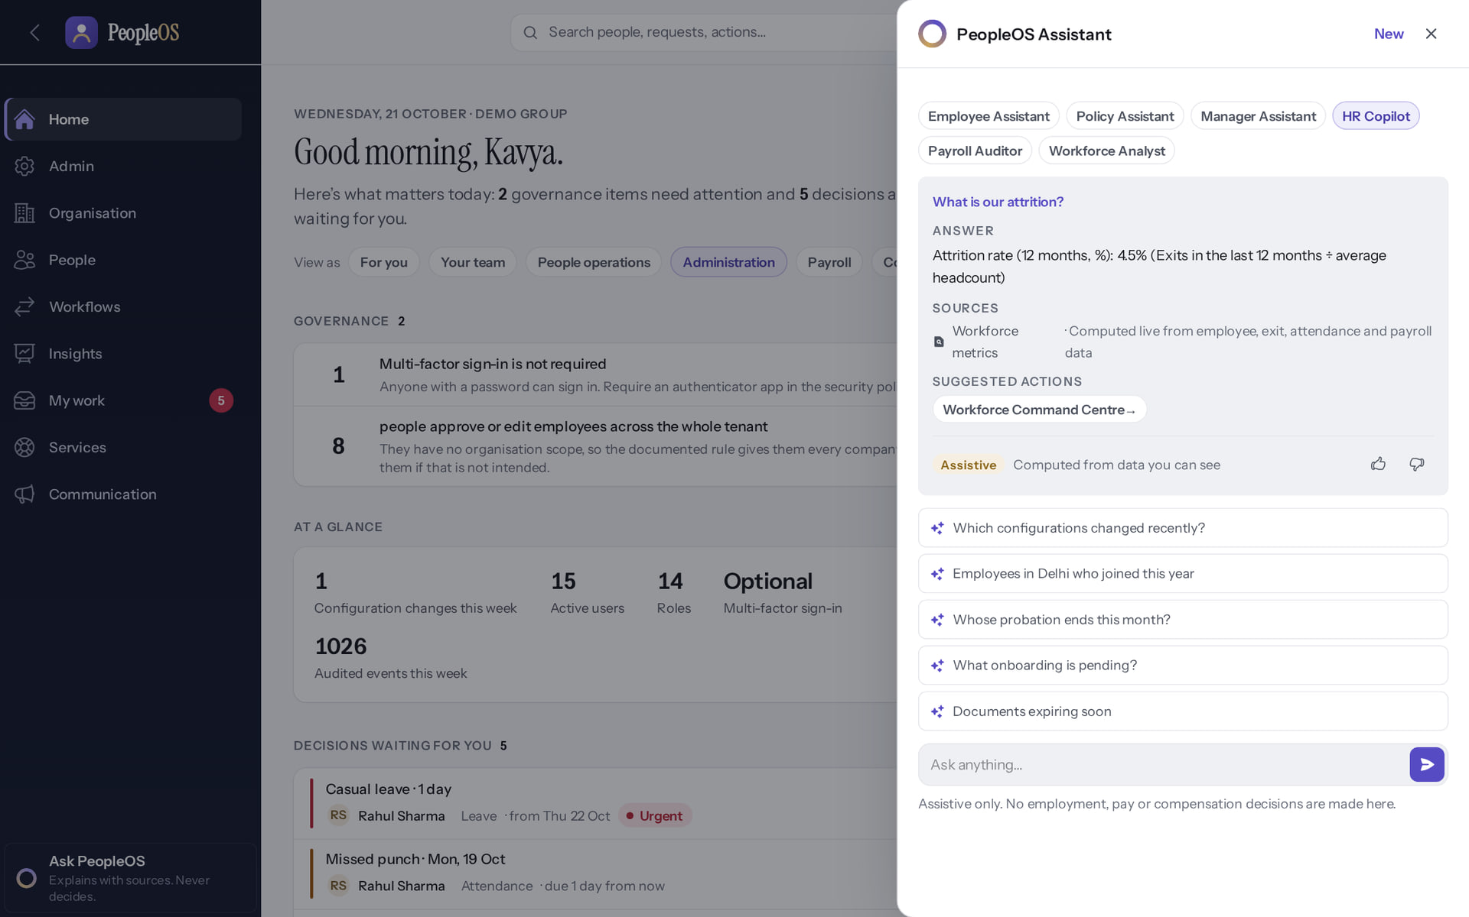
Ask PeopleOS: answers with sources
AUDIT
Verified in the running application
1
The question: "What is our attrition?"
RESULT Answer: 4.5% (exits in the last 12 months ÷ average headcount), with its source (Workforce metrics, computed live). The external language model is off by default; answers are rule-based and logged.
1
Real screen · Kavya Menon (Tenant HR Admin + Employee) · Ask PeopleOS panel (PeopleOS Assistant)
Notes:
SAY: Answer: 4.5% (exits in the last 12 months ÷ average headcount), with its source (Workforce metrics, computed live). The external language model is off by default; answers are rule-based and logged.
ON SCREEN: Ask "What is our attrition?".
WALK THROUGH: (1) The question: "What is our attrition?"
LEARNERS SHOULD SEE: Observed answer: "Attrition rate (12 months, %): 4.5% (Exits in the last 12 months ÷ average headcount)" with Sources (Workforce metrics, computed live) and a suggested action; marked Assistive. External language model off by default
SCREEN: Ask PeopleOS panel (PeopleOS Assistant). Signed in as Kavya Menon (Tenant HR Admin + Employee). Prerequisite: Assistant permission and feature; ai.llm off (no external model).
EVIDENCE: screenshot screenshots/analytics/80-ins-17-ask-peopleos.png, captured 2026-10-21 on the disposable training database (fictional people).

Slide 34
Reconcile before you publish a figure
RECONCILIATION
Same date
Same scope
Explain blanks
Set "As of" (People analytics) or the report period to the date of your source figure.
Your figures cover only the people your role and scope reach. Compare with an administrator if numbers differ.
A "—" group means the field is empty on some records (e.g. no department). Fix the records, re-run.
Small groups
Drill down
Keep evidence
People, performance, compensation and service analytics and talent pools suppress counts below 5 on purpose. Use a wider grouping instead of asking for the detail.
Select a figure on the Workforce pulse to see the people behind it; compare with the Employees register filters.
Export the CSV; the export is recorded in Change history with your name and time.
Notes:
SAY: Reconcile before you publish a figure.
- Same date: Set "As of" (People analytics) or the report period to the date of your source figure.
- Same scope: Your figures cover only the people your role and scope reach. Compare with an administrator if numbers differ.
- Explain blanks: A "—" group means the field is empty on some records (e.g. no department). Fix the records, re-run.
- Small groups: People, performance, compensation and service analytics and talent pools suppress counts below 5 on purpose. Use a wider grouping instead of asking for the detail.
- Drill down: Select a figure on the Workforce pulse to see the people behind it; compare with the Employees register filters.
- Keep evidence: Export the CSV; the export is recorded in Change history with your name and time.
ASK: "Which of these points needs more explanation for your team?"

Slide 35
Reports you may expect but will not find today
GAPS
Desired report | Situation | Status
Payroll register, payslip and statutory return reports | Need finalised runs; finalisation blocked until statutory rules are verified (0 of 24) | Disabled (gate)
New grouped or filtered custom reports | Report builder Group by, filter and sort lists empty (F44) | Incomplete
Executive dashboards with figures | Executive role lacks dataset permissions (F45); fix by role configuration | After configuration
Scheduled starter reports | Starter reports have no owner, so scheduled runs fail (F46) | Incomplete
PDF exports of reports | CSV only | Not implemented
Predictive attrition per person | Deliberately not built: facts only, no individual predictions | Not implemented
Notes:
SOURCE: documentation-gaps F44, F45, F46; Workforce Intelligence page text; release gate 5.
SAY: Reports you may expect but will not find today.
- Payroll register, payslip and statutory return reports | Need finalised runs; finalisation blocked until statutory rules are verified (0 of 24) | Disabled by safety or commercial gates
- New grouped or filtered custom reports | Report builder Group by, filter and sort lists empty (F44) | Incomplete · known defect or gap
- Executive dashboards with figures | Executive role lacks dataset permissions (F45); fix by role configuration | Available only after configuration
- Scheduled starter reports | Starter reports have no owner, so scheduled runs fail (F46) | Incomplete · known defect or gap
- PDF exports of reports | CSV only | Not implemented
- Predictive attrition per person | Deliberately not built: facts only, no individual predictions | Not implemented

Slide 36
Practice
PRACTICE
Open the HR overview. What is the attrition figure and how is it calculated?
1
Run "Headcount by department" and export it. Where can an auditor see that you exported it?
2
In People analytics, which figures show "fewer than 5" and why?
3
An executive says some HR overview widgets say "You cannot report on…". What is the cause and who can fix it?
4
Answer key: on the next slide, and in the speaker notes.
Notes:
RUN: give learners about 10 minutes in a practice tenant (never a live one). Walk around and help.
SUCCESS: each learner can show the result on screen.
ANSWER KEY: (1) 4.5%: exits in the last 12 months ÷ average headcount. (2) Insights › Audit › Change history: an Export event with your name. (3) Figures where fewer than 5 people are counted (e.g. joiners and exits under People, pending requests under Leave): privacy suppression. (4) The Executive role has no dataset permission (F45); a Tenant Super Admin extends the role.

Slide 37
Answer key
PRACTICE
# | Answer
1 | 4.5%: exits in the last 12 months ÷ average headcount (HR overview, Attrition tile).
2 | Insights › Audit › Change history lists an Export event with the report name, your name and the time.
3 | Figures where fewer than 5 people are counted (for example joiners and exits under People, pending requests under Leave) show "fewer than 5" to protect privacy.
4 | Report-based widgets need dataset permissions the Executive role lacks (F45). A Tenant Super Admin can add them to the role.
Notes:
SAY: Answer key.
- 1 | 4.5%: exits in the last 12 months ÷ average headcount (HR overview, Attrition tile).
- 2 | Insights › Audit › Change history lists an Export event with the report name, your name and the time.
- 3 | Figures where fewer than 5 people are counted (for example joiners and exits under People, pending requests under Leave) show "fewer than 5" to protect privacy.
- 4 | Report-based widgets need dataset permissions the Executive role lacks (F45). A Tenant Super Admin can add them to the role.

Slide 38
Summary
Figures are computed from what your role may see; some analytics hide small groups.
HR overview, Workforce pulse and People analytics answer most questions.
Starter reports run and export to CSV; every export is audited.
Change history proves who changed what, with a hash chain that can be verified.
Known gaps: report builder (F44), executive datasets (F45), payroll reports until payroll is finalised.
NEXT STEPS & HELP
Deck 03: the HR screens behind these figures
Deck 08: audit and access controls
Ask your administrator for dataset permissions
Release gate: NO-GO (10 of 14 gates blocked, re-verified 13 Oct 2026). Not yet generally available.
Notes:
SAY: Recap the key points:
- Figures are computed from what your role may see; some analytics hide small groups.
- HR overview, Workforce pulse and People analytics answer most questions.
- Starter reports run and export to CSV; every export is audited.
- Change history proves who changed what, with a hash chain that can be verified.
- Known gaps: report builder (F44), executive datasets (F45), payroll reports until payroll is finalised.
POINT TO: Deck 03: the HR screens behind these figures; Deck 08: audit and access controls; Ask your administrator for dataset permissions
ASK: "What will you do first in PeopleOS?" Collect questions you cannot answer and send them to the PeopleOS team.

