Slide 1
Steering a cursor with four muscles
BIOMEDICAL ROBOTICS · ASSIGNMENT 1
Today, in the lab
Then, by yourself
One person per group wears the MCI and records a reaching session: about 15 min of setup and calibration, then 15 min of play. In the meanwhile, the others start to work on pre-recorded data.
You get your recording and a code skeleton the goal is to rebuild the cursor from the raw EMG and compare them.
Deadline: 03/11/2026.
Notes:
This comes right after the MCI presentation, so no need to explain how it works again. The message: today each group produces its own data; the assignment is about understanding it.

Slide 2
From your session to one .mat file
make_group_mat
What you find in the workspace
Takes the session folder saved by the MCI software (Acquisizioni + Calibrazione) and packs everything you need into one file.
Variable | Contents
centerout | table, one row per sample: t, raw_R_biceps … raw_R_trapezius, env_R_biceps … env_R_trapezius, cursor_x_px, cursor_y_px, cursor_x_cm, cursor_y_cm
centerout_targets | table, one row per target: target_x_px, target_y_px, spawn_time, hit_time, reach_time, overshoots
random, random_targets | the same, for the random task
info | fs, muscles, screen size, cm_per_px, calib_max, gain_cm_s, W, map_x, map_y
make_group_mat(sessionFolder, ...
'Cometa', 'Group_A.mat')
load('Group_A.mat')
env_ columns = the activation the MCI computed live (0–1)
Notes:
The .mat is the only input students need. make_group_mat is run by us after the lab; show the call so they know where the file comes from. Point out the column names: raw_ is what they will process, env_ is what the MCI computed, and the cursor is the ground truth for what they rebuild.

Slide 3
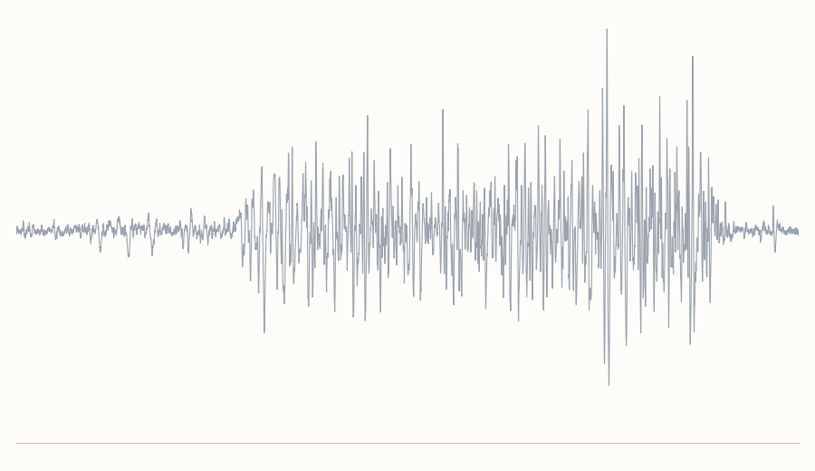
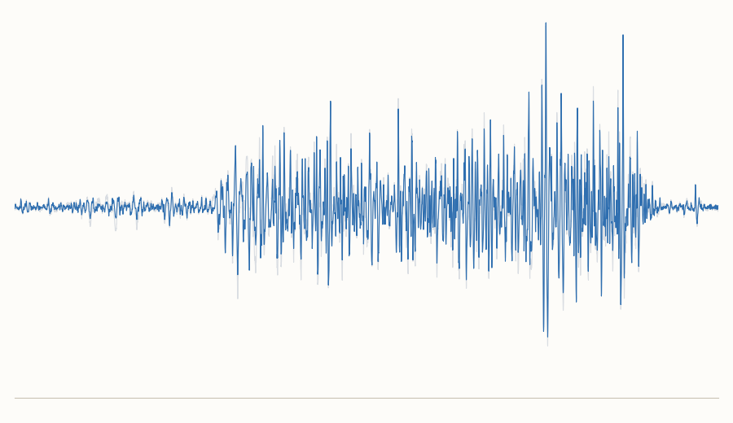
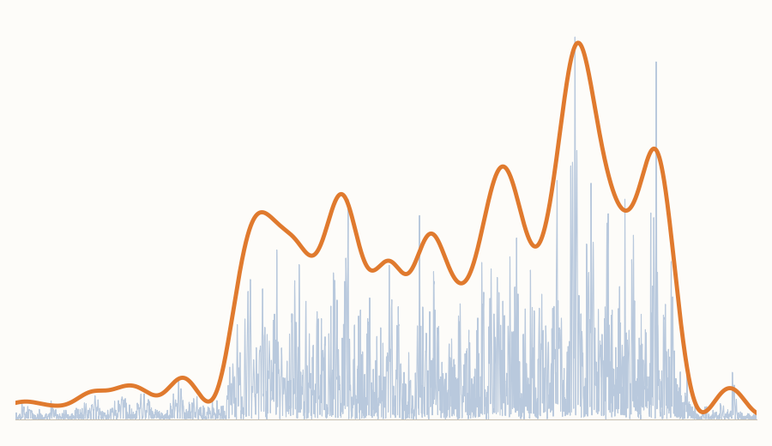
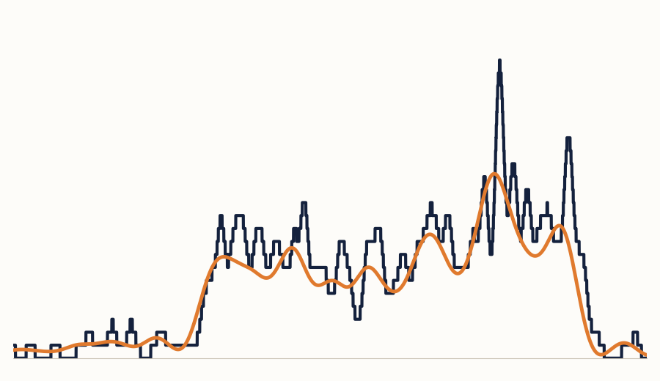
The assignment in three parts
Part 1 · The pipeline to obtain envelopes
Raw EMG
Band-pass 30–450 Hz
Rectify + low-pass 5 Hz
Yours (orange) vs MCI (black)
Part 2 · Fit the map
Part 3 · Cursor
Use the gains and the envelope to create the map that goes from muscle intensity to cursor velocity.
After applying the MCI map to get the cursor velocity, integrate it into a position, animate it with the targets.
Compare it with the cursor that was logged
Bonus: use your cursor to drive a simulated 2-link robot arm (Jacobian) .
Notes:
The four plots are real: right biceps of our test subject, 3 seconds with one contraction. Raw and filtered look almost the same because the hardware already filters 10–500 Hz. The last plot shows that their envelope will have the right shape but not exactly the MCI’s size and timing: that is the point of the comparison.

Slide 4
The map, the gains and the numbers you need
The map is given
Good to know
velocity = gain · env · W′
What | Value
Sampling | 2000 Hz (info.fs)
Screen | 2560 × 1600 px = 38.8 × 24.3 cm
px → cm | × info.cm_per_px (≈ 0.0152 cm/px)
Axes | origin top-left, x right, y down
Center target | (1280, 800) px
Raw EMG | already band-passed 10–500 Hz by the hardware
env_ columns | (envelope − rest) / max; the max can be raised live
Downsample | only after the envelope, never on raw EMG
Center-out | 48 targets: 24 out, 24 back to the center
Random | 100 s; the last target may never be hit (NaN)
gain = info.gain_cm_s = 50 cm/s.
W = info.W: one row per axis, one column per muscle.
W | R biceps | L biceps | L trap | R trap
x (right) | +1 | −1 | 0 | 0
y (down) | 0 | 0 | −1 | +1
The same in words: info.map_x and info.map_y. Velocity is in cm/s: integrate it in cm, then convert.
Notes:
The map is not something to discover: it comes ready in info. Highlight the conventions that cause most bugs: y grows downward, velocity is in cm/s while targets are in pixels, and downsampling must come after the envelope. The env_ row links back to the colleague’s calibration slide: since the max can be raised during the run, the MCI envelopes and theirs won’t have exactly the same size.

Slide 5
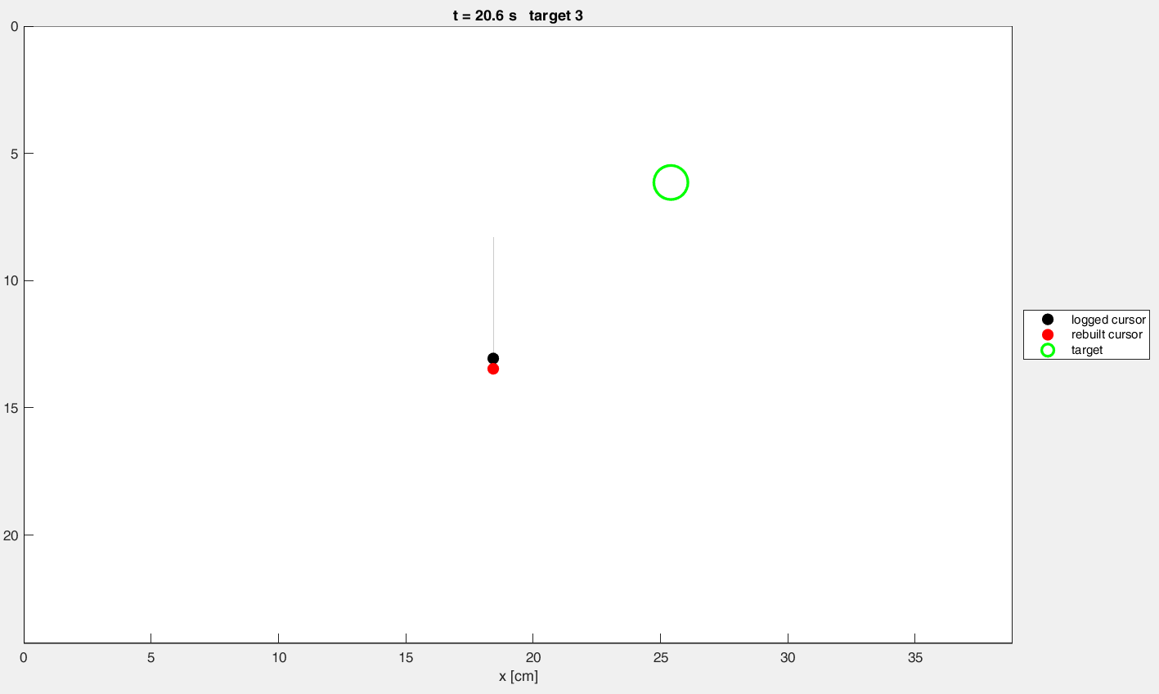
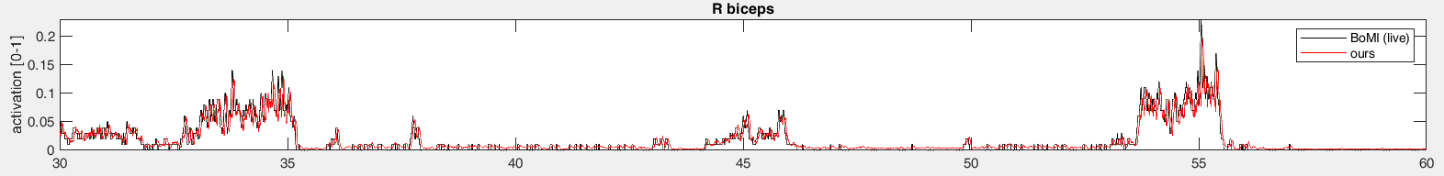
What to hand in
Part 3 · Your cursor vs the logged one, with the target
One folder per group
Group_#_Assignment_1/
├── *.m commented code
├── Group_#.mat your data
└── Group_#.pdf figures
Part 1 · Your envelope vs the one the MCI computed live (R biceps)

