Slide 1
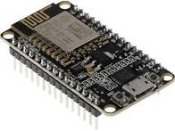

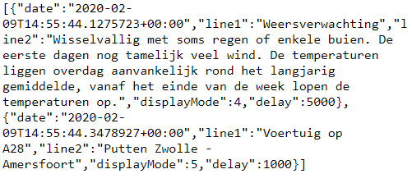
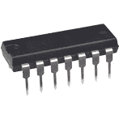
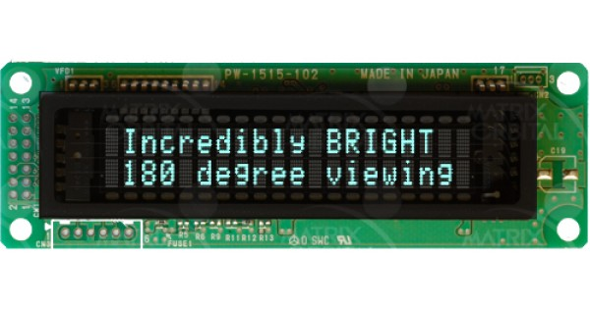
ESP8266
https get
Response (json):
tx
3.3v and gnd
Hosted on Microsoft Azure
5v and gnd
sn74hc04n
tx (inverted)
Vacuum Fluorescent Display (VFD)

