Slide 1



The General Linear Model

Slide 2


The GLM Family
$$y=Xβ+ε$$
$$ε\sim N\left(0,σ2I\right)$$
Dependent Variable (y)
Predictors (X)
Analysis
Continuous
One predictor
Regression
Continuous
Two+ preds
Multiple Regression
One continuous DV, normally distributed error
Categorical
1 pred., 2 levels
2-sample t-test
General Linear Model
Categorical
1 p., 3+ levels
One-way ANOVA
Categorical
2+ predictors
Factorial ANOVA
1 categorical
1 continuous
ANCOVA
Notes:
http://www.statsoft.com/textbook/stglm.html
Statsoft textbook:
Multivariate linear regression -> multiple DVs, multiple columns of betas, but solution/algebra is identical
GLM differences from multiple regression/multivariate regression:
allows for multivariate tests of significance, with correlated DVs
Test contrasts across multiple DVs
Generalized inverse: can handle non-full-rank design matrix
A generalized inverse is any matrix that satisfies AA⁻A = A

Slide 3


The GLM Family: Correlated errors
Dependent Variable (y)
Predictors (X)
Analysis
Error structure
2 repeated measures
0 between
1 within
Paired t-test
k repeated measures
0 between
k – 1 categorical within
One-way RM-ANOVA, MANOVA
Correlated errors
across subjects (typically)
4+ repeated measures
0 between
2+ categorical within
Factorial RM-ANOVA
4+ repeated measures
1+ between
2+ categorical within
Mixed-effects GLM
Correlated errors
across time
Many repeated time series
Autoregressive models
Mixed-effects GLM
Any of the above
$$y=Xβ+ε$$
$$ε\sim N(0,V)$$
Notes:
http://www.statsoft.com/textbook/stglm.html
Statsoft textbook:
Multivariate linear regression -> multiple DVs, multiple columns of betas, but solution/algebra is identical
GLM differences from multiple regression/multivariate regression:
allows for multivariate tests of significance, with correlated DVs
Test contrasts across multiple DVs
Generalized inverse: can handle non-full-rank design matrix
A generalized inverse is any matrix that satisfies AA⁻A = A

Slide 4
GLM with uncorrelated errors
GLM with correlated errors
GLM with link function (generalized LS)
Is Predictor (or IV) continuous?
Yes
No
Is/are the Outcome(s) (or DVs) continuous?
Is/are the Outcome(s) (or DVs) continuous?
Yes
No
Yes
No
Is there more than one Predictor (or IV)?
Logistic Regression
How many Predictors (or IVs)?
Logistic Regression
Yes
No
1
2+
OLS Regression
Pearson’s R
How many levels of the Predictor (or IV)?
Are any of the samples paired (dependent)?
2
3+
Yes
No
Are the samples paired (dependent)?
Are the samples paired (dependent)?
Yes
No
No
Mixed or Repeated Measures Factorial ANOVA
Factorial ANOVA
Yes
Dependent Samples T-Test
Independent Samples T-Test
Repeated Measures One-way ANOVA
One-Way ANOVA

Slide 5


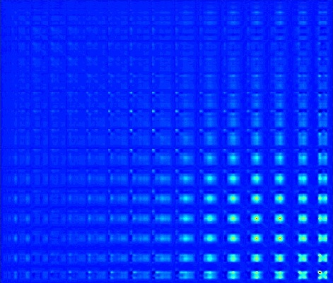
Structural model for the GLM
There can be more than one predictor. Predictors can be categorical (like sex) or continuous variables (like performance score).
Variables
DV
Pred1
Pred2
Predk
Parameters
Slope 1
Slope k
intercept
Slope 2
Error
Matrix notation

Slide 6

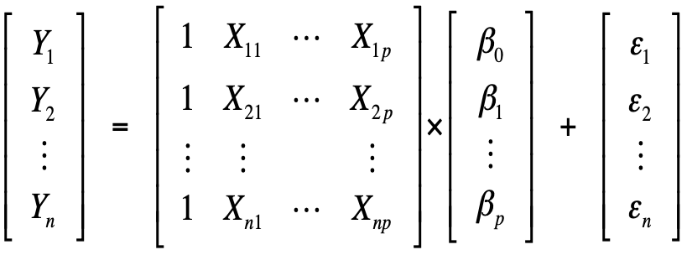
Matrix Notation
Alternatively, we can write
solve for beta vector
minimize sum of squared residuals
as
fMRI Data
Design matrix
Residuals
Model parameters

Slide 7
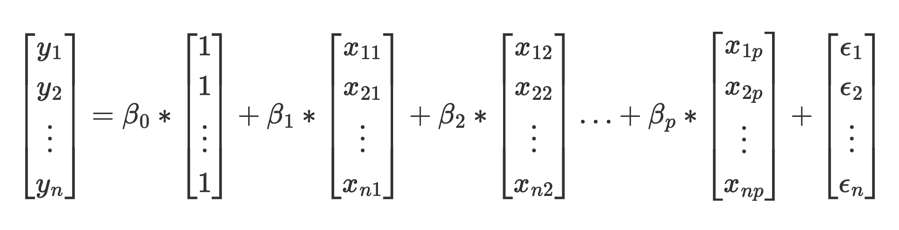
Matrix Notation
fMRI Data
Design matrix
Residuals
Model parameters
Is the same as:

Slide 8
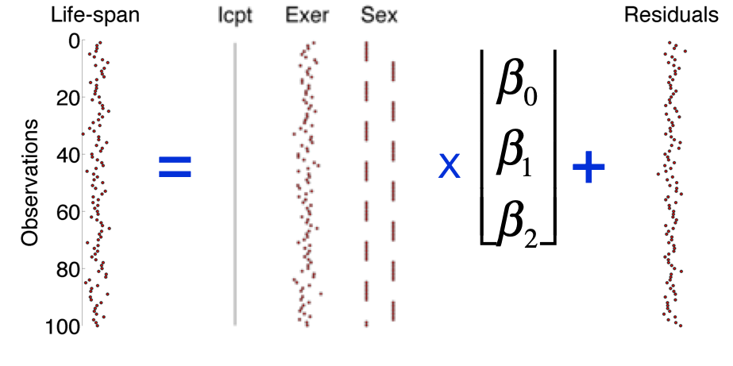
Matrix Notation
fMRI Data
Design matrix
Residuals
Model parameters
An Example:

Slide 9


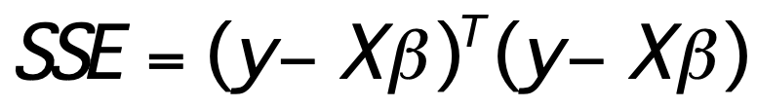
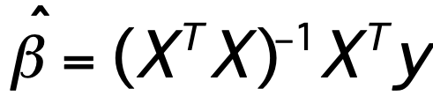
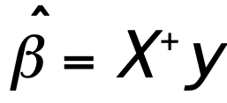
Fitting the model:
A geometric interpretation
Minimize error ( , epsilon):
y
Solve for beta
Project data (y) onto subspace of X
e
X₁
fit
X₂
Partial fits
X₂β₂
X₁β₁
(pseudoinverse of X) * y
fit

Slide 10
Algebraic Foundations: Design Efficiency
Statistical power depends on the magnitude of an effect (e.g., contrast magnitude (c’bhat)) divided by it’s standard error, a measure of variability due to noise
For a t-test:
Data is not required to estimate this!
Does not depend on data, as long as the form of the model is correct.
A closer look at the standard error:
Residual noise
Design inefficiency
What is it?
A-optimality

Slide 11
Algebraic Foundations: Design Efficiency
To minimize standard error:
Efficiency
Reduce noise
Make design more efficient
Understanding and maximizing efficiency is one of the foundations of experimental design
Maximizing average efficiency for effects you care about is called A-optimality. It is directly related to statistical power.
There are other criteria, too (e.g., D-optimality).
What is it?
A-optimality
Efficient designs:
Maximize variance of predictors
Minimize covariance among predictors (orthogonal predictors)
In fMRI designs, formula is more complex, principle is the same

Slide 12
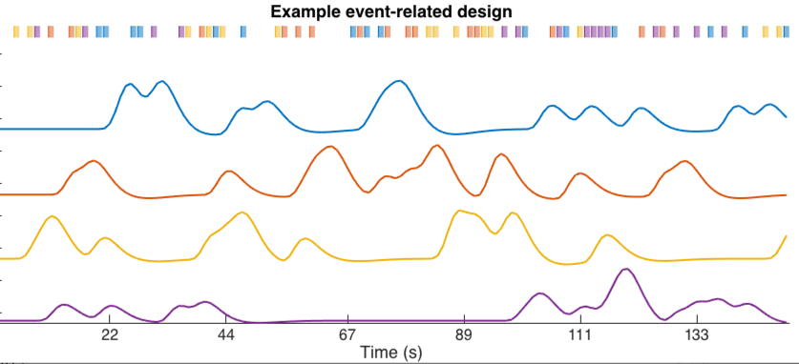
Algebraic Foundations: Design Efficiency
Example event-related design with 4 event types:
Efficiency
Dale 1999; Josephs & Henson 2000; Friston et al. 2000; Wager & Nichols 2003; Liu 2004; Hayasaka et al. 2007; Mumford & Nichols 2008
What is it?
A-optimality
Notes:
create_figure;
[X, e] = create_random_er_design(1, 1.3, 1, [.1 .1 .1 .1], 180, 0);
axis tight
title('Example event-related design');

Slide 13
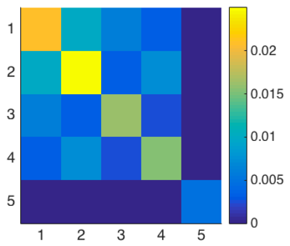
Algebraic Foundations: Design Efficiency
Higher values:
Less efficient, lower power
Efficiency
Diagonals related to
Error variance
Higher values:
Parameter estimates are correlated
Off-diagnals:
Error covariance
Intercept
What makes diagonal values smaller (and designs efficient)?
Large rise and fall in predictors (predictor variance)
Low covariance among predictors (orthogonal predictors)
Large sample sizes (standard error proportional to sqrt(n))
What is it?
A-optimality
Notes:
create_figure;
[X, e] = create_random_er_design(1, 1.3, 1, [.1 .1 .1 .1], 180, 0);
axis tight
title('Example event-related design');

Slide 14
Contrasts

Slide 15

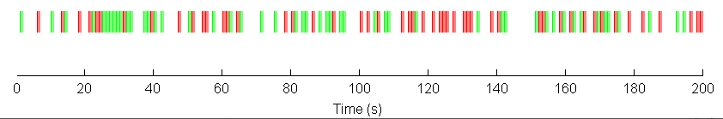

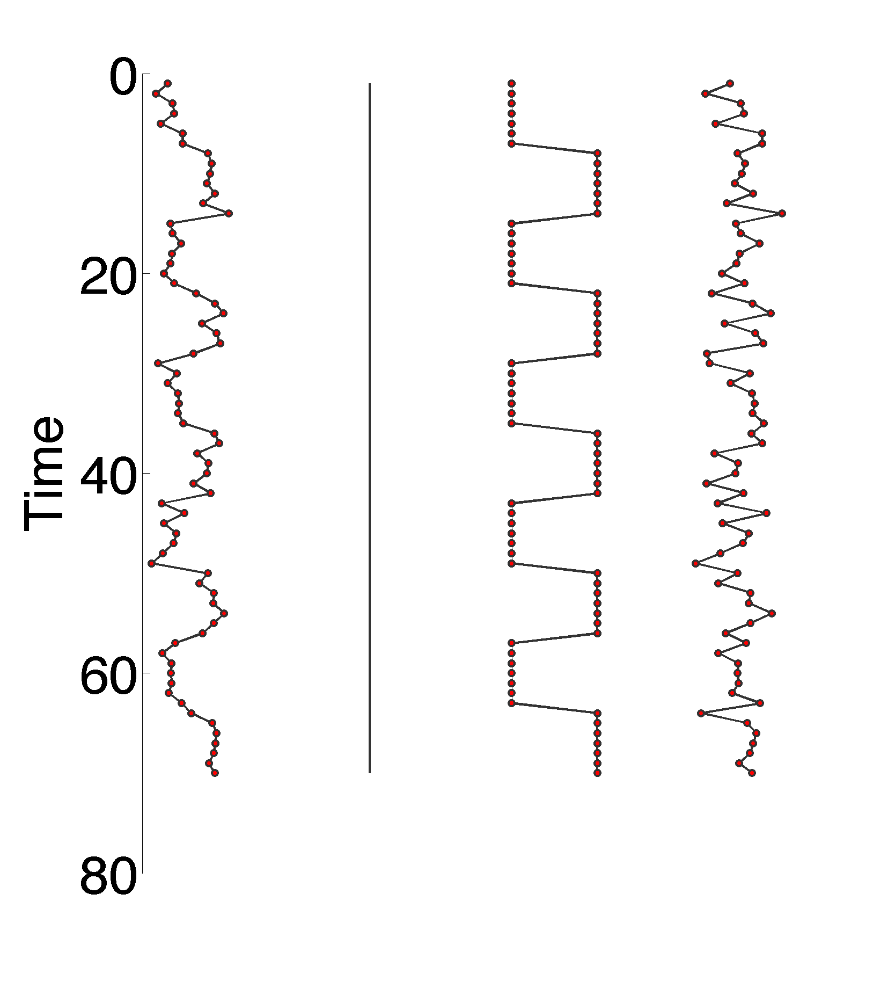
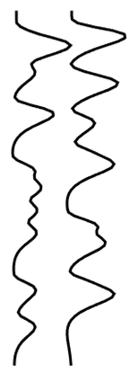
Multiple-predictor designs and contrasts
With event-related designs, model each event type separately
fMRI Data
Design matrix
Model
parameters
Residuals
You can now assess the difference, each one separately, or their average
These functions are specified by different linear contrasts
=
X
+
Intercept
Task regressors
Betas
(slopes)

Slide 16

Contrasts: A flexible and powerful tool
Contrast: A linear combination of GLM parameters
T-contrast: Single, planned contrast -> t-test
Specified by a vector of weights (c), so that c^{T}β = a scalar value
Signed: Can have negative or positive values
ˆ
c^{T}β
fMRI Data
Design matrix
Model
parameters
Residuals
Difference
=
X
+
Sum (average)
Single event
Intercept
Task regressors
Betas
(slopes)

Slide 17
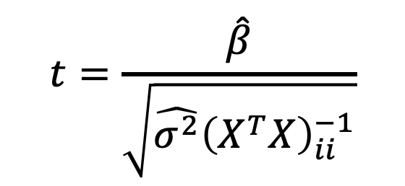
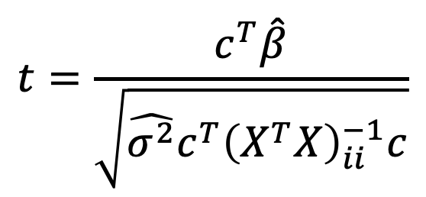
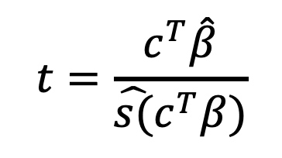
Contrasts: A flexible and powerful tool
Contrast: A linear combination of GLM parameters
T-contrast: Single, planned contrast -> t-test
Specified by a vector of weights (c), so that c^{T}β = a scalar value
Signed: Can have negative or positive values
ˆ
c^{T}β
For a single regressor:
Effect magnitude
_______________
Standard error
$$t=\frac{\hat{β}}{\sqrt{\hat{σ^{2}}{\left(X^{T}X\right)}_{ii}^{−1}}}$$
For a contrast:
$$t=\frac{c^{T}\hat{β}}{\hat{s(}c^{T}β)}$$
Effect magnitude
_______________
Standard error
$$t=\frac{c^{T}\hat{β}}{\sqrt{\hat{σ^{2}}c^{T}{\left(X^{T}X\right)}_{ii}^{−1}c}}$$

Slide 18
Model building and contrasts: multiple predictors
Factor 2
Example: Memory experiment
Four word types, grouped into two factors:
Factor 1: Visual vs. Auditory presentation (2 levels)
Factor 2: High vs. low imageability (2 levels)
A
B
Factor 1
C
D
Dependent Variable
Predictors
Analysis
4+ repeated measures
0 between
2+ categorical within
Factorial RM-ANOVA
“Factorial repeated-measures ANOVA design”
Very typical in fMRI experiments

Slide 19
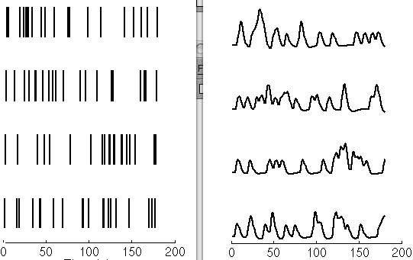

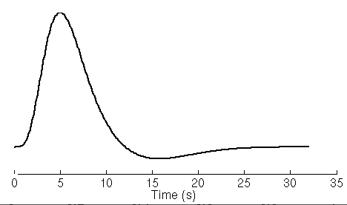
Model building and contrasts: multiple predictors
Factor 2
Example: Memory experiment
Four word types, grouped into two factors:
Factor 1: Visual vs. Auditory presentation (2 levels)
Factor 2: High vs. low imageability (2 levels)
A
B
Factor 1
C
D
Indicator functions
(onsets)
Assumed HRF
(Basis function)
Design Matrix (X^{T})
Design Matrix (X)
A
B
C
D
A
A
B
B
Time
C
C
D
D
Time (s)
Time (s)

Slide 20
Contrasts for ANOVA design: Planned comparisons to identify effects of interest
Contrast weights
1
1
-1
-1
Effect
B
C
D
Design Matrix (X)
*
=
(A+B) - (C+D)
Main effect of Factor 1
A
Factor 2
Time (s)
A
B
+
+
Factor 1: Visual vs. Auditory presentation (2 levels)
Factor 2: High vs. low imageability (2 levels)
Factor 1
C
D
-
-

Slide 21

ANOVA contrasts
C can be a matrix
Columns are applied independently and do not affect one another, so each is a separate test
SCANLab
ˆ
Factor 2
Factor 2
Factor 2
c^{T}β is mean(A,B) - mean(C,D)
e.g., a main effect across 4 conditions
A
B
A
B
A
B
+
+
+
-
+
-
Factor 1
Factor 1
Factor 1
C
D
C
D
C
D
-
-
+
-
-
+
ˆ
c^{T}β has three columns, corresponding to main effects and interaction: standard ANOVA contrasts

Slide 22
Custom contrasts
Testing of custom hypotheses
- Not limited to ANOVA contrasts
- Can specify planned tests that make sense based on your hypotheses:
c^{T}β is ‘simple effect’, difference [A – B]
High – low imageability effect for visual items only
c^{T}β is effect magnitude estimate for 2*A - B – C
ˆ

Slide 23
Rules for T-contrasts: Sum to zero
Expected value of c^{T}β under the null hypothesis should be 0
Ho (null): c^{T}β = 0. Alternative Ha: c^{T}β ≠ 0, permits t-test
If you are testing a difference between conditions, contrast weights should sum to zero
Consider a contrast C across 4 conditions:
Valid: Expected value is zero with no true difference in β
ˆ
c^{T}β is effect magnitude estimate for 2*A – B – C
Invalid: Expected value is not zero
c^{T}β is effect magnitude estimate for 2*A – B
ˆ
Notes:
Beware if you have missing sessions or runs!
Sum across 3 runs ([1 1 1]) is not equivalent to sum across 4 ([1 1 1 1])

Slide 24
Rules for T-contrasts: Sum to zero
One case in which weights do not need to sum to zero: Testing the average of one or more conditions against the implicit baseline
Betas from regression are signed and zero under null, so testing against zero is reasonable.
Ho: β_{A} = 0
Under null hypothesis of no activation in A, E(β_{A}) = 0
C’b is beta for A only
i.e., whether response to A > 0
Ho: (β_{A} + β_{B}) / 2 = 0
C’b is sum (or average) beta for A and B

Slide 25

Rules for T-contrasts: Scaling
For a single subject, scaling of weights affects magnitude, but not inference (t-values, p-values).
[1 -1] and [.5 -.5] give same statistical result.
$$t=\frac{c^{T}\hat{β}}{\sqrt{\hat{σ^{2}}c^{T}{\left(X^{T}X\right)}_{ii}^{−1}c}}$$
c^{T}β is effect magnitude estimate for 2*A - B – C
ˆ
ˆ
c^{T}β is effect magnitude estimate for A – mean(B, C)
Statistically identical to above.
Notes:
Beware if you have missing sessions or runs!
Sum across 3 runs ([1 1 1]) is not equivalent to sum across 4 ([1 1 1 1])

Slide 26
Design Efficiency for Contrasts
Formula is more complex, principle is the same
Factor in contrasts, high-pass filtering and autocorrelation
Contrast weights
1 1 -1 -1
Factor 2
B
C
D
A
B
Design Matrix (X)
*
+
+
Factor 1
C
D
-
-
A
Time (s)
Contrast: main effect of Factor 1
Variance/covariance of contrast values
C can be a matrix (one column per contrast); contrasts will be evaluated independently of one another

Slide 27
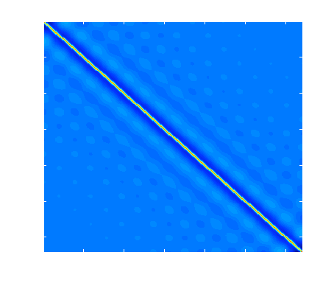
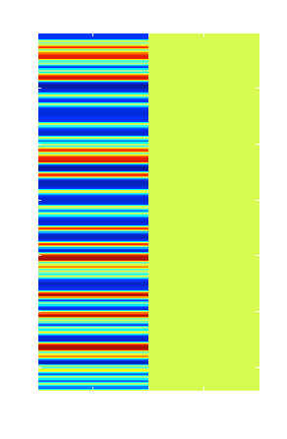
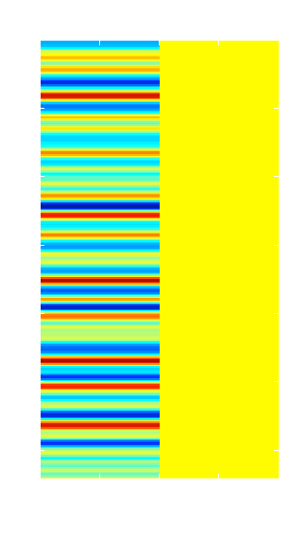
Design Efficiency with Filtering (preprocessing)
Formula is more complex, principle is the same.
Factor in filtering
Define: high-pass filtering matrix = K
Filtered design matrix = Z
*
=
K
*
X
=
Z

Slide 28
Design Efficiency under Autocorrelation
Formula is more complex, principle is the same
Factor in autocorrelation
Define: autocorrelation matrix = V
when not rank deficient
Proportional to statistical power, and can be converted to power given effect sizes
See Friston et al., 2000; Zarahn, 2001

Slide 29
Design efficiency: Rules of thumb
Maximize variance of predictors
Equal numbers across different trial types
Create large manipulations: Concentrate on extremes
Keep designs simple (not too many event types)
Appropriate trial ordering and spacing (more on this soon)
And, always, try to create a large psychological effect!
Doesn’t affect predictor variance per se, whose scaling is arbitrary
Does affect the magnitude of the effect relative to error

Slide 30
Efficiency in a Multi-level Setting
In a group analysis, efficiency (and power) depend on within-person and between-person variance.
Sample size
Variance/covariance of contrast values
Within-person standard errors
(1/efficiency)
Variance/covariance of individual differences between people
Increasing within-person efficiency (e.g., by collecting more data) helps up to a point
Increasing sample size always helps
The greater the between-person variance, the more sample size is important.
e.g. Wager & Nichols, 2003

