Slide 1
JPEG2000

Slide 2
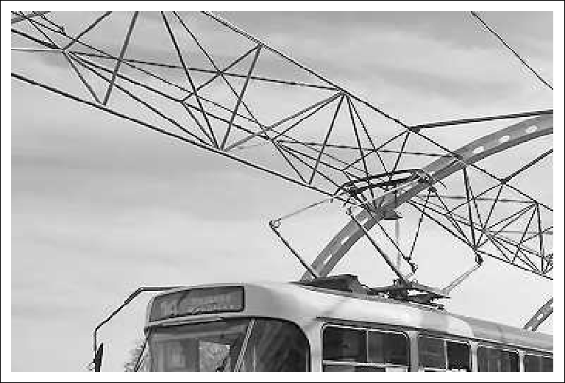
Presentation

Slide 3
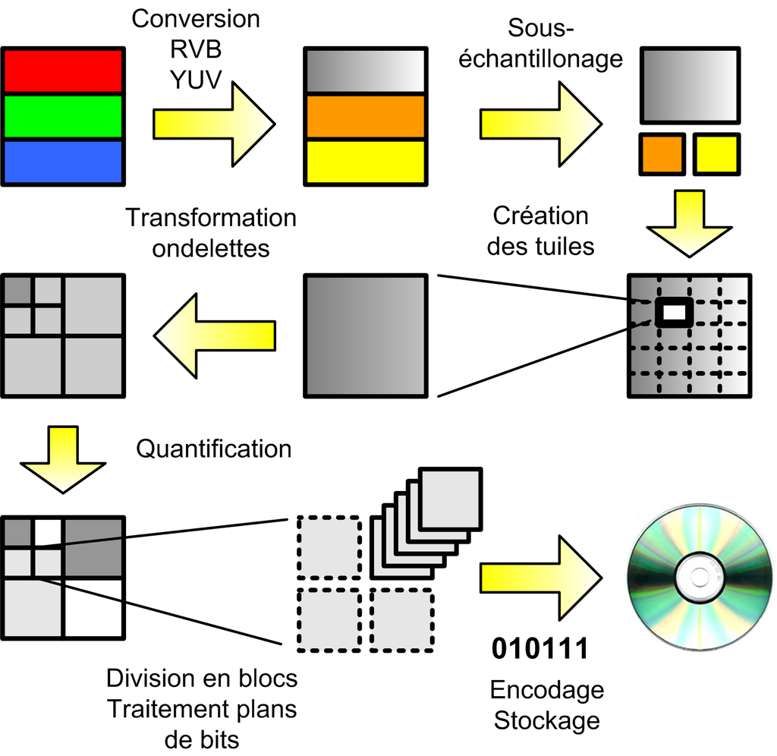
Algorithme

Slide 5
Conclusion

