Slide 1

Hugging Face vs. OpenAI
Open-Source & Self-Hosted AI vs. Proprietary Cloud APIs
Course: ITA2376
Team: Elijah Raines (Team Leader), Brandon Matias, Justin Davis, Jonah Joseph, Osemudia Ogedengbe

Slide 2
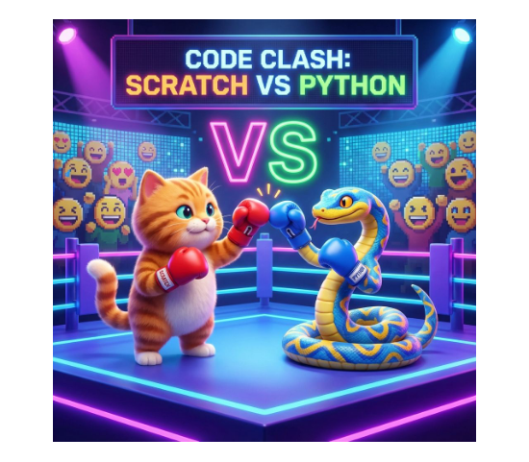
The Core Dilemma in AI Engineering
Build & Host vs. Consume via API
Do-It-Yourself (DIY): Do you want to build and host the AI yourself using open-source tools?
Service-Based: Or do you just want to pay to use a finished, super-smart AI over the internet?
This big choice impacts your project's privacy, cost, hardware needs, and ease of use.
Let's explore the two biggest players in the AI world today!

Slide 3






Deep Dive: Hugging Face (DIY AI)
Origins
Total Control
Runs Offline
Started in 2016. Created a massive library that lets anyone use powerful, pre-built AI models completely for free.
You have total ownership! See exactly how the AI works, change it to fit your needs, and keep everything strictly private.
Download the files once to your local system, allowing it to run entirely offline using your own computer's processing power.

Slide 4






Deep Dive: OpenAI GPT-4 API (Service)
Origins
Incredibly Easy
Always Evolving
Launched in 2023. This is a premium service where you pay a small fee to use a very advanced AI over the internet.
No powerful computers needed! Just send a simple request and get an answer back instantly. You can start using it today.
Constantly improved behind the scenes by OpenAI, so you always have access to the latest, smartest version automatically.

Slide 5
Head-to-Head Comparison Matrix
Comparison | Hugging Face (DIY) | OpenAI (Service)
Ease of Use | Requires technical skills and your own computers. | Very easy; works like a website service.
Privacy | Excellent; your data stays with you. | Data is sent to OpenAI to be processed.
Cost | You pay for the computer power you use. | You pay for each answer the AI gives you.

Slide 6




Real-World Applications
Hugging Face
OpenAI API
Best for: Organizations like hospitals or banks that must keep their data strictly private and on their own internal systems.
Best for: Quickly building new apps, creating smart customer service bots, or accessing the smartest AI without buying servers.
Example: JPMorgan Chase uses open-source transformer models to analyze financial documents safely on their own infrastructure.
Example: Duolingo integrates GPT-4 to power their AI language tutor, ensuring students get the most advanced teaching possible.

Slide 7

Practical Demonstration
🤗 Hugging Face (The Specialist)
Purpose-Built: We used a small, open-source model trained specifically for sentiment analysis.
Simple Input: We just fed it the sentence. Since its only job is sentiment, it didn't need extra instructions.
Local Speed: It ran entirely on our machine (Google Colab), giving us instant results without the internet.
☁️ OpenAI API (The Generalist)
All-Purpose: We connected to gpt-4o-mini, a massive AI that can do almost anything.
Explicit Prompting: Because it's a general AI, we had to tell it exactly what to do ("Classify sentiment as POSITIVE/NEGATIVE").
Cloud Processing: Our text was securely sent over the internet to OpenAI’s servers to be processed.

Slide 8


Summary & Trade-off Framework
The Final Decision
Use Hugging Face if... you must keep data strictly private, need it to work offline, or want total ownership.
Use OpenAI if... you want the absolute smartest AI possible, want to build apps quickly, and prefer a service over buying hardware.
Any Questions?

