Slide 1
Web Based Application Using NodeJS Express and MongoDB

Slide 2
Presentation Flow
Introduction
Project Category: Web Based Application
Purpose of Web Application
Sequence Diagram
Project Architecture
Database Structure
Application Deployment
Conclusion
Web based Application

Slide 3
Introduction
A web application is a client-server program. It means that it has a client-side and a server-side. The term "client" here refers to the program the individual uses to run the application. It is part of the client-server environment, where many computers share information. For example, in the case of a database, the client is the program through which the user enters data. The server is the application that stores the information.
This application is developed using NodeJS and the Express framework and MongoDB database.
Web based Application

Slide 4
Project Category
Tools and Software’s used :- Editor Used: Visual Studio Code ∞ Operating System: Windows 10 ∞ Browser: - Chrome ∞ Documentation: - MS Word .
Technologies used :- Languages: HTML, CSS, JavaScript.
Runtime: - Node Js.
Non-RDBMS: MongoDB .
Library/Framework: Express, Mongoose, Bootstrap.
Services Used :- Cloud Foundry.
Web based Application

Slide 5
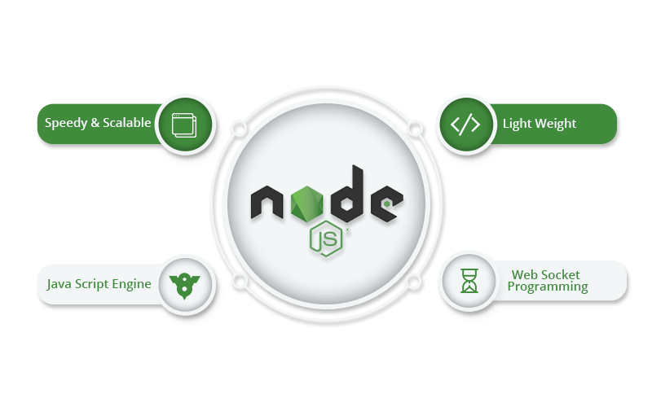
What is Node JS ?
Node.js is an open-source, cross-platform, back-end JavaScript runtime environment that runs on the V8 engine and executes JavaScript code outside a web browser. Node.js runs on various platforms (Windows, Linux, Unix, Mac OS X, etc.) and also Node.js runs single-threaded, non-blocking, asynchronously programming, which is very memory efficient.
Web based Application

Slide 6
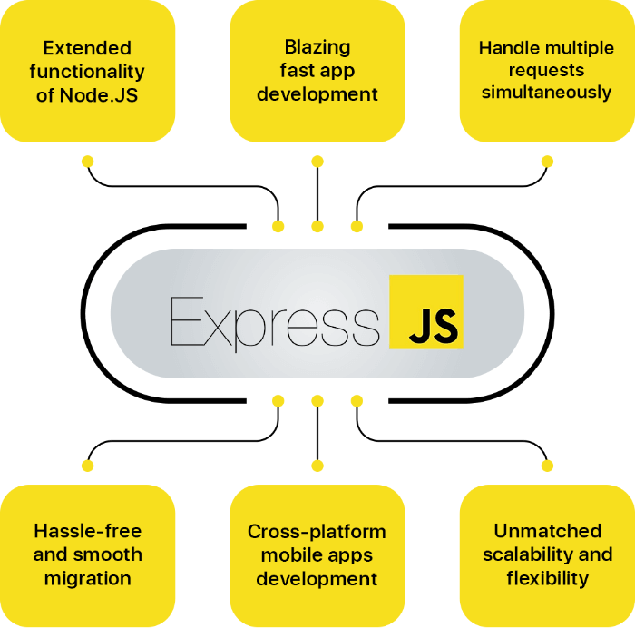
What is Express JS ?
Express.js is a modular web framework for Node.js. It is used for easier creation of web applications and services.Express.js simplifies development and makes it easier to write secure, modular and fast applications.
Web based Application

Slide 7
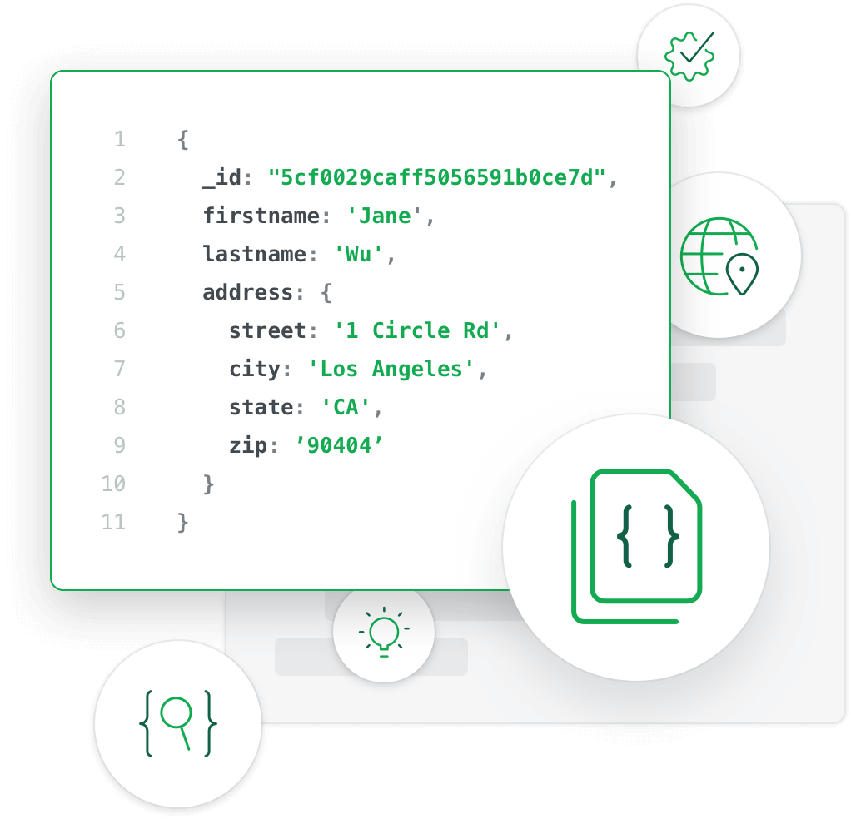
What Is MongoDB ?
MongoDB is an object-oriented, simple, dynamic, and scalable NoSQL database. It is based on the NoSQL document store model. The data objects are stored as separate documents inside a collection — instead of storing the data into the columns and rows of a traditional relational database.
Web based Application

Slide 8

What is Cloud Foundry ?
I am using IBM Cloud Foundry for deploying with some easy few clicks and securing, high scalability web application using simple web console method. Our web app required CD/CI integration, so IBM Cloud Foundry helped us to have user-friendly PaaS. It helped us to manage our staging and production process, this helped us to focus more towards development instead of managing deployments. Overall IBM Cloud Foundry helped us to improve the performance of Web application.
Web based Application

Slide 9
Sequence Diagram
Open Web Application
Enter Login Credentials
Logged in Successfully
Request for Required Fields
Select Required Fields
Display Will Display
Required Fields Selected Success
User can access dashboard
Web based Application

Slide 10
Project Architecture
Server Side Node JS
Mongo DB
Frontend design views
Express JS
Web based Application

Slide 11
Database Structure
Database (Registrationdb)
_Id | By Default
Firstname | Enter first name
Lastname | Enter last name
email | Enter email
gender | Select gender
Phone | Enter phone num
Password | Enter password
Confirm Password | Your Confirmation
Collection (Registers)
Documents
Web based Application

Slide 12
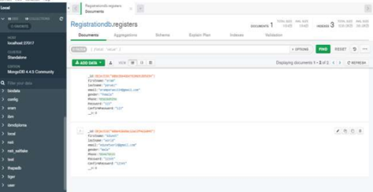
Database Structure
In MongoDB, data is stored as documents. These documents are stored in MongoDB in JSON (JavaScript Object Notation) format. JSON documents support embedded fields, so related data and lists of data can be stored with the document instead of an external table. JSON is formatted as name/value pairs.
Web based Application

Slide 13
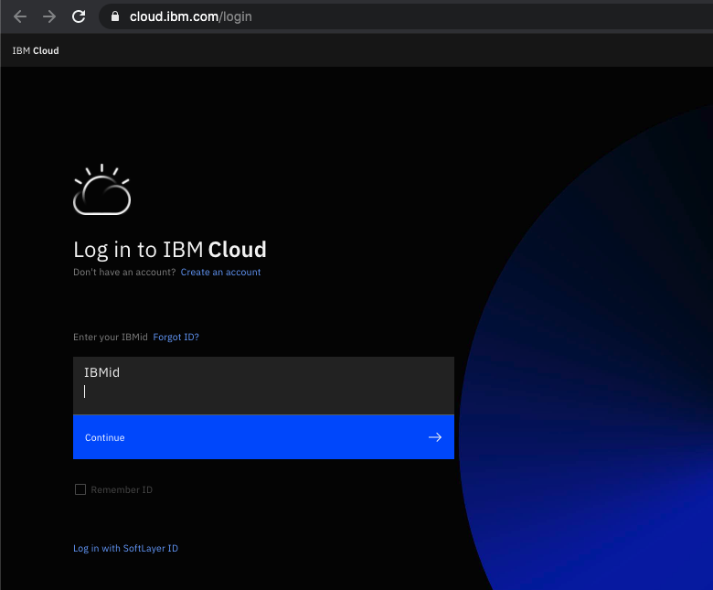
Application Deployment
Cloud deployment technologies are used to place workloads into a cloud computing environment. They provide the foundation to facilitate execution of applications and services. These technologies range from bare metal to serverless computing and enable organizations to realize the benefits of cloud computing.
Web based Application

Slide 14
Conclusion
Node.js is a rapidly growing technology that has been overtaking the world of server-side programming with surprising speed. MongoDB is a technology that’s revolutionizing database usage. Together, the two tools are a potent combination, thanks to the fact that they both employ JavaScript and JSON.
Web based Application

Slide 15
Thank You
Submitted by Eram Perwez
Email : eramperwez334@gmail.com
Github: https://github.com/Eram334/Node_or_MongoDB_Application_EM1
Web based Application

