Slide 1
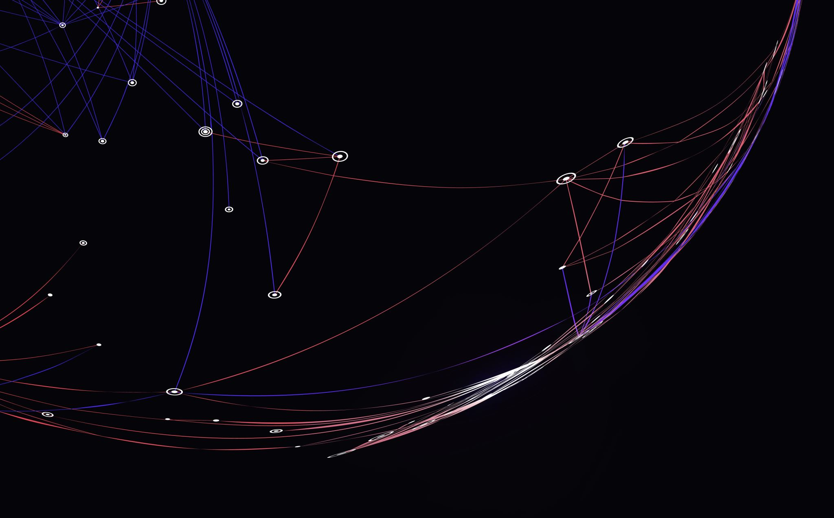


FeelMyText – Pre-Trained Emotion Classifier
Deep Learning 046211
Students: Eran Yermiyahu & Yossi Meshulam

Slide 2
Goals
Explore data set augmentation using ChatGPT.
Investigate the effects of data imbalance, i.e., differing sample sizes for various labels.
Examine the use of pre-trained models for specific tasks and identify strategies for improvement.

Slide 3
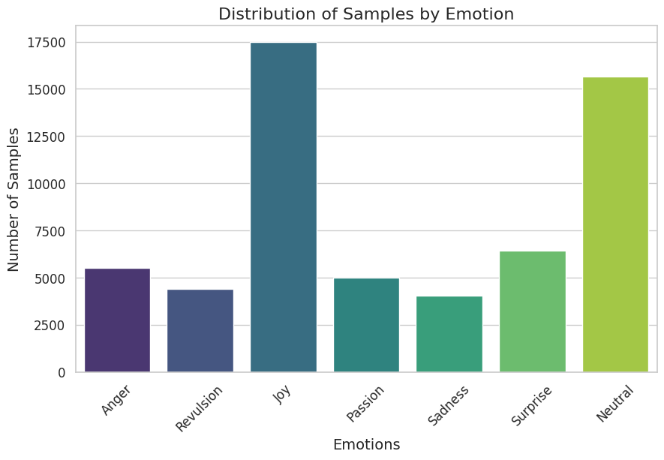
Dataset - GoEmotions
“Drunk and crying in bed with my pets. :|” (Sadness)

Slide 4
Model - RoBERTa-base Pretrained Model
Developed by Facebook AI, RoBERTa is a variant of BERT (Bidirectional Encoder Representations from Transformers) and stands for Robustly Optimized BERT Pretraining Approach.
RoBERTa was designed with the goal of improving the performance of BERT by refining its training process using more data and also optimizing the training hyperparameters.

Slide 5
Goals
Explore data set augmentation using ChatGPT.
Investigate the effects of data imbalance, i.e., differing sample sizes for various labels.
Examine the use of pre-trained models for specific tasks and identify strategies for improvement.

