Slide 1
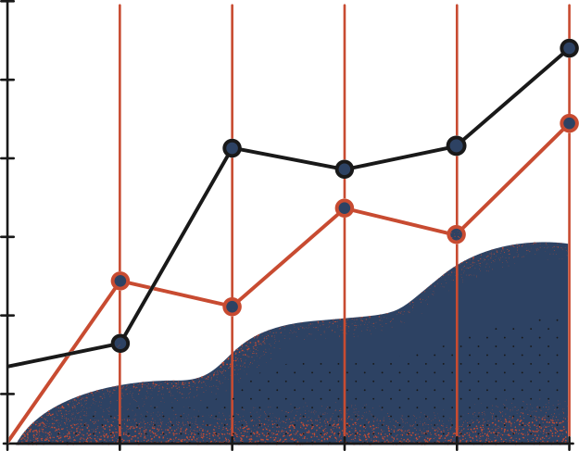

QUIC Attacks:
Implementation
and Analysis
STUDENT
ADVISOR
YUCHEN WANG
SHAN CHEN

Slide 2
Goal
I
Implement Version Negotiation Request Forgery (VNRF)
II
Implement Connection Migration Request Forgery (CMRF)
III
Mitigation Approaches

Slide 3
Table of Contents
I
QUIC Basis & Threat Model
II
Version Negotiation Request Forgery (VNRF)
III
Experiment

Slide 4
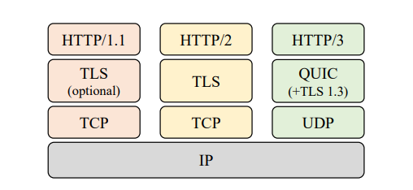
I
QUIC Basis & Threat Model
UDP-based
Connection Oriented
TLS Handshake Parameter

Slide 5
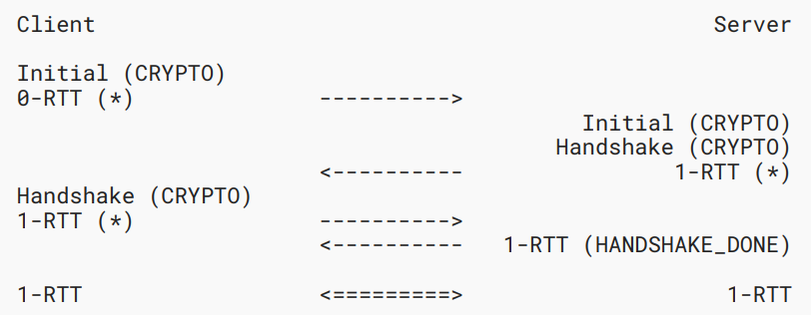
I
QUIC Basis & Threat Model
Version Negotiation
Triggered by unknown version

Slide 6
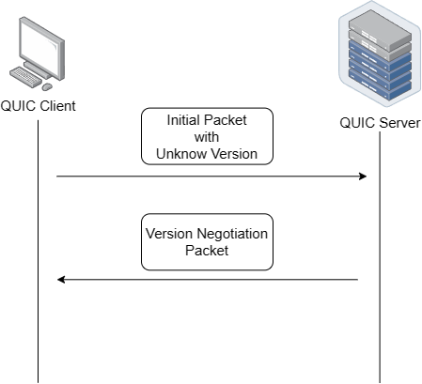
I
QUIC Basis & Threat Model
Version Negotiation
Triggered by unknown version

Slide 7
I
QUIC Basis & Threat Model
Version Negotiation
Triggered by unknown version
With IP Spoofing?

Slide 8
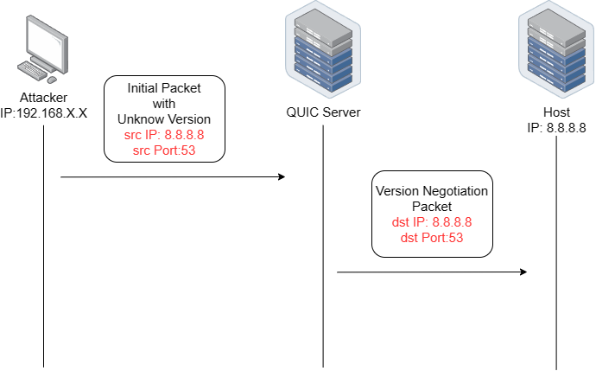
I
QUIC Basis & Threat Model
Version Negotiation
Triggered by unknown version
With IP Spoofing?

Slide 9
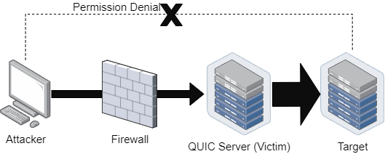
I
QUIC Basis & Threat Model
Request Forgery
Server send “unintended” request to other host
Attacker gain high privilege and bandwith

Slide 10
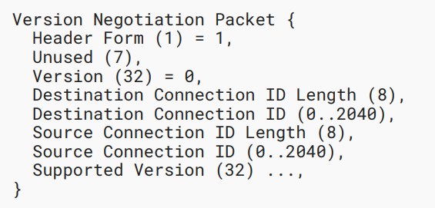
II
Version Negotiation Request Forgery (VNRF)

Slide 11
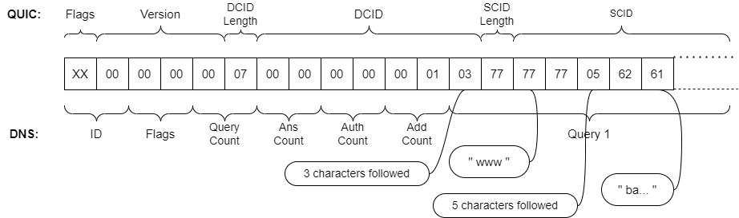
II
Version Negotiation Request Forgery (VNRF)

Slide 12
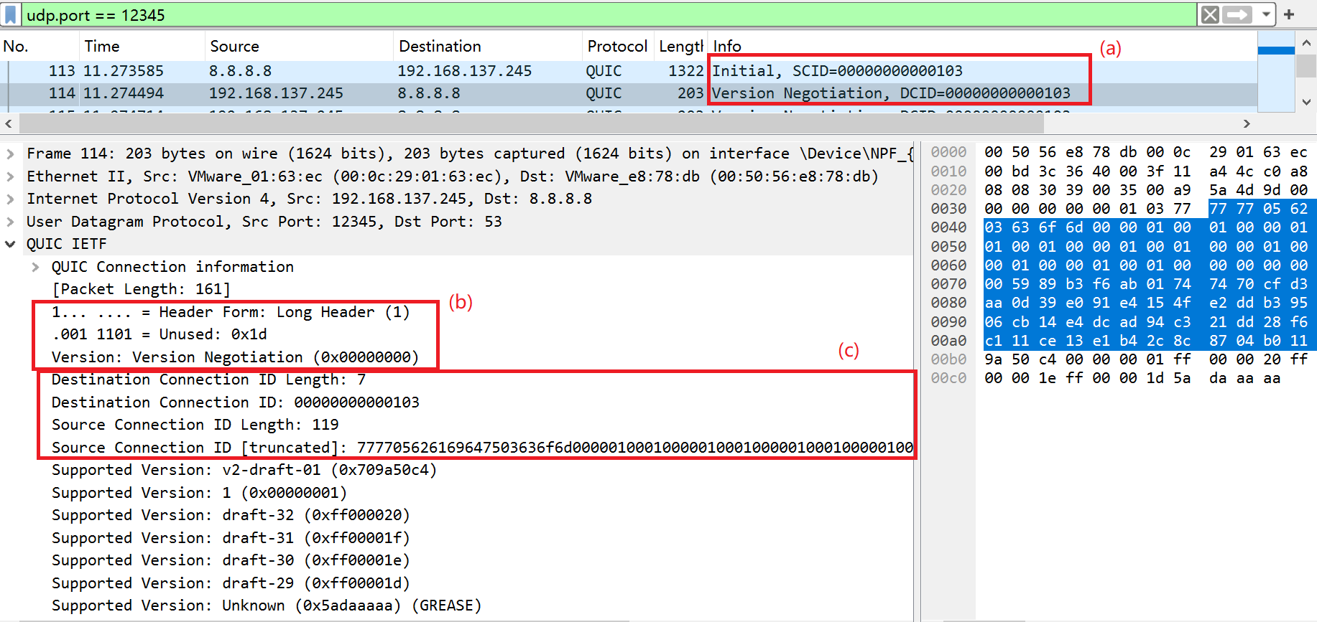
III
Experiment

Slide 13
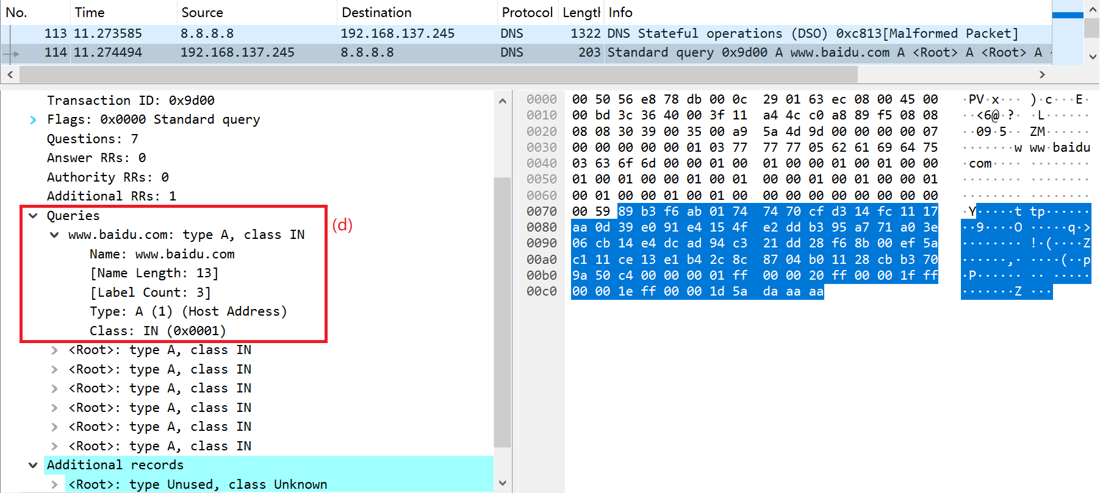
III
Experiment

Slide 14
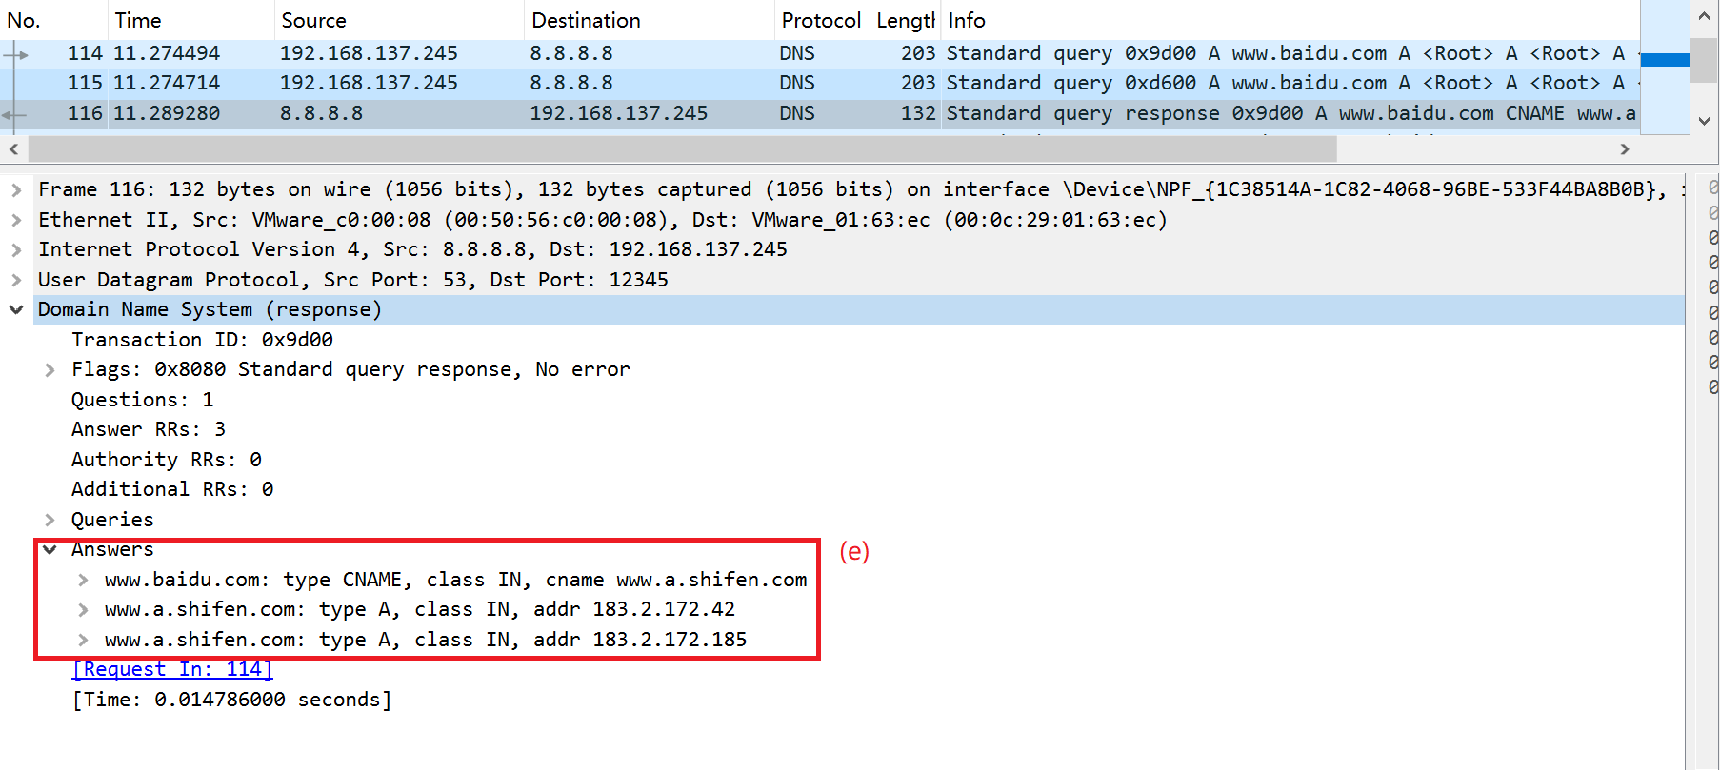
III
Experiment

Slide 15
Future Work
I
Implement Connection Migration Request Forgery (CMRF)
II
Mitigation Approaches

Slide 16
The End
Thank you
for listening

