Slide 1

Math Function Calculator
Von: Menschen

Slide 2
Gliederung
Design & Features
Development
  Tools
  Costs
  Gantt
  Target specification
Code Example
  Plans for future versions
Live demonstration

Slide 3

Design & Features
https://wallpapercave.com/python-code-wallpapers

Slide 4
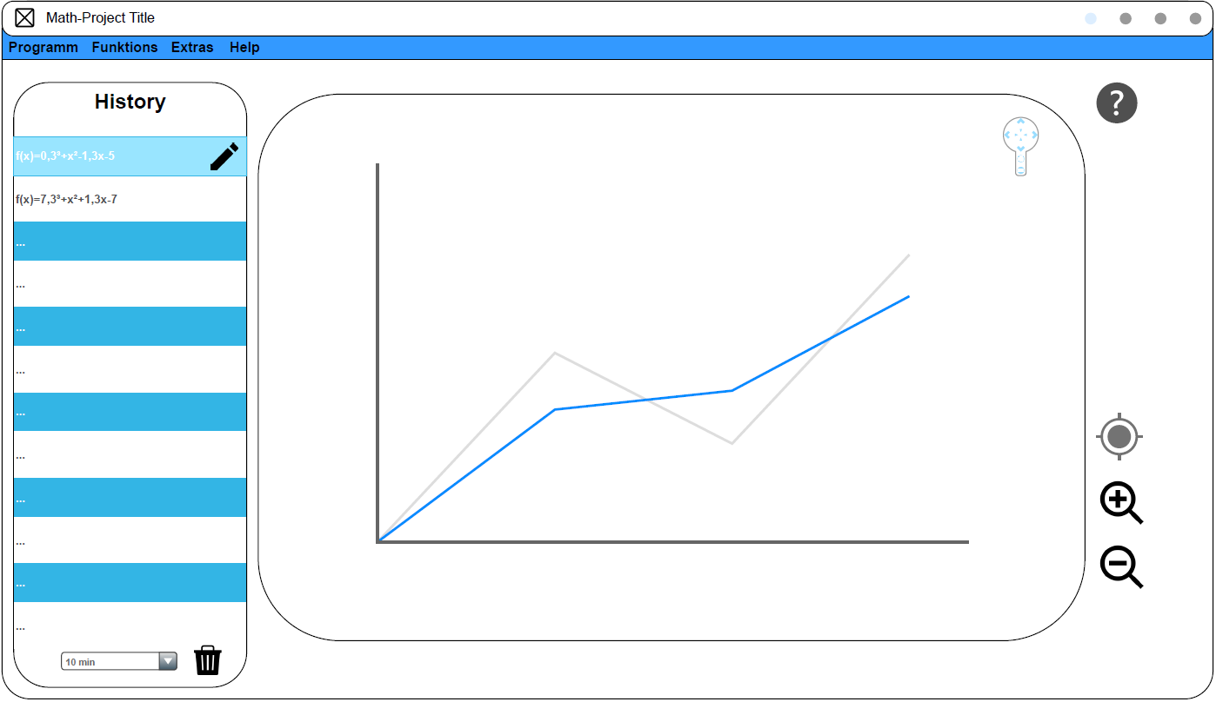
Mockup
* Dies ist ein Demonstrationsmodell und kann von Endprodukt abweichen

Slide 5
Toolchanger
Tool 1
Tool 2
Tool 3
Tool 4
Function Analyzer
Trigonometry
Exponential
Integral
- Linear functions
- Quadratic functions
- Polynomial function
- Differential calculus
- Curve sketching
- Trigonometric functions
- Exponential functions
- Integral functions

Slide 6


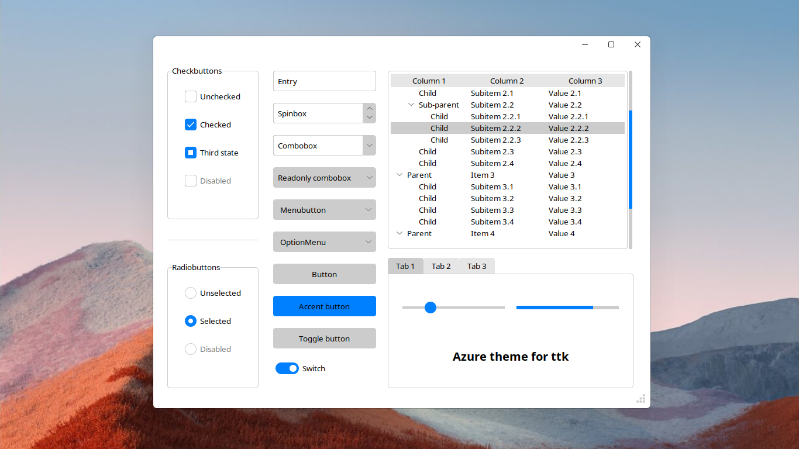


Features
Fast Response Time
Ultra Lightweight
Decentralized On Your Device
Modern UI
Modular Structure

Slide 7

Development

Slide 8



Tools we used
NeoVim
VS Code
Git

Slide 9

Costs
https://offermann-internet.de/kosten-allgemein/

Slide 10

Gantt

Slide 11
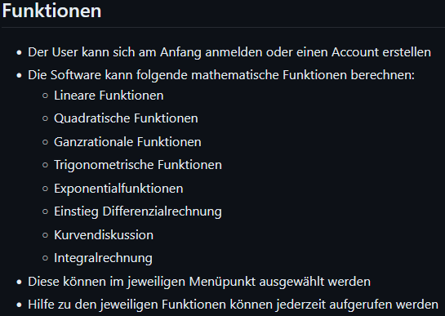
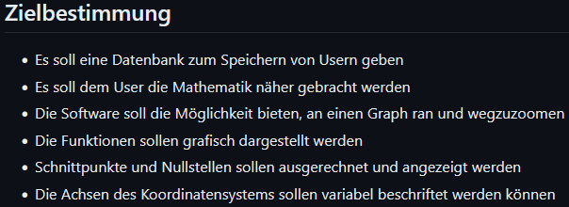
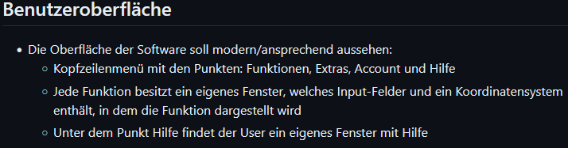


Our target specifiction

Slide 12

Code Examples

Slide 13
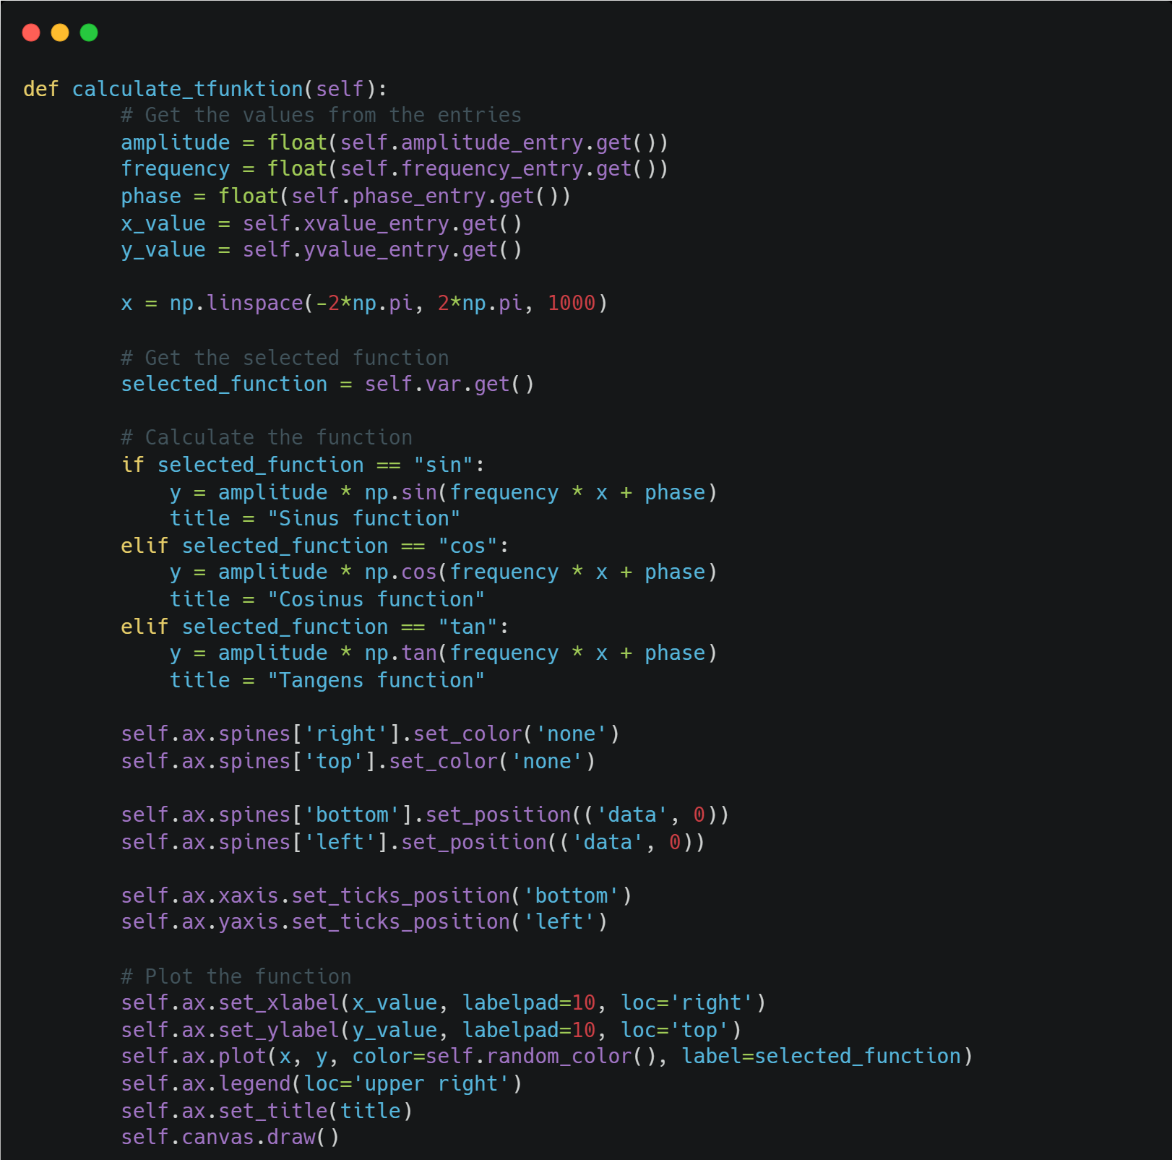

Slide 14
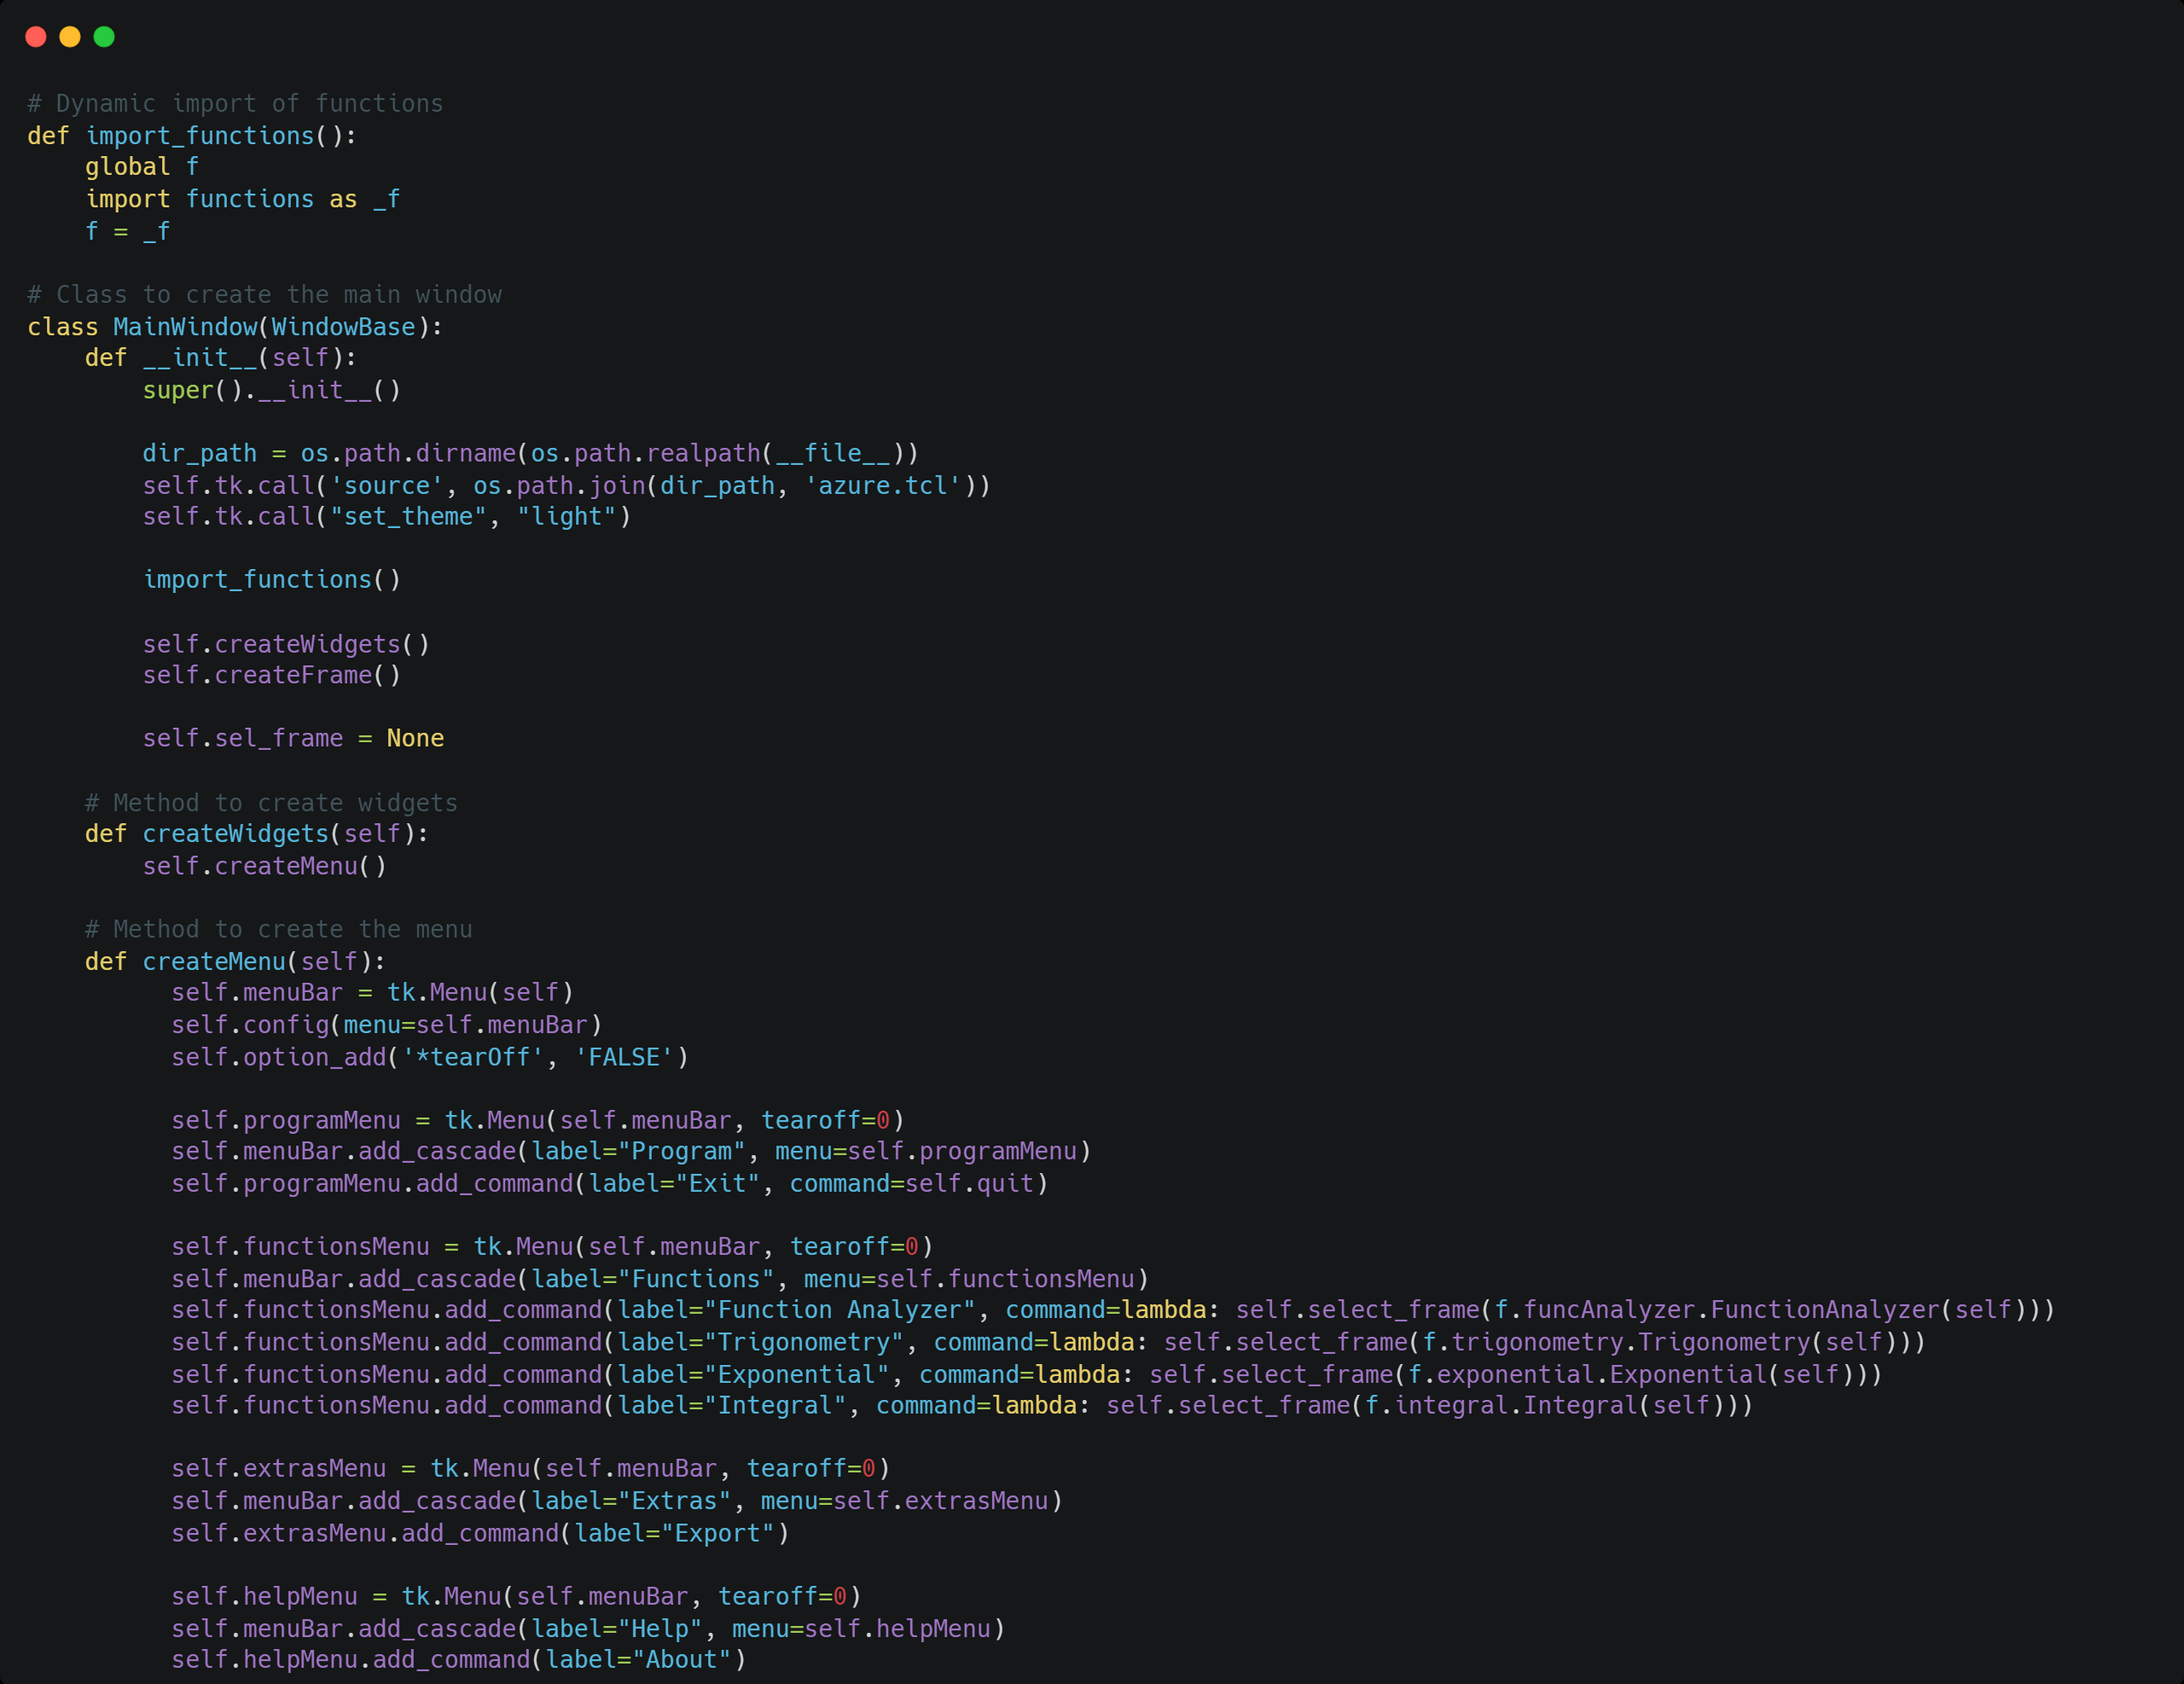

Slide 15

LIVE Demo

Slide 16

Plans for future versions
Debugging of the Function Analyzer
Feature: History
Feature: Function generator

Slide 17
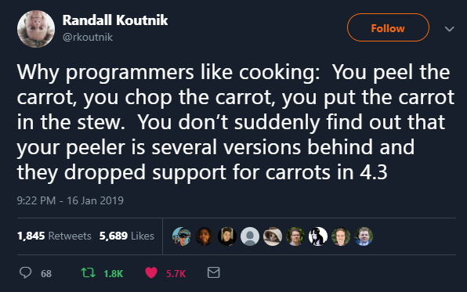
Thank you for your attention!
https://www.reddit.com/r/devhumor/comments/v35x0g/that_why_i_like_cooking_more_that_coding_somethime/#lightbox

