Slide 1
Software Dependability Project Presentation
By Aouni Wrocklage, Luka Nola and Janna Piontek

Slide 2
Overview
Context of Project and Used Library
Goals and Methodical Steps
Results and Findings
Conclusion & Outlook

Slide 3
Context & Inspected Library
Context: Software Dependability
Reliable Software
Open Source Library
Chosen Library: DbUtils – JDBC Utility Component
Simplified JDBC (Java Database Connection) Handling
Effortless Data Mapping
Automatically populates JavaBean properties

Slide 4
Goals
Conduct an extensive quality analysis using modern tools
Code Quality
Evaluate and improve the quality of the code
Software Tests
Ensure robustness and reliability of the codebase
Performance & Scalability
Identify bottlenecks and optimize critical components
Vulnerabilities
Detect and address vulnerabilities in the code

Slide 5
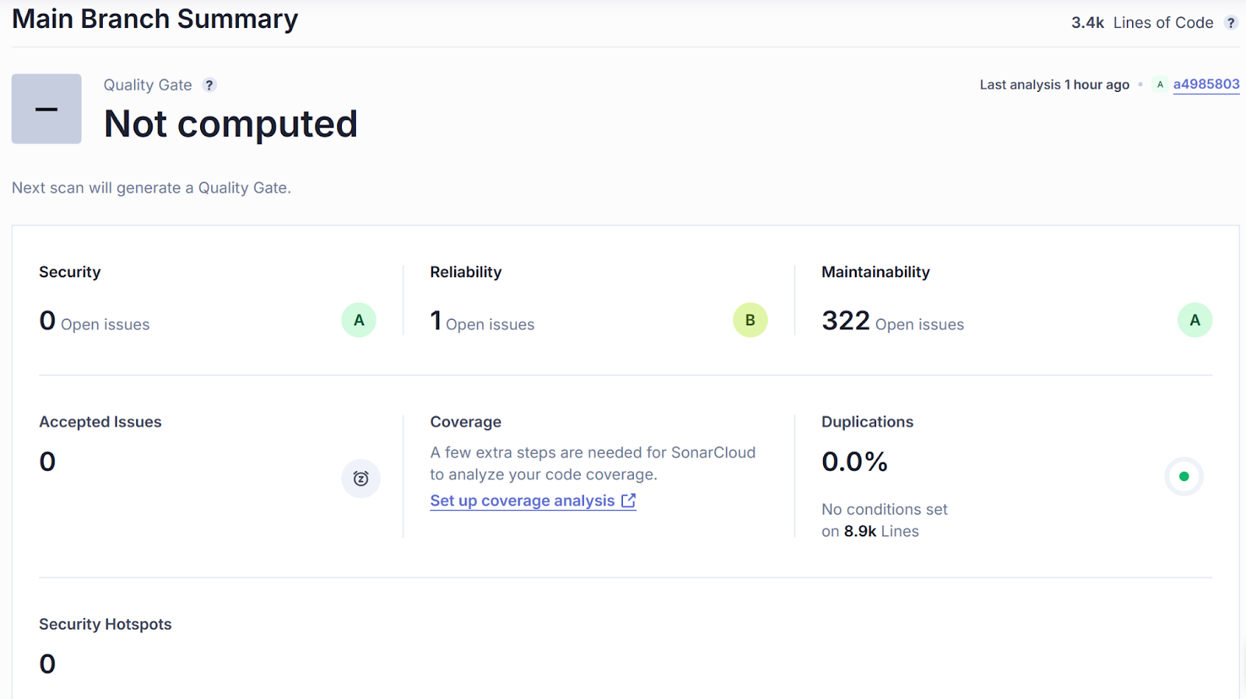
Methodological Steps & Results: Code Quality
Technology: Sonarcloud
27 high severity issues
16 tests without assertions
6 empty methods
3 repeated string literal duplication
2 high cognitive complexity
Some issues were not fixed
Seen as false positives

Slide 6
Results: Software Test Analysation - Quantity

Slide 7
Results: Software Test Analysation - Quality

Slide 8
Methodological Steps & Results: Software Tests Generation - Randoop
Settings for generation command
--classlist for six poorly tested classes
--time-limit=600 (6*100)
Explicit usage of java 11 for compatibility
result
> 9000 regression tests
Small varying improvements of the test coverages
Between 0 and 7% improvement in instruction coverage

Slide 9
Methodological Steps & Results: Software Tests Generation – Github Copilot
For three least tested classes
Github Copilot chat as IntelliJ plugin
Generating process
Prompt fine-tuning for better / working results
Iteratively repeating prompts to avoid output limit
Deleting duplicate test methods
Results
> 200 test methods
Test coverage improved to ~80%

Slide 10
Results: Performance

Slide 11
Results: Dockerization

Slide 12
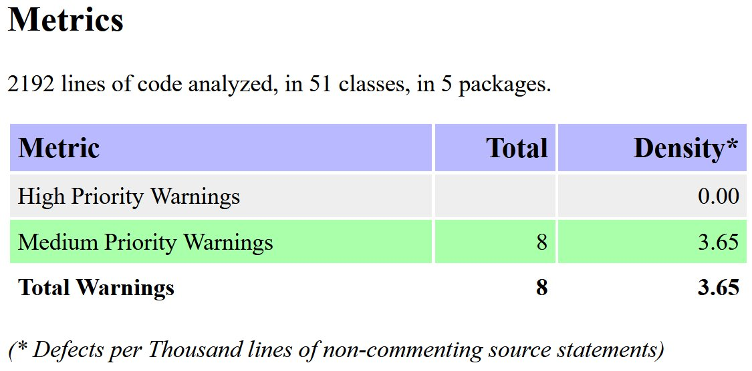
Methodological Steps & Results: Vulnerabilities
Technologies: OWASP FindSecBugs & OWASP DC
FindSecBugs:
8 warnings
1 possible information exposure
7 possible vulnerabilities for SQL injection
personal evaluation: all false positives

Slide 13
Conclusion and Outlook

Slide 14
Sonarcloud Overview
27 high severity issues
16 tests without assertions
6 empty methods
3 repeated string literal duplication
2 high cognitive complexity
Some issues were not fixed
Seen as false positives
Notes:
Not fixed: tests witout assertions

Slide 15
Testgeneration
Settings for generation command
--classlist for six poorly tested classes
--time-limit=600 (6*100)
Explicit usage of java 11 for compatibility
result
> 9000 regression tests
Small varying improvements of the test coverages
Between 0 and 7% improvement in instruction coverage
Notes:
Compatibility between test cases and project (-> test cases don't use language features of 12+)

Slide 16
Testgeneration with Github Copilot
For three least tested classes
Github Copilot chat as IntelliJ plugin
Generating process
Prompt fine-tuning for better / working results
Iteratively repeating prompts to avoid output limit
Deleting duplicate test methods
Results
> 200 test methods
Test coverage improved to ~80%

Slide 17
Findings / Randoop vs. Copilot
Something what we feel is useful for what?
Randoop for small overall improvements without much afford
Copilot for focussing on specifcal methods / classes but more manual interactions needed
I'll filll this slide (more) if you feel it's useful / bringing us closer to the requirements

Slide 18

OWASP FindSecBugs
Example:
public <T> T insert(final Connection conn, final String sql, final ResultSetHandler<T> rsh, final Object... params) throws SQLException {
[…]
try {
if (params != null && params.length > 0) {
final PreparedStatement ps = conn.prepareStatement(sql, Statement.RETURN_GENERATED_KEYS);
stmt = ps;
this.fillStatement(ps, params);
ps.executeUpdate();
} […]
} […]
}
Output as html
8 warnings
1 possible information exposure
7 possible vulnerabilities for SQL injection
personal evaluation: all false positives
Notes:
Method to print stack trace
Methods that used a string sql parameter, combined with parameters parameter

Slide 19
Overview
Project Library (Aouni)
Sonarcloud Overview (Janna)
Dockerization (Luka)
Code Coverage & Mutation Test Campaign (Aouni)
Performance Testing (Luka)
Testgeneration with new analysis (Janna & Aouni)
Security analysis with OWASP (Janna + Aouni)

