Slide 1
Software Dependability Project Presentation
By Aouni Wrocklage, Luka Nola and Janna Piontek

Slide 2
Overview
Context of Project and Used Library
Goals
Methodical Steps and Results
Conclusion & Outlook

Slide 3
Context & Inspected Library
Context: Software Dependability
Reliability of Software
Open Source Library
Chosen Library: DbUtils – JDBC Utility Component
Simplified JDBC (Java Database Connection) Handling
Effortless Data Mapping
Automatically populates JavaBean properties

Slide 4
Goals

Slide 5
Goals
Conduct an extensive analysis and improvement using modern tools
Code Quality
Evaluate and improve the quality of the code
Software Tests
Ensure robustness and reliability of the codebase
Performance & Scalability
Identify bottlenecks and optimize critical components
Vulnerabilities
Detect and address vulnerabilities in the code

Slide 6
Code Quality

Slide 7
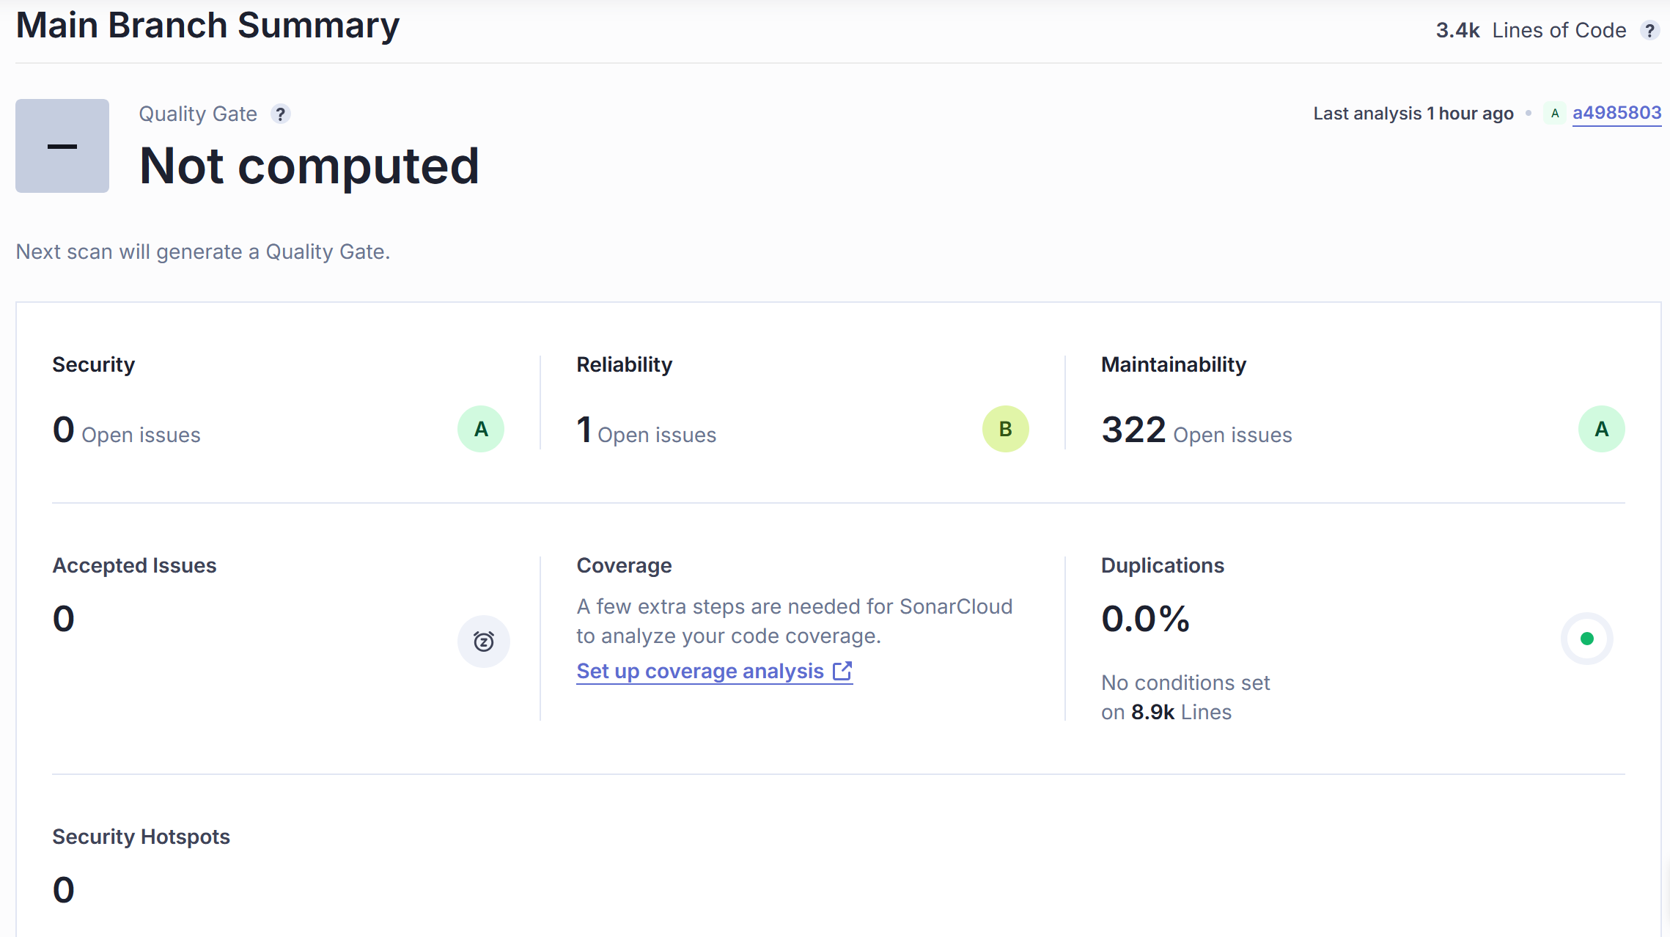
Methodological Steps & Results: Code Quality
Technology: Sonarcloud
27 high severity issues
16 tests without assertions
6 empty methods
3 repeated string literal duplication
2 high cognitive complexity
Some issues were not fixed
Seen as false positives

Slide 8
Test Quality and Quantity

Slide 9

Methodological Steps & Results: Software Tests – Quantity & Quality
Quantity
Technology: Jacoco
Test Coverage Analysation
Quality
Technology: Pit Test
Mutation and Teststrength analysation
Objective: Identify poorly tested classes based on the following thresholds
Test Coverage < 80% || Untested Lines >10
Mutation Coverage & Test Strength < 80%

Slide 10
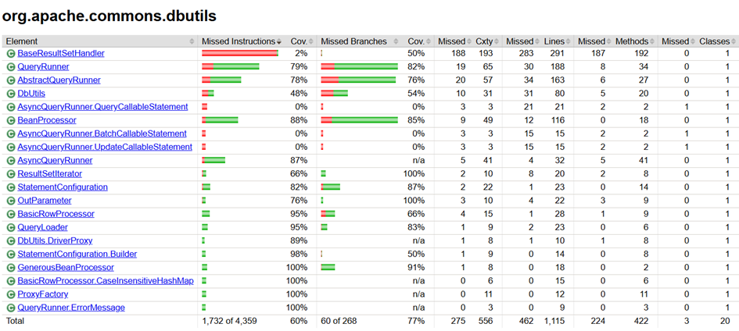
Methodological Steps & Results: Software Tests – Quantity

Slide 11
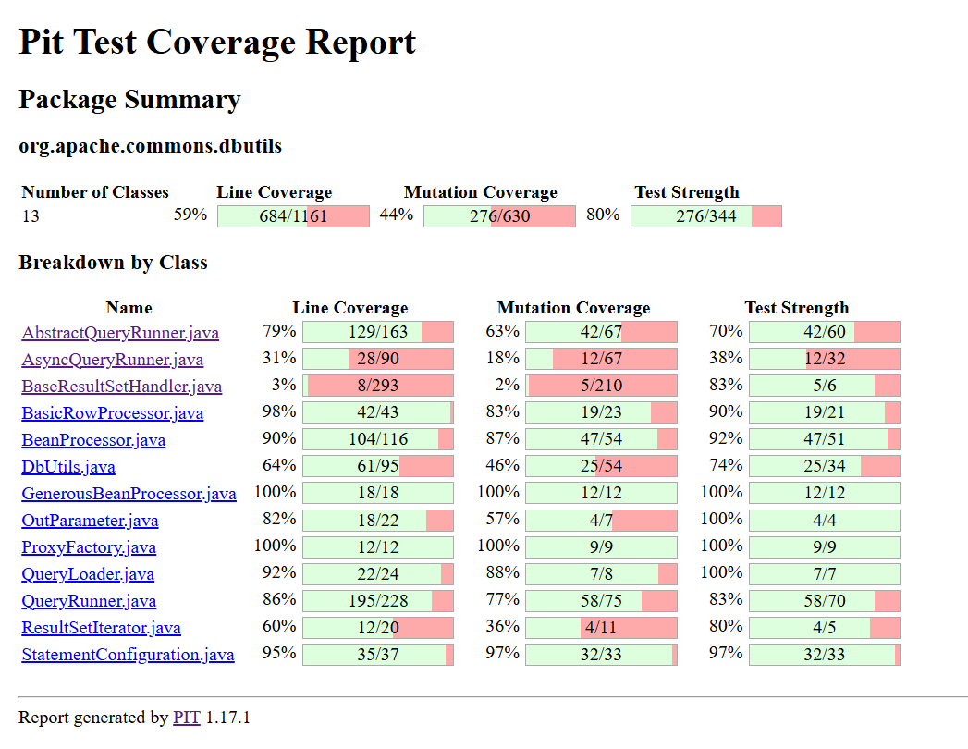

Methodological Steps & Results: Software Tests – Quality

Slide 12
Methodological Steps & Results: Software Tests – Quantity & Quality: Results
Classes that need more & better testing:
BaseResultSetHandler
simplifies the process of converting SQL ResultSet objects into various target types
DBUtils
provides a simple set of helper functions for working with JDBC
AbstractQueryRunner
QueryRunner class simplifies executing SQL queries and updates in Java applications
AsyncQueryRunner
Asynchronous Implementation of AbstractQueryRunner
QueryRunner
Synchronous Implementation of AbstractQueryRunner
BeanProcessor
Matches column names to bean property names

Slide 13
Test Generation
Notes:
To improve

Slide 14
Methodological Steps & Results: Software Tests Generation – Randoop
Explicit usage of java 11 for compatibility
Between 0 and 7% improvement in instruction coverage
Settings for generation command
--classlist for six poorly tested classes
--time-limit=600 (6*100)
result
> 9000 regression tests
Small varying improvements of the test coverages
Notes:
Options

Slide 15
Methodological Steps & Results: Software Tests Generation – Github Copilot
Github Copilot chat as IntelliJ plugin
Deleting duplicate test methods
> 200 new test methods
Three least tested classes
Context
Generating process
Prompt fine-tuning for better / working results
Iteratively repeating prompts to avoid output limit
Notes:
Especially BaseResultSetHandler

Slide 16
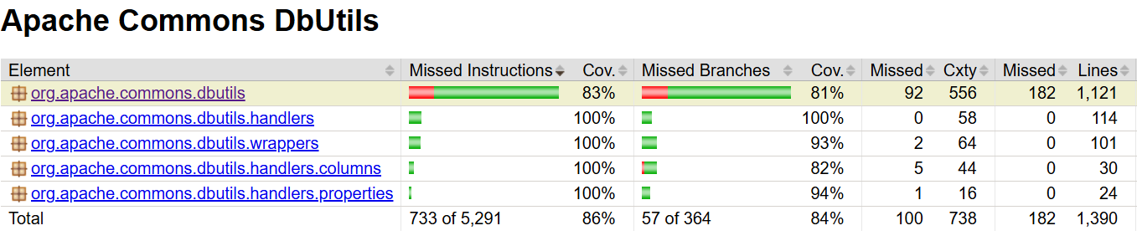
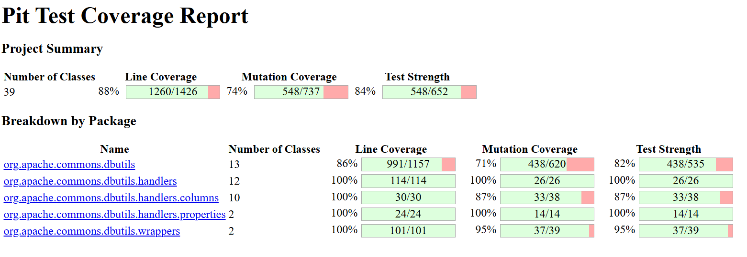
Methodological Steps & Results: Software Tests – Analysis after Generation
Jacoco
Pit Test
Notes:
Whole package – good instruction coverag
Pitest – mutation coverage much better but still room for improvement

Slide 17
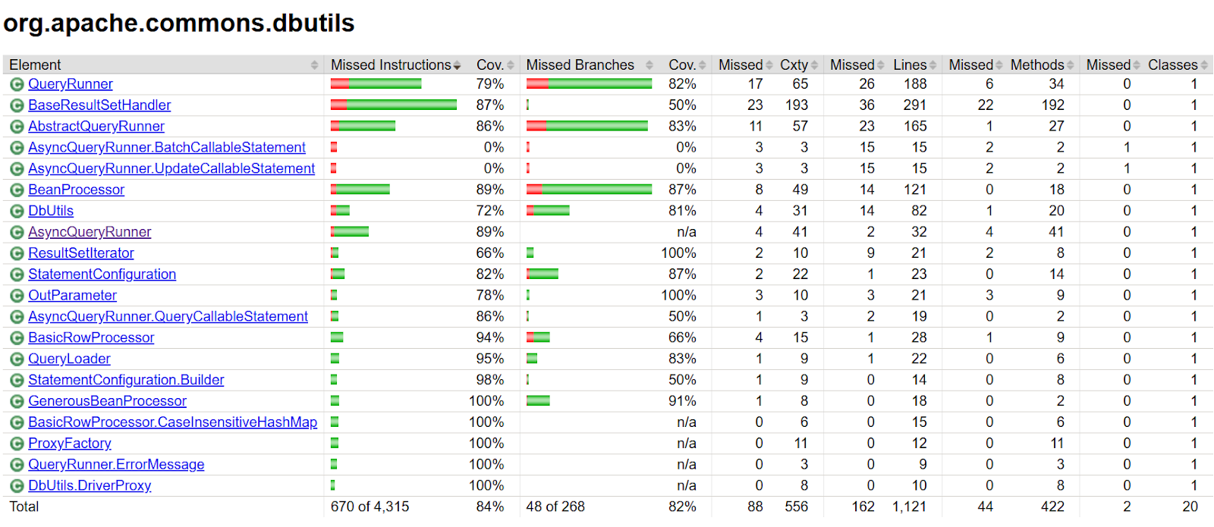
Methodological Steps & Results: Software Tests – Analysis after Generation

Slide 18
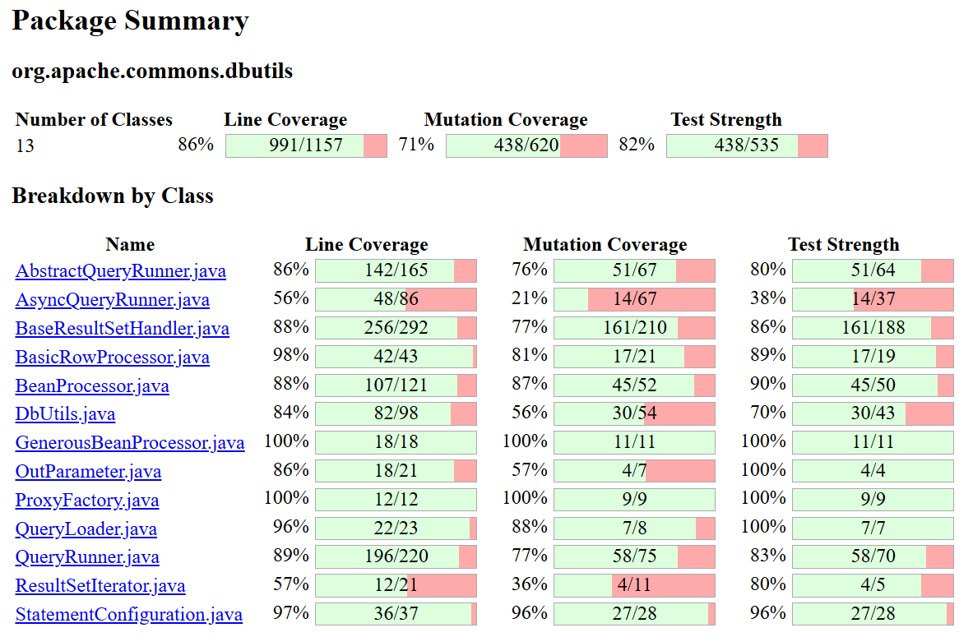


Methodological Steps & Results: Software Tests – Analysis after Generation

Slide 19
Performance & Dockerization

Slide 20
Methodological Steps & Results: Microbenchmarking Performance
JMH
Choosing the most cumbersome classes and methods
DbUtils.java (close, closeQuietly, commitAndClose, rollbackAndClose)
BasicRowProcessor.java (toArray, toBean, toBeanList)
QueryRunner.java (query, batch, update)
Results
Expected
Baseline

Slide 21
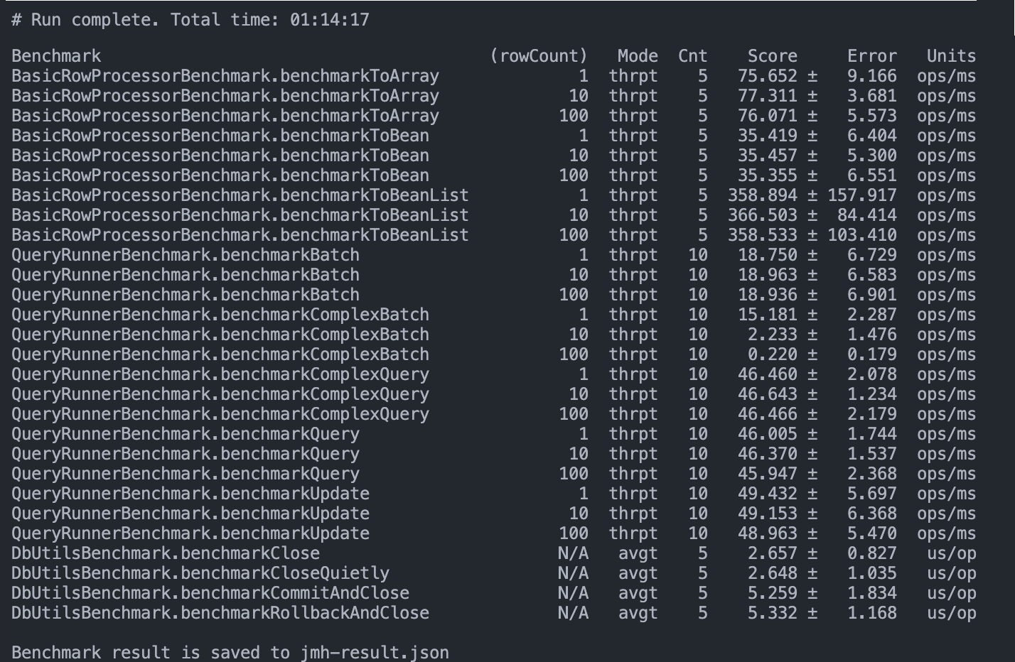
Methodological Steps & Results: Microbenchmarking Performance

Slide 22
Methodological Steps & Results: Microbenchmarking Performance

Slide 23
Methodological Steps & Results: Microbenchmarking Performance

Slide 24
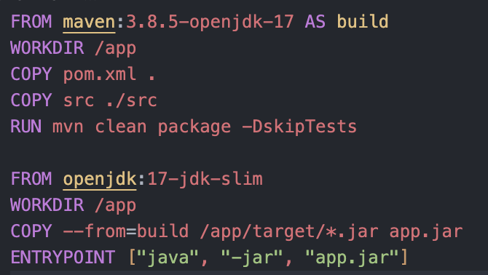
Methodological Steps & Results: Dockerization
dbutils-webapp rationale
Docker image
$ mvn spring-boot:build-image –DskipTests
Alternative Dockerfile

Slide 25
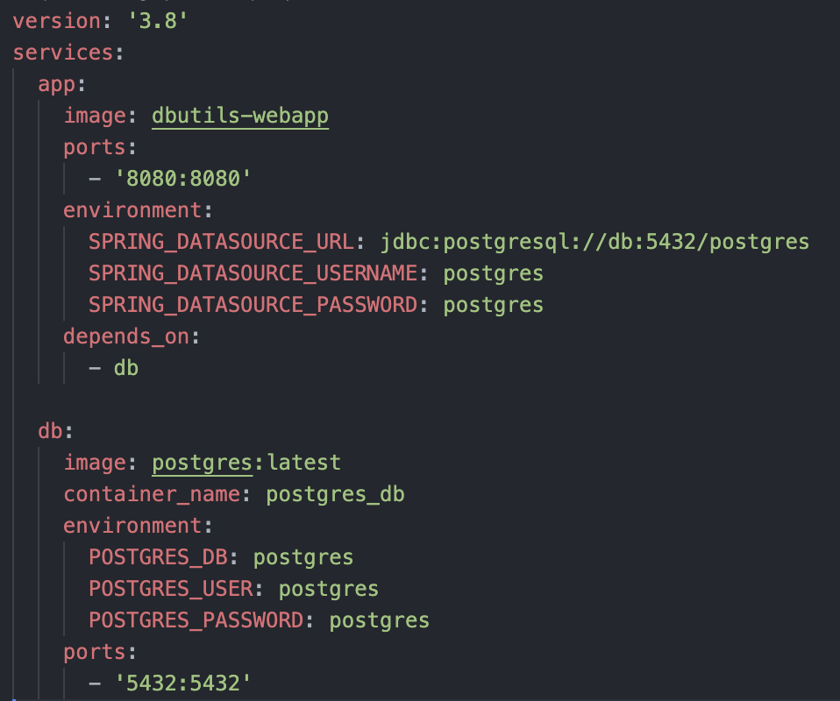
Methodological Steps & Results: Dockerization
docker-compose.yml

Slide 26
Security Vulnerabilities

Slide 27
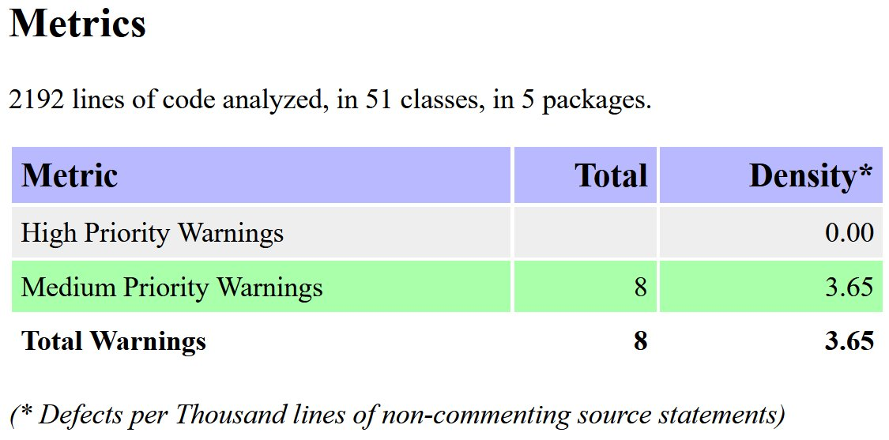
Methodological Steps & Results: Vulnerabilities
Technologies: OWASP FindSecBugs & OWASP DC
FindSecBugs:
8 Medium Priority warnings
1 possible information exposure (stack trace)
7 possible vulnerabilities for SQL injection
personal evaluation: all false positives
Dependency Check:
Library uses 0 dependencies (outside of test-scope)

Slide 28
Conclusion and Outlook

Slide 29
Conclusion
Code Quality: All High Severity Issues from Sonarcloud cleared
Test Quality: Test Coverage, Mutation Score and Teststrength greatly improved
Performance: A minimum baseline for performance set, Strenghtening security in Performance Under Load, Deployment and Orchestration
Security: Very Safe (no bugs, no dependencies)

Slide 30
Outlook
Software Tests
Quantity: some small improvements possible
Quality: improve AsyncQueryRunner & DbUtils tests
Clean up repository to create pull request for the official branch
Performance: introduce benchmarks for other classes

Slide 31
Thanks for your attention

Slide 32
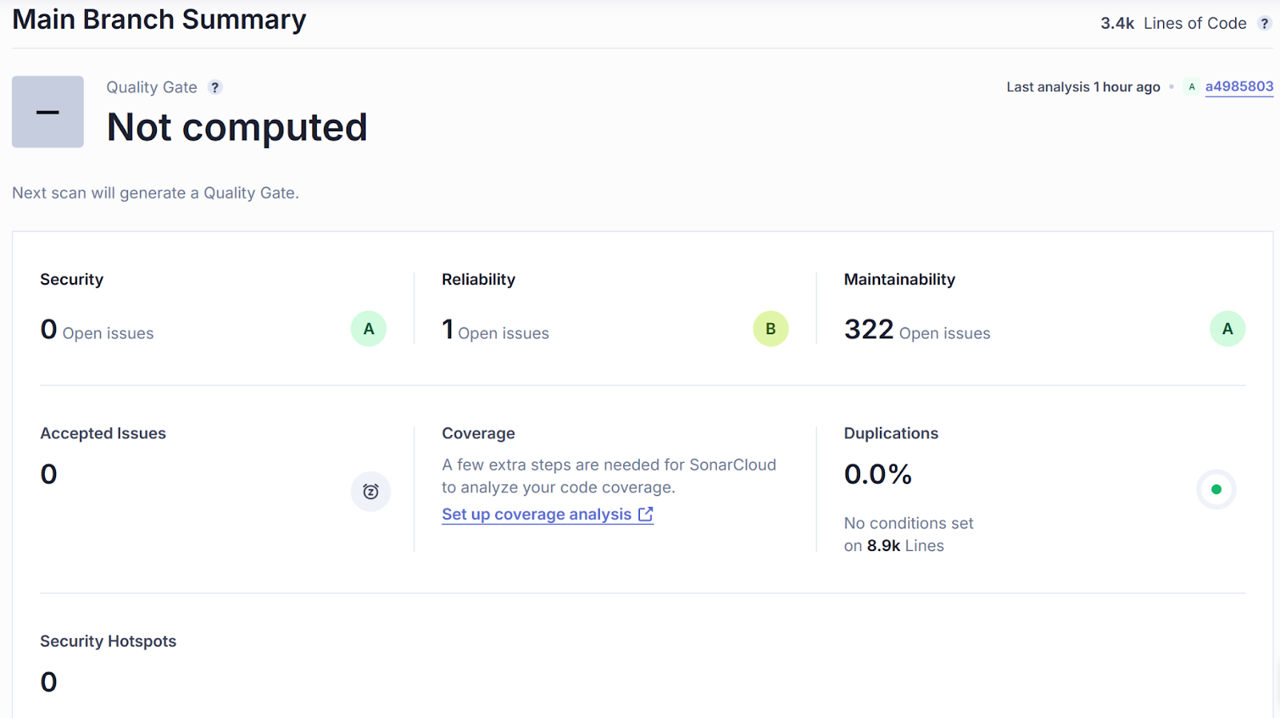
Sonarcloud Overview
27 high severity issues
16 tests without assertions
6 empty methods
3 repeated string literal duplication
2 high cognitive complexity
Some issues were not fixed
Seen as false positives
Notes:
Not fixed: tests witout assertions

Slide 33
Testgeneration
Settings for generation command
--classlist for six poorly tested classes
--time-limit=600 (6*100)
Explicit usage of java 11 for compatibility
result
> 9000 regression tests
Small varying improvements of the test coverages
Between 0 and 7% improvement in instruction coverage
Notes:
Compatibility between test cases and project (-> test cases don't use language features of 12+)

Slide 34
Testgeneration with Github Copilot
For three least tested classes
Github Copilot chat as IntelliJ plugin
Generating process
Prompt fine-tuning for better / working results
Iteratively repeating prompts to avoid output limit
Deleting duplicate test methods
Results
> 200 test methods
Test coverage improved to ~80%

Slide 35
Findings / Randoop vs. Copilot
Something what we feel is useful for what?
Randoop for small overall improvements without much afford
Copilot for focussing on specifcal methods / classes but more manual interactions needed
I'll filll this slide (more) if you feel it's useful / bringing us closer to the requirements

Slide 36

OWASP FindSecBugs
Example:
public <T> T insert(final Connection conn, final String sql, final ResultSetHandler<T> rsh, final Object... params) throws SQLException {
[…]
try {
if (params != null && params.length > 0) {
final PreparedStatement ps = conn.prepareStatement(sql, Statement.RETURN_GENERATED_KEYS);
stmt = ps;
this.fillStatement(ps, params);
ps.executeUpdate();
} […]
} […]
}
Output as html
8 warnings
1 possible information exposure
7 possible vulnerabilities for SQL injection
personal evaluation: all false positives
Notes:
Method to print stack trace
Methods that used a string sql parameter, combined with parameters parameter

Slide 37
Overview
Project Library (Aouni)
Sonarcloud Overview (Janna)
Dockerization (Luka)
Code Coverage & Mutation Test Campaign (Aouni)
Performance Testing (Luka)
Testgeneration with new analysis (Janna & Aouni)
Security analysis with OWASP (Janna + Aouni)

