Slide 1

JDE6
Junior Data Engineer Program (Cohort 6)
Final Project

Slide 2


Our Team
GiGi
Erasmus
Neil
Data Analysis
Identify
Recommendation
Preparation
Find insights

Slide 3
Agenda
01
Introduction
Aims, Preparation, Olist Dataset
02
Key Performance Indicator
Sales & Customers
03
Analysis for the Dataset
Find insights and correlation between different features
04
Insight & Recommendation
Increase revenue and customers retention rate
05
Conclusion
06
Q & A Section

Slide 4
Aims
Using Business Intelligence tools
Provide some marketing findings
Recommendations in a report

Slide 5
SWOT Analysis
Strengths
Weaknesses
Largest department store in Brazilian marketplaces
Hard to maintain the quality of sellers
S
W
Threats
Opportunities
T
O
Phishing, Credit Card Fraud
Can reach unlimited number of customers on the internet

Slide 6
Preparation
Data preprocessing
Data Collection
Data Research

Slide 7
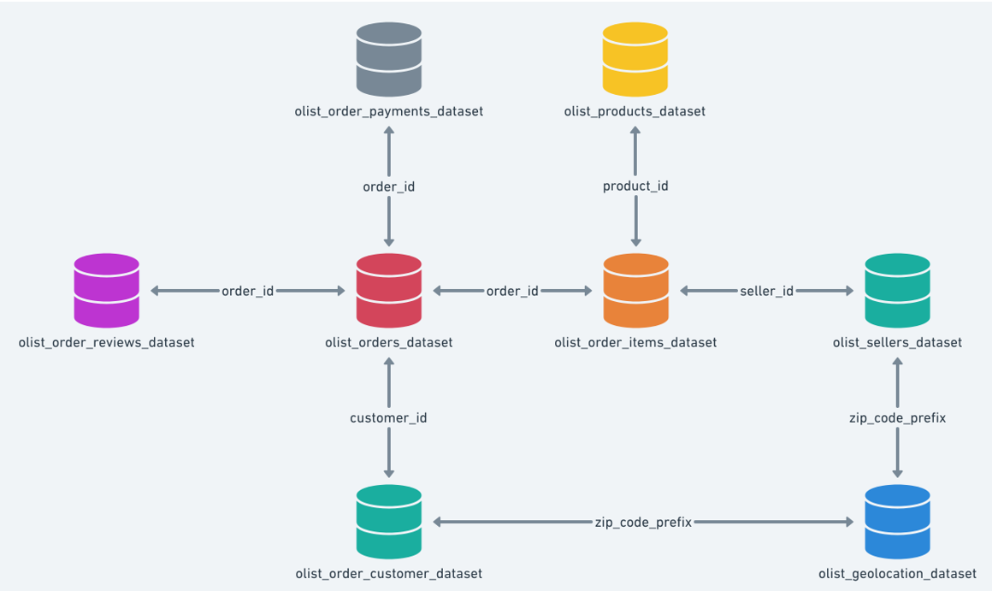
Brazilian E-Commerce Public Dataset by Olist
2016
2017
2018
Sep-Dec
Jan-Dec
Jan-Oct
About Dataset
Olist connects small businesses from
all over Brazil to channels without hassle
and with a single contract
100k orders from 2016 to 2018 in Brazil

Slide 8
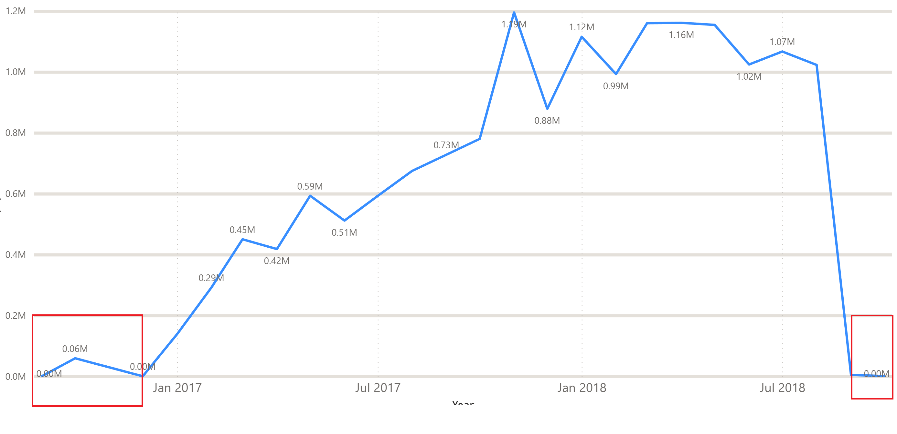
Brazilian E-Commerce Public Dataset by Olist
2016
2017
2018
Sep-Dec
Jan-Dec
Jan-Oct

Slide 9

Brazilian E-Commerce Public Dataset by Olist
2016
2017
2018
Sep-Dec
Jan-Dec
Jan-Aug
About Dataset
Filter out the data of Sep-Dec of 2016
Filter out the data of Sep-Oct of 2018

Slide 10
KPIs
Sales
Period growth
Average value
01
02
Products Performance
03
06

Slide 11
KPIs
Sales & Customers
Period growth
Average value
01
02
Products Performance
Repeat purchase
03
04
03
Review response
Processing cycle length
05
06
06

Slide 12
Insight and Recommendation
Black Friday
Most of the delivery time seem reasonable
Sales
adjust future planning strategies and allocate resources to the appropriate markets
Delivery
Establishing a new system or rules to change the current situation
Price range focus on lower price
Repeat Purchase Rate is low
Product
Increase the volume on the high value product
Customers
Membership Rewards Program
Provide electronic code or discount in 6 months for customer use, increase repeat customer
Most of review score seem in high rate
Reviews
Increase quality of sellers

Slide 13
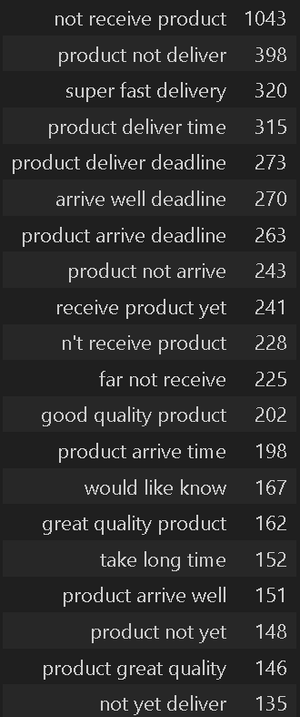
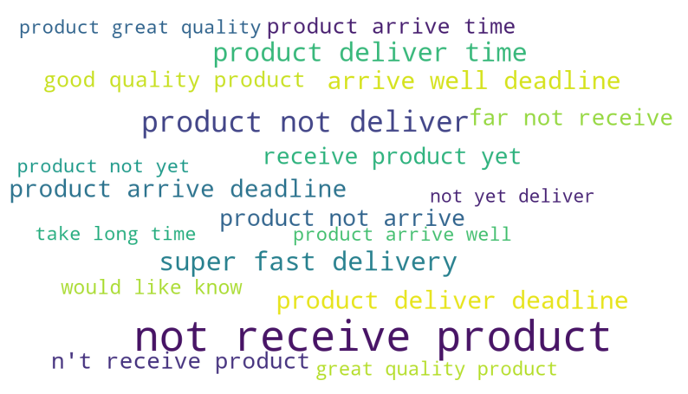
Conclusion

Slide 14

References
Population
Estimates of resident population for Municipalities and Federation Units | IBGE
https://www.ibge.gov.br/en/statistics/social/population/18448-estimates-of-resident-population-for-municipalities-and-federation-units.html?edicao=31468
‌
Per Capita Income
IBGE releases per capita household earnings in 2016 | News Agency
https://agenciadenoticias.ibge.gov.br/en/agencia-press-room/2185-news-agency/releases-en/10474-ibge-releases-per-capita-household-earnings-in-2016
IBGE releases per capita household earnings 2017 | News Agency
https://agenciadenoticias.ibge.gov.br/en/agencia-press-room/2185-news-agency/releases-en/20175-ibge-releases-per-capita-household-earnings-2017
IBGE releases per capita household earnings 2018 | News Agency
https://agenciadenoticias.ibge.gov.br/en/agencia-press-room/2185-news-agency/releases-en/23873-ibge-releases-per-capita-household-earnings-2018
GDP
Gross Domestic Product of Municipalities | IBGE
https://www.ibge.gov.br/en/statistics/economic/national-accounts/19567-gross-domestic-product-of-municipalities.html?=&t=resultados

Slide 15
THANK YOU
For your attention

Slide 16
Q & A

