Slide 1
Robotics - Project
Eray Felek – 150160081
İbrahim Ethem Türkeri – 150150045

Slide 2
What we did?
We created an environment including different colored boxes.
We requested user input to determine which box will be cleaned.
Eray implemented an algorithm to clean around the box.
İbrahim implemented an algorithm to find the box with requested color using camera and turn until turtlebot faces that box.

Slide 3
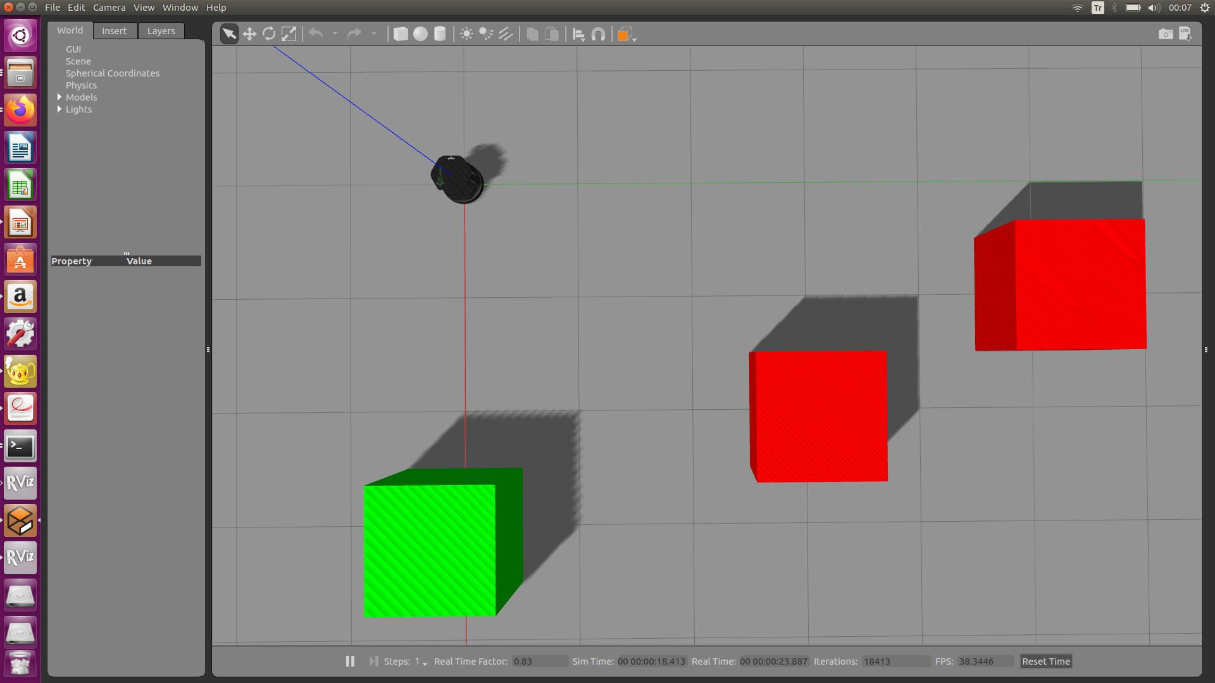
Sample Environment

Slide 4
Pseudocode
State 0 – In this state, I approached to selected box until turtlebot reach a predefined distance.
State 1 – I apply an angular velocity to turn left(if it is the fitst time checked by a global variable called “already”). The angular turn is almost 90 degrees at the first time and it is gradually decreased in the state 2. After my variable count(to publish 10 times) reaches zero I change the state to 2 and make the angular velocity 0

Slide 5
Pseudocode
In the state 2 I check the already(the first time our bot faces a box it turns left and after that it always turns right. I also check the side left in or der to avoid collision and give a little angular just to be on track. In the case my left or right becomes suddenly gets bigger, I publish an x velocity just to proceed a little farther than the corner so that I can avoid collision

Slide 6
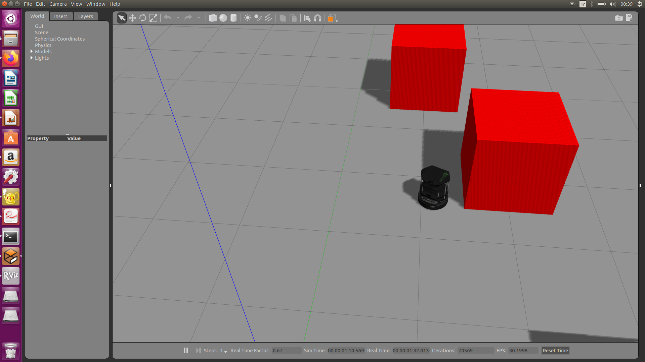
Pseudocode

Slide 7
Pseudocode
Firstly, I took the photo with the camera.
I read that picture by using cv2 and found the location of the box by counting pixels with non-selected color.
I turned the turtlebot until it faces to the selected box (when the left and the right get nearly equal).
I checked selected color by using these:
red > green + blue => red
green > red + blue => green

Slide 8
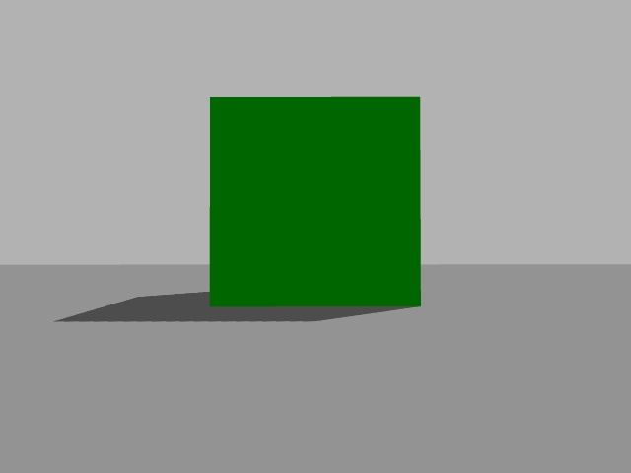

Slide 9
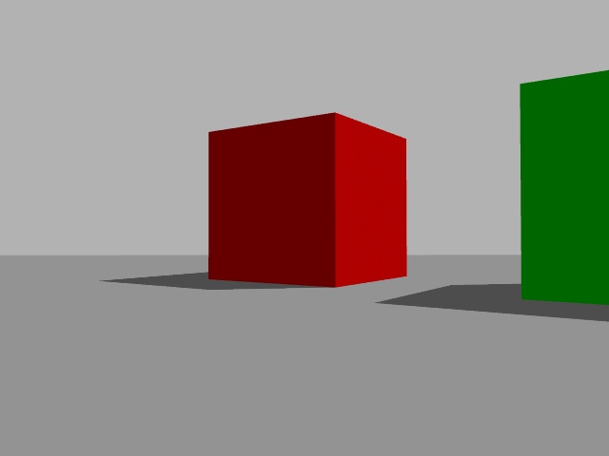

Slide 10
We wanted to clean around the objects and recognize objects. We mostly accomplished these goals.
We could not be able to recognize walls and avoid them.

