Slide 1



DSA-210 Fall Term Project
Eray Koyak

Slide 2

IDEA
This project will focus on analyzing my expenditures over different periods. I will combine credit card transactions for a comprehensive analysis. To make the analysis more organized and understandable, I plan to separate my expenses into specific and meaningful groups. These categories will include cafeteria (food) to reflect meals purchased on campus, grocery to cover spending at both local markets and online supermarkets, and subscriptions to services like Spotify, Amazon Prime, and other recurring payments. Additionally, I will analyze travel expenses, which include flights, train tickets, and subway fares, which may fluctuate depending on my schedule and commitments. Other categories will include online shopping, which includes purchases made through e-commerce platforms, and online food delivery, which reflects meals ordered from apps or websites in times when convenience is a priority.
Slide Num 3:Motivation and Prediction
Slide Num 4: How did I get the data?
Slide Num 5:Hypotesis testing
Slide Num 5: Starting of Analysis of data and my comments about my prediction
Slide Num 14: forecasting with machine learning
Slide Num 15-16: What I learned about myself and What I want to do as a solution
Slide Num 17: What could be done better?
Slide Num 18: REPORT

Slide 3
MOTIVATION
PREDICTION
The biggest motivation for this project is to understand the impact of exams on my life. I want to see how my spending patterns change during these periods (when I am busier and more stressed) and identify which types of expenses are most affected. For example, I suspect that certain areas, such as online food or online shopping, may see noticeable changes when I'm busier and more stressed. Additionally, it could help me develop strategies to manage my finances more effectively during high-pressure periods, ensuring that I stay on track with my overall financial goals while maintaining a healthy balance in other aspects of my life.
I believe that happiness has a significant impact on spending habits. For this reason, I think my expenditures decrease to a minimum, especially 1-2 days before exams, then increase after the exams, and rise even further once the exam period is over. I attribute this to the fact that during stressful and unhappy times, my consumption of meals and snacks tends to decrease. Additionally, since my number of trips off-campus drops significantly during these periods, I expect this to be reflected in my expenses. I'm curious to analyze the extent of these changes.I am particularly curious to measure the extent of these changes and analyze how closely they correspond to my emotional state at different stages of the exam period. By exploring the relationship between my happiness levels, stress, and spending habits, I hope to gain valuable insight into the psychological factors that influence financial behavior.

Slide 4
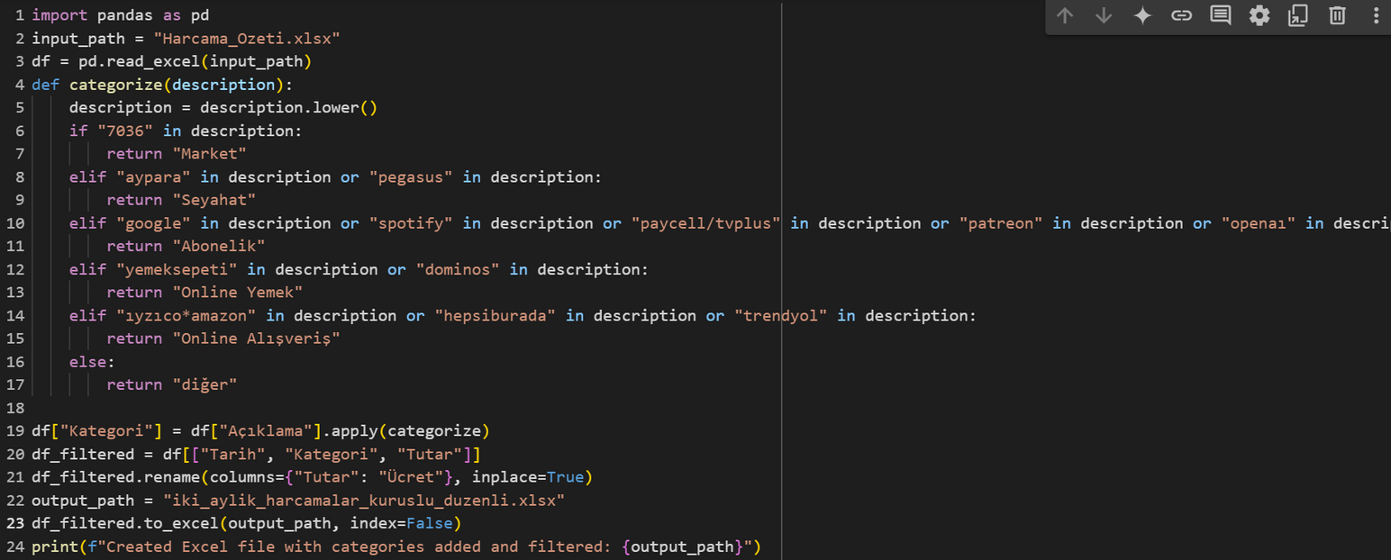
I received the credit card statement in Excel from the bank application. To make this Excel file the way I wanted, I used the code from Excel_data_organizing.ipynb, which I also added to github. Thus, I obtained an Excel file that is both more understandable, organized and analyzable.
I only entered the amazon subscription manually in the subscription section, the reason for this was that the subscription looked like shopping and confused it with amazon, which is online shopping.
I also manually entered food (cafeteria) data at the end of each day.

Slide 5
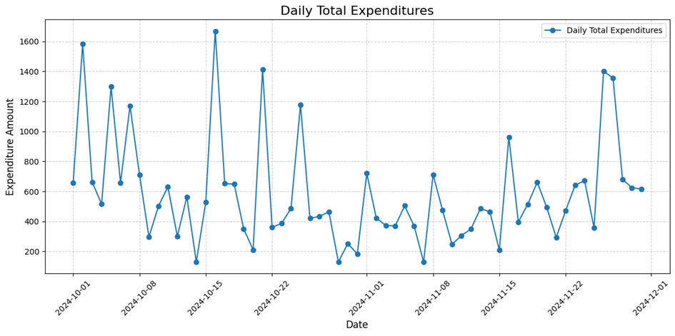
Hypotheses:
H0: There is no significant difference in expenditures between days.
H1: There is a significant difference in expenditures between days.
ANOVA Test Result: F-statistic: 0.8108 and P-value: 0.5662
Conclusion: H₀ cannot be rejected as the p-value is >= 0.05.
There is no significant difference in expenditures between days

Slide 6
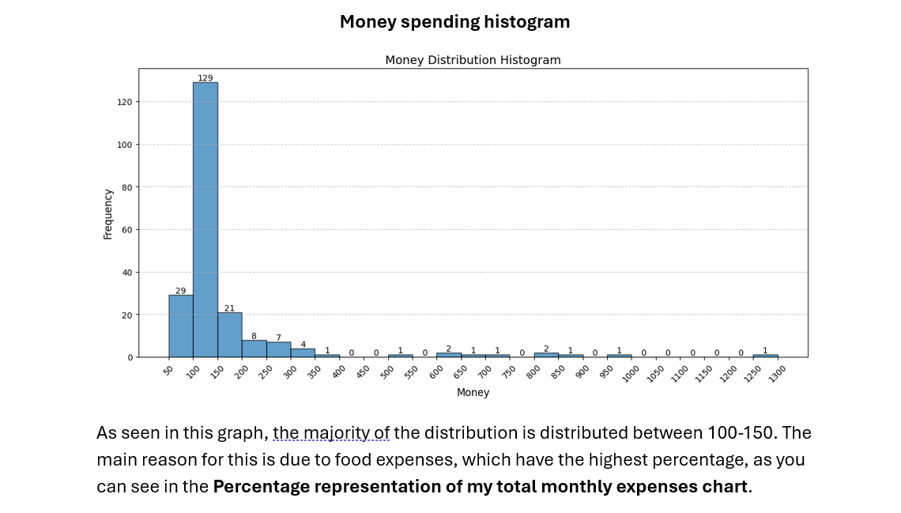
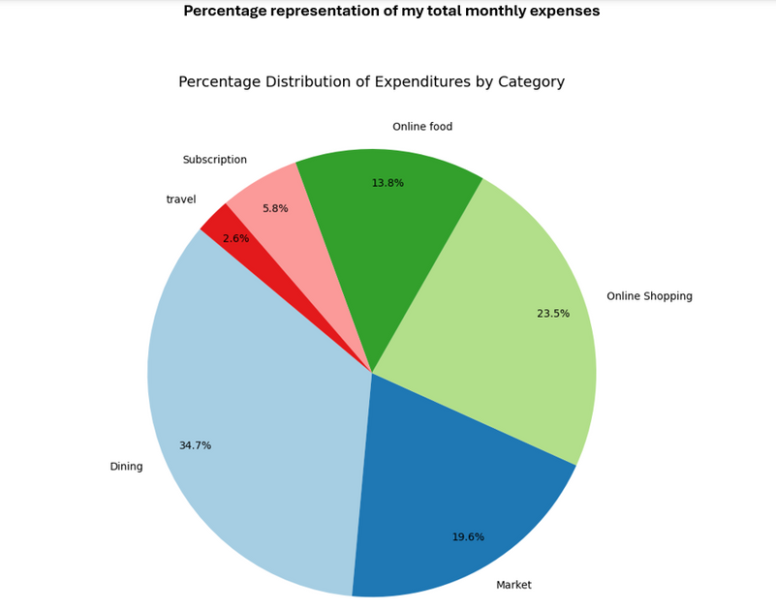
As seen in this graph, the majority of the distribution is distributed between 100-150. The main reason for this is due to food expenses (Since my food cost is 122 tl or 130 tl per meal.), which have the highest percentage, as you can see in the Percentage representation of my total monthly expenses chart.

Slide 7
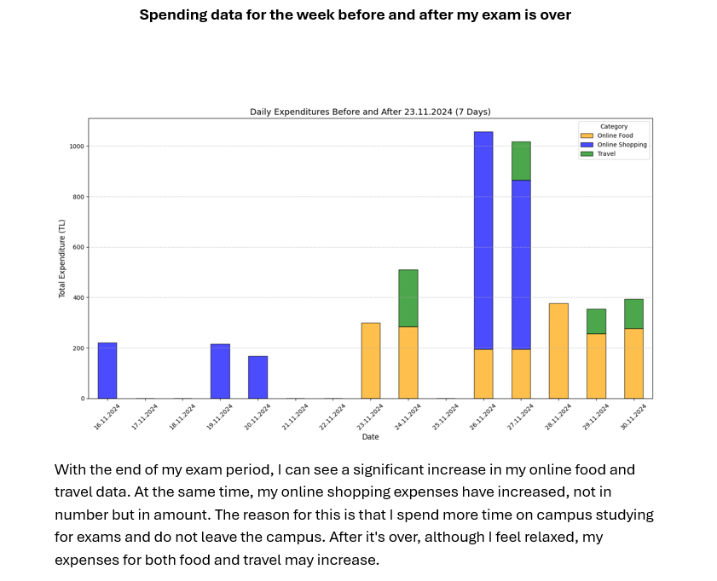
With the end of my exam period (23 november), I can see a significant increase in my online food and travel data. At the same time, my online shopping expenses have increased, not in number but in amount. The reason for this is that I spend more time on campus studying for exams and do not leave the campus. After it's over, although I feel relaxed, my expenses for both food and travel may increase.
This matches my earlier predictions. I think the reason for this is that as my body relaxes with the decrease in stress, I feel hungrier, my appetite increases and I eat more easily. Additionally, I think the reason for the increase in travel expenses is that I have more free time after the exams are over.

Slide 8
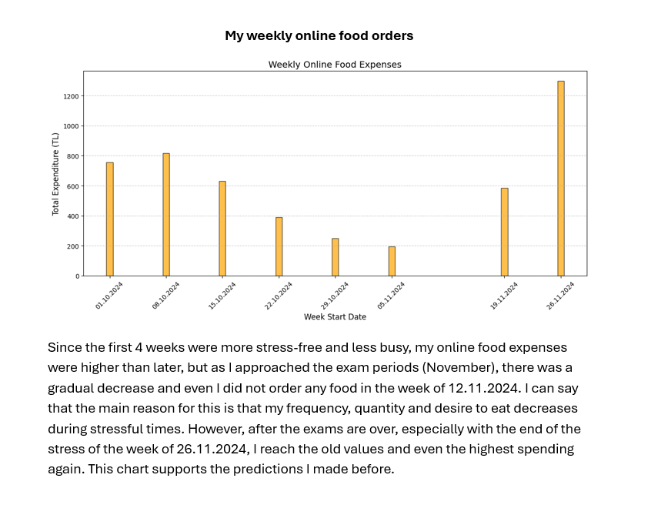
Again, as I said in the previous slide, we can see in this table that, in parallel with my predictions, my food order decreases at the beginning of stressful periods and my desire to eat increases with its end.
Since the first 4 weeks were more stress-free and less busy, my online food expenses were higher than later, but as I approached the exam periods (November), there was a gradual decrease and even I did not order any food in the week of 12.11.2024. I can say that the main reason for this is that my frequency, quantity and desire to eat decreases during stressful times. However, after the exams are over, especially with the end of the stress of the week of 26.11.2024, I reach the old values ​​​​and even the highest spending again. This chart supports the predictions I made before.

Slide 9
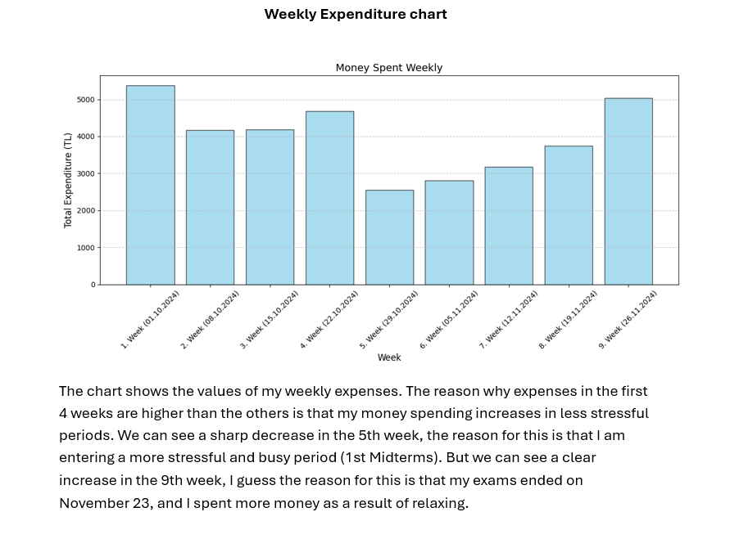
Consistent with the predictions, we can see a serious decrease at the beginning of the exam period (the first week of November) and a serious increase at the end (November 23).
The chart shows the values ​​of my weekly expenses. The reason why expenses in the first 4 weeks are higher than the others is that my money spending increases in less stressful periods. We can see a sharp decrease in the 5th week, the reason for this is that I am entering a more stressful and busy period (1st Midterms). But we can see a clear increase in the 9th week, I guess the reason for this is that my exams ended on November 23, and I spent more money as a result of relaxing.

Slide 10
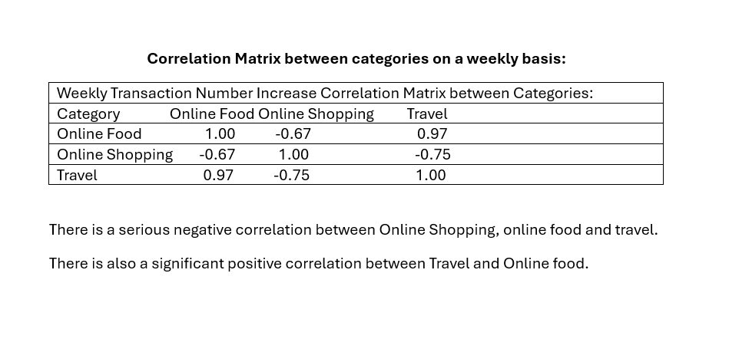
There is a serious negative correlation between Online Shopping, online food and travel.
There is also a significant positive correlation between Travel and Online food.
I think the reason why my travel and online food expenses increase and decrease at the same time is that they are both directly linked to exam periods.

Slide 11
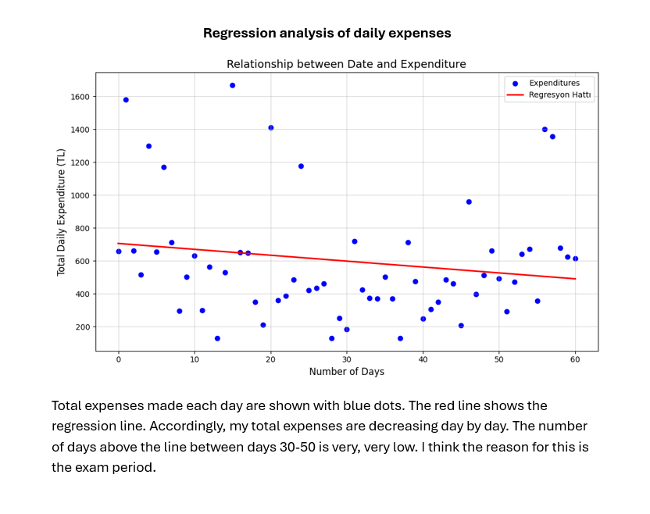
My expenses seem to be decreasing day by day. On the 30th day, that is, the week the exams start, there is a decrease in expenditures that go above the regression line, but with the end of the exams (approximately the 50th day), expenses that go above the regression line again can be seen. This also matches my predictions
Total expenses made each day are shown with blue dots. The red line shows the regression line. Accordingly, my total expenses are decreasing day by day. The number of days above the line between days 30-50 is very, very low. I think the reason for this is the exam period.

Slide 12
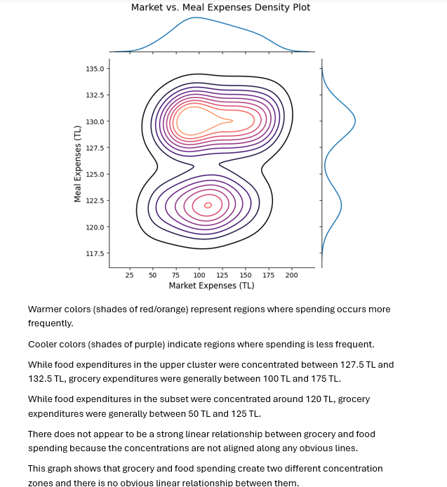
While food expenditures in the upper cluster were concentrated between 127.5 TL and 132.5 TL, grocery expenditures were generally between 100 TL and 175 TL.
While food expenditures in the subset were concentrated around 120 TL, grocery expenditures were generally between 50 TL and 125 TL.
There does not appear to be a strong linear relationship between grocery and food spending because the concentrations are not aligned along any obvious lines.
Warmer colors (shades of red/orange) represent regions where spending occurs more frequently.
Cooler colors (shades of purple) indicate regions where spending is less frequent.

Slide 13
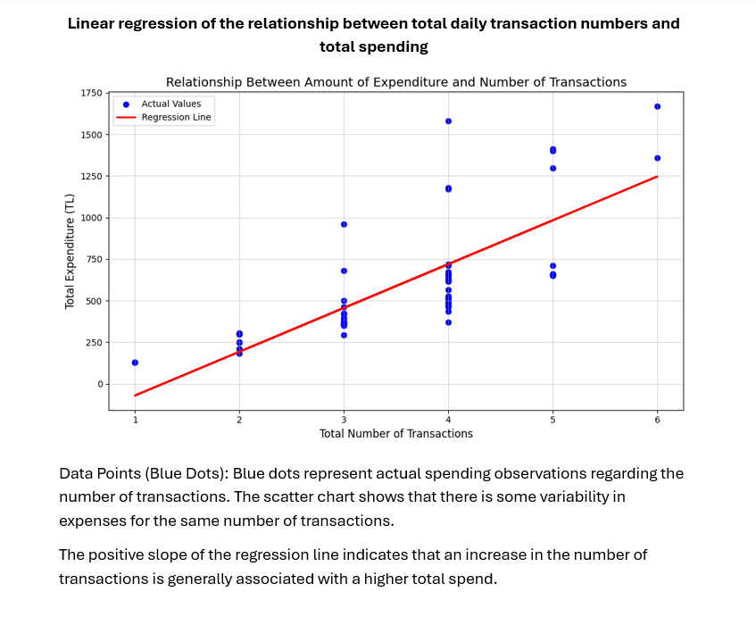
Data Points (Blue Dots): Blue dots represent actual spending observations regarding the number of transactions. The scatter chart shows that there is some variability in expenses for the same number of transactions.
The positive slope of the regression line indicates that an increase in the number of transactions is generally associated with a higher total spend.

Slide 14
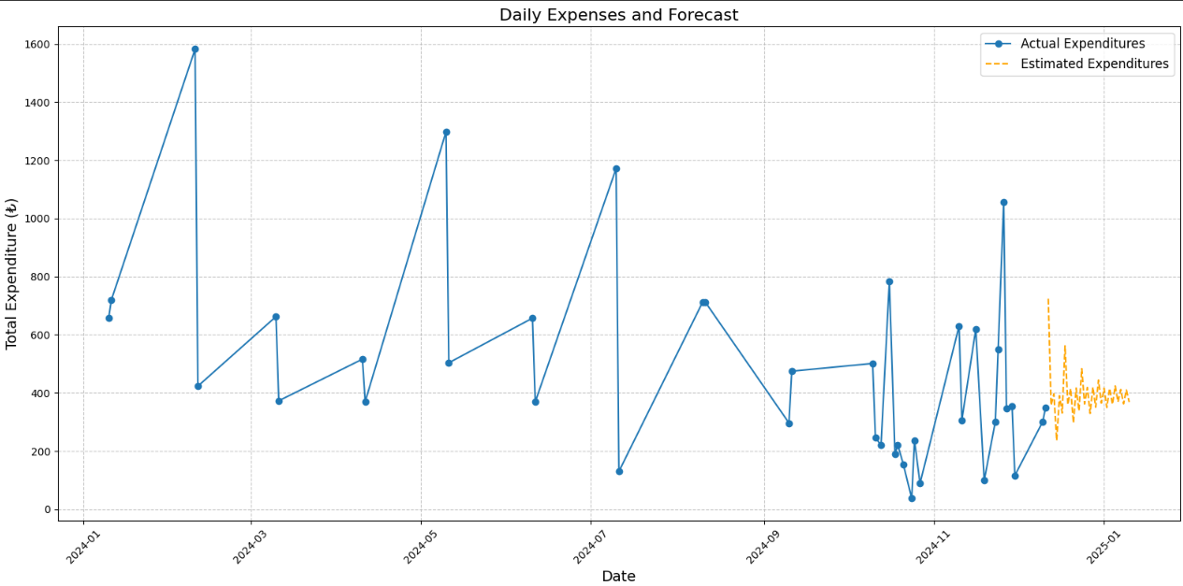
This is a model that predicts my expenses in the coming months, created using my data from the past two months (you can find its code in the code file called forcast with machine learning.ipynb).

Slide 15
What I realized about myself
I realized that I was going through the same cycle after every exam period. The feeling of relief after stressful days also brings with it uncontrolled spending. After the exams, I noticed that my expenses increased significantly (especially online food and shopping). I think this increase is mostly uncontrolled and unplanned. I find that these expenses, which I usually make for the purpose of relieving stress or rewarding myself, are sometimes unnecessary and harm my own economy.
Realizing this situation was an important step for me. I decided to review my spending habits in order to better manage my own financial situation and develop savings habits in the long term.

Slide 16
I specifically think of taking these steps to regulate my habits:
Awareness: I will regularly analyze my spending habits and identify where I spend unnecessary expenses.
Understanding Myself: I will try to understand the emotions that trigger my spending. Finding out what is at the root of my spending out of stress or reward will be the first step in breaking this cycle.
Spending thoughtfully: Before spending, I will ask myself, "Is this really necessary?" I think this simple step will be an effective method to reduce unnecessary expenses and become a conscious consumer.

Slide 17
What could be done better?
I think stress also has an effect on my weight. It would be nice to regularly add my weight data to this project and analyze them. The project could have been more detailed and included more analysis about me.
In addition, since exams changed my eating habits, it would be nice to include the amount of calories I consume daily, even at each meal, in this project.

Slide 18
REPORT
This report provides an analysis of my personal spending habits over different periods, focusing on the impact of stressful periods such as exams on my financial behavior. Data for this analysis was obtained from a credit card statement.
The main objective is to understand spending patterns and their relationship over periods and suggest strategies for better financial management.
Data Collection and Organization
The data was sourced from:
Credit card statements exported from a banking application.
Cafeteria (on-campus food)
Grocery (local and online supermarkets)
Subscriptions (e.g., Spotify, Amazon Prime)
Travel (flights, train tickets, subway fares)
Online shopping
Online food delivery
Special adjustments were made to:
Include manually entered cafeteria transactions.
Separate Amazon subscriptions from shopping data.
The data was processed using a script (Excel_data_organizing.ipynb) to achieve a structured and analyzable format.

Slide 19
REPORT
Key Findings
Hypothesis Testing
Null Hypothesis (H₀): There is no significant difference in expenditures between days.
Alternative Hypothesis (H₁): There is a significant difference in expenditures between days.
Results:
ANOVA Test yielded an F-statistic of 0.8108 and a P-value of 0.5662.
H₀ could not be rejected, indicating no significant daily differences in expenditures.
Spending Patterns
General Trends:
Expenses tended to decrease during exam periods and increase significantly after exams.
Stressful periods were associated with reduced online food and travel expenditures.
Category-wise Analysis:
Food and Grocery: Cafeteria expenses dominated daily spending. Spending dropped significantly during exam periods due to reduced appetite and fewer social activities.
Travel: Declined during exams, likely due to reduced movement, but increased afterward.
Online Shopping: Frequency remained stable, but the total amount spent increased after exams.
Weekly Analysis:
Stress-free weeks showed higher spending compared to exam weeks.
A sharp decline in week 5 corresponded to the onset of exams, followed by an increase in week 9 post-exams.

Slide 20
REPORT
Correlations
Positive correlation between travel and online food expenses.
Negative correlation between travel, online shopping, and food expenses during exam periods.
Regression analysis indicated a general decline in total daily expenditures over time, with exceptions during post-exam recovery periods.
Insights and Self-Reflection
Behavioral Observations:
Spending habits cyclically changed in response to stress and relief.
Post-exam spending spikes were often uncontrolled and unnecessary.
Lessons Learned:
Recognized the need for better financial planning.
Awareness of stress-related spending behaviors was a key step toward improvement.
Proposed Solutions:
Regularly analyze spending habits to identify unnecessary expenses.
Understand emotional triggers behind spending and address root causes.
Adopt thoughtful spending practices by asking, “Is this really necessary?” before making purchases.

Slide 21
REPORT
Suggestions for Future Analysis
Combine weight and calorie consumption data to discover the impact of stress on physical health as well as financial habits.
Expand the dataset to include additional variables such as income patterns and seasonal effects.
Conclusion
This analysis provided me with valuable insight into the interplay between stress, emotional well-being, and financial habits. By understanding and addressing the root causes of stress-related spending, it is possible to create healthier financial behaviors and achieve long-term savings goals.

Slide 22
END OF THE PRESENTATION
THANK YOU FOR YOUR TIME

