Slide 1

Monopoly
CS 434/534
Burcu Sarikaya
Ugur Ozkan
Eray Tuncer

Slide 2
Patterns followed
Factory Pattern
Used when we read Cards and Lands
Command Pattern
Used generally for every rule and execution
Visitor Pattern
Used when we calculate rent of properties
Null Object Pattern
Used in empty command
Mediator
Used to correlate the buttons on info screen
MVC
Strategy Pattern
Template method

Slide 3
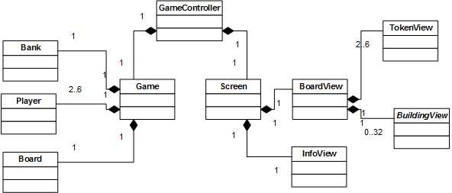
MVC Pattern

Slide 4
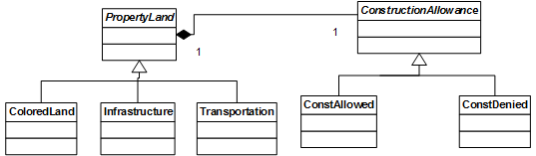
Strategy Pattern

Slide 5
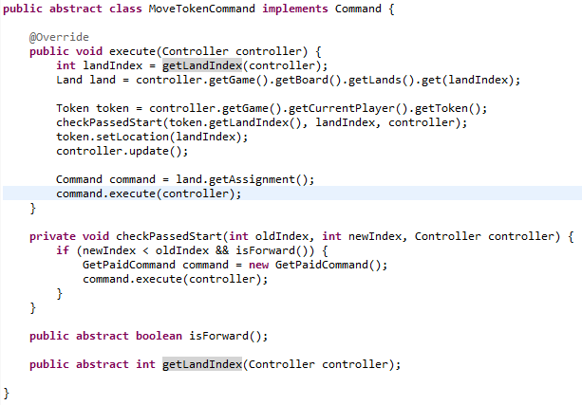
Template Method

