Slide 1

PTCG一站式交易平台
python網站框架開發助理證書
CT290DS10
趙功就 李卓仁 梁子奇 許金澎
2026-08-24

Slide 2
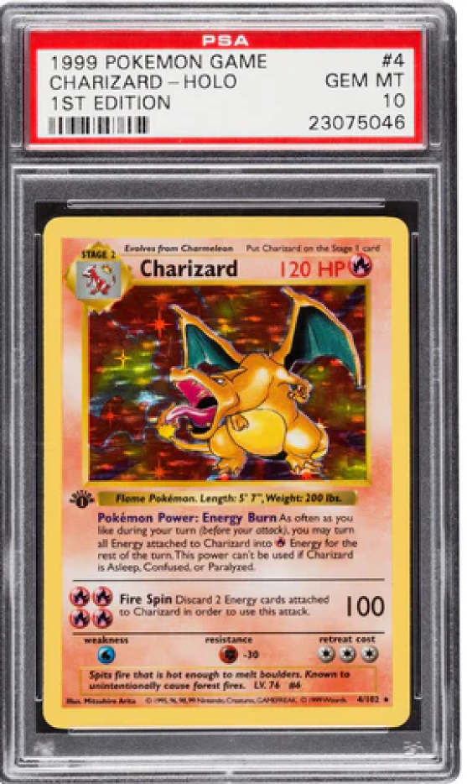
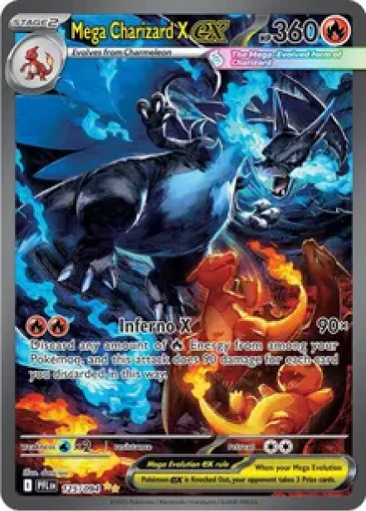
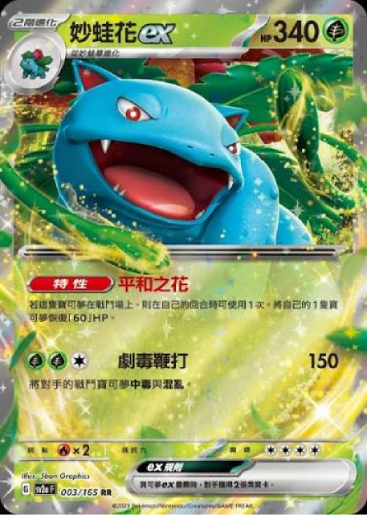
PTCG

Slide 3
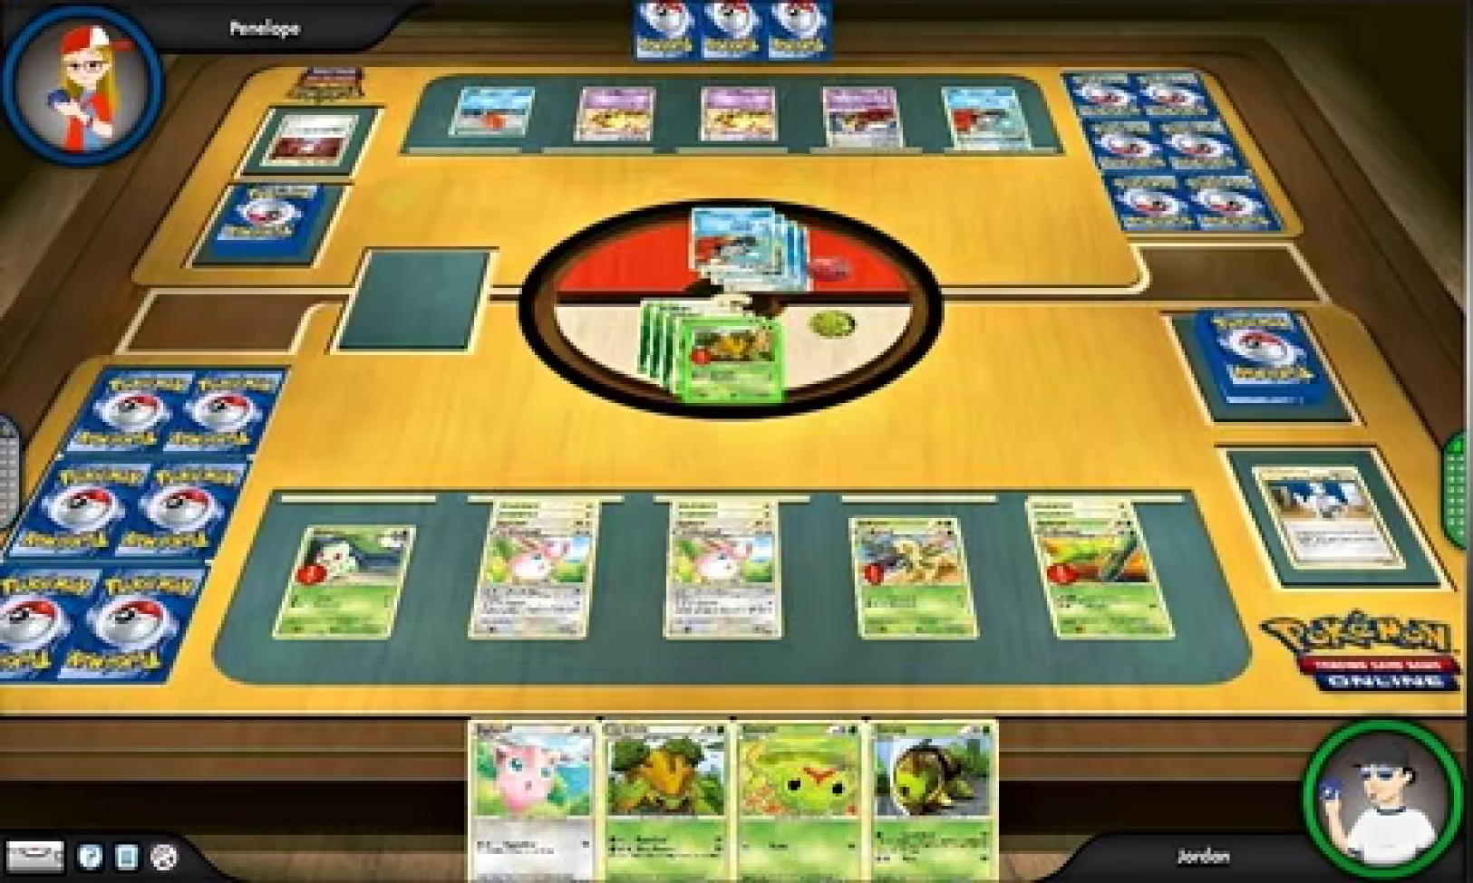

Slide 4
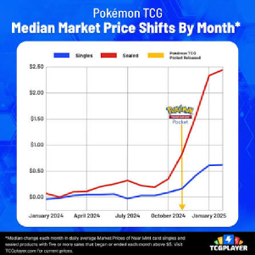
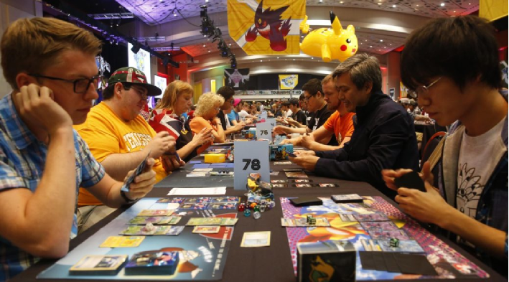
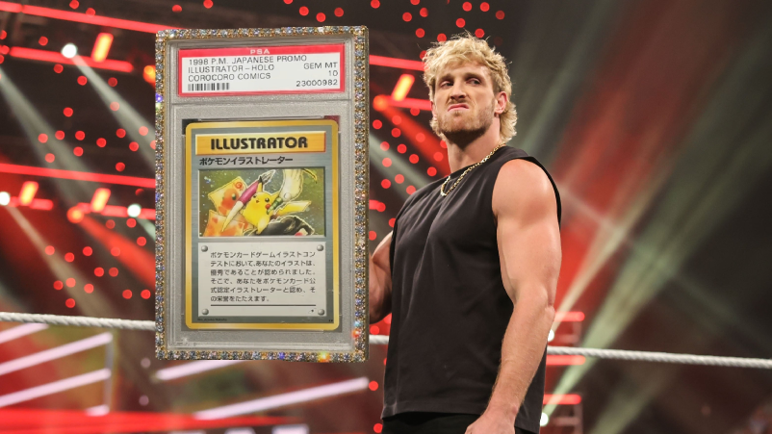
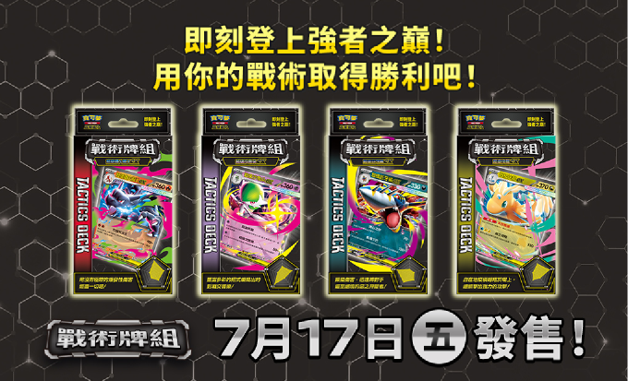
市場
PTCG興起
多人玩的須求
頻繁交易
目標人物 玩家 炒家 好奇者
MEME
HKD1.3億
1996

Slide 5






GOALS
價格不透明與資訊零碎
卡牌網上搜尋
極具風險
PTCG 的痛點
Pokémon TCG 的爆紅帶動了集換式卡牌的熱潮與二手市場的榮景，吸引大量玩家與投資者湧入。
>卡牌網上下交易極具風險
>店舖地域與信任制度
>二手市場混亂
> 價格不透明與資訊零碎
顧客心聲
二手市場混亂
地域與信任
限制

Slide 6

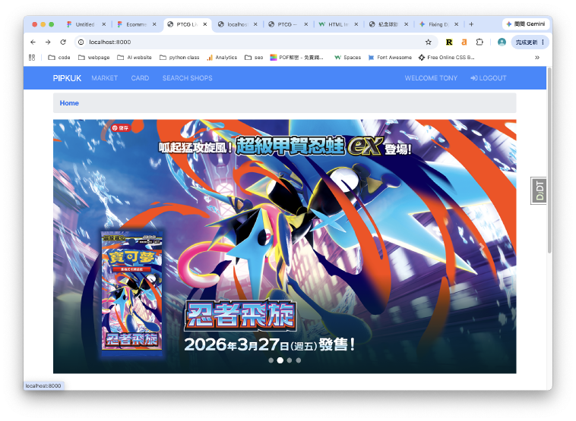
REPORT DATA SOURCES
願景

Slide 7
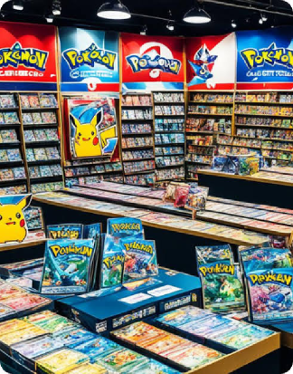
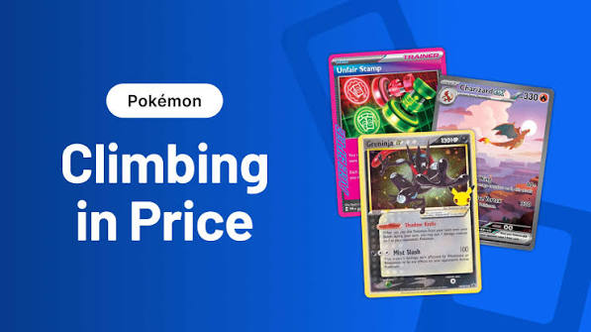




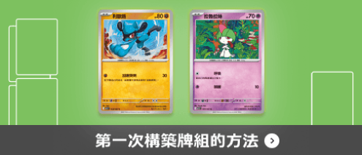
REPORT DATA SOURCES
核心功能

Slide 8
Frontend: HTML CSS JS BOOTSTRIP
Tech
Backend: Django
Database: PostgreSQL

Slide 9
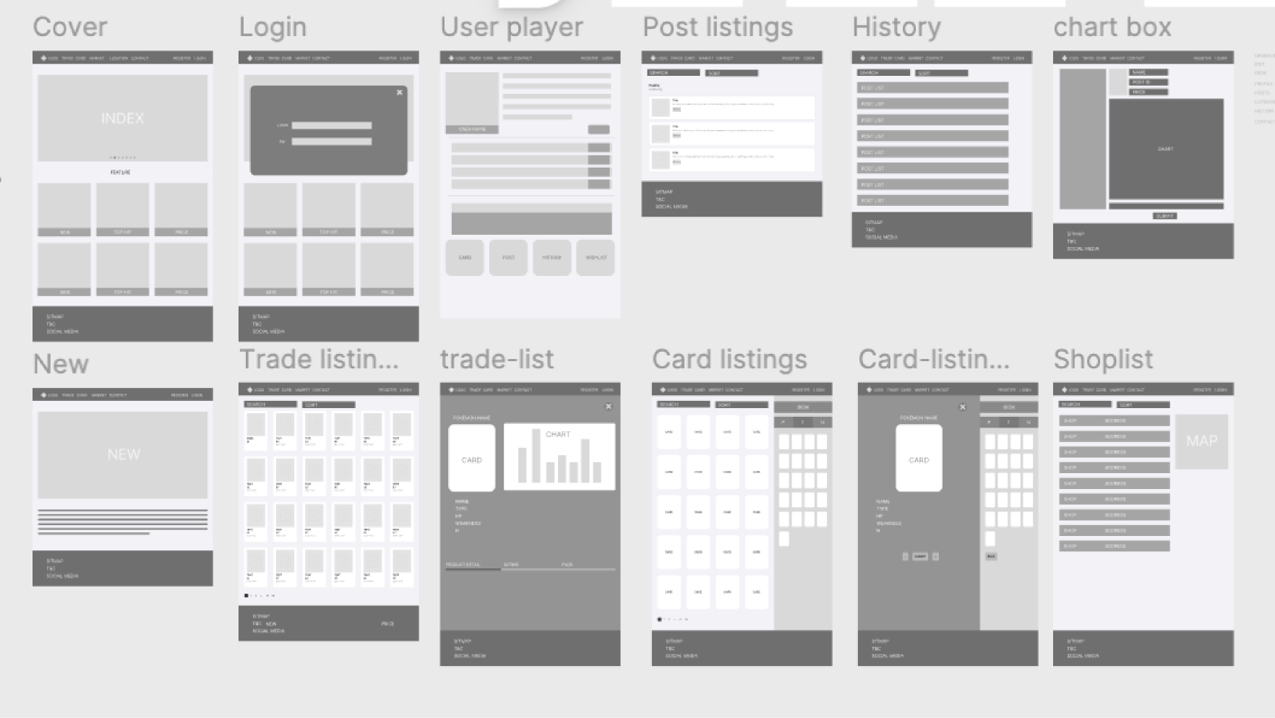

Slide 10

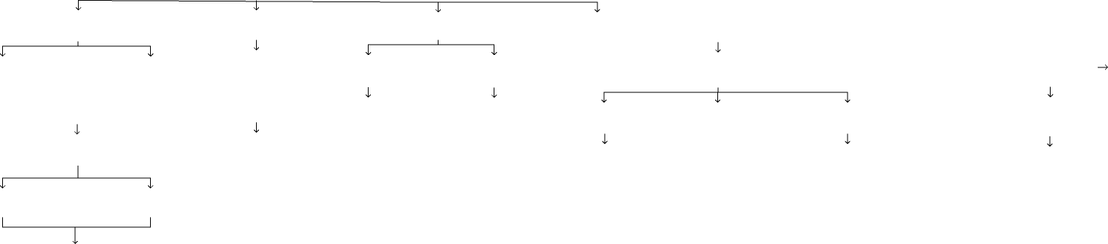







Python ver. 3.12.13
User
Member
User flowchart
SHORT CUT URLS
Banner
Home
Trade_Listings
Shops_list
Cards
Register
Login
Dashboard
Edit
Search/Filt
Search/Filt
Add to Deck
Create Deck
Item Views
Profile
Logout
Listing_ID
Listing_ID
Search Shops
Deck_ID
Card_ID
Post
Product
Chat
EditProfile
listing
Shop
All Chats
Change Name
Post ID
Edit
Selling Chats
Change Email
回覆買家
Chat
聯絡賣家
Comment
Completed Transactions
Change Password
Chats
Spam → Restore to "Buying"
Change Bio
History
Buying Chats
Change Phone num
Mark as spam
Sold items marked "Sold"
Comment

Slide 11









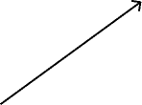








class diagram
Energy_Cost
+int id
+str energy_type
+int quantity
User
Shoplist
+int id
+str shopname
+str address
+str district
+text website
+str monday~sunday
+bool card_identification
+str phone_number
+image shop_logo
N
1
1
Weakness
+int id
+str energy_type
+int weakness_value
+str weakness_modifier
Attack
+int id
+str title
+text description
+int damage_value
+str damage_modifier
Ability
+int id
+str title
+text description
N
Deck
N
N
N
1
1
1
Resistance
+int id
+str energy_type
+int resistance_value
+str resistance_modifier
Card
+int id
+str category
+image photo_main
+str stage
+str rarity
+str title
+int hp
+str energy_type
+int card_number
+int transaction
1
1
N
N
DeckCard
TradingRecord
+int id
+text buyer_comment
+int buyer_star
+text seller_comment
+int seller_star
+bool is_public
+datetime created_at
Tradelist
+int id
+str sell_item_name
+image sell_item_main_photo
+image photo_2~photo_9
+int price
+str condition
+float identification_score
+str series_name
+str series_number
+text descriptions
+str deal_place
+bool is_sold
+datetime list_date
1
Message
+int id
+text content
+datetime created_at
+bool is_read
N
1
N
Retreat
+int id
+str energy_type
+int quantity
1
N
Generation
+int id
+str name
+int total_cards
Chat
+int id
+datetime created_at
+datetime updated_at
+bool trade_finished
+bool is_spam
Profile
+int id
+str phone
+str bio
BannersItem
+int id
+str banner_id
+image photo_banner
+str url_link
User
+int id
+str username
+str email
+str password
+str first_name
+str last_name

Slide 12




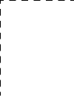
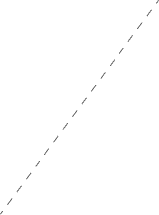










class diagram
Shops_list
Cards
Banner
Shoplist
+int id
+str shopname
+str address
+str district
+text website
+str monday~sunday
+bool card_identification
+str phone_number
+image shop_logo
Card
+int id
+str category
+image photo_main
+str stage
+str rarity
+str title
+int hp
+str energy_type
+int card_number
+int transaction
BannersItem
+int id
+str banner_id
+image photo_banner
+str url_link
User 1
Account
Market
Contact
Chat
Trade_Listings
User 2
Seller
Tradelist
+int id
+str sell_item_name
+image sell_item_main_photo
+image photo_2~photo_9
+int price
+str condition
+float identification_score
+str series_name
+str series_number
+text descriptions
+str deal_place
+bool is_sold
+datetime list_date
Chat
+int id
+datetime created_at
+datetime updated_at
+bool trade_finished
+bool is_spam
User
+int id
+str username
+str email
+str password
+str first_name
+str last_name
Profile
+str phone
+int id
+str bio
+comment
TradingRecord
+int id
+text buyer_comment
+int buyer_star
+text seller_comment
+int seller_star
+bool is_public
+datetime created_at
login
Message
+int id
+text content
+datetime created_at
+bool is_read
User 3
Buyer

Slide 13


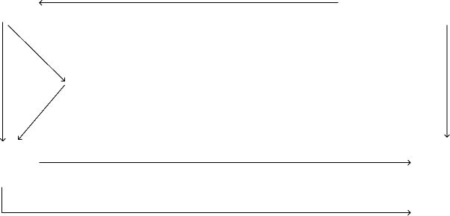



Python ver. 3.12.13
transaction record of listing
Card_Listing
transaction record
sucess or
fail
Contact/
Msg
//card & collection
of card
Banner
Bookmark
all conversation
Trade_Listing
Enterprise
is_published?
is_soldOut?
Individual

Slide 14
Thanks

