Slide 1

Singularities as Solitons
Eren Erberk Erkul
Wed, September 23, Pisa

Slide 2
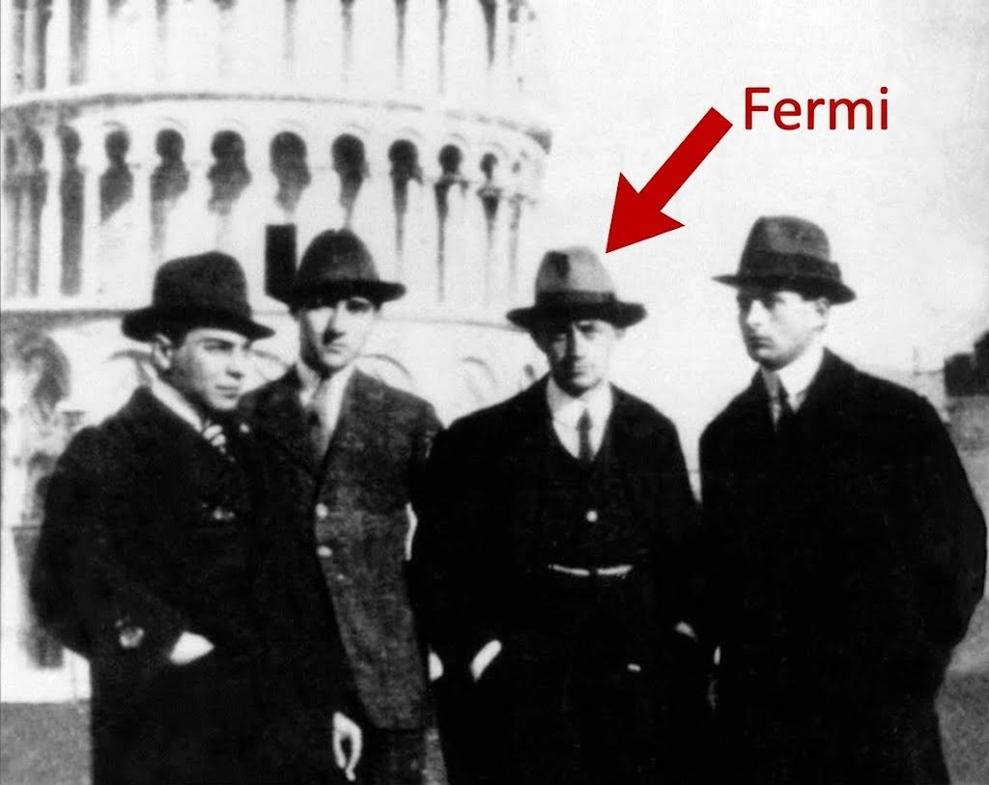

Slide 3
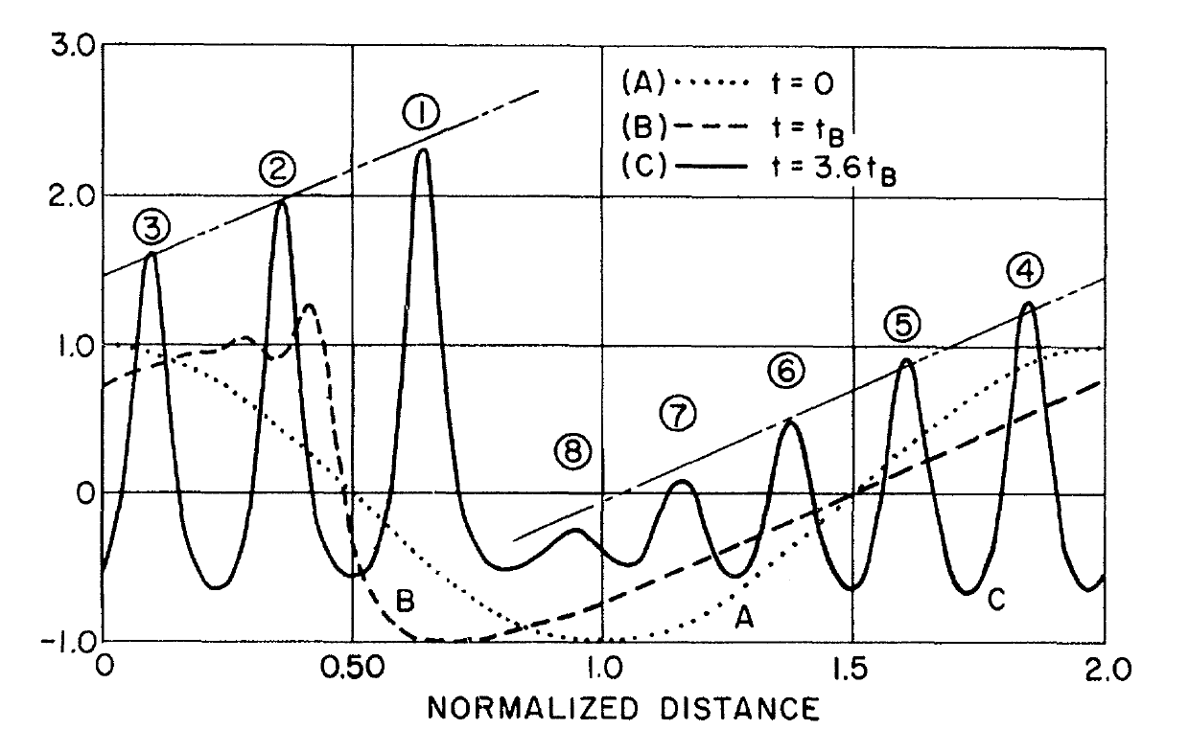
The emergence of solitons
Zabusky & Kruskal · Physical Review Letters (1965), Fig. 1

Slide 4
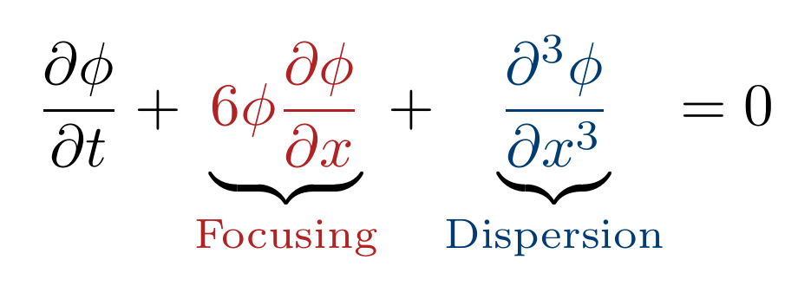
KdV Equation

Slide 5
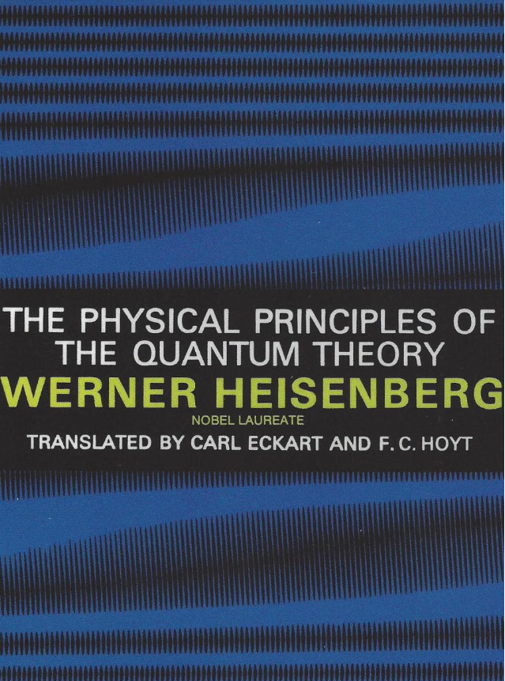
Vacuum fields
“Every measurement can yield only an average value of the amplitude in a very small region of space and during a very short interval of time.”
Werner Heisenberg, 1930
The Physical Principles of the Quantum Theory

Slide 6
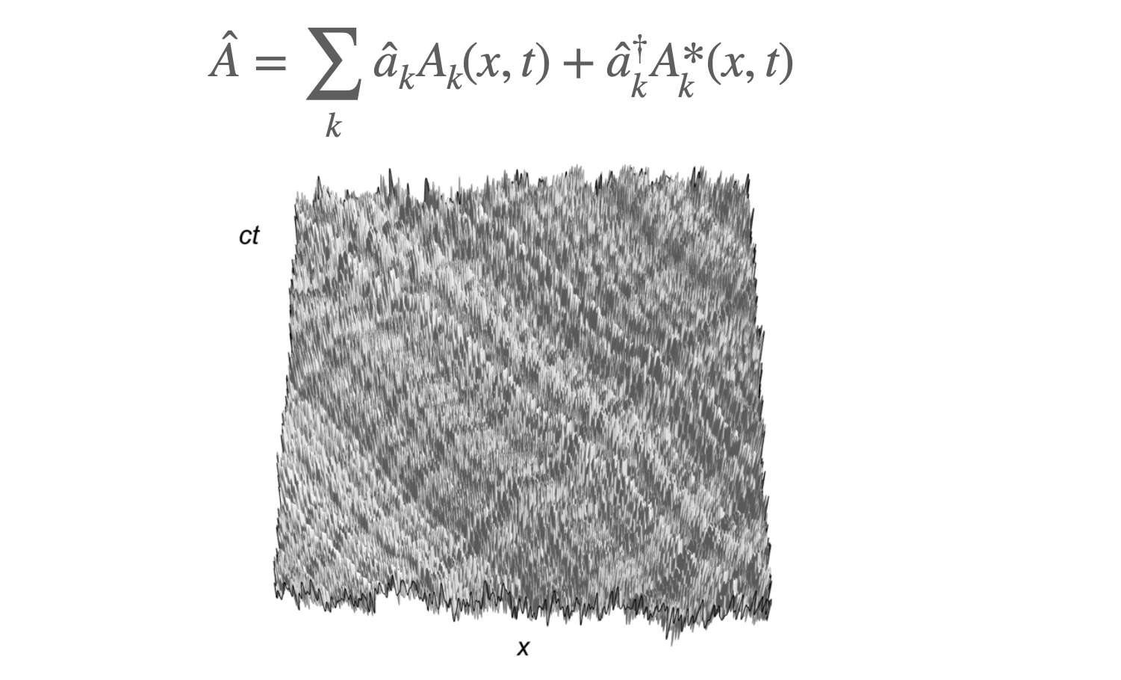
Vacuum is Dispersive

Slide 7
Can dispersion balance collapse?

Slide 8
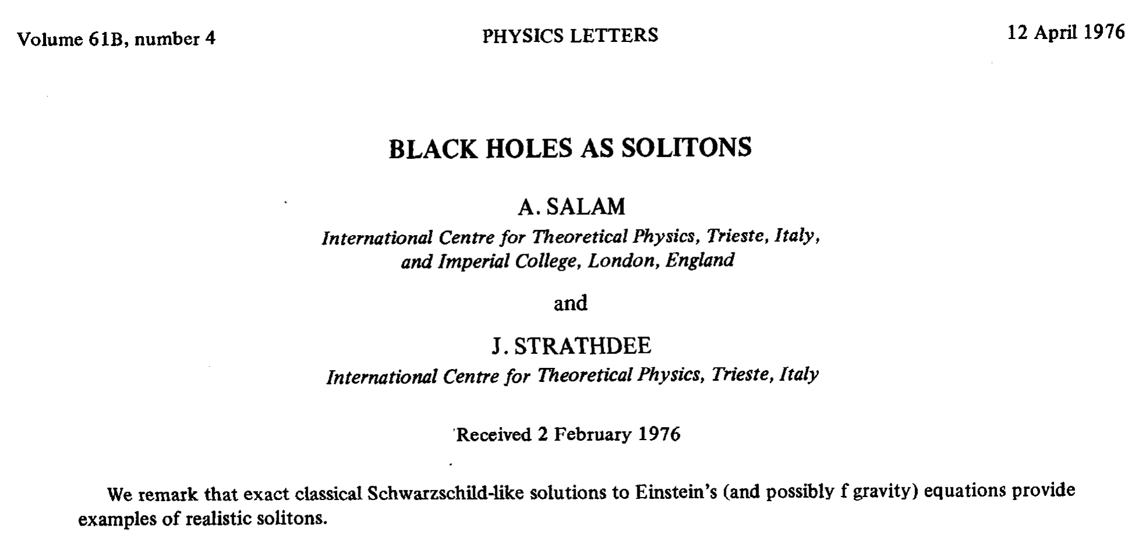

Slide 9
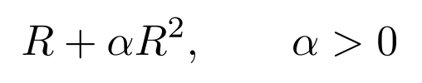
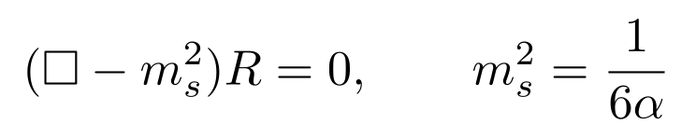
The scalaron

Slide 10
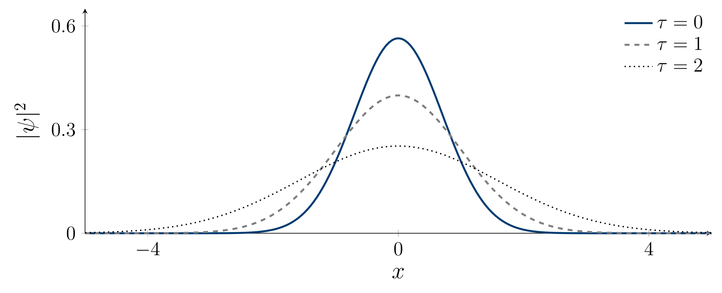
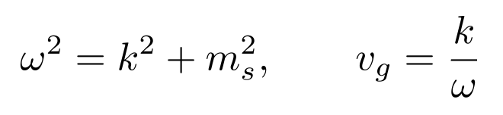
Scalaron dispersion
Free slow-envelope limit

Slide 11
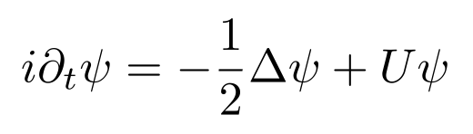
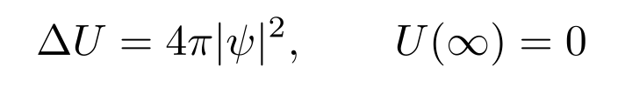
The scalaron soliton

Slide 12
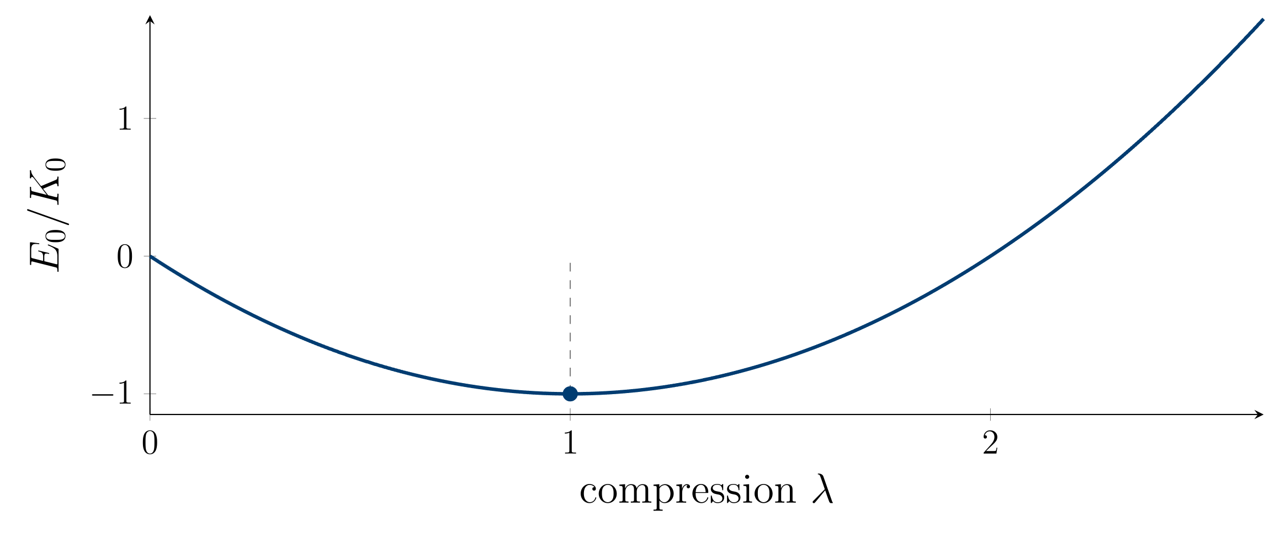
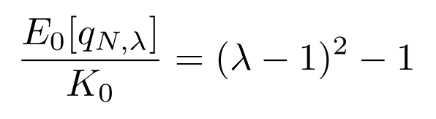
Dispersion and binding

Slide 13
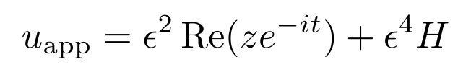
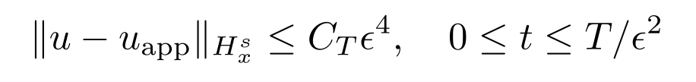
Exact gravitational evolution

Slide 14
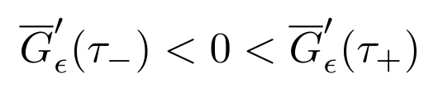
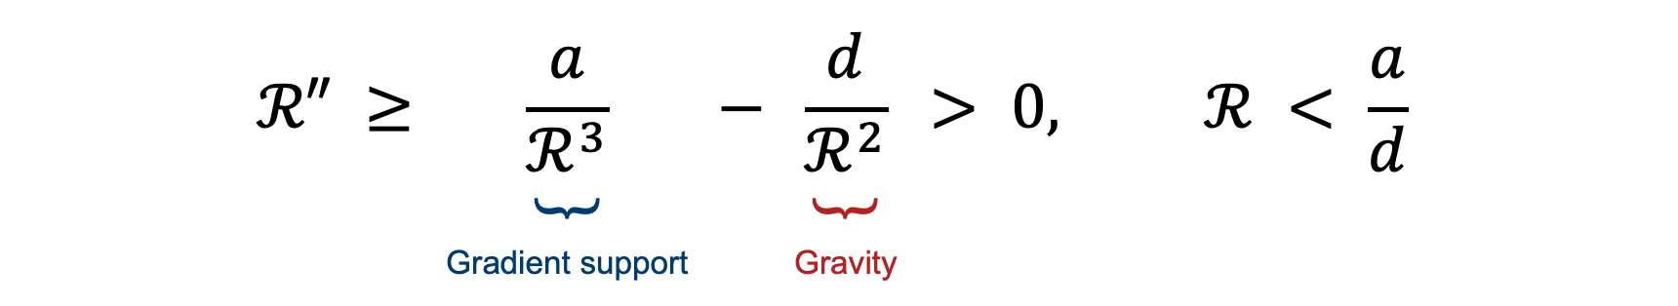
Contraction and re-expansion
$$ℛ″ ≥ \underset{\begin{aligned} \\ \text{Gradient} \text{support}\end{aligned}}{\underbrace{\frac{a}{ℛ^{3}}}} − \underset{\begin{aligned} \\ \text{Gravity}\end{aligned}}{\underbrace{\frac{d}{ℛ^{2}}}} > 0, ℛ < \frac{a}{d}$$

Slide 15

Gradient support at strong compactness
$$(2 − 3C_{∗})X > C_{∗}Y + 6σ_{A}Z, C_{∗} < \frac{2}{3}$$

Slide 16
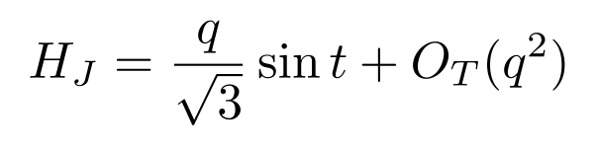

Strong compactness
$$\frac{r_{J}(t_{n})}{r_{J}(0)} = 1 \underset{\begin{aligned} \\ \text{Inward} \text{drift}\end{aligned}}{\underbrace{−\frac{π^{2}n^{2}}{3}q^{2}}} + O_{T}(q^{3})$$

Slide 17
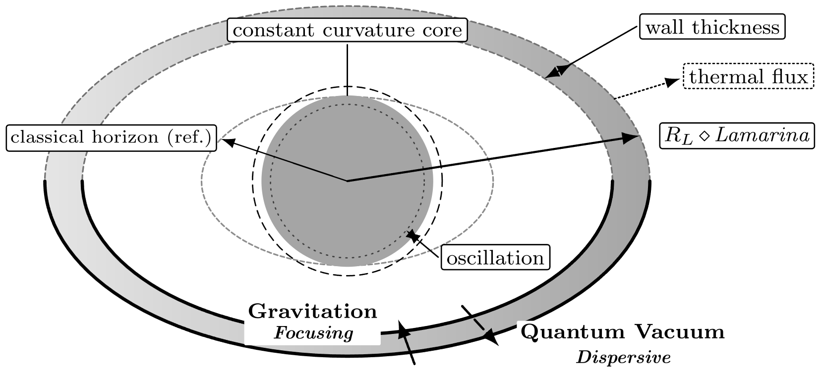
The Lamarina

Slide 18
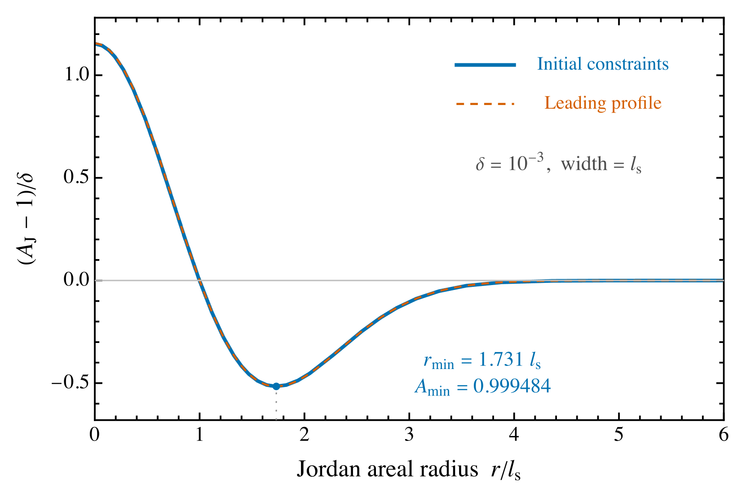
A regular lapse well

Slide 19
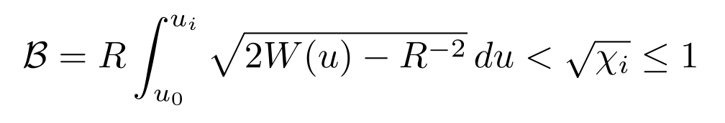
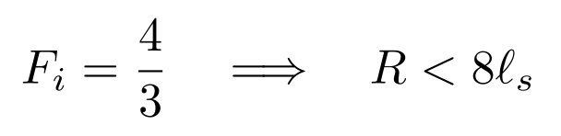
The wall

Slide 20
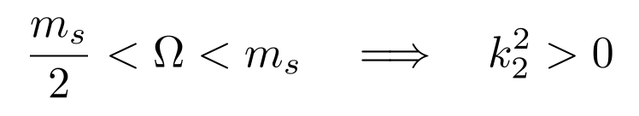

Radiation
$$k_{2}^{2} = \underset{\begin{aligned} \\ \text{Second} \text{harmonic}\end{aligned}}{\underbrace{4Ω^{2}}} − \underset{\begin{aligned} \\ \text{Mass} \text{threshold}\end{aligned}}{\underbrace{m_{s}^{2}}}$$

Slide 21
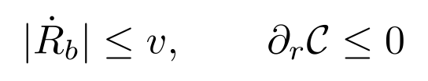
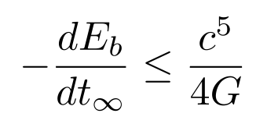
The core power bound

Slide 22
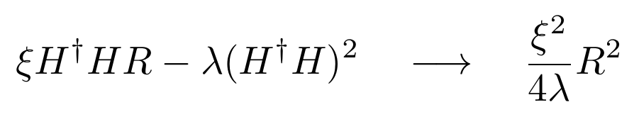
A Field-Theoretic Origin?
Bezrukov & Shaposhnikov (2008)

Slide 23
Are Singularities Solitons?
Thank you

