Slide 1
A Holographic Shortcut
for 3D Orientation
Eren Erberk Erkul · Murat Temiz
Physics & Electrical and Electronics Engineering
Middle East Technical University

Slide 2
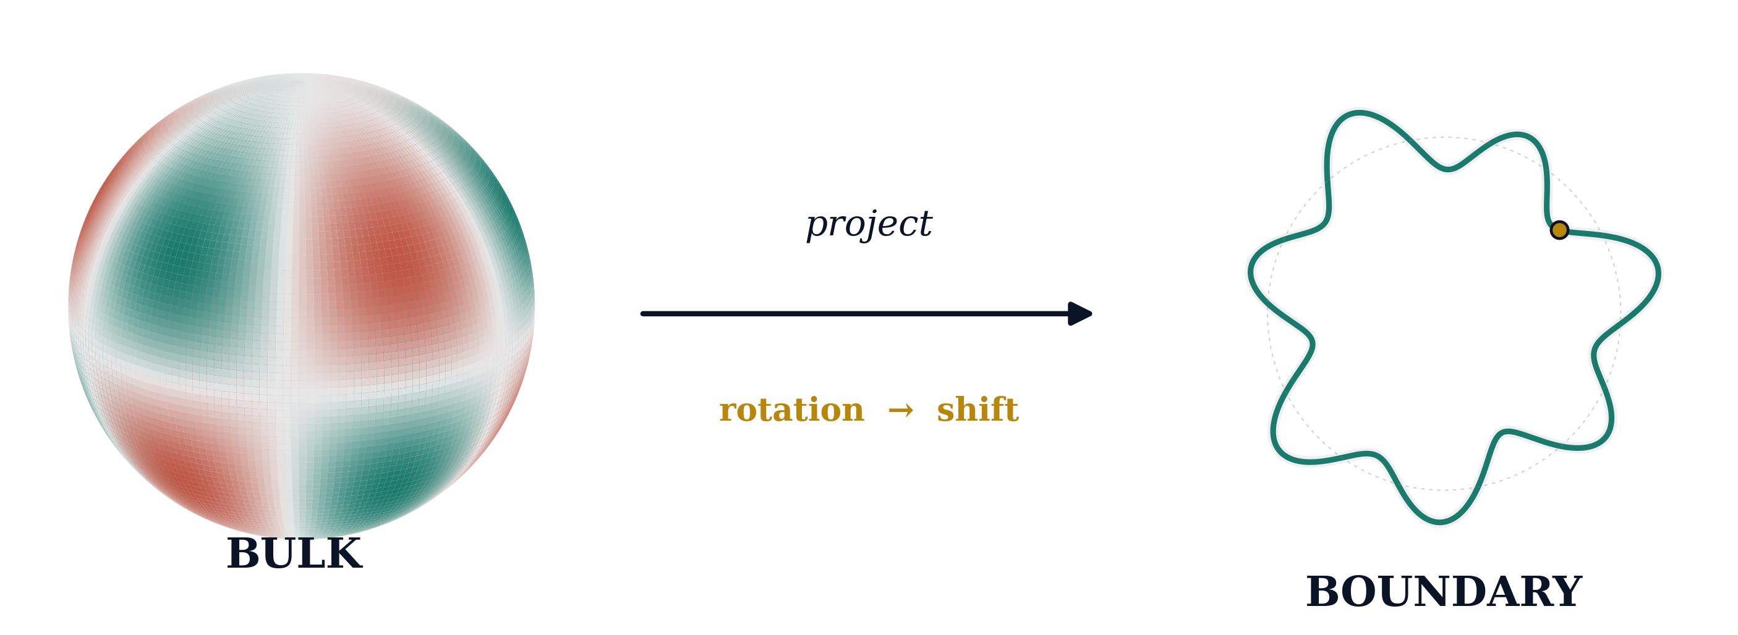
≈ 100× faster
2–5° accuracy
Notes:
You have a 3D shape. Someone has rotated it, and you need to figure out by how much. This is three-dimensional orientation estimation, and it is one of the core problems in computer vision, molecular reconstruction, and robotics. The standard approach is brute force. You try every possible rotation, check how well it matches, and keep the best one. This works, but it scales as L-to-the-fourth with the angular resolution — and that gets slow very fast. My name is Eren Erkul. I am a double major in physics and electrical engineering at METU, working with Professor Murat Temiz. And we found a shortcut — in a very unexpected place. In 1993, the physicist Gerard 't Hooft proposed that the information inside a black hole is encoded on its surface. The 3D bulk lives on the 2D boundary. This is the holographic principle. We asked: can the same idea help us solve orientation estimation? Here is what we do. We take the 3D shape and decompose it into spherical harmonics — a Fourier transform wrapped around a sphere. Then we project those coefficients onto a one-dimensional sequence that we call the hologram. And here is the key insight. When you rotate the 3D shape, the hologram does not change shape — it just shifts. Like sliding a groove on a record. Detecting shifts is fast — it is standard FFT-based phase correlation. Two of the three rotation angles come directly from this step. The third requires only a one-dimensional search instead of a full three-dimensional sweep. We call this Holographic Spectral Alignment. It reduces the dominant complexity from O(L-to-the-fourth) to O(L-cubed log L) — roughly a hundred times faster at high resolution. On synthetic test shapes, we achieve orientation errors of two to five degrees, matching or exceeding volumetric methods. We back this up with four theorems: a sharp expansion of the rotation matrix's off-diagonal energy, an operational regime for the boundary estimator, a Cramér–Rao bound for the polar angle, and an information-loss law showing the boundary preserves a closed-form fraction of the bulk Fisher information — about four over L. But maybe the most interesting result is what this says about holography itself. We proved that any fixed boundary encoding must be lossy — lossless encoding requires the boundary to depend on the signal. This is the same state-dependence that physicists have identified in quantum gravity. Our algorithm provides a concrete, fully analyzable classical example of this structure. A black-hole idea gave us a faster algorithm. And the algorithm, in return, gives physics a test bench for holographic encoding. Thank you.

Slide 3
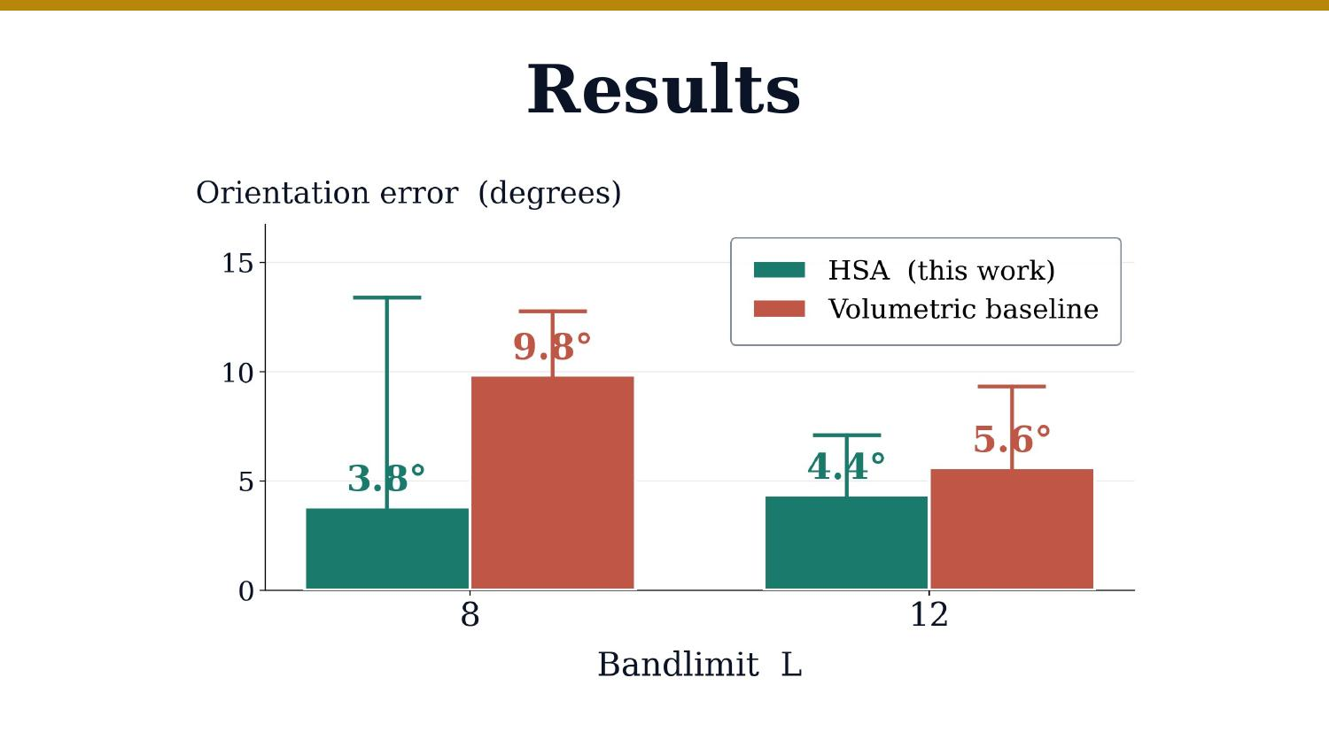
Results

