Slide 1


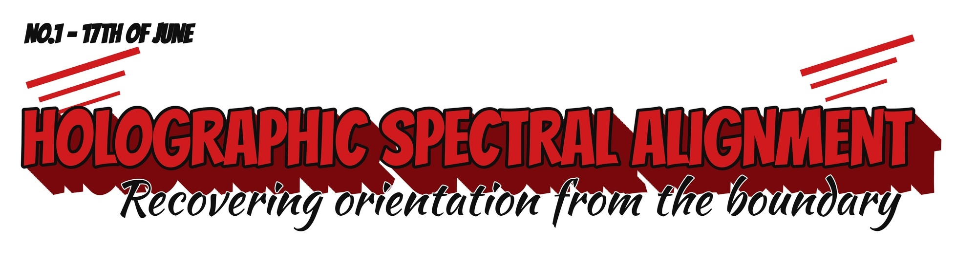



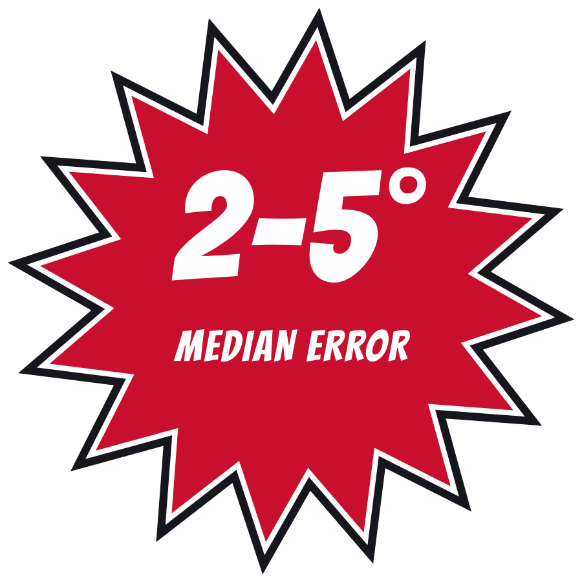
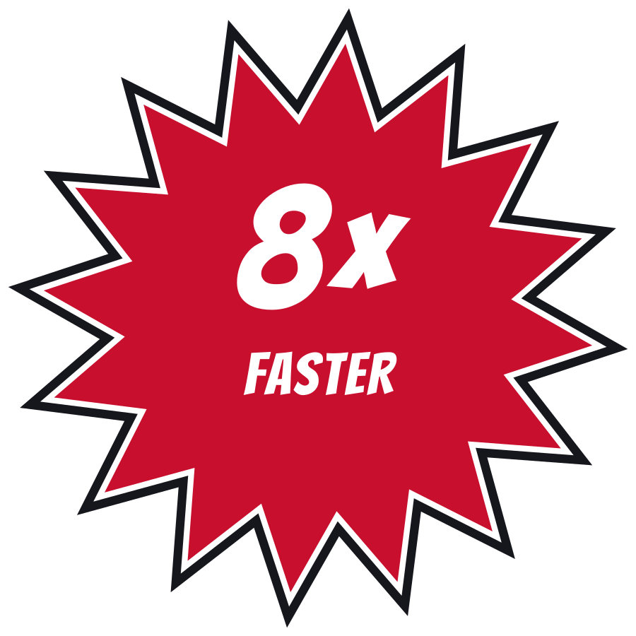



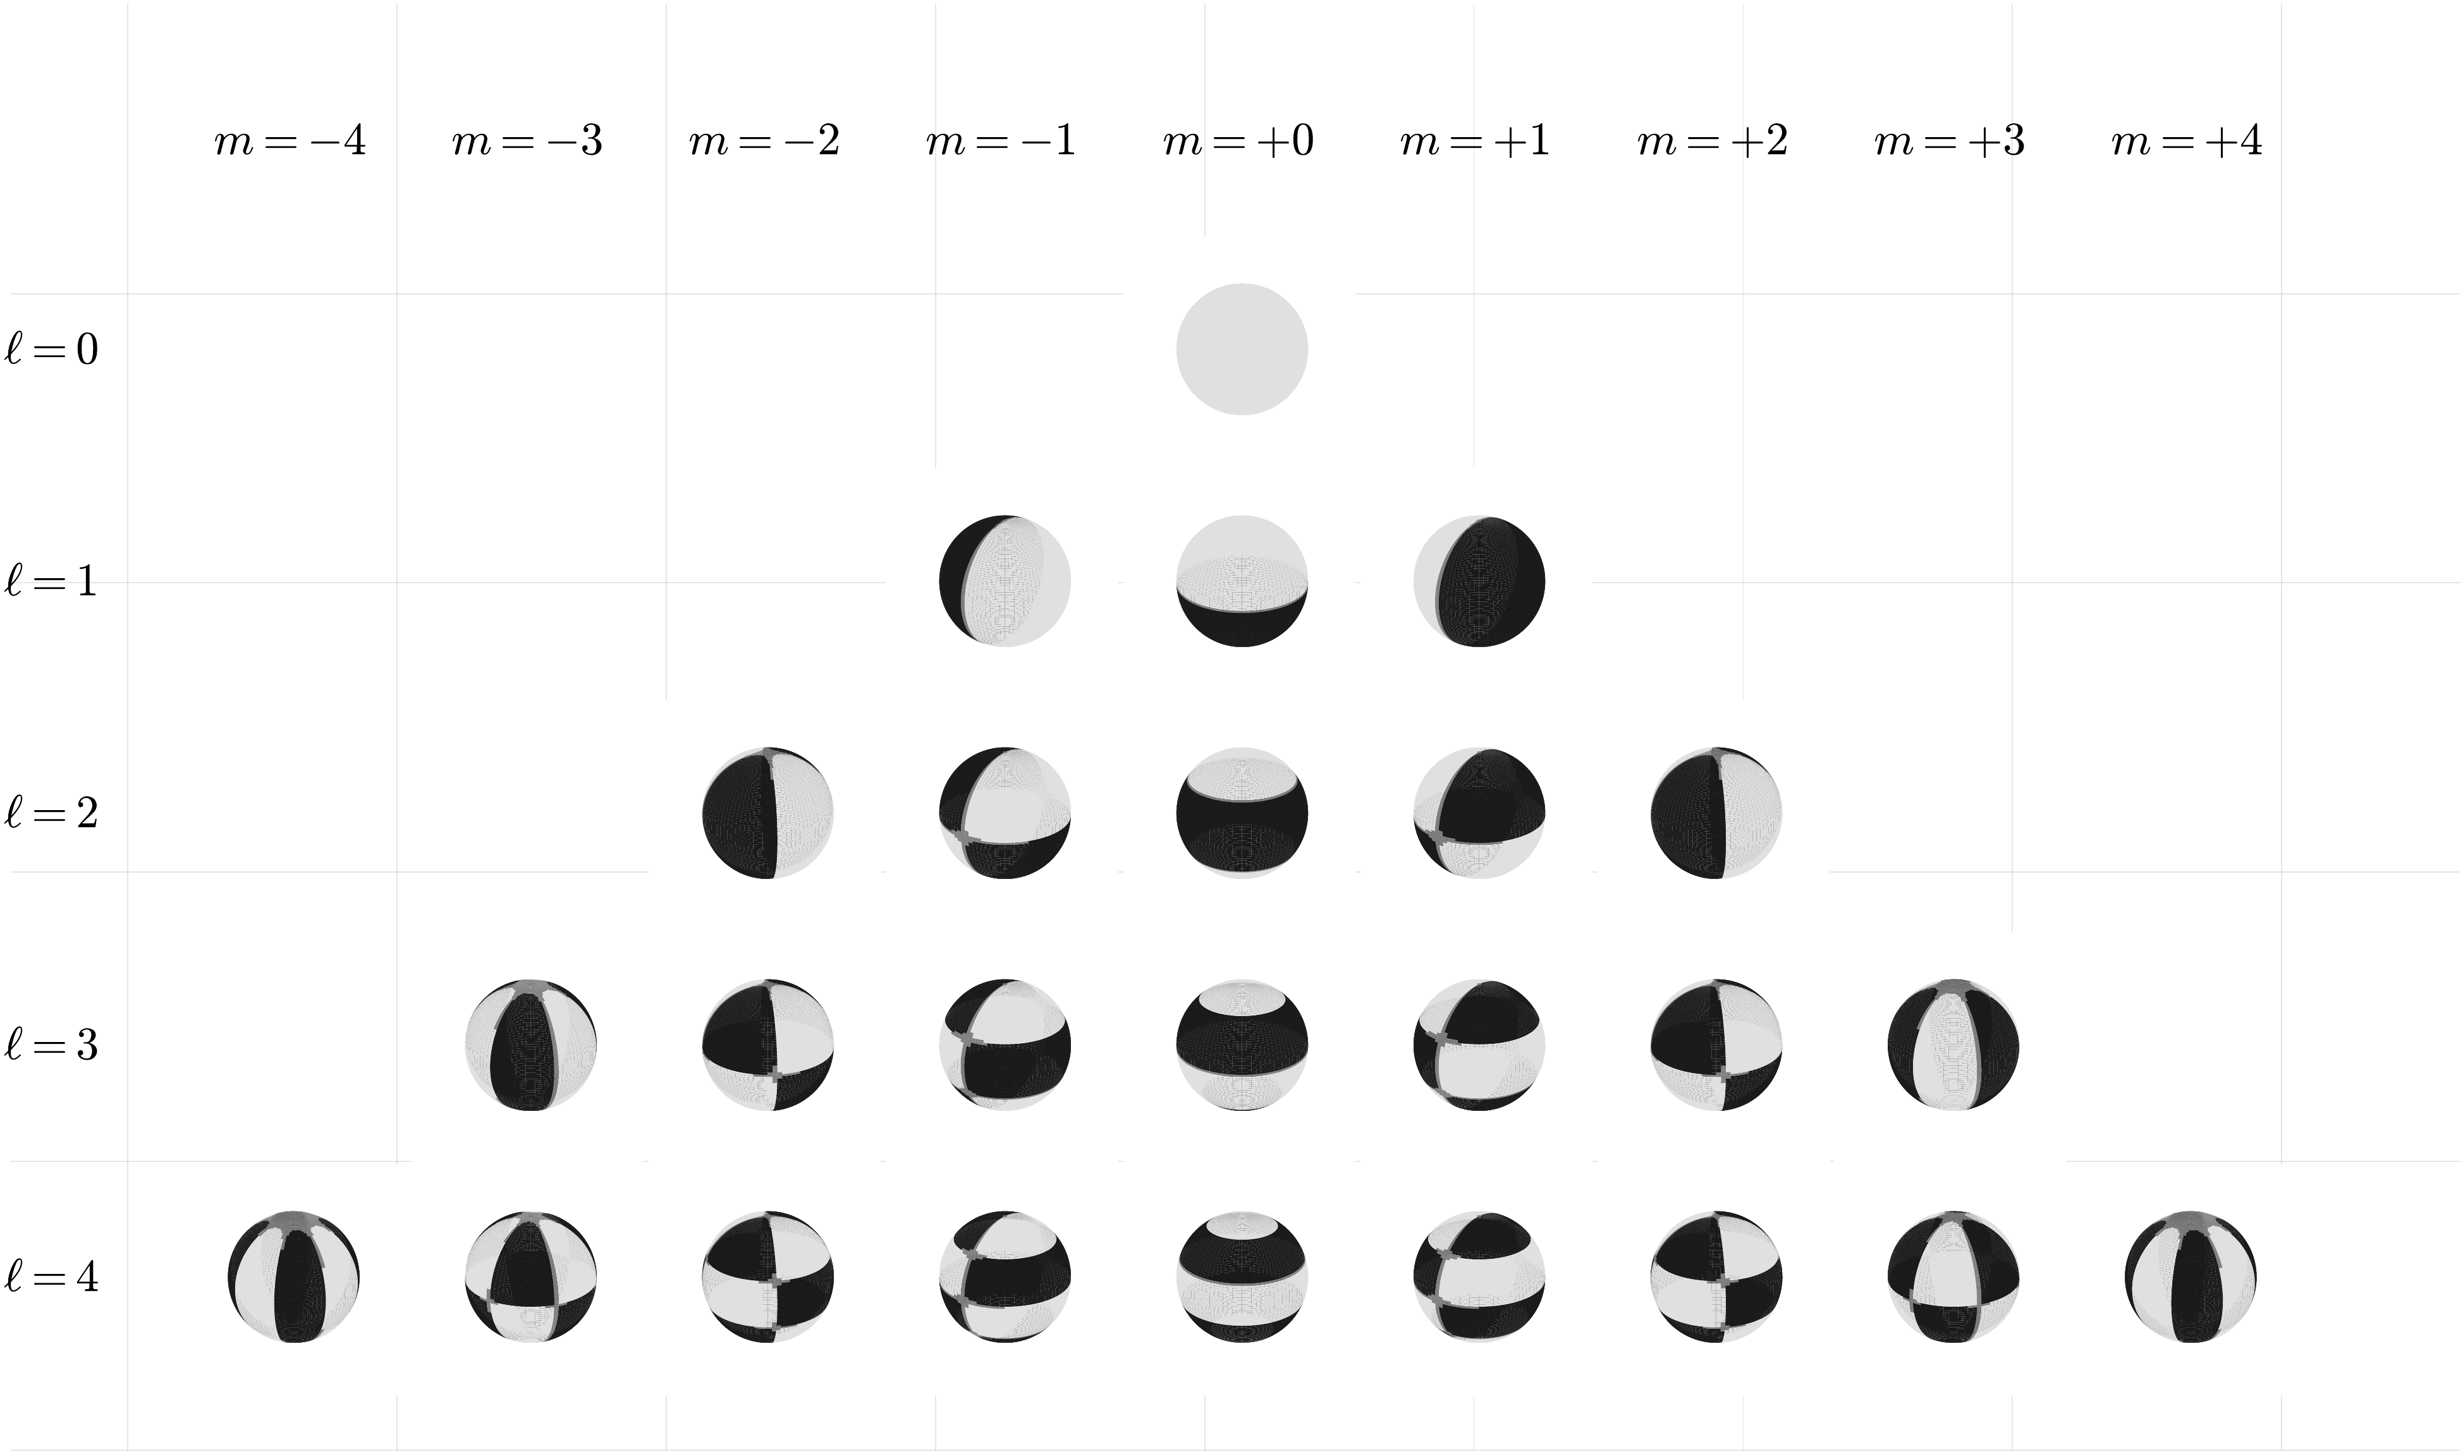
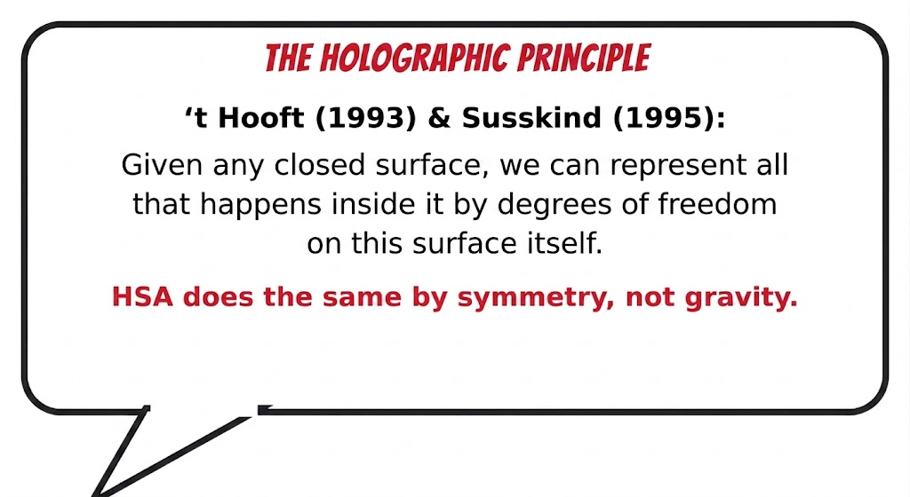
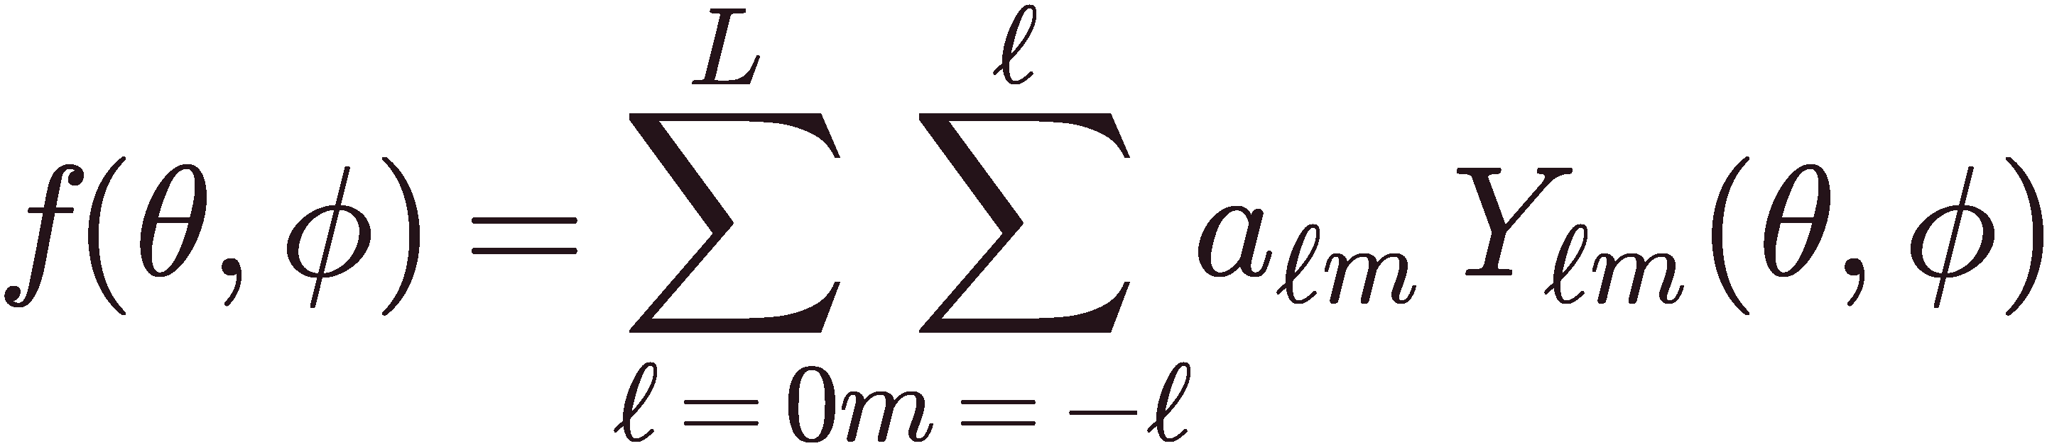
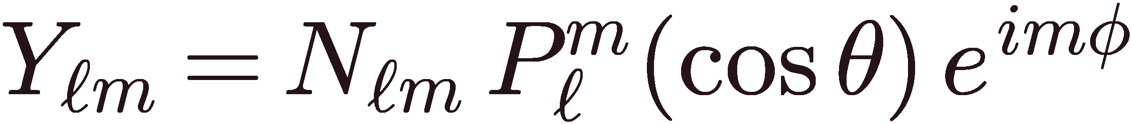
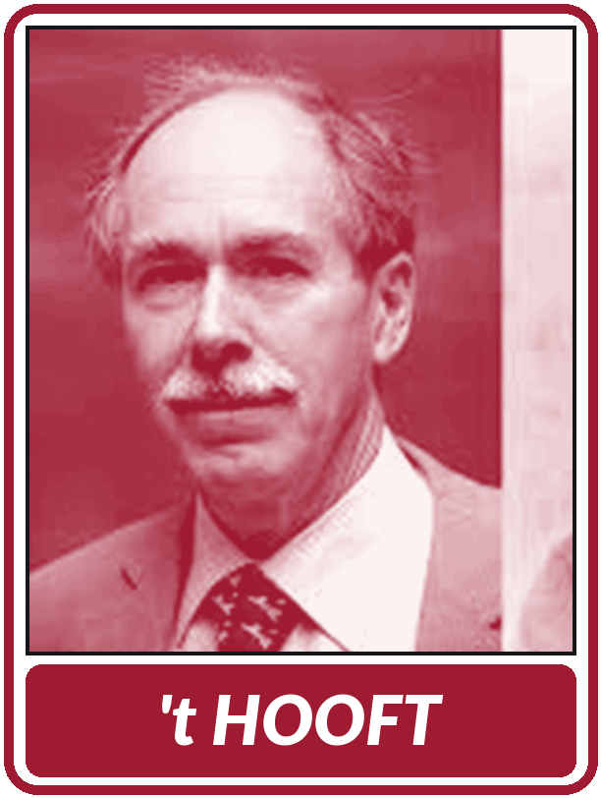
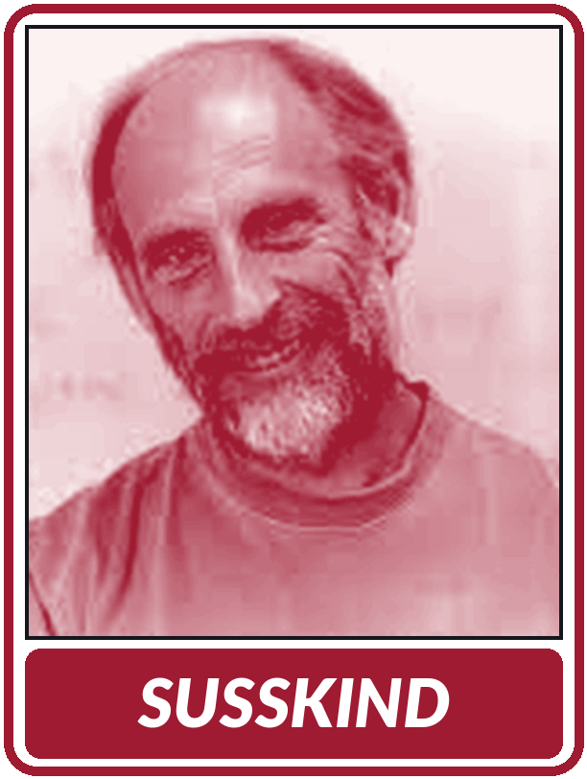

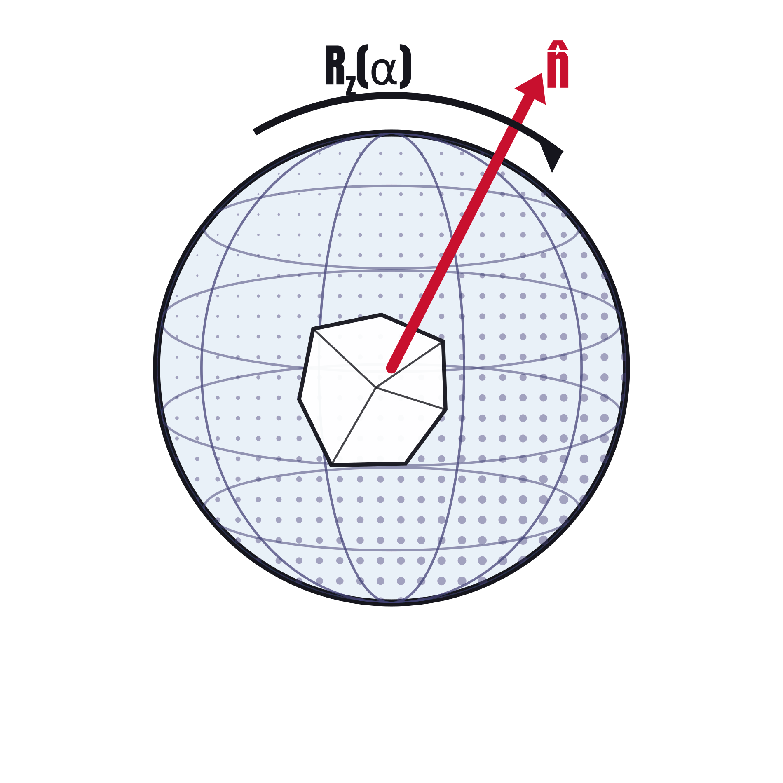
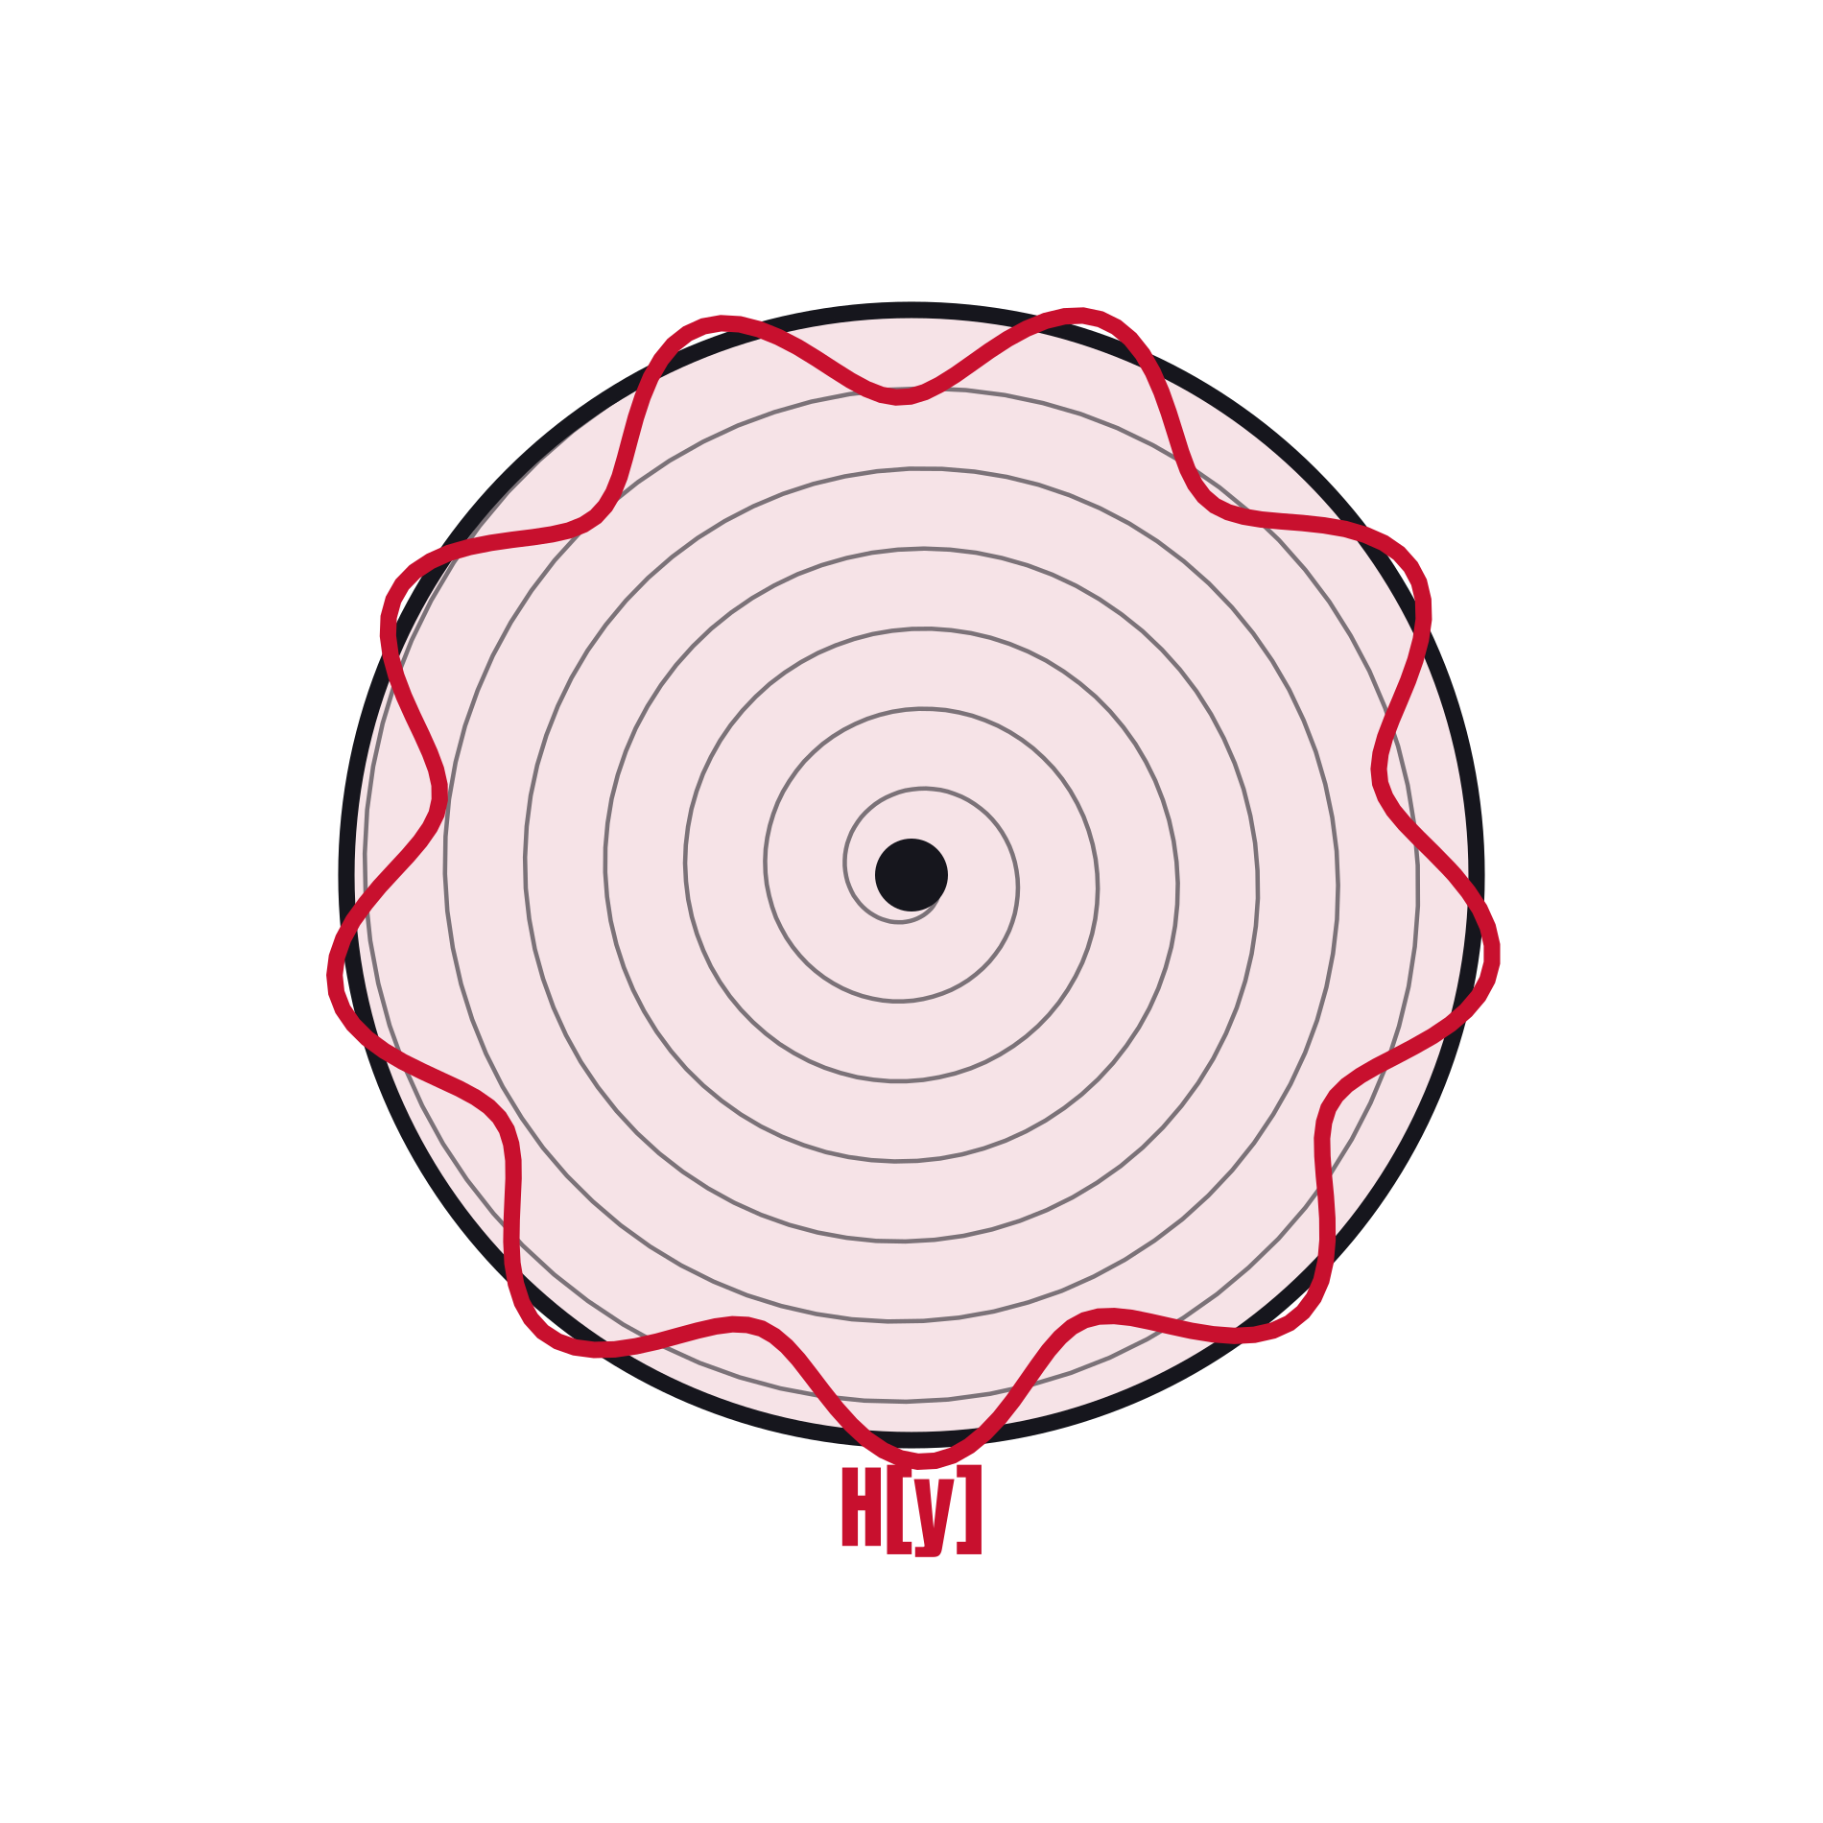

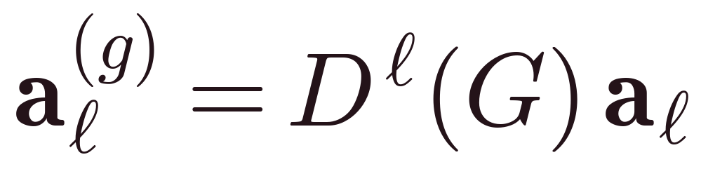
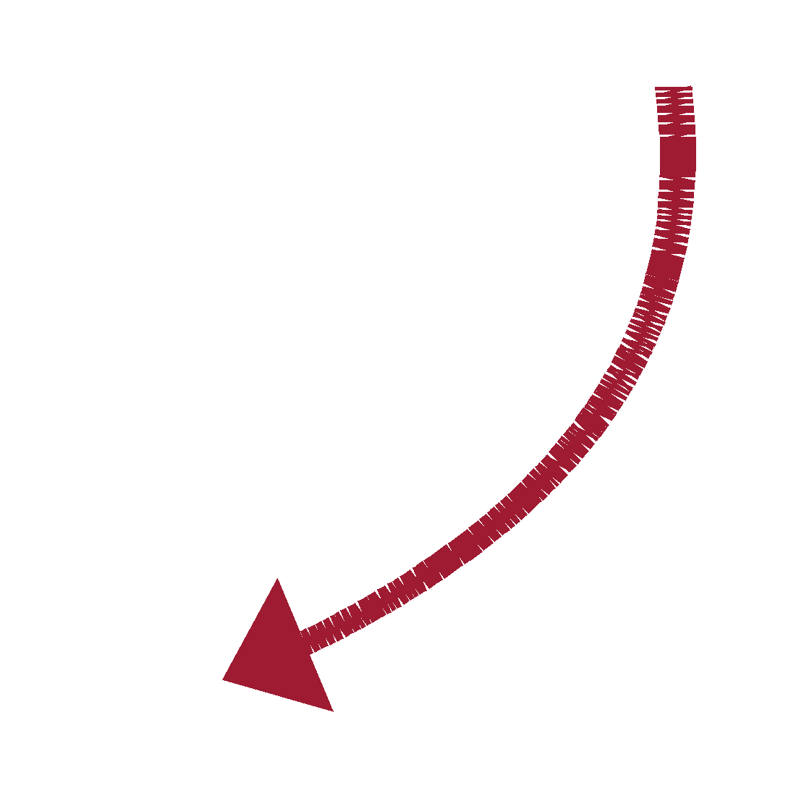

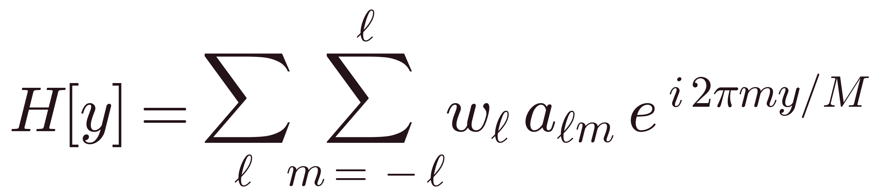
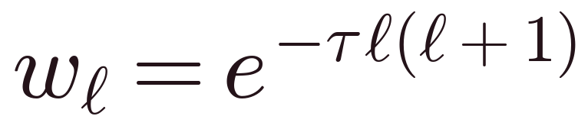

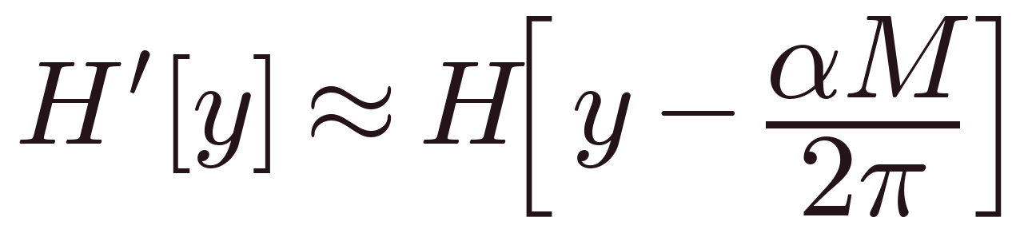

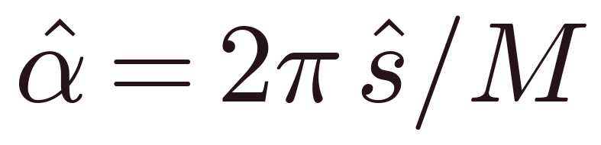
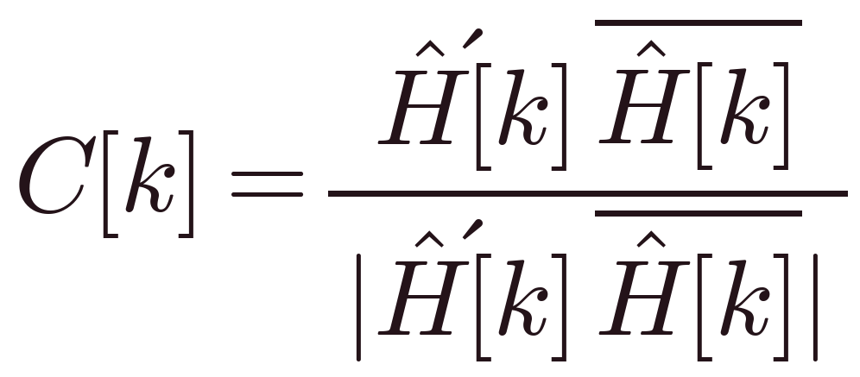

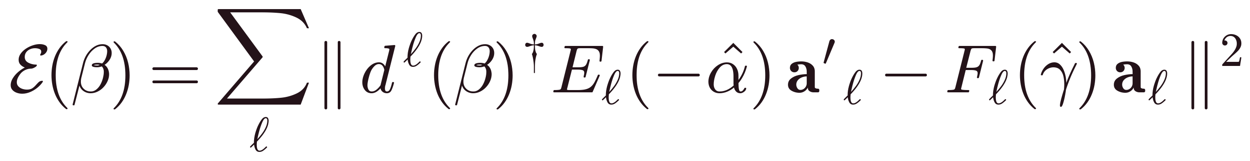

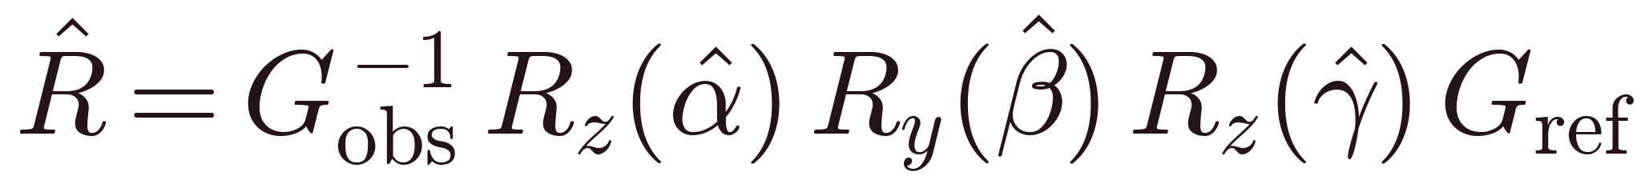


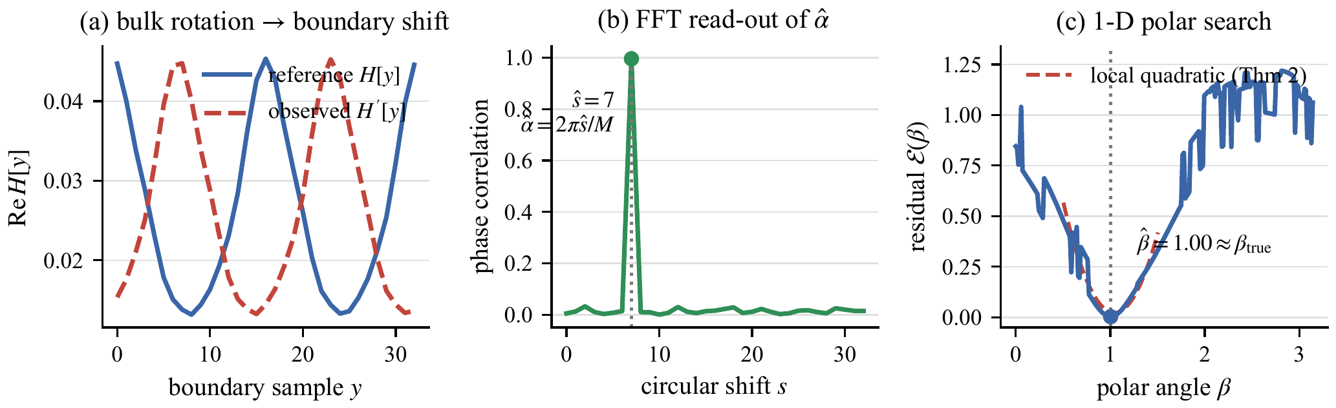
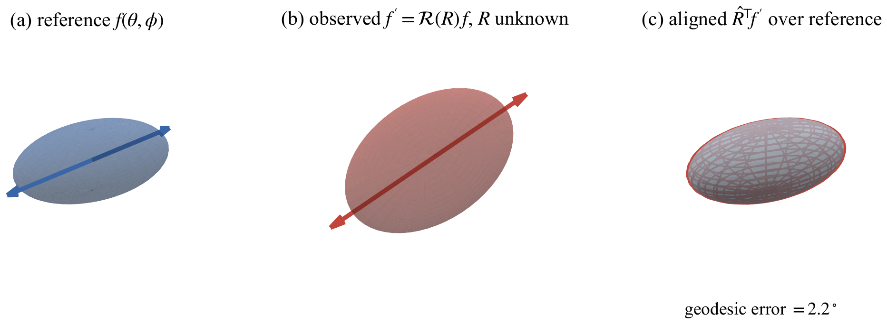
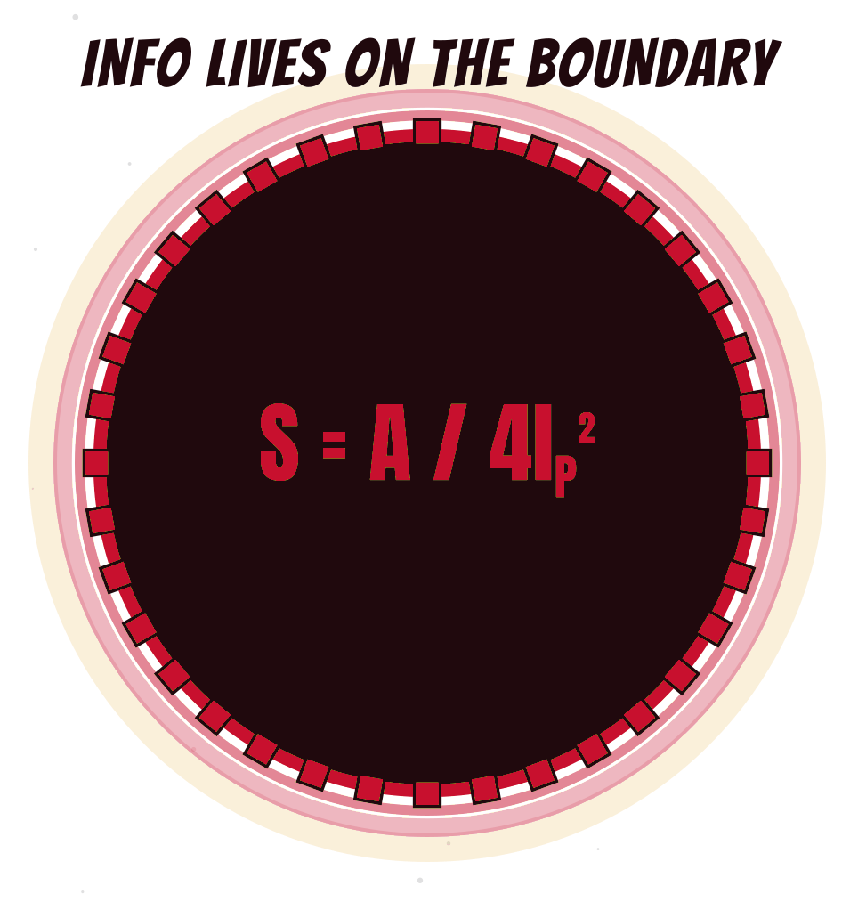
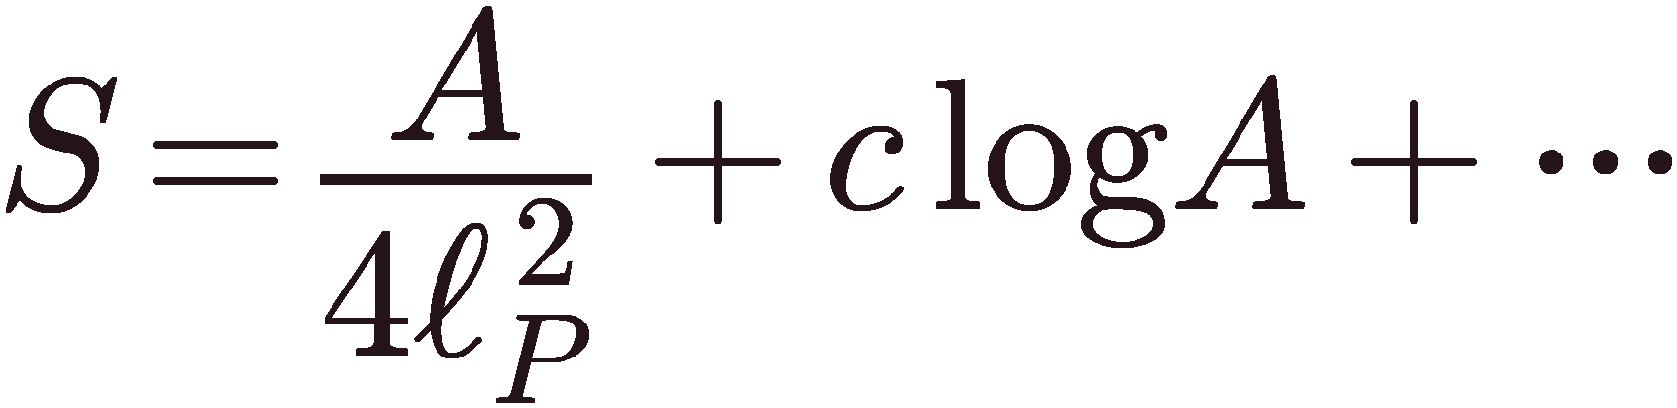
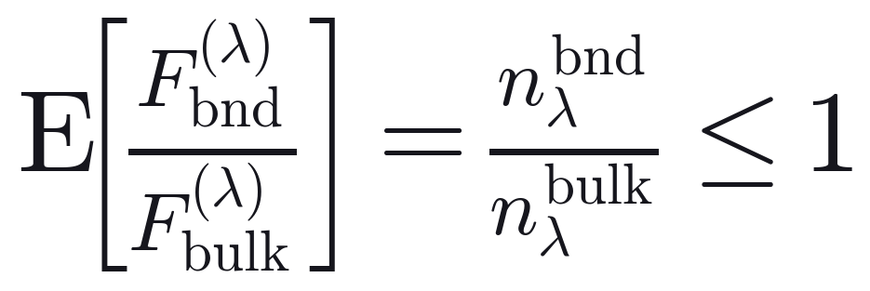
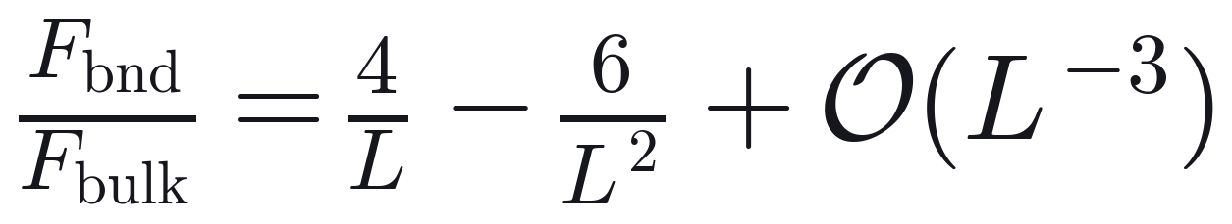

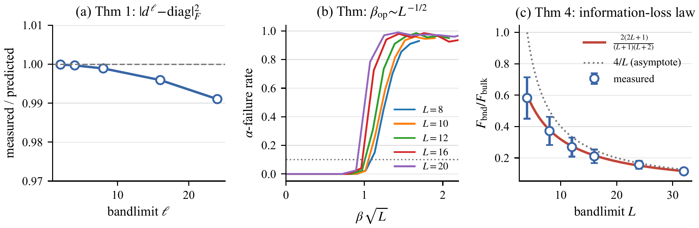
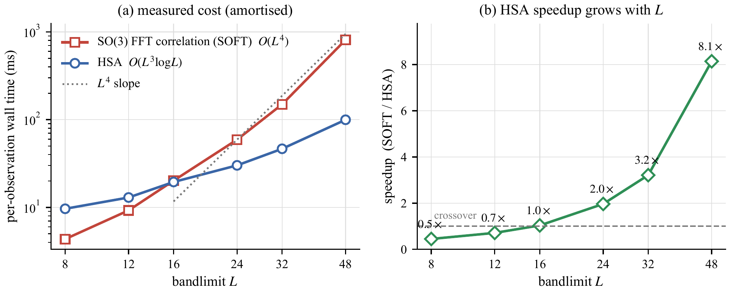
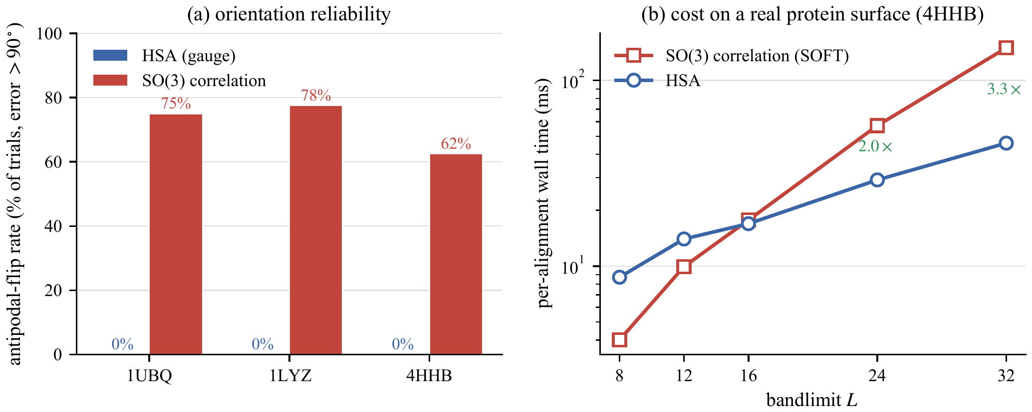
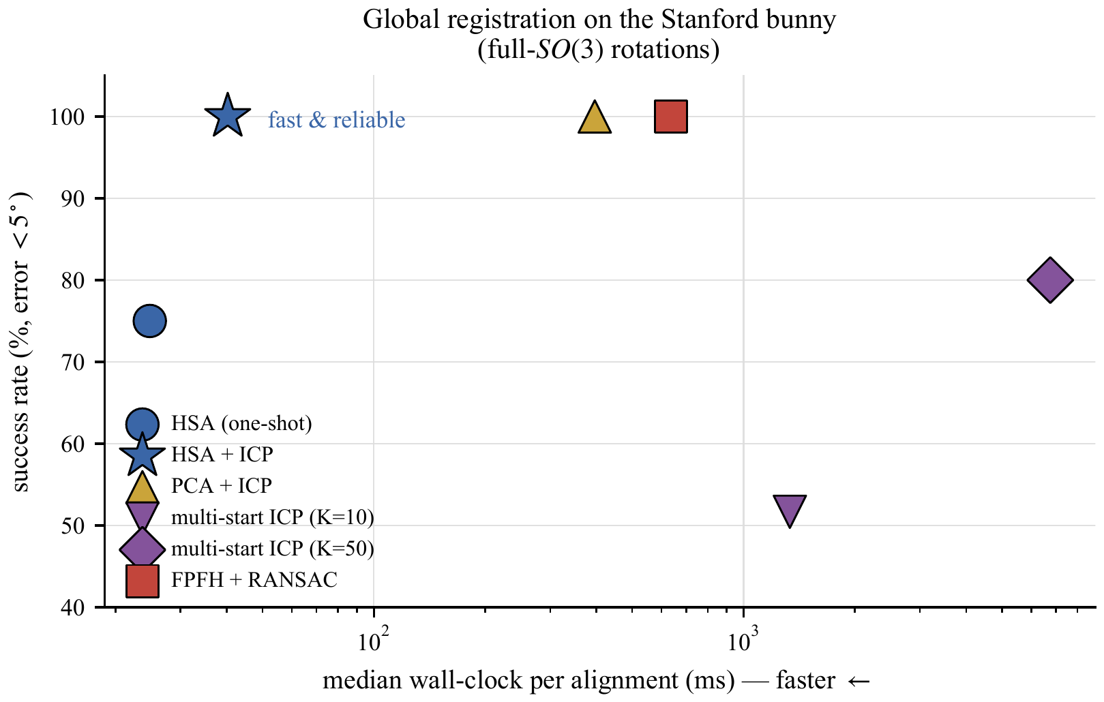
Eren Erberk Erkul
& Murat Temiz
Middle East Technical University , Ankara, Turkey
Department of Physics & EEE · PHYS400 Final Project · 2026
Recover R ∈ SO(3) that aligns an observed object to a reference.
A Fourier transform wrapped around the sphere.
Robotics & pose · molecular reconstruction · computer vision
all on band-limited data on the sphere.
VOLUMETRIC: ✓ global & reliable ✗ but O(L⁴) — costly
LOCAL (ICP): ✓ cheap per step ✗ but needs init · local minima
ℓ — angular frequency; m — azimuthal order.
WE WANT: deterministic · global · fast.
m → east–west nodal lines
ℓ−|m| → north–south circles.
High |m| modes hug the equator
the part of the boundary hologram reads best!
Nodal patterns Yℓm (ℓ = 0…4)
THE BULK-BOUNDARY MAP
2
Gauge
quadrupole, β small
give it a 3-D TWIST!
…and it just SLIDES!
Holography
boundary hologram H[y]
5
Rotation → shift
6
Fourier shift on the boundary
Read α
FFT phase correlation
THE BULK
Rotation
Polar search
1-D in β, γ per trial
Simple Shift!
Compose R
undo the gauge
Analogy is a two way street. The boundary map is lossy (~4/L).
Pushing this purely geometric bound into black hole thermodynamics predicts
a logarithmic area correction to the Bekenstein–Hawking entropy.
even BLACK HOLES agree!
Schur's lemma + Cauchy–Schwarz set c from the bulk symmetry group
Same structure without gravity!
All four theorems verified numerically. Measured vs. predicted within ~1%.
HSA overtakes the O(L⁴) baseline at L=16; 8× faster by L=48 as the gap grows like L/log L.
On real proteins (PDB) antipodal flips drop 62–78% to 0%, staying 2–3× faster.
Stanford bunny: HSA+ICP is 100% reliable at 40 ms,
the fast and reliable corner, ~16× under FPFH+RANSAC.
References: Kostelec–Rockmore ’08 · Driscoll–Healy ’94 · Kuglin–Hines ’75 · Besl–McKay ’92 · Kovacs–Wriggers ’02 · ’t Hooft ’93 · Almheiri–Dong–Harlow ’15 · Cover–Thomas ’06 · Cohen et al. ’18.

