Slide 1
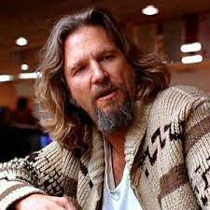
GOALS
To live a happy life doing the things he loves.
Challenges
Long work hours so it’s hard to do recreational activities
Name: Globe Snow
Age: 26
City: Barrie
Profession: Manager of Walmart
Education: Highschool Diploma
Hobbies
Collecting snow globes for his collection

