Slide 1
Mobile IP Cam (single node)
Server
Webpage
Video Input From Cam
Smart Phone
YOLO
Encode Video
RTSP/HTTP Protocol
Capture Video
SSDCN
Location
Decode Signal
Control Signal
Socket
Module
Crowd Size
Bluetooth Connection
End Users
Process Input
MCU
Keyboard Input From Admin
Realtime
Video
Mechanics
Flask Web Framework

Slide 2
Get Image Thread
SS-DCNet/YOLO Detection Thread
Camera-bot Controller Thread
Init video camera
Load
trained
model
Establish Bluetooth connection
Read a frame
Read keyboard command
Sample raw frame
Raw frame
Encode
message
Ctrl signal
Predict using
model
Decode location msg
Raw frame
Number estimation
Frame with boxes
Camera location
Global Variable Pool
Flask API & Socket-IO

Slide 3
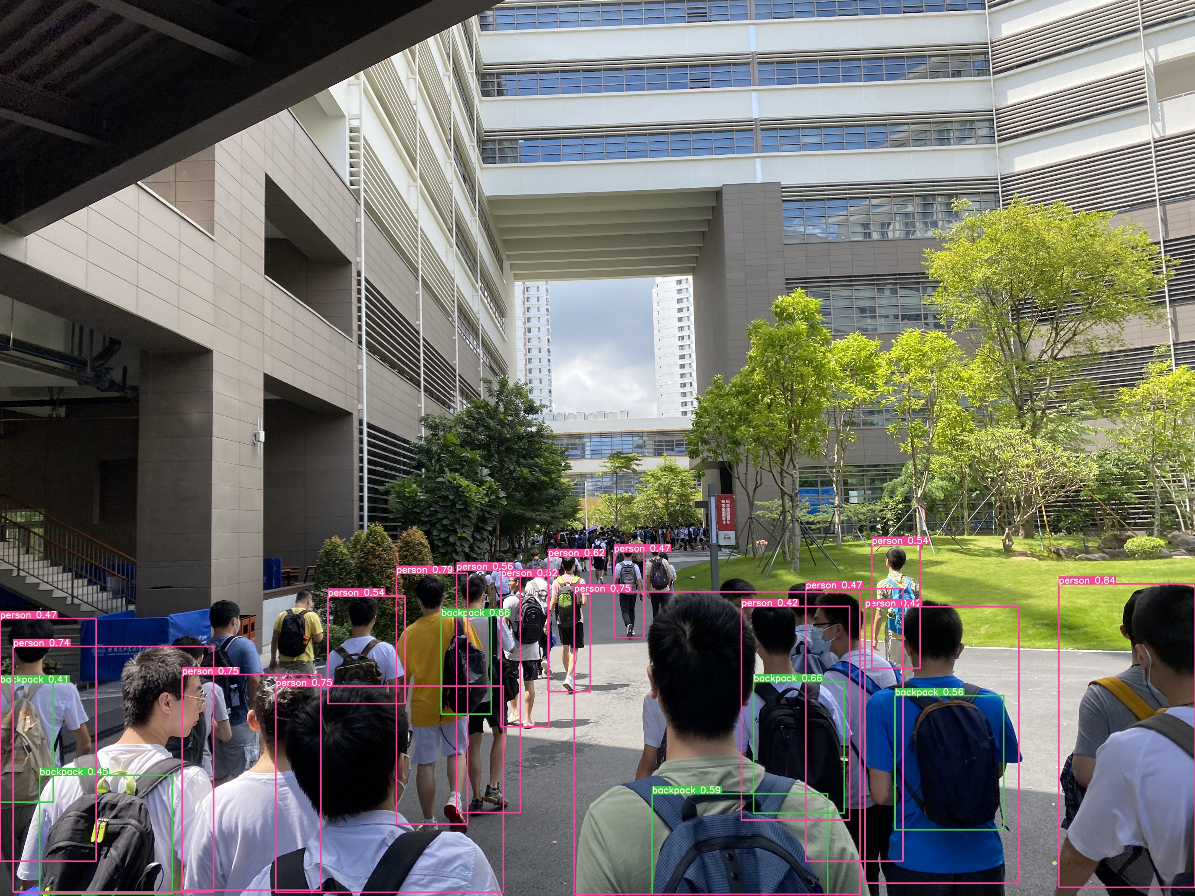
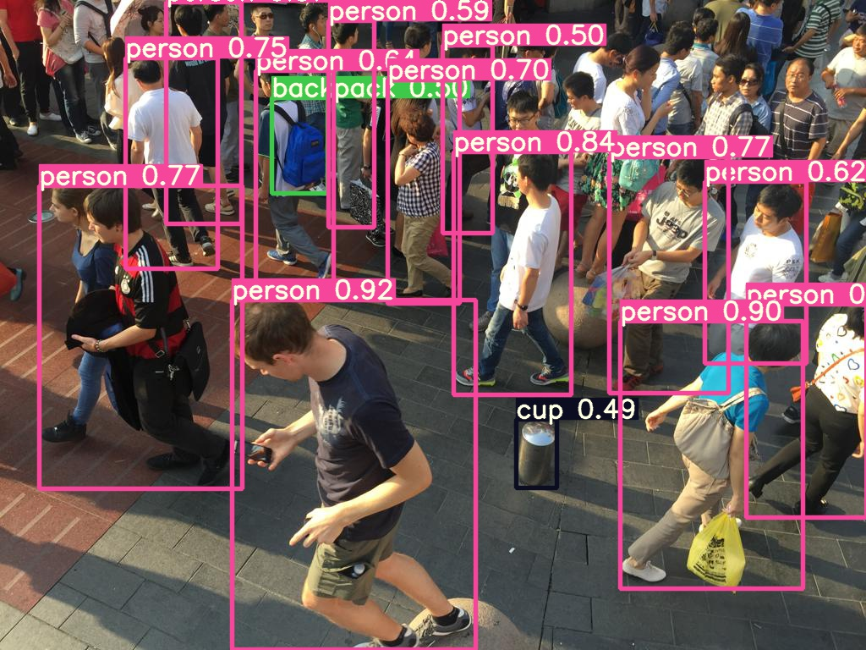
YOLO
SSDCN
16 persons
6 backpacks
Done in 0.032s
110 persons
13 persons
1 backpacks
1 cups
Done in 0.031s
37 persons

Slide 4

Position Control Process
IP Camera Process
Android APP
MCU
Start as a client
Init peripherals
Establish connection
(BT/socket)
Init FREERTOS
Timer thread
UART Interrupt
Decode control signal
Decode BT msg
Send control command via BT
Blink
to show status
Car control using PWM

