Slide 1






Customer admin
Customer AAD tenant
Customer Azure subscription
Azure marketplace
Managed application resource group
Managed app offer
Managed app
ARM templates and other resources
Managed resource group
Publisher AAD tenant
Authorizations for the offer plan
Users
Groups
Apps – service principals

Slide 2

Customer admin
Customer AAD tenant
Customer Azure subscription
Azure marketplace
Managed application resource group
Managed app offer
Managed app
ARM templates and other resources
Managed resource group
Managed identity
Publisher AAD tenant
Authorizations for the offer plan
Users
Groups
Apps – service principals

Slide 3
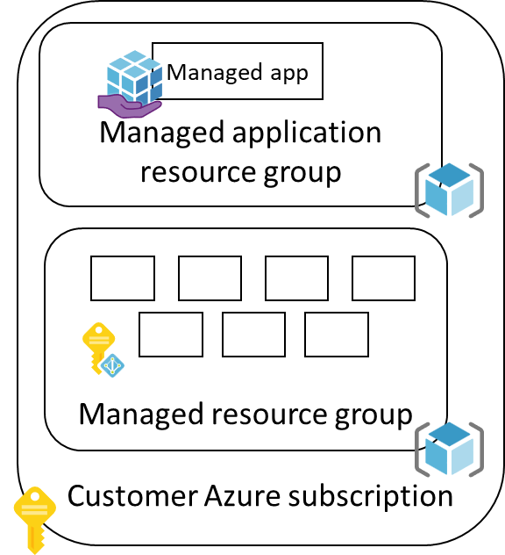
Commercial marketplace
Call metering API
Call metering API
Access control list
Publisher subscription
Publisher Service
Option 1: direct
Option 2: Indirect

