Slide 1
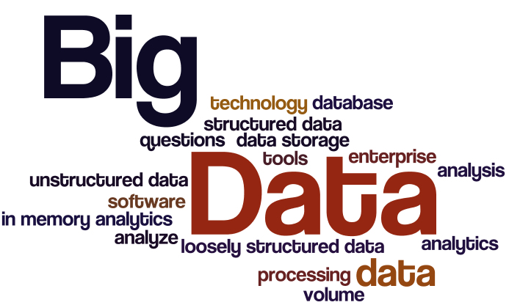
ERCAN KARAÇELİK
24/04/2020

Slide 2
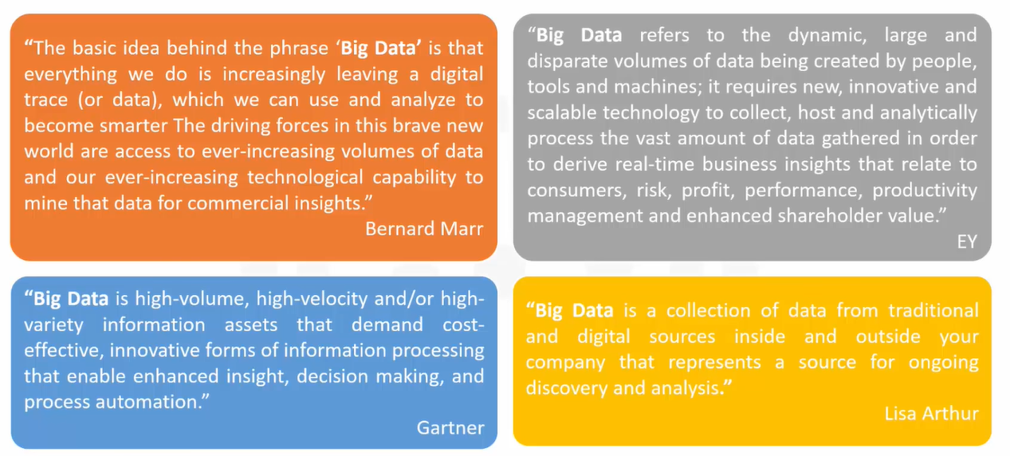
Big Data Definitions
There is no one definition of Big Data.

Slide 3
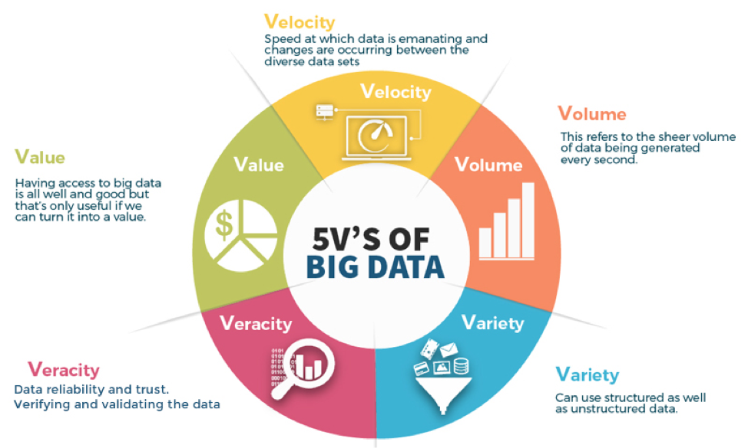
WHAT ARE THE V’s OF BIG DATA?

Slide 4


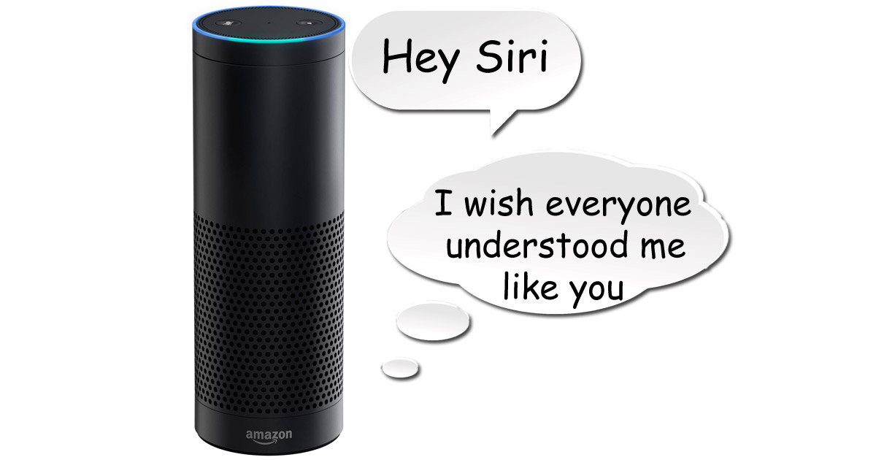

The Impact of Big Data on Business and People

Slide 5

THE SECRET BEHIND THE NETFLIX HIT, ‘HOUSE OF CARDS’
Günümüzde Washington, DC'de geçen House of Cards, Güney Karolina'dan seçilmiş Demokratik Partili bir kongre üyesi olan Frank Underwood'un (Kevin Spacey) kendisine vadedilen ABD Dışişleri Bakanlığı pozisyonuna başkasının atanmasından sonra uygulamaya koyduğu planınını konu almaktadır.

Slide 6
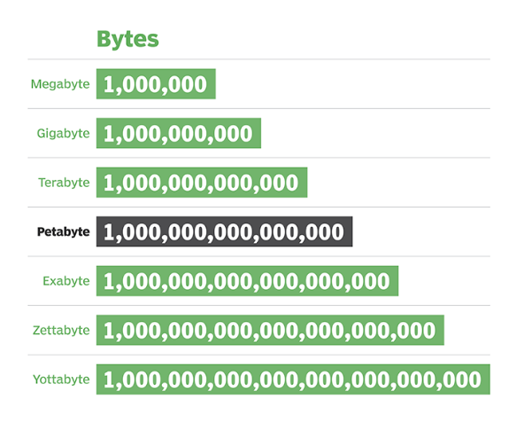
WHY IS EVERYONE TALKING ABOUT BIG DATA?
More data has been created
By 2020, about 1.7 mb of new information will be created every second

Slide 7

Where is all the data coming from?
There are 3 major sources of Big Data:
People generated data
Machine generated data
Businees generated data

Slide 8
Structure of Big Data
Structured → RDBMS, spreadsheets
Unstructured → Unstructured data files often include text and multimedia content. e-mail messages, videos, photos, audio files, presentations, webpages and many other kinds of business documents.
Semi- Structured → XML, JSON file

Slide 9
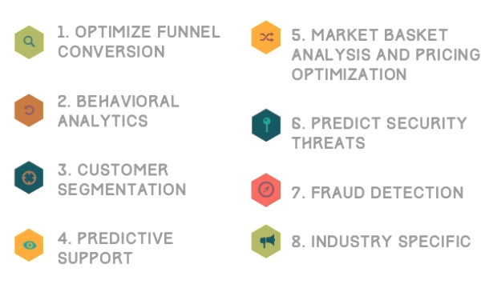
BIG DATA USE CASES

Slide 10
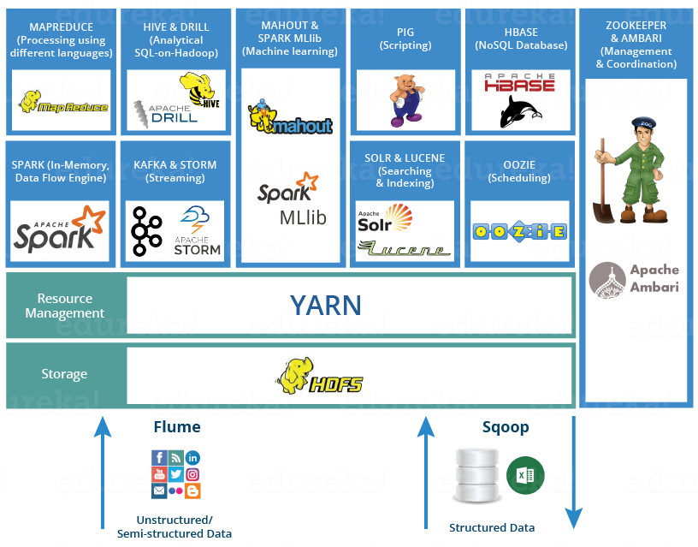
Component and Ecosystem Of Big Data

