Slide 1

Ercan Karaçelik

Slide 2
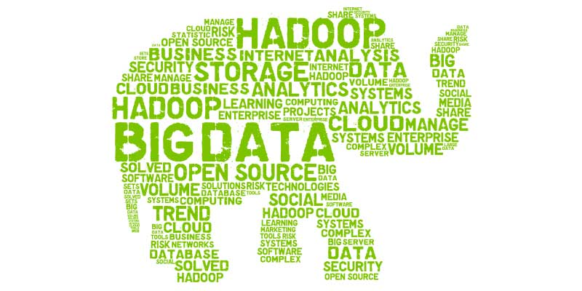
Big Data
Big data is larger, more complex data sets, especially from new data sources. These data sets are so voluminous that traditional data processing software just can’t manage them. But these massive volumes of data can be used to address business problems you wouldn’t have been able to tackle before.

Slide 3
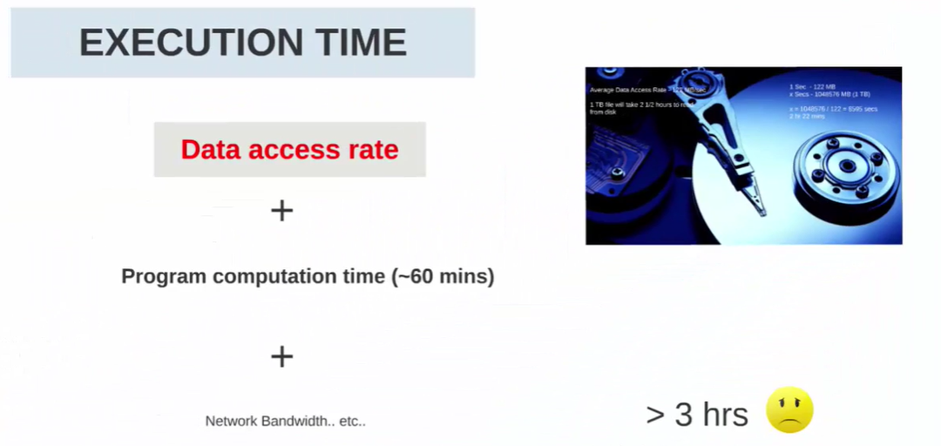

Slide 4
Hadoop
Put simply, Hadoop can be thought of as a set of open source programs and procedures (meaning essentially they are free for anyone to use or modify, with a few exceptions) which anyone can use as the "backbone" of their big data operations.
Bernard Marr
Apache Hadoop is an open source framework that is used to efficiently store and process large datasets ranging in size from gigabytes to petabytes of data. Instead of using one large computer to store and process the data, Hadoop allows clustering multiple computers to analyze massive datasets in parallel more quickly.
Amazon

Slide 5
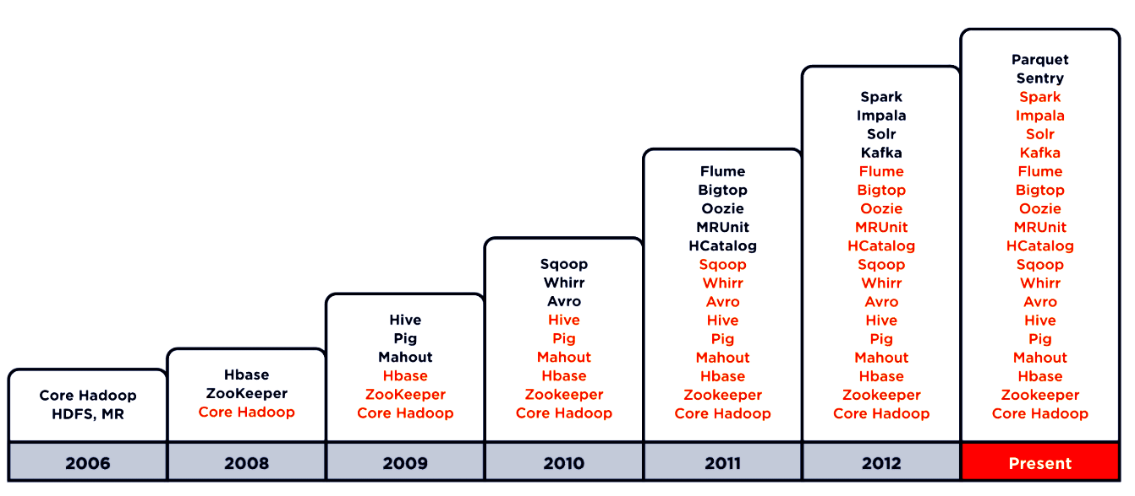
Hadoop Ecosystem Evolution

Slide 6
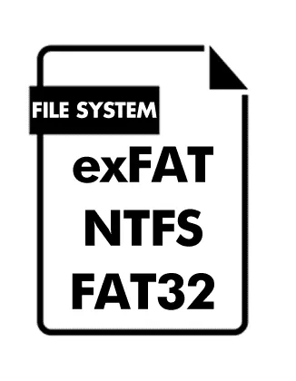
Functions Of File System
Control how data is stored and retrieved
Metadata about the files and folders
Permissions and security
Manage storage space efficiently

Slide 7
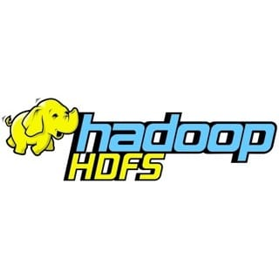
HDFS
HDFS (Hadoop Distributed File System): A file system that is distributed amongst many networked computers or nodes. HDFS is fault tolerant because it stores multiple replicas of files on the file system, the default replication level is 3. HDFS was designed to survive failures.

Slide 8
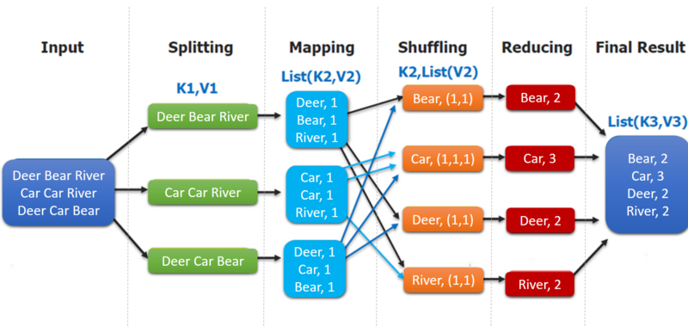
MapReduce
MapReduce is a programming model for processing large data sets with a parallel , distributed algorithm on a cluster (source: Wikipedia). Map Reduce when coupled with HDFS can be used to handle big data.

Slide 9

Yarn
Coordinates tasks running on the cluster and assigns new nodes in case of failure. Comprised of 2 subcomponents: the resource manager and the node manager. The resource manager runs on a single master node and schedules tasks across nodes. The node manager runs on all other nodes and manages tasks on the individual node.

Slide 10
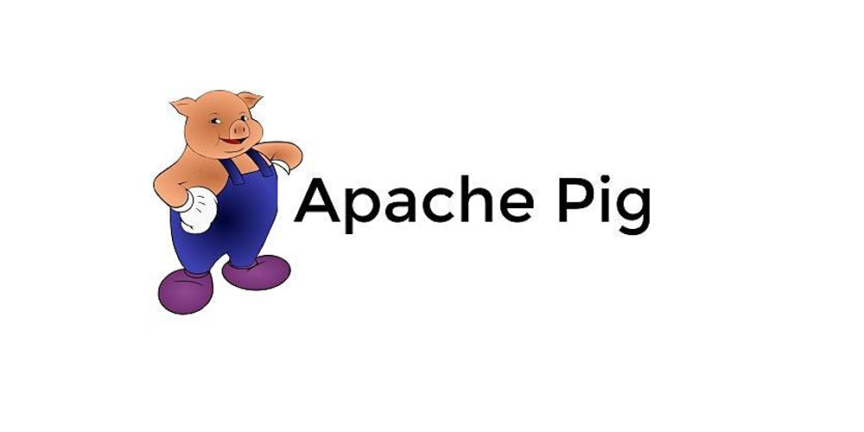
Pig
High level scripting language (Pig Latin) that enables writing complex data transformations. It pulls unstructured/incomplete data from sources, cleans it, and places it in a database/data warehouses. Pig performs ETL into data warehouse while Hive queries from data warehouse to perform analysis (GCP: DataFlow).

Slide 11

Hive
Data warehouse software built o top of Hadoop that facilitates reading, writing, and managing large datasets residing in distributed storage using SQL-like queries (HiveQL). Hive abstracts away underlying MapReduce jobs and returns HDFS in the form of tables (not HDFS).

Slide 12

Sqoop
Transferring framework to transfer large amounts of data into HDFS from relational databases (MySQL)

Slide 13

Kafka
Apache Kafka is an open-source stream-processing software platform developed by LinkedIn and donated to the Apache Software Foundation, written in Scala and Java. The project aims to provide a unified, high-throughput, low-latency platform for handling real-time data feeds.

Slide 14

Spark
Framework for writing fast, distributed programs for data processing and analysis. Spark solves similar problems as Hadoop MapReduce but with a fast in-memory approach. It is an unified engine that supports SQL queries, streaming data, machine learning and graph processing. Can operate separately from Hadoop but integrates well with Hadoop. Data is processed using Resilient Distributed Datasets (RDDs), which are immutable, lazily evaluated, and tracks lineage.

Slide 15

Beam
Programming model to define and execute data processing pipelines, including ETL, batch and stream (continuous) processing. After building the pipeline, it is executed by one of Beam’s distributed processing backends (Apache Apex, Apache Flink, Apache Spark, and Google Cloud Dataflow). Modeled as a Directed Acyclic Graph (DAG).

Slide 16

Oozie
Workflow scheduler system to manage Hadoop jobs.

Slide 17

Hue
Hue is a web-based interactive query editor that enables you to interact with data warehouses.

Slide 18

Ambari
The Apache Ambari project is aimed at making Hadoop management simpler by developing software for provisioning, managing, and monitoring Apache Hadoop clusters. Ambari provides an intuitive, easy-to-use Hadoop management web UI backed by its RESTful APIs.

Slide 19
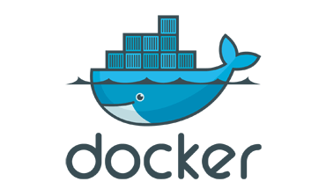
Docker Installation
windows
https://www.youtube.com/watch?v=_9AWYlt86B8
mac
https://www.youtube.com/watch?v=MU8HUVlJTEY
After Installation:
Step 1
docker -v
docker run hello-world
Step 2
docker pull cloudera/quickstart:latest
Step 3
docker run --hostname=quickstart.cloudera --privileged=true -t -i -p 8888:8888 -p 80:80 cloudera/quickstart /usr/bin/docker-quickstart
Step 4 Browse hue localhost:8888

