Slide 1
Population Aging and Bank Deposit Funding: The Role of Financial System Structure
St.Gallen, 18th March 2026

Slide 2
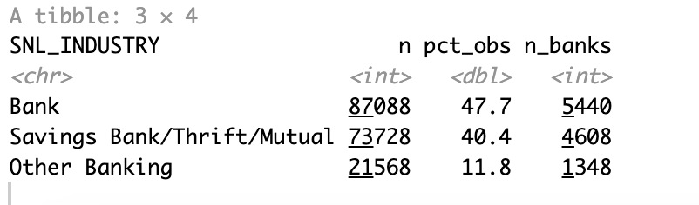
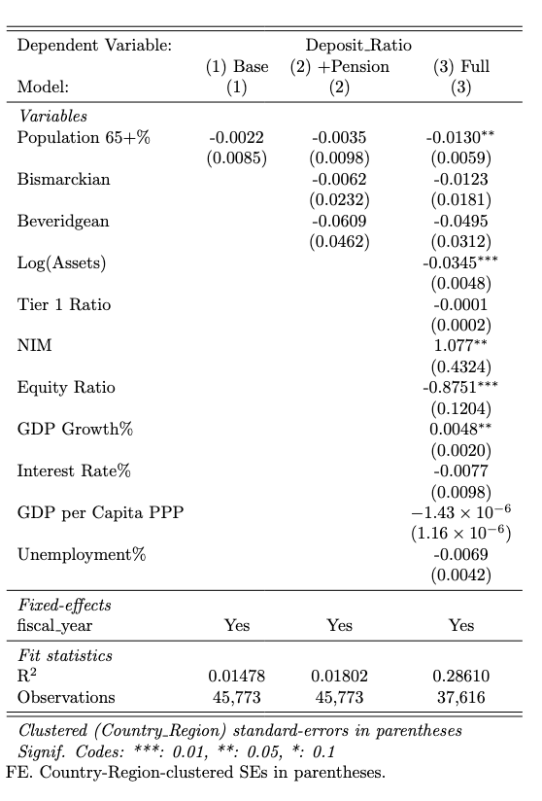
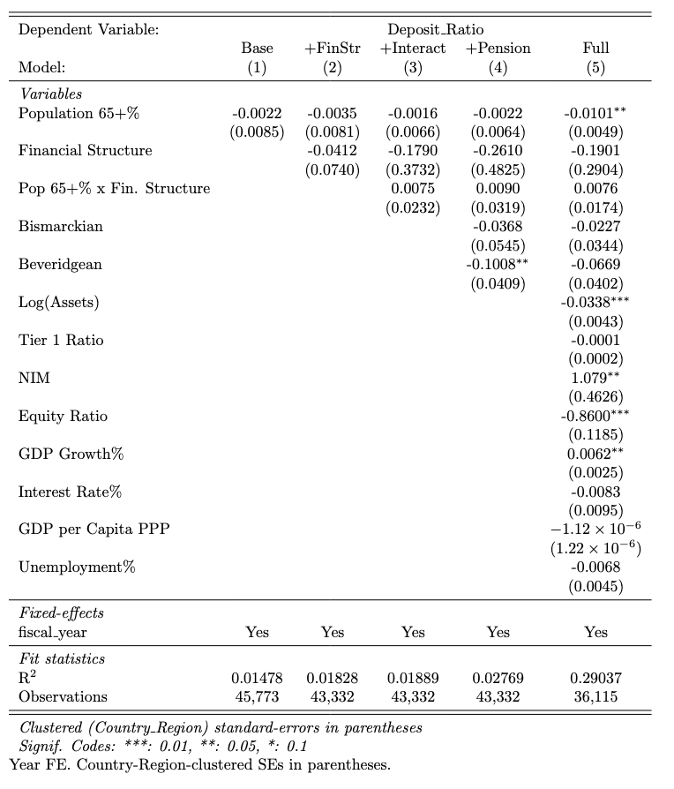
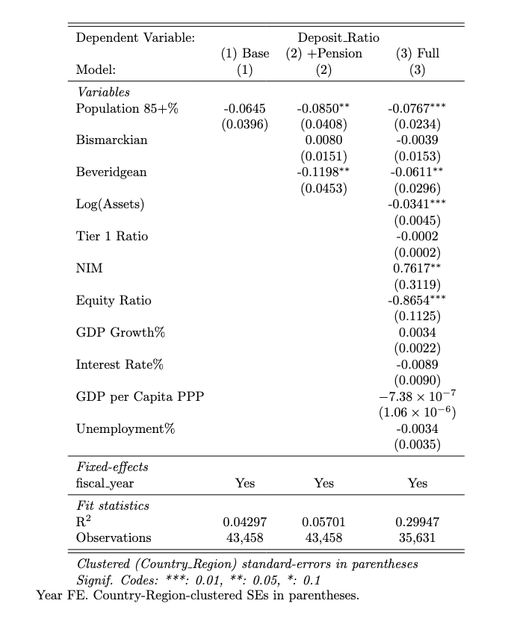
Data: EU28; Cluster: Country_Region (43)
5
H1
H2
H3

Slide 3
Data: EU28 + OECD; Cluster: Country_Region (c. )
5
H1
H2
H3

Slide 4
NB Regressions below

Slide 5
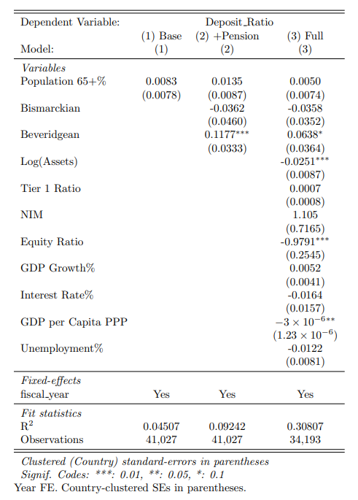
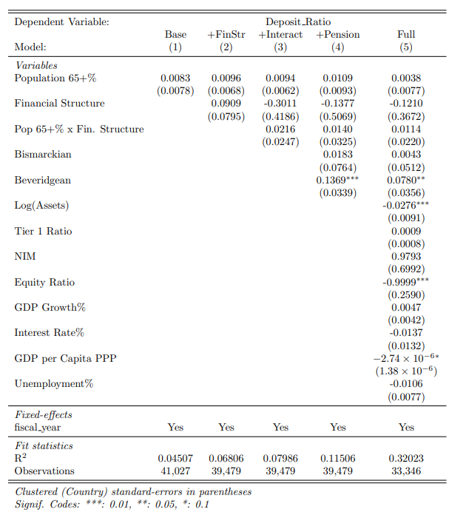
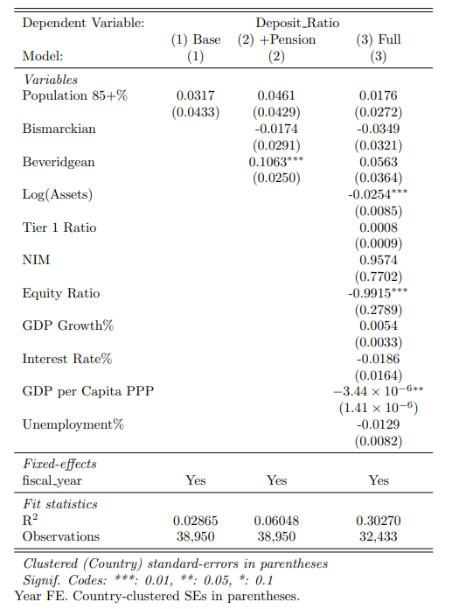
Only saving banks
H1
H2
H3

Slide 6
Aggregated
H1
H2
H3

Slide 7
Only saving banks: H2

