Slide 1
IBM – Data Science
Capstone Project

Slide 2
INTRODUCTION
This Project is for IBM Data Science Professional Certificate Program’s Capstone. In this Project, hypothetical case is created by me that Toronto Area needs more Italian Restaurant.So, I will design this project to help me find the most suitable location for my Italian Restaurant.

Slide 3
BUSINESS UNDERSTANDING
Problem : I want to open a new Italian Restaurant in Toronto, Canada.
Question : If anybody wants to open an Italian Restaurant in Toronto, where should they consider openning it?
Method : Data Science Methodology
Algorithm : Machine Learning Algorithm such as clustering

Slide 4
Data & SOURCE
List of neighborhoods in Toronto, Canada Latitude and Longitude of these neighborhoods Venue data related to Italian restaurants.
Toronto neighborhoods according to Wikipedia Geocoder Package Foursquare API

Slide 5
METHODOLOGY
Get the list of neighborhoods from Wikipedia.
Scraping the data with Pandas HTML.
Match the coordinates of Toronto Neighborhoods with Geocoder Package.
Visualize the map of Toronto using Folium Package to verify correct coordinates.
Create Foursquare developer account.
Use Foursquare API to pull the list of top 100 venues within 500 meters Radius.
Analyze each neighborhood by grouping the rows by neighborhood and take the mean on the frequency of occurence of each venue category.
Look for Italian Restaurant.
Performe the clustering method by using KMeans.
Cluster the neighborhoods in Toronto into three clusters based on their frequency of occurence for Italian Food .
Recommend the ideal location to open the restaurant.

Slide 6
LIBRARIES
numpy
pandas
requests
BeautifulSoup
tabulate
KMeans
folium
geocoder

Slide 7
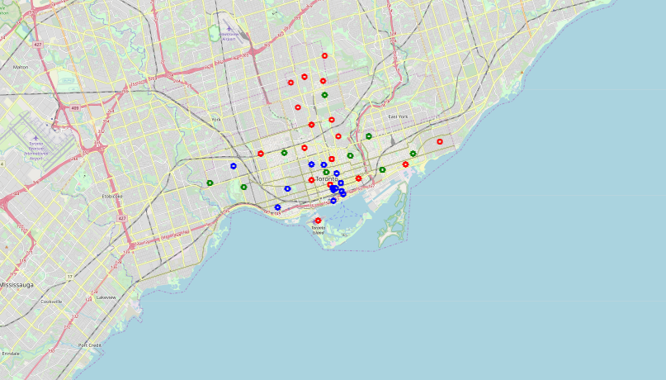
RESULTS

Slide 8
RESULTS
Cluster 0 : Neighborhoods with no Italian restaurants.
Cluster 1 : Neighborhoods with the more number of Italian restaurants.
Cluster 2 : Neighborhoods with the less number of Italian restaurants.

Slide 9
RECOMMENDATIONS
Most of the Indian restaurants are in cluster 1.
Lowest in Cluster 0 which are in North Toronto. Also, there are good opportunities to open.
Looking at nearby venues it seems cluster 2 might be a good location as there are not a lot of Italian restaurants in these areas. Therefore, this project recommends the entrepreneur to open an Italian restaurant in these locations.

