Slide 1
PREDICTING TRAM DELAYS BASED ON WEATHER
LAUra bąkała
Wojciech kretowicz
Karol pysiak
Mateusz szysz

Slide 2
Short recap
The goal is to:
predict in a real-time Warsaw tram delays and
monitor them lively
The data sources are Warszawskie Dane (timetables and current position of trams) and OpenWeatherMap (weather prognoses)

Slide 3
Updates to milestone 2
Adding Kafkas
Improving documentation descriptions
Redefining the goal of using HBase

Slide 4
Developing analYtical module
Extracting tram routes from timetables
Calculating tram delays
Developing speed layer
Explanatory data analysis

Slide 5
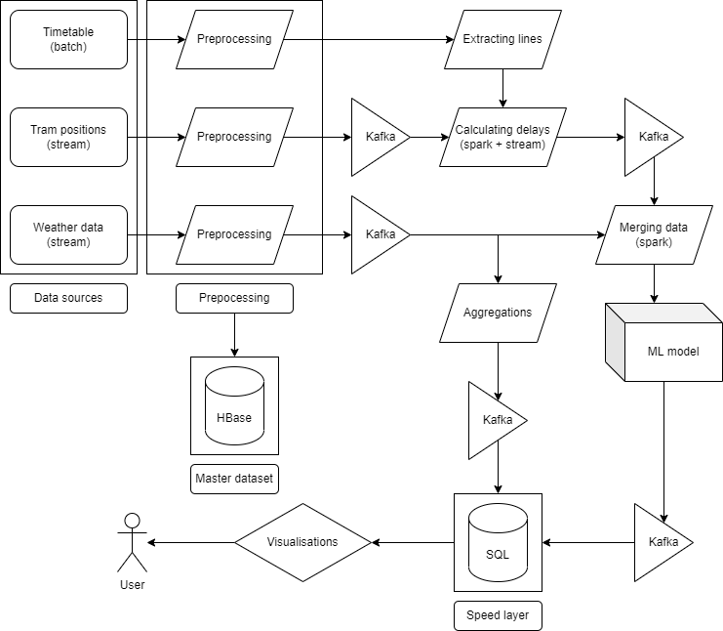
Architecture

Slide 6
Data sources - recap
Timetables are rarely updates and contain static information describing how the tram traffic should look like
Tram positions in the API are updated every few seconds, this includes:
longitude and latitude
timestamp
line, vehicle identifier and brigade
Weather data is updated every 3 hours and contains many parameters regarding weather condition

Slide 7
Problems with Warsaw Open Data
Single message about tram does not contain any information about the direction nor about previous/next stop
Timetable has a complex structure:
Bus stops are grouped by "busstopId"
Particular stop in bus group is identified by "busstopNr"
Each bus stop group contains 1 to 6 different stops
There is no information about the direction of line except for the next stop name which is not usefull because is not compatible with "busstopId" and "busstopNr"

Slide 8
Our solution Part I – extracting lines
We sort all entries by "time"
We group all entries by "line", "busstopId", "busstopNr"
For each group we number consecutive entries
Entries across different groups with the same number conststute a single line in a single direction preserving their order

Slide 9
Our solution part II – approximation of delays
For each message about tram we find 4 closest stops (these are grouped in two bus stop groups each with two actual stops)
For these 4 stops we calculate time discrepancies and we find iteration that achieves minimum absolute time discrepancy
For these 4 stops within best iteration we select 2 stops with minimum absolute time discrepancy and we calculate an average of delays

Slide 10
Architecture solution for timetables
Time table data is downloaded once a day (in a middle of a night)
Next, this data is put to HBase and in parallel saved temporarily in files in csv format on a disk
The temporary files are then once a day read by the python script that extracts the lines
Extracted lines are pushed then to a designated kafka topic

Slide 11
Architecture solution for delays approximations
Delays has to be calculated in a continuous manner, as part of a stream
Thus, we use Spark to enhance the tram position stream
Spark pulls timetable data from kafka topic once a day in order to have the most timely data
Spark pulls stream of tram positions from kafka topic
Both objects: stream and static dataframe, are then processed together and a new stream with delays is being pushed to a new kafka topic:
Data transformation currently implemented in Python and batch processing, stream processing is still being developed

Slide 12
Architecture solution for DELAYS MODEL
Model will be updated once a day
Predictions will be made in the streaming fashion, when weather data arrives
Every delay prediction will be streamed to the speed layer
Possibly, we will base the model not only on weather data, but on trams data either. Still, predictions will be in the streaming fashion

Slide 13
Architecture solution for ADDITIONAL WEATHER DATA
When we receive the weather forecasts we push the data to the speed layer for users to look up
We filter mainly unimportant data
Everything is done in the streaming fashion
Transformed data is stored in the sql database ready to analyse

Slide 14
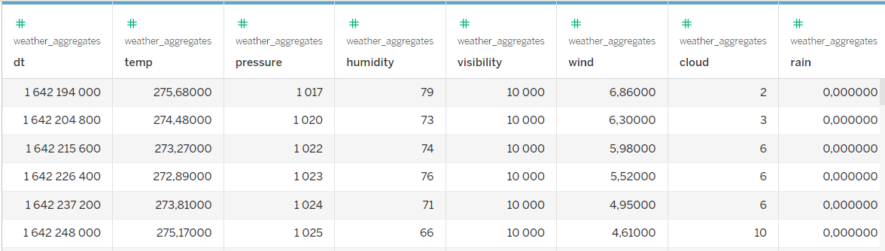
SPeed LAYER

Slide 15
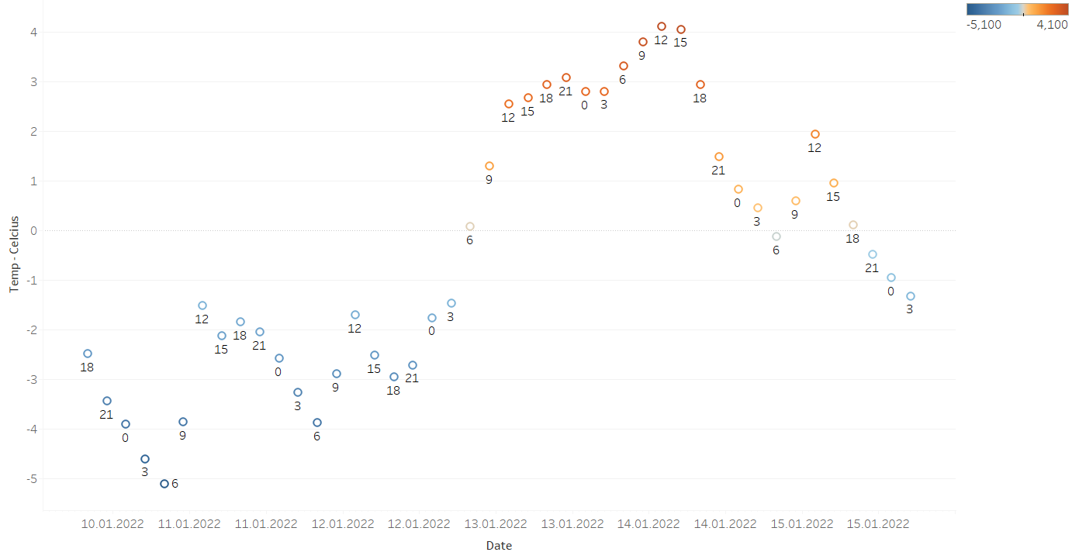

Slide 16
What will be added In the final milestone?
Developing final model
Dashboards with (let's hope) real time visualizations

Slide 17
Thank you for your attention

