Slide 1
Document Object Model (DOM) TypeScript
INFWEB01-D and INFWEB21-D

Slide 2
Topics
The View in the MVC
The view using template engines
Document Object Model (DOM)
Types in Typescript

Slide 3
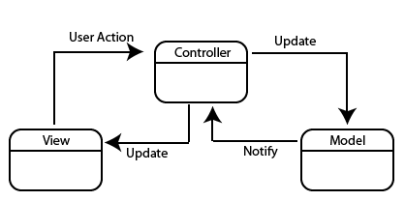
The View in MVC
We discussed that modern web applications use the MVC architectural pattern to separate the logic of our application

Slide 4
The View in MVC.
We discussed that modern web applications use the MVC architectural pattern to separate the logic of our application
The model component manages the data and the logic to interact with a database provider

Slide 5
The View in MVC..
We discussed that modern web applications use the MVC architectural pattern to separate the logic of our application
The model component manages the data and the logic to interact with a database provider
The controller component handles requests and return responses to clients

Slide 6
The View in MVC…
We discussed that modern web applications use the MVC architectural pattern to separate the logic of our application
The model component manages the data and the logic to interact with a database provider
The controller component handles requests and return responses to clients
The view component is responsible for presenting content through the user interface
Any representation of information such as a chart, diagram or table

Slide 7
The View in MVC….
In the context of web application we typically use the browser to interact and view content
The browser receives documents from the server that has a specific structured

Slide 8
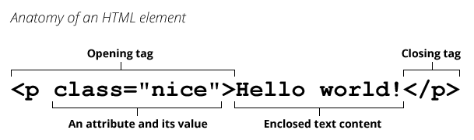
The View in MVC…..
In the context of web application we typically use the browser to interact and view content
The browser receives documents from the server that has a specific structured
This document is typically a HyperText Markup Language (HTML) document
An HTML document is a plaintext document structured with elements
For instance, an element that refers to a paragraph is <p>

Slide 9
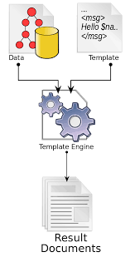
The View in MVC…..
The server can reply to a client request with a response containing an HTML document
This is typically the case when we refer to template engine-based implementation on the server side
Notes:
Dotnet new mvc
Explain the code structure:
Controller for HOME
Methods index, about etc.
Views for each of those methods
@ character and renderbody and rendersection

Slide 10
The View in MVC…..
The server can reply to a client request with a response containing an HTML document
This is typically the case when we refer to template engine-based implementation on the server side
The engine has a markup syntax for embedding server-based code into webpages
Notes:
Dotnet new mvc
Explain the code structure:
Controller for HOME
Methods index, about etc.
Views for each of those methods
@ character and renderbody and rendersection

Slide 11
The View in MVC…..
The server can reply to a client request with a response containing an HTML document
This is typically the case when we refer to template engine-based implementation on the server side
The engine has a markup syntax for embedding server-based code into webpages
A character starts code blocks to mark the code part of the engine for dynamic data processing
Example “@” in Razor (.Net)
Data + HTML Template = Template engine
Demo
Notes:
Dotnet new mvc
Explain the code structure:
Controller for HOME
Methods index, about etc.
Views for each of those methods
@ character and renderbody and rendersection

Slide 12
The View in MVC……
The browser also contains some APIs useful for various tasks
These can be accessed using JavaScript code, and allows you to manipulate any HTML element:
Document Object Model (DOM): allows access to and modification of the current document
Device APIs: allows access to various hardware features available to Web pages
Data management APIs: allows local managing of the data
In this course we will discuss only the DOM

Slide 13
Document Object Model (DOM)
DOM is a programming API for HTML and XML documents
It defines the logical structure of documents

Slide 14
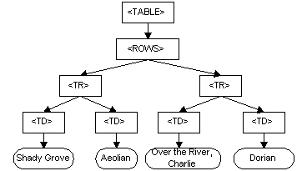
Document Object Model (DOM).
DOM is a programming API for HTML and XML documents
It defines the logical structure of documents
It also defines the way a document is accessed and manipulated
Consider the following HTML table structure
<TABLE>
<ROWS>
<TR>
<TD>Shady Grove</TD>
<TD>Aeolian</TD>
</TR>
<TR>
<TD>Over the River, Charlie</TD>
<TD>Dorian</TD>
</TR>
</ROWS>
</TABLE>
Table in HTML
Dom in the browser

Slide 15
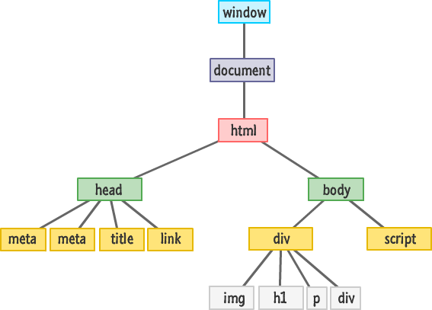
Document Object Model (DOM)..
DOM is an API that connects web pages to scripts or programming languages.

Slide 16
Document Object Model (DOM)...
DOM is an API that connects web pages to scripts or programming languages
The DOM model represents a document with a logical tree.

Slide 17
Document Object Model (DOM)….
DOM is an API that connects web pages to scripts or programming languages
The DOM model represents a document with a logical tree
DOM methods allow programmatic access to the tree

Slide 18
Document Object Model (DOM)…..
DOM is an API that connects web pages to scripts or programming languages
The DOM model represents a document with a logical tree
DOM methods allow programmatic access to the tree
Each branch of the tree ends in a node

Slide 19
Document Object Model (DOM)…..
DOM is an API that connects web pages to scripts or programming languages
The DOM model represents a document with a logical tree
DOM methods allow programmatic access to the tree
Each branch of the tree ends in a node
This allows to change document's structure, style or content.

Slide 20
Document Object Model (DOM)…...
DOM is an API that connects web pages to scripts or programming languages
The DOM model represents a document with a logical tree
DOM methods allow programmatic access to the tree
Each branch of the tree ends in a node
This allows to change document's structure, style or content
Nodes can have event handlers attached to them.

Slide 21
Document Object Model (DOM)……
How does JavaScript perform a change to a DOM element?

Slide 22
Document Object Model (DOM)……
How does JavaScript perform a change to a DOM element?
We know that the DOM is a tree of node objects
Each Node object corresponds to the HTML elements on a page.
JS code can examine these nodes to see the state of an element
(e.g. to get what the user typed in a text box)

Slide 23
Document Object Model (DOM)……
How does JavaScript perform a change to a DOM element?
We know that the DOM is a tree of node objects
Each Node object corresponds to the HTML elements on a page.
JS code can examine these nodes to see the state of an element
(e.g. to get what the user typed in a text box)
JS code can edit the attributes of these nodes to change the attributes of an element
(e.g. to toggle a style or to change the contents of an <h1> tag)

Slide 24
Document Object Model (DOM)……
How does JavaScript perform a change to a DOM element?
We know that the DOM is a tree of node objects
Each Node object corresponds to the HTML elements on a page.
JS code can examine these nodes to see the state of an element
(e.g. to get what the user typed in a text box)
JS code can edit the attributes of these nodes to change the attributes of an element
(e.g. to toggle a style or to change the contents of an <h1> tag)
JS code can add elements to and remove elements from a web page by adding and removing nodes from the DOM

Slide 25
Document Object Model (DOM)……
// Returns the DOM object for the HTML element
// with id="button", or null if none exists.
let element = document.querySelector( ‘#button’ );
<button id= “button” >Send</button>

Slide 26
Document Object Model (DOM)……
// Returns the DOM object for the HTML element
// with id="button", or null if none exists.
let element = document.querySelector( ‘#button’ );
<button id= “button” >Send</button>
// Returns a list of DOM objects containing all
// elements that have a "quote" class AND all
// elements that have a "comment" class.
let elementList = document.querySelectorAll( '.quote, .comment’ ); <button class= “button” >Send</button>
<button class= “button” >Send</button>

Slide 27
JavaScript
JavaScript is an interpreted programming language.
It is also dynamically typed
Type modification happens at runtime
// Type of x is integer
var foo = 123;
// Type of x is now string
foo = ‘567’;
JavaScript runs in varying environments
Testing and debugging is needed to verify its behavior across multiple browsers
Adding type checking could eliminates a class of programming errors

Slide 28
TypeScript
TypeScript is a typed superset of JavaScript
TypeScript code can be transpiled into JavaScript
JavaScript is what you are actually going to execute (either in the browser or on the server)
There are two main goals of TypeScript:
• Provide an optional type system for JavaScript.
• Provide planned features from future JavaScript editions to current JavaScript engines

Slide 29
The TypeScript type system
• Types increase the quality of the code when doing refactoring.
It's better for the compiler to catch errors than to have things fail at runtime.
• Types are one of the best forms of documentation you can have.
The function signature is a theorem and the function body is the proof.

Slide 30
Types in Typescript
Types can be Implicit
var foo = 123;
foo = '456'; // Error: cannot assign `string` to `number

Slide 31
Types in Typescript
Types can be Implicit
var foo = 123;
foo = '456'; // Error: cannot assign `string` to `number
Types can be Explicit
var foo: number = 123;
var foo: number = '123'; // Error: cannot assign a `string` to a `number`

Slide 32
Example
Demo
Notes:
Create a node project => npm --init
Install typescript locally => npm – i typescript build-dev
Create a typescript project => tsc –init
Show tsconfig
Create a Program.tsx file
Create an index.html page
Link Program.js to index.html

Slide 33
Types in Typescript.
There are additional types that we don’t have in languages such as Java and C#
Union types
we can join types together, obtaining all values of both types:
let x1: number | "loading" | "error" = "loading"

Slide 34
Types in Typescript.
There are additional types that we don’t have in languages such as Java and C#
Union types
we can join types together, obtaining all values of both types:
let x1: number | "loading" | "error" = "loading"
we can also join more complex types together
type Recor = Movie | Actor
to recover the original type information, we can use a discriminated union

Slide 35
Types in Typescript.
There are additional types that we don’t have in languages such as Java and C#
Union types
we can join types together, obtaining all values of both types:
let x1: number | "loading" | "error" = "loading"
we can also join more complex types together
type Record = Movie | Actor
to recover the original type information, we can use a discriminated union
Discriminated union: an element allows us to discriminate the specific case of a value

Slide 36
Types in Typescript..
Intersection Types:
• the same discriminated union can be built by reusing the previously defined types, augmented with intersections;
• this results in less code, and better intention declaration:
type Record = Movie & { kind: "Movie" } | Actor & { kind: "Actor" }

Slide 37
Types in Typescript..
Union is a sort of sum, or set union:
A | B is a type that contains:
all the values of A,
and all the values of B, one next to each other;
type A = { x:"A1" | "A2" }
type B = { y:"B1" | "B2" | "B3" }
What are possible values of A | B?

Slide 38
Types in Typescript..
Union is a sort of sum, or set union:
A | B is a type that contains:
all the values of A,
and all the values of B, one next to each other;
type A = { x:"A1" | "A2" }
type B = { y:"B1" | "B2" | "B3" }
Values of A | B are { x:"A1" }, { x:"A2" }, but also { y:"B1" }, etc. There are five of them;

Slide 39
Types in Typescript..
Union is a sort of sum, or set union:
A | B is a type that contains:
all the values of A,
and all the values of B, one next to each other;
type A = { x:"A1" | "A2" }
type B = { y:"B1" | "B2" | "B3" }
Values of A | B are { x:"A1" }, { x:"A2" }, but also { y:"B1" }, etc. There are five of them;
Intersection is a sort of product, or cartesian product over sets:
A & B is a type that contains all the combinations of values of A and B at the same time:
type A = { x:"A1" | "A2" }
type B = { y:"B1" | "B2" | "B3" }
What are possible values of A & B?

Slide 40
Types in Typescript..
Union is a sort of sum, or set union:
A | B is a type that contains:
all the values of A,
and all the values of B, one next to each other;
type A = { x:"A1" | "A2" }
type B = { y:"B1" | "B2" | "B3" }
Values of A | B are { x:"A1" }, { x:"A2" }, but also { y:"B1" }, etc. There are five of them;
Intersection is a sort of product, or cartesian product over sets:
A & B is a type that contains all the combinations of values of A and B at the same time:
type A = { x:"A1" | "A2" }
type B = { y:"B1" | "B2" | "B3" }
Values of A & B are { x:"A1", y:"B1" }, { x:"A1", y:"B2" }, etc. There are six of them;

Slide 41
Example
Demo

Slide 42
Currying in Typescript
Currying is the technique of translating the evaluation of a function that takes multiple arguments into evaluating a sequence of functions

Slide 43
Currying in Typescript.
Currying is the technique of translating the evaluation of a function that takes multiple arguments into evaluating a sequence of functions
Each function with a single argument

Slide 44
Currying in Typescript..
Currying is the technique of translating the evaluation of a function that takes multiple arguments into evaluating a sequence of functions
Each function with a single argument

Slide 45
Currying in Typescript…
Currying is the technique of translating the evaluation of a function that takes multiple arguments into evaluating a sequence of functions
Each function with a single argument
f (n, m) --> f’ (n)(m)
Example:
add (x,b) => add (a)(b)

Slide 46
Currying in Typescript….
Currying is the technique of translating the evaluation of a function that takes multiple arguments into evaluating a sequence of functions
Each function with a single argument
f (n, m) --> f’ (n)(m)
Example:
add (x,b) => add (a)(b)
Using higher order functions (functions accepting other functions as parameters) can also be combined with generics leading to complex constructions

Slide 47
Currying in Typescript…..
Currying is the technique of translating the evaluation of a function that takes multiple arguments into evaluating a sequence of functions
Each function with a single argument
f (n, m) --> f’ (n)(m)
Example:
add (x,b) => add (a)(b)
Using higher order functions (functions accepting other functions as parameters) can also be combined with generics leading to complex constructions
type Fun<A,B> = (_:A) => B

Slide 48
Currying in Typescript……
Currying is the technique of translating the evaluation of a function that takes multiple arguments into evaluating a sequence of functions
Each function with a single argument
f (n, m) --> f’ (n)(m)
Example:
add (x,b) => add (a)(b)
Using higher order functions (functions accepting other functions as parameters) can also be combined with generics leading to complex constructions
type Fun<A,B> = (_:A) => B
let pipeline : <A,B,C>(_:Fun<A,B>) => (_:Fun<B,C>) => Fun<A,C> = f => g => (x => g(f(x)))

Slide 49
Example
Demo
Notes:
Show an example of a pipeline for incr, double and divide functions

