Slide 1
RESTful web application INFWEB01-D and INFWEB21-D

Slide 2
Overview
Recap
Distributed Application (Client-Server)
Model-View-Controller(MVC)
The Controller in MVC
What is an HTTP API
Basics of REST
Implementation of REST in .NET Core
Pagination
Filtering

Slide 3

Distributed Application
A distributed application (client-server) structure is a partition of the tasks/workloads
What is the task of the server?
How is the communication between client and server implemented?
Notes:
A distributed application is a partition of tasks between servers, and service requesters, called clients to perform specific task-
- A server runs one or more server programs which share their resources with clients
A client does not share any of its resources, but requests a server's content or service function
Client and server communication is implemented using network protocols such as IP, TCP, UDP, or HTTP

Slide 4
Distributed Application
A distributed application (client-server) structure is a partition of the tasks/workloads
What is the task of the server?
How is the communication between client and server implemented?
Client and server communicate using Hypertext Transfer Protocol (HTTP)
HTTP functions as a request–response protocol
Notes:
A distributed application is a partition of tasks between servers, and service requesters, called clients to perform specific task-
- A server runs one or more server programs which share their resources with clients
A client does not share any of its resources, but requests a server's content or service function
Client and server communication is implemented using network protocols such as IP, TCP, UDP, or HTTP

Slide 5

The Controller in MVC
A server needs to handle requests and return responses to clients
The response is a resource, which could be an HTML file, JavaScript Object Notation (JSON) , or any other valid content
This task is normally implemented in the controller part of the MVC model

Slide 6
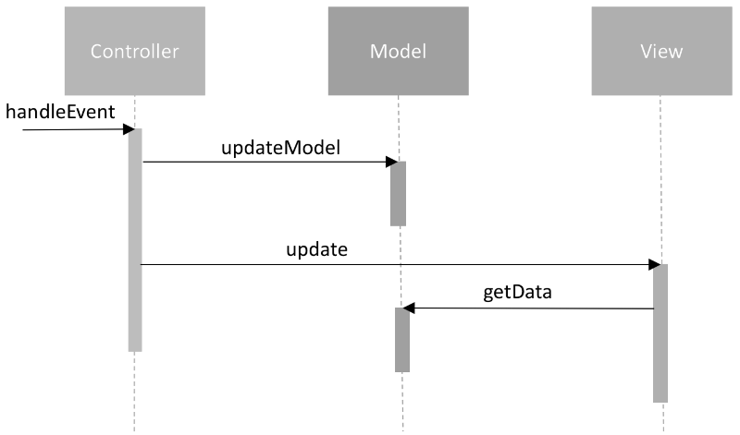
The Controller in MVC
A Controllers is a layer that handles user interaction and interacts with the model
For example, the controller could:
handle query-string values,
and pass these values to the model, which in turn might use these values to update the database

Slide 7
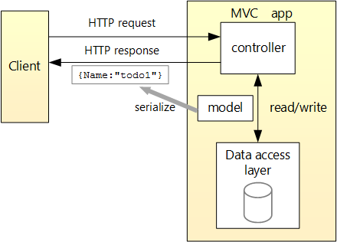
Example of an HTTP API and MVC
A HTTP response could be:
A JSON file
A XML file
A HTML file
Notes:
Discuss with the students how the client is built
Template engine would respond with a html file for each request
Single page application would respond with an html file one and then with JSON

Slide 8
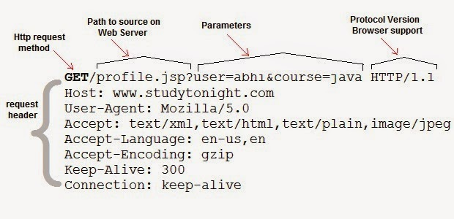
HTTP API

Slide 9
HTTP API.
HTTP API Is a series of methods that follow a specific protocol=> HTTP protocol

Slide 10
HTTP API..
HTTP API Is a series of methods that follow a specific protocol => HTTP protocol
It allows the remote communication between entities
in our case between a client and the controller

Slide 11
HTTP API...
HTTP API Is a series of methods that follow a specific protocol => HTTP protocol
It allows the remote communication between entities
in our case between a client and the controller
In a HTTP API (API) the methods can be invoked remotely by calling specific unique URL’s

Slide 12
HTTP API….
HTTP API Is a series of methods that follow a specific protocol (HTTP)
It allows the remote communication between entities
in our case between a client and the controller
In a HTTP API (API) the methods can be invoked remotely by calling specific unique URL’s
Method parameters are passed as elements of the URL, or inside the body

Slide 13
HTTP API…..
HTTP API Is a series of methods that follow a specific protocol (HTTP)
It allows the remote communication between entities
in our case between a client and the controller
In a HTTP API (API) the methods can be invoked remotely by calling specific unique URL’s
Method parameters are passed as elements of the URL, or inside the body
A URL request also contains a tag (HTTP method): GET, POST, PUT, and DELETE

Slide 14
REST: Representational State Transfer
REST is a common approach to architect/structure data access that uses the HTTP protocol
REST assumes that all calls related to an entity are found/based on a single URL(Uniform Interface):
Such as mydomainname.com/movies,
And mydomainname.com/actors

Slide 15
REST: Representational State Transfer.
The communication is stateless and some of the possible HTTP methods are:
— GET on mydomainname.com/movies will give us back all movies
— GET on mydomainname.com/movies/{id} will give us back the movies with id = {id}

Slide 16
REST: Representational State Transfer.
The communication is stateless and some of the possible HTTP methods are:
— GET on mydomainname.com/movies will give us back all movies
— GET on mydomainname.com/movies/{id} will give us back the movies with id = {id}
— POST on mydomainname.com/movies will create a new movie (usually the movie to add is in the body of the request)

Slide 17
REST: Representational State Transfer.
The communication is stateless and some of the possible HTTP methods are:
— GET on mydomainname.com/movies will give us back all movies
— GET on mydomainname.com/movies/{id} will give us back the movies with id = {id}
— POST on mydomainname.com/movies will create a new movie (usually the movie to add is in the body of the request)
— PUT on mydomainname.com/movies/{id} will change movie with id = {id} to the value sent through the body

Slide 18
REST: Representational State Transfer.
The communication is stateless and some of the possible HTTP methods are:
— GET on mydomainname.com/movies will give us back all movies
— GET on mydomainname.com/movies/{id} will give us back the movies with id = {id}
— POST on mydomainname.com/movies will create a new movie (usually the movie to add is in the body of the request)
— PUT on mydomainname.com/movies/{id} will change movie with id = {id} to the value sent through the body
— DELETE on mydomainname.com/movies/{id} will remove the movie with id = {id}

Slide 19
Example
Live code
Notes:
Add model to the project
Rename the value controller to Movie
Implement the GET, POST, UPDATE methods

Slide 20
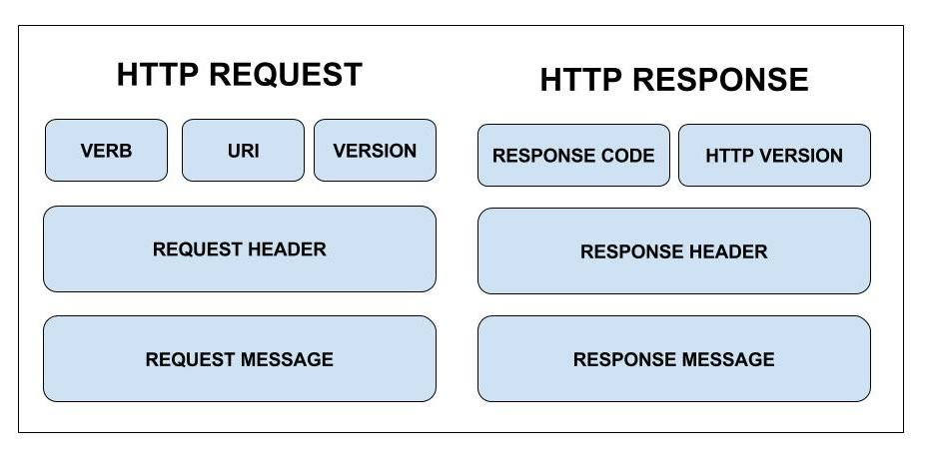
Messages in REST API

Slide 21
Messages in REST API…
HTTP messages in REST become very descriptive; indeed they need to describe completely the users’ intentions and the servers’ response:
Request
Resource URL
HTTP Method: GET, POST, PUT or DELETE
Query parameters
Request headers such as accept that specify the content-type of a message (image, json, html)
Request body definition
Response
HTTP status code (for example 200 when successful)
Response headers
Response body
* Example of body format
common formats are XML, JSON, or HTML
Note: Those formats are not efficient compared to binary, but it is helpful for humans

Slide 22
REST evolution
Level 0 : HTTP Tunneling
One URI, one HTTP method, for example POST
XML-Remote Procedural Calls (RPC)

Slide 23
REST evolution.
Level 0 : HTTP Tunneling
One URI, one HTTP method, for example POST
XML-Remote Procedural Calls (RPC)
Level 1: Resources
Many URIs, one HTTP method for example POST

Slide 24
REST evolution..
Level 0 : HTTP Tunneling
One URI, one HTTP method, for example POST
XML-Remote Procedural Calls (RPC)
Level 1: Resources
Many URIs, one HTTP method for example POST
Level 2: HTTP
Many URIs each with many HTTP methods: GET, POST, PUT, etc.

Slide 25
REST evolution...
Level 0 : HTTP Tunneling
One URI, one HTTP method, for example POST
XML-Remote Procedural Calls (RPC)
Level 1: Resources
Many URIs, one HTTP method for example POST
Level 2: HTTP
Many URIs each with many HTTP methods: GET, POST, PUT, etc.
Level 3: Hypermedia controls
Involves web linking in the messages
Example as XML response
HTTP/1.1 200 OK
Content-Type: application/xml
Content-Length: ...
<?xml version="1.0"?>
<Movies>
<Title>12345</Title>
<link rel="Actors" href="https://mydomainname.com/movies/12345/actors" />
<link rel="Comments" href="https://mydomainname.com/movies/12345/comments" />
</Movies>

Slide 26
Pagination
The process of dividing a document into discrete pages

Slide 27
Pagination.
The process of dividing a document into discrete pages
Pagination can be handled client-side or server-side
Notes:
Reason for pagination:
- GetAll is a bit of an issue (to much data)
- A malicious attacker could cause a DDOS by simply spinning up a lot of requests
- Requests would all eventually fail because of timeout
- Our server would be quickly overwhelmed
Server-side pagination is more common
Client-side pagination can be used when there are very few records to be accessed

Slide 28
Pagination..
The process of dividing a document into discrete pages
Pagination can be handled client-side or server-side
How to implement Pagination on the server?
Notes:
Reason for pagination:
- GetAll is a bit of an issue (to much data)
- A malicious attacker could cause a DDOS by simply spinning up a lot of requests
- Requests would all eventually fail because of timeout
- Our server would be quickly overwhelmed
Server-side pagination is more common
Client-side pagination can be used when there are very few records to be accessed

Slide 29
Pagination..
The process of dividing a document into discrete pages
Pagination can be handled client-side or server-side
How to implement Pagination on the server?
We need to specify the following:
Notes:
Reason for pagination:
- GetAll is a bit of an issue (too much data)
- A malicious attacker could cause a DDOS by simply spinning up a lot of requests
- Requests would all eventually fail because of timeout
- Our server would be quickly overwhelmed
Server-side pagination is more common
Client-side pagination can be used when there are very few records to be accessed

Slide 30
Pagination...
The process of dividing a document into discrete pages
Pagination can be handled client-side or server-side
How to implement Pagination on the server?
We need to specify the following:
The URI to the resource that needs to be paginated
Total amount of records in the database
Current index (starting point)
Number of records to be viewed on each page
Total number of pages that can be viewed
Notes:
Reason for pagination:
- GetAll is a bit of an issue (too much data)
- A malicious attacker could cause a DDOS by simply spinning up a lot of requests
- Requests would all eventually fail because of timeout
- Our server would be quickly overwhelmed
Server-side pagination is more common
Client-side pagination can be used when there are very few records to be accessed

Slide 31
Example
Live code
Notes:
Implement pagination

Slide 32
Filtering
The GET method for pagination is containing basic filtering
Where?
It is possible to add more parameters to perform extra filtering
Notes:
Filtering is usually based on a given a parameter in the header

Slide 33
Filtering.
The GET method for pagination is containing basic filtering
Where?
It is possible to add more parameters to perform extra filtering
A typical strategy is also to define a parameterized, hierarchical data structure
Does the client needs to know about this structure?
Notes:
Filtering is usually based on a given a parameter in the header
Show how the parameter in the header could be extended
The client must generate a hierarchical data structure in the format that is acceptable by the server

Slide 34
Filtering..
The GET method for pagination is containing basic filtering
Where?
It is possible to add more parameters to perform extra filtering
A typical strategy is also to define a parameterized, hierarchical data structure
Does the client needs to know about this structure?
The server must provide the possibility of building expressions dynamically,
In LINQ Expression is an interface to automatically build predicates and other expressions dynamically
Expr = And(Expr, Expr) | Or(Expr,Expr) | | ...
Notes:
Filtering is usually based on a given a parameter in the header
The client must generate a hierarchical data structure in the format that is acceptable by the server

Slide 35
Filtering…
Example of the hierarchical data structure that we can use to dynamically generate expressions:
Simple equality:
{
"Kind": 0,
”Att": "title",
"Value": "Indiana Jones"
}
Notes:
Filtering is usually based on a given a parameter in the header
The client must generate a hierarchical data structure in the format that is acceptable by the server

Slide 36
Filtering….
Example of the hierarchical data structure that we can use to dynamically generate expressions:
Complex equality:
{
”Kind": 1,
”F1": {
"Kind": 0,
”Att": "title",
"Value": "Indiana Jones"
}
”F2":{
”Kind": 3,
”Att": "release",
”Value": ”2009"
}
}
Notes:
Filtering is usually based on a given a parameter in the header
The client must generate a hierarchical data structure in the format that is acceptable by the server

Slide 37
Filtering....
Example of using LINQ expression:
Our goal is to create expressions dynamically:
Consider the following expression:
Func<Movie, bool> isMatching = p => p.Title == “Indiana Jones”
Notes:
Filtering is usually based on a given a parameter in the header
The client must generate a hierarchical data structure in the format that is acceptable by the server

Slide 38
Filtering.....
Example of using LINQ expression:
Our goal is to create expressions dynamically:
Consider the following expression:
Func<Movie, bool> isMatching = p => p.Title == “Indiana Jones”
This expression is a binary expression:
- The left side of the expression: p.Title
- The right side of the expression is a constant expression: “Indiana Jones”

Slide 39
Filtering......
Consider the following expression:
Func<Movie, bool> isMatching = p => p.Title == “Indiana Jones”
The left side of the expression consist of:
- Expression parameter of type Movie: p
- Expression property: Age

Slide 40
Filtering......
Consider the following expression:
Func<Movie, bool> isMatching = p => p.Title == “Indiana Jones”
The left side of the expression consist of:
- Expression parameter of type Movie: p
- Expression property: Age
The last part of the expression is the kind of the comparison:
- equality expression
- greaterThan expression
- gretterThanOrEqual expression
- and expression
- or expression
- etc.

Slide 41
Example
Live code

