Slide 1
RESTful web application INFWEB01-D and INFWEB21-D

Slide 2
Overview
Recap
Distributed Application (Client-Server)
Model-View-Controller(MVC)
The Controller in MVC
What is an HTTP API
The basics of RESTfull applications
Implementation of REST in .NET Core
Pagination
Filtering

Slide 3

Distributed Application
A distributed application (client-server) structure is a partition of the tasks/workloads
What is the task of the server?
How is the communication between client and server implemented?
Notes:
A distributed application is a partition of tasks between servers, and service requesters, called clients to perform specific task-
- A server runs one or more server programs which share their resources with clients
A client does not share any of its resources, but requests a server's content or service function
Client and server communication is implemented using network protocols such as IP, TCP, UDP, or HTTP

Slide 4
Distributed Application
A distributed application (client-server) structure is a partition of the tasks/workloads
What is the task of the server?
How is the communication between client and server implemented?
Client and server communicate using Hypertext Transfer Protocol (HTTP)
Their are other protocols involved, like IP/TCP, but will focus on HTTP
HTTP functions as a request–response protocol
Notes:
A distributed application is a partition of tasks between servers, and service requesters, called clients to perform specific task-
- A server runs one or more server programs which share their resources with clients
A client does not share any of its resources, but requests a server's content or service function
Client and server communication is implemented using network protocols such as IP, TCP, UDP, or HTTP

Slide 5

The Controller in MVC
A server needs to handle requests and return responses to clients
The response is a resource, which could be an HTML file, JavaScript Object Notation (JSON) , or any other valid content
This task is normally implemented in the controller part of the MVC model

Slide 6
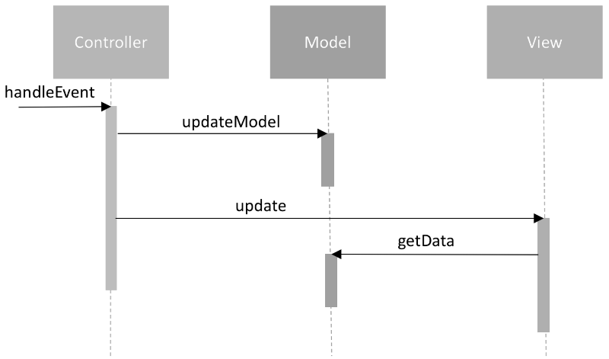
The Controller in MVC
A Controllers is a layer that handles user interaction and interacts with the model
For example, the controller could:
handle query-string values,
and pass these values to the model, which in turn might use these values to update the database

Slide 7
The Controller in MVC
A Controllers is a layer that handles user interaction and interacts with the model
For example, the controller could:
handle query-string values,
and pass these values to the model, which in turn might use these values to update the database
Ideally the interaction between The M and the C should be separated from each other

Slide 8
Dependency Injection
dependency injection is creational design pattern used to achieve separation of concerns of construction and use of objects
In our example application the controller is dependent on DbContext to query the database, that is part of the model.
There are many ways to implement dependency injection
One way to implement it is to provide a parameter in the constructor of the controller for this dependency instead of instantiating the DbContext as we did in previous implementations

Slide 9
Dependency Injection
dependency injection is creational design pattern used to achieve separation of concerns of construction and use of objects
In our example application the controller is dependent on DbContext to query the database, that is part of the model.
There are many ways to implement dependency injection
One way to implement it is to provide a parameter in the constructor of the controller for this dependency instead of instantiating the DbContext as we did in previous implementations
This requires the existence of a service and an injector in the application

Slide 10
Dependency Injection
We could provide a parameter in a constructor of the controller for this dependency instead of instantiating the DbContext as we did in previous implementations
class MovieController{
private MyDbContext _context;
public MovieController (MyDbContext context) {
// Save the reference to the passed-in service inside this client
this._context = context;
}
}

Slide 11
Dependency Injection
Live demo

Slide 12
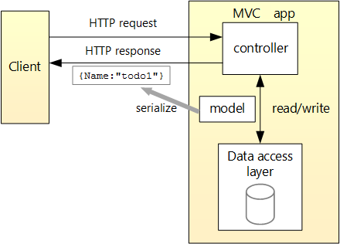
Example of an HTTP API and MVC
A HTTP response could be:
A JSON file
A XML file
A HTML file
Notes:
Discuss with the students how the client is built
Template engine would respond with a html file for each request
Single page application would respond with an html file one and then with JSON

Slide 13
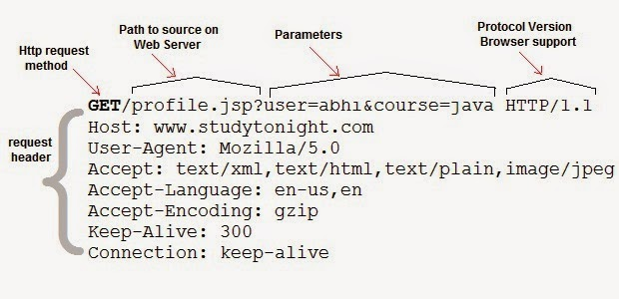
HTTP API

Slide 14
HTTP API.
HTTP API Is a series of methods that follow a specific protocol=> HTTP protocol

Slide 15
HTTP API..
HTTP API Is a series of methods that follow a specific protocol => HTTP protocol
It allows the remote communication between entities
in our case between a client and the controller

Slide 16
HTTP API...
HTTP API Is a series of methods that follow a specific protocol => HTTP protocol
It allows the remote communication between entities
in our case between a client and the controller
In a HTTP API the methods can be invoked remotely by calling specific unique URL’s

Slide 17
HTTP API….
HTTP API Is a series of methods that follow a specific protocol (HTTP)
It allows the remote communication between entities
in our case between a client and the controller
In a HTTP API the methods can be invoked remotely by calling specific unique URL’s
Method parameters are passed as elements of the URL, or inside the body

Slide 18
HTTP API…..
HTTP API Is a series of methods that follow a specific protocol (HTTP)
It allows the remote communication between entities
in our case between a client and the controller
In a HTTP API the methods can be invoked remotely by calling specific unique URL’s
Method parameters are passed as elements of the URL, or inside the body
A URL request also contains a tag (HTTP method): GET, POST, PUT, and DELETE

Slide 19
REST: Representational State Transfer
REST is a common approach to architect/structure data access that uses the HTTP protocol
REST assumes that all calls related to an entity are found/based on a single URL(Uniform Interface):
Such as mydomainname.com/movies,
And mydomainname.com/actors

Slide 20
REST: Representational State Transfer.
The communication is stateless and some of the possible HTTP methods are:
— GET on mydomainname.com/movies will give us back all movies
— GET on mydomainname.com/movies/{id} will give us back the movies with id = {id}

Slide 21
REST: Representational State Transfer.
The communication is stateless and some of the possible HTTP methods are:
— GET on mydomainname.com/movies will give us back all movies
— GET on mydomainname.com/movies/{id} will give us back the movies with id = {id}
— POST on mydomainname.com/movies will create a new movie (usually the movie to add is in the body of the request)

Slide 22
REST: Representational State Transfer.
The communication is stateless and some of the possible HTTP methods are:
— GET on mydomainname.com/movies will give us back all movies
— GET on mydomainname.com/movies/{id} will give us back the movies with id = {id}
— POST on mydomainname.com/movies will create a new movie (usually the movie to add is in the body of the request)
— PUT on mydomainname.com/movies/{id} will change movie with id = {id} to the value sent through the body

Slide 23
REST: Representational State Transfer.
The communication is stateless and some of the possible HTTP methods are:
— GET on mydomainname.com/movies will give us back all movies
— GET on mydomainname.com/movies/{id} will give us back the movies with id = {id}
— POST on mydomainname.com/movies will create a new movie (usually the movie to add is in the body of the request)
— PUT on mydomainname.com/movies/{id} will change movie with id = {id} to the value sent through the body
— DELETE on mydomainname.com/movies/{id} will remove the movie with id = {id}

Slide 24
Example
Live code
Notes:
Add model to the project
Rename the value controller to Movie
Implement the GET, POST, UPDATE methods

Slide 25
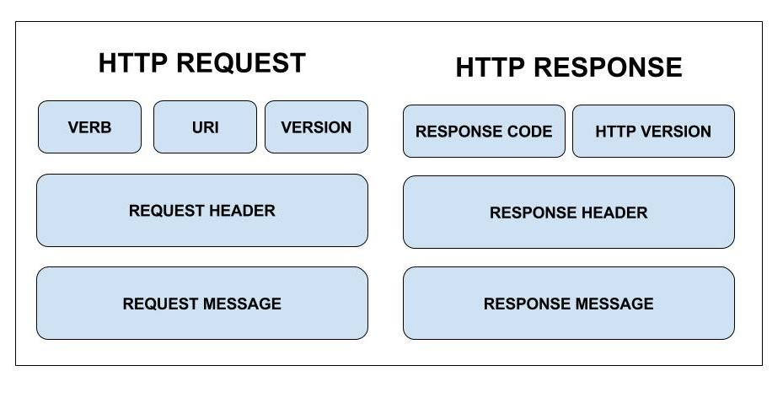
Messages in REST API

Slide 26
Messages in REST API…
HTTP messages in REST become very descriptive; indeed they need to describe completely the users’ intentions and the servers’ response:
Request
Resource URL
HTTP Method: GET, POST, PUT or DELETE
Query parameters
Request headers such as accept that specify the content-type of a message (image, json, html)
Request body definition
Response
HTTP status code (for example 200 when successful)
Response headers
Response body
* Example of body format
common formats are XML, JSON, or HTML
Note: Those formats are not efficient compared to binary, but it is helpful for humans

Slide 27
REST evolution
Level 0 : HTTP Tunneling
One URI, one HTTP method, for example POST
XML-Remote Procedural Calls (RPC)

Slide 28
REST evolution.
Level 0 : HTTP Tunneling
One URI, one HTTP method, for example POST
XML-Remote Procedural Calls (RPC)
Level 1: Resources
Many URIs, one HTTP method for example POST

Slide 29
REST evolution..
Level 0 : HTTP Tunneling
One URI, one HTTP method, for example POST
XML-Remote Procedural Calls (RPC)
Level 1: Resources
Many URIs, one HTTP method for example POST
Level 2: HTTP
Many URIs each with many HTTP methods: GET, POST, PUT, etc.

Slide 30
REST evolution...
Level 0 : HTTP Tunneling
One URI, one HTTP method, for example POST
XML-Remote Procedural Calls (RPC)
Level 1: Resources
Many URIs, one HTTP method for example POST
Level 2: HTTP
Many URIs each with many HTTP methods: GET, POST, PUT, etc.
Level 3: Hypermedia controls
Involves web linking in the messages
Example as XML response
HTTP/1.1 200 OK
Content-Type: application/xml
Content-Length: ...
<?xml version="1.0"?>
<Movies>
<Title>12345</Title>
<link rel="Actors" href="https://mydomainname.com/movies/12345/actors" />
<link rel="Comments" href="https://mydomainname.com/movies/12345/comments" />
</Movies>

Slide 31
Pagination
The process of dividing a document into discrete pages

Slide 32
Pagination.
The process of dividing a document into discrete pages
Pagination can be handled client-side or server-side
Notes:
Reason for pagination:
- GetAll is a bit of an issue (to much data)
- A malicious attacker could cause a DDOS by simply spinning up a lot of requests
- Requests would all eventually fail because of timeout
- Our server would be quickly overwhelmed
Server-side pagination is more common
Client-side pagination can be used when there are very few records to be accessed

Slide 33
Pagination..
The process of dividing a document into discrete pages
Pagination can be handled client-side or server-side
How to implement Pagination on the server?
Notes:
Reason for pagination:
- GetAll is a bit of an issue (to much data)
- A malicious attacker could cause a DDOS by simply spinning up a lot of requests
- Requests would all eventually fail because of timeout
- Our server would be quickly overwhelmed
Server-side pagination is more common
Client-side pagination can be used when there are very few records to be accessed

Slide 34
Pagination..
The process of dividing a document into discrete pages
Pagination can be handled client-side or server-side
How to implement Pagination on the server?
We need to specify the following:
Notes:
Reason for pagination:
- GetAll is a bit of an issue (too much data)
- A malicious attacker could cause a DDOS by simply spinning up a lot of requests
- Requests would all eventually fail because of timeout
- Our server would be quickly overwhelmed
Server-side pagination is more common
Client-side pagination can be used when there are very few records to be accessed

Slide 35
Pagination...
The process of dividing a document into discrete pages
Pagination can be handled client-side or server-side
How to implement Pagination on the server?
We need to specify the following:
The URI to the resource that needs to be paginated
Total amount of records in the database
Current index (starting point)
Number of records to be viewed on each page
Total number of pages that can be viewed
Notes:
Reason for pagination:
- GetAll is a bit of an issue (too much data)
- A malicious attacker could cause a DDOS by simply spinning up a lot of requests
- Requests would all eventually fail because of timeout
- Our server would be quickly overwhelmed
Server-side pagination is more common
Client-side pagination can be used when there are very few records to be accessed

Slide 36
Example
Live code
Notes:
Implement pagination

Slide 37
Filtering
The GET method for pagination is containing basic filtering
Where?
It is possible to add more parameters to perform extra filtering
Notes:
Filtering is usually based on a given a parameter in the header

Slide 38
Filtering.
The GET method for pagination is containing basic filtering
Where?
It is possible to add more parameters to perform extra filtering
A typical strategy is also to define a parameterized, hierarchical data structure
Does the client needs to know about this structure?
Notes:
Filtering is usually based on a given a parameter in the header
Show how the parameter in the header could be extended
The client must generate a hierarchical data structure in the format that is acceptable by the server

Slide 39
Filtering..
The GET method for pagination is containing basic filtering
Where?
It is possible to add more parameters to perform extra filtering
A typical strategy is also to define a parameterized, hierarchical data structure
Does the client needs to know about this structure?
The server must provide the possibility of building expressions dynamically,
In LINQ Expression is an interface to automatically build predicates and other expressions dynamically
Expr = And(Expr, Expr) | Or(Expr,Expr) | | ...
Notes:
Filtering is usually based on a given a parameter in the header
The client must generate a hierarchical data structure in the format that is acceptable by the server

Slide 40
Filtering…
Example of the hierarchical data structure that we can use to dynamically generate expressions:
Simple equality:
{
"Kind": 0,
”Att": "title",
"Value": "Indiana Jones"
}
Notes:
Filtering is usually based on a given a parameter in the header
The client must generate a hierarchical data structure in the format that is acceptable by the server

Slide 41
Filtering….
Example of the hierarchical data structure that we can use to dynamically generate expressions:
Complex equality:
{
”Kind": 1,
”F1": {
"Kind": 0,
”Att": "title",
"Value": "Indiana Jones"
}
”F2":{
”Kind": 3,
”Att": "release",
”Value": ”2009"
}
}
Notes:
Filtering is usually based on a given a parameter in the header
The client must generate a hierarchical data structure in the format that is acceptable by the server

Slide 42
Filtering....
Example of using LINQ expression:
Our goal is to create expressions dynamically:
Consider the following expression:
Func<Movie, bool> isMatching = p => p.Title == “Indiana Jones”
Notes:
Filtering is usually based on a given a parameter in the header
The client must generate a hierarchical data structure in the format that is acceptable by the server

Slide 43
Filtering.....
Example of using LINQ expression:
Our goal is to create expressions dynamically:
Consider the following expression:
Func<Movie, bool> isMatching = p => p.Title == “Indiana Jones”
This expression is a binary expression:
- The left side of the expression: p.Title
- The right side of the expression is a constant expression: “Indiana Jones”

Slide 44
Filtering......
Consider the following expression:
Func<Movie, bool> isMatching = p => p.Title == “Indiana Jones”
The left side of the expression consist of:
- Expression parameter of type Movie: p
- Expression property: Age

Slide 45
Filtering......
Consider the following expression:
Func<Movie, bool> isMatching = p => p.Title == “Indiana Jones”
The left side of the expression consist of:
- Expression parameter of type Movie: p
- Expression property: Age
The last part of the expression is the kind of the comparison:
- equality expression
- greaterThan expression
- gretterThanOrEqual expression
- and expression
- or expression
- etc.

Slide 46
Example
Live code

