Slide 1

KAFKA
Messaging System

Slide 2
History
Apache Kafka was originated at LinkedIn and later became an open sourced Apache project in 2011, then First-class Apache project in 2012.
Kafka is written in Scala and Java.
Apache Kafka is publish-subscribe based fault tolerant messaging system.
It is fast, scalable and distributed by design.

Slide 3
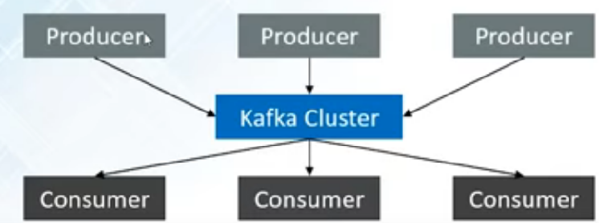
A Stream of Messages of Particular category is called a topic. Producers publish messages to a topic. A producer can be any application who can publish messages to a topic. Consumers subscribe to topics and consume the messages. Kafka cluster is a set of servers, each of which is called broker.

Slide 4

Zookeeper and Kafka
Each Kafka Broker coordinates with other Kafka brokers using Zookeeper.
Producers and consumers are notified by Zookeeper service about the presence of new broker in Kafka system or failure of the broker in Kafka system.

Slide 5
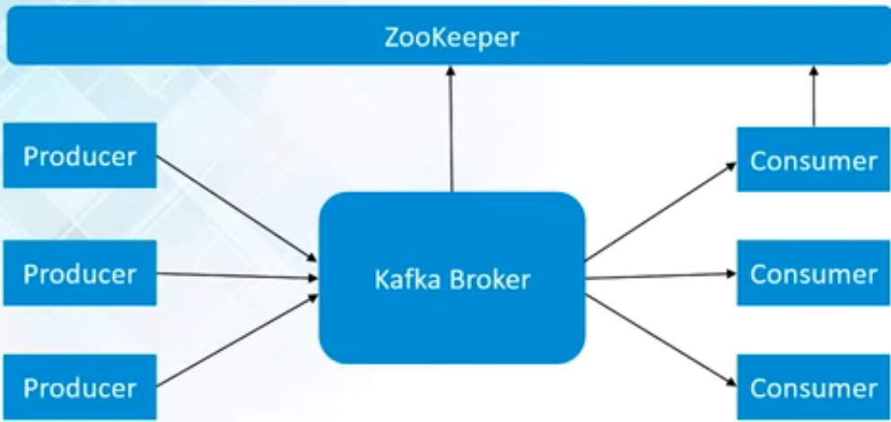
Single Mode Single Broker Cluster.

Slide 6
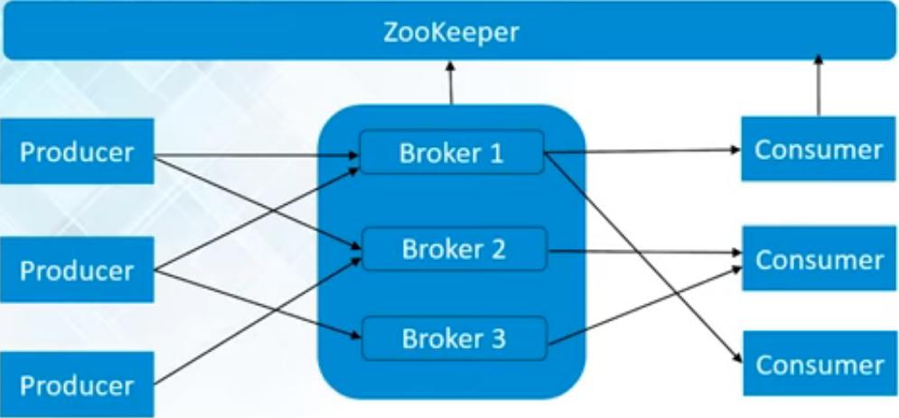
Single Mode Multiple Broker Cluster.

Slide 7
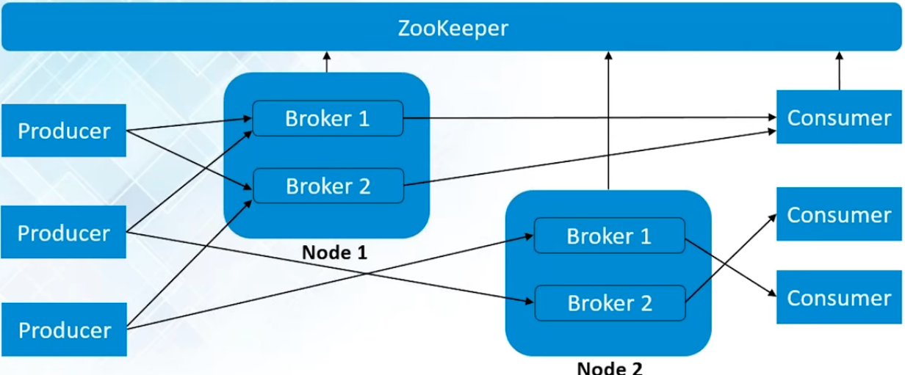
Multiple Mode Multiple Broker Cluster.

Slide 8
Benefits of Kafka
Reliability.
Kafka is a distributed system, which is able to be scaled quickly and easily without incurring any downtime.
Scalability.
Kafka persists the messages on the disks, which provides intra-cluster replication. This makes for a highly durable messaging system.
Durability.
Kafka replicates data and is able to support multiple subscribers. Additionally, it automatically balances consumers in the event of failure
Performance.
Kafka delivers high throughput for both publishing and subscribing, utilizing disk structures that are capable of offering constant levels of performance, even when dealing with many terabytes of stored messages.

