Slide 1
SPARK SQL

Slide 2
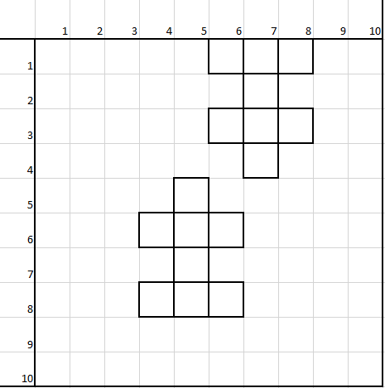
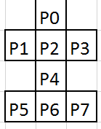
Shooting game
Database ?

Slide 3
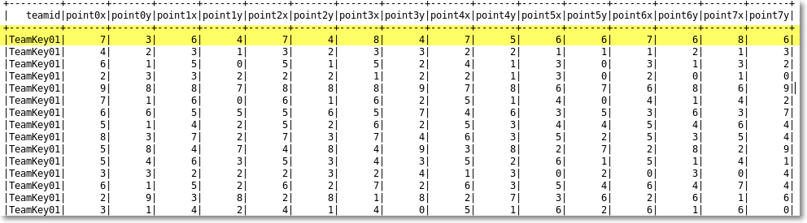
DATABASE

Slide 4
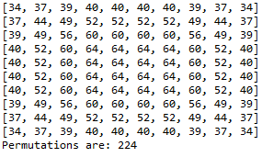
Where to Shoot ?

Slide 5
DATABASE OPERATIONS
CREATE TABLE
DROP TABLE
SELECT

Slide 6
HOW TO choose shooting point
SHOOT AT POINT WHERE HAS HIGHEST PROBABILITY
SAVE SHOOTEN POINT TO LIST
SELECT SHOOTING POINTS EXCLUDING SHOOTEN POINT
SHOOT AT POINT WHERE HAS HIGHEST PROBABILITY
IF THERE ARE SEVERAL PROBABILTIES ARE CHOOSE FIRST ONE WHICH IS HEADPOINT

