Slide 1
Predicting Football Player Performance Decline After Transfer
Arash Karimi Ferhat Karabatman
Erdös Data Science Bootcamp 2025

Slide 2
Why Predict Transfer Decline?
Football clubs invest millions in player transfers.
Many signings underperform after joining new clubs.
Goal: Predict the likelihood of a player’s performance decline post-transfer.
Key Question:
Given pre-transfer data, can we predict if a player’s performance will drop after a move? Stakeholders: Scouts | Recruiters | Club Managers | Analysts

Slide 3

Why It Matters?
Data-driven recruitment reduces financial risk.
Objective: identify high-risk transfers before committing resources.
Key Metrics:
Accuracy = 0.72
ROC-AUC = 0.76
F1 (Decline Class) = 0.59
Decision Use: Helps prioritize scouting budgets and optimize player portfolios.

Slide 4
Data Sources & Overview
FBref – Performance stats (minutes, goals, GA90).
Transfermarkt – Transfer fees, market values, league info.
Merged records: ≈ 5000 player-seasons.
Key Variables: from_league, to_league, position, transfer_fee, market_value_in_eur, height_in_cm, DeclineFlag.
Main Limitation: No injury or morale data.

Slide 5
Turning Raw Data into Signals
Encoded categorical columns (league, position, foot).
Scaled numerical features.
Derived features: goal rate per minute, pre-transfer minutes, market-value ratios.
Dropped IDs and redundant columns.

Slide 6
From Baselines to Final Model
Model | Notes | ROC-AUC
Logistic Regression | Interpretable baseline | 0.70
Decision Tree | Slight overfit | 0.72
Random Forest (300 trees) | Best generalization | 0.76
Discarded: Gradient Boosting overfit given limited samples.

Slide 7
Results
Final Performance on Test Data
Accuracy = 0.72,
ROC-AUC = 0.76,
F1 = 0.59
(for Decline class)
Confusion Matrix → heatmap image
ROC Curve
Balanced Precision/Recall between classes.

Slide 8
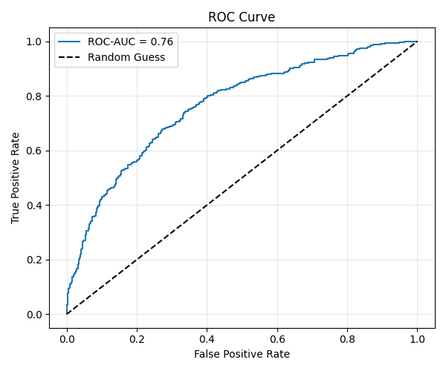
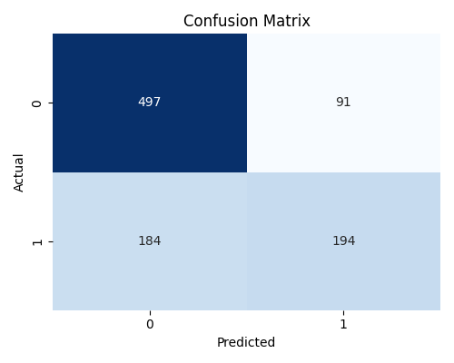
Confusion Matrix for test data
ROC Curve

Slide 9
What the Model Tells Us
Players moving to higher-tier leagues → higher decline risk.
Age, minutes played, and transfer fee are top predictors.
Defenders show more stable performance post-transfer.
The model captures general patterns but not psychological or team fit factors. (Insert bar chart of top-20 feature importances.)

Slide 10
Limitations & Next Steps
Missing injury and fitness data.
Class imbalance → some decline cases under-represented.
League coding masks within-league variation. Next Steps
Add FIFA/EA performance ratings and injury stats.
Try XGBoost or LightGBM for recall boost.
Deploy Streamlit dashboard for scouting use.

Slide 11
Business Impact & Conclusion
Quantifies risk for every potential transfer.
Supports clubs in contract negotiations and budget allocation.
Enables data-driven scouting to avoid costly mistakes. Final Takeaway:
A 0.76 AUC model can meaningfully reduce transfer risk through data-driven analytics.

