Slide 1

DATA SCIENCE • TRAFFIC EARLY WARNING
SafeFlow
Predicting freeway congestion
before it starts
Can we warn of congestion early enough to act — without overwhelming operators with false alarms?
Team SafeFlow | Erdős Institute Data Science Boot Camp | Fall 2026
Current deck uses development evidence only. Final holdout results plug in near the end.
Notes:
Traffic congestion is easy to recognize after it starts. SafeFlow asks a more useful question: can we warn that a freeway station is about to become congested, early enough to act, without flooding operators with false alarms? We use Caltrans PeMS data and compare three model families under one common evaluation framework.

Slide 2
The prediction task: warn before the slowdown arrives
A decision-oriented target turns raw traffic measurements into an early-warning problem.
SENSOR OUTPUT EVERY 5 MINUTES
Why this framing matters
NOW
+5
+10
+15
+20
+25
+30
Predicting an exact speed is useful, but an operator needs a decision: “Should I pay attention now?”
So we evaluate not only model ranking, but also how many real congestion onsets are caught early — and how much false-warning burden that creates.
Inputs at the forecast origin
Model output
29 shared features
• speed, flow, occupancy
• recent lags and trends
• spatial / station context
• time-of-day context
Probability that measured speed falls below 40 mph at any point in the next 30 minutes
Current development comparison: Caltrans District 12
Eligible forecasts are currently uncongested station-times; the system is asked to identify an upcoming onset, not merely confirm an existing jam.
Source: SafeFlow repository README / RESULTS_SUMMARY.md, development snapshot 2026-11-04. Data source: Caltrans PeMS.
Notes:
Every five minutes, SafeFlow looks at an uncongested station and asks whether measured speed will drop below forty miles per hour at any point in the next thirty minutes. We build 29 features from speed, flow, occupancy, recent history, spatial context, and time of day. The output is a risk probability. That framing matters because an operator needs a warning decision, not just a predicted speed.

Slide 3
Evaluation is designed to look like deployment
Traffic is strongly time-correlated, so a random train/test split would give an unrealistically easy problem.
EXPANDING WALK-FORWARD VALIDATION
2023
2024 Q1
Q2
Q3
Q4
2025 Q1
Q2
Jul–Dec 2025
TRAIN
START
VAL 1
VAL 2
VAL 3
VAL 4
VAL 5
VAL 6
FINAL HOLDOUT
7-day gap before each validation quarter
What gets tuned?
What stays frozen?
What stays sealed?
Model parameters and warning thresholds are chosen using development periods only.
Each next-quarter policy is evaluated without retuning on that quarter.
July–December 2025 is untouched until the finalist and procedure are frozen.
This is why the current numbers are “development evidence” — not final performance.
Source: SafeFlow README / RESULTS_SUMMARY.md. Six quarterly folds: 2024 Q1–2025 Q2; seven-day training gap; final holdout: Jul–Dec 2025.
Notes:
Traffic data are strongly autocorrelated, so a random split would leak near-duplicate conditions across train and test. Instead, we use six expanding quarterly walk-forward folds from 2024 Q1 through 2025 Q2, with a seven-day gap before validation. Thresholds are learned from earlier quarters and then frozen forward. Most importantly, July through December 2025 remains completely sealed until we freeze the final model and evaluation procedure.

Slide 4
Three model families, one fair comparison
All models see the same 29 logical features and the same walk-forward folds; the Transformer additionally sees sequence history.
Random Forest
Boosted Trees
Transformer
+
+
Many independent trees vote
Trees correct earlier mistakes
Attention over recent history
• Robust tabular baseline
• Captures nonlinear interactions
• Parallel / relatively interpretable
• Strong tabular learner
• Focuses on hard residual patterns
• Current best mean development AP
• Up to 24 historical feature vectors
• Learns temporal dependencies directly
• Sequence model for evolving traffic
NOVELTY IS THE COMBINATION
A fair model comparison + forward threshold transfer + operational warning-cost analysis
Source: SafeFlow RESULTS_SUMMARY.md. Shared 29-feature representation; Transformer consumes up to 24 historical feature vectors.
Notes:
We compare three model families with different strengths. Random Forest averages many independent trees. Boosted trees build trees sequentially to correct earlier errors. The Transformer uses attention across up to 24 historical feature vectors, so it can learn how traffic evolves over time instead of seeing only the current engineered vector. The novelty is not simply using a Transformer; it is comparing these models fairly, on the same features and folds, and then evaluating them as warning systems rather than score generators.

Slide 5
Development evidence: ranking quality and warning quality are not the same
The two leading models are close — and the operational tradeoff matters more than a tiny score difference.
1 Ranking quality (mean Average Precision)
DEVELOPMENT ONLY • HOLDOUT UNTOUCHED
2 Early warning at the same intended duration budget
Boosted trees
0.767
Transformer
53.2%
Transformer
0.763
Boosted trees
52.7%
Random Forest
0.750
Random Forest
43.5%
AP asks: do higher model scores usually belong to true upcoming congestion?
Timetable
27.4%
At a 4 wrong-alert-hours/day calibration budget, the Transformer and boosted trees catch about half of onsets at least 15 minutes early.
+0.50 pp
[-0.66, +1.57]
−2.08
−0.12 h
Transformer vs boosted trees
95% weekly interval
false episodes/day
wrong-alert hours/day
early-catch difference
contains zero
Transformer − boosted
Transformer − boosted
Current decision: keep Transformer and boosted trees as finalists. The evidence does not yet justify declaring a winner.
Source: SafeFlow RESULTS_SUMMARY.md, 2026-11-04. Six-fold AP; five-quarter forward warning-budget validation; paired weekly bootstrap intervals.
Notes:
So far, boosted trees have the best mean development Average Precision at 0.767, with the Transformer close at 0.763 and Random Forest at 0.750. But ranking is not the same as useful warning. Under a forward policy calibrated to four wrong-alert hours per day, the Transformer catches 53.2 percent of onsets at least 15 minutes early, versus 52.7 percent for boosted trees. That half-point difference is not clearly significant, while the Transformer has somewhat lower average warning burden. So our finalists remain boosted trees and the Transformer.

Slide 6
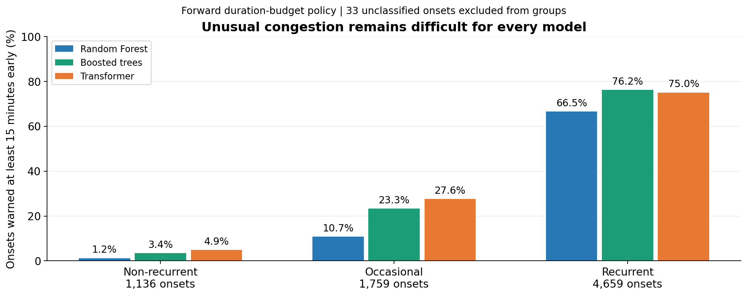
The important failure mode: unusual congestion
Aggregate metrics look respectable, but rare non-recurrent onsets remain extremely hard to warn about early.
All models miss more than 95% of unusual onsets at a 15-minute lead time.
Source: SafeFlow RESULTS_SUMMARY.md. Forward duration policy; 1,136 non-recurrent onsets across five evaluated quarters.
Notes:
The most important weakness is unusual congestion. When an onset occurs at a place and time where historical training data says congestion is normally rare, early detection collapses. The Transformer catches only 4.9 percent at least 15 minutes early, boosted trees 3.4 percent, and Random Forest 1.2 percent. So all three miss more than 95 percent of these atypical events. That matters more to us than a tiny average-score gap, because it shows exactly where the system is not yet deployment-ready.
Repository visualization: https://github.com/Erdos-Projects/fall-2026-safeflow/blob/bf877dd4f279a93685858132605225a806c8f894/results/figures/summary/recurrence.png (development forward validation).

Slide 7
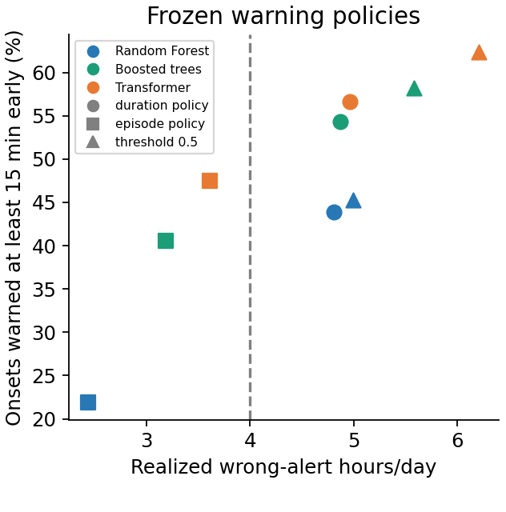
Final holdout: the tradeoff survives out of sample
Boosted trees rank best; the Transformer catches more onsets early; neither meets the intended warning budget.
Duration policy: higher early catch,
but above the 4-hour budget
Transformer: 56.7% early catch, 4.97 h/day
Boosted trees: 54.3% early catch, 4.87 h/day
Circles show the duration policy used for the headline results. Squares and triangles show alternative frozen policies.
No duration-policy model meets the intended budget. Keep both finalists and use a fresh test period for further tuning.
Holdout: Jul–Dec 2025 • 966,000 rows • 125 days • 3,497 onsets • Source: RESULTS_SUMMARY.md / HOLDOUT_REPORT.md
Notes:
We then opened the frozen July-to-December 2025 holdout exactly once. Boosted trees retained the best ranking quality, with AP 0.7412, compared with 0.7380 for the Transformer and 0.7216 for Random Forest. The Transformer, however, caught 56.7 percent of onsets at least 15 minutes early, versus 54.3 percent for boosted trees. That gain came with 4.97 wrong-alert hours per day, compared with 4.87 for boosted trees. All three models exceeded the intended four-hour warning budget.
Repository visualization: https://github.com/Erdos-Projects/fall-2026-safeflow/blob/bf877dd4f279a93685858132605225a806c8f894/results/figures/summary/holdout_warning_tradeoffs.png (first panel only; no data altered).

Slide 8
Final Takeaways
Accuracy alone is not enough. A useful congestion-warning system must warn early and keep false alarms manageable.
1 On the unseen holdout (Jul–Dec 2025)
0.741 vs 0.738
56.7% vs 54.3%
≈ 4.9 h/day
Boosted trees rank best
The Transformer warns earliest
Both exceed the 4-hour budget
PR-AUC on onsets, vs the Transformer
onsets warned ≥15 min ahead, vs boosted trees
wrong-alert time, summed over 46 stations
2 Safeflow
1
Predict the event that matters
2
Compare models fairly
3
Test forward in time
4
Price the cost of warnings
Congestion within 30 min, from measured readings
Same features, folds and targets
Thresholds frozen; holdout tested once
Early catch with false episodes and wrong-alert time
Where current models need to improve
Unusual jams: over 90% of non-recurrent onsets are still missed 15 minutes ahead.
Stable alert burden: thresholds set on one season ran about 20% over budget in the next.
Holdout: Jul–Dec 2025 • thresholds frozen before access • Source: HOLDOUT_REPORT.md / RESULTS_SUMMARY.md • Project repository: Erdos-Projects/fall-2026-safeflow
Notes:
Our main takeaway is that prediction accuracy alone is not enough. A useful congestion-warning system must provide advance notice while keeping false alarms manageable. On the holdout, boosted trees ranked best, while the Transformer warned of the most onsets at least 15 minutes ahead, and both exceeded the four-hour alert budget. SafeFlow gives us a framework for measuring both, and shows where improvements in current models are needed: unusual, non-recurrent congestion, and keeping the alert burden stable over time.

